Slide 1
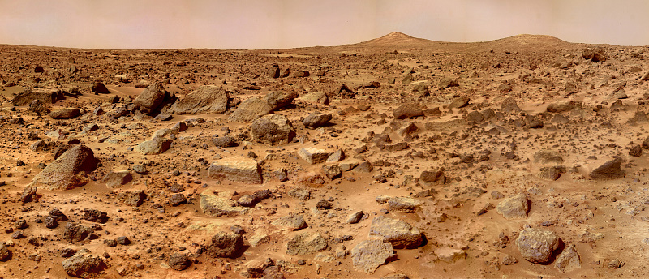


Terrestrial Implications From the Petrogenic History of Olivine Megacrysts in Martian Basalts
Pamela Aaron, Dr. Charles Shearer, and Paul Burger

Slide 2
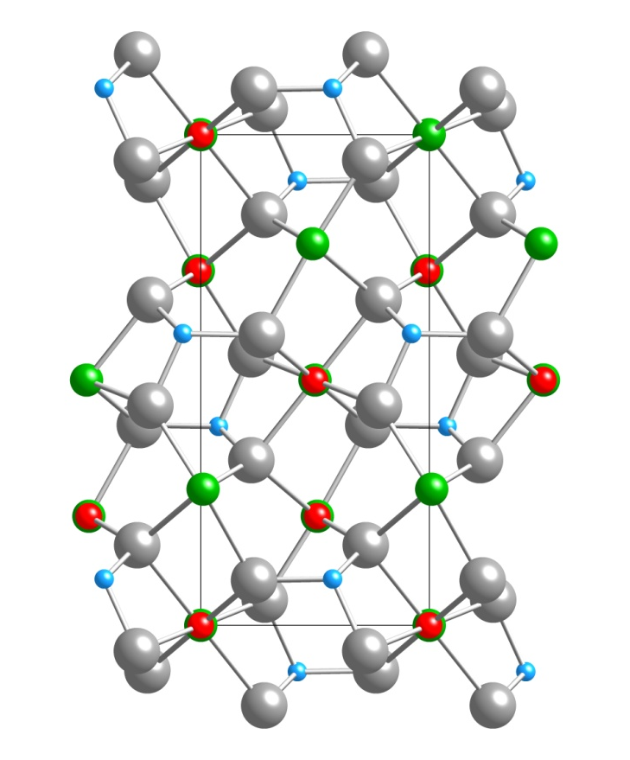
Introduction
Olivine ((Mg, Fe)₂SiO₄) is an early crystallizing phase in planetary basalts.
The purpose of this study is to explore the origin of olivine megacrysts in Martian basalts and relate these findings to similar findings on Earth.
The samples used will be NWA1183, paired with NWA1068/1110, an LREE enriched shergottite and Y980459, an REE depleted shergottite.
NWA1183 olivine model
along the 001 axis

Slide 3
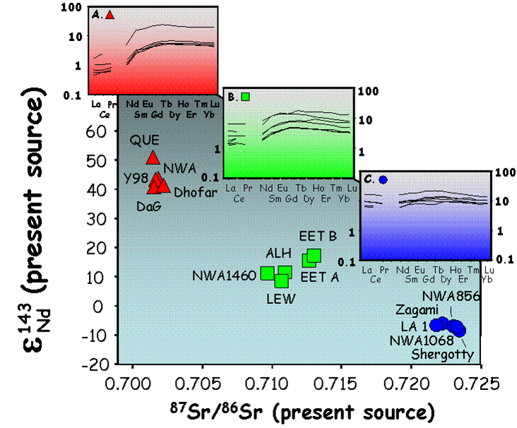
Geochemical Array of Shergottites
fO₂ Reduced
_{fO2} _{Oxidized}
from Shearer et al. (2008)

Slide 4
Analytical Methods
Samples were initially characterized with optical and backscattered electron imaging (BSE).
Suitable grains chosen for WDS mapping.
Low beam current WDS mapping of major elements (Fe, Mg, Ca, Cr, and Mn).
NWA 1183
Y 980459
BSE images of selected grains in each sample.
NWA 1183
Y 980459
WDS maps of Mg in each sample.

Slide 5
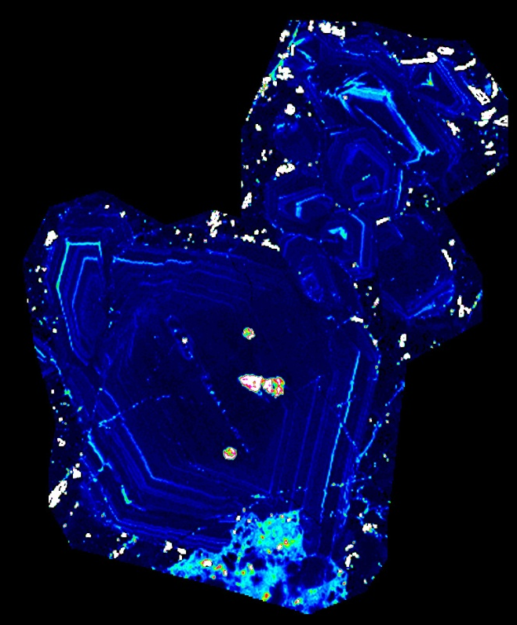
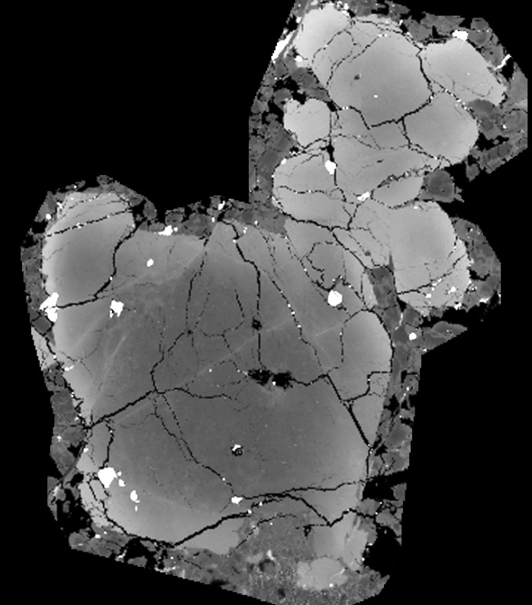
Analytical Methods
High beam current WDS mapping of minor elements (P, V, Na, Ca, and Ti)
WDS maps were used to position traverses for quantitative analysis of the elements Al, Fe, Mg, Si, Ti, Na, Mn, Cr, Ca, P, V, and Ni.
NWA 1183
Y 980459
WDS maps of P in each sample.
Traverse 1
Traverse 2
Traverse 2
Traverse 3
Traverse 1
NWA1183
Y980459
BSE image showing location of traverses.

Slide 6
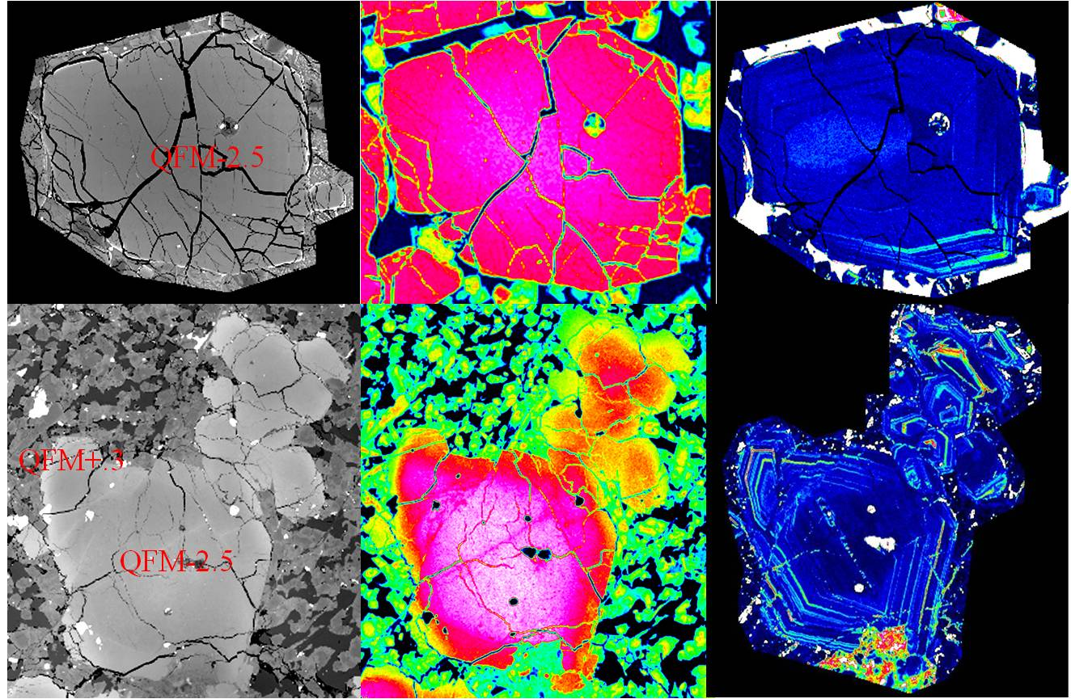
WDS Map Comparison

Slide 7
Mg# and Mn
The Mg# of the megacrysts in Y 98 is higher than NWA 1183 and there is no overlap in Mg chemistry. Other divalent cations such as Mn, Ca, and Ni generally exhibited a similar zoning style, with Mn and Ca increasing from core to rim and Ni decreasing. Manganese is especially correlated to Mg#, and is generally lower in Y 98 compared to NWA 1183.

Slide 8
Correlations with Phosphorous
There also seems to be a correlation between the location of the zones of P enrichment and proximity to other crystals. For example, in Y 98 the P zoning is far less prominent in the portions of the olivine adjacent to other olivine megacrysts.
Within the capabilities of the EPMA, there appears to be a slight correlation between P and Al. While there is no identifiable correlation between P and either Ti or Cr.

Slide 9
Phosphorous Incompatibility
The incompatibility of P in olivine results in a higher concentration of P within the melt while slow diffusion leads to the inability to “outrun” the growing olivine crystal faces. Visible P zones are the result of periods of rapid crystal growth due to increases in cooling rate.
This mechanism is inhibited in environments in which there are large adjacent megacrysts, as shown in Y 98.

Slide 10

Zoning
Oscillatory zoning is preserved because of the low diffusivity of P in olivine. Aluminum, Cr, and Ti could also exhibit behavior similar to P, however their correlation to P in these basalts is determined by the interplay of several factors such as their respective compatibility in olivine (P<Al<Ti<Cr), diffusivity in both melt and olivine (D_{P}<D_{Al}<D_{Ti} <D_{Cr}), and instrument precision.

Slide 11
Coupled Substitution
Due to the charge (5+) and ionic radius (0.17 Å in 4-fold coordination) of the P cation in magmatic environments, it most readily substitutes into the tetrahedral site of olivine that is occupied by Si⁴⁺ (0.26 Å). Phosphorous substitution into this site requires a coupled mechanism to maintain charge balance within the crystal structure.
NWA1183 olivine model
along the 001 axis

Slide 12
Possible Substitution Mechanisms
The correlation of P and Al in NWA 1183 points to a possible substitution mechanism:
2Si_{T}⁴⁺ ↔ P_{T}⁵⁺ + Al_{T}³⁺
The correlation between Al and P in our data is further complicated by other substitutions into the olivine structure that involve Al, such as:
Si_{T}⁴⁺ + Mg_{O}²⁺ ↔ Al_{T}³⁺ + Al_{O}³⁺
(T and O in the above equations refers to the Tetrahedral and Octahedral sites, respectively).
The correlation between Al and P can also be further complicated by coupled substitutions that involve P in the tetrahedral site balanced by either vacancies or monovalent cations in the octahedral site (e.g. Li, Na).

Slide 13
Martian Conclusions
In the case of these two Martian basalts, we suggest that the formation and preservation of the P concentric zoning is closely tied to the diffusivity of P within both the melt adjacent to the growing olivine megacrysts and the olivine megacrysts themselves.
The difference in P₂O₅ in the olivine megacrysts in NWA 1183 and Y 98 indicates that the first silicate phase (olivine) crystallized from enriched and depleted basalts, respectively. This suggests that the olivine megacrysts most likely represent phenocrysts and that the enriched and depleted signatures were added to the basalts prior to crystallization.

Slide 14
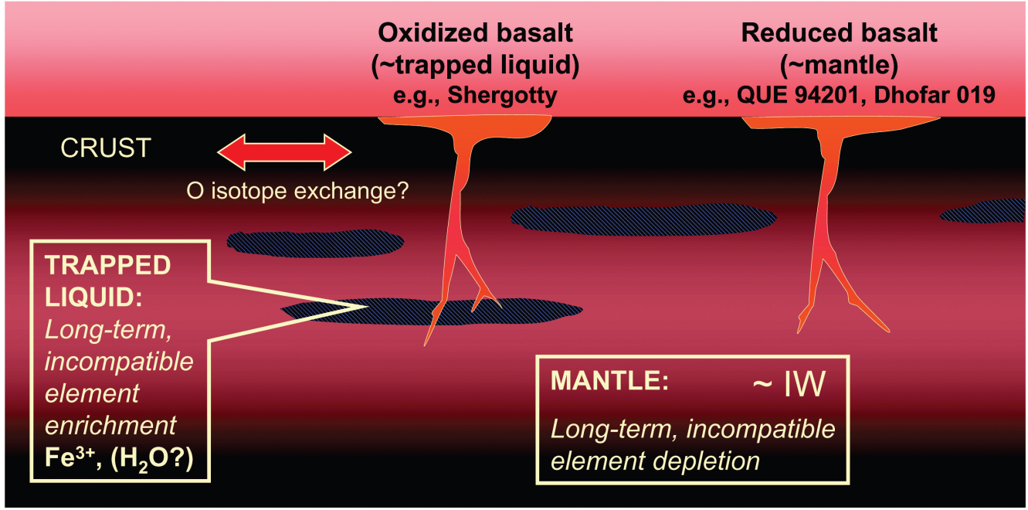
REE’s and Oxygen Fugacity
Based on mineral equilibria and V oxybarometry, Herd concluded that the megacrystic olivine in NWA 1068/1110 crystallized at an fO₂ of QFM-2.5, whereas phases in the crystallization sequence (including olivine rims) crystallized at an fO₂ of QFM+0.3.
These observations, along with our observations on olivine, indicate that the enriched signature and fO₂ are decoupled and that an enriched and oxidized Martian mantle may not exist.
From Herd 2003

Slide 15
Terrestrial Implications
There have been several terrestrial studies that indicate similar zoning patterns in San Carlos, Hawaiian, and experimental olivine
These studies also indicate that P zoning is a function of P incompatibility and slow diffusion rate
Terrestrial samples and experimentation have also shown that fO₂ is recorded in olivine during crystallization
This study illustrates how olivine in terrestrial basalts can be used to explore variations in fO₂, crystallization kinetics, and trace element characteristics

Slide 16
Thank you, questions?

