Slide 1
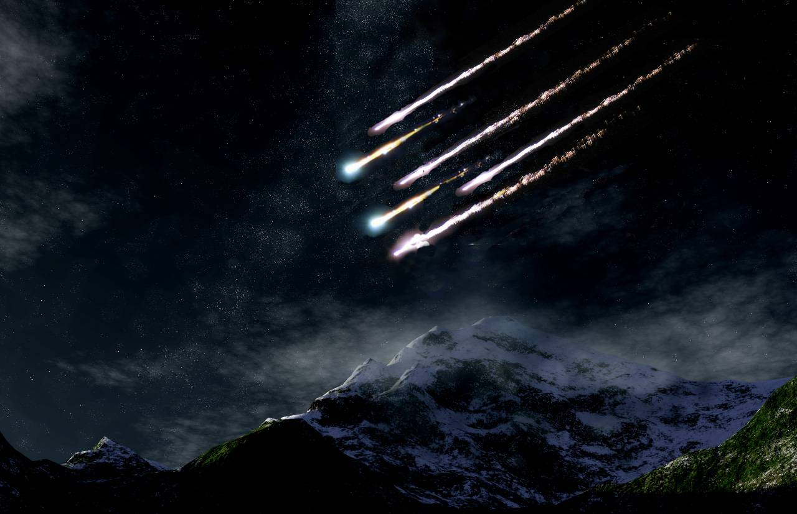
The Colorado Cataclysm:
An Impact Crater Cluster
in the Front Range
Joel G. Duncan
Colorado School of Mines

Slide 2
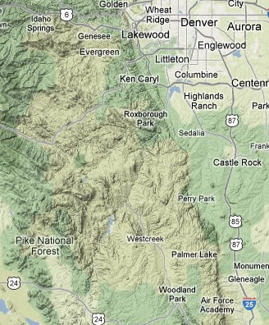
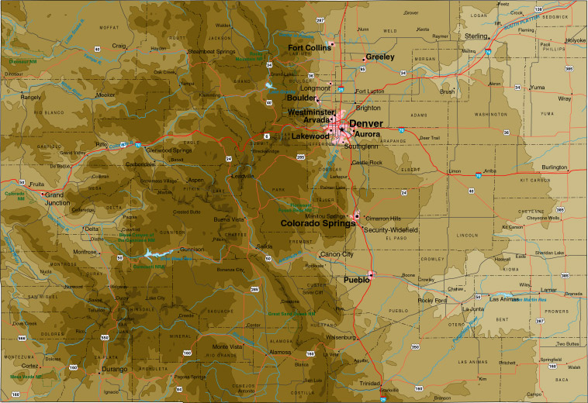
Study Area
2500 square km
Bailey
F r o n t R a n g e
15 km
Google Terrain Map

Slide 3
Methods
Topographic/Satellite Photo Analysis
  - Google Earth Images
  Google Terrain Maps
  Shaded Relief Maps
Field Investigations
  Rock Macro Structures
  Sample Collection/Description
Petrographic Analyses
  Thin section study

Slide 4
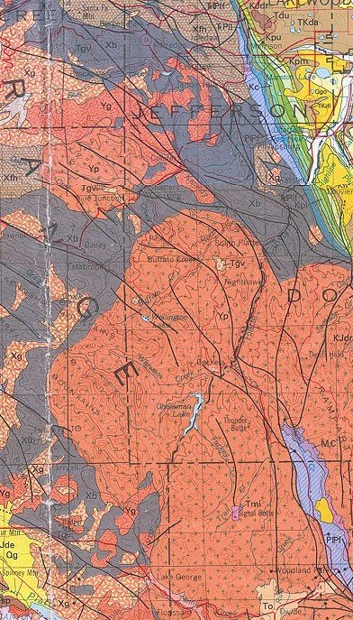

Geologic Map of a Portion
of the Front Range
Generalized Stratigraphic Column
Perm./Penn Fountain
and Lyons Fms,
Undifferentiated
PlPf
_
MOC
Camb. Sawatch, Ord.
Manitou Springs, & Miss.
Leadville Fms, Undiff.
Yp
1.04 BY Pikes Peak Granite
Yg
Xb
1.44 – 1.72 BY Precambrian
Metamorphics and Granite
Xg
15 km
(after Tweto, 1979)

Slide 5
Results: Impact Crater Evidence
  6 “Ringed” Structures Identified
  Confirmation of Impact Origin
    Shock Metamorphic Features
      Shatter Cones*
      Parallel deformation Lamellae (PDFs)*
      Diaplectic glass*
      Coesite*
      Impact melt glass/lechatelierite*
    Supplemental Evidence
      Pseudotachylite Breccia
      Magnetic Anomalies
*Shock metamorphic features that are definitive evidence
of impact origin (French, 1998)

Slide 6
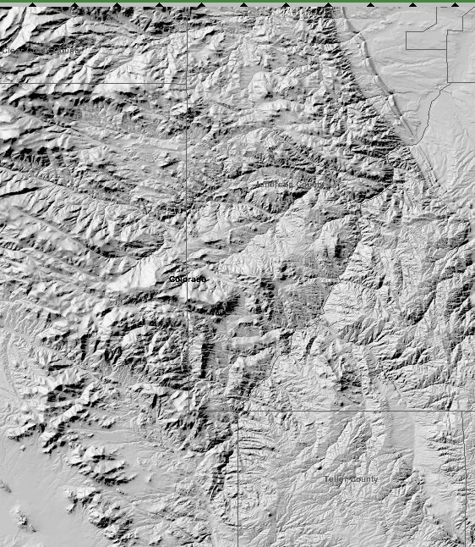
Evergreen
Morrison
Aspen Park
6 “Ringed” Structures
Identified
Deer Ck
Name | Diameter (km)
Aspen Park | 22
Buffalo Ck | 32
Lost Ck | 16
Goose Ck | 24
Lake George | 16
Deer Ck | 10
Pine
Buffalo Ck
Bailey
Lost Ck
Goose Creek
7
Lake George
0 5 10
km
Shaded Relief Map (USGS, modified)
l
Notes:
6

Slide 7
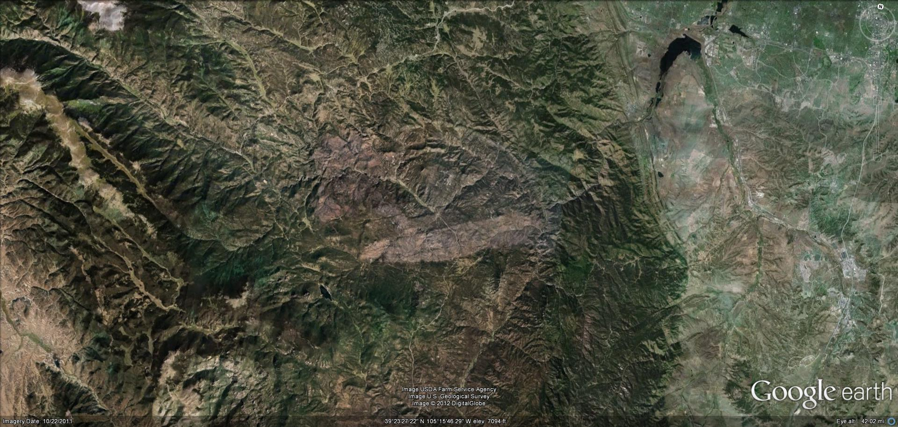
Google Earth Image - Buffalo Creek Impact Structure
Bailey
Pine
South Platte River

Slide 8
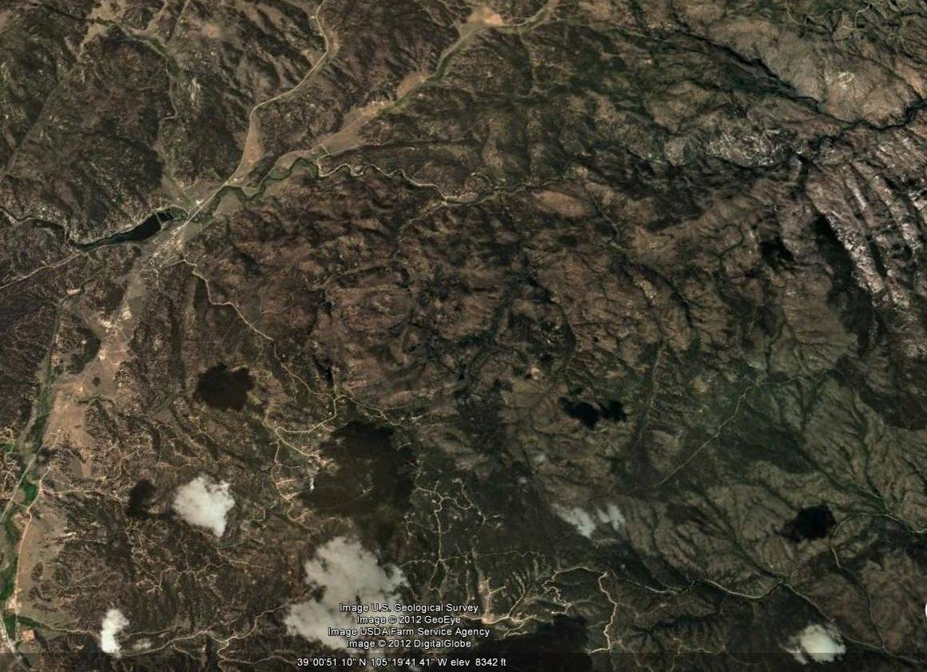
Google Earth Image - Lake George Impact Structure
Oblique View Looking North

Slide 9
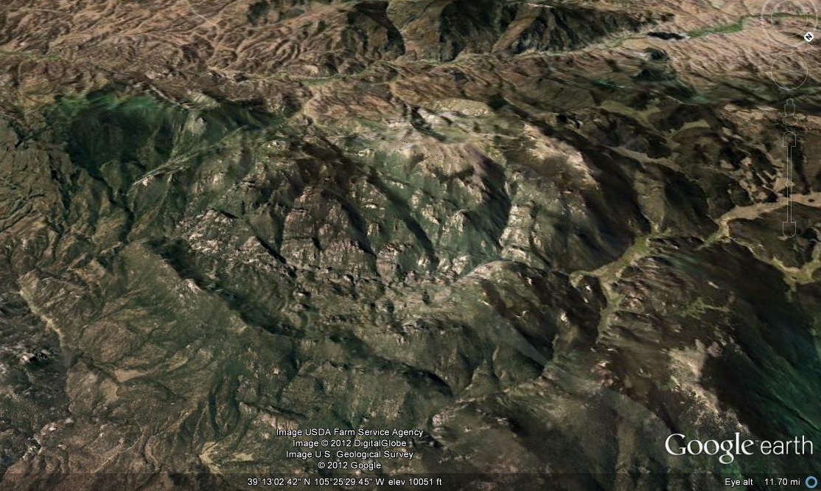
Tarryall Creek
Kenosha Mts
Lost Creek Impact Structure: Oblique View Looking South

Slide 10
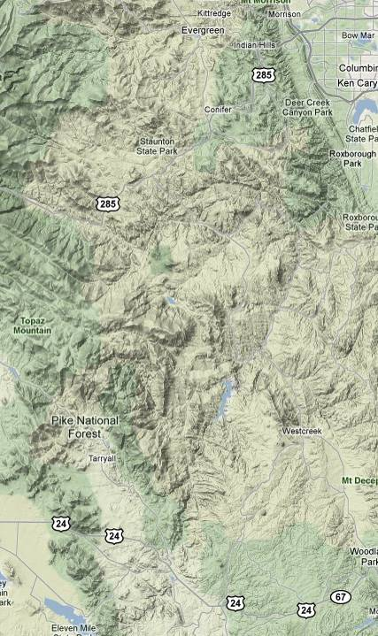
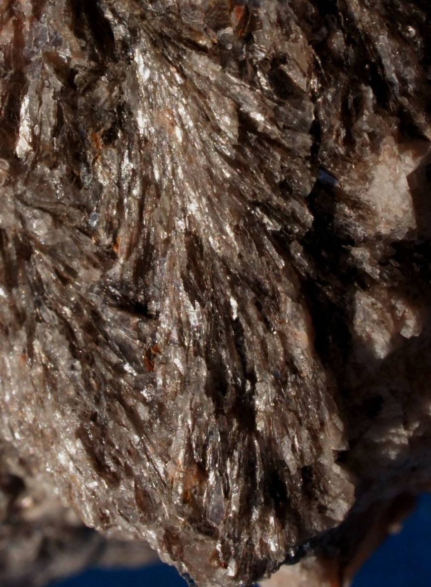
Shock Metamorphic
Features: Shatter Cones*
Google Terrain Map
Conifer
Bailey
Buffalo Ck
Deckers
West Creek
0 5 10 km
.5 cm
Lake George
Shatter Cones in Granite Pegmatite: Aspen Park Structure
Shatter Cone Locations

Slide 11
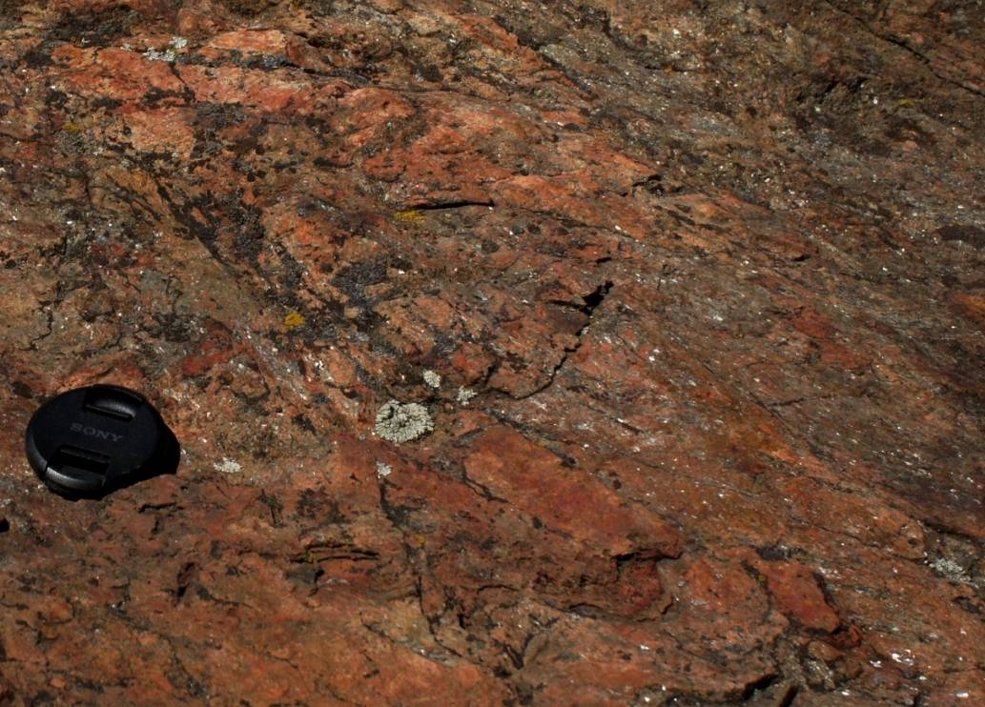
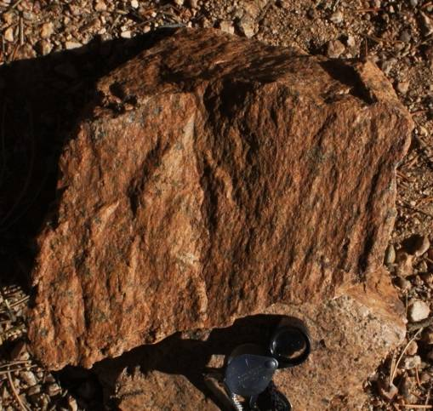
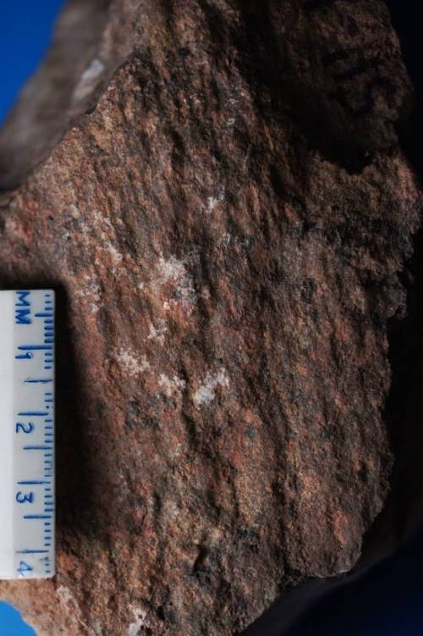
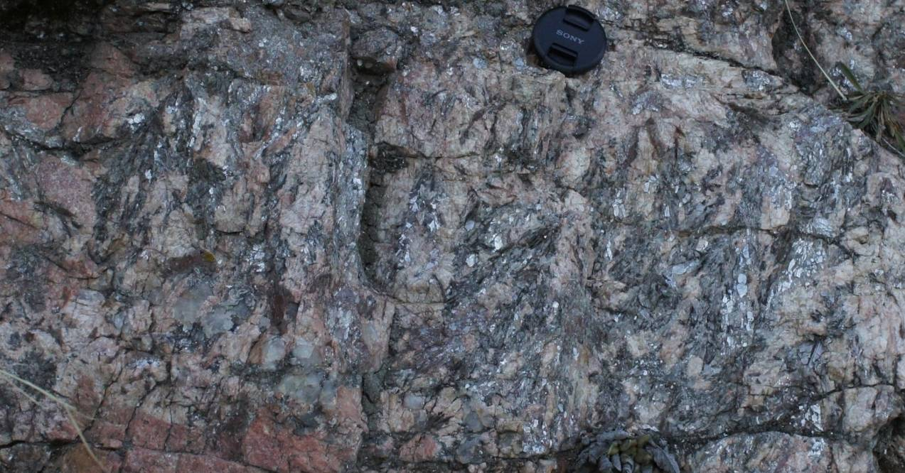
Shatter Cones
(arrows show “horsetail” direction)
Lost Creek
Deer Creek
Goose Creek
Aspen Park

Slide 12
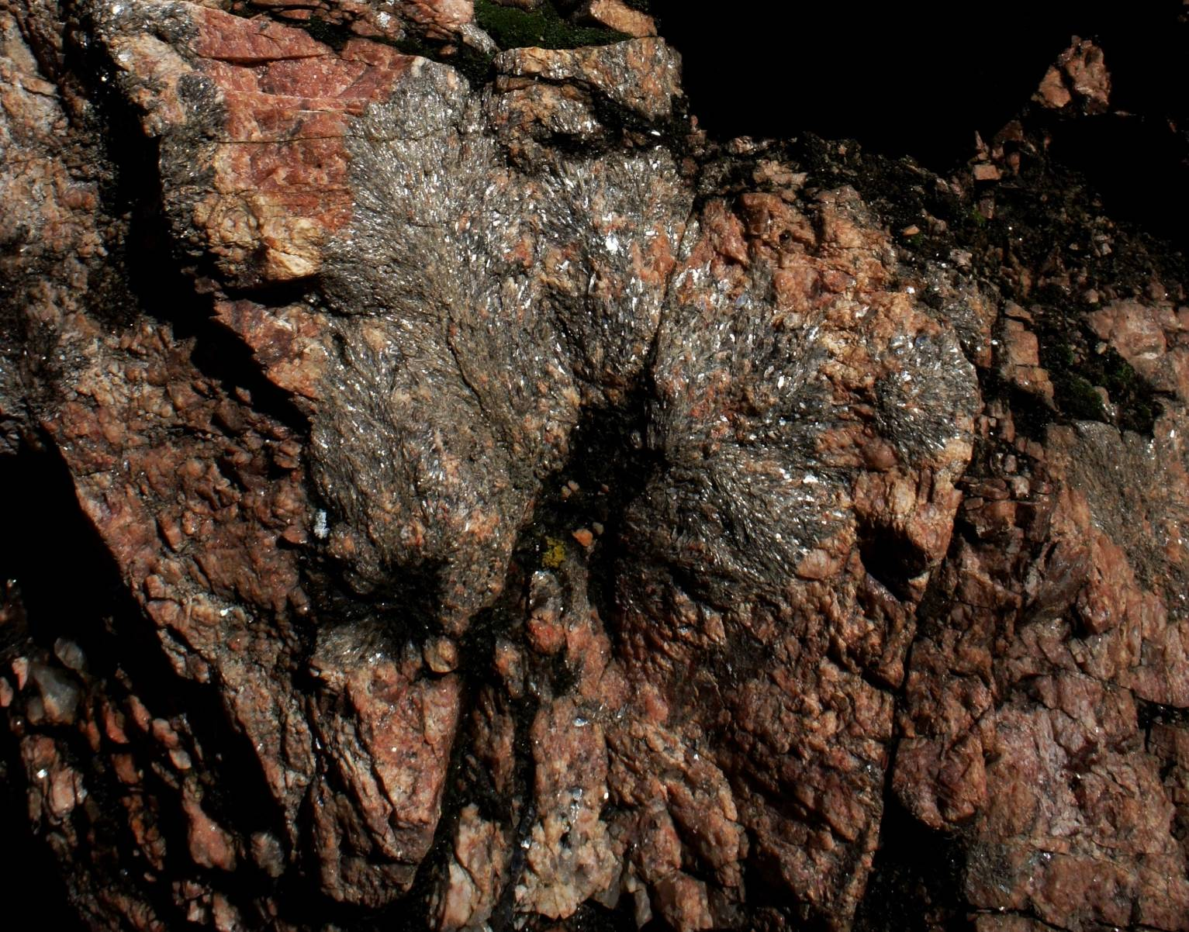
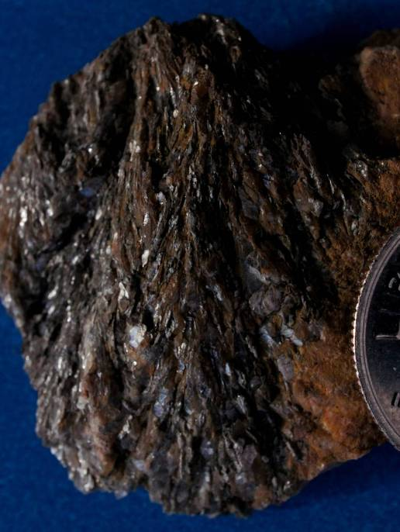
Muscovite Shatter Cone Detail:
Aspen Park Impact Structure
3 cm

Slide 13
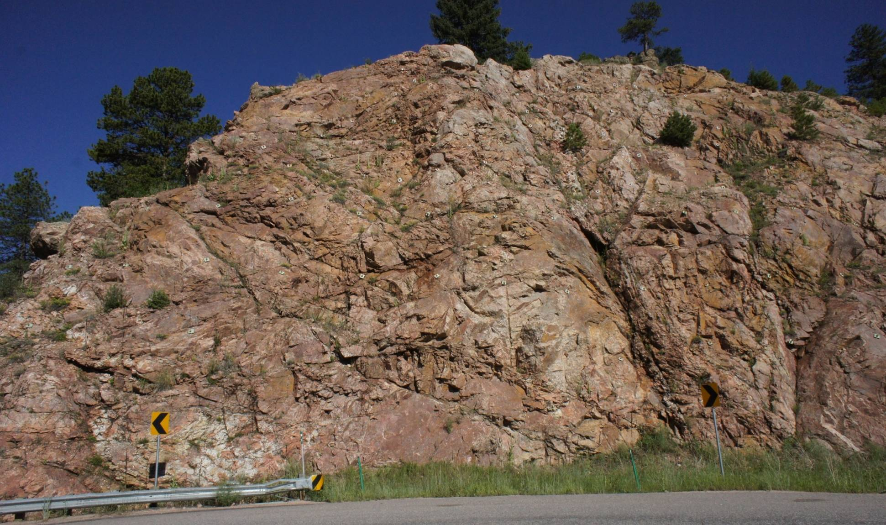
Mega-Shatter Cones:
Aspen Park Impact Structure
18 m exposed from top to base

Slide 14
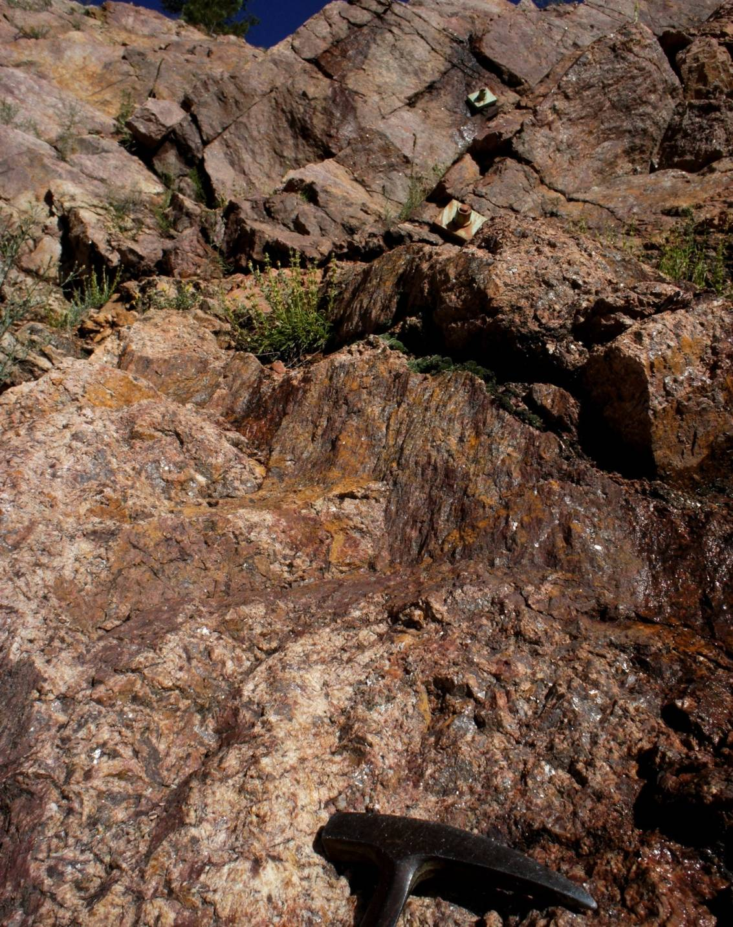
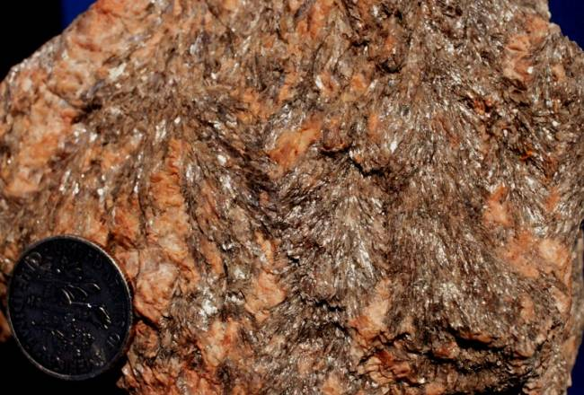
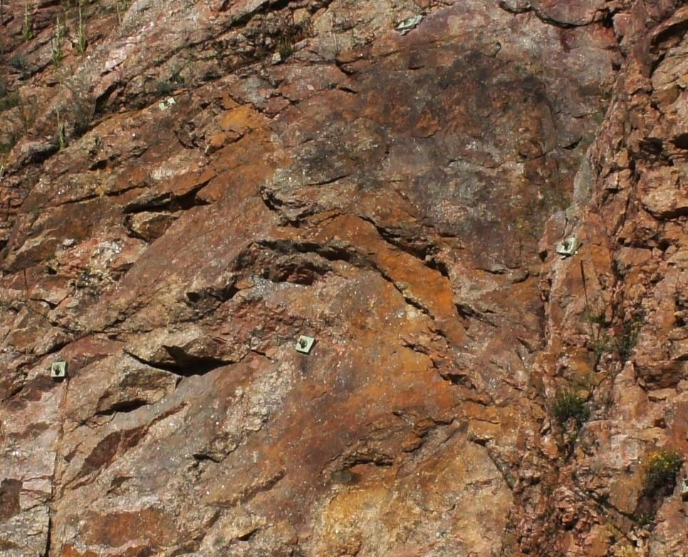
Parasitic Cones on Mega
Shatter Cone
Multiple Shatter Cones Fracture Surfaces

Slide 15
Evergreen
Morrison
Shock Metamorphic
Features: Glass and
Melt Rock
Aspen Park
Deer Ck
Diaplectic Glass*
Melt Glass*/Ballen
Structure
Pseudotachylite
Breccia
Pine
Buffalo Ck
Bailey
Lost Ck
Goose Creek
Melt Rock
Lake George
0 5 10
km
l

Slide 16
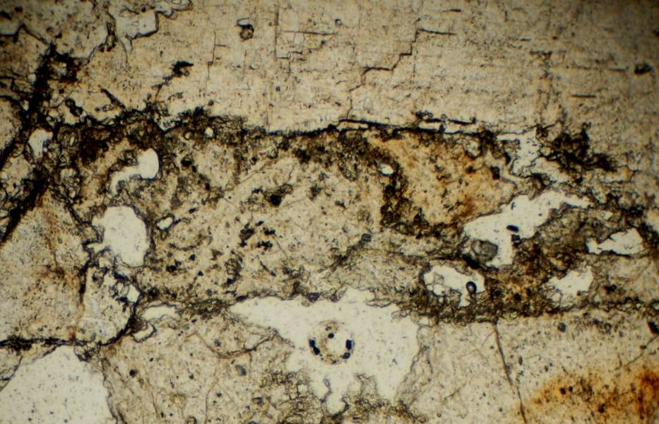
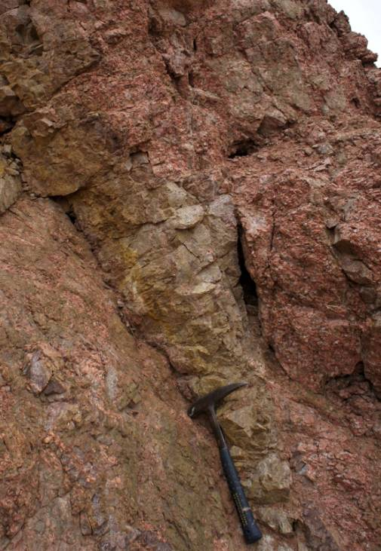
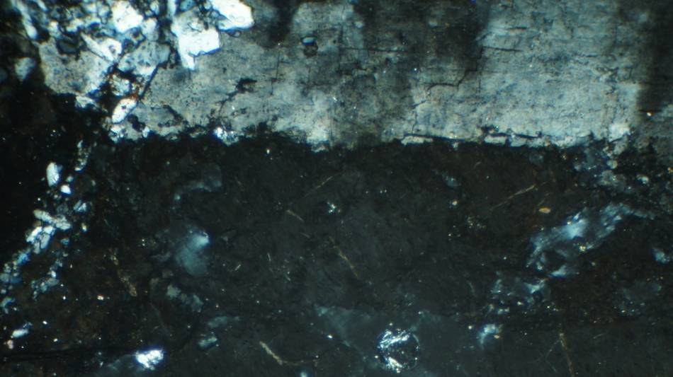
Diaplectic Glass*: Buffalo Creek
Impact Structure
Diaplectic
Glass
Evergreen
Morrison
.5 mm
PPLight
Glassy Quartzite Dike
In Pikes Peak Granite
CPLight

Slide 17
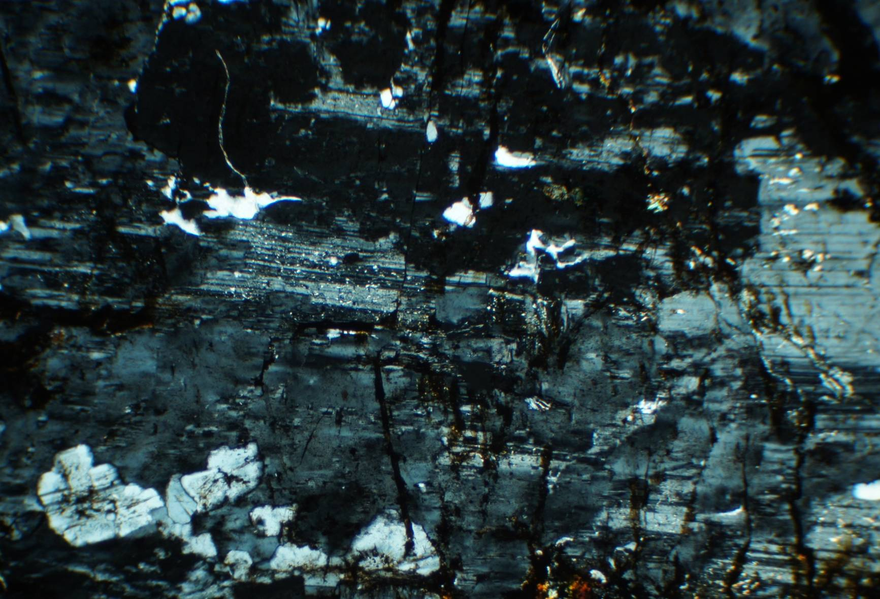
Deformed Plagioclase with Diaplectic Regions:
Aspen Park Impact Structure
Notes:
Micro faulted plagioclase with diapletic glass regions. Mt Berrian

Slide 18
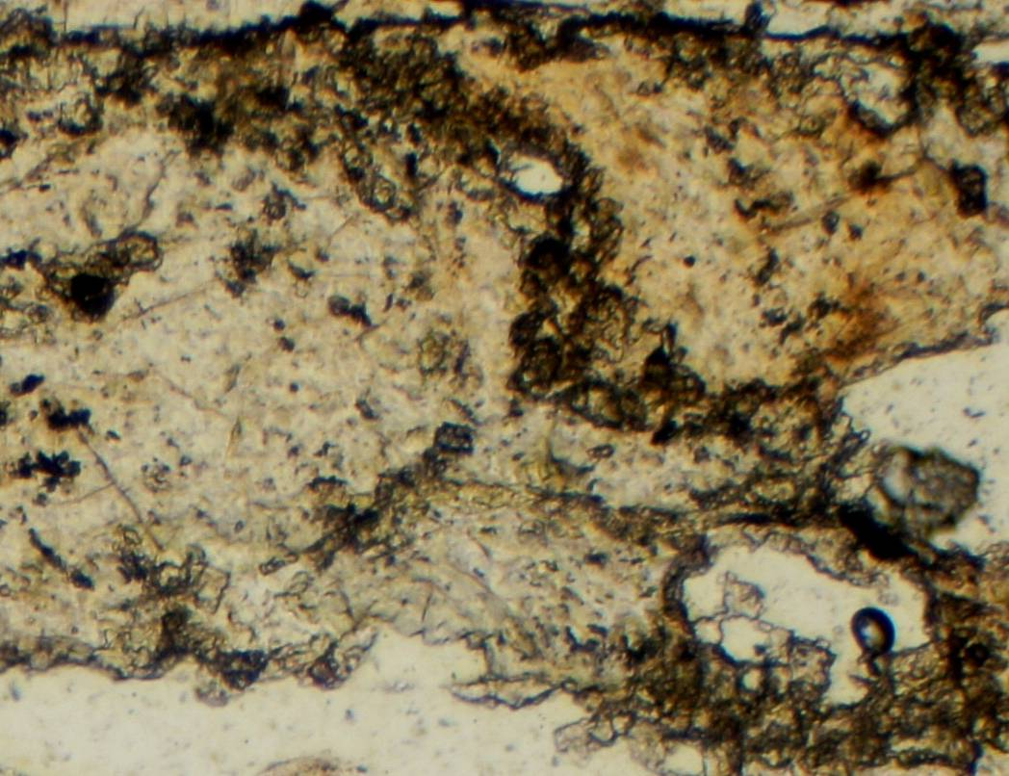
Coesite* and Diaplectic*: Buffalo Creek
Impact Structure
Coesite
Diaplectic
Glass
Diaplectic Glass
.25 mm

Slide 19
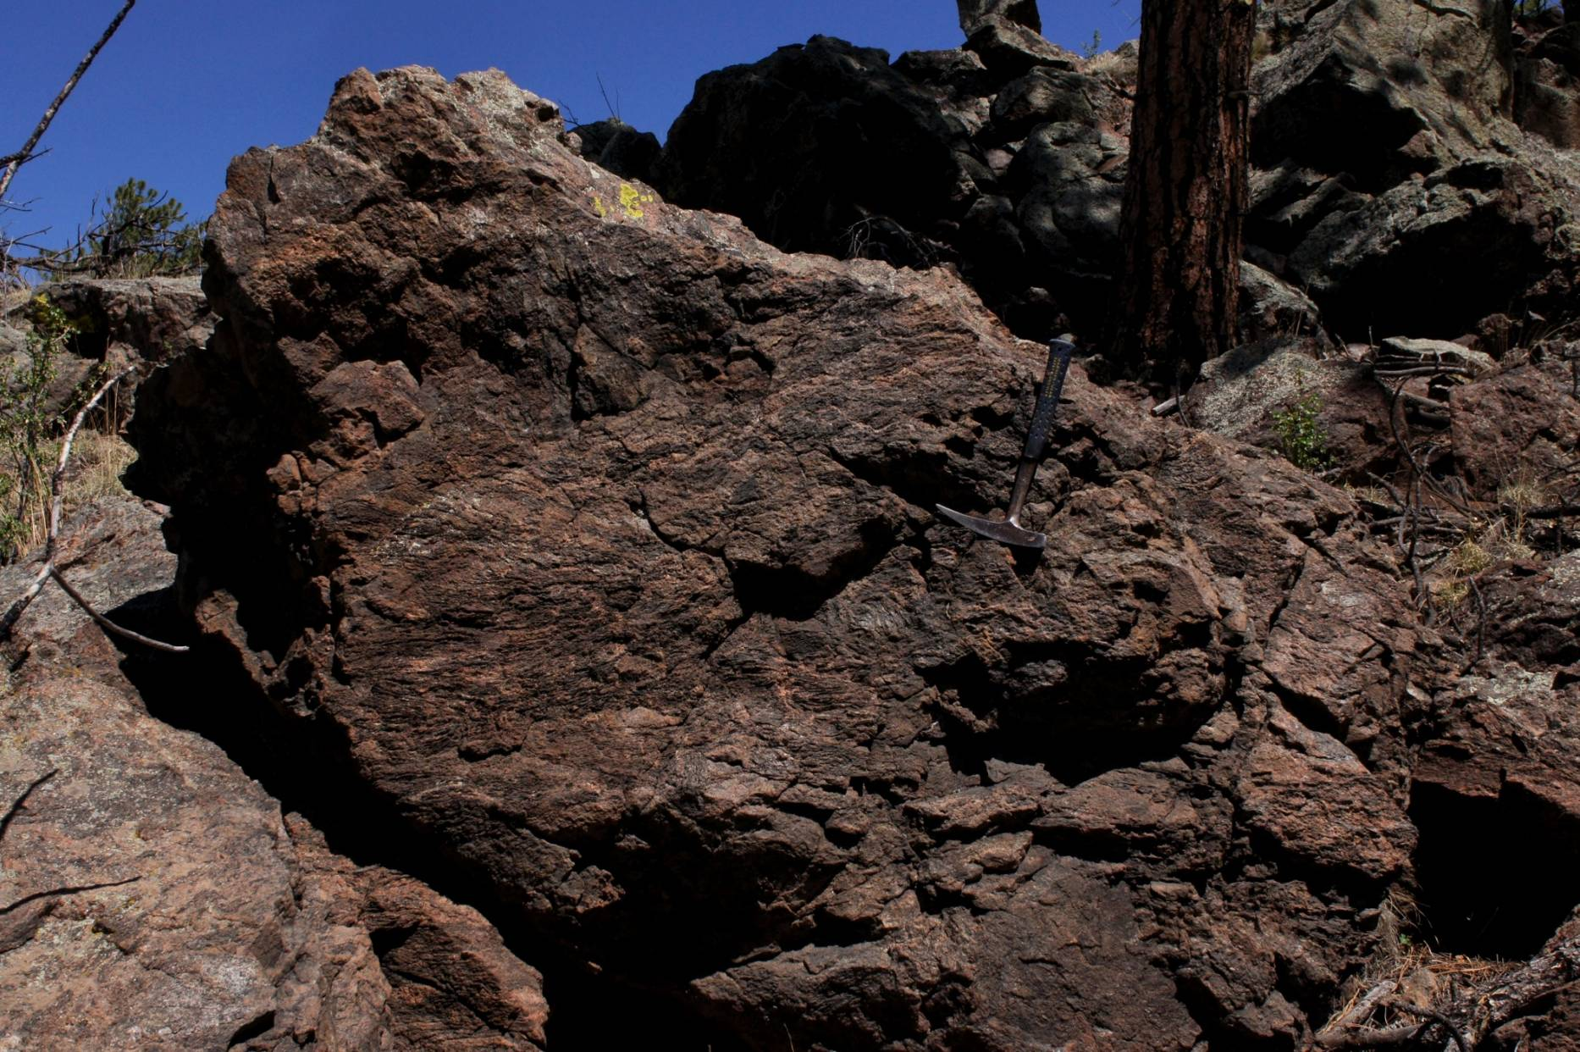
Glassy Impact Melt Breccia: Crater Fill
Material, Lake George Impact Structure
Evergreen
Pine
Bailey
l
Clast

Slide 20
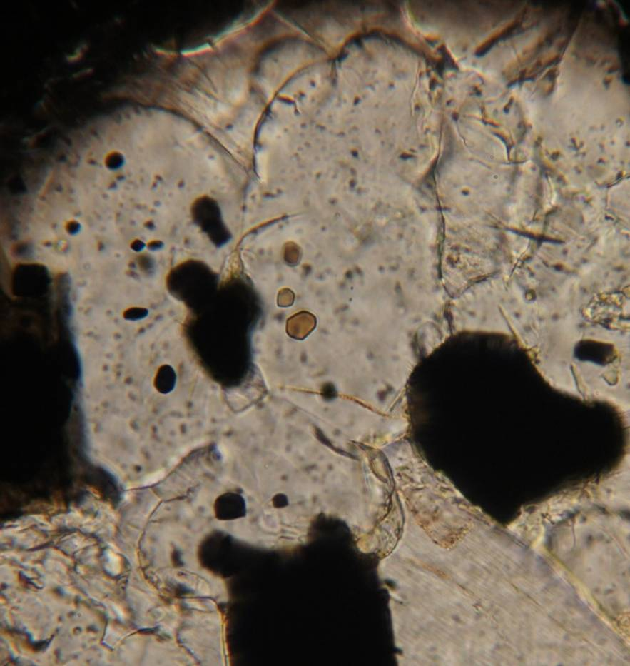
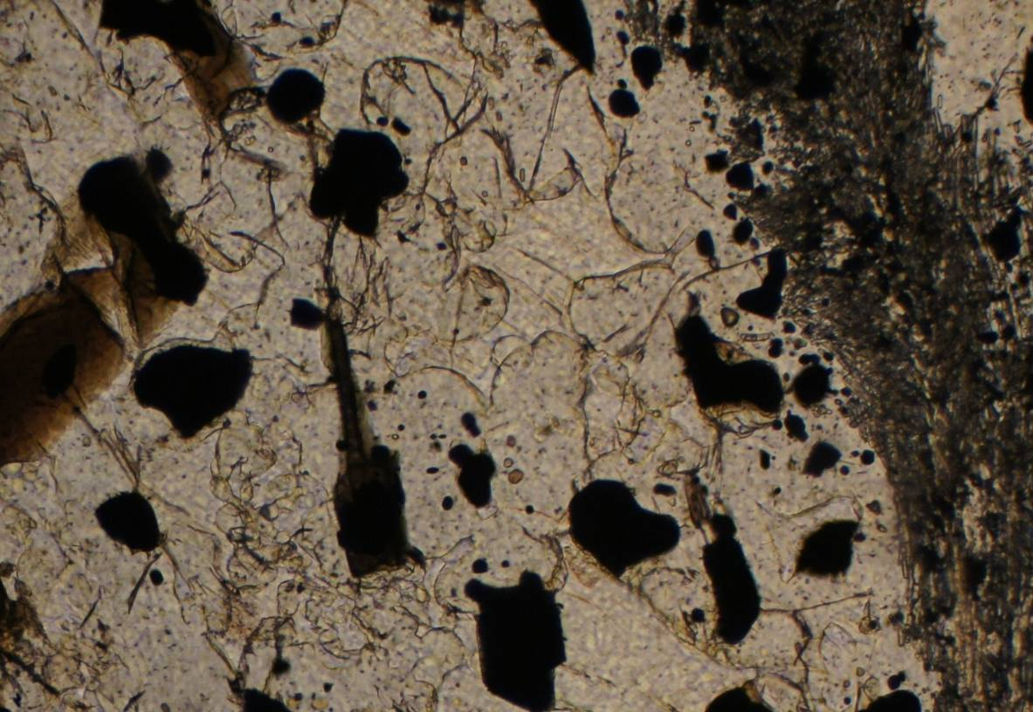
Melt Glass/Ballen Structure*:
Lake George Impact Structure
.2 mm
.1 mm

Slide 21
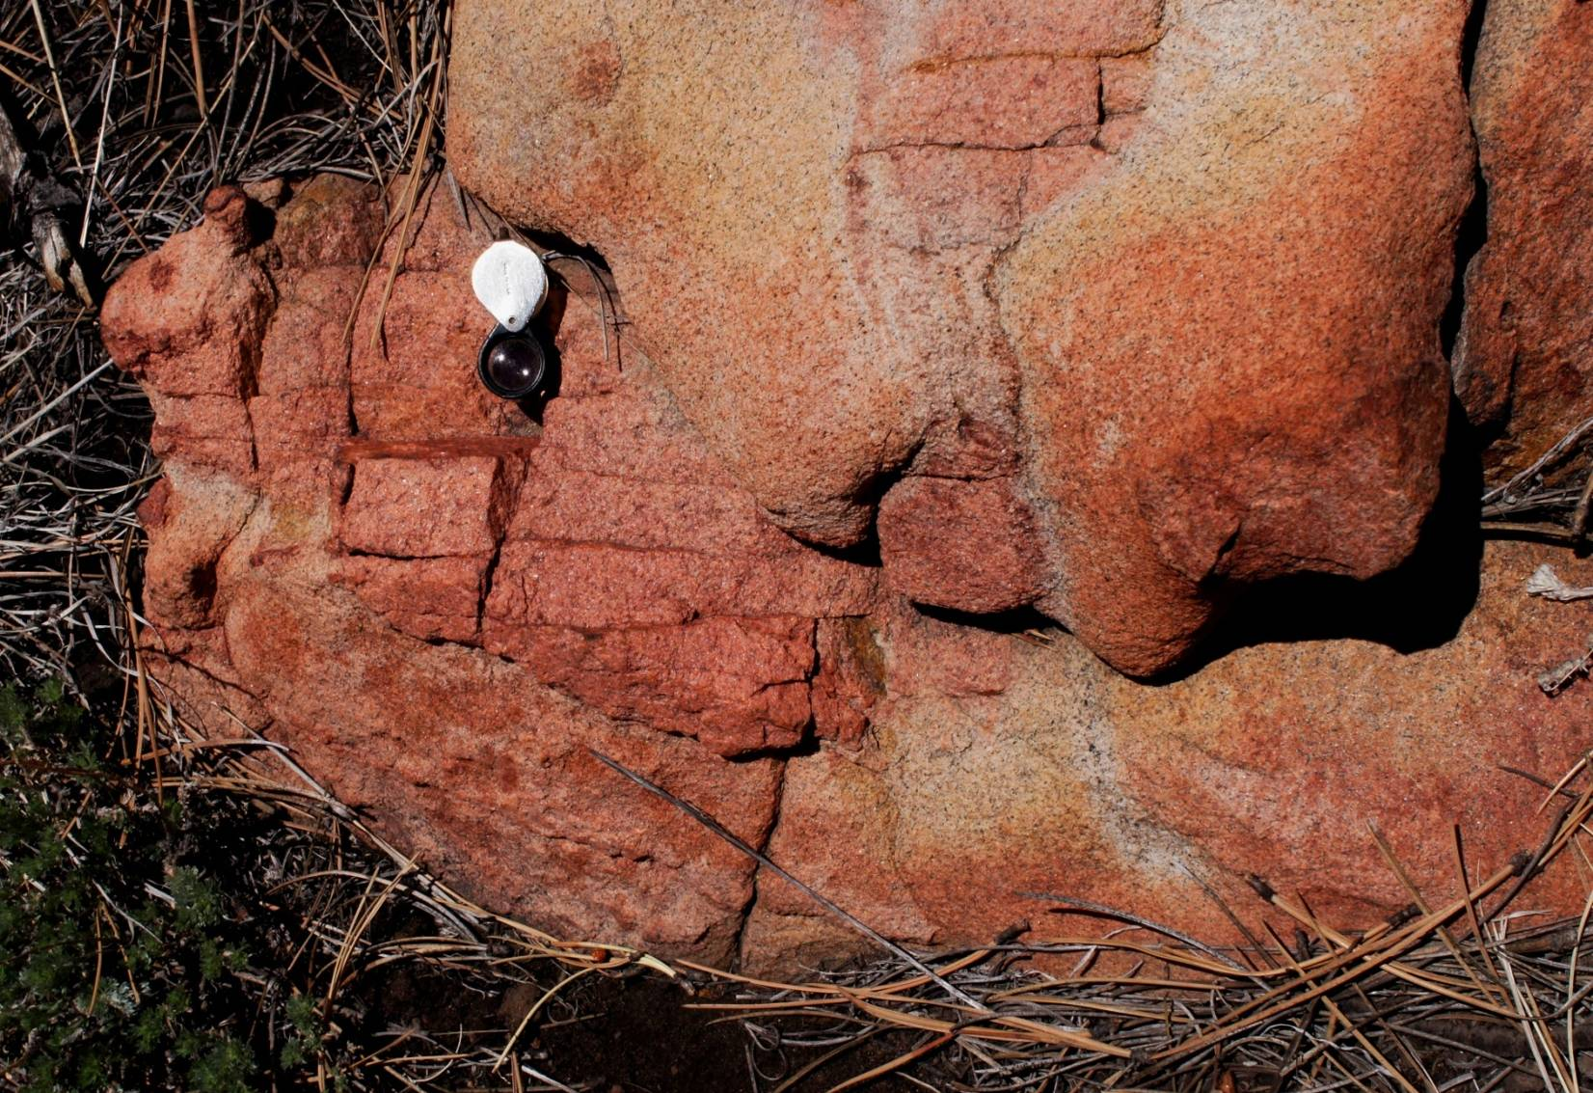
Impact Melt with Clasts of Pikes Peak
Granite: Lake George Impact Structure

Slide 22
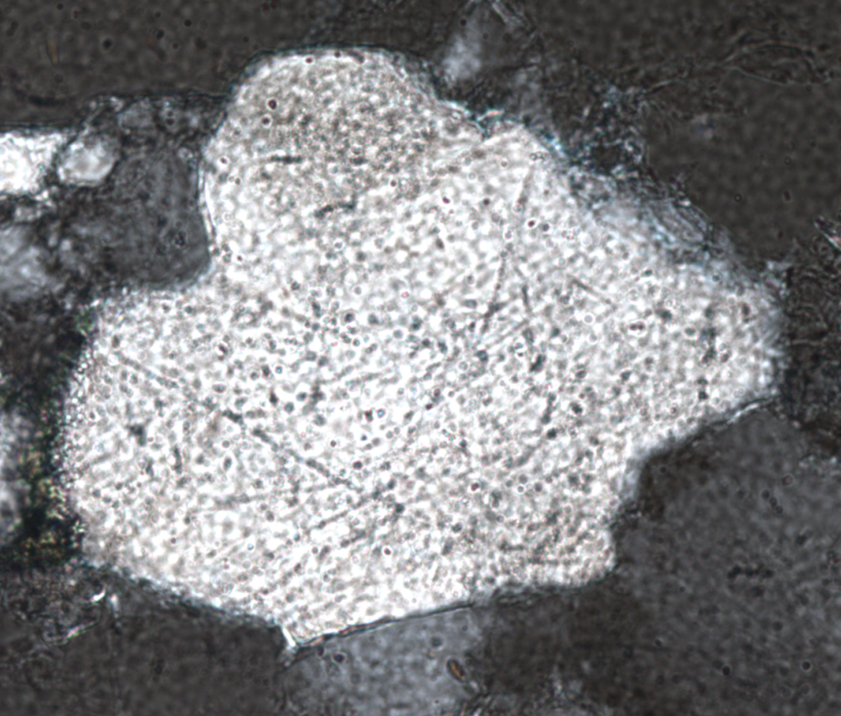
Shock Metamorphic
Features: Parallel
Deformation Lamellae
(PDFs?)
Evergreen
Morrison
Aspen Park
Deer Ck
Pine
Buffalo Ck
Bailey
Lost Ck
Goose Creek
7
(Photo by T. McElvain)
Probable PDFs in Quartz Grain:
Buffalo Creek Impact Structure
Lake George
0 5 10
km
l

Slide 23
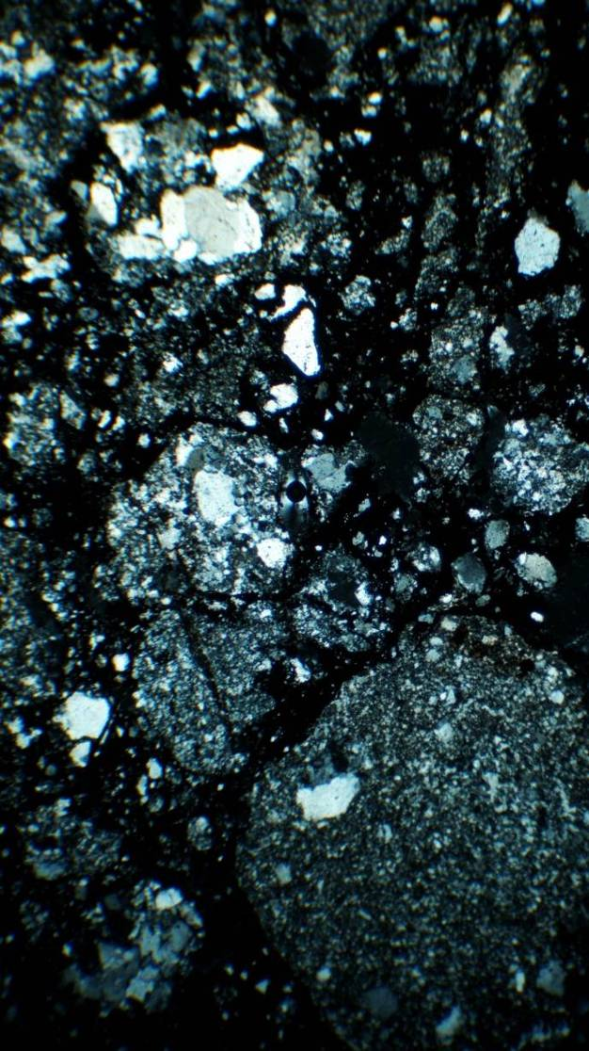
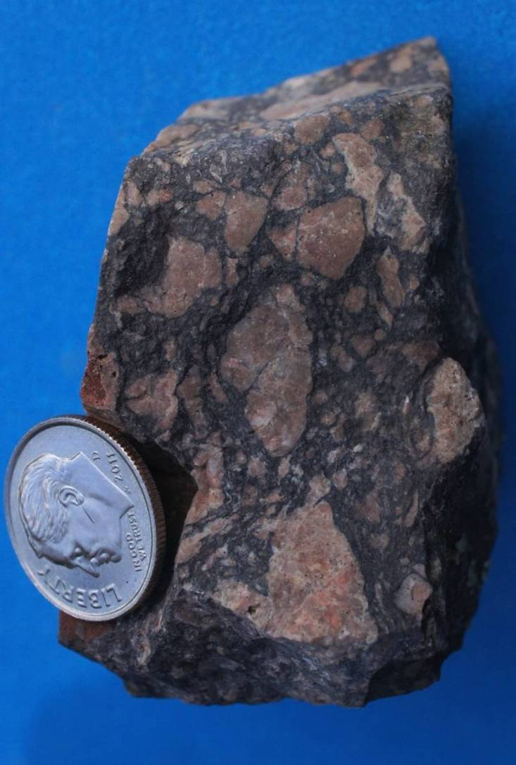
Supplemental Evidence: Psuedotachylite Breccia: Aspen Park Impact Structure
Evergreen
Morrison
4mm
Thin Section, Cross Polarized View

Slide 24
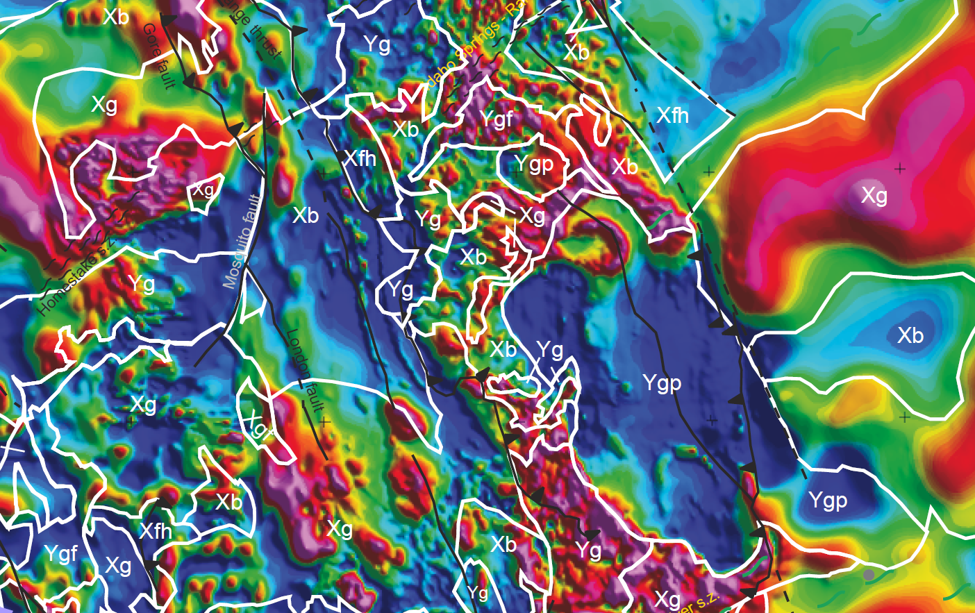
Supplemental Impact Evidence:
Magnetic Anomalies
Deer Creek
Evergreen
Morrison
Buffalo Creek
Aeromagnetic Map of Colorado, after Oshetski and Kucks, 2000 USGS

Slide 25
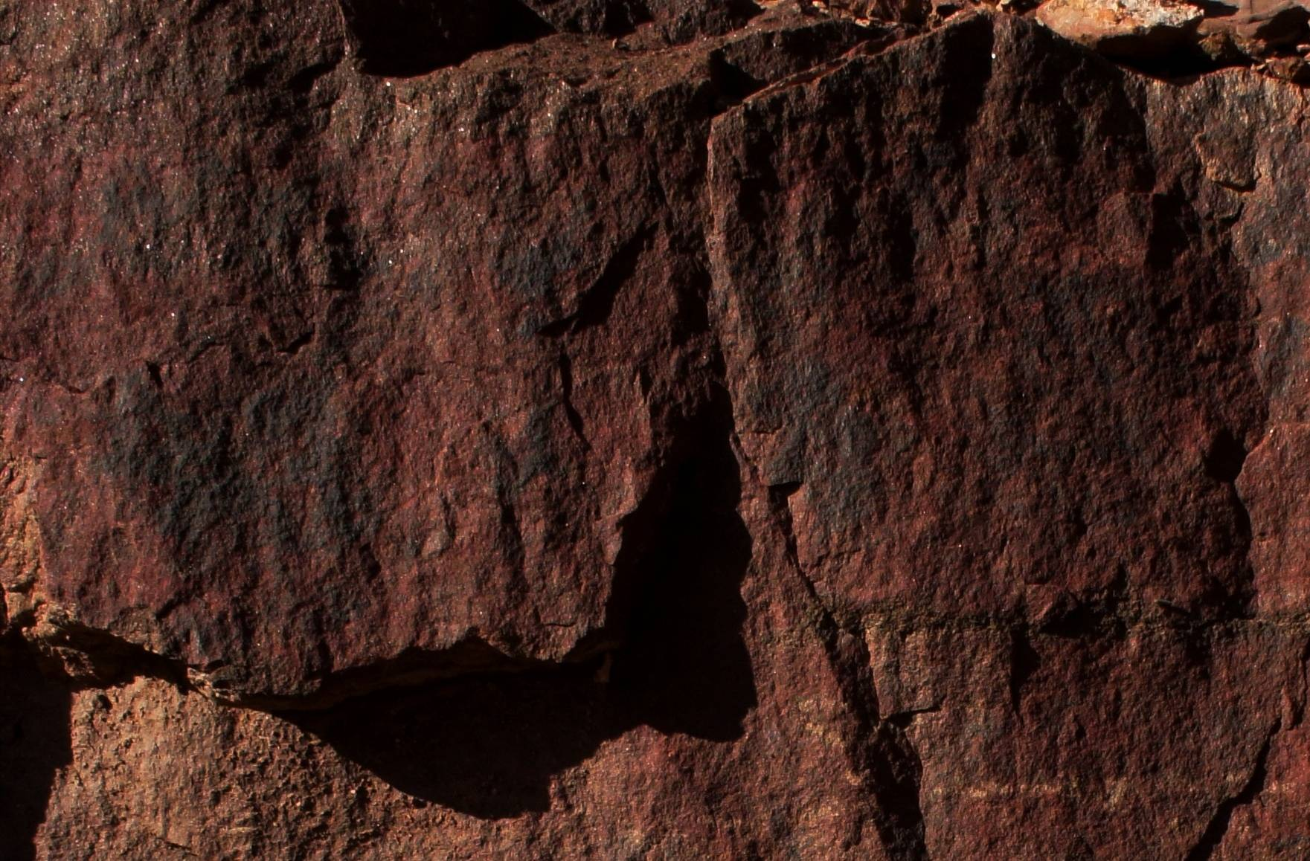
Age of Impacts: Post Cambrian, Pre-Laramide
5 cm
Shatter Cones in Cambrian Sawatch Sandstone

Slide 26
Estimated Pre-Break-Up Impactor Diameter*
Impact Structure | Impactor Diameter (km)
Aspen Park | 1.14
Deer Creek | .441
Buffalo Creek | 1.46
Lost Creek | .736
Goose Creek | 1.35
Lake George | .736
Pre-Break Up Diameter | 5.86
Chicxulub | 10
*Based on the Lunar and
Planetary Laboratory’s
Crater Projectile Size
Calculator by Melosh and Beyer, 1991

Slide 27
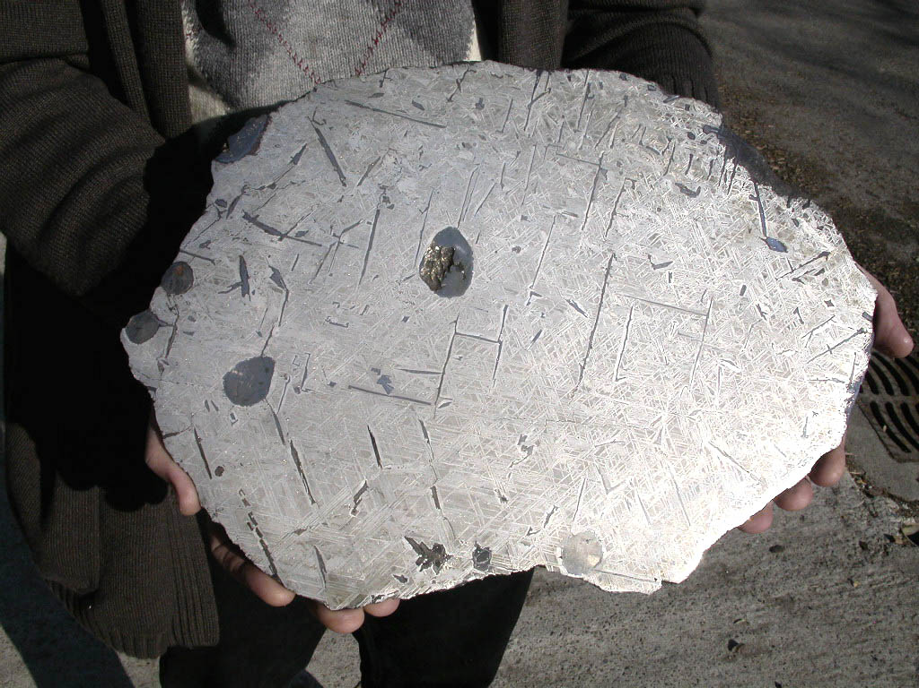
Conclusions
Shock metamorphic features confirm an impact origin for the 6 ringed structures named here the Colorado Impact Crater Cluster
The craters formed by the near simultaneous impacts of 6 asteroids or comet fragments
Impact structure sizes indicate they are complex (peak ring) craters
Age: Post dates the Cambrian and predates the Laramide Orogeny (500 - 75 MYA)
Estimated pre-break diameter was 6 km
Ties to a mass-extinction level event are possible with precise age constraints
Background: 226 kg Bear Creek Meteorite, found near the center of the Aspen Park Impact Structure

