Slide 1
AMS Weather,
Ocean, and Climate Studies
Innovative Use of Real-World Data to Teach Geoscience
in K-16
Dr. Jim Brey
Director
AMS Education Program
GSA Rocky Mountain Meeting 2012

Slide 2


American Meteorological Society
Founded in 1919
Over 14,000 members
Organizes over a dozen conferences annually
Publishes 11 leading journals
Certifies consultants and broadcasters
Significant educational activity since 1990
Non Profit 501 c3
Our Mission:
Promote the development
and dissemination of information and education on the atmospheric and related oceanic and hydrologic sciences and the advancement of their professional applications in service to society.

Slide 3
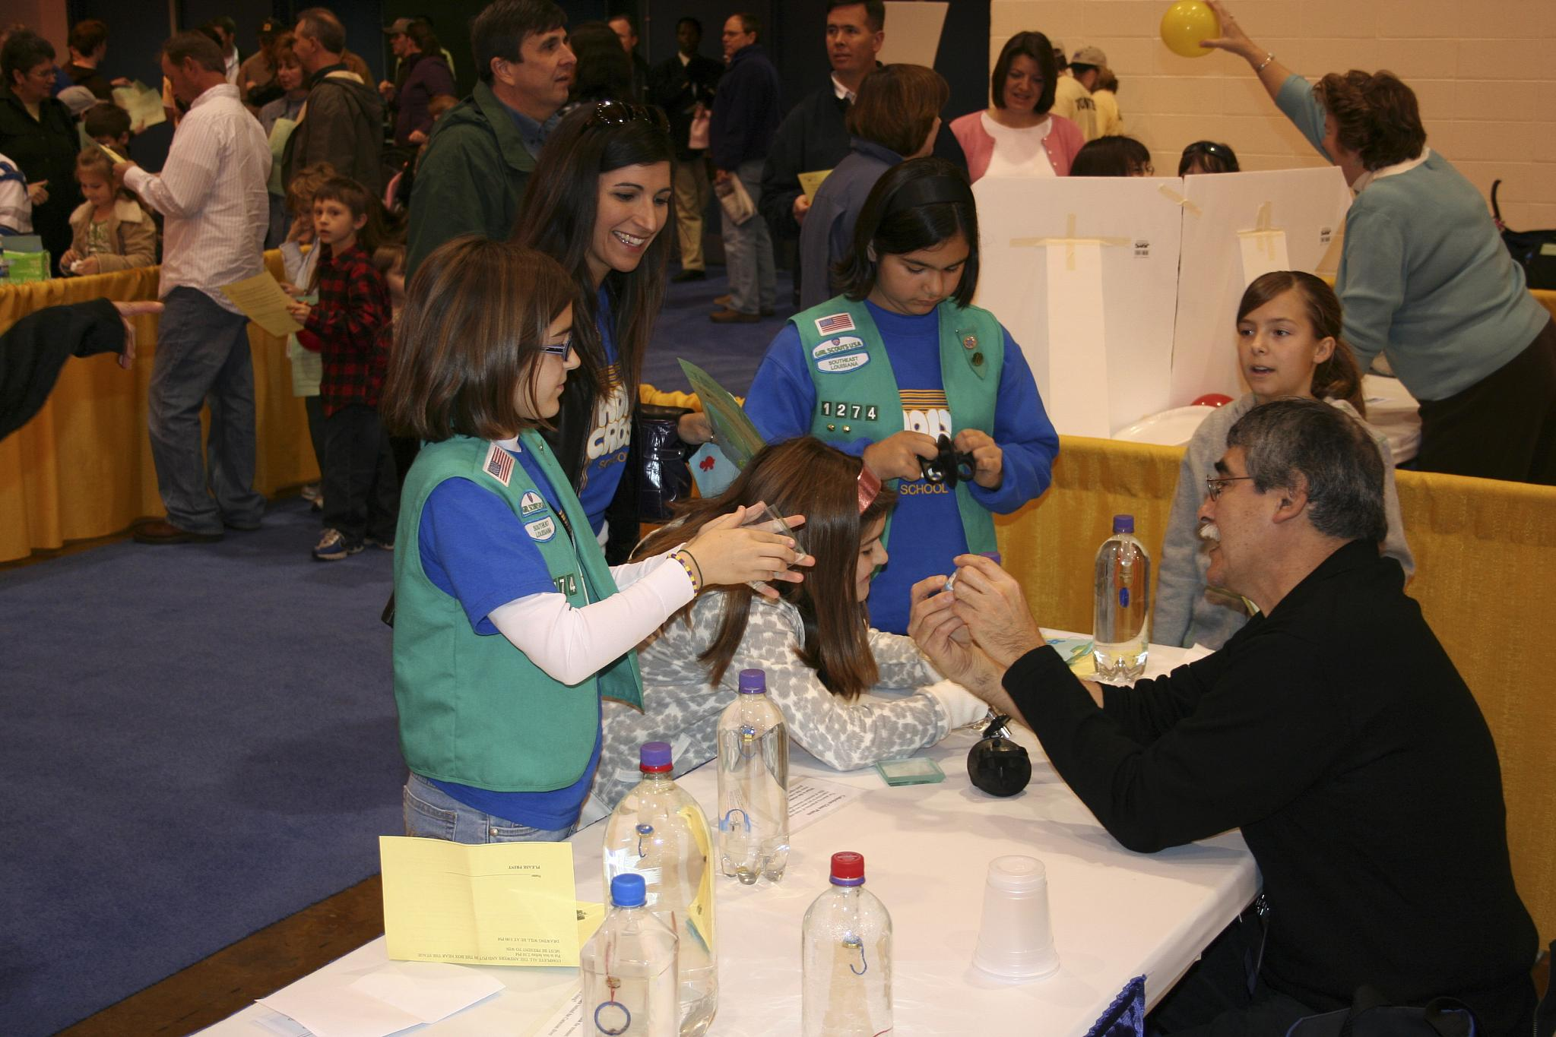
AMS Education Program Mission
To better equip students in science and math through:
Professional development opportunities for teachers nationwide
Free graduate credits through SUNY Brockport
Innovative undergraduate course packages licensed to
universities, colleges, and community colleges
  Including significant numbers of minority serving institutions (MSIs)
Facilitating the development of partnerships among institutions and individuals
This is what we are most concerned with and this is what we do best!

Slide 4
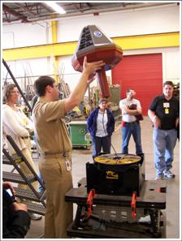
Opportunities in our Disciplines
Encourage members of underrepresented groups to aspire to an Earth science career
Prepare the next generation of earth scientists by promoting workforce development
Introduce role models to emulate
Provide insight into the excitement of Earth system science
Careers in Earth Science are exciting and offer many opportunities!

Slide 5
It Starts with the Teachers
Maury Project
DataStreme Atmosphere, Ocean, Earth’s Climate System
Project Atmosphere
Improve teachers’ competence and confidence
Provide materials that are standards-based and scientifically accurate
  Transformed by teachers into discipline- and age-appropriate lessons
Offer FREE graduate credits (SUNY Brockport)
Create a structure for peer-training
  Training impacts felt in schools and communities
Create pathway for continued communication between trained teachers, scientists, and mentors

Slide 6
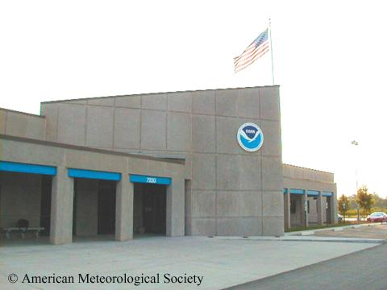
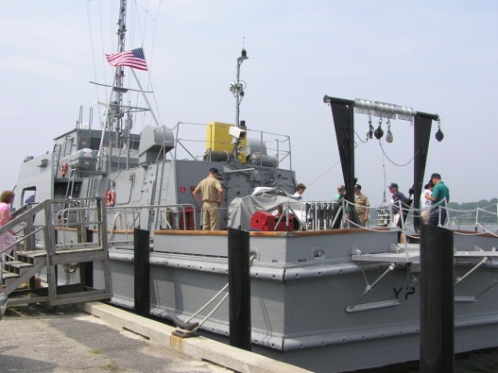
Project Atmosphere & the Maury Project
Two-week summer workshops on the fundamentals of meteorology (PA) and physical oceanography (MP)
Held at the National Weather Service Training Center in Kansas City, MO (PA) and the Naval Academy in Annapolis, MD (MP)
3 FREE graduate credits from SUNY Brockport
Leadership training for AMS Education Resource Agents (AERAs)
  AERA leadership essential every other AMS Education endeavor
Project Atmosphere
Maury Project

Slide 7
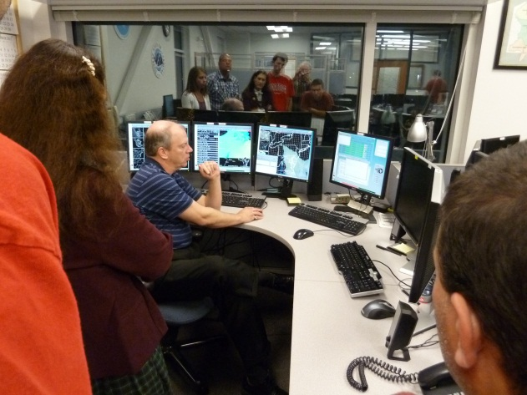
DataStreme Courses
Distance-learning K-12 teacher professional development courses
  Scientific inquiry utilizing near real-time geoscience data
Customized textbook, investigations manual, & website
Local Implementation Teams (LITs) provide mentoring by scientists and practitioners
3 FREE graduate credits from SUNY Brockport
Teachers serve as resource agents in their school districts and contribute to curriculum reform
DataStreme Atmosphere, Ocean, Earth’s Climate System

Slide 8
DataStreme Process
Local Implementation Teams (LITs) recruit teachers
Typically a group is composed of 8 teachers.
AMS develops materials
Goal is for teachers to introduce other teachers/ administrators/community leaders to benefits of using real-world, current, environmental data for learning!
LITs offer course online with several in-person meetings

Slide 9
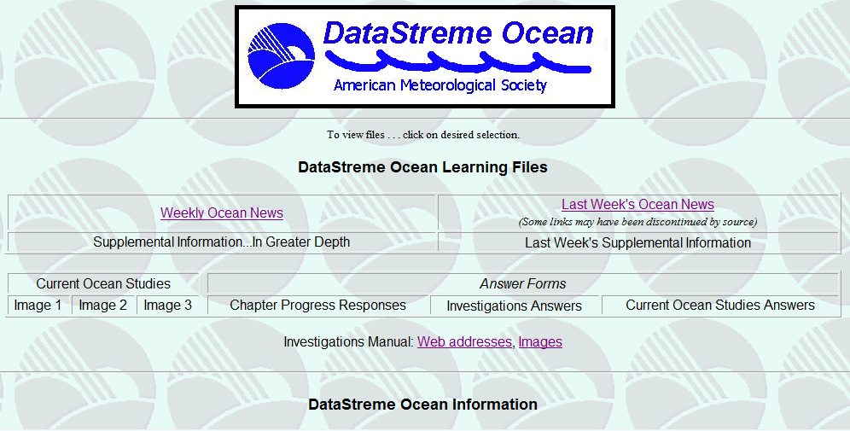
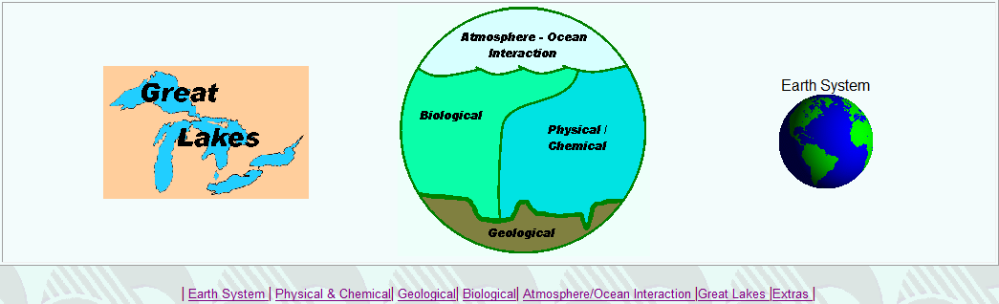
Course Website
Weekly Ocean/Weather/ Climate News
Current Ocean/Weather/ Climate Studies
Links to current environmental data

Slide 10
Undergraduate Earth Science Courses
AMS Climate Studies
AMS Weather Studies
AMS Ocean Studies
Introductory courses where students use real-world and real-time data
Emphasis on hands-on investigations and critical thinking skills
Designed by and licensed through the AMS
Can be offered in a variety of learning environments
NASA, NOAA, and NSF-supported Diversity Projects facilitate implementation at MSIs nationwide

Slide 11

AMS Climate Studies
Focuses on the science, but also addresses the societal impacts that draw the attention of students
  Foundations of Earth’s climate system, including climate dynamics
  Contributions of human activities to climate change
  Societal and ecosystem vulnerability and response
  Political and economic aspects of climate change
The same effective turnkey package as AMS Weather Studies & AMS Ocean Studies
Also, serves as a great primer for students entering technical ‘green’ programs
Licensed by more than 40 institutions since implementation in Fall 2010

Slide 12
Course Implementation
Instructor
Course offering by experienced science faculty or those new to teaching the subject matter
Setting
Range from traditional lecture-based to totally online
Students
Receive local institutional credit
Purchase course materials through local bookstore

Slide 13
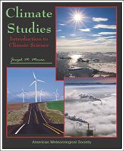

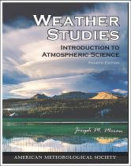
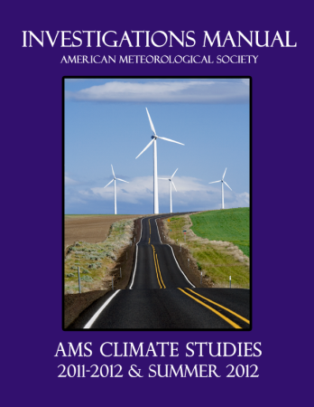
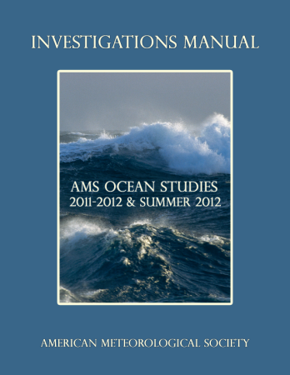
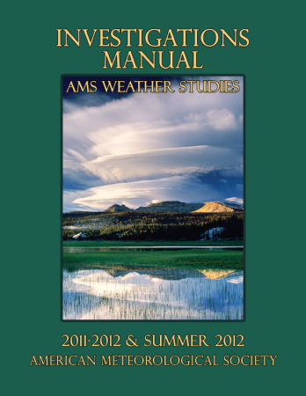
Course Materials
Fully-integrated packages; contain both printed and online learning materials:
  Comprehensive 15-chapter, full color, hard cover textbook*
  Investigations Manual with 30 laboratory-style activities*
  Course website*
  Faculty website
  Faculty resource CD
  Course Management System-compatible files
  * Also included in DataStreme courses

Slide 14
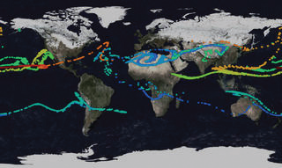

Investigations Manual
Includes 30 lab-type investigations (two per chapter)
AMS Weather Studies
  Recent meteorological case studies and an overview of the day’s weather
AMS Ocean Studies
  Inflatable globe guides visualization of complex ocean phenomena (such as tides, El Niño/La Niña, and tsunami trajectories)
AMS Climate Studies
  AMS Conceptual Energy Model
    Visualizing the effects of changing atmospheric composition
  DataStreme ECS uses EdGCM

Slide 15
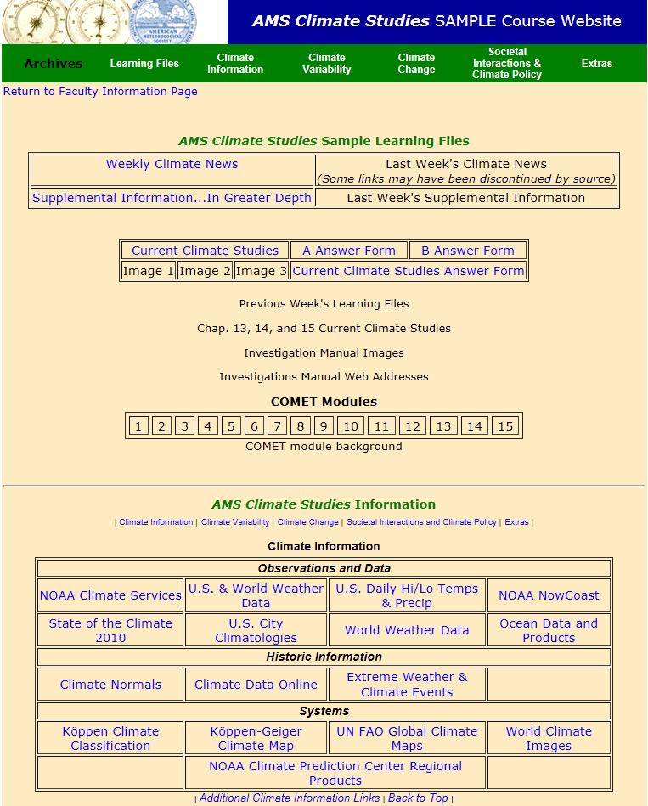
Course Website
Weekly Climate/Weather/Ocean News
Current Climate/Weather/Ocean Studies
Links to current environmental data:
Climate Information
Climate Variability
Climate Change
Societal Interactions & Climate Policy

Slide 16
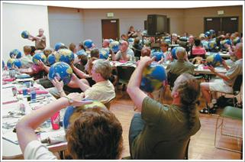
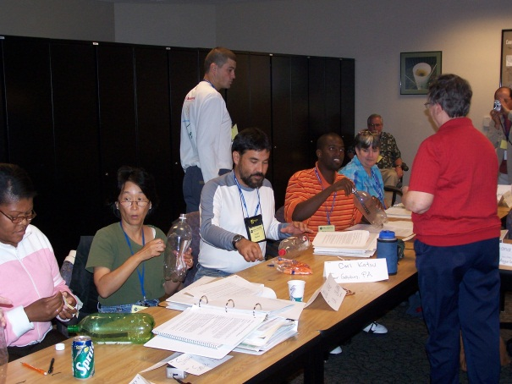
Faculty Resource Materials
Faculty CD
Faculty manual
Textbook images suitable for PowerPoint presentations
Test bank questions
Answers to review & critical thinking questions
Course Management System-compatible files
Faculty website
Weekly discussions
Answer keys
Faculty Mentoring
Available by other AMS-trained faculty members

Slide 17
Conclusions & Future Directions
AMS has trained almost 18,000 teachers through K-12 programs, effecting more than 1 million students.
AMS Weather, Ocean, and Climate Studies have introduced geoscience education to almost 700 institutions (220 of these are MSIs).
Courses encourage additional student explorations of the geosciences, possibly leading to science careers.
AMS Water Studies currently in planning phase, developmental
funding will be sought.
AMS Climate Studies Diversity Project currently in planning phase. Inaugural workshop 20-25 May.
      Ocean Leadership/AMS NSF OEDG Planning Grant funded to develop a similar program dealing with Paleoclimate with a workshop in summer 2012.

Slide 18
Acknowledgements
AMS Weather Studies and AMS Weather Studies Diversity Project were funded by NSF grants GEO-0119740 (OEDG) and DUE-0126032 (CCLI_ND)
AMS Ocean Studies Diversity Project is supported by NSF grant DUE-0442497 (CCLI-ND)
AMS Climate Studies is supported by NASA grants NNX-09AP58G and NNX-08AN53G
The AMS Climate Studies Diversity Project is supported by NSF Grant 1107968 “AMS Climate Studies: Fostering Climate Science Literacy and Promoting Minority Participation in the Geosciences.”
DataStreme Atmosphere and DataStreme Ocean are supported by NOAA award NA07SEC4690023
DataStreme Earth’s Climate System is supported by NASA award NNL10ZB1011C and NSF GEO-1034999

Slide 19






Slide 20
Contact
Dr. Jim Brey
Director
AMS Education Program
brey@ametsoc.org
202-737-1043
American Meteorological Society
1200 New York Ave NW
Suite 500
Washington, DC 20005
www.ametsoc.org/amsedu
Email: amsedu@ametsoc.org
See us at Booth #12

