Slide 1

Use of Radium Isotopes to Evaluate Naturally-occurring Uranium and Radium Sources and Behavior in New Mexico Groundwaters: Examples from Three Sites
May 10, 2012
C.R. Bryan⁽¹⁾, M.D. Siegel⁽²⁾, D.S. Vinson⁽³⁾, H. Raanan-Kiperwas⁽⁴⁾, A. Vengosh⁽⁵⁾, and G.S. Dwyer⁽⁵⁾
⁽¹⁾Sandia National Laboratories; ⁽²⁾University of new Mexico; ⁽³⁾University of Arizona; ⁽⁴⁾U.S. EPA Wetlands Division; ⁽⁵⁾Duke University
Sandia National Laboratories is a multi-program laboratory managed and operated by Sandia Corporation, a wholly owned subsidiary of Lockheed Martin Corporation, for the U.S. Department of Energy’s National Nuclear Security Administration under contract DE-AC04-94AL85000.

Slide 2
Outline
In this presentation, we will:
Provide background on U, Th, and Ra geochemistry and Ra isotope occurrence.
Discuss interpretation of variations in isotope occurrence and activity ratios
Discuss analytical methods, concentrating on a relatively new and simple method for assessing groundwater ²²⁶Ra and ²²⁸Ra concentrations
Present and interpret isotopic data from three New Mexico locations as examples of the use of Ra isotopes to interpret groundwater data

Slide 3
Background
Elevated levels of uranium and radium are relatively common in New Mexico groundwaters
Natural enrichments
Surface and underground mining activities
Groundwater contaminant plumes are difficult and expensive to remediate
Accurately determining the sources of contamination in groundwater allows apportionment of financial responsibility for remediation costs
U and Ra concentrations and isotope activity ratios:
provide a useful tool for establishing provenance of groundwater contamination
provide information on source lithologies and hydrologic conditions, potentially aiding in developing effective treatment strategies

Slide 4
General geochemistry: U and Th decay chains

Slide 5
General geochemistry: U and Th decay chains
Half-lives, absolute concentrations, and concentration ratios of decay chain daughter products vary by several orders of magnitude
However, at secular equilibrium, the activities of all daughter radionuclides in a chain will be the same.
Variations in activity ratios (ARs), rather than concentration ratios, provide evidence of disequilibrium, and insights in chemical and physical processes that discriminate between Th and U, or that can separate the different daughters.
Important ratios in these systems are:
²³⁴U/²³⁸U
²²⁴Ra/²²⁸Ra
²²⁸Ra/²²⁶Ra

Slide 6
Uranium Geochemistry
Uranium behavior in groundwaters is controlled by three major factors: redox condition, complexation in solution, and sorption
Low Eh—U(IV)
Low solubility (UO₂ or coffinite)
Weakly complexing
Oxidizing conditions—U(VI) (UO₂²⁺)
Much higher solubility
Forms stable uranyl-carbonato and uranyl-hydroxyl complexes in solution (concentration strongly a function of pH and carbonate concentrations)
Sorption: highly variable, but in general:
U(IV) sorbs more strongly than U(VI) species
U sorption decreases in the presence of complexing ligands (carbonate, hydroxyl) or competing cations (Ca, Mg)
Strongly sorbing minerals include iron oxyhydroxides, carbonate minerals, clays

Slide 7
Uranium isotope activity ratios
²³⁵U/²³⁸U — isotopes do not fractionate in nature; significant variations in this ratio are extremely rare (e.g. Oklo)
²³⁴U/²³⁸U — Secular equilibrium (AR = 1) requires hundreds of thousands of years
Groundwater ²³⁴U/²³⁸U AR values are commonly >1.0, and can be >10. ²³⁴U enrichment is due to:
Preferential release of ²³⁴U from damaged crystal lattice sites (Slizard-Chalmers effect)
Alpha recoil—²³⁴U or one of its shortlived parents is preferentially ejected from a mineral by radioactive decay processes.
In stable, near-equilibrium systems, α recoil and preferential dissolution processes dominate, resulting in ²³⁴U/²³⁸U > 1.0
In perturbed systems where active U-mineral dissolution is occurring, ²³⁴U and ²³⁸U are released in proportion to abundance in the rock. Groundwater ²³⁴U/²³⁸U ARs are close to 1.0. AR values of ~1.0 have been used to source groundwater contamination to uranium mining and storage sites (Rhodes et al., 2006; Zeilinski et al, 2008; Johnson et al., 2009; Otton et al., 2010)

Slide 8
Radium Geochemistry
Controls on Ra concentration in groundwater:
Abundance of U and Th parents in the source rocks
Granitic rocks and clasts enriched in U and Th
U enriched in carbonates, or by post-depositional redox processes in sandstones
Th enriched in sandstones containing lag concentrations of heavy minerals
Ra geochemistry
Solubility — low solubility Ra-sulfate; co-precipitation with Ba-sulfate
Sorption/Ion exchange — Fe, Mn oxyhydroxides and clays
Aqueous Ra concentrations largely controlled by factors that affect sorption and ion exchange. High Ra generally associated with reduced, acidic, or high ionic strength groundwater (Vengosh et al., 2009; Szabo et al., 2012)
Redox potential — elevated Ra may be linked to reductive dissolution of Fe, Mn oxides
pH — affects surface charge of sorbing minerals
Ionic strength — competition with other cations (Ca, Mg) for sorption sites

Slide 9
Radium isotope activity ratios: ²²⁸Ra/²²⁶Ra
Ra ARs are strongly affected by the balance between alpha recoil processes and removal mechanisms (sorption, precipitation) (Vengosh et al. 2009)
²²⁸Ra/²²⁶Ra — provides information on Ra sources and aquifer geochemistry
AR commonly ~ equal to the average Th/U activity ratio in the aquifer rocks (Dickson 1990)
Igneous rocks: ~1.0–1.4 (crustal average)
Carbonate aquifers (U-enriched): ²²⁸Ra/²²⁶Ra <1.0
Sandstones enriched in U via post-depositional processes (e.g. U roll-front deposits): ²²⁸Ra/²²⁶Ra <1.0
Sandstones containing resistate minerals (Th-enriched): ²²⁸Ra/²²⁶Ra >1.0
Can deviate from parent ratio in aquifer rocks due to:
Dissolution of Ra-containing minerals—elevates long-lived relative to short-lived isotope (lower ²²⁸Ra/²²⁶Ra)
Alpha recoil processes, coupled with rapid removal (sorption/precipitation)—elevates short-lived relative to long-lived isotope (higher ²²⁸Ra/²²⁶Ra)

Slide 10
Radium isotope activity ratios: ²²⁴Ra/²²⁸Ra
²²⁴Ra/²²⁸Ra — provides information on residence time, relative importance of sinks vs. alpha recoil
²²⁴Ra/²²⁸Ra > 1.0
Elevated ²²⁴Ra/²²⁸Ra attributed to alpha-recoil, combined with rapid removal from solution via sorption/precipitation (Szabo et al. 2012)
²²⁴Ra/²²⁸Ra ≈ 1.0
Low sorption, such that the contribution of excess ²²⁴Ra due to alpha recoil is small relative to the total Ra in solution (Szabo et al., 2012)
Exchangeable sorption, such that the sorbed and solution Ra fractions maintain isotopic equilibrium. This requires that the rate of desorption be “…comparable to or greater than the radioactive decay rate of ²²⁴Ra and much greater than that of ²²⁸Ra” (Krishnaswami et al. 1982)
²²⁴Ra/²²⁸Ra < 1.0
Radium transported far from source

Slide 11
Methods
TIMS
γ-spec.
Delayed coincidence alpha counter
RAD-7 radon counter

Slide 12
Radium isotope analysis: ²²³Ra, ²²⁴Ra
Determination of radium isotopes (based on methods of Kim et al. 2001 and Moore and Arnold 1996)
²²³Ra and ²²⁴Ra
Radium quantitatively extracted from 5-20 liters of groundwater by pumping the water through a glass column packed with Mn-oxide coated fibers.
²²³Ra and ²²⁴Ra determined within 48 hours of collection by counting the fibers with a delayed coincidence alpha counter

Slide 13
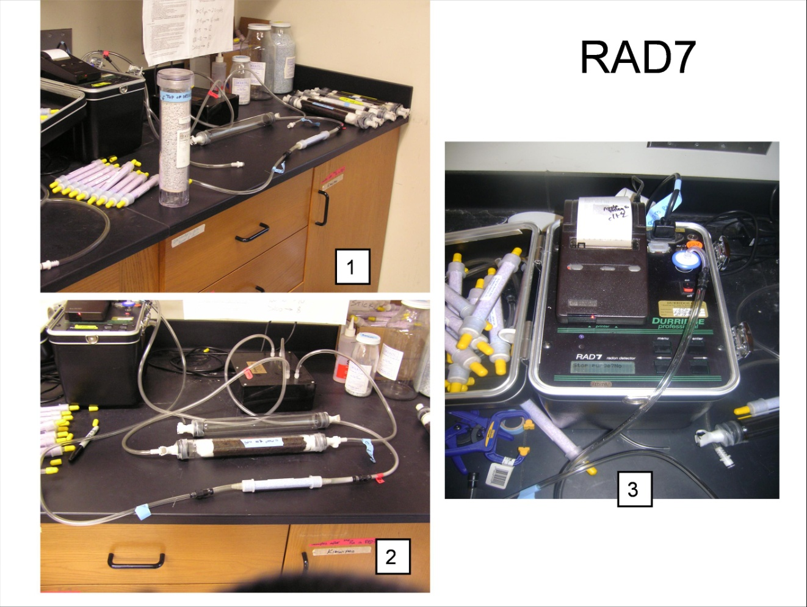
Radium isotope analysis: ²²⁶Ra, ²²⁸Ra
²²⁶Ra
Following pre-concentration onto the Mn-fibers, the glass filter tubes are purged with He and sealed
Tubes are allowed to incubate for 3 weeks, to allow ingrowth of ²²²Rn
Tubes are hooked to RAD-7 radon analyzer, and the gas is recirculated through the detector. ²¹⁸Po, the daughter of ²²²Rn, is collected electrostatically and counted
²²⁶Ra is determined indirectly via ²²²Rn, in turn determined by counting decay of ²¹⁸Po
²²⁸Ra
Following ²²⁶Ra analysis, Mn-oxide fibers are extracted, dried and crushed into cans
Cans are counted using γ-spectrometry. ²²⁸Ra is determined indirectly by decay of daughter ²²⁸Ac

Slide 14
Results
Three contrasting sites examined
Glorieta area
Four public and private wells
Completed in Permian sandstones
Elevated U (8.5–24.2 µg/L), and in one case elevated Ra (up to >14 pCi/L)
Zuni Mountains area
Two wells
One deep well has extremely elevated Ra (>20 pCi/L) and low U
A nearby, shallower well has low Ra and U
Laguna area
Four wells
Completed in the Jackpile and Brushy Basin members of the Morrison Formation, units which host U roll-front deposits nearby
Low U and Ra

Slide 15
Piper Diagram
Laguna
Laguna: Na, SO₄, HCO₃
Glorieta: Ca, Mg, Na,HCO₃, Cl
Zuni-shallow: Na, HCO₃, SO₄
Zuni-deep: Ca, Mg, SO₄,HCO₃
Glorieta
Zuni-shallow (low Ra)
Zuni-deep (high Ra)

Slide 16
Glorieta
Oxic waters
Elevated U (8.5–24.2 µg/L)
²²⁸Ra/²²⁶Ra AR values vary
Range of U/Th ratios in aquifer sediments (variable degree of U enrichment?)
²²⁴Ra/²²⁸Ra AR ~1.0
Ra is locally generated
Ra is labile and aquifer sorptive capacity is low.
Irreversible removal of Ra (e.g. precipitation) is not important (consistent with low SO₄ concentrations)
Well: | Glorieta Estates | Glorieta MDWA | Private Well A | Private Well B
pH | 7 | 6.96 | 6.79 | 6.74^{b}
DO mg/L | 2.3 | 0.57 | 3.8 | 2.6
NO₃ | 10.18 | 1.42 | 48.69 | 16.38
HCO₃ | 378 | 354 | 610 | 329
TDS mg/L | 623 | 358 | 648 | 469
²²³Ra, pCi/L | 0.053 ±0.063 | 0.027±0.020 | 0.019±0.021 | 0.006±0.019
²²⁴Ra, pCi/L | 2.15±0.12 | 0.55±0.04 | 1.15±0.06 | 0.63±0.05
²²⁶Ra, pCi/L | 6.24±0.27 | 2.91±0.17 | 0.31±0.05 | 0.31±0.05
²²⁸Ra, pCi/L | 1.21±0.13 | 0.46±0.09 | 1.02±0.09 | 0.5±0.06
²²⁶Ra+²²⁸Ra | 7.45 | 3.37 | 1.33 | 0.81
Ra, pCi/L | 9.36 | 3.89 | 2.36 | 1.35
²²⁴Ra/²²⁸Ra | 1.54 | 1.04 | 0.98 | 1.09
²²⁸Ra/²²⁶Ra | 0.19 | 0.16 | 3.27 | 1.64
U, µg/L | 15.5 | 8.5 | 24.2 | 21
²³⁴U/²³⁸U | 1.708±0.0029 | 1.712±0.0051 | 1.629±0.0026 | 2.067±0.0034

Slide 17
Zuni area
Anoxic
Well #2: strong enrichment of U in aquifer sediments indicated by:
Extremely elevated Ra (>20 pCi/L), mostly ²²⁶Ra
Very low ²²⁸Ra/²²⁶Ra AR values (<0.1)
U concentrations are low, probably limited by solubility of U(IV) species
Well #1: enrichment of U in aquifer sediments indicated by low ²²⁸Ra/²²⁶Ra
Well: | Well #1* | Well #2*
pH | 9.01 | 7.04
DO mg/L | 0.8 | 0.31
NO₃, mg/L | ND (<0.1) | ND (<0.1)
HCO₃, mg/L | 269 | 237
TDS mg/L | 323 | 459
²²³Ra, pCi/L | NA | 0.62±0.2
²²⁴Ra, pCi/L | NA | 2.47±0.3
²²⁶Ra, pCi/L | 0.8±0.11 | 19.82±0.66
²²⁸Ra, pCi/L | <0.2 | 1.72±0.21
²²⁶Ra+²²⁸Ra | <1.0 | 21.54
Ra, pCi/L | NA | 24.6
²²⁴Ra/²²⁸Ra | NA | 1.44
²²⁸Ra/²²⁶Ra | <0.25 | 0.09
U, µg/L | 0.3 | 0.75
*Composite analyses

Slide 18
Laguna area
Three of four anoxic
All have low U, low Ra
Low ²²⁸Ra/²²⁶Ra ARs suggest enrichment of U relative to Th in aquifer sediments
²²⁴Ra/²²⁶Ra ARs >1.0 suggest presence of irreversible/slowly reversible sinks for Ra
Ra and Ba sulfate precipitation (supported by high SO₄ concentrations), or
Effective sorption/ion exchange (groundwater low in Ca, Mg)
Well: | Laguna #1 | Laguna #2 | Laguna #3 | Laguna #4
pH | 7.78 | 7.73 | 7.94 | 7.13
DO mg/L | 0.7 | 0.31 | 0.25 | 2.2
NO₃, mg/L | 0 | 0 | 0 | 1.81
HCO₃, mg/L | 476 | 317 | 451 | 463
TDS mg/L | 630 | 945 | 734 | 618
²²³Ra, pCi/L | 0.017±0.023 | 0.123±0.072 | 0.046±0.031 | 0.009±0.014
²²⁴Ra, pCi/L | 0.68±0.05 | 1.82±0.13 | 0.85±0.07 | 0.52±0.04
²²⁶Ra, pCi/L | 0.69±0.06 | 3.16±0.19 | 1.84±0.11 | 1.11±0.08
²²⁸Ra, pCi/L | 0.72±0.09 | 1.21±0.11 | 0.67±0.09 | 0.3±0.08
²²⁶Ra+²²⁸Ra, pCi/L | 1.41 | 4.37 | 2.51 | 1.41
Ra, pCi/L | 2.01 | 6.07 | 3.29 | 1.87
²²⁴Ra/²²⁸Ra | 0.82 | 1.3 | 1.1 | 1.5
²²⁸Ra/²²⁶Ra | 1.05 | 0.38 | 0.37 | 0.27
U, µg/L | 0.1 | 0.4 | 0.7 | 1.9

Slide 19
General trends
Samples with isotopic data indicating U enrichment in aquifer sediments plot along the carbonate dissolution line, indicating that processes raising P_{CO2} (microbial?) occurred in the presence of carbonate minerals.
CaCO₃(s) + CO₂(g) +H₂O = Ca²⁺ + 2HCO₃–
If CO₂-generating processes are microbial, they must have occurred in the vadose zone at Glorieta (waters remained oxic). Can uranium in Glorieta groundwaters be sourced to carbonate dissolution in the vadose zone?
Zuni
19

Slide 20
Conclusions
Data are presented from three contrasting sites in bedrock aquifers, representing both reducing and oxic conditions, elevated U and Ra, elevated Ra alone, and low U and Ra.
At each site, trends in Ra isotope ratios were successfully used to provide insights into sources and mobility of U and Ra in groundwater and aquifer sediments
This study used an innovative, low-cost method for ²²⁶Ra determination with an inexpensive radon-in-air detector (RAD-7™); the method could be used for low-cost long-term monitoring or pilot tests for radium treatment

