Slide 1
Profiling the buried Cambrian sedimentary and bimodal igneous stratigraphy of the Southern Oklahoma Rift Zone using basement well penetrations.
Robert E. Puckett Jr., Richard E. Hanson, Amy M. Eschberger, Casey L. Bulen, Matthew E. Brueseke, Stanley A. Mertzman

Slide 2
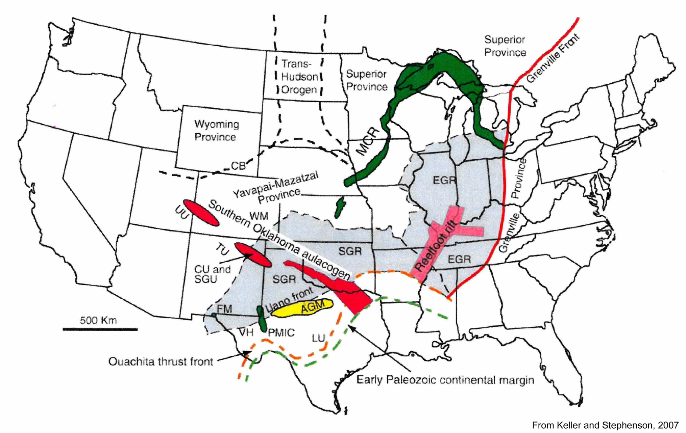
Southern Oklahoma Rift Zone

Slide 3
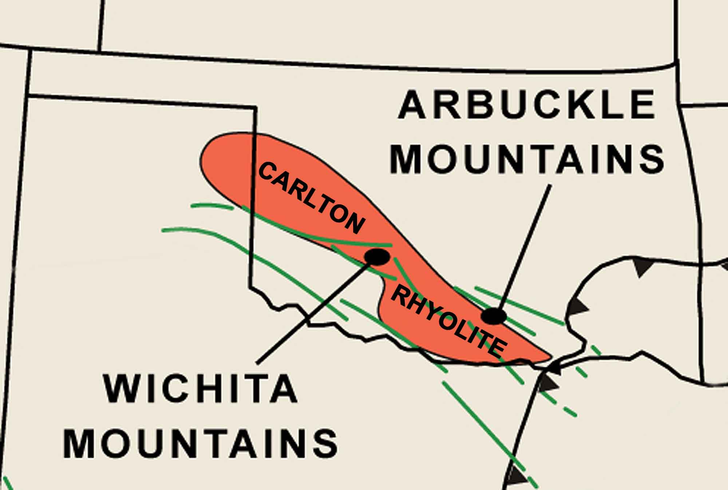
40,000 km² of Rhyolite Traced in the Subsurface
From Hanson et al. (2011), modified from McConnell and Gilbert (1990), subsurface rhyolite modified
from Ham et al. (1964), Ouachita overthrust front modified from Keller and Stephenson (2007)

Slide 4
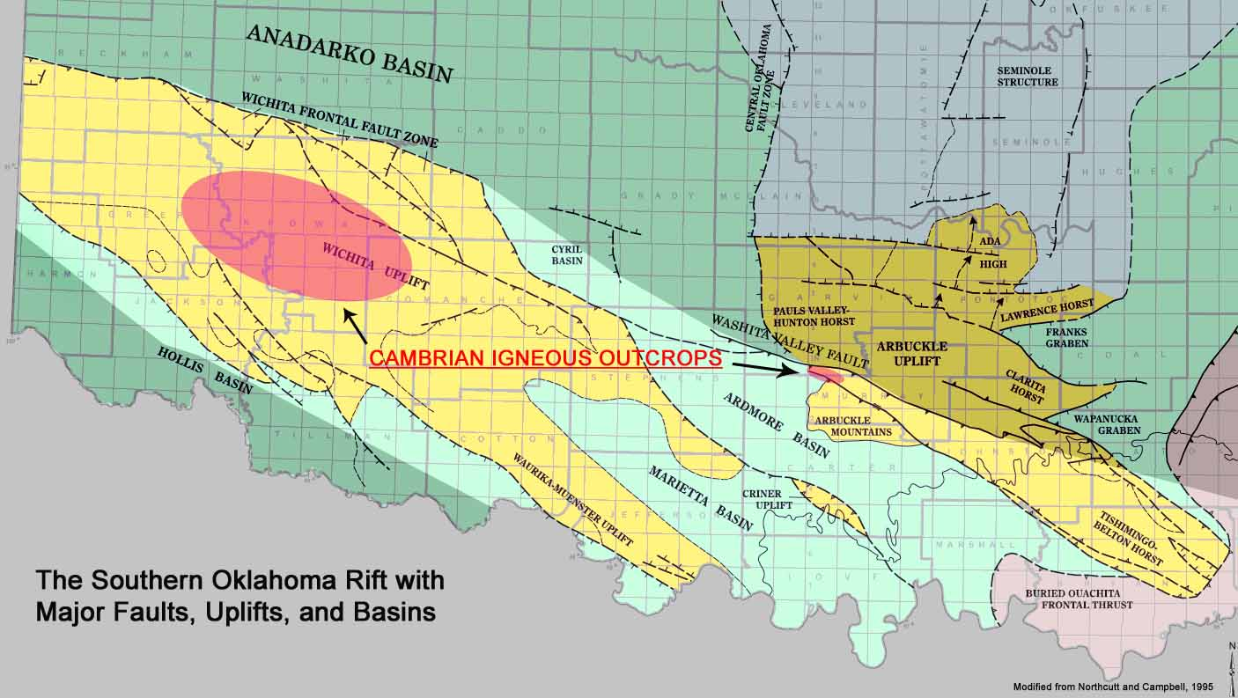
The rift in southern Oklahoma

Slide 5
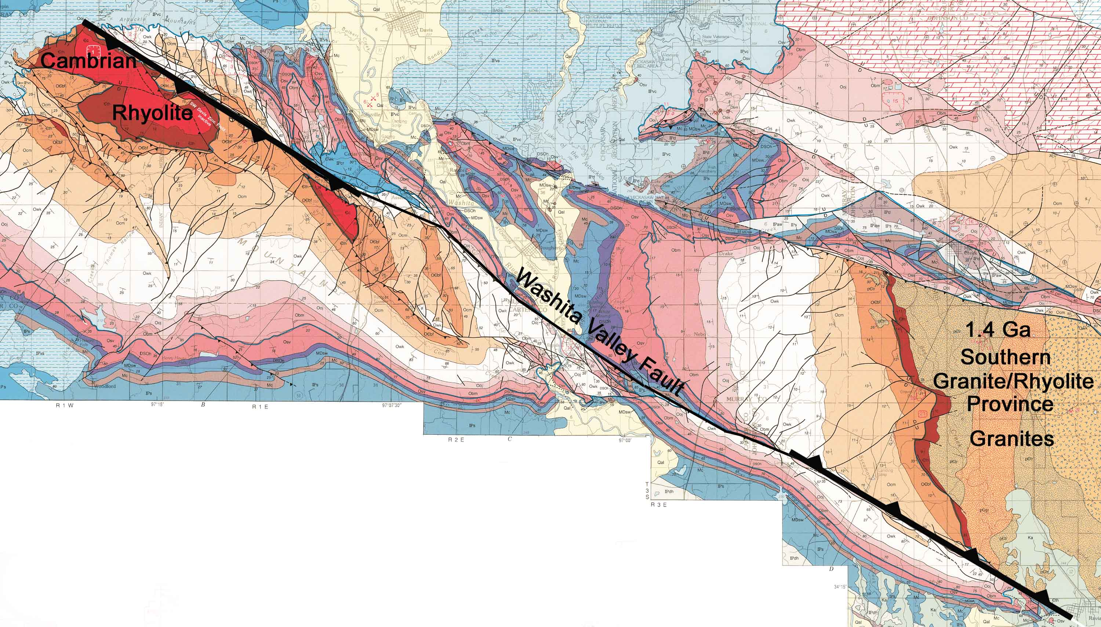
The Washita Valley Fault in the Arbuckle Mountains Area
Modified from Ham et al, 1954, revised by Johnson, 1990

Slide 6
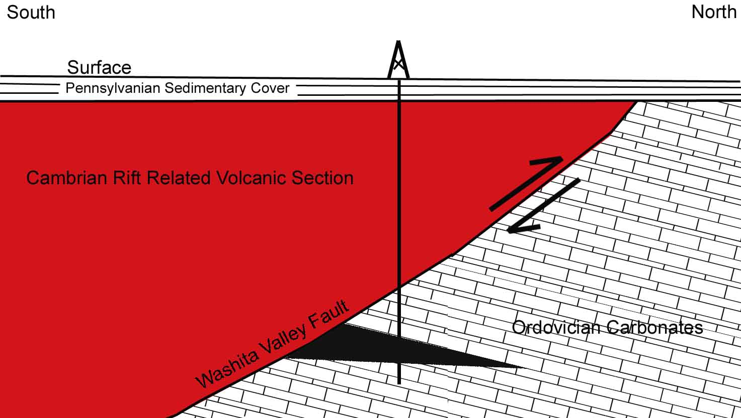
Overthrust Penetration Wells Schematic Cross Section
Overthrust Drilling Penetration

Slide 7
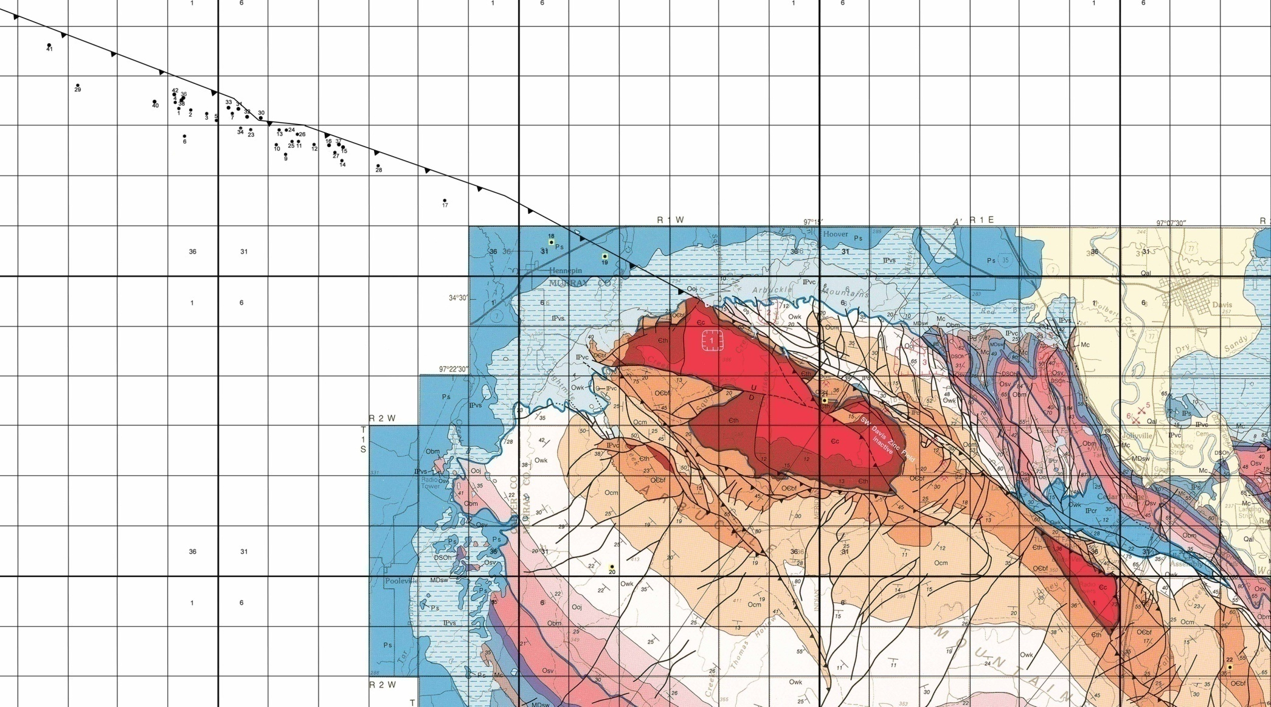
Overthrust Penetrations – Western Arbuckles
42 km
42 km
35 overthrust penetrations
365 m - 457m to 4.3km of igneous rocks
Penetrated igneous sections per well: 475m to 4.3km
37km of non-correlated igneous section available for examination
Modified from Ham et al, 1954, revised by Johnson, 1990

Slide 8
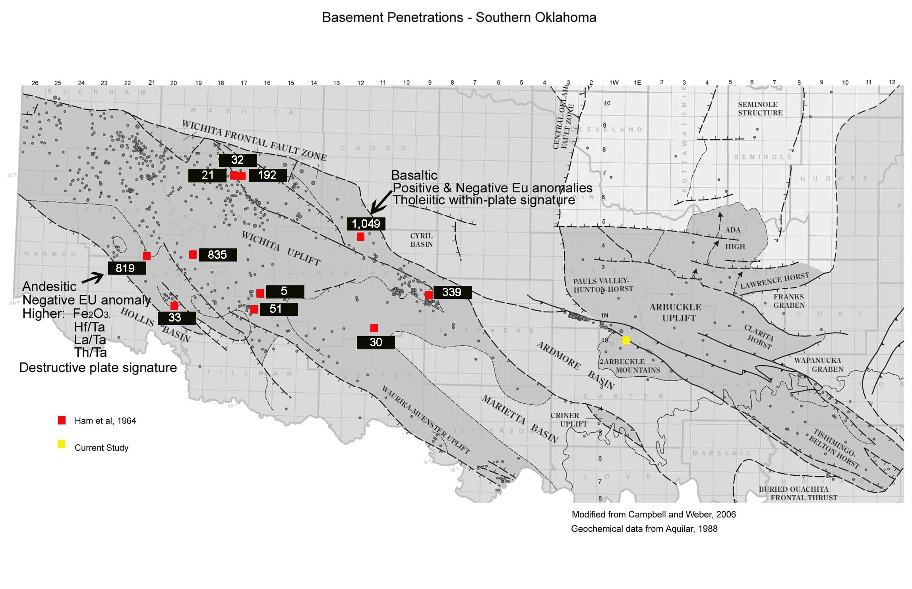
Documented Basalt Penetrations – Southern Oklahoma

Slide 9
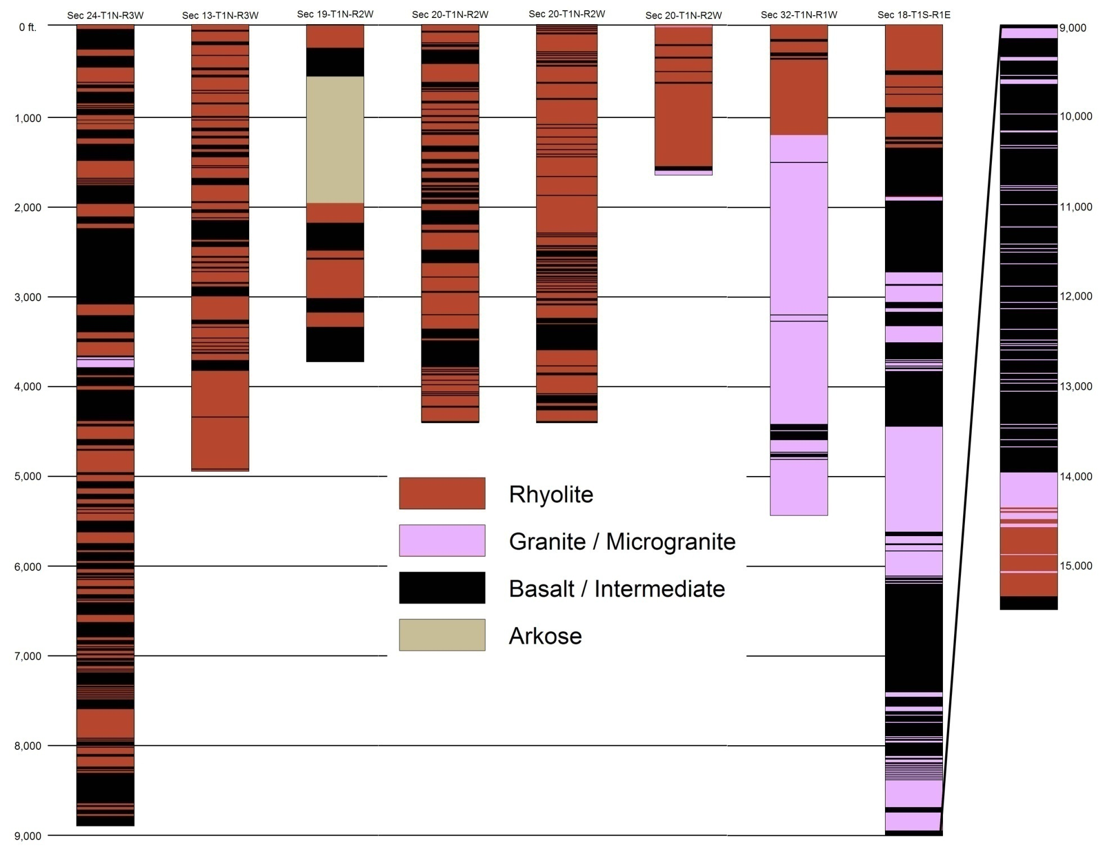
23.5 km
Intercalated Rhyolites and Basalts

Slide 10
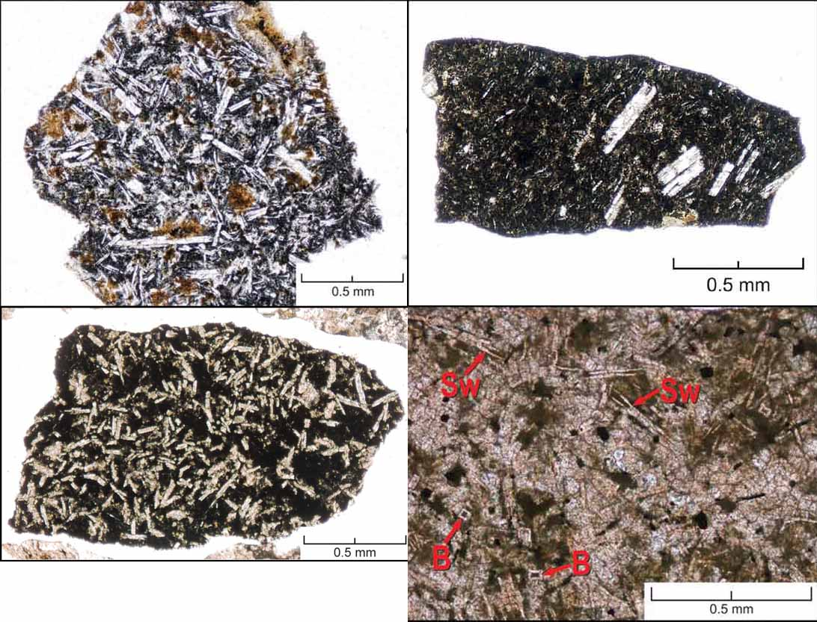
Representative Basalt Textures
Sw = Swallow-Tail Plagioclase B = Belt-Buckle Plagioclase

Slide 11
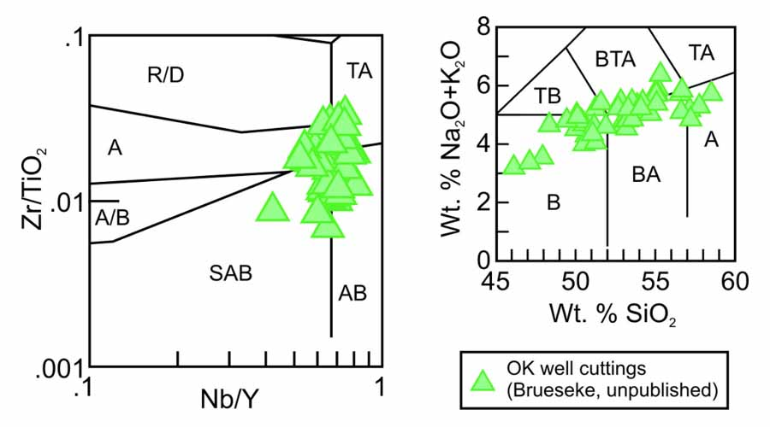
Arbuckle Basement Wells Mafic Geochem Plots
Basalt to andesite
Dominantly subalkaline to mildly alkaline
CIPW calculations for two samples yield olivine tholeiite to quartz tholeiite

Slide 12
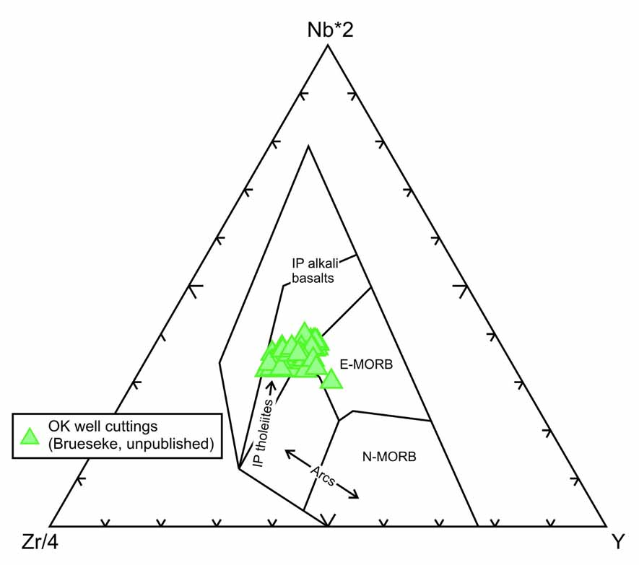
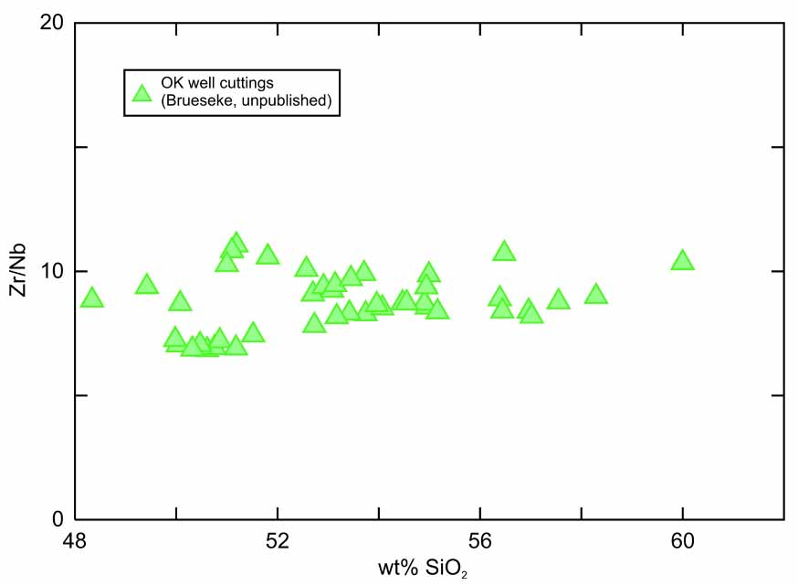
Arbuckle Basement Wells Mafic Discrimination Plot
and Zr/Nb vs. SiO₂
Straddles the region between intraplate tholeiites and E-MORB
Zr/Nb values of 7 to 11, average 8.7, similar to EM1-OIB
Similar to flood basalt packages in other LIPs

Slide 13
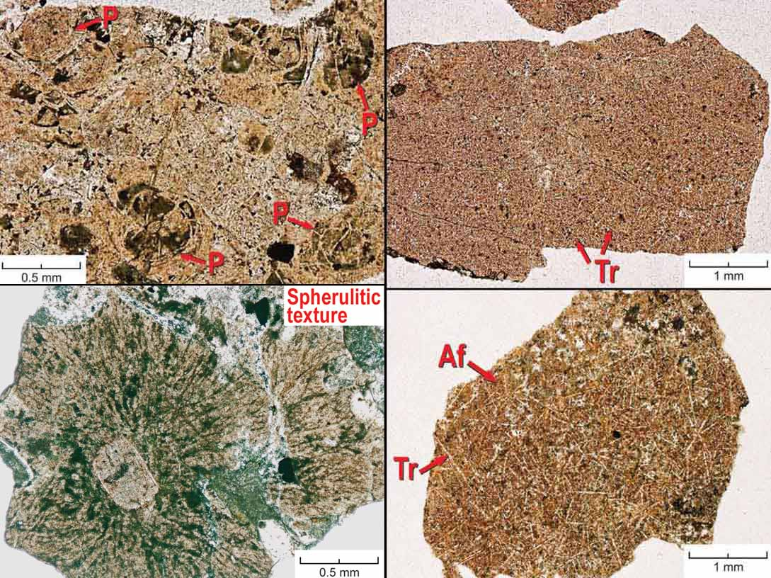
Representative Rhyolite Textures
P = Perlitic cracking Tr = Tridymite (High temp SiO₂ now altered to quartz)
Pl = Plagioclase Af = Alkali Feldspar

Slide 14
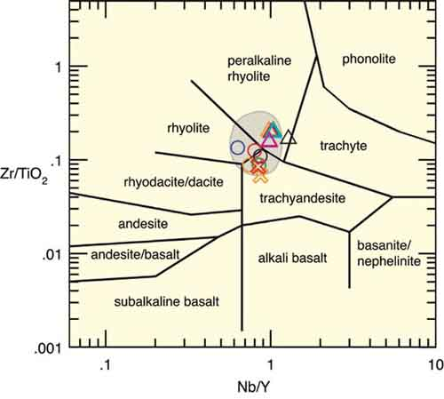
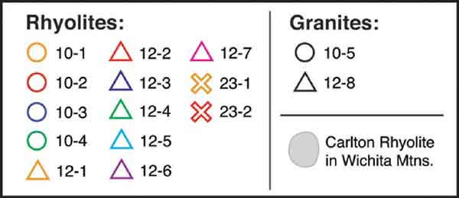
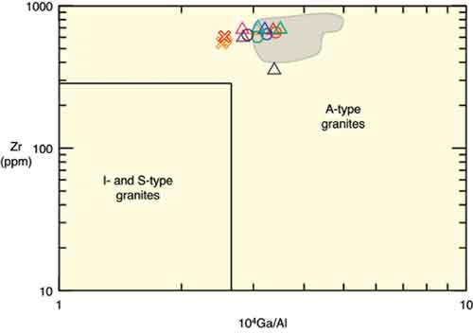
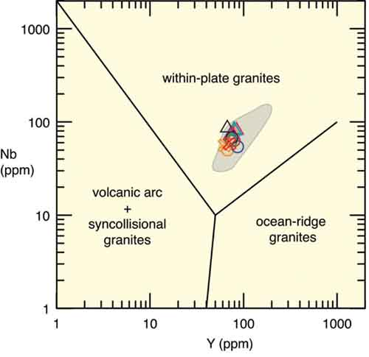
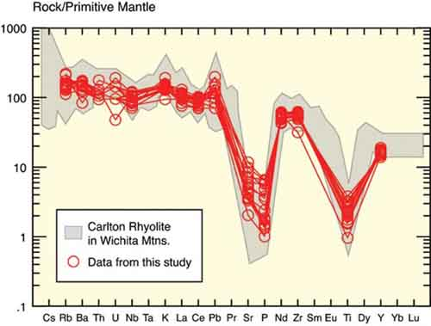
Rhyolite Geochemistry

Slide 15

23.5 km
Clastic Fan Delta

Slide 16
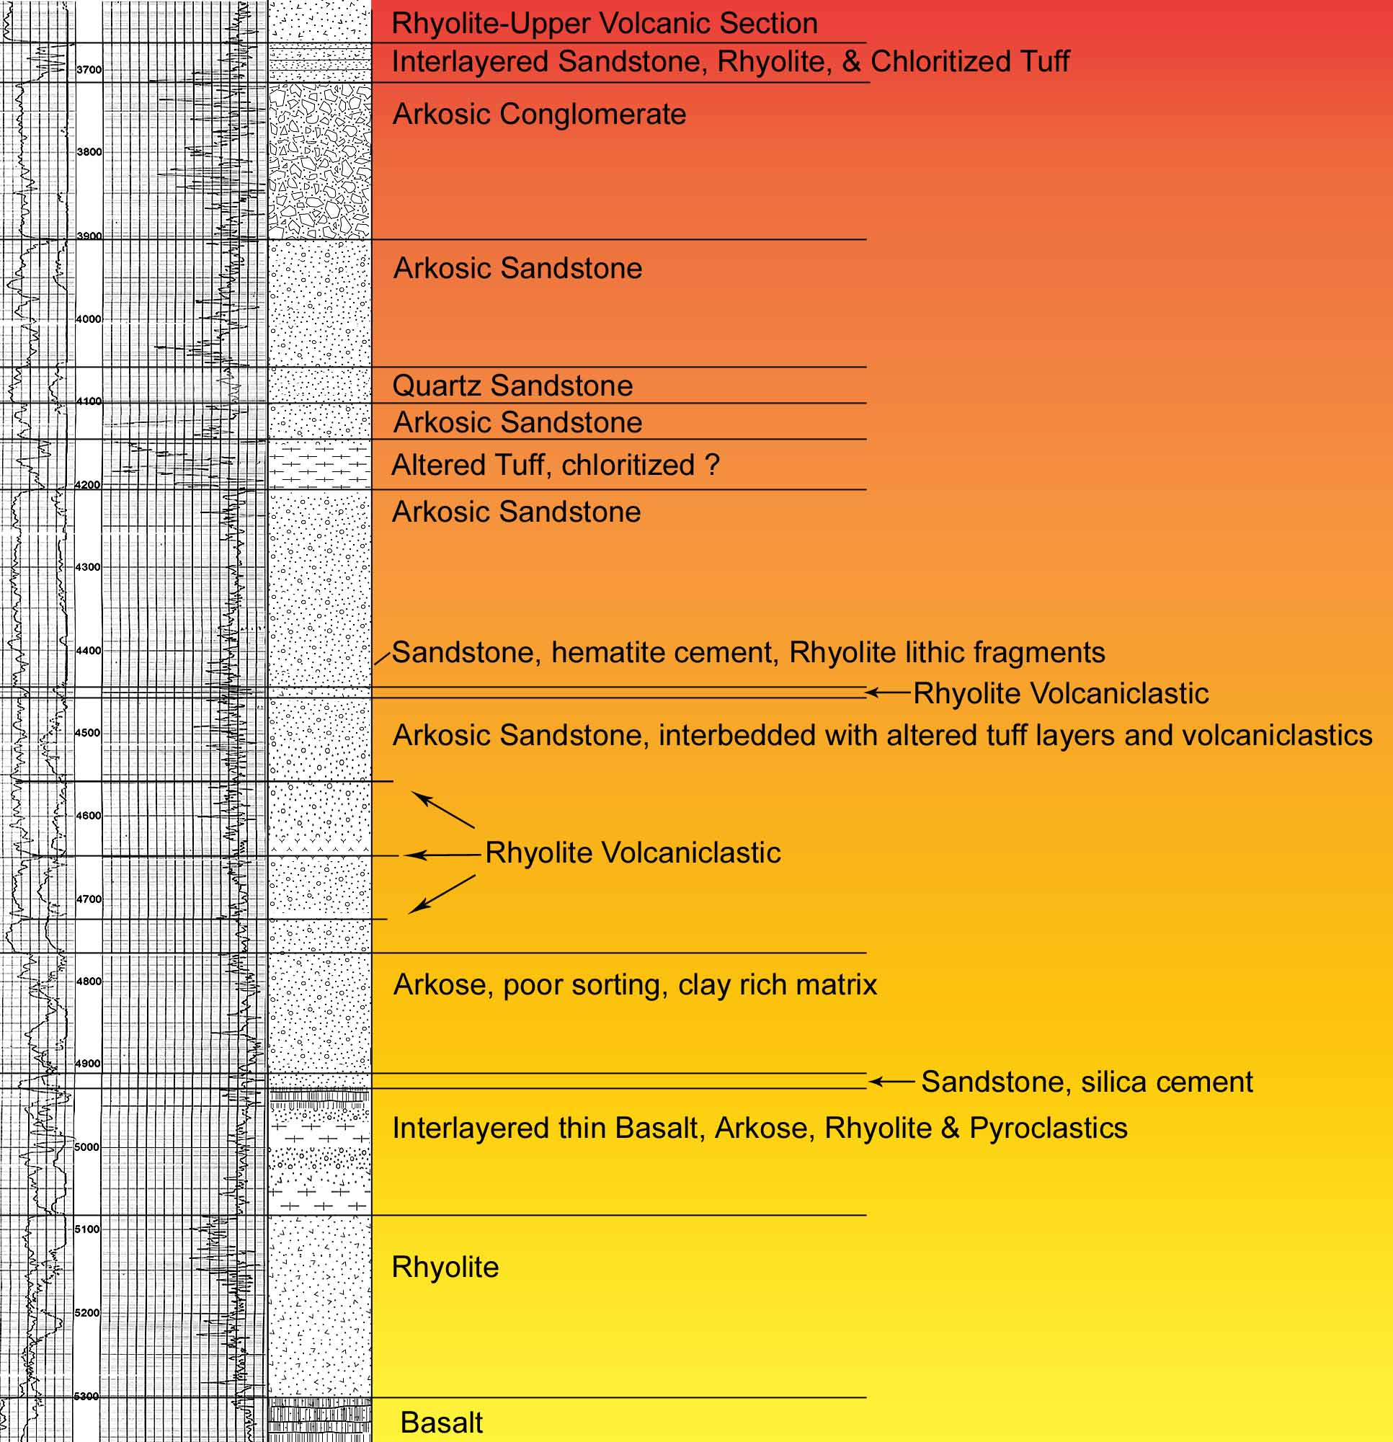
Clastic
Interval
Pan American Oil Company
Jarman #1
Sec 19-T1N-R2W

Slide 17
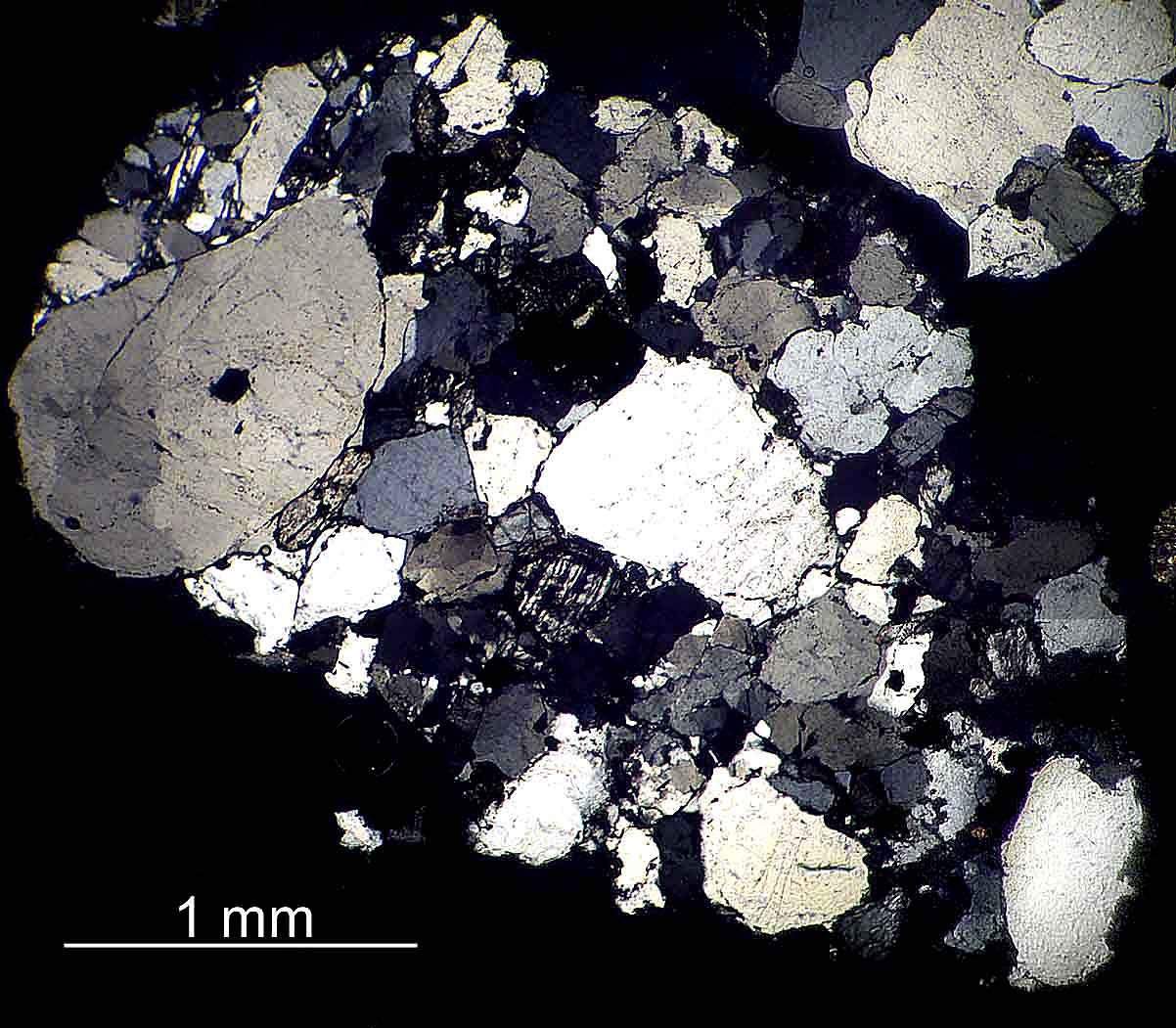
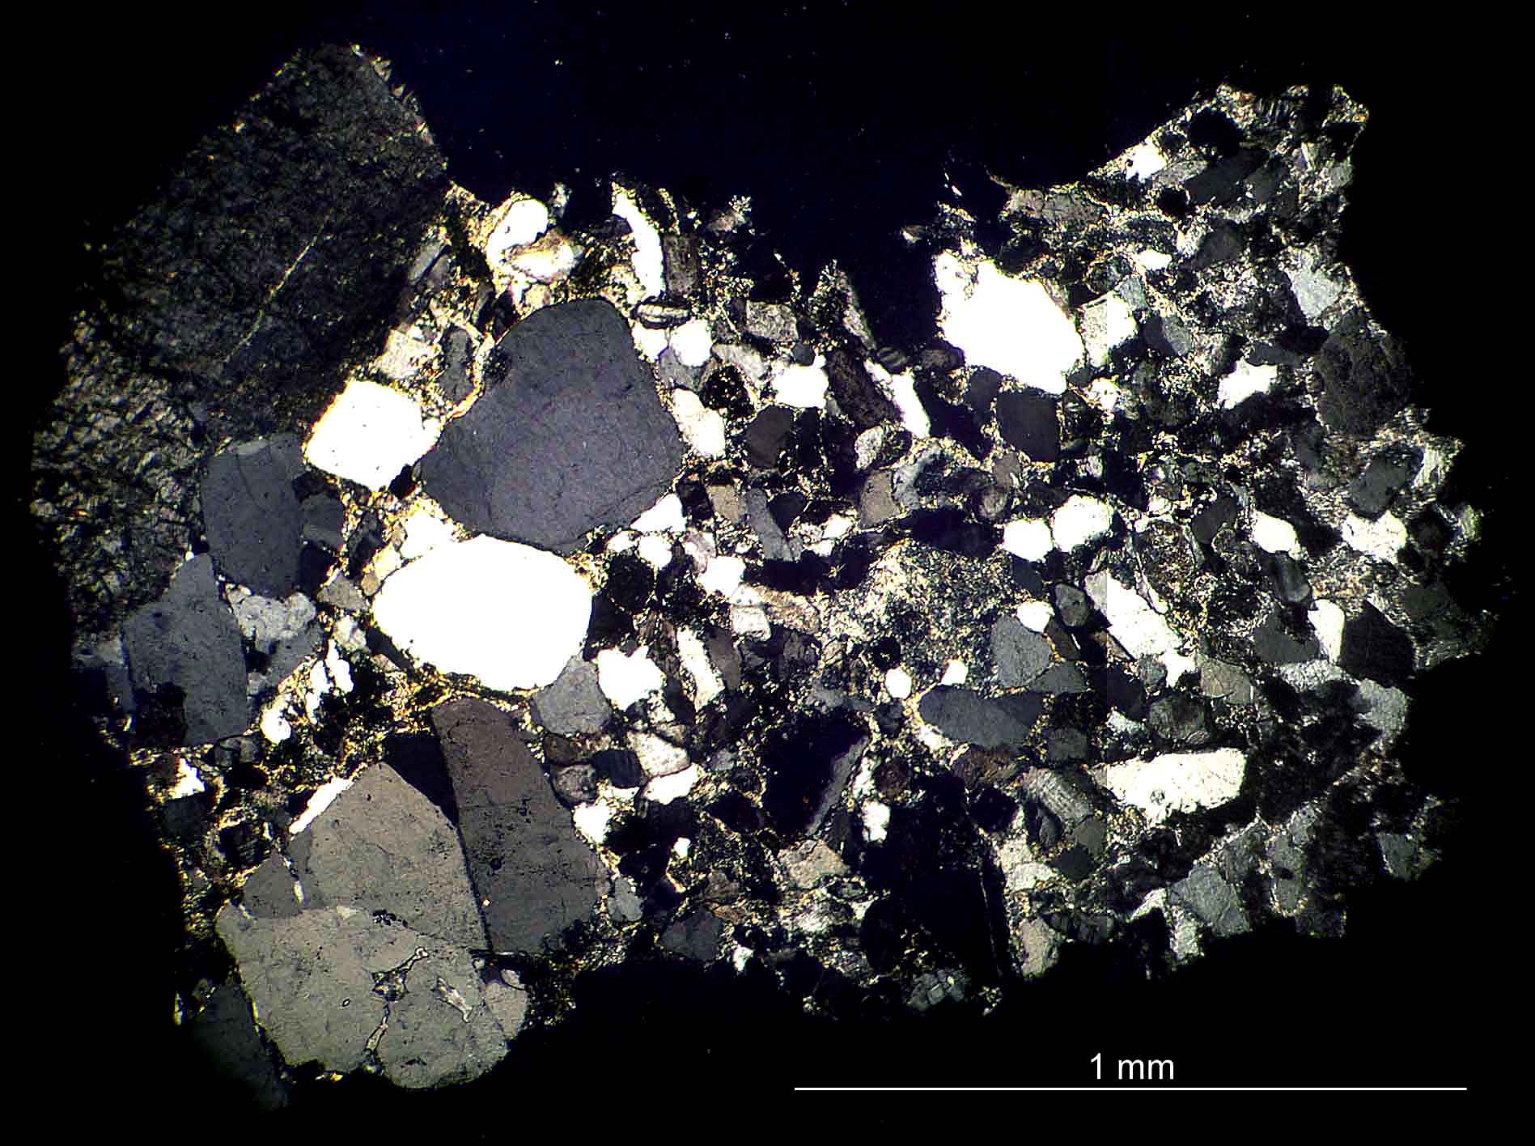
Relatively coarse granitic detritus derived from Proterozoic basement granites outside of
the rift zone.

Slide 18
23.5 km
Pyroclastics

Slide 19
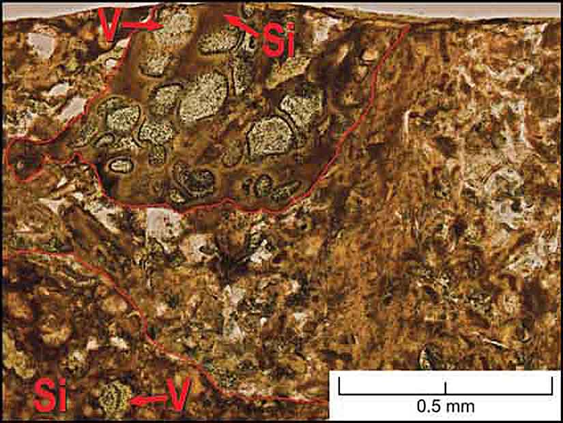
Basaltic Pyroclastic Rock
Two coarse-grained basaltic pyroclasts outlined consisting of
sideromelane (Si), and vesicles (V) filled with zeolites and chlorite
Set in a matrix of finer grained sideromelane ash particles.

Slide 20
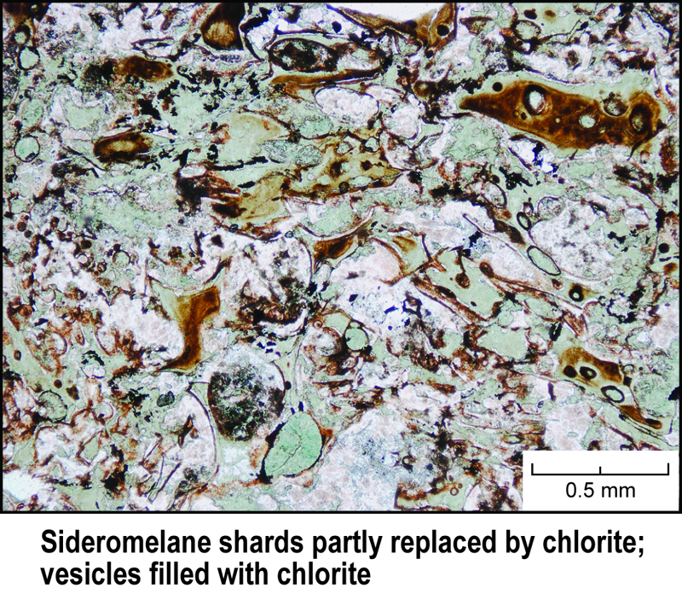
Basaltic Pyroclastic Rock

Slide 21
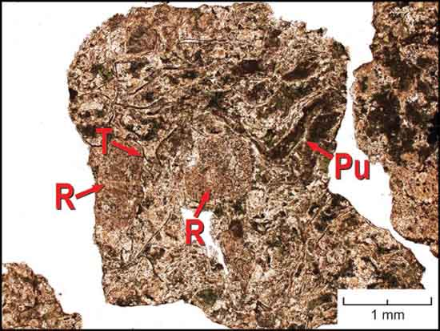
Rhyolite Pyroclastic Rock
R = Rhyolite Lithic Fragment T = Tricuspate Shard
Pu = Compacted Pumice Shard

Slide 22
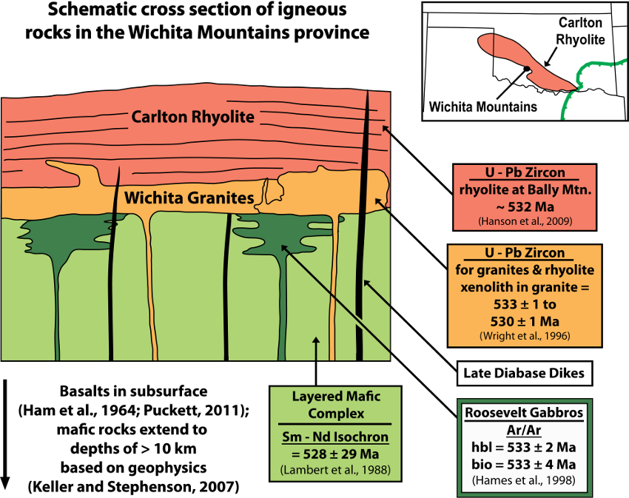
Schematic Igneous Stratigraphy, Wichita Mountains
Hanson et al. 2011
Modified from Hogan and Gilbert, 1998

Slide 23
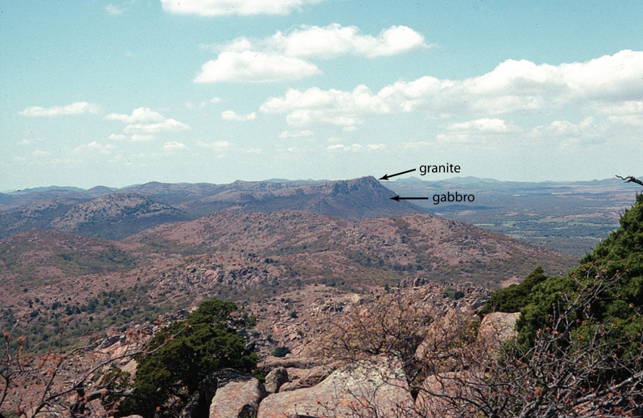
Mt. Scott Granite sill overlying the gabbroic layered complex in the Wichita Mountains.
From Hanson et al., 2011

Slide 24

23.5 km
Granites

Slide 25
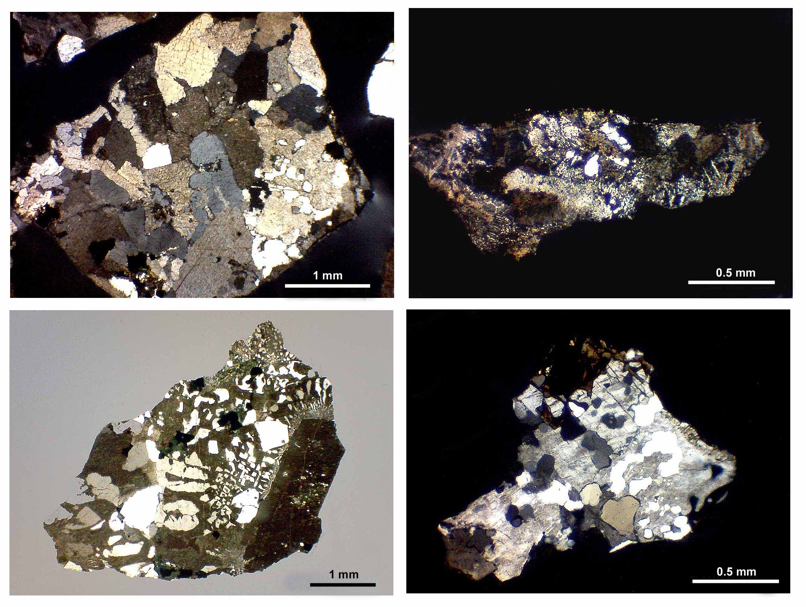
Representative Wichita Granite Textures from Arbuckle Basement Wells

Slide 26
Summary
Correlation of drilling data with high resolution surface mapping presents a much
more complete picture of the rift than either data set would independently.
Igneous activity was strongly bimodal with a significant mafic and intermediate
component.
Intercalated rhyolite and basalt deposits formed thick accumulations in the
Arbuckle area.
Clastic fan-deltas originating on the Proterozoic craton flowed into the rift
during volcanism.
Rhyolitic pyroclastic deposits, as seen in surface mapping, form thin beds between
flows.
Basalt pyroclastics appear to be related to phreatomagmatic eruptions.

Slide 27
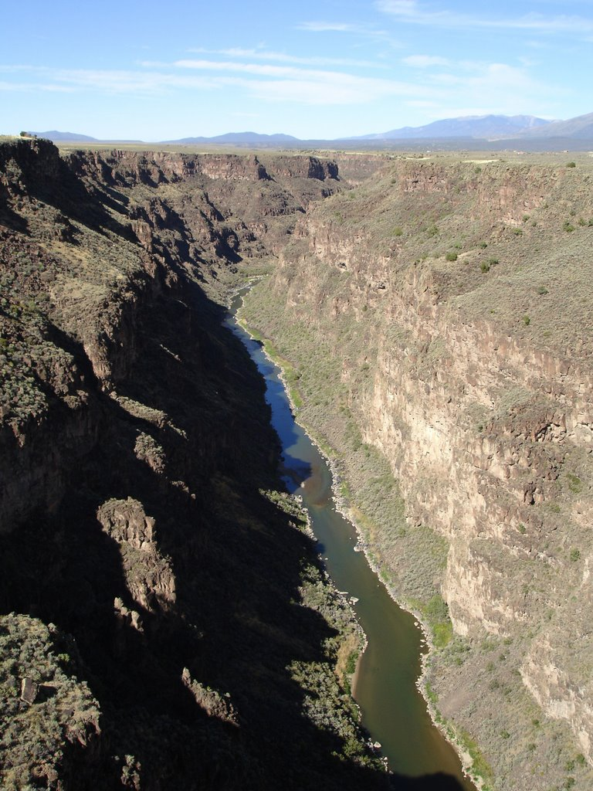
Rio Grande Rift
Similar fan deposits can be
seen in the basalt walls of the
Rio Grande Gorge near Taos
Alluvial fans originating in
Proterozoic granites flowed into
the rift
Encapsulated by later eruptions.

