Slide 1
Sand Springs
Lithotectonic Assemblage
Possible Link between
Sierra Nevada and
Luning-Fencemaker thrust belt
Joe Satterfield, Angelo State University
and
John S. Oldow, University of Texas at Dallas

Slide 2
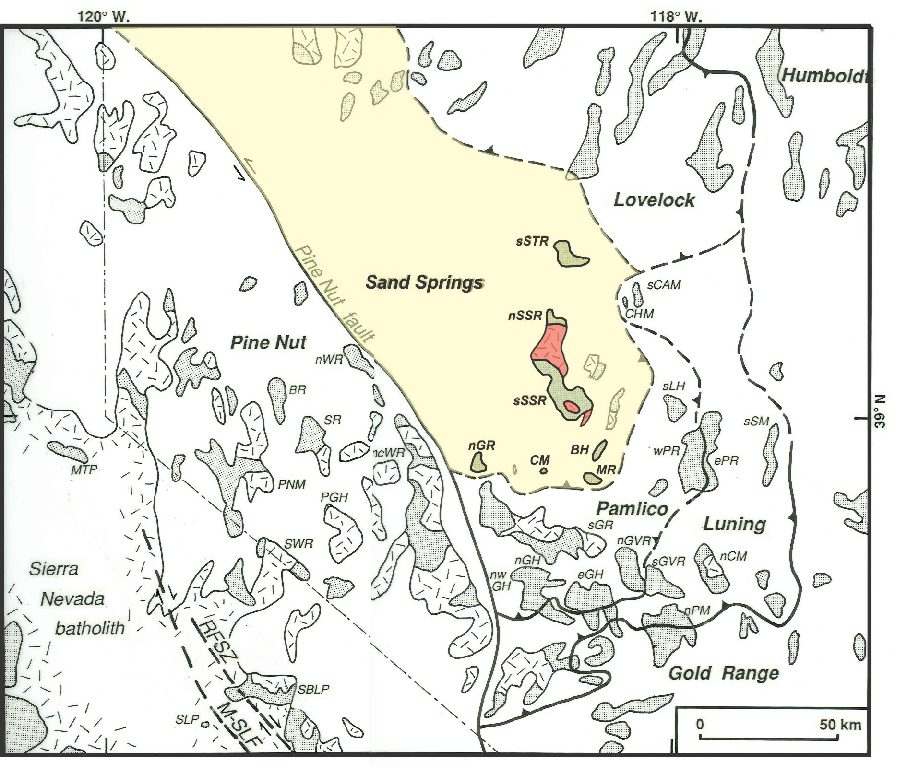
Notes:
1. Generalized geologic map showing Sierra Nevada batholith and major thrust faults of the Luning-Fencemaker thrust belt in hinterland of Cordilleran orogen
2. Random dashes- Jurassic – Cretaceous plutons. Shaded- Pre-Tertirary sedimentary and metamorphic rocks
3. Sand Springs lithotectonic assemblage (SSA) one of 8 lithotectonic assemblages distinguished. Others distinguish 3 – 4 in this area.
4. Boundaries poorly exposed; partly because of Basin and Range extension, magmatism.
5. SSA data from 5 mountain ranges: southern Stillwater Range (sSTR), Sand Springs R. (nSSR and sSSR), northern Gillis R. (nGR), Copper Mountain (CM), and Gabbs Valley R. (MR and BH).

Slide 3
Fundamental problems
Finding poorly-exposed terrane boundaries such as Mojave-Sonora Megashear, Pine Nut fault, Mojave-Snow Lake, W. NV shear zone (all same?)
Correlating multiple deformation phases across orogens (D1a,b, D2, D3) overprinted by Basin and Range def. in SN and LFTB
Notes:
Problems addressed in this study are fundamental ones in any orogen.

Slide 4
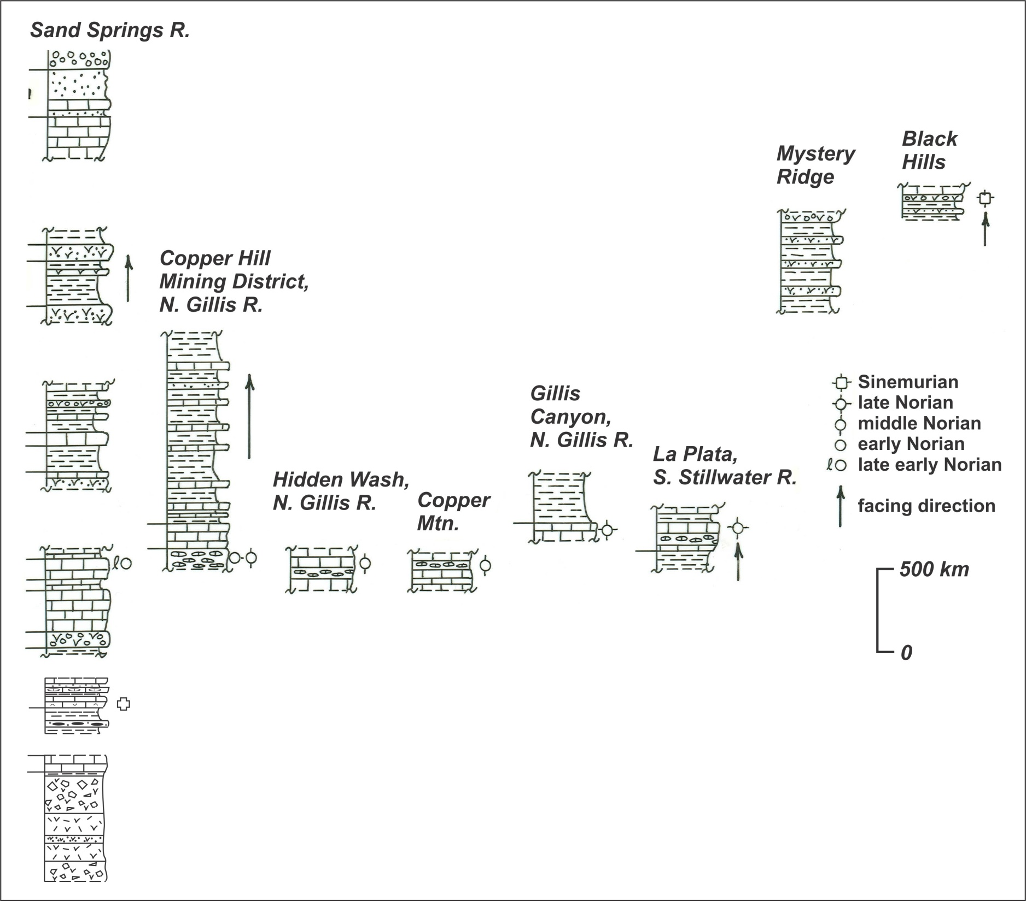
Notes:
Compilation of SSA stratigraphic and biostratigraphic data. N.J. Silberling provided biostratigraphic data, mostly from ammonites. Sand Springs Range, Copper Hill, and Copper Mountain data from our mapping. Other sources of stratigraphic data: Silberling (1984), Hardyman (1980; northern Gillis Range), John and Silberling (1992; southern Stillwater Range), Gelber (1985; Mystery Ridge, Black Hills)
Eight fragmentary sections in 5 mountain ranges.
Arrows show facing direction where known
Total thickness >3 km
Late Triassic: interstratified carbonate and volcanogenic rocks
Early Jurassic: volcanogenic sandstone and shale overlain by quartz-rich sandstone and conglomerate

Slide 5
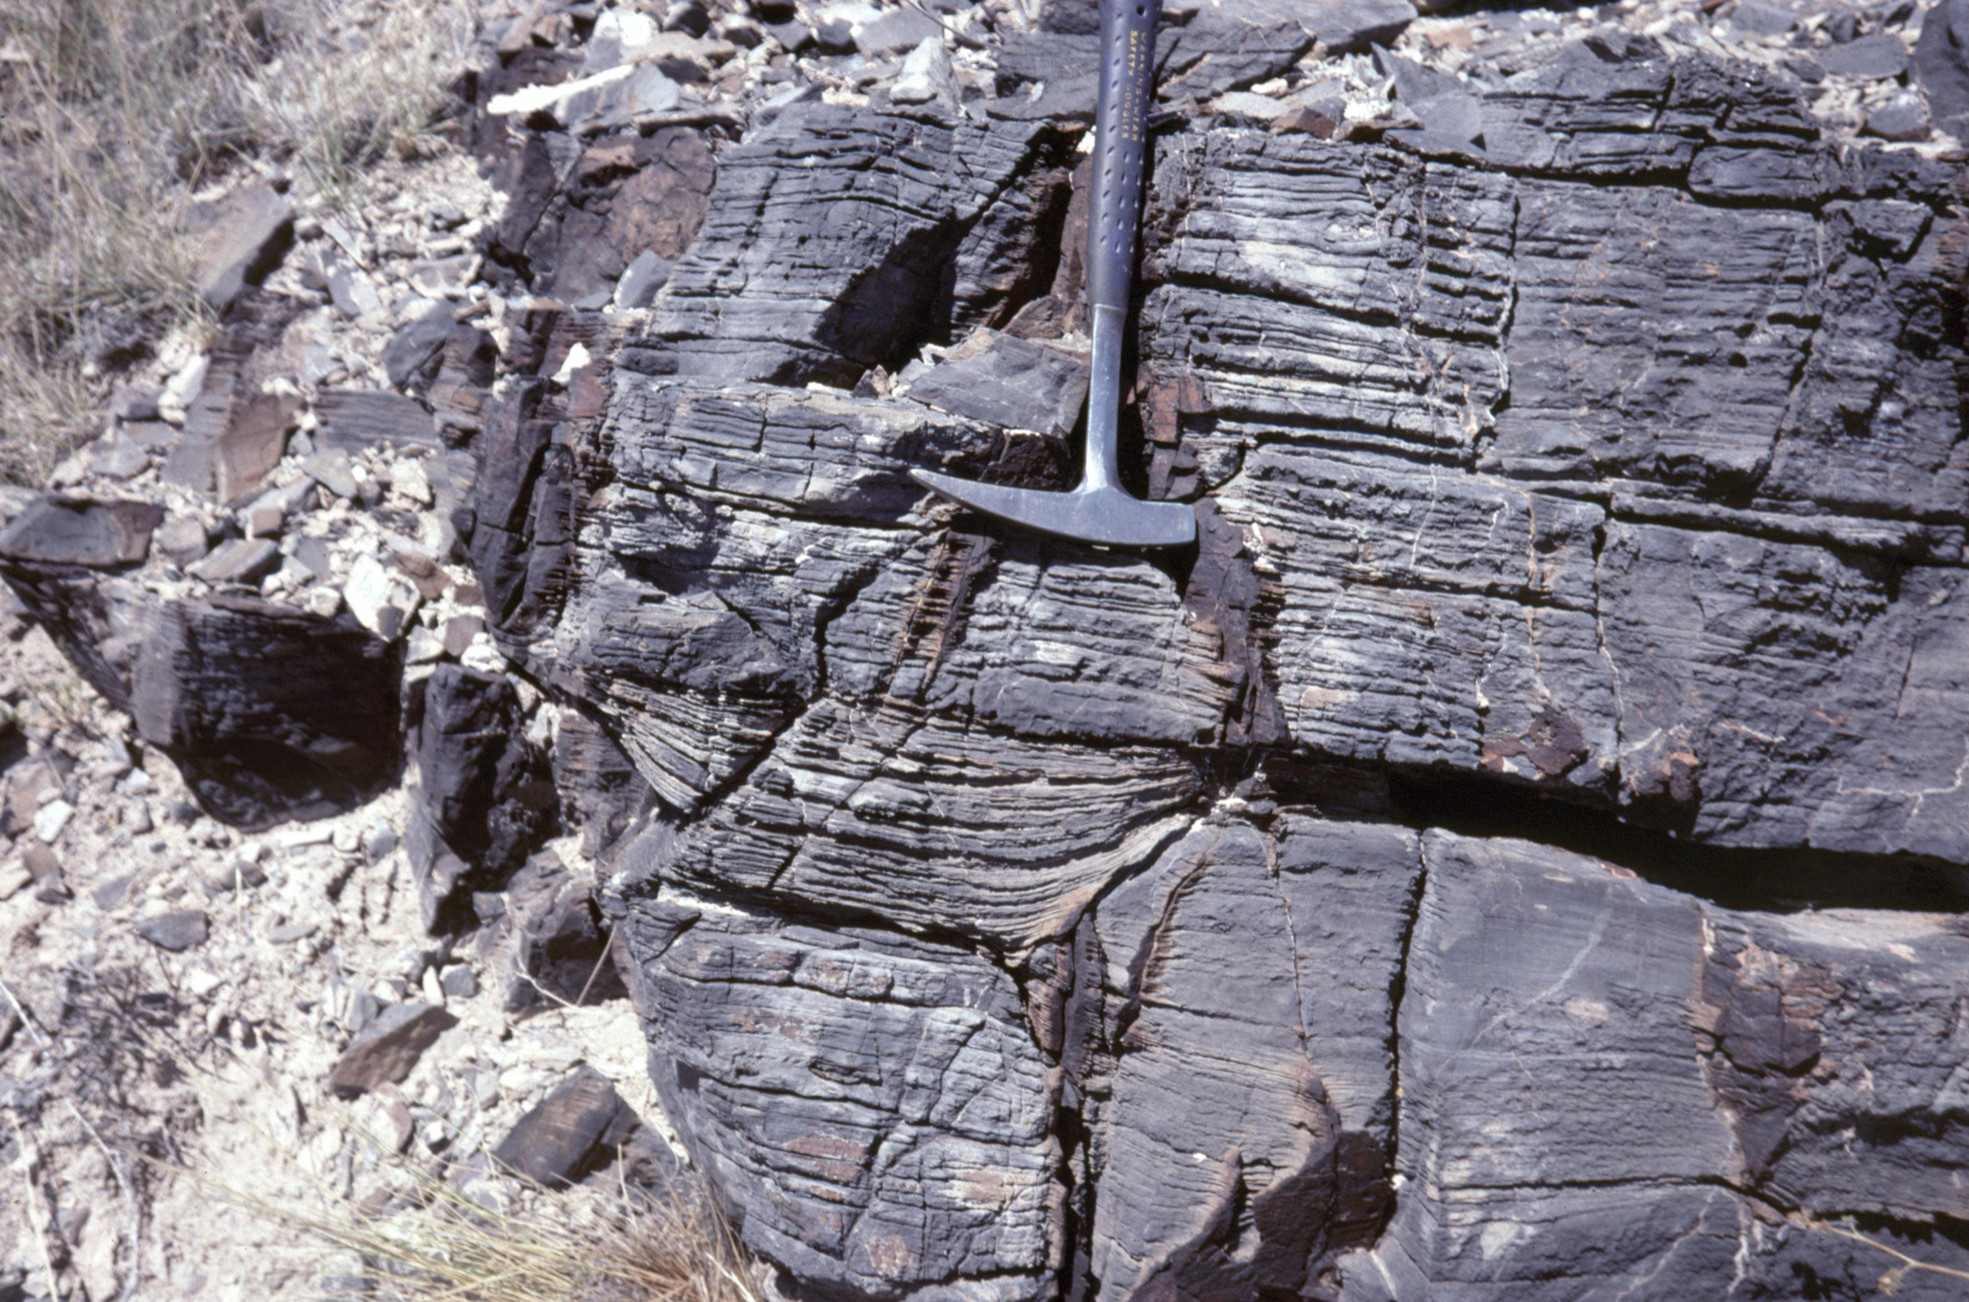
Notes:
Photo of middle Norian limestone at Copper Mountain
Dark gray, laminated limestone including channel. Laminated limestone here and in 4 other sections interstratified with carbonate diamictite
Late Triassic carbonates are transported, deep marine deposits

Slide 6
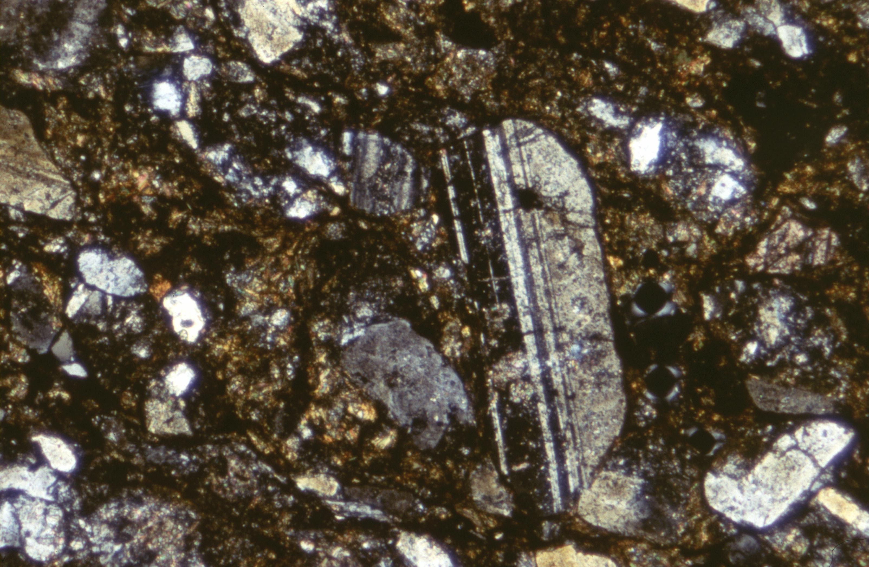
Notes:
Photomicrograph of typical Sinemurian feldspathic wacke from Mystery Ridge, southern Gabbs Valley Range.
Almost no quartz unlike quartz-rich Sinemurian sandstone interbedded with shale in Lovelock assemblage or “mudpile” north of SSA
Sandstone and interbedded shale contain features of turbidite sequence interpreted to be deposited in deep marine environment.

Slide 7
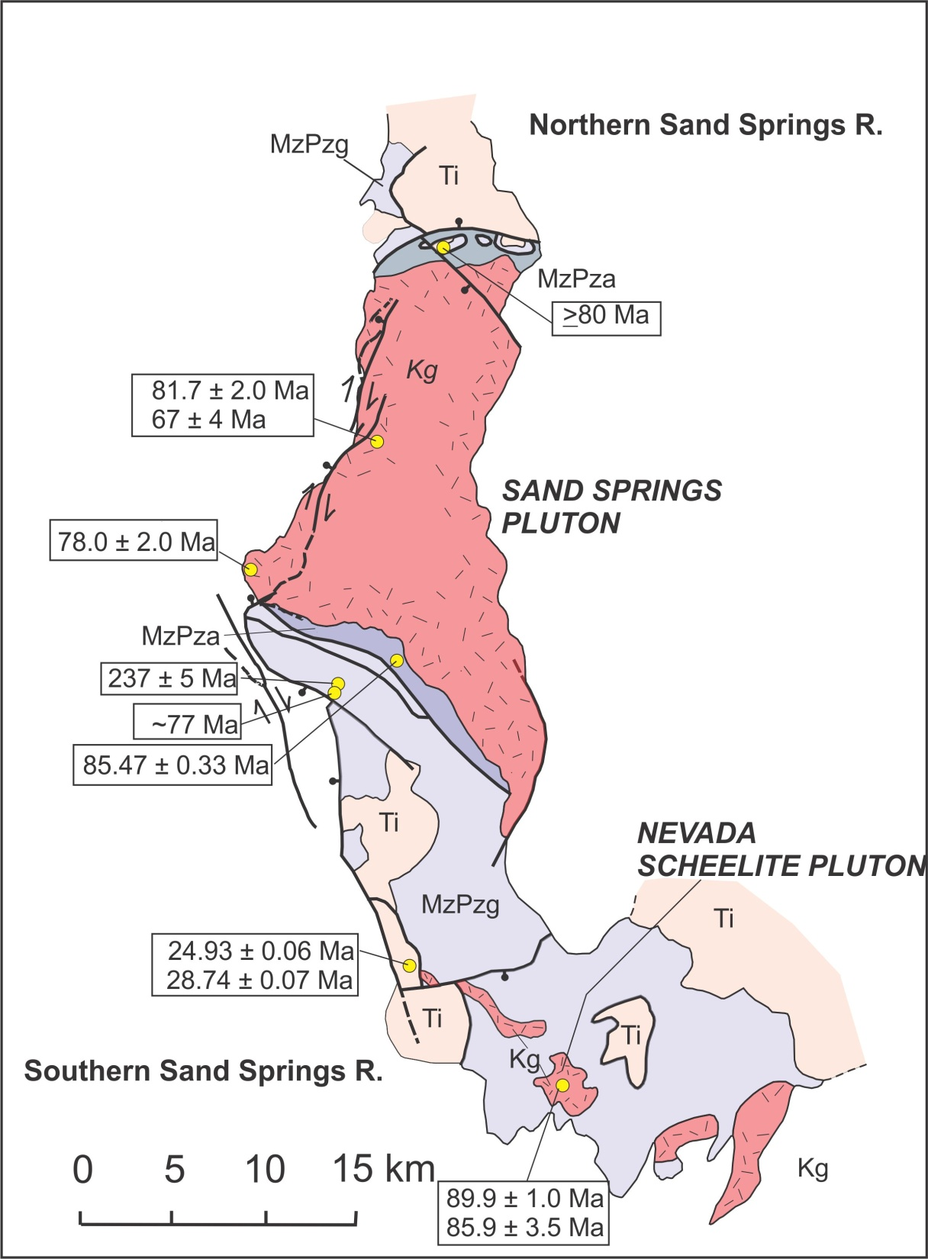
Notes:
Sand Springs Range (SSR) is the largest exposure of pre-Cretaceous rocks in SSA
Contains greenschist facies tectonites and lower amphibolite facies tectonites juxtaposed by thrusts
Tectonites cross-cut by Cretaceous and Tertiary intrusives and in faut contact with Tertiary pyroclastic rocks and lava flows, some steeply tilted.
Map shows unpublished and published isotopic dates from SSR. Oldest 237 Ma (pre-tectonic intrusion), several K dates on Sand Springs and Nevada Scheelite plutons, youngest: 13 Ma (Bunejug Fm basalt)

Slide 8
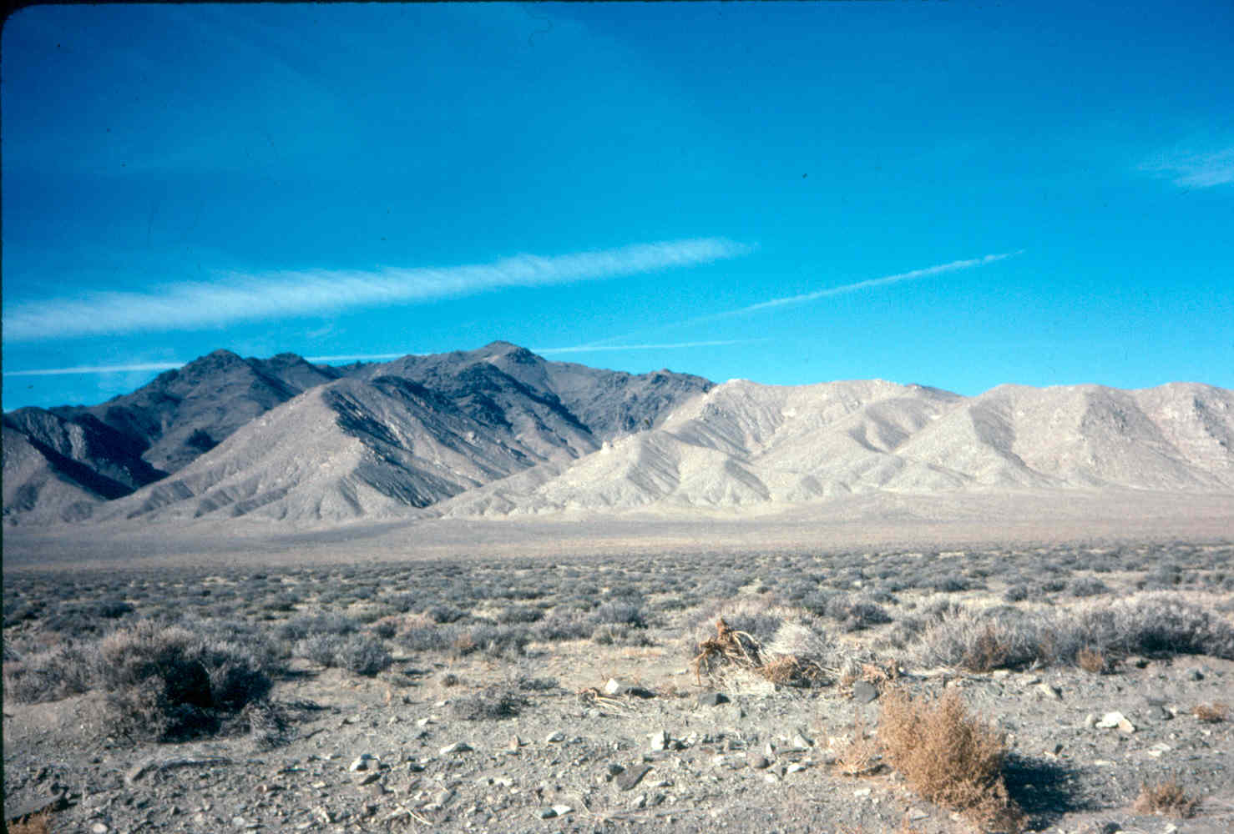
Notes:
View of E range front of southern SSR
Cretaceous Sand Springs pluton to right (north) and dark greenschist and amphibolite tectonites to left.

Slide 9
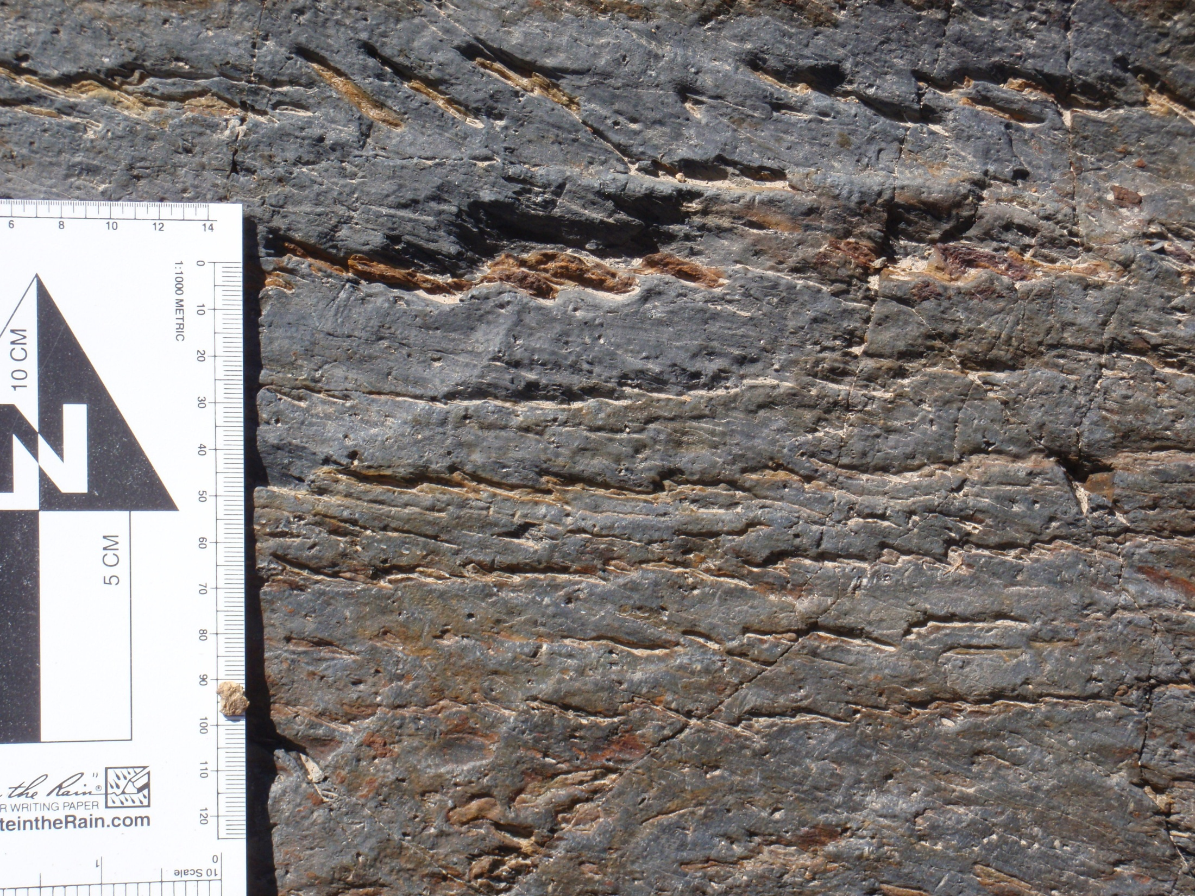
Notes:
Andalusite-graphite schist in northern SSR
Correlated with less-metamorphosed black shale containing late Norian fossils in southern Stillwater R. and northern Gillis R.
Quartz-rich laminae defining S0 (original sedimentary bedding) are partially transposed to S1 (tectonic foliation axial planar to D1 folds)

Slide 10
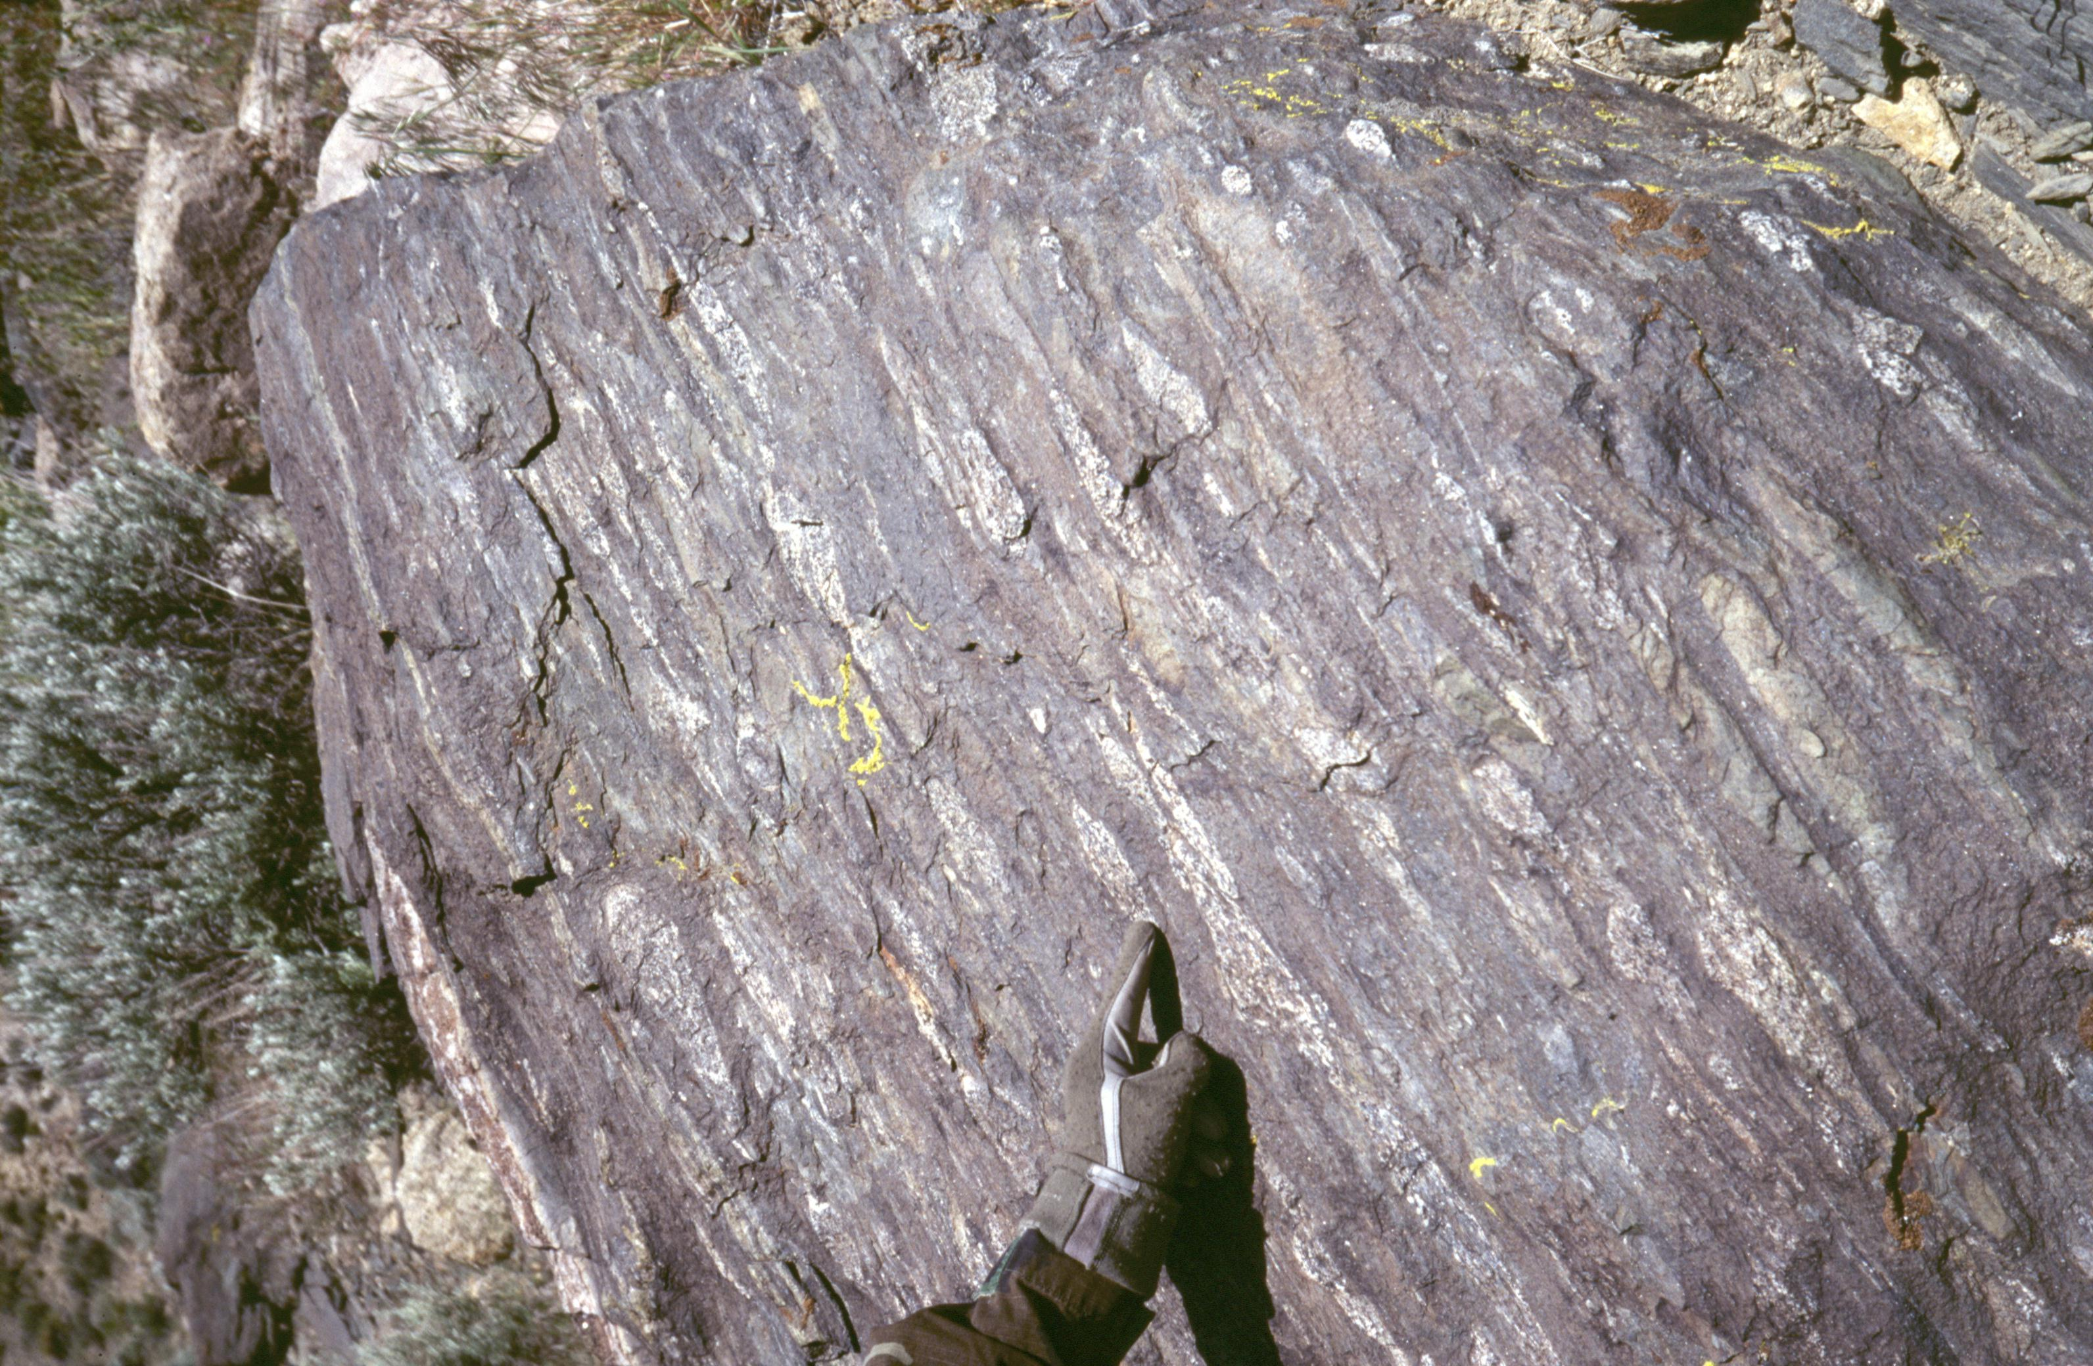
Notes:
Hornblende-biotite schist in southern SSR
Protolith is Mesozoic and/or Paleozoic
Stretched igneous clasts define a first-phase (D1) lineation parallel to D1 fold axes, an indication of high strain

Slide 11
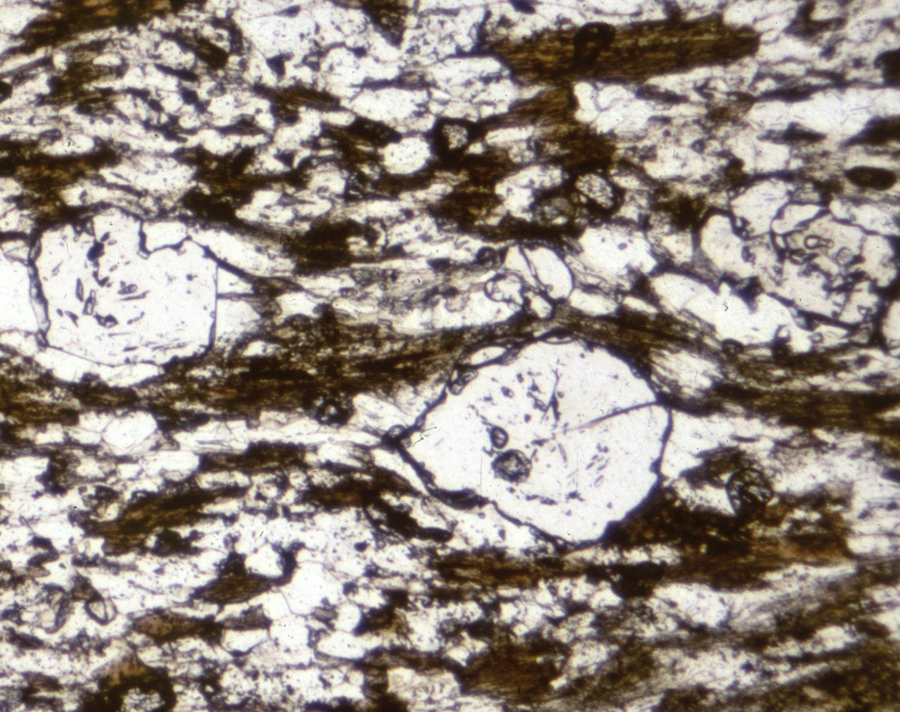
Notes:
Garnet-biotite schist in northern SSR
Biotite defines foliation parallel to D1 axial planes (S1)

Slide 12
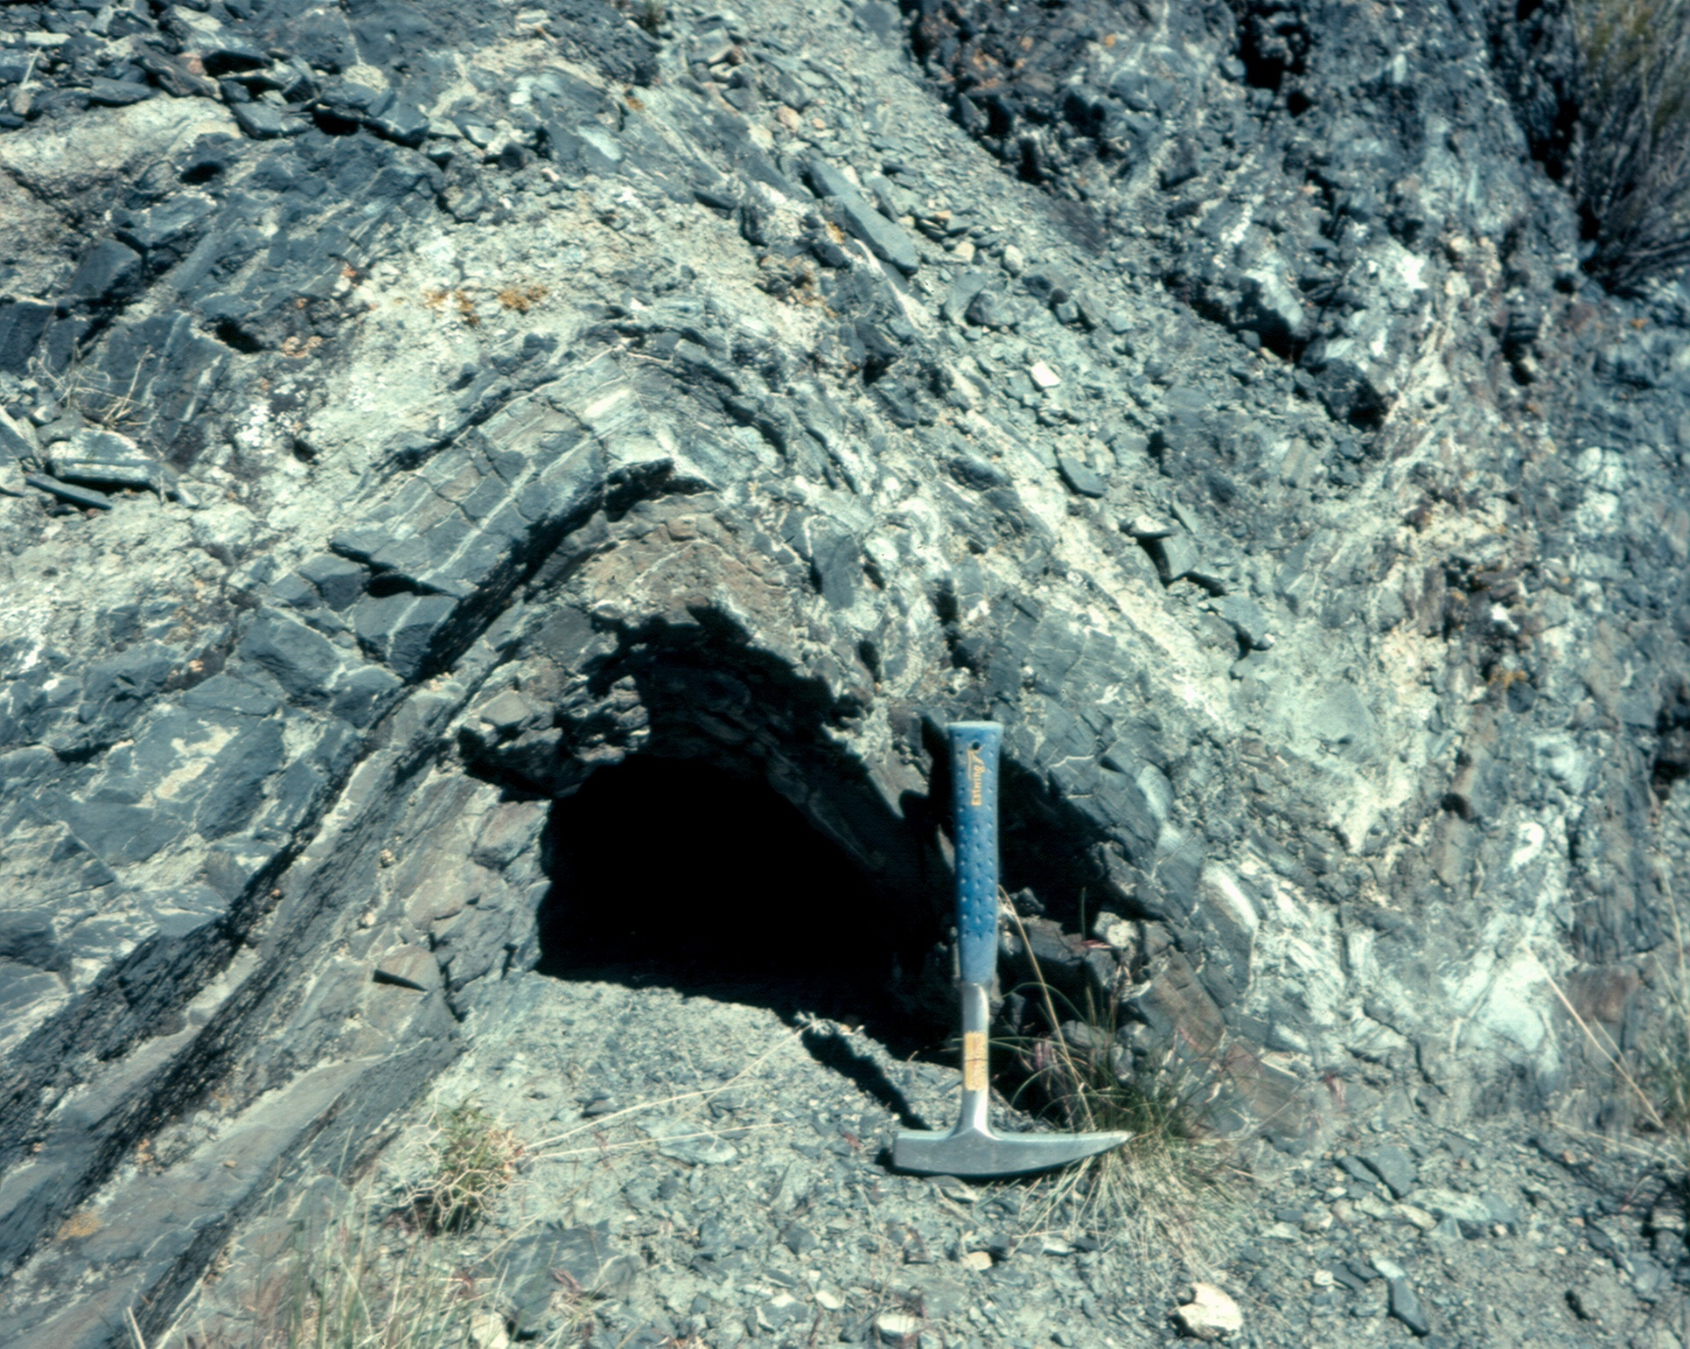
Notes:
Outcrop-scale folds that formed in D1, D2, and D3 are common
These are second-phase (D2) folds in southern Stillwater Range that refold S1

Slide 13
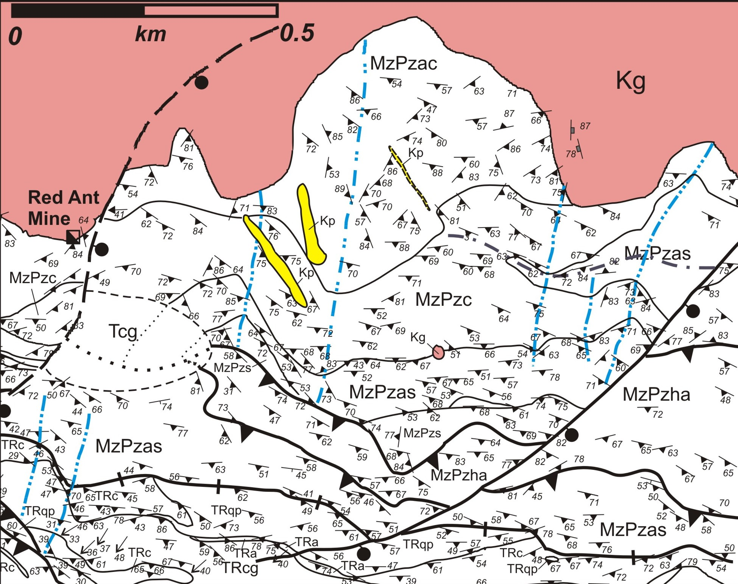
Notes:
Geologic map of southern SSR mapped at 1:8000-scale (note scale bar)
Uncolored: - ~15 tectonite map units. Cross-cut by 81.7 Ma granite and pegmatite dikes (Kg and Kp)
Strike and dip symbols are all S1
NE portion: Map-scale D1 fold showing many axial-planar S1 measurements. Surface trace of axial plane identified. This D1 fold refolded by 3 D2 folds. NE-trending axial traces shown.
D2 thrust faults cross-cut D2 folds.
K pegmatite dikes cross-cut D2 fold

Slide 14
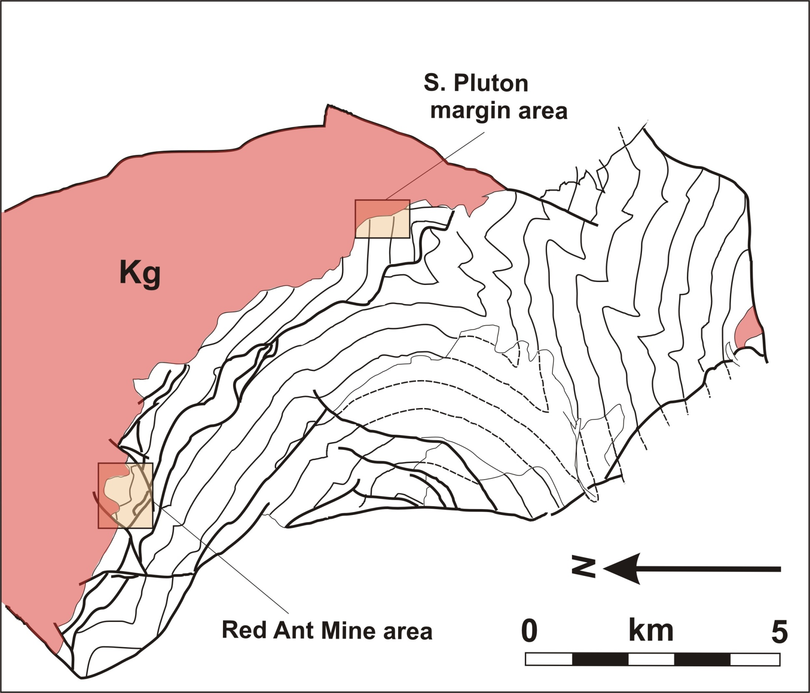
Notes:
Southern SSR
Thin lines are S1 formlines drawn parallel to the strikes of S1 measurements
S1 formlines show 3-km wavelength, NE-trending D2 folds
Kg sharply cross-cuts S1

Slide 15
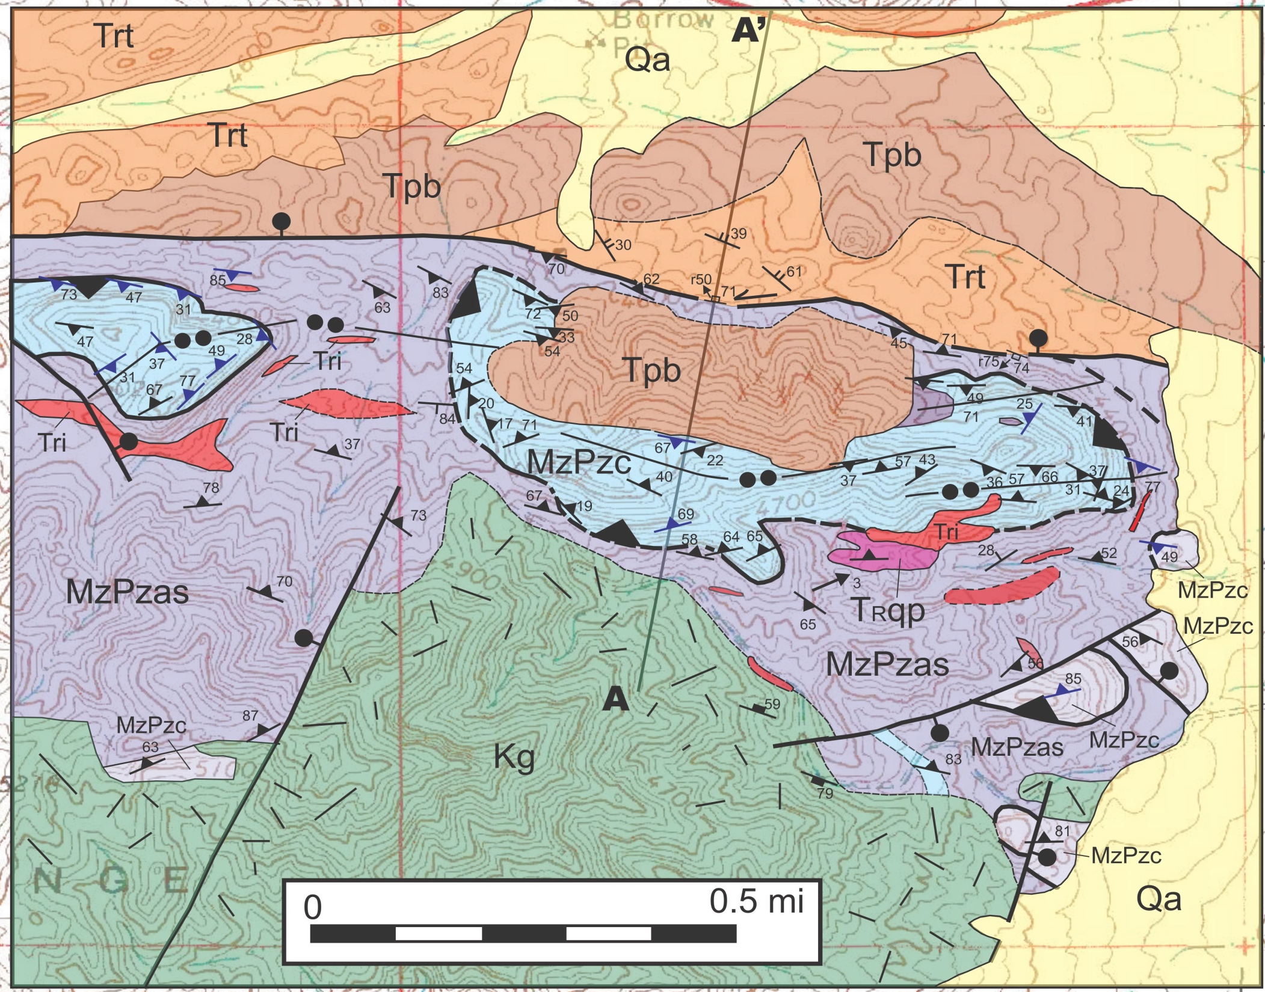
Notes:
1. Portion of northern SSR, S of US 50 mapped at 1:12,000-scale in 2011
2. Low angle contacts between MzPzc and MzPzas are fault contacts interpreted to be D2 thrusts. Strike and dip symbols with triangular dip direction indicators are S1. Black lines with two dots are surface traces of D2 folds.
3. Thrust faults cross-cut S1 foliation and D2 folds and are gently folded in D2 folds, implying thrust movement within a longer interval of D2 folding.
4. Tpb is a Tertiary porphyritic basalt previously interpreted by us to be as old as Jurassic. Recent mapping documents Tpb is interstratified within Tertiary ash flow tuff and overlaps D2 thrust.

Slide 16
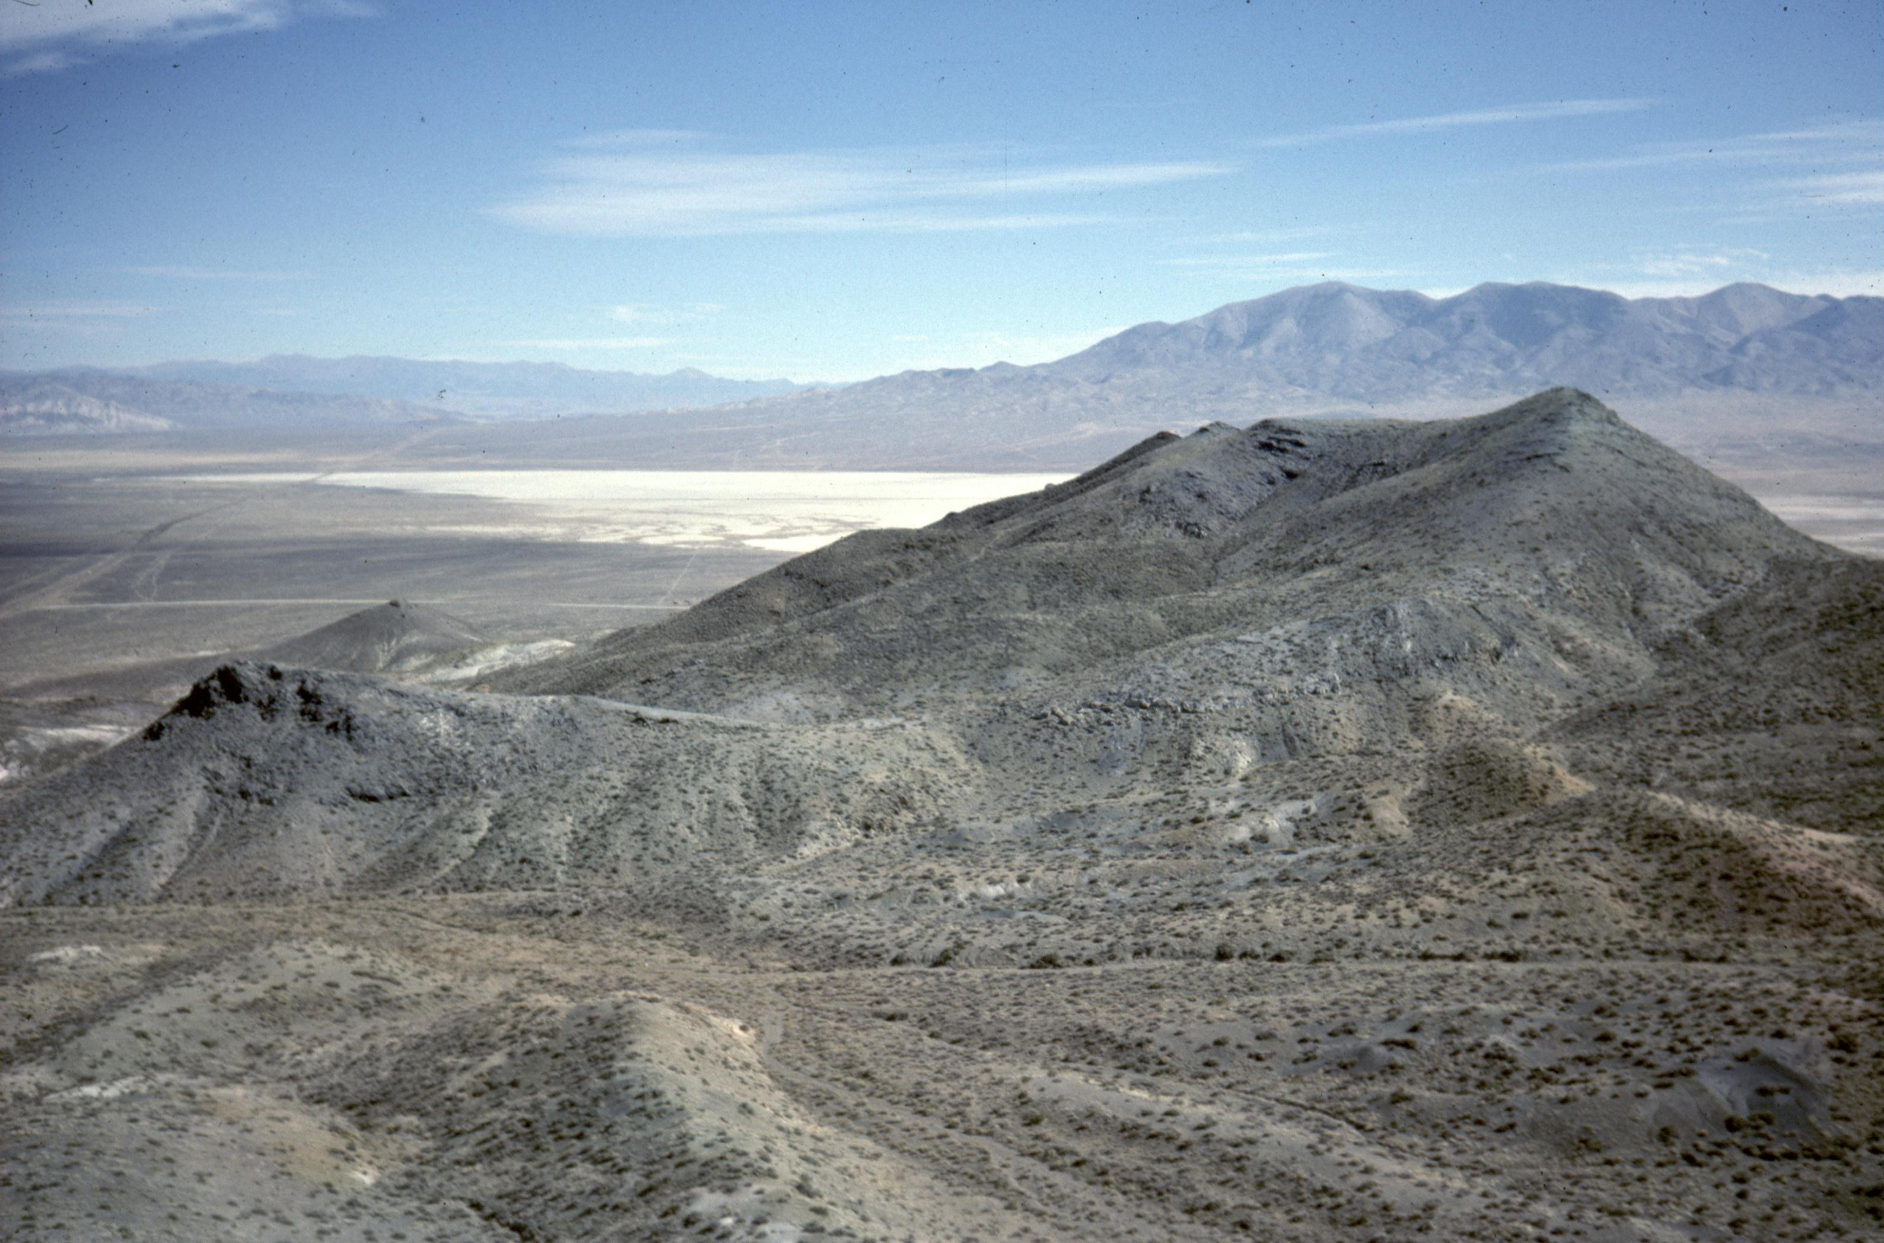
Notes:
View to E of Eastern well-exposed thrust fault (a klippe) from western klippe in previous slide
Photo shows pastel slope-forming MzPzas (andalusite schist and interstratified quartz-rich garnet biotite schist) below and craggy gray MzPzc (foliated marble) above. Thrust is folded in gentle D2 syncline.
Brown Tpb overlies MzPzc

Slide 17
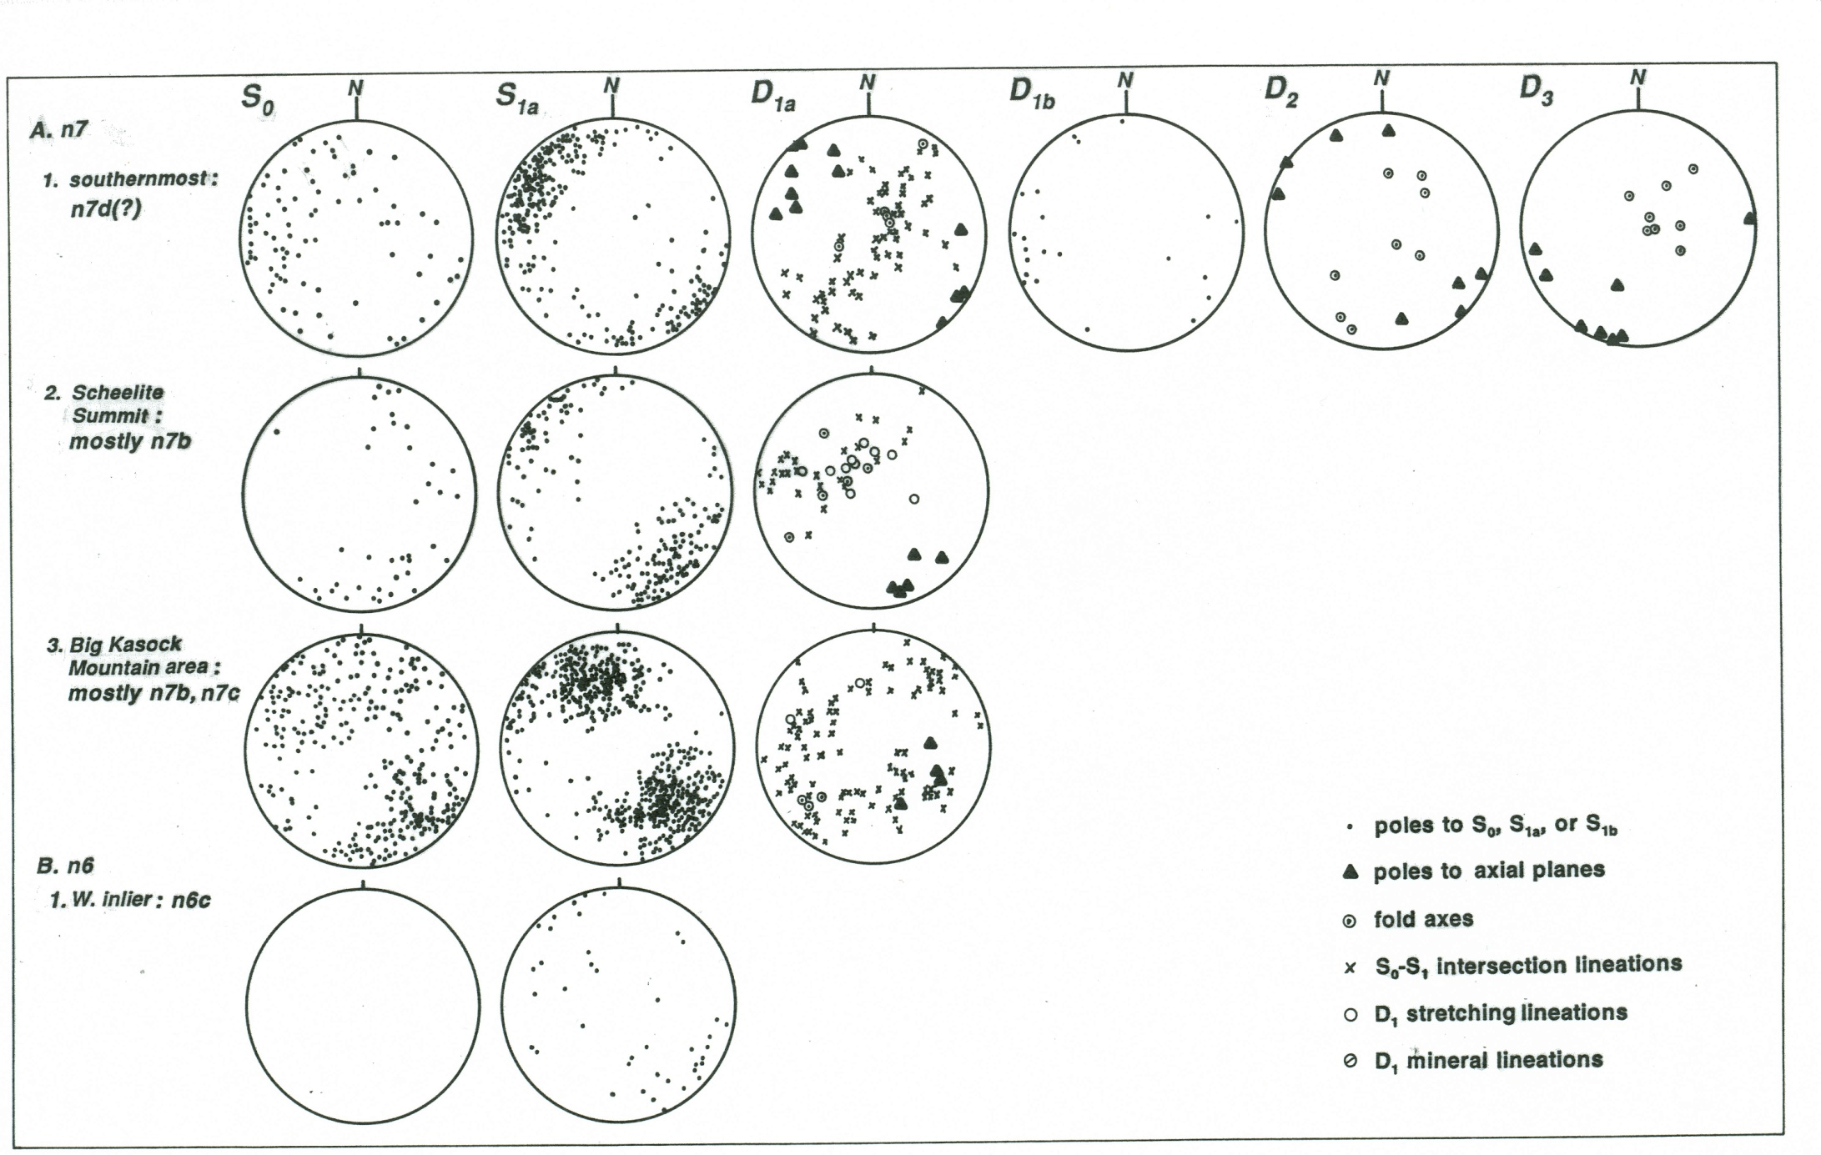
Notes:
Compilation of outcrop- and map-scale structural data on stereonets
Figure shows 4 structural domains in 2 greenschist facies thrust nappesS0 column: dots- poles to original bedding
Key to symbols used on figure. D1a data includes axial plane poles, fold axes, stretching lineations, and bedding-cleavage intersections
Girdle distribution of fold axes and bedding-cleavage intersections indicates high strain
D2 folds contain subvertical NE-striking axial planes
D3 folds contain subvertical NW-striking axial planes

Slide 18
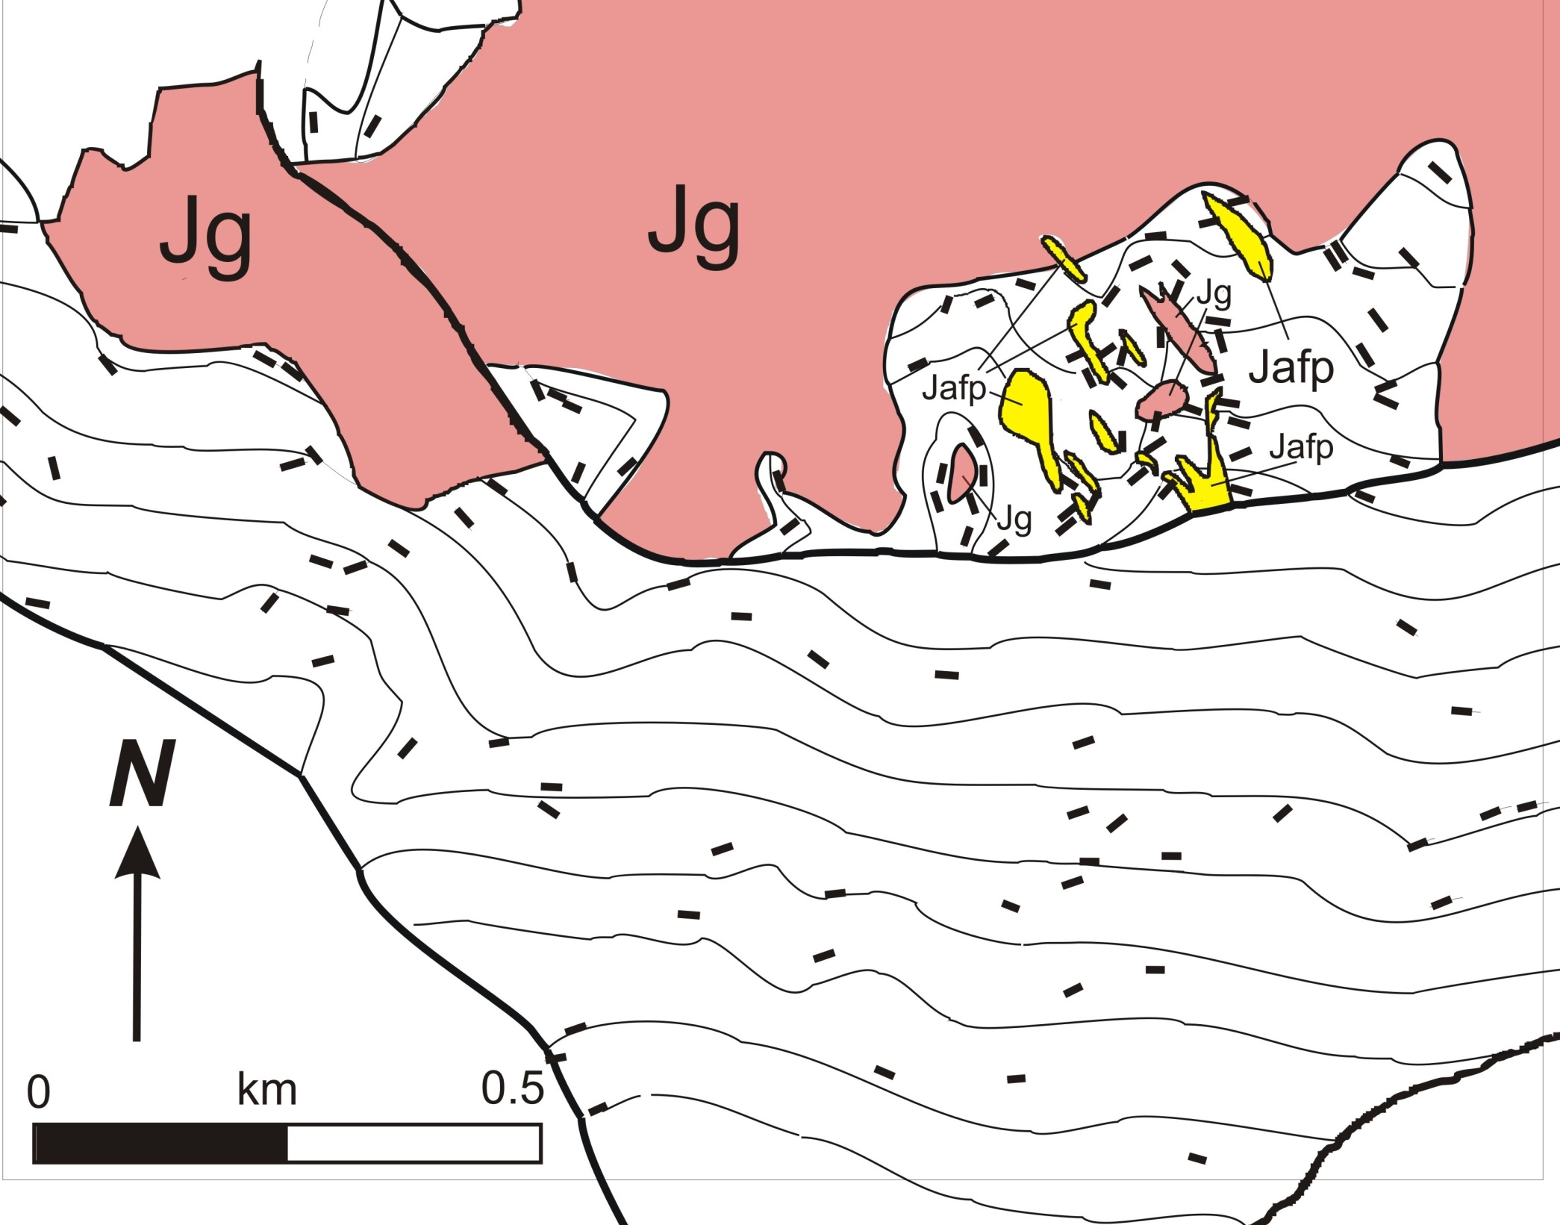
155 -158 Ma (K-Ar)
Copper Mtn
Notes:
Copper Mountain contains Jurassic granitoid (ref)
Bars are strikes of S1 foliation and cleavage in Triassic carbonate. Thin lines are S1 formlines.
S1 formlines are crosscut by granitoid
SSA D1 is pre-158 Ma

Slide 19
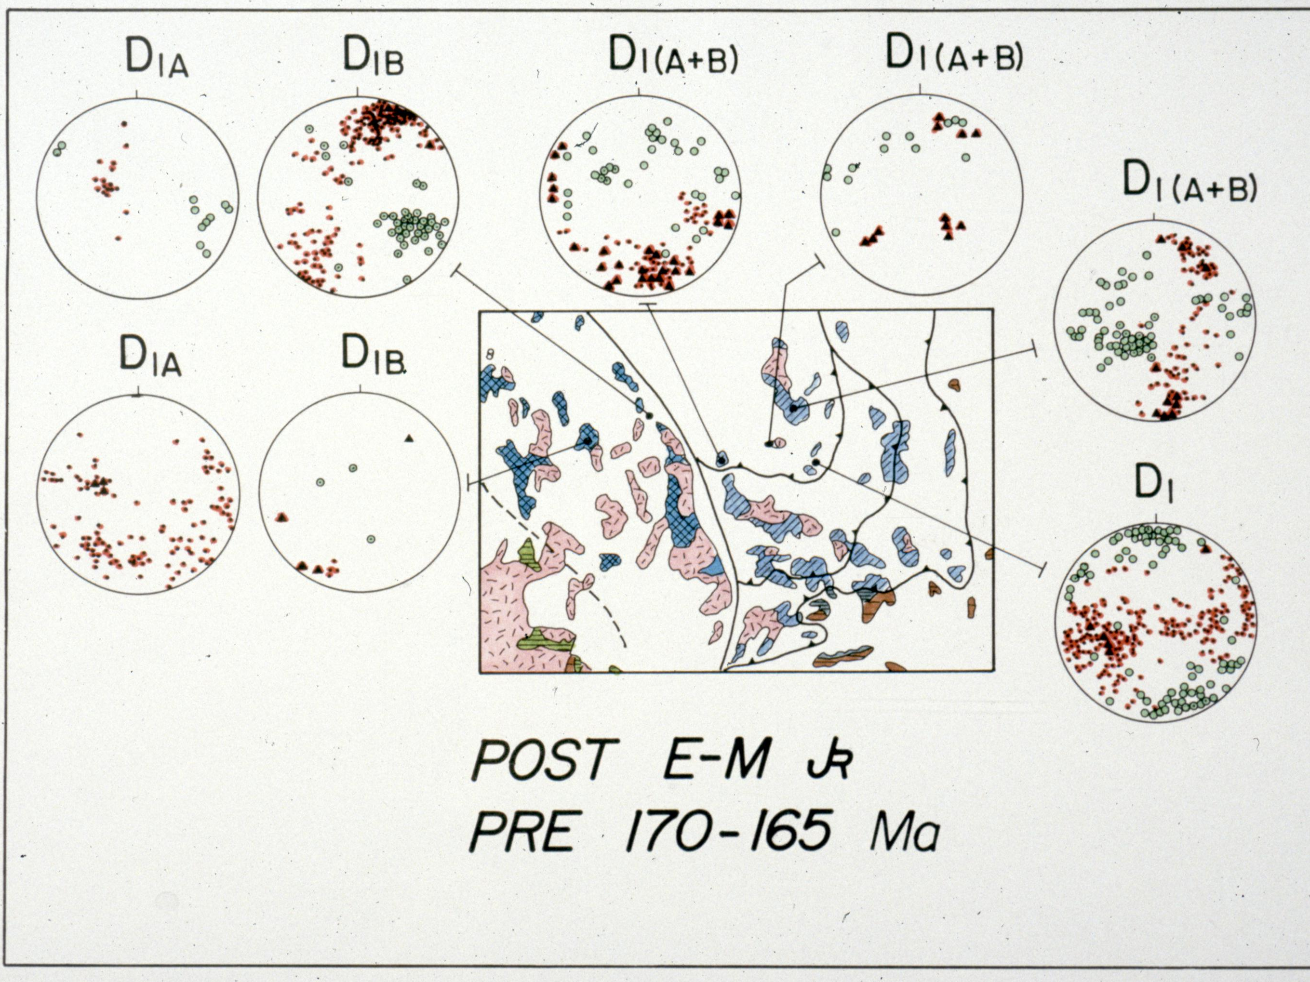
Notes:
This figure and next show our regional correlations of SSA fold generations
Includes our measurements on folds and related features from 4 SSA localities plus surrounding assemblages
SSA D1 folds and related metamorphism present only in SSA and Pine Nut assemblage of eastern Sierra Nevada
4. SSA D1 structures are allowably Sierran structures

Slide 20
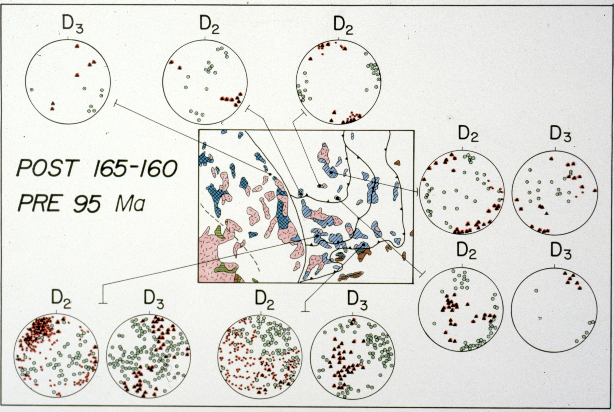
Notes:
Figure shows our data and correlations of SSA D2 and D3 folds
NE-trending D2 folds only found in SSA and other LFTB assemblages E of the Pine Nut fault
D2 is the main phase of shortening in the LFTB
NW-trending D3 folds found throughout LFTB and eastern Sierra Nevada

Slide 21
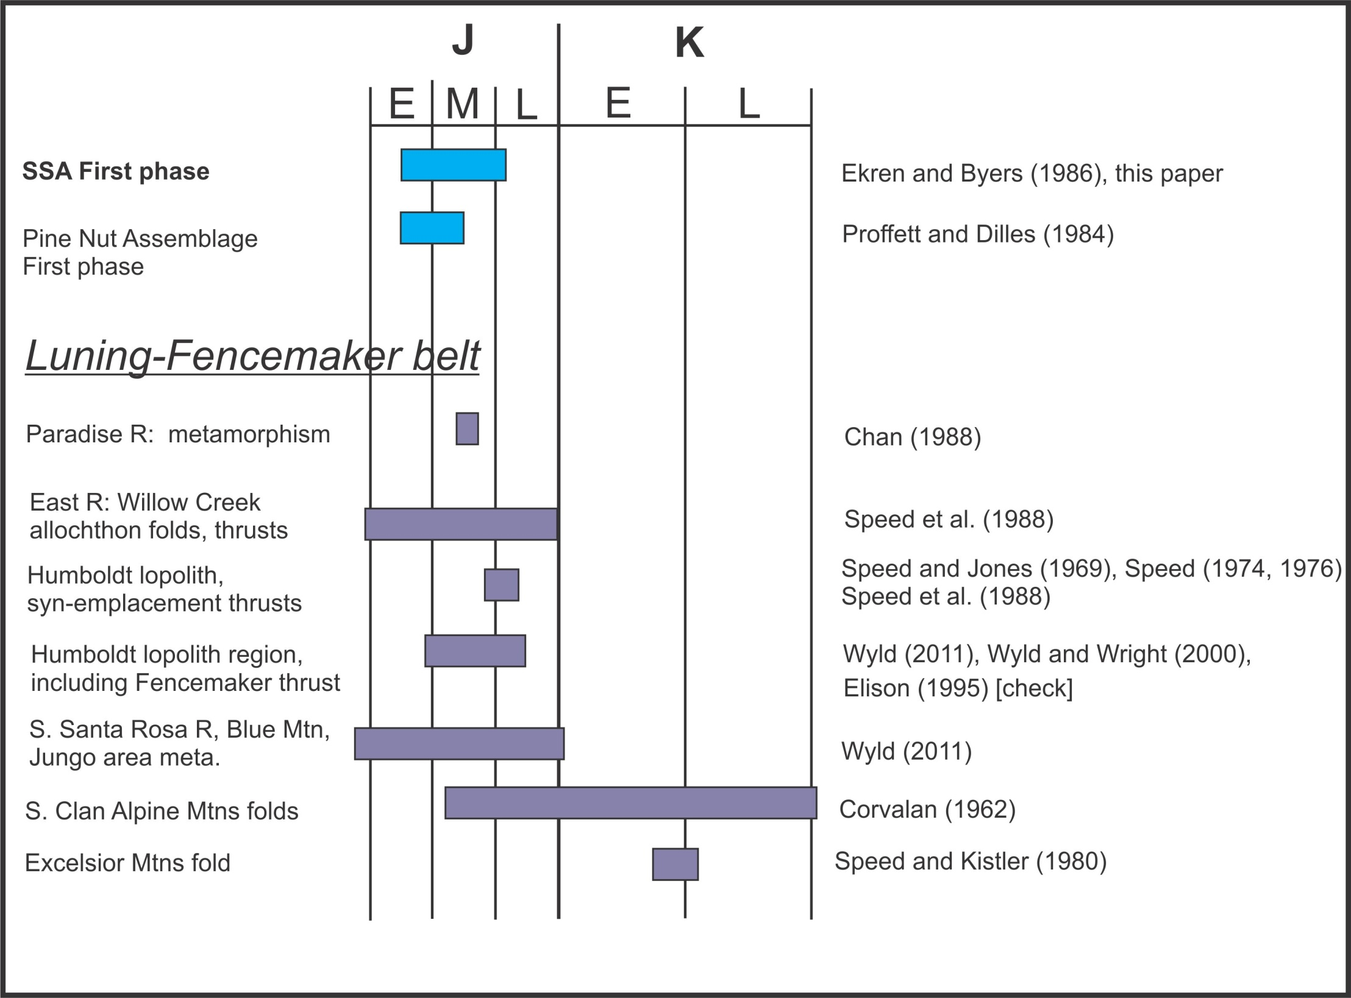
Notes:
1. Comparison of SSA timing constraints on deformation phases to timing constraints for Pine Nut assemblage in eastern Sierra Nevada and to timing constraints in LFTB
2. Timings are not tightly constrained
3. Our regional D1 – D3 correlations are allowable given present broad constraints.

Slide 22
Major Points
Sierran structures predated LFTB structures
Terrane bounding-fault separates SSA from Sierra Nevada (transpressional Pine Nut fault)

Slide 23
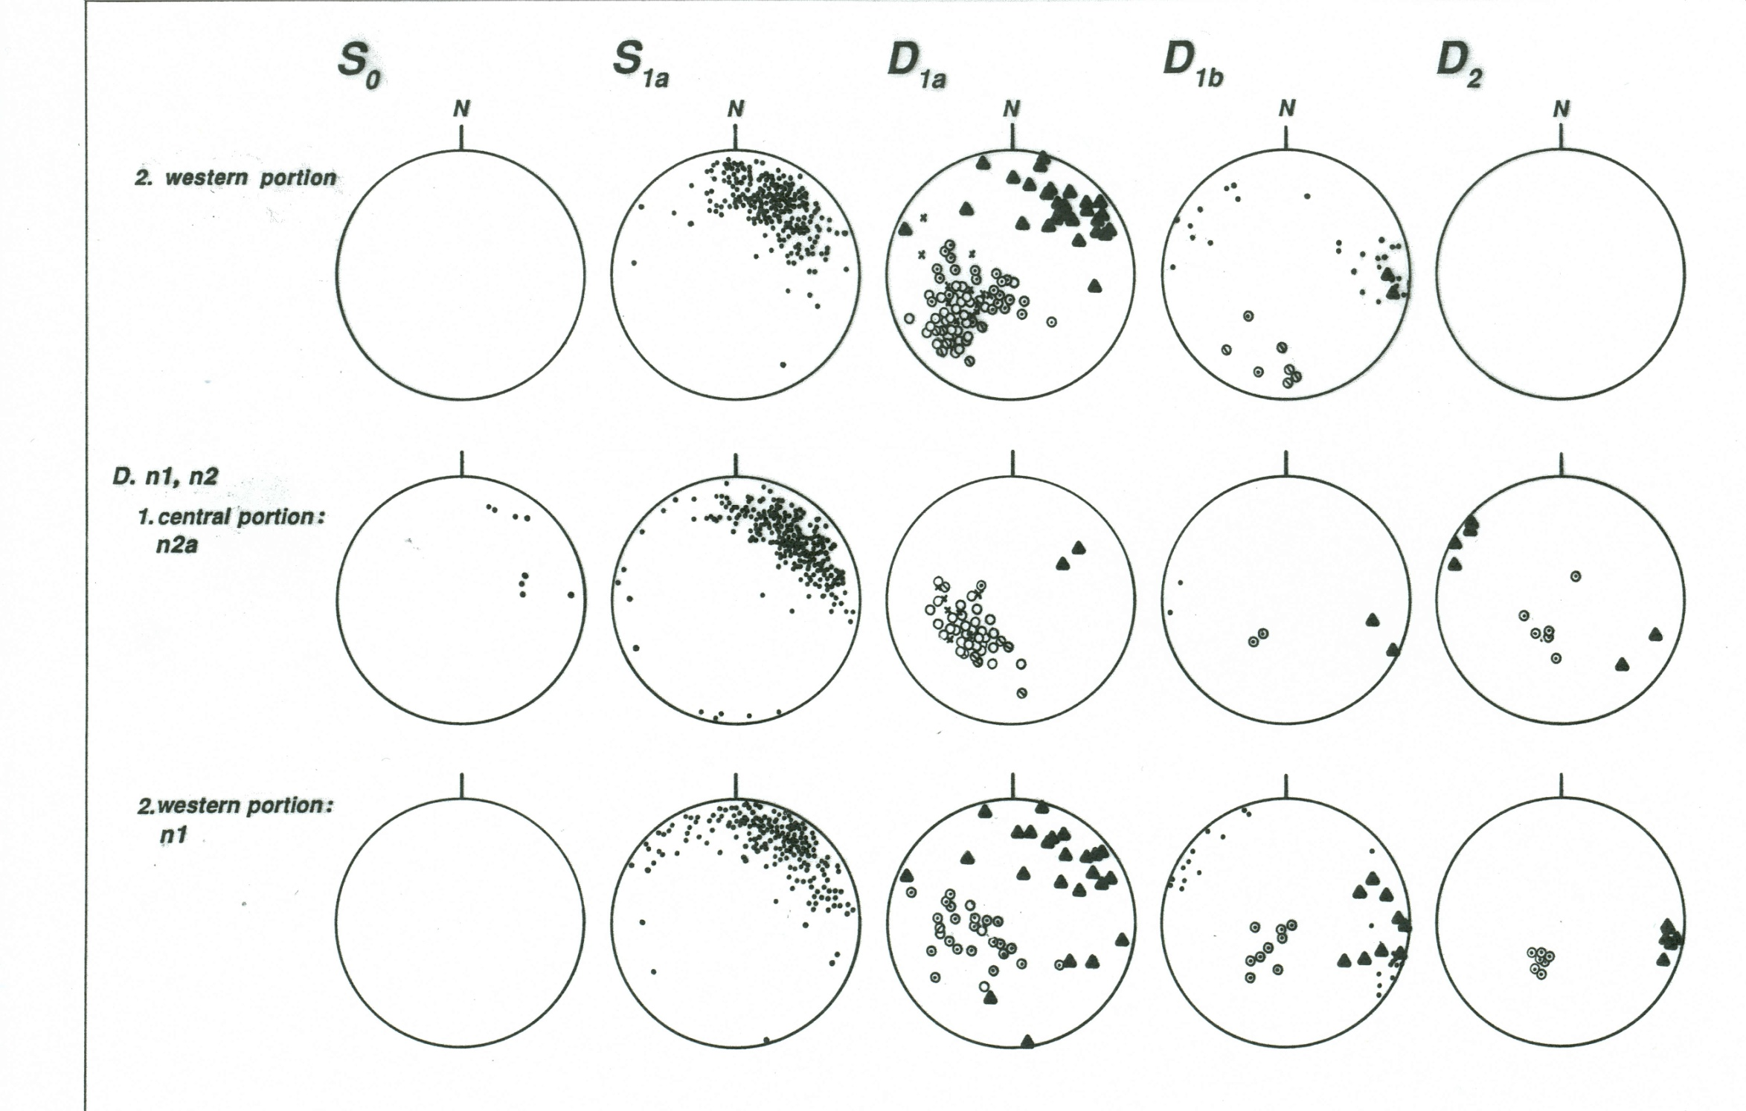

Slide 24
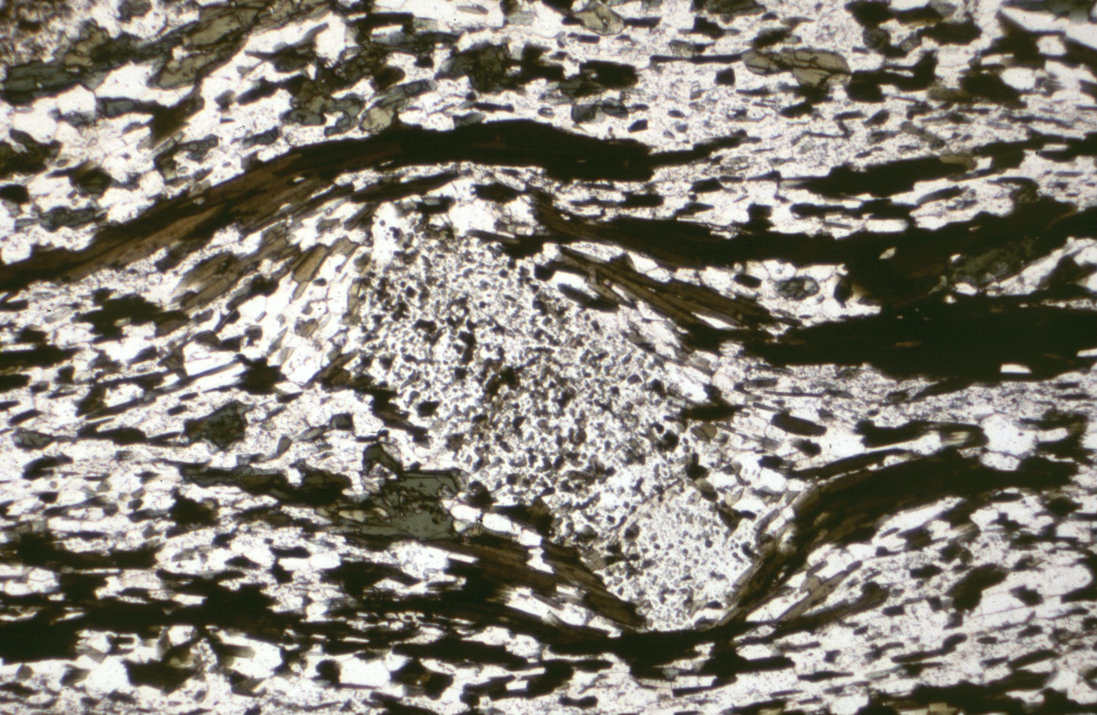

Slide 25
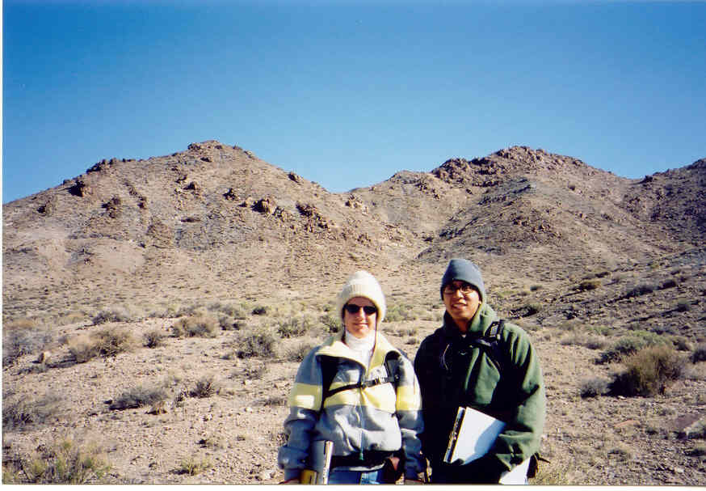

Slide 26
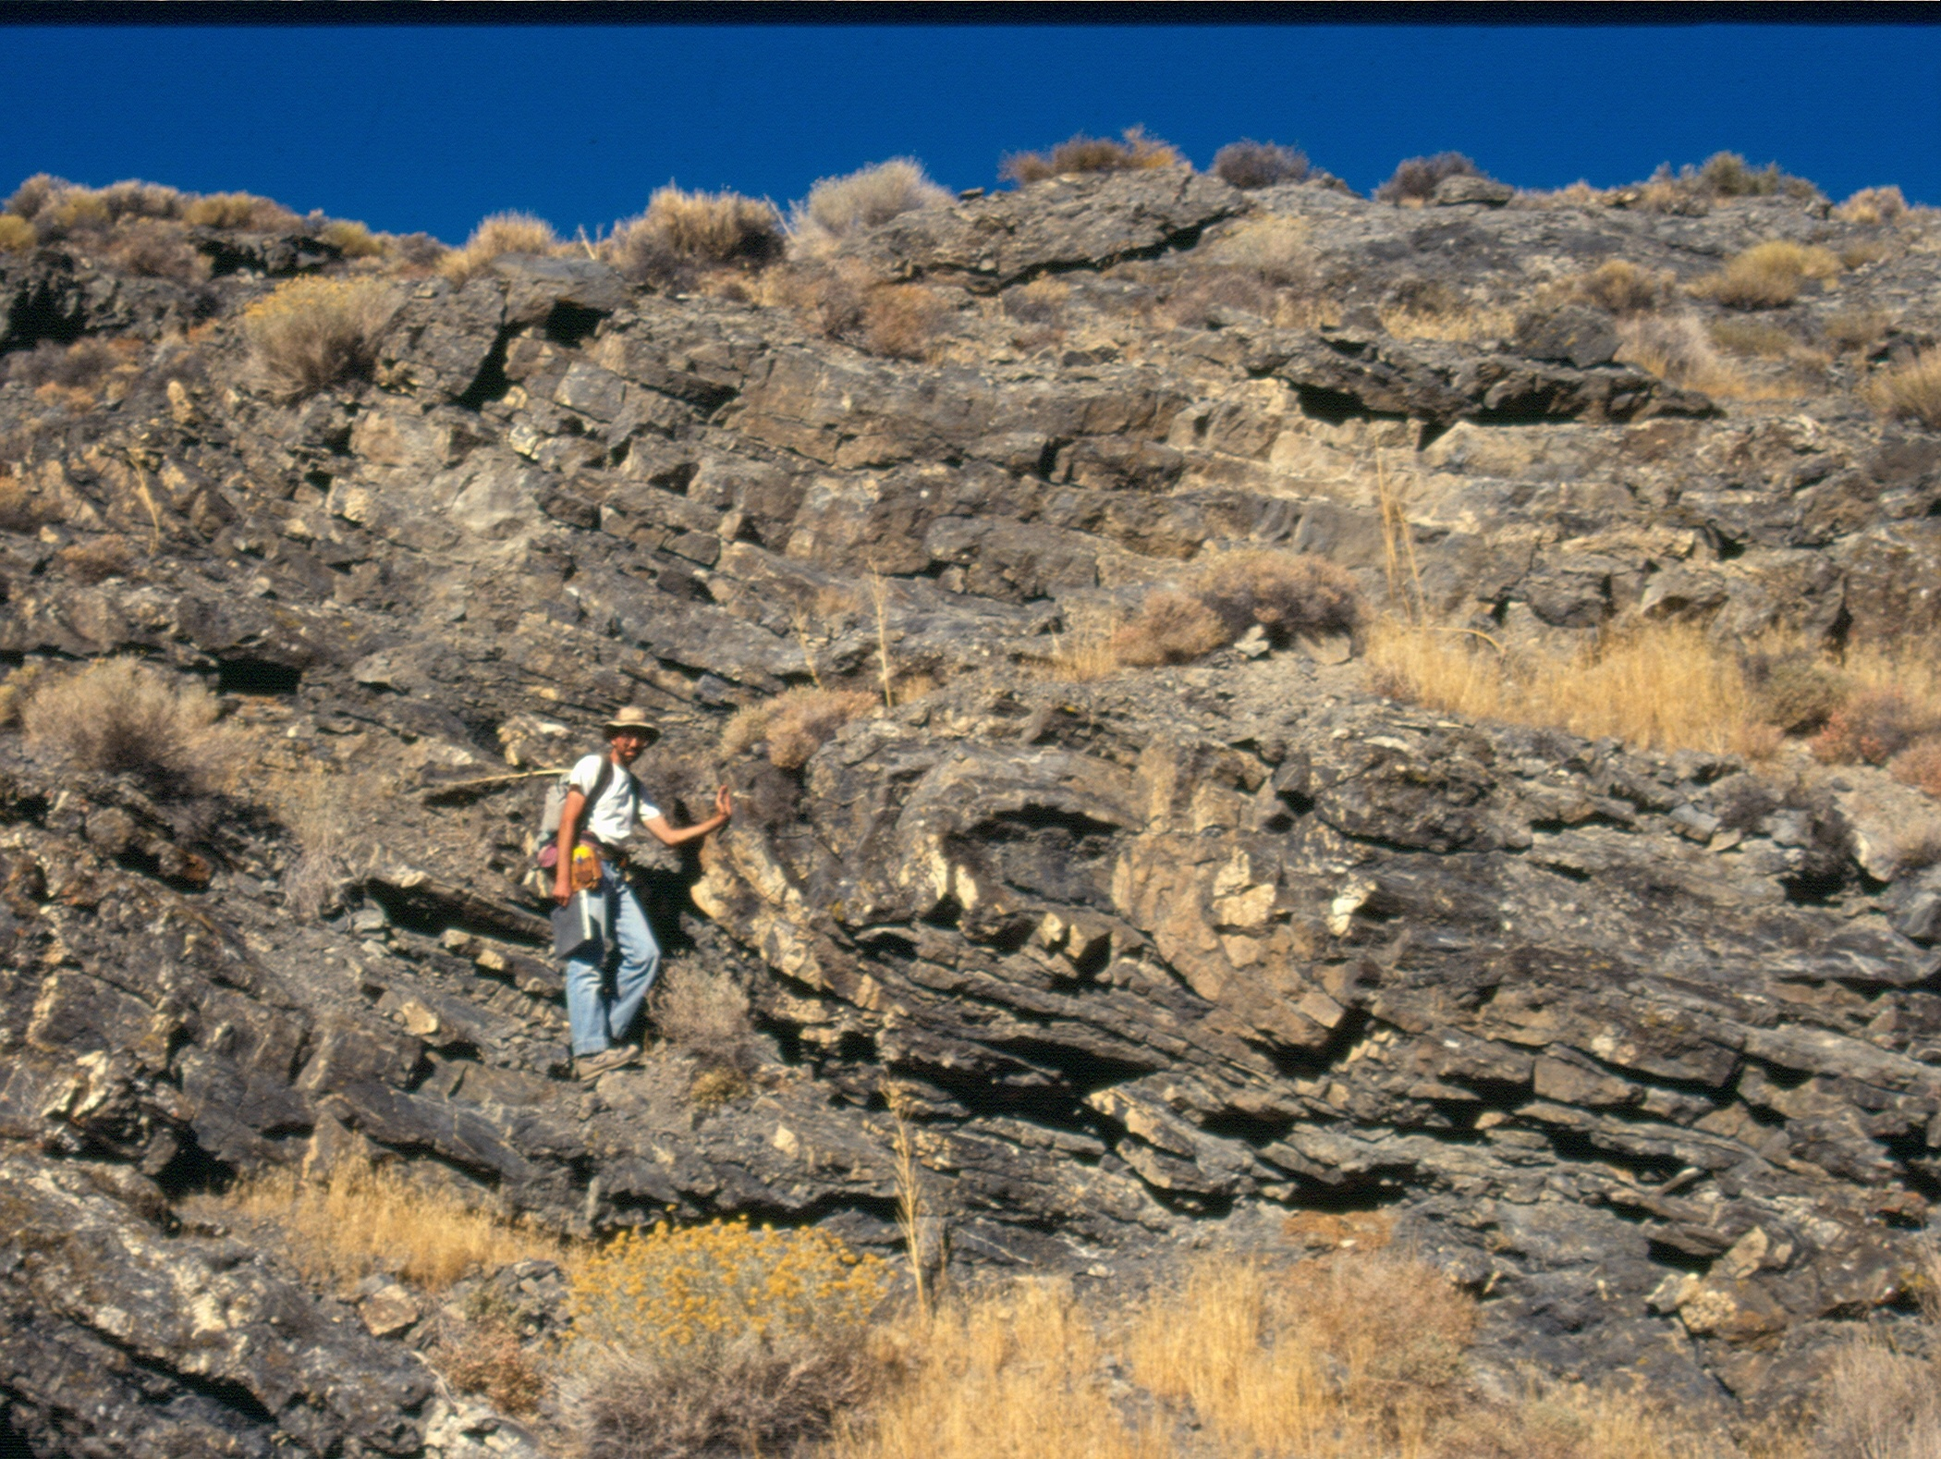

Slide 27
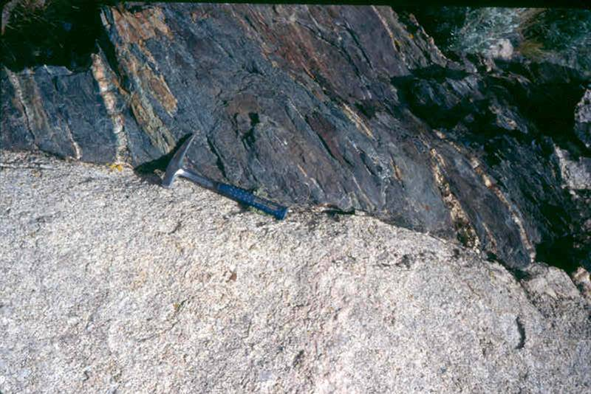

Slide 28
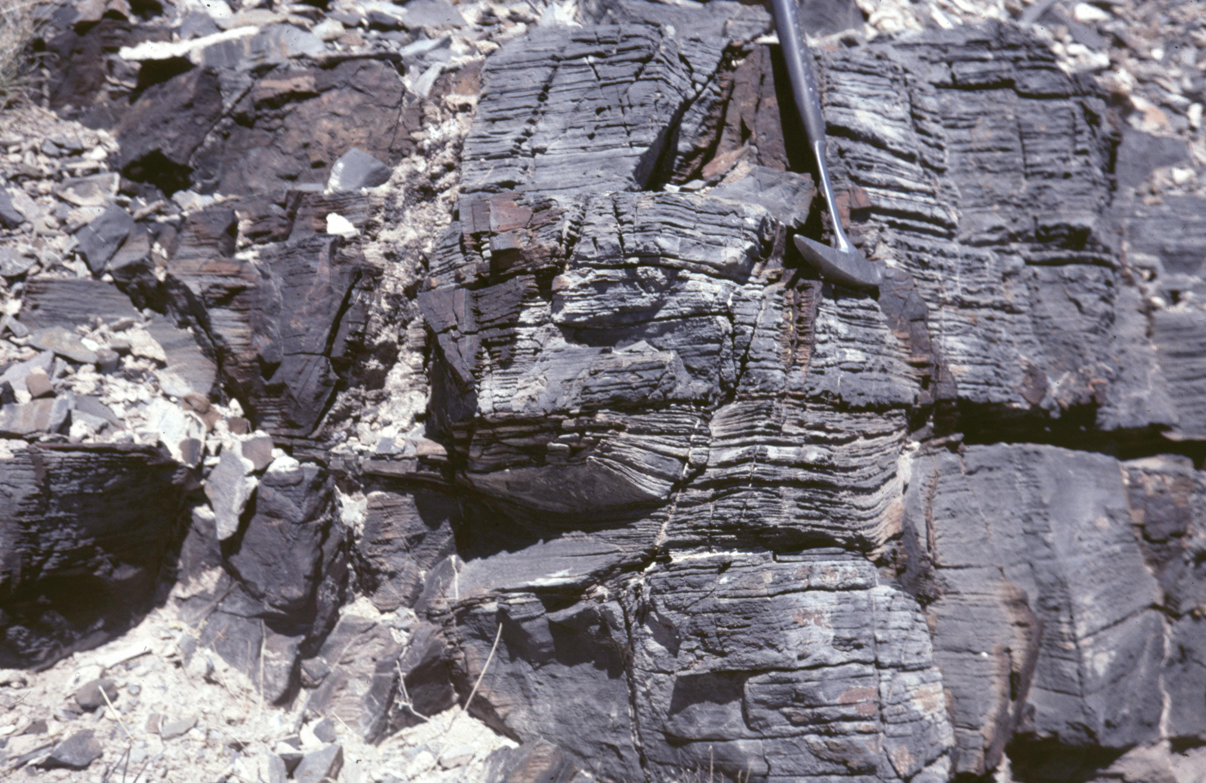

Slide 29
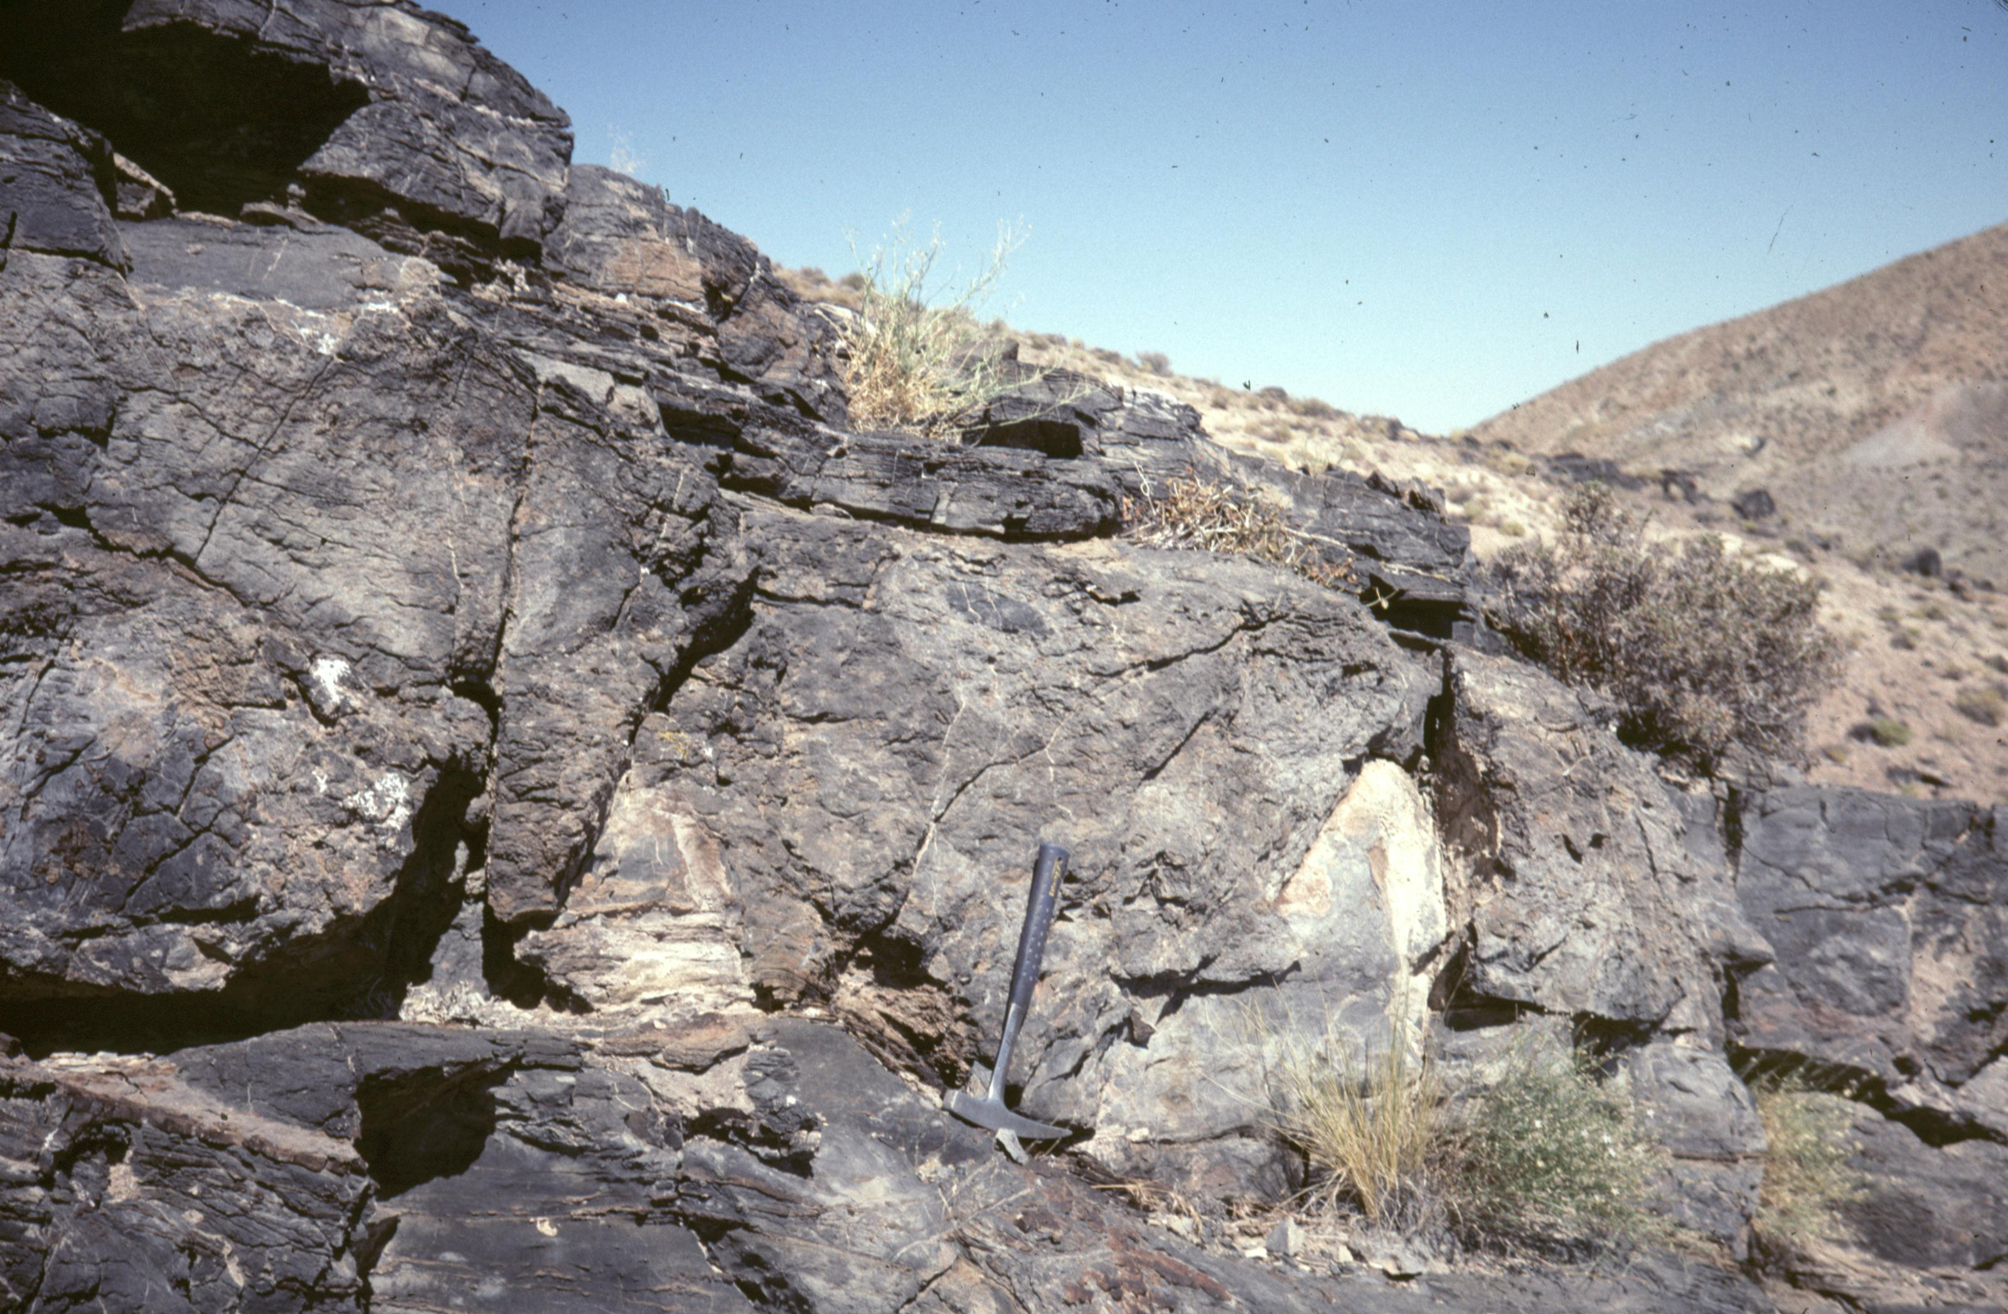

Slide 30
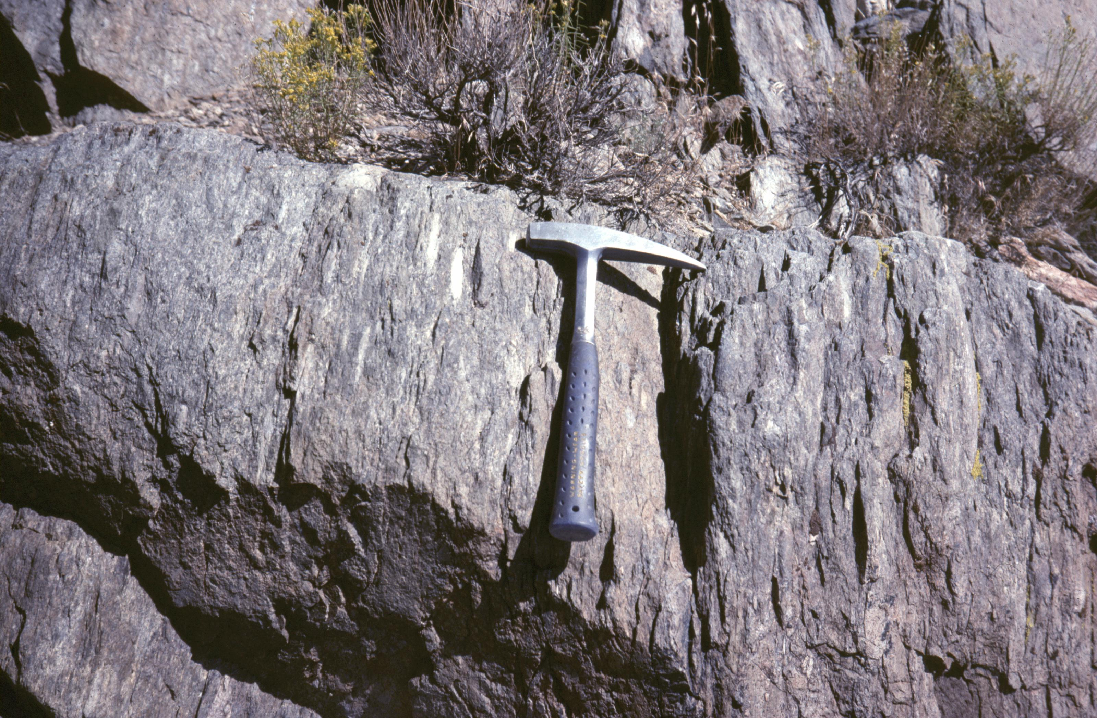

Slide 31
