Slide 1
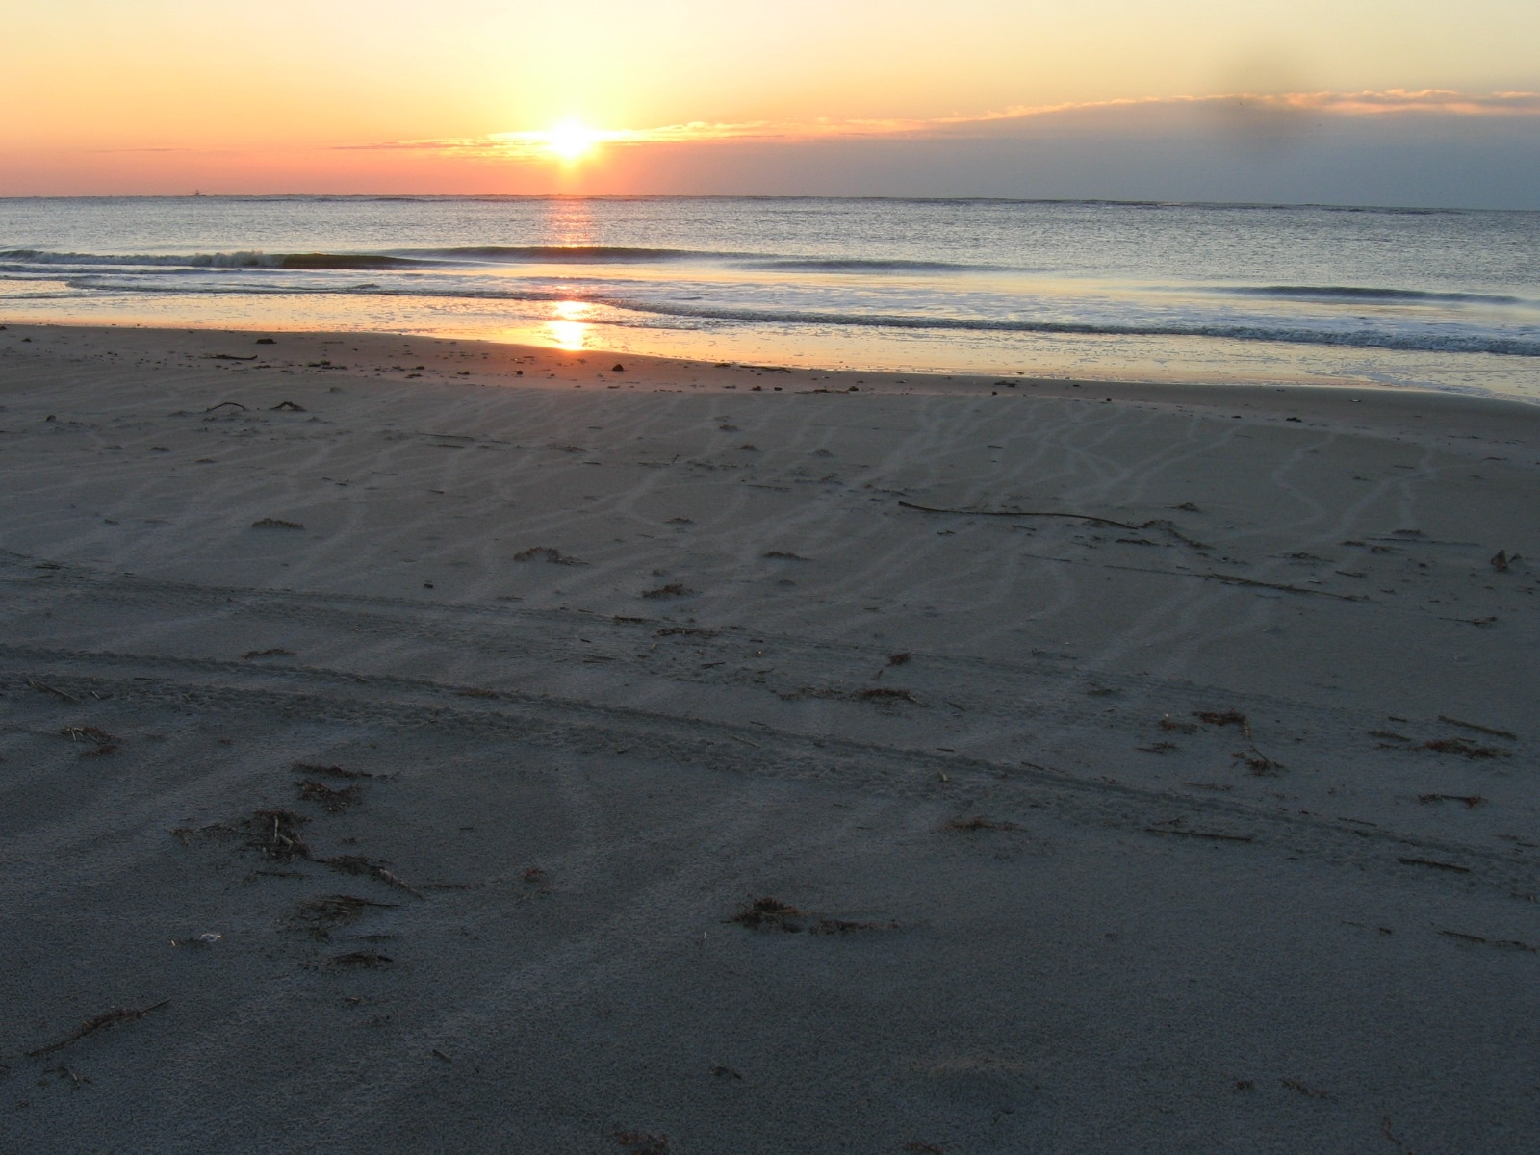
IMPROVING K-12 TEACHER CAPABILITY
THROUGH A FIELD-BASED INTEGRATED SCIENCE PROGRAM
R. Kelly Vance - Georgia Southern University
Gale A. Bishop – GeoTrec LLC & Georgia Southern Univ.
Fredrick J. Rich – Georgia Southern University
Nancy B. Marsh – Jenkins County Middle School
Martha L. Schriver – Georgia Southern University
Royce H. Hayes – St. Catherines Island Foundation

Slide 2
Program Support
Georgia Improving Teacher Quality Grants
St. Catherines Island Foundation & SCI Staff
Georgia Southern University
Georgia Dept. of Natural Resources
M. K. Pentecost Ecology Fund
GeoTrec LLC
American Museum of Natural History Staff

Slide 3
The Program – Delivery & Structure
Credit: *4 hrs for GEOL 5740G (summer)
*4 hrs for GEOL 5741G (dist. follow-up for previous cohort)
*3 hrs for GEOL 5890G - 2 options for return as mentors
GEOL 5740G internship course:
  * May, June - meeting & web * July - 8 days on St. Catherines Island * Sept. - 2 days on St. Catherines Island

Slide 4
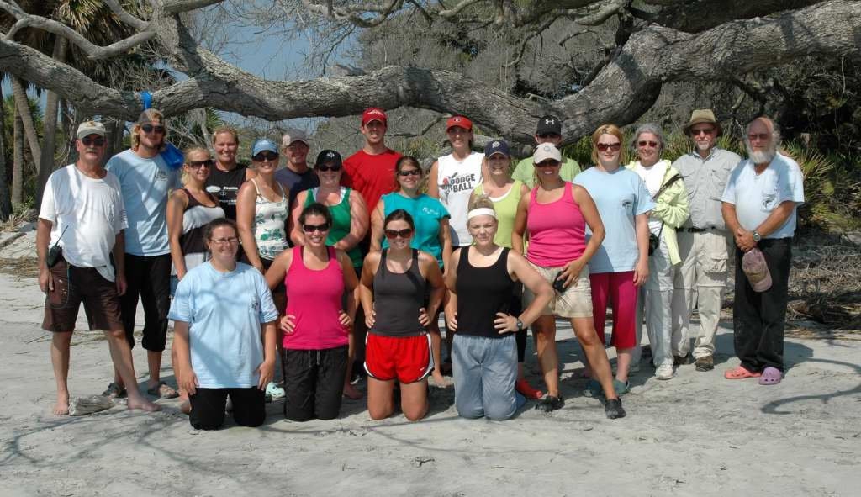
2011 SCISTP Teachers and Staff

Slide 5
Challenges for K-12 Science Teachers
Preparation – traditional education curriculum
  emphasis on “how to…” courses, child development and psychology, cognition, curriculum design, social-cultural issues…
  Insufficient science content and lack of research experience
  Practice – meeting grade level performance standards, standardized test requirements…

Slide 6
The St. Catherines Island Sea Turtle Program
Field-based - St. Catherines Island, Georgia
“Vehicle” – conservation of loggerhead sea turtles (Caretta caretta)
Record: 22 years, 288 interns, 2,615 nests, 153,974 hatchlings into the Atlantic
Staff –
3 geologists (Sand is the key!)
2 science education specialists
1 naturalist/historian (superintendent)
1 Wildlife veterinarian – GSTC
2-3 teacher mentors

Slide 7
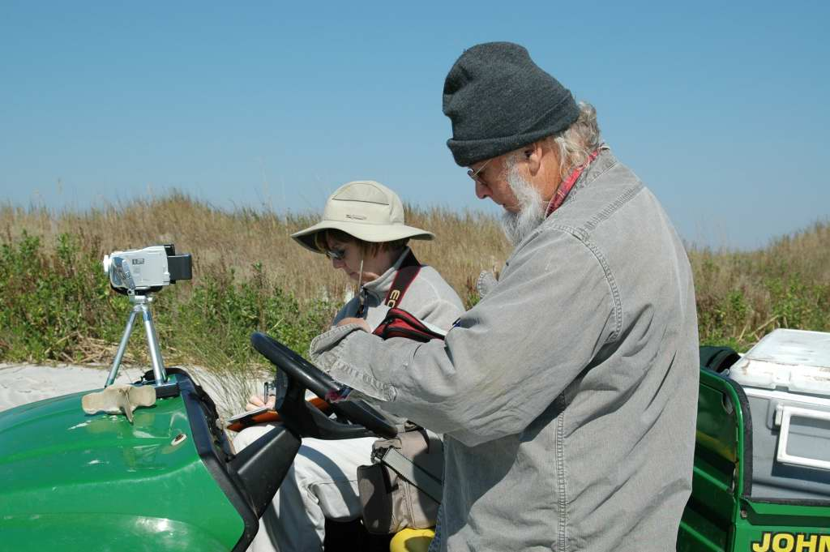
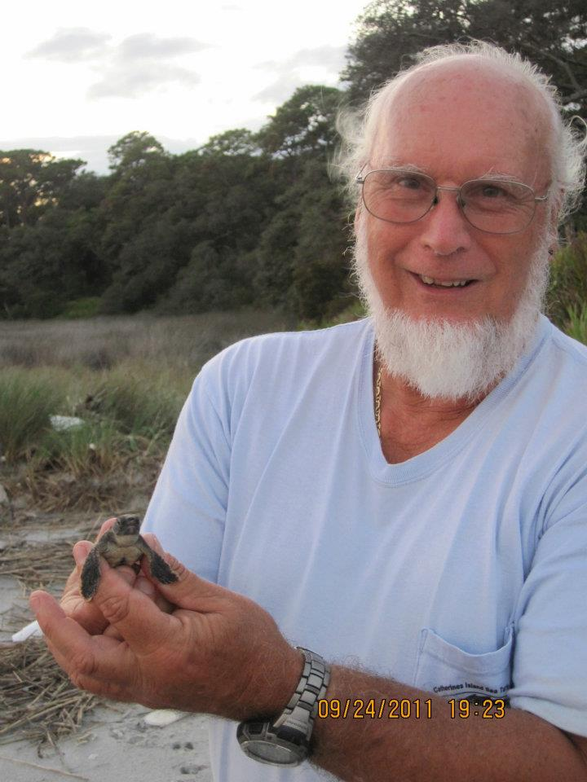
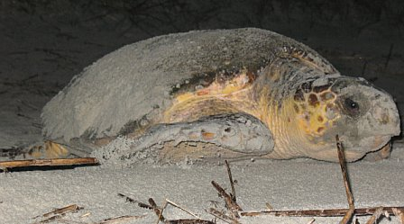
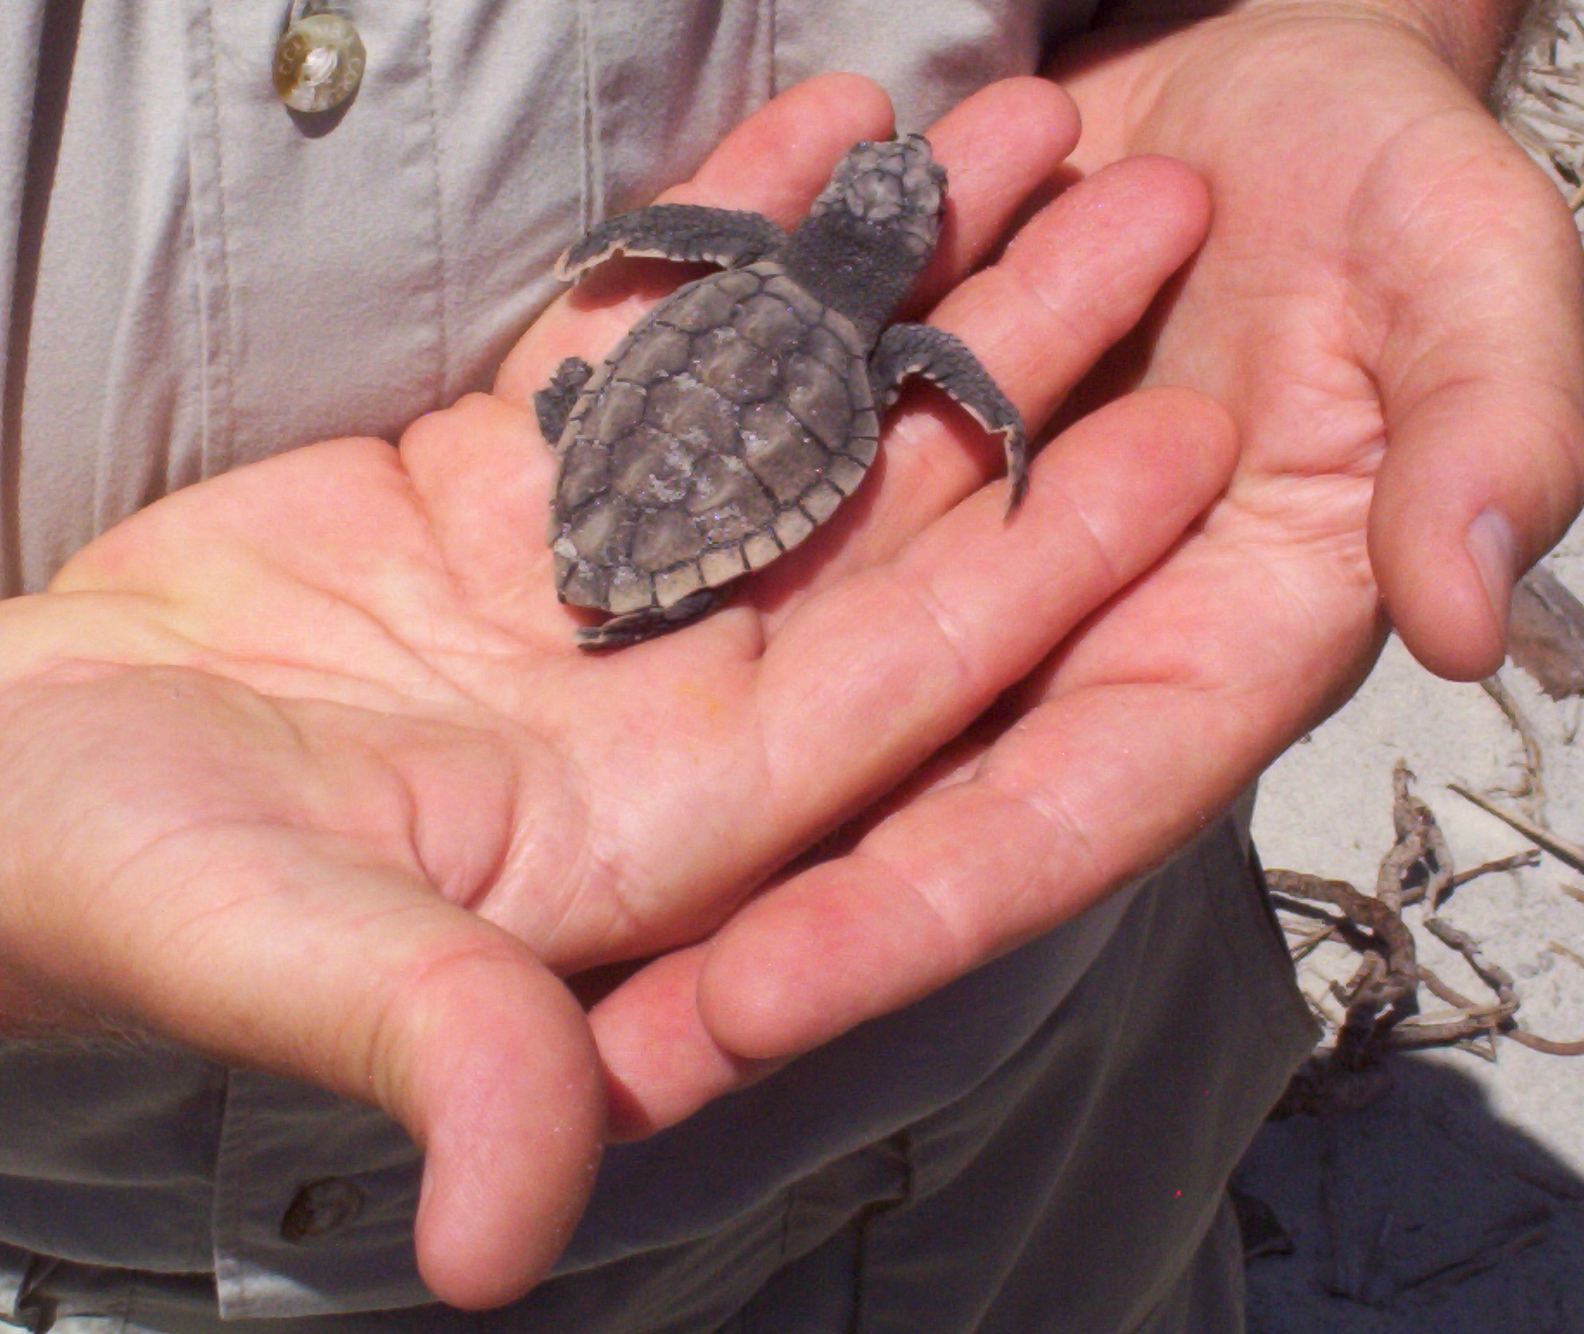
Program Founders and Director
Gale Bishop
Nancy Marsh

Slide 8
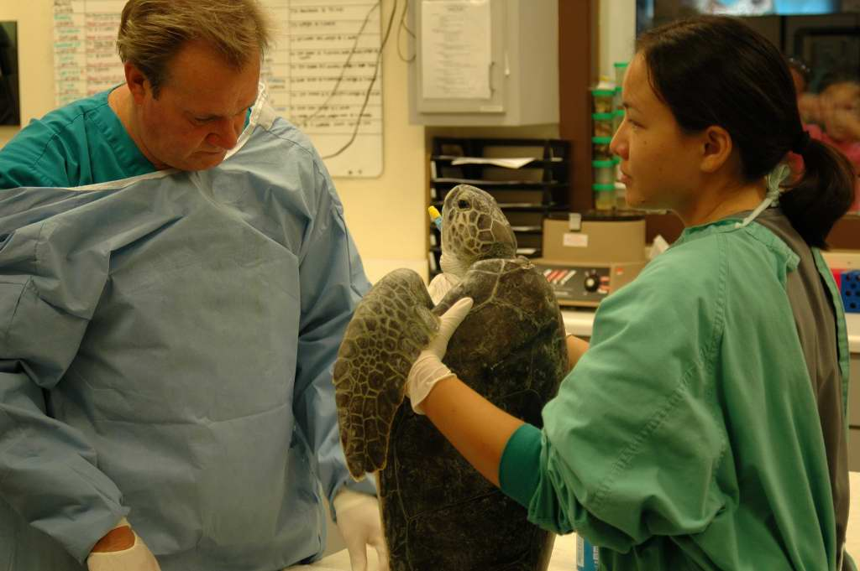
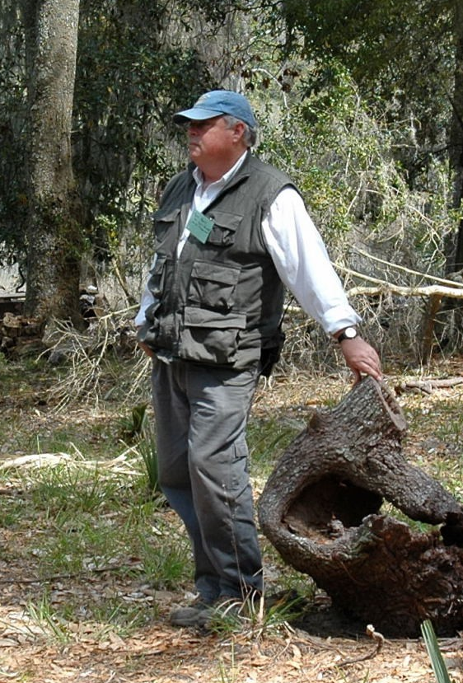
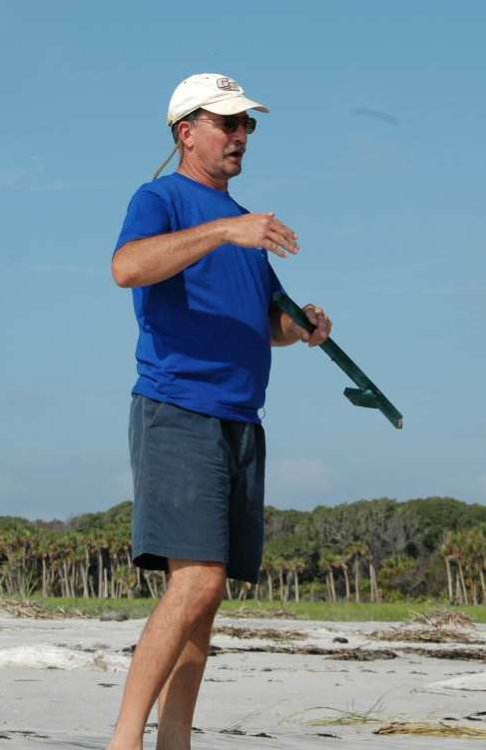
Program Staff
Royce Hayes –SCI Superintendent
Fred Rich - geologist
Terry Norton – Wildlife DVM, Director of GSTC

Slide 9
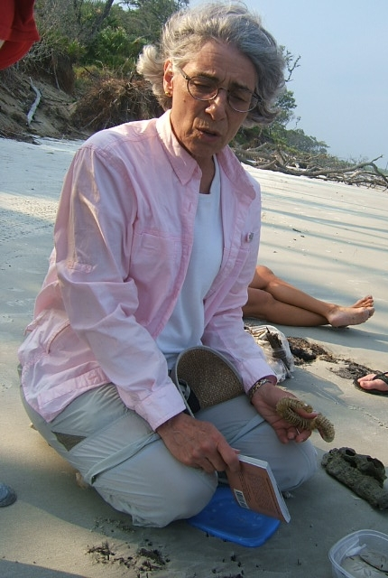
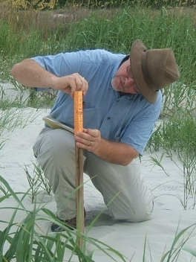
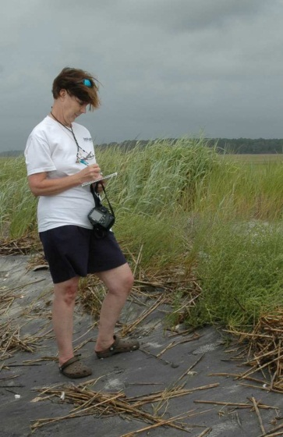
Program Staff
Nancy Marsh – Science Ed. Specialist, program co-founder
Marti Schriver – Science Ed. Specialist
Kelly Vance – geologist, grant PI

Slide 10
Our Classroom and Lab
St. Catherines Island
~20 km x 2- 4 km barrier island
Pleistocene Core
Holocene ridge & swale flanks
Former island couplet (Guale Isl. eroded away)
Long Record of human habitation:
  4000 years BP shell ring (AMNH), ancient pottery
  Guale Indians & Spanish ~1575 to 1680
  Mission Santa Catalina de Guale (AMNH)
  Colonial, antebellum plantations, logging
  Present – St. Catherines Island Foundation

Slide 11
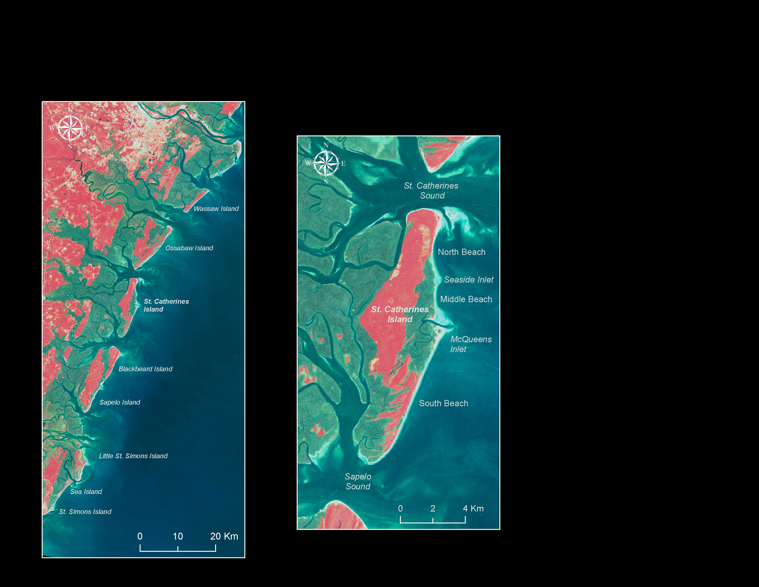

Slide 12
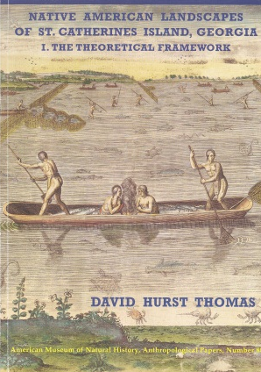
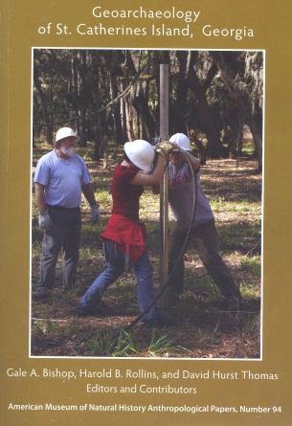
Integrated Science on SCI
Sea Turtle Conservation & Research
Biology, Geology, Hydrology & Island Evolution
The St. Catherines Island Experience
Island Ecology
& Environments
Archaeology, Anthropology, History, Human Impact

Slide 13
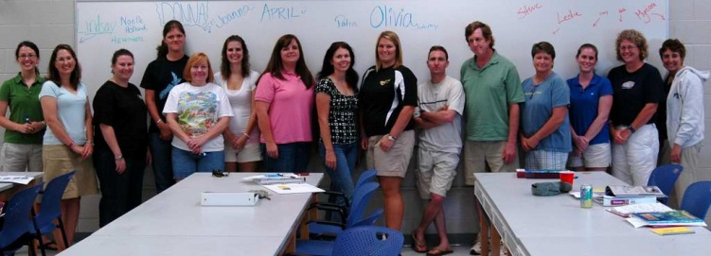
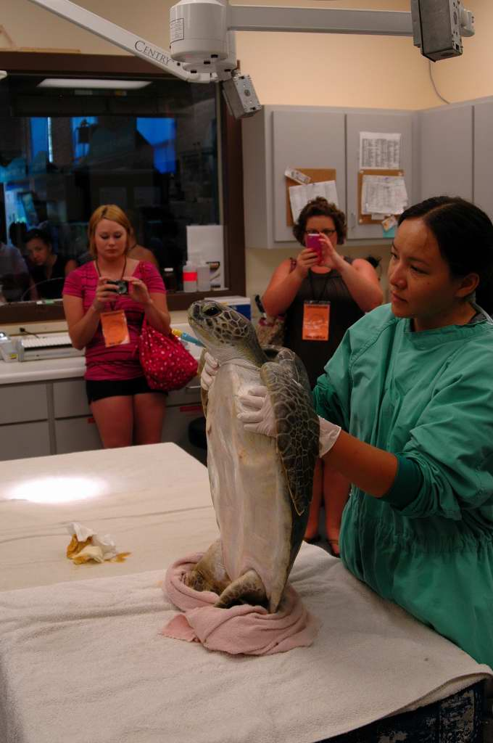
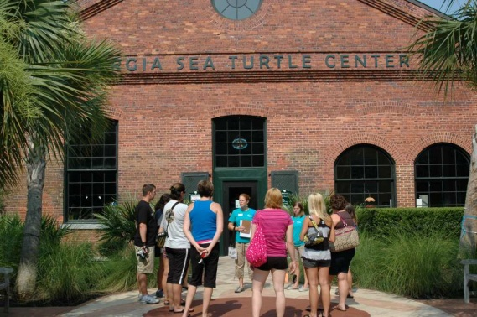
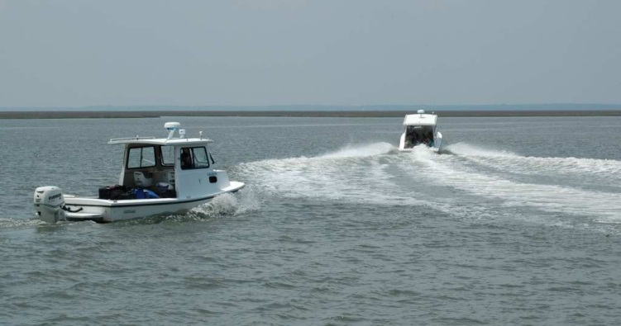
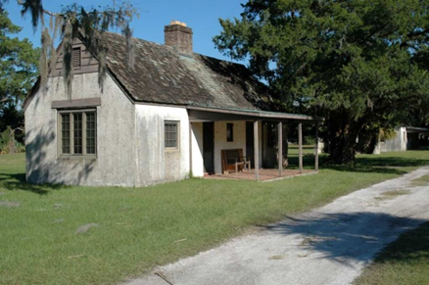
SCISTP Learning Path
May - at GSU
June - scistp.org, FB
July – GSTC tour
- boat to SCI
- move in cabins
……… hit the beach!

Slide 14
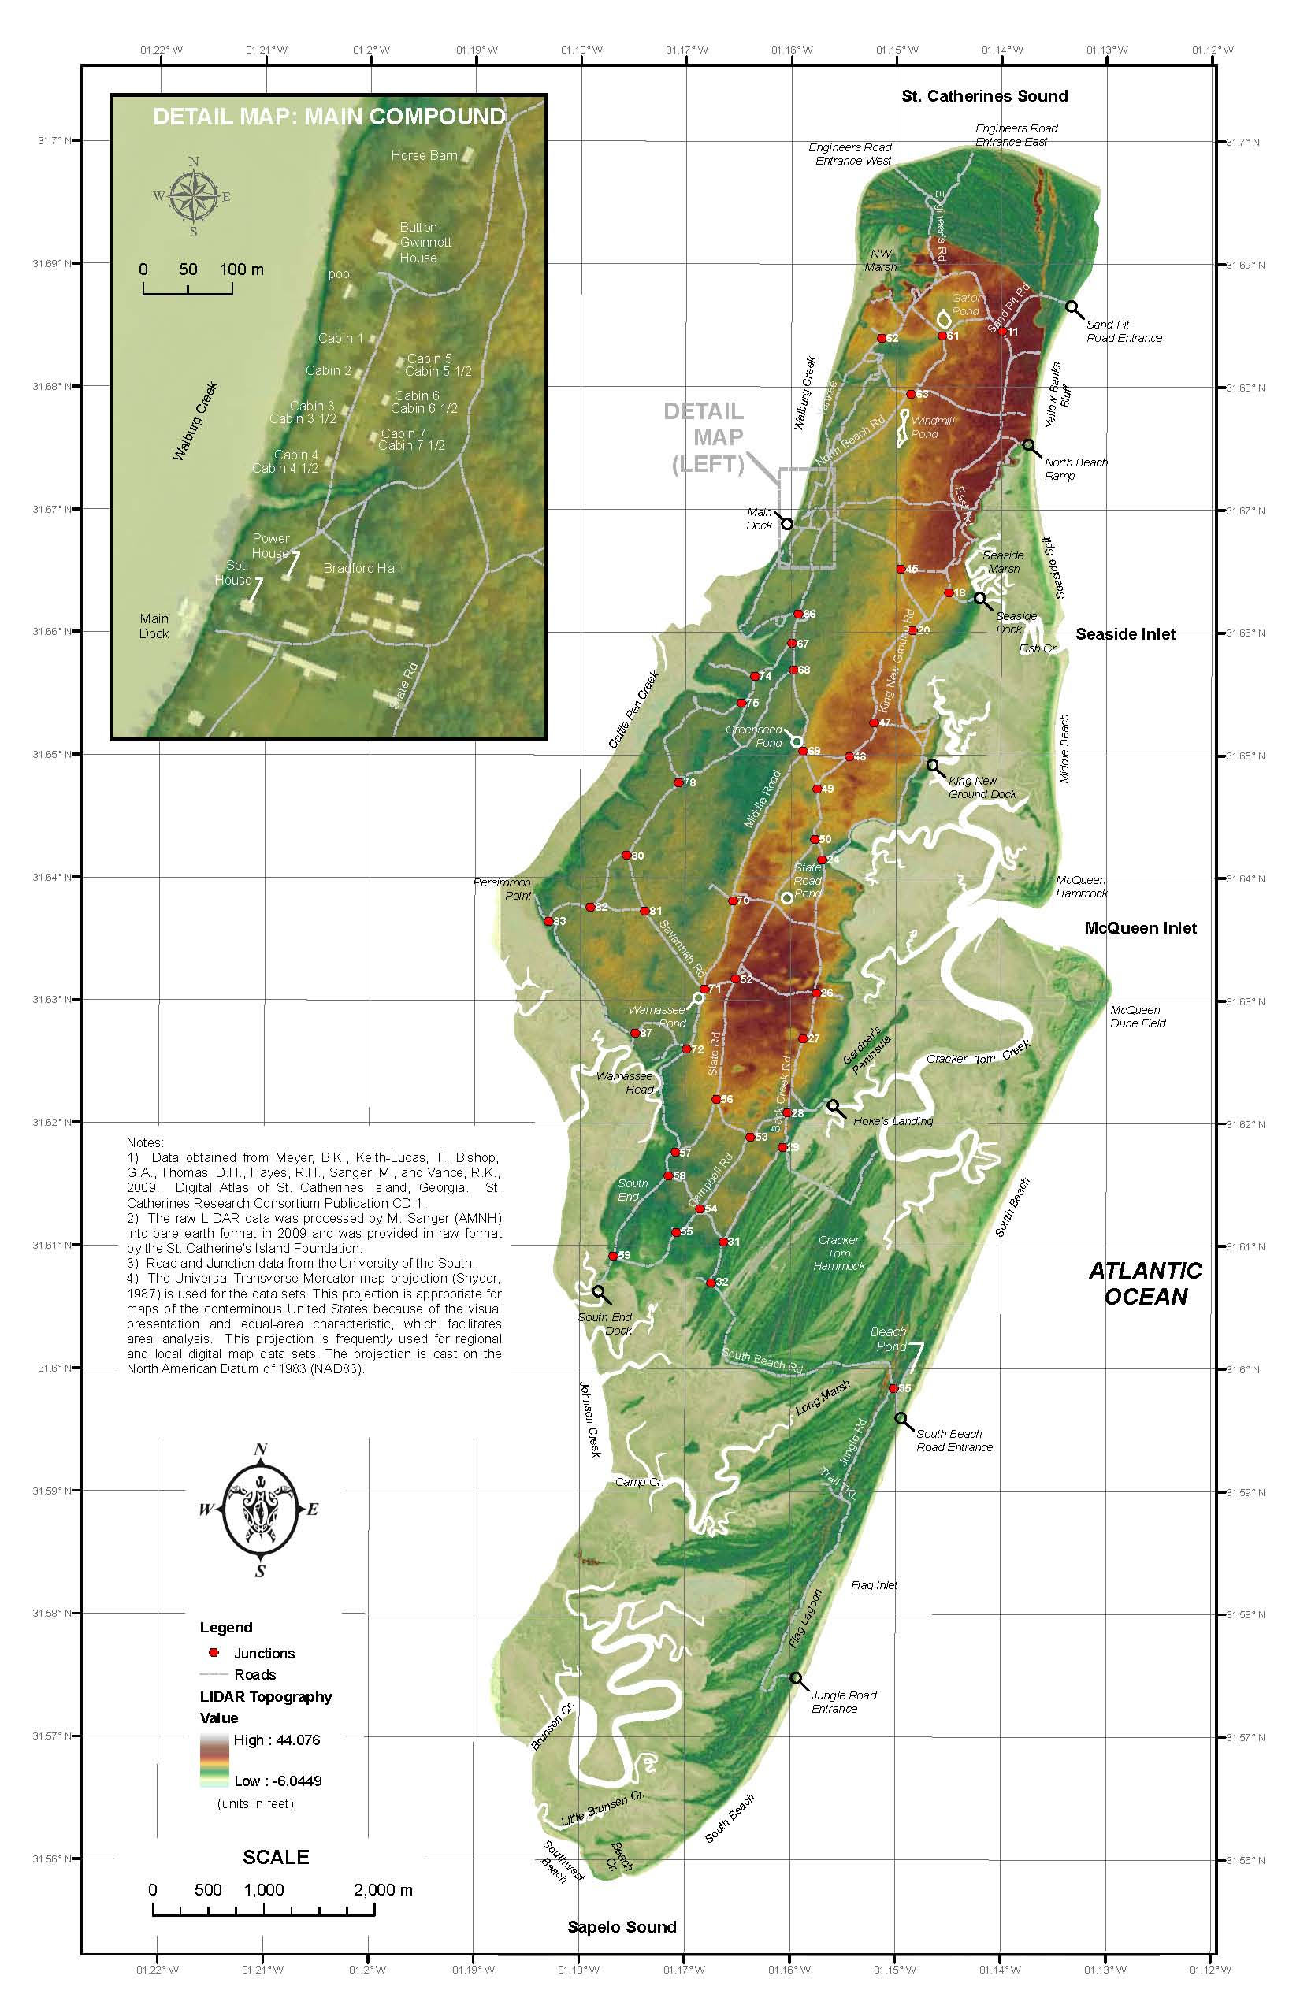
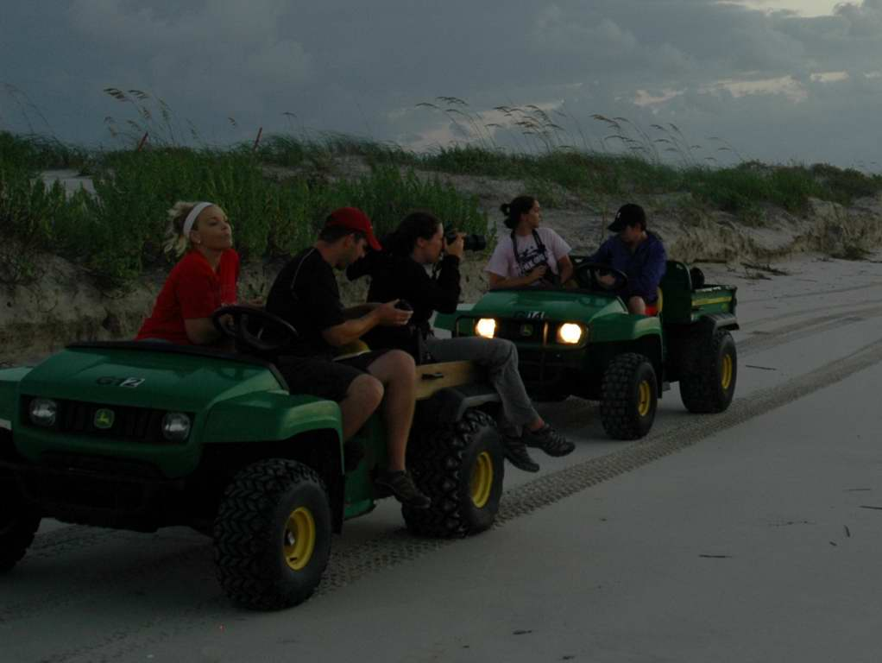
Sea turtle conservation work:
18 kms of beach to monitor each day, 3 to 4 access points
LIDAR topo base map of SCI generated by Brian Meyer (2012)

Slide 15
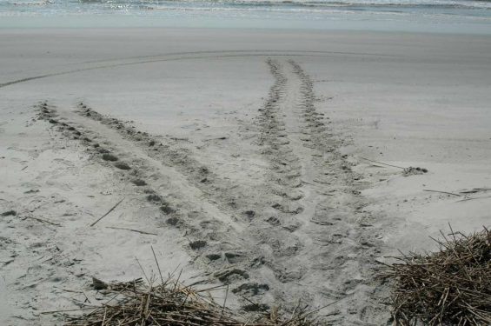
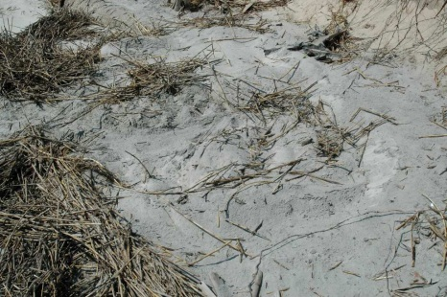
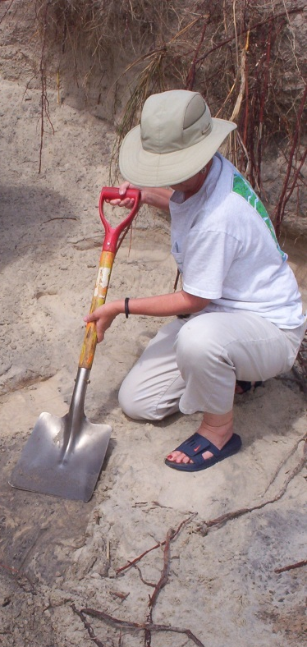
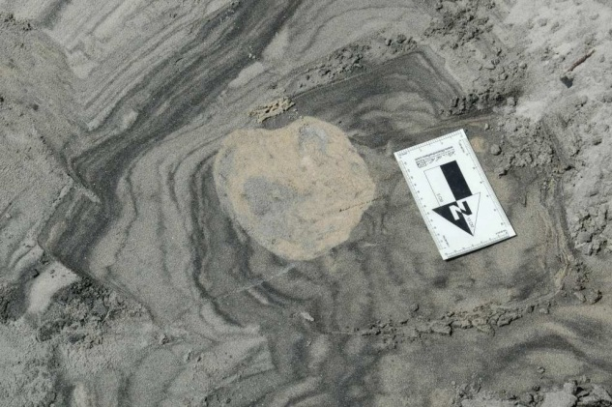
Using Fundamental Geologic Principles and the Loggerhead Ethogram to Interpret Sea Turtle Crawlways and Nests
Cross-cutting relations & superposition

Slide 16
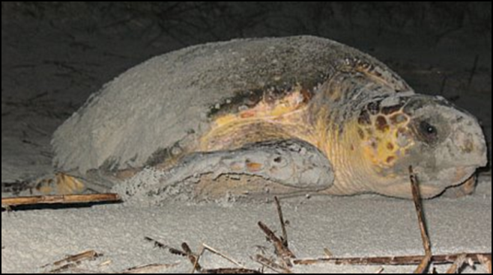
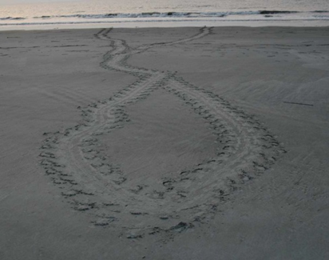
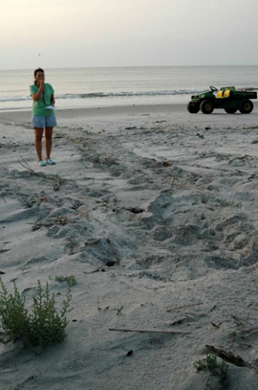
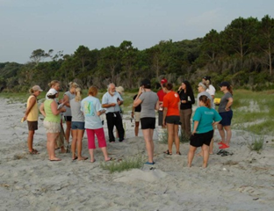
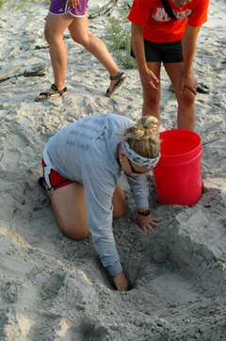
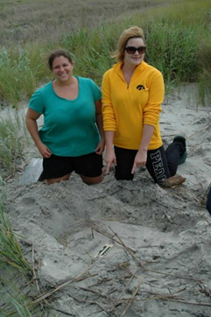
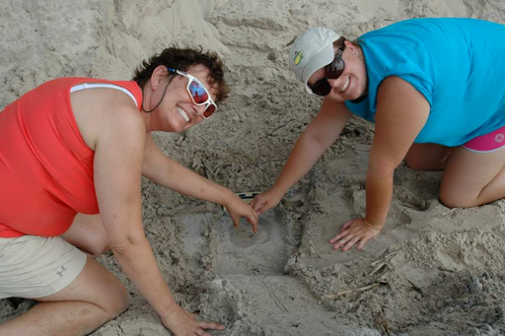
Teachers as Conservation Scientists
On the beach: From initial group demo to teacher-mentor teams

Slide 17
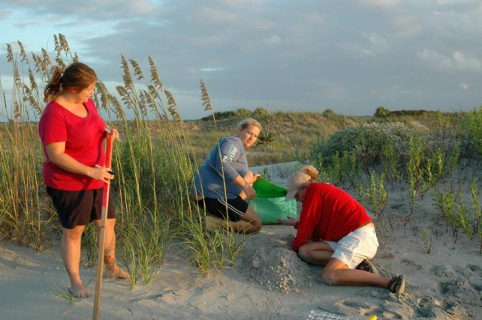
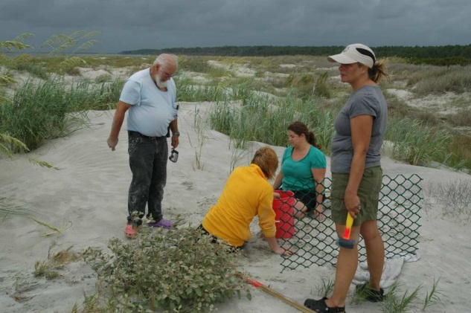
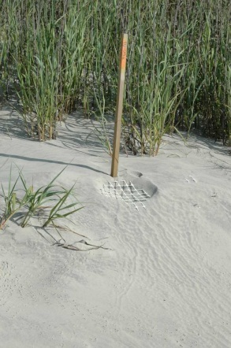
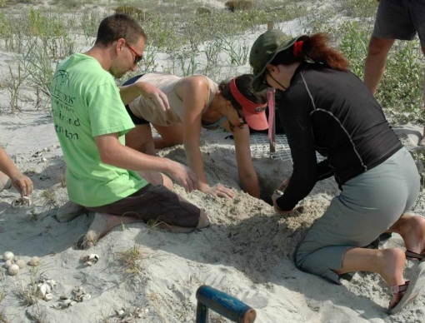
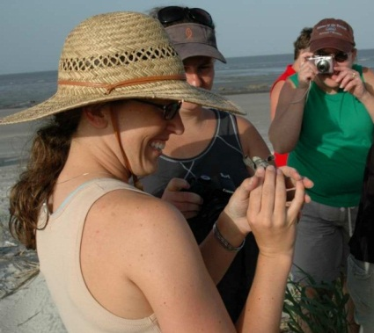
Teachers as Conservation Scientists

Slide 18
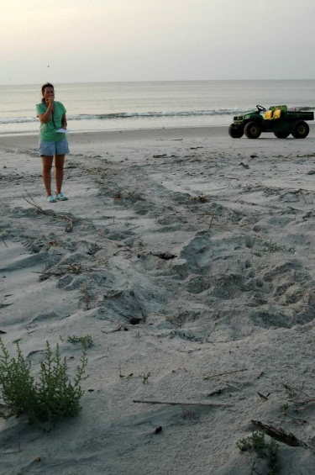
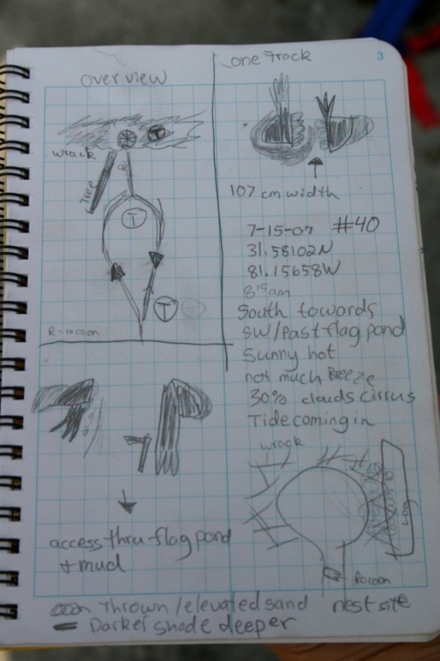
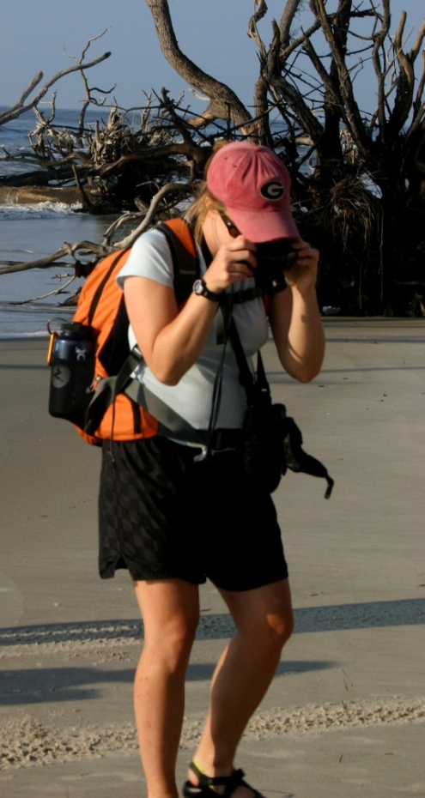
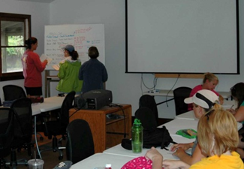
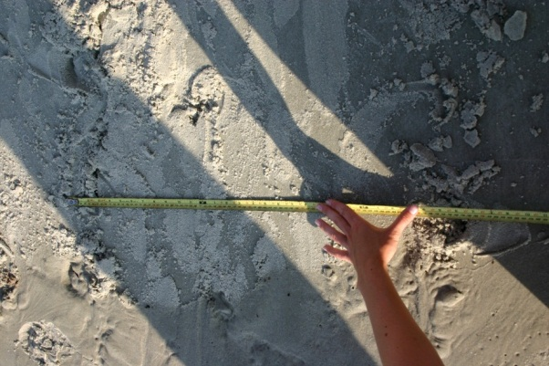
Field Science Methods
Observation
Measurement
Sketches
Digital Images
Notes
Interpretation
GPS location
Site Assessment
Decisions
Data Assessment

Slide 19
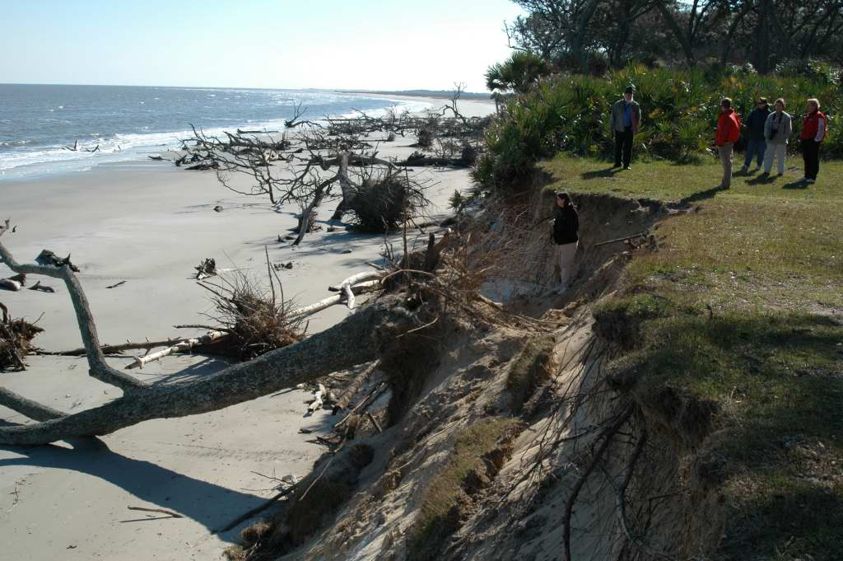
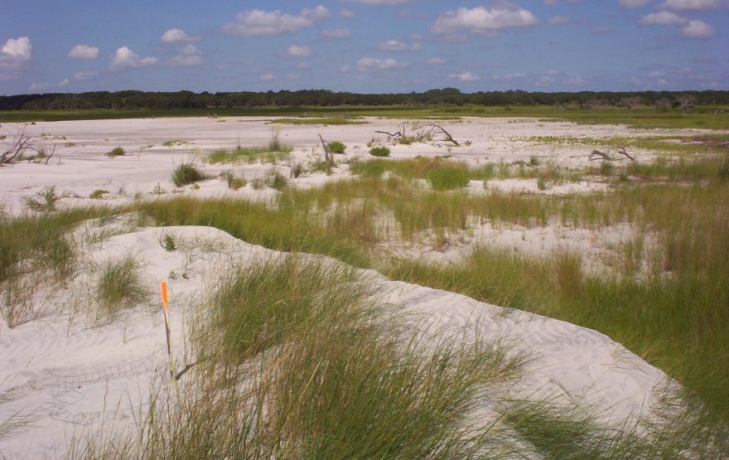
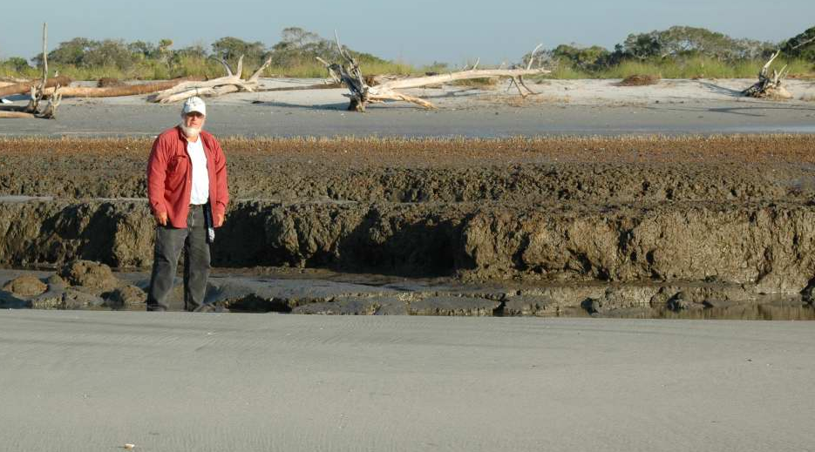
Barrier Island Geology – Erosion & Accretion
Transgression, Walther’s Law, Uniformitarianism

Slide 20
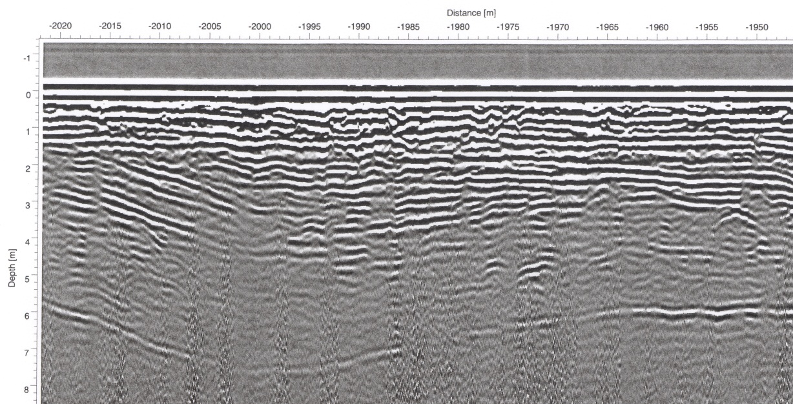
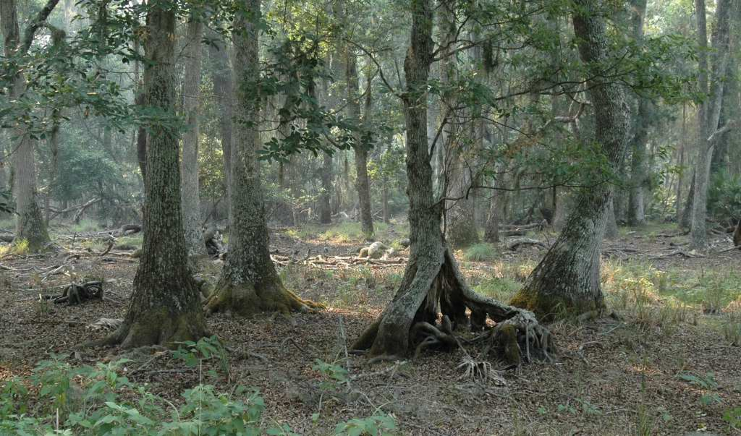
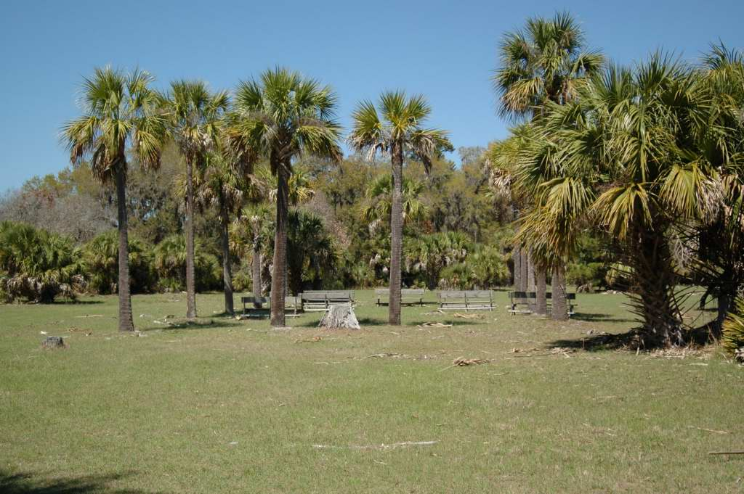
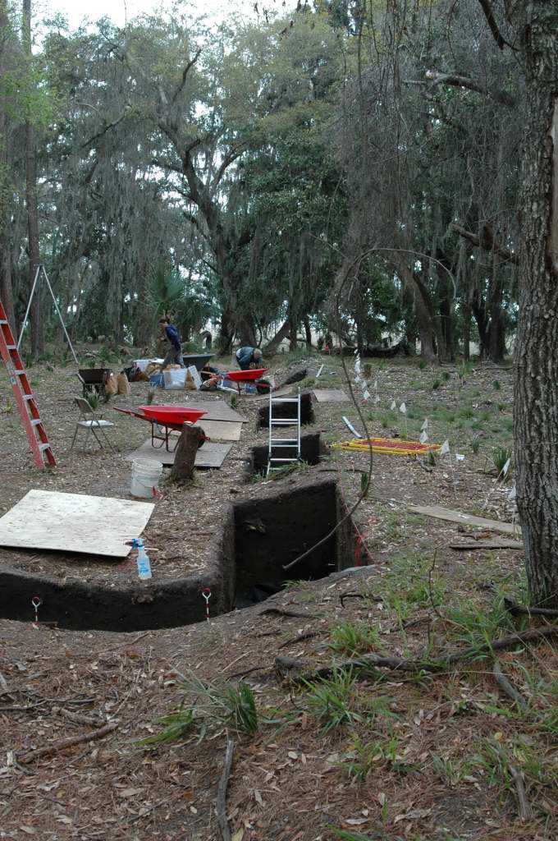

Sag Structures & Hydrology
Shell Ring
Archaeology
Anthropology
History
Mission Site
Gwinnett House

Slide 21
High Impact Pedagogy
Process-Oriented Guided Inquiry Learning
Place-Based Science Education
Maximum Impact (> 100 contact hrs)
Strong Science Content & Methodology
Participation in a Learning Community
Two-Stage Civic Engagement
  Teachers conserving sea turtles
  Teachers → students (building a conservation ethic)

Slide 22






Conservation
Research
Education
St. Catherines Island Sea Turtle Program

Slide 23


Always something new…
Warming to a new species on SCI…

