Slide 1



The Right Tool for the Job: The North Carolina Geological Survey’s Landslide Hazard Maps
Jennifer B. Bauer, L.G.
Appalachian Landslide Consultants, PLLC
Co-Authors/Former NCGS Landslide Mapping Team:
Rick Wooten, Anne Witt, Ken Gillon,
Tommy Douglas, Stephen Fuemmeler
Notes:
Acknowledge teammates. Intro – from the fall of 2005 to June of 2011, the NCGS had funding to complete county wide landslide hazard mapping. The purpose of these maps was to increase awareness of landslides and landslide hazards in WNC for public safety and emergency management purposes. The maps we created are now available tools that can be used in a variety of ways to achieve this purpose, as well as inform smart decision making, and help people save money, property, and lives.

Slide 2
The Tool
I. Develop Landslide Inventory
NCGS Landslide Mapping Program
II. Create Landslide Hazard Mapping Products
III. Map Distribution and Public Outreach
Notes:
First I’ll discuss the tool. There are three parts of the landslide mapping program

Slide 3
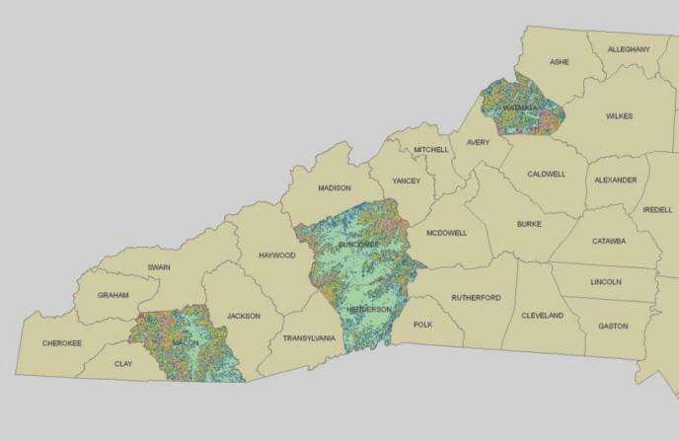
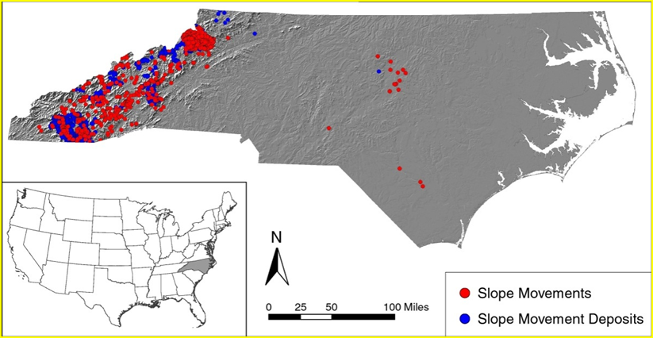
I. Landslide Inventory
Watauga
Buncombe
Macon
Aerial Photographs
LiDAR
Field Verification
Henderson
3,294
3,251
Notes:
Overall status

Slide 4
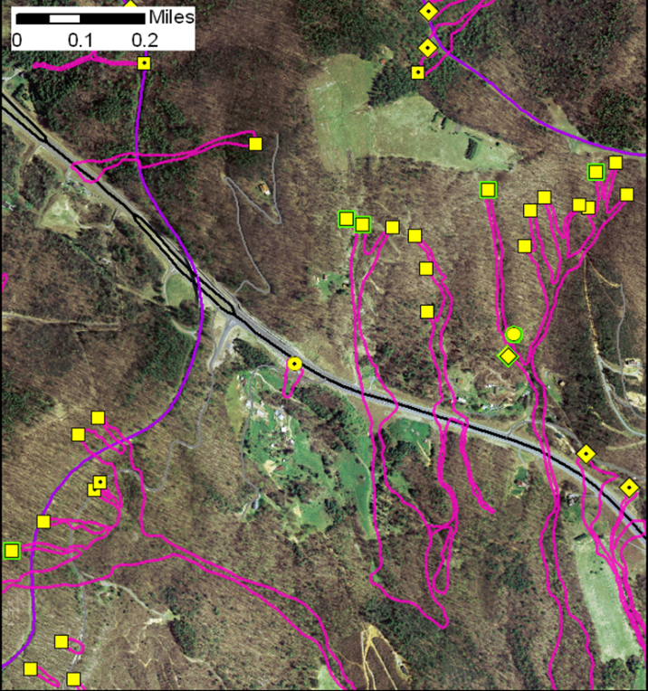
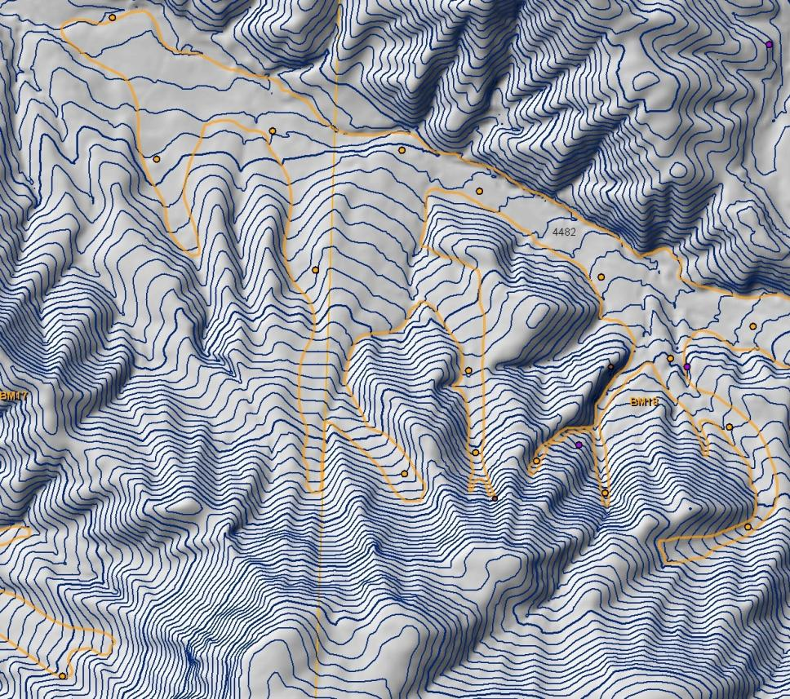
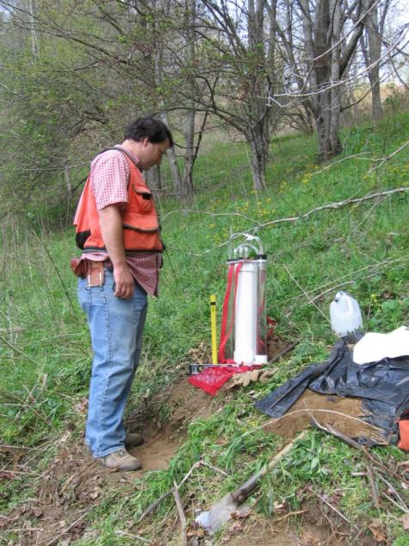
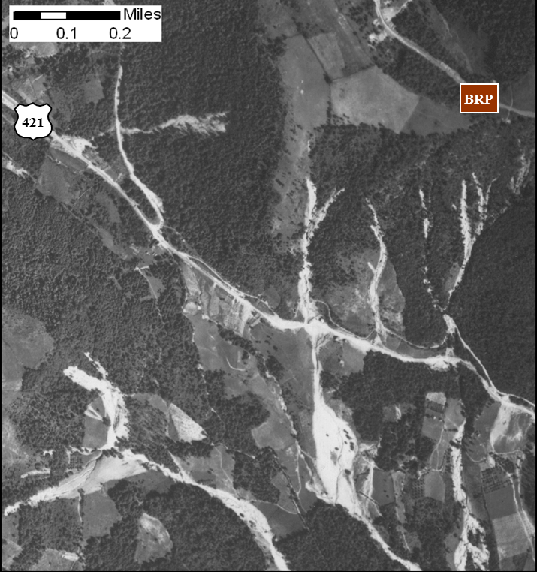
I. Landslide Inventory Remote Sensing and Field Verification
2005 orthophoto and 1940 aerial photo
LiDAR DEM
Field Work
Notes:
1940 storm story in Watauga Co. rained 1 3/4 inches per hour for 6 hours, close to 15 inches of rain as storm total, mapped close to 2100 landslides from aerial photos. We then field verified these areas collecting location data, damage and movement history, geomorphic data, rock and soil information, and hydrology. We would then come back to the office, modify and update the database and model, and repeat until we had our final maps, or reached a deadline, which ever came first.

Slide 5
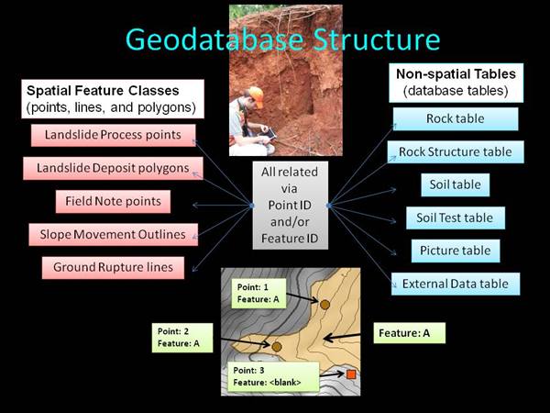
I. Landslide Inventory
Slope Movement – Slope Movement Deposit Geodatabase
Information collected includes:
Location Data
Damage/Movement History
Geomorphic Data
Rock Information
Soil data
Site Hydrology
Notes:
We then field verified these areas collecting location data, damage and movement history, geomorphic data, rock and soil information, and hydrology. We would then come back to the office, modify and update the database and model, and repeat until we had our final maps, or reached a deadline, which ever came first.

Slide 6
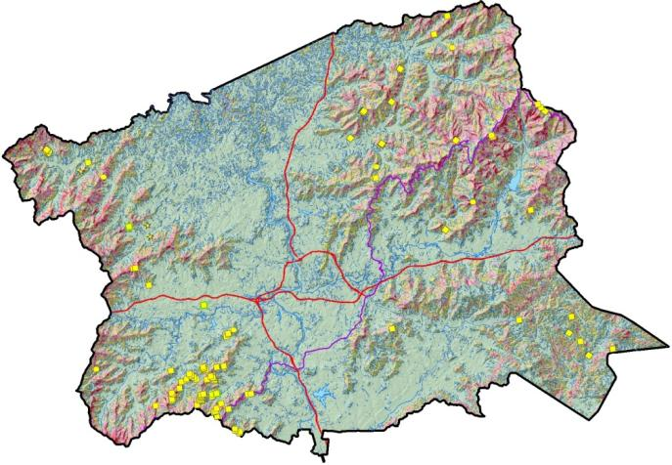
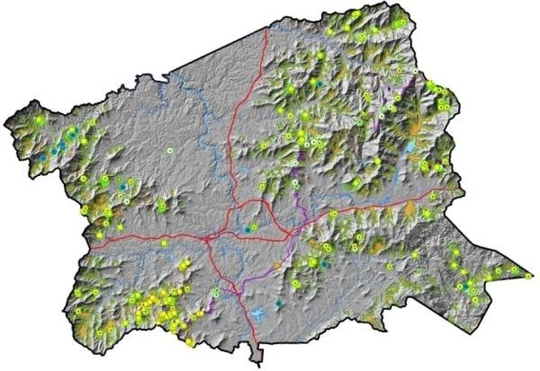
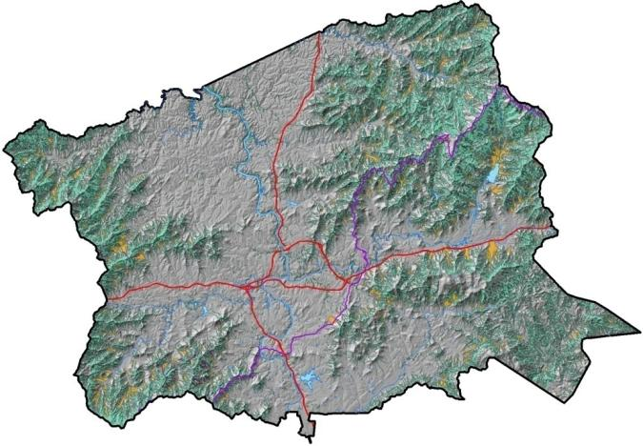
II. Landslide Hazard Mapping Products
Stability Index Map –
where landslides might start
Slope Movements - Slope Movement Deposits Map–
where landslides have occurred or are occurring.
Potential Debris Flow Pathways Map – where landslides might go

Slide 7
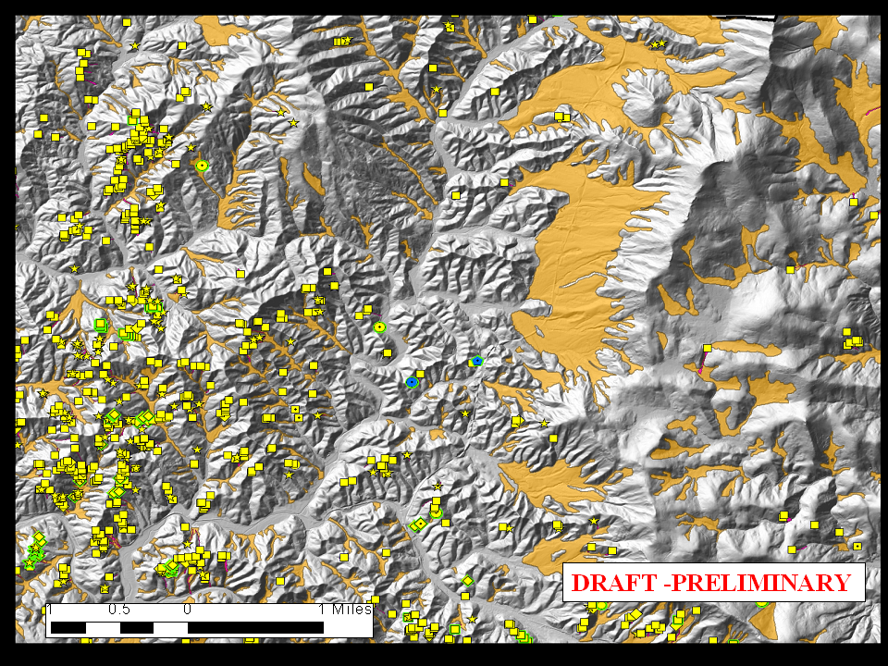
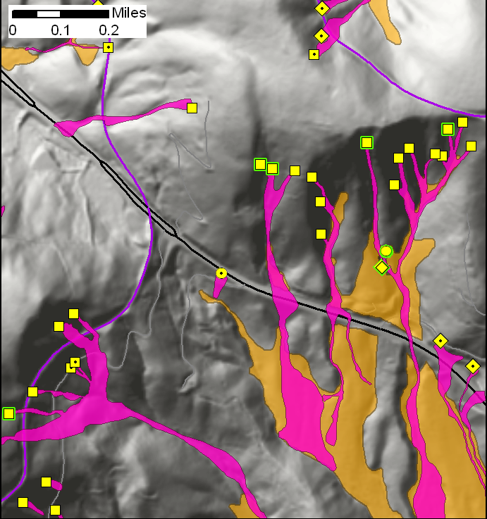
II. Landslide Hazard Mapping Products Slope Movement – Slope Movement Deposits Map
BRP
421
BRP
Slope movement outlines
Slope movement initiation zone
Slope movement deposit

Slide 8
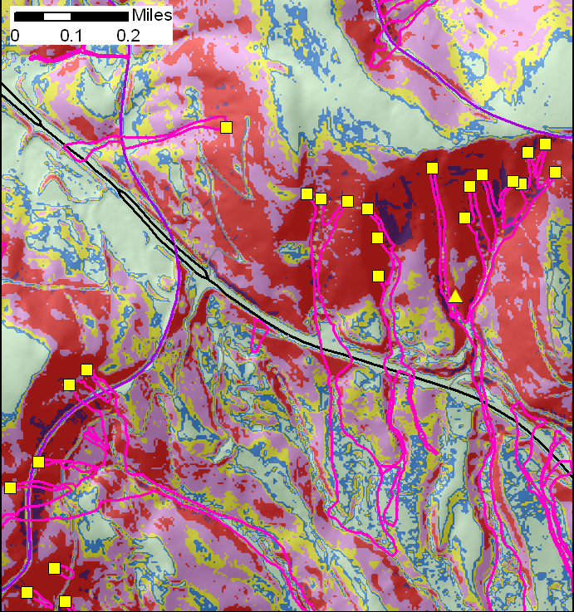
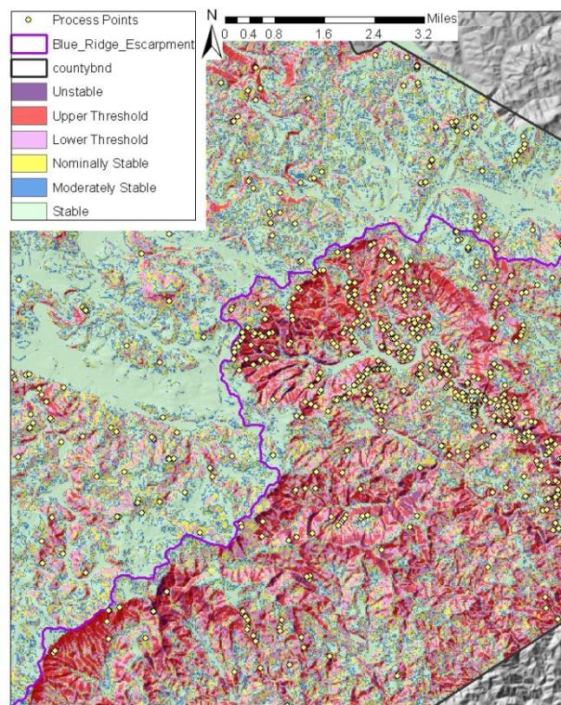
II. Landslide Hazard Mapping Products Stability Index Map (SINMAP)
BRP
421
BRP
SINMAP Program by Pack et al. 1998
Notes:
Stability Index map is computer generated model developed by Pack and others in 1998 that predicts where debris flows will start given 5 inches of rain in 24 hours. Only for shallow, translational movements on unmodified slopes.
Mapping locations where debris flows have started (initiation zones) is an important aspect of calibrating the Stability Index Map so that the predictive map adequately portrays the relative stability of an area.
Soil and hydrologic parameter values are adjusted within reasonable ranges for each region of the map so that the greatest number of debris flow initiation zones are captured within high hazard (purple and red) zones on the map.
Left: zoom in of SINMAP in Watauga County Right: Zoom out of the Stability Index Map for the same region

Slide 9
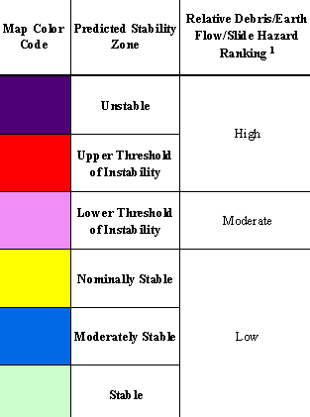
II. Landslide Hazard Mapping Products Stability Index Map (SINMAP)
BRP
421
BRP
Notes:
We then take a look at the map and determine if as many known debris flow initiation zones have been captured as possible. If not, we adjust the soil and hydrologic parameters within their reasonable range, run the model again, and re-evaluate the IZ calibration.

Slide 10
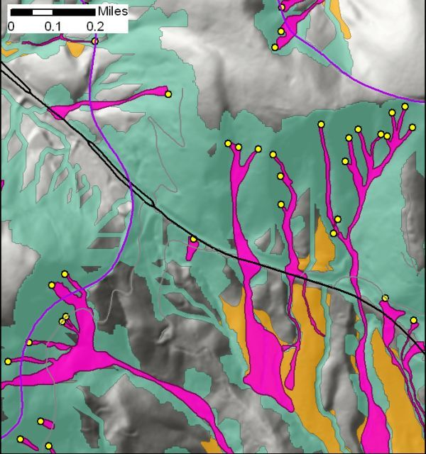
II. Landslide Hazard Mapping Products Potential Debris Flow Pathways
Increasing
Mapped debris flow pathways
Potential debris flow pathways
Past debris flow activity (deposits)
No known past or potential debris flow activity
Relative Hazard
Decreasing
Hydrologic Flow paths generated from high hazard SINMAP zones using LiDAR DEM & Streambed Mapping
Includes mapped debris flow pathways and deposits
Notes:
How the Debris Flow Pathways Map is derived from the Stability Index Map. Flow lines generated in ArcHydro from areas >0.25 acre in the high hazard zone are buffered 33 ft (10m) on either side. This value is the approximate average width of the actual mapped debris flow pathways in the geodatabase. Flow lines are terminated at the base of cut slopes, mapped water impoundments, at the 500-year flood plain, or where the stream gradients are less than 3 degrees. The pathways extend to the downslope extent of mapped deposits where they occur downslope of the 3 degree slope gradient.
Methodology
Hydrologic Flow paths generated from high hazard SINMAP zones using LiDAR DEM.
Flow paths buffered to 65 ft (20 m) wide.
Flow paths terminated:
At slopes of 3 degrees or the toe of deposits
At bases of cut slopes.
When they encounter impoundments.

Slide 11
III. Map Distribution and Public Outreach
Data delivered to Counties for use in County GIS
Online Landslide Map Viewer
Invited Presentations
Public Inquiries
Emergency Response
Notes:
County to distribute to interested landowners and to do with what they pleased.
Wanted a way to directly get information to users, since counties were not distributing it in a timely manner or were letting it sit on the shelf. Developed an online map viewer which shows the layers like we feel they are best displayed.
Invited Presentations from groups ranging from grading contractors to Realtors, to land conservation groups
All data is public record and available for public use, answered many public inquiries about the maps and slope stability issues in general.
Also responded to several landslide emergencies to assess any potential continued instability before clean-up crews came in and before people downslope were allowed back into their homes.

Slide 12
The Job
Property protection
Proper construction
Development planning and design
Structure siting
Public Safety
Notes:
Well drilling application, groundwater

Slide 13
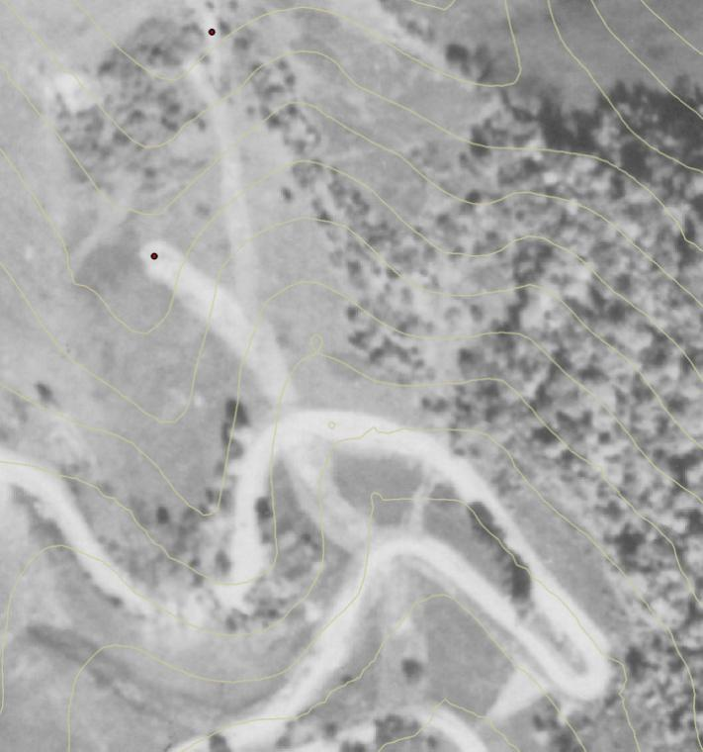
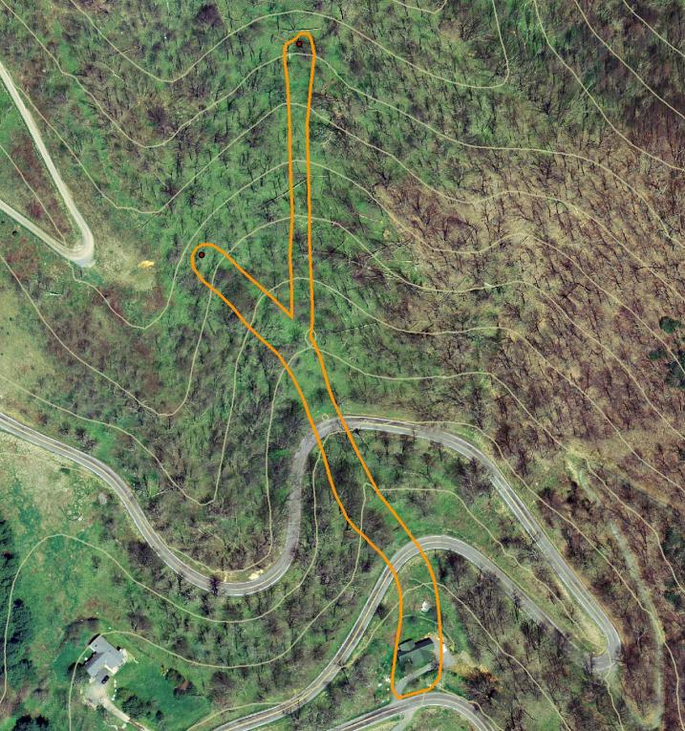
Property Protection – Known Landslide Problem Areas
1940 aerial photo
2005 orthophotograph with 1940 tracks and initiation points
Notes:
Shows importance of mapping these on older photos. House in track shown on most recent photography. These homes were offered flood insurance by the Federal Flood Insurance Program.

Slide 14
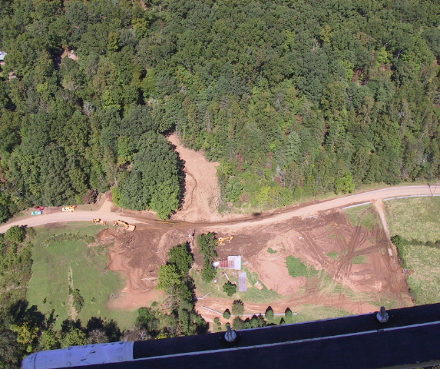
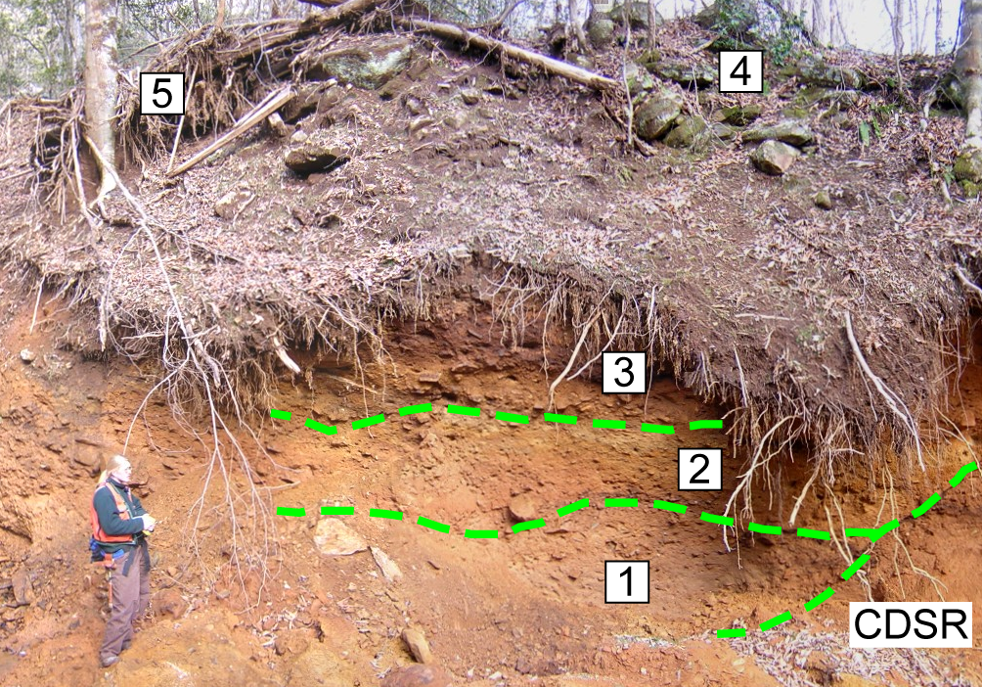
Proper Construction - Known Landslide Deposits
old fan
recent
Unconsolidated material
Groundwater seeps and springs
Notes:
Illustrates how multiple debris flows can occur in same drainage or general area. Importance of mapping deposits to show where have happened in past and may happen in future.

Slide 15
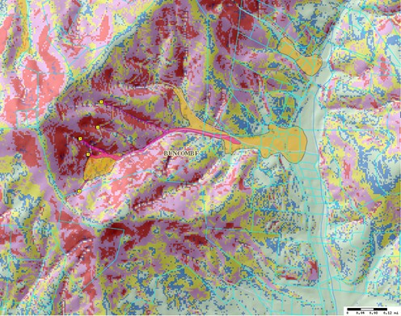
Development Planning and Design - Landslide Hazard Zones
Parcel-group scale

Slide 16
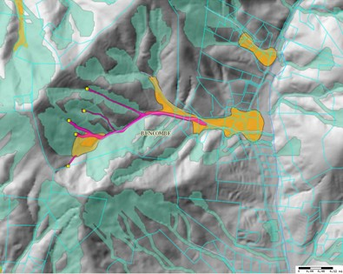
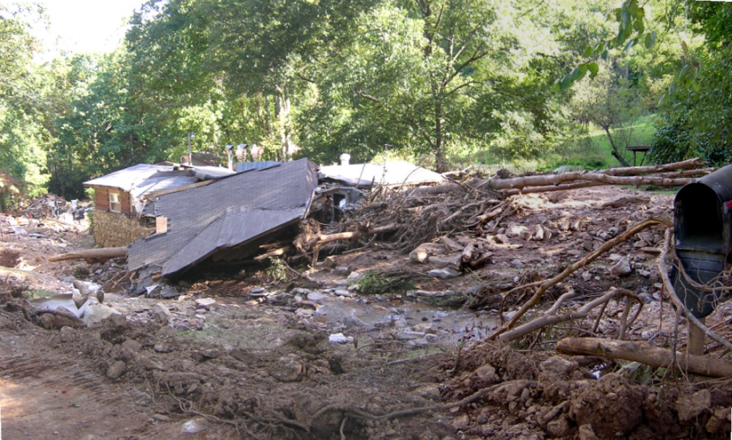
Structure Siting – Potential Debris Flow Pathways
Set backs
Starnes Cove Buncombe County Ivan Sept. 16, 2004

Slide 17
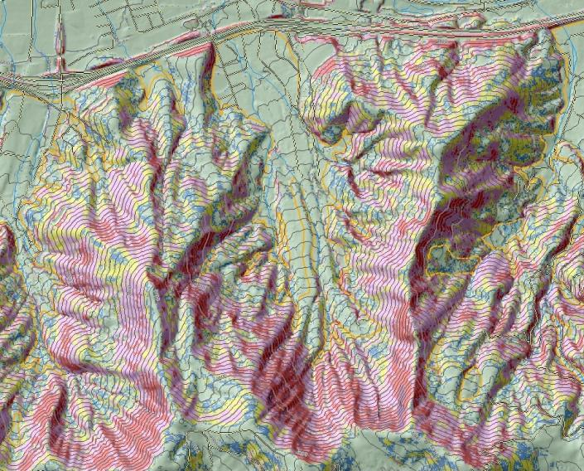
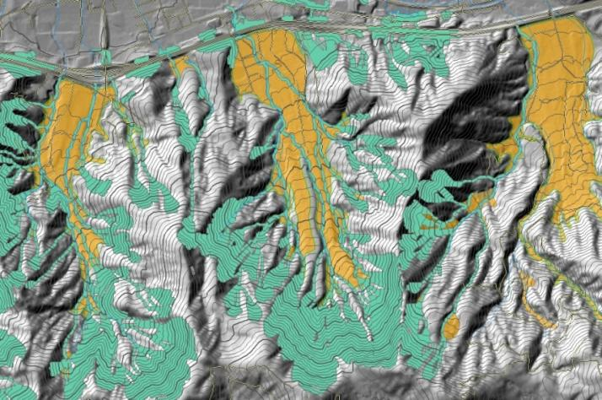
Public Safety Hazard Map Series
ID areas that need site specific evaluation
Notes:
Shows importance of mapping these on older photos. House in track shown on most recent photography. These homes were offered flood insurance by the Federal Flood Insurance Program.

Slide 18
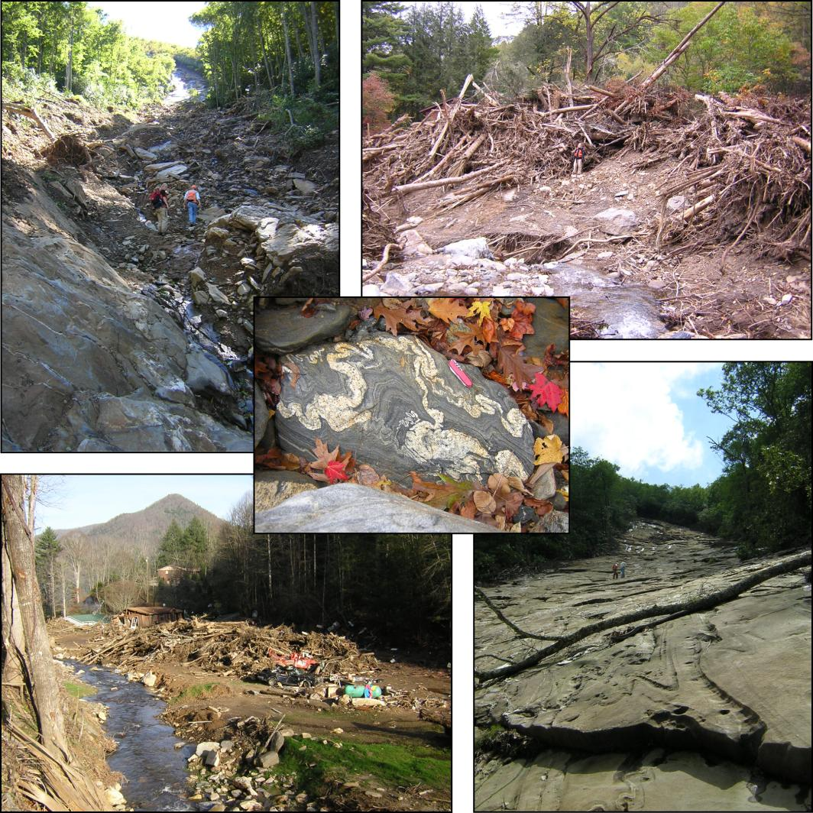
The Job
The Right Tool for the Job
Notes:
Landslides are a real hazard to western north carolina, as the citizens of the Peeks Creek community know all too well. Due to the work of the NCGS, some of these citizens now have the tools to be aware of these hazards and to plan for them before the next hurricanes come.
continuing scaled down version of the program as a private firm b/c there is a need a support in WNC. Not only landslide mapping, but outreach component, and inquiry response as well.

Slide 19
Questions?
Jennifer Bauer, L.G.
Appalachian Landslide Consultants, PLLC
jennbbauer@gmail.com
www.appalachianlandslide.com
Notes:
Landslides are a real hazard to western north carolina, as the citizens of the Peeks Creek community know all too well. Due to the work of the NCGS, some of these citizens now have the tools to be aware of these hazards and to plan for them before the next hurricanes come.
continuing scaled down version of the program as a private firm b/c there is a need a support in WNC. Not only landslide mapping, but outreach component, and inquiry response as well.

