Slide 1
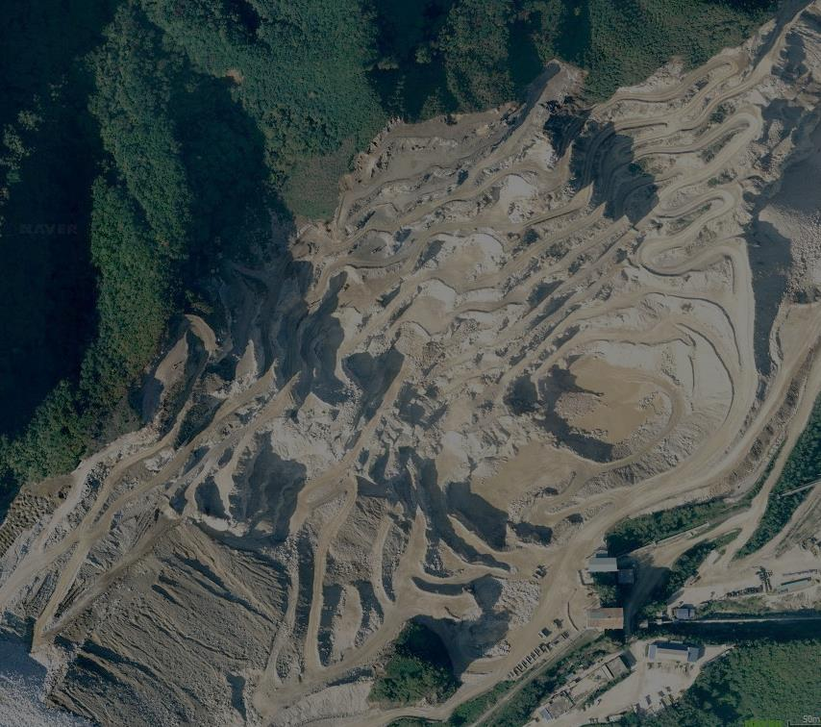

Session No. 106
T75. Landslide Inventories, Data Dissemination, & Risk Reduction
Stability Analysis of Discontinuous Rock Slopes for the LH Open Pit Limestone Mine in Korea
28 October 2013
S.K. Chung, E.S. park, Y.B. Jung,
C. Park, B.J. Lee, C. Sunwoo,
H.W. Kim, S.S. Kang, J.S. Kang

Slide 2
Outline
1
Introduction
2
Geological/Geophysical investigation
3
Numerical analysis for slope stability
4
Conclusions
1

Slide 3
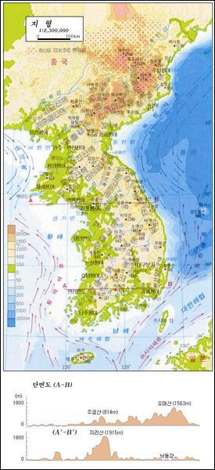
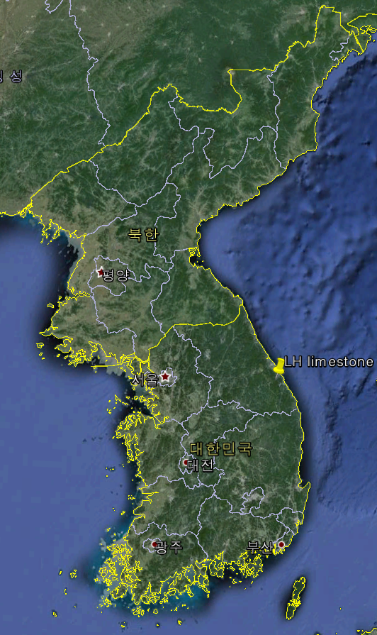
Geology of Korea & location
LH limestone
open pit mine

Slide 4
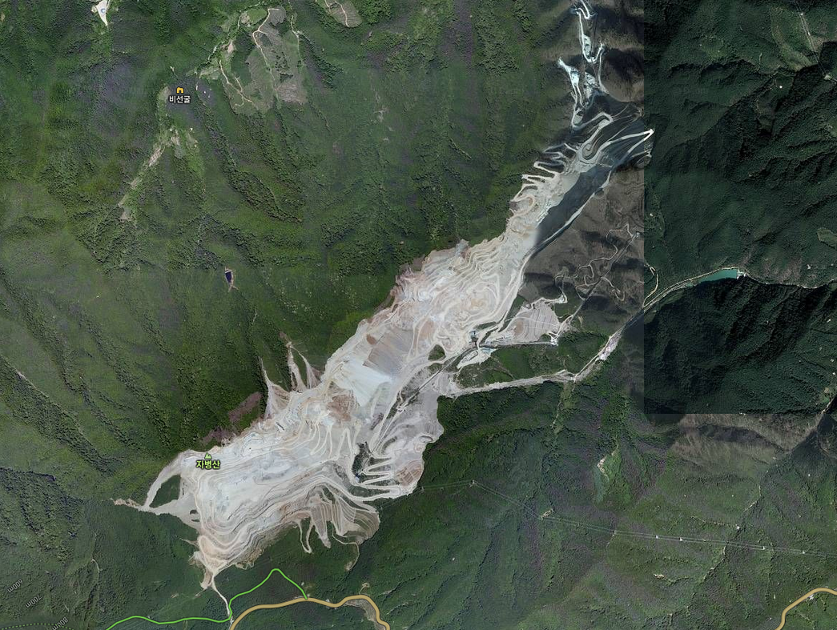
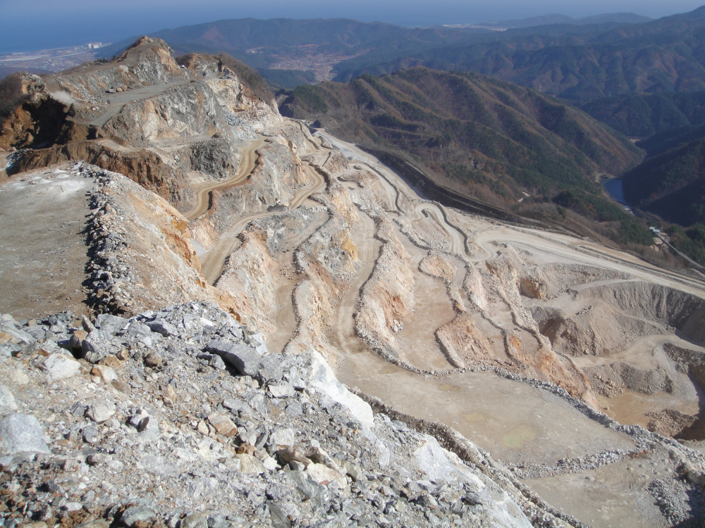
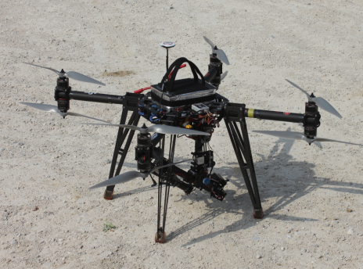
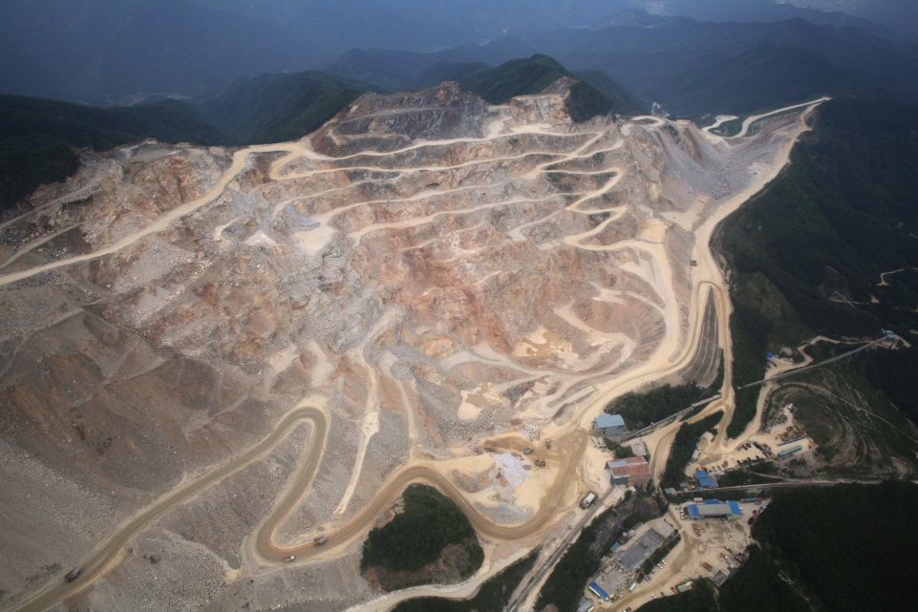
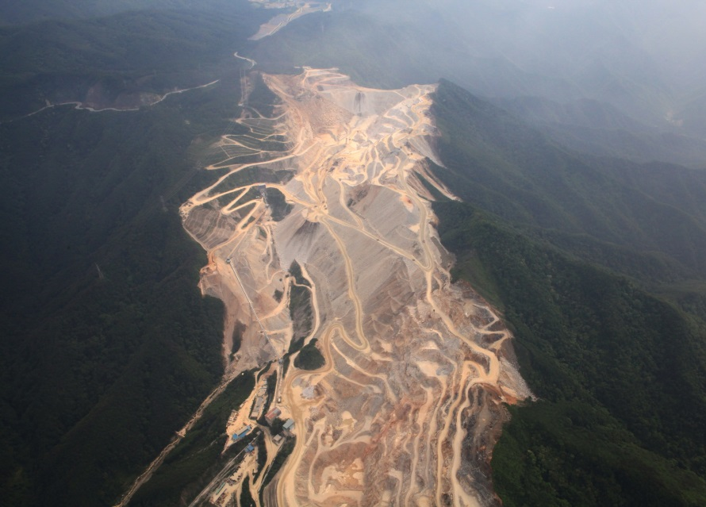
Aerial observation of LH site

Slide 5
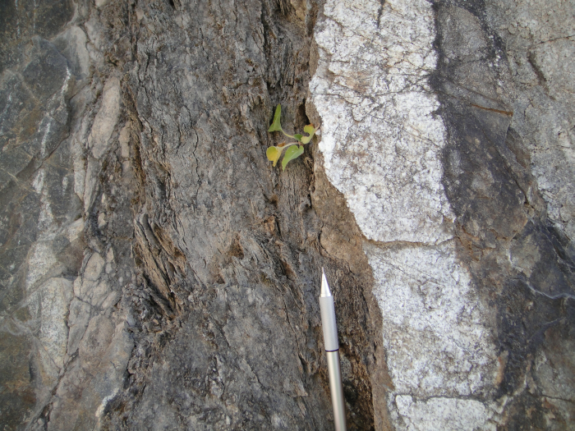
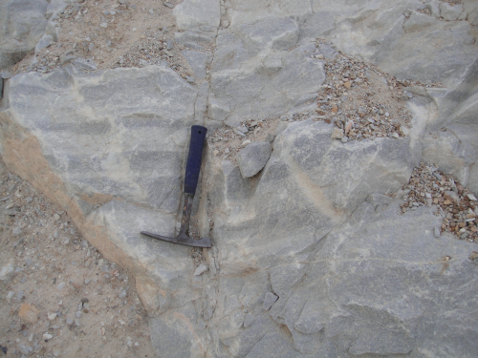
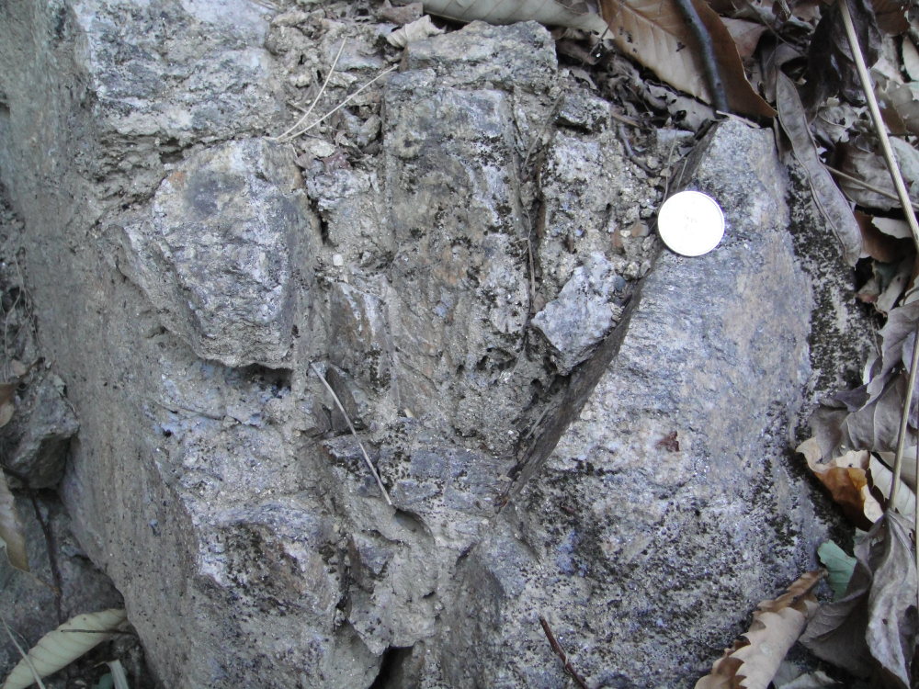
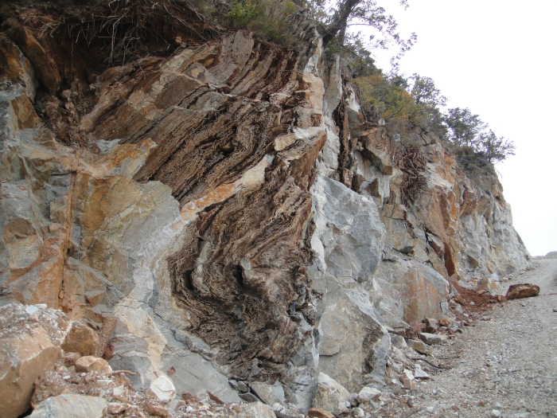
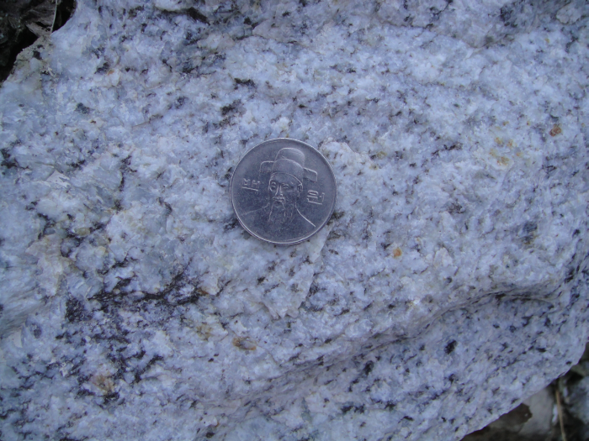
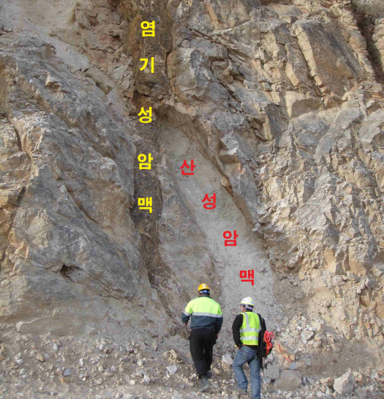
Rock types in the study area
Mica schist & sandy schist
(Myobong formation)
Carbonate rich limestone
Leucocratic granite gneiss
Worm-eaten limestone
(Hwajeol formation)
Granite
basic & acidic dyke

Slide 6
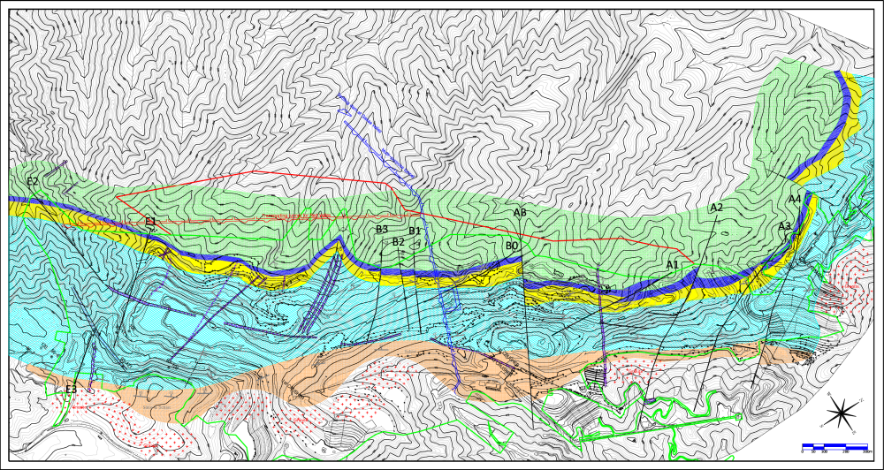
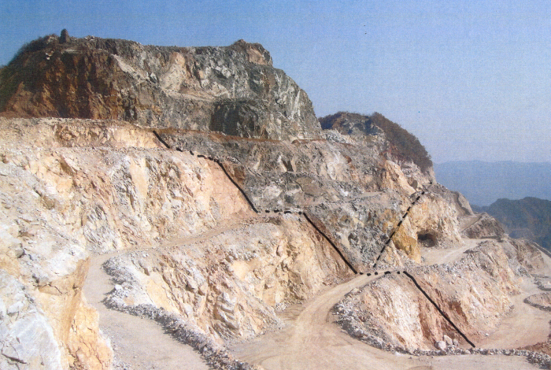
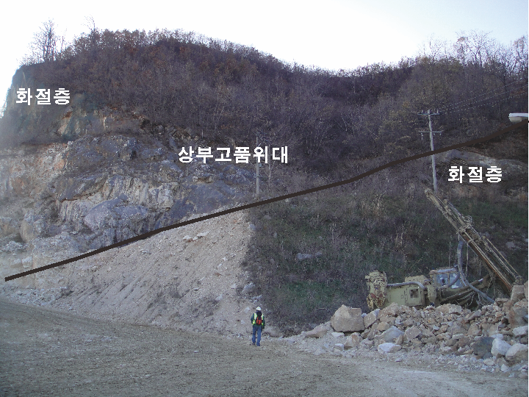
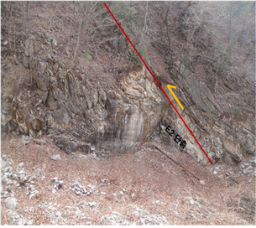
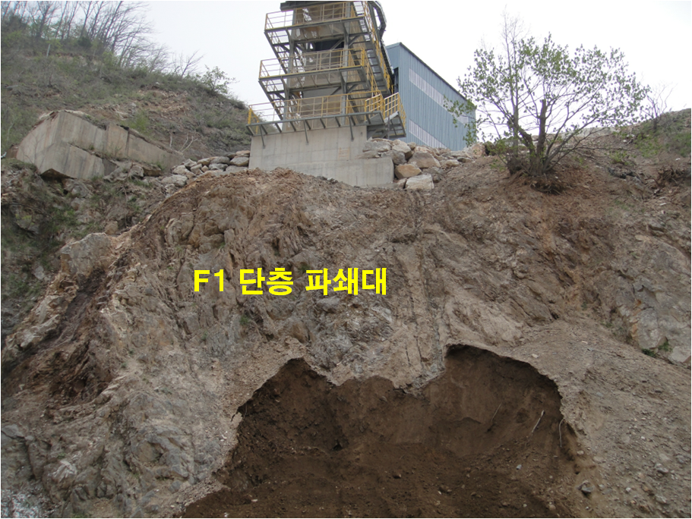
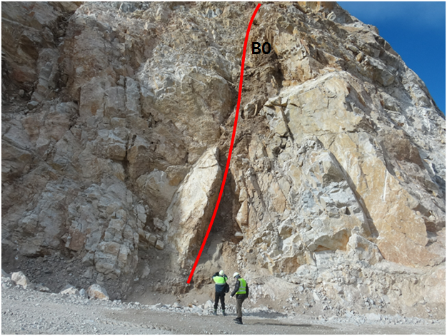
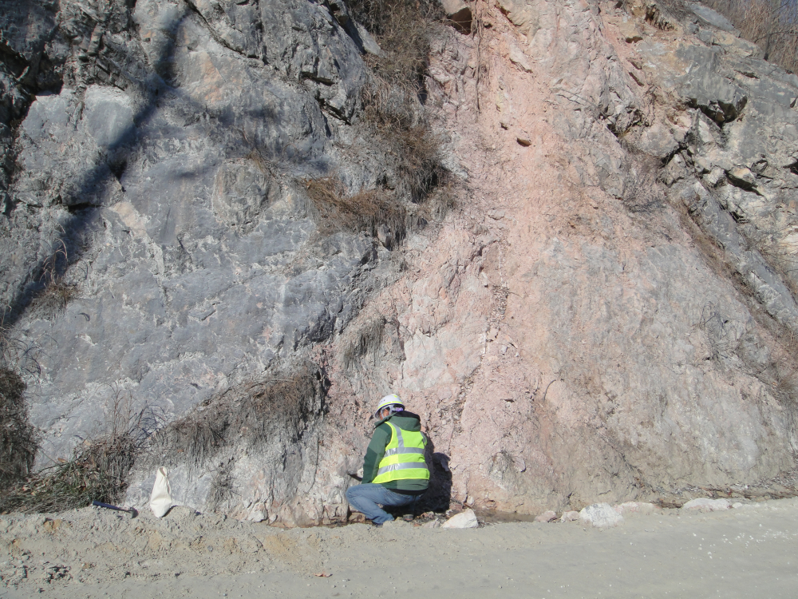
Geology of LH Open Pit Mine
Fault AB
N40W/75NE
Upper carbonate rich limestone
Dolomite
Hwajeol formation
Fault A1
N65E/80SE
Lower limestone
Schist
F1
granite/gneiss
Fault E2
N20E/70SE
Fault F1
N20E/70SE
Fault B0
N20E/70SE
Fault A4
N35W/70NE

Slide 7
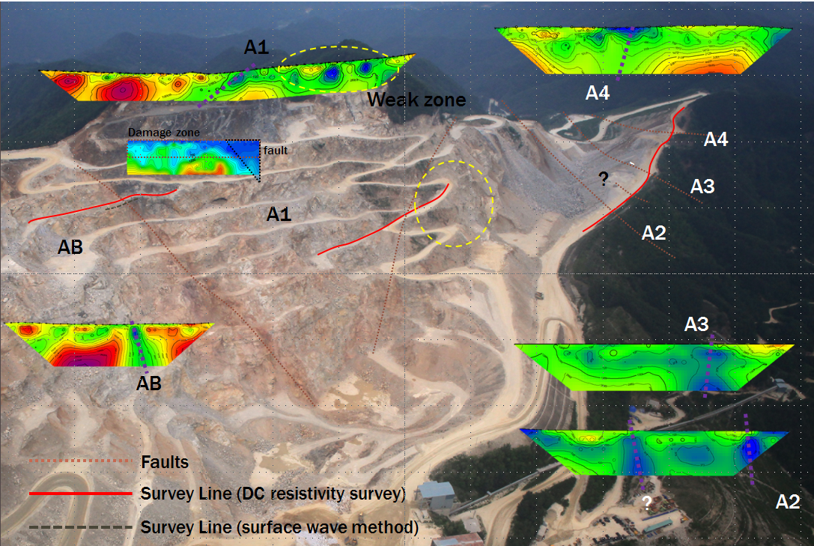
Result of geophysical survey on faults
Notes:
The results of geophysical surveys are displayed on the aerial photograph of project area. Five DC resistivity survey lines were designed across the five major faults to investigate exact locations and shapes of the faults found from geological ground survey and weak zones around. One surface wave method survey line was designed across the AB fault to estimate in-site elastic modulus of fault zone.
Low resistivity structures in the results of DC resistivity survey which are continued from surface to the underground can be considered fault structure underground. Those structures are exactly coincident with real location of faults AB and A1 which are exposed due to excavation. Faults A2-A4 can be located on the road to the mine office from the DC restivity survey results of Zones A2-A4. Especially eastern part of Zone A1 shows low resistivity to the depth of around 20m. Which is considered it’s from dikes, severe weathering and joints and it could be checked in-situ exploration and aerial photos.
Surface wave method provided shear wave velocity map around fault AB. Shallow subsurface to the depth of 5m shows low velocity due to blasting disturbance and weathering. Fault zone also show 1/3-1/2 low velocity compared with the sound rock zone.

Slide 8
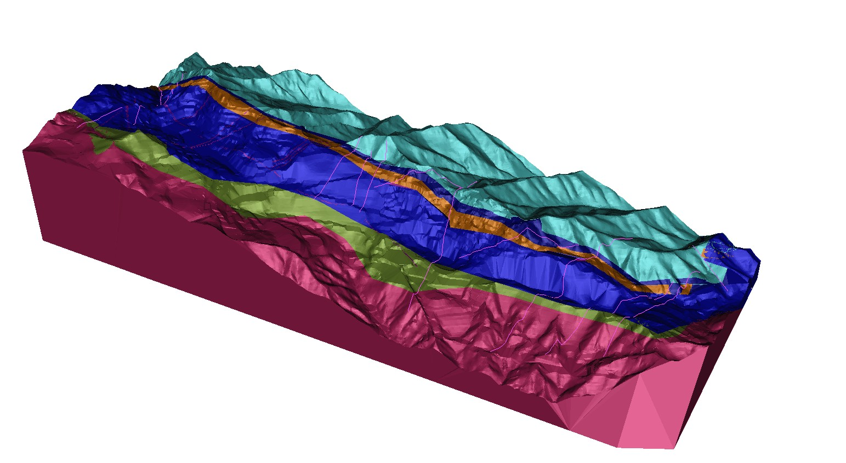
3-D Geological modeling
Granite
Myobong formation
Lower limestone
Middle dolomite
Upper carbonate rich limestone
Hwajeol formation
Fault & Dyke

Slide 9
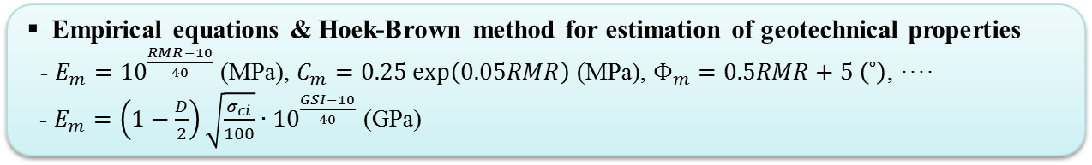
Estimation of geotechnical properties
Mechanical laboratory tests
- Uniaxial & tri-axial compressive
strength test
- Indirect tensile strength test, etc.
Rock mass classification
- RMR (rock mass rating)
- GSI (geological strength index)
Empirical equations & Hoek-Brown method for estimation of geotechnical properties
- $E_{m}={10}^{\frac{RMR−10}{40}}$ (MPa), $C_{m}=0.25\exp\left(0.05RMR\right)$ (MPa), $Φ_{m}=0.5RMR+5 \left(˚\right)$, ····
- $E_{m}=\left(1−\frac{D}{2}\right)\sqrt{\frac{σ_{ci}}{100}}∙{10}^{\frac{GSI−10}{40}}$ (GPa)
Rock type | Deformation Modulus (MPa) | Poisson’s ratio | Cohesion (MPa) | Friction angle (˚) | Tensile strength (MPa) | Density (kgf/m³)
Limestone | 28,000 | 0.22 | 3.70 | 43 | 0.9 | 2,700
Dolomite | 33,000 | 0.22 | 4.30 | 44 | 2.4 | 2,850
Granite | 28,000 | 0.21 | 4.40 | 47 | 0.4 | 2,630
Schist | 15,000 | 0.19 | 1.95 | 42 | 0.7 | 2,800
Hwajeol formation | 28,000 | 0.22 | 3.70 | 43 | 0.9 | 2,700
Fault | 9,000 | 0.22 | 1.20 | 30 | 0 | 2,700

Slide 10
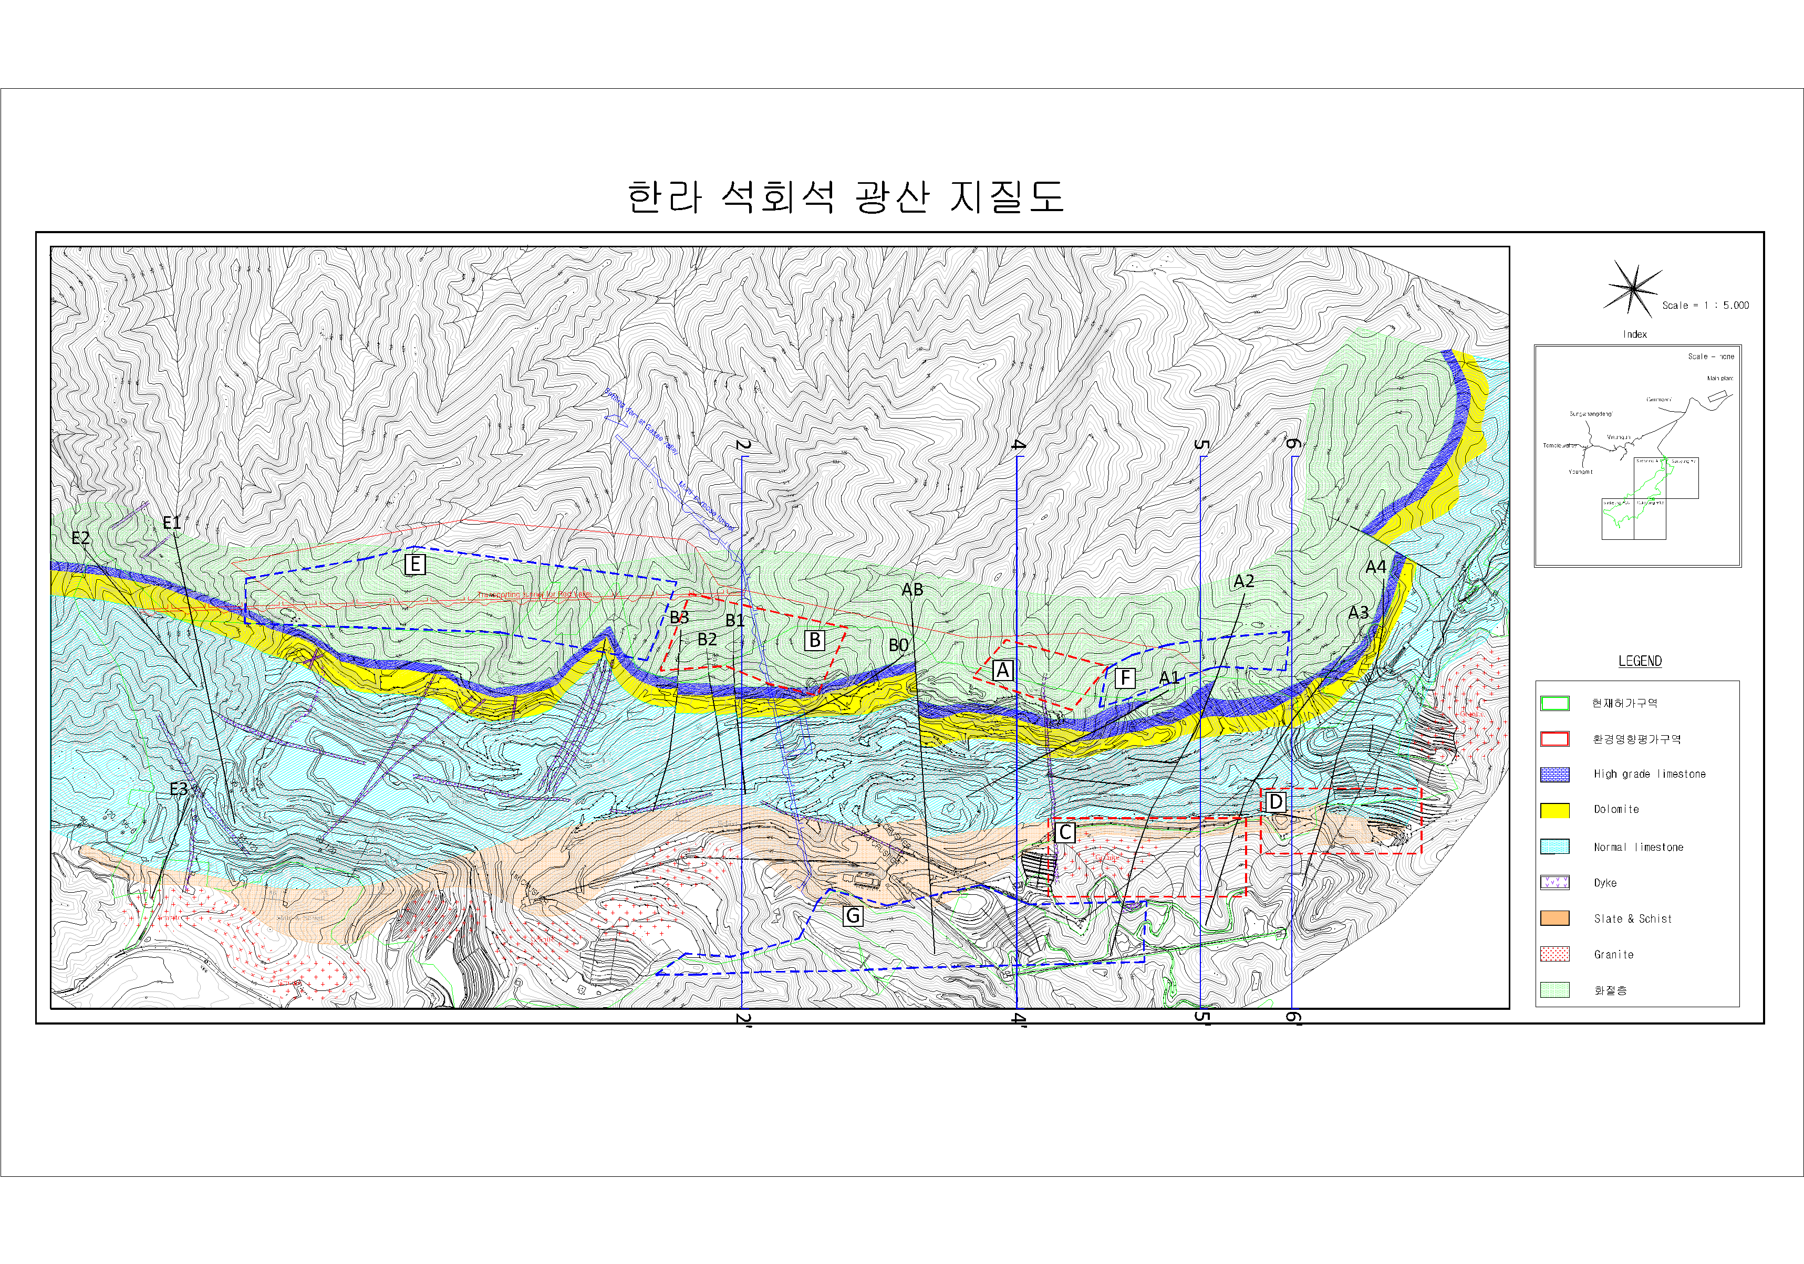
Selected sections for 2-D analysis
Analysis type: LEM(Limit Equilibrium Analysis) + SSR(Shear Strength Reduction Method)
1
2
3
4
5
6
확률론적 사면 안정성 평가 결과 (Section A)
1’
2’
3’
4’
5’
6’
Location of 2-D section (zone A:4-4’, B:2-2’, C:5-5’ & D:6-6’, E:1-1’, F:5-5’, G:3-3’)

Slide 11
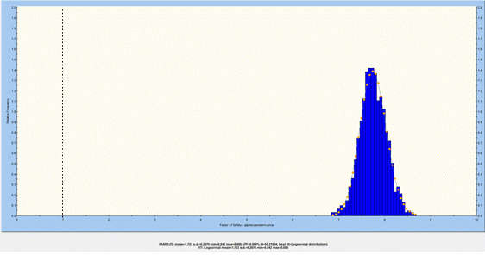
Result of analysis for Zone A
SF = 7.73
SF = 7.52
SF = 7.67
PoF = 0.00%
Reliability index = 23.48
2-D model boundary
Criteria
SF > 1.5
PoF < 0.1%
Reliability index > 3
Zone A: 4-4’
Stable

Slide 12
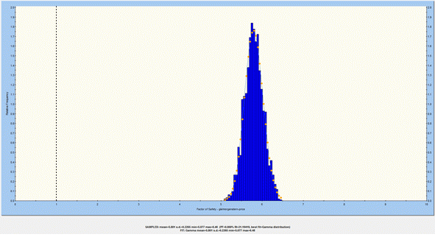
Result of analysis for Zone B
Boundary
of mine
광산영향평가경계
광산영향평가경계
SF = 6.62
SF = 5.79
2-D model boundary
SF = 5.35
PoF = 0.00%
Reliability index = 21.19
Criteria
SF > 1.5
PoF < 0.1%
Reliability index > 3
Zone B: 2-2’
Stable

Slide 13
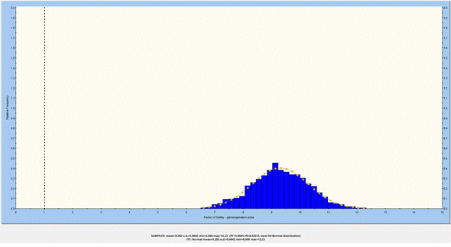
Result of analysis for Zone C
도로
SF = 9.30
PoF = 0.00%
Reliability index = 8.43
SF = 9.38
도로
Criteria
SF > 1.5
PoF < 0.1%
Reliability index > 3
Zone C: 5-5’
Stable

Slide 14
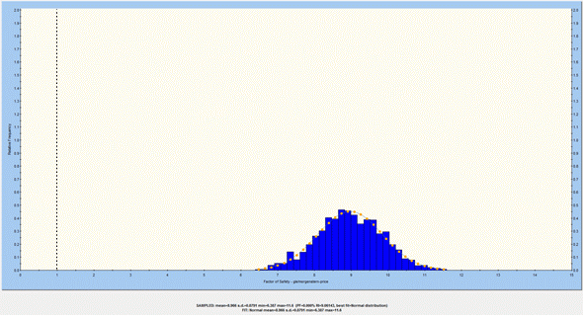
Result of analysis for Zone D
도로
SF = 8.97
PoF = 0.00%
Reliability index = 9.06
SF = 8.77
도로
Criteria
SF > 1.5
PoF < 0.1%
Reliability index > 3
Zone D: 6-6’
Stable

Slide 15
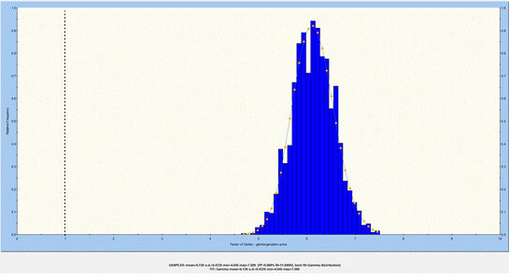
Result of analysis for Zone E
Boundary
of mine
Boundary
of mine
SF = 8.68
SF = 6.13
SF = 6.13
PoF = 0.00%
Reliability index = 11.85
Boundary
of mine
광산영향평가경계
Criteria
SF > 1.5
PoF < 0.1%
Reliability index > 3
Zone E: 1-1’
Stable

Slide 16
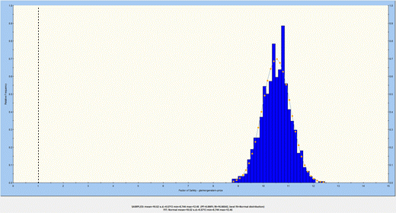
Result of analysis for Zone F
Boundary
of mine
Boundary
of mine
SF = 8.81
SF = 10.26
Boundary
of mine
SF = 9.02
PoF = 0.00%
Reliability index = 16.67
Criteria
SF > 1.5
PoF < 0.1%
Reliability index > 3
Zone F: 5-5’
Stable

Slide 17
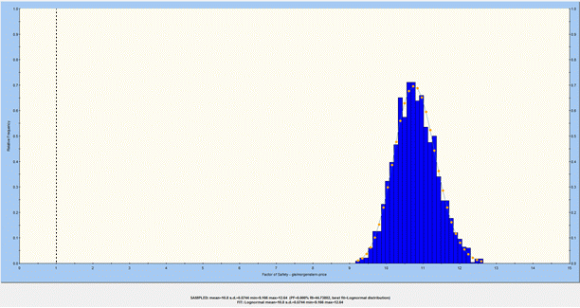
Result of analysis for Zone G
Boundary
of mine
Boundary
of mine
SF = 20.86
SF = 10.78
Boundary
of mine
PoF = 0.00%
Reliability index = 17.06
SF = 10.52
Criteria
SF > 1.5
PoF < 0.1%
Reliability index > 3
Zone G: 3-3’
Stable

Slide 18
Summary of stability analyses
Zone | LEM (Slide) |  |  |  | SSR (Phase) | Criteria | Stability
 | SF_L | SF_R | PoF | Reliability index, β | SF
A | 7.52 | 7.73 | 0.000% | 23.48 | 7.67 | SF > 1.5, β > 3, PoF < 0.1% | Stable
B | 6.62 | 5.79 | 0.000% | 21.19 | 5.35 |  | Stable
C | - | 9.30 | 0.000% | 8.43 | 9.38 |  | Stable
D | - | 8.97 | 0.000% | 9.06 | 8.77 |  | Stable
E | 8.68 | 6.13 | 0.000% | 11.85 | 6.13 |  | Stable
F | 8.81 | 10.26 | 0.000% | 16.67 | 9.02 |  | Stable
G | 20.86 | 10.78 | 0.000% | 17.06 | 10.52 |  | Stable

Slide 19
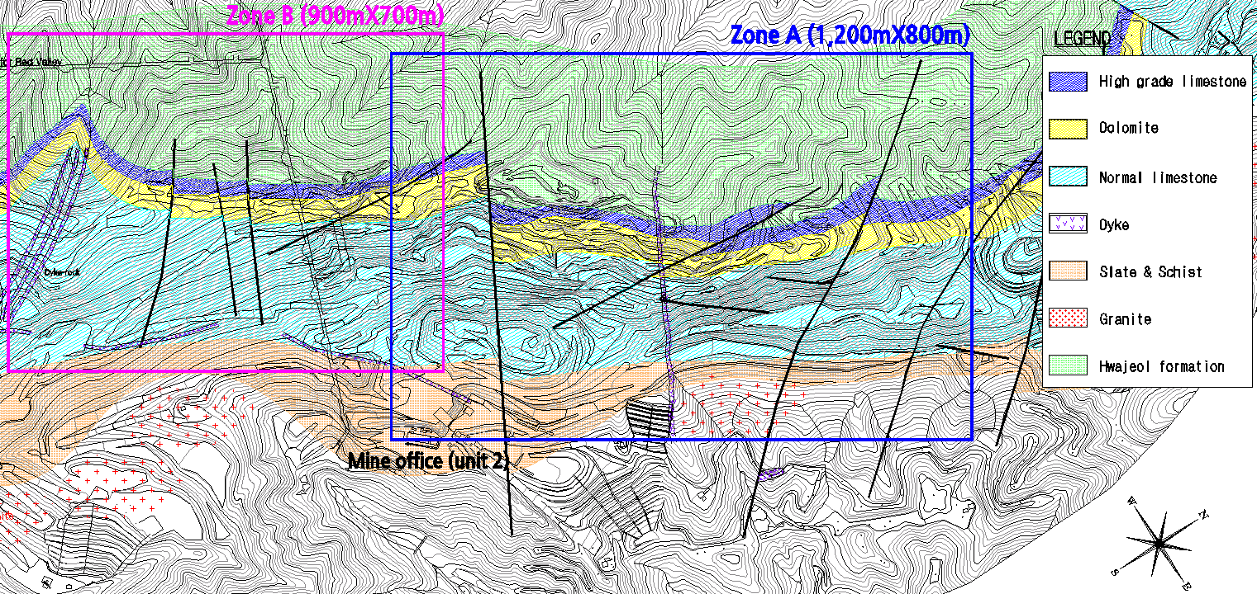
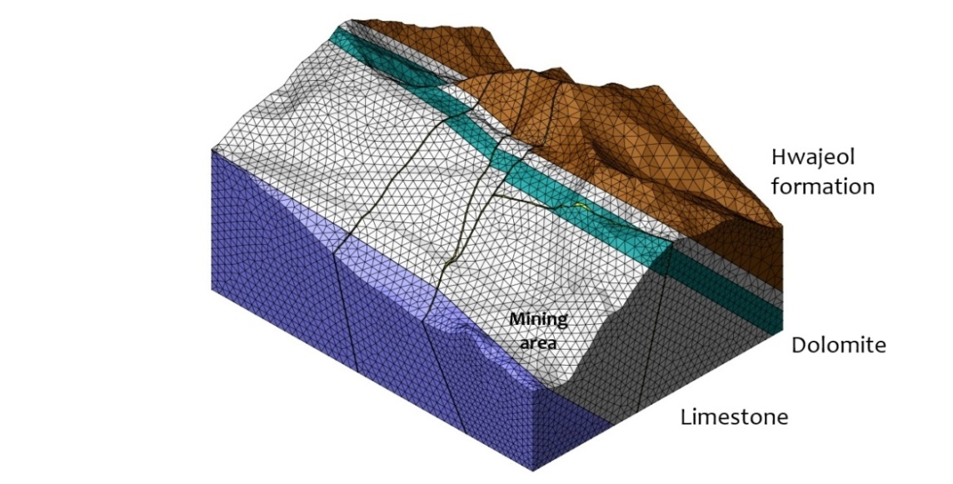
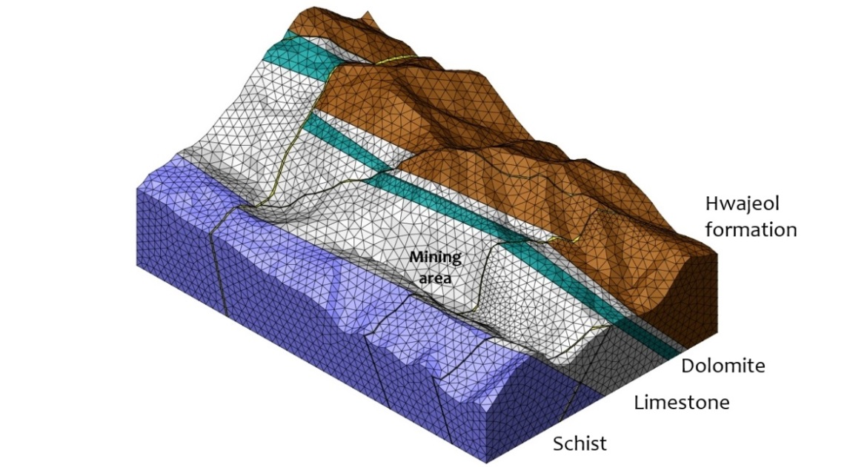
3D slope stability analysis
MIDAS GTS (FE analysis program) & Strength reduction technique → FoS

Slide 20
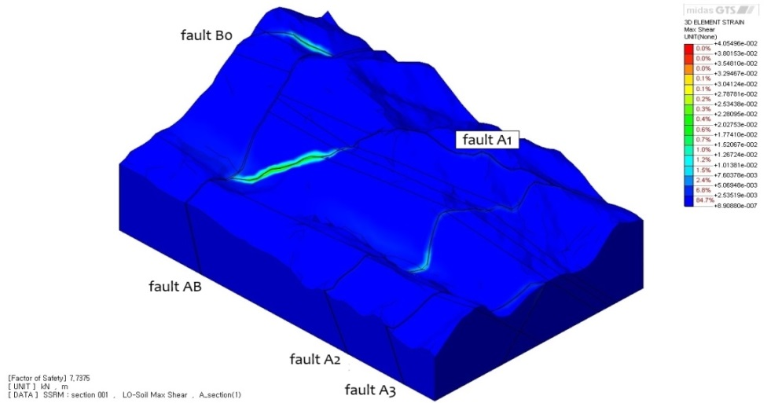
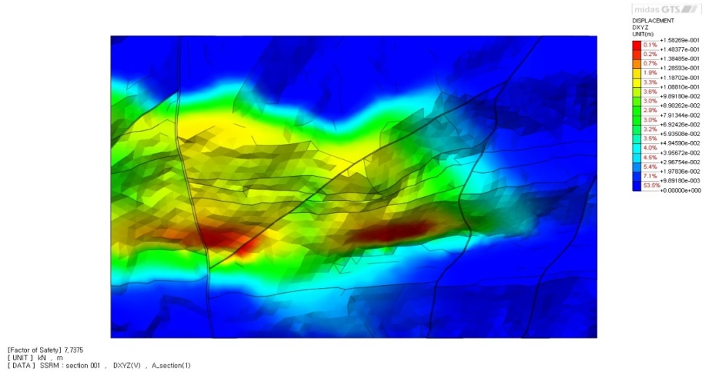
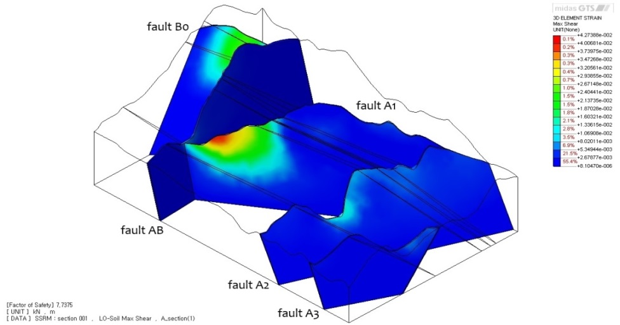
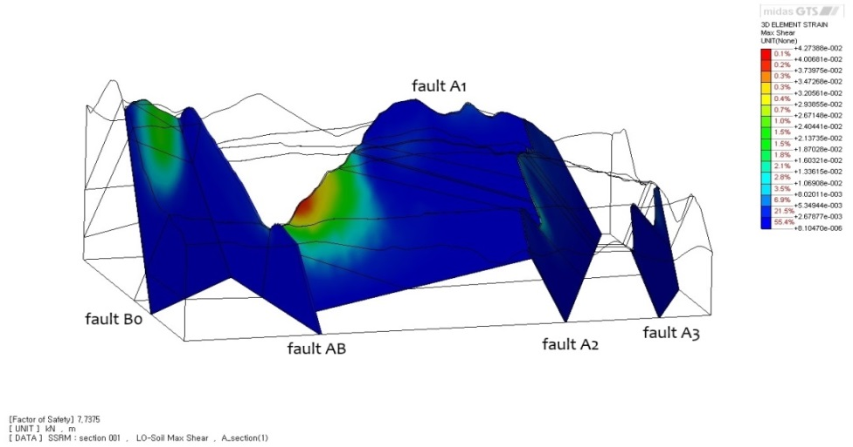
Result of 3-D analysis for Zone A
Maximum shear strain
Displacement magnitude
Maximum shear strain in faults
Zone | Min. FoS | Criterion | Remark
A | 7.73 | FoS > 1.5 | Stable

Slide 21
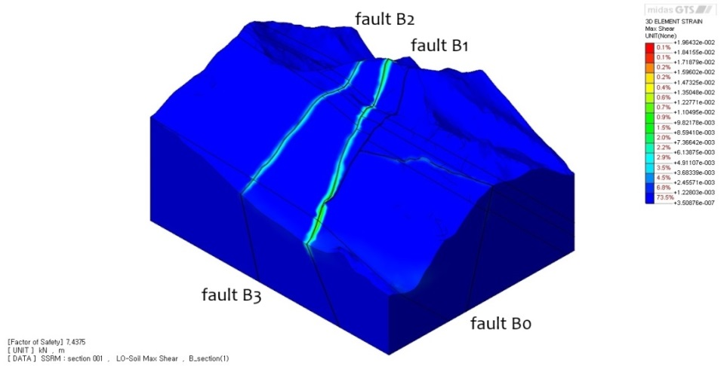
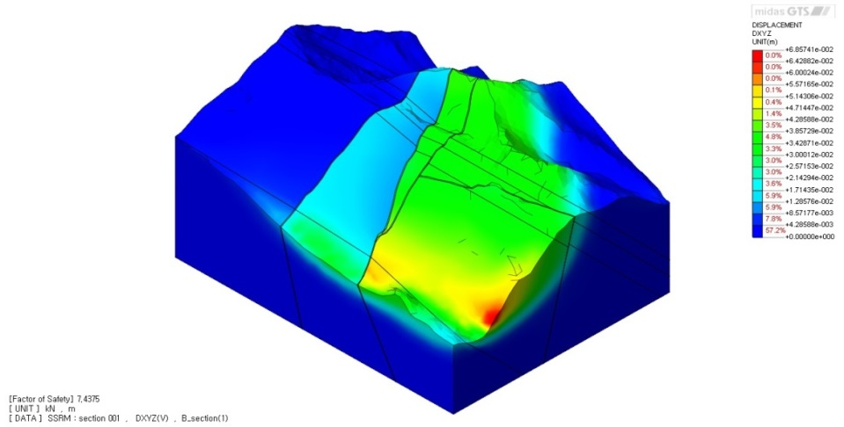
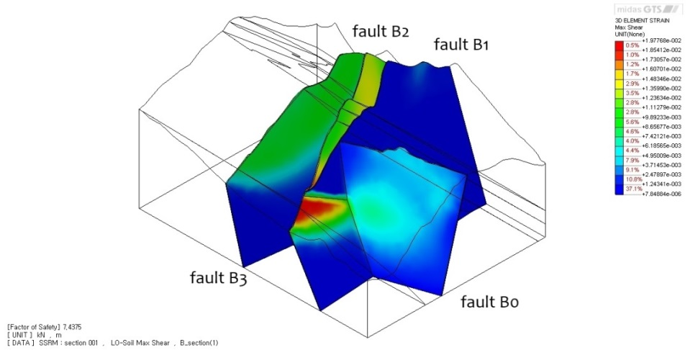
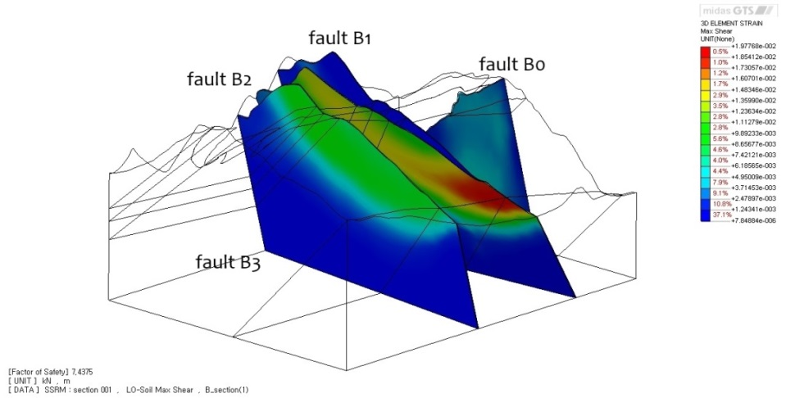
Result of 3-D analysis for Zone B
Maximum shear strain
Displacement magnitude
Maximum shear strain in faults
Zone | Min. FoS | Criterion | Remark
B | 7.43 | FoS > 1.5 | Stable

Slide 22
Conclusions (1)
The slope stability conditions at the LH open pit mine are governed mainly by the very continuous joints and faults. As a result of unfavorable combinations of directions of major joints and faults, local stability problems may occur at several places on the slope walls.
A series of extensive geological surveys were carried out to investigate the geological features including joints and faults, by using the surface geological mapping and 3D laser scanning.
Based on the stereographic projection technique it has been found that the orientation of main joints was divided into four sets in the area. When these joints are oriented approximately parallel to the slope wall, and have a dip angle steeper than that of the slope, sliding tends to occur unless the necessary stabilizing measures are taken in time. So, stability problems due to wedge and plane failure can occur locally in the slope wall.

Slide 23
Conclusions (2)
Two- and three-dimensional numerical analyses based on the strength reduction method were conducted to investigate failure mechanisms in more detail and to explore the general characteristics of slope failure. From the numerical results, the overall stability of slopes was estimated by the criteria of the minimum value of safety factors and probability of failure.
As the rock mass class of the slope is greatly affected by the quality of blasting, a controlled perimeter blasting is a prerequisite for the stability of slopes and also for ensuring safe working conditions at lower levels of the mine.
As an early detection and remedy for unstable conditions is very important for economy and safety of the open pit mining, various monitoring techniques can be suggested for detecting unstable conditions of rock slopes and taking the necessary stabilizing measures in time.

Slide 24
Thank you for attention !

