Slide 1

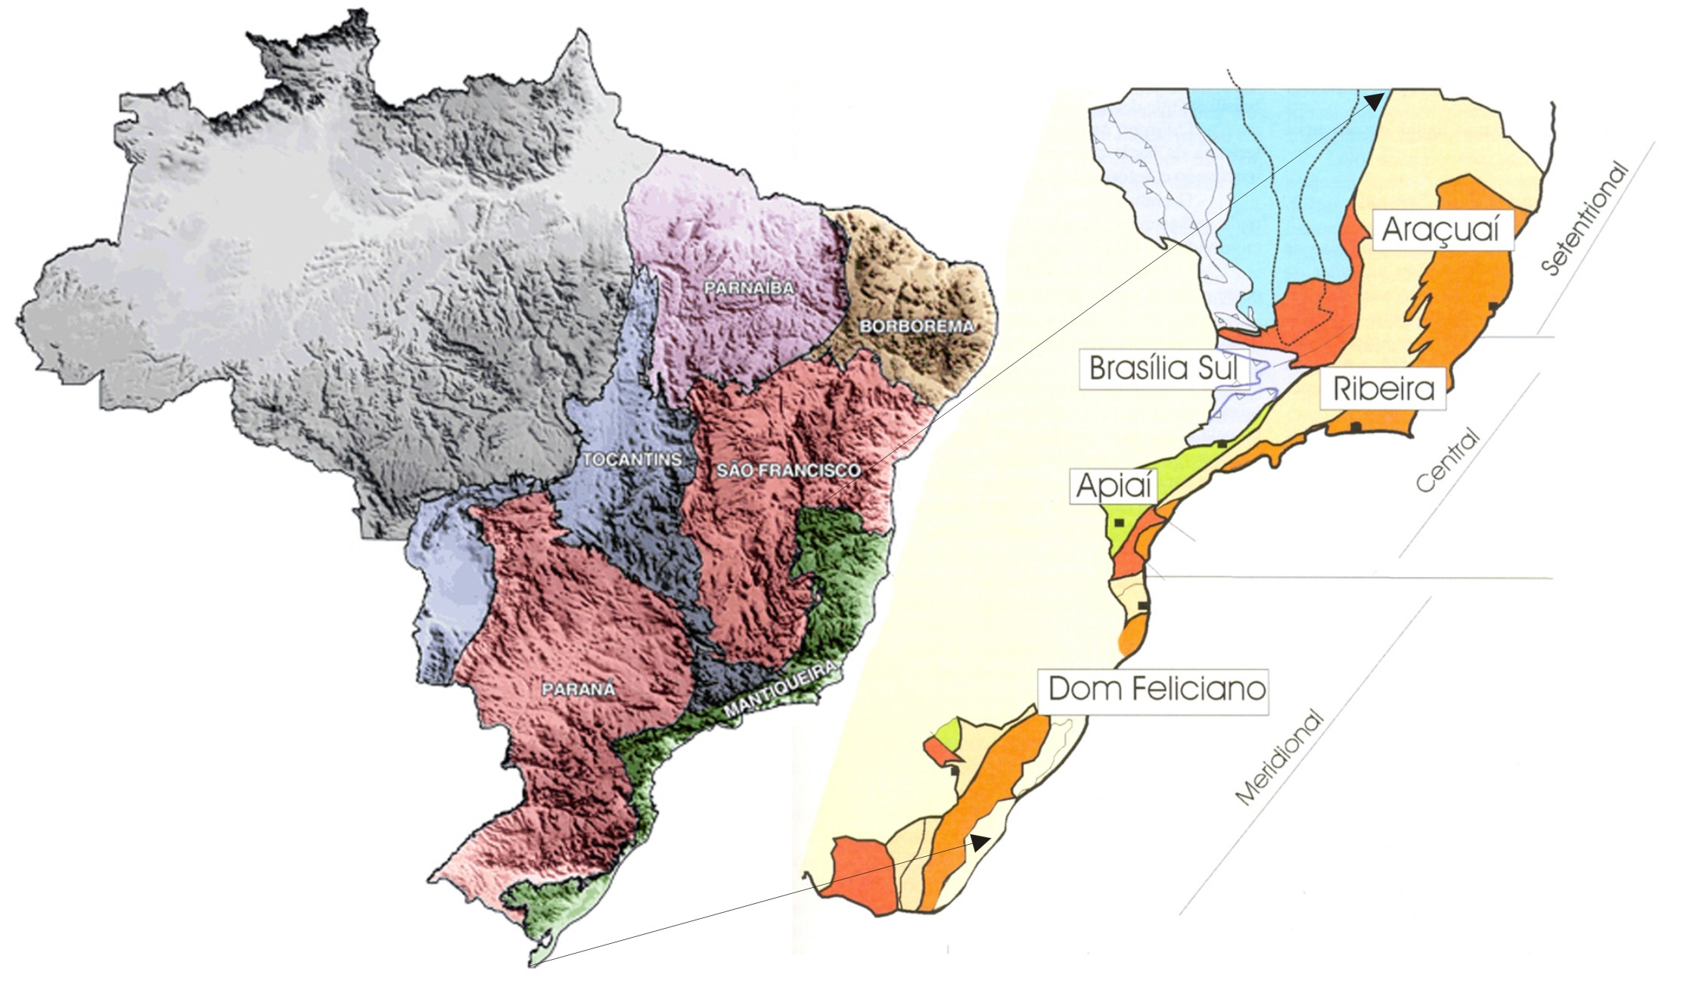
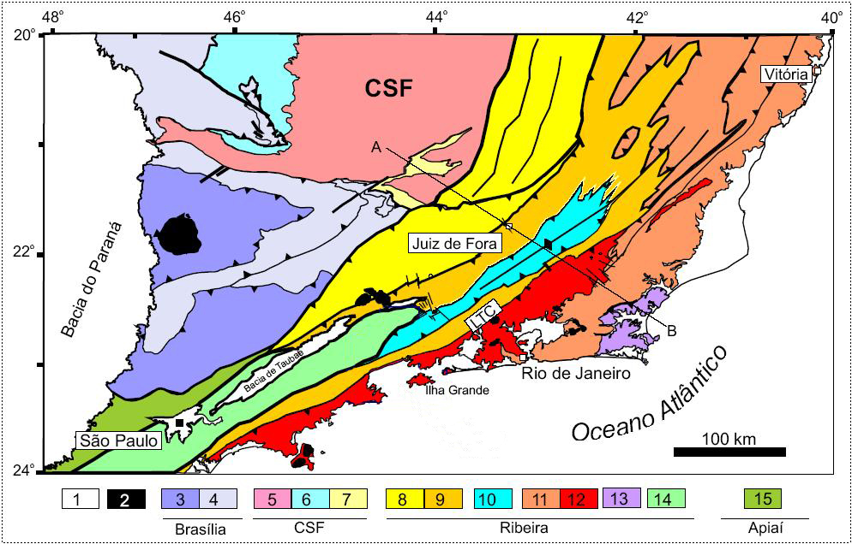
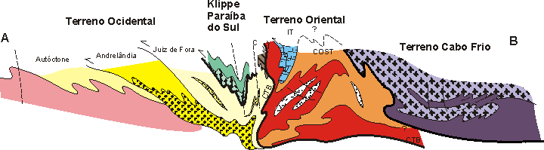
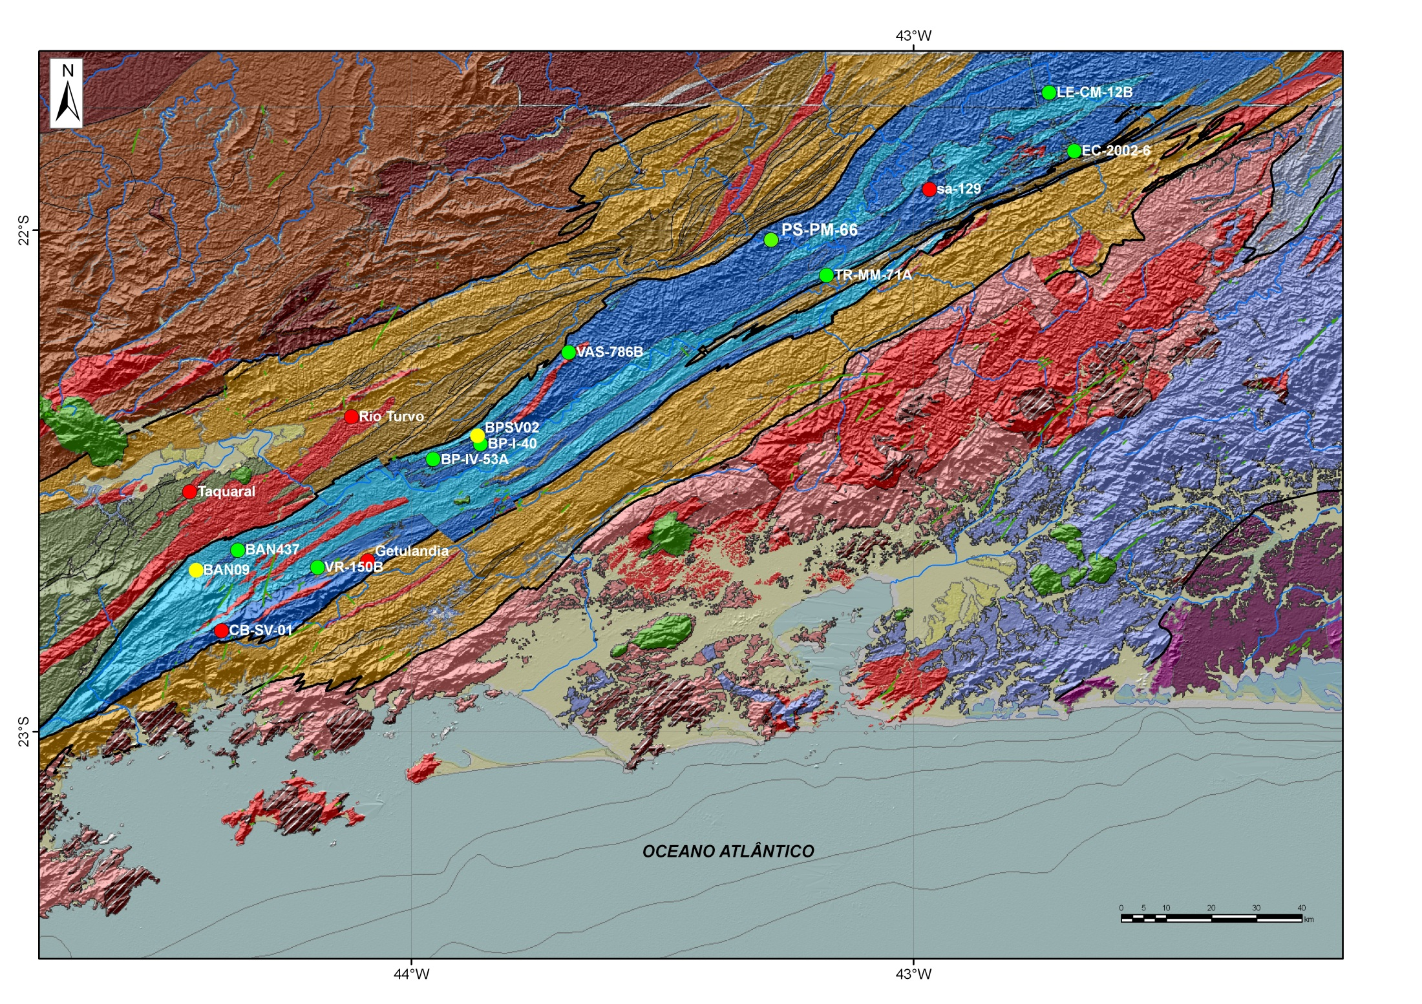
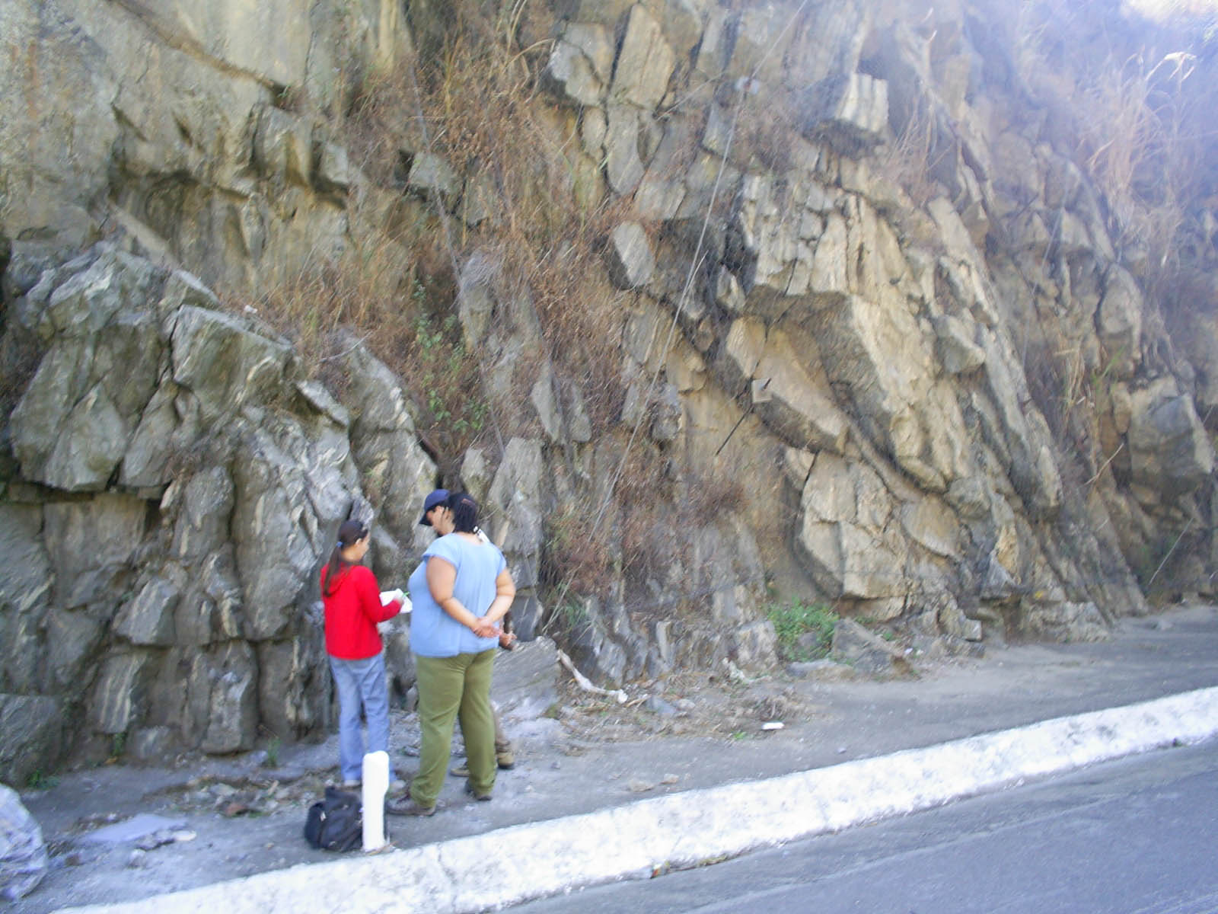
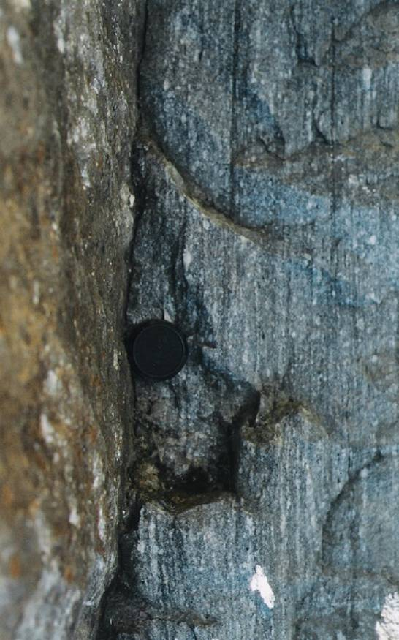
LA-ICPMS zircon U-Pb geochronology and chemistry: implications to the evolution of the reworked
Paleoproterozoic Quirino complex within the Neoproterozoic Ribeira belt, SE-Brazil.
Claudia Sayão Valladares ^{1,2} and Cin-Ty A. Lee²
¹ UERJ-Brasil-CNPq scholarship /²Rice University-– email: claudia.s.valladares@gmail.com
Geotectonic Setting
LA-ICPMS chemistry on zircons
RESULTS 2:
The Ribeira belt (Figure 1) resulted from the youngest lithospheric convergence of the Pan African-Brazilian collage. The Quirino complex represents the reworked Paleoproterozoic basement of the Paraíba do Sul terrane (Figure 2 and Figure 3).
Motivations:
c) REE pattern and ƒO2
1) The ability of zircon to influence or record petrogenetic processes in igneous and metamorphic systems.
2) Interpret the geologic significance of multiple ages (Archean, Paleoproterozoic and Neoproterozoic), recorded by zircon growth in the Quirino complex, Paraiba do Sul terrane, Ribeira belt, SE Brazil.
Most (32 of 35) Paleoproterozoic zircons show expected pattern for zircons.
Figure 1
Figure 2
RESULTS 1:
1) Conditions of formation:
a) Th/U ratio.
Figure 3- Transect A-B
Why 9 of 12 U-Pb Neoproterozoic zircons (interpreted by geochronology as metamorphic) show Th/U ratio> 0.5?
Most of he Neoproterozoic zircons (9 of 12) show unexpected pattern, probably caused by allanite inclusions.
Age Ma
Paraiba do Sul Terrane-
Terrane with Archean to Paleoproterozoic basement units: relicts of older continental plates.
Paraíba do Sul Terrane/Klippe
ca. 2.3-2.1 Ga Arc
ca. 3.4-2.7 Ga Archean inheritance
Th/U
They are enriched in U and Th.
The Neoproterozoic zircons show positive correlation Ce-Th and Ce-U
Chondrite-normalized REE plot for LA-ICP-MS zircon data (CI chrondrite values from Anders and Grevesse, 1989).
U ppm
U ppm
Allanite inclusions
Lack of positive correlation between Eu and Ce anomalies in 9 of 12 Neoproterozoic zircons (not related to ƒO2). The 3 grains of the diamagnetic fraction that show positive correlation reveal oxidant condition.
Figure 4- Geologic Map and
sample location (dark blue arrow).
Eu/Eu*
Th ppm
Th ppm
Age Ma
Ce ppm
Ce/Ce*
Legend: Blue - Paleoproterozoic and Archean zircons;
Red (F.F. 5˚) and green (Diamagnetic fraction) – Neoproterozoic zircons
CONCLUSIONS
U-Pb geochronology
c) Ti-in-zircon thermometry
The outcrop- A mylonitic granitic hbl-bt-orthogneiss with Archean, Paleoproterozoic and Neoproterozoic zircons was selected.
Ti ppm
1) The presence of inclusions, in this work figure out by the zircon chemistry, could lead to misinterpretation related to: genesis of zircon (igneous or metamorphic) and conditions of formation (Ti-in-zircon thermometer and ƒO2).
2) Most (9 of 12) of the Neoproterozoic grains grew after or simultaneously with the others grains of the matrix, in a solid state, including biotite, allanite and/or ilmenite-rutile being interpreted as metamorphic.
3) Ti-in-zircon thermometer for the Neoproterozoic zircons based on 3 grains of diamagnetic fraction with no inclusions (green symbols), reveals high-amphibolite facies metamorphic process under at 620-670˚C.
Temp ˚C
Fe ppm
Age Ma
Mg ppm
U-Pb geochronology reveals protolith crystallized at 2308 ± 9Ma (upper intercept) and metamorphosed at 606 ± 22 Ma (lower intercept). One Archean zircon (3388 ± 16 Ma), represents minimum ²⁰⁷Pb/²⁰⁶Pb age inheritance.
Enrichment in Ti. Causes?
Fe-Ti (ilmenite) and/or Ti-rich inclusions (rutile).
Fe ppm
Positive correlation Fe-Mg (biotite inclusions).

