Slide 1
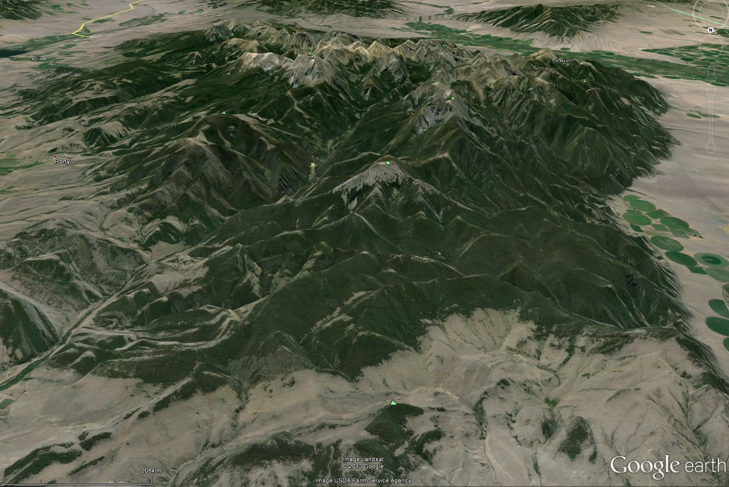



Rock Glaciers in the Tobacco Root Mountains, MT
Andrew Gustin – Indiana University
Advisors:
Greg Olyphant
Sally Letsinger
Bruce Douglas

Slide 2
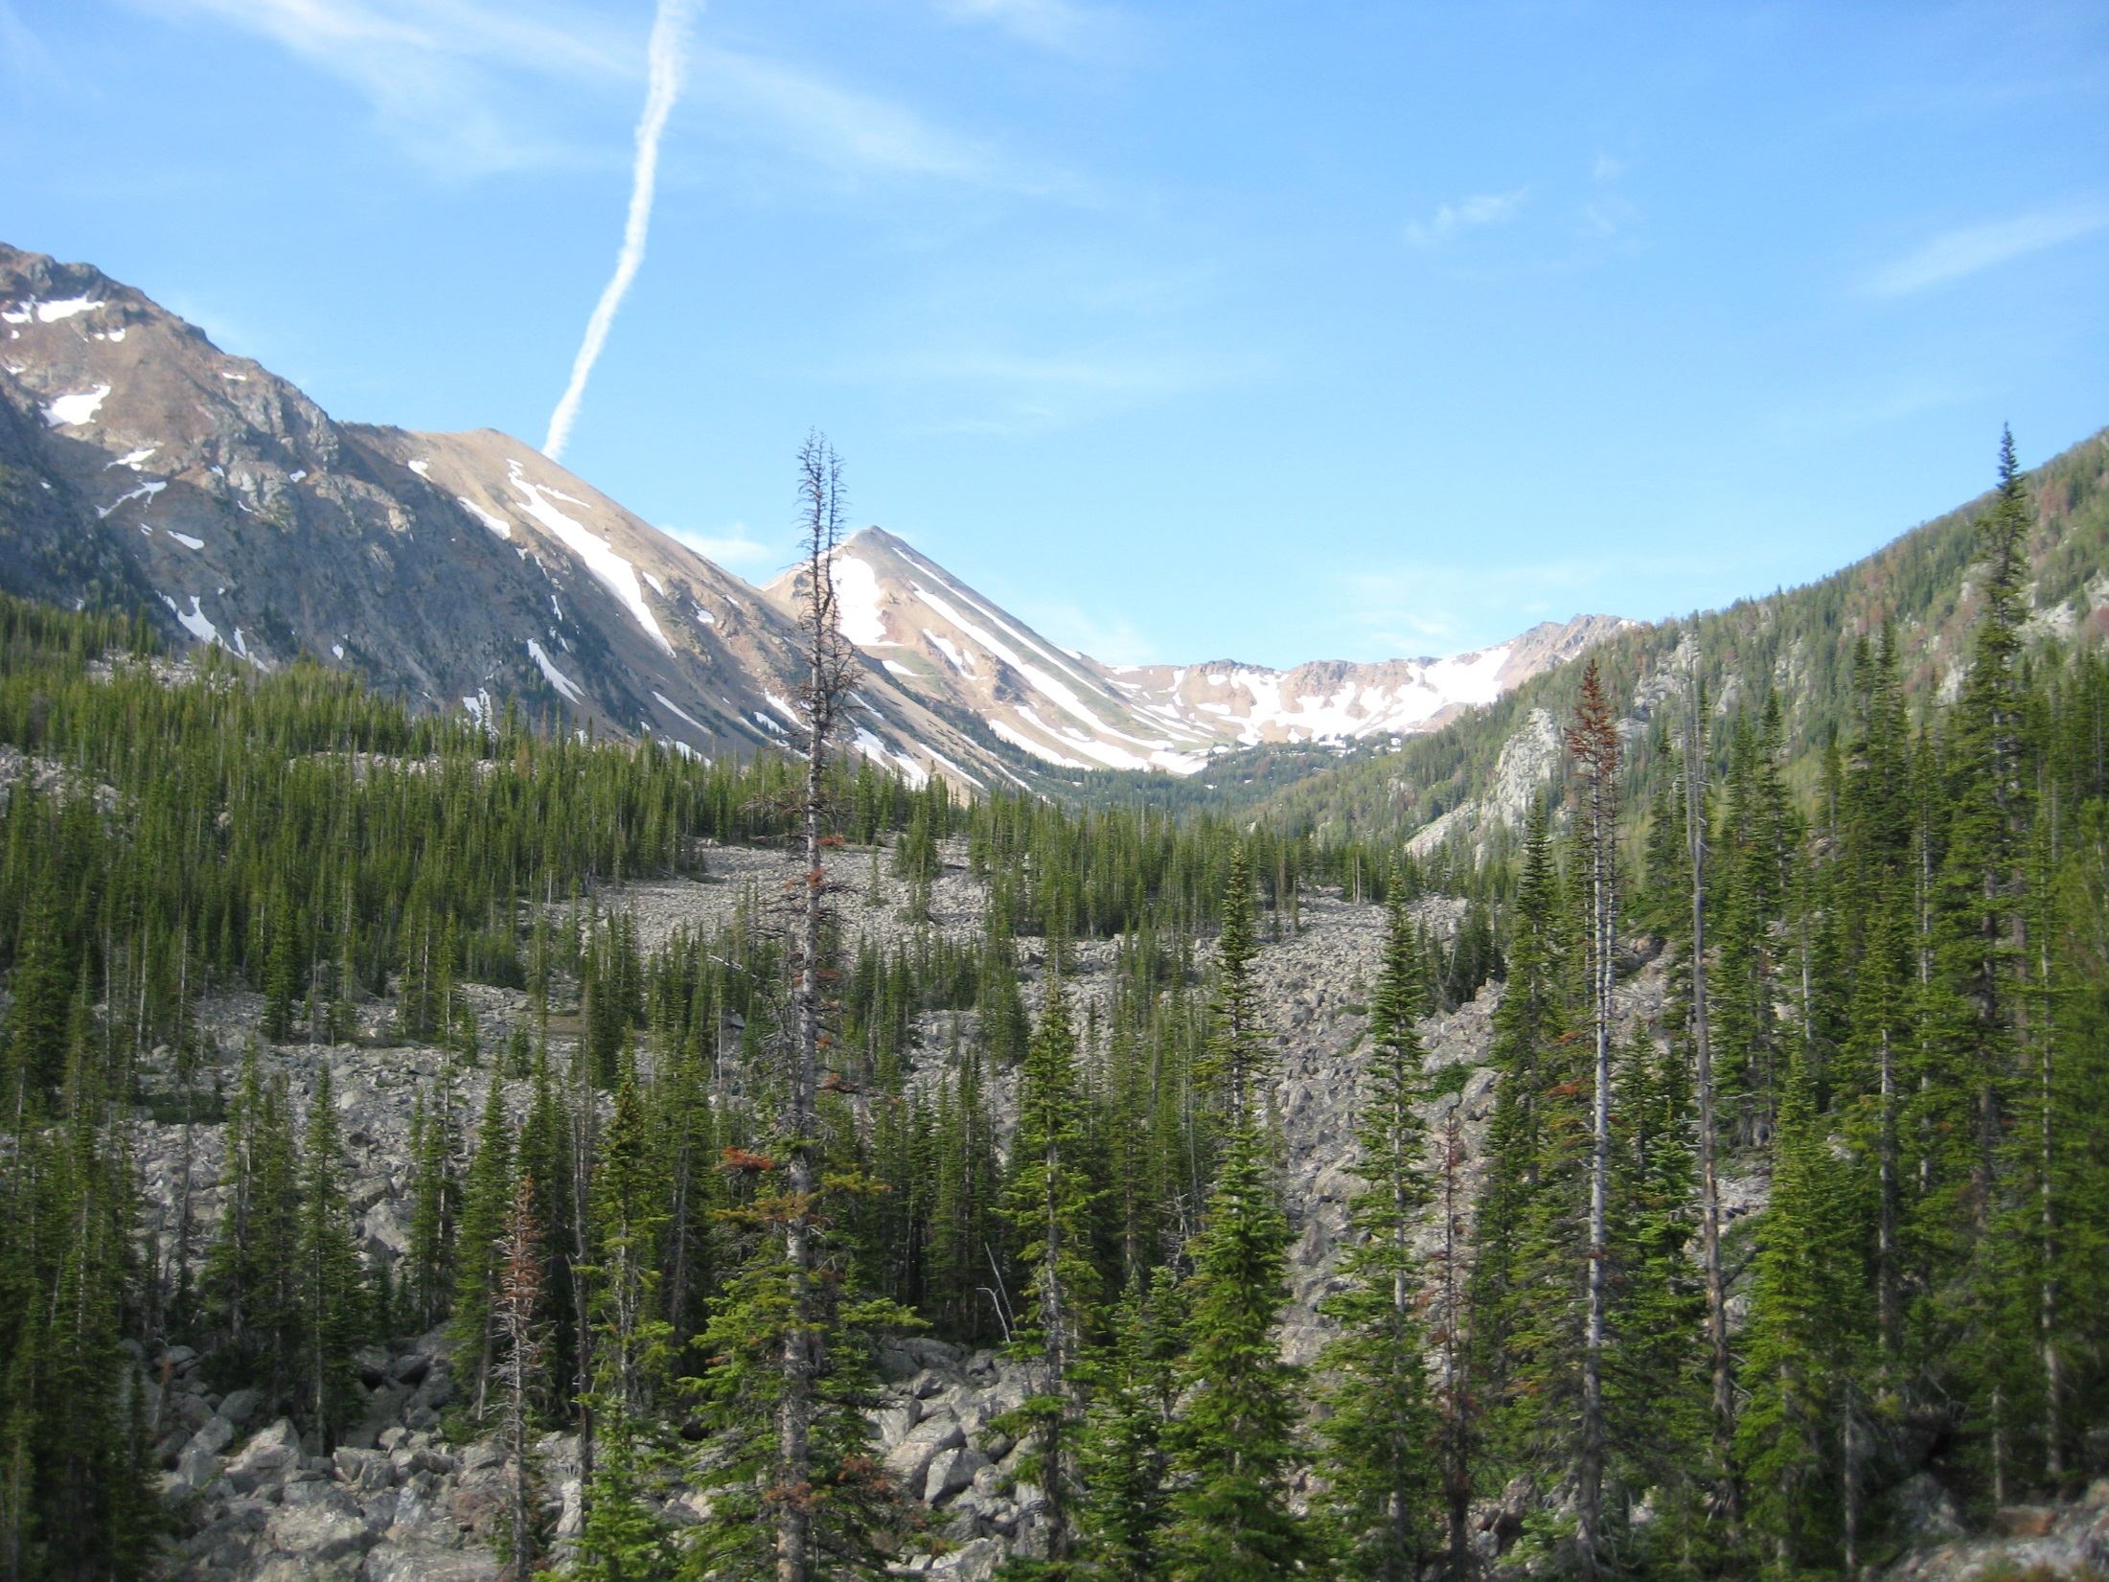
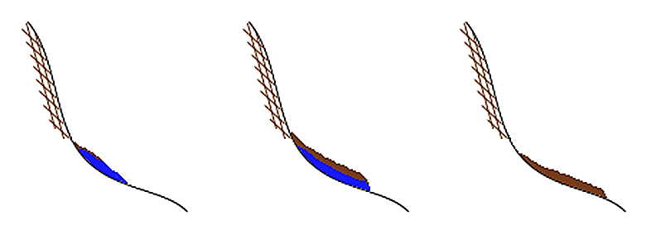
What is a rock glacier?
Glaciogenic origin
Receding Glacier Advancing (Rock) Glacier Inactive Rock Glacier

Slide 3
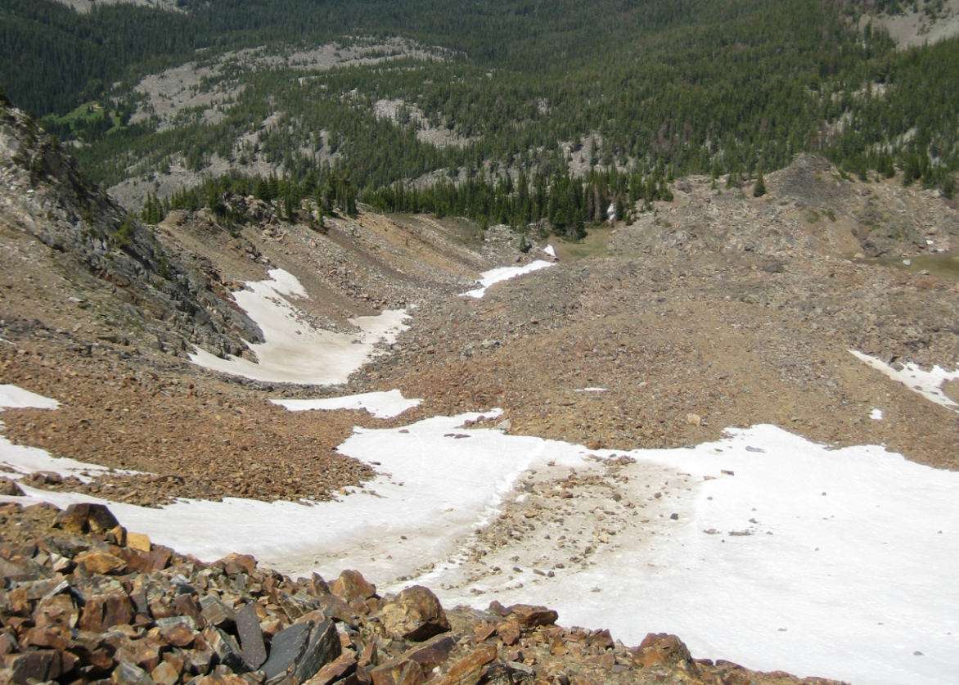
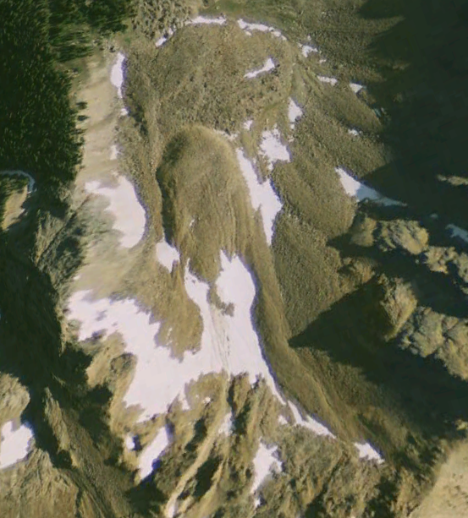
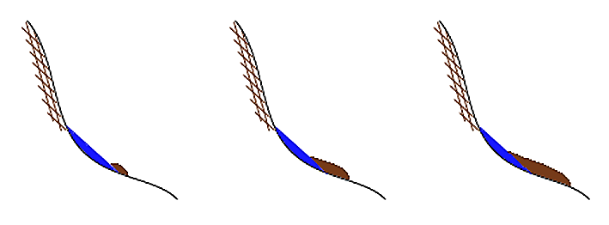
Periglacial origin - Facies model (Madole, 1972)
Protalus Rampart Lobate Rock Glacier Tongue-Shaped Rock Glacier

Slide 4
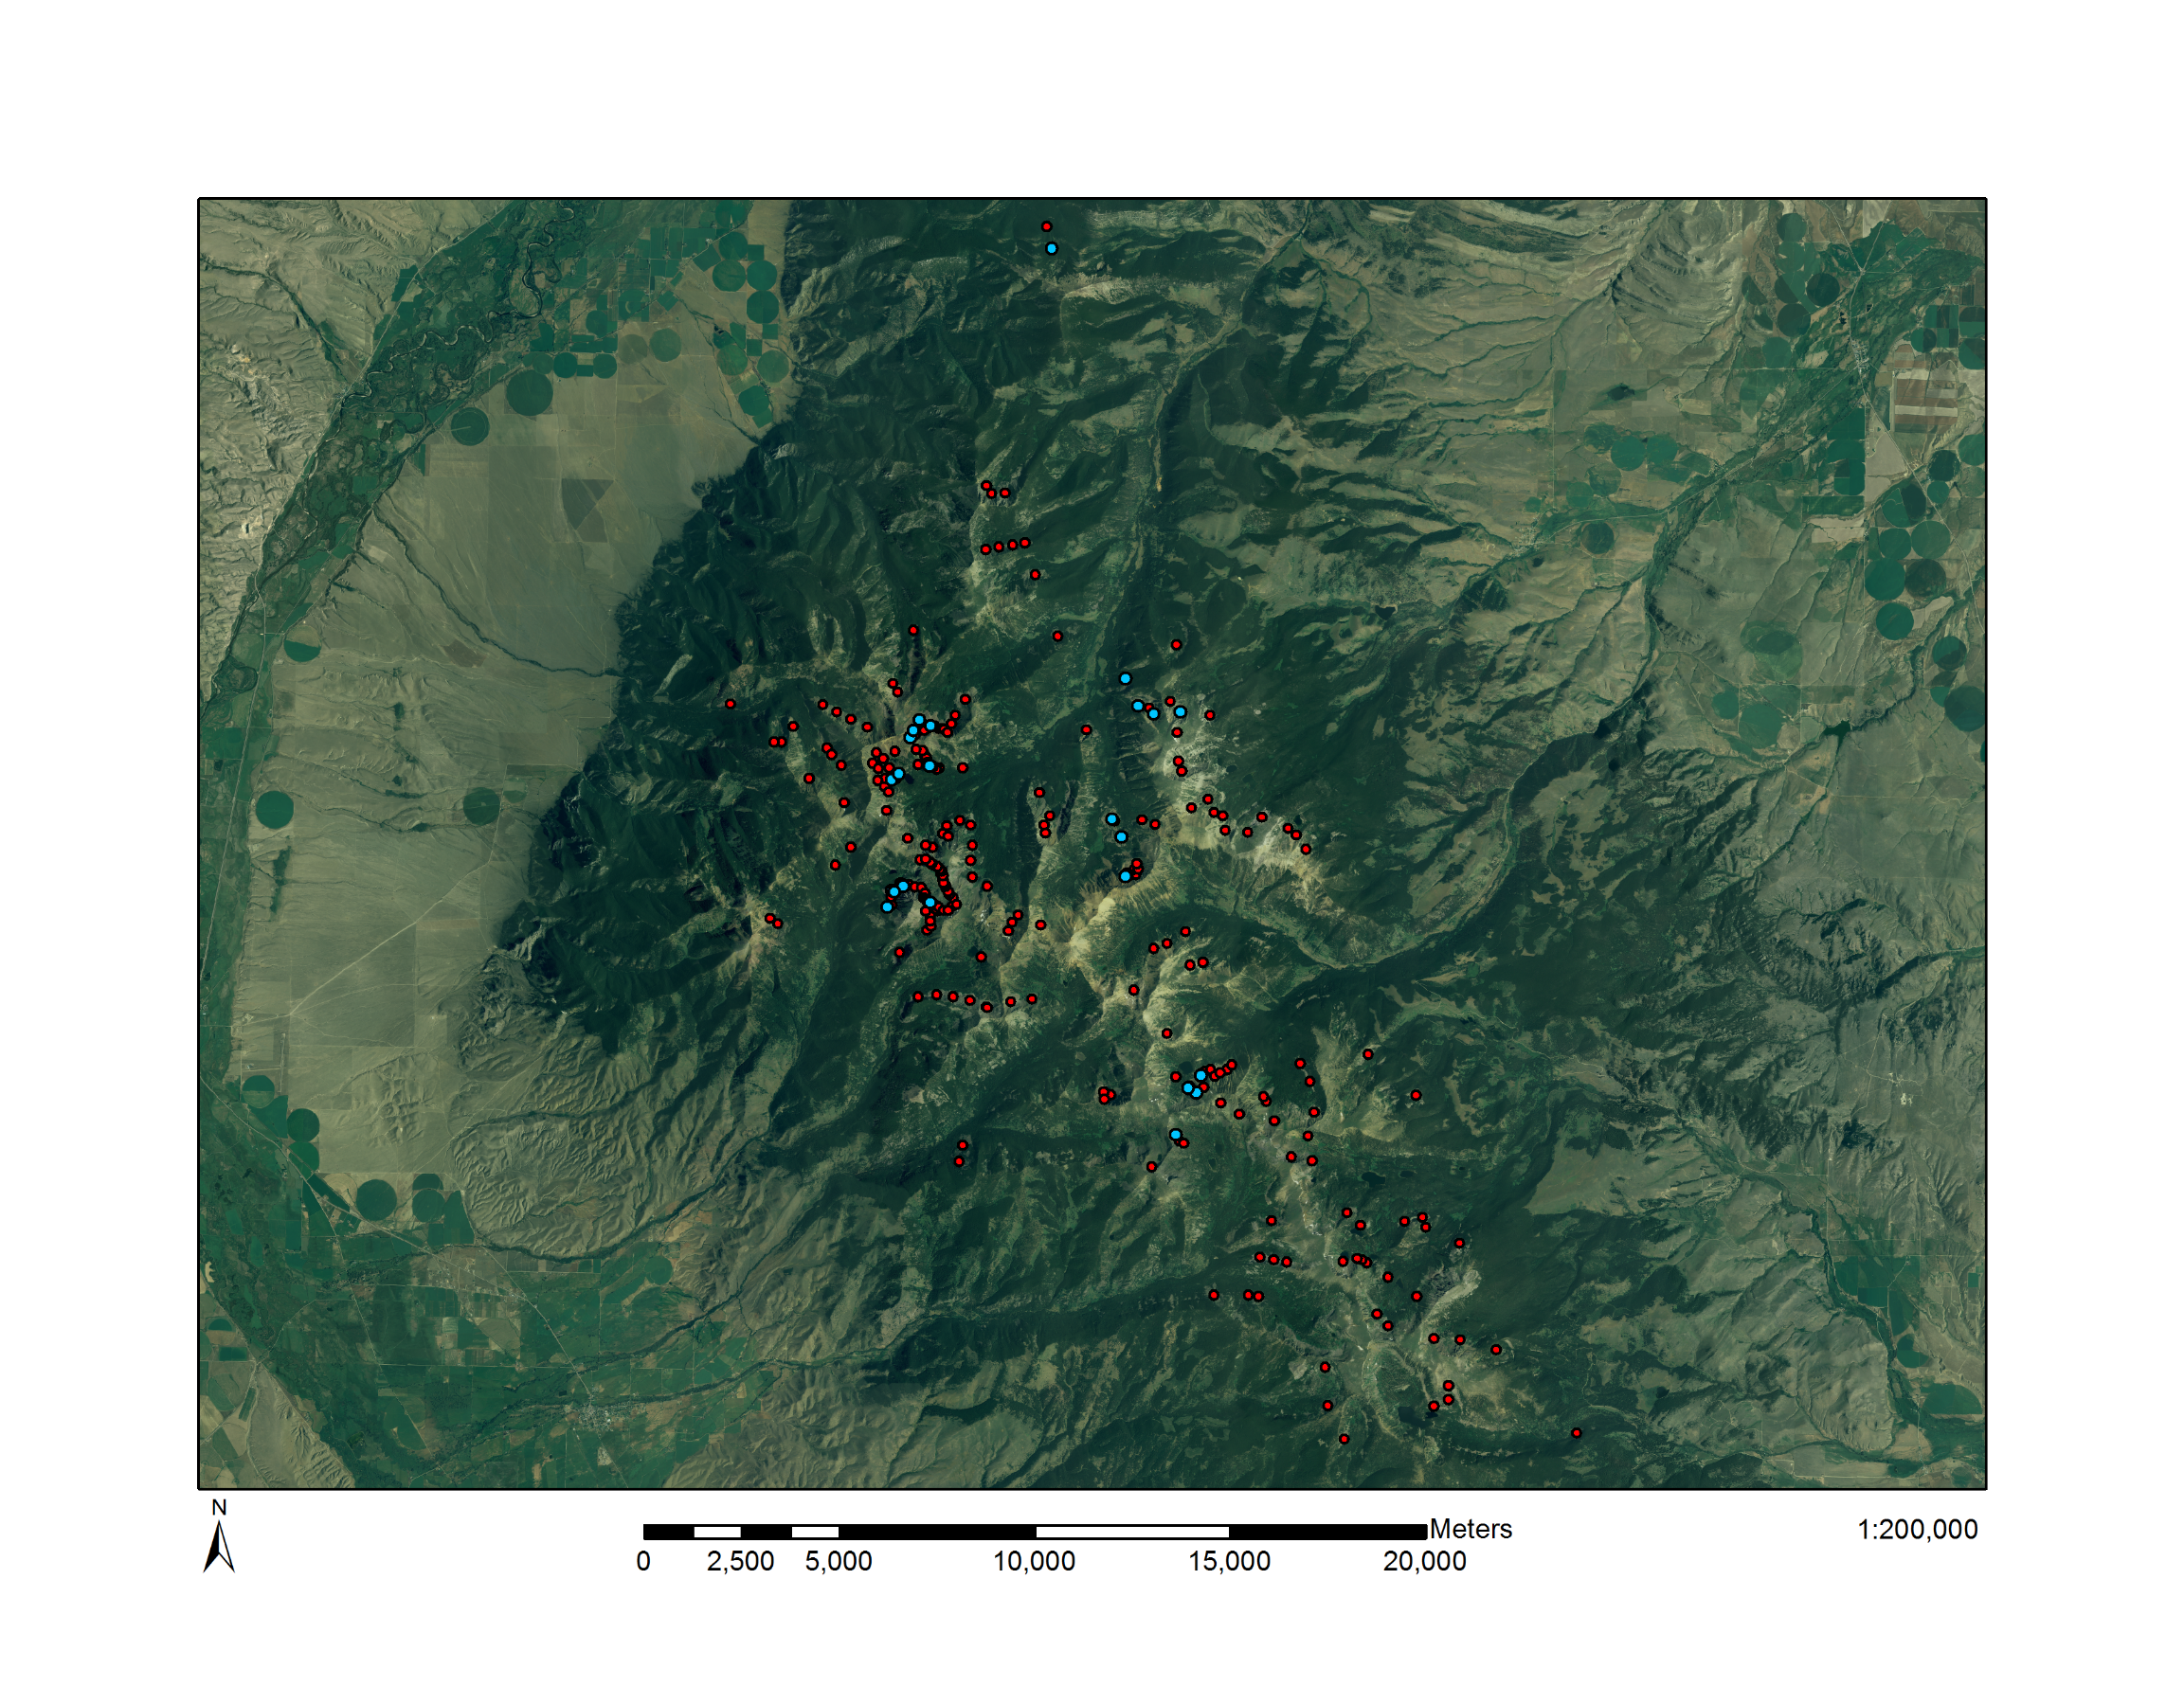
Priority deposits (n=34)
All deposits (n=248)
Tongue – 90; Lobate – 98; Protalus - 60

Slide 5
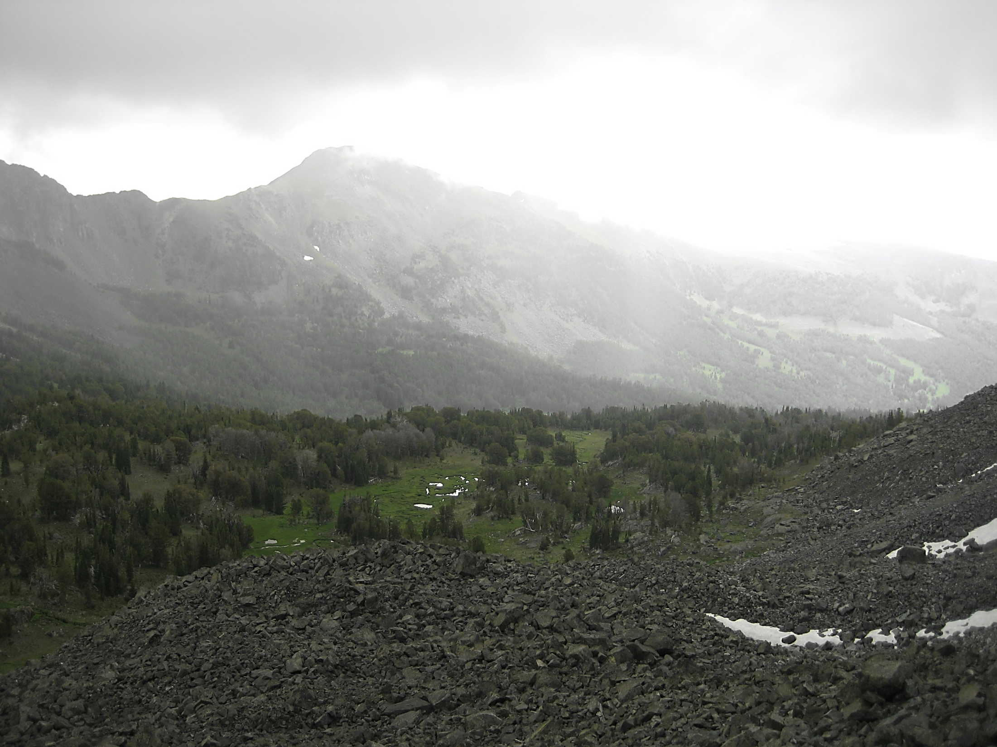
All deposits (n=248):
Feature Identification and Extent Mapping
Minimum Bounding Geometry
Interpolated Thickness Estimation
DEM - Solar Radiation Reduction, Cirque points
Priority deposits (n=34):
Contributing Rockshed Delineation
Alternative Slope-Curve Thickness Estimation
Headwall Fracturing – Density and orientation (15 sites)
Relative Age Dating – 24 sites

Slide 6
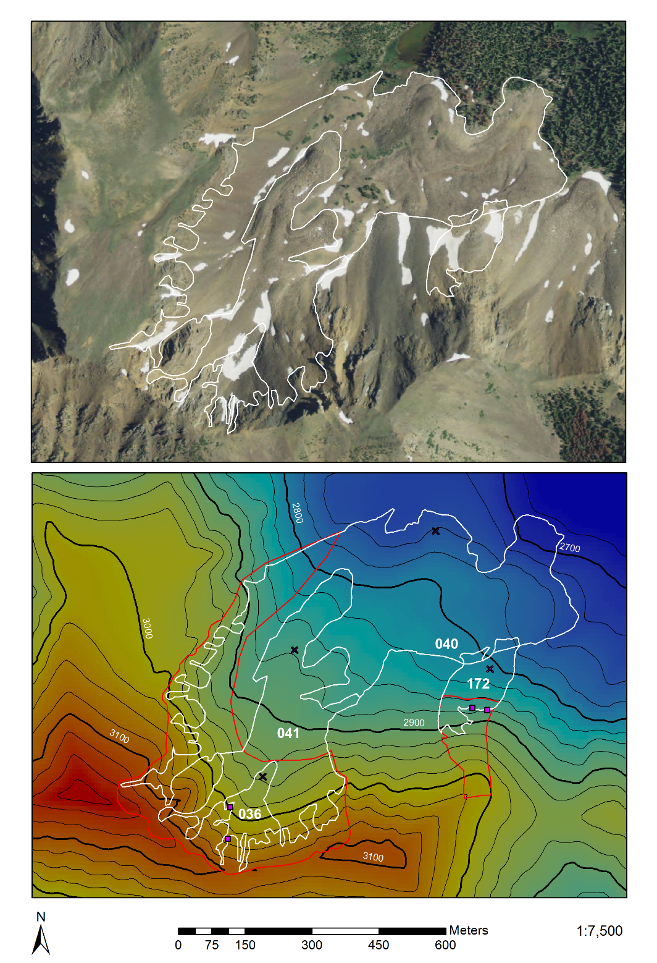
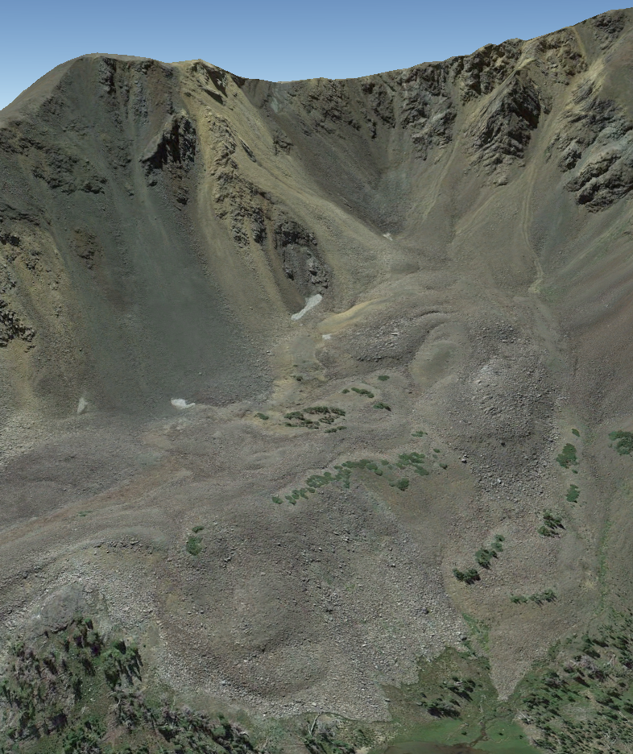

Feature Identification

Slide 7
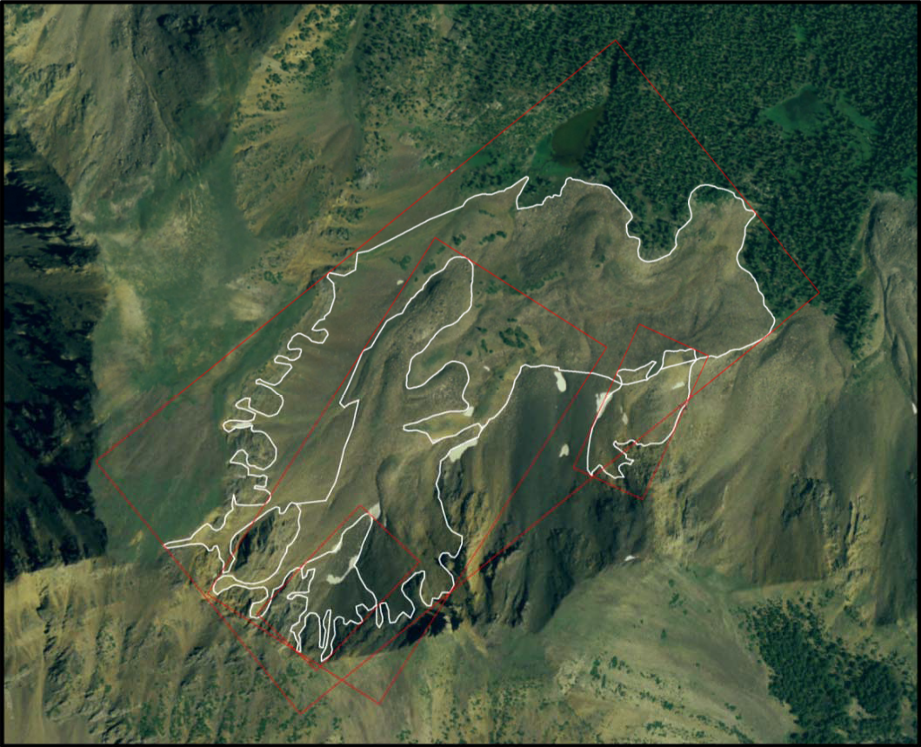

Minimum Bounding Rectangles

Slide 8
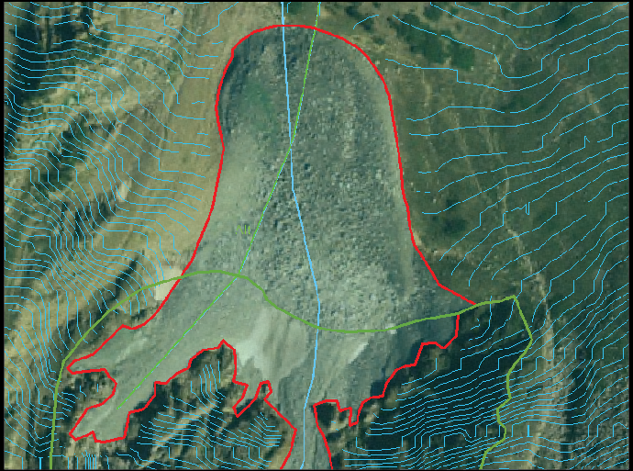
Thickness Estimations
Automated interpolation method - All 248 deposits

Slide 9
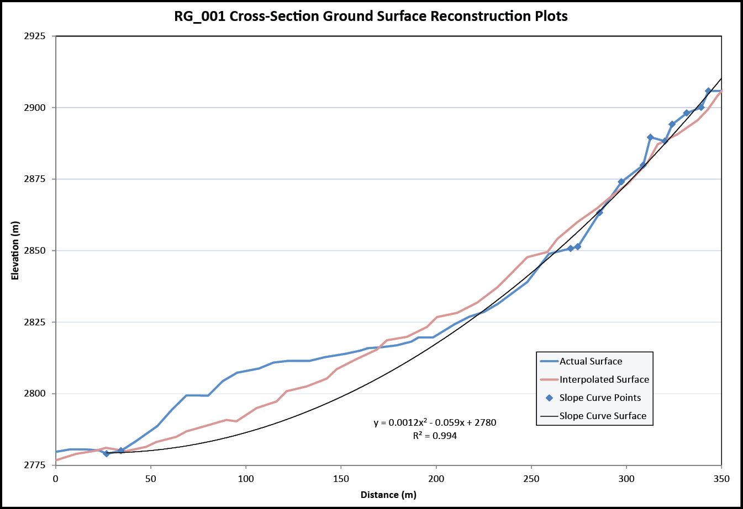
Slope-Curve method - Priority deposits only (34)

Slide 10
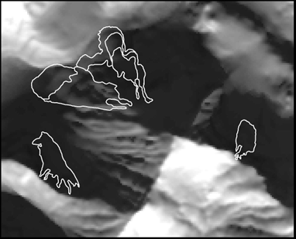
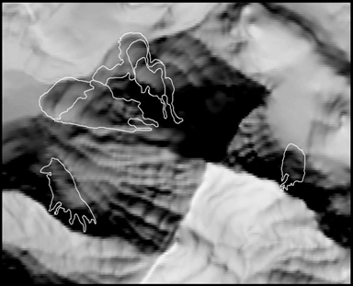
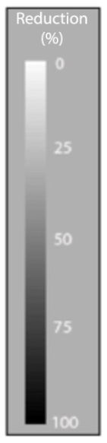
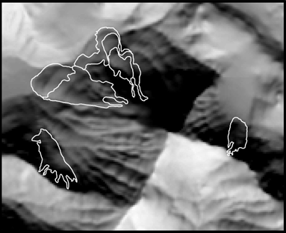
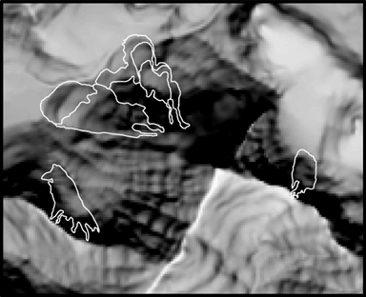

Radiation Reduction
Winter Solstice
Summer Season
Vernal Equinox
Summer Solstice

Slide 11
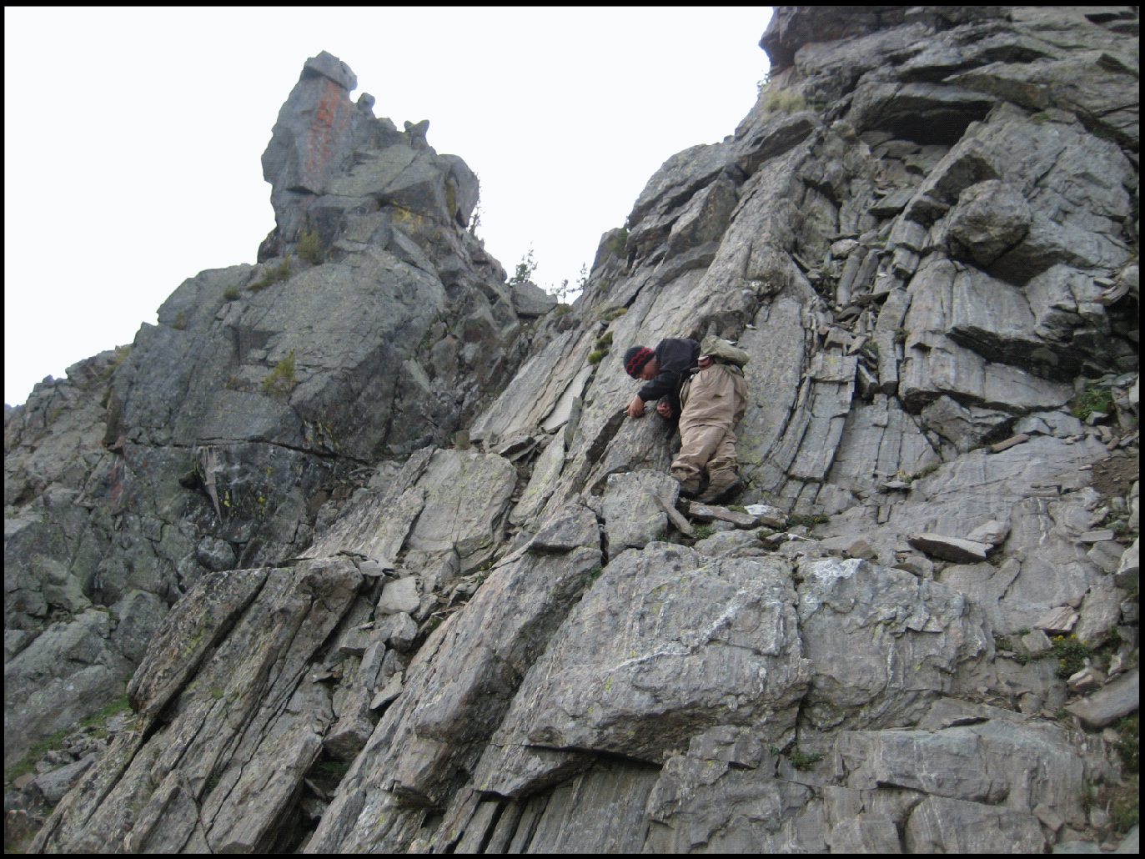
Headwall Measurements
Fracture Orientations
Fracture Density
Bedrock Lithology
Dip-Slope Fractures
Compositional Banding
Photo by GRBR

Slide 12
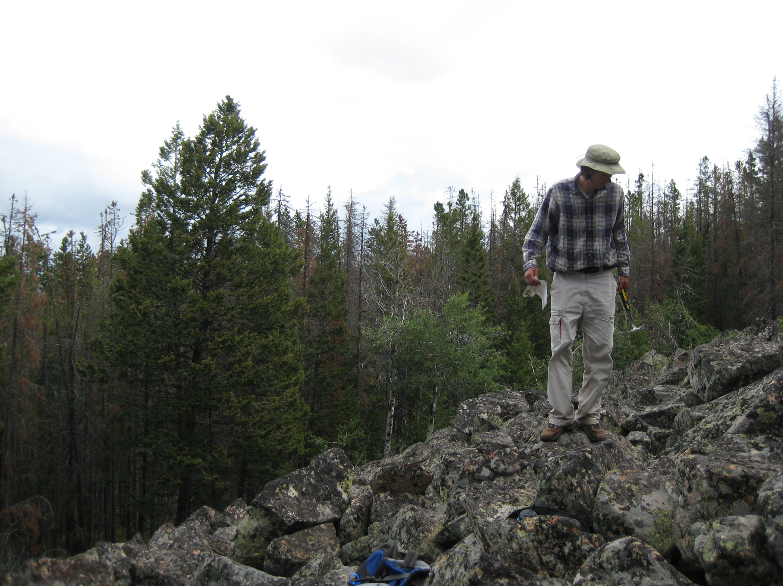
Relative Age Dating
Oxidation Cover and Rind Thickness
Lichen Cover and Diameter
Pitting Cover and Depth
Percent Weathered
Boulder Diameter
Crystal Height
Angularity
<- Jolyphan
Principle
Component Analysis

Slide 13
Results – Statistical Analyses
Facies progression – Protalus → Lobate → Tongue

Slide 14
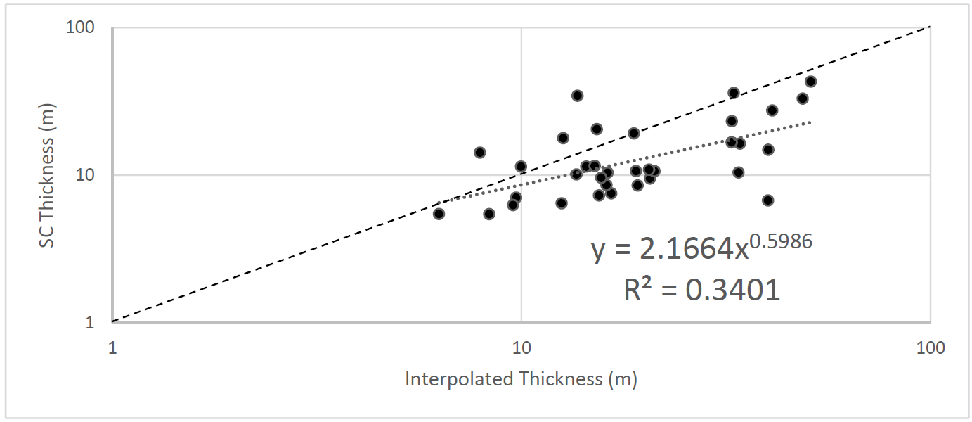
Thickness Estimations

Slide 15
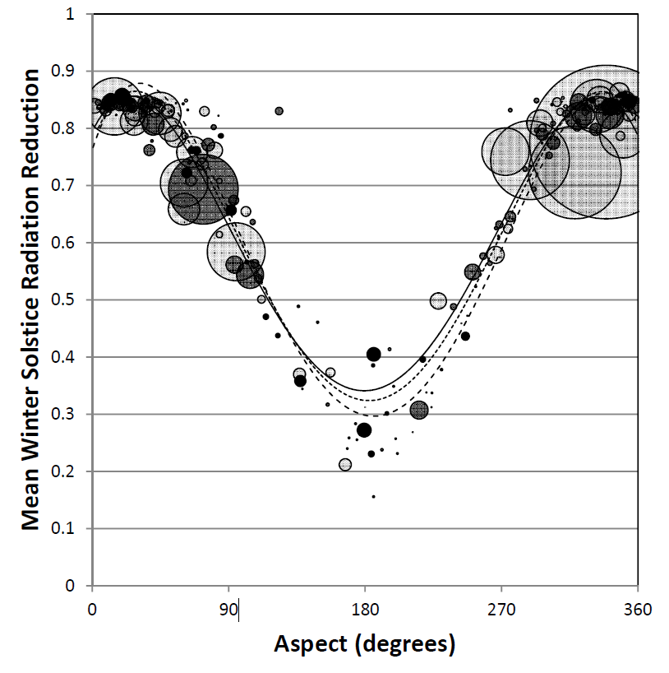
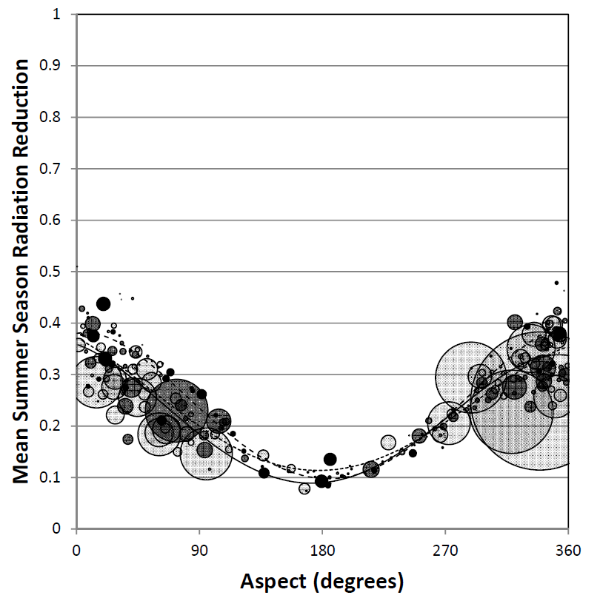
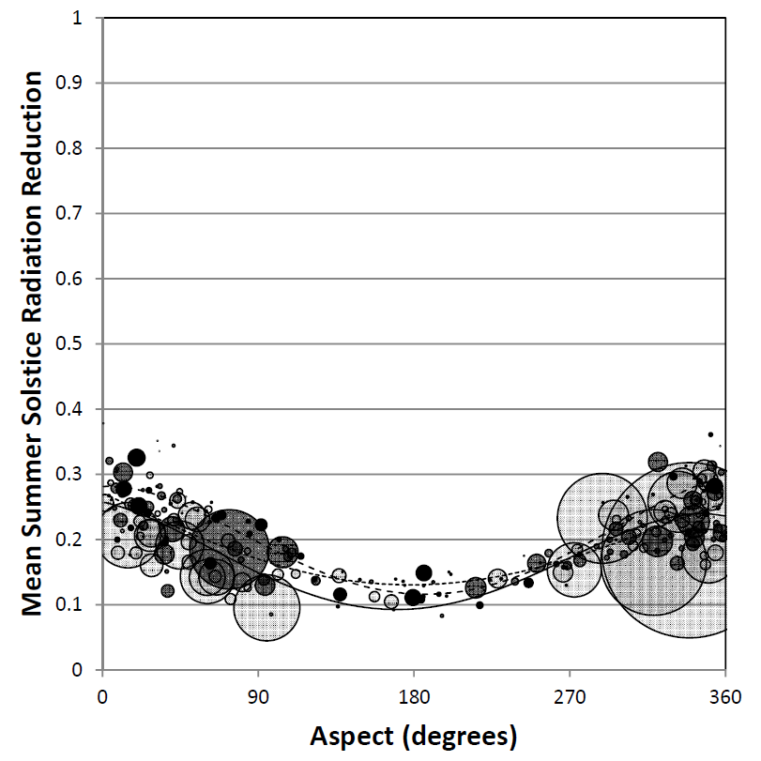
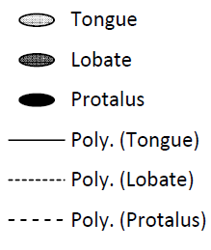
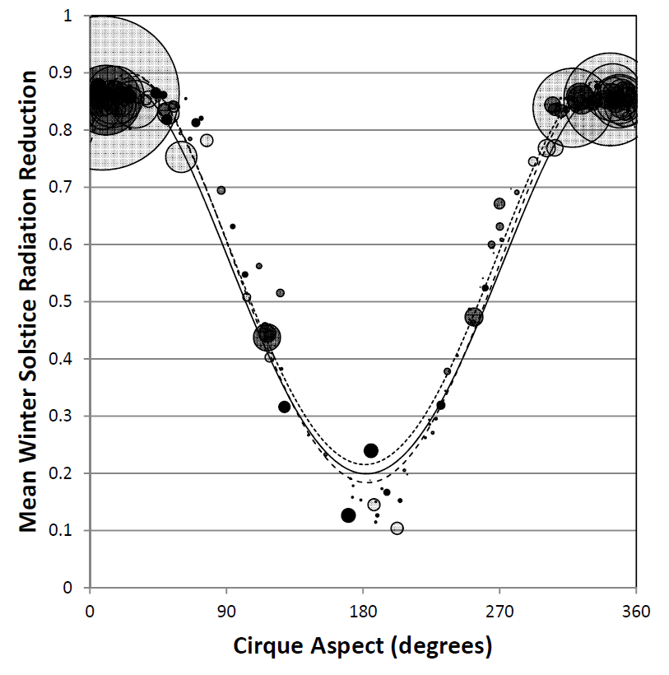
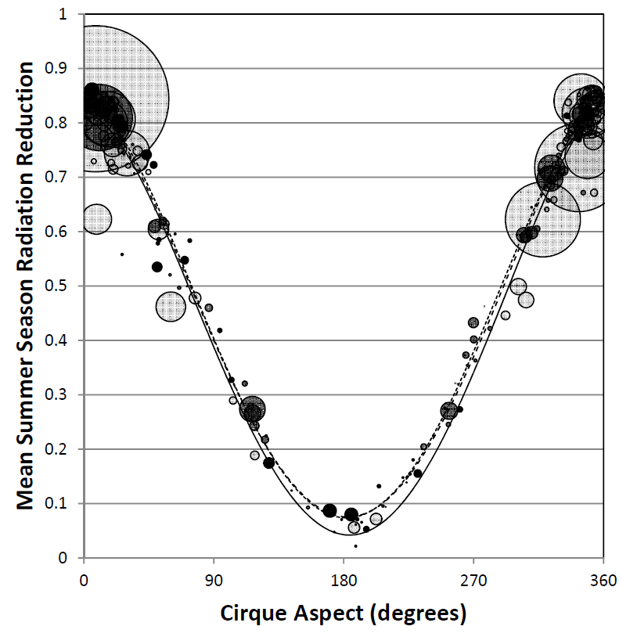
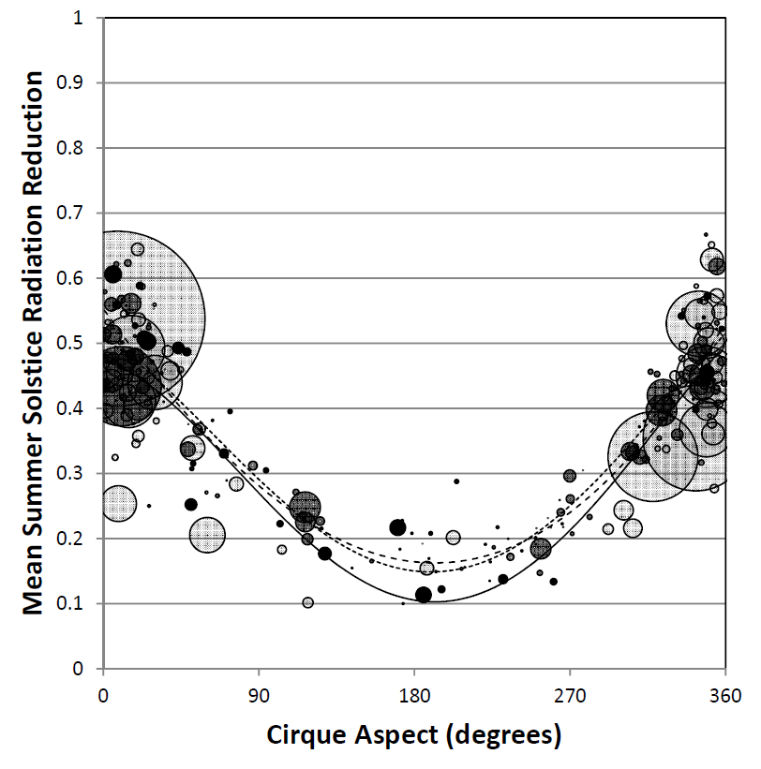
Radiation Reduction
100
50
0
100
50
0
100
50
0
Deposit
Max
100
50
0
100
50
0
100
50
0
Cirque
Winter Solstice Summer Season Summer Solstice
(equinox to equinox)

Slide 16
Priority Headwall Data
QFG – Quartzofeldspathic Gneiss QMG – Mafic Gneiss with Quartz CBF – Compositional Banding Fractures DSF – Dip-Slope Fractures

Slide 17
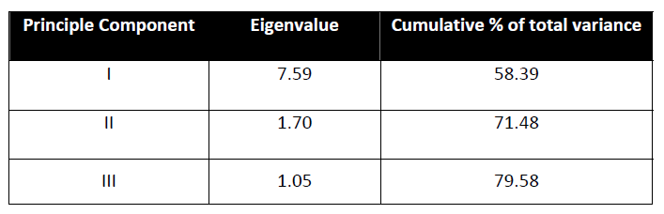
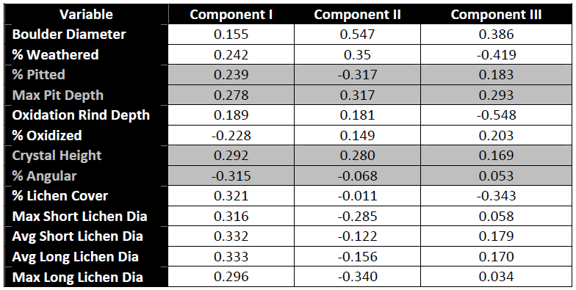
Principle Components Analysis

Slide 18
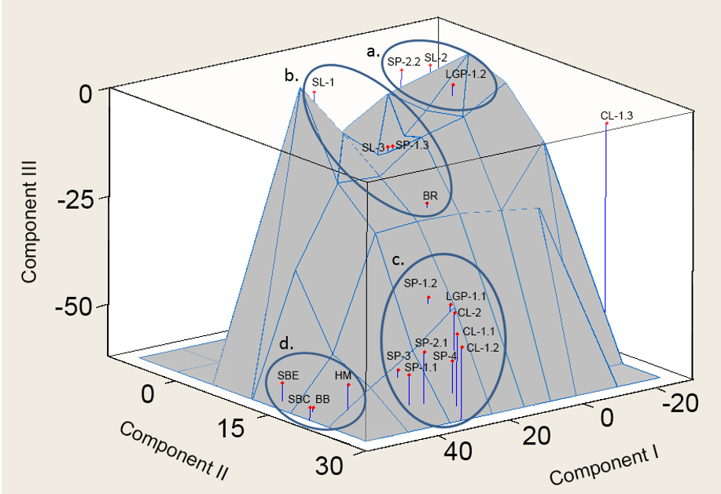
Principle Components Analysis
Audubon
Gannett Peak
Pinedale or older
Early Neoglacial

Slide 19
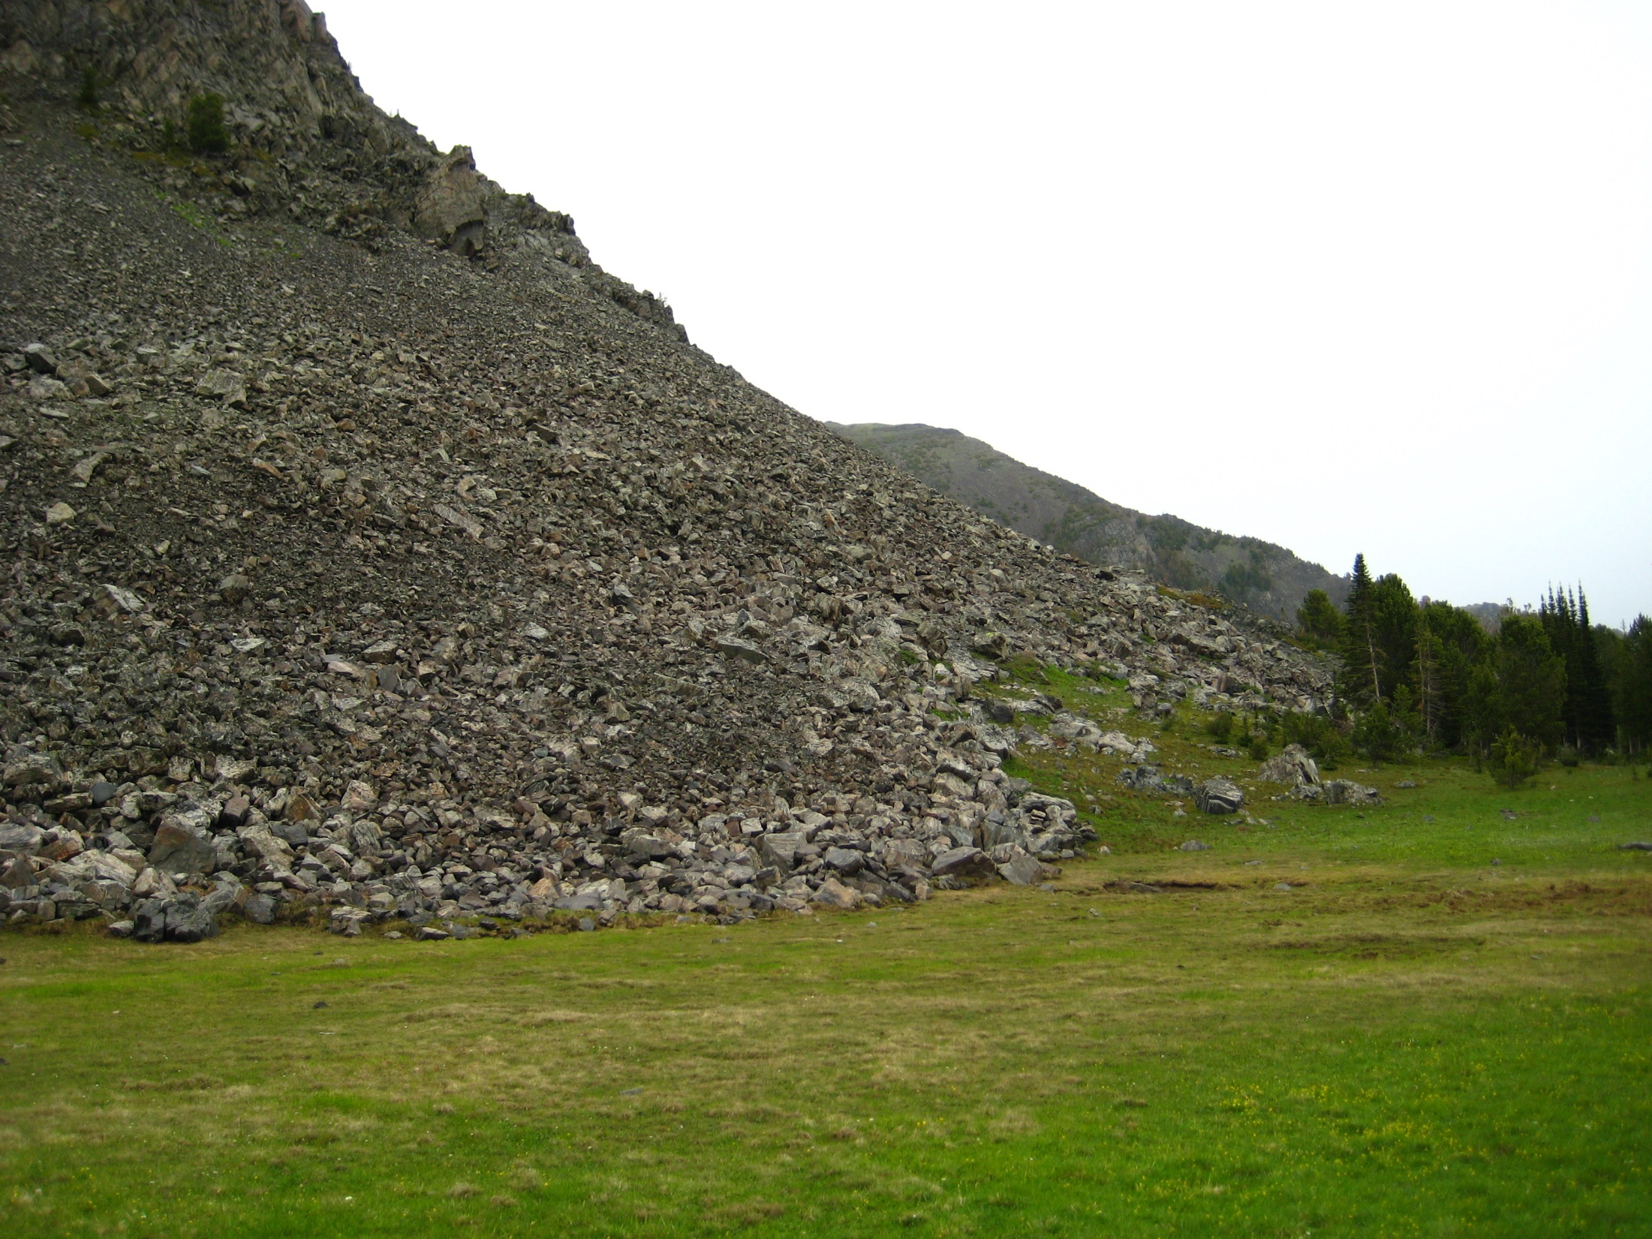
Conclusions
Four periods of periglacial development identified
Most deposits originated during the Early Neoglacial
Deposits emanate from topoclimatic niches of increased solar radiation reduction
Statistically significant differences between morphologies consistent with facies model
Fracture orientation can influence debris availability and deposit volume

Slide 20
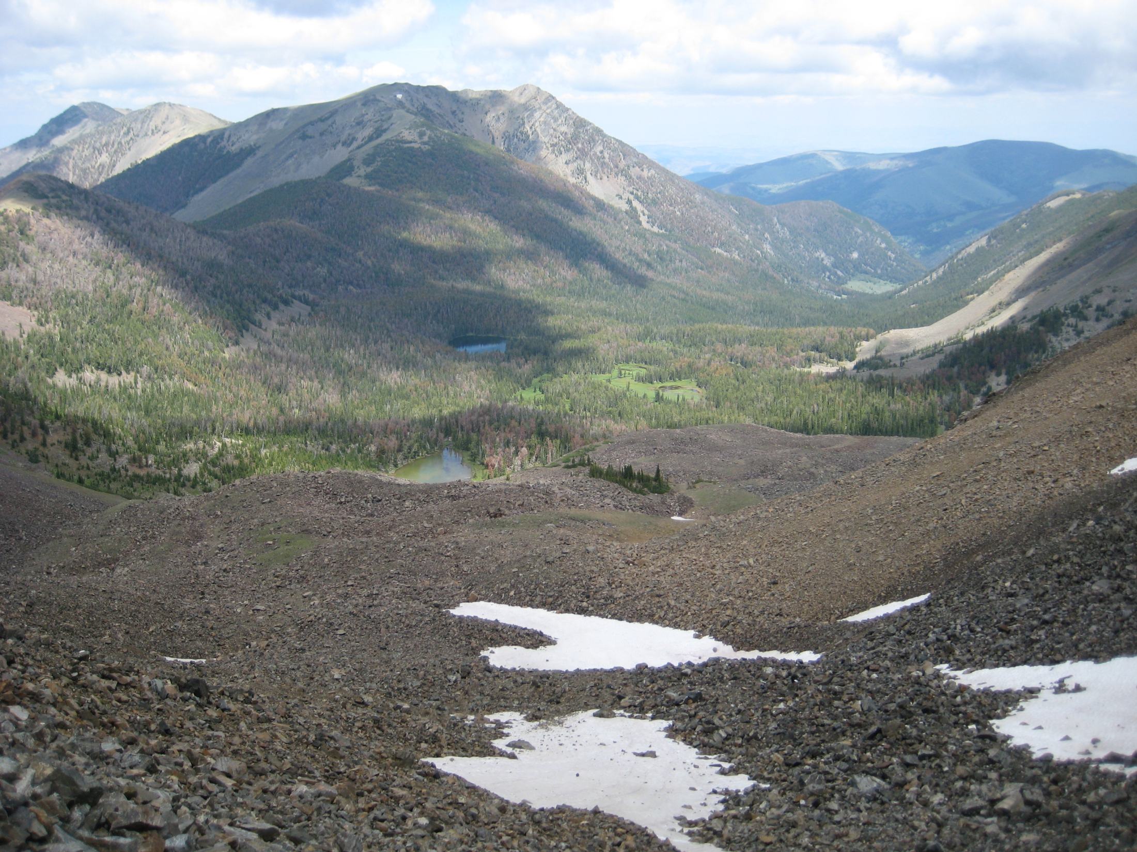
Questions?

