Slide 1



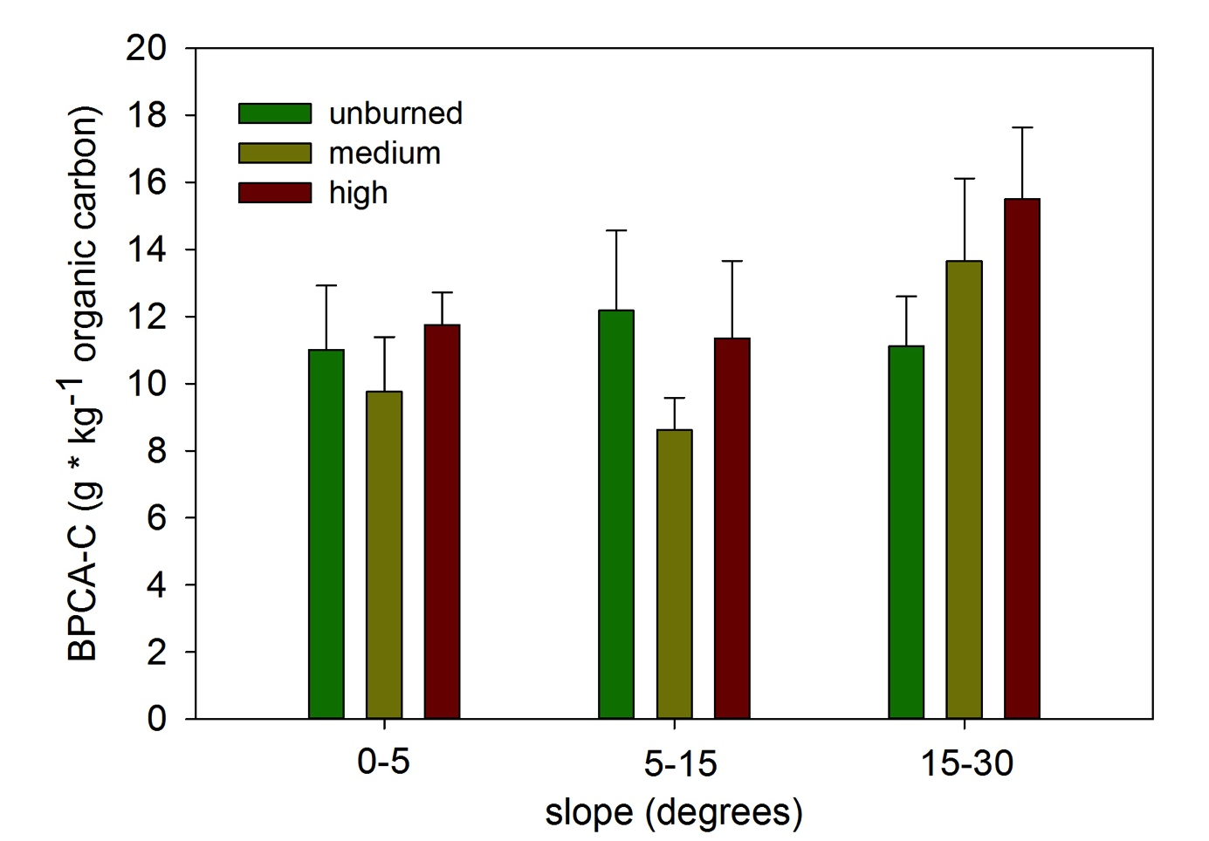
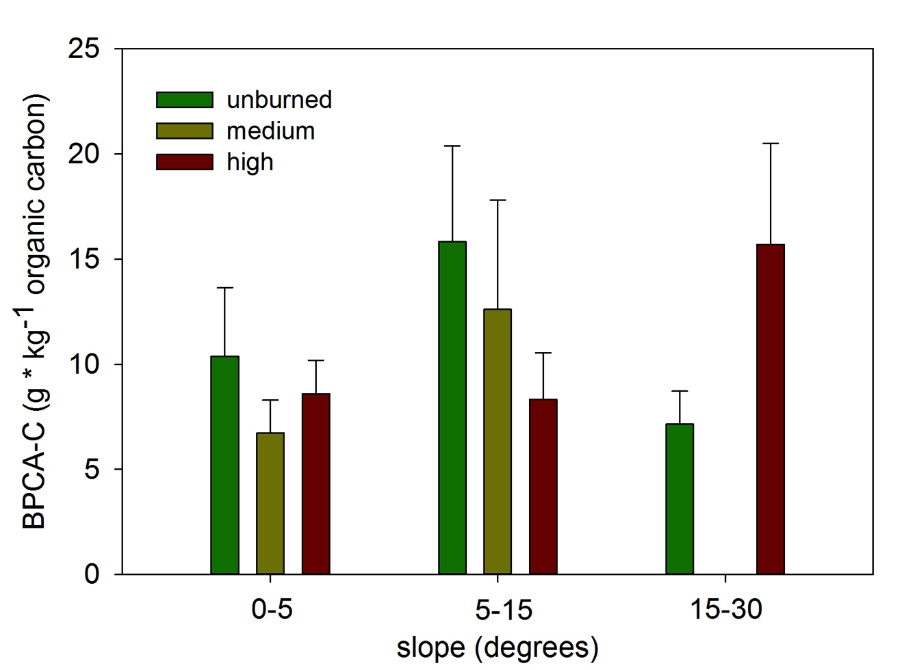
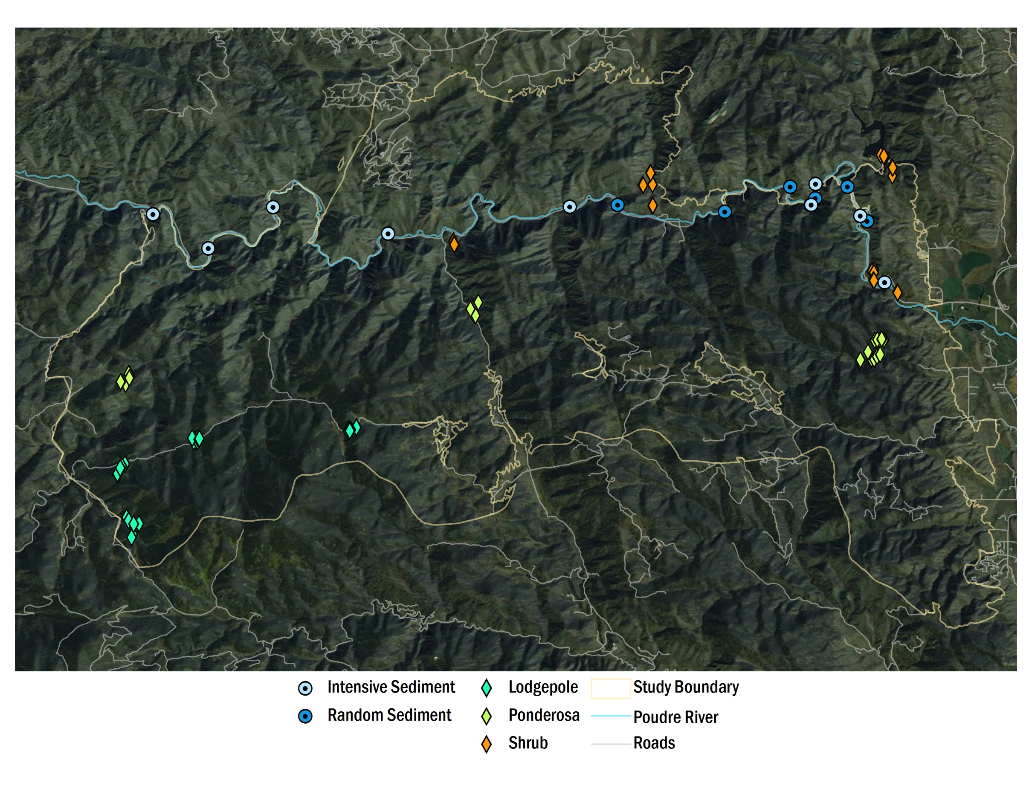
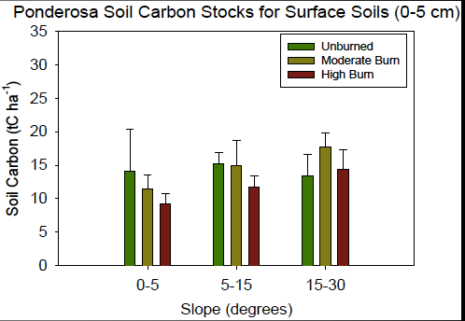
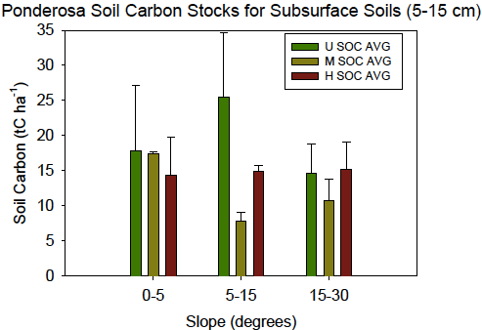
Accounting for Pyrogenic Carbon Stocks in the Cache La Poudre Watershed
following the High Park Fire
Claudia M. Boot, Michelle L. Haddix, Keith Paustian, M. Francesca Cotrufo
¹Natural Resource Ecology Laboratory, ²Soil and Crop Sciences, Colorado State University, Fort Collins, CO 80523
claudia.boot@colostate.edu
INTRODUCTION
A few estimates exist of pyrogenic C (PyC) production after fire (e.g., Santin et al., 2012), as well as of PyC stocks in soils, for different ecosystems (Bird et al. 1999, Cusack et al., 2012, Skiemstad et al. 2002).
Yet, estimates of PyC production and losses are not balanced (Czimczik & Masiello 2007, Rivas et al., 2012), clearly identifying our lack of understanding and the need for a full accurate accounting of PyC dynamics at the watershed level.
Between June 9th-24th, 2012, the High Park fire burned more than 35,000 ha, including ponderosa pine (Pinus ponderosa) and lodgepole pine (Pinus contorta) forests, and shrubland dominated by mountain mahogany (Cercocarpus montanus), along the Cache la Poudre River in northern Colorado.
QUESTIONS and EXPECTED RESULTS
What is the content of PyC in surface and subsurface soils, river sediments, and dissolved and particulate organic matter in the Cache La Poudre watershed following the High Park Fire?
In soil collection, we expected to find more PyC in surface soils, in moderate and high burn intensities, and low to moderate slopes.
EXPERIMENTAL DESIGN and METHODS
Site Selection: 3 burn intensities (unburned, moderate, high) 3 vegetation types (ponderosa pine, lodgepole pine, shrub), 3 slopes (0-5, 5-15, 15-30 degrees), 4 depths (surface litter, 0-5 cm, 5-15 cm, 15-30 cm)
Soil Collection: sampled 20×20 cm surface area monoliths, %C was measured by elemental analyzer (LECO), bulk density was measured by the millet method
PyC Quantification: benzene polycarboxylyic acid (BPCA) biomarkers
IV. METHOD DEVELOPMENT
Quantification of PyC: benzene polycarboxylyic acid (BPCA) biomarkers
solid phase: Waters Xbridge C18 column 3.5 μm particle size
mobile phase: buffered phosphoric acid (A) and acetonitrile (B) with gradient elution
gradient: 5 min hold @ 0.5% B, 25 min to 30% B, .1 min to 95% B, 5 min hold
detection: photodiode array @ 240 and 216 nm
quantification: standards with UV properties and retention times
V. DATA
a. method validation
b. soil C content
DATA, continued
c. soil PyC content
surface soil (0-5 cm) subsurface soil (5-15 cm)
VI. SUMMARY and FUTURE WORK
Soil C stocks were highly variable post-fire and ranged from 8.7-25.9 tC ha⁻¹ in the ponderosa pine soils. In surface soils, the high burn intensity tended to have lower soil C stocks compared to the moderate and unburned soil.
Contrary to our expectations, BPCA-C data from ponderosa pine soils indicated there were similar quantities of PyC in surface and subsurface soils among the different slopes, and that PyC tended to increase with burn intensity only on the steepest slopes.
High amounts of PyC in unburned and subsurface soils may be from previous fires, or from atmospheric deposition of PyC from burned areas to unburned sites. Additionally, lower amounts of PyC in high burn intensity sites may be due to losses from wind transport or combustion of residual soil PyC during the High Park fire.
Data collection are ongoing for this effort and include lodgepole and shrub surface and subsurface soils, riverine sediments and particulate and dissolved PyC from time course sampling of the Cache la Poudre.
VII. REFERENCES
Bird MI, Moyo C, Veenendaal EM, Lloyd J, Frost P (1999) Stability of elemental carbon in a savanna soil. Global Biogeochemical Cycles, 13, 923-932.
Czimczik CI, Masiello CA (2007) Controls on black carbon storage in soils. Global Biogeochemical Cycles, 21, doi:10.1029/2006GB002798.
Cusack DF, Chadwick OA, Hockaday WC, et al. (2012) Mineralogical controls on soil black carbon preservation. Global Biogeochemical Cycles, 26, doi: 10.1029/2011GB004109
Rivas Y, Matus F, Rumpel C, et al. (2012) Black carbon contribution in volcanic soils affected by wildfire or stubble burning. Organic Geochemistry, 47, 41-50.
Santin C, Doerr SH, Shakesby RA, et al. (2012) Carbon loads, forms and sequestration potential within ash deposits produced by wildfire: new insights from the 2009 'Black Saturday' fires, Australia. European Journal of Forest Research, 131, 1245-1253.
Skiemstad JO, Reicosky DC, Wilts AR, McGowan JA (2002) Charcoal carbon in US agricultural soils. Soil Science Society American Journal, 66, 1249-1255.
VIII. ACKNOWLEDGEMENTS
Amy Swan, Daniel Wiedemeier, Michael Schmidt, Clarie Freeman, John Norman, Tara Baker, Geoffrey Bedrosian, Jake Betzen, Daniel Kovar, Bryan Brown, Robert Murphy, Allison Reser, Halle Pooaw, Michael Jurich, Erika Szonntag, Joey e’Silva. Funding: NSF DEB 1261383.
U vs. H p = 0.084
U vs. H p = 0.056

