Slide 1
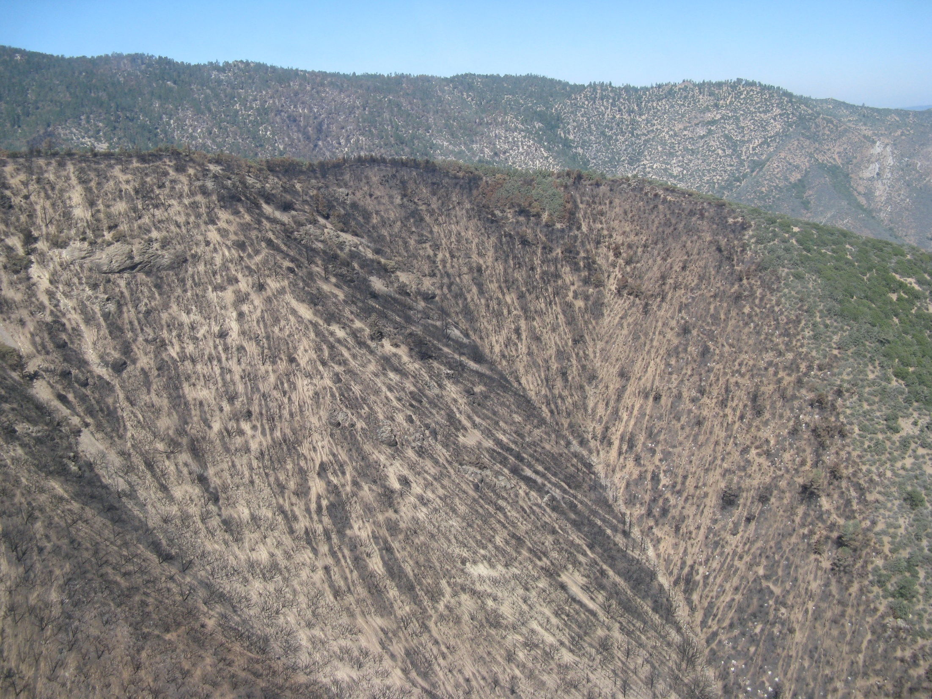

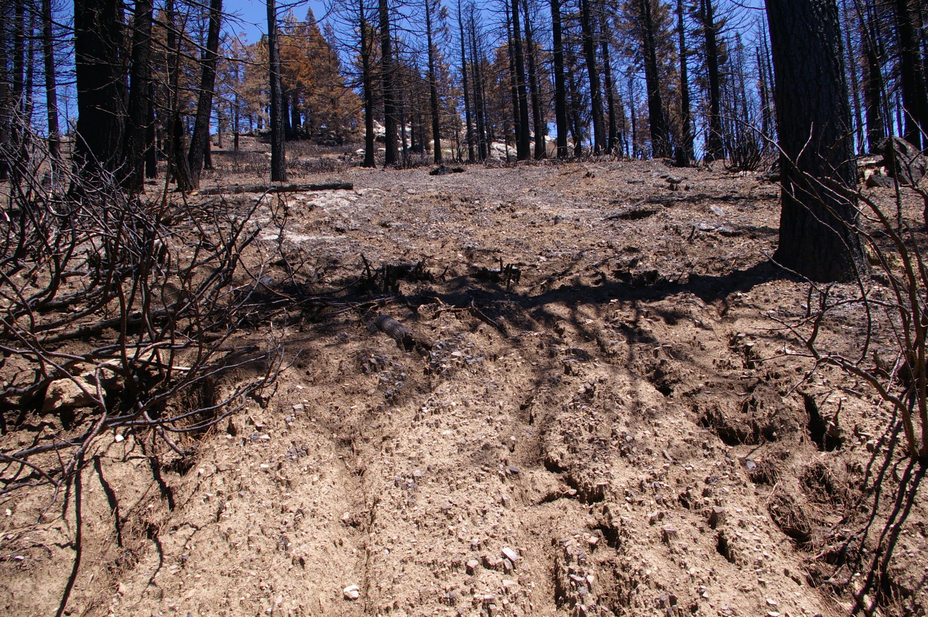
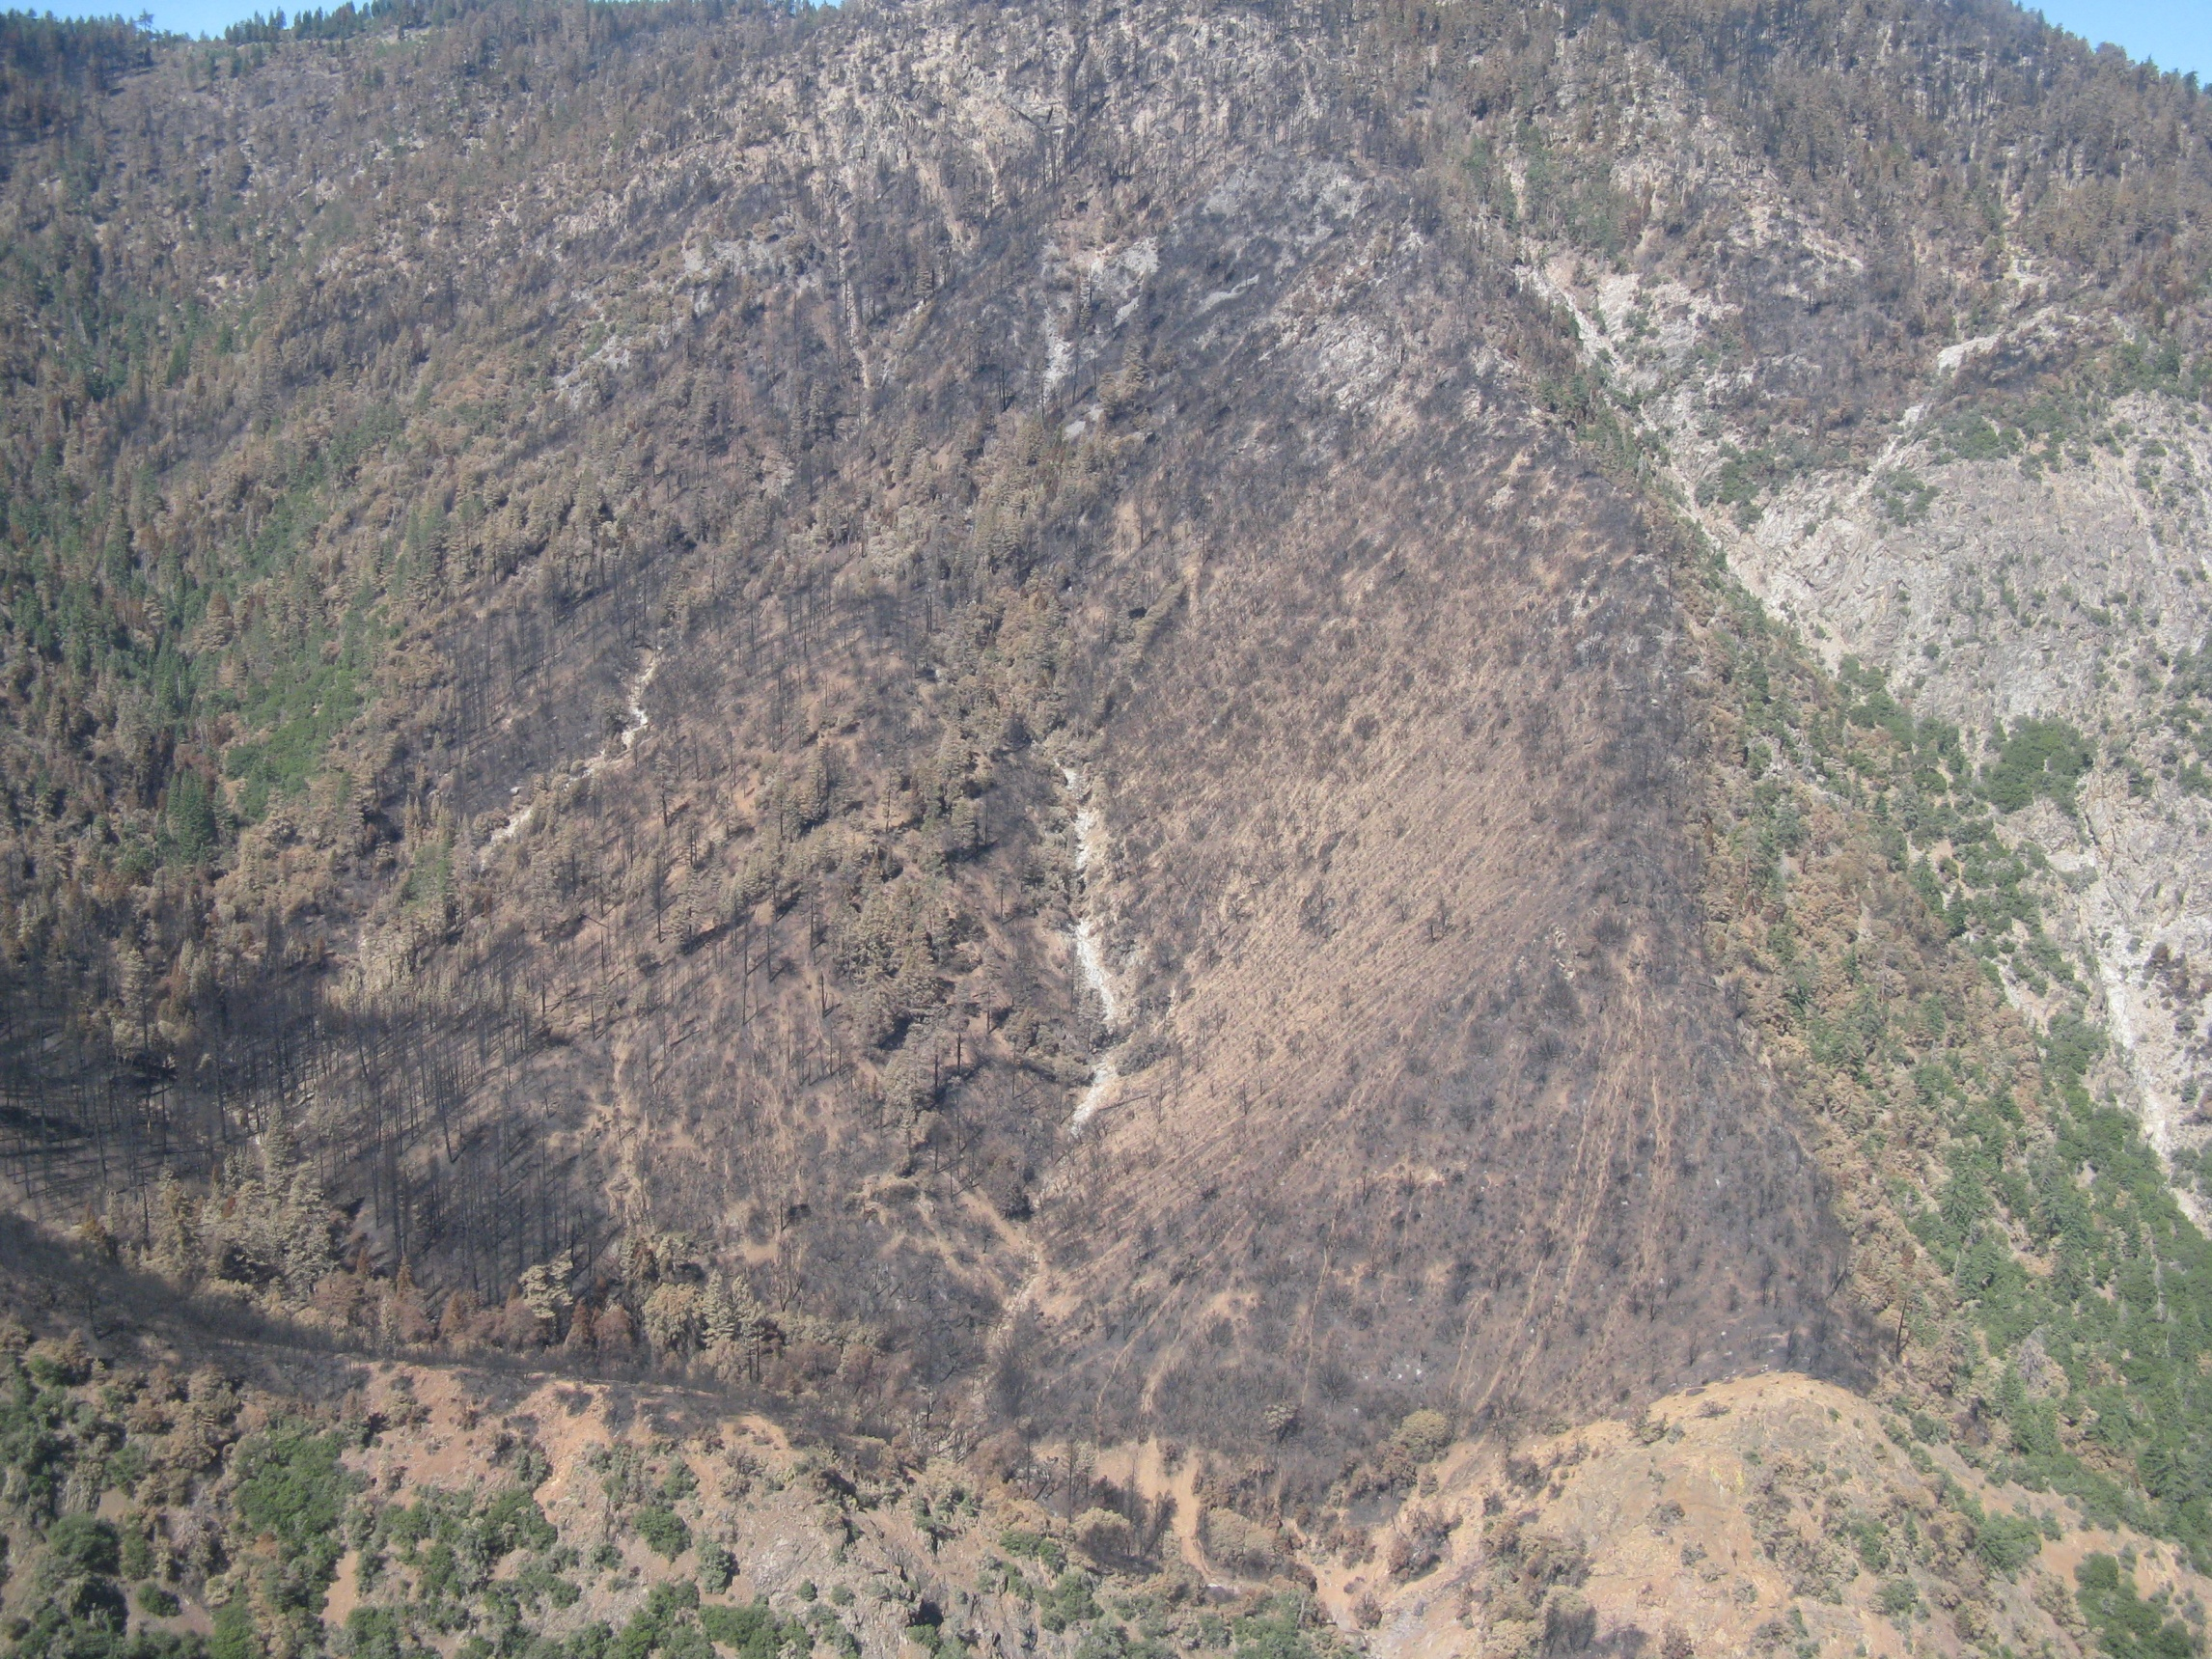
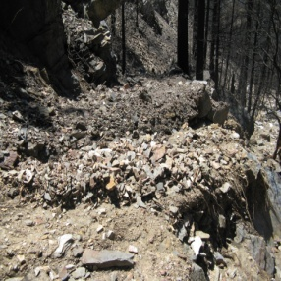
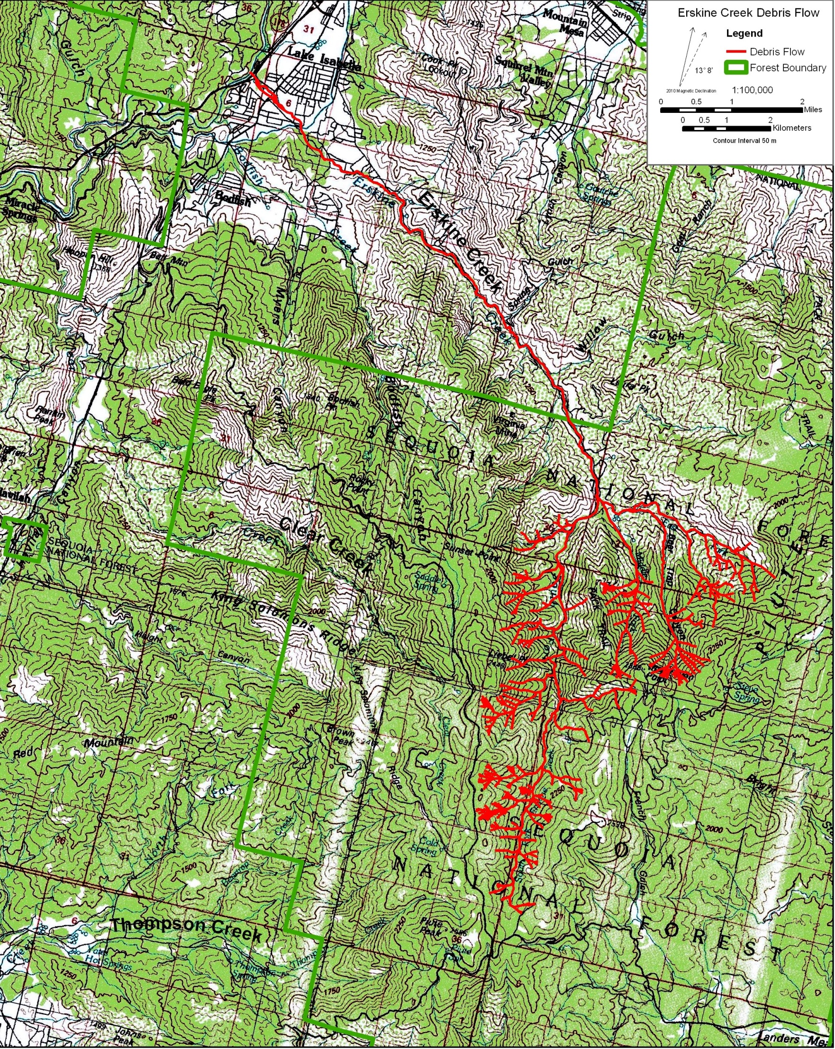
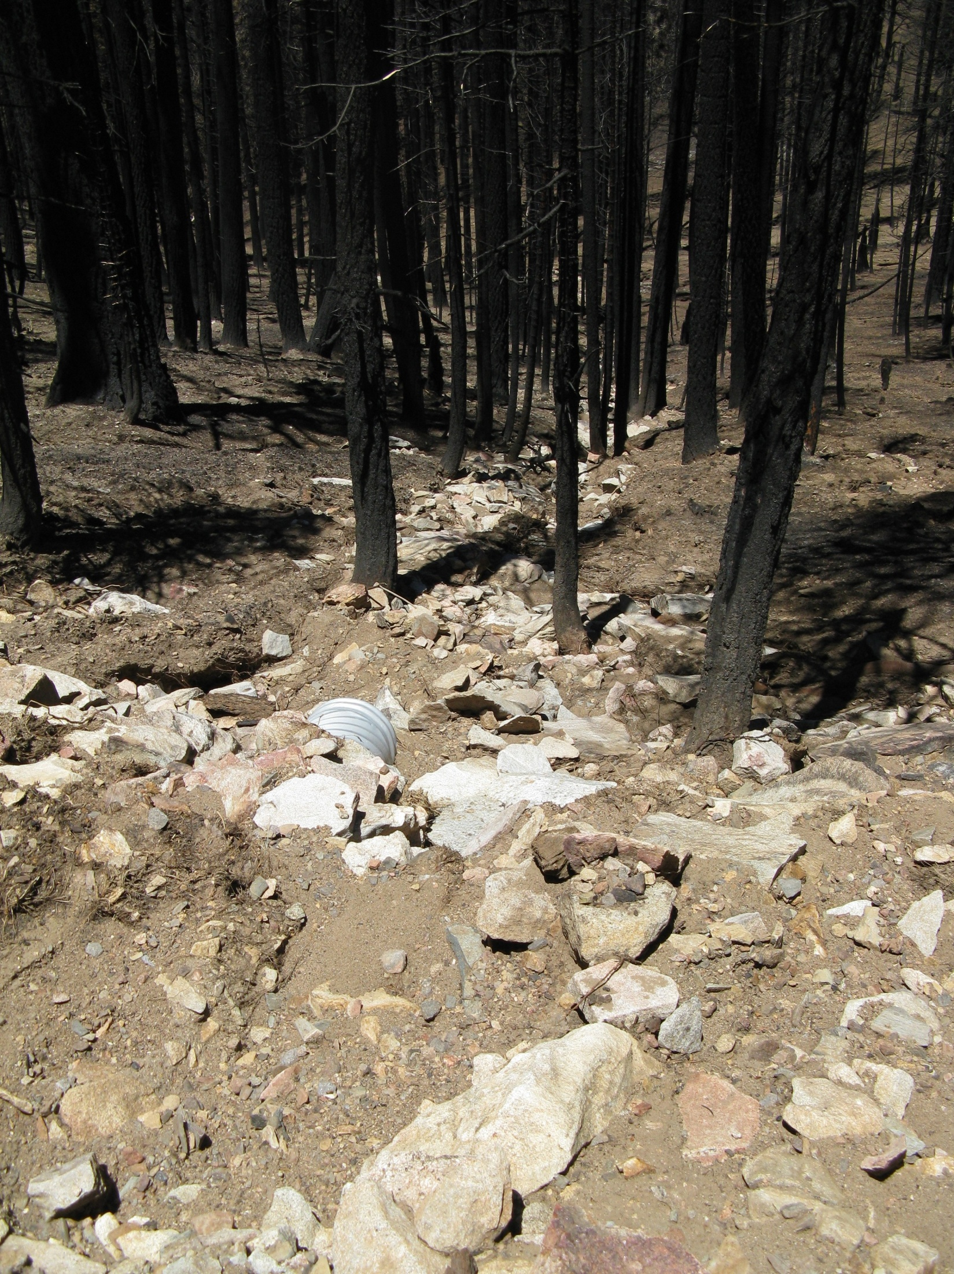
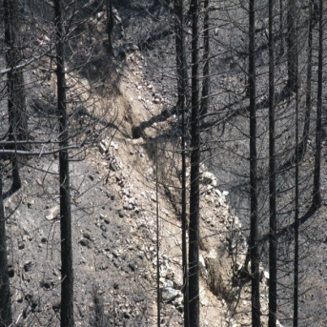
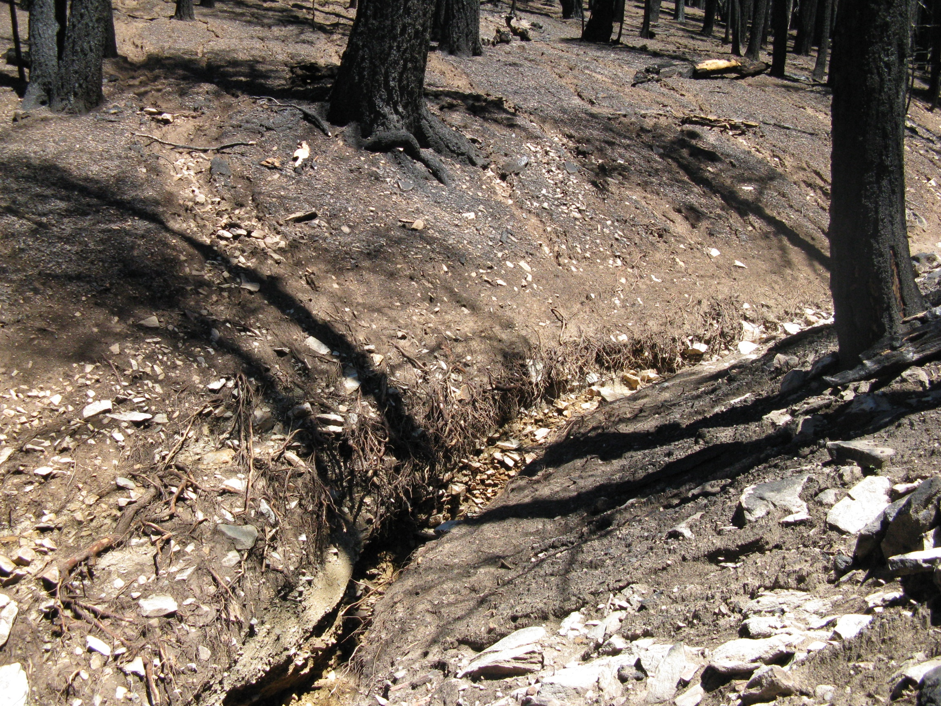
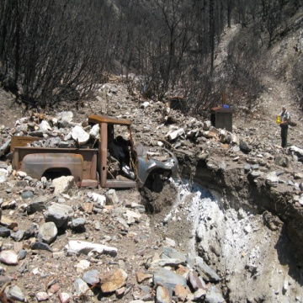
Observations demonstrating the runoff-initiation of the July 12, 2008 Piute wildfire debris flows, Sierra Nevada, California. Jerome V. De Graff and Alan J. Gallegos, USDA Forest Service, Clovis, CA
Abstract
On July 12, 2008, an intense rainfall fell on the Piute Mountains south of Lake Isabella, CA. At Piute Peak, a remote automated weather station recorded a rainfall intensity rate of 16.2 and 20.4 mm.hr during a thirty-minute period (De Graff et al., 2011). The rainfall triggered three large debris flows which passed down Erskine Creek, Clear Creek, and Thompson Canyon respectively. Much of the headwater source areas for these debris flows were burned by the Piute wildfire eleven days earlier. Within a week of the storm event, field observations were made of extensive rilling throughout the burned area. This indicated debris flow generation was due to erosion and entrainment of material by surface runoff, a process well documented in other parts of the western United States (Parise and Cannon, 2012). Examination at two areas, one in the headwaters of Thompson Canyon and the other within a major tributary to the South Fork of Erskine Creek, verified this process in the generation of the July 12th debris flows.
Thompson Canyon near Piute Peak
Tributary to South Fork of Erskine Creek
A
Levees at the mouth of small unnamed branch of tributary channel. At least, two surges of debris issued into the main flow based on the presence of the smaller levee inset from larger outer levee. The red dashed line indicates the center of the contributing debris flow path into the main debris flow.
Another of the multiple small debris flows which joined the debris flow in the main tributary. The flow path is clearly bordered by levees of coarse rock along its steep channel.
C. A view up the channel along the path taken by the debris flow in the tributary to the South Fork of Erskine Creek. The debris flow passed through an abandoned mine destroying small structures and eroding a large waste rock pile (in the foreground). The mine access road is visible in the right background behind the person standing on the outer edge of the debris flow levee.
Rills on area of high soil burn severity
A
Closely-spaced rills in the headwaters of Thompson Canyon were eroded in the soil bared by the wildfire. This is close to the location of the remote automated weather station at Piute Peak.
Runoff from the rills collected along ephemeral channels.. This runoff contained significant sediment eroded from the channel leaving a lag deposit of large rocks behind.
C. At some point down channel, theis hyperconcentrated sediment flow transformsed into a debris flow. The viscous, fluid debris flow mass had sufficient shear strength to “track” like a race car in a curve. The channel was efficiently eroded by its passage.
B
B
C
C
References
De Graff, J., , Wagner, D., Gallegos, A., DeRose, M., Shannon, C. and Ellsworth, T. (2011) The remarkable occurrence of large rainfall-induced debris flows at two different locations on July 12, 2008, southern Sierra Nevada, California: Landslides 8:343-353.
Parise, M. and Cannon, S.H. ((2012) Wildfire impacts on the processes that generate debris flows in burned watersheds: Natural Hazards 61:217-227

