Slide 1

The provenance challenge of the Harmony Formation in central Nevada: An enigmatic piece in the Cordilleran jigsaw puzzle
Gwen M. Linde*, Patricia H. Cashman*,
William R. Dickinson**, and James H. Trexler, Jr.*
*Department of Geological Sciences and Engineering, University of Nevada, Reno, Nevada
**Department of Geosciences, University of Arizona, Tucson, Arizona

Slide 2
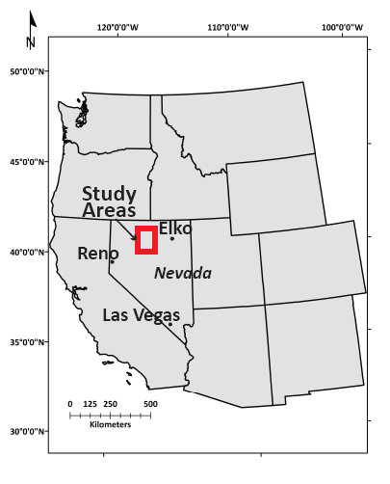
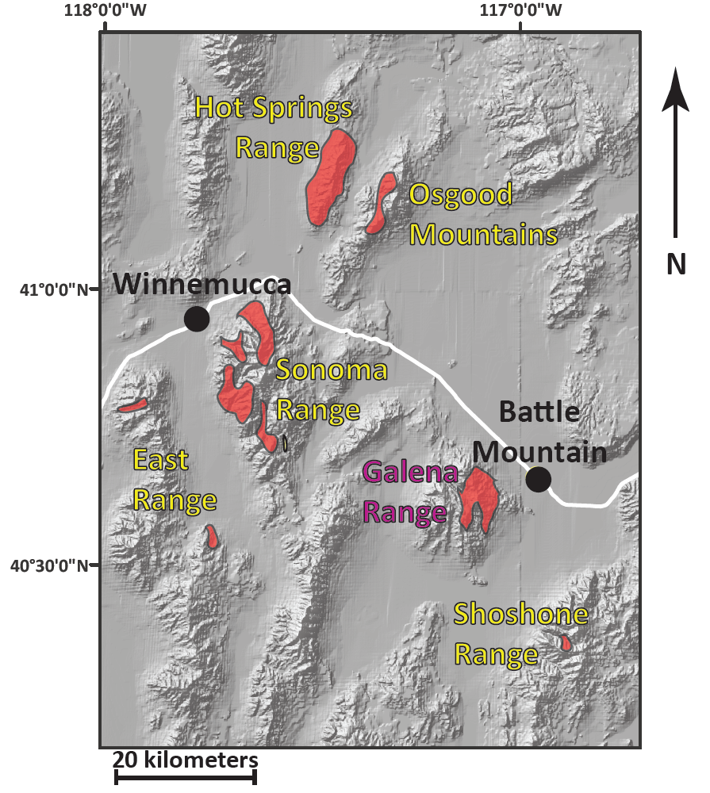
Harmony Formation
Harmony A – Galena Range
Harmony B – All ranges

Slide 3
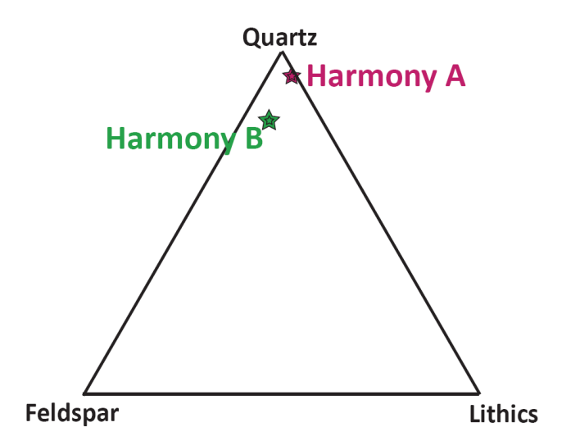
Q = 80
F = 15
L = 5 *
Harmony B
Q = 93
F = 1
L = 6 *
Harmony A
(crossed Nicols)
* Dickinson and Gehrels, 2000

Slide 4
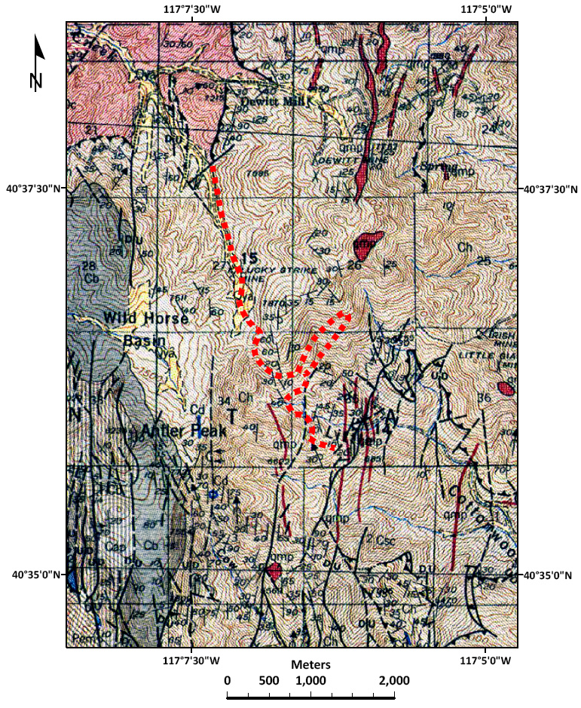
Little Cottonwood Canyon (Galena Range)
Harmony B
Harmony A
Antler Peak Limestone
Battle Formation
---- : Contact Harmony A -- B
Harmony Formation
Comus Formation
Base: Antler Peak Quad,
Roberts, 1951

Slide 5
Harmony Formation Occurrence
Top nappe
Roberts Mountains Allochthon
Underlying the Antler Overlap Sequence
Clasts, with other RMA rocks
in Mississippian Antler Foreland Basin strata

Slide 6
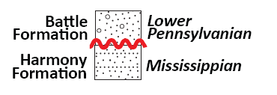
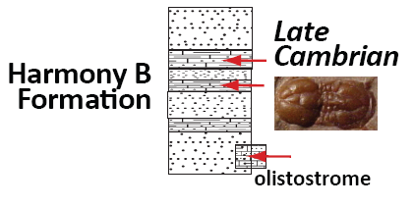
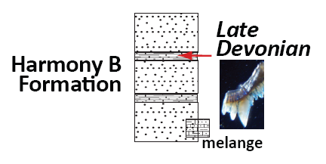
Harmony Formation Age
Roberts, 1951
Hotz & Willden, 1964
Jones, 1997; Ketner, 2000

Slide 7
Sample locations
Gough’s Canyon (B)
Kluncy Canyon (B)
Little Cottonwood
Canyon (A & B)

Slide 8
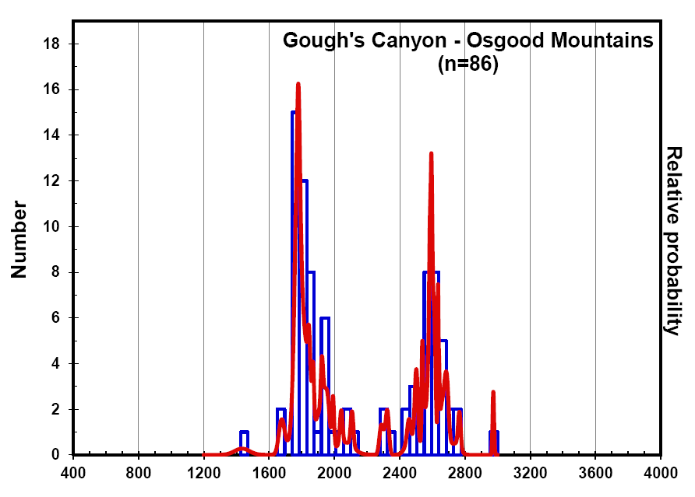
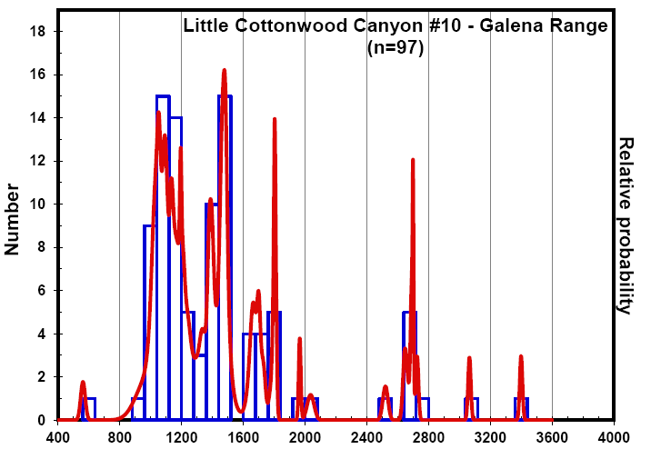
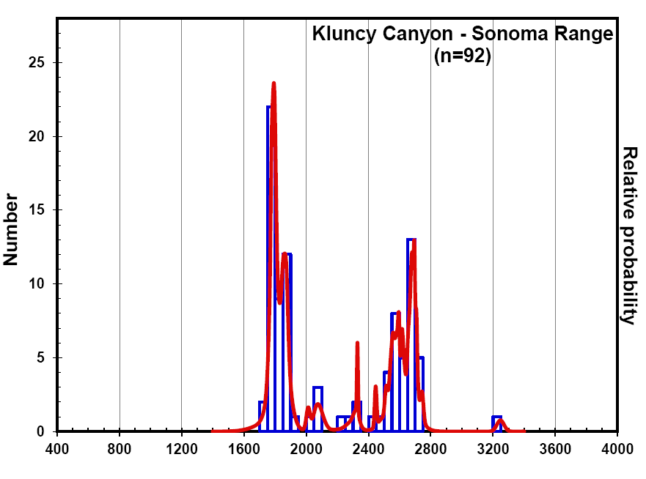
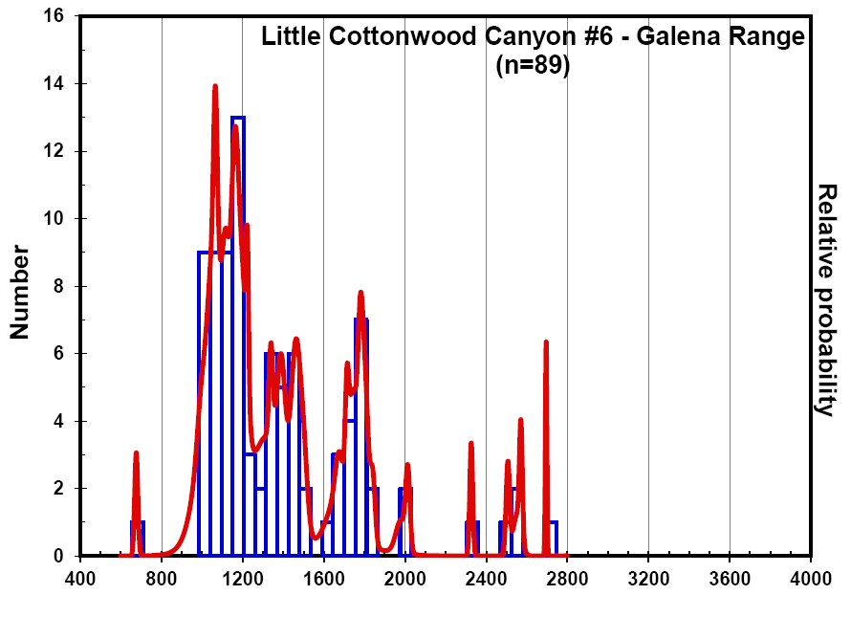
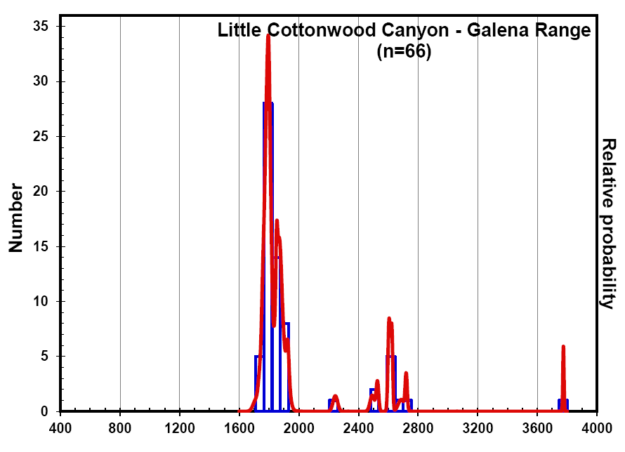
Harmony B (arkosic)
Harmony Formation
Harmony A (quartzose)
(Relative probability graphs)
Reported U-Pb ages are concordant ages from LA-ICP-MS at
University of Arizona LaserChron Center

Slide 9
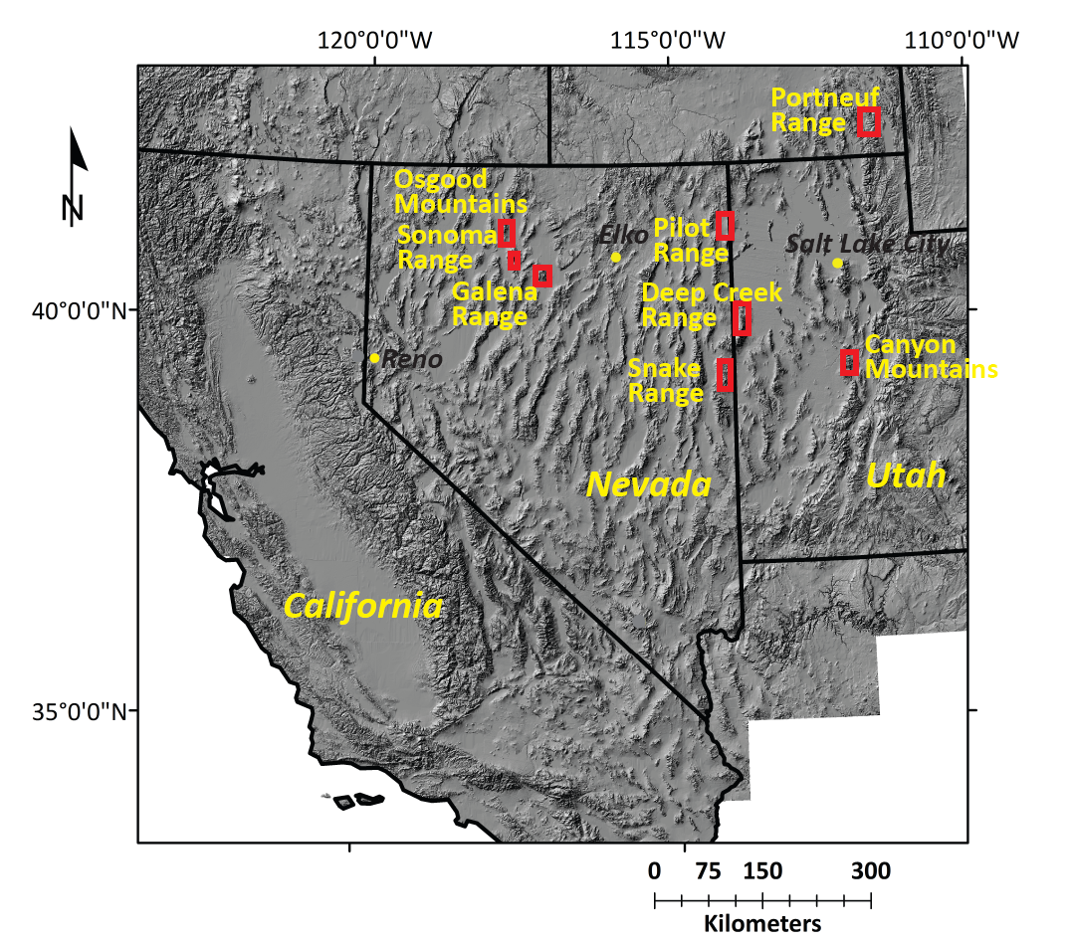
Harmony Formation compared to: Neoproterozoic/Cambrian Passive Margin

Slide 10
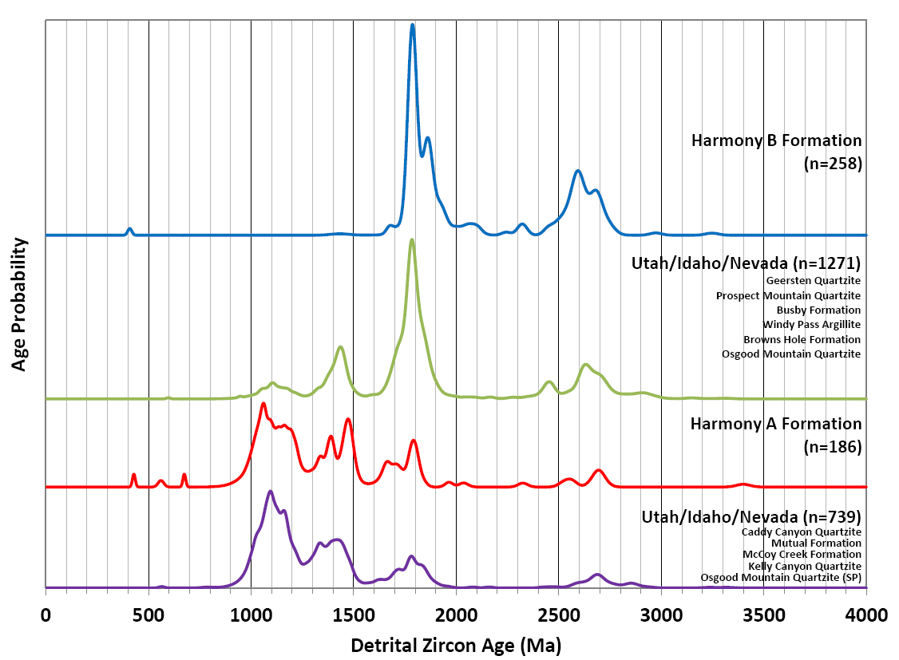
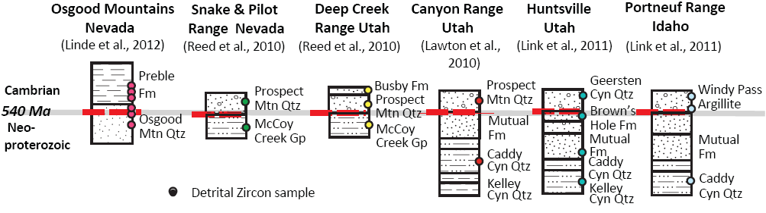
1.34-1.40, 1.40-1.48 provinces
Grenville Orogen
Maz/
Yav
Archean
Craton
Passive Margin
1
3
4,5
4
3
Younger
Passive Margin
3
2
1
Older
Passive Margin
5
3
4
3
2
1: This study; 2: Linde et al., 2012; 3: Link, et al., 2011;
4: Reed et al., 2012; 5: Lawton et al., 2010
(Normalized probability graph)

Slide 11
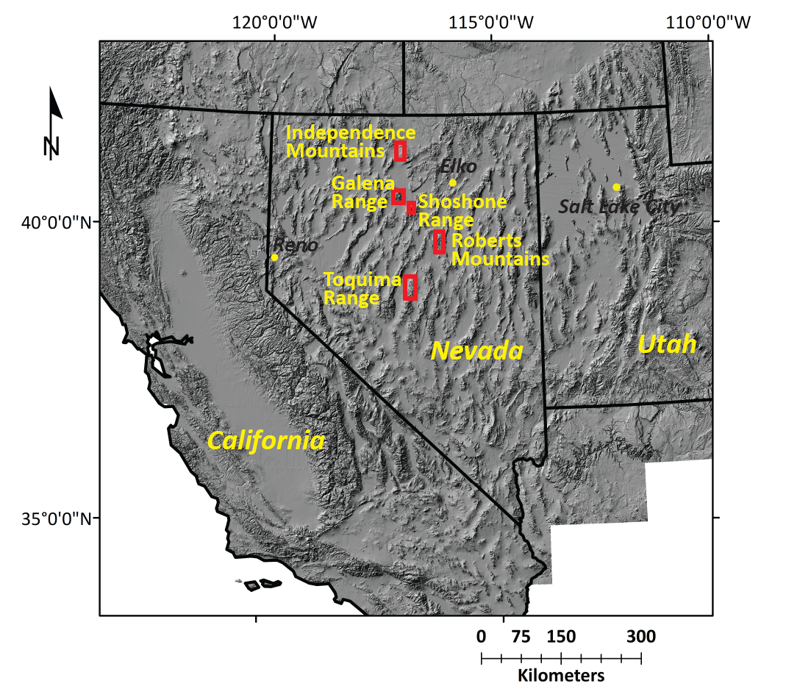
Harmony Formation compared to: Ordovician – Devonian Roberts Mountains Allochthon

Slide 12
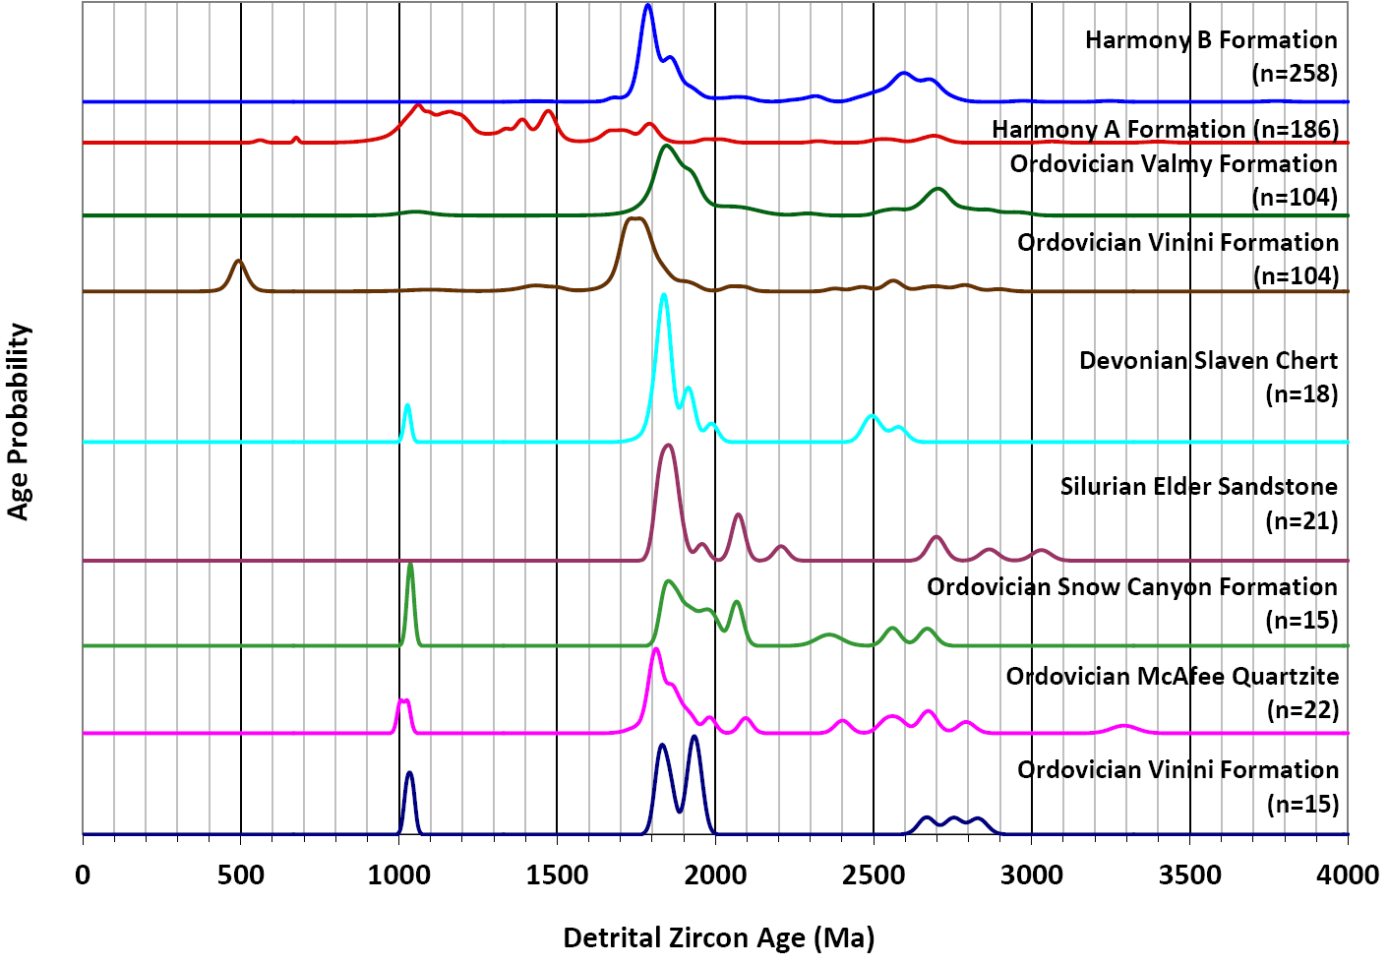
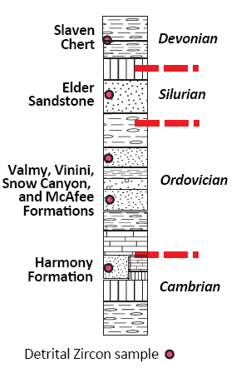
1.34-1.40, 1.40-1.48 provinces
Mazatzal Yavapai
Archean
Craton
Grenville Orogen
1
Harmony Formation
1
Roberts
Mountains
Allochthon
2
3
4
4
4
4
4
1: This study; 2: Smith & Gehrels, 1994;
3: Gehrels & Stewart, 1998; 4: Gehrels et al., 2000
After Gehrels
et al., 2000
(Normalized probability graph)

Slide 13
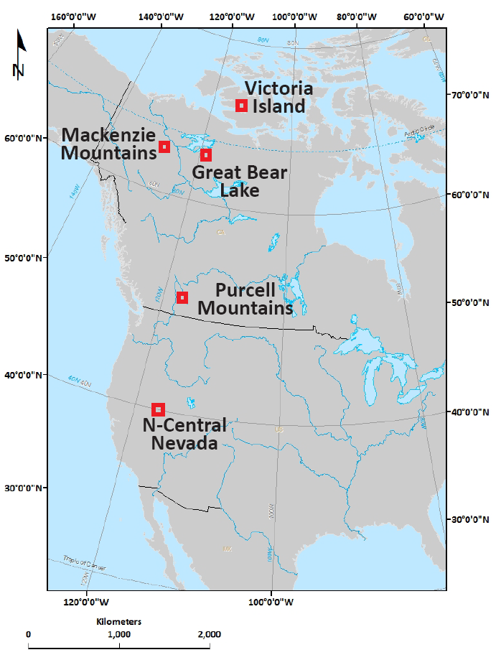
Harmony Formation compared to: NP/Cambrian Canadian Arctic & BC

Slide 14
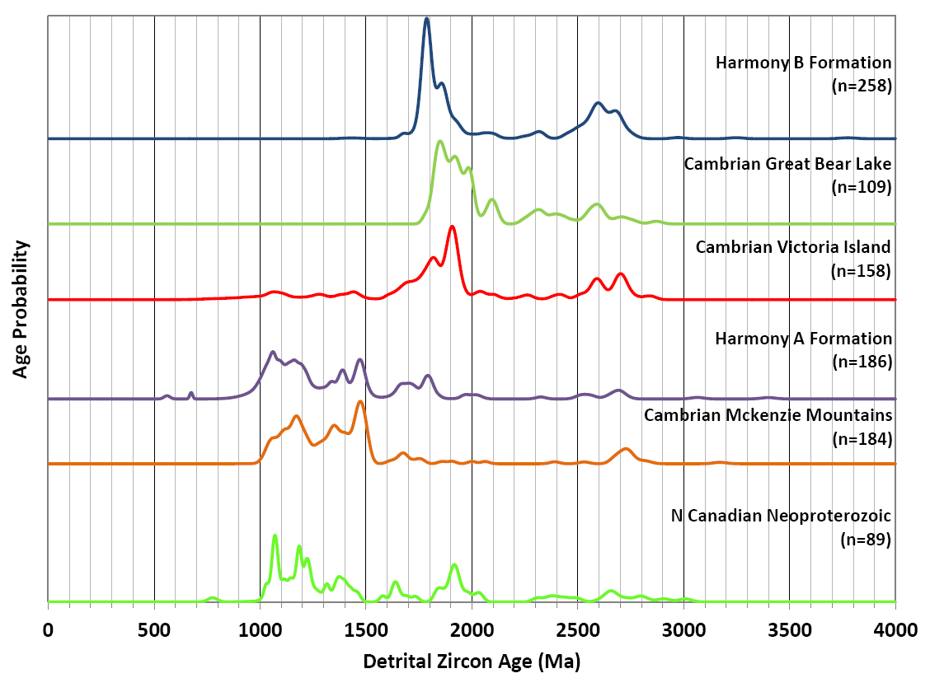
Neoproterozoic/Cambrian
Canadian Arctic
1.34-1.40, 1.40-1.48 provinces
Mazatzal and
Yavapai
Grenville Orogen
Archean
Craton
1
2
2
1
2
2
(Normalized probability graph)
1: This study; 2: Hadlari et al., 2012

Slide 15
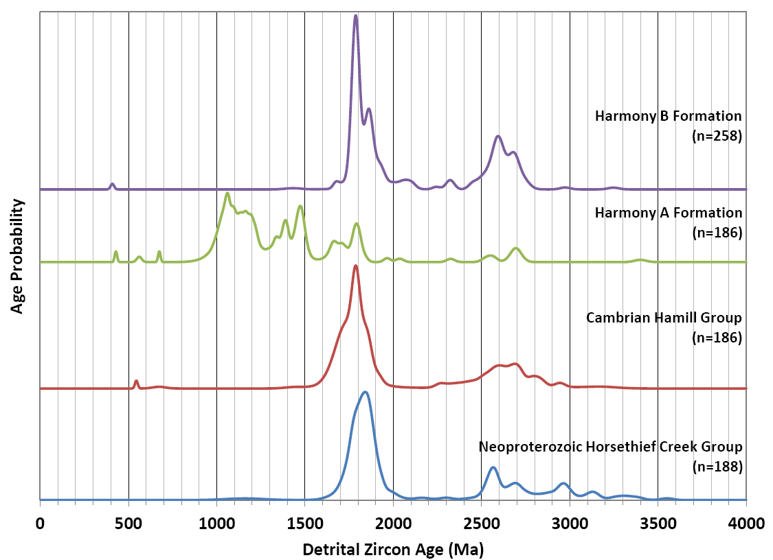
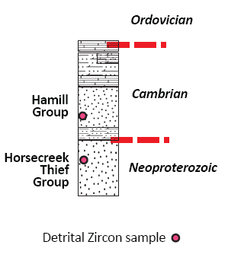
Neoproterozoic/Cambrian
Southern British Columbia
1.34-1.40, 1.40-1.48 provinces
Mazatzal and
Yavapai
Grenville Orogen
Archean
Craton
1
1
2
2
1: This study; 2: Gehrels & Ross, 1998
(Normalized probability graph)

Slide 16
Harmony Formation Provenance
Source? Depocenter? Age?
Must account for A and B
Must be Laurentian
Relative immaturity of Harmony B

Slide 17
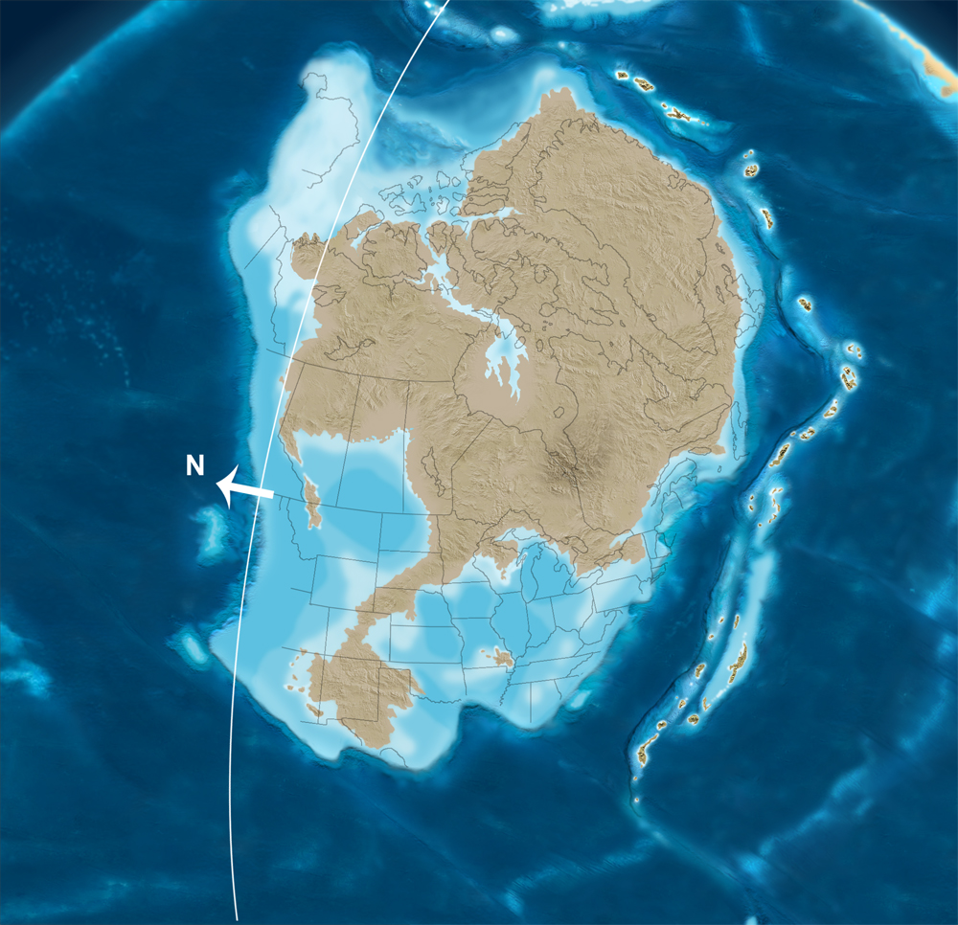
What if the Harmony is Late Cambrian?
Sources
1.0-1.2 Ga
1.7-1.8 Ga
500 Ma
Paleogeography:
Ron Blakey,
NAU Geology

Slide 18
What if the Harmony is Late Cambrian?
Sources
Arctic
1.0-1.2 Ga
1.7-1.8 Ga
Basins
British Columbia
Paleo-Pacific
500 Ma
Paleogeography:
Ron Blakey,
NAU Geology

Slide 19
What if the Harmony is Late Cambrian?
Sources
Arctic
1.0-1.2 Ga
1.7-1.8 Ga
Basins
British Columbia
Paleo-Pacific
Pathways
Harmony B
Harmony A
500 Ma
Paleogeography:
Ron Blakey,
NAU Geology

Slide 20
What if the Harmony is Late Cambrian?
Sources
Arctic
A
1.0-1.2 Ga
1.7-1.8 Ga
Harmony B
Basins
British Columbia
Paleo-Pacific
Pathways
500 Ma
Paleogeography:
Ron Blakey,
NAU Geology

Slide 21
What if the Harmony is Late Cambrian?
Sources
Arctic
1.0-1.2 Ga
1.7-1.8 Ga
Basins
British Columbia
Harmony A
B
Pathways
Paleo-Pacific
500 Ma
Paleogeography:
Ron Blakey,
NAU Geology

Slide 22
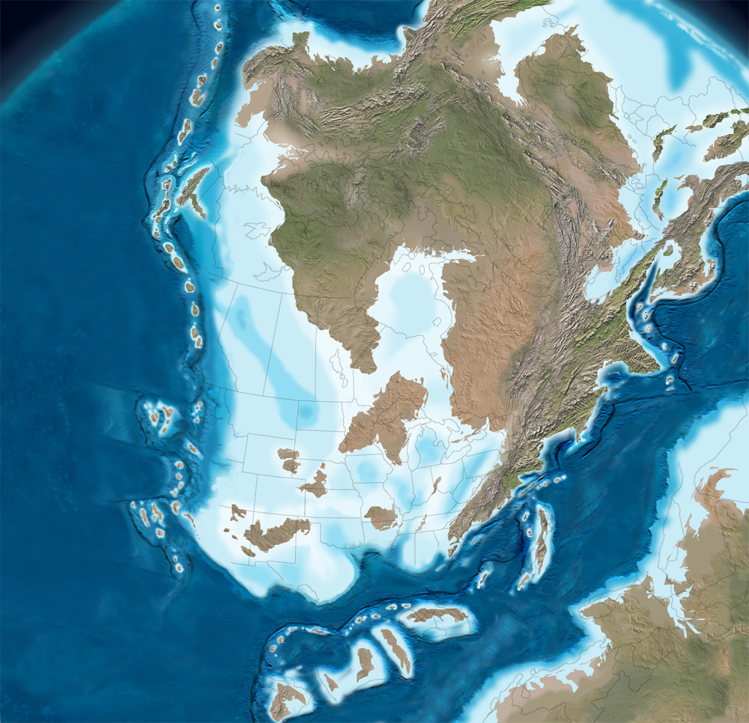
What if the Harmony is Late Devonian?
Sources
1.0-1.2 Ga
1.7-1.8 Ga
360 Ma
Paleogeography:
Ron Blakey,
NAU Geology

Slide 23
What if the Harmony is Late Devonian?
Sources
1.0-1.2 Ga
1.7-1.8 Ga
Basins
Paleo-Pacific
360 Ma
Paleogeography:
Ron Blakey,
NAU Geology

Slide 24
What if the Harmony is Late Devonian?
Sources
1.0-1.2 Ga
1.7-1.8 Ga
Basins
Paleo-Pacific
Pathways
Harmony B
Harmony A
360 Ma
Paleogeography:
Ron Blakey,
NAU Geology

Slide 25


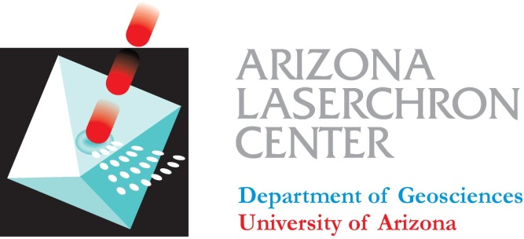

Thank you!
Dan Sturmer and Ross Miller, LA-ICP-MS assistants
George Gehrels, the Arizona LaserChron staff, and NSF EAR 1032156 supporting LaserChron & grad students
NSF Graduate Research Fellowship Program
NSF EAR 0510915 (Pat Cashman PI)
UNR grad student association travel grant
U.S. Dept of Veterans Affairs Post-9/11 G.I. Bill
GSA travel grant

Slide 27
Harmony Formation
Harmony A
quartzose
Harmony B
arksoic
(uncrossed Nicols)

