Slide 1
Developing a Protocol to Describe and Delineate Episodic Streams on Arid Landscapes FOR PERMITTING UTILITY-SCALE SOLAR POWER PLANTS
Roland H. Brady III
Brady and Associates Geologic Services
Kris Vyverberg
California Department of Fish and Wildlife

Slide 2
Thanks to:
California Energy Commission (Funding)
Singleton Thibodeaux-Yost (Graduate student, CSU-Fresno)
Carolyn Chainey-Davis (Botanist-Consultant)
Kirk Vyverberg (Field support, editorial review, great camp cookin’)

Slide 3
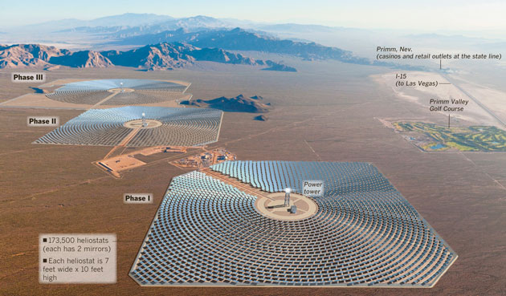
Development of utility-scale, solar power plants have high priority to provide much needed electrical energy in CA.
Ivanpah Solar Thermal EGS
Largest in world
3500 acres
377 MW
Supply 14,000 homes annually
Photo and data courtesy BrightSource Energy

Slide 4
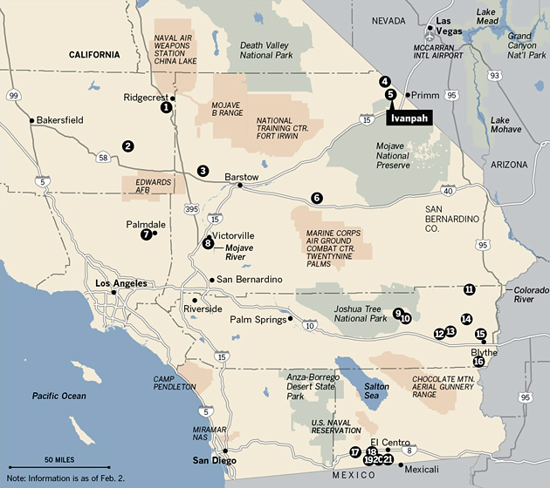
21 pending permit applications in CA desert. Proposed plant sitings covers hundreds of thousands of acres.
Map courtesy of Los Angeles Times Data Desk.

Slide 5
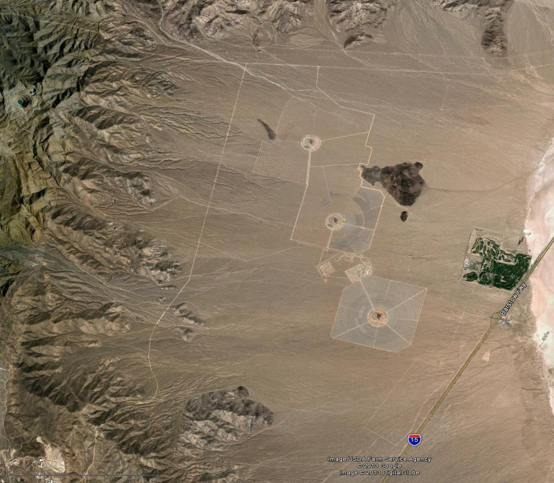
Desert -- area of ephemeral watersheds. Years between flows.
2 mi
Project footprint
Ivanpah STEGS

Slide 6
IMPORTANCE OF EPHEMERAL STREAMS IN ARID ECOSYSTEMS
Higher biodiversity along stream corridors.
Streams transport water, organic matter; disperse seeds and sediment.
Channels provide elevational connectivity and refuge for animal migration.
“Home” - - softer sediment in stream channel = greater ease of burrowing than on fan.
Because ephemeral stream habitats scarce in arid landscapes should be protected whenever possible.

Slide 7
Project Permitting
Environmental permitting process extensive.
Solar thermal (and maybe photo-voltaic) projects permitted through California Energy Commission (CEC).
CDFW responsible for conserving, protecting, and managing California's fish, wildlife, and native plant resources:
Identify potential adverse impacts to fish and wildlife.
Identify measures to eliminate or reduce impacts including avoidance, minimization, and mitigation.

Slide 8
Fish and Game Code (Section 1602)
1600 Lake and Streambed
Alteration Agreement
“Applies to any work undertaken in or near a river, stream, or lake that flows at least intermittently through a bed or channel. Includes ephemeral streams, desert washes, and watercourses with a subsurface flow.”

Slide 9
1600 requires entity to notify CDFW of any proposed activity or project that may:
Substantially modify a river, stream, or lake;
Substantially divert or obstruct the natural flow;
Substantially change or use any material from the bed, channel, or bank, or;
Deposit or dispose of debris, waste, or other material….. where it may pass into any river, stream, or lake.
Damage to jurisdictional streams requires on- or off-site mitigation.

Slide 10
Compliance requires proper recognition of active steams and their delineation = determination if jurisdictional.
HOWEVER:
Although delineation = Fluvial geomorphology, commonly conducted by consulting staff having little or no experience in desert fluvial geomorphology.
No consistent protocols for delineating streams.
No consistent terminology for describing ephemeral stream features and processes.
CDFW claim to jurisdictional waterways has been inconsistent.

Slide 11
Little communication between stormwater engineers and environmental compliance staff.
Applicants’ general misunderstanding of ephemeral stream features and processes. e.g:
Not recognizing indicators of stream flow = not recognizing presence of stream.
Identifying (incorrectly) streams as “inactive” but not documenting features indicating age (soils, pavement, varnish, weathering).
Misinterpreting distributed out-of-channel flow as “sheetflow” (no channel, thus non-jurisdictional).

Slide 12
Although much conceptual and regulatory guidance for perennial streams, little guidance to assist in task in mapping/delineating ephemeral stream systems:
US Army Corps of Engineers Ordinary High Water.
Application to ephemeral streams doubtful (USACE presently modifying guidelines for arid watersheds).
Stream Processes and Forms in Dryland Watersheds K. Vyverberg, ed., (2010) CDFW.

Slide 13
Negative incentive to document streams at permit site.
Guiding principle:
Fewer streams =
Less jurisdictional area =
Less mitigation =
Less $$ to client.

Slide 14
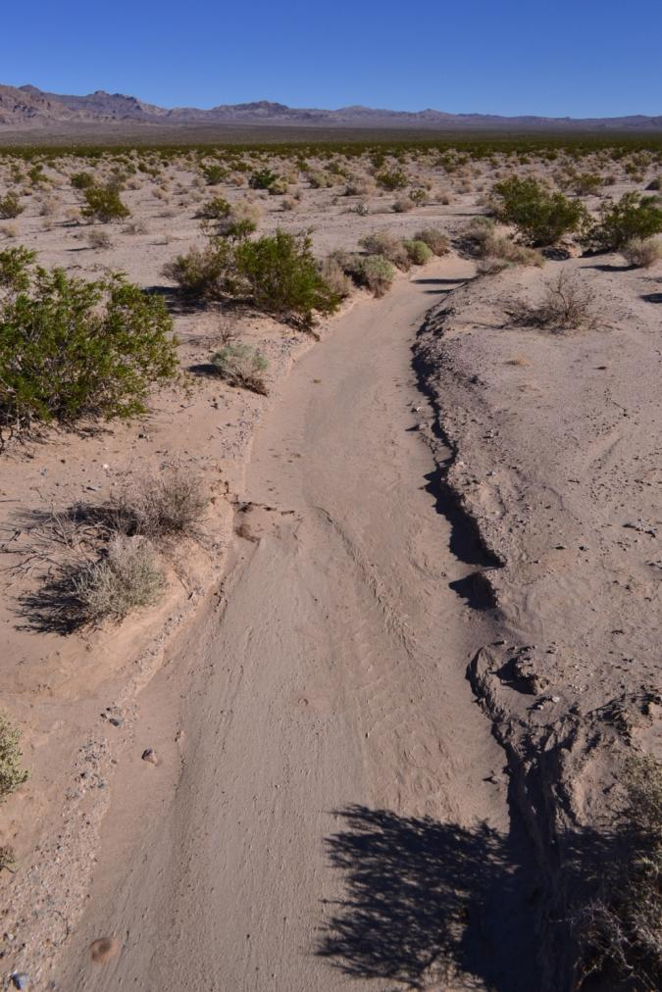
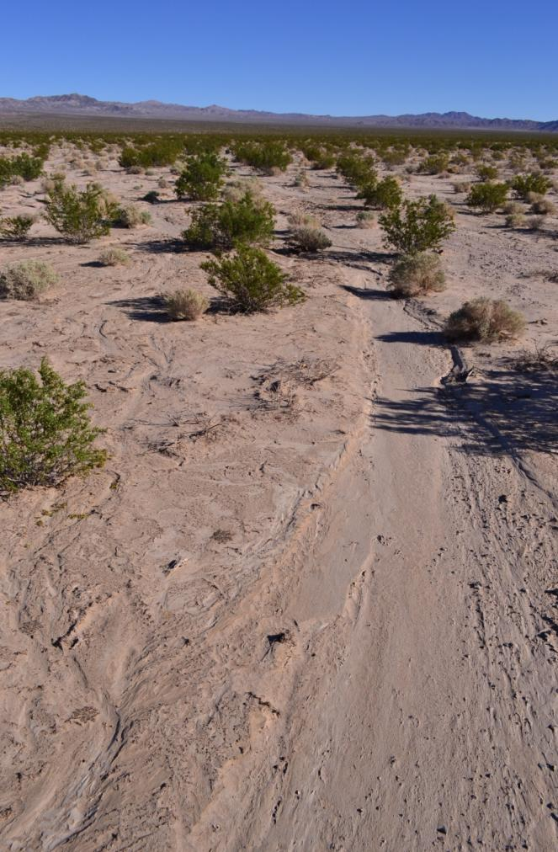
Stream
“Not a stream”
Silurian Hills

Slide 15
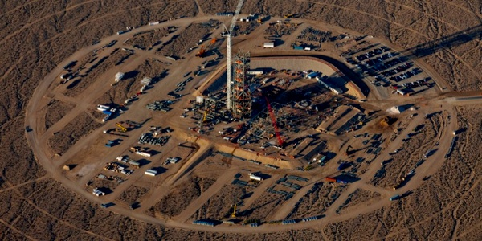
Projects Affect Streams
Infrastructure alters natural drainage (roads, buildings, berms).
Site grading removes natural channels (habitat). Water diverted. “Turns off” streams, habitat.
Ivanpah STEGS Photo courtesy Los Angeles Times Data Desk.
Water diverted and concentrated downslope => erosion and incision; sedimentation. Often off site impacts to property, infrastructure, and habitat.

Slide 16
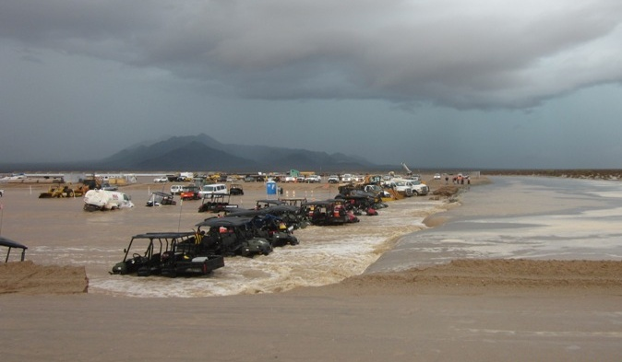
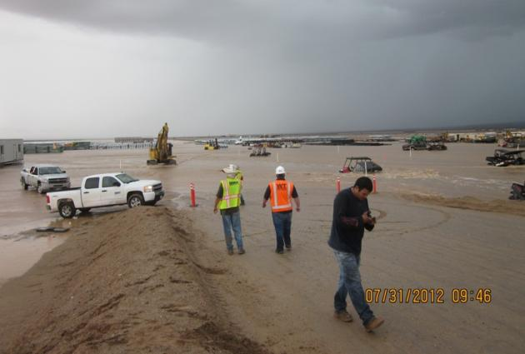
Streams Affect Projects
Flooding
Accelerated erosion
Damage to infrastructure
Time delays and mitigation for environmental and off-site damage
Genesis SEP
Failure to incorporate ephemeral stream processes in project design can have significant consequences on cost and operation.

Slide 17
….and costly delays in permitting process if, upon inspection, permit application does not properly represent conditions on site, must reapply and go to the “back of the line”.

Slide 18
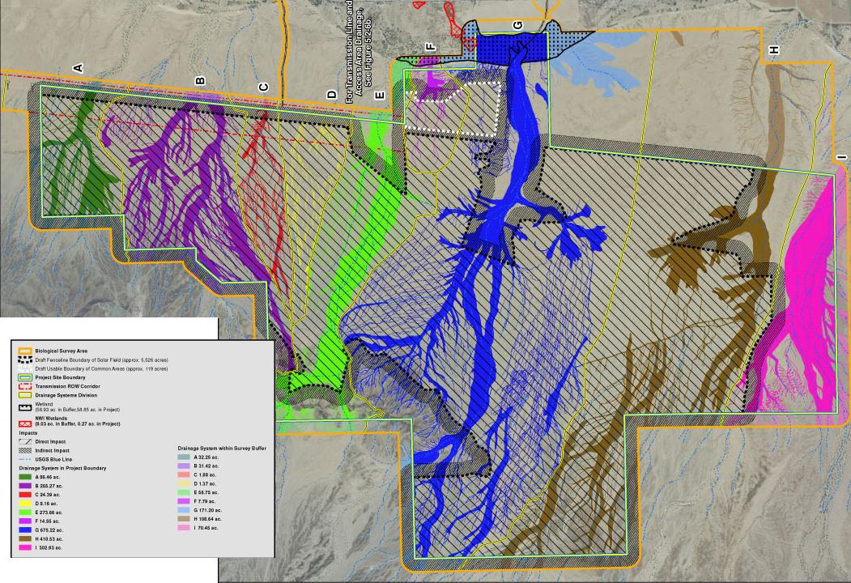
Some stream delineations are thorough and well executed.

Slide 19
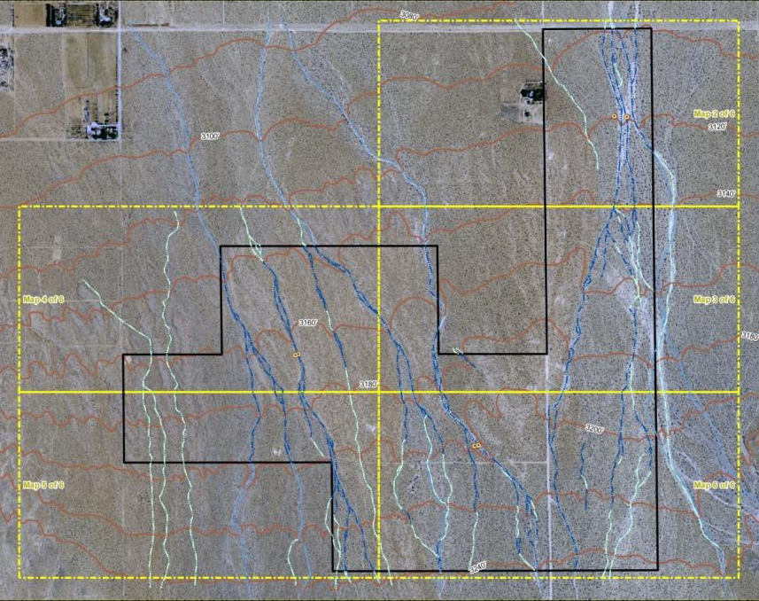
Others are not.
Non-jurisdictional
Non-jurisdictional
“100-yr floodway”
Non-jurisdictional
Jurisdictional
Non-jurisdictional
Jurisdictional
Jurisdictional
Non-jurisdictional

Slide 20
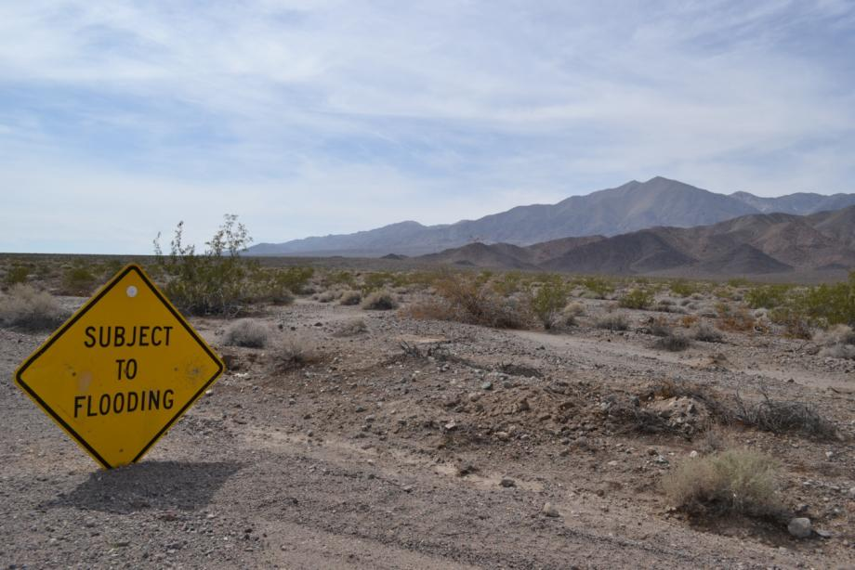
CEC CONTRACT TO DEVELOP PROTOCOLS FOR DELINEATING DESERT STREAMS
Select 6 sites typical of sites for large, solar arrays.
3 having permit applications and 3 without.

Slide 21
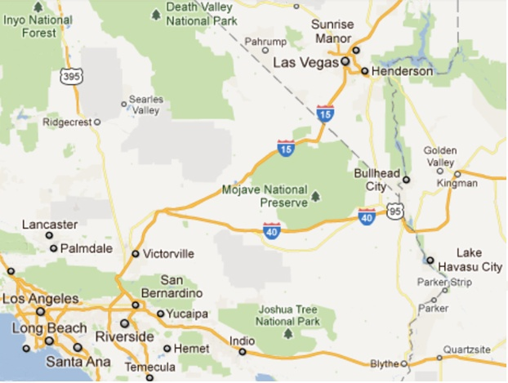
Avawatz Mts
Silurian Hills
El Paso Mts
Lucerne Valley
Coxcomb Mts
Palo Verde Mesa

Slide 22
Method:
Google Earth Pro images on iPad, laid out transects.
Field mapped stream features. Plotted on GIS iPad using Garafa GIS program.
Photographed hundreds of stream features from 8’ ladder.
Excavated 22 soil trenches. Conducted 28 infiltrometer tests.
Delineated CDFW jurisdictional streams. Compared with permit applications for 3 sites.
WOW!!

Slide 23
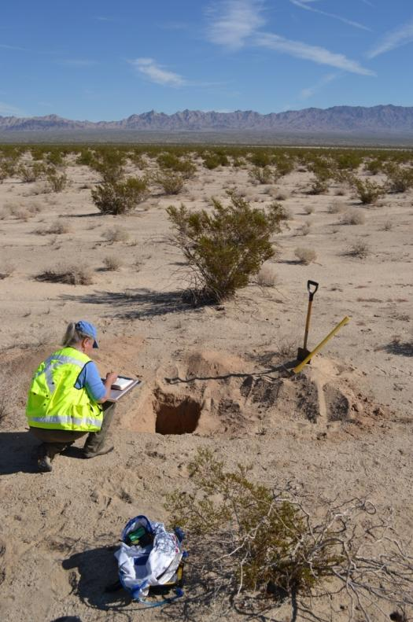
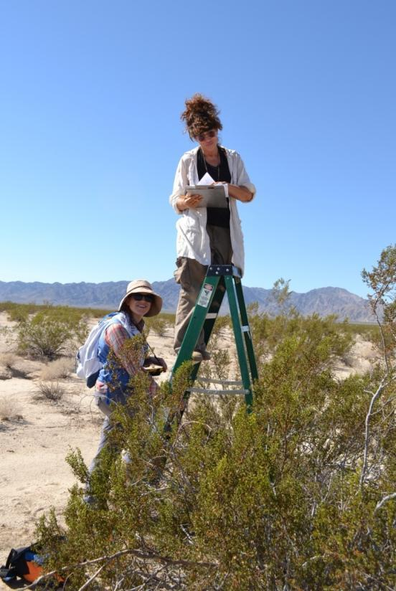
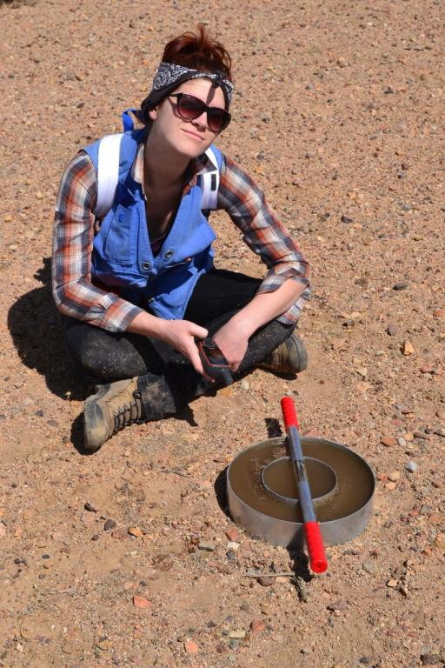
Soil pits
“Arial” mapping
Infiltrometer tests.

Slide 24
RESULTS/RECOMMENDATIONS:
Field Guide to Fluvial Indicators. Photographic atlas of ephemeral stream features and landscapes including indicators of antiquity.

Slide 25
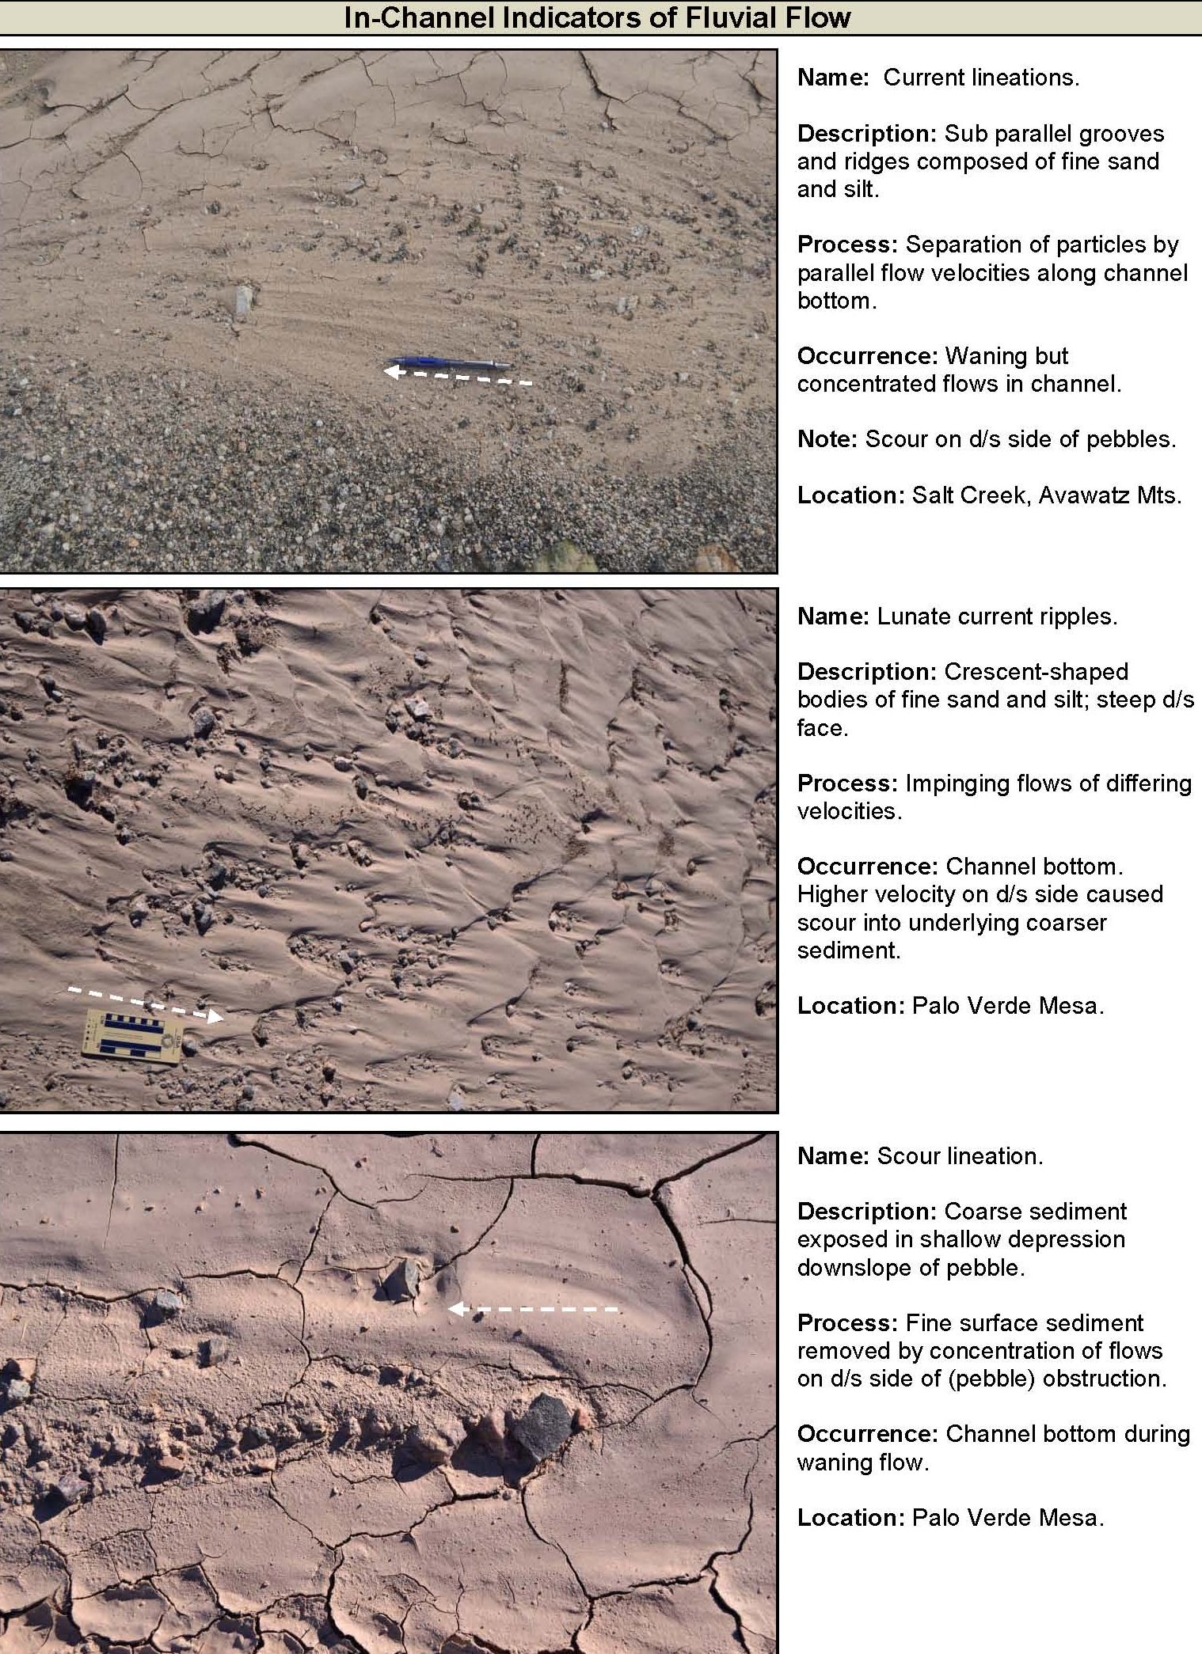

Slide 26
Stream “activity”:
“Active” - indicators of flow present or existent connectivity to water source.
“Dormant” - indicators of flow may be absent. Channel isolated from water source but has potential for reactivation w/i lifetime of project (75 years).
“Abandoned” - channel isolated from water source by natural or anthropogenic causes; not part of modern channel system.
“Relict” - abandoned channel having evidence of antiquity due to time/climate change.

Slide 27
Field Data Sheet For use in field assessment. Documents what features are and are not present (presence/absence of flow indicators) indicating channel “activity”.

Slide 28
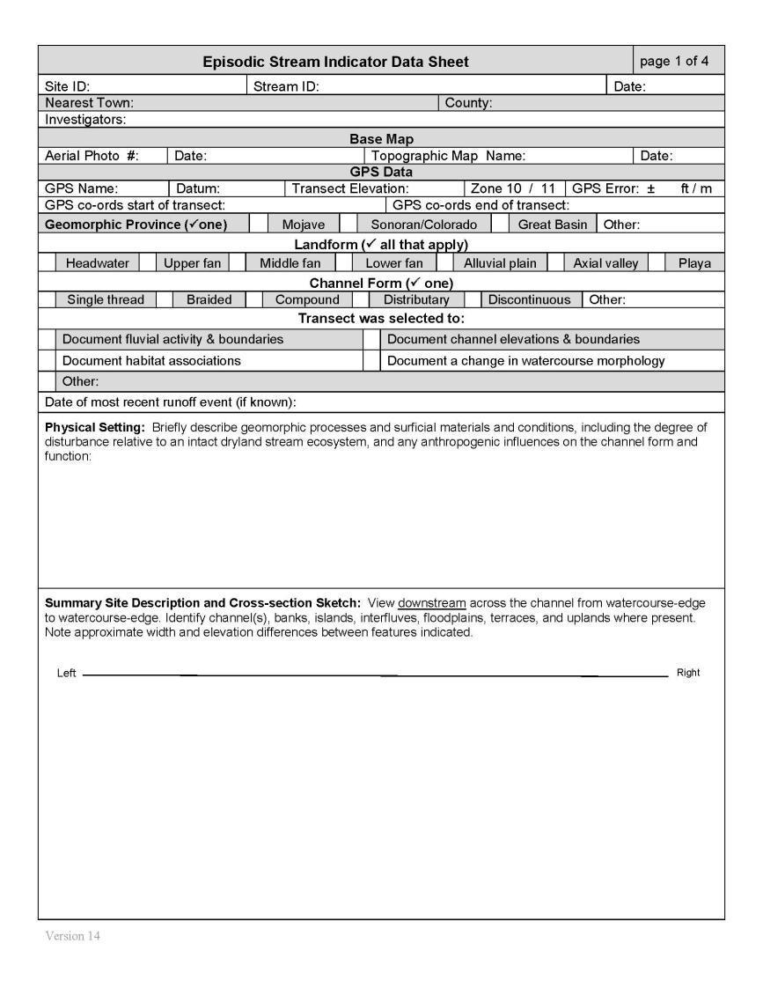

Slide 29
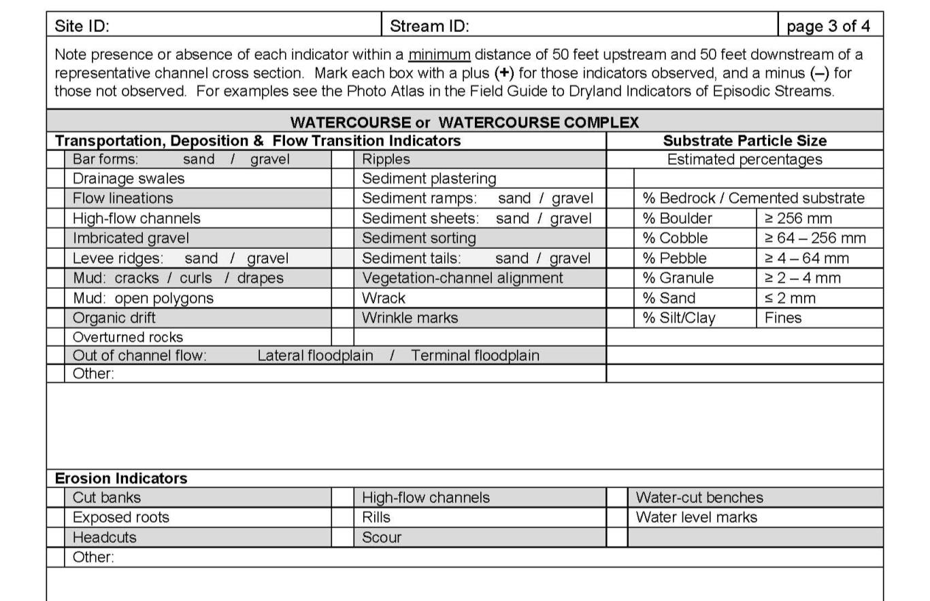
⁺
-

Slide 30
Minimum map scale 1” = 500’.
Map “watercourse” Map area rather than individual streams (linear).

Slide 31
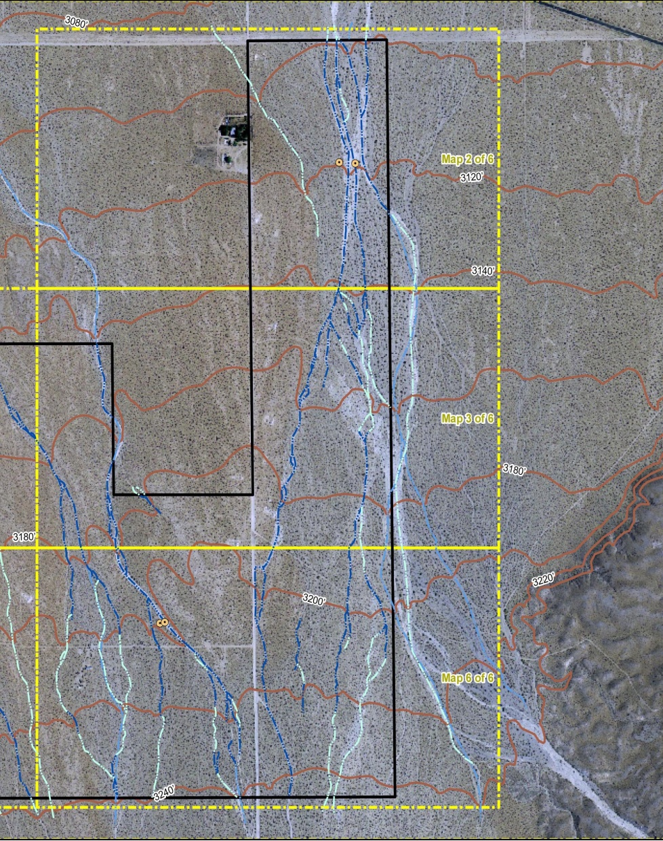
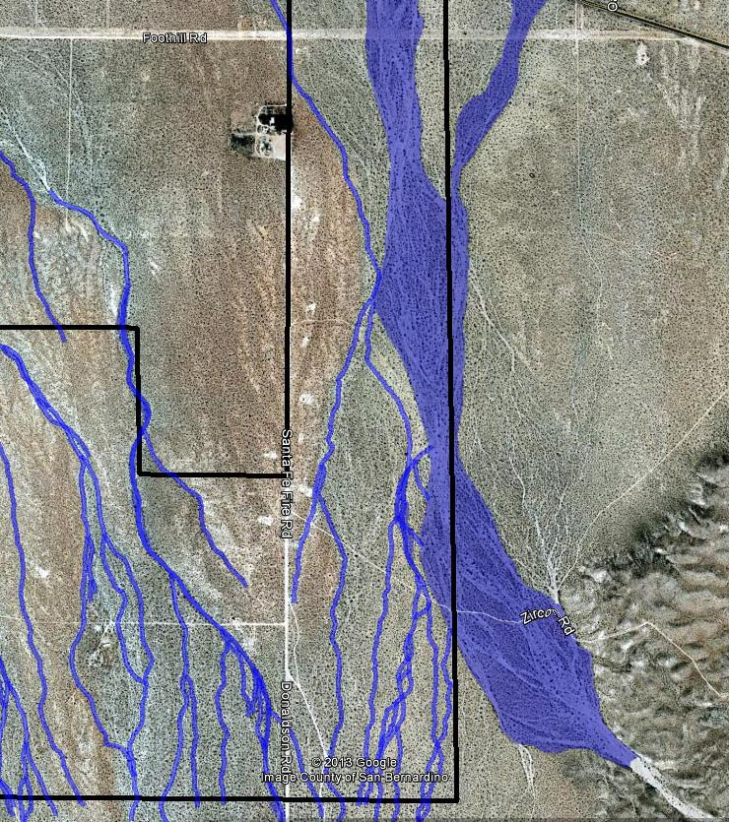
Jurisdictional
Jurisdictional
Non-jurisdictional
Permit application delineation.
Revised delineation.

Slide 32
Oversight. Project overseen by licensed geologist (PG) with experience working in arid watersheds who stamps and signs delineation report.

Slide 33
DISADVANTAGES
Requires greater attention to site evaluation.
Practitioners learn new protocol.
Commonly increases jurisdictional stream length/area (increases mitigation obligation).
Increases cost of assessment, but very small (<1/2% of total).

Slide 34
BENEFITS:
To Taxpayers:
Most effective use of agency time in assessing permit applications.
Appropriate oversight of qualified personnel (Licensed Geologist).
To project developers:
Speeds review of permit application.
Reduces chances for rejection by regulators due to faulty delineation.
Streamlines field assessment methods.
Consistent application of mitigation obligation.

Slide 35
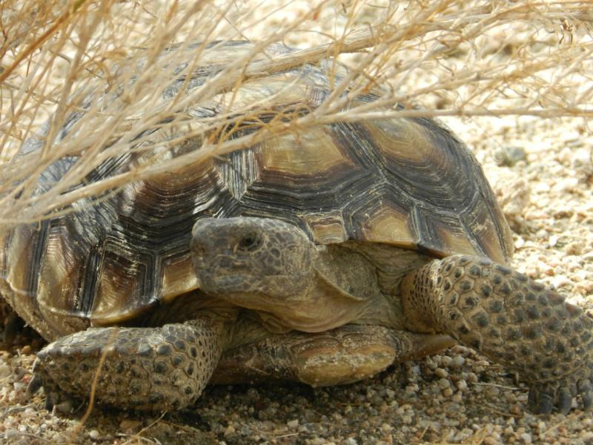
To Environment:
Recognizes realistic area and location of stream habitat.
Aids in appropriate placement of footprint. Avoidance, mitigation obligation.
Protects fragile desert ecosystem without compromising production of electrical energy.
Thanks, geologists!!

