Slide 1
Relationship Between Depth and Hydraulic Conductivity Within the St. Francois Aquifer, Missouri
Emme Mayle
Dr. Charles Rovey
Missouri State University
Notes:
Hello, my name is Emme Mayle, and I’m a graduate researcher in geospatial sciences at Missouri State University. The topic of my presentation today is the correlation we’ve found between depth below ground surface and permeability in Missouri’s St. Francois Aquifer.

Slide 2
Introduction
Why do we care about the St. Francois Aquifer?
Water supply
CO₂ sequestration
Why look for relationships?
Money
…and money
Notes:
The St. Francois Aquifer is comprised of the lowermost depositional formations above Precambrian basement rock in Missouri, and spans most of the state. Because of its relative depth compared with overlying aquifers, it has not been utilized much in southwestern Missouri, but can nonetheless become an auxiliary water supply when low-yield situations arise. It also contains the primary target injection formation for CO₂ sequestration in the state of Missouri: The Lamotte Sandstone. For either of these uses, the aquifer’s permeability must be above a certain threshold to be efficient.
Even though it is possible to run around testing permeability all over the state to create a totally accurate permeability map, that would require more money (and time) than people have. It’s necessary to find out the permeability in a site if it is to be used for pumping, and drilling blindly with no preliminary hypothesis can also be a very expensive endeavor. For exactly that reason, this research is being conducted to help give people some idea of where to not even bother trying and where could potentially be a good place to try to put a well, without the need to spend as much to drill test wells. This isn’t an exact science, but it should serve to help generalize the better areas for exploratory drilling.

Slide 3
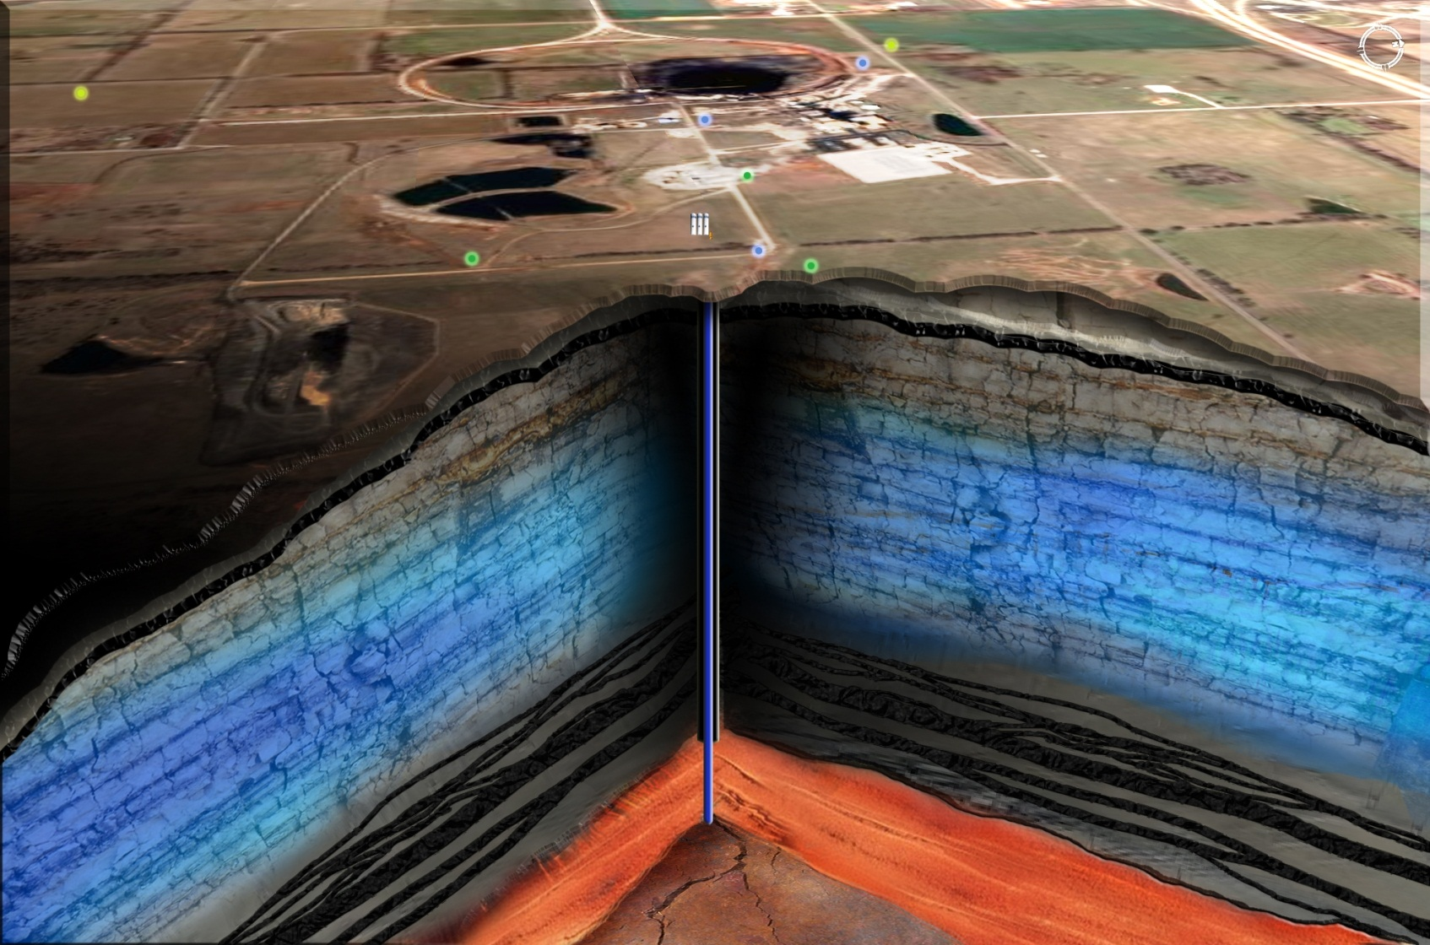
Background
Image courtesy of
City Utilities of Springfield, 2013
Ozark Aquifer
St. Francois
Confining Unit
St. Francois Aquifer
“Basement”
Main target for CO2 injection throughout Missouri.
Viability depends on effective caprock and high permeability injection zone.
Notes:
The St. Francois Aquifer lies directly above basement rock, as before mentioned, and just below the Ozark Aquifer in much of southwestern Missouri. The confining unit is very important, as it would, in most tested areas, stand between the CO₂ injection layer and the underground water supply. The St. Francois Aquifer is buffered in confinement by multiple layers with very low permeability, which will be looked at closer in the study area section.

Slide 4
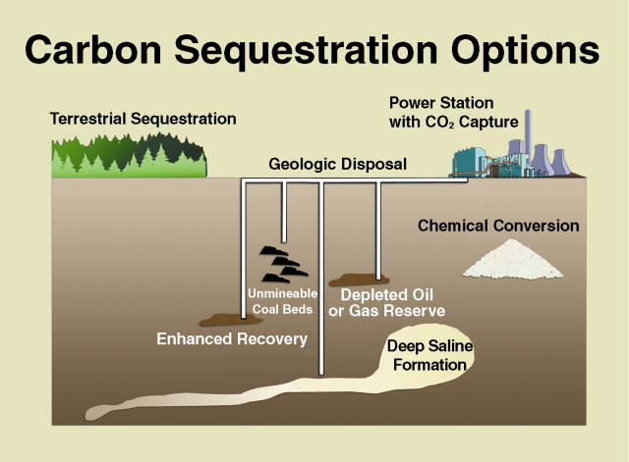
Image courtesy of Big Sky Carbon Sequestration Partnership.
Notes:
We all know that excessive CO₂ in the atmosphere is a concern, and there are many ways of sequestering it into less harmful scenarios—for instance in depleted coal and oil beds or terrestrially in tree plantations, but for Missouri, the likeliest geologic medium for sequestration is the saline aquifer.

Slide 5
Geologic CO₂ Sequestration into an Aquifer
Conditions:
Saline
Fully confined
Large
Near emissions source
Permeable
Stratigraphic trapping
Notes:
You may have discovered by now that there are a lot of qualifications for an aquifer to be a good sequestration option. A few of these will be mentioned in terms of the St. Francois Aquifer here. Amongst other things, the aquifer is highly saline in areas, fully confined except for a few places in the St. Francois Mountains, very vast laterally, and variably but acceptably thick throughout its water-bearing formations. For saline aquifer sequestration, the most sensible places for injection wells are near the emitters to avoid extra transport costs, and the St. Francois Aquifer’s availability near these sources of CO₂ is very convenient. Lastly, the aquifer must be highly permeable near the well site.
There are three different means of trapping CO₂ in an aquifer: Geochemically as minerals, in solution with the water, or stratigraphically.

Slide 6
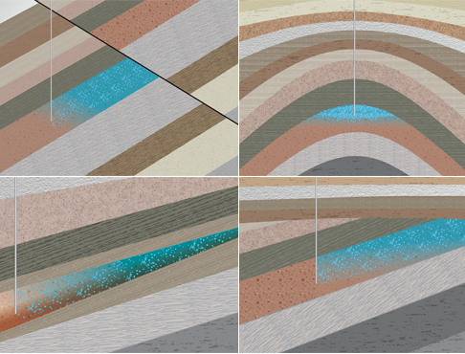
Image courtesy of Australian Government Cooperative Research Centres “CO2CRC”
2011
Notes:
Stratigraphic or hydrodynamic trapping of CO2 occurs where the depth of injection formation is at a local peak; this form of trapping is a function of the injection layer’s surface. This can come about via dome structure, faulting, pinching out of the formation, or unconformity, and effectively hold the CO2 in place permanently, as it is less dense than water and therefore won’t sink back down. As long as the confining unit is not leaky or failing, the CO2 cannot escape upward into groundwater or to the surface.

Slide 7
Water Supply
Primary aquifers experiencing low-yield situations
St. Francois could be used where fresh
Notes:
The additional use of the St. Francois Aquifer as a water supply is also worthwhile in areas that have low yield due to local drawdown in the primary aquifer (the Ozark Aquifer), or where the demand for water has grown beyond the supply readily available. There are portions of the St. Francois Aquifer too fresh for use in sequestration, and given that the proper buffer zones are applied and considerations made, these could be used as a municipal water source to ease the strain on the overlying aquifer.

Slide 8
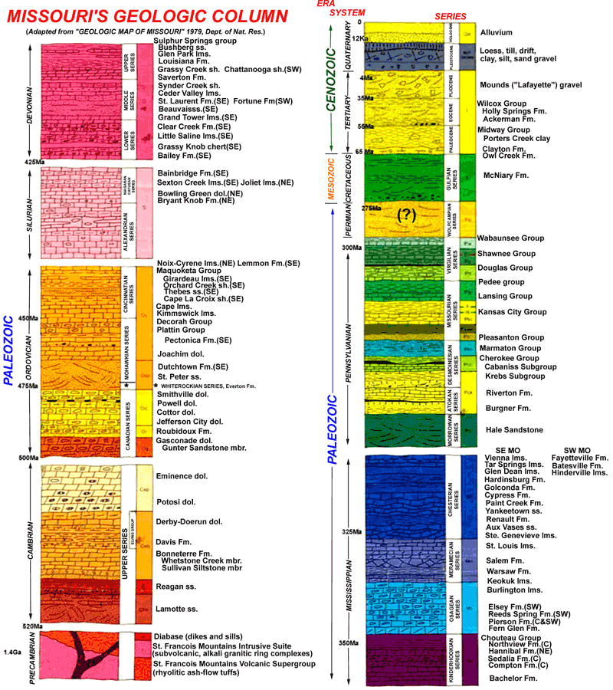
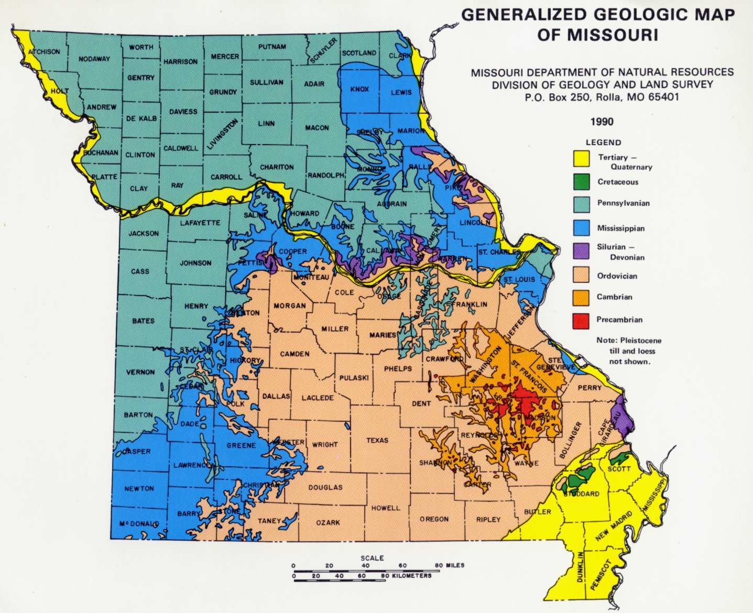
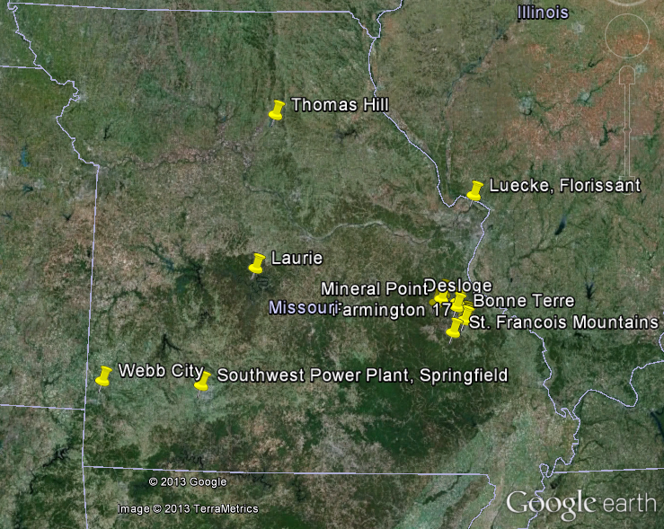
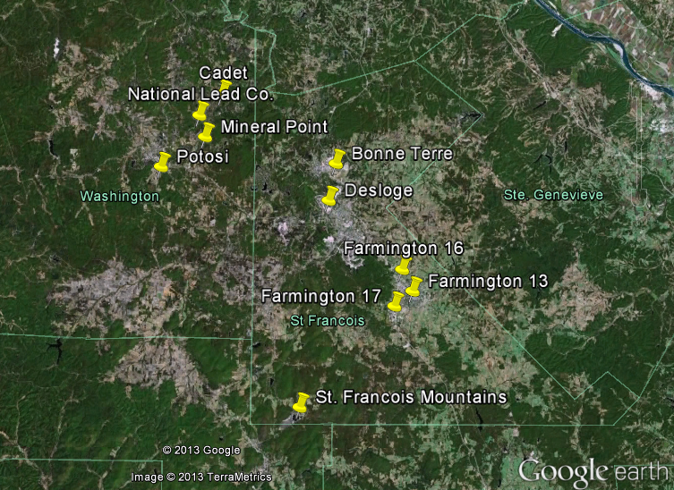
Study Area
St. Francois Aquifer
Lamotte and Reagan Sandstones
Testing sites
Courtesy of mofossils.com
Notes:
The St. Francois Aquifer is present throughout most of Missouri, and outcrops in the southeastern St. Francois Mountains area, where it is often used for water supply. The St. Francois Aquifer consists of the Lamotte Sandstone, which is the primary water-bearer, the Reagan Sandstone where present, which is separated from the Lamotte by some low-permeability shaley layers, the Bonneterre Dolomite, which is low-permeability on its own, and the Davis Shale, the official confining unit, which grades into the Derby-Doerun Dolomite, another very-low-permeability formation. All of these comprise the Cambrian deposition in Missouri. As you can see, there is a lot of Cambrian rock exposed here, where the St. Francois Mountains are uplifted; that’s the St. Francois Aquifer outcropping. Fifteen sites were used to test permeability, including ones far from the St. Francois Mountains outcrop area such as Webb City, Springfield, Laurie, and Thomas Hill, and ones much closer to the mountains like Farmington, Potosi, and Desloge.

Slide 9
Study Area
St. Francois Aquifer
Lamotte and Reagan Sandstones
Testing sites
The Confining Units
Derby-Doerun and Davis
Vertical K as low as 9x10⁻¹² cm/s
- Kleeschulte and Seeger, 2003
Notes:
The Davis Shale and Derby-Doerun Dolomite were treated as the confining units for the St. Francois Aquifer in a study done in 2003 by Kleeschulte and Seeger. This study found the vertical conductivity, or vertical leakage, we could say here, to be as low as 3*10⁻¹³ ft/s, or 9*10⁻¹² cm/s. Because of this very low conductivity, the St. Francois Aquifer can be treated as a fully confined aquifer where no intense fracturing has occurred.

Slide 10
Methods
Hydraulic conductivity and transmissivity
Field:
Luecke, Florissant, Missouri
Thomas Hill, Huntsville, Missouri
Notes:
Hydraulic conductivity is the coefficient of permeability around a pumping site, and transmissivity relates that coefficient to the entire saturated thickness of the formation at that site. These were used to quantify the ability of fluids to flow through the aquifer. This particular portion of the Missouri Carbon Sequestration Project has involved pump testing in the field on two of the sites from which data was gathered: The Thomas Hill Power Plant north of Moberly, Missouri, and the Luecke site near Florissant, Missouri. Simple single-well drawdown testing was used to indicate the rate at which water can be pumped from the aquifer at these sites. Similar drawdown data was collected from the Missouri DNR’s Division of Geology and Land Survey for five other sites and analyzed using the computer curve-matching program AQTESOLV. By alternating possible transmissivities and storavities at the well site, data were matched as closely as possible to three kinds of lines: the Cooper-Jacob straight line, the traditional Theis confined aquifer curve, and the Hantush-Jacob leaky confined aquifer curve. Of these, the Cooper-Jacob line emphasizes the early-time measurements the most, the Hantush-Jacob curve tends to flatten down more at the late-time measurements due to the leakage of the water out of the aquifer, and the Theis curve is meant to indicate the ideal fully confined aquifer. Some results were simple and by-the-book, down to the effects of the water stored in the well hole showing up in early-time measurements. Others, be it due to variable pumping or isolated fractures in the formations, were a bit more difficult to curve-match. The best fits of these curves were used to determine the conductivity and transmissivity of the aquifer in each of these sites.

Slide 11
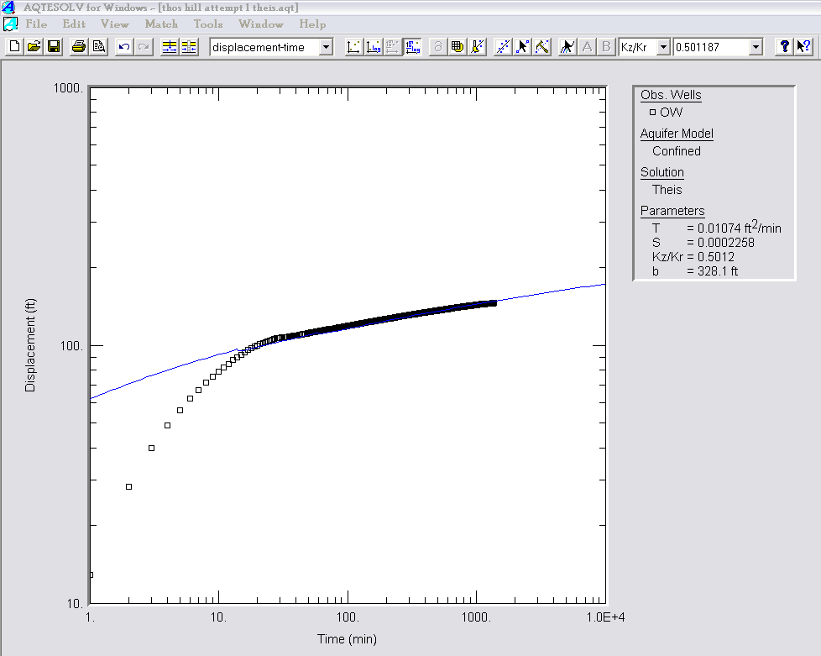
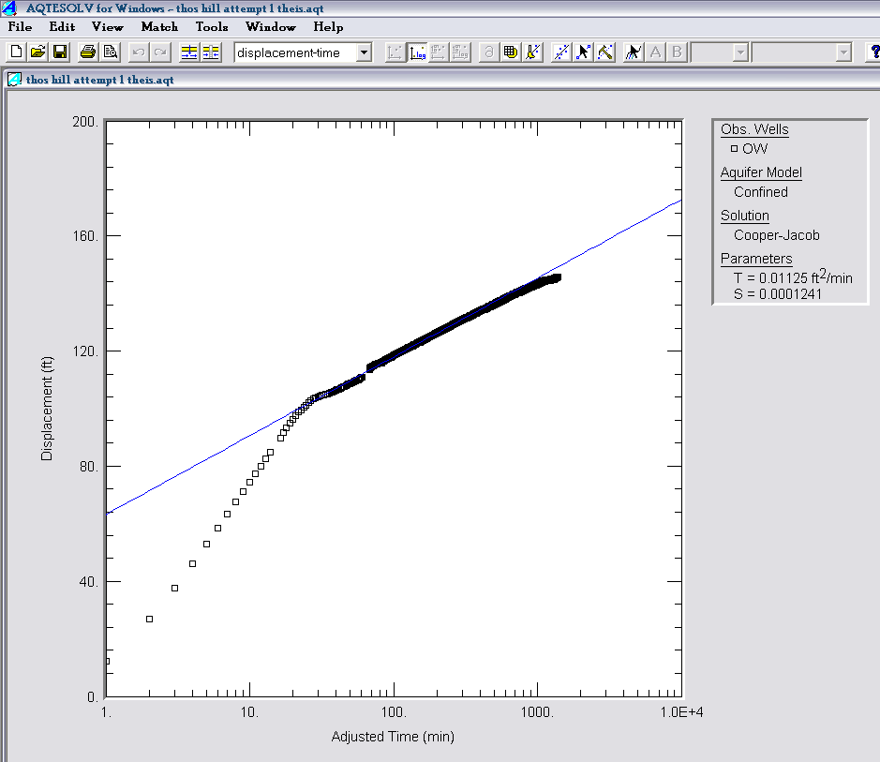
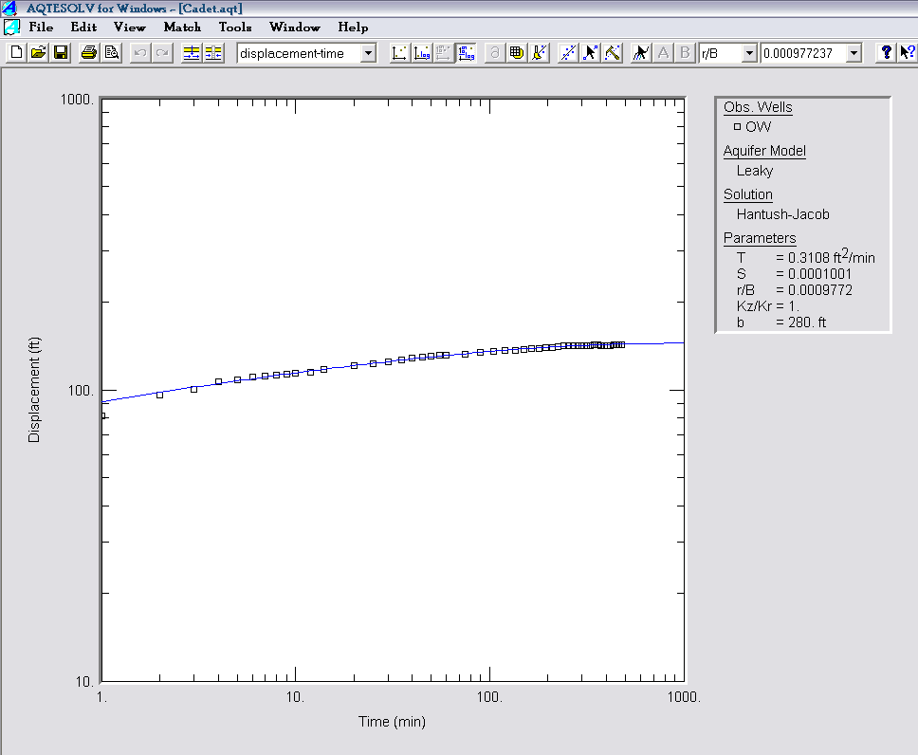
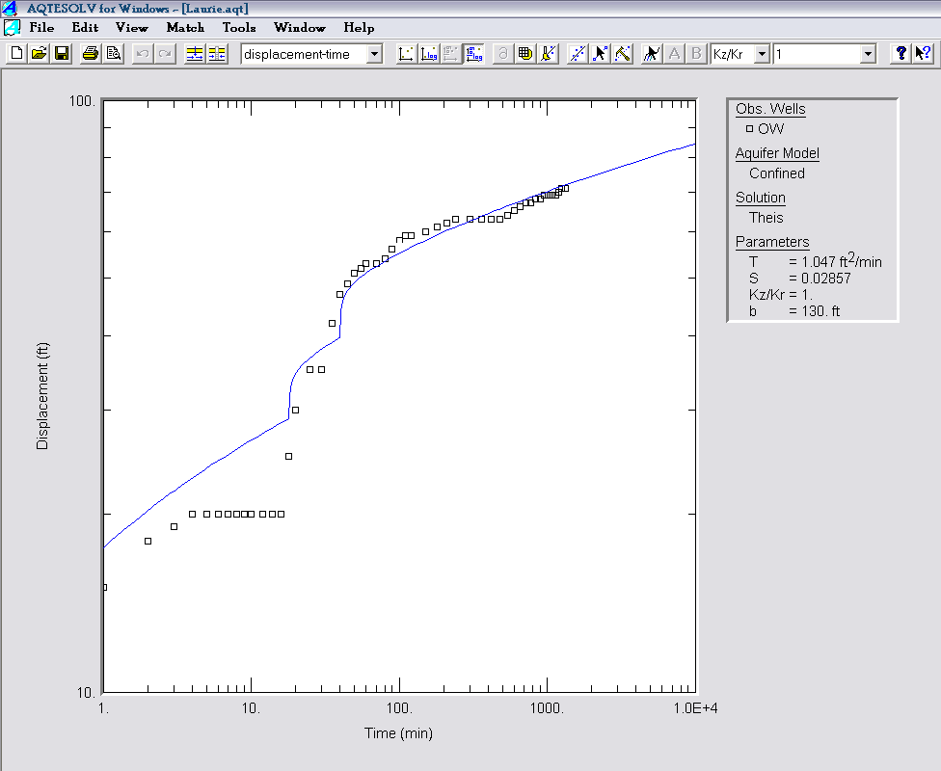
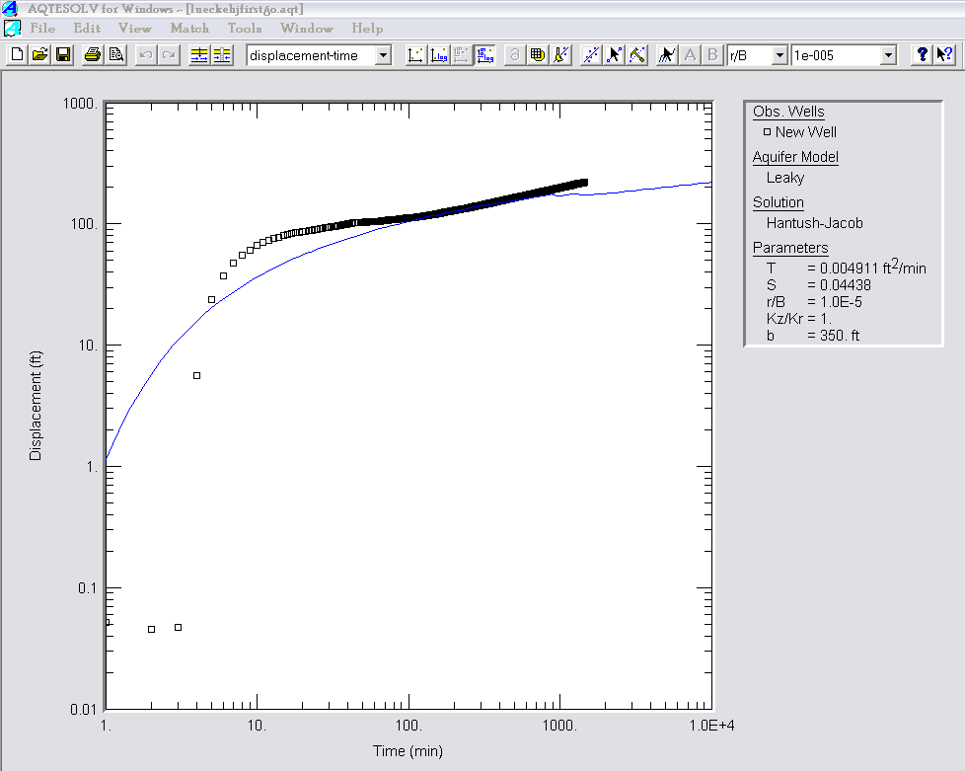
Methods
Hydraulic conductivity and transmissivity
Field:
Luecke, Florissant, Missouri
Thomas Hill, Huntsville, Missouri
Analysis:
AQTESOLV
Cooper-Jacob straight line method
Theis log-linear method
Hantush-Jacob for leaky confined aquifers
Notes:
Hydraulic conductivity is the coefficient of permeability around a pumping site, and transmissivity relates that coefficient to the entire saturated thickness of the formation at that site. These were used to quantify the ability of fluids to flow through the aquifer. This particular portion of the Missouri Carbon Sequestration Project has involved pump testing in the field on two of the sites from which data was gathered: The Thomas Hill Power Plant north of Moberly, Missouri, and the Luecke site near Florissant, Missouri. Simple single-well drawdown testing was used to indicate the rate at which water can be pumped from the aquifer at these sites. Similar drawdown data was collected from the Missouri DNR’s Division of Geology and Land Survey for five other sites and analyzed using the computer curve-matching program AQTESOLV. By alternating possible transmissivities and storavities at the well site, data were matched as closely as possible to three kinds of lines: the Cooper-Jacob straight line, the traditional Theis confined aquifer curve, and the Hantush-Jacob leaky confined aquifer curve. Of these, the Cooper-Jacob line emphasizes the early-time measurements the most, the Hantush-Jacob curve tends to flatten down more at the late-time measurements due to the leakage of the water out of the aquifer, and the Theis curve is meant to indicate the ideal fully confined aquifer. Some results were simple and by-the-book, down to the effects of the water stored in the well hole showing up in early-time measurements. Others, be it due to variable pumping or isolated fractures in the formations, were a bit more difficult to curve-match. The best fits of these curves were used to determine the conductivity and transmissivity of the aquifer in each of these sites.

Slide 12
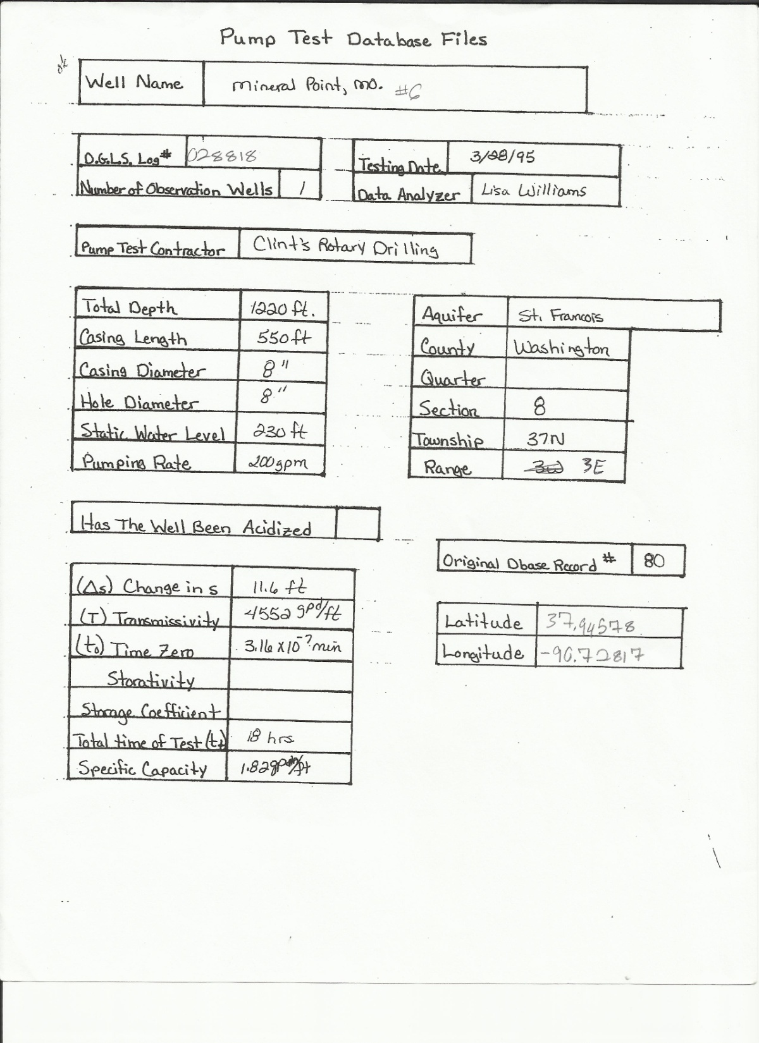
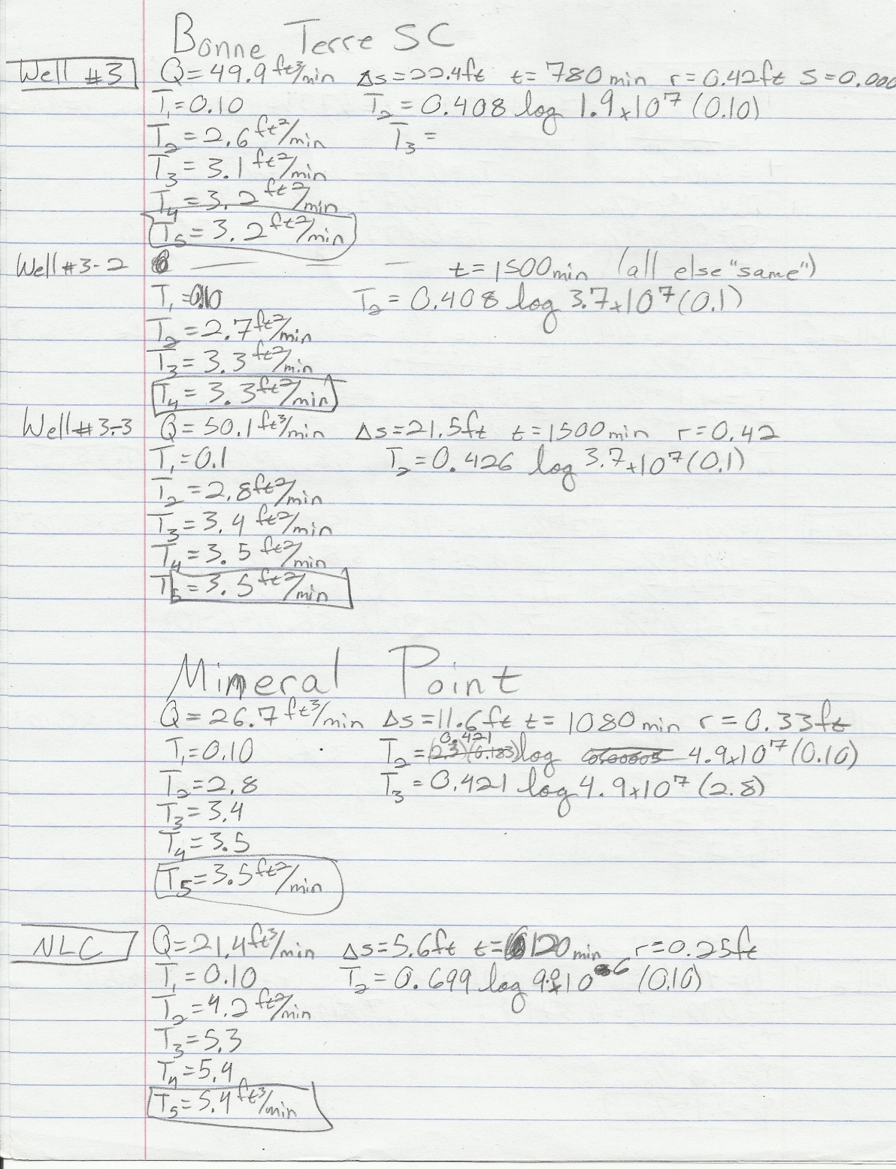
Methods
Hydraulic conductivity and transmissivity
Field:
Luecke, Florissant, Missouri
Thomas Hill, Huntsville, Missouri
Analysis:
AQTESOLV
Specific capacity
Notes:
Specific capacity data were collected for seven sites and translated manually into transmissivity and conductivity, using thicknesses listed on well logs from each site. Specific capacity tests can be redefined into transmissivity data using the pumping rate, or Q, the borehole’s radius, the total time of test, and the change in head (denoted here as delta s). Using the specific capacity formula, the calculation was manually reiterated using the previous iteration’s determined transmissivity, until the transmissivity’s first two significant figures remained the same as the previous calculation’s.

Slide 13
Methods
Hydraulic conductivity and transmissivity
Field:
Luecke, Florissant, Missouri
Thomas Hill, Huntsville, Missouri
Analysis:
AQTESOLV
Specific capacity
Compare conductivities
Notes:
From this, a visual comparison of conductivities was able to be done, including both top depth of formation and distance from a point chosen arbitrarily to indicate the “center” of the St. Francois Mountains. This comparison gave rise to the question of relationships between these variables and the permeability of the aquifer.

Slide 14
Methods
Hydraulic conductivity and transmissivity
Field:
Luecke, Florissant, Missouri
Thomas Hill, Huntsville, Missouri
Analysis:
AQTESOLV
Specific capacity
Compare conductivities
Graph possible correlations
Notes:
After the variables to be tested were decided upon, they were plotted against both transmissivity and conductivity using an Excel graph to show the possible relationships in greater detail.

Slide 15
Results
No distance-conductivity correlation
Notes:
Because transmissivity and conductivity are such similar values for this study, only the graphs of conductivity have been used here to indicate relationships. As you can see, the graph of distance from the central St. Francois Mountains against conductivity shows little pattern and would be difficult to correlate. The graph of conductivity against the top depth of the formation, however, shows a noticeable inverse relationship. The site on the far right here that is marked by a big triangle instead of a diamond is the Luecke site, and because of some isolated fractures in the formations above the Lamotte, the values determined for this point are considered to be “maximum possible Lamotte permeability” measurements. It was included in the data for the regression line shown here, but in reality the conductivity of the Lamotte at this site is probably orders of magnitude lower, so this probably skews the regression quite a bit. Further testing to be carried out in the summer of this year should hopefully help to narrow down the window of permeability for the Lamotte Sandstone at this site.

Slide 16
Results
Depth-conductivity

Slide 17
Results

Slide 18
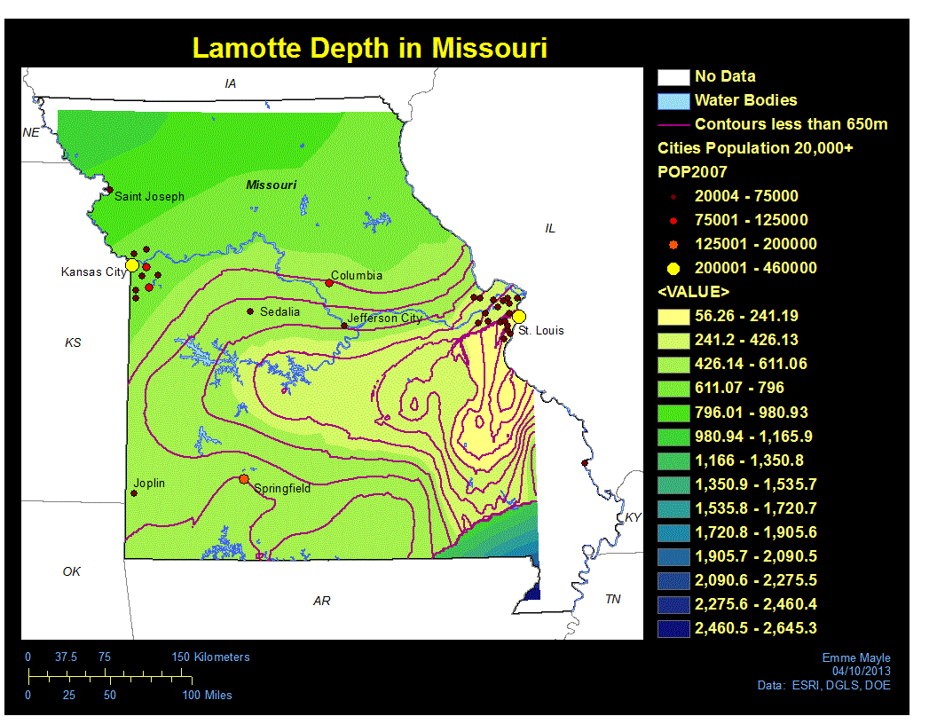
Results
Useful to ~650 meters depth
Early-stage mapping using DNR well logs
Notes:
From this analysis, and using Lamotte Sandstone depths retrieved from the Missouri Department of Natural Resources’ online well logs, a depth map for the Lamotte Sandstone throughout the state was created. This is only a preliminary map that gives us some idea of the depths and the permeability potential. Because cementation renders CO2 storage below around 650 meters unlikely (except in particularly thick segments of the Lamotte), this value was used to create the 50-meter contours seen here, starting at the west and shallowing eastward. Effective use as a water supply ends below approximately 550 meters. The values seen in the legend are interpolated values and not actual depth values, but the interpolation gives us a visual representation of the depth of the Lamotte Sandstone throughout the state, and a clear idea that much of Missouri could potentially utilize the St. Francois Aquifer as far as permeability is concerned.

Slide 19

Notes:
From this analysis, and using Lamotte Sandstone depths retrieved from the Missouri Department of Natural Resources’ online well logs, a depth map for the Lamotte Sandstone throughout the state was created. This is only a preliminary map that gives us some idea of the depths and the permeability potential. Because cementation renders CO2 storage below around 650 meters unlikely (except in particularly thick segments of the Lamotte), this value was used to create the 50-meter contours seen here, starting at the west and shallowing eastward. Effective use as a water supply ends below approximately 550 meters. The values seen in the legend are interpolated values and not actual depth values, but the interpolation gives us a visual representation of the depth of the Lamotte Sandstone throughout the state, and a clear idea that much of Missouri could potentially utilize the St. Francois Aquifer as far as permeability is concerned.

Slide 20
Discussion
Final map will include more in-depth permeability information for sites sponsored by MCSP, and should display closer precision.
Concerns about depth
St. Francois Aquifer has definite potential where shallow for both CO₂ storage and water wells.
Notes:
The final product of this research should include better detail of the relationship between conductivity and depth, as well as having more retrieved depth data for the Lamotte across the state, but even without this final information, it is apparent that the St. Francois Aquifer has a lot of potential for use as either a carbon sequestration aquifer or a public water supply in the state of Missouri, especially in the shallower mid-state belt. Although the St. Francois Aquifer is the deepest depositional series in Missouri, it is shallower than most saline aquifer sequestration occurs, but the strength of confinement means that this shallowness is not an immediate concern as far as vertical leakage goes. There is some uncertainty as to what injection into such shallow depths could mean in terms of seismicity, as the shallow crust is known to have greater strain than deeper, higher-pressure crust, but modeling and research will be done on this subject once the relationship between depth and conductivity has been fully established. Other than the potential for seismicity, the St. Francois Aquifer appears to fit many of the requirements for geologic sequestration, and is (for good reason) Missouri’s main target for aquifer disposal of CO_{2.}

Slide 21
Disclaimer
This report was prepared as an account of work sponsored by an agency of the United States Government. Neither the United States Government nor any agency thereof, nor any of their employees, makes any warranty, express or implied, or assumes any legal liability or responsibility for the accuracy, completeness, or usefulness of any information, apparatus, product, or process disclosed, or represents that its use would not infringe privately owned rights. Reference herein to any specific commercial product, process, or service by trade name, trademark, manufacturer, or otherwise does not necessarily constitute or imply its endorsement. Recommendation, or favoring by the United States Government or any agency thereof. The views and opinions of authors expressed herein do not necessarily state or reflect those of the United States Government or any agency thereof.
Notes:
The U.S. Government does not take responsibility for anything I’ve said, nor does it necessarily endorse any of my statements or remarks.

Slide 22
Acknowledgements
City Utilities of Springfield
Mr. Gary Pendergrass
Dr. Tom Plymate
Dr. Doug Gouzie
MO Department of Natural Resources
Everyone involved with MCSP
This material is based upon work sponsored by the
Department of Energy National Energy Technology
Laboratory under Award Number DE-NT0006642 to City
Utilities of Springfield, MO.
Notes:
At this time I’d like to acknowledge acknowledge Drs. Plymate and Gouzie of Missouri State University’s Geography, Geology, and Planning Department, not to mention my advisor Dr. Rovey, the folks at Missouri DNR, City Utilities of Springfield, Mr. Gary Pendergrass, and everyone else involved the Missouri Carbon Sequestration Project.

Slide 23
Thank you! Questions?
Feel free to e-mail me any questions
Emme27@live.missouristate.edu
Notes:
So thank you for your time and attention. Are there any questions at this point?

