Slide 1
MacGyver Week and other novel tasks in a methods class for preservice Earth science teachers
Anthony D. Feig
Leah Cooperrider
Interdisciplinary Science Education Council
Central Michigan University

Slide 2
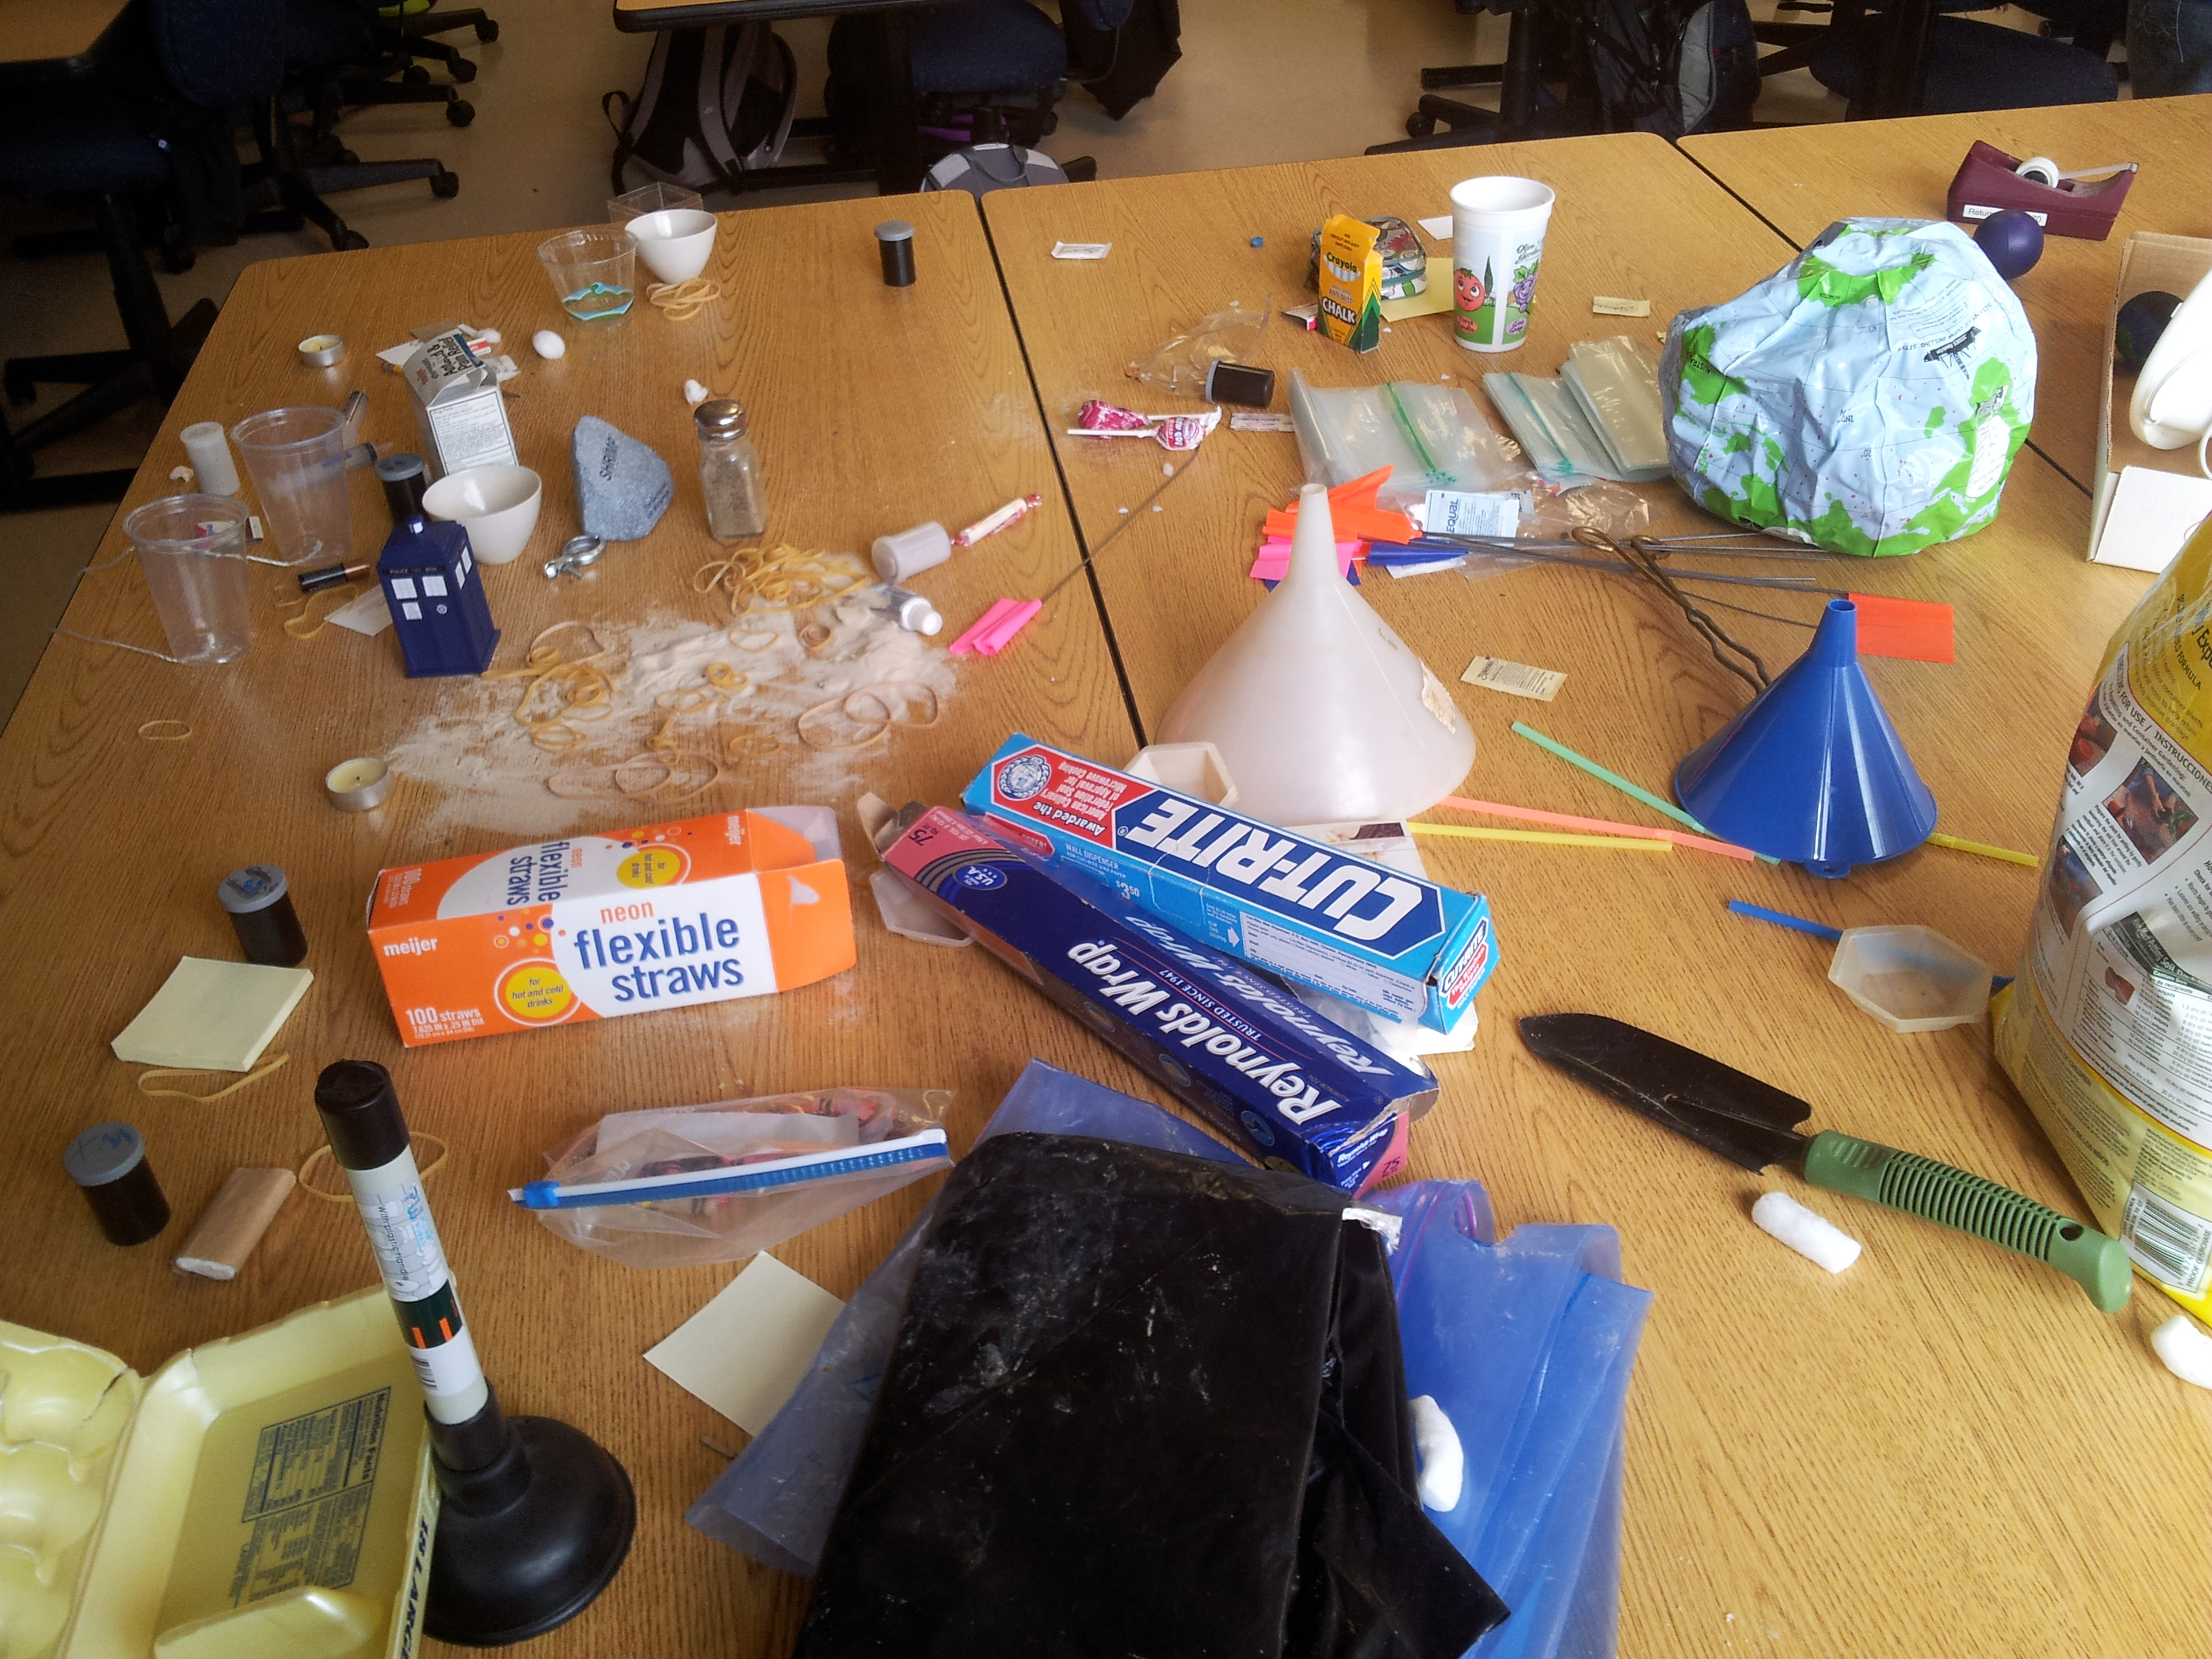

Slide 3
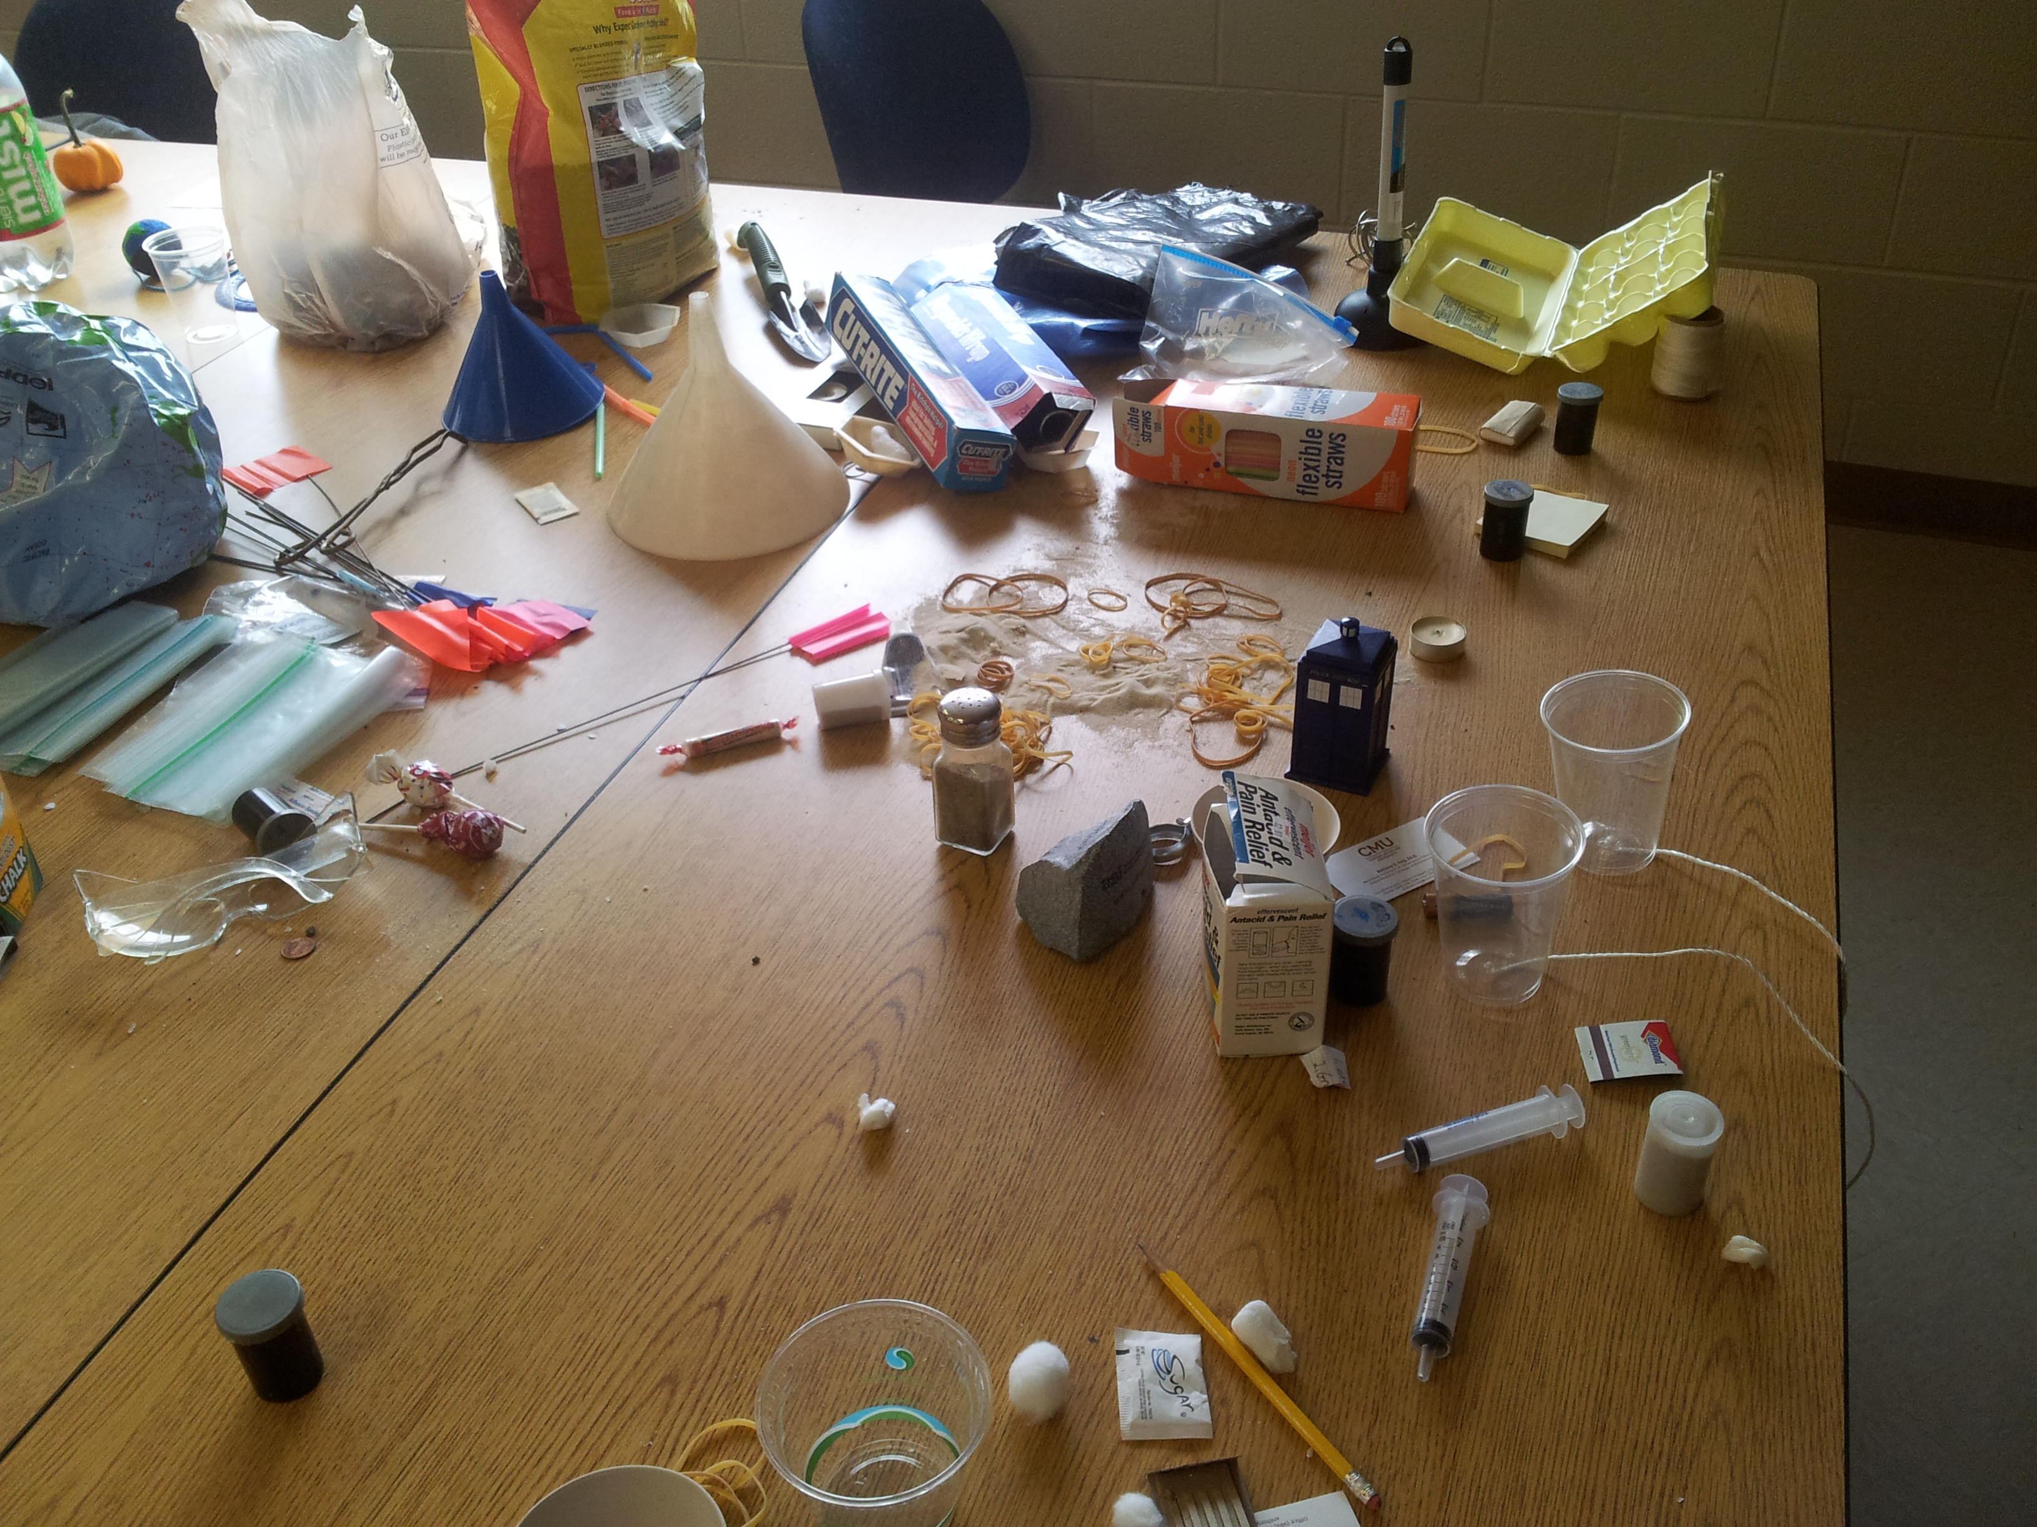

Slide 4
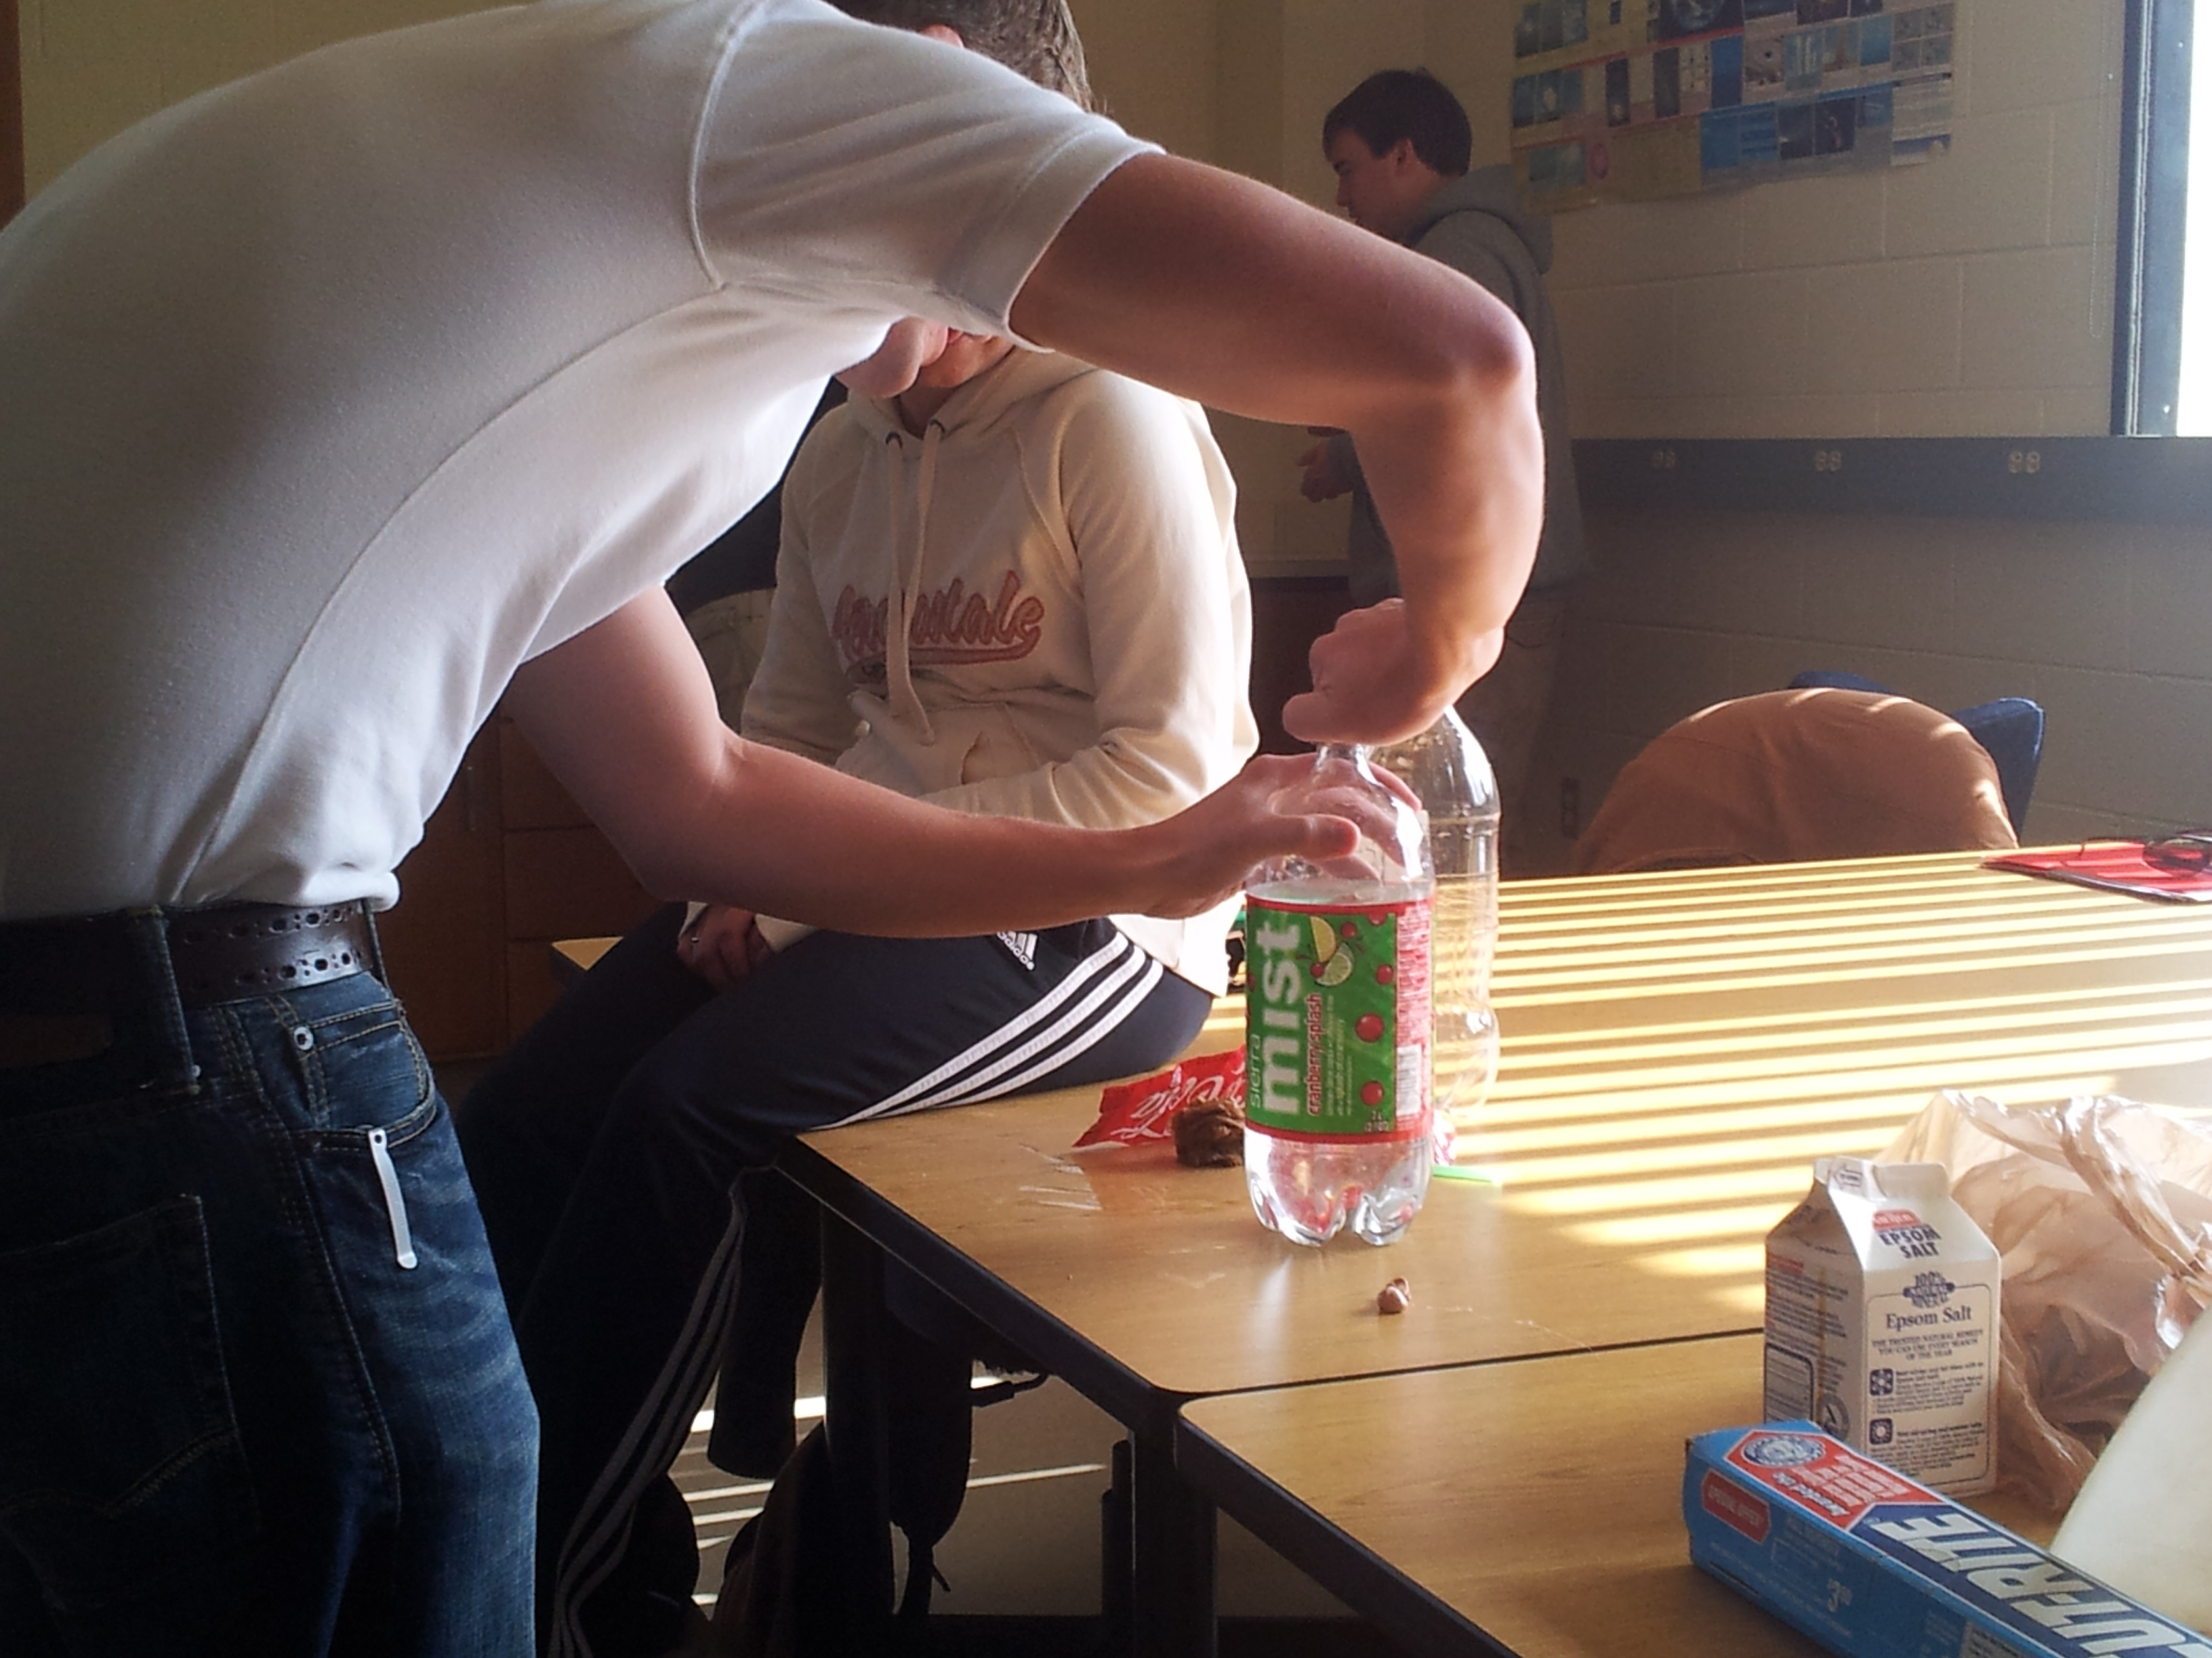

Slide 5
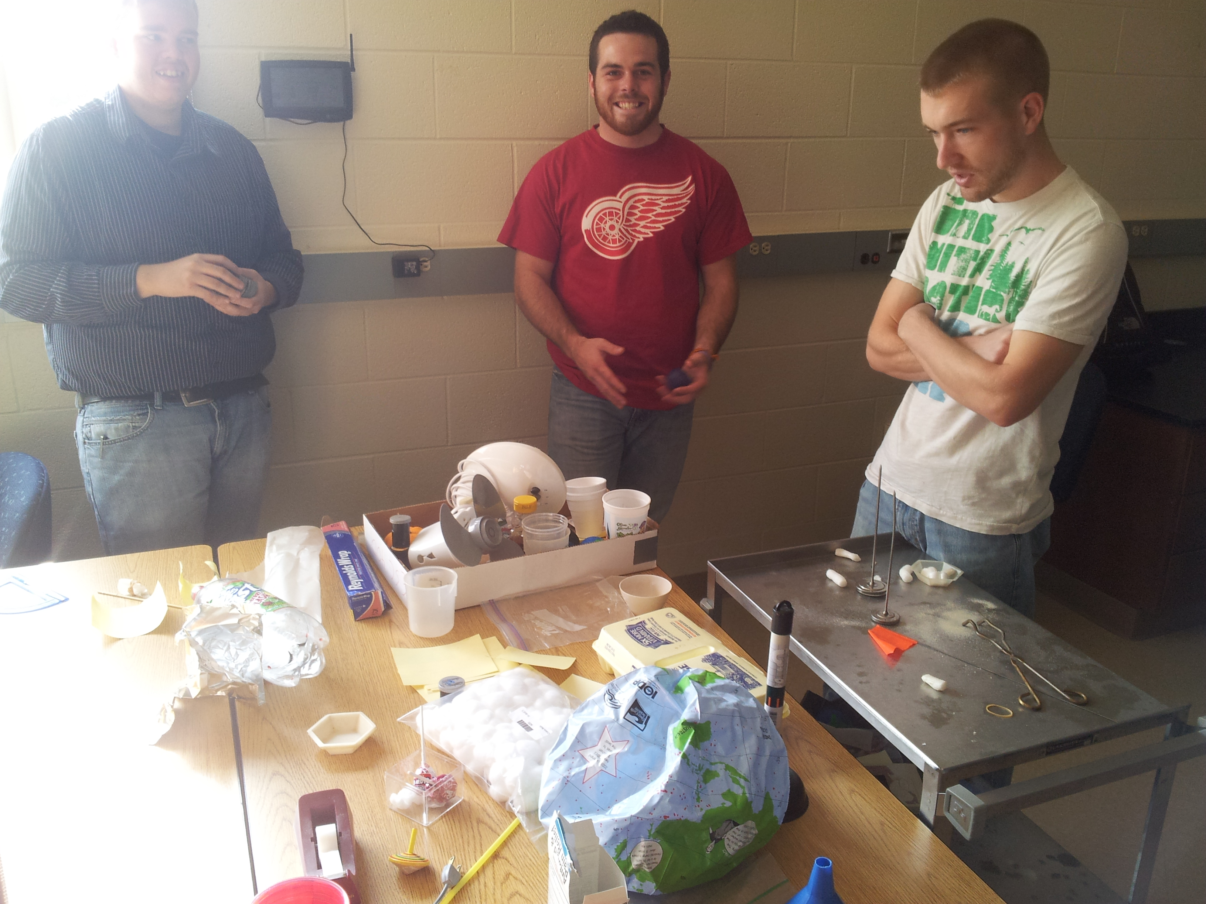

Slide 6
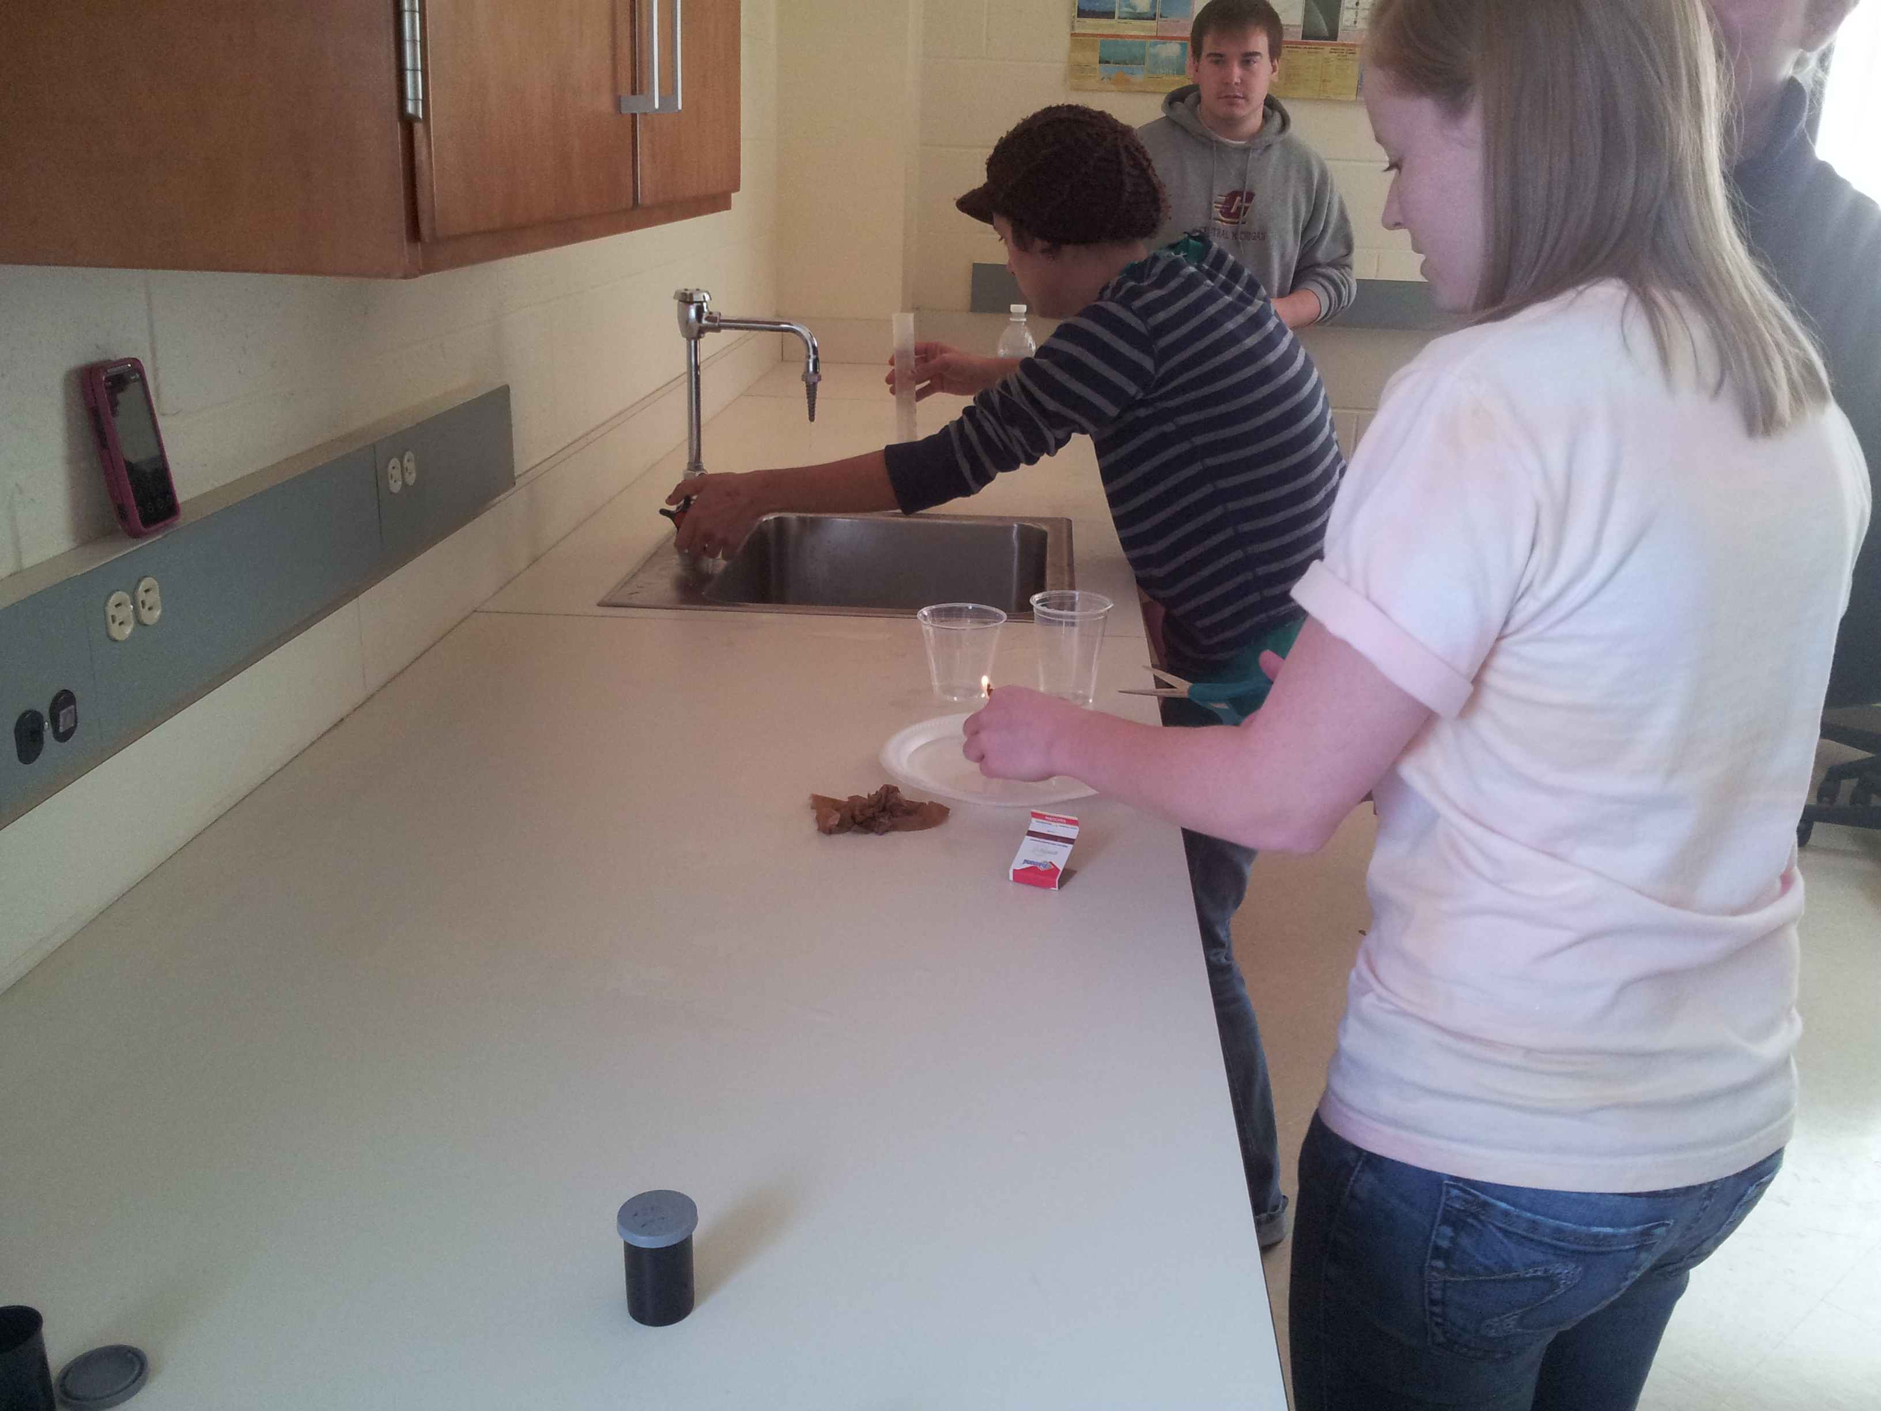

Slide 7
The usual demos…
Dissolution & Precipitation
Soap, water & black pepper on the plate
Surface tension, but sometimes mistaken for acid-base rxns
Light the match, suck in the plate
“OK the air is gone because of conservation of energy or something…”
Skewer the balloon
Plop plop fizz fizz and other fun with Alka-seltzer

Slide 8
Microteach 1
Focus on delivery
7 minutes
Grade Acceptable/Not Acceptable on:
Volume, clarity, confidence bearing, truthfulness
Topics
Hydrologic cycle
Phases of the Moon
Rocks & the rock cycle
Constraint: Use the graphics provided
1 week to prep

Slide 9
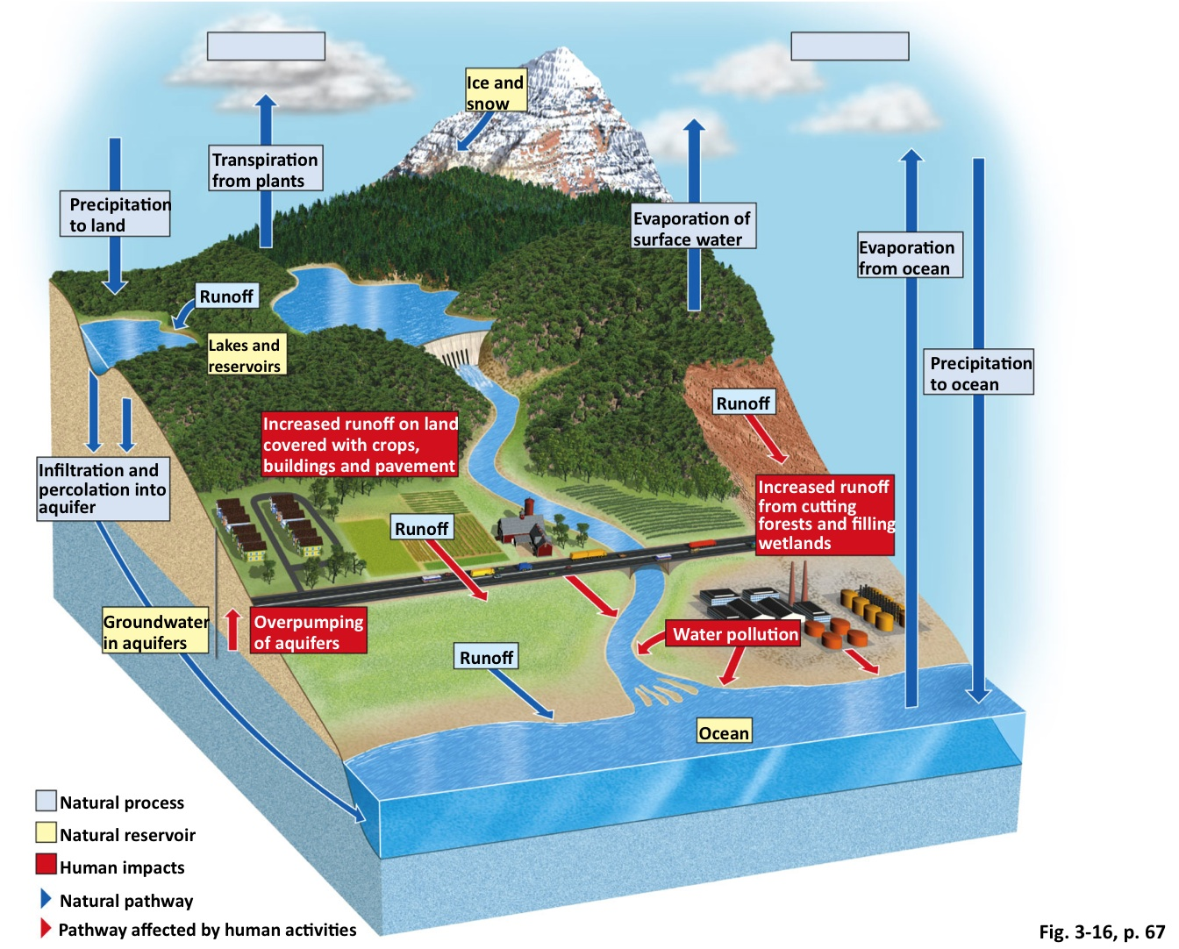
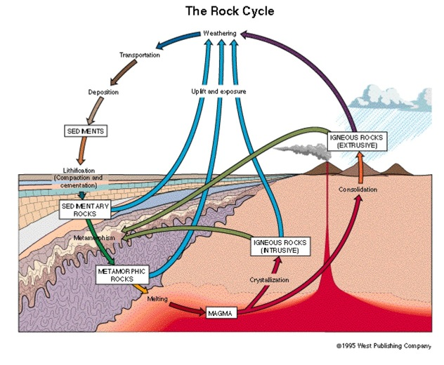
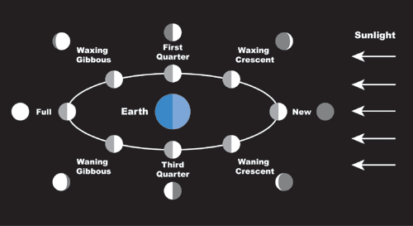

Slide 10
Microteach 2
10 minutes
Focus on content
Part of a larger lesson plan
Peer evaluation of delivery
Instructor evaluation of content
~3 weeks to prep
No constraints on materials

Slide 11
Nanoteach
Narrate an image caption
Bank of printout images provided
Short kinesthetic demo
Props provided
Focus on rapid response
2 minutes to plan/prepare

Slide 12
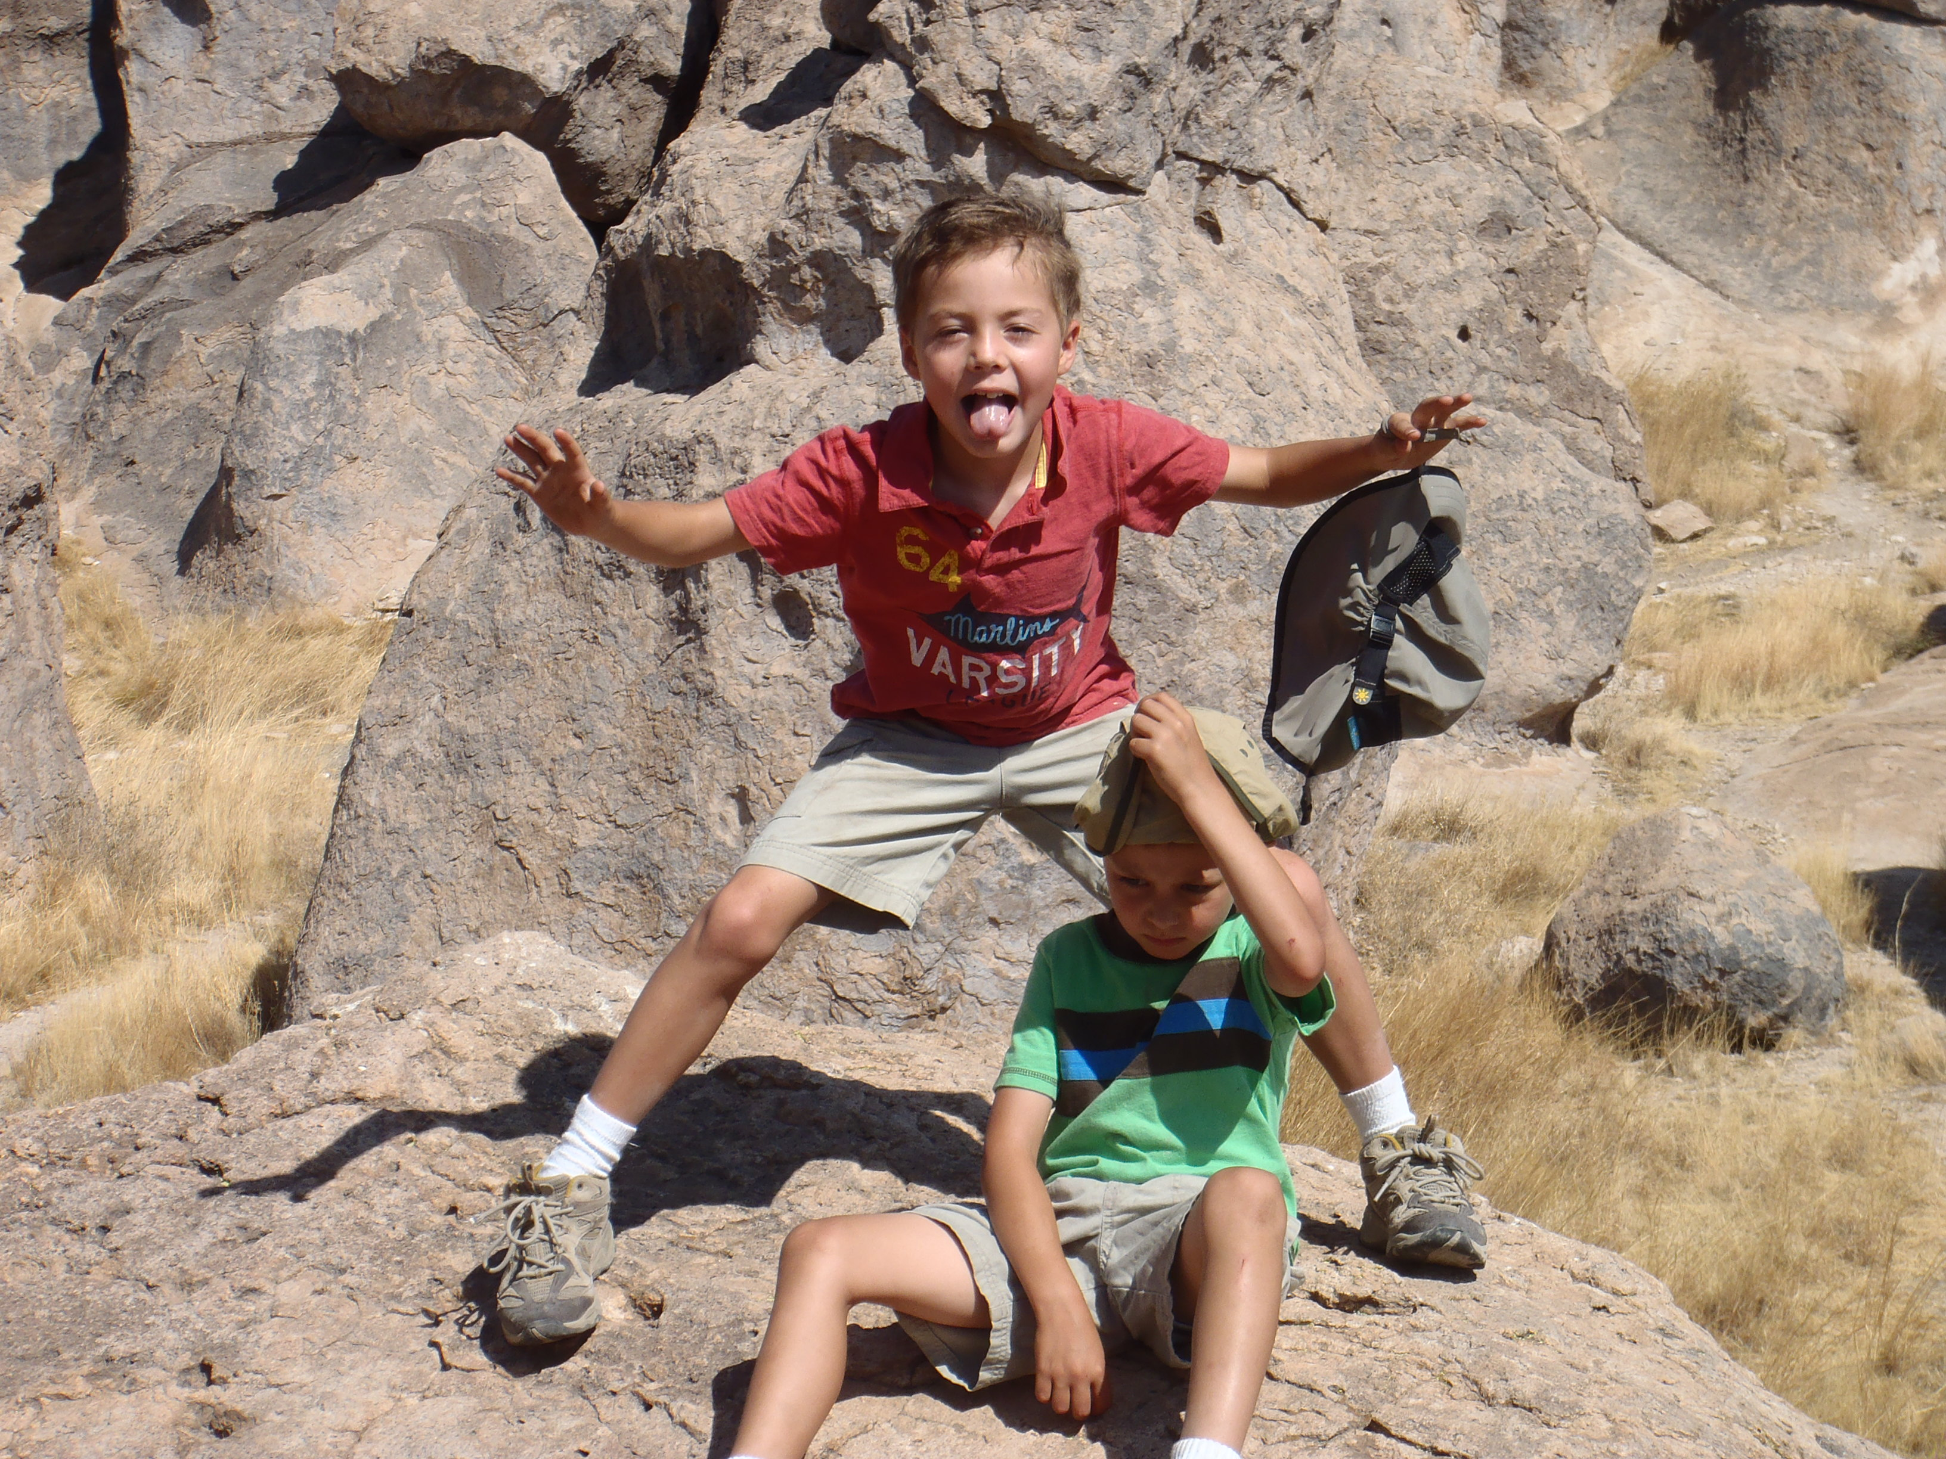
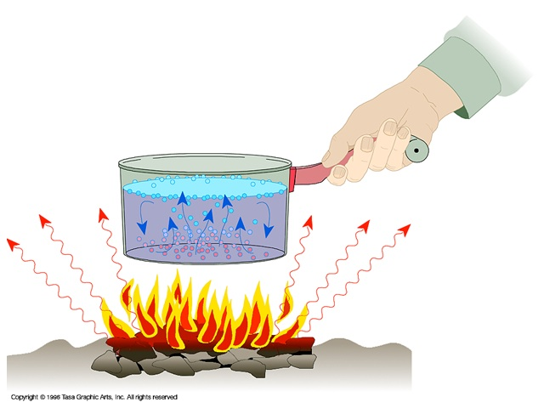
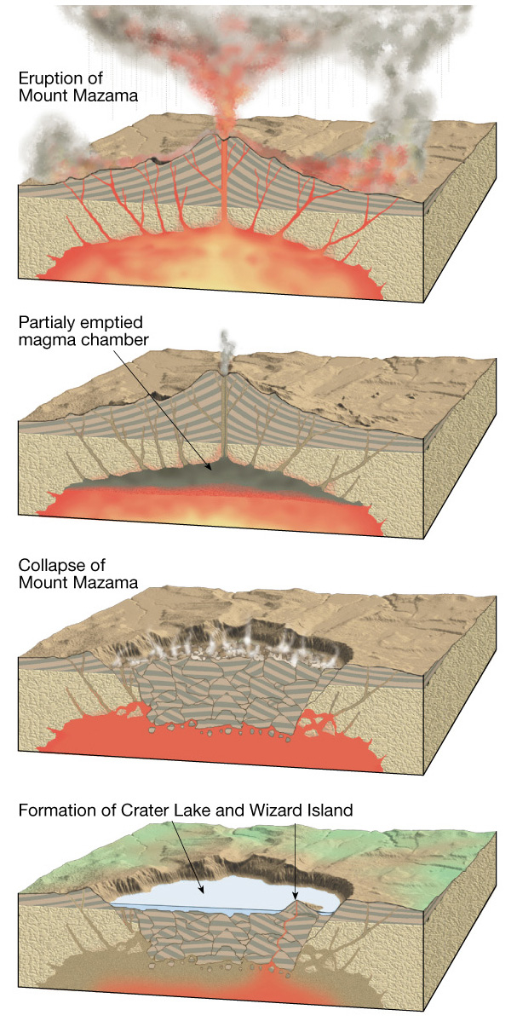
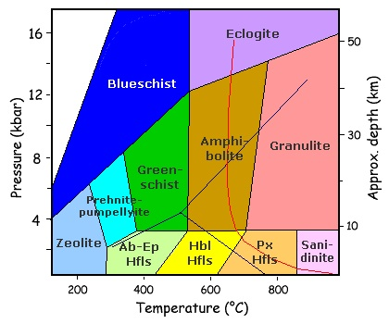
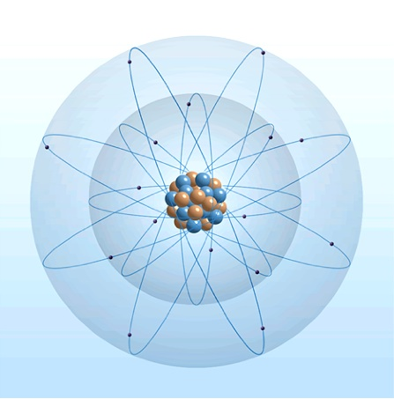
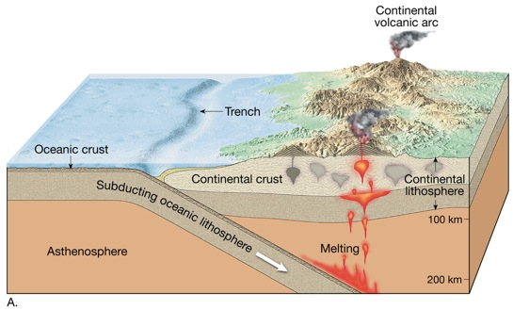
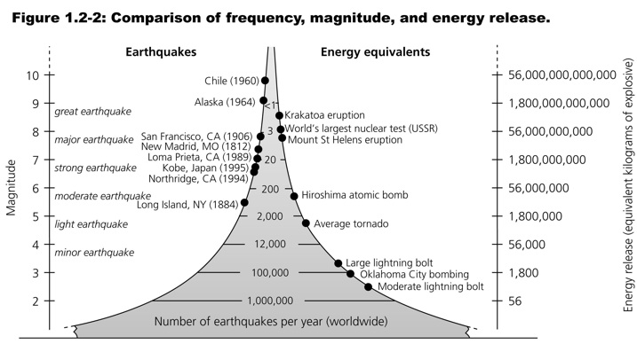
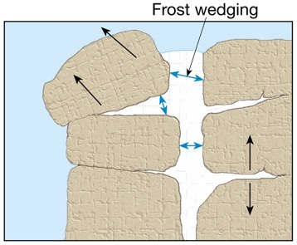
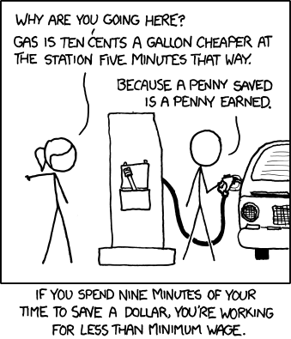
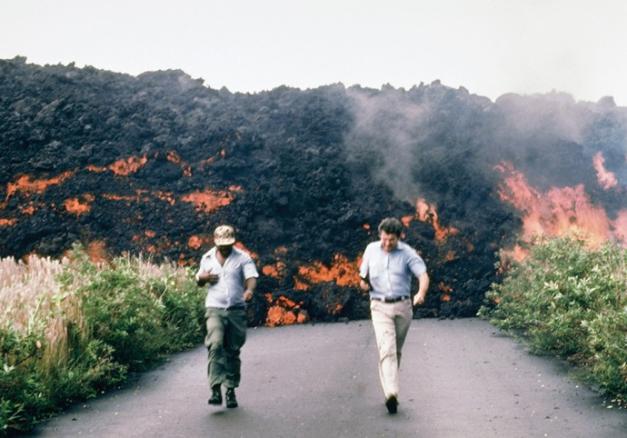
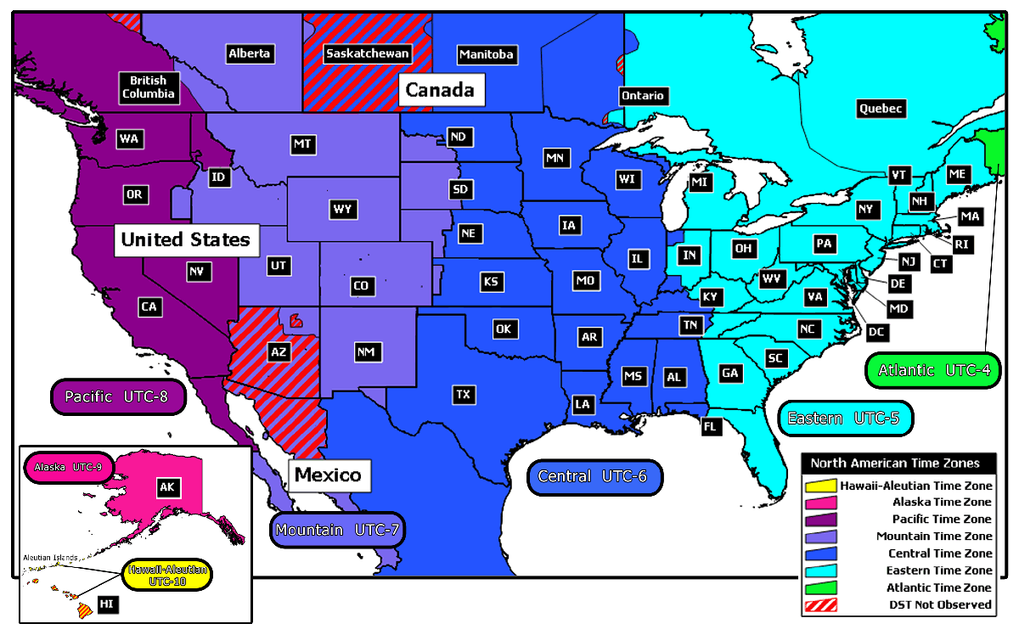

Slide 13
Reflections
Students are either Planners or Wingers
Planners resist spontaneous activity
Wingers choose not to plan well/use time well
SEC: prefer to plan but dislike constraints
ELE: like to plan but better at winging
ELE better at delivery
SEC better at content

Slide 14
Presentation proficiency
Elementary
Content
Proficiency
Secondary

Slide 15
High
Planners
ELE
Delivery Proficiency
Behavior
SEC
Wingers
Low
Content Proficiency
High

Slide 16
Recommendations…

