Slide 1
Upland Gravels of the Mississippi River Valley and their Insights to the Preglacial Drainage in Central North America
Will Cupples
GSA North-Central Section
5/2/13
University of Memphis

Slide 2
Outline
Background of the Upland Complex gravel
Arc River hypothesis
Other upland gravels along the Mississippi River valley
The path of the Pliocene Mississippi River
Longitudinal Profiles
Conclusions

Slide 3
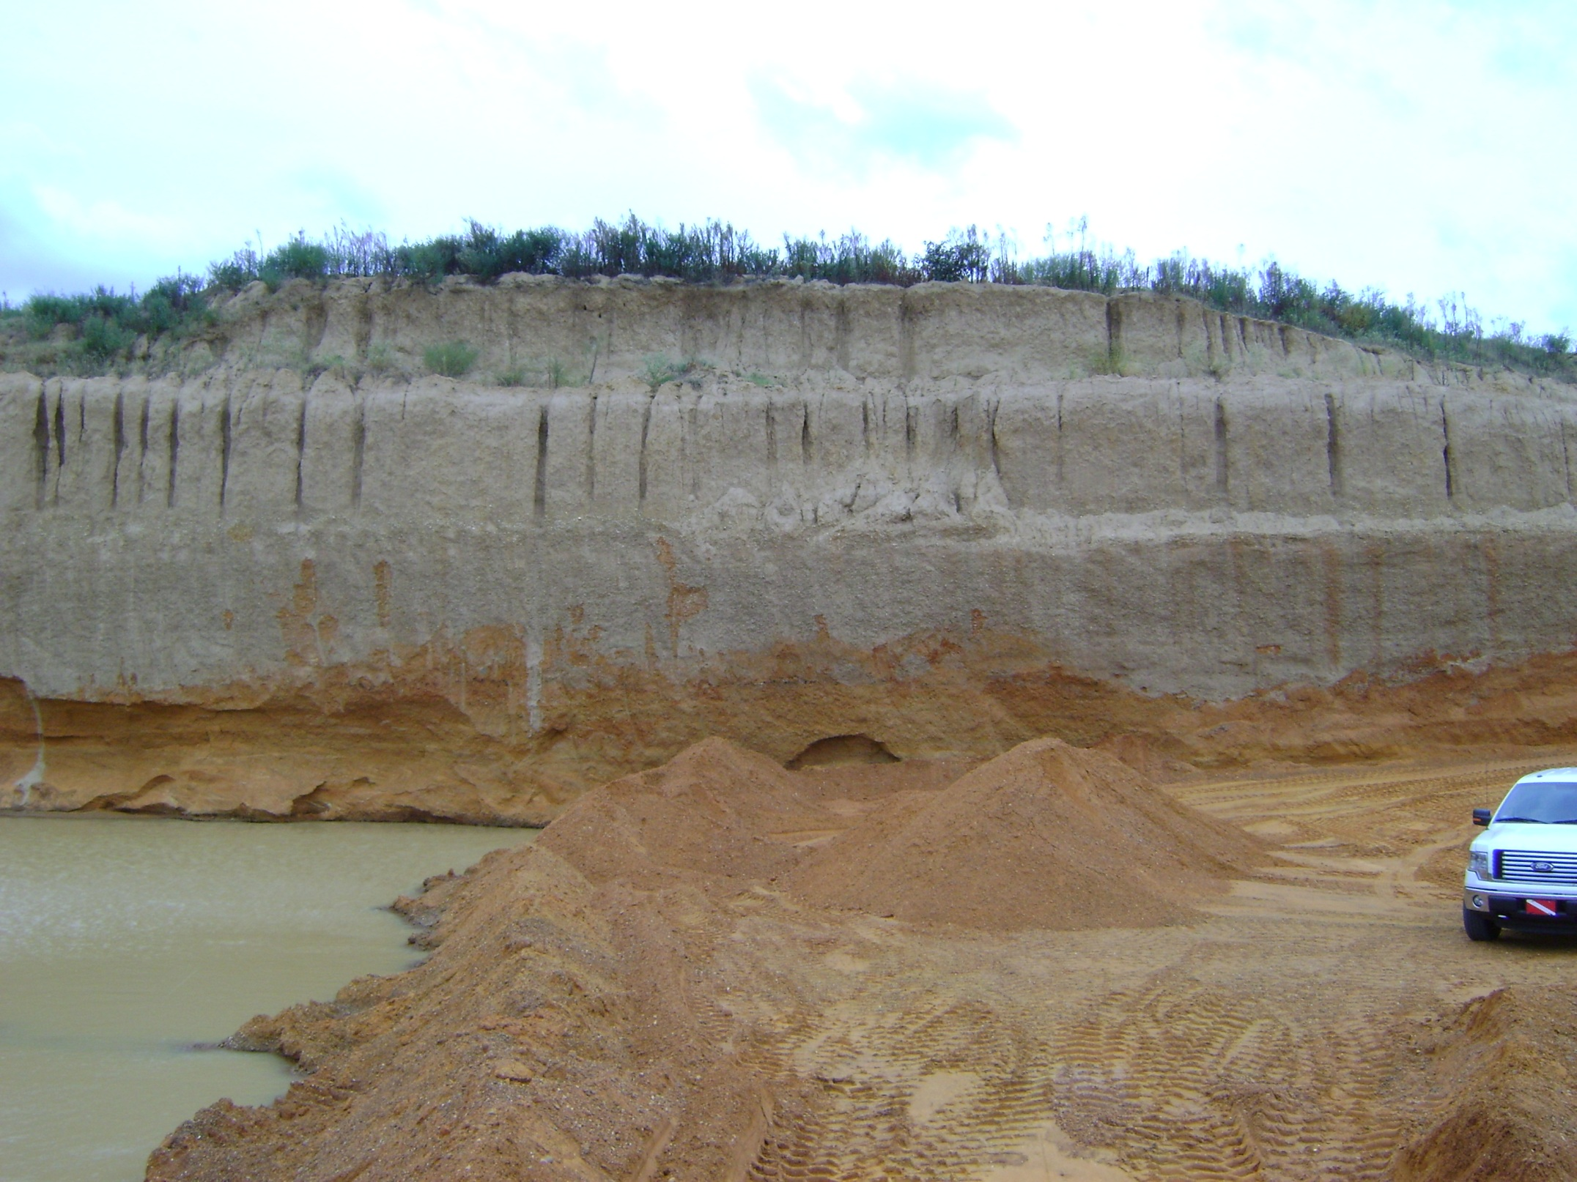
Loess
Upland Complex

Slide 4
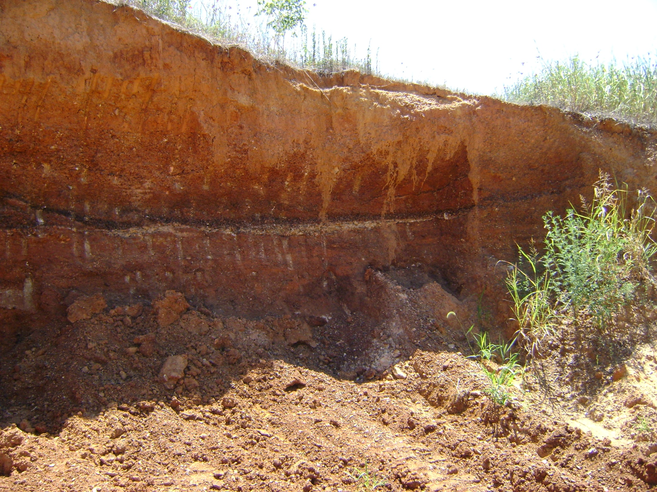

Slide 5
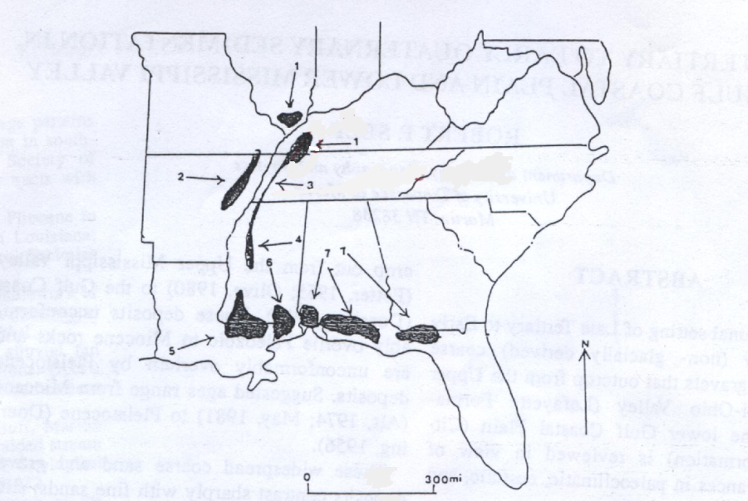
Upland Complex
Interpretations?
Alluvial Fan deposit from the Nashville Dome?
Terrace of a south-flowing ancestral Mississippi River?
From Self, 1993

Slide 6
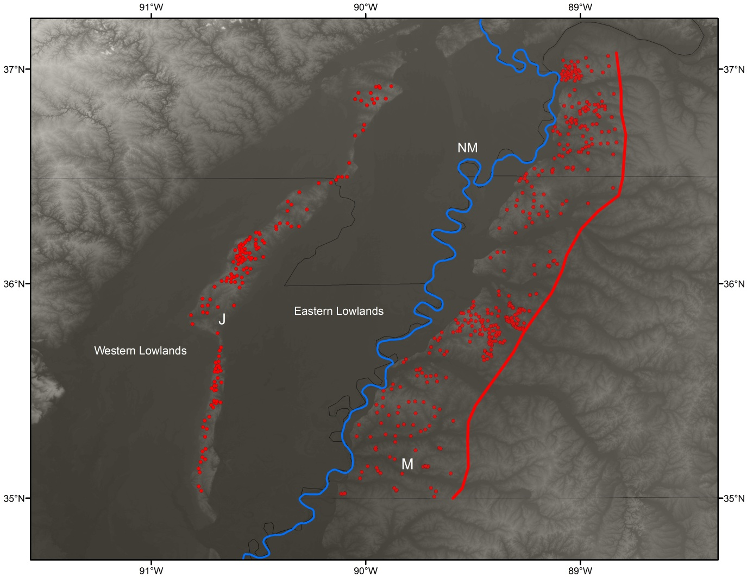
Upland Complex
Eastern Boundary
Southerly slope
Thins to the east in TN & KY

Slide 7
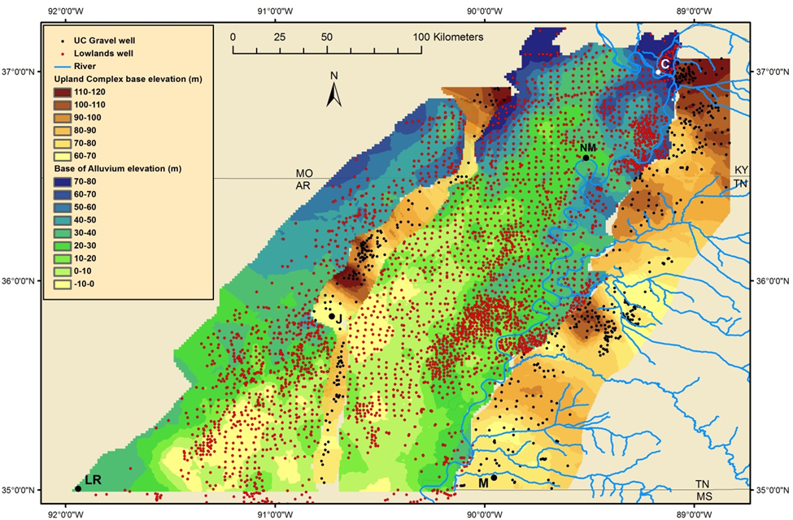

Slide 8
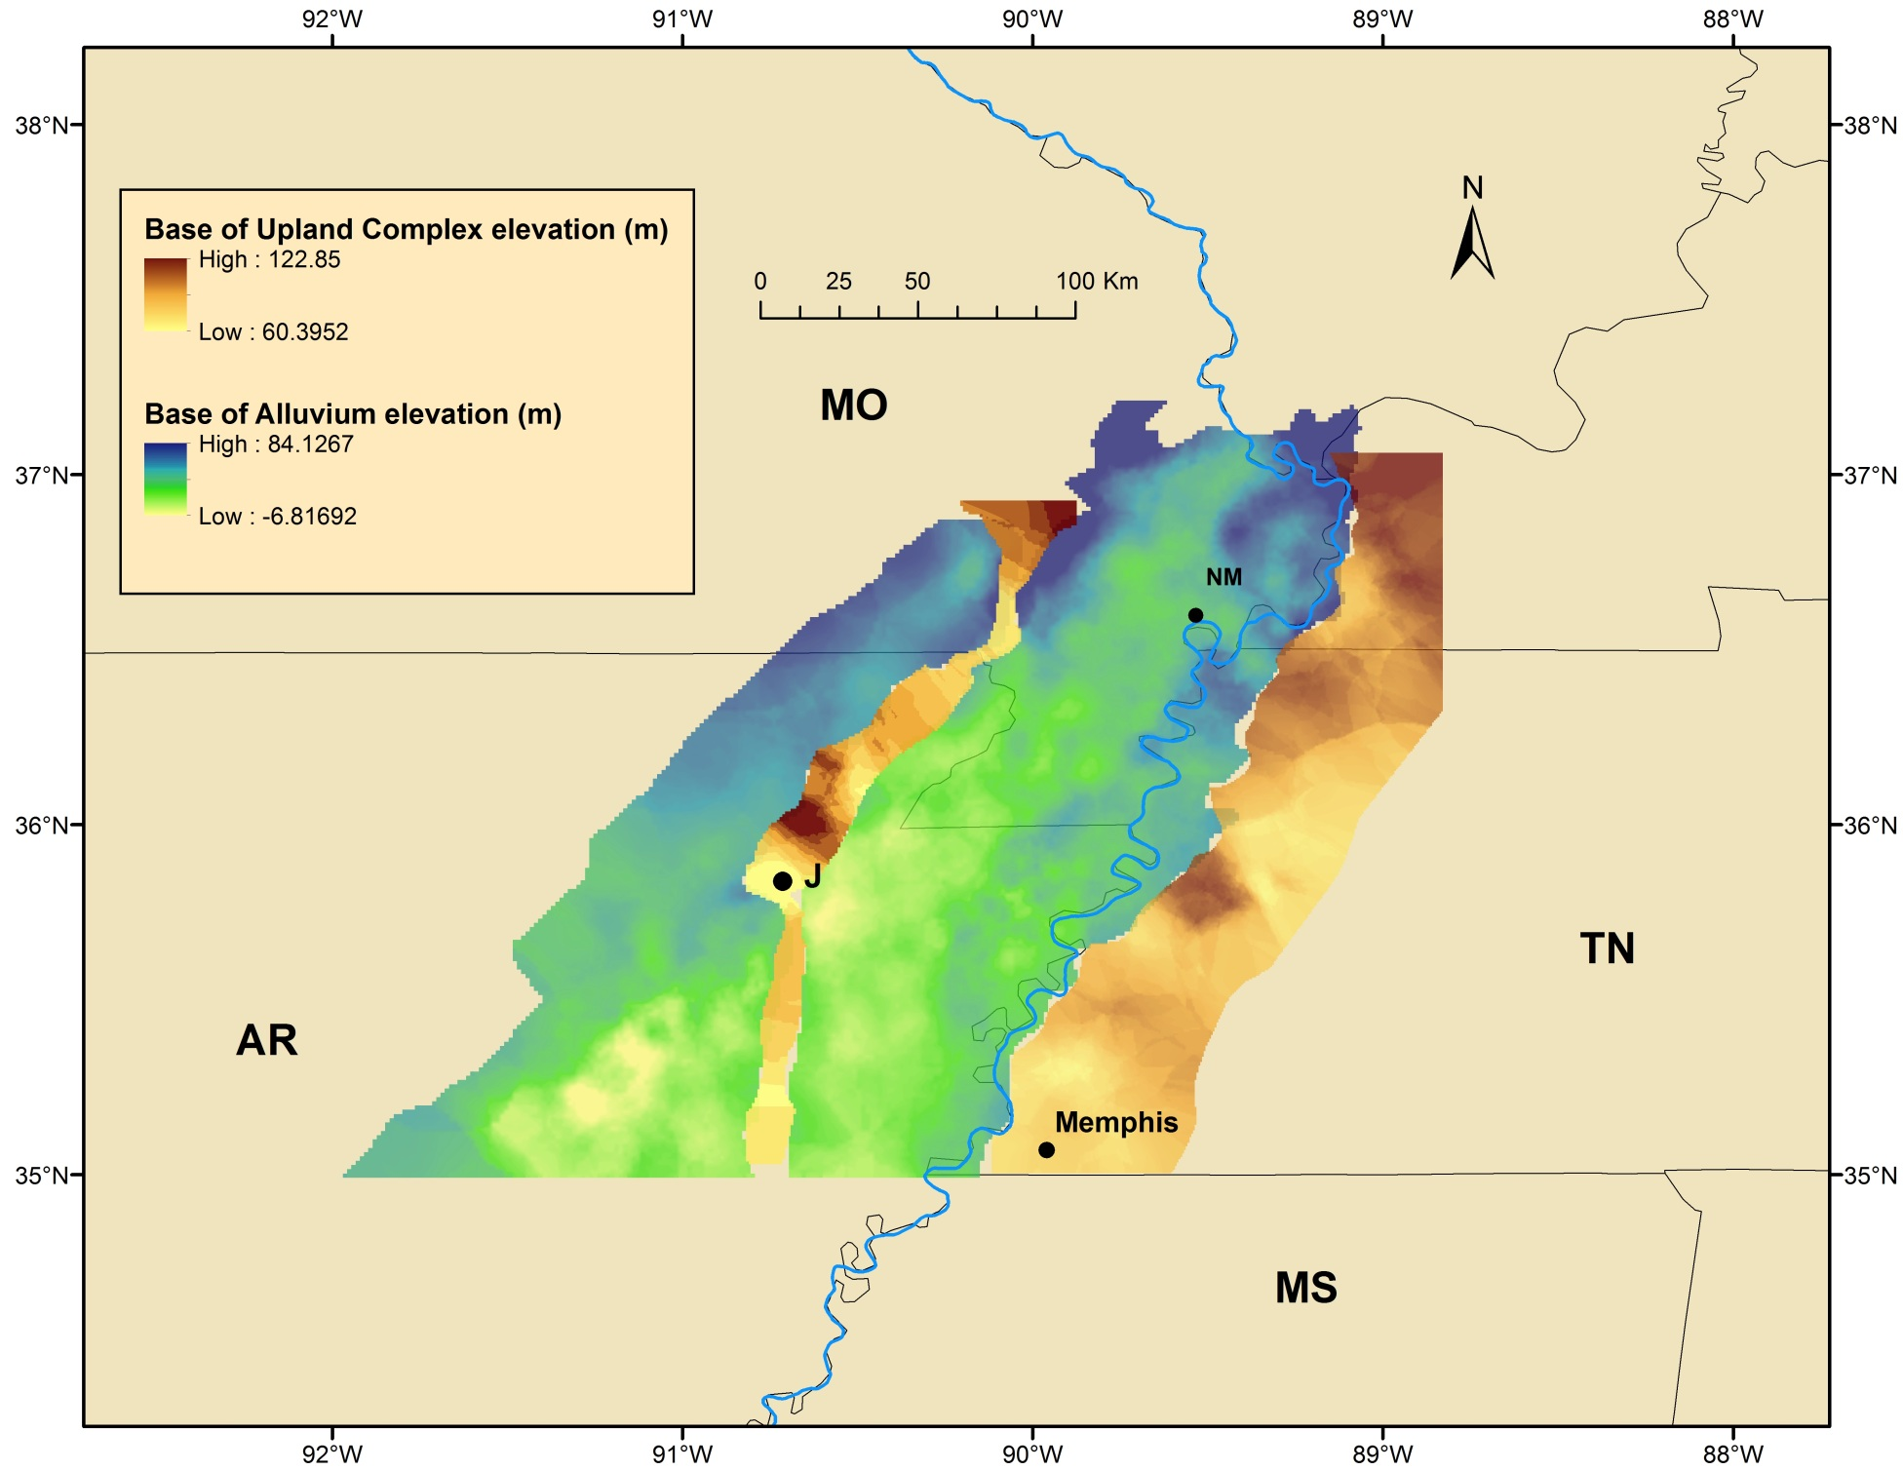

Slide 9
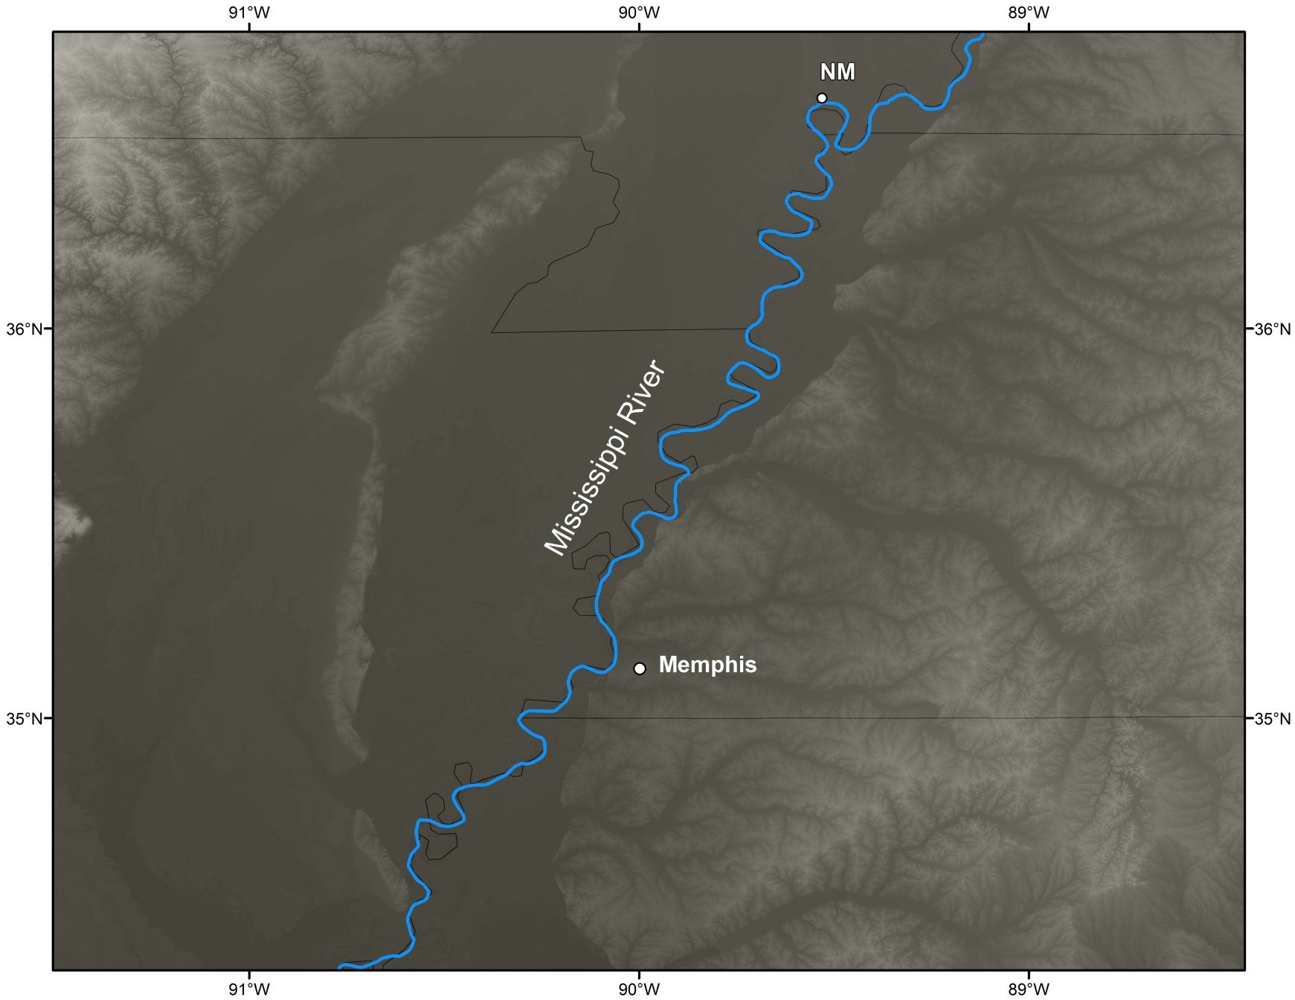
Arc River Hypothesis
Mississippi River
Memphis

Slide 10
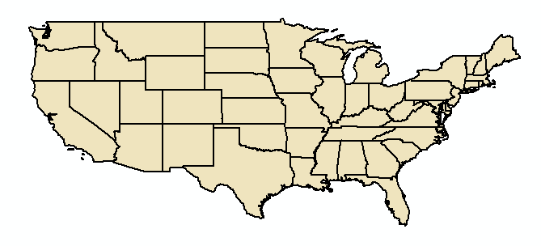
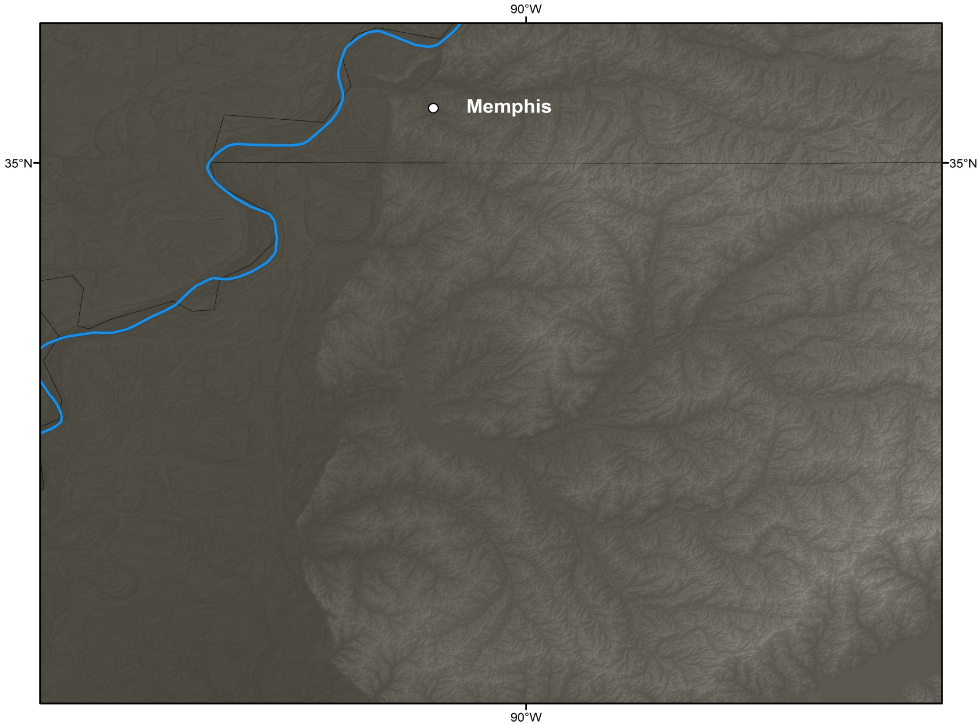
Memphis
Large Arc or Oxbow shaped topographic lows preserved in the Upland Complex gravels
~17-20 km in diameter
Former courses of the preglacial Mississippi River
Larger discharge = larger drainage basin
6 km
20 km

Slide 11
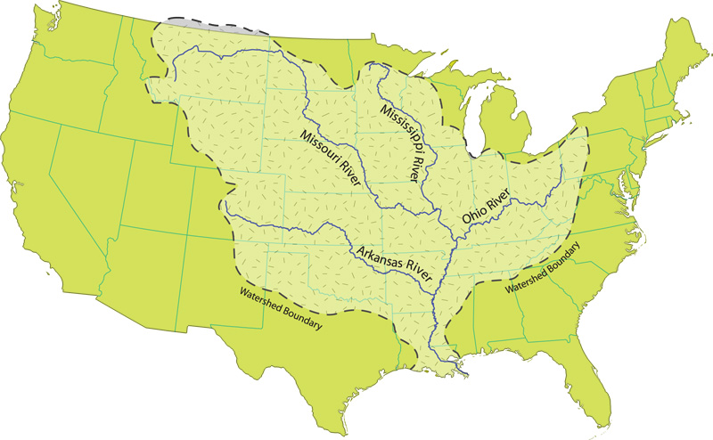
Drainage Area?

Slide 12
Arc River Evidence
Upland gravels in Illinois, Minnesota, and Wisconsin along the Mississippi River valley.
Gravels of the same composition (rounded reddish-brown chert).
Evidence in the driftless area (unglaciated regions of Illinois, Iowa, Wisconsin, and Minnesota).
Southerly slope of base of preglacial gravels

Slide 13
Other Upland Gravels
Mounds Gravel- (Southern Illinois and Missouri) rounded, reddish-brown chert gravel. Identical to the Upland Complex, with some quartzite. (sampled)
Grover Gravel- (Northern Illinois and St. Louis, MO) rounded reddish-brown chert gravel, and includes boulders of pink and purple quartzite. (sampled)
Windrow Gravel- (Wisconsin, Iowa, and Minnesota) very patchy, but very similar to the Grover gravel and is sometimes called the Grover in Wisconsin. (not sampled)

Slide 14
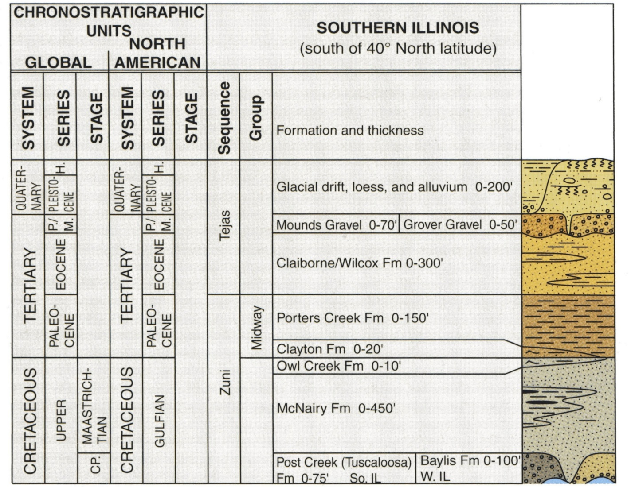
Stratigraphic Column
(Kolata and Nimz, 2010)
*Further north in Illinois, the upland gravels sit on Paleozoic bedrock

Slide 15
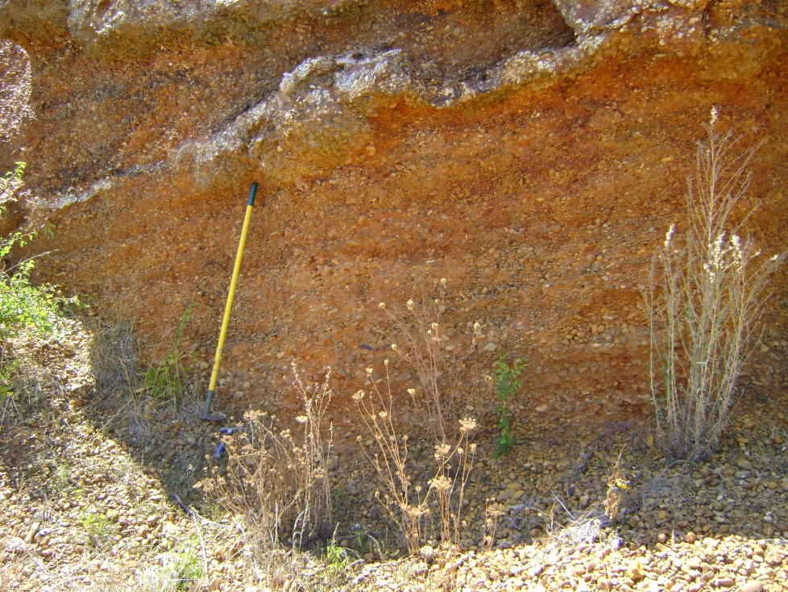
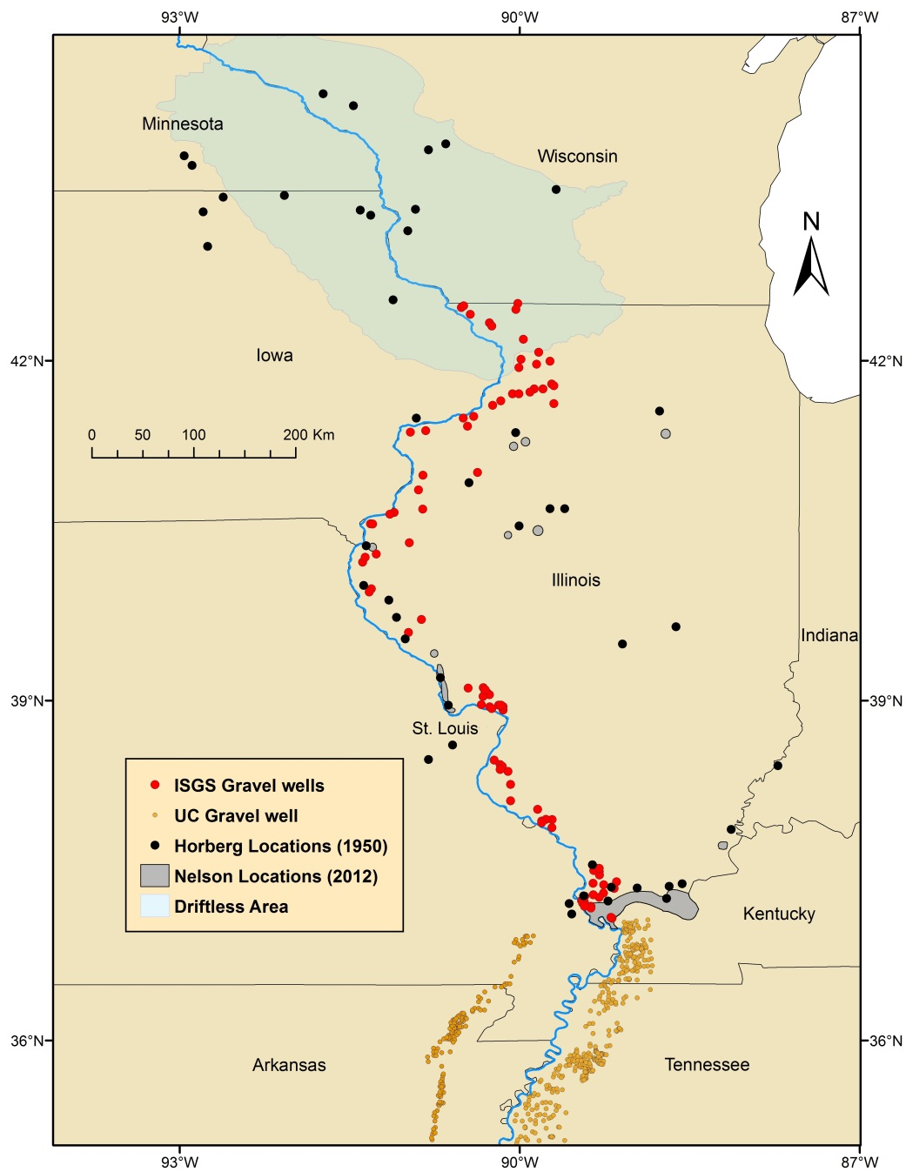
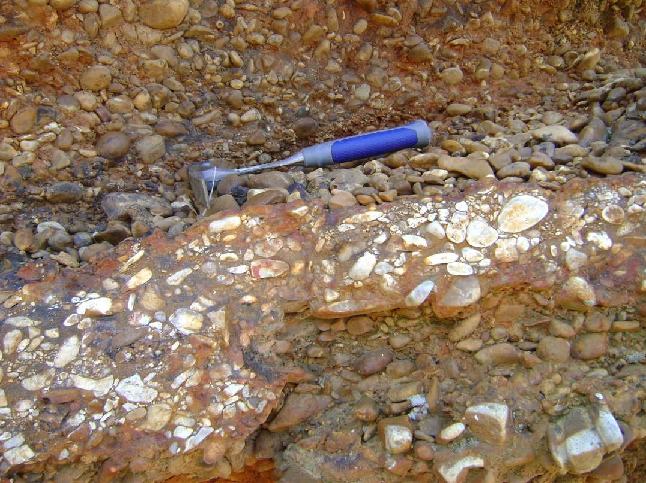
Mounds gravel (S. Illinois and Missouri)

Slide 16
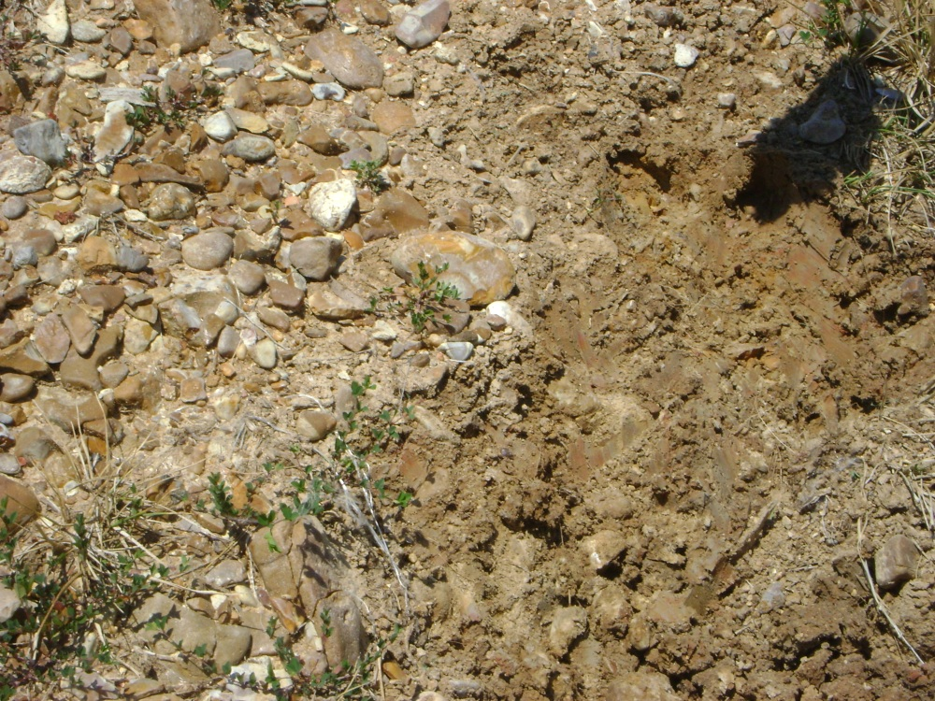
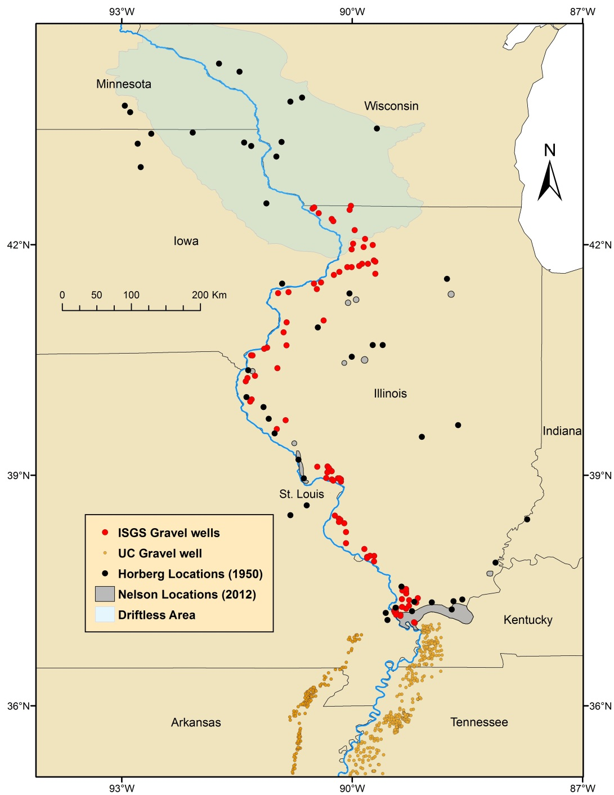
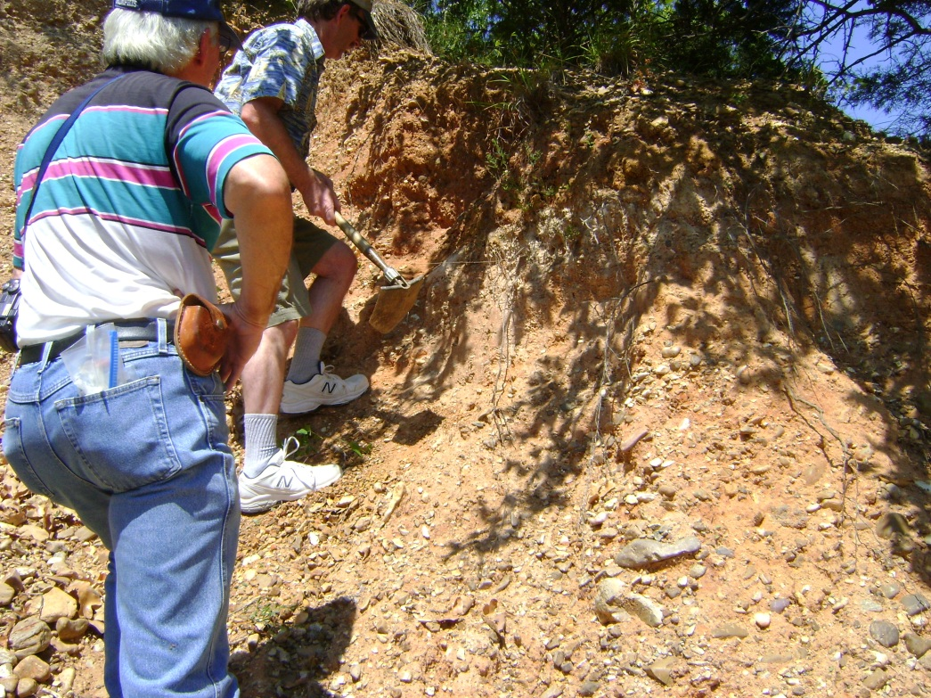
Grover gravel (Northern Illinois and St. Louis, Missouri)

Slide 17

Windrow gravel (IA, MN, and WI)
Very patchy
Very similar to the Grover gravel
Assigned to the Cretaceous, but could be Pliocene.
(Willman and Frye, 1970)

Slide 18
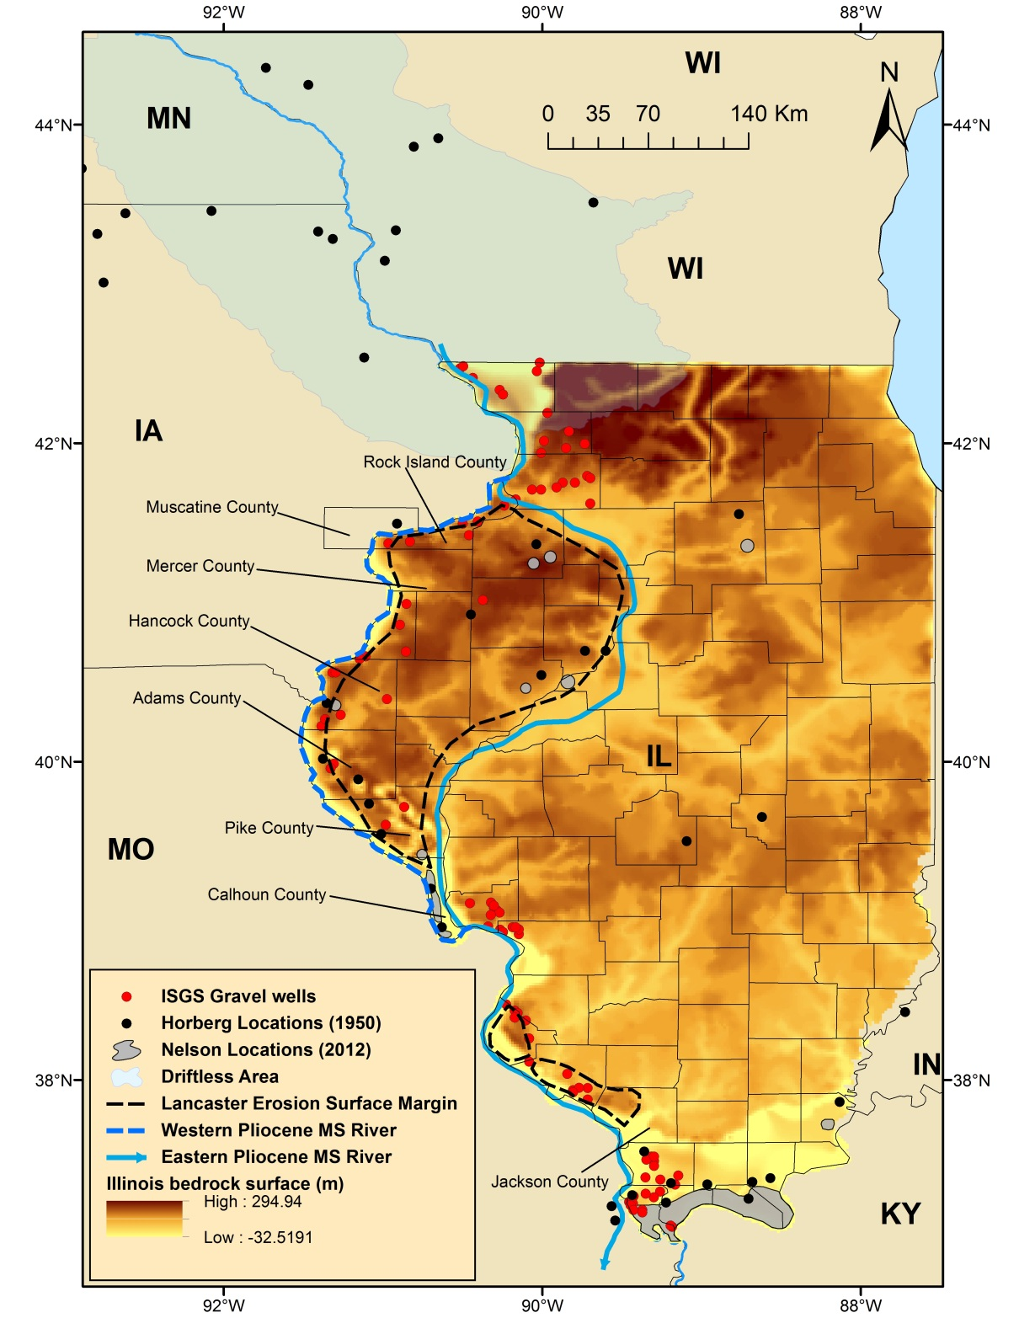
Sequence of Events
1. Mid-Pliocene course of the Mississippi River was close to the modern Mississippi River course.
2. Late Pliocene or Early Pleistocene: Ice lobe shifted the Mississippi River to its central Illinois course.
3. Wisconsin glacial lobe shifted the Pleistocene Mississippi River to its modern course on the western border of Illinois.

Slide 19
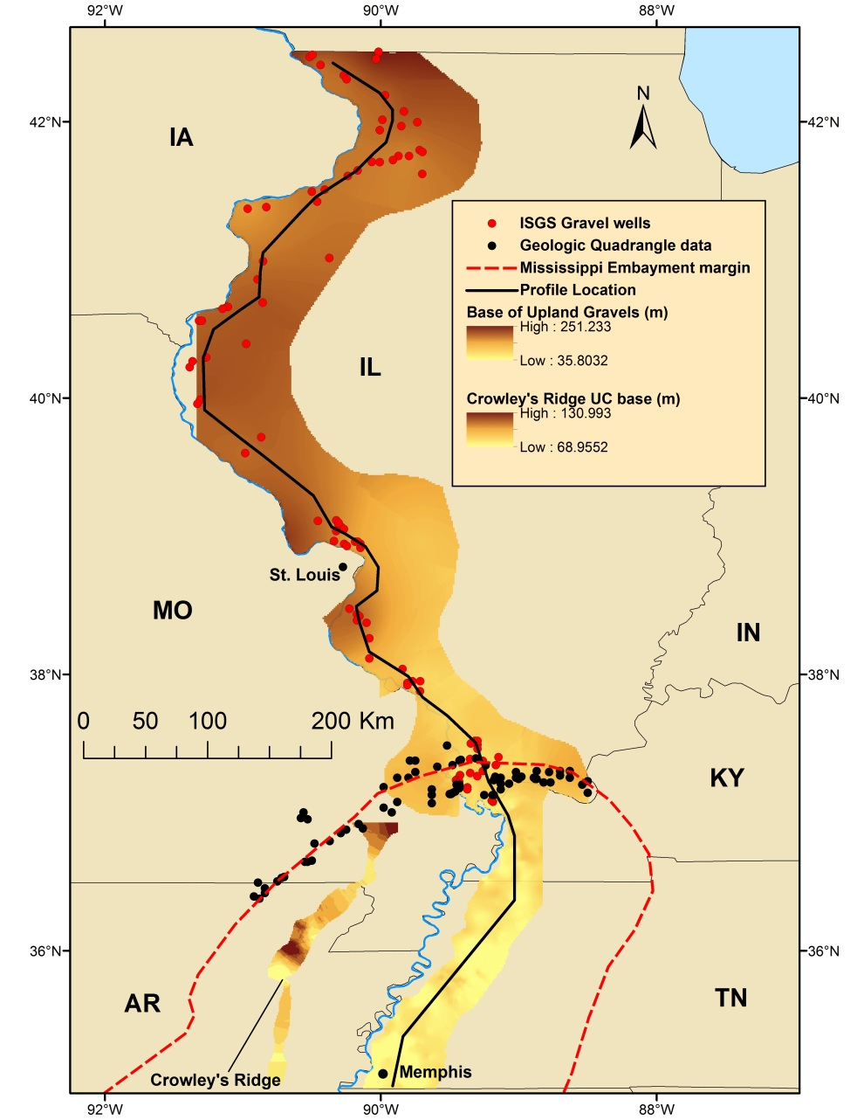
Base of Upland Gravels
Structure contour map for the base of the upland gravels from northern Illinois to Memphis, TN.
Longitudinal profile from north to south.

Slide 20
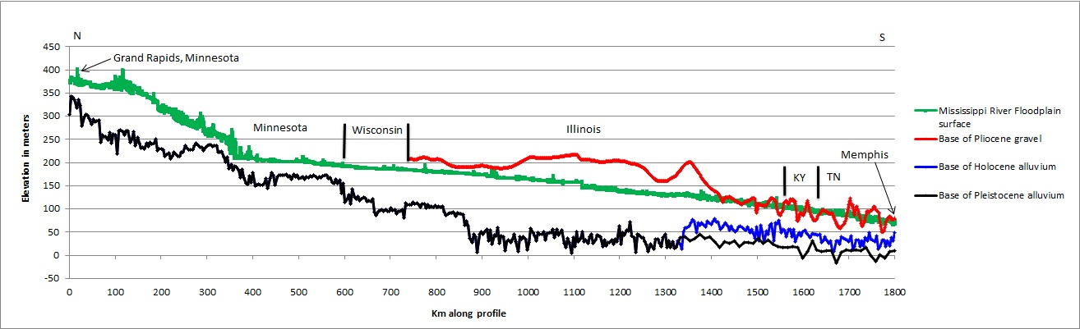
Longitudinal profiles

Slide 21
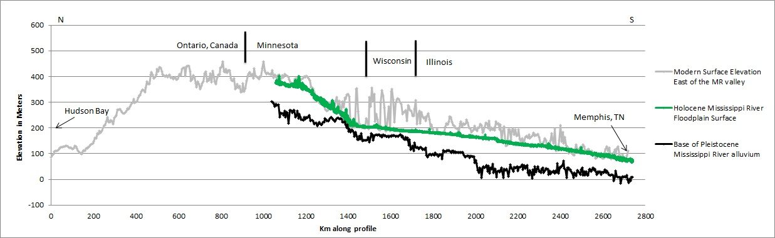
Longitudinal Profiles

Slide 22
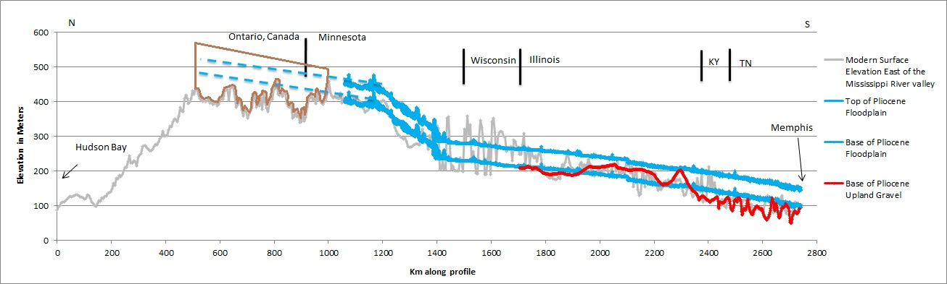
Longitudinal profiles
Brown = Paleozoic sedimentary rocks
Project the base and top of the Pliocene floodplain north into Canada. The base of the floodplain sits ~30 m above the surface.
Pliocene Arc (Mississippi) River can be considered plausible, but needs more detailed mapping of Pliocene deposits, and provenance studies.
Using the gradient of the Holocene floodplain as a proxy for the Pliocene (~50 m thick).

Slide 23
Conclusions
Based on their similarities and position in the landscape, these upland gravels can be considered related.
Their distribution suggests that the course of the ancestral Mississippi River shifted from its Pliocene to Pleistocene to Present day path.
Arc River hypothesis can be considered plausible.

Slide 24
Thank You
?
Acknowledgements:
Dr. Roy Van Arsdale
Dr. Randel Cox
Dr. David Lumsden
Richard Martin
Energen Resources Corp.

