Slide 1
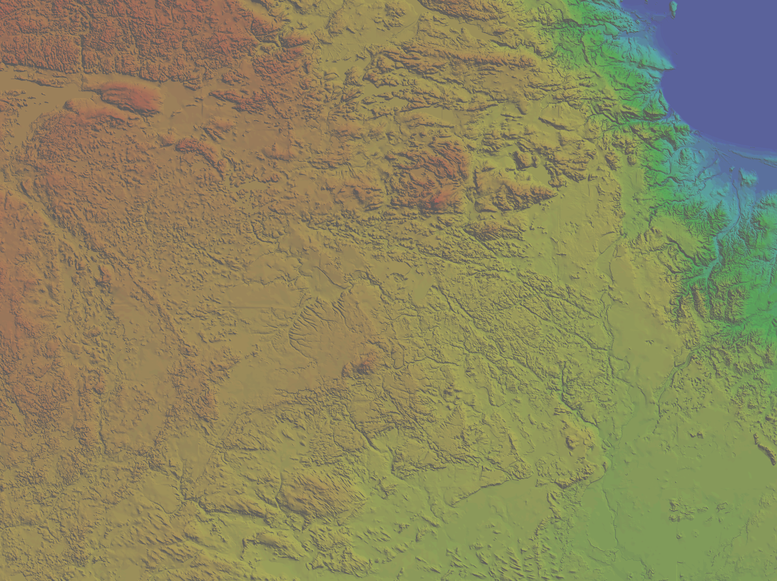
A Case for Step-Wise Retreat of the Laurentide Ice Sheet During the Younger Dryas: Central Upper Peninsula of Michigan
Kent A. Walters
Thomas V. Lowell
The University of Cincinnati
May 2, 2013

Slide 2
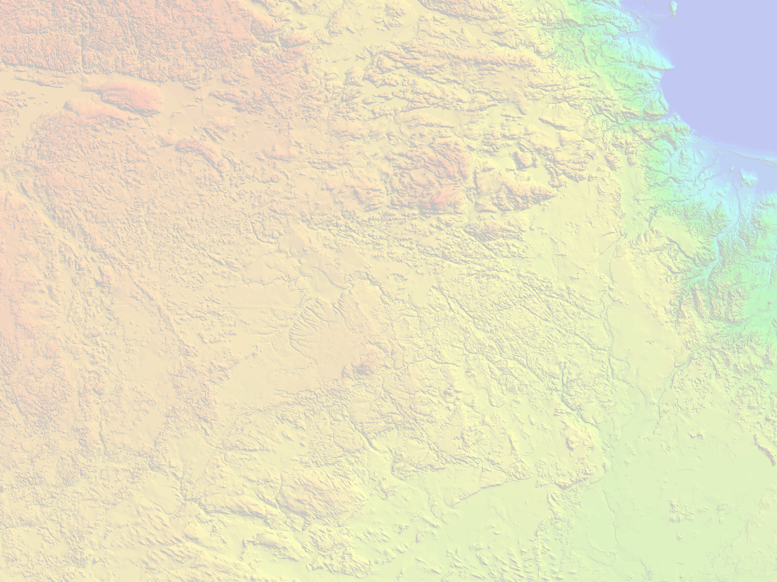

Acknowledgements
Dr. Aaron Putnam - Lamont-Doherty Earth Observatory
Dr. Robert Regis
Dr. Timothy G. Fisher
Dr. David B. Nash
Paul Wilcox
Colby Smith

Slide 3
Climate Change and Glaciers
Small glaciers are sensitive and respond to climate change.
Climate sensitivity and responsiveness of ice sheets is less known

Slide 4
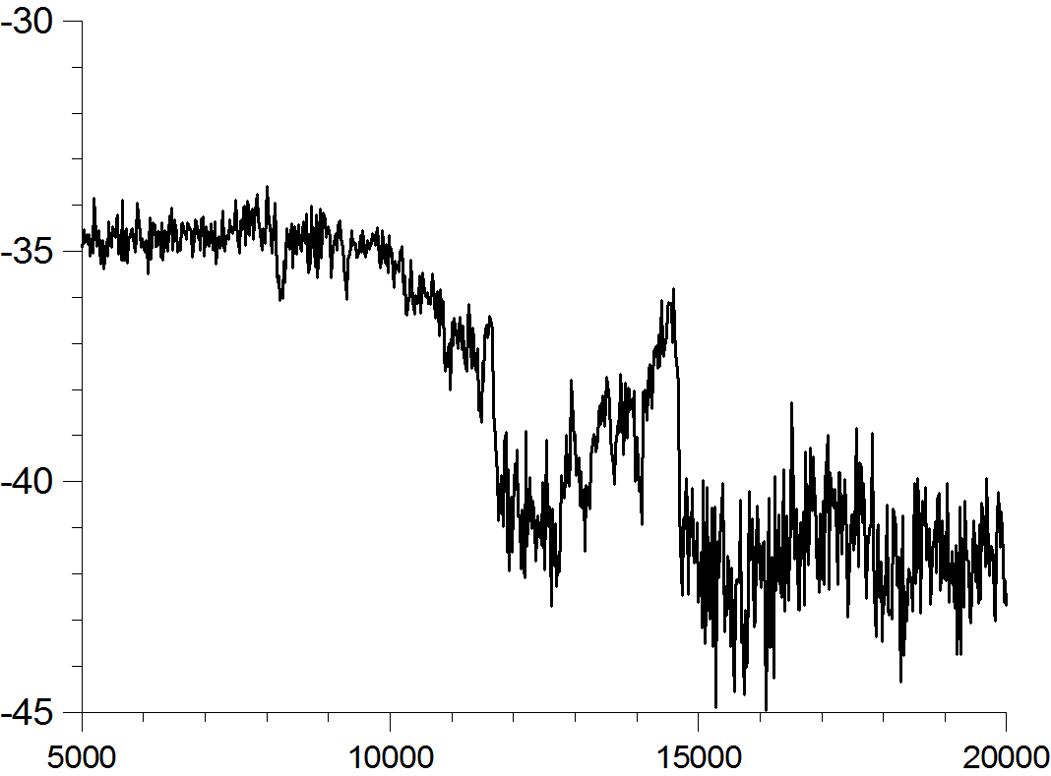
The Younger Dryas
The Younger Dryas
~12,900-11,600 years before present
Rapid transition to glacial temperatures
Last major climatic change in geologic history.
Warm
Younger Dryas
GRIP-Greenland ice core record
δO¹⁸
Cold
Calibrated Years Before Present
Notes:
Leave out the 15 degrees cooler than present
Explain the graph first, time is old to young, isotopes records indicate temperature, warm during the holocene and flip flop in the middle. The Younger dryas is the cold part of the flip flop
What is the younger Dryas?,
The younger dryas is a well known paleoclimatic event in which many scientist have made a living by. Although suggested by other lines of evidence like pollen records and beetle parts, it was widely accepted after the collection of the GRIP ice cores from the Greenland Ice Sheet.
The Younger Dryas although still being refined occurred between 12.9 and 11.6 ka calibrated years ago, approximately 11-10 radiocarbon years.
Another thing which makes the Younger dryas unique is that it interrupted a return to interglacial climates and brought the climate to near glacial conditions. Along with returning the temperatures to near glacial conditions it did so very rapid, in what some say decades. Very fast climate changes.
The Younger dryas is also the last major climatic change recorded in geologic history. Scientist like to study the younger dryas because they are interested to how climate may repsond to rapid change like the younger dryas.

Slide 5
Research Question
How does the Laurentide ice sheet respond during the Younger Dryas chronozone?
Notes:
Unfortunately this is unresolved because there are two competing hypotheis, large retreat, no retreat

Slide 6
Study Location
Study Location
Lake Gribben
11,600 BP
LAKE SUPERIOR
Michigan
Wisconsin
Younger Dryas
12,900-11,600 BP
LAKE MICHIGAN
Michigan
Two Creeks
13,700 BP
Notes:
Make sure to mention these ages represent when ice advances to this position. Mention that we are going to tweak the age to represent more “stable” time of when the ice sheet was building the moraine.

Slide 7
Presentation Structure
Mapping of glacial landforms
Chronology of ice sheet retreat
Interpretation
Notes:
Spend about 15 secs on slide.

Slide 8
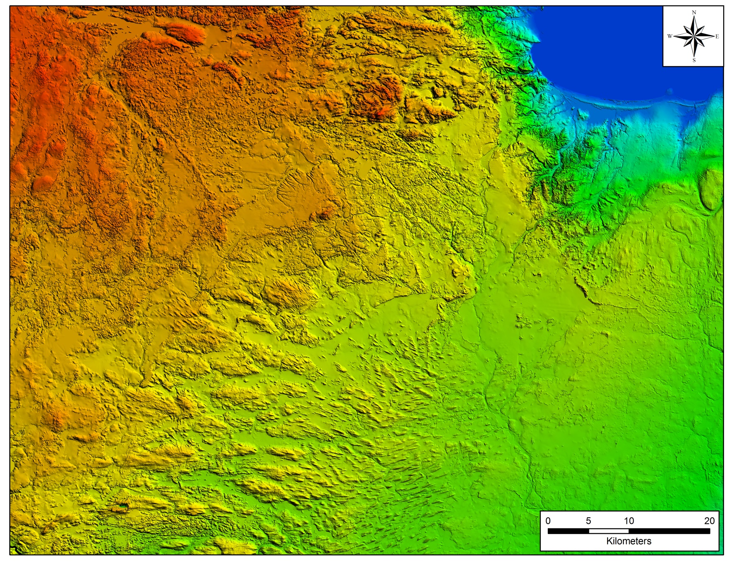
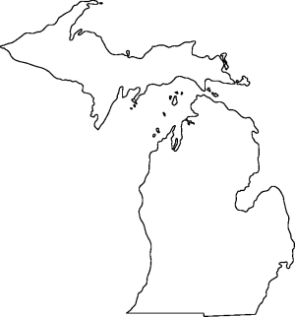
Mapping
Notes:
-Reds are high, blues are low
-Zoom in to a moraine, and explain how it takes time for a moraine to form, then zoom back out and indicate how there are 8 of these moraines.

Slide 9
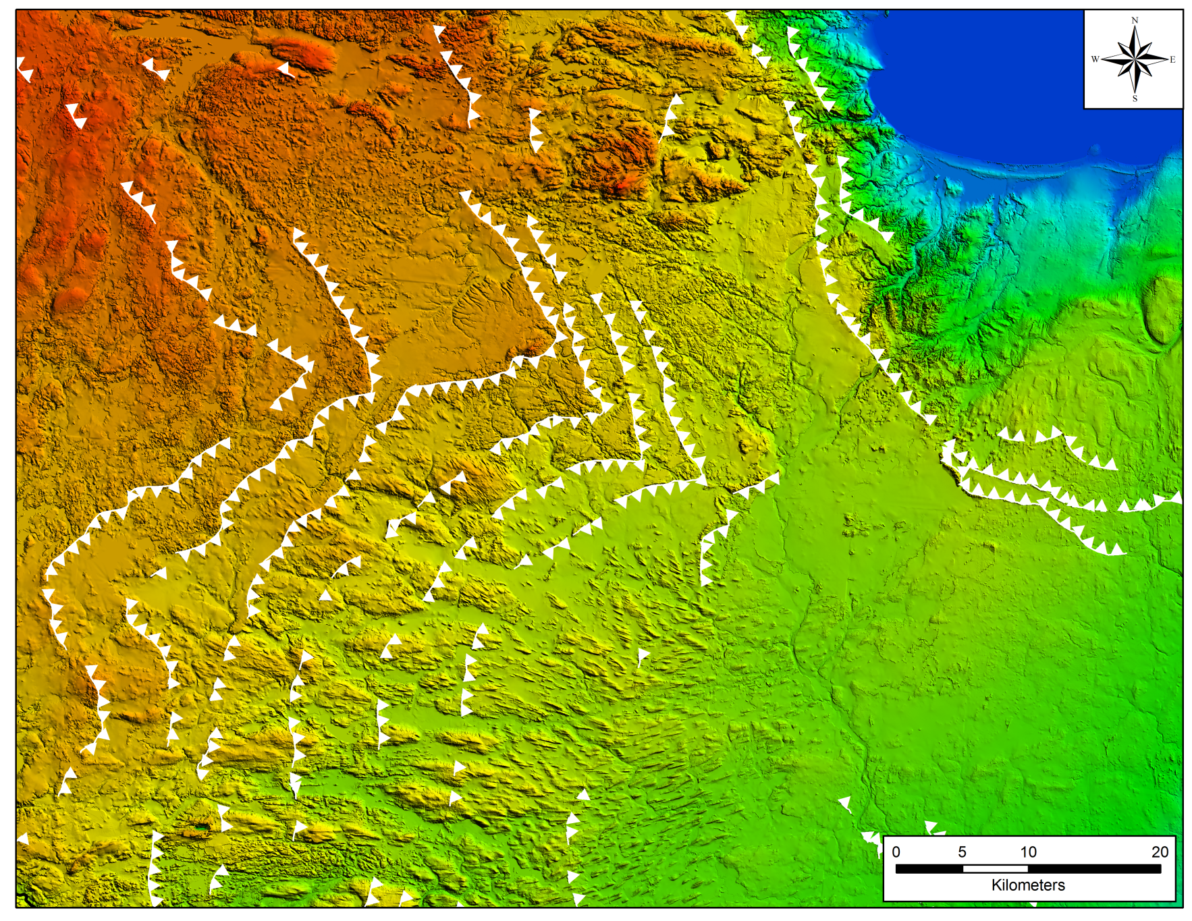
Mapping
Notes:
Make moraines larger and contrast the color to make more visible.
then zoom back out and indicate how there are 8 of these moraines.

Slide 10
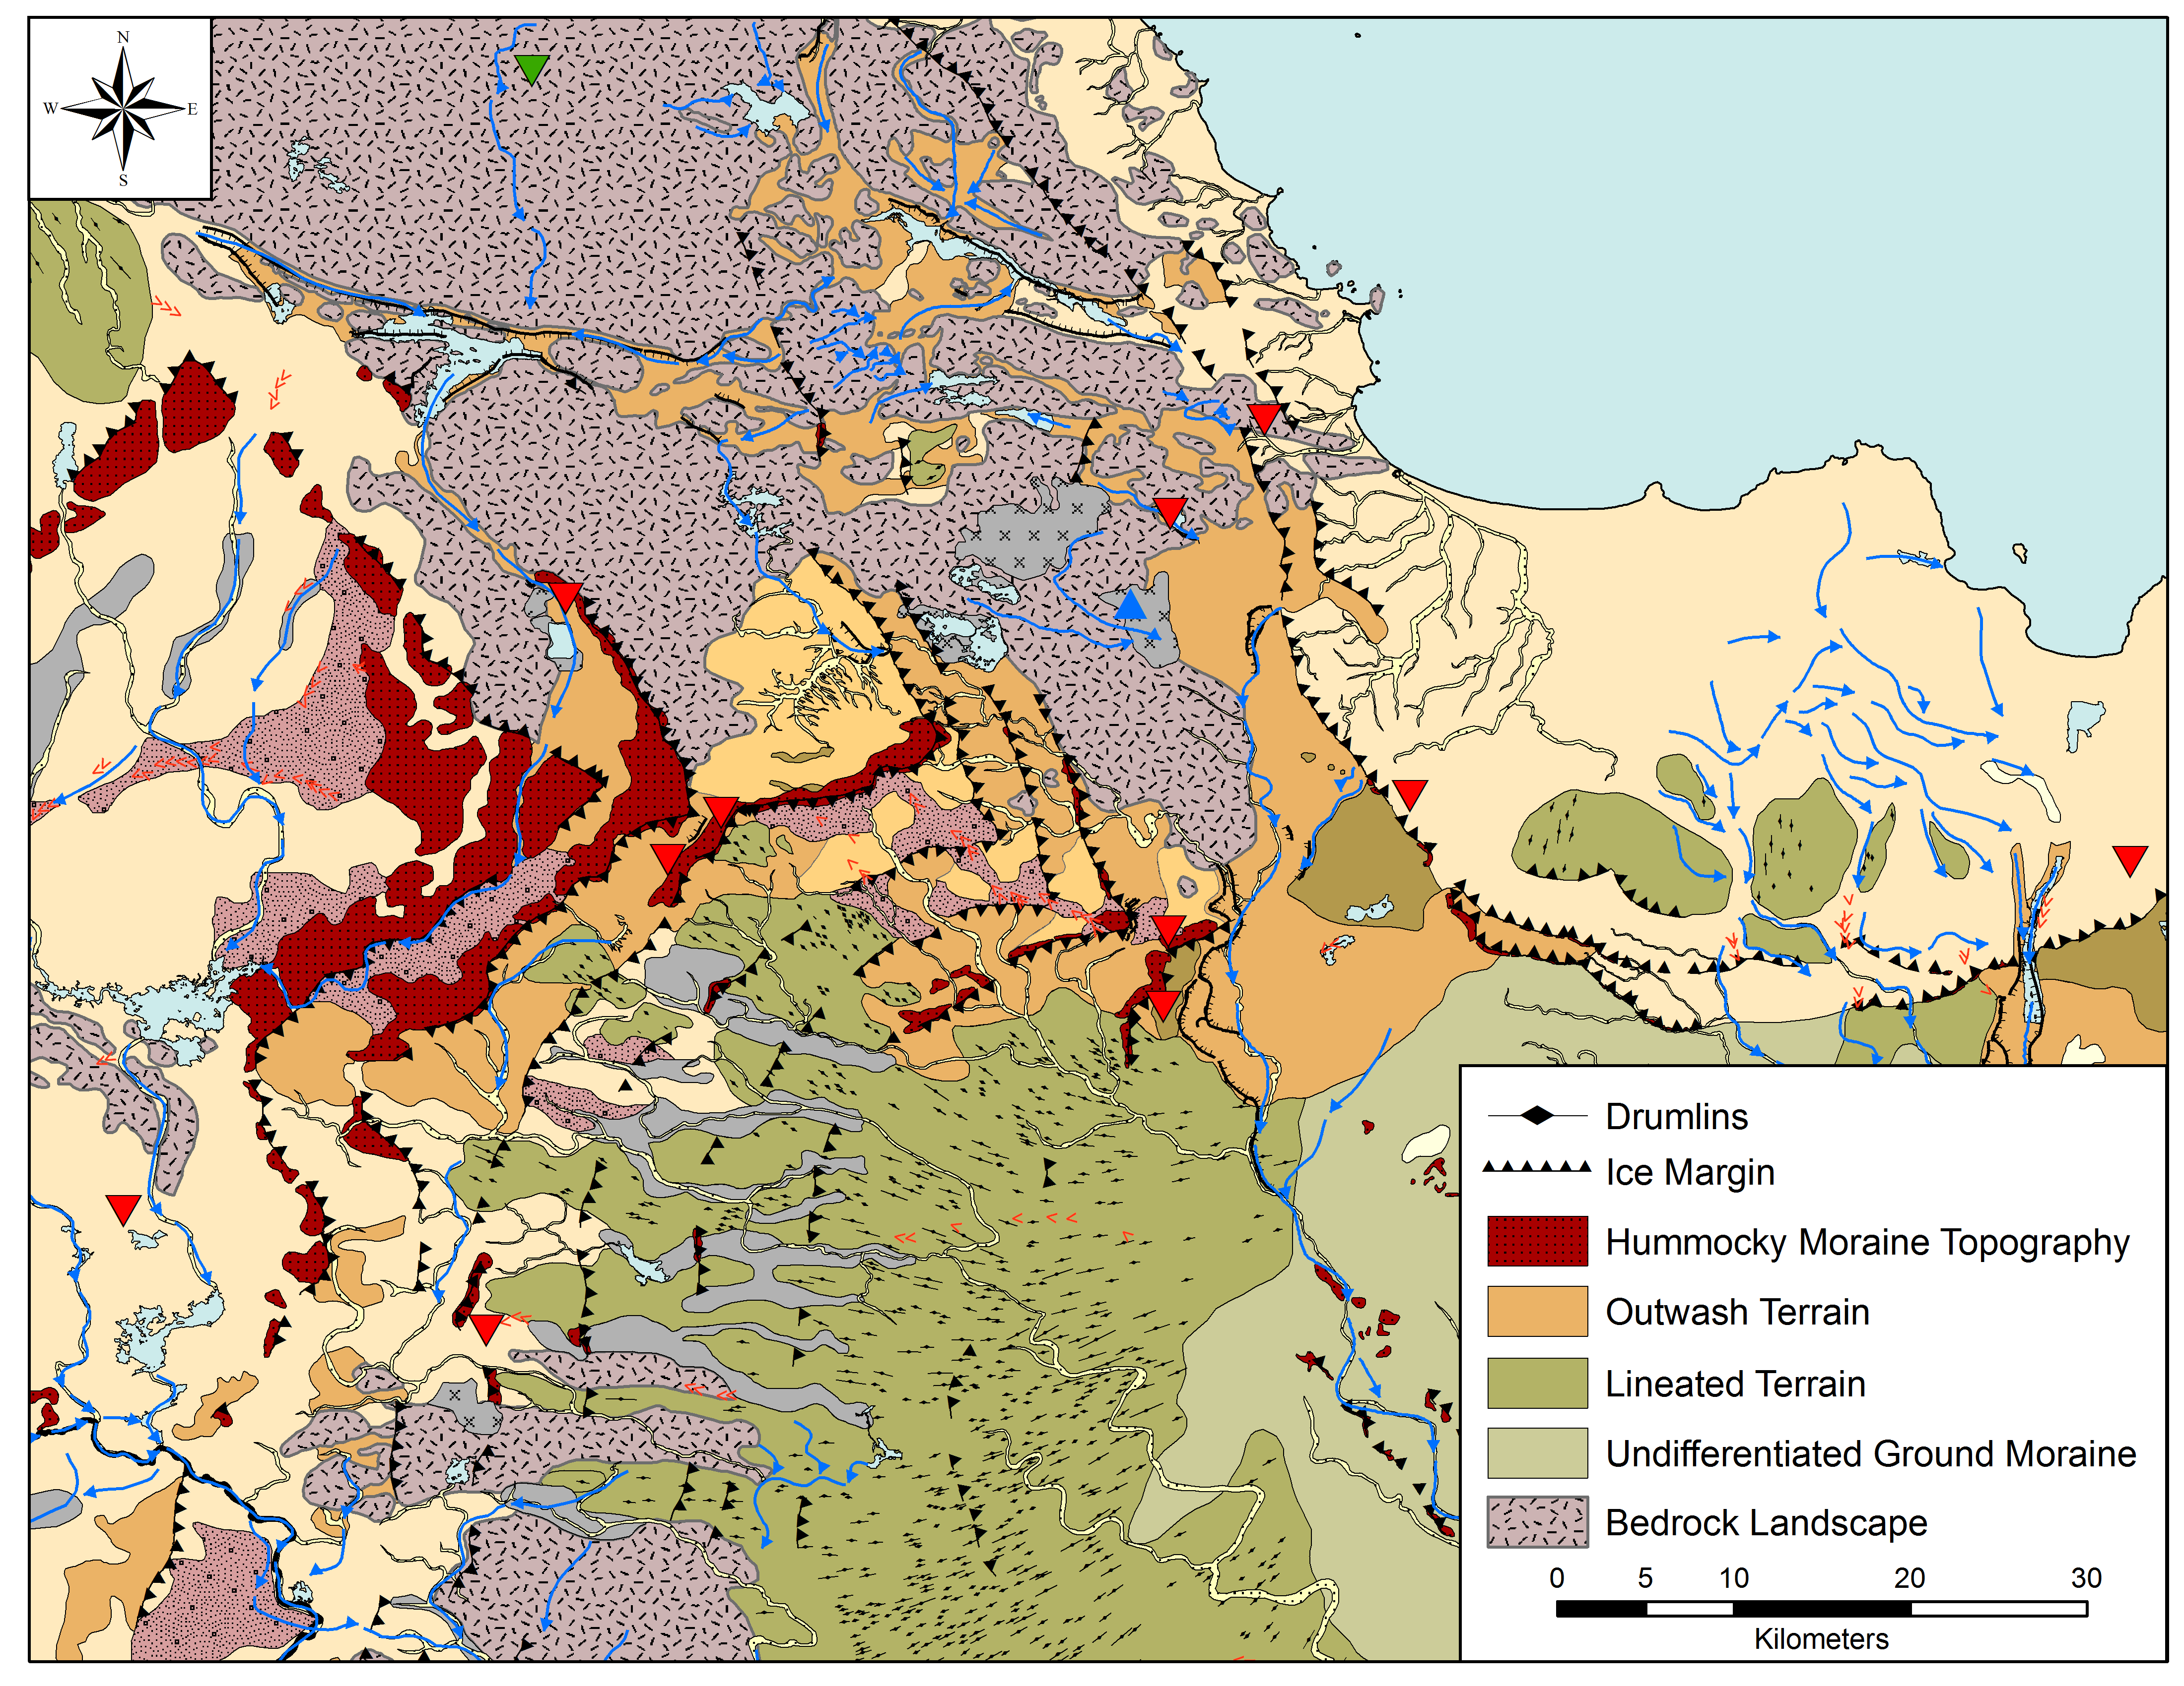
LAKE SUPERIOR
Notes:
Focus on a few things, make legend larger. Lineated terrain, drumlins, moraines, outwash

Slide 11
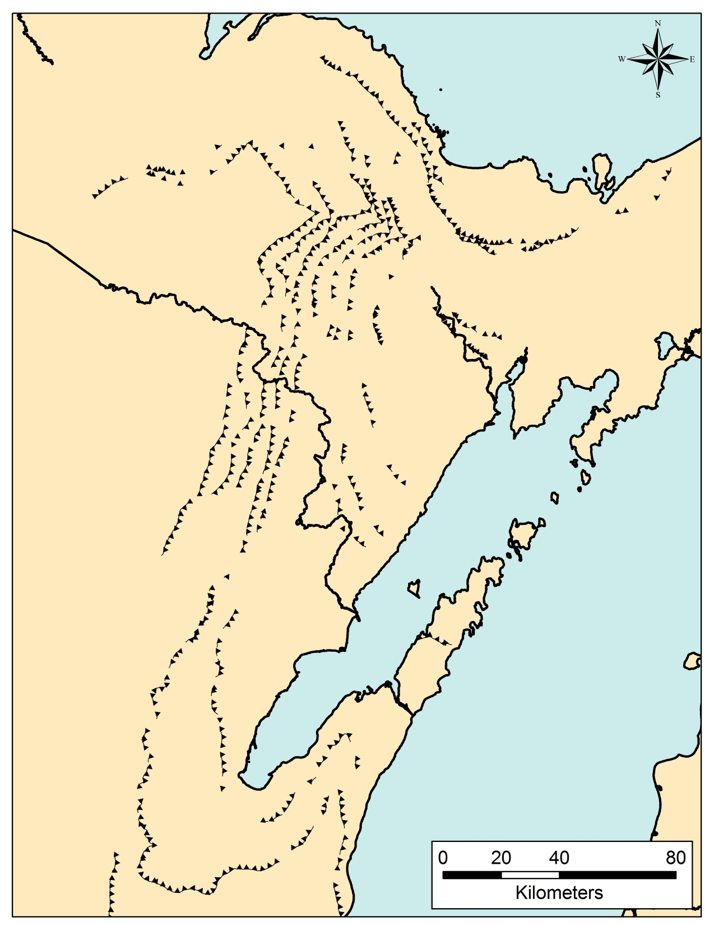
Notes:
-Because of the geometry of the ice lobe, there are places where the moraines are far apart and close together (30km)
Use buried forest place names for events like the Marquette moraine and XXX (two Creeks aged moraines)
Explain that the stepped patter is not only on the lateral moraines, but also the longitudinal direction.
Six ice margins, regularly spaced and consistent that there is some stepping pattern to ice retreat

Slide 12
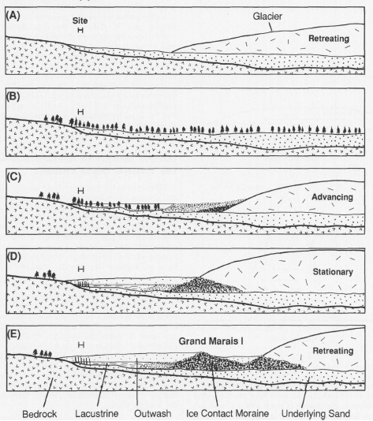

Chronology
Depth (cm)
Bracket the timing of ice sheet activity
Maximum ages
Minimum ages
9600 ± 60
Notes:
First time organics appears, meaning the glacier had to be gone by then.
Lake, trees, sed core- combine the max min explanation into this slide.
Need to apply existing chronology and generate new chronology to understand retreat

Slide 13
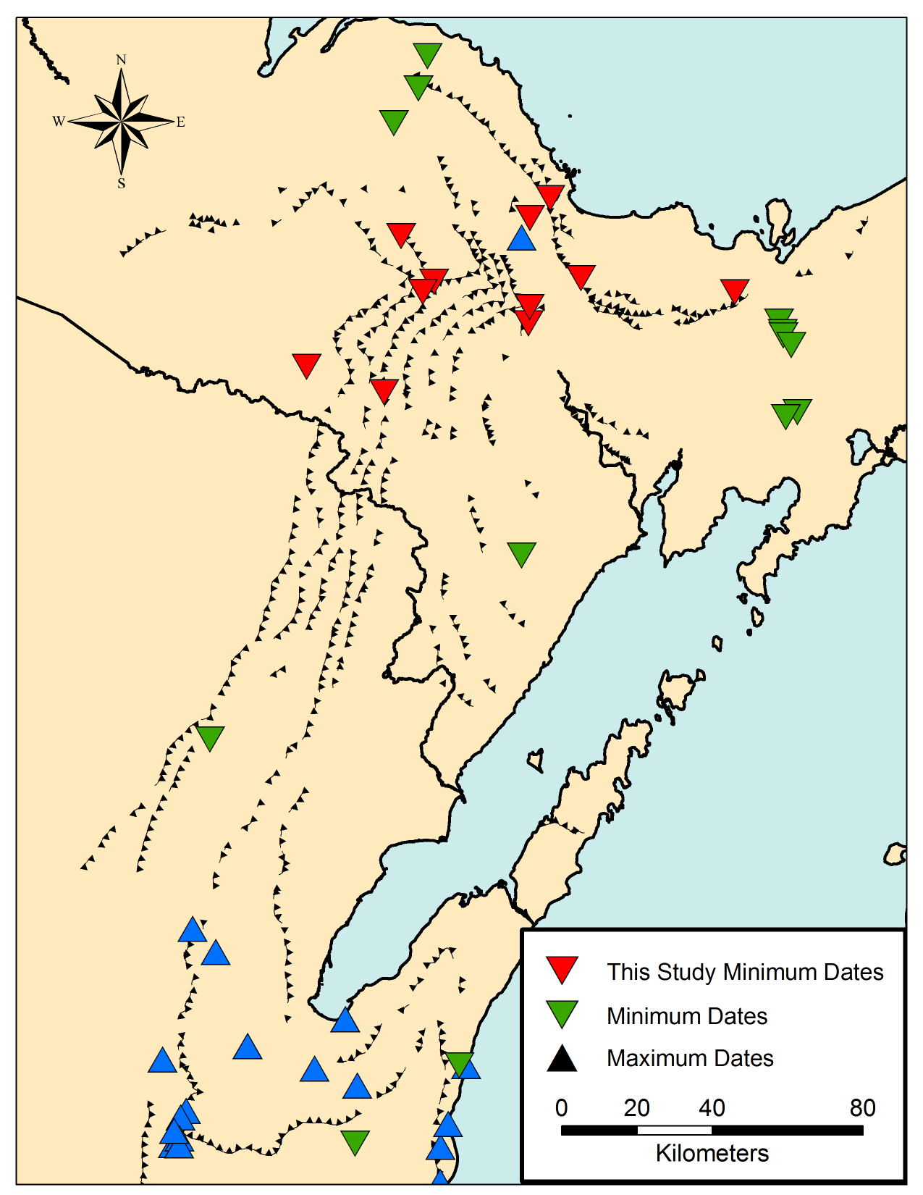
LAKE SUPERIOR
Michigan
Wisconsin
LAKE MICHIGAN
GREEN BAY
Notes:
Change black to blue triangles
Triangles bigger
Point out the sample locations of this study in the red, then talk about the availability of the remainder of the data

Slide 14
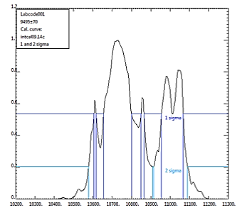
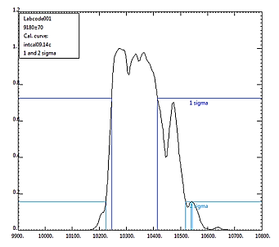
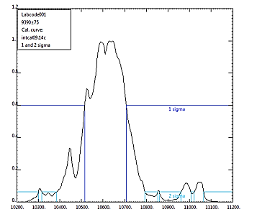
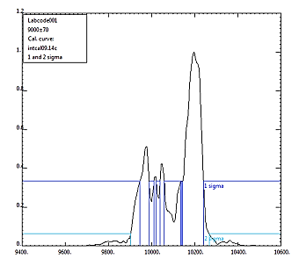
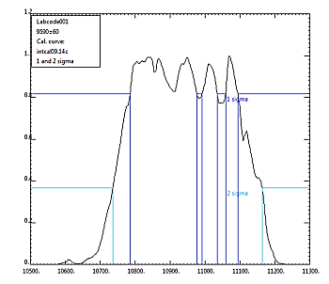
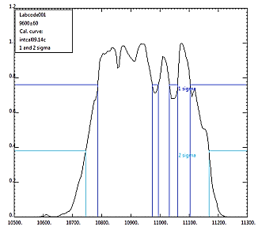
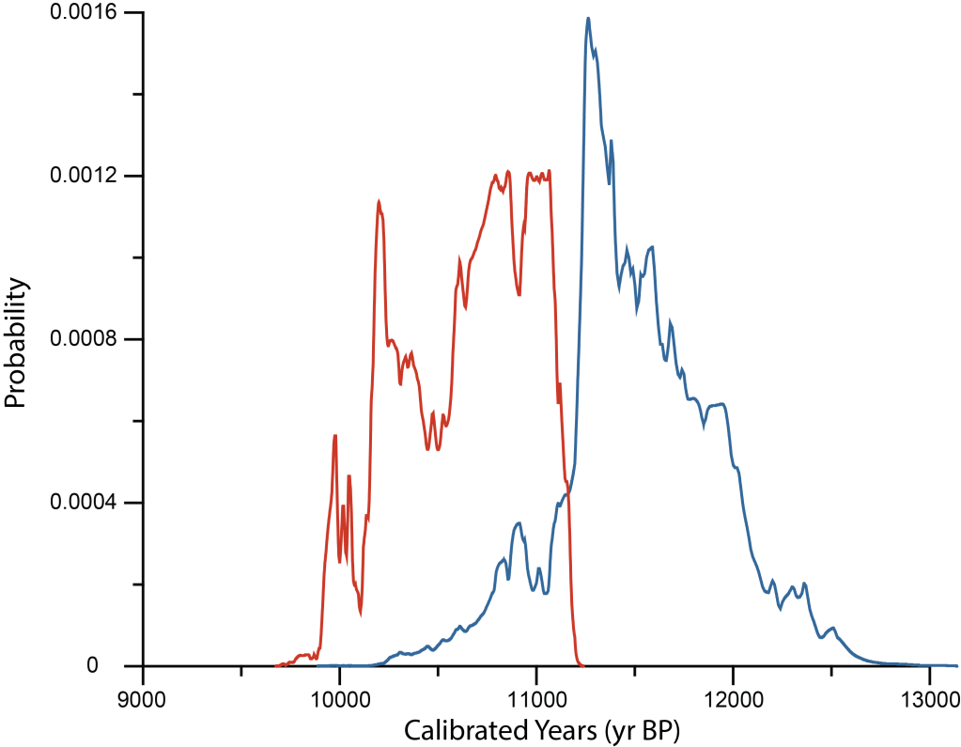
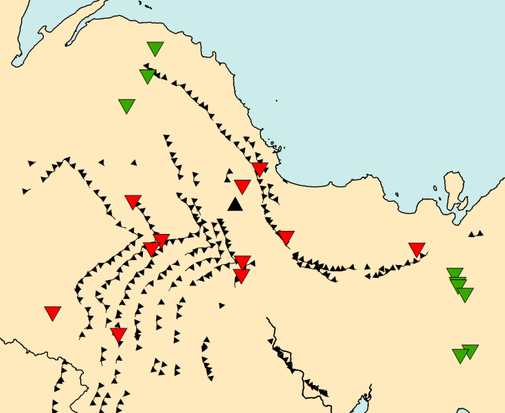
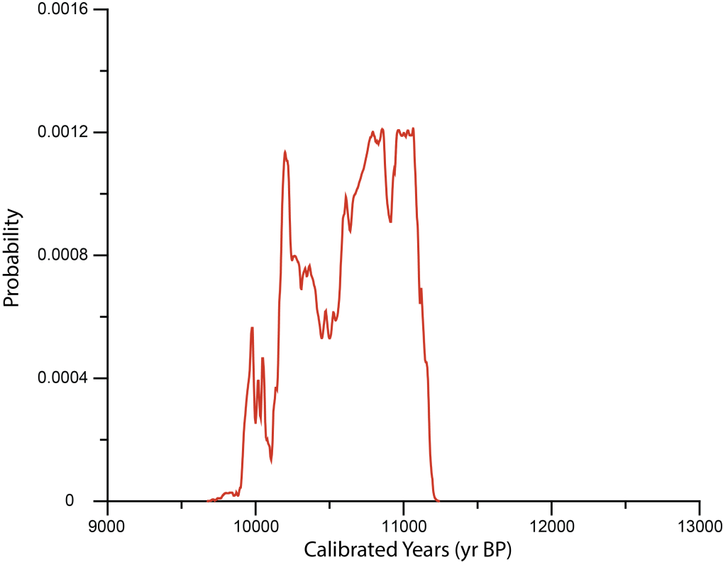
Summing Probabilities

Slide 15
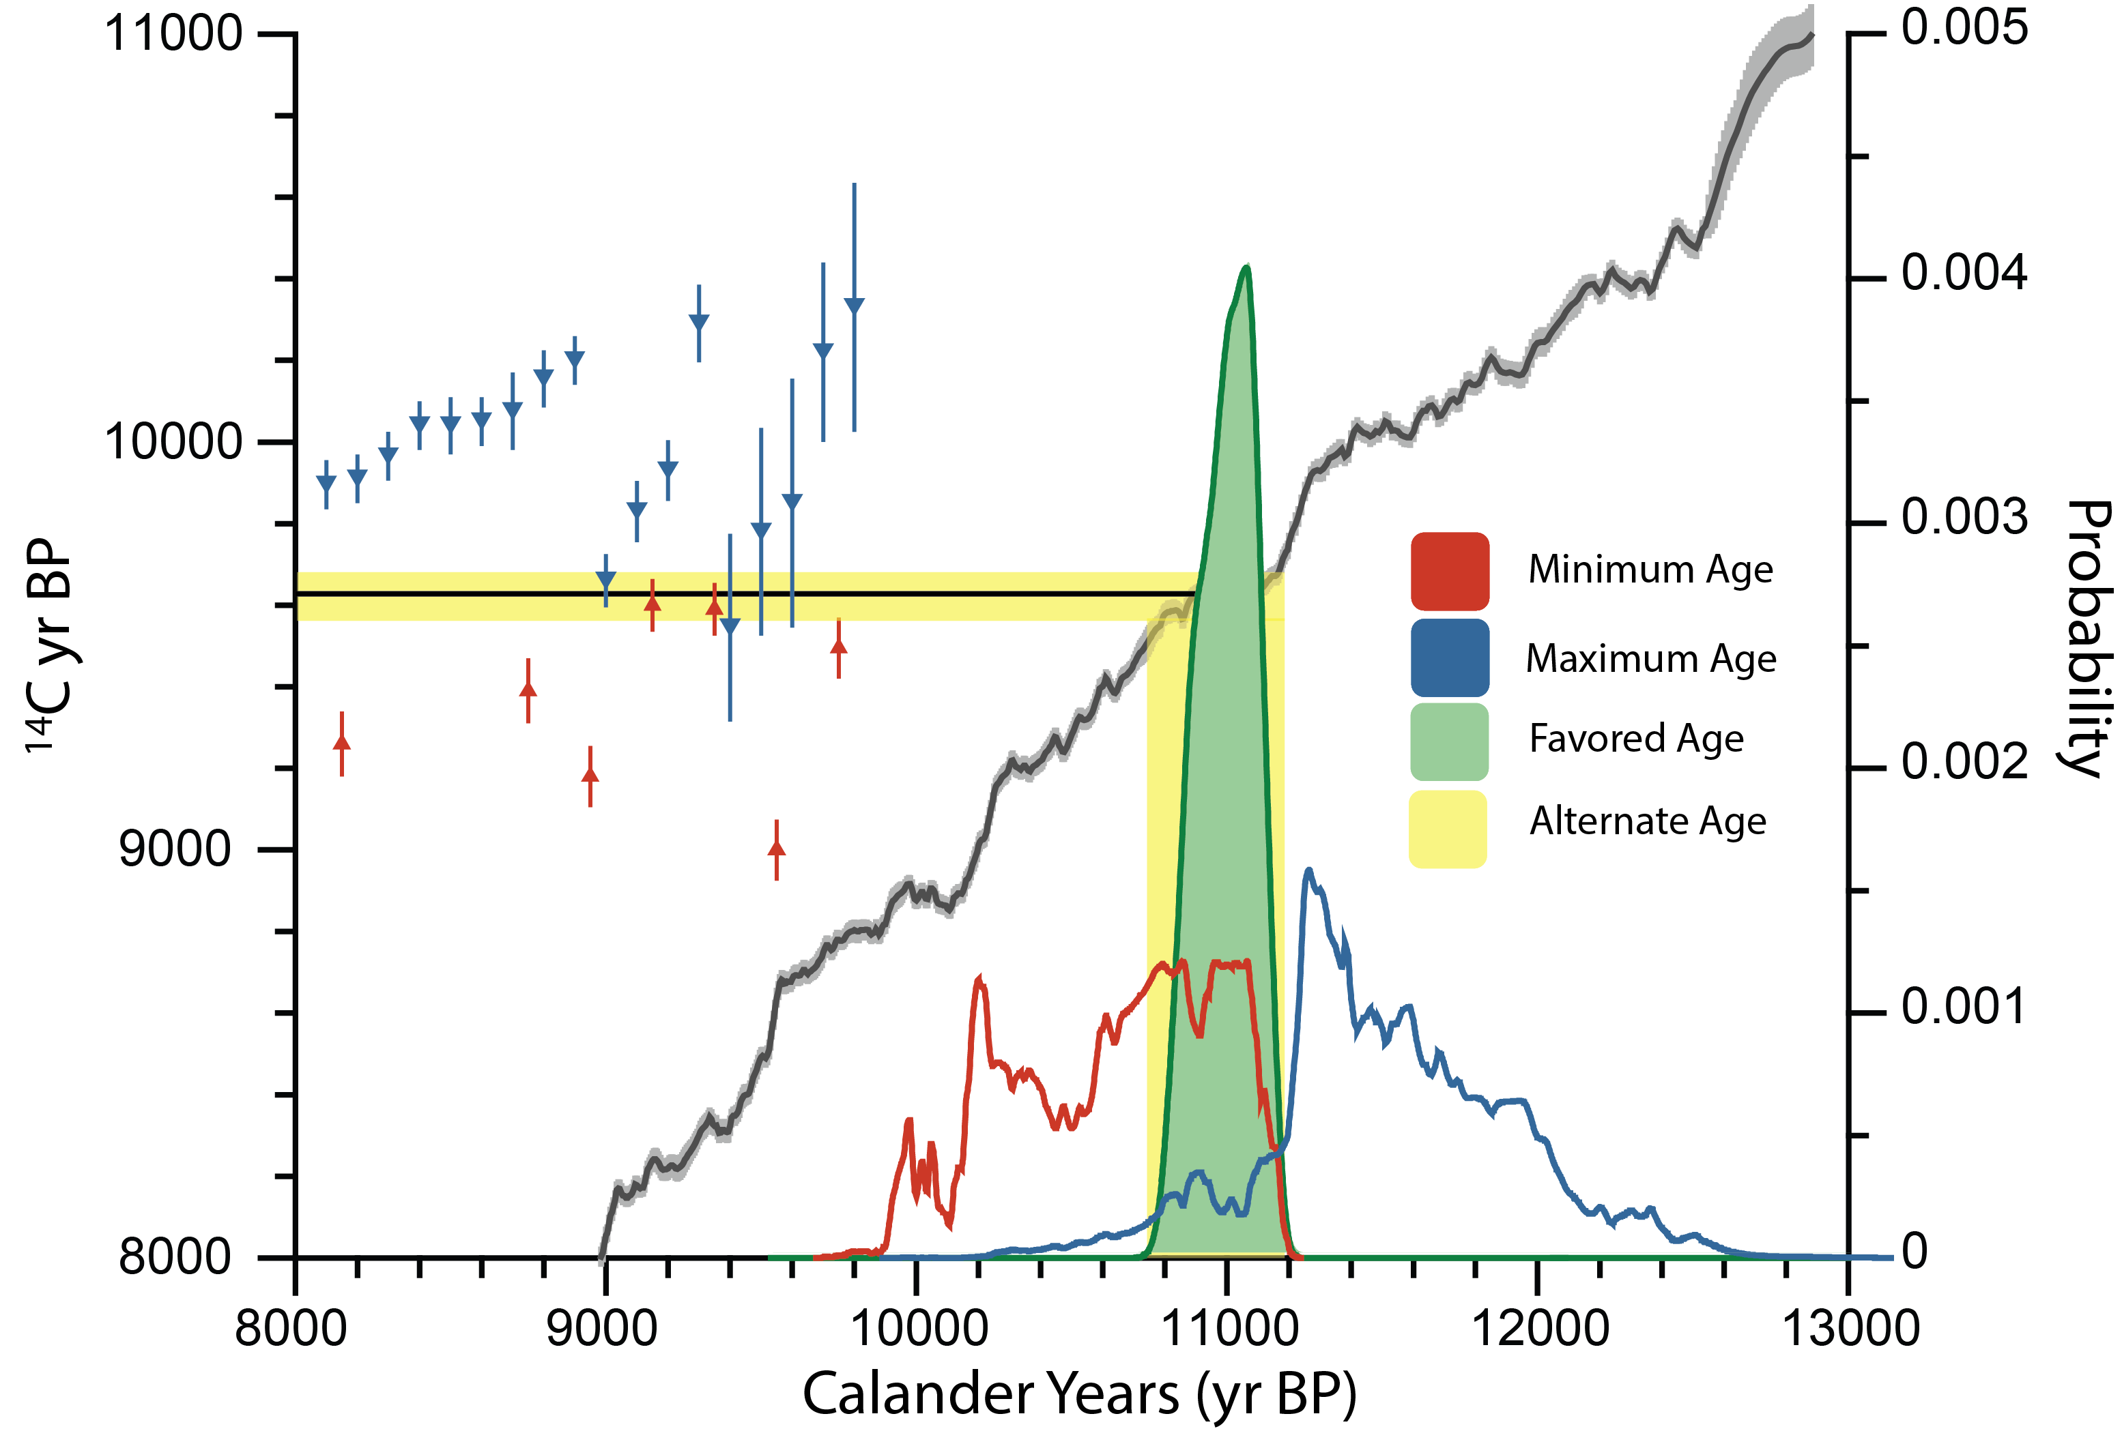
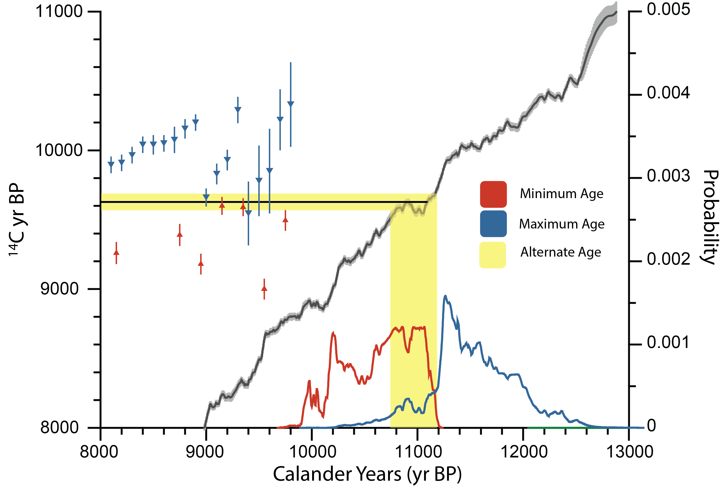
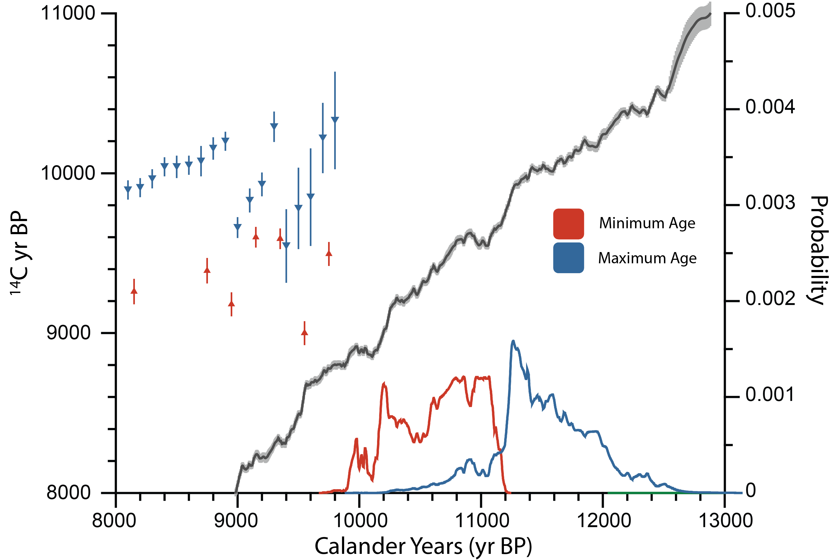
Age of the Gribben Moraine
11,060 ± 150 BP
Notes:
-Two possible approaches, A and B, they give us similar results. We prefer this methods because it allows us to give some uncertainty assessment.

Slide 16
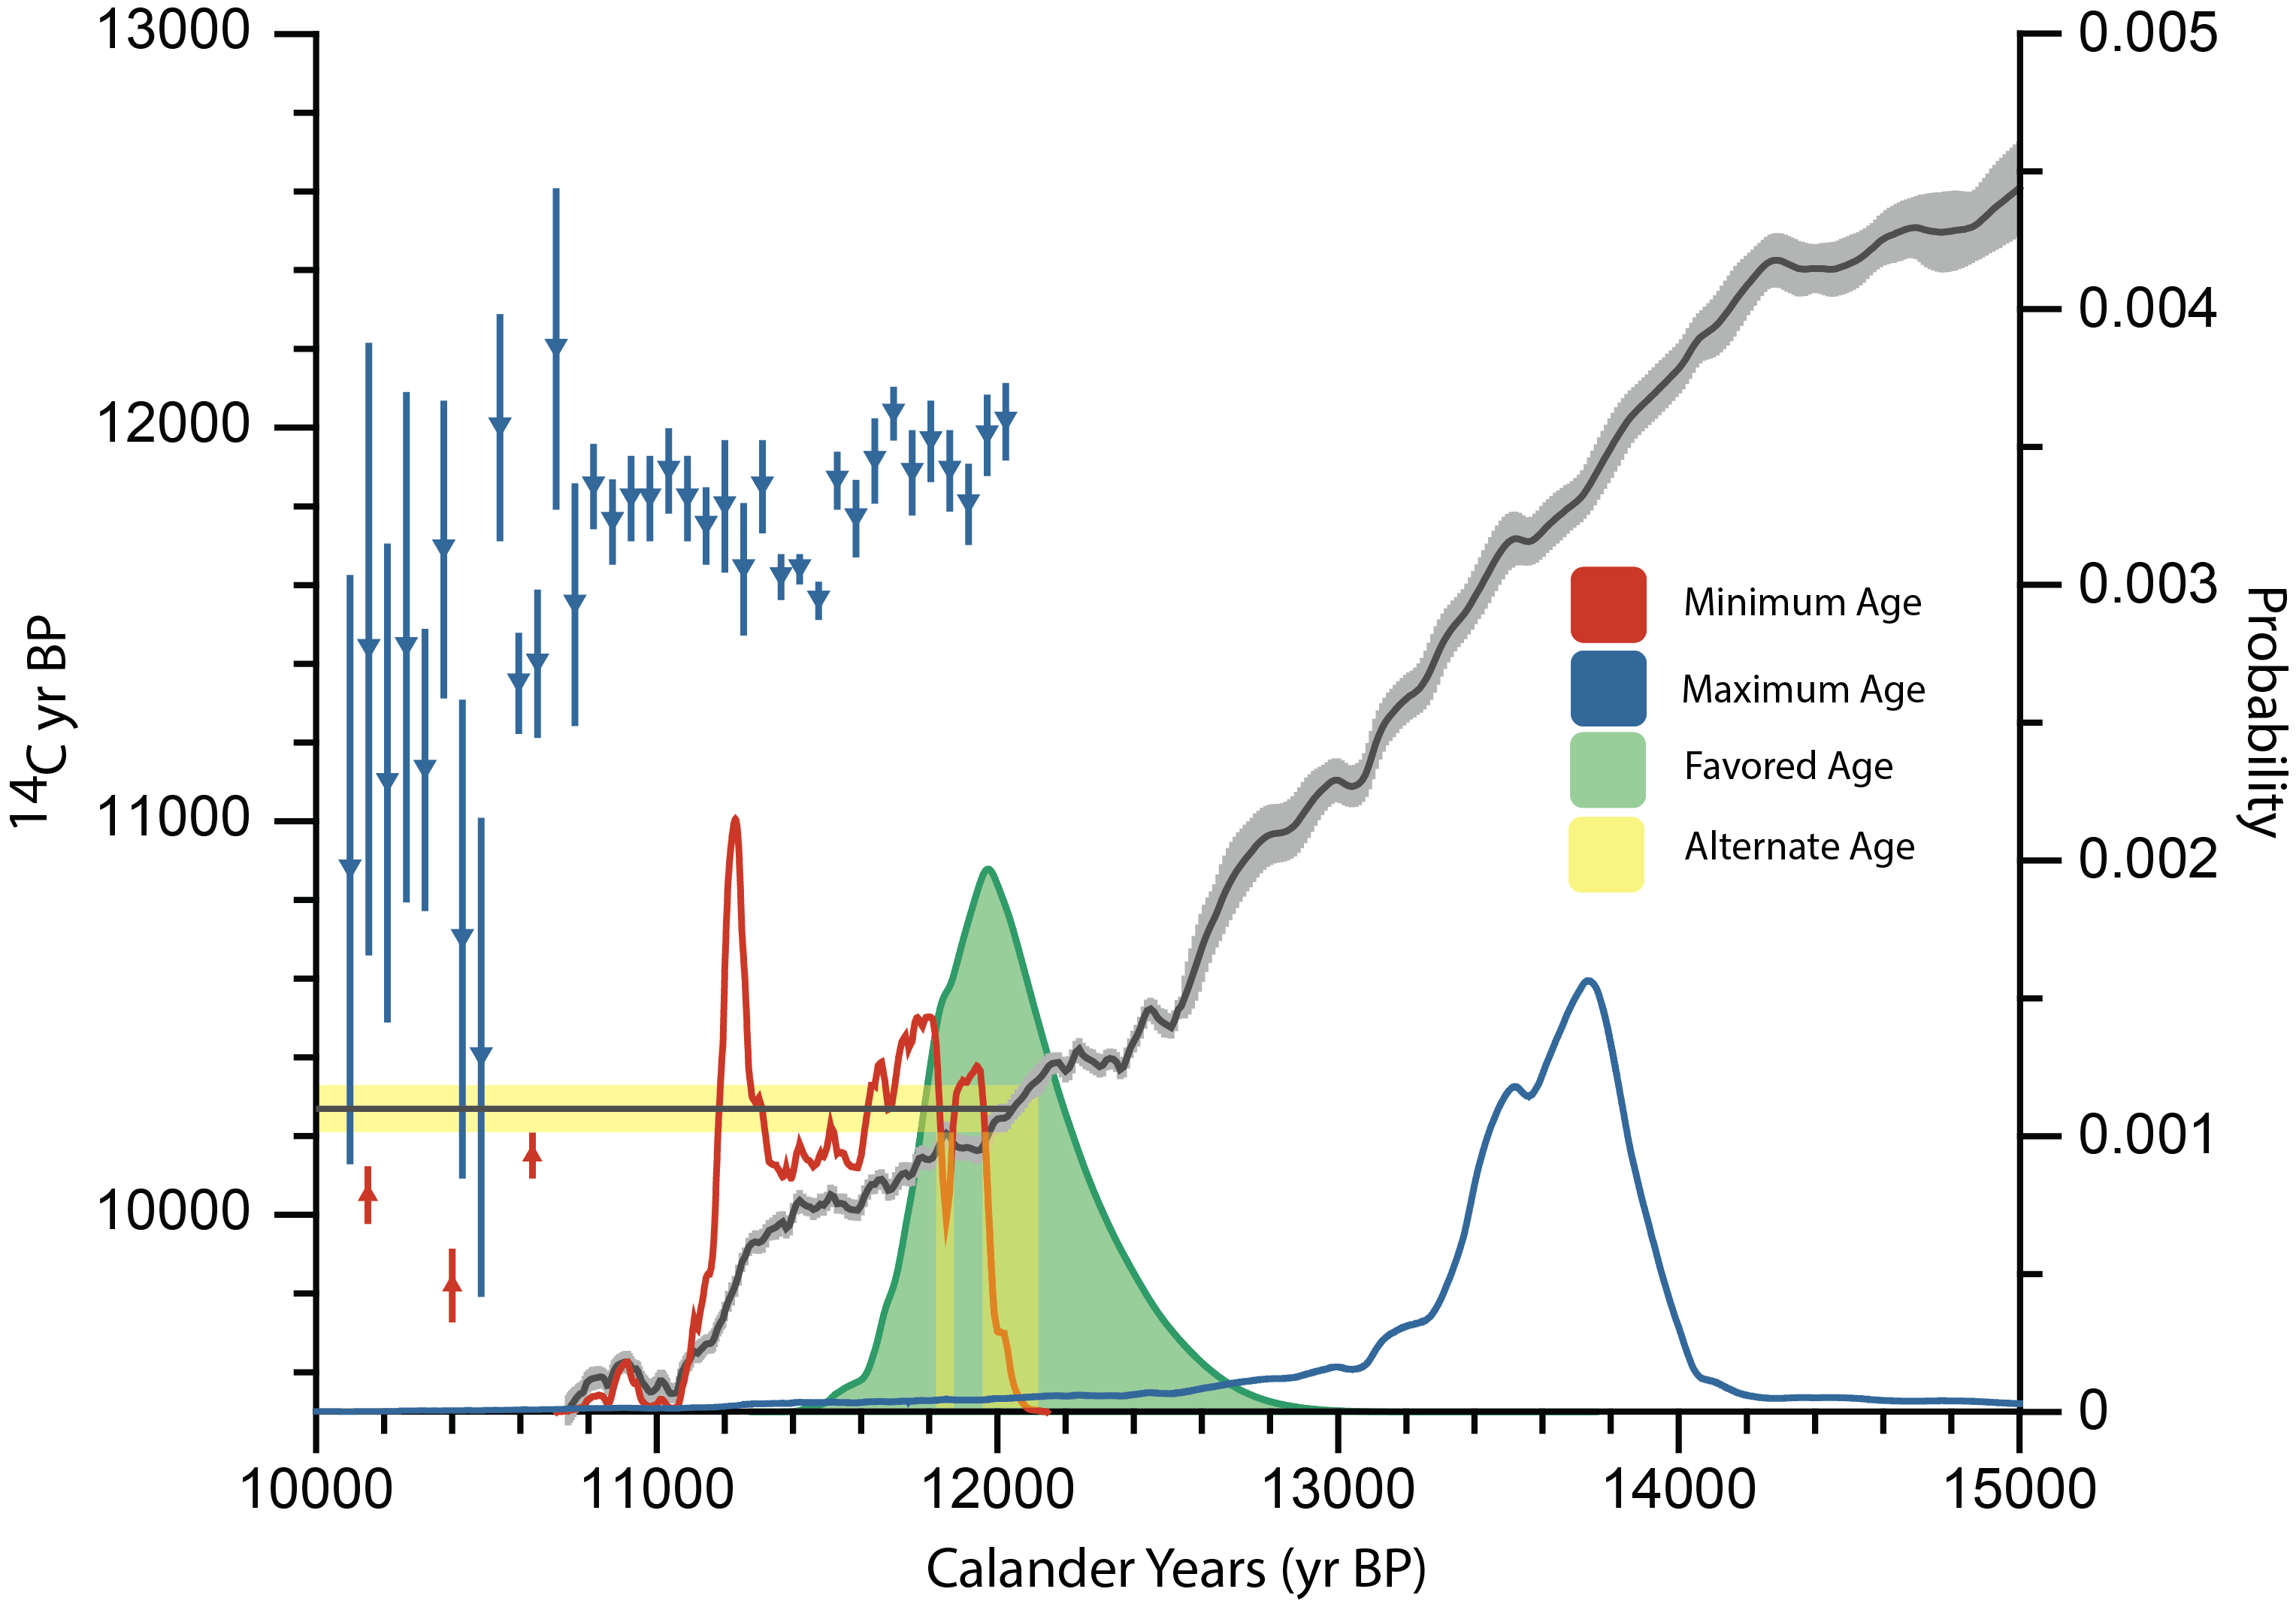
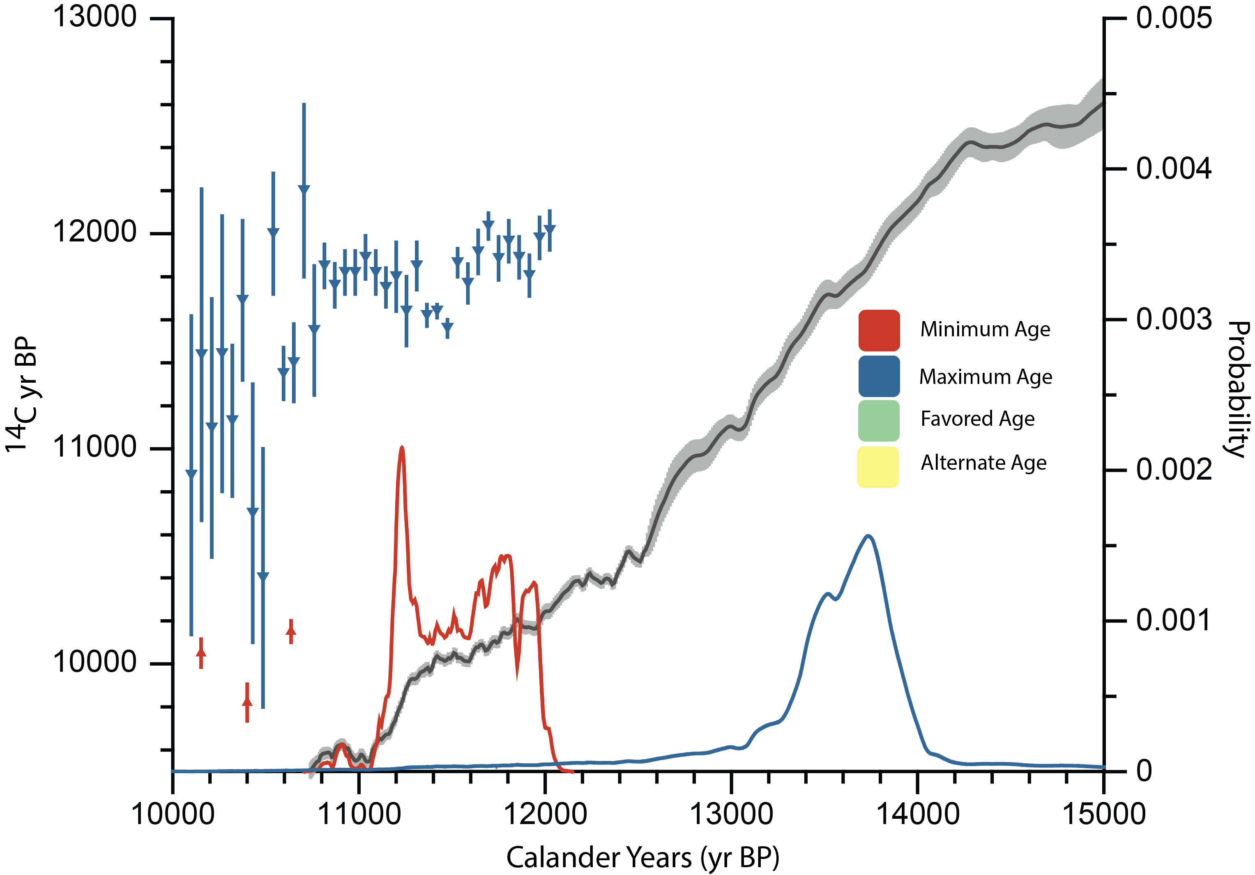
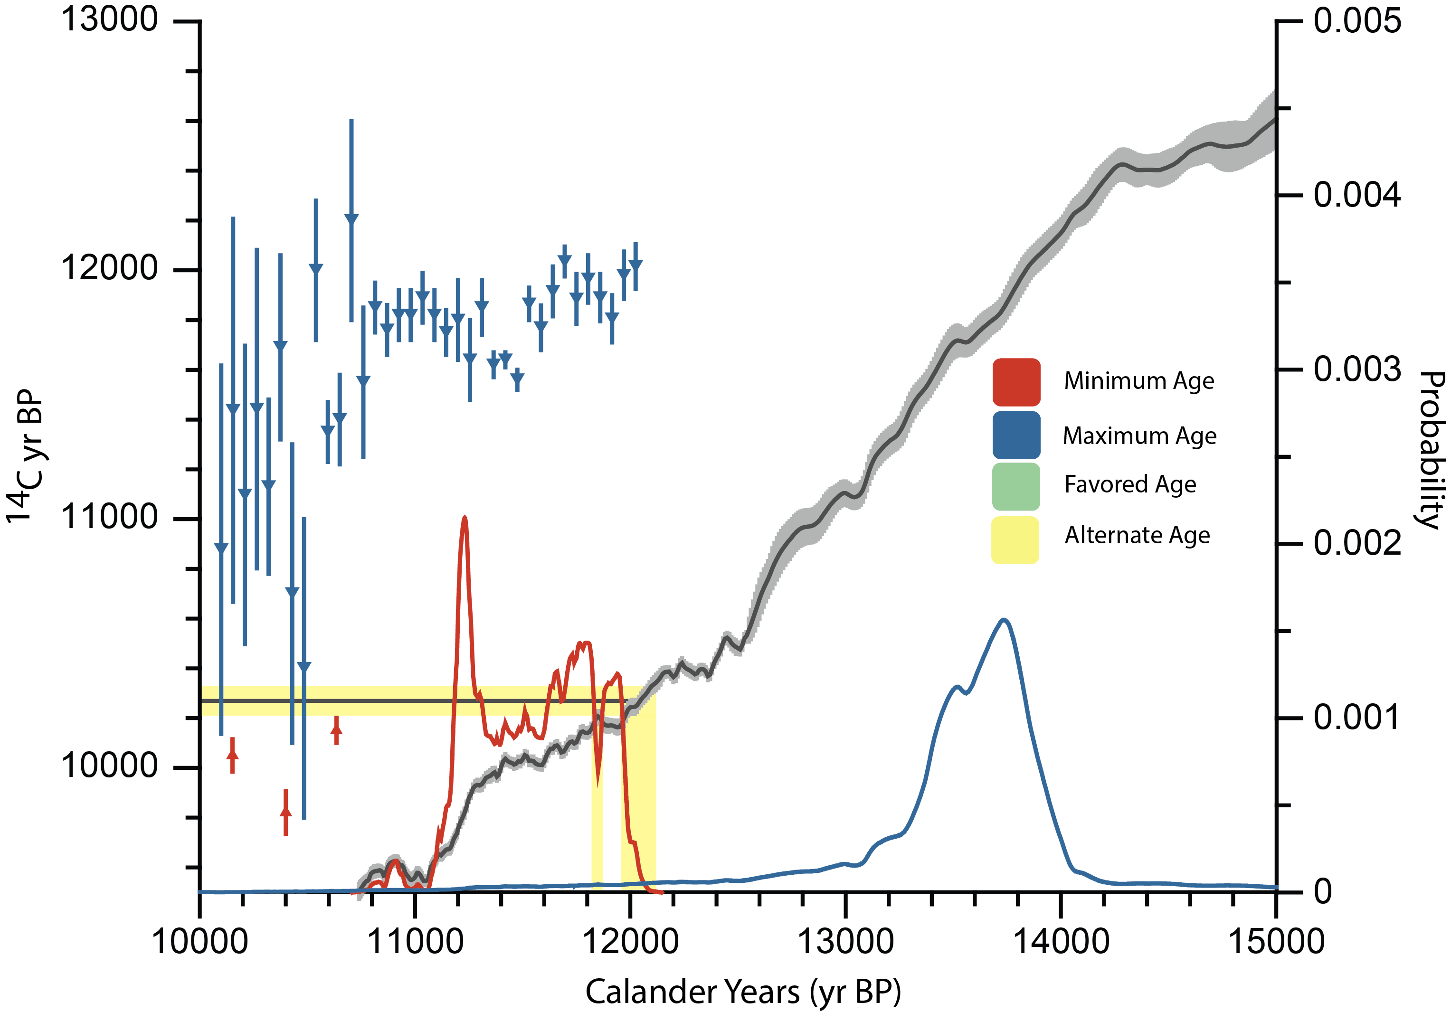
Age of the Two Creeks Moraine
12,000 ± 400 BP

Slide 17
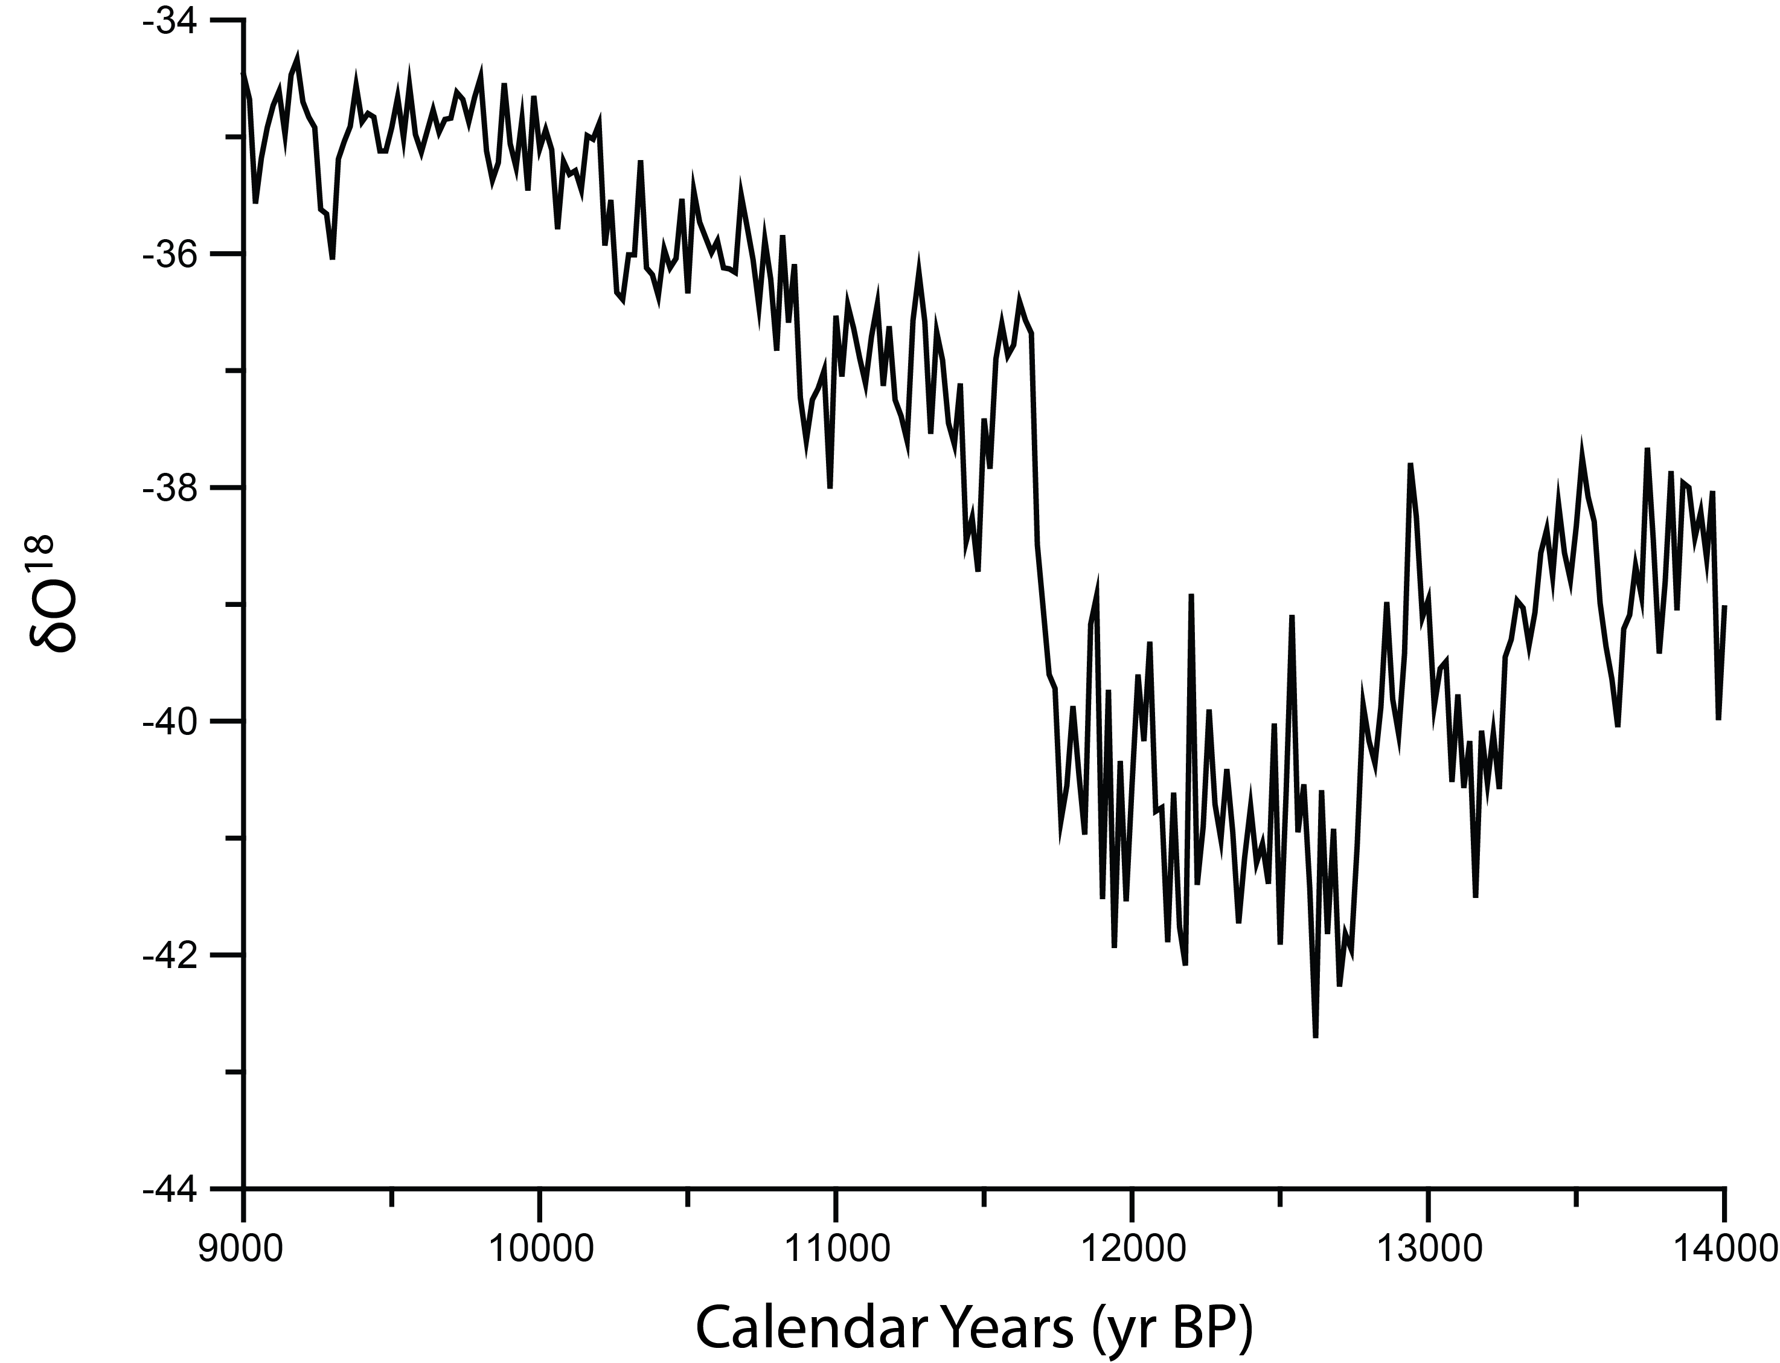
The Younger Dryas
The Younger Dryas
Age of Lake Gribben Moraine
Warm
Younger Dryas
2,100 years
1,000 years
Cold
Notes:
Emphasize the time. Maximum amount of time for retreat and show minimum time of retreat. Include ages of retreat interval for the LIS

Slide 18
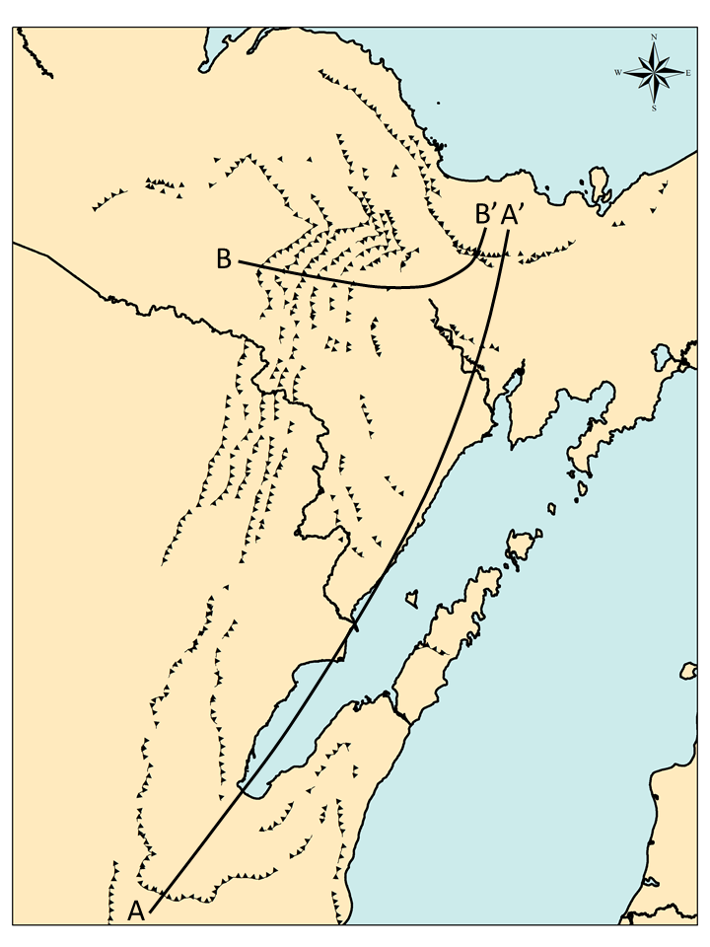
Test
LAKE
SUPERIOR
Michigan
Wisconsin
LAKE MICHIGAN
Notes:
We have a time and a distance
Highlight two creeks and Marquette moraines

Slide 19
Test
B-B’
2100 yr | 50 m/y
1000 yr | 100 m/y
LAKE
SUPERIOR
Michigan
Wisconsin
A-A’
2100 yr | 120 m/y
1000 yr | 250 m/y
LAKE MICHIGAN
Notes:
We have a time and a distance
Highlight two creeks and Marquette moraines

Slide 20
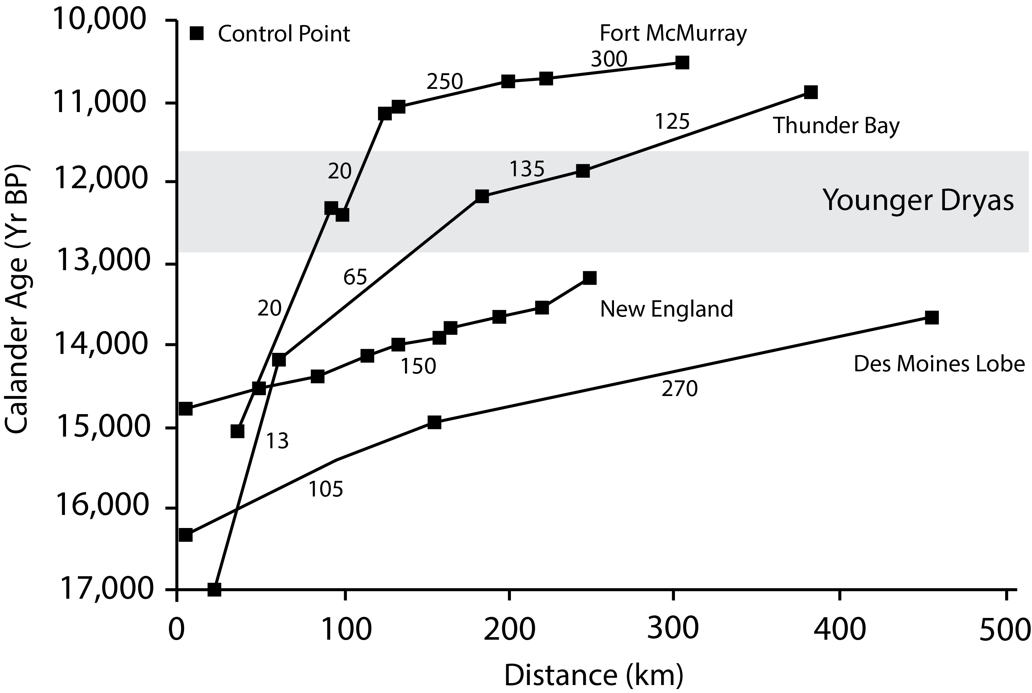
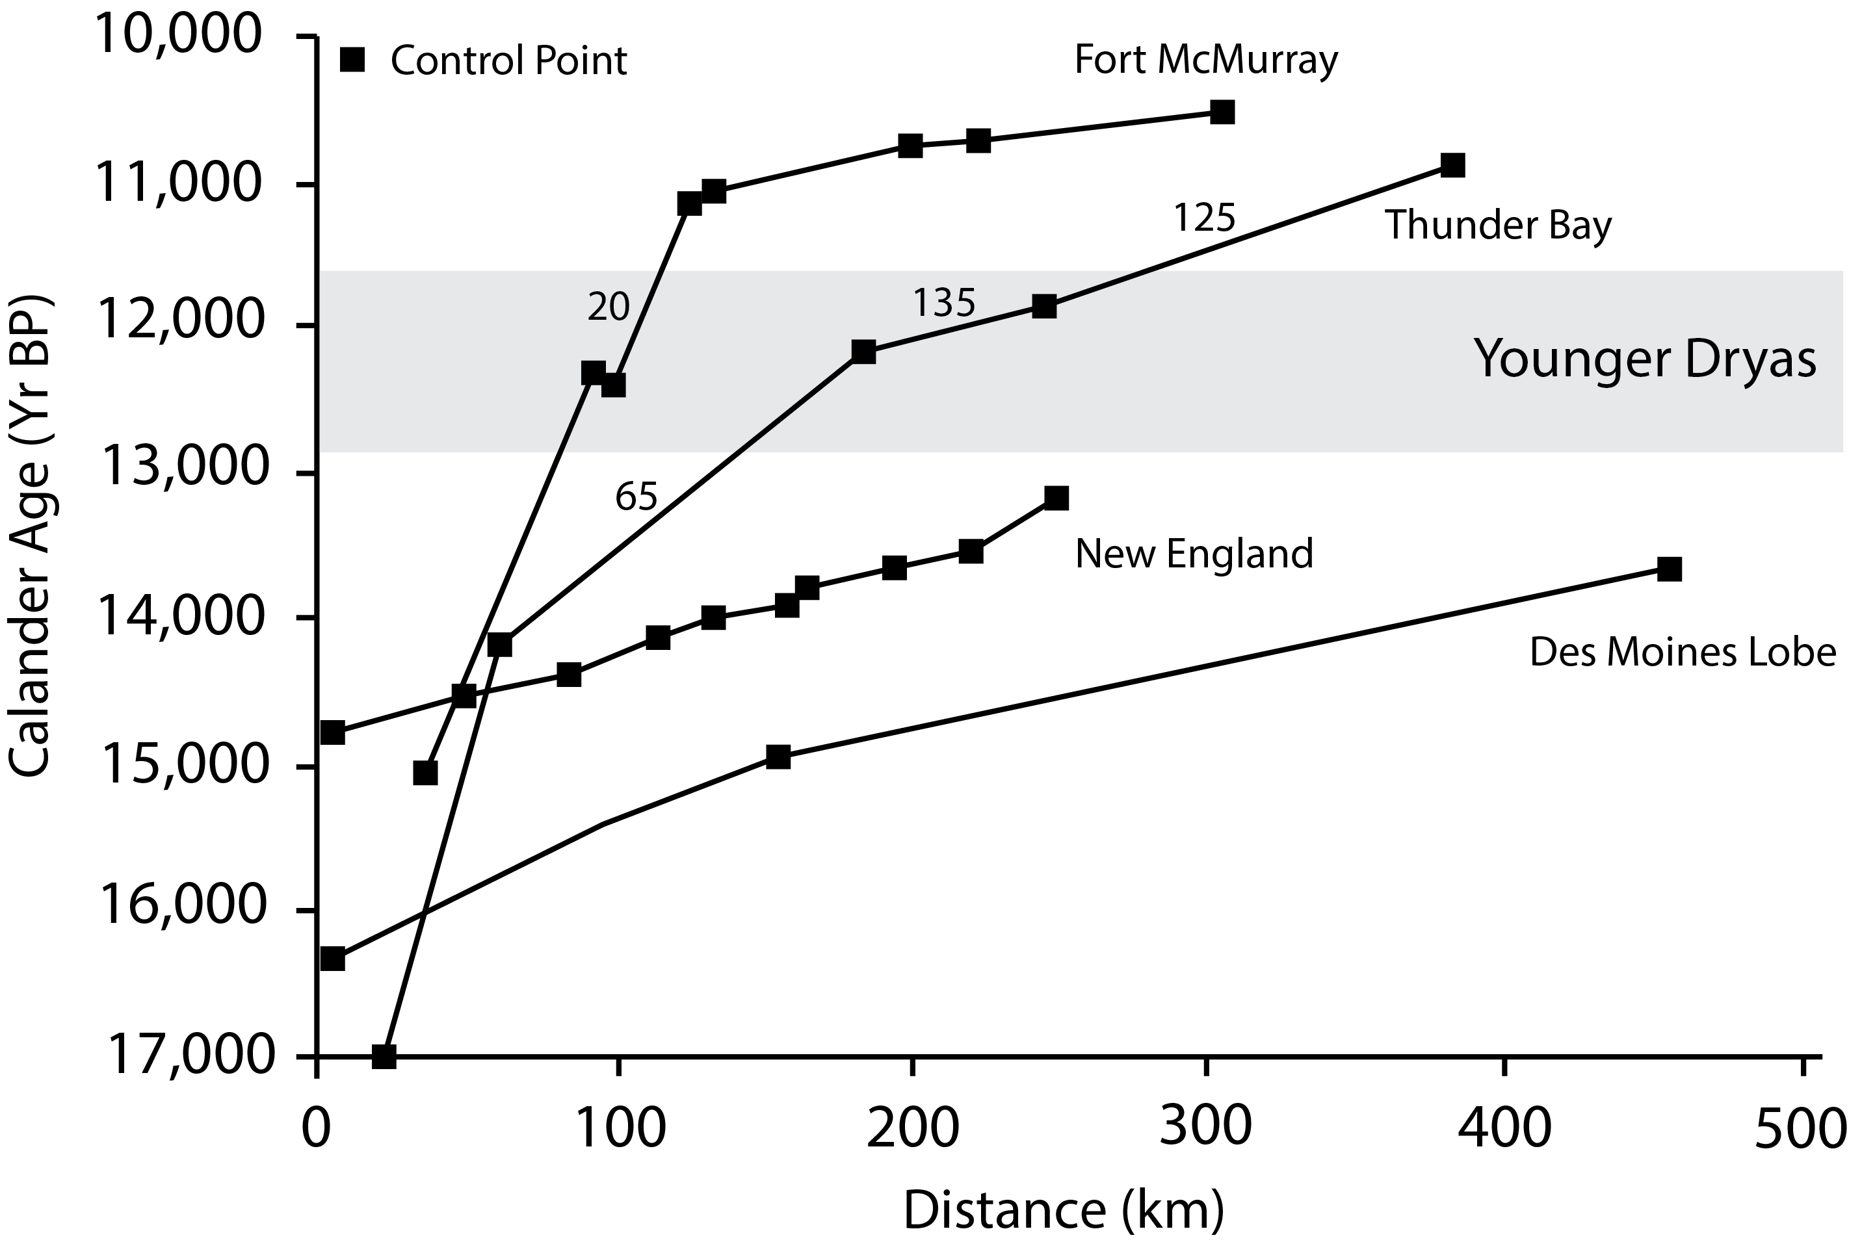
Green Bay Lobe Retreat Rates
A-A’
120 m/y
250 m/y
B-B’
50 m/y
100 m/y
Notes:
Retreat rates before have been calcuted to a slower rate
Take of my values, these are some numbers for retreat rates for the LIS, then plot on my values showing they are compatable. Lose the red lines, the plot up values in the bottom right of graph to compare, use the same boxes from prevoius slide

Slide 21
Synthesis
Geomorphic and chronologic evidence suggest that during the Younger Dryas chronozone this sector of the Laurentide Ice Sheet was retreating in a step-wise pattern
Retreat rates on the order of 185 m/y for the center line of the Green Bay lobe
Consistent patterns of retreat on the west side of Lake Superior

Slide 22
Discussion
How does the Laurentide Ice Sheet respond during the Younger Dryas chronozone?
Why does a ice sheet retreat during a cold interval?
The Laurentide Ice Sheet appears to be retreating
Why?
1:
Retreat dynamics are not controlled by temperature
2:
Disconnect between the oxygen isotope temperature reconstruction and Laurentide Ice Sheet response
Notes:
We don’t understand the dynamics of ice sheets or the ice core record is wrong,

Slide 23
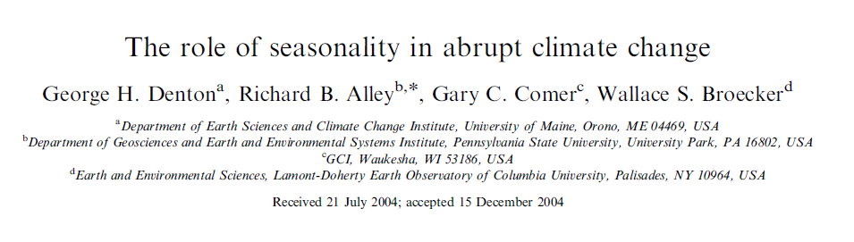
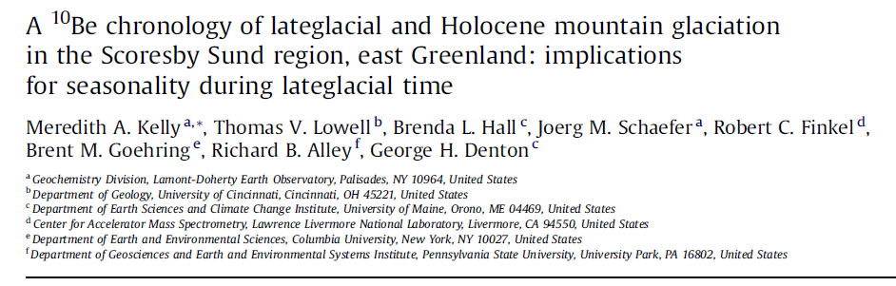
Seasonality
Seasonality
Notes:
First paper where it was introduced, second paper tested it.
Summer temperatures are warm enough during the the younger dryas that the LIS could retreat during this time
Note that little ice age cooling was about 1 degree than today and their moraines are located just inside younger dryas aged moraines, meaning that such a large magnitude of cooling did not trigger a large glacial advance.

Slide 24
Conclusions
1:
The Laurentide Ice Sheet retreated in a step-wise pattern during the Younger Dryas chonozone
2:
Possibility of greater seasonality in the Upper Peninsula of Michigan

Slide 25
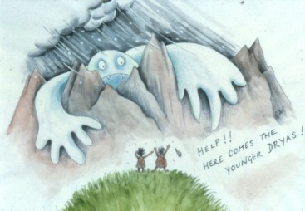
Questions/Comments?

