Slide 1


Using GIS to Inventory Common Variety Mineral Materials
Huron-Manistee National Forests
U.S.D.A. Forest Service
Trevor C. Hobbs, GeoCorps America Participant
Notes:
Thanks for including me in FLT, project for last several months

Slide 2
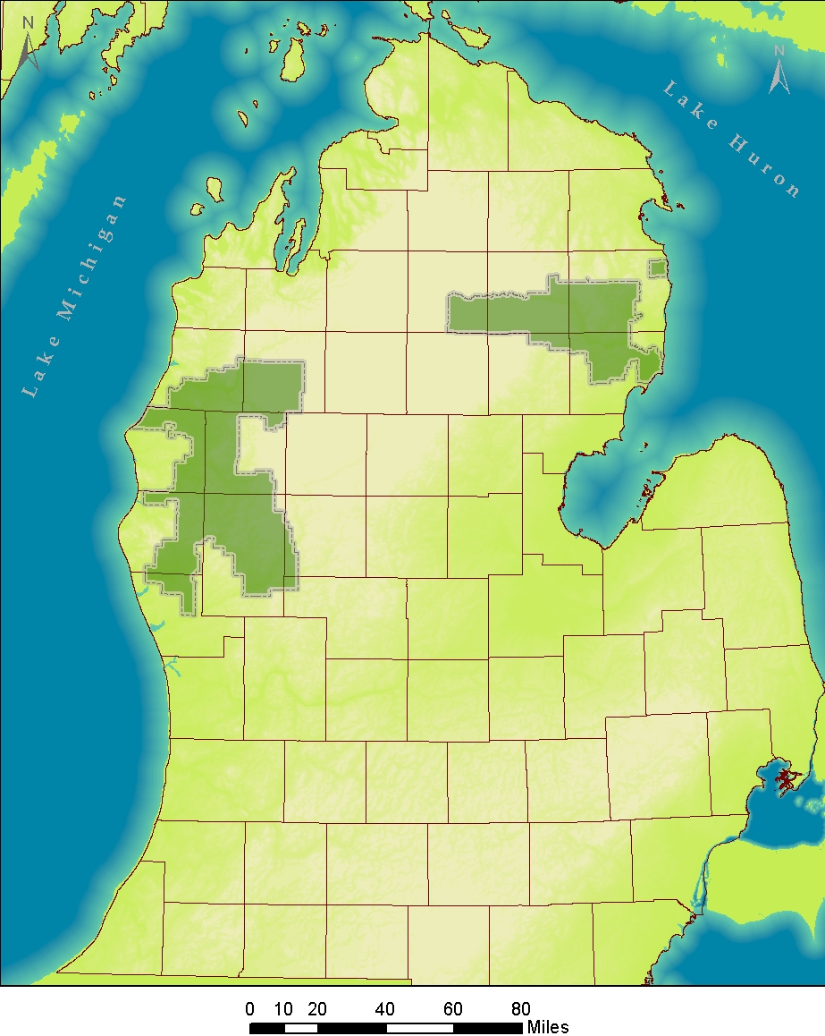
Huron-Manistee National Forests
~ 1 million Acres of public land
Mixed Use (resources, recreation, habitat)

Slide 3
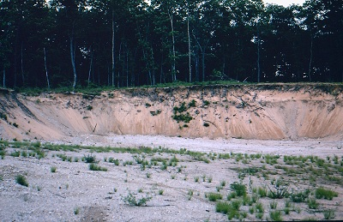
Photo by: Lance Tidwell
Commonly occurring non-petroleum geologic resources, excluding deposits of those materials which are valuable because of some property giving them distinct and special value (36 CFR §228.42, p. 144).
Examples: Crushed stone, “rip-rap”, boulders, gravel, sand, clay
Notes:
Technically peat and marl are also included in this list, though their occurrence and use on the forest is minimal.

Slide 4
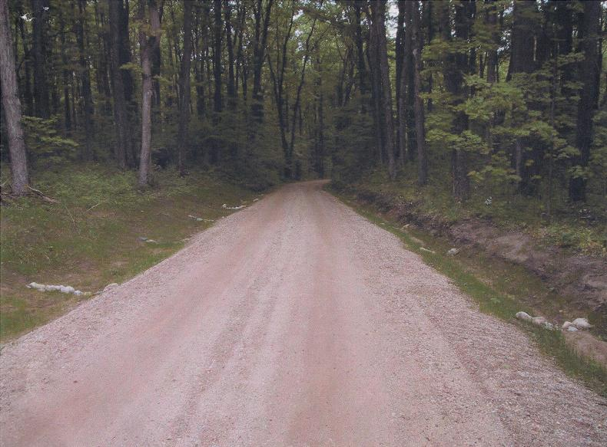
Photo courtesy of: Doug Gullekson
Road construction and maintenance
Notes:
Grade 22 A aggregate for road surface, cobbles for erosion control in ditches

Slide 5
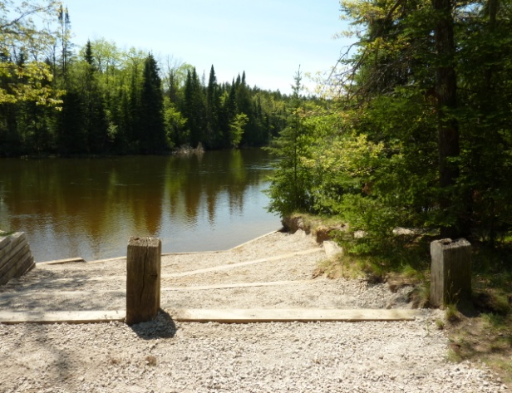
Photo courtesy of: Huron Pines
Canoe Landing Sites
Notes:
Crushed limestone packed with fine sand and clay at a canoe landing site (Louds rest area)

Slide 6
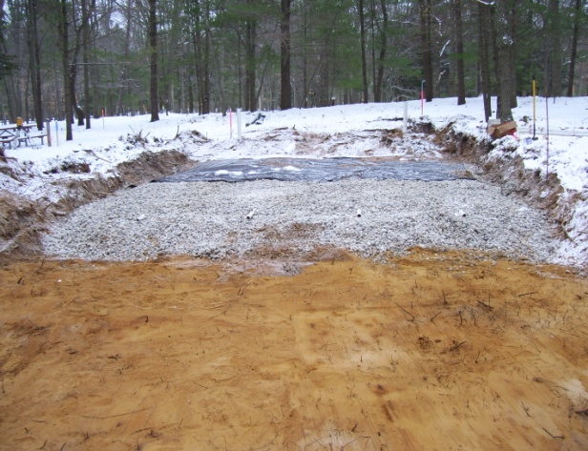
Photo courtesy of: Russ Sutton
Septic Drainage Fields
Notes:
Well sorted sand underlying coarse gravel in a septic drainage field

Slide 7
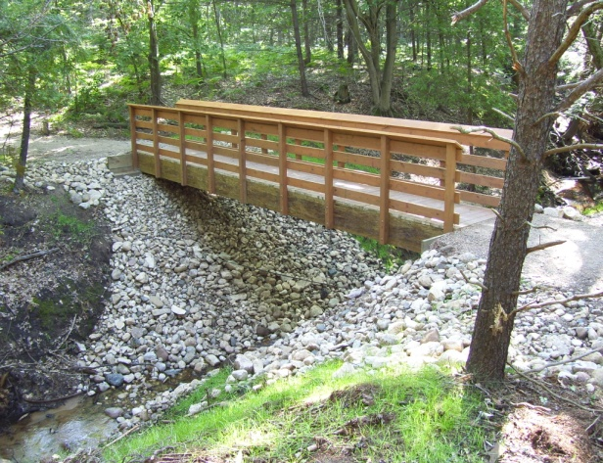
Photo courtesy of: Rich Corner
Stream Crossings/Channel Stabilization
Notes:
Boulders and cobbles for stream bank stabilization

Slide 8
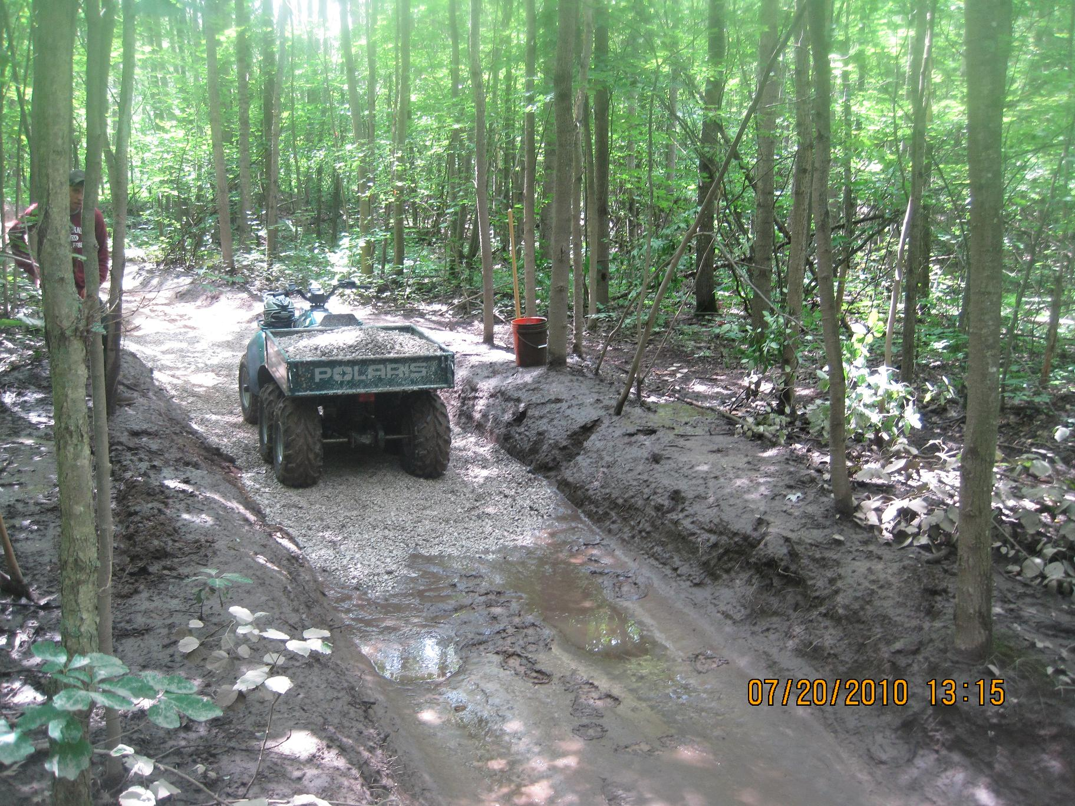
Insert picture of trail maintenance
Photo courtesy of: Dave Jaunese
Trail Maintenance
Notes:
Pea gravel to improve drainage on an ORV trail.

Slide 9
$23,642
$22,086
Notes:
Previous graph is hard to derive meaning from- Another way to think about it is take the average of the 12 year period for each forest… it is reasonable to assume that each forest could expect to offset at least this much of the costs of aggregate for yearly improvement projects

Slide 10
$23,642
$22,086
Notes:
When you consider that in a typical year the HMNF spends an estimated $30,000 on aggregate for projects, it begs the question of whether or not it could be economically feasible to offset some of the purchasing costs with in-service use.

Slide 11
Decline of sourcing materials directly from FS lands in recent decades…
…may be related to several complicating factors:
Abundance of private and commercial suppliers nearby.
Fragmented mineral ownership patterns (mixed surface/subsurface- Federal, State, and Private owners).
Lack of detailed geologic maps covering forest lands.
Uncertainty surrounding costs vs. benefits of developing pits for in-service use.
Notes:
Clearly a demand for these materials to complete FS projects, yet the use of CVMs for in-service use has been minimal over the last 15 years. Several factors may have contributed to this trend…

Slide 12
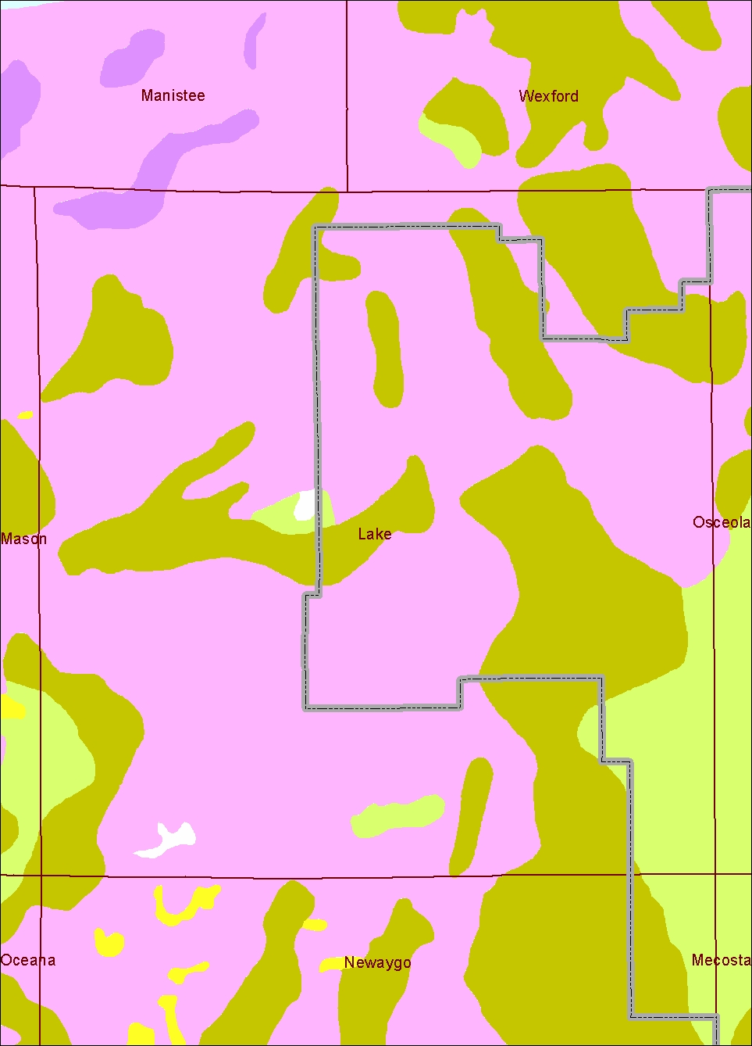
Statewide Quaternary Geology Map (Farrand & Bell, 1982) is most detailed map available.
-Doesn’t provide a realistic sense of resource availability at this scale.
Notes:
At the county level scale, essentially you see 4 kinds of data in Lake County,

Slide 13
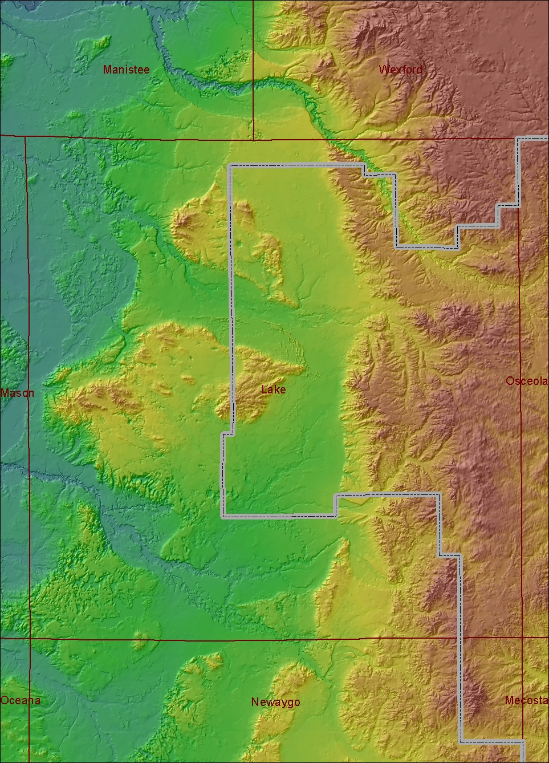
Statewide Quaternary Geology Map (Farrand & Bell, 1982) is most detailed map available.
-Doesn’t provide a realistic sense of resource availability at this scale.
Notes:
When in reality there’s an incredible amount of spatial variation in the kinds of deposits. Dune field north of the moraine, drumlin like features, wave cut bluffs, etc.

Slide 14
Declining use and development of sand, gravel, clay resources in recent decades…
…may be related to several complicating factors:
Abundance of private and commercial suppliers nearby.
Fragmented mineral ownership patterns (mixed surface/subsurface- Federal, State, and Private owners).
Lack of detailed geologic maps covering forest lands.
Uncertainty surrounding costs vs. benefits of developing pits for in-service use.
Notes:
Clearly a demand for these materials to complete FS projects, yet the use of CVMs for in-service use has been minimal over the last 15 years. Several factors may have contributed to this trend…

Slide 15
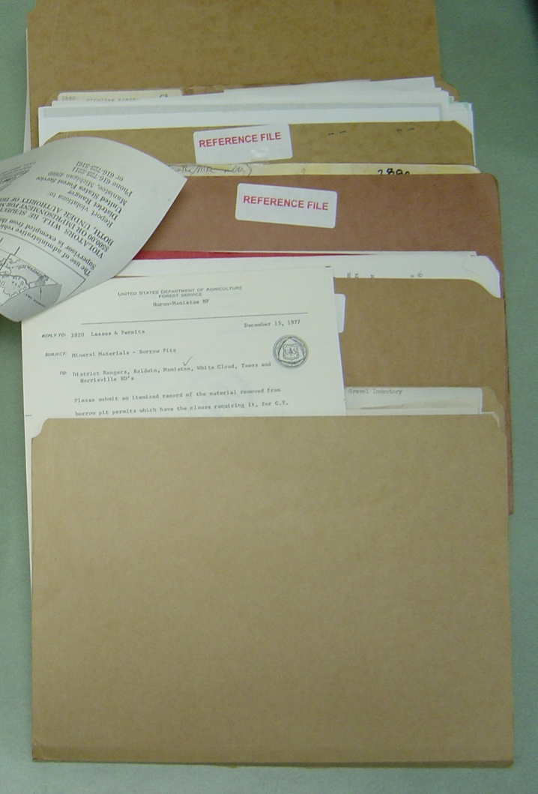
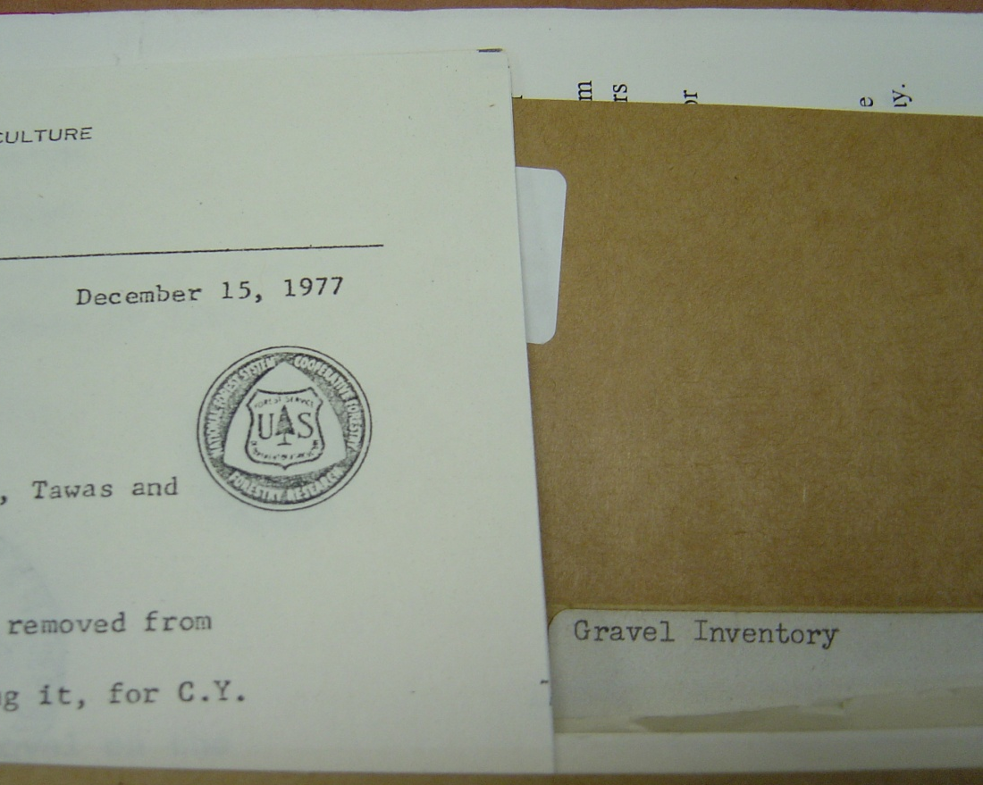
Information on Forest Service sand and gravel pits has become antiquated
Mostly historic/archival
Files on individual pits dispersed across ranger districts
Notes:
The information we have on file about sand and gravel pits mostly consists of permits, email correspondence, requests for replies due concerning usage, and annual reports. The files span from about 1950’s to 2007. beyond that there really isn’t much information available.

Slide 16

Book of tabular data on pits ~1950s…

Slide 17

PURPOSE: To gather relevant information about pits across the Huron-Manistee National Forest and store it in a manageable/useful geodatabase.
Multiple users
Geodatabase
GOALS
Map pit locations across the National Forest.
Increase awareness of pit locations, and availability of resources.
Provide a foundation of accessible information for planning purposes.
Notes:
There are three main goals associated with this project. The first, more mechanical goal to map the pit locations. With two other intangible goals to increase the awareness of cvm resources and provide a foundation of accessible pit information for planning purposes.

Slide 18
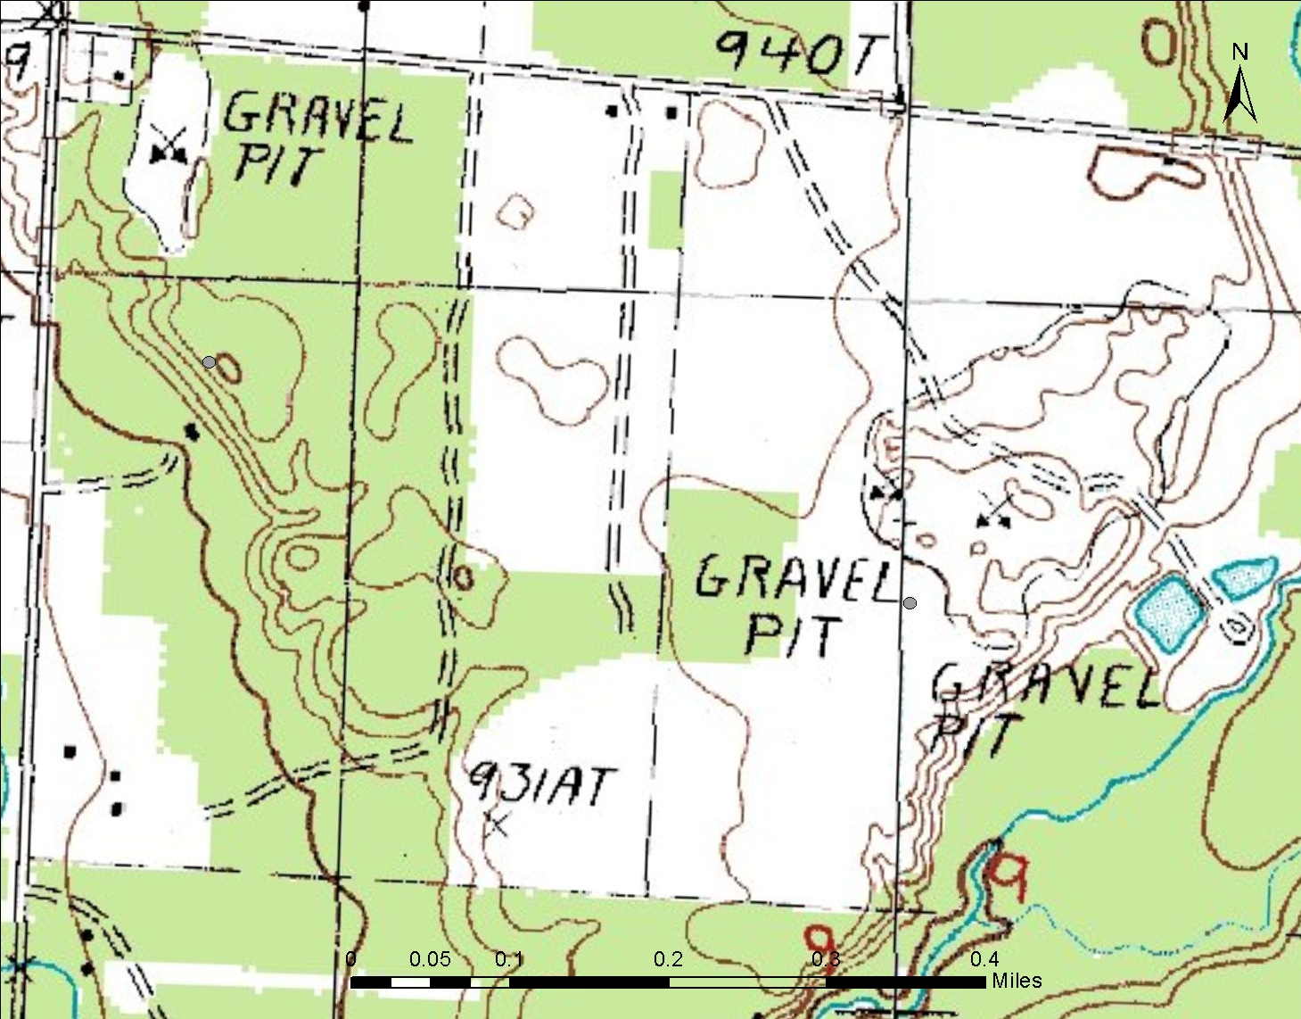
Notes:
Here’s an example of what I mean- consider the location of these pits on the USGS topo quad which was created in 1983, then compare that to what the Aerial photos look like in 2010, and you can see how the pits have migrated

Slide 19
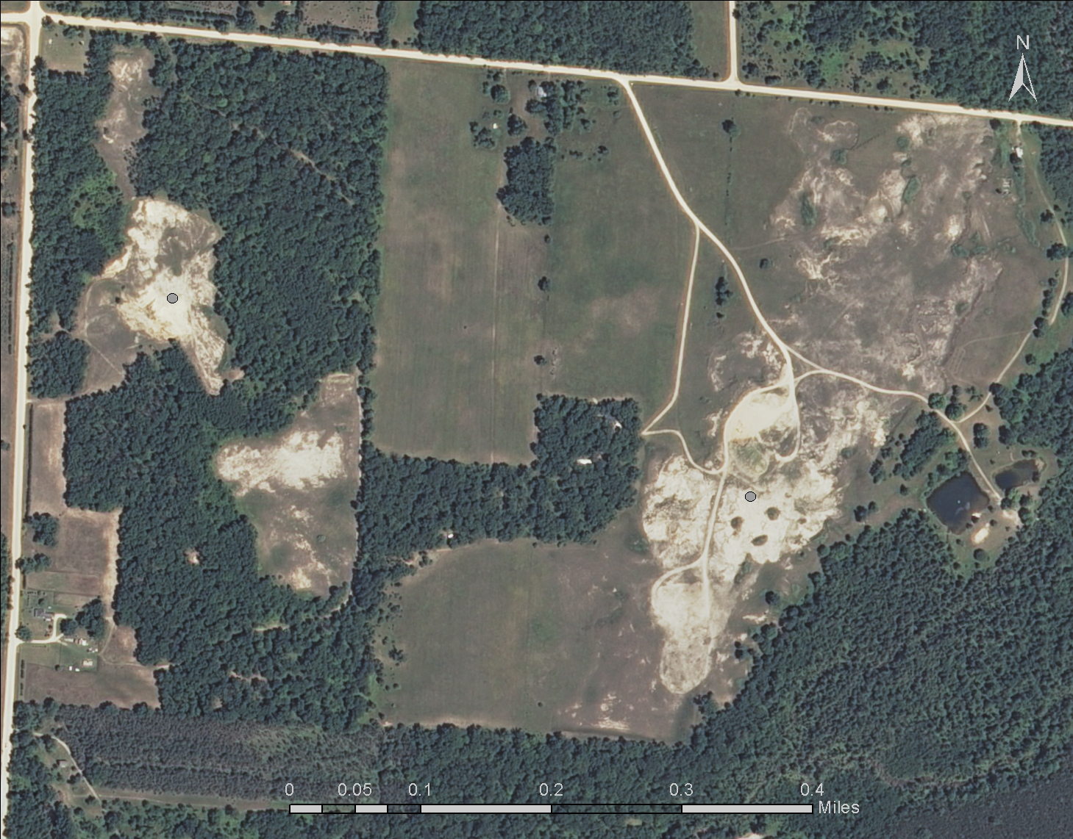

Slide 20
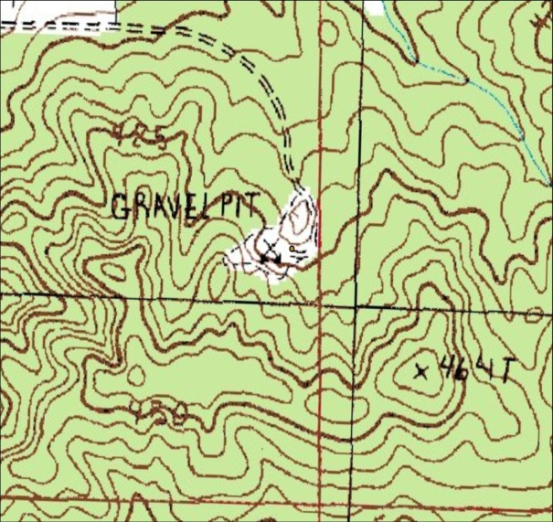
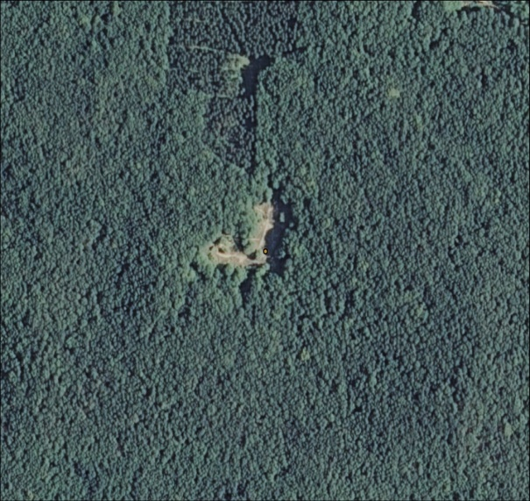
Data sources for mapping current and historic pit locations…
Manistee National Forest Map (1979)- paper map
1:24,000 scale USGS Topographic Quads (1983)
1:100,000 scale USGS Topographic Quads (date?)
Shapefiles provided by MDEQ (2000)
NAIP Aerial Photography (2010)- reference map to determine if pit still exists
Personal interviews with forest service personnel
Paper files of permits/contracts stored in Minerals and Geology office
Notes:
Because the inventory should include an accurate record of historic pit locations, a variety of different data sets was used to do the mapping. Essentially, the process involved comparing historic sources with current reference map. For this project, the current reference map is the 2010 NAIP Aerial photo (however, a 2012 one is now out- went online right at the end of mapping pits…).

Slide 21
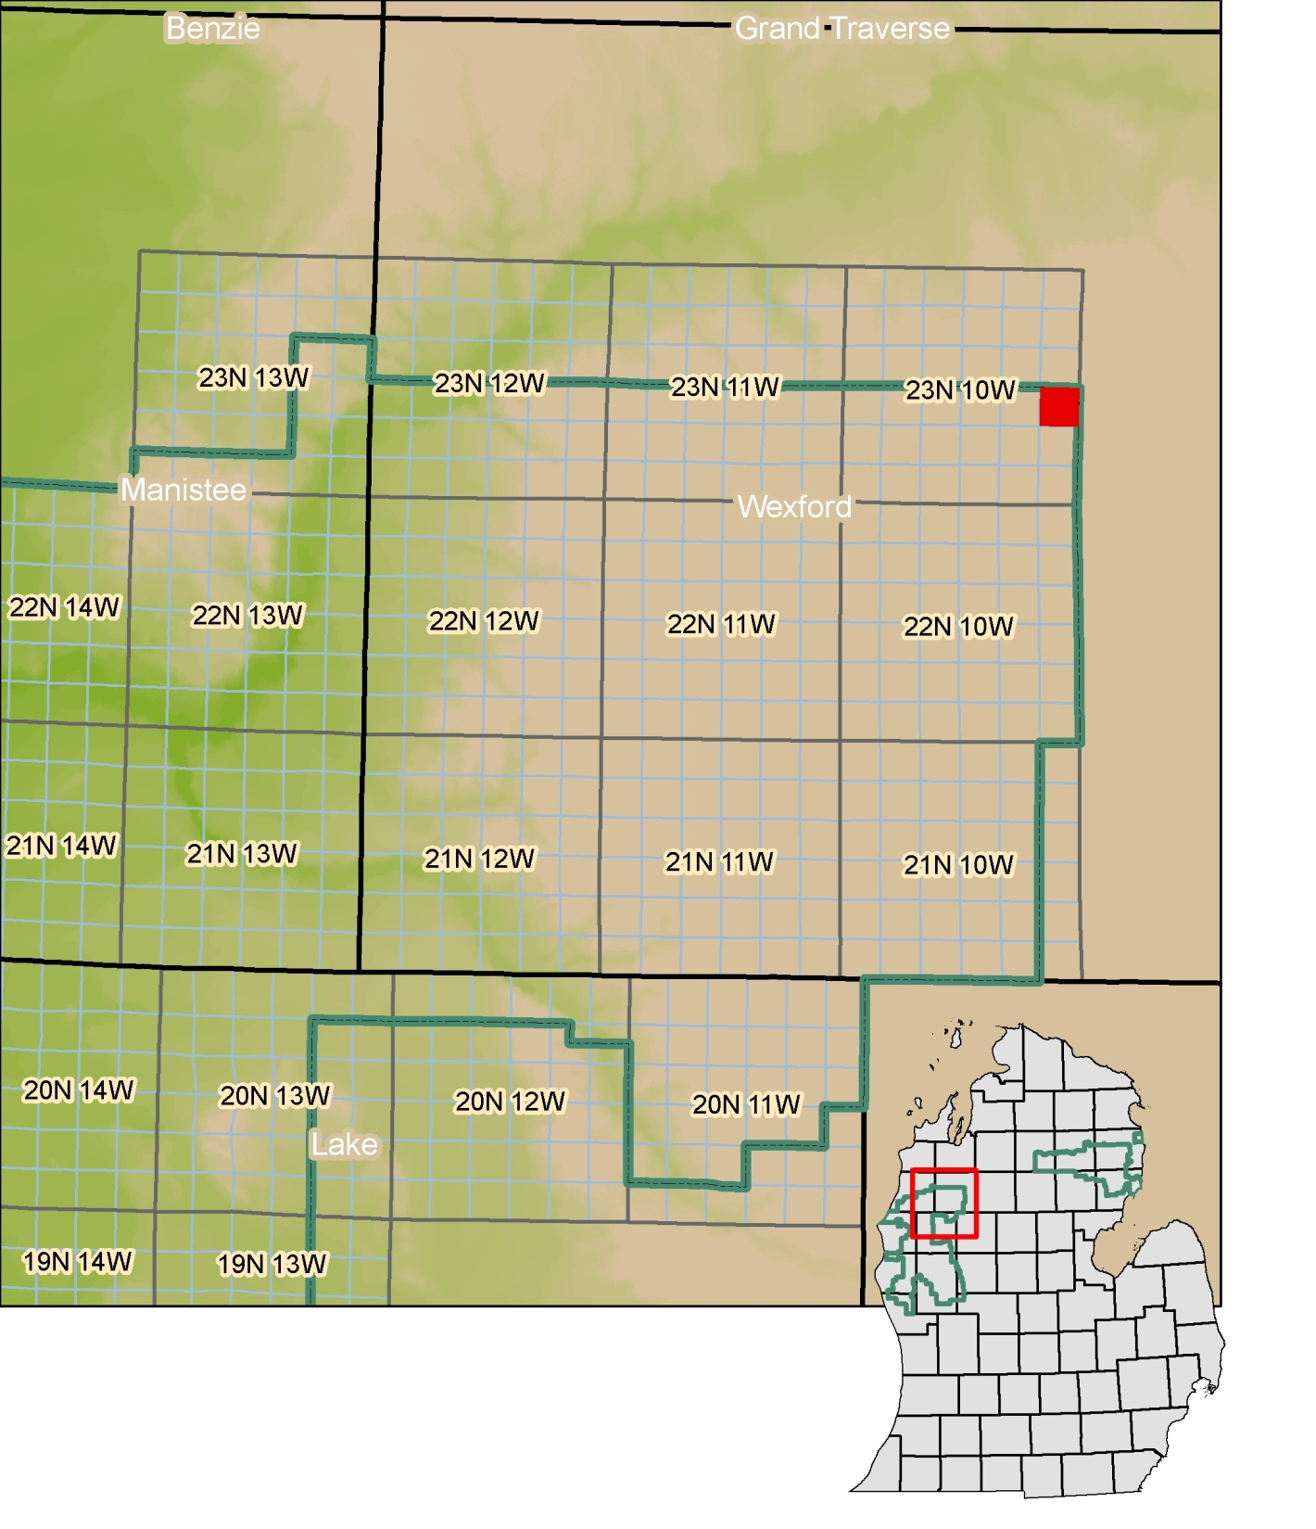

Slide 22
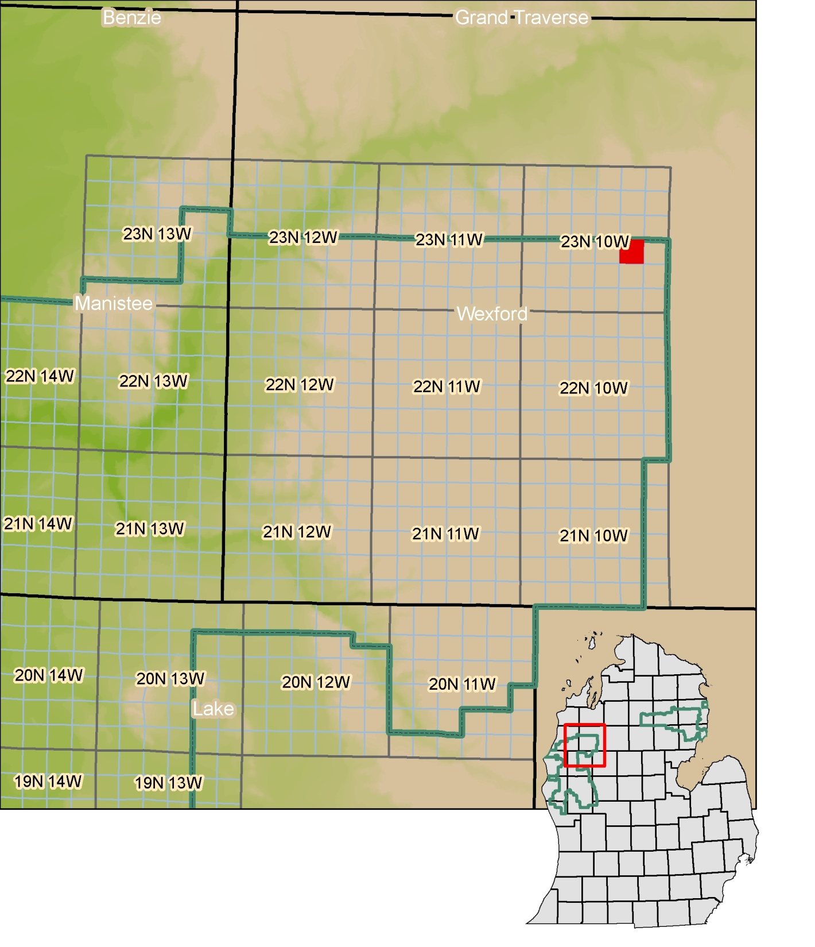

Slide 23
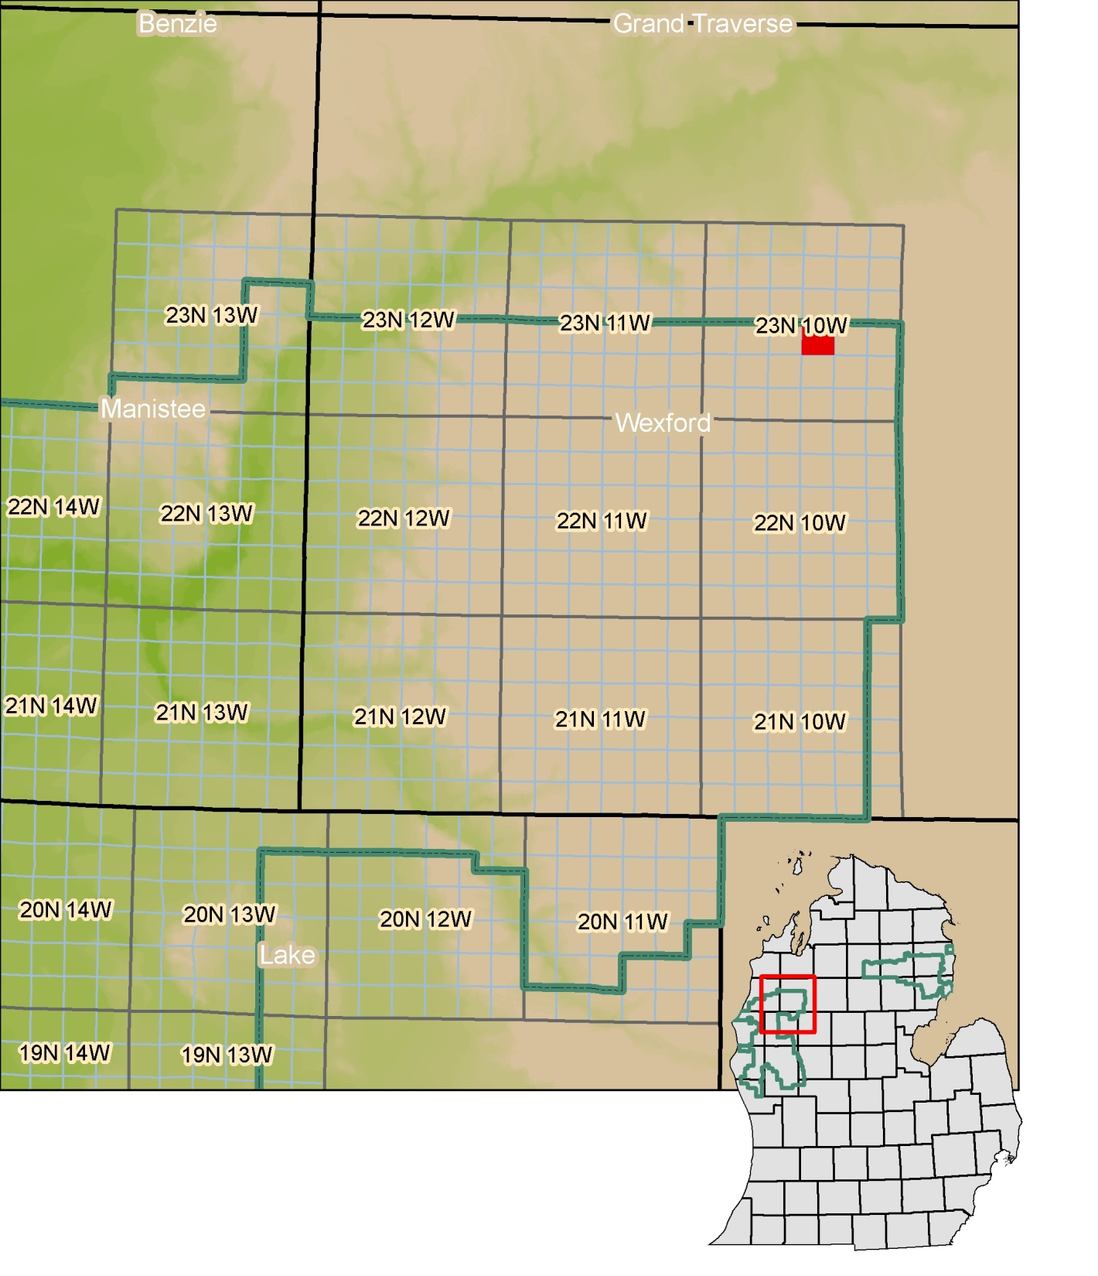

Slide 24


Slide 25


Slide 26
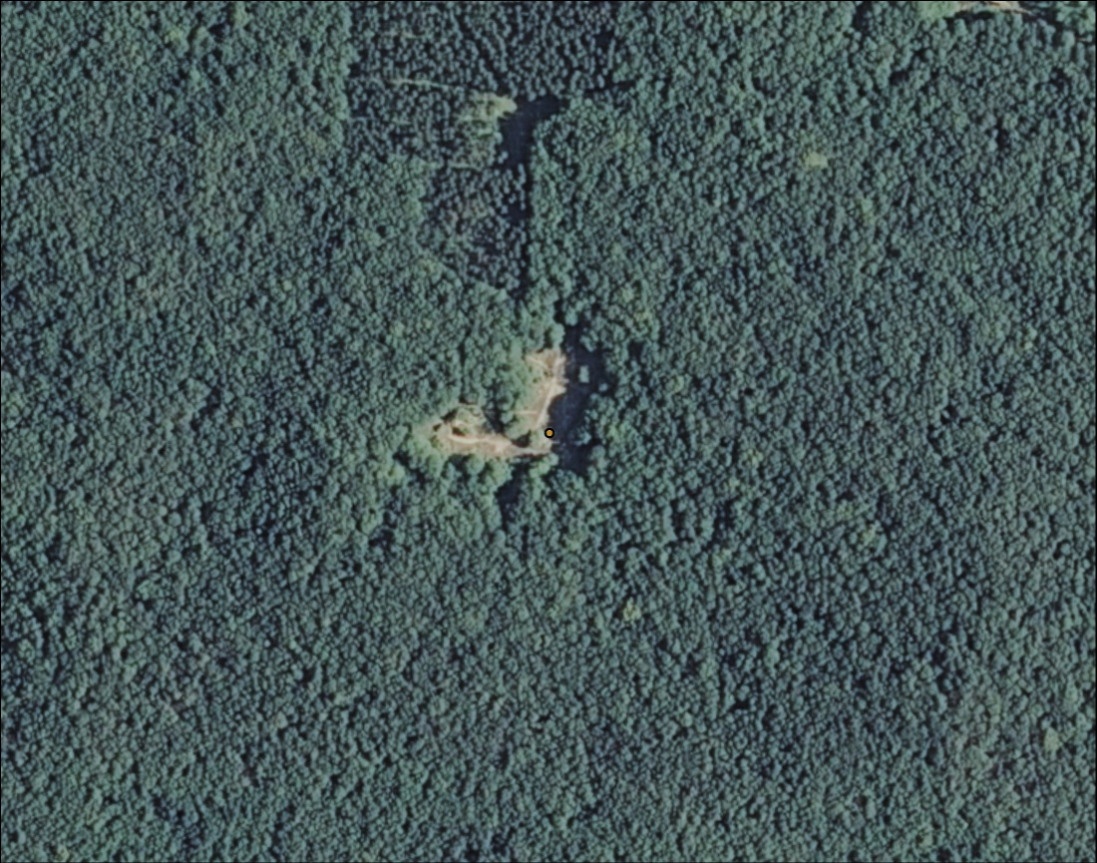

Slide 28
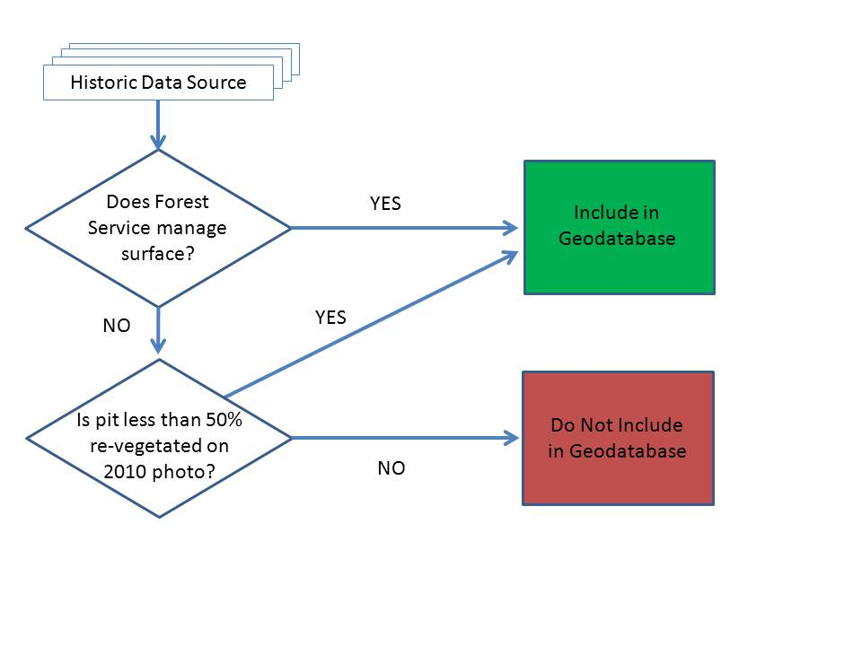
Workflow for choosing whether or not to map pits…
Notes:
So, to summarize the mapping methods, and provide a conceptual way to look at the decision making process to map pits, here’s the workflow I went through… Historic data sources…

Slide 29
Example of two private/commercial pits visible on 2010 NAIP Aerial Photo…
Less than 50% re-vegetated (mapped).
More than 50% re-vegetated (not mapped)
Notes:
Here’s an example of two pits on private land that are classified differently. The one on the right is “closed” because it is more than 50% re-vegetated. The other one, to the northwest of it, may be more than 50% re-vegetated, but it is too close to call on the aerial photo, and shows more signs of excavation than the other one. Mapping conservatively, this pit is included. It can later be field verified to determine its actual status. Where this kind of thing really matters is when new maps are published. The pit to the left will likely outlast the one in the middle- therefore, the map data will be relevant for a longer period of time.

Slide 30
Examples of attributes recorded during mapping effort…
Ranger District
County
Legal Location
Latitude
Longitude
Operation Status (active, inactive, reclamation in progress, closed)
Mineral Ownership (Federal, State, Private or Commercial)
Ownership Entity (Name of owner)
Deposit Type (Primary material extracted- Gravel, Sand, Clay, etc.)
Map Source (the map on which the original location appears)
Pit ID Key
USGS Name (Topo quad the pit falls within)
Comments
Notes:
While mapping, I also made further determination about a pit’s “Operation Status”. These calls were based on how the pit visually looks on the Aerial photo. Pits that are active…

Slide 31
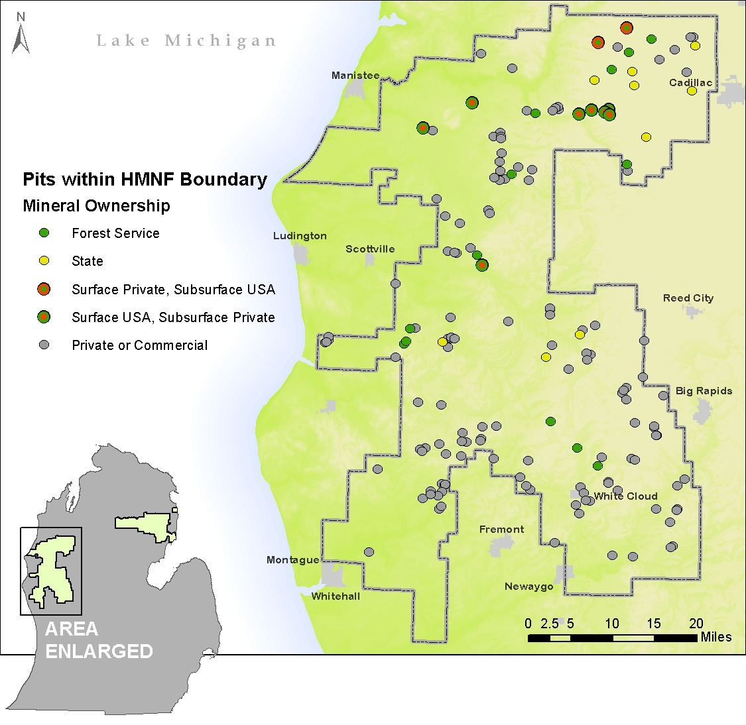
Manistee Side
F.S. Pits = 33
Private Pits = 128
Notes:
What’s notable about this map is that it confirms the suspicion that commercial sand and gravel pits far outnumber forest service pits on the Manistee side.

Slide 32
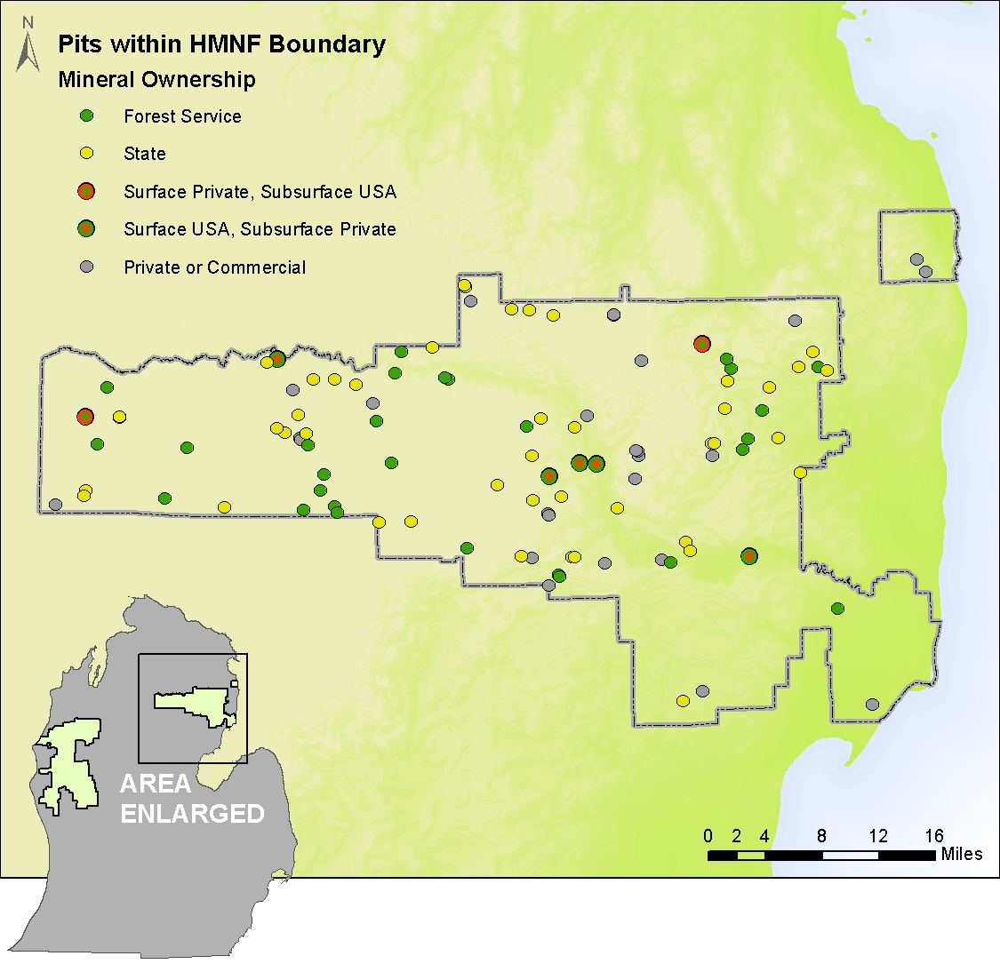
Huron Side
F.S. Pits = 79
Private Pits = 26

Slide 33

Huron Side
Active Pits on FS land = 4
Notes:
These 4 pits represent all of the active pits for both sides of the forest.

Slide 34
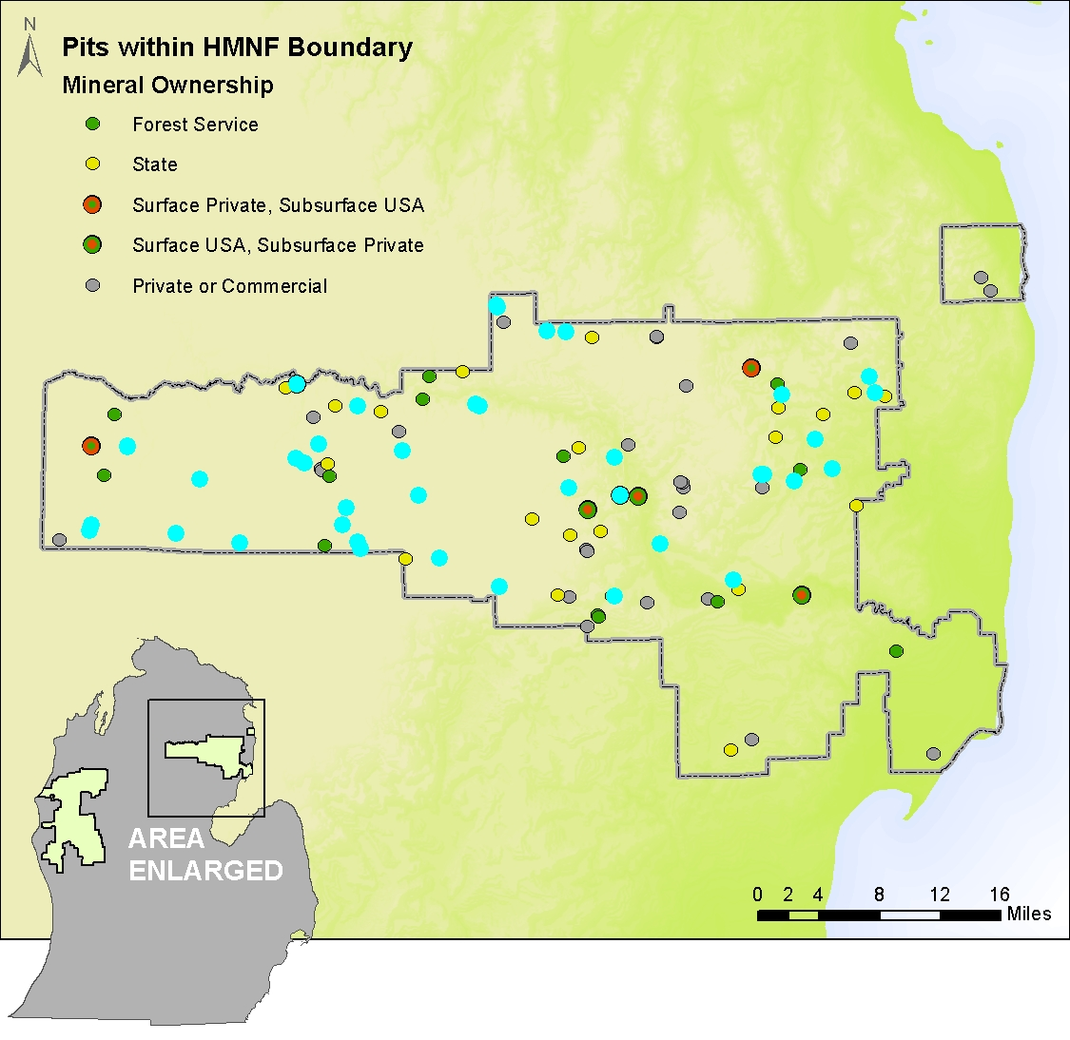
Huron Side
FS Pits “Reclamation in Progress”= 40
Notes:
These pits are all considered “reclamation in progress” according to the definition… they appear to have been re-sloped and seeded, but still have not returned to their previous state.

Slide 35
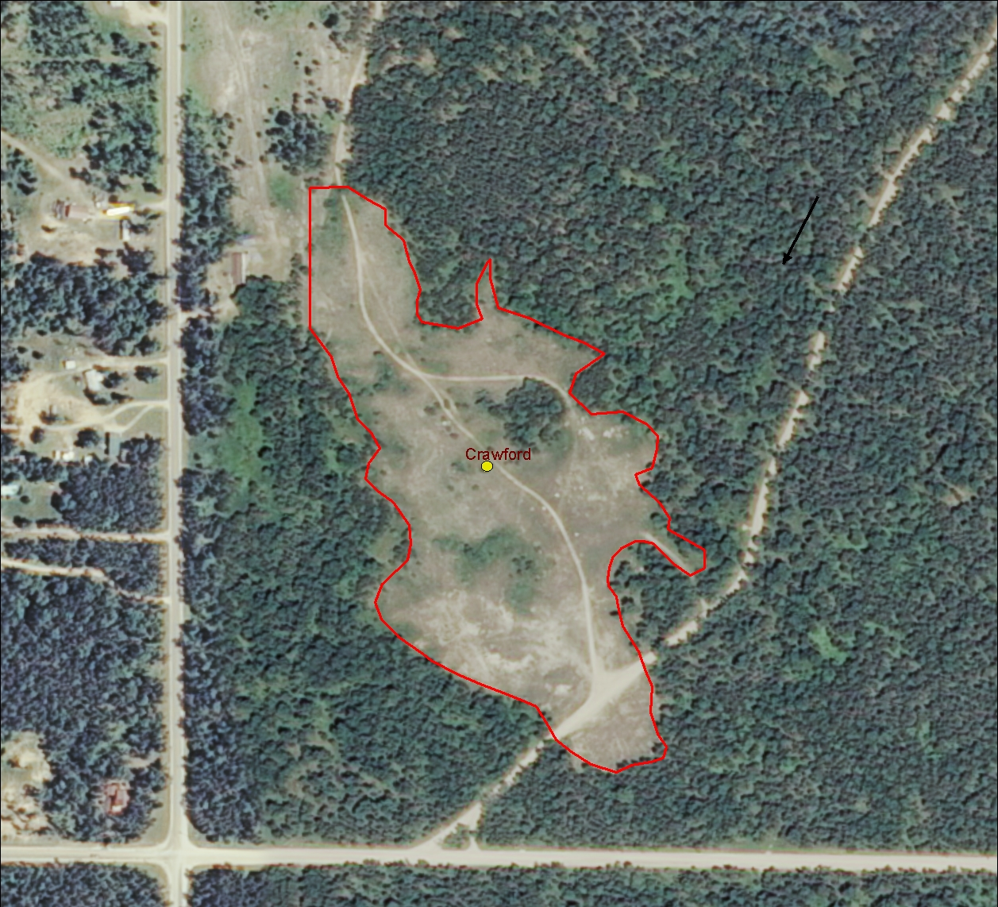
Reclamation in Progress Pit Example

Slide 36

Other information stored in Geodatabase…
Geodatabase
Pit Points
District
County
Legal Location
Latitude
Longitude
Operation Status
Mineral Ownership
Ownership Entity
Deposit Type
Map Source
Pit ID Key
USGS Name
Comments
Pit Areas
District
Pit Name
Shape Length
Shape Area
Longitude
Operation Status
Comments
Pit Photos
PDF
Permit history
Digital scans of Paper documents
Notes:
Other information about the pits was gathered on the fly during the mapping effort. These include… Then, where they exist, I also attached photos and PDFs of permits or other relevant information to the pits.

Slide 37
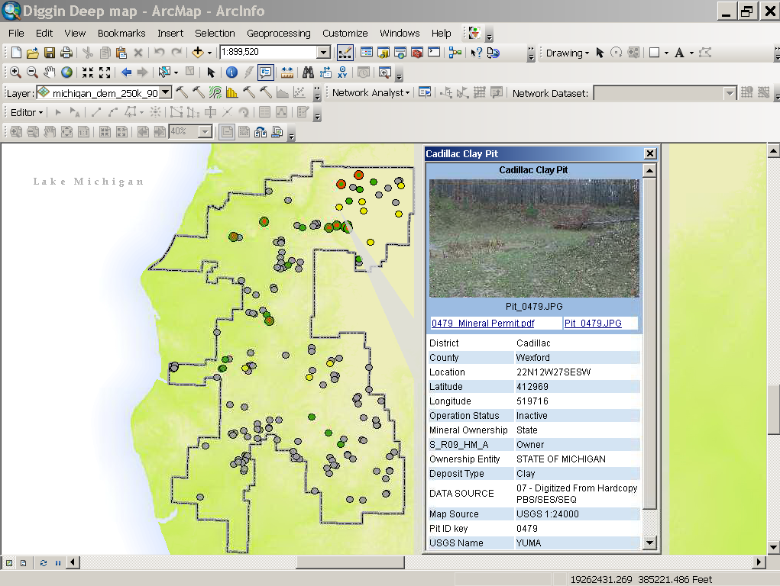
Notes:
Picture, and eventually relevant scans of paper documents on file will also be attached

Slide 38
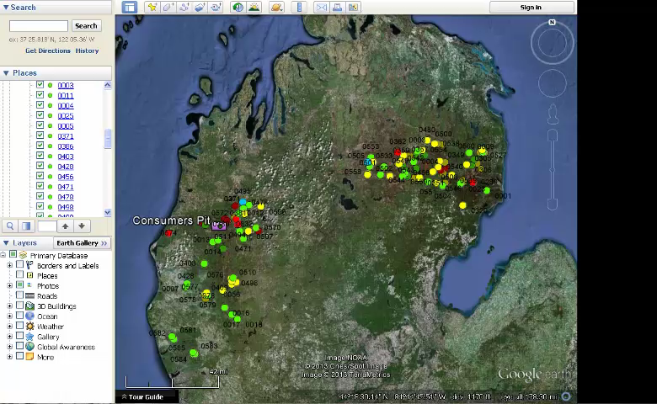

Slide 39
Work in Progress...
Continue field work..
Confirm operation status of “unknown” pits.
Continue Photo Documentation.
Assess quality and quantity of materials in active FS pits.
Automate data storage between Geodatabase → Google Earth/ kmz files
Spherical panoramas are data intensive- need to be efficiently stored, updated, and served.

Slide 40
Thanks for your input, help, resources, support…
Terry Saarela, Rich Corner, Tracy Miller, Scott Peedle, Jessica Stuntebeck, Suzanne Johnson, Greg Knight, Russ Sutton, Kate Salm, Doug Gullekson, Dave Jaunese, Kristen Thrall, Paul Salvatore, Geological Society of America GeoCorps program, Huron-Manistee National Forests, and many others…
Questions?

Slide 41
Summary...
Mapped pit locations and areas of open pits within the HMNF Proclamation boundary, including active private and commercial pits.
Up-to-date inventory allows for more informed decision making, including sourcing materials and monitoring reclamation progress.
Storing and maintaining info in GIS environment opens up data to a wide range of spatial analysis tools, applications, and visual communication.
Up-to-date pit locations can also serve future geologic mapping efforts.

