Slide 1
Paleoenvironments of the Alpena-Amberley Ridge
Dr. Elizabeth (Lisa) Sonnenburg
SSHRC Postdoctoral Fellow
University of Michigan Museum of Anthropology
North-central GSA Meeting, Kalamazoo
May 3, 2013

Slide 2
Objectives
To determine the paleoenvironmental conditions on the area on the Alpena-Amberley Ridge ca. 10-7.5 YBP
To refine our knowledge of water-level changes in Lake Huron during the Lake Stanley low stand
To understand past and present surficial and taphonomic processes
To identify areas of potential human occupation using microdebitage.

Slide 3
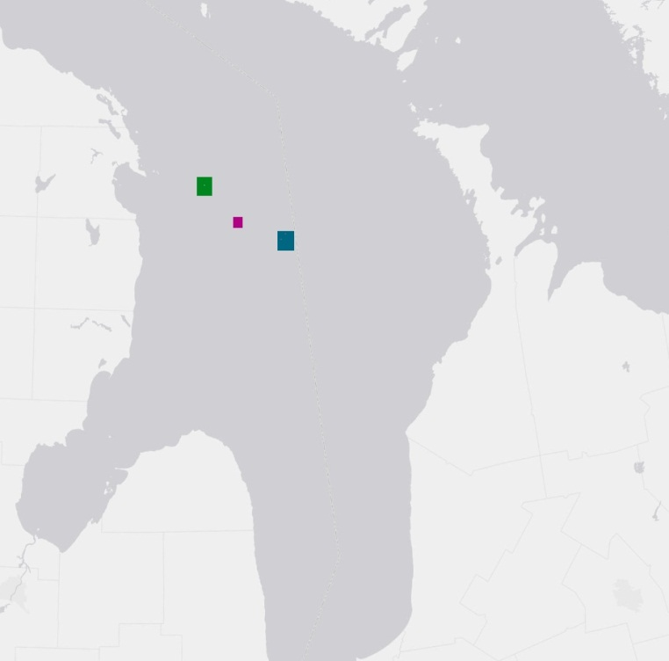
N

Slide 4
Sediment Particle Analysis
Particle size- laser diffraction
Sediment classification
VCS-Very Coarse Sand
CS- Coarse Sand
MS-Medium Sand
FS- Fine Sand
VFS-Very Fine Sand
CSMS-Coarse Silty Medium Sand
MSMS-Medium Silty Medium Sand
FSMS-Fine Silty Medium Sand
VFSMS- Very Find Silty Medium Sand
MUD-Mud

Slide 6
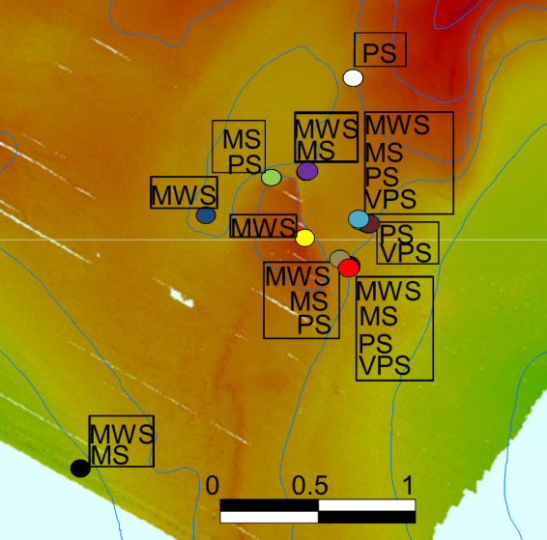
Sediment Particle Analysis
Sediment Sorting
MWS-Moderately Well Sorted
MS-Moderately Sorted
PS-Poorly Sorted
VPS- Very Poorly Sorted

Slide 8
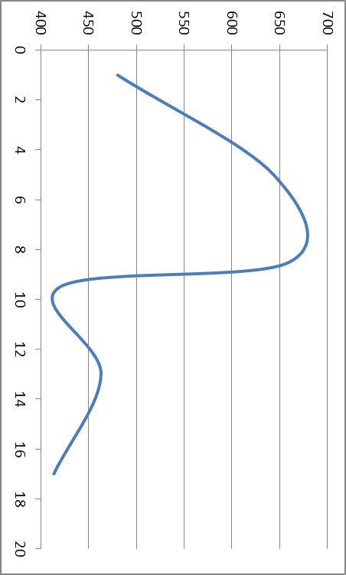
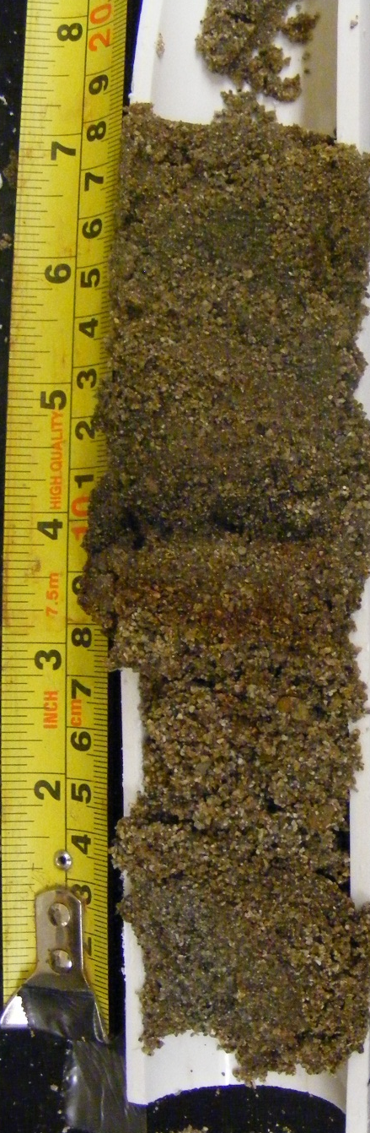
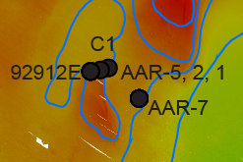
µm
cm
Mean particle size
92912E

Slide 9
Grain Shape and Source
Understand sediment source and surficial/taphonomic process and well as establishing baseline for microdebitage studies
HS-High sphericity
LS-Low sphericity
VA-Very angular
A-Angular
SA- Sub-angular
SR-Sub-rounded
Q-Quartz
C-Chert
S-Sandstone
B-Basalt

Slide 10
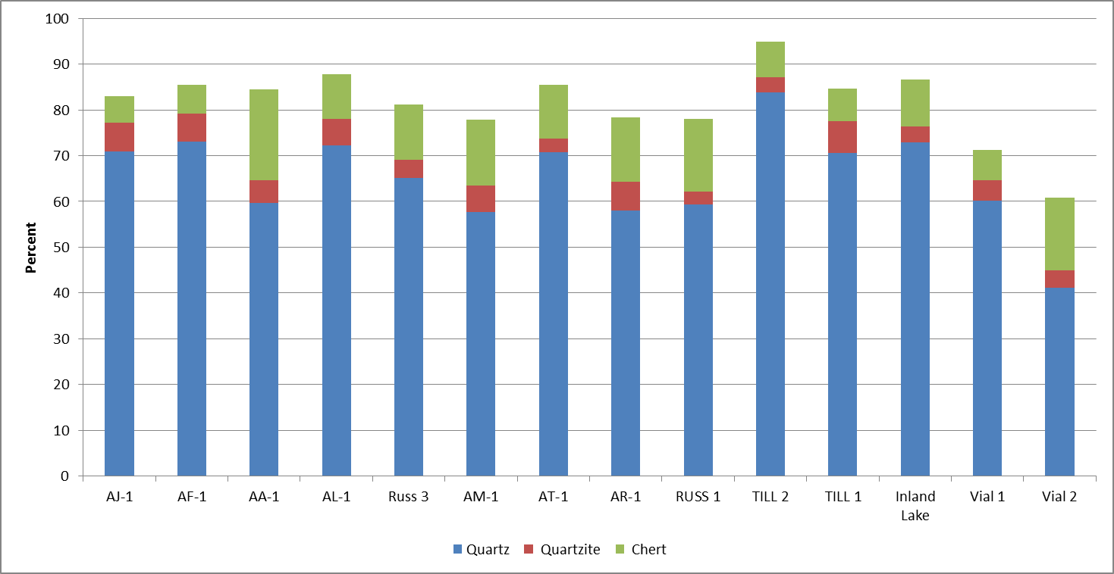
Grain Source

Slide 11
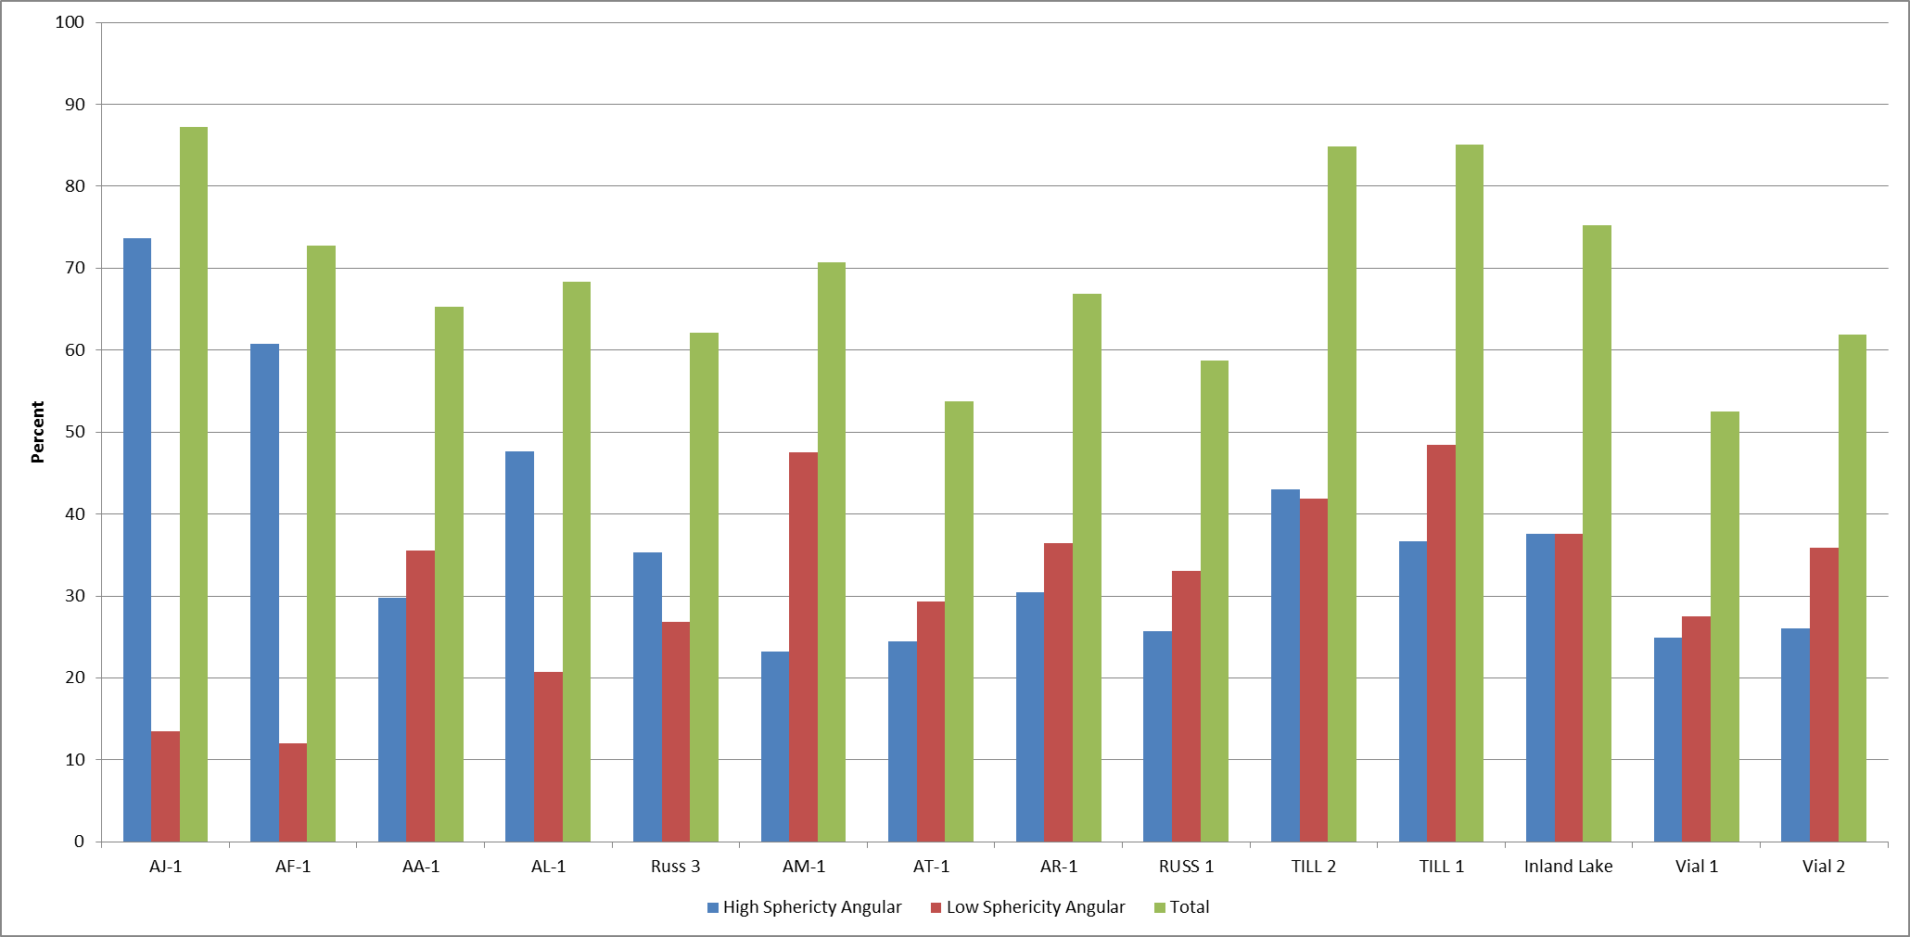
Grain Shape

Slide 12
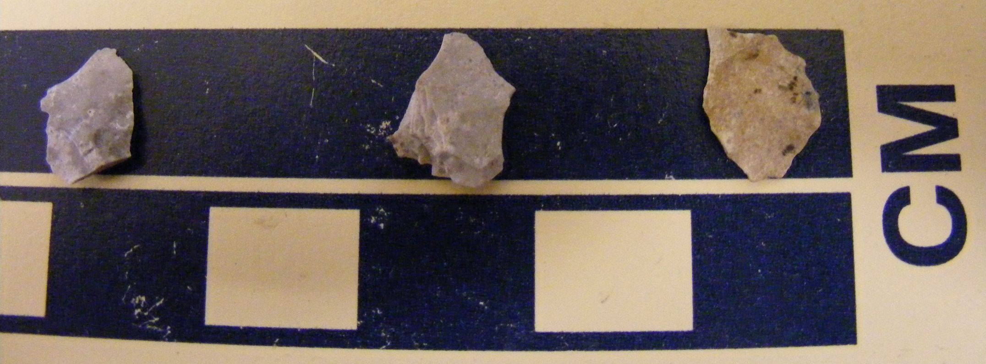
Microdebitage?
Vial 2 chert flake (?)
Experimental pressure flakes-Bayport Chert (courtesy of R. Love)

Slide 13
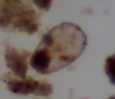
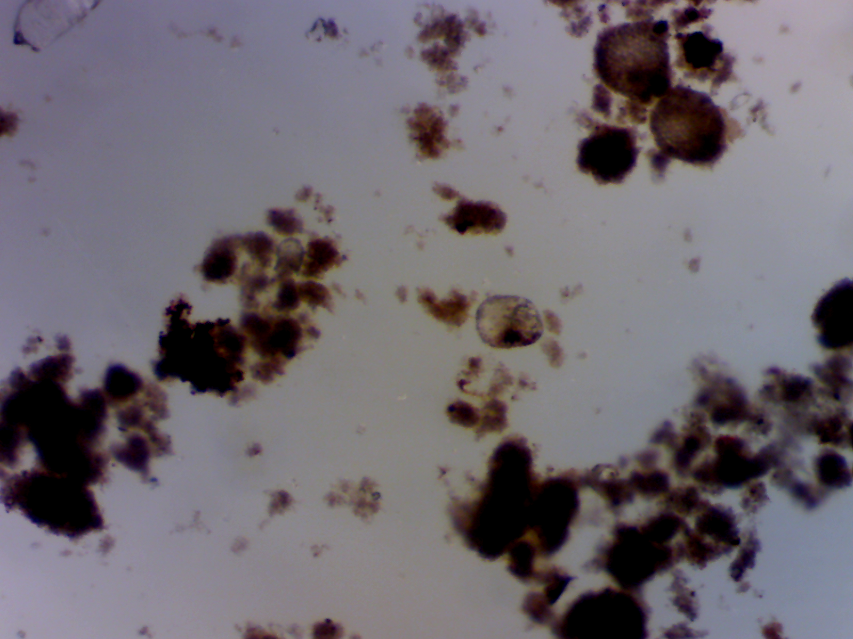
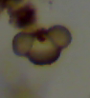
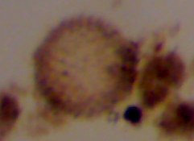
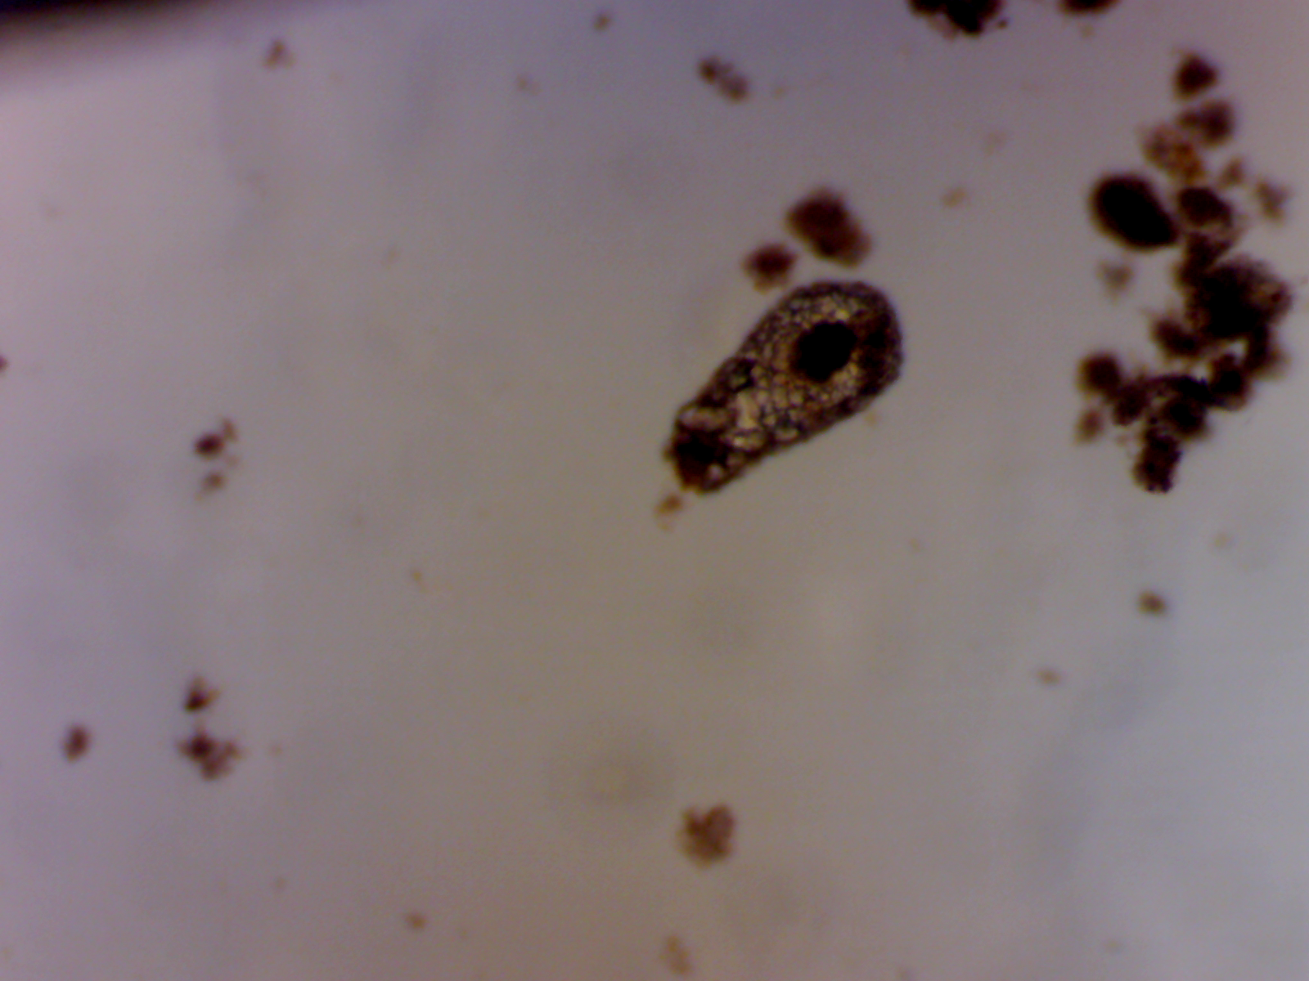
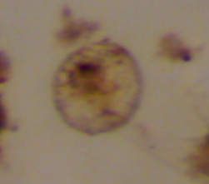
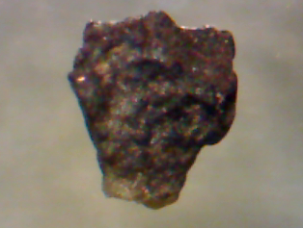
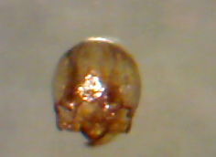
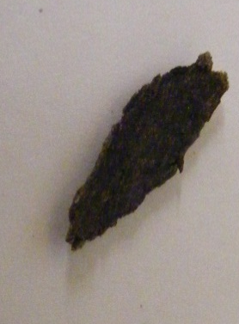
Microfossils
Testate amoebae
Pollen
Other organics-wood, charcoal, seeds

Slide 14
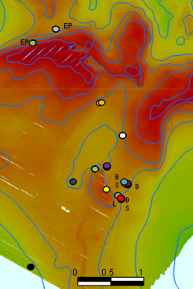
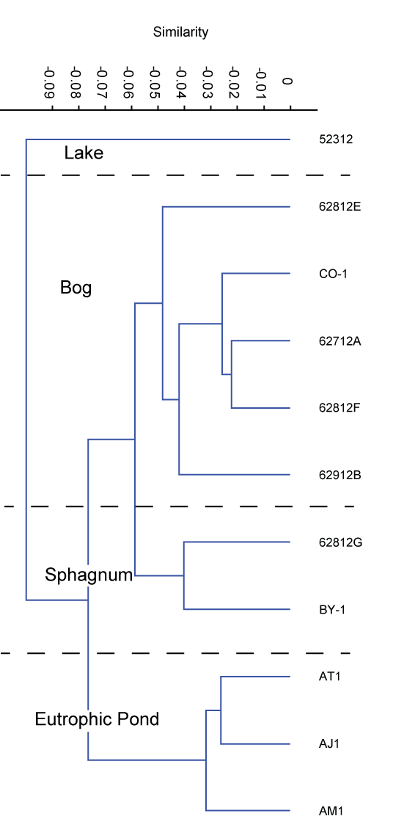

Slide 15
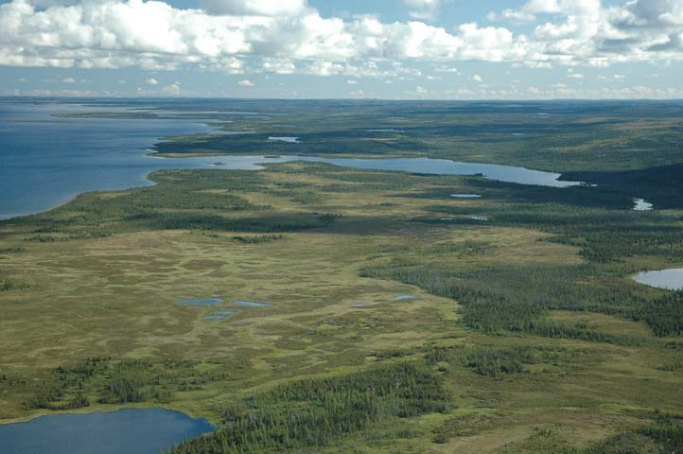
The story so far….
The Ridge during the lowstand was series of micro-environments; the Ridge itself may have affected local climate
Prairie Parkland of grasses, tamarack and spruce
Patchwork of boggy marsh, small shallow ponds and rivers, and larger lakes
Department of Natural Resources, Northwest Territories, Canada

Slide 16
The story so far……..
Grain morphology, the presence of distinct marsh thecamoebian assemblages and non-arboreal pollen indicate a stable surface and rapid inundation
Grain morphology and source may be able to distinguish between microdebitage and naturally occurring angular sediments

Slide 17
Acknowledgements
Social Sciences and Humanities Research Council of Canada (SSHRC)
Drs. John O’Shea, Guy Meadows and Robert Reynolds
Ashley Lemke, Ellie Callison, Rachel Ross
Michigan Adventure Diving-Ty Schultz, Michael Courvoisier, Annie Davidson
Robert Love
UMMA
Dr. Ed Reinhardt, McMaster Micropaleo Lab, McMaster University, Hamilton, Ontario, Canada
Dr. Joe Boyce

