Slide 1


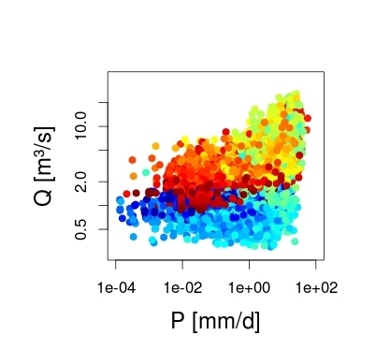
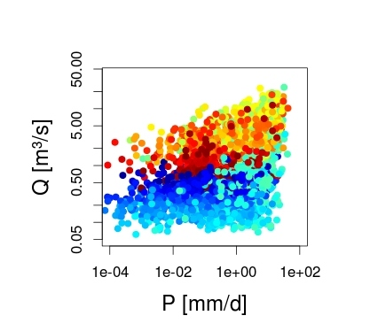
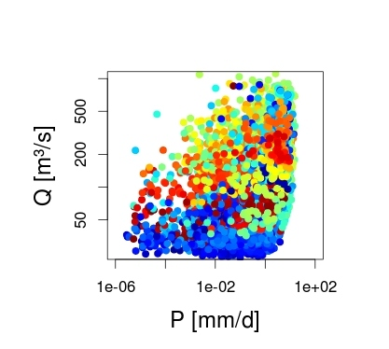
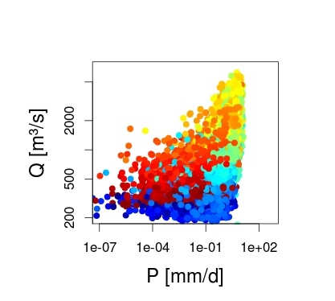
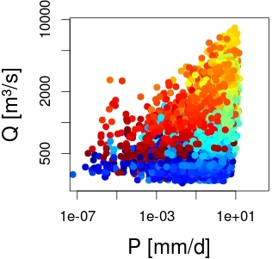
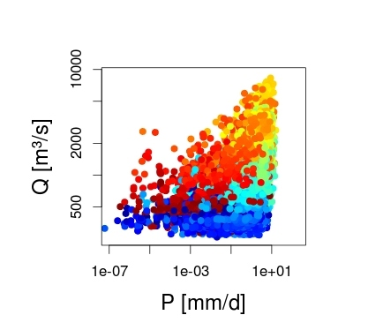
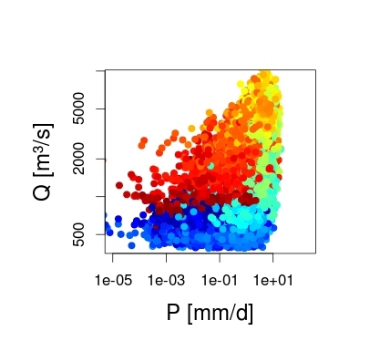
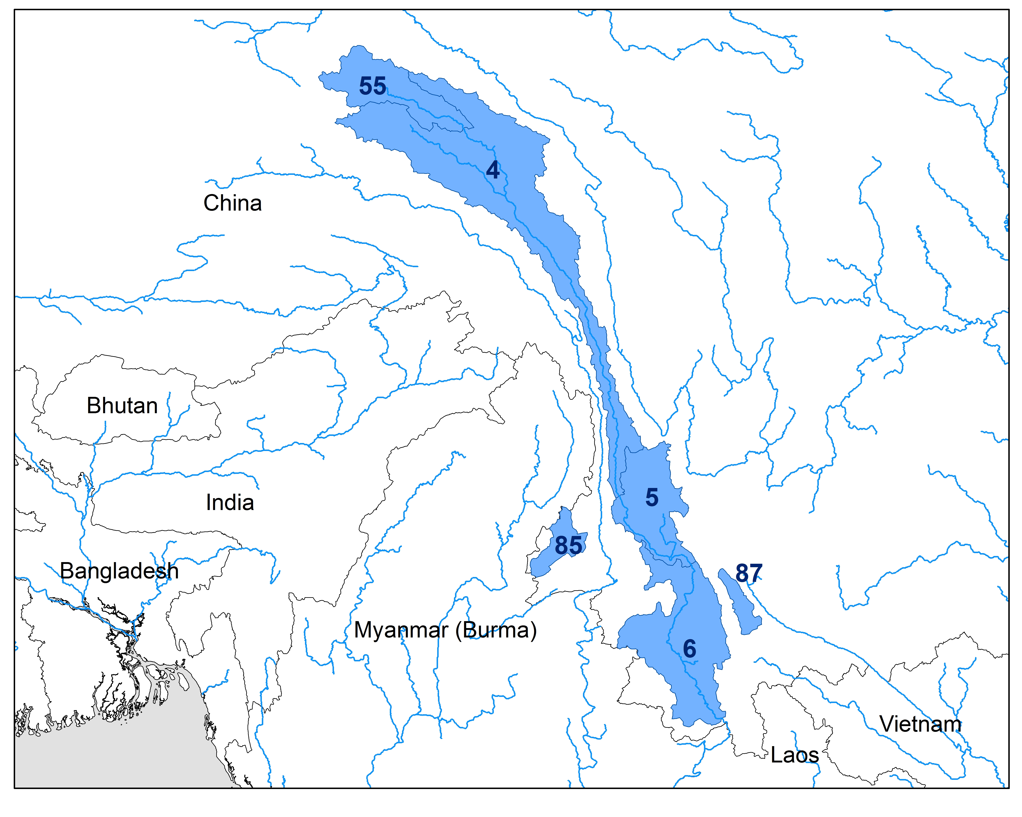

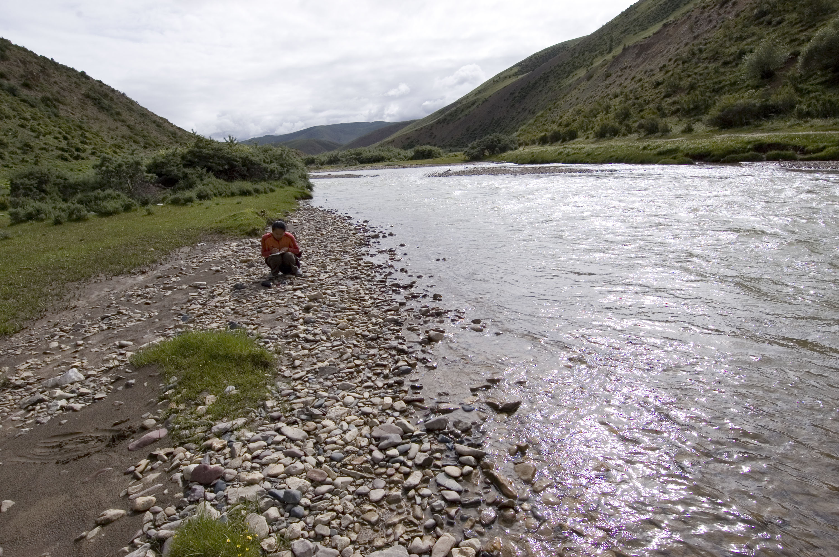
xxx
GROUNDWATER STORAGE IN WESTERN CHINA AND EASTERN TIBET OBSERVED FROM PRECIPITATION-DISCHARGE HYSTERESIS
Gilliom, Alden J.¹; Schmidt, Amanda¹; Andermann, Christoff²; Rothenberg, Miriam¹ ¹Geology Department, Oberlin College, 403 Carnegie Building 52 W. Lorain St. Oberlin, Ohio 44074
²Institute of Earth and Environmental Sciences, University of Potsdam, Karl-Liebknecht-Str. 24-25 14476 Potsdam-Germany
Purpose
To determine if precipitation-discharge hysteresis occurs in western China and eastern Tibet groundwater systems and, if so, the duration of hysteresis.
Results
Data shows a lag between peak precipitation and peak discharge which is indicative of a hysteresis environment.
The first part of the year (January-April) displays low discharge with increasing precipitation along the bottom of the graph. Mid-year (May-August), precipitation levels reach their maximum and start to fall while discharge reaches its peak. Toward the final months of the cycle (September-December) the precipitation and discharge fall to original levels for the next season.
The counterclockwise loop that forms on the graphs shows movement modeling the cycle of groundwater storage.
Precipitation levels peak while discharge is still low and then as precipitation falls discharge peaks. The lag between the two peaks is the hysteresis.
Conclusions
It is clear that hysteresis occurs in these systems. This indicates groundwater storage although quantitative results on the duration are forthcoming.
Ongoing work will include quantifying the hysteresis results to determine the residence time between precipitation and discharge. If the systems are similar to those of Andermann, et al. (2012) peak discharge would be expected between 30 and 60 days following peak precipitation.
Future work could include modeling the climate and environmental factors influencing each watershed, such as glaciers. Glaciers act as a reservoir for freshwater. Such modeling would give a more complete picture of the water budget for the area and allow for a more precise calculation of the groundwater residence time.
Overall, there is strong qualitative evidence for hysteresis occurring in this area. The pronounced loops of data across watersheds with varying sizes points to a similar groundwater system throughout the area.
Station 85
Station 87
Introduction
Groundwater is the water that moves underneath the surface of the Earth by way of rock fractures and sediment pores.
Hysteresis is the time between peak precipitation and peak discharge in a chosen watershed system.
The area has a monsoonal climate.
The Himalayas lead to complicated geology.
Work in this area is important because groundwater does not react as quickly as surface water and may not display side effects to the system until a later time. This has the potential to affect seasonal patterns associated with the area.
Station 55
Station 4
© File copyright Colin Purrington. You may use for making your poster, of course, but please do not plagiarize, adapt, or put on your own site. Also, do not upload this file, even if modified, to third-party file-sharing sites such as doctoc.com. If you have insatiable need to post a template onto your own site, search the internet for a different template to steal. File downloaded from http://colinpurrington.com/tips/academic/posterdesign.
January-April
Methods
Utilized the work of Christoff Andermann, et al. (2012) on groundwater storage in the Nepali Himalayas and applied the concepts to western China and eastern Tibet.
Plotted 26 years of data between 1955 and 1987 with 6 years of missing data due to incomplete records.
Study area included 6 watersheds of varying sizes.
Data obtained from the Chinese Hydrology Bureau and Dr. Amanda Schmidt’s graduate work at the University of Washington (Schmidt et al. 2011)
Data formatted using MATlab (version 2010b) and analyzed with Rstudio script modified from Andermann et al. (2012).
May-August
September-December
Station 5
Station 6
These graphs display the hysteresis loops that are a function of groundwater storage. The colors represent months of the year ranging from blue (January) to red (December). Discharge (Q) is measured in meters³/day while precipitation (P) is in millimeters/day.
An intermediate river in the study area during near baseflow conditions.
Context map by Amanda Schmidt (2013)
Works Cited
Andermann, C., Longuevergne, L., Bonnet, S., Crave, A., Davy, P., and Gloaguen, R., 2012, Impact of transient groundwater storage on lllllthe discharge of Himalayan rivers: Nature GeoScience, v. 5, p. 127.
Schmidt, A. H., Montgomery, D. R., Huntington, K. W., and Liang, C., 2011. The myth of Communist land degradation: new evidence lllllfrom local erosion and basin-wide sediment yield in SW China and SE Tibet. Annals of the Association of American Geographers. lllll101(3):1-19.
Acknowledgments
Dr. Jeff Witmer, Caitlin Zinsley, Lydia Curliss, Oberlin College Geology Department.

