Slide 1
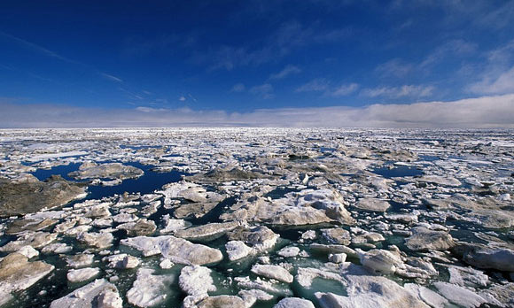



Linking 2,000 years of Sedimentation in the Western Arctic Ocean to an Atmospheric Temperature Proxy Record from a Glacial Lake in the Brooks Range, Alaska
HARRISON, Jeffrey M, ORTIZ, Joseph D, ABBOTT, Mark B, BIRD, Broxton W, HACKER, David B, GRIFFITH, Elizabeth M, and DARBY, Dennis A
Jeffrey M Harrison
Department of Geology
Kent State University
jharri72@kent.edu
Notes:
This thesis conducted a direct correlation of sedimentation within the western Arctic with an atmospheric climate proxy from northern alaska
The time interval investigate here was over last 2,000 years of the late Holocene
HARRISON, Jeffrey M, ORTIZ, Joseph D, ABBOTT, Mark B, BIRD, Broxton W, HACKER, David B, GRIFFITH, Elizabeth
M, and DARBY, Dennis A

Slide 2
Previous Research
Work conducted by:
Darby, D. A., J. D. Ortiz, L. Polyak, S. P. Lund, M. Jakobsson, and R. A. Woodgate (2009). The role of currents and sea ice in both slowly deposited central Arctic and rapidly deposited Chukchi-Alaskan margin sediments. Global and Planetary Change, 68: 58-72.
Analyzed the grain-size distribution of a marine core (JPC-16)
Compared core sediment to sea-ice entrained sediments
Looked at the entire Holocene (~8,000 years)
This research enhances the resolution of the Marine Core
Same analytical methods
18 & 35 yr sample interval vs. ~88 yr interval
Looked at the recent Holocene (Last 2,000 years)
Notes:
122 samples versus 26

Slide 3
Purpose of Study
Characterize marine sedimentation at a higher resolution
Identify how atmospheric climate is related to patterns of sedimentation in the western Arctic Basin
Aid in a better understanding of the distribution and circulation of sea-ice related to atmospheric patterns
Data reflects natural variability
Notes:
PAPER

Slide 4
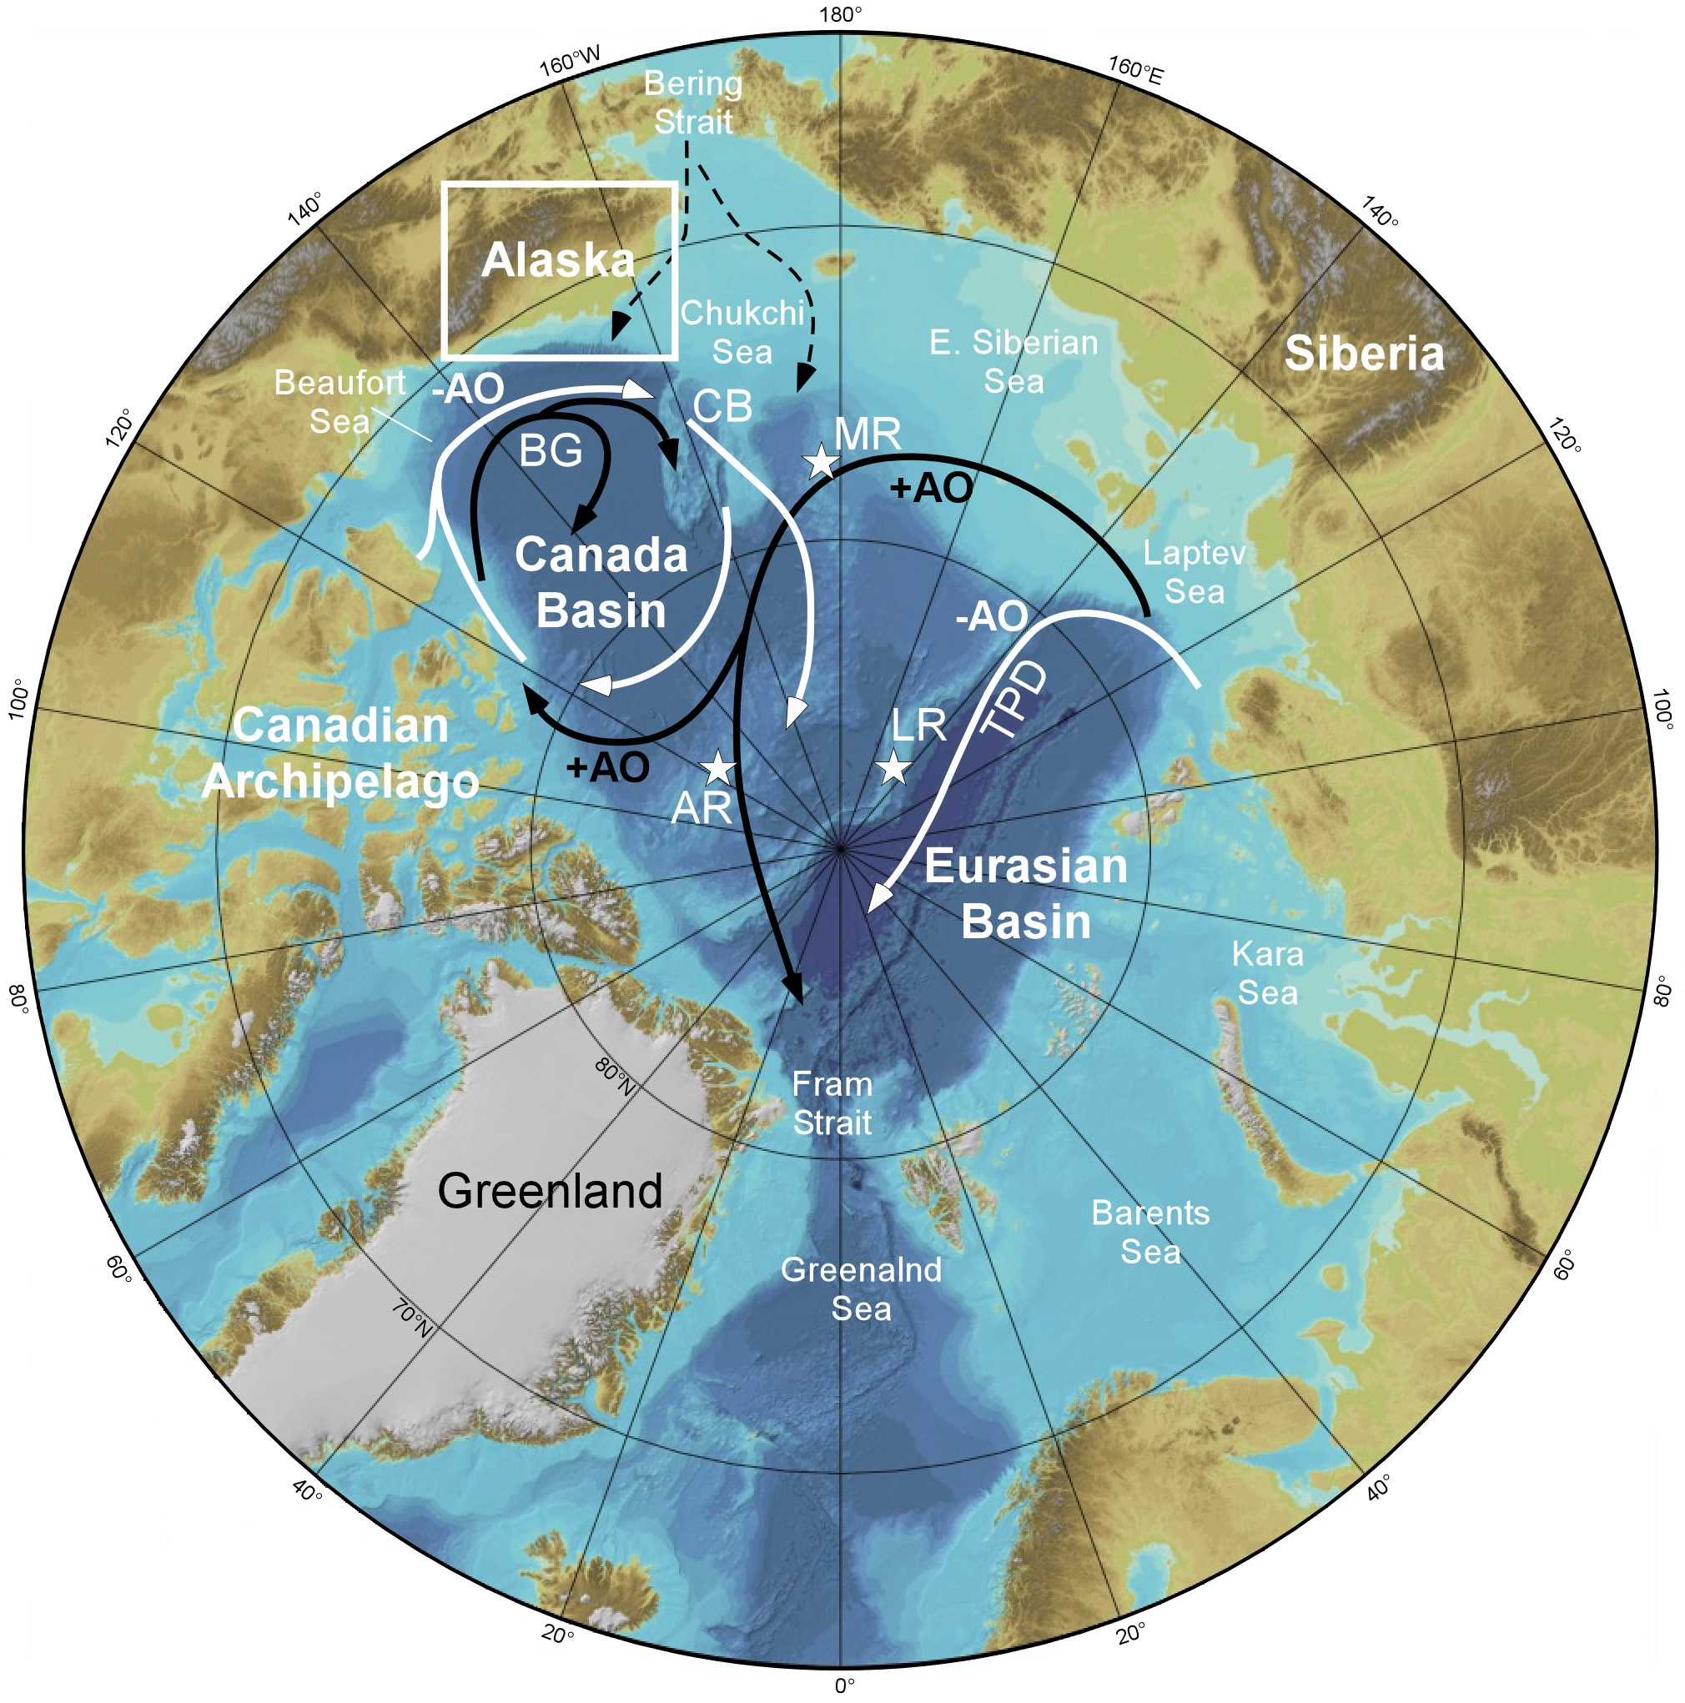
Western
Arctic
Eastern
Arctic
Notes:
Western and Eastern Basins are isolated
PAPER

Slide 5
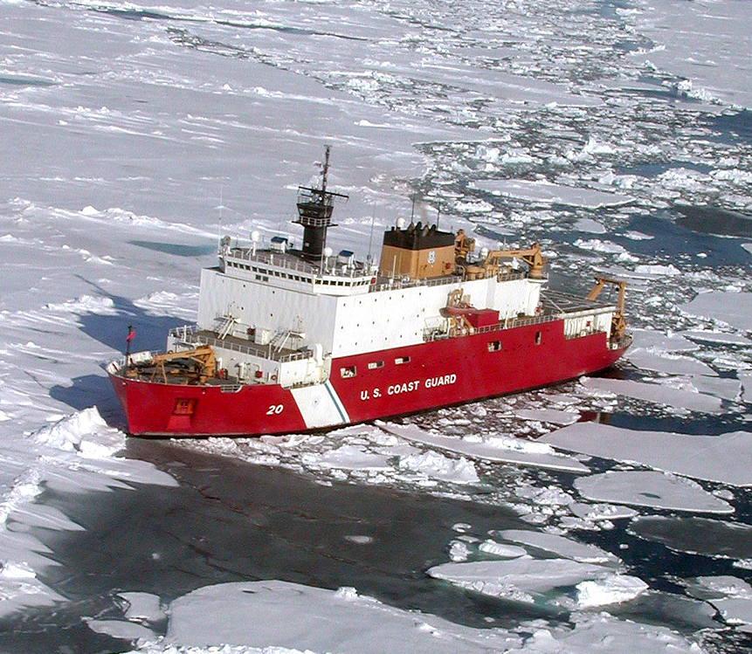
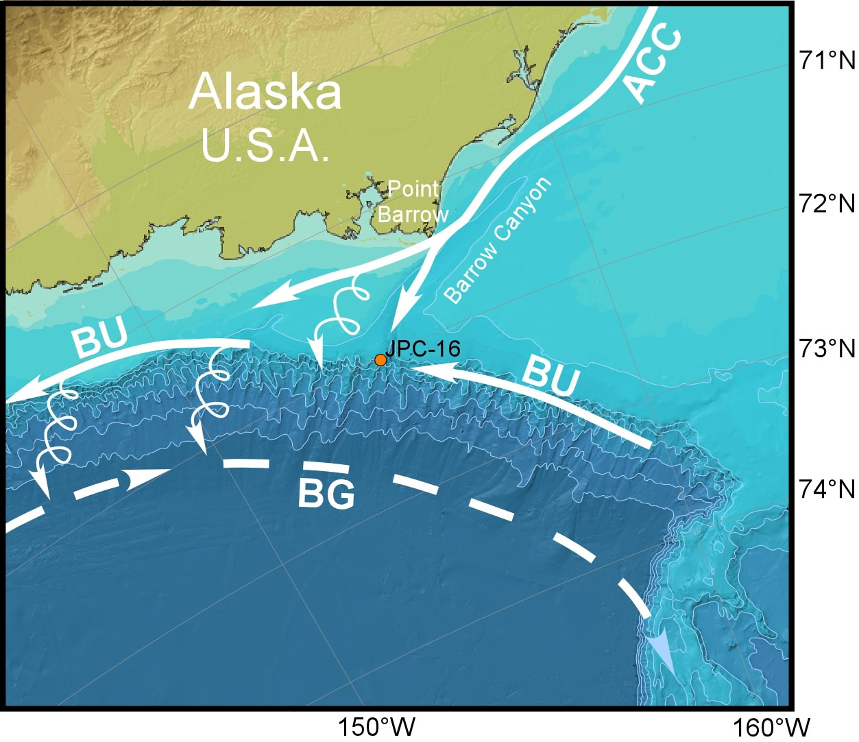
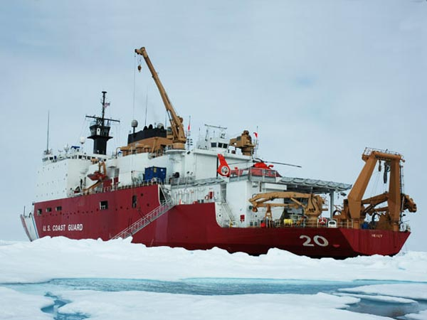
Marine Core
This study examines marine sedimentation processes on the Alaskan Continental shelf
Samples analyzed for grain-size distributions
Performed statistical analysis to determine mechanisms that contribute to the majority of the variation in the core section
The core site is influenced by:
Ocean Currents
Eddies that spinoff as water moves down the central-axis of Barrow Canyon
An Annual sea-ice cover
Storm events and reworking of sediments

Slide 6
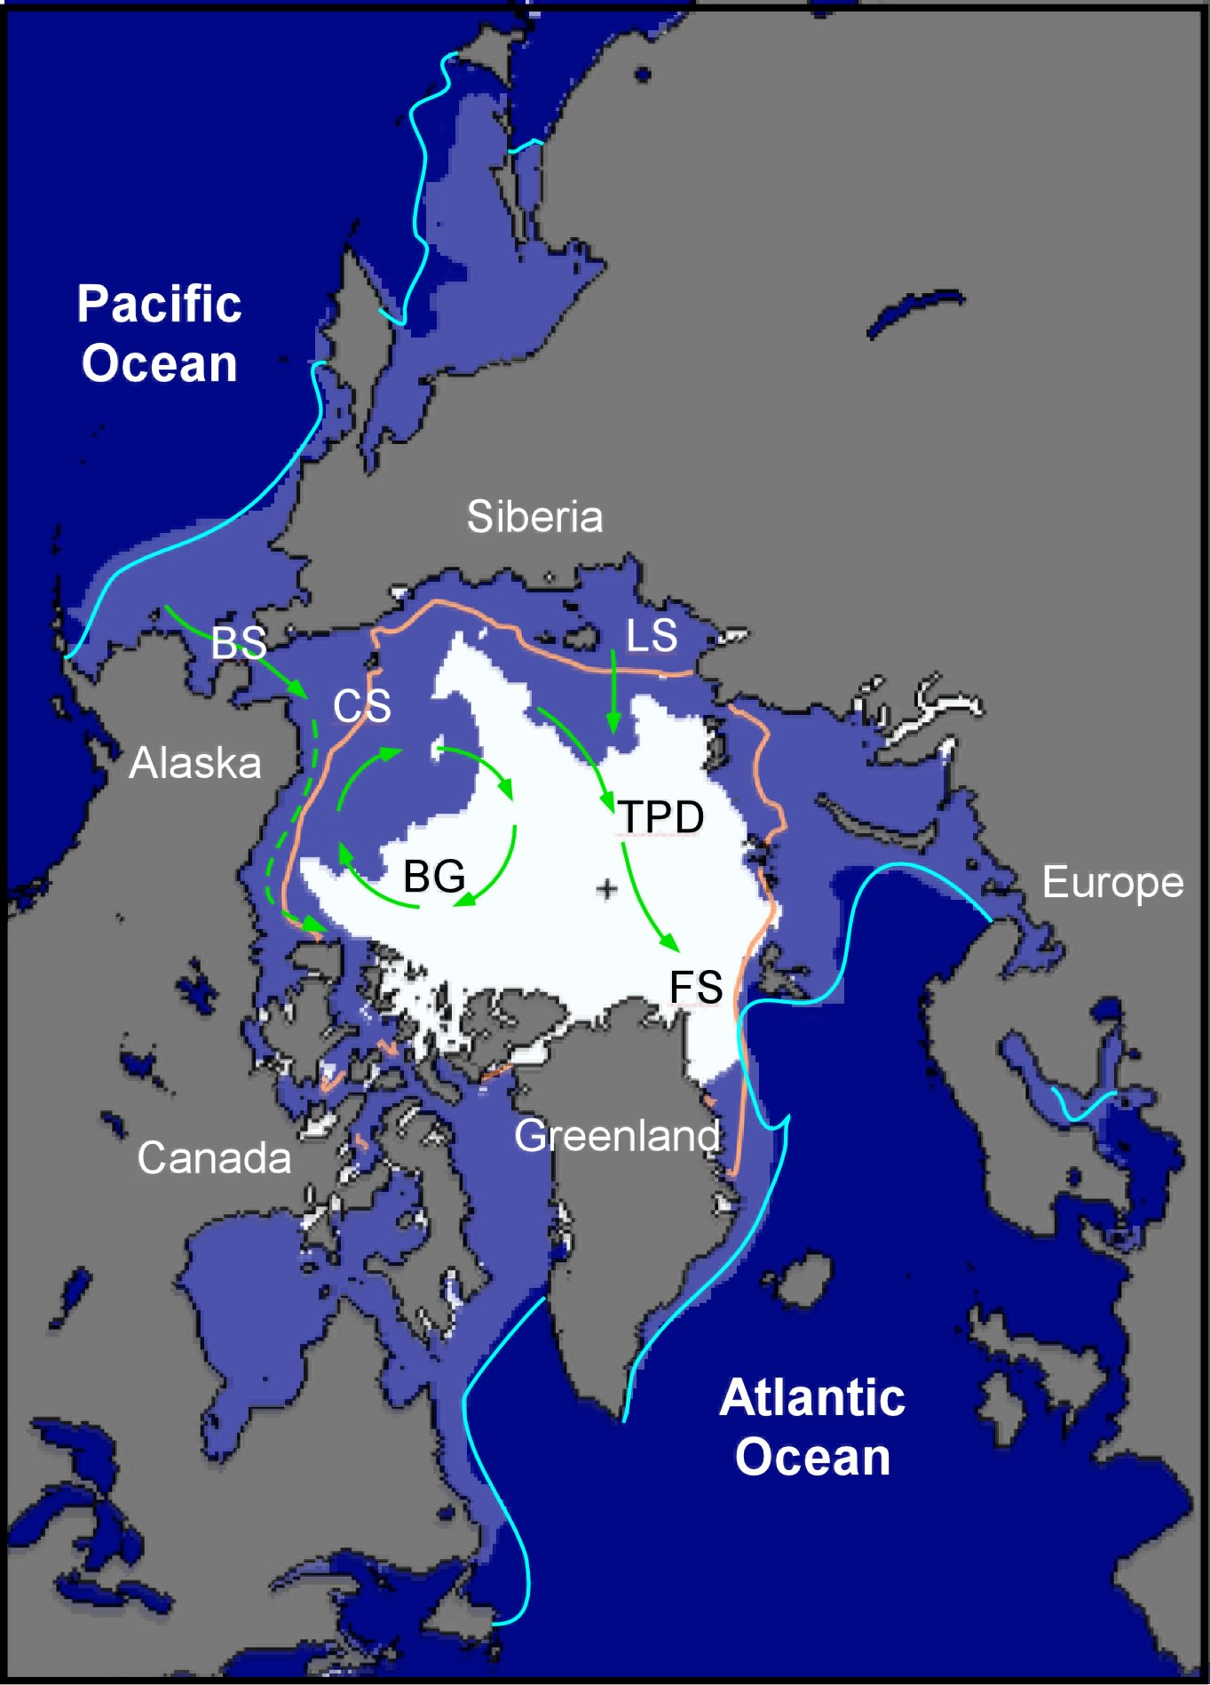
Sea-Ice
Sea-ice in the Arctic has been decreasing dramatically since the 1970’s
Fluctuations in sea-ice have occurred throughout geologic history
How is sea-ice connected to atmospheric variability?
Notes:
Arctic Sea ice has been disappearing at astonishing rates.
There is not a lot of detailed studies on how sea-ice has varied during the past especially in relation to atmospheric shifts beyond instrumental records.
We know that the sea-ice extent will decrease with increasing temperature but this has not been directly observed over geologic time

Slide 7
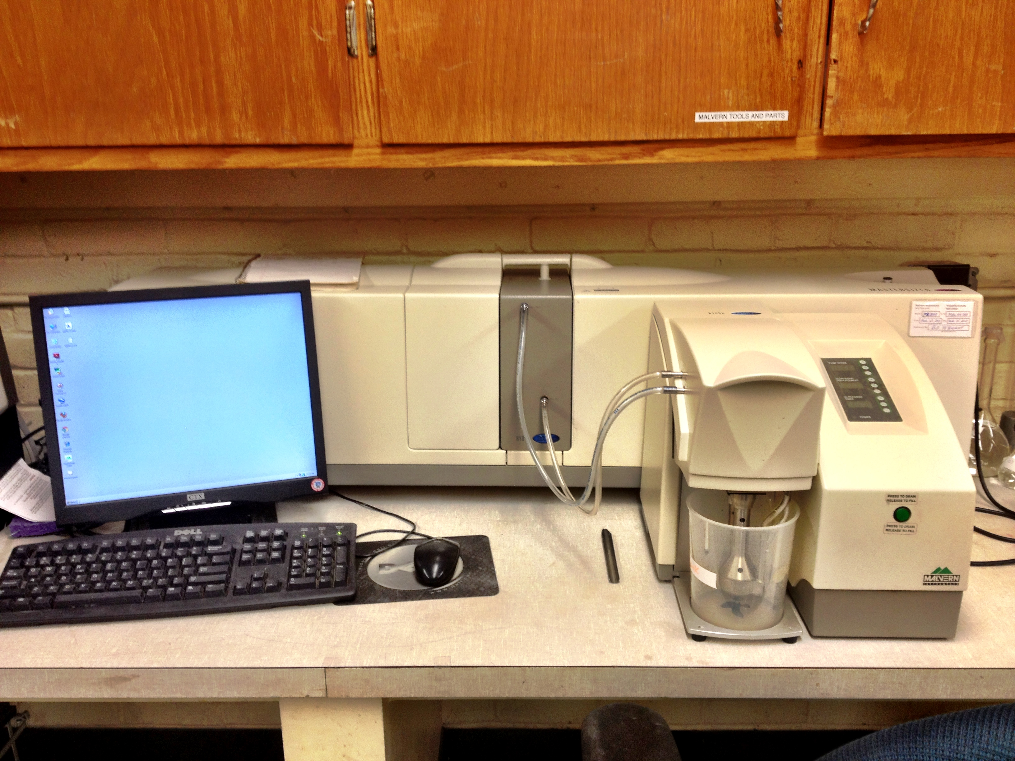
Malvern Analysis
Laser Diffraction Method
Analysis of diffracted light produced when a laser beam passes through dispersed particles
Particularly useful for measuring very fine grained particles
Particle size distributions are calculated by comparing a sample’s scattering pattern with an appropriate optical model

Slide 8
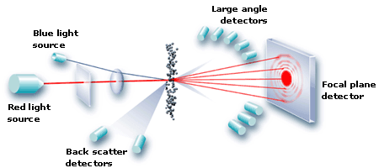
Mie Scattering Theory
Larger particles diffract light at greater angles and therefore, the light from these is detected by sensors closer to the window.
From Malvern
Counts from the sensors are tallied, averaged and reported as a grain-size distribution.
Notes:
If the particles are illuminated with a laser, the intensity of the scattered light fluctuates at a rate that is dependent upon the size of the particles.

Slide 9
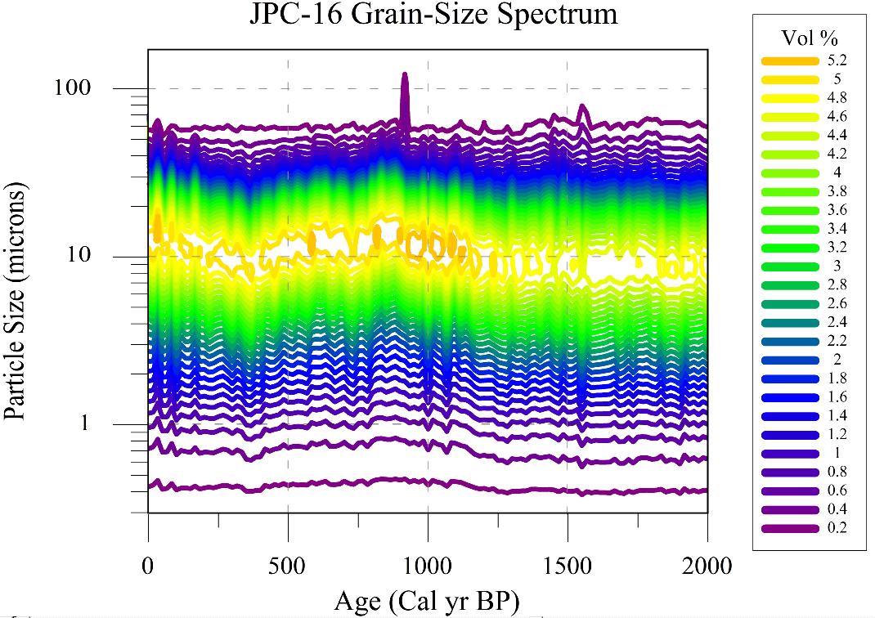
Malvern Results
Bin Number | particle size (um)
Bin024 | 0.30
Bin025 | 0.34
Bin026 | 0.38
Bin027 | 0.42
Bin028 | 0.48
Bin029 | 0.53
Bin030 | 0.60
Bin031 | 0.67
Bin032 | 0.75
Bin033 | 0.84
Bin034 | 0.95
Bin035 | 1.06
Bin036 | 1.19
Bin037 | 1.34
Bin038 | 1.50
Bin039 | 1.69
Bin040 | 1.89
Bin041 | 2.12
Bin042 | 2.38
Bin043 | 2.67
Bin044 | 3.00
Bin045 | 3.36
Bin046 | 3.77
Bin047 | 4.23
Bin048 | 4.75
Bin049 | 5.33
Bin050 | 5.98
Bin051 | 6.71
Bin052 | 7.53
Bin053 | 8.45
Bin054 | 9.48
Bin055 | 10.64
Bin056 | 11.93
Bin057 | 13.39
Bin058 | 15.02
Bin059 | 16.86
Bin060 | 18.91
Bin061 | 21.22
Bin062 | 23.81
Bin063 | 26.71
Bin064 | 29.97
Bin065 | 33.63
Bin066 | 37.74
Bin067 | 42.34
Bin068 | 47.51
Bin069 | 53.30
Bin070 | 59.81
Shows how overall mean grain-size varies through time
Notes:
These results are useful but additional information can be extracted

Slide 10
Principal Component Analysis (PCA)
Used to discover or reduce the dimensionality of a data set
For data of high dimensions, where graphical representation is difficult, PCA is a powerful tool for analyzing data and finding patterns within a dataset (grouping).
Identifies meaningful and underlying variations
Grain-size bins produced by the Malvern are placed in to different groups
Each component explains some underlying variance within the data
Notes:
Principal Component Analysis (PCA) provides the most significant and meaningful variables which can be attributed to the sources of variation with in a dataset
PAPER

Slide 11
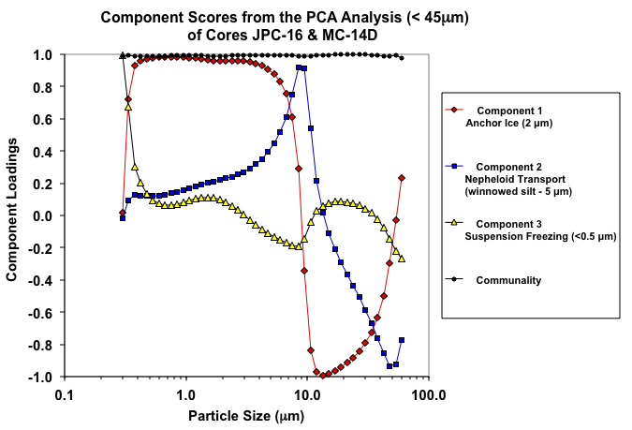
PCA Components
Suspension
Freezing
Anchor Ice
Winnowed
Silt
Notes:
The loadings from each PC were plotted against the grain-sizes or bin
From here we can begin to determine the processes involved in depositing the specific particles

Slide 12
JPC-16 Components
Marine Record
The three significant modes of sedimentation can be described as:
a) Component 1: Anchor Ice
b) Component 2: Nepheloid Flows or winnowed silt
c) Component 3: Suspension Freezing

Slide 13
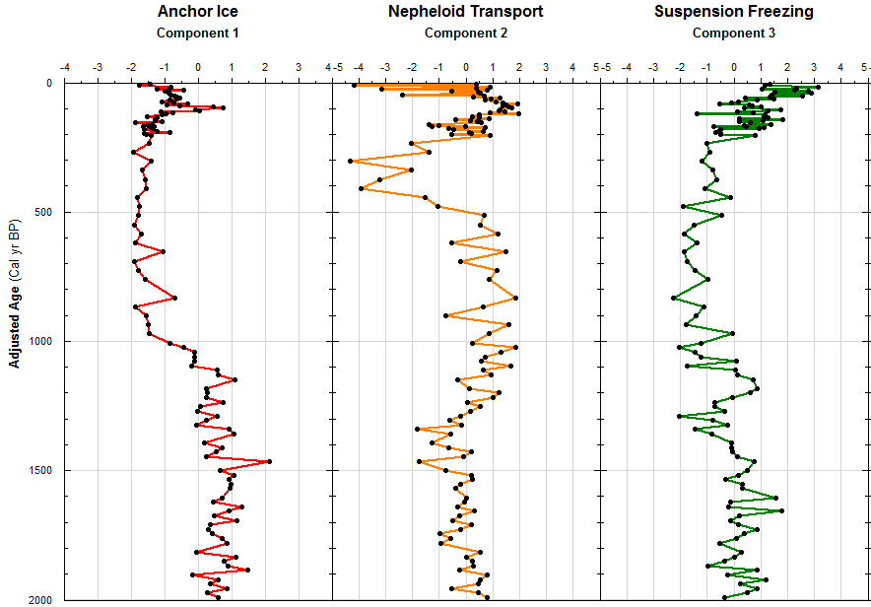
Components through Time
0.62 Correlation b/w PC-1 & PC-3
PC-2 likely represent more of a marine influence
Notes:
We will now mostly focus on the sedimentation that has been related to sea-ice

Slide 14
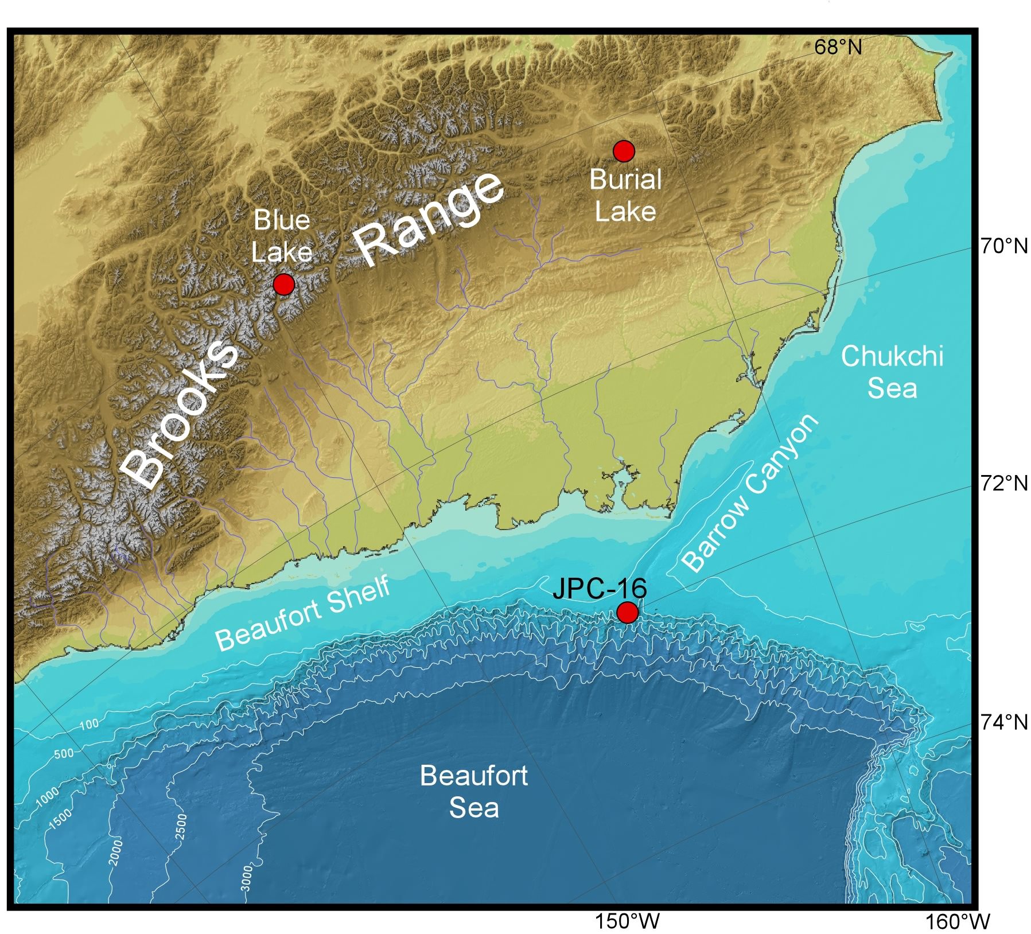
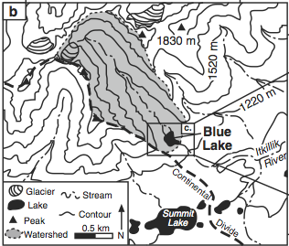
Blue Lake
Within the crest of the Brooks Range
Retrieved cores show millimeter scale laminations
Glacially fed
Bird, B. W., M. B. Abbott, B. P. Finney, and B. Kutchko (2009). A 2000 year varve-based climate record from the central Brooks Range, Alaska. Journal of Paleolimnology, 41: 25-41.
From Bird et al., 2009
Notes:
north of the 50-degree latitude tree line.

Slide 15
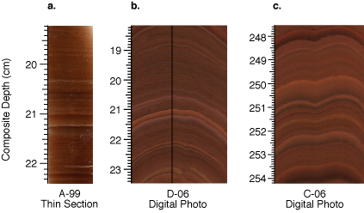
Varve Formation
An annually resolved record
Indicate variations in summer melt characteristics
Varve couplet reflects seasonal sedimentation
Light (reddish), coarser material results from sedimentation during periods of meltwater discharge
From Bird et al., 2009
Dark, finer layers form when fine-organic particles settle out due to stagnant conditions (ice covered)
Notes:
Because of the pronounced seasonality in the type of material deposited, varve sequences provide direct calendar dating with extremely high resolution

Slide 16
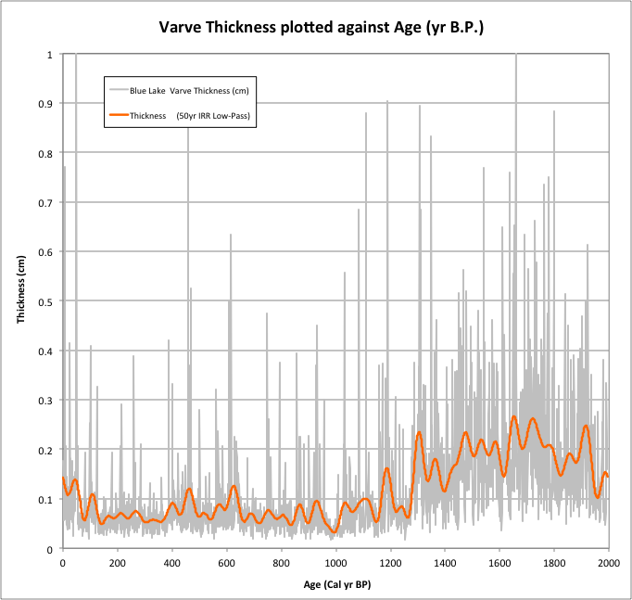
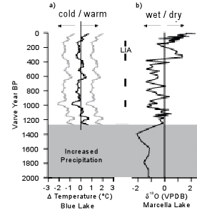
Blue Lake Temperature
The thicker varves are related to warmer temperatures and an increase in precipitation
From Bird et al., 2009

Slide 17
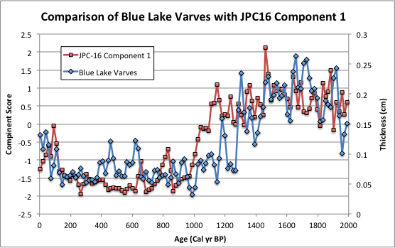
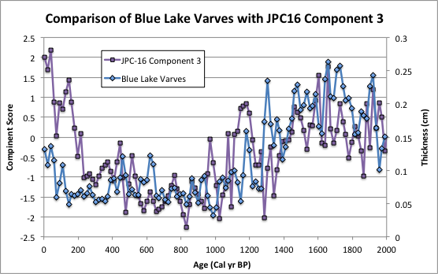
Record Correlation
Zero lag Correlation = 0.74 (p<0.01) Max Lag = 0.75 (-1)
Zero lag Correlation = 0.41 (p<0.05) Max Lag = 0.53 (1)
Notes:
It should be noted that this is a direct comparison and there was no age adjustment or wiggle matching

Slide 18
Arctic Oscillation (AO)
The AO is the dominant mode in atmosphere circulation and sea ice drift variability (Decadal)
Positive and Negative phases affect drift in the Arctic
Positive Phase: low pressure system dominates the Arctic and causes storms to move northward
Negative Phase: High pressure system that causes cold out burst to the temperate regions
Notes:
PAPER

Slide 19
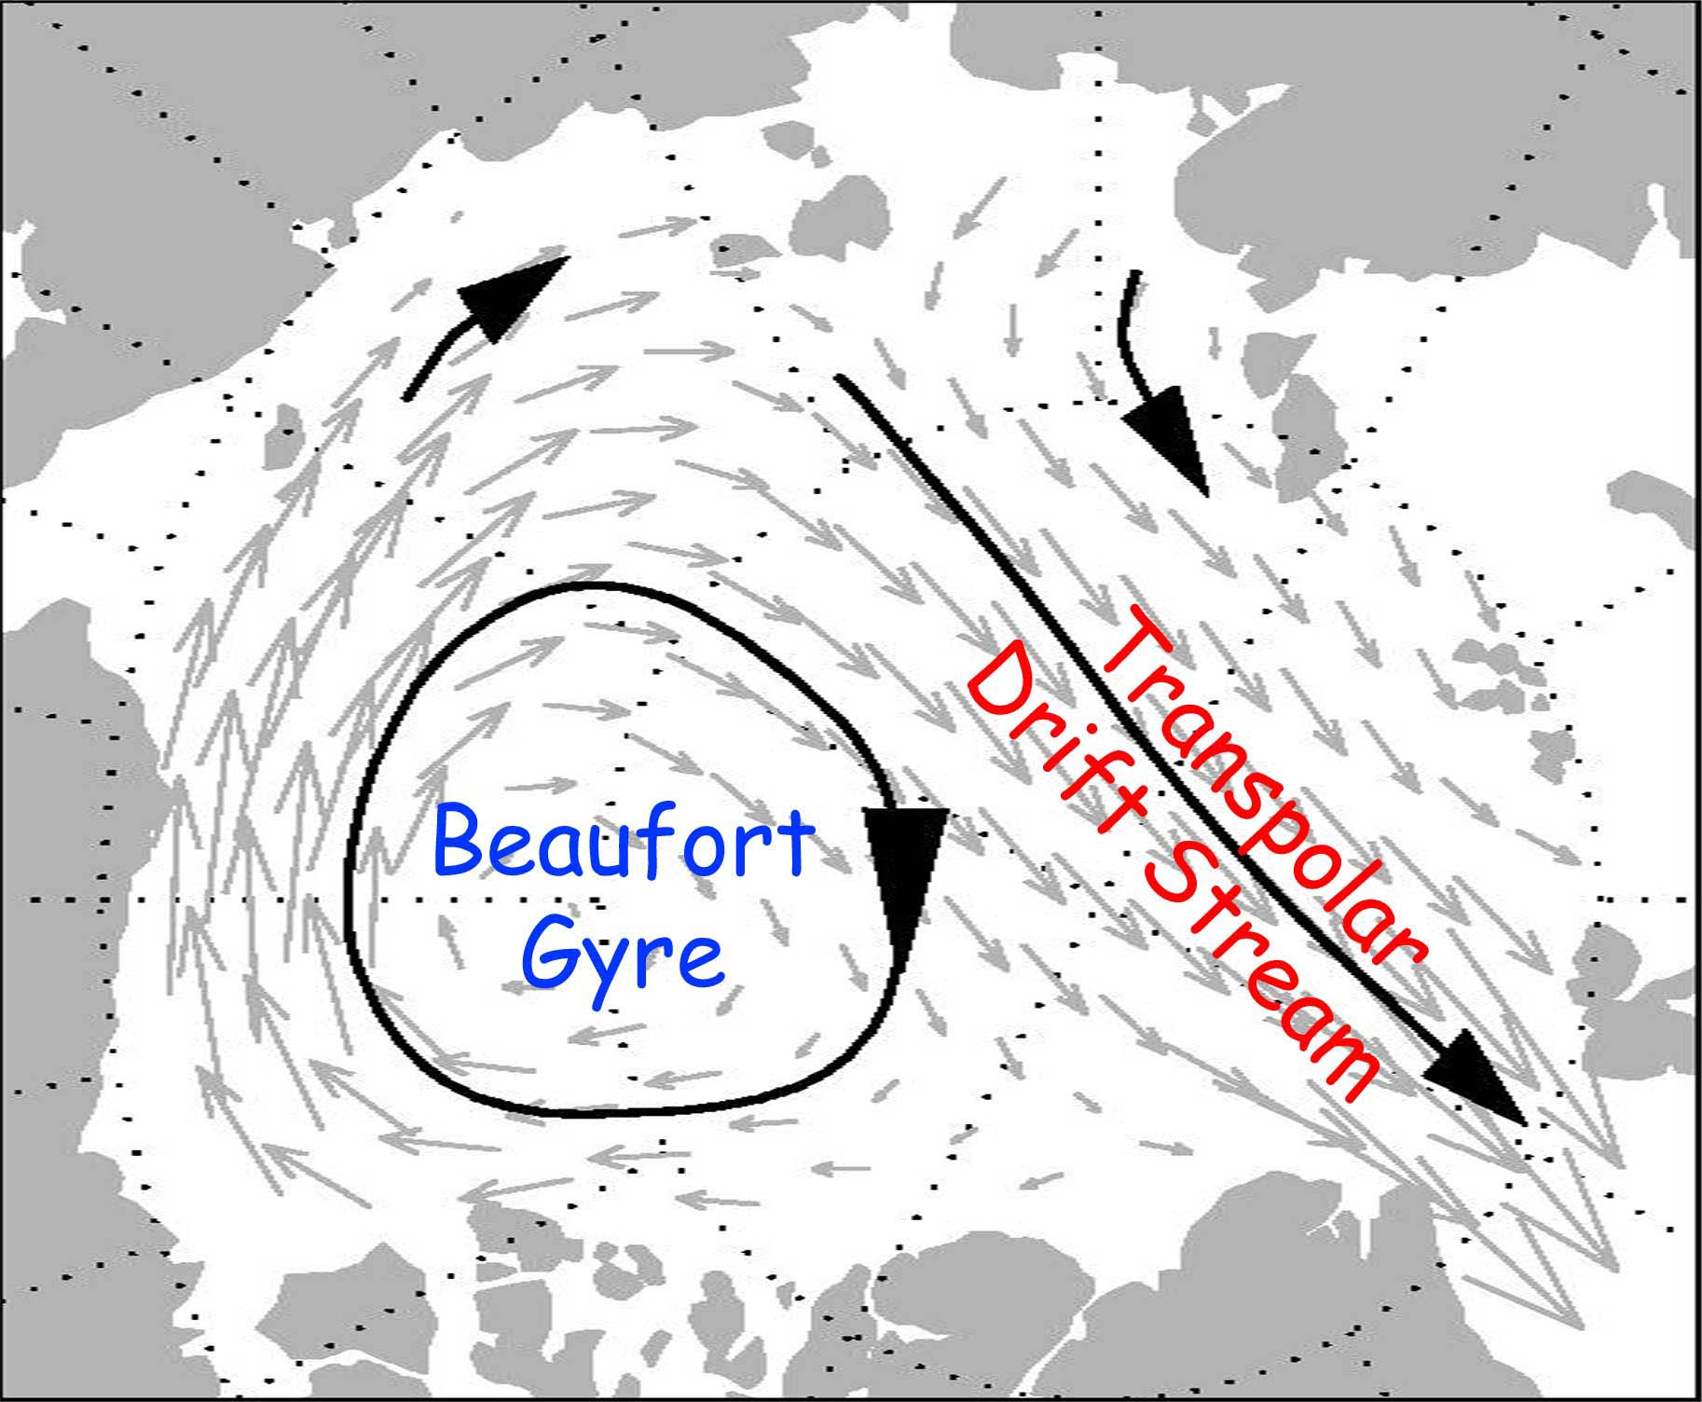
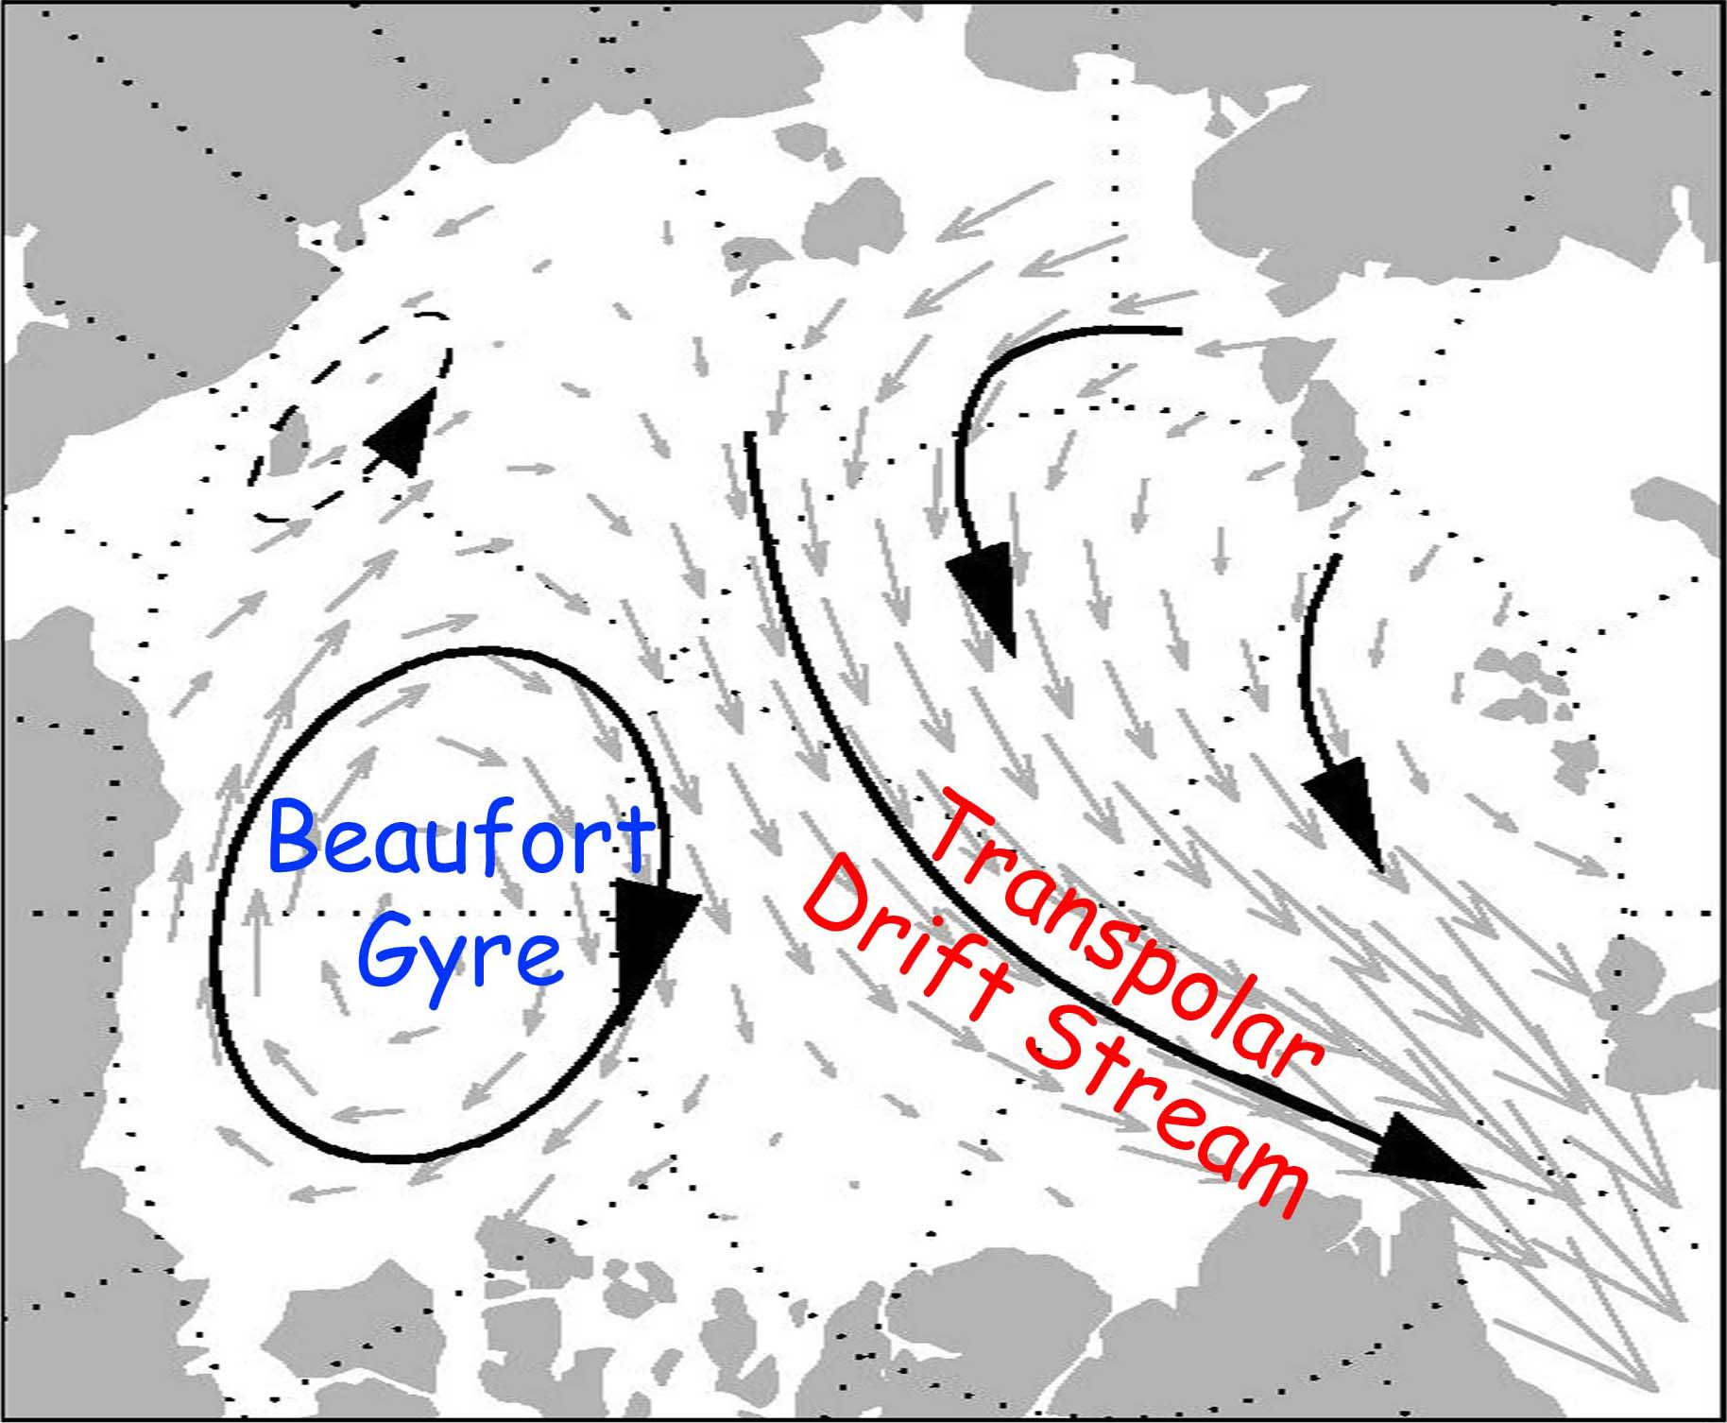
AO Two Dominant Regimes
Negative AO
Positive AO
ICE
Transport Towards
Alaska
Colder winter temperatures
Strong Beaufort Gyre
Warmer winter temperatures
Transpolar Drift Stream sweeps ice out of Arctic Ocean

Slide 20
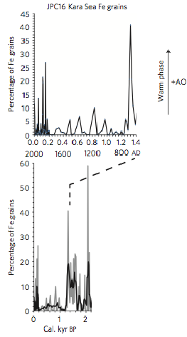
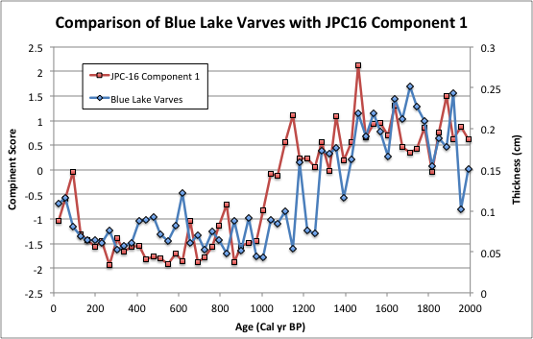
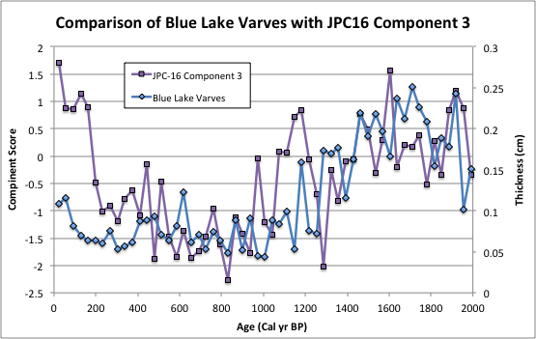
From Darby et al., 2012

Slide 21
Conclusions
Release of sediment from sea-ice imparts a unique textural signature on the marine deposits
Western Arctic sea-ice transport/sedimentation is significantly correlated to Northern Alaskan atmospheric climate (temp. proxy)
It is likely that shifts in pressure systems in the Arctic affect both sea-ice and terrestrial climate
Changes in the phase of the AO would explain:
The influx of sea-ice-related sediment towards the Alaskan shelf (JPC-16)
The increase in varve thickness found in Blue Lake prior to 1,200 yr BP

Slide 22
Thank You !!!

Slide 23
Questions

Slide 24
References
Bird, B. W., M. B. Abbott, B. P. Finney, and B. Kutchko (2009). A 2000 year varve-based climate record from the central Brooks Range, Alaska. Journal of Paleolimnology, 41: 25-41.
Darby, D. A., J. D. Ortiz, C. E. Grosch, and S. P. Lund (2012). 1,500-year cycle in the Arctic Oscillation identified in Holocene Arctic sea-ice drift. Nature Geoscience, 5: 897-900.
Darby, D. A., J. D. Ortiz, L. Polyak, S. P. Lund, M. Jakobsson, and R. A. Woodgate (2009). The role of currents and sea ice in both slowly deposited central Arctic and rapidly deposited Chukchi-Alaskan margin sediments. Global and Planetary Change, 68: 58-72.
Jakobsson, M., L. A. Mayer, B. Coakley, J. A. Dowdeswell, S. Forbes, B. Fridman, H. Hodnesdal, R. Noormets, R. Pedersen, M. Rebesco, H. W. Schenke, Y. Zarayskaya A, D. Accettella, A. Armstrong, R. M. Anderson, P. Bienhoff, A. Camerlenghi, I. Church, M. Edwards, J. V. Gardner, J. K. Hall, B. Hell, O. B. Hestvik, Y. Kristoffersen, C. Marcussen, R. Mohammad, D. Mosher, S. V. Nghiem, M. T. Pedrosa, P. G. Travaglini, and P. Weatherall (2012). The International Bathymetric Chart of the Arctic Ocean (IBCAO) Version 3.0. Geophysical Research Letters, 39: L12609.
Malvern-Instruments (1997). Manual: Mastersizer S & X, Getting Started, Issue 1.3. Malvern Instruments Ltd., Malvern, UK, pp. 98.

Slide 25
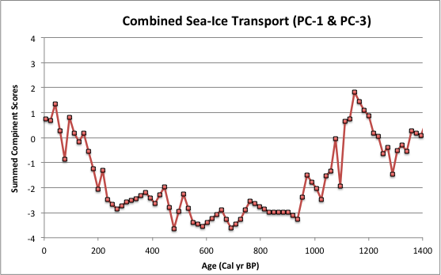
Combined Sea-Ice Components
From Darby et al., 2012

Slide 26
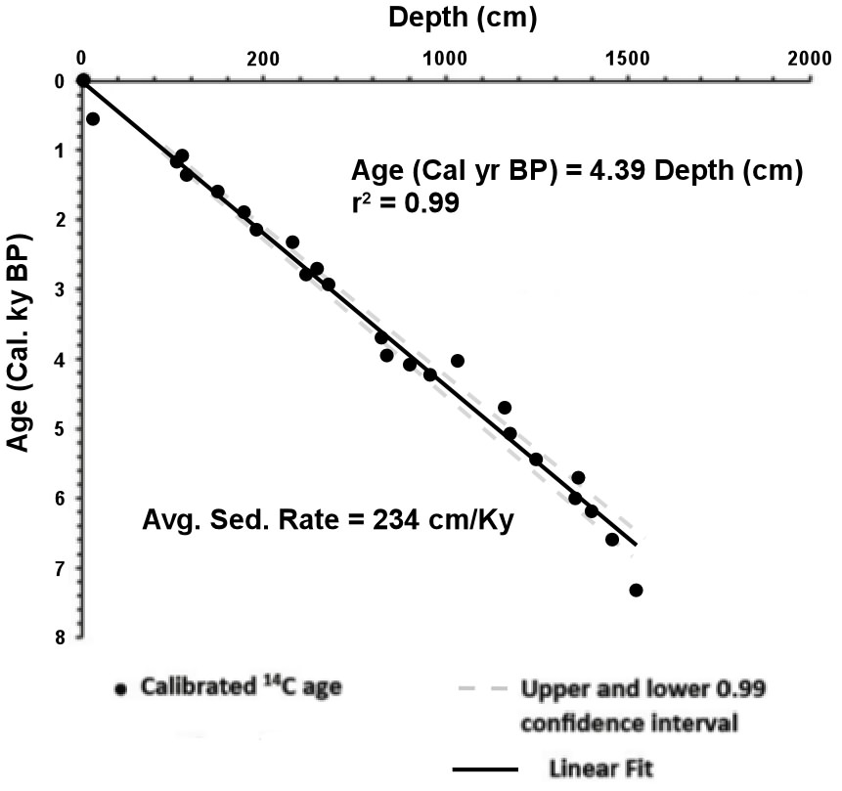
Age-Depth Model

Slide 27
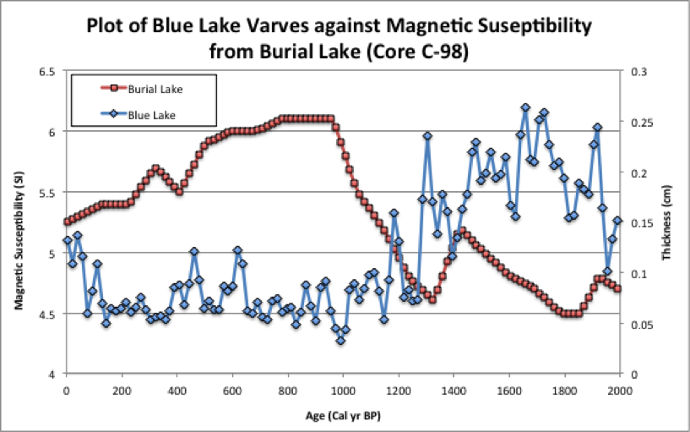
Blue Lake Vs Burial Lake

