Slide 1


PAIRED PROJECT-BASED FIELD TRIPS TO THE STARVED ROCK AREA, MATTHIESSEN AND BUFFALO ROCK STATE PARKS, AND THE ILLINOIS AND MICHIGAN CANAL STATE TRAIL - ILLINOIS
HUYSKEN, Kristin T., ARGYILAN, Erin P., and VOTAW, Robert, Department of Geosciences, Indiana University Northwest, 3400 Broadway, Gary, IN 46408-1197, khuysken@iun.edu

Slide 2
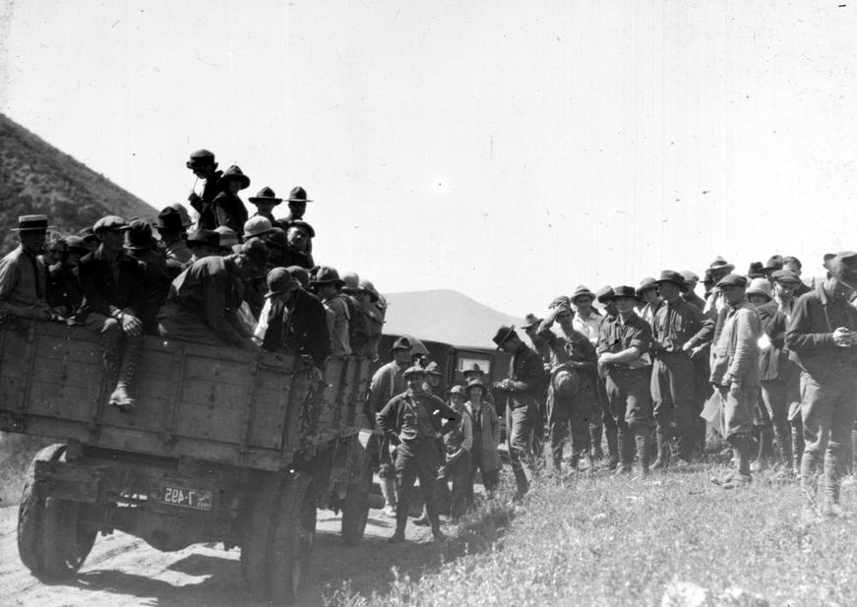
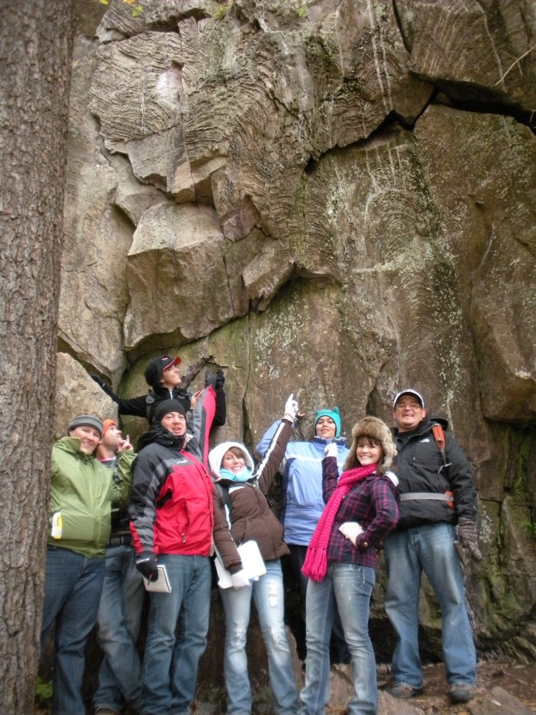
Field trips have long been important in undergraduate education
  We have used the outstanding field trip guides published by the Illinois State Geological Survey to enhance the undergraduate curriculum at Indiana University Northwest
  Describe a pair of field-based projects that make use of State Parks and Natural Areas in the Starved Rock area near LaSalle, IL
  Goal of constructing level-appropriate experience in approaching real field problems and themes
  Have been used for all levels of geology students, and pre- and in-service teachers
    Scaffold approach , revisiting or adding to previous projects to support student learning at a variety of levels
  Suggest that incorporating field-based exercises into field trips can enhance the enrich student learning
Alpine School [of Brigham Young University] in summer on a botany and geology field trip, [Provo], Utah, 1923 - digital collection: American Environmental Photographs, Library of Congress
Petrology students of Indiana University Northwest on a geology field trip to the Marquette, MI area, 2010.

Slide 3
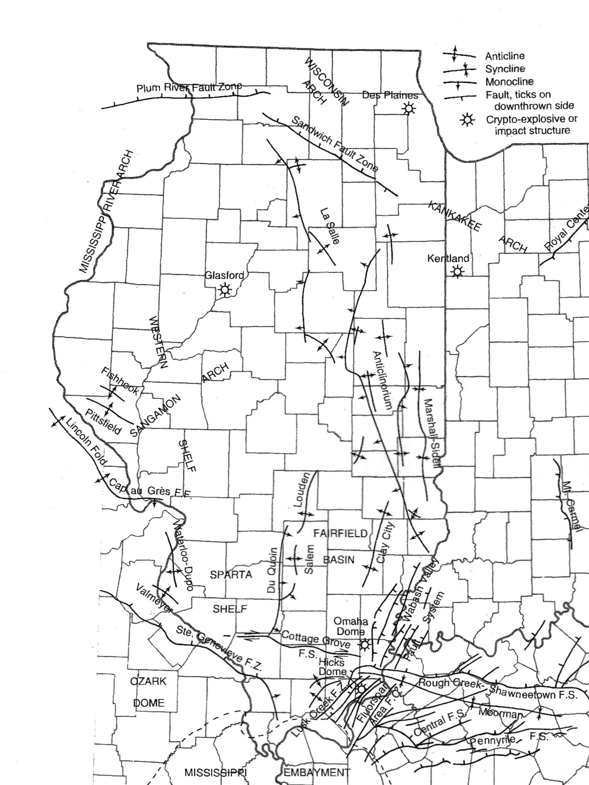
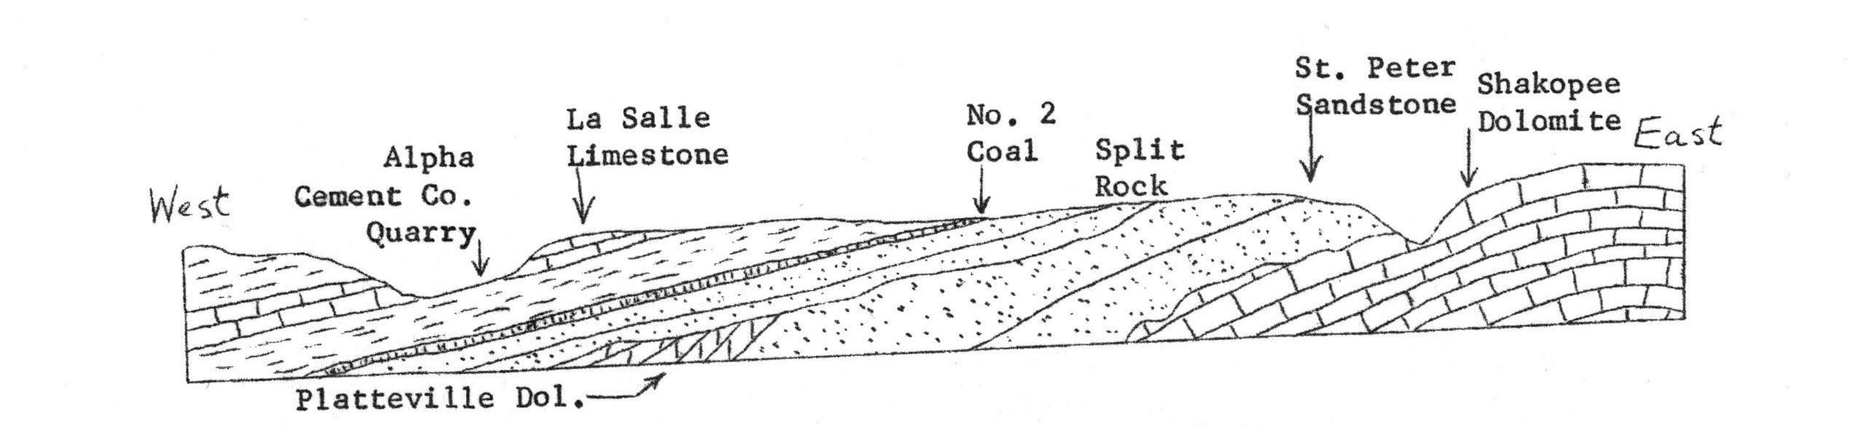
Bedrock Features in the Starved Rock Area
LaSalle Anticline – broad anticlinorium – largest structural feature in Illinois
Northernmost segment (also known as the Peru Monocline) is exposed in the LaSalle area
Asymmetric fold with the west limb dipping more steeply than the east
Rock units that form the structure include Lower Ordovician Shakopee Dolomite, Middle Ordovician St. Peter Sandstone and Platteville Limestone.
Unconformity - Overlain by Pennsylvanian strata (sandstone, coal and mudstone).
Nelson, 1995, Structural Features in Illinois,
ISGS Bulletin 100
Illinois State Geological Survey Field Trip Guide 1962C

Slide 4
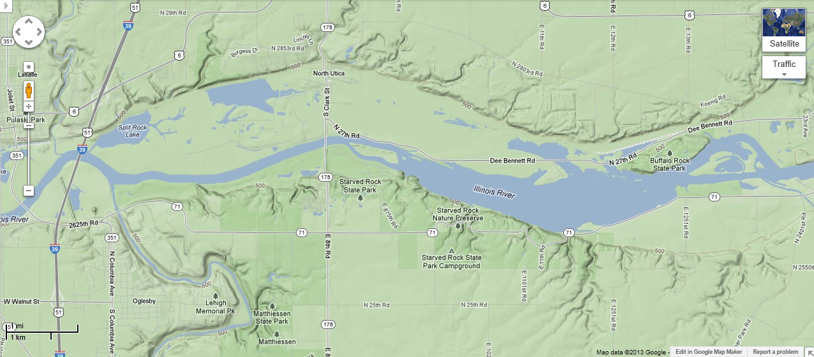
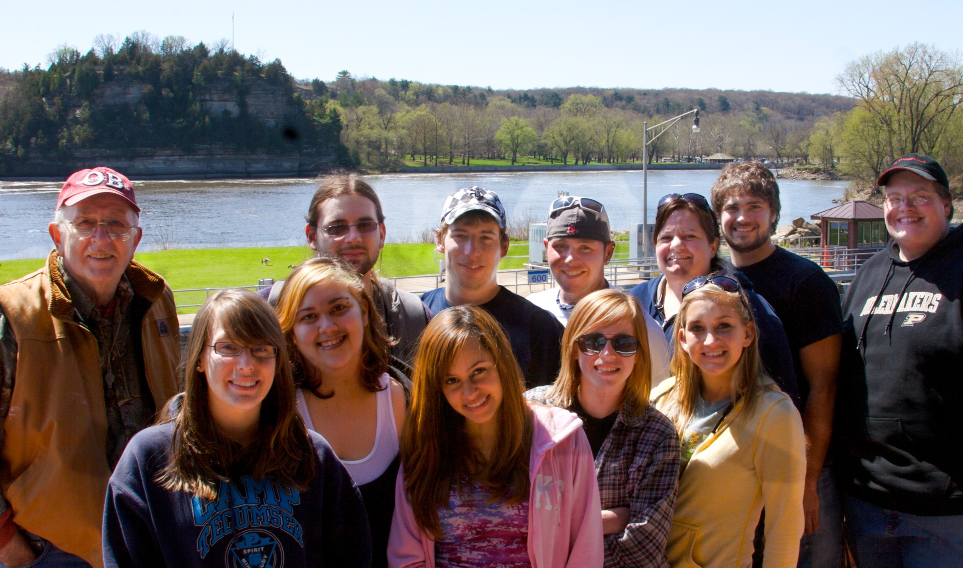
Project-based trip #1
Freshman- and Sophomore-level geology courses including Historical Geology
Learning Objectives
  Identify rocks in the field & place them in the stratigraphic sequence
  Recognize strike and dip
  Locating position on map
  Plot data on X-section
  Hypothesis development , data collection
  Interpret results
    Recognize geologic structures, unconformities
    Recognize the relationship of individual outcrops to regional relationships
Project-based trip #1

Slide 5
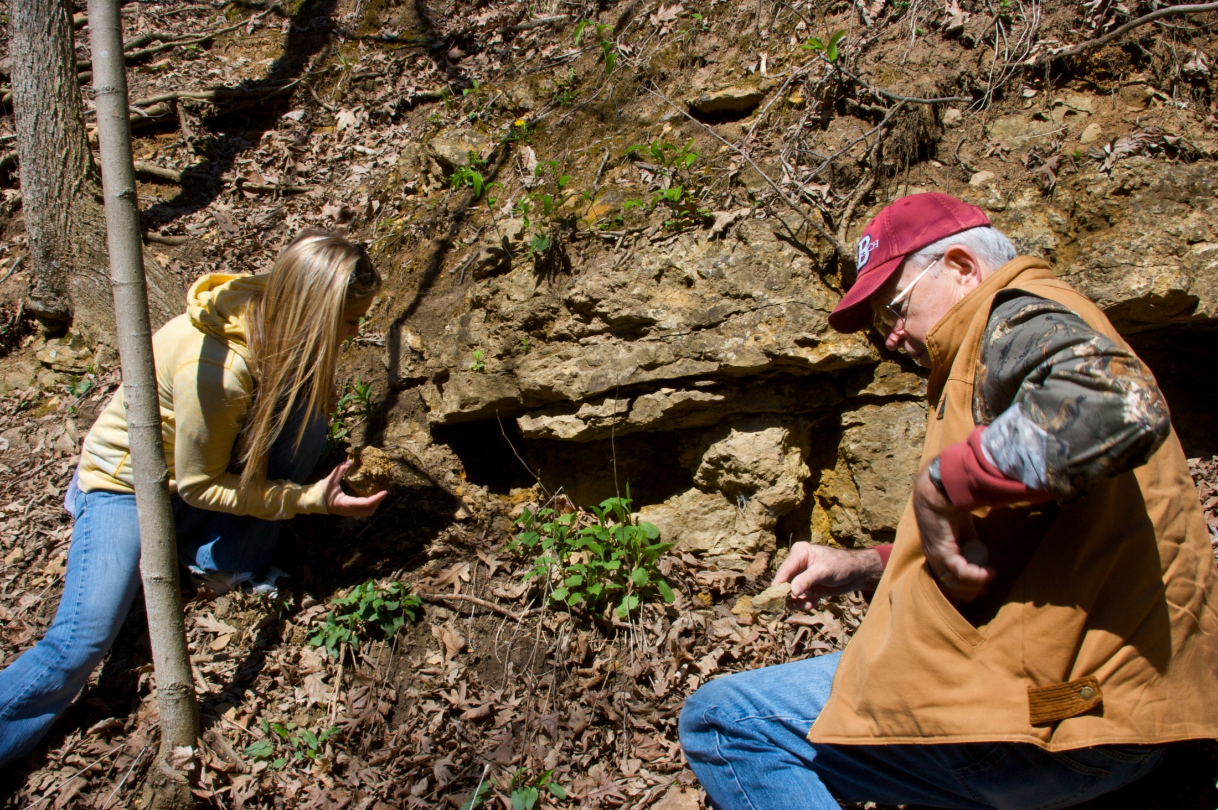
Students receive field packets that include the following…
Map – plot location of each stop

Slide 6
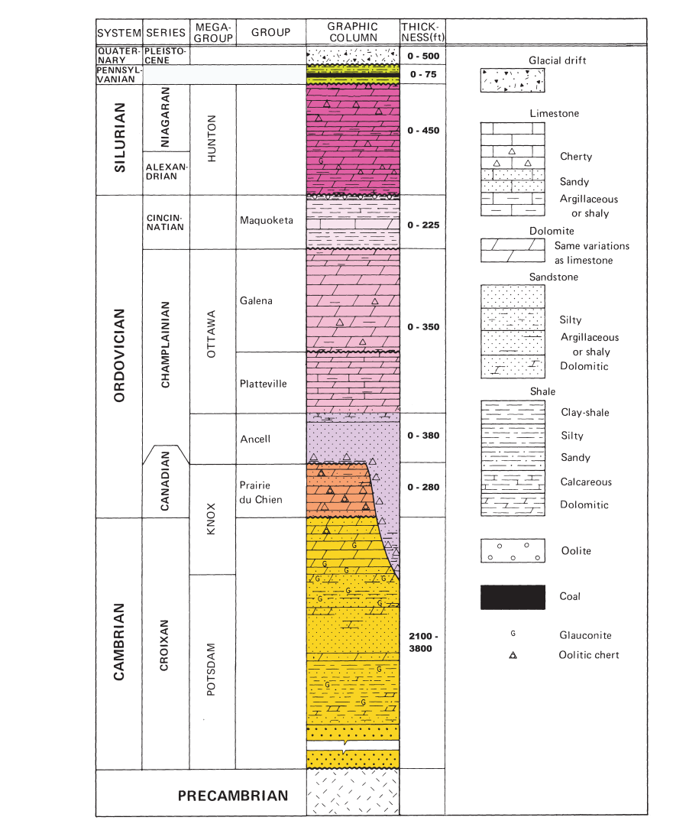
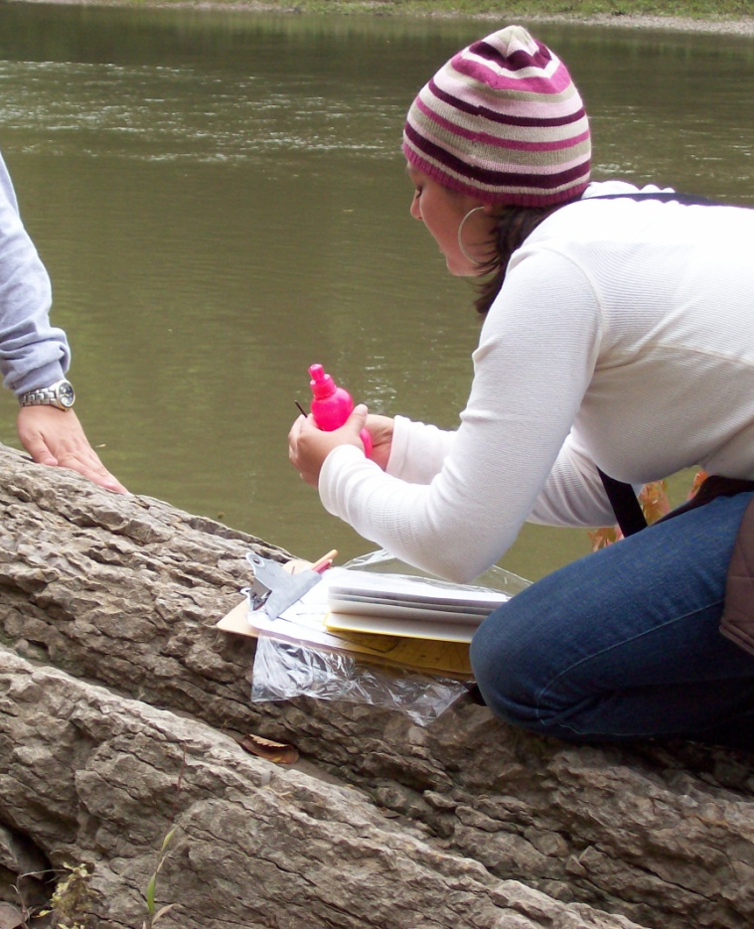
Students receive field packets that include the following…
Generalized Geologic Column
  Fit rock types into the regional stratigraphy
  At each stop, students are asked to keep track of elevation, and the attitude of the beds – make predictions as to what rock formations they expect to find at various locations.

Slide 7
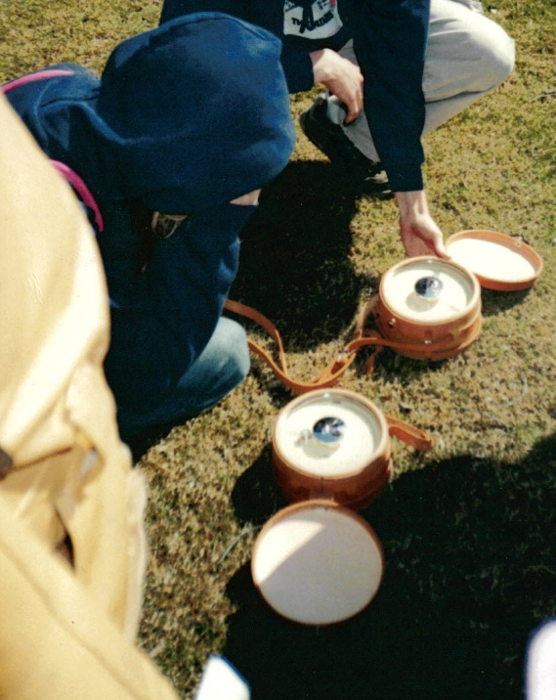
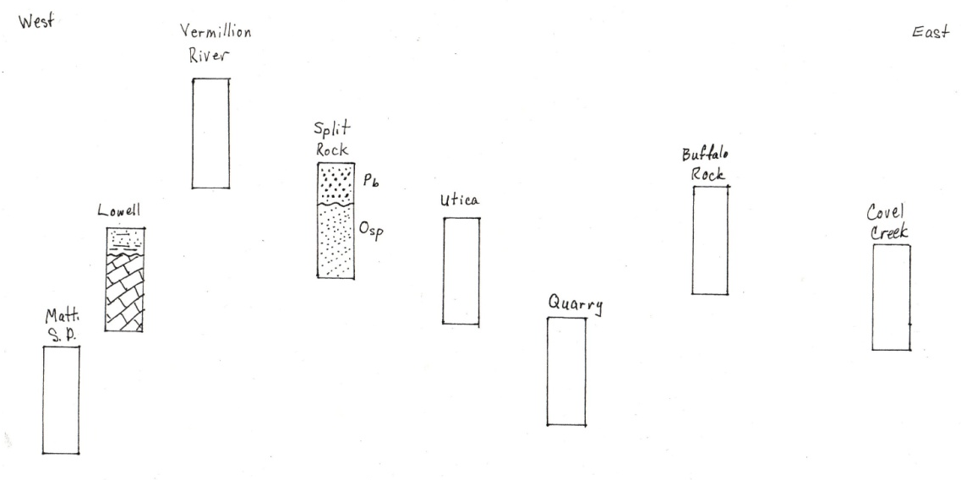
Students receive field packets that include the following…
Cross-section worksheet – at each location, students have a small project to complete
  Identify the rock(s) that make up the outcrop – identify contacts
  Using the Geologic Column, determine which formations to which the rocks belong, and record that information
  Record elevation at each stop – altimeter, GPS, topographic maps.
Not to scale

Slide 8
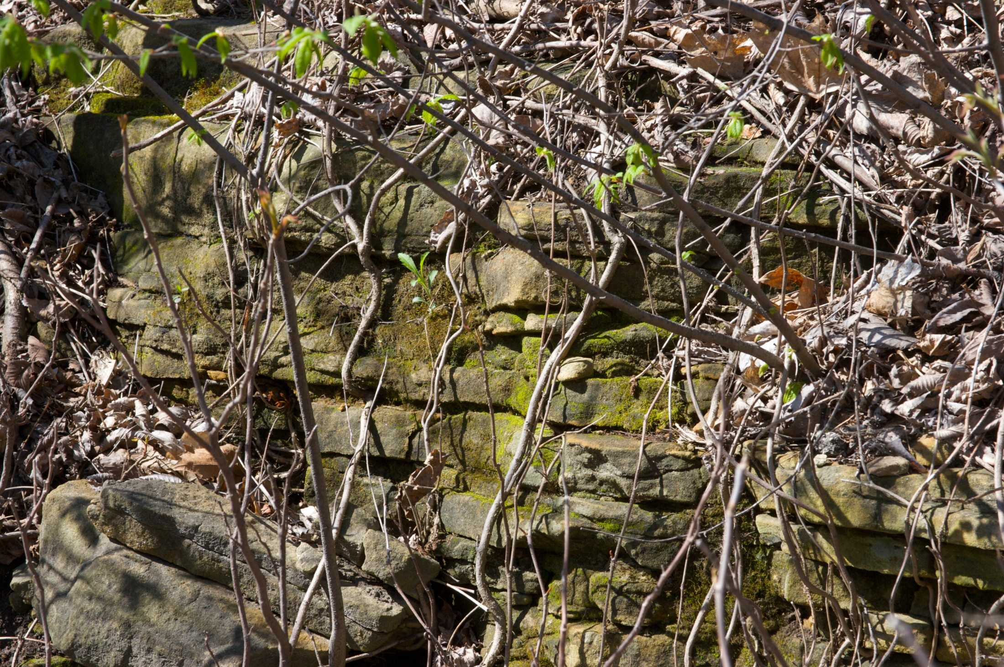
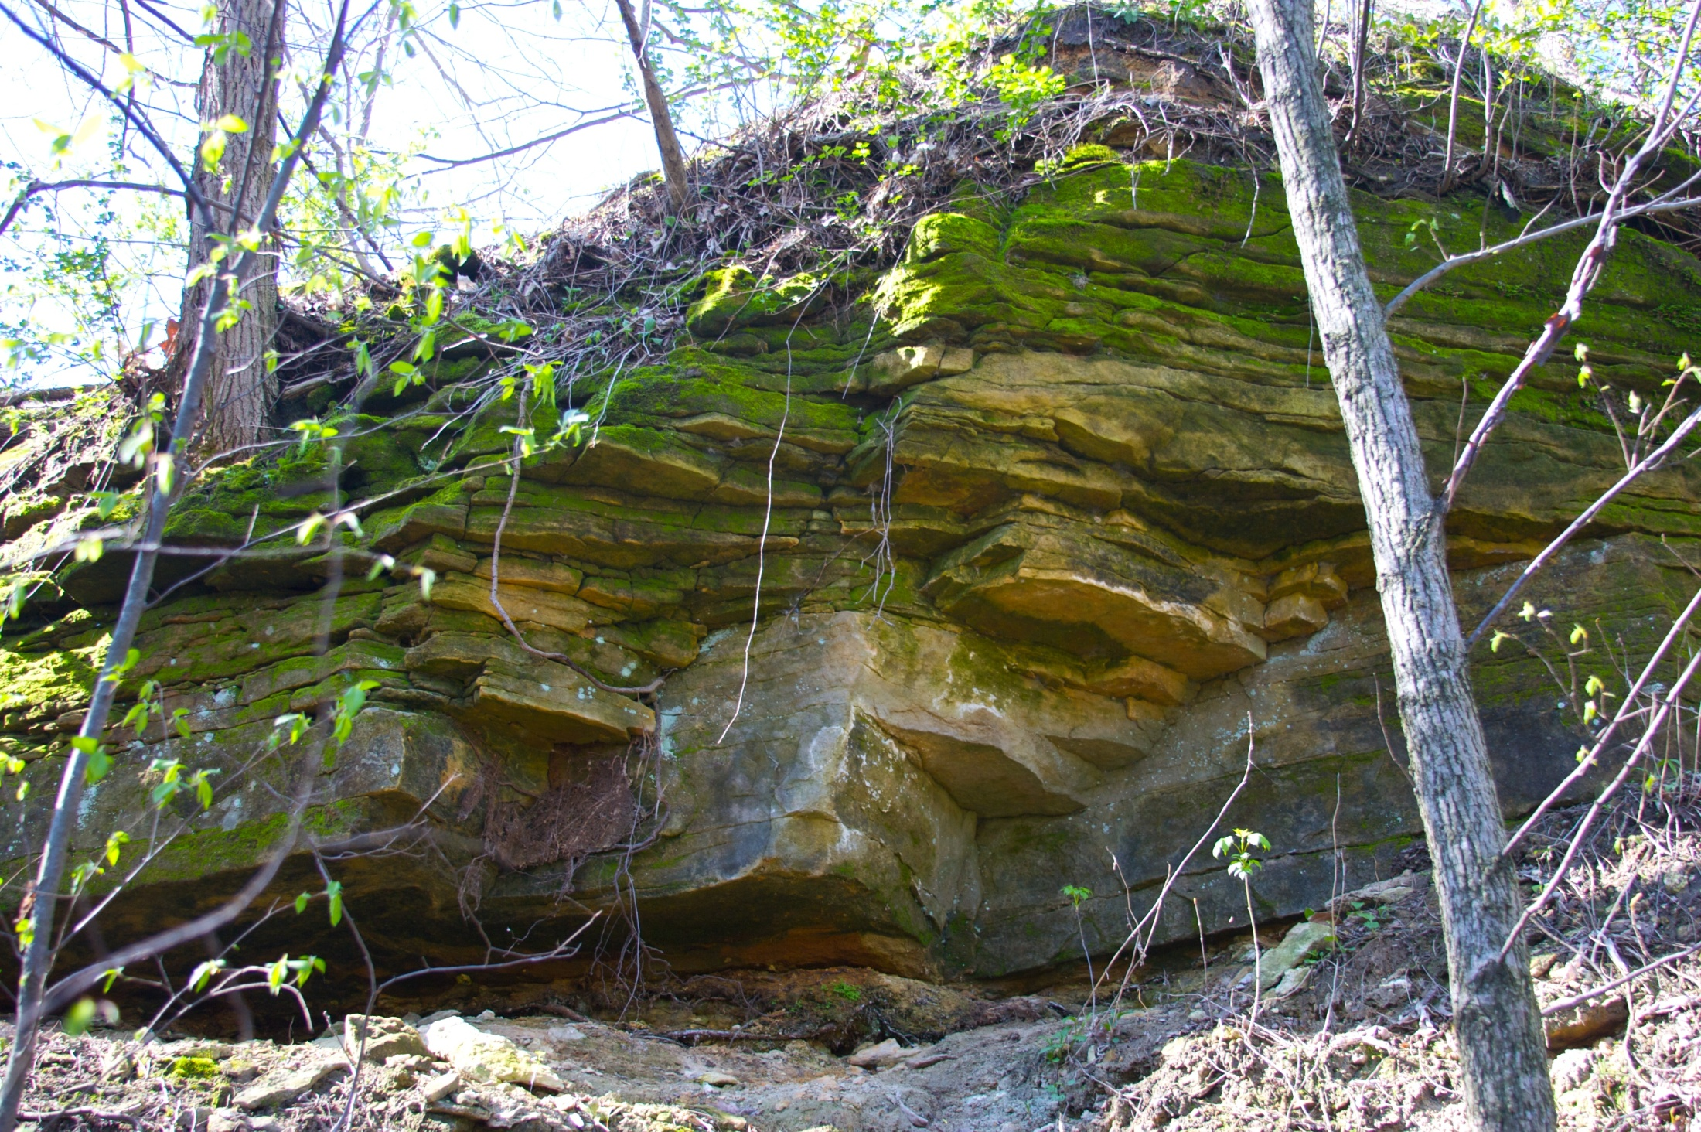
Utica
  Students are introduced to the rocks of the LaSalle area
Project-based trip #1
Sandstone (St. Peter Fm.)

Slide 9
Utica
  Students are introduced to the rocks of the LaSalle area
Project-based trip #1
St. Peter Sandstone
Sandstone (St. Peter Fm.)
Shakopee Dolostone

Slide 10
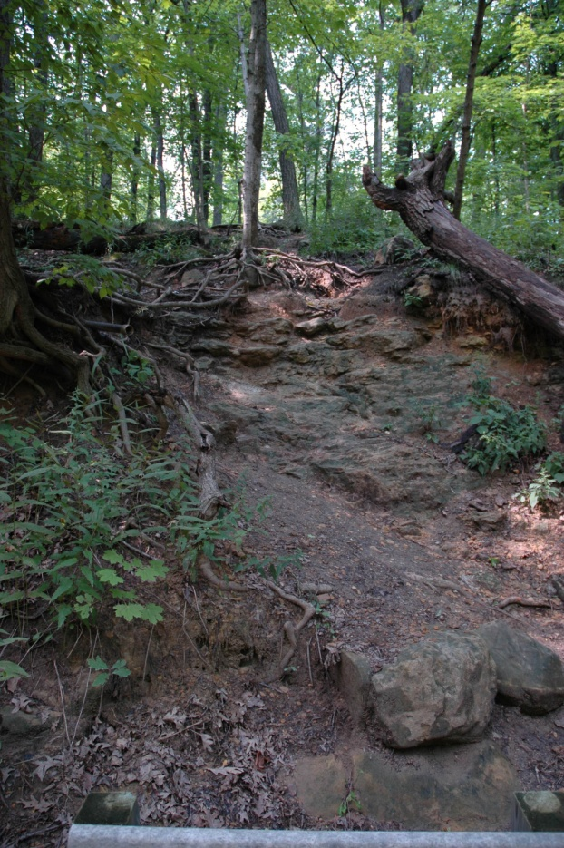
Project-based trip #1
Matthiessen State Park
  Further develop understanding of the stratigraphy
  Bridge crossing creek – Sandstone (St. Peter) overlain by Limestone (Platteville Group) – bedding orientation
  Introduction to the regional structure

Slide 11
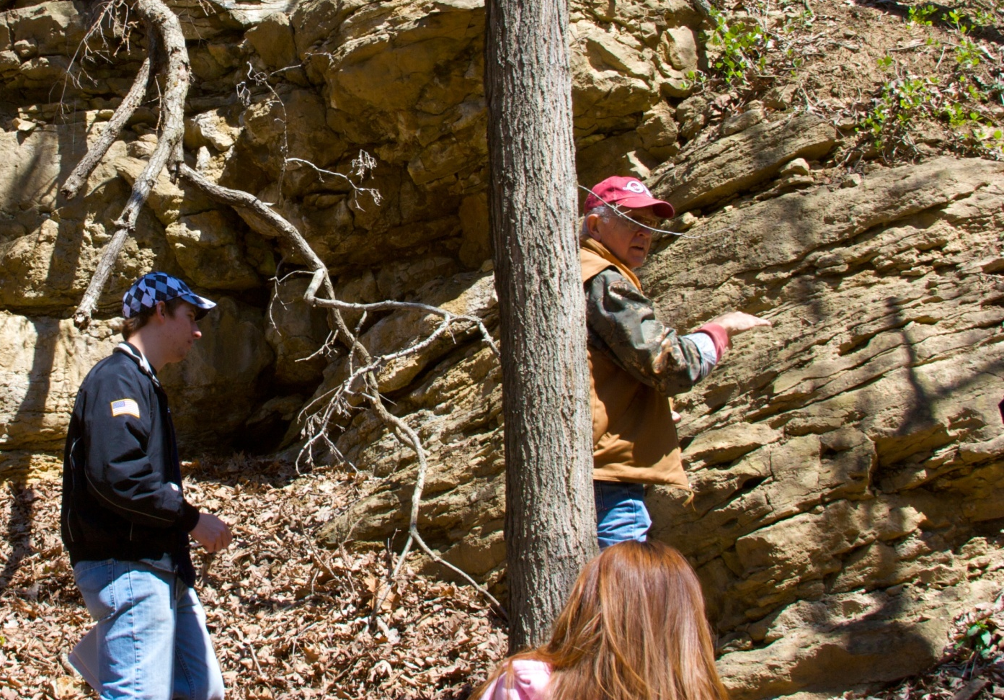
Project-based trip #1
Matthiessen State Park
  Head west – descend in elevation.
  Predict what rock type they might expect to encounter –provide rationale
  Limestone – poses a small puzzle
  Encourage observations, and comparisons to previous outcrop (e.g. tilted beds!)
  Possible causes? Construct argument.
  How might you test this?

Slide 12
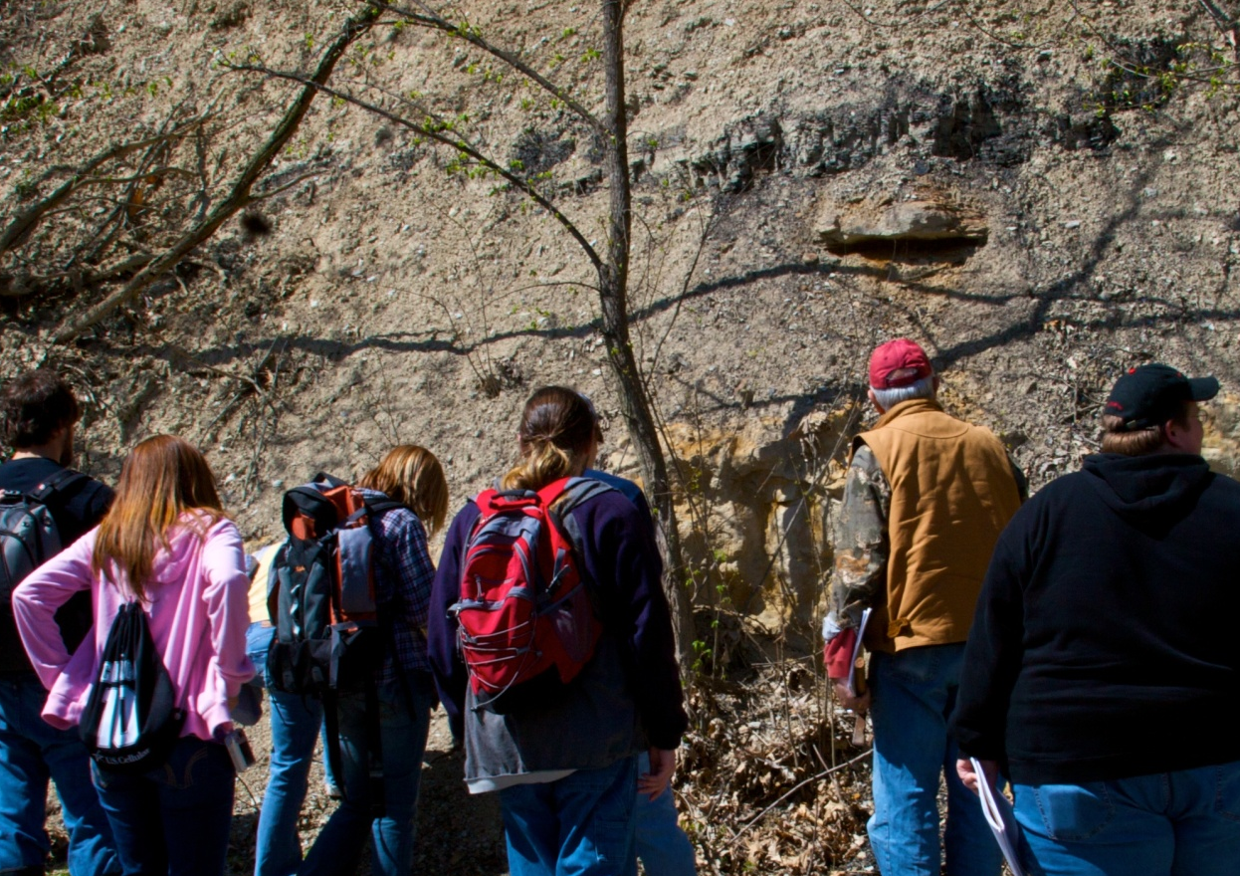
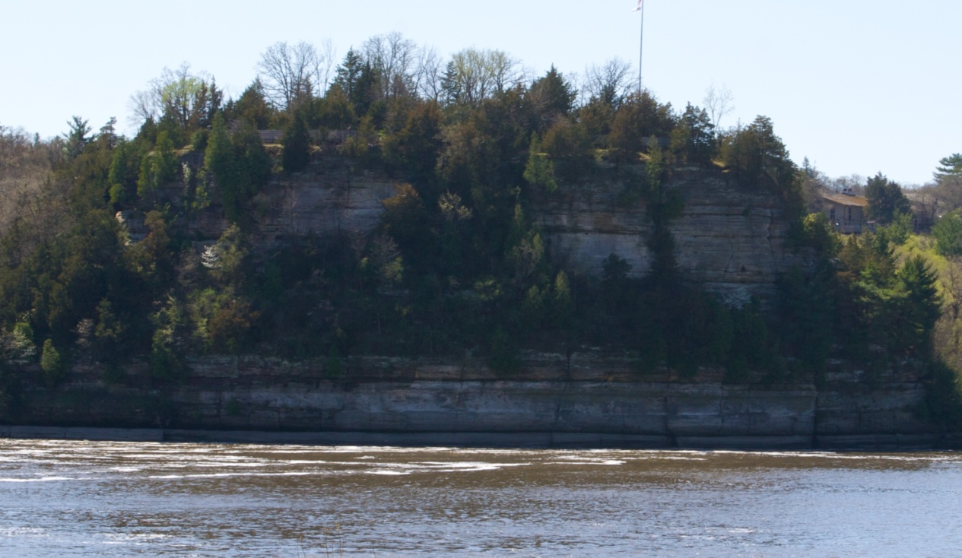
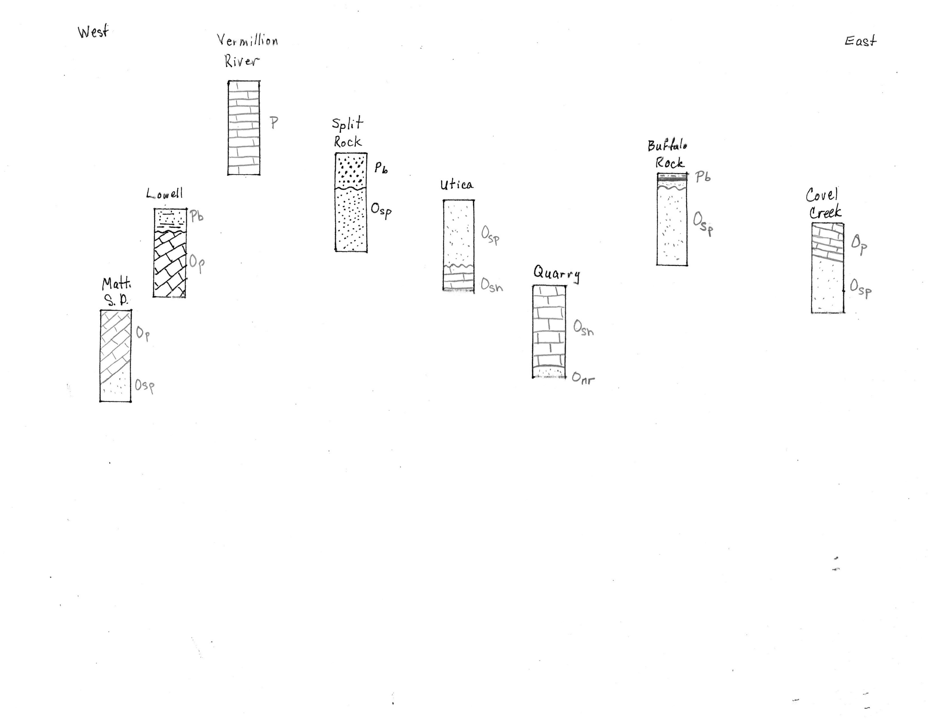
Project-based trip #1

Slide 13
Project can be scaled to fit various time allotments – order matters
Cross-section worksheet
  We generally provide information for Split Rock and Lowell locations
  Quarry stop is usually handled as a discussion outside of the quarry gates
Not to scale

Slide 14
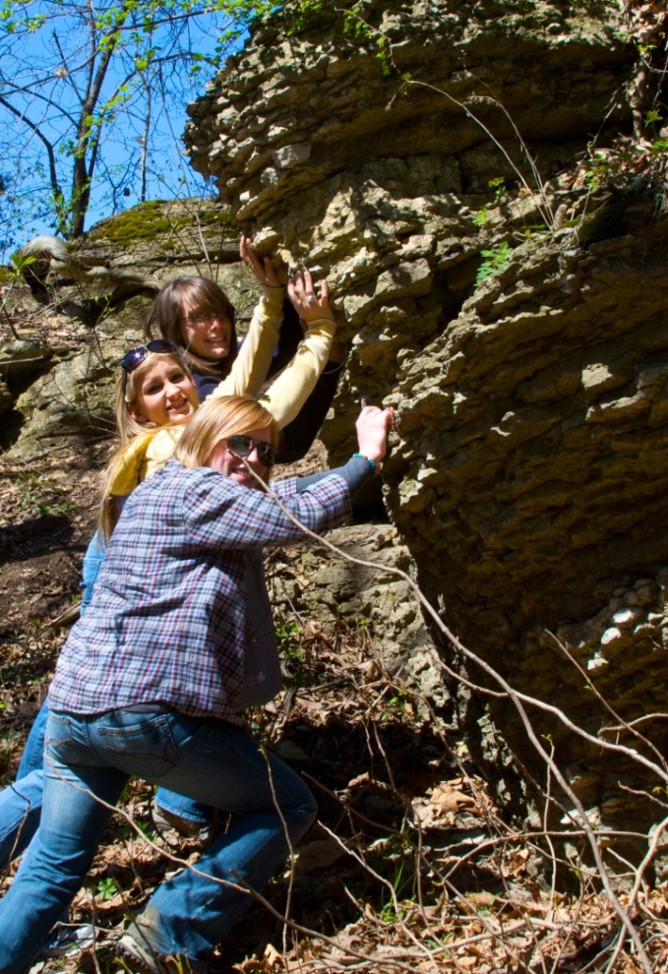
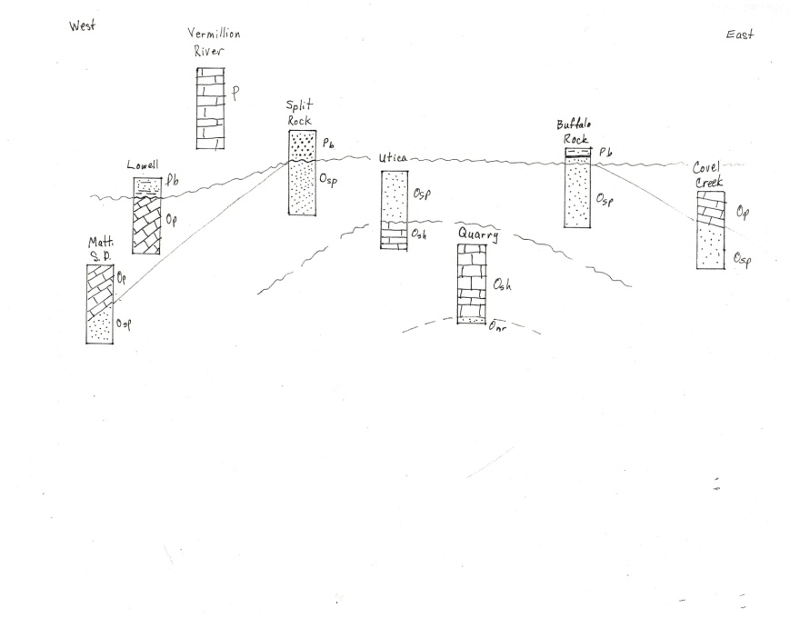
Students construct a cross section
Lessons for success!
  Students should be given ample time at each outcrop to complete activities but also to simply ponder, discuss, and enjoy the rocks.
  Number of outcrops - not as important as the order.
  Group discussion near the end of the day provide students with an opportunity to synthesize the information gathered throughout the day.
  Reflections provide students with an opportunity to recognize their progress
Example questions for reflection and learning goal assessment
    With 1 being not comfortable at all, and 5 being very comfortable, please rate your comfort-level identifying sedimentary rocks.
      1 2 3 4 5
    Once you identified a rock at a particular outcrop (sandstone, for example), explain your approach to determining where the rock fit in the geologic column.
    Throughout the day, you made predictions as to which rock types you expected to find at the various stops.
      Reflect on an instance when your prediction was correct. What data did you draw on in order to make that prediction? Explain how you tested your hypothesis?
      Now reflect on an instance when the rocks you encountered were not those you anticipated.

Slide 15
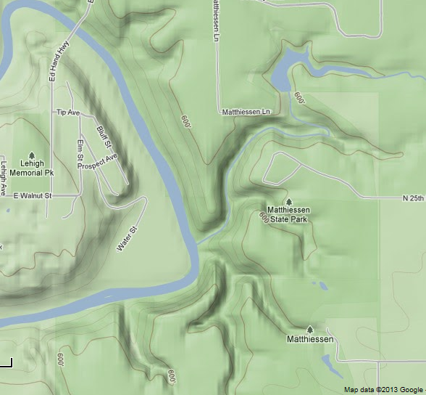
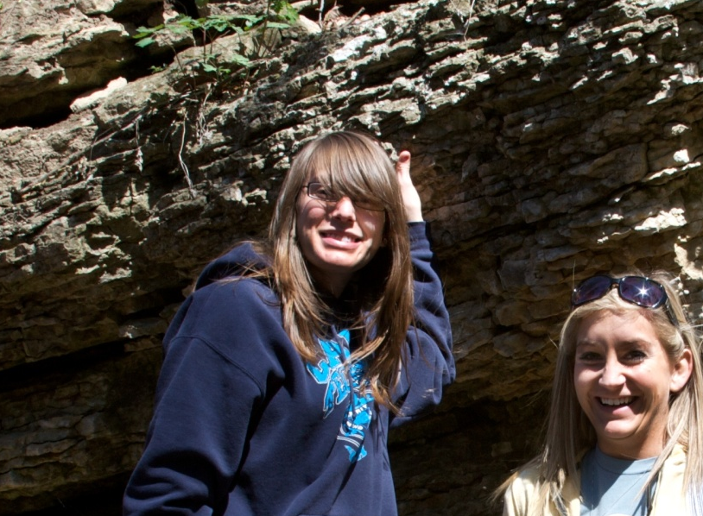
Sophomore- to Junior- or Senior-level geology courses including
  Field and Laboratory Techniques
  Structural Geology
Constructing bedrock map and cross-section – Learning Objectives
  Use of the Brunton compass
  Locate and plot position on map
  Measure and plot bedding orientations
  Sketch bedding contacts where data is present and where data is missing
  Interpret geologic structures in the subsurface
Project-based trip #2 – Matthiessen State Park

Slide 16
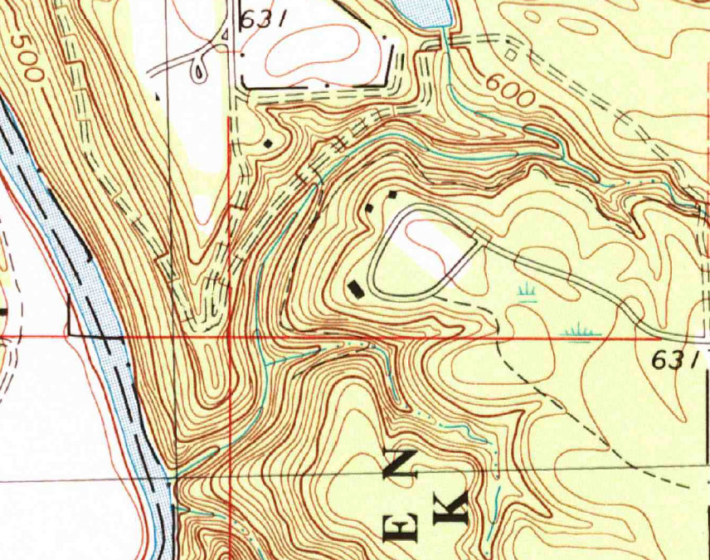
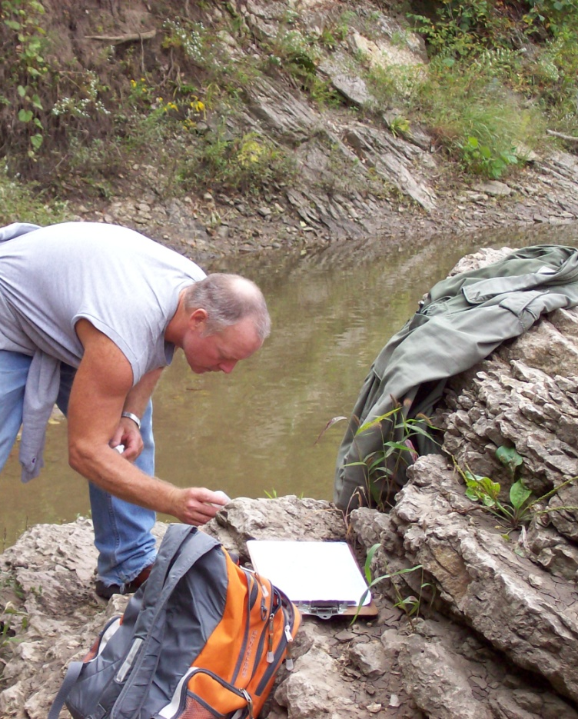
Focus: Deer Creek
Ideal location for a first mapping project
  The predominate structure measurable over only a few hundred feet.
  Contact between the St. Peter Sandstone and overlying Platteville Limestone visible (or can be determined within a few feet) at several locations
Limestone (Platteville)
Sandstone (St. Peter Fm.)
300 feet

Slide 17
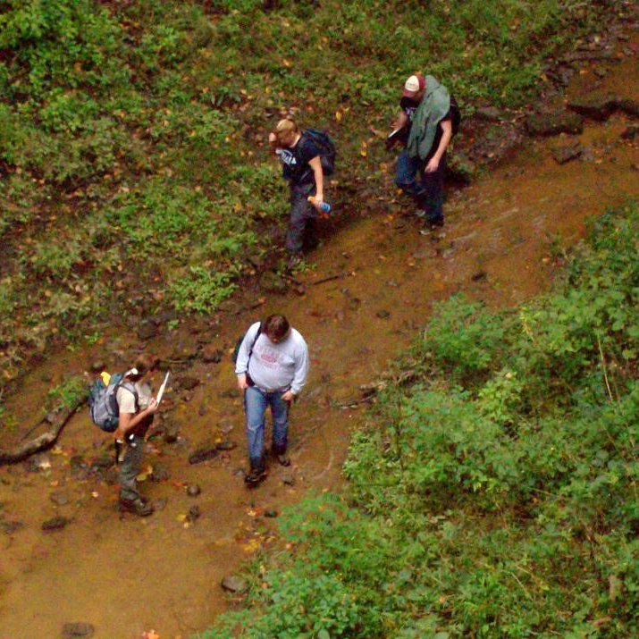
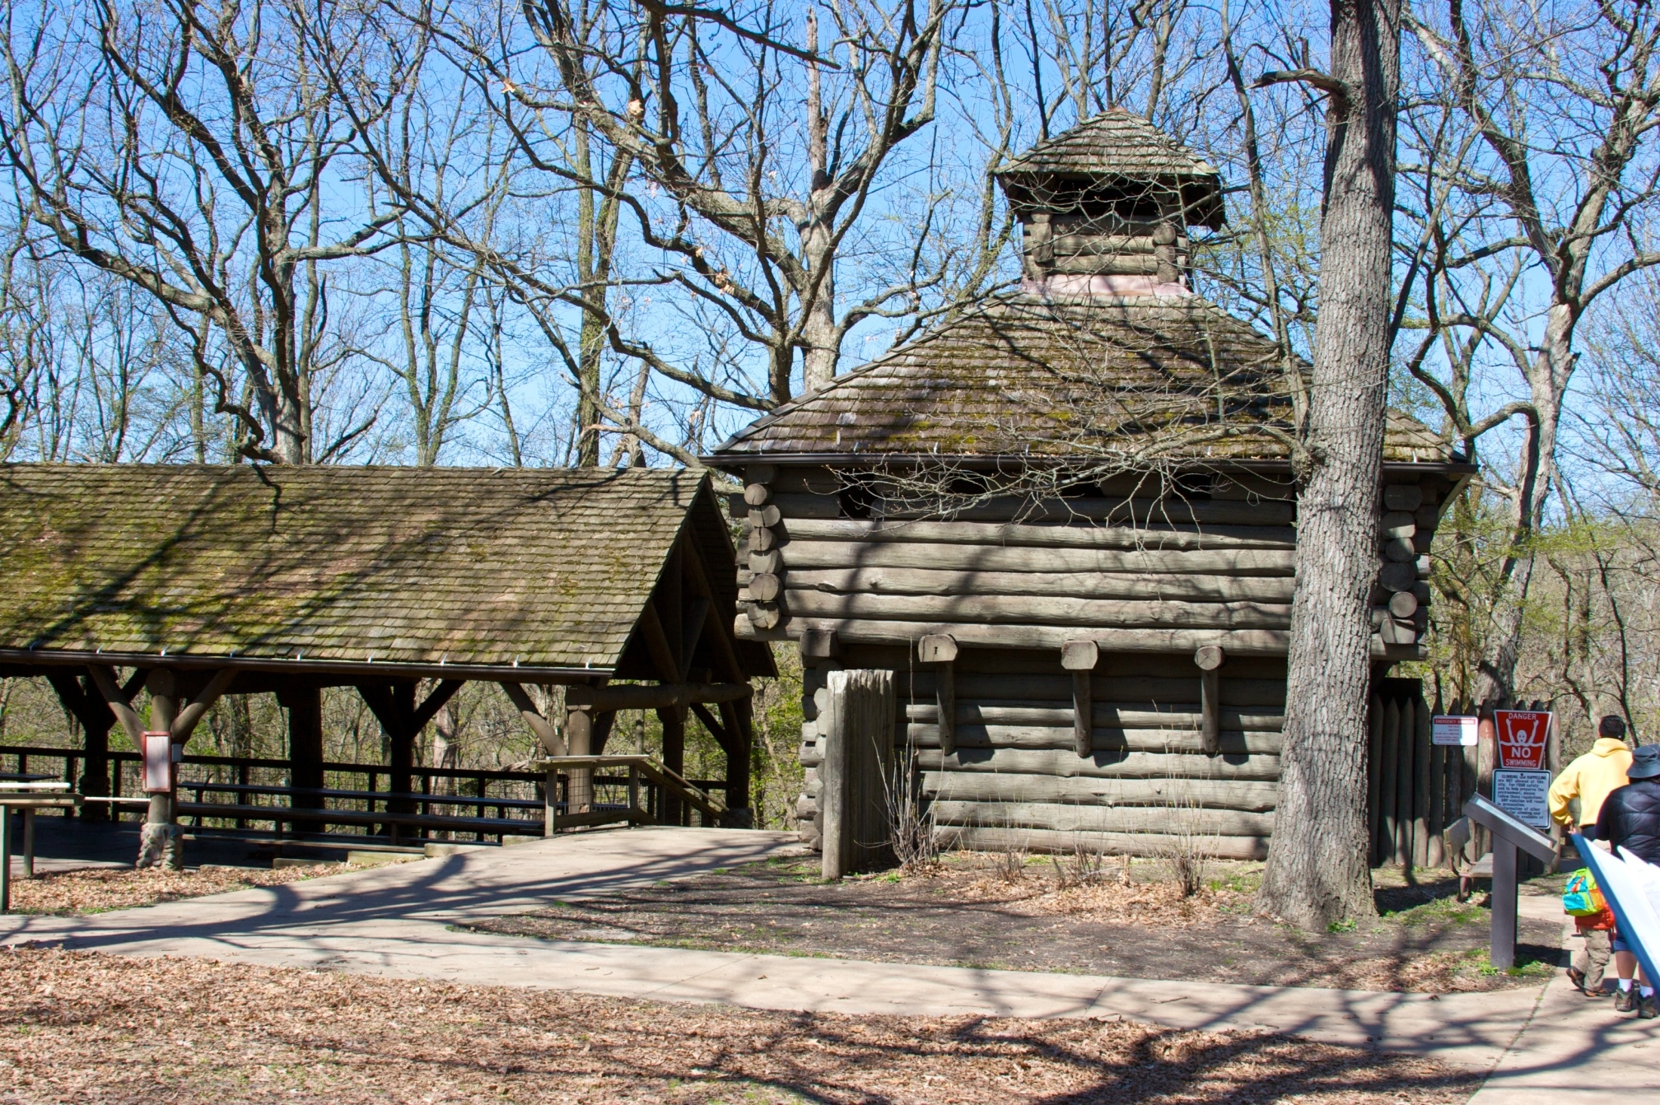
Ideal location for a first mapping project
  Area is small – students can revisit portions of the field area
  Students do not have to contend with roads and traffic
  A sheltered picnic area with tables provides an outstanding facility for discussion and x-section construction
300 feet

Slide 18
Students are equipped with
  Two base maps, general geologic column, Brunton Compass
  Field book, clipboard, Hand lens, HCl, pen knife, zip-lock bags (in case of rain), etc., no hammers
First part of the day is spent on lessons in orienteering and constructing maps
  Determine pace, setting magnetic declination, determine scale, north
  Walk through – two stops to examine rock type (placing into stratigraphic framework) and structure
  Learning how to use Brunton Compass to measure strike and dip
Pairs of students set loose to map the contact between the St. Peter and the Platteville
Limestone (Platteville)
Sandstone (St. Peter Fm.)
Lesson: Give adequate time and attention to first lessons of the day!

Slide 19
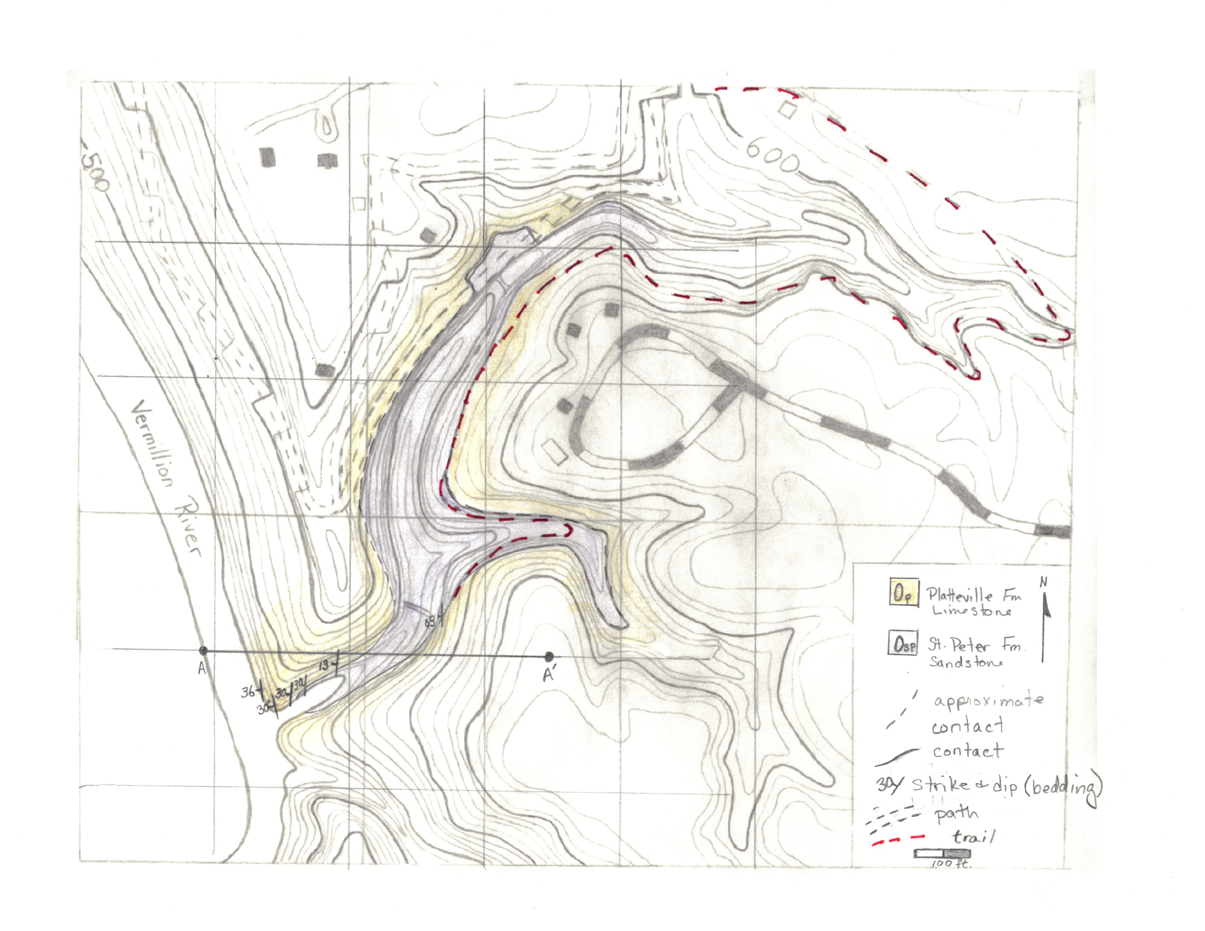
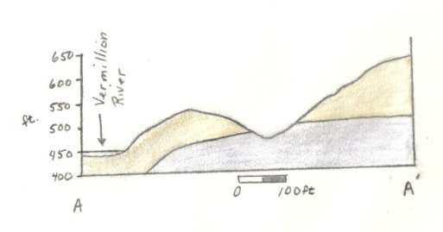
Lessons for success!
  Frequent construction of “working cross sections” – sketches
    provide students the opportunity to test various geometries, modify their thoughts and approach throughout the course of the project
    To be effective, must be field checked by faculty and discussed
  Group presentations or discussion during lunch or early afternoon.
    Groups share observations, discuss interpretations.
  Students benefit from revisiting outcrops after the group discussion

Slide 20
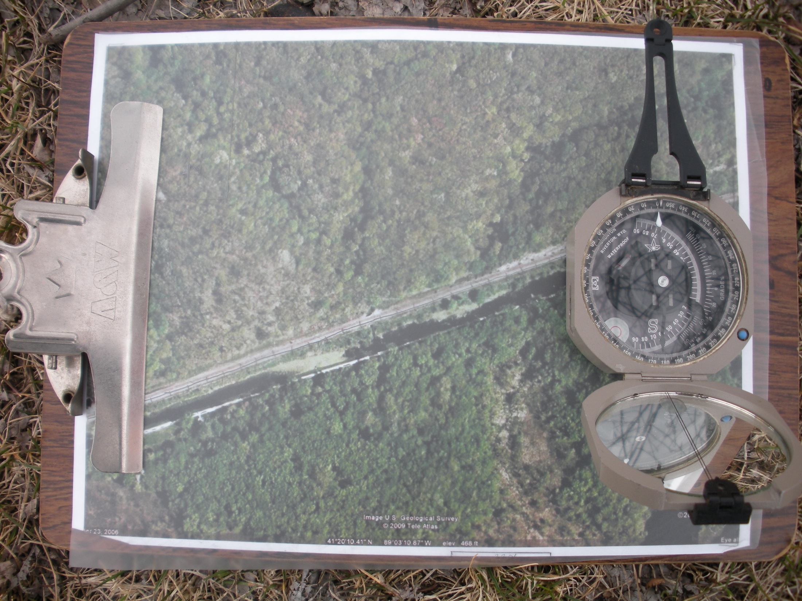
Project-based trip #2 + - Split Rock
Project-based trip #1
Depending on educational goals and time available, this location can be treated as a short stop, or can be used as a more in depth project.

Slide 21
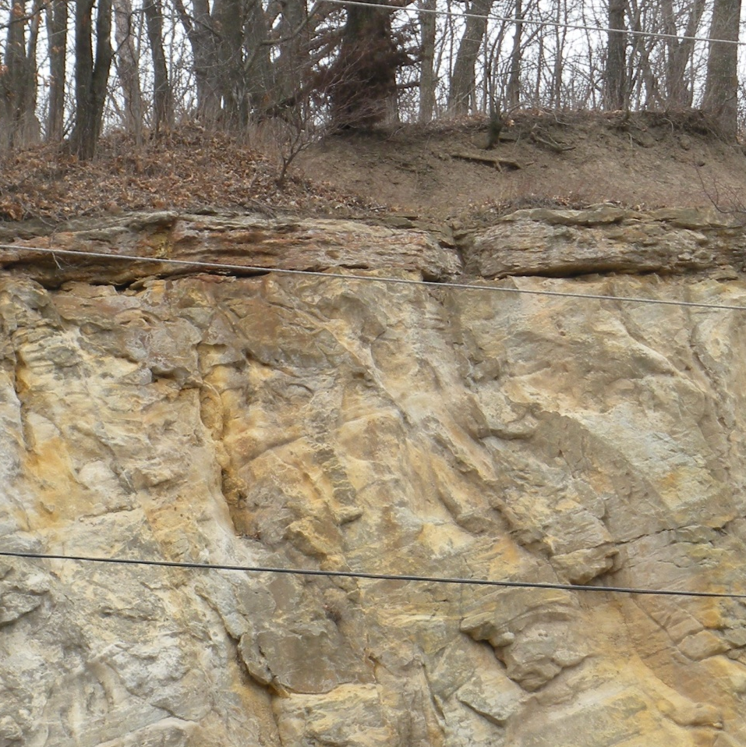
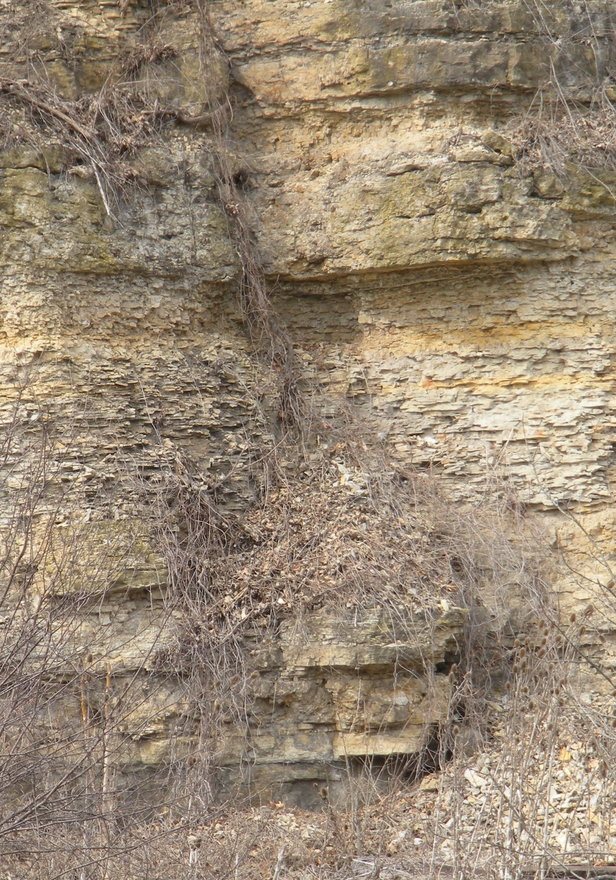
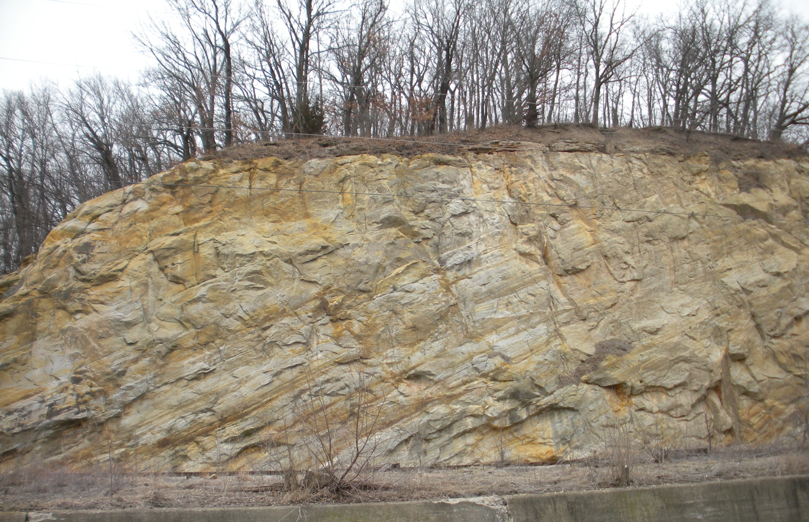
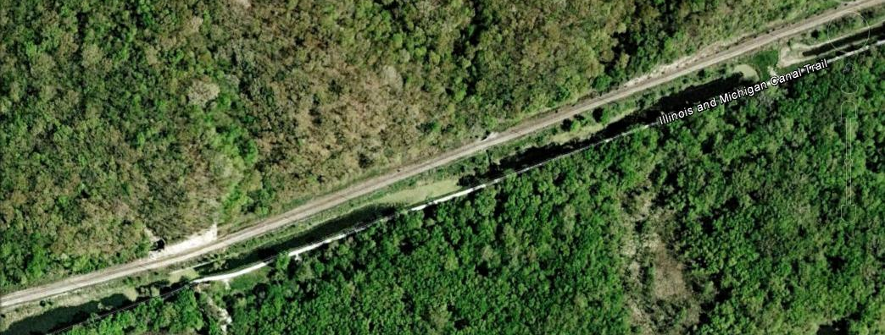
Mapping project – using areal photography (Google Earth map)
Goals and activities
  Identify Rock types & fit in to the local stratigraphy – up section direction vs. down section direction – recognize unconformity
Identify and map contact between St. Peter Fm. and Shakopee Fm. and between the St. Peter Fm. and overlying Pennsylvanian strata
Compare stratigraphy and structure to Matthiessen
Locate and map position and orientation of fold axis
Fold Axis

Slide 22
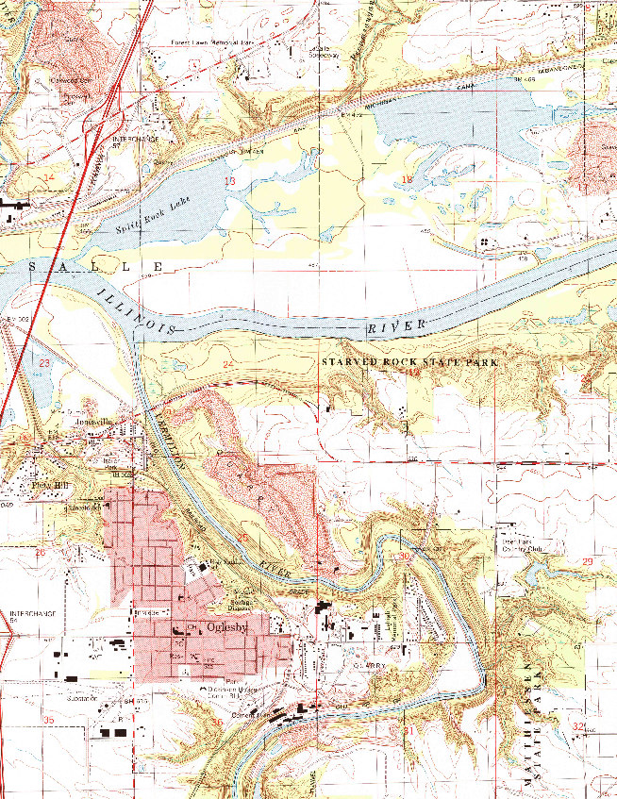
Understand the relationship between the fold mapped at Matthiessen State Park and Split Rock
Express that relationship on a map
1 km

Slide 23
Conclusions & Future Work
ISGS field trip guides of the LaSalle area provide an outstanding resource from which we have developed a two field-based projects – making use of State Parks and Natural Areas near LaSalle, IL
    The projects are independently scalable in the sense that the breadth and length can be modified to accommodate different learning levels, student populations, and time allotments.
    We have used a scaffold approach – revisiting or adding to previous projects to support student learning at a variety of levels.
Next step: developing detailed project guides – with the goal of producing a set of projects that can be used in conjunction with ISGS field trip guide(s) for various levels of undergraduate instruction. Ideally, we would like these projects to be available to any field trip group visiting the area as a supplement to published field trip guides.

