Slide 1
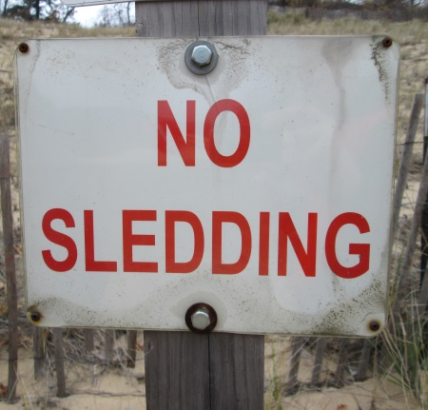
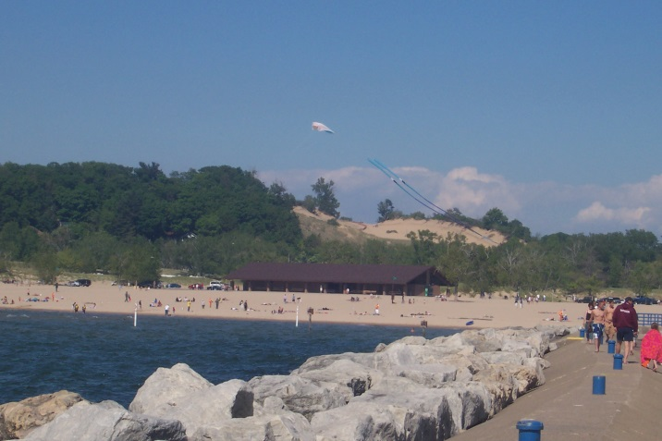
Evaluating the Effectiveness of Management Techniques Used at Mt. Pisgah
Joe Arevalo, Taylor Emmons, Sarah Harefa, Ashley Van Wyk, and Jacob Zondag
Calvin College
Department of Geology, Geography, and Environmental Studies
Notes:
*Standardize use of capitals in chart titles*Standardize use of visitors v respondents*Standardize “our” v “the” study
The Great Lakes contain the largest freshwater dune complex in the world, much of which is concentrated on the western coast of Lake Michigan. Due to their popularity as tourist destinations, many dunes are intensely managed to preserve them for future generations to enjoy. Few studies have examined the effectiveness of management efforts. This study evaluates the effectiveness of management techniques employed at Mt. Pisgah, a dune in Holland, Michigan.

Slide 2
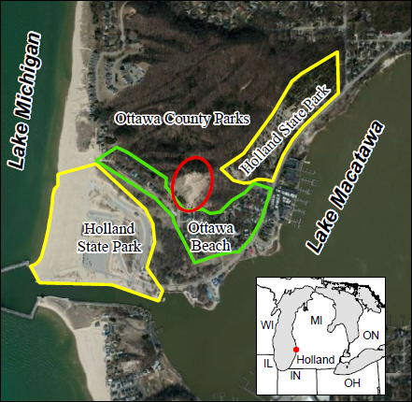
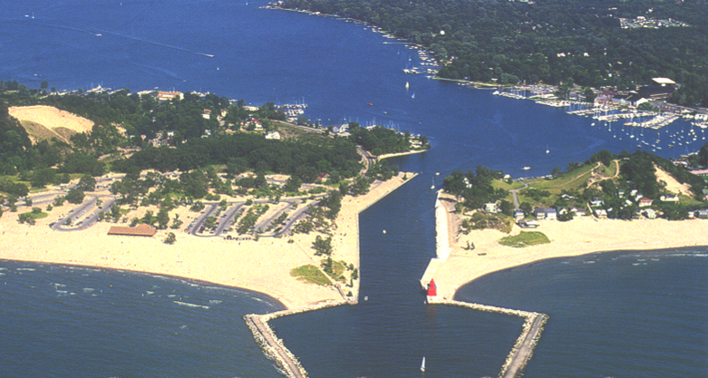
Study Area
Holland, Michigan – Mt. Pisgah circled in red
Notes:
-Mt. Pisgah is a large parabolic dune circled in red on this map. The local landmark has a height of 48 meters above Lake Michigan.
-It is located in between two separate parts of Holland State Park, the campground and the beach (point out both). In between those parts, there is also the historic Ottawa Beach Community. To the north the dune connects to a series of forest trails.
-Holland State Park is extremely popular, receiving 1.5 M visitors every year.
-As people are prone to do, visitors at the campground found the easiest way to get to the beach, which was climbing over Mt. Pisgah and tramplin through the yards of homes in Ottawa Beach. This happened for decades and some people reported having that route recommended to them by park rangers.

Slide 3
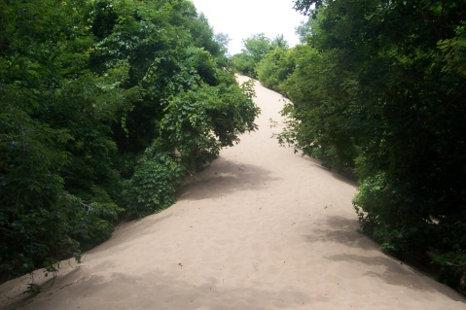
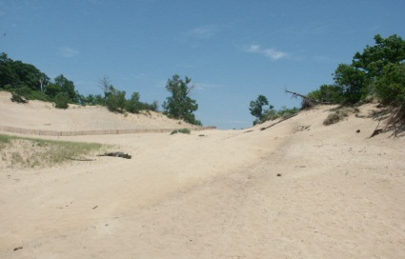
Background
Trampling impact (Andersen 1995)
van Dijk and Vink (2005) study results
Unnaturally angled ramp down bare sand slipface
Notch in crest 5 meters lower than surrounding crest
Most visitors not local and do not believe the dune has problems
Management techniques completed in 2009
Notes:
*keep heigh point? *describe each technique in more detail?*say something about aeolian processes?
-One of the ways human activity alters the form and natural processes of dunes is walking over areas or trails repeatedly, known as trampling. This occurred at Mt. Pisgah for decades. Trampling erodes sand, destroys vegetation, and increases the formation of blowouts.
-In 2005, the county authority commissioned a study in response to local claims that the dune crest was being lowered by visitor activities
-The study by van Dijk and Vink surveyed the dune, took photographs, and distributed a questionaire to visitors. Results showed an unnaturaly angled ramp down the bare sand slipface (pictured on your left) and a notch in the crest 5 meters lower than the surrounding crest (pictured on your right) . Also, questionnaire responses showed that most visitors are not from the local area and do not believe there are problems with the dune.
-As recommended by the study, a number of techniques were implemented including stairs, boardwalk, viewing platforms, signs, fences, and dune grass plantings

Slide 4
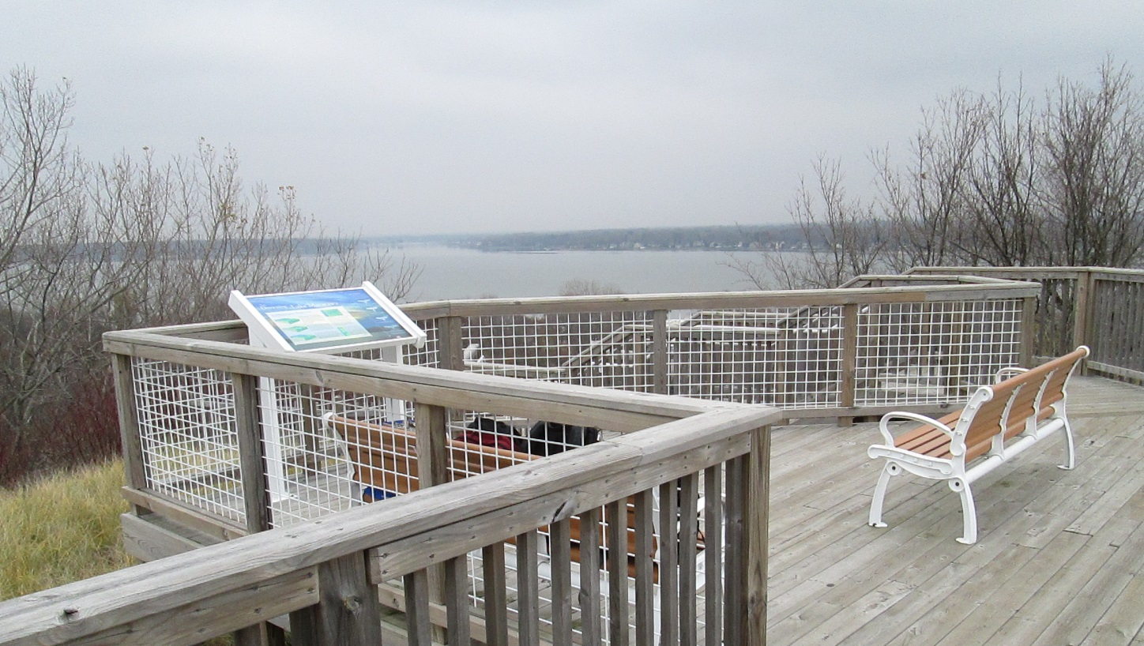
Research Question
Have management techniques at Mt. Pisgah been effective?

Slide 5
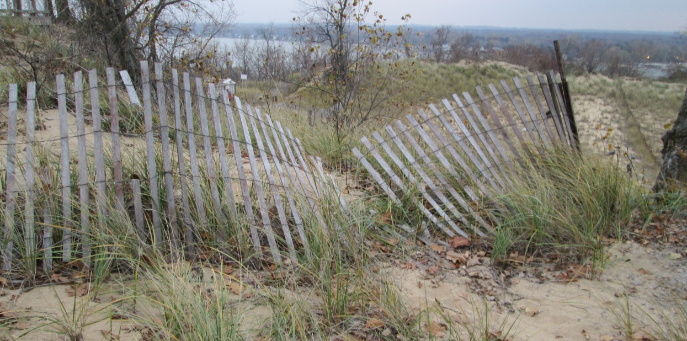
Study objectives
To measure activity on the dune.
To compare extent of activity measured to results of van Dijk and Vink (2005) study.
To map and assess the presence and quality of dune management techniques implemented.
To understand visitors perception of dune management at Mt. Pisgah.

Slide 6
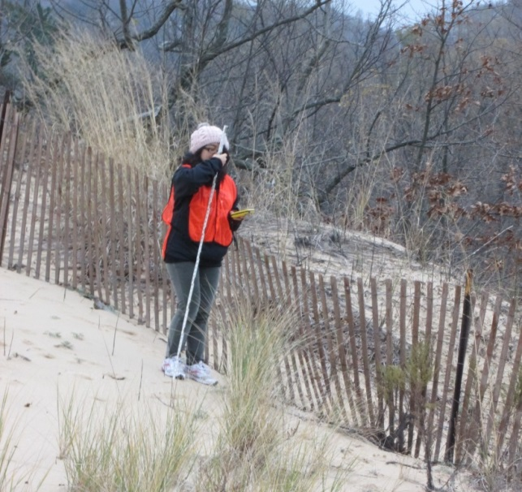
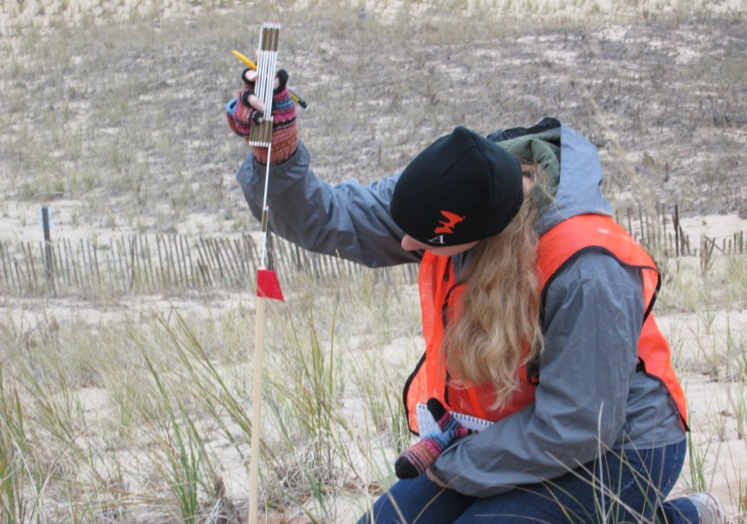
Methods
Measured sediment activity with erosion pins
Compared extent of activity by replicating pictures taken in 2005
Mapped management techniques and human impacts
Gauged visitor perceptions by distributing questionnaire
Notes:
-To accomplish these objectives, we measured the sediment activity with erosion pins. 9 erosion pins were placed on the dune in areas where erosion or deposition was suspected, such as blowouts or dune grass. 2 stable fixtures in the dune were also used to measure changes in the height of sand.
-We compared the extent of sediment activity on the dune by replicating pictures taken in 2005.
-We used gps to map management techniques and human impacts
-and we gauged visitor perceptions by distributing questionnaires to visitors when they came to the main viewing platform. The questionnaire repeated many questions asked in 2005.

Slide 7
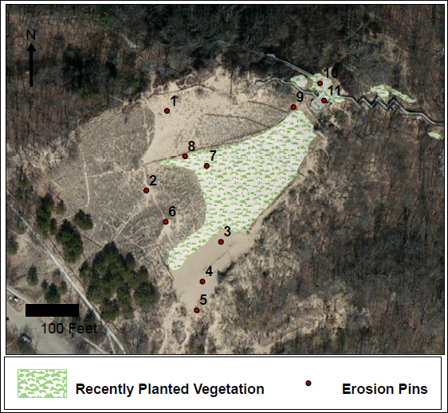
Measuring Sediment Activity
Notes:
*include bare sand slipface area?
Results from the erosion pins show that over a week long period, all changes in height were less than 30 mm, suggesting low levels of sediment movement.
This is despite the fact that remnants of Hurricane Sandy were affecting Michigan during the time of our study.

Slide 8
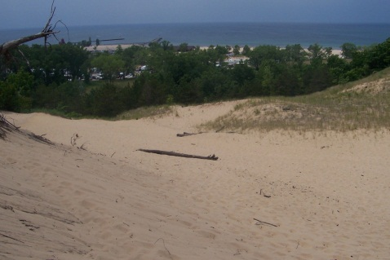
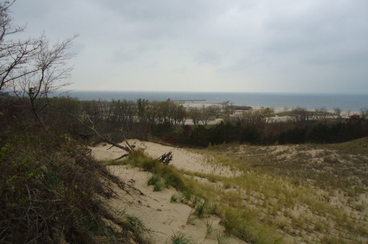
Comparing Activity Levels
2005 2012
View along southern arm looking west
Notes:
See more vegetation

Slide 9
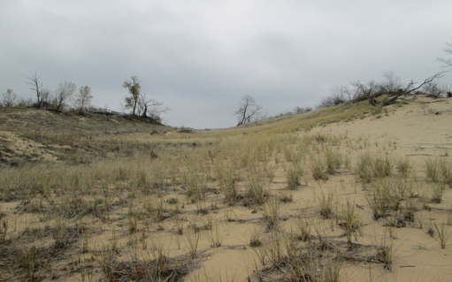
Comparing Activity Levels
2005 2012
View from blowout looking toward the crest
Notes:
This view shows the aformentioned notch. In 2005 someone walking up the blowout would see the notch as a clear destination. Now the presence of vegetation makes it less clear where to walk.

Slide 10
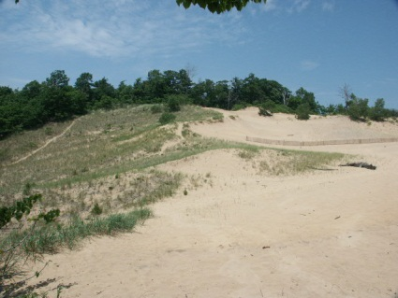
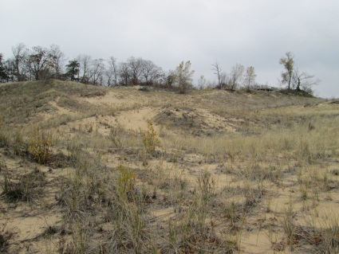
Comparing Activity Levels
2005 2012
View across middle of the blowout looking north
Notes:
Here again you see more vegetation

Slide 11
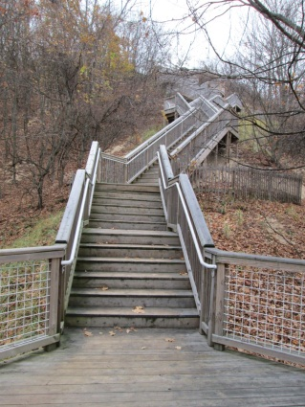
Comparing Activity Levels
2005 2012
View from base of leeward slope looking west – unnaturally angled slope
Notes:
This is the aforementioned ramp, which now has a stairway over it so that people can’t walk on the slipface and a lot of vegetation has been planted around the stairs.

Slide 12
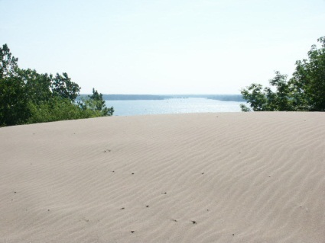
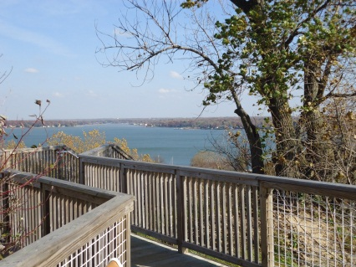
Comparing Activity Levels
2005 2012
View from crest towards Lake Macatawa
Notes:
This view from the notch in the dune crest shows how now the crest contains stairs and the viewing platform
All together these pictures show how now less sediment activity is occurring on the dune than in 2005 and more recovery is occurring.

Slide 13
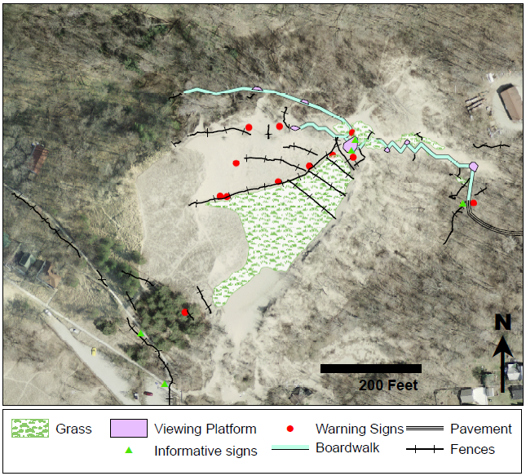
Map of Management Techniques
Notes:
*should I mention pavement trail from gazebo to boardwalk*find “official” names for everything
Here you can see all the management efforts mapped out.
They are comprehensive – addressing the entire visitor experience as well as natural processes
A visitor to the dune will be led to the stairs by a paved trail, at the top of the stairs there is the main viewing platform which branches off to a smaller platform and boardwalk wrapping around the leeward slop of the dune, connecting to forest trails. There are informative signs at the bottom and top of the dune for reading and numerous spots to stop and enjoy the scenery.
Planted dune grass helps slow and capture wind blown sediment. Some fences are located to slow wind blown sediment while others are designed to limit human access to the dune. There are also numerous signs warning visitors to stay off the dune because of the restoration project.
The techniques are in good condition besides fences that have been damaged, which I will show later.

Slide 14
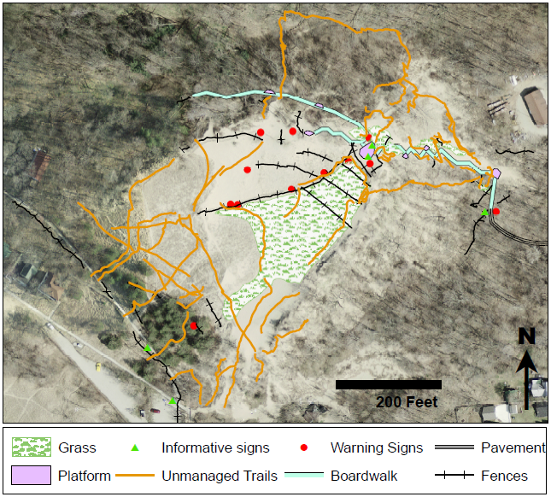
Map of Human Impacts: Unmanaged Trails
Notes:
This next map overlays the unmanaged trail we mapped. There are several things to note here. First, the density of trails is greatest in the blowout of the dune, away from management techniques. Second, many trails begin near management techniques. And third, looking at trails near the main viewing platform, people taking the trails clearly are ignoring multiple warning signs to walk on the trails.

Slide 15
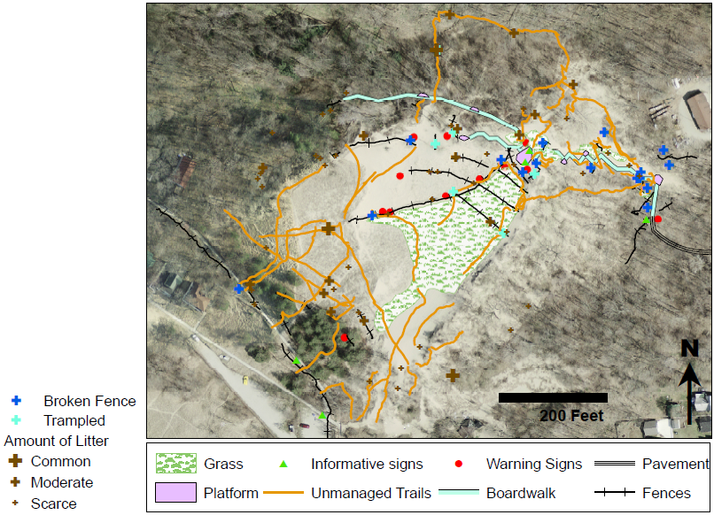
Map of Human Impacts: Litter and damaged fences
Notes:
This last map adds broken fences, trampled fences (which are ones completely knocked over), and litter.
Extent of trails and correlation with broken and trampled fences, often around warning signs, indicates an uncooperative segment of society
Possible interpretations of this data include
The dune is an important cultural landmark and the local culture that went on the dune itself before management feels entitled to continue doing so after management.
the broken fences encourage some to climb onto the dune who wouldn’t otherwise because they figure other people do so why shouldn’t they
Or 3. it could be summer visitors who lack the same level of concern for the dune as local residents, this is a point that requires further study in the summer.

Slide 16
Visitor Perceptions
Notes:
During the 8 hours data was collected, 69 visitors came, with 3 dogs brought.
32 questionnaires were filled out, representing 65 visitors.
The vast majority - 90.8% - of dune visitors who filled out the questionnaire were from Holland and all were from somewhere within an hour of Holland.

Slide 17
Visitor Perceptions
Notes:
*keep??
A high percentage of visitors come to Mt. Pisgah in every season but winter, with the highest percentage in the summer and fall. This shows that respondents were very familiar with the dune

Slide 18
Visitor Perceptions
Notes:
This chart shows the activities visitors participate in while on Mt. Pisgah and includes results of the questionaire distributed to neighbors of the dune in 2005.
The most popular activities on the dune in 2012 were climb the stairs, enjoy the scenery, and go for a walk
10.8 % climb the dune in 2012, compared to 44.7% in 2005
1.5 % run down the dune on the sand, compared to 34.2% in 2005
These changes indicate cooperation with management techniques

Slide 19
Visitor Perceptions
Notes:
*keep???
The visitors to the dune reported a variety of levels of knowledge about dunes, but the majority at least knew a little, possibly influencing their perceptions of dune management

Slide 20
Visitor Perceptions
Notes:
*rearrange so limiting access to protect dune areas in green and placement of sand fencing to stop sand movement in blue on top
This chart shows visitors opinions of dune management and interpretation activities.
Notice the lack of Strongly oppose and oppose, the majority favored or strongly favored all management and interpretation activities, even limiting access to protect dune areas in green and placement of sand fencing to stop sand movement in blue.
This indicates acceptance of management techniques

Slide 21
Visitor Perceptions
Notes:
This chart shows visitors responses to questions of whether they considered things to be problems or annoyances on the dune.
The item most considered a problem at some level litter, suggesting a segment of visitors that does not fully respect the dune.
However, the second most responded problem was damage to dune, in purple, indicating that visitors were BUYING INTO the goals of the management efforts.

Slide 22
Visitor Perceptions
Notes:
Lastly, this chart illustrates in a simple fashion that visitors perceive the management efforts to be successful.

Slide 23
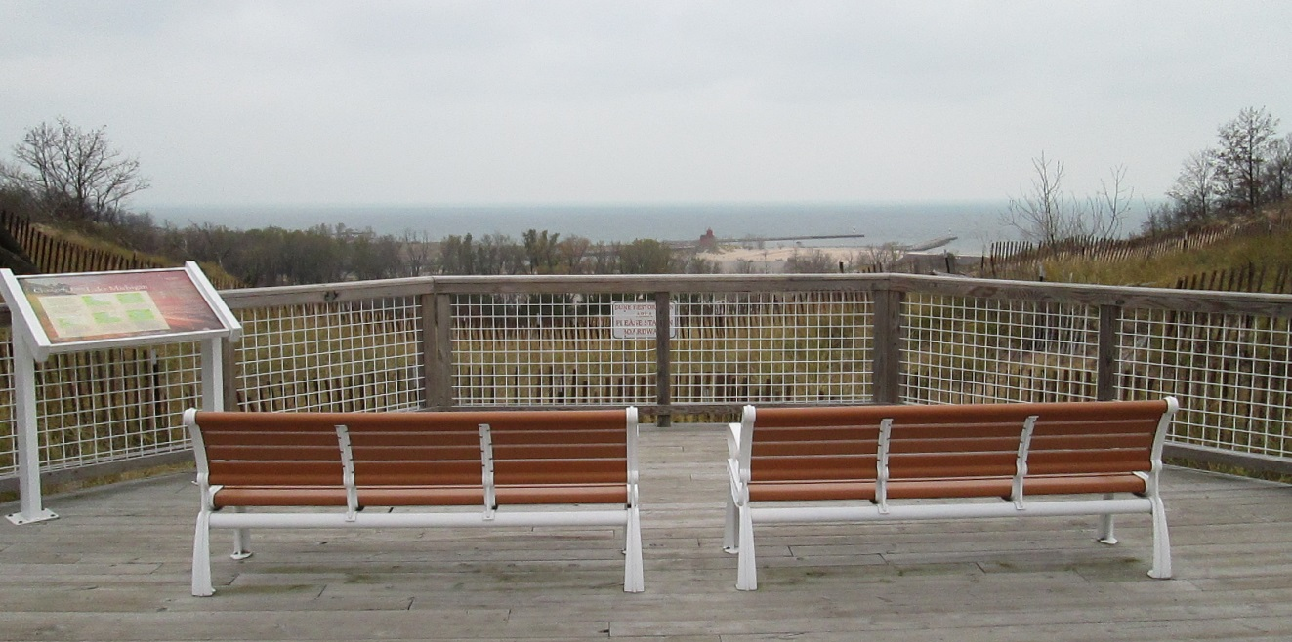
Conclusions
Management techniques have been effective at limiting and mitigating human impact.
In general, there is public acceptance and cooperation with management techniques.
However, unmanaged trails, litter, and damaged fences indicate an uncooperative segment of visitors.
Notes:
-In GIS find percentage deemed high quality, if I possess that
-Include sediment activity?
PUBLIC COOPERATION
-Questionnaire responses indicate acceptance and adherence to management techniques
-Climb the dune and run down the dune no longer top activities
-Majority of respondents said they were in favor or strongly in favor for all management techniques
UNMANAGED TRAILS
-Indicate uncooperative segment of visitors
-Local culture
Place of significance
Accustomed to going on the dune
-Non-local visitors
Less understanding or care for dune

Slide 24
WORKS CITED
Andersen, U.V. 1995. “Resistance of Danish coastal vegetation types to human trampling.” Biological Conservation 71:223–230.
Michigan Department of Natural Resources. “Holland State Park.” Slideshow. <http://www.michigan.gov/documents/dnr/Holland_SP_Slideshow_334712_7.pdf>.
van Dijk, Deanna and D. Robert Vink 2005. “Visiting A Great Lakes Sand Dune: The Example of Mt. Pisgah in Holland, Michigan.” The Great Lakes Geographer 12(2): 45-63.
ACKNOWLEDGEMENTS
Ottawa County Parks and Recreation Commission who provided our research site and Calvin College for providing facilities and equipment.
This research was supported by the National Science Foundation Grant 0942344, Melanie Manion and Deanna van Dijk.

