Slide 1
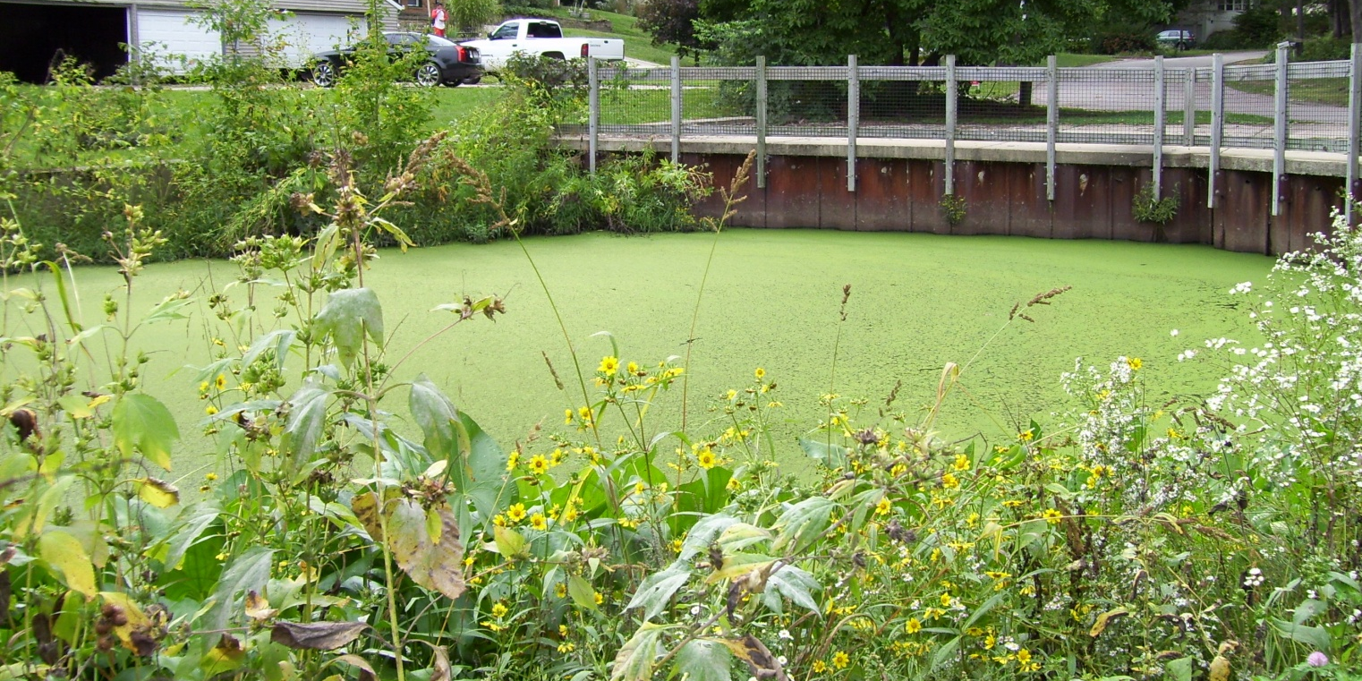
Generating Content Knowledge Gains that Stick: Cracking the code in a field-based water quality course
Kate Rowbotham
Western Michigan University

Slide 2
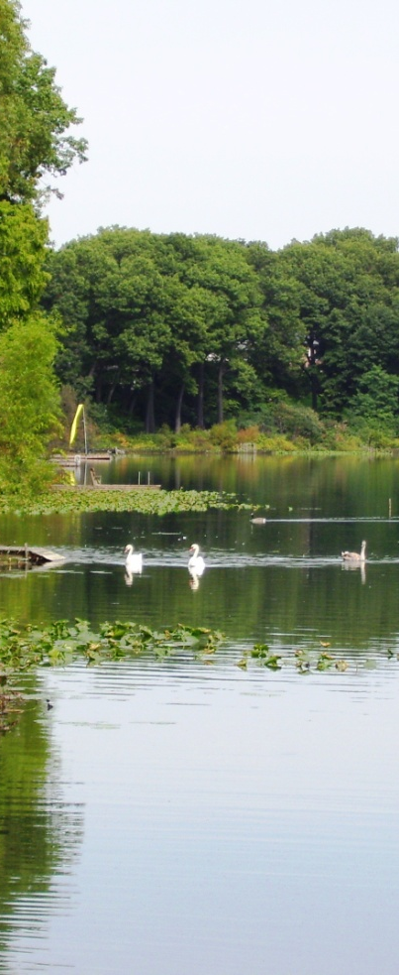
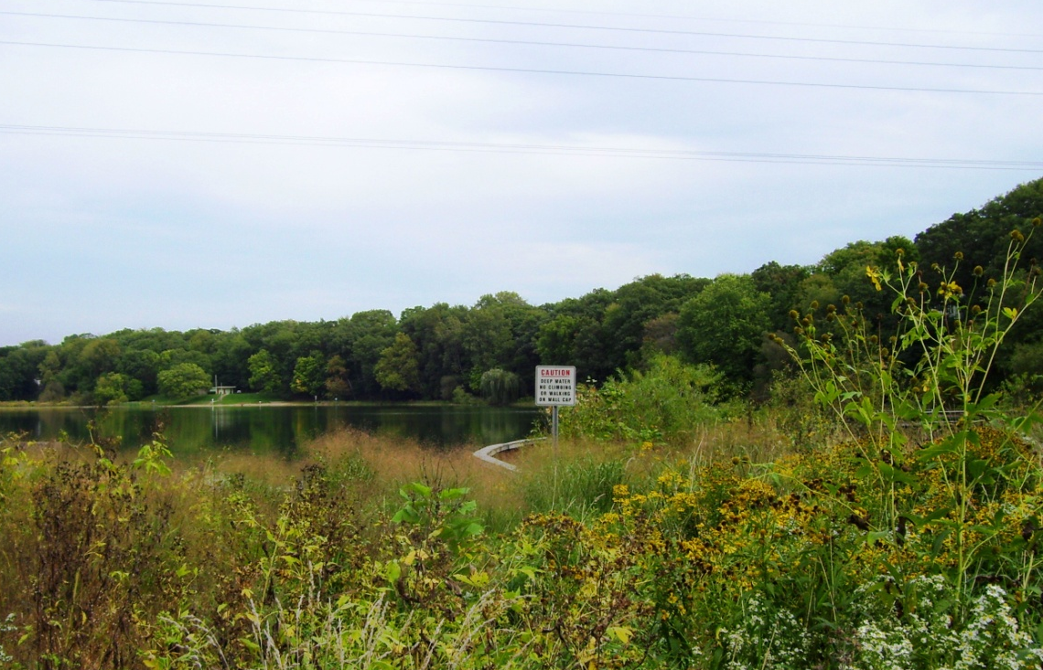
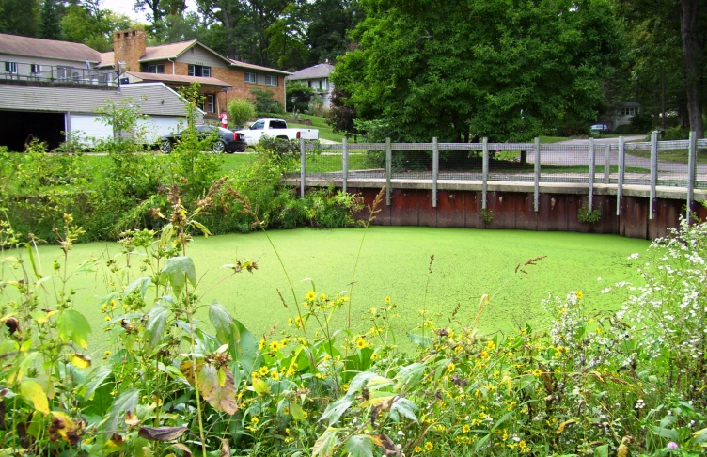
Where we’re going…
Our Environmental Field Geochemistry course
2009-2010 Results
New questions for 2011-2012
2011-2012 Results
Where we’re headed next…

Slide 3
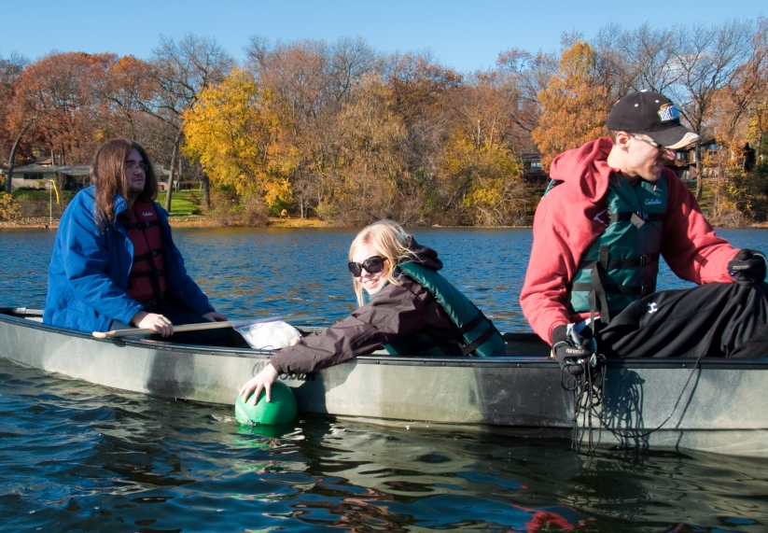
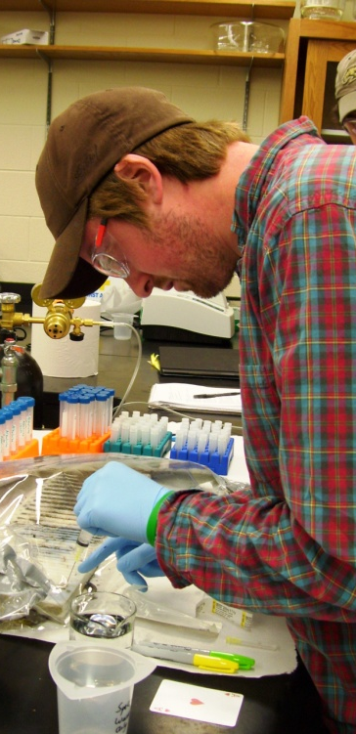
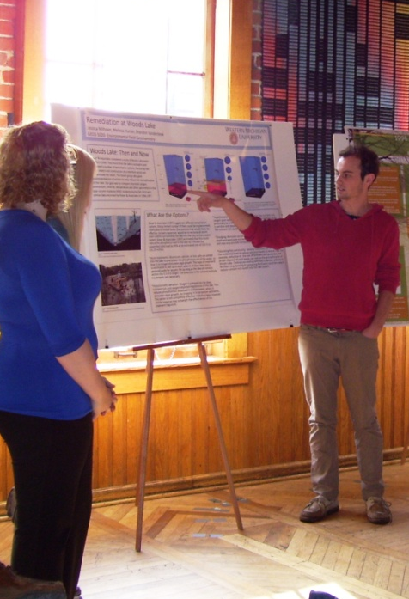
The Course:
All upper level students
GEOS and ENVS majors
Some graduate students
Demographics
Close to 50/50 male/female
Most students between 22 and 25 years old
Semester flow = gradual reduction in scaffolding
Intro to content/methods
Student-led investigation

Slide 4
The Course – Content:
Process
Causes
Results
Lake
Systems
Remediation
Chain of Events
Eutrophication
Spatiotemporal Heterogeneity
Biogeochemical Cycling
Oxygen
Phosphorous
Nitrogen

Slide 5
The Course – Content:
Process
Causes
Results
Written
Report
Poster
Lake
Systems
Remediation
Chain of Events
Synthesis
of Findings
Eutrophication
Spatiotemporal Heterogeneity
Methods & Techniques
Biogeochemical Cycling
Oxygen
Phosphorous
Nitrogen

Slide 6
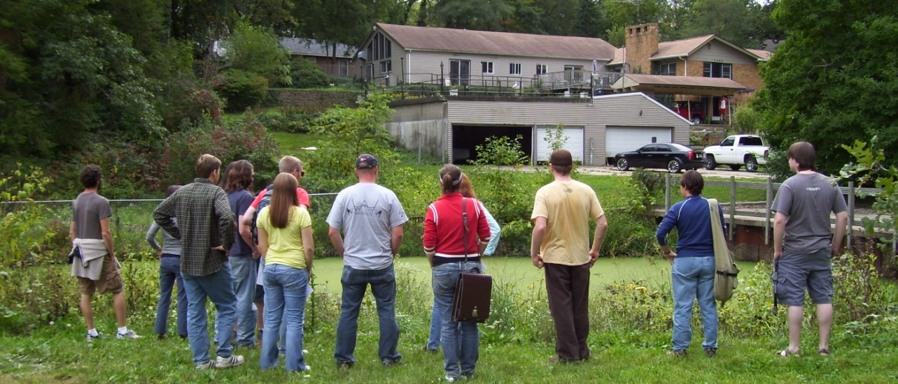
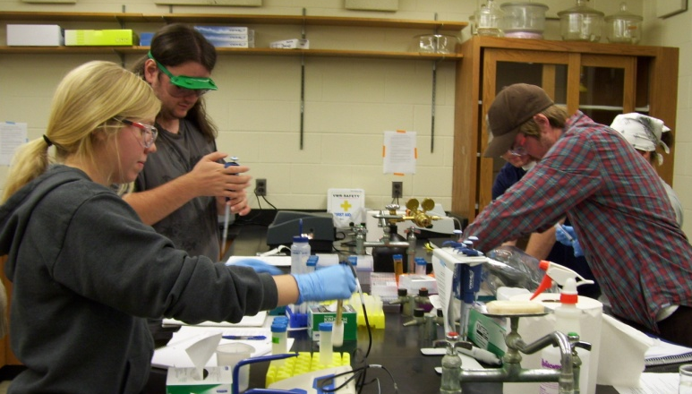
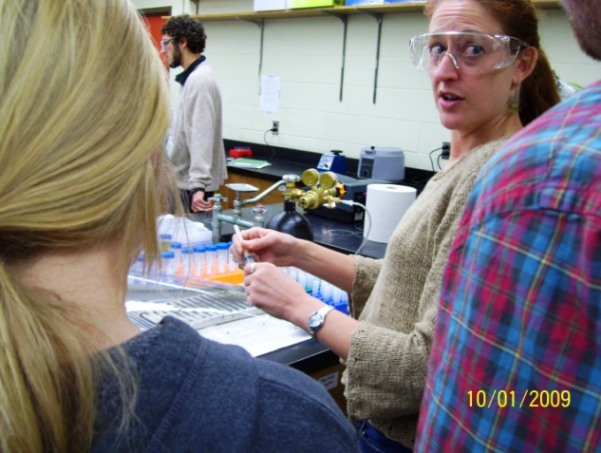
The Course – Teaching Methods:
Class time
20% classroom-based learning experiences and presentations
80% field- and lab-based work
Classroom-based learning experiences
Question of the Day (QOD) – individual, group, mini-lecture
Homework assignments follow up on QOD content

Slide 7
The Study:
Some of the data we collected from all consenting students in 2009-2010:
Geochemistry Content Knowledge Survey – unique scoring (-25 to +25 or -26 to +26)
2009: Min Gain = 2, Mean Gain = 14.2, Max Gain = 24****
2010: Min Gain = 1, Mean Gain = 11.3, Max Gain = 19
Interviews conducted with four purposefully selected individuals each year:
Series of four to five interviews
Each was 20-45 minutes
Notes:
Two-tiered consent – consent to participate (basically just let us look at the stuff you have to do for the course anyway) and consent to be interviewed, if selected = smaller subset of first tier.

Slide 8
General Trend in 2009 and 2010 Interviews:
Students’ understandings of eutrophication were typically more complete and connected post-course than pre-course.
Interview on 9/24/2010
KATE: … So, what is eutrophication? [In your QOD response,] you said, “It is when nutrient levels in a body of water promote accelerated aquatic plant growth.” So let me first ask what does that mean, “nutrient levels?”
NICK: Like phosphorus or nitrogen levels, … they’re fertilizers for terrestrial plants. Aquatic plants are technically no different than terrestrial ones. So [it’s] … basically fertilizing the little plants and critters and stuff in the water.
KATE: Then it says, “All those [little plants] grow, die and remove dissolved oxygen from the water.” How do they [do that]?
NICK: … I know that when they die, it removes dissolved oxygen. I don’t know [how] exactly, I just know that it does …
Notes:
“Pre-course” (after only 2 or 3 weeks of instruction) = disarticulated concepts that are often fragmented, isolated, sometimes inaccurate.
Draw attention to next slide (interview during last week of course with same student as before) and the more holistic understanding of eutrophication.

Slide 9
Interview on 12/10/2010
KATE: So what is eutrophication as a process?
NICK: Eutrophication basically is when limiting nutrients such as phosphorus or nitrogen are added unnaturally to a lake system – be it from fertilizers, from run-off, from storm drains – it gets in there somehow and it causes heavy algal growth or plant growth in the lake. And then when those algae die they sink to the bottom and they decompose. And the process of decomposition removes oxygen from the water. Where you have higher than normal algal growth, you have higher than normal death rate [and] you have higher than normal decomposition so it removes all the oxygen from the bottom [of the water column] and creates these dead zones where nothing can live – no fish, no crappie, no mollusks, no nothing … And the lake turns green, it stinks, it just looks sick.
KATE: Anything else you want to tell me about eutrophication?
NICK: Even if it’s just a lake in the middle of the woods and … just randomly something happened [with] a lot of run-off … I mean you're poisoning a lake. We don't have a right to do that, you've got to fix it.

Slide 10
New Questions for 2011-2012:
Which aspects of the course might be responsible for promoting these knowledge gains?
Might student engagement be connected to knowledge gained in some way?
Do the 2011 and 2012 classes demonstrate similar content knowledge gains? Are these gains sticky (durable)?

Slide 11
2010, 2011, 2012 Pre/Post GK Survey Data:
Line of No Learning
Note: Colors represent year enrolled. Circled data points represent students selected for the 2010 interview series.

Slide 12
2011 Delayed GK Survey Data:
Line of No Learning
Note: Circles represent posttest #1. Dashes represent posttest #2 (delayed posttest). Circled data points represent students selected for the 2010 interview series.

Slide 13
2011-2012 Results:
Pre/Posttest (2011 and 2012)
2011: Min Gain = 1, Mean Gain = 13.8, Max Gain = 21
2012: Min Gain = -1 (loss), Mean Gain = 14.1, Max Gain = 30
Delayed Post-test (2011 only)
Posttest to Delayed Posttest
Min Gain = -11 (loss), Mean Gain = -2.2 (loss), Max Gain = 4
Pretest to Delayed Posttest
Min Gain = 4, Mean Gain = 10.7, Max Gain = 17 → DURABILITY!
Notes:
Two-tiered consent – consent to participate (basically just let us look at the stuff you have to do for the course anyway) and consent to be interviewed, if selected = smaller subset of first tier.

Slide 14
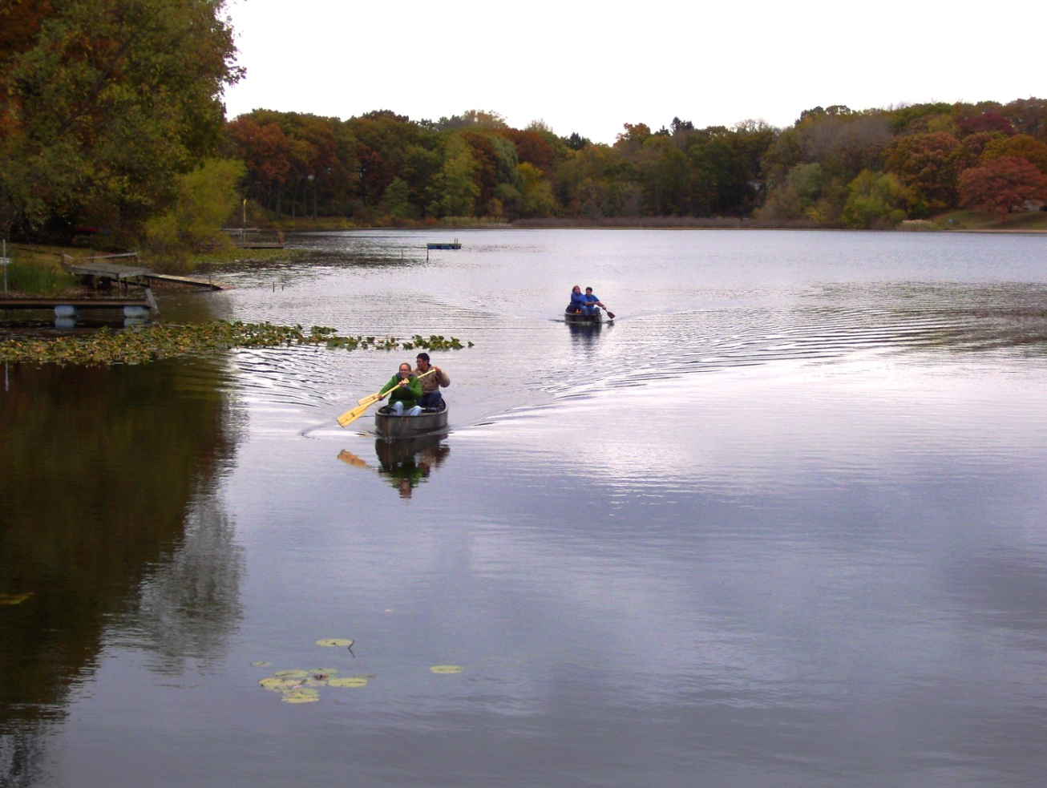
Where we’re headed next…
Which aspects of the course might be responsible for promoting these knowledge gains?
Might student engagement be connected to knowledge gained in some way?
Are these gains sticky (durable)?

Slide 15
Acknowledgements:
Heather Petcovic and Carla Koretsky are the co-PIs for the research study discussed in this presentation. This work is supported by the National Science Foundation under Grant No. GEO-0807578 (PI Petcovic).
Our thanks to:
Julie Libarkin for her input in the design of pre-course instruments
Karen McNeal for her advice for evaluating student conceptions of eutrophication.
Yoko Furukawa, Christof Meile, and Kim Hunter for their assistance in reviewing the 2010 version of the Geochemistry Knowledge Survey.

