Slide 1

LIMITING WATER QUALITY IMPACTS
DUE TO LARGE SCALE BLASTING
Presented by:
Charles A. Crocetti

Slide 2
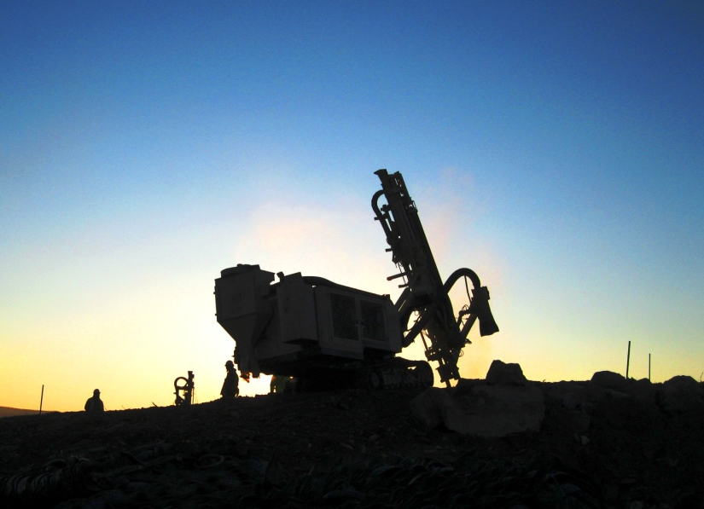
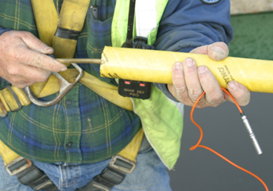
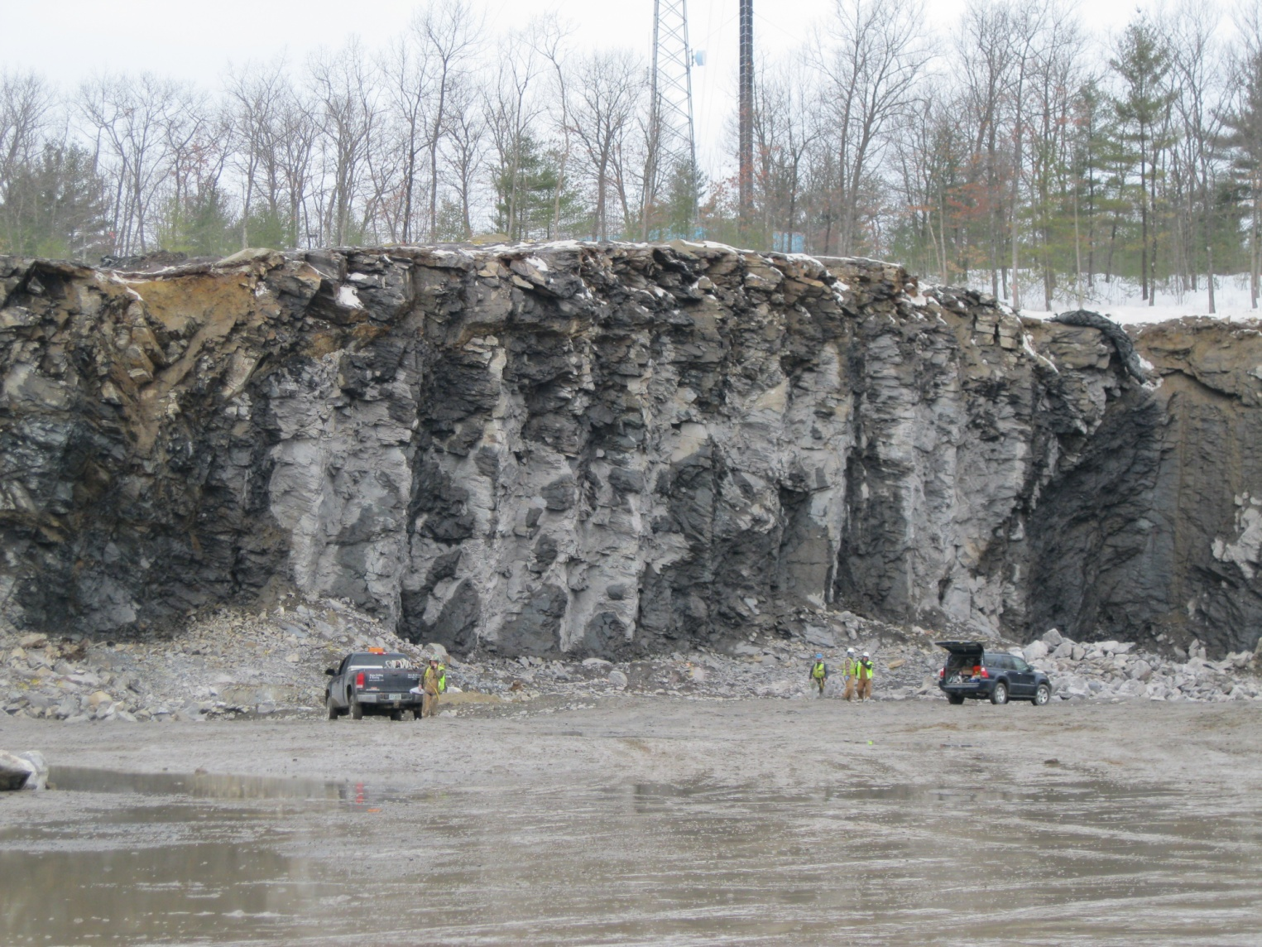
Outline
Site Background
Site Description
Water Quality Monitoring Program
Blasting Program
Observed Water Quality
Conclusions

Slide 3
Site Background
1 Million cubic yards of bedrock removal
Town water supply well 3,000’ from blasting
Several recent highly publicized nearby incidents blasting impacts to water supply wells
Very high level of scrutiny from Town, Town’s consultant, abutters and general public

Slide 4
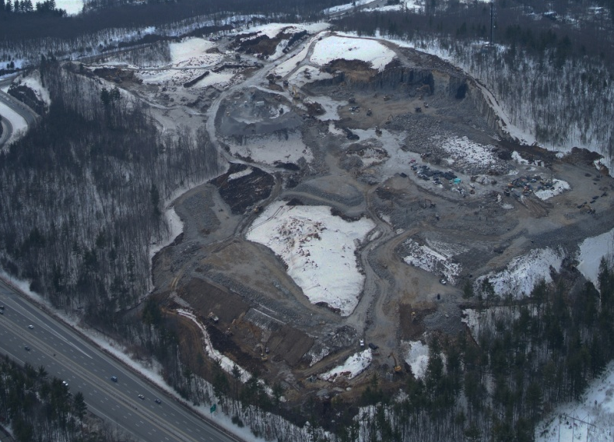
Site Description
400,000-square foot building footprint
160-acre site

Slide 5
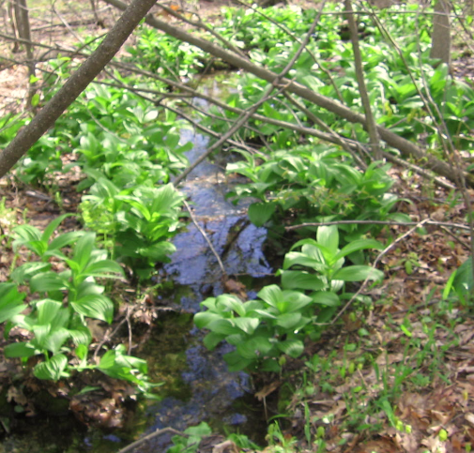
Development of Water Quality Monitoring Program
Monitoring locations
Monitoring frequency
Water quality parameters
Notification and Action Levels

Slide 6
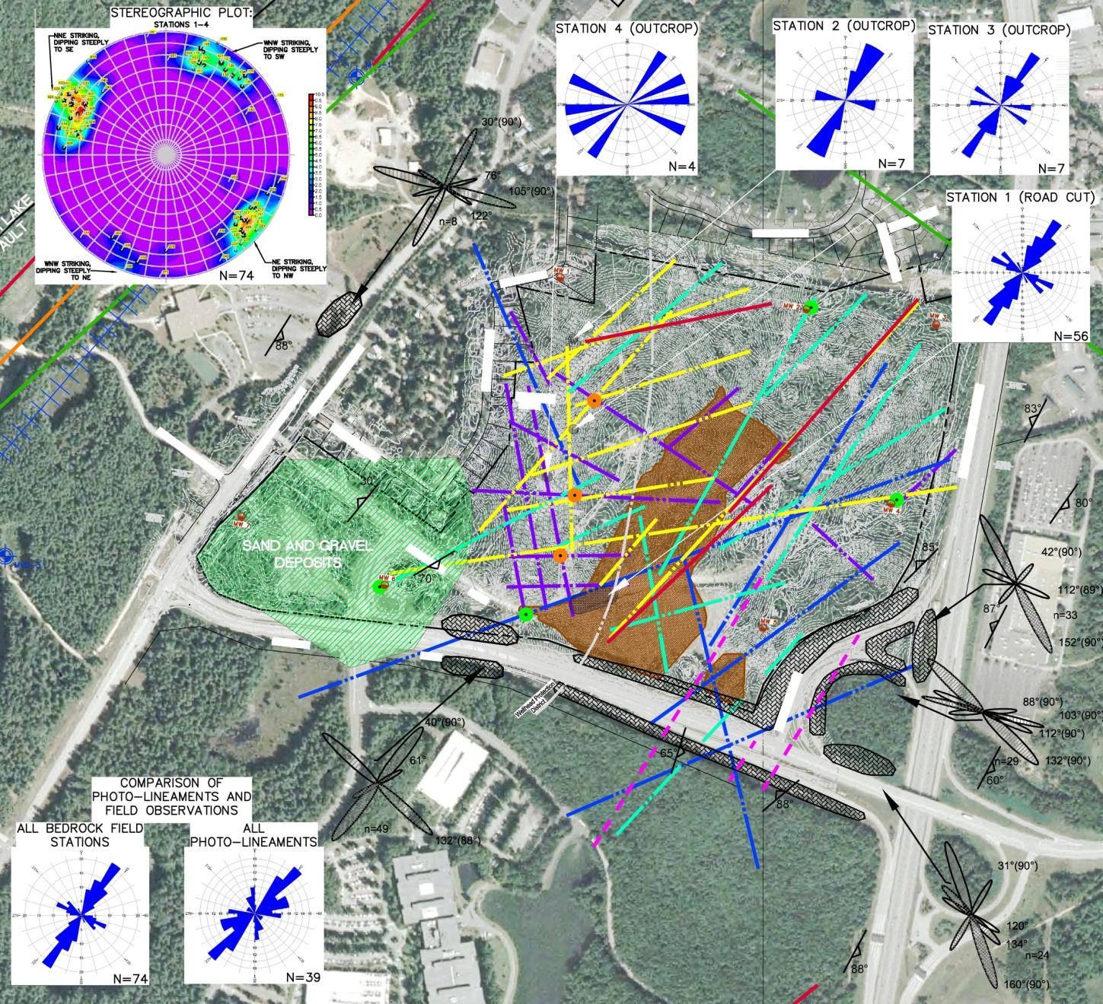


Fracture Trace/Bedrock Structural Analysis

Slide 7
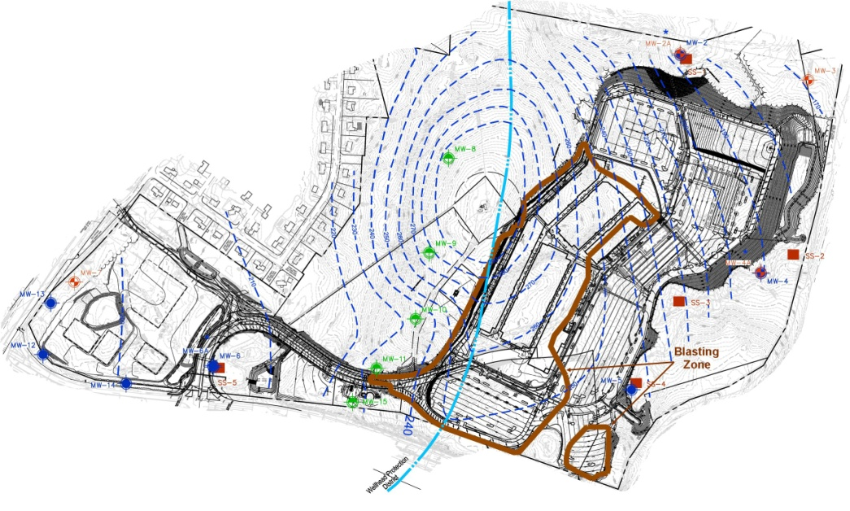
Groundwater and Surface Water Monitoring Locations
17 GW MWs - based on site hydrogeologic study, fracture trace analysis and bedrock structural evaluation
5 SW locations - based on site surface water drainage

Slide 8
Monitoring Frequency
One to three preconstruction rounds
23 Monthly rounds completed during construction – initial
ground breaking to receipt of CO
Semi-annual rounds for five years after completion of construction

Slide 9
Water Quality Parameters
Potential blasting agent components:
  Nitrate
  Ammonia
  PHCs
  VOCs
  PAHs
  Perchlorate
General water quality indicators
  TSS, conductivity, sodium, chloride, phosphorous

Slide 10
Notification and Action Levels
Inside WHPZ:
Notification Level - background or 25% of federal/ state groundwater and surface water standards, any detects for VOCs & PAHs, (nitrate - 2.5 mg/l)
Action Level - background or 50% of federal/state GW and SW standards (nitrate - 5 mg/l)
Outside WHPZ:
Notification and Action Levels - federal/state GW and SW standards (nitrate -10 mg/l)

Slide 11
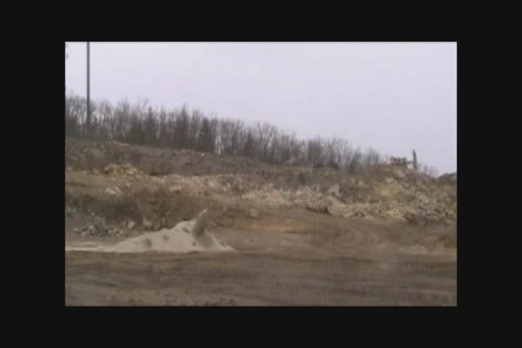
Blasting Program

Slide 12
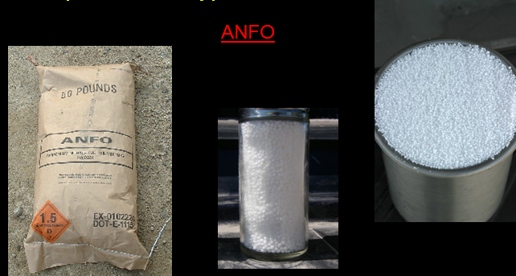
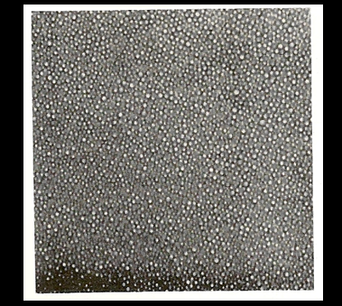
Blasting Program
No perchlorate containing explosives
No ANFO (ammonium nitrate/fuel oil) west of (inside) WHPZ, only emulsion-based blasting agents
Emulsions are relatively water resistant – ammonium nitrate
Solution is present as microscopic droplet emulsion in fuel (oil) phase.
ANFO: ammonium nitrate/fuel oil is relatively highly water soluble

Slide 13
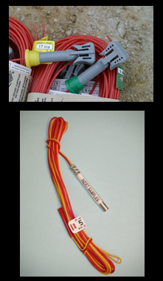
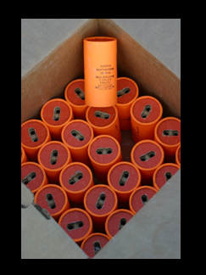
Blasting Program
One detonator per 10 feet of bedrock height
High velocity primers used to promote full explosive consumption
Detonators
High explosive velocity boosters/primers

Slide 14
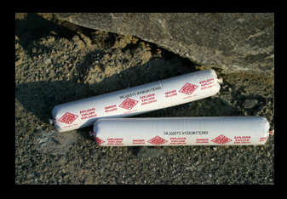
Blasting Program
Water removed from drill holes and prepackaged waterproof explosives used where water present, or significant fractures observed (to avoid emulsion loss into formation)
Prepackaged
waterproof explosives

Slide 15
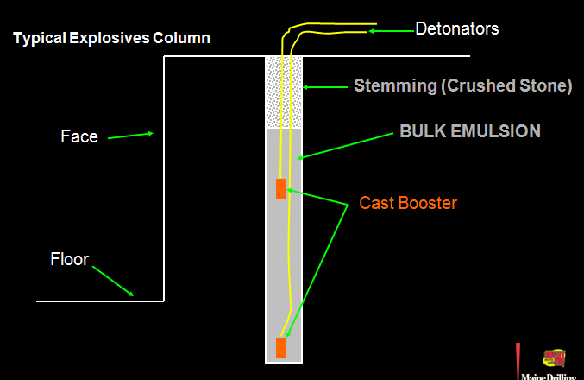

Blasting Program

Slide 16
Blasting Program
No blasting during precipitation events
Surface water to be diverted to the east including areas west of Wellhead Protection District Divide
No crushing operations or stockpiling of blasted rock west of Wellhead Protection District Divide
Total of 2,000,000 pounds of blasting agents used to remove 1,400,000 tons of bedrock

Slide 17
Observed Water Quality
Only minor exceedances of project water quality criteria related to site blasting – limited to nitrate
Appear due to “misfire” in late June 2011, because of dry summer, was not evident until September 2011
Generally limited to close proximity of misfire, highest nitrate =17 mg/l, nitrate >10 mg/l for 2 - 3 mos at most
No off-site impacts observed
No delays in construction due to these limited blasting-related impacts to water quality

Slide 18
Conclusions
Large quantities of rock can be blasted with only limited impacts to water quality if blasting plan has appropriate precautions, and plan is followed diligently
Observed water quality impacts were short-lived, did not extend off-site
Adequate background/pre-blasting data to demonstrate some limited water quality criteria exceedances are unrelated to blasting (e.g., phosphorous, low level PHCs)
Nitrogen-containing fertilizers should not be used during blasting, or used only very sparingly, to avoid possible “false-positive” for blasting impacts

Slide 19
Discussion
Chip Crocetti
cacrocetti@sanbornhead.com
(603) 415-6121

