Slide 1
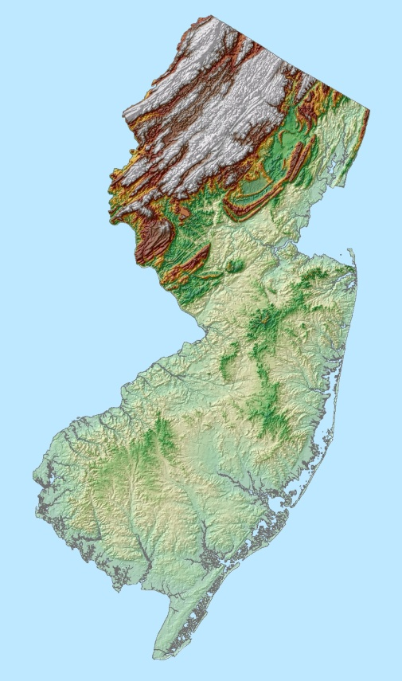


Impacts of Hurricane Sandy on the New Jersey Coastline and How Can We Respond?
Stewart Farrell, Ph.D.
Brad Smith, PSM
Jane Uptegrove, M.S.
Scott Stanford, Ph.D.
Notes:
Good morning! I hope everyone has been enjoying their experience at the GSA meeting, I know I sure have. I hope our presentation can provide you with a clear concept on how NJ is responding to the impacts of Hurricane Sandy and what can be done.
This presentation is a result of research by: The Coastal Research Center, and The New Jersey Geological and Water Survey

Slide 2
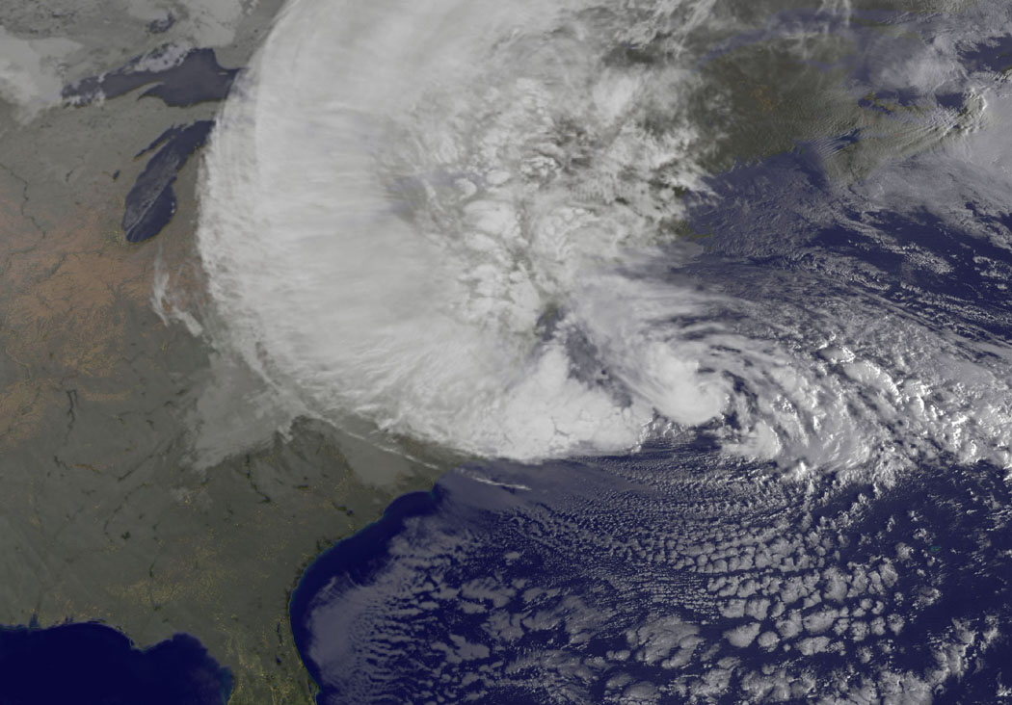
Hurricane Sandy
Sandy made landfall near Atlantic City, NJ. on October 29th at 8pm with sustained winds at 80mph (Category 1). High tide was at 8:20pm.
Occurred on a full moon high tide which made tides 20% higher than normal and amplified the storm surge.
Sandy was the second-largest Atlantic tropical cyclone on record with hurricane-force winds extending 175 miles from its center and tropical storm force winds extending out to 485 miles.
First Hurricane to make landfall in NJ Since 1903 “Vagabond Hurricane”.
Notes:
In the background you can see a satellite image and see just how large of a storm Hurricane Sandy really was.
(click)
Sandy made landfall near Atlantic City on October 29th at approximately 8pm with 80mph sustained winds. High tide was at 8:20 pm. Unfortunately Sandy occurred on a full moon high tide which made the tides 20% higher than normal and amplified the storm surge.
You might recall in 2011 Irene made landfall near Little Egg inlet. However, it was originally thought to have made landfall as a Hurricane but it was later downgraded to a Tropical Storm.

Slide 3
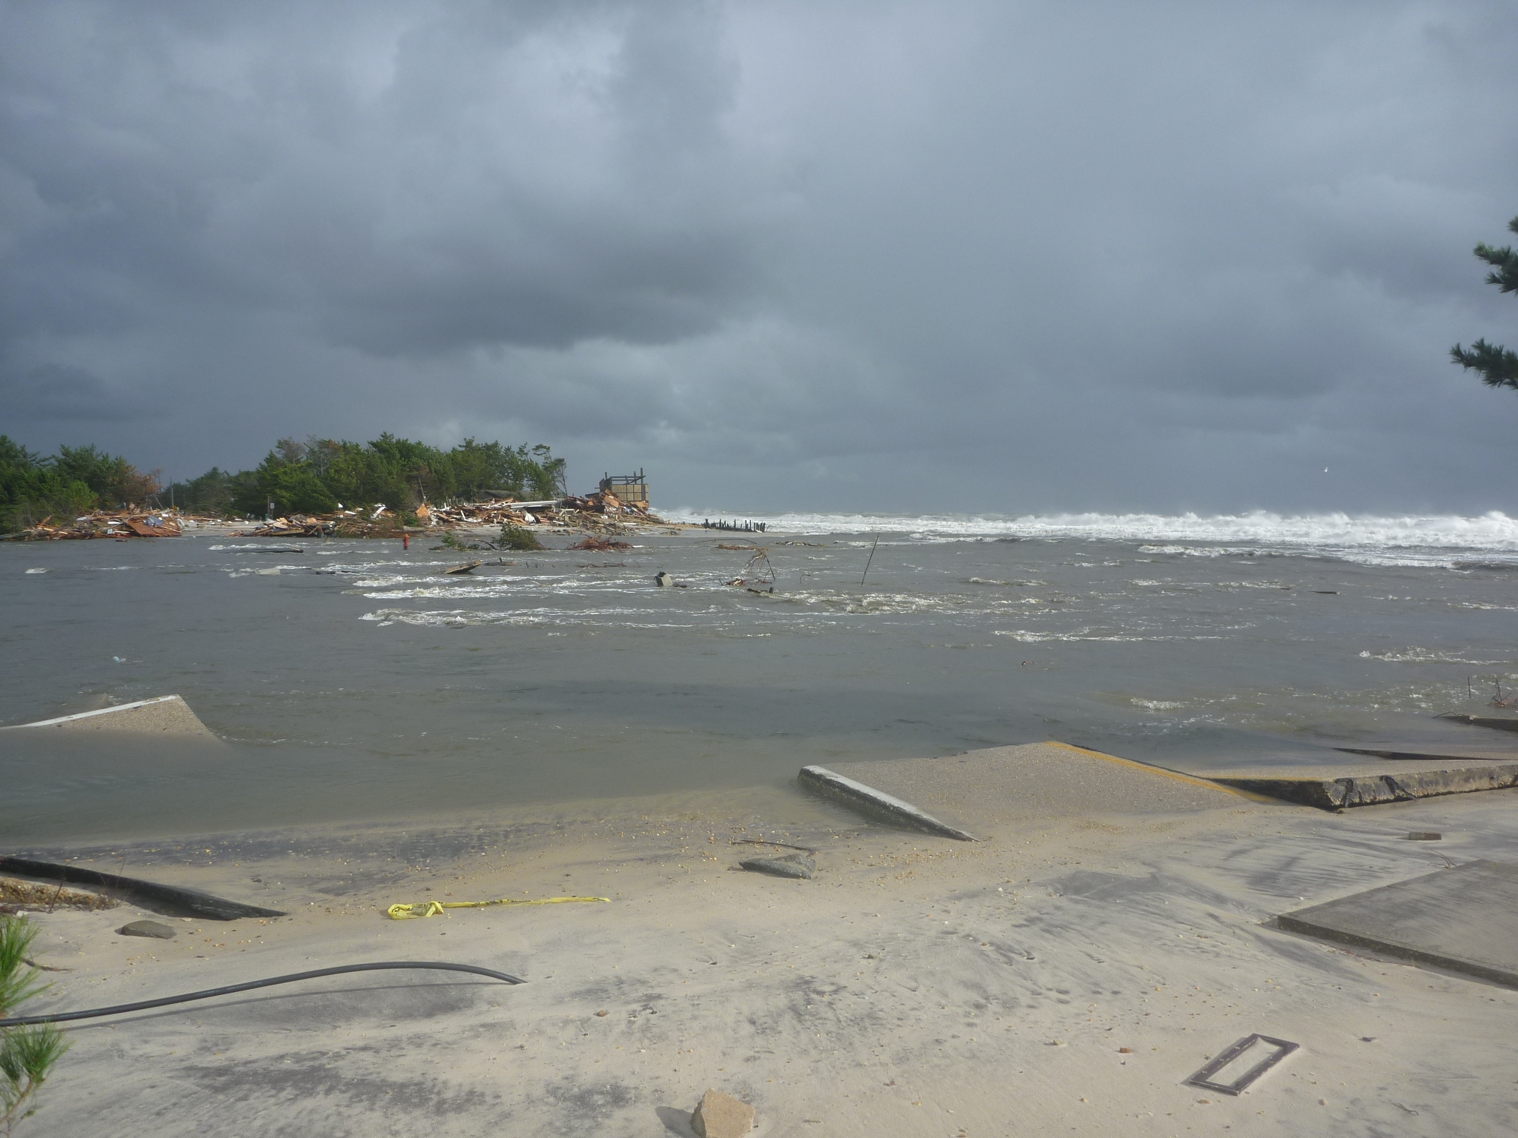
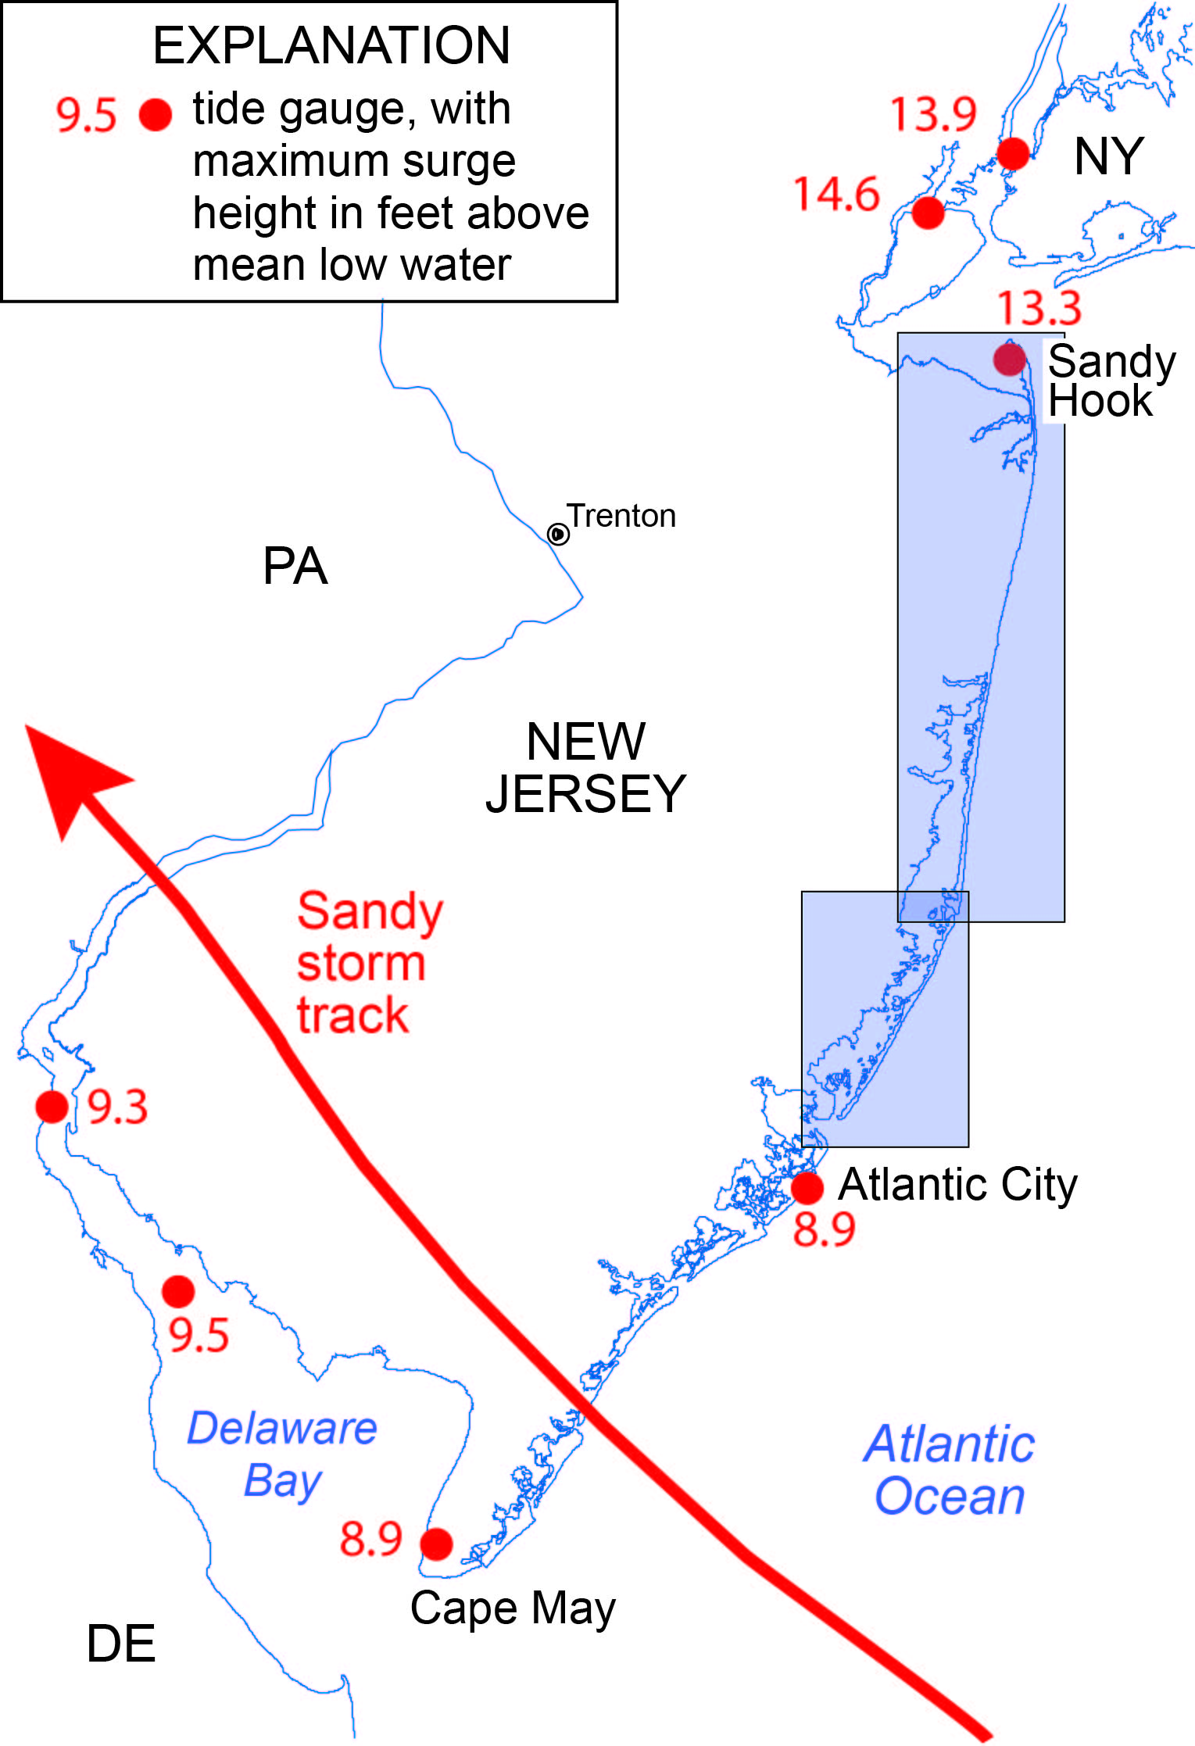
Notable Tide Gauge Readings During Sandy
Sandy Hook
13.3 feet above mean low water
The Battery (Lower Manhattan)
13.9 feet above mean low water
Kill van Kull (Staten Island)
14.6 feet above mean low water
Atlantic City & Cape May
8.9 feet above mean low water
Minor Tidal Flooding – 6.7 feet
Moderate Tidal Flooding – 7.7 feet
Major Tidal Flooding – 8.7 feet
Mean Lower Low Water
Sandy Hook Reference Tide Gauge
(Photo courtesy of Joseph Ochanas
NJDEP BCE, 2012)
Notes:
The background image shows the view looking north from rt. 35 North at the Herbert Street Inlet formed in Mantoloking. This is in Northern Ocean County…
(click)
Ok, so here you can see the Track of Hurricane Sandy. Surge levels were higher north of Atlantic City because prevailing winds were blowing onshore north of the
eye of the storm, geographically the configuration of the New Jersey and Long Islands’ shoreline funneled the surge onto the northern New Jersey shore, and into New York and Raritan bays.
(Read from slide)

Slide 4
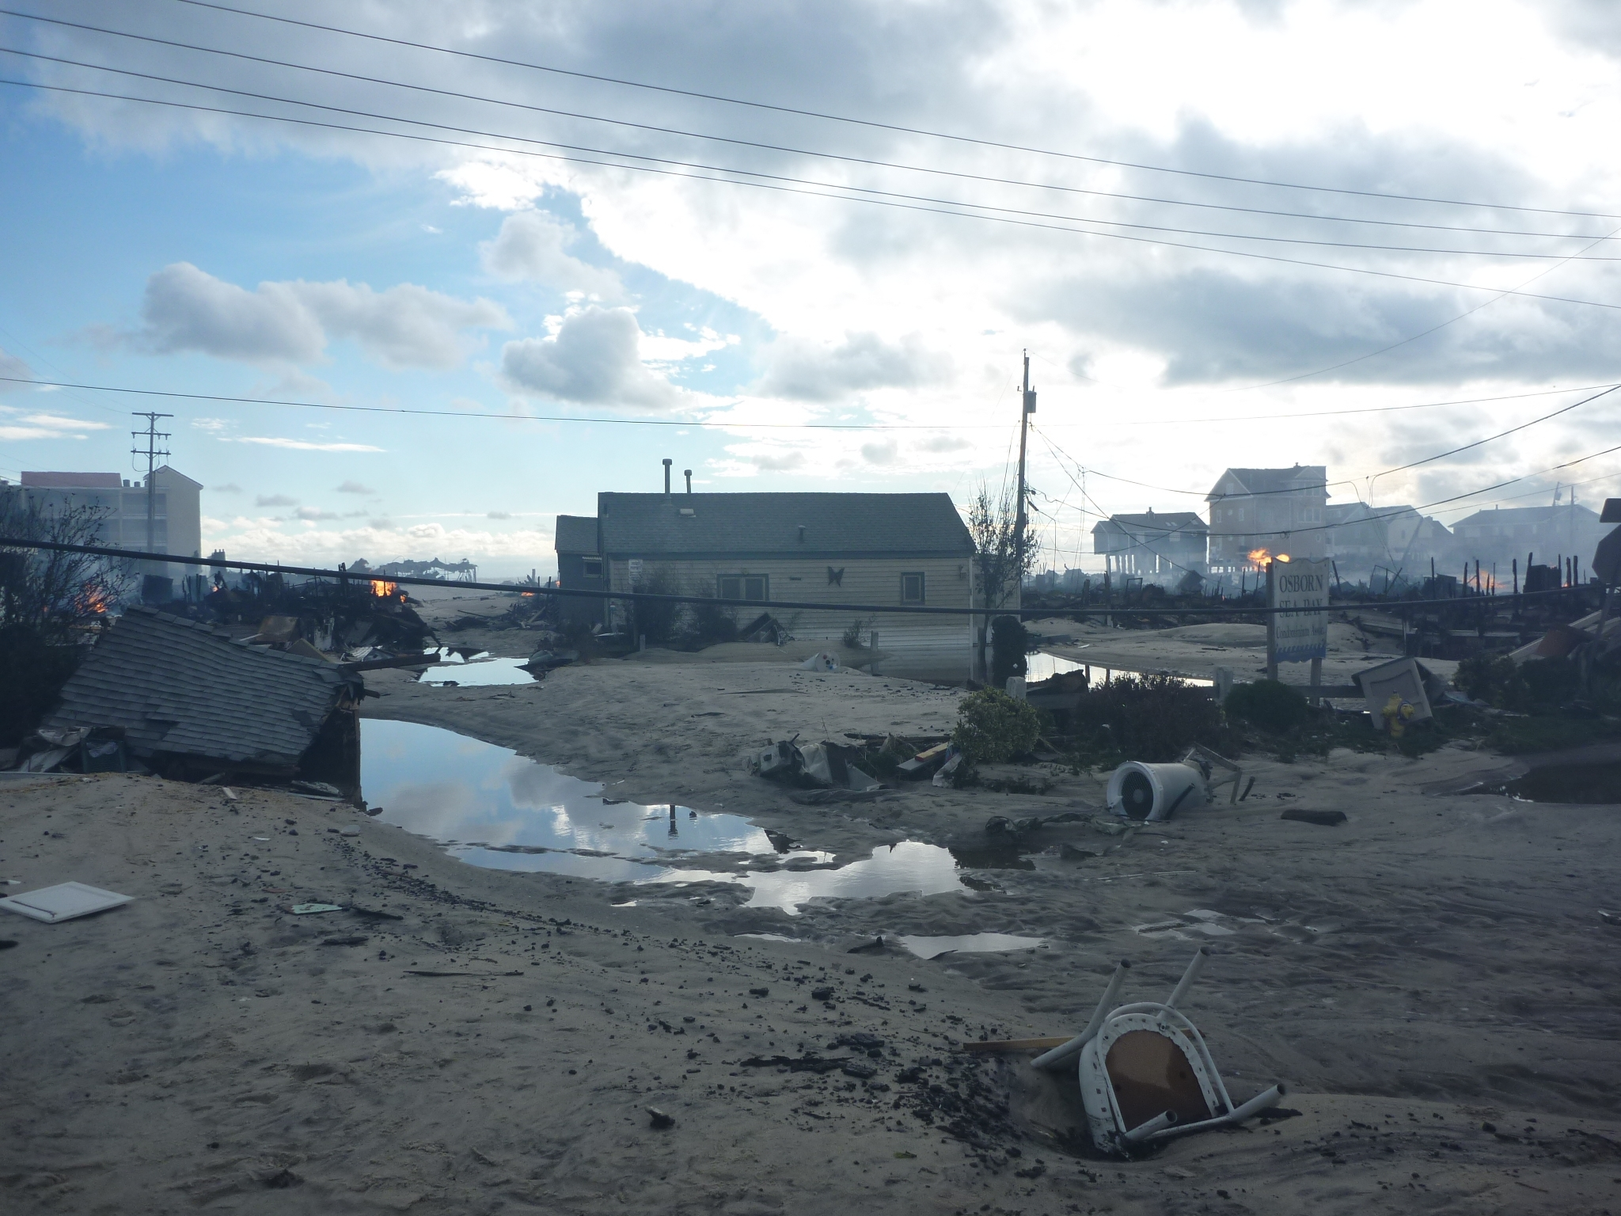
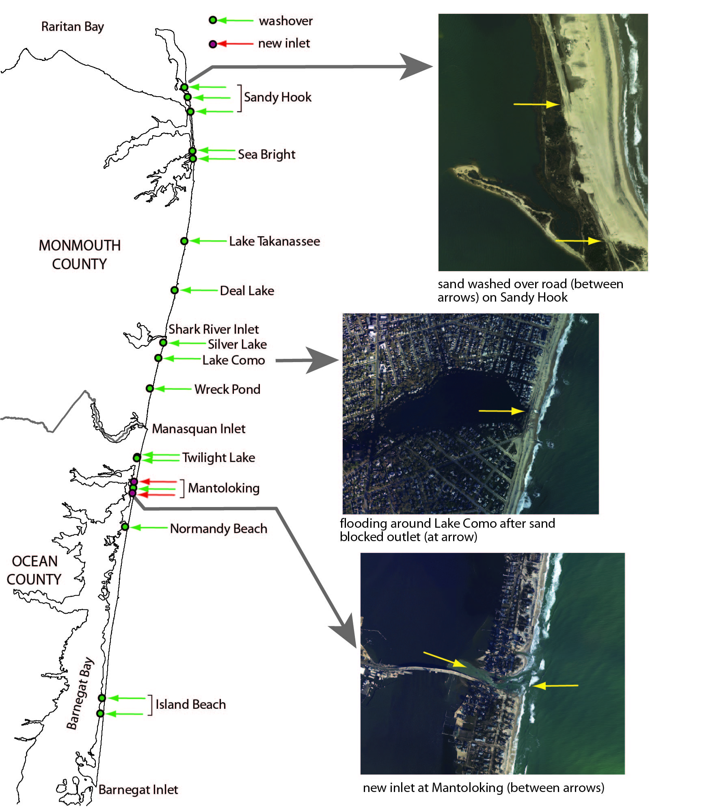
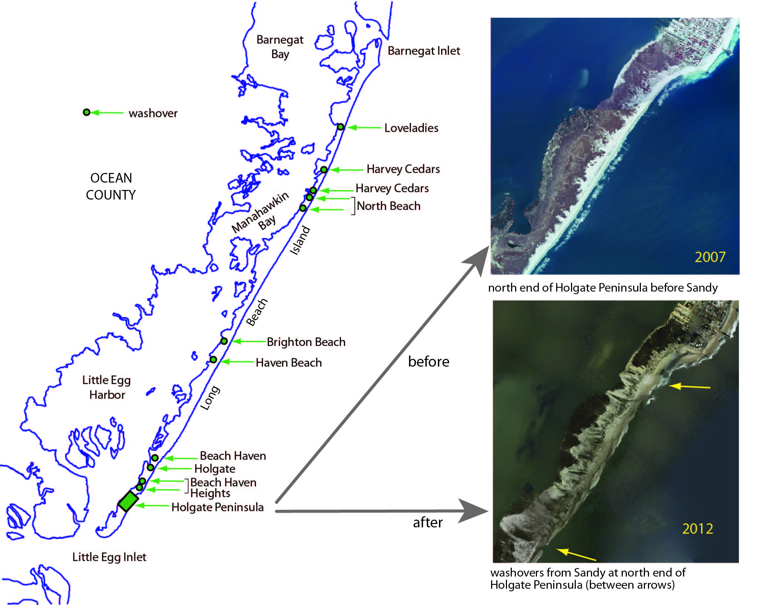
Washovers in Ocean & Monmouth County
The surge eroded dunes, flooded
beach communities, destroyed
structures, and washed sand inland
along the entire New Jersey shore.
The most prominent erosional
features were on the narrowest parts
of the barriers north of Little Egg
Inlet.
(Photo courtesy of Joseph Ochanas
NJDEP BCE, 2012)
Notes:
The Background image shows the view looking east from Brick Beach. This was one of the areas where the natural gas lines connected to the homes were severed and what was left standing after the Hurricane became an inferno when ignited, much like Highly publicized Breezy Point fires in Queens, NY.
(click)
You can see in these diagrams areas where there were washovers (shown by Green arrows) and where two new inlets in the north end of Barnegat Bay were formed in Mantoloking (shown by Red Arrows). You can see that sand from the beach and dunes was washed over the entire width of the barrier spit in a number of places.
The Holgate Peninsula at the southern tip of Long Beach Island, (shown in the top right image) is a beach that has not been stabilized or modified by roads, structures, seawalls, or artificial dunes, and so provides a view of the natural response to the storm surge. In the narrow northern end of the peninsula, sand was transported over the barrier island from the ocean side into the bay creating a series of washover fans extending 1.4 miles along the length of the beach. Under natural conditions, repeated storm washovers gradually move the barrier landward, depositing sand on top of the bay and salt-marsh deposits.

Slide 5
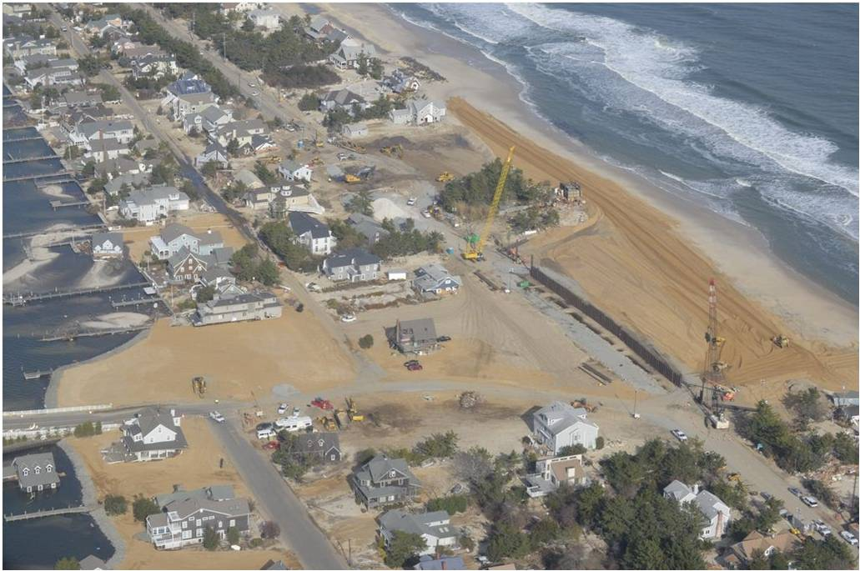
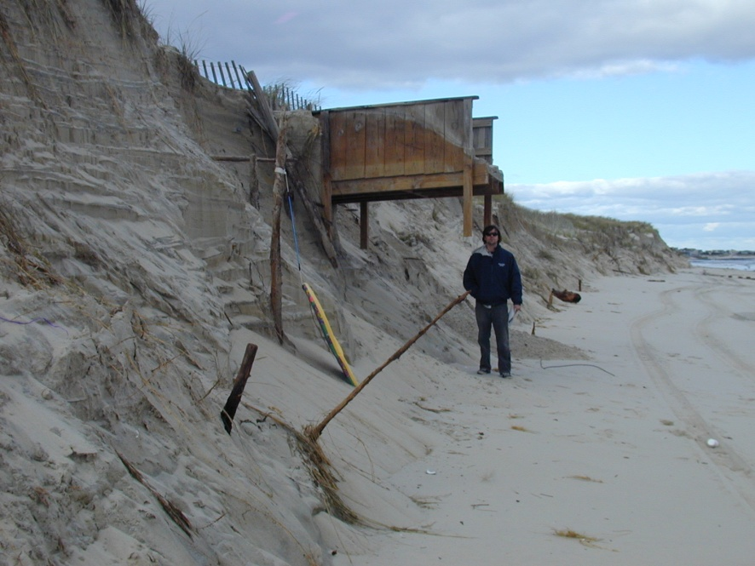
New Jersey Beach Profile Network
Established in 1986 as a result of Hurricane Gloria
Created out of a need to quantify the amount of damage and severity of the storm losses
Lack of data prevented the State from determining any damage for imbursement from the Federal Emergency Management Agency (FEMA)
(Photo courtesy of Dan Kelly, USACE Philadelphia District, 2012)
Notes:
Ok so the background image shows the Herbert Street Inlet in Mantoloking once it was filled in…
(click)
One of the research projects we used to analyze the storm damage is called the New Jersey Beach Profile Network or NJBPN. NJBPN was established in 1986; the motivation for this research originated from the coastal damage caused by a 1984 northeast storm and Hurricane Gloria in 1985. The lack of survey data for any New Jersey coastal region prior to the storm events restricted the State’s ability to substantiate the amount of damage and severity of the storm losses from beaches. This prevented the State from quantifying any damage for reimbursement through FEMA Disaster Declaration Funds.

Slide 6
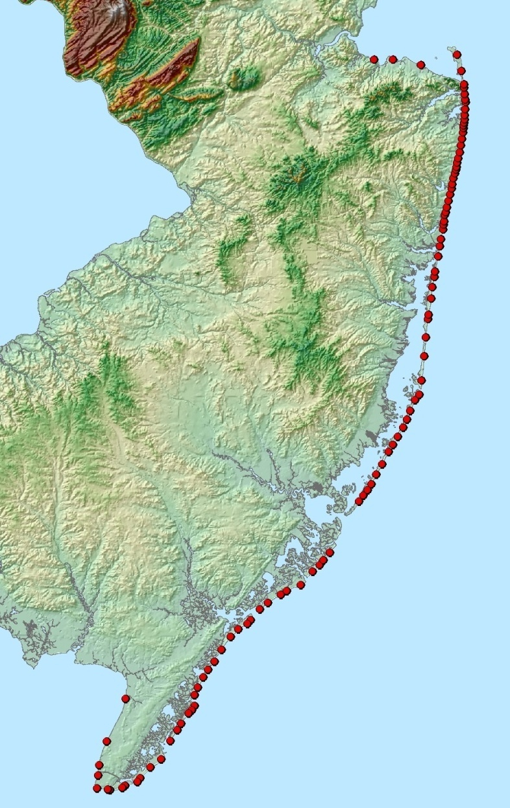
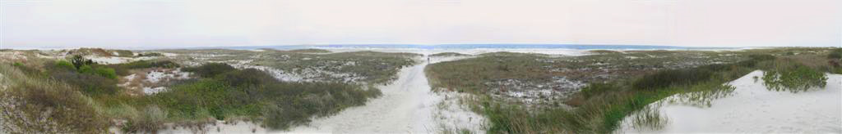
New Jersey Beach Profile Network
Shoreline and volume changes along New Jersey’s coast
NJBPN consists of 105 beach profile sites along the entire shoreline, including the Raritan and Delaware Bays
Notes:
NJBPN monitors shoreline and volume changes along New Jersey’s Coast, and consists of 105 beach profile sites along NJ’s shoreline which is surveyed bi-annually. The image on the left here shows each the entire Beach Profile Network.

Slide 7
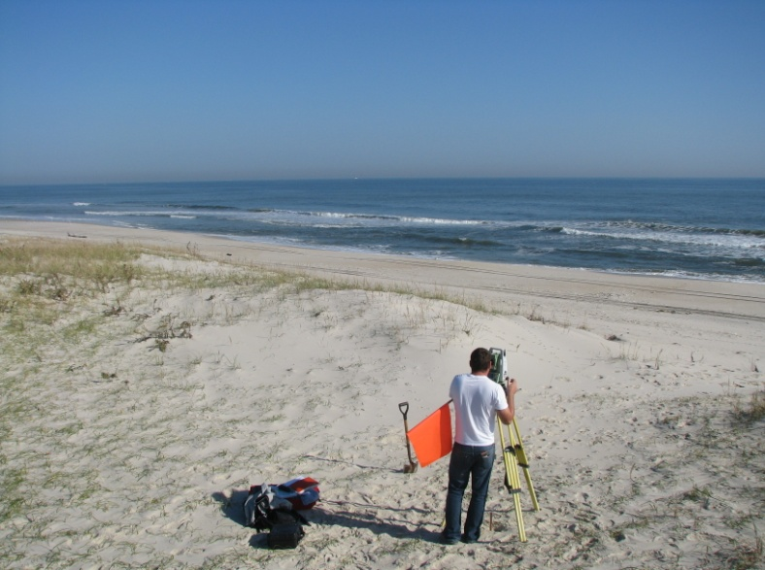
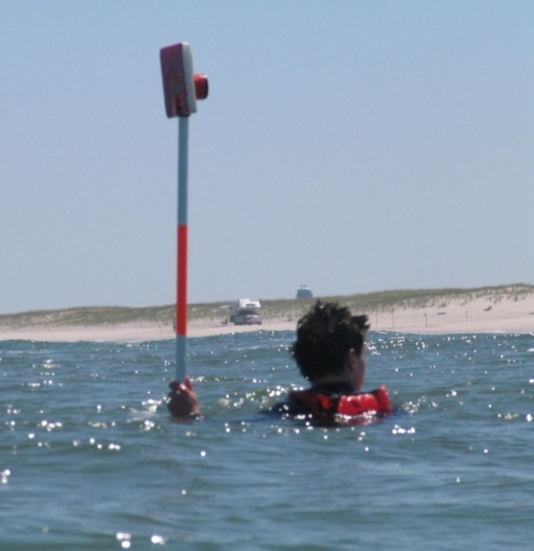
Data Collection
The dune, beach, and nearshore are surveyed at each profile site twice a year (fall and spring), and analyzed for seasonal and multiyear changes in shoreline position and sand volume.
Survey grade total station transit technology
X, Y, and Z data is collected to create a topographic profile of the dune, beach, and nearshore to a minimum depth of 12 feet
Photographic record is kept of the beach/dune system at each site
Notes:
The beach profiles are surveyed by walking the onshore portion and by swimming the offshore portion. Each profile starts at a fixed reference position landward of the dunes, and extends up and over the dunes, across the beach, and out into the nearshore to a closure depth between 12-20 feet.
Elevation and distance measurements are made at every significant change in slope along the profile (or every 25-30 feet), and X, Y, and Z data is collected using RTK-GPS and total station transit technologies to create a topographic profile.

Slide 8
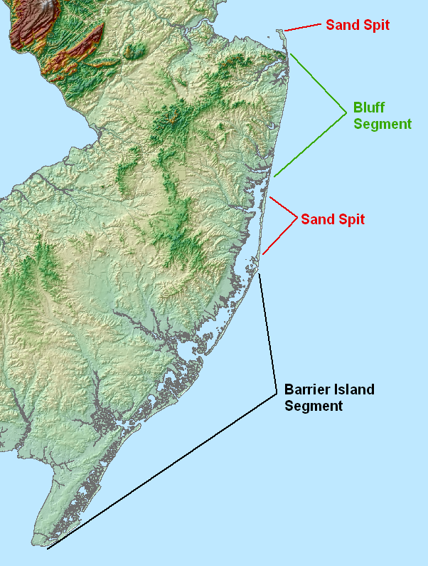
New Jersey Coastal Zone
Monmouth County headlands consist of beaches backed by a bluff of older sediments and two major sand spits
One to the north from Long Branch (Sandy Hook)
One to the south from Bay Head (Mantoloking to Island Beach State Park)
The barrier island segmented shoreline covers the remainder of the NJ coastline where individual islands are separated from the mainland by a series of bays and tidal lagoons
Notes:
Here’s a bit of background information about the New Jersey Coastal Zone:
(Read first 3 bullets)
The northern NJ coast in Monmouth County is carved into older geologic sedimentary units that created a sandy beach backed by a bluff of the older sediments, which eroded during serious storm events. The erosion provided new sand supplies and some gravel to the beach system, but the repeated bluff retreat produced by storms quickly became a serious problem following extensive human development during the last third of the 19th Century.
(Read forth bullet)
These islands have no natural local sand supply to add to the beach forcing the island to follow any rise in sea level by moving landward. These islands continue to be in ongoing equilibrium between storms, waves, sea level and tidal currents in spite of all human efforts to enforce stability and bring permanence for man-made development.

Slide 9
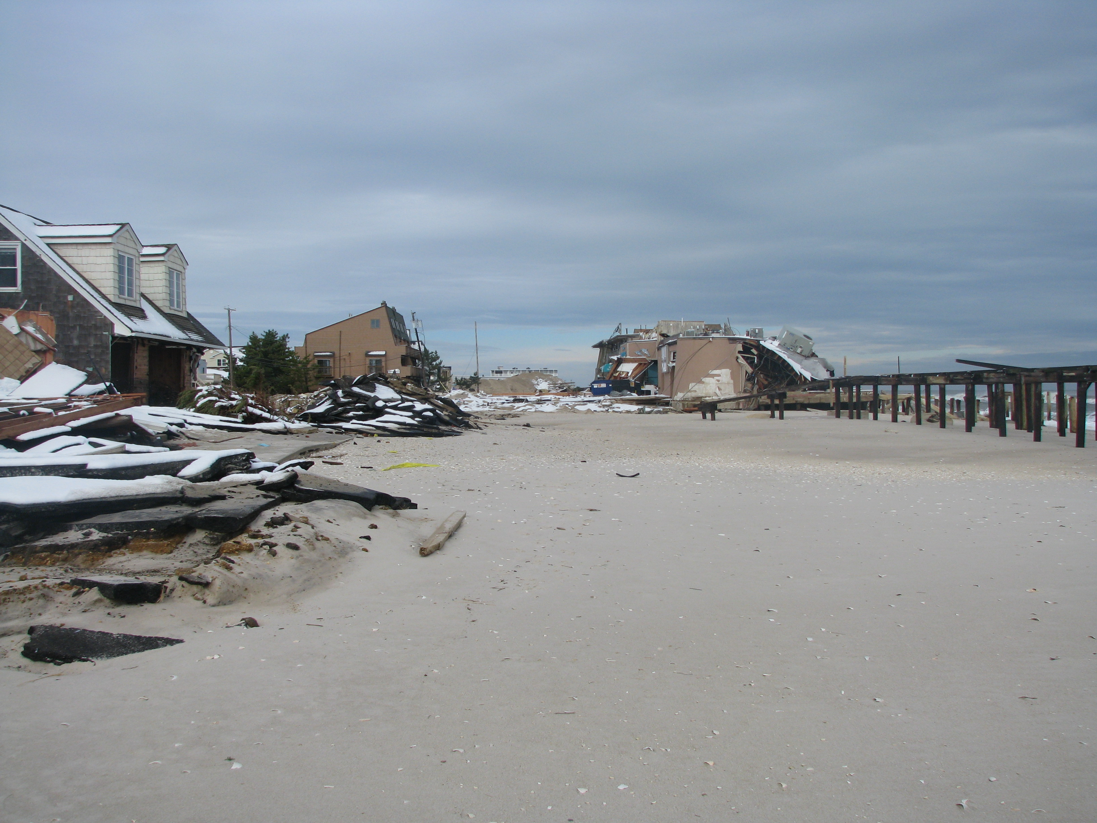
Beach Dune Susceptibility Assessment
A GIS-based beach-dune system susceptibility assessment began in 2007 to evaluate the performance potential of the oceanfront beach-dune system, identifying weaknesses in the system and highlighting areas that may be vulnerable to storm damage.
The assessment was carried out by segmenting the beach-dune system, long-shore into uniform zonal analysis areas, called "bins“.
For each bin, several variables relating to dune, beach, and nearshore geomorphology, and to the presence of vegetation and structures (such as groins), were collected, compiled, and evaluated in order to determine the susceptibility of the dune system to potential damage from storm activity.
The assessments have been performed for all of Ocean and Atlantic County prior to Hurricane Sandy.
Cape May County currently being assessed
Notes:
The background image was taken in 8th Avenue in Ortley Beach, NJ. Which is in Northern Ocean County as well. What is interesting to note here is what is not shown in this picture. This photo was taken from where a street intersection used to be. Seaward of this picture there used to be road, a sidewalk, a boardwalk, a dune, and then a beach. All of that has obviously been removed…
(click)
Another key research project used to analyze the impact Hurricane Sandy had was The Beach Dune Susceptibility Assessment. It is a GIS based dune susceptibility assessment that began in 2007 to evaluate the performance potential of beach-dune systems.

Slide 10
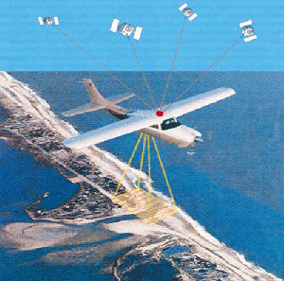
How does the Assessment work?
Incorporates advanced spatial analytical techniques
GIS (Geographic Information Systems)
LiDAR (LIght Detection And Ranging) data
Photogrammetry (Use of vertical
aerial photography to perform analysis)
RTK-GPS surveying (verification)
Utilizes the knowledge and expertise of CRC staff experience
Storm Survey experience (39 years)
NJBPN (26 years)
Post storm surveys and analysis
RTK-GPS and Total Station Survey of storm damage and calculation of sand losses create a real-life testing of the assessments validity and facilitates improvements in methodology and technique.
Notes:
The Dune Susceptibility works by incorporating GIS, LIDAR, Photogrammetry RTK-GPS surveys for verification.
Hurricane Sandy allowed us an opportunity for a real life testing of the assessments validity

Slide 11
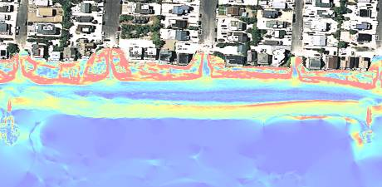
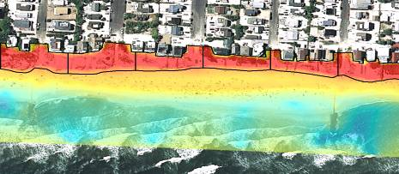
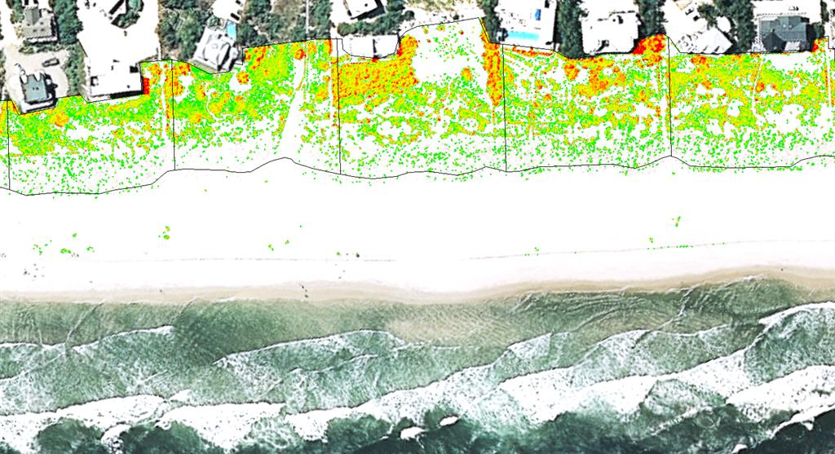
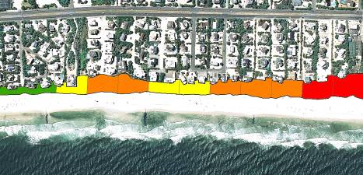
Beach Dune Susceptibility Assessment
Incorporates advanced spatial analytical techniques
Photogrammetry (Use of vertical aerial photography to perform analysis)
Beach Slope
Dune Elevation
Dune Vegetation
Dune Width
Notes:
Here you can see the various spatial analytical techniques; in particular the use of photogrammetry.
Particularly beach slope, dune elevation, dune vegetation, and dune width.

Slide 12
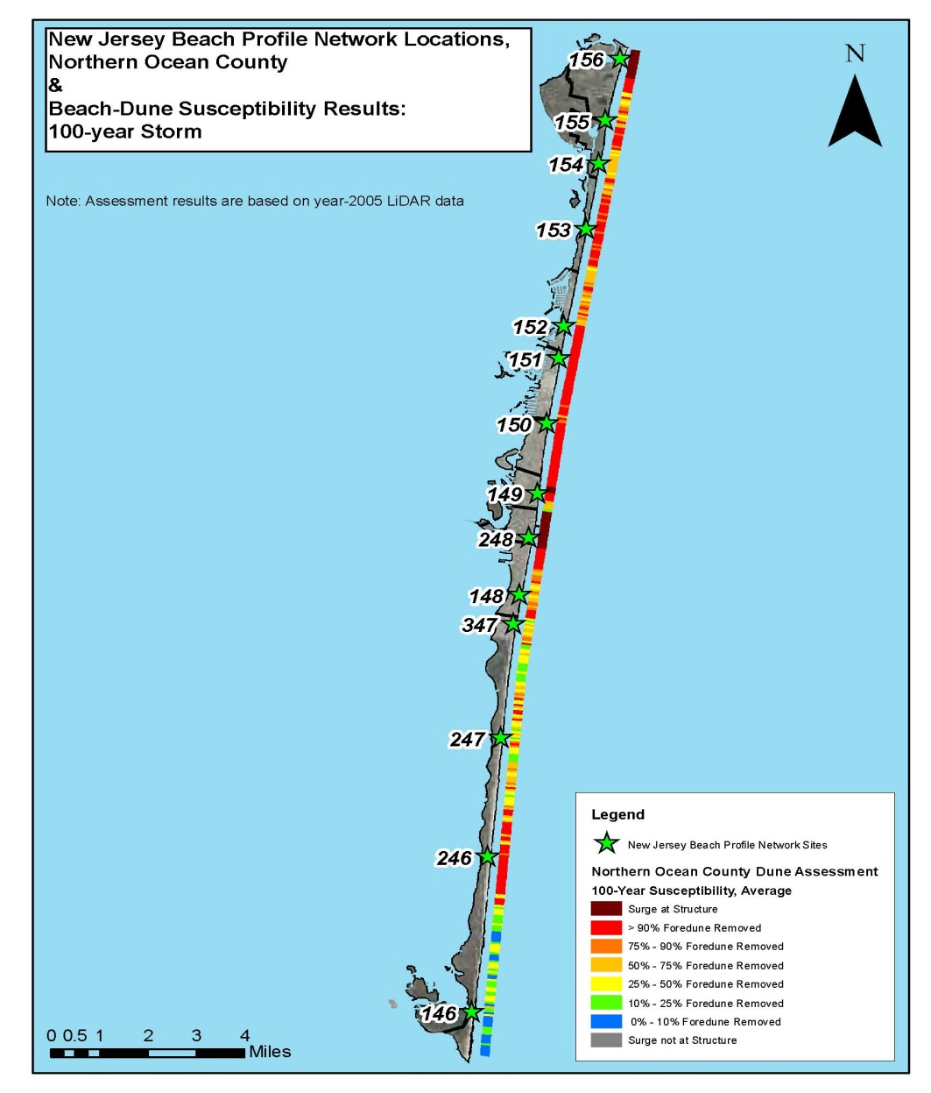
Northern Ocean County
14 pre-existing New Jersey Beach Profile Network (NJBPN) monitoring sites were used to provide an accurate comparison and assessment of storm related shoreline and beach volume changes.
Notes:
Ok so here you have northern Ocean County; with site 146 to the south being the southern extent of Island Beach State Park, and site 156 to the north being Point Pleasant. Here you see the product of the dune susceptibility assessment on one of the hardest hit areas of Northern Ocean County where 14 pre-existing NJBPN monitoring sites were used to provide an accurate assessment of the storm related shoreline and beach volume changes and to test the dune assessments validity.
In the bottom right is the scale where you can see that red represents 90% foredune removal to blue which represents 10% foredune removal. Notice the significant amount of reds and oranges in this section…

Slide 13
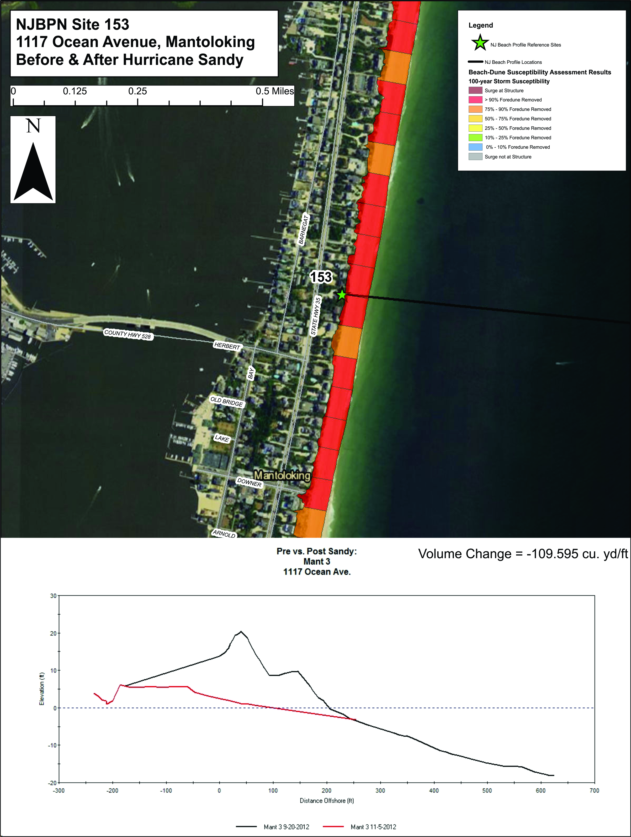
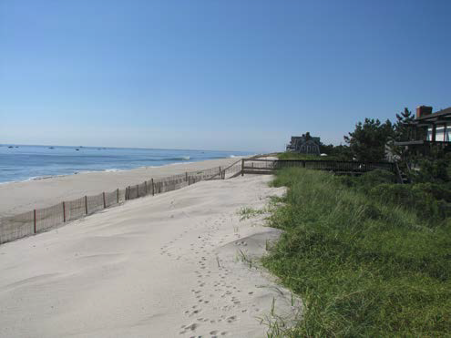
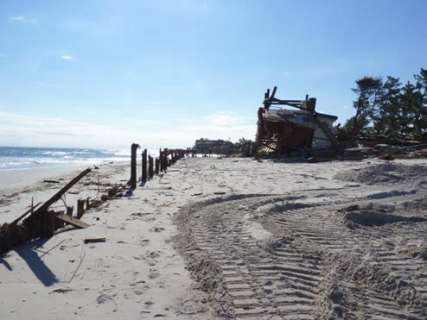
Mantoloking NJBPN 153
Before
After
Notes:
Here’s a close-up look at the dune susceptibility model in one of the hardest hit locations in the state; Mantoloking near Herbert Street. You can see (in the bottom left) the before and after profile of the beach, along with the before and after photos of the site (to the right). There are a few things that are important to note here.
1st is that the dune susceptibility shows that with a 100 years storm greater than 90% of the foredune was predicted to be removed.
2nd you can see in the plot shown here in the bottom left that the entire dune was removed, confirming the prediction made by the dune susceptibility model.
3rd the before an after images do not appear as dramatic as they really are. These pictures were taken in the exact same location horizontally. Where before the storm the elevation was 20 ft. after the storm the elevation was 1 ft (NAVD 88).

Slide 14
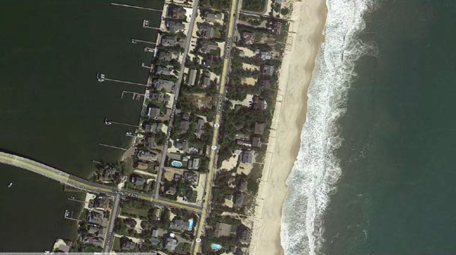
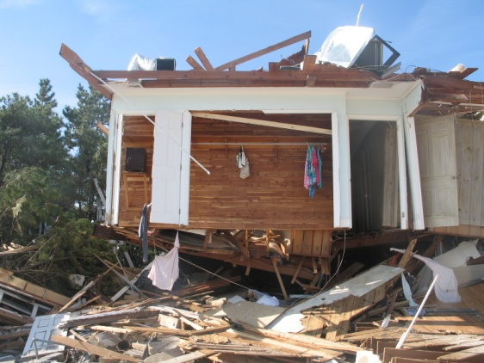
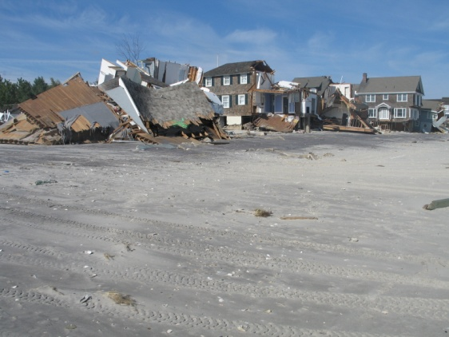
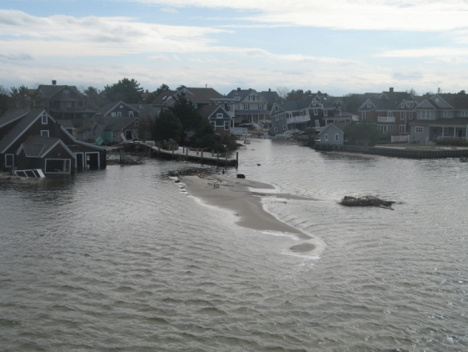
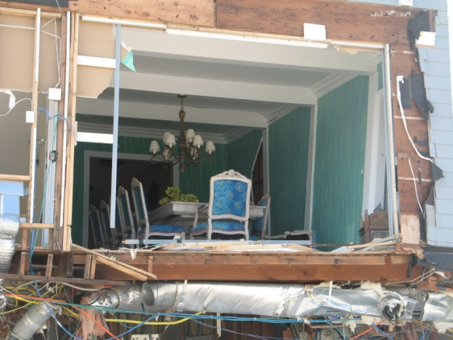
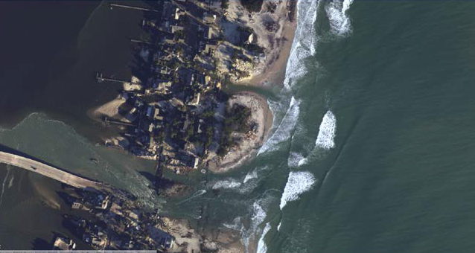
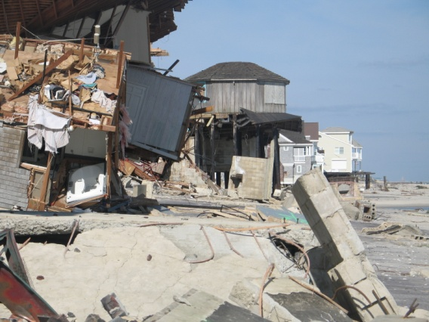
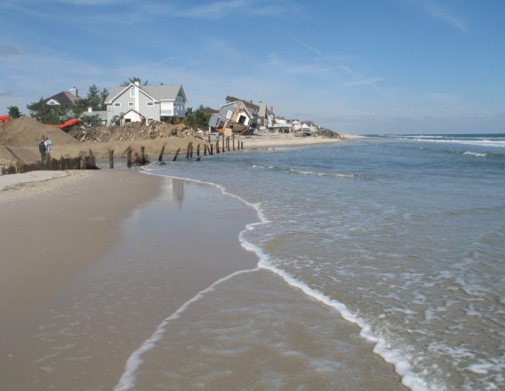
Mantoloking NJBPN 153
Before
After
Notes:
Here’s another look at the location highlighted in the previous slide. Notice the red arrows showing configuration before and after Hurricane Sandy. 2 inlets opened up here one as Herbert Street (to the south) and one at Lymans Street (to the north).

Slide 15
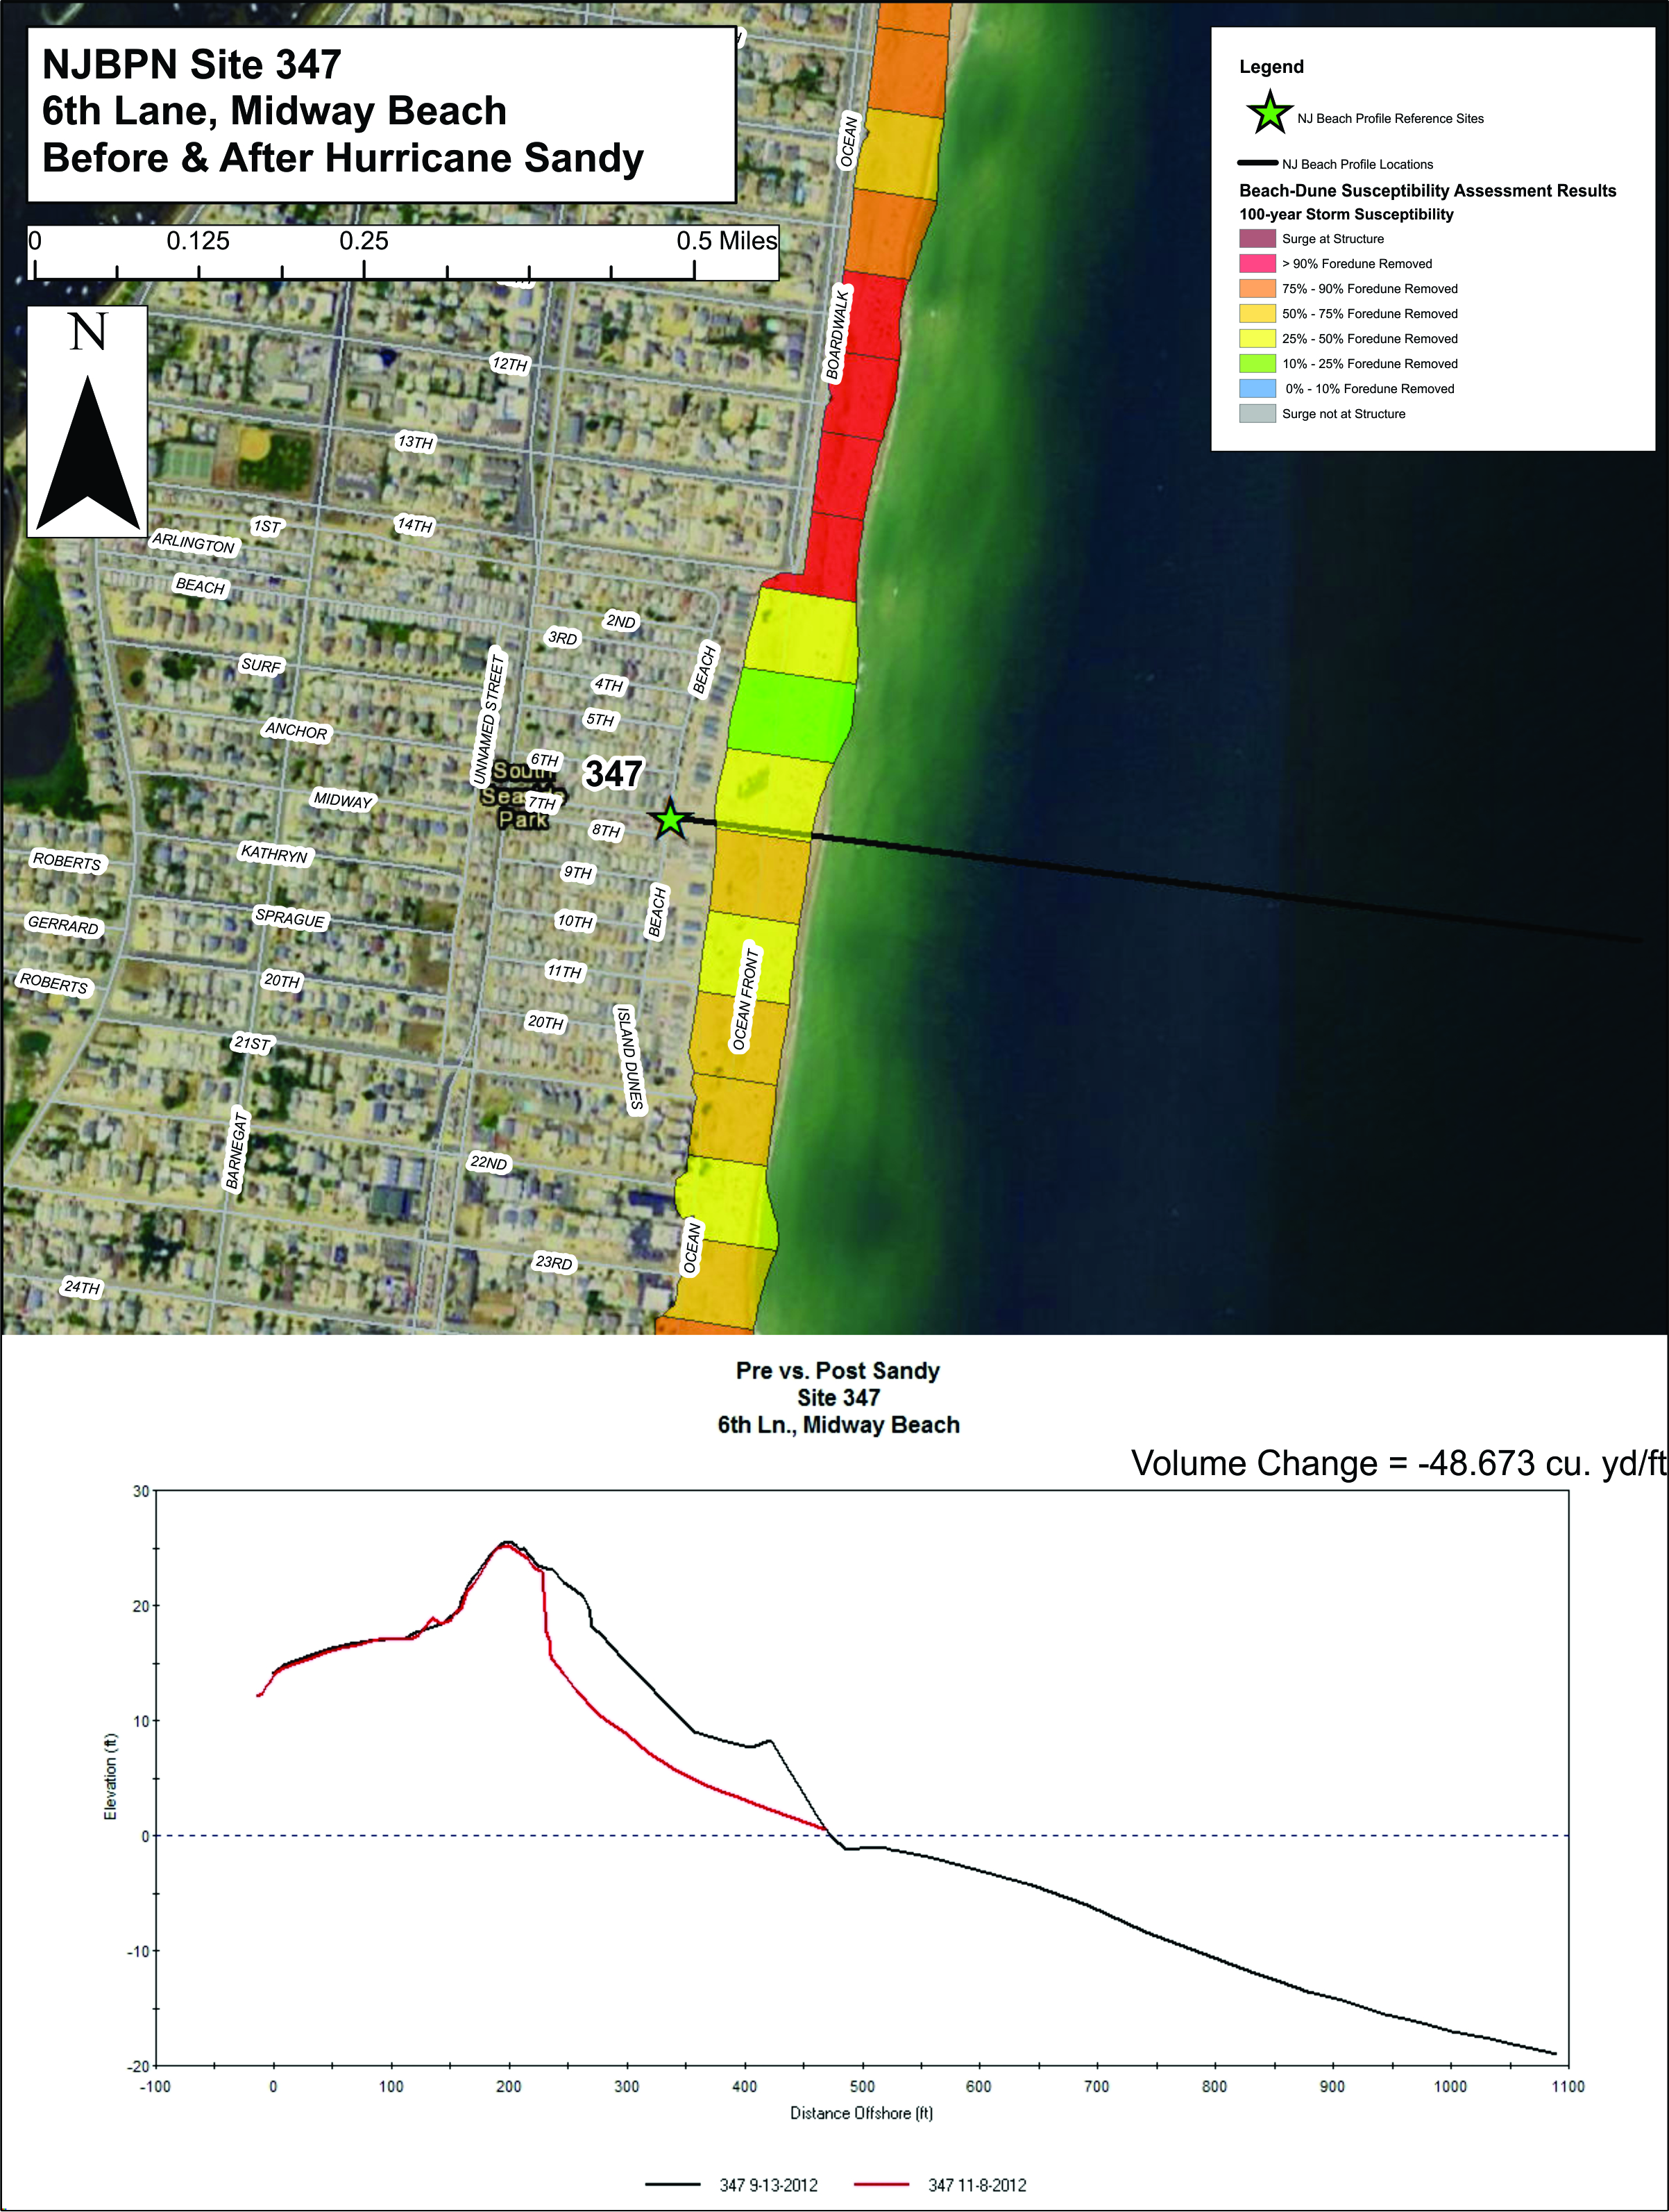
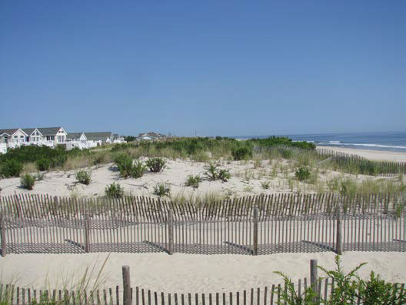
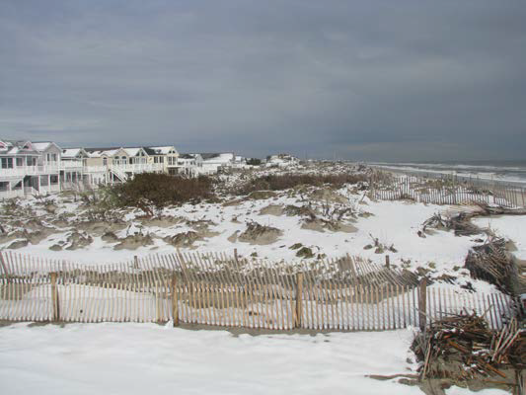
Seaside Park NJBPN 347
Before
After
Notes:
Ok so here’s another site in Northern Ocean County in Seaside Park. NJ. You’ll notice that instead of the consistent red colors (which represented greater than 90% foredune removal), here you’re seeing yellow and green colors which represent 25% of the foredune being removed as a result of a 100 year storm event.
1st thing you’ll notice from the plot (located in the lower left of the screen) is that the dune survived the storm as predicted from the dune susceptibility assessment.
The 2nd thing you’ll notice visually from the pictures is that the homes that exist in both the before and after images are intact and undamaged. A significant amount of sand was lost from the dune however, in the end the dunes did what they were supposed to do and held.

Slide 16
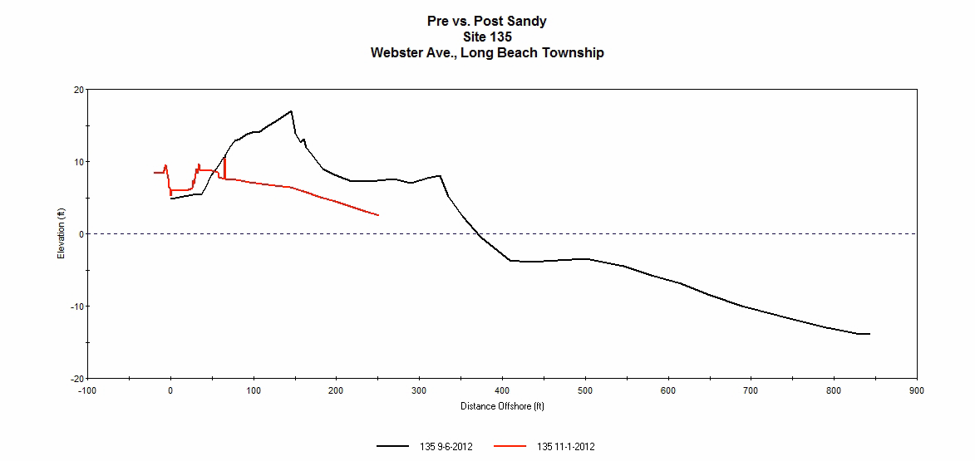
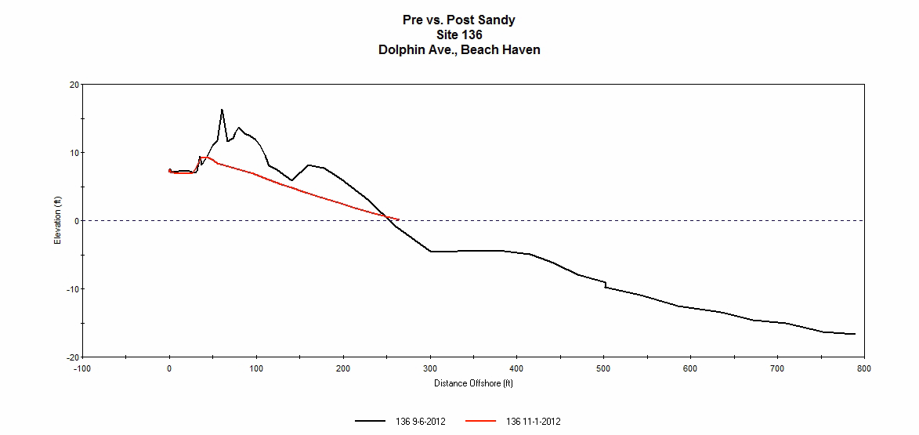
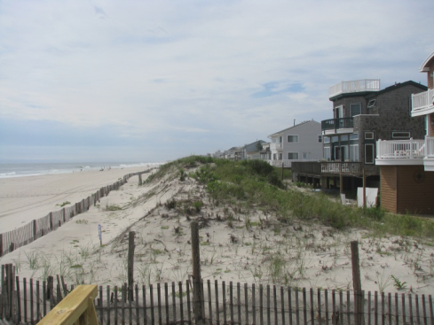
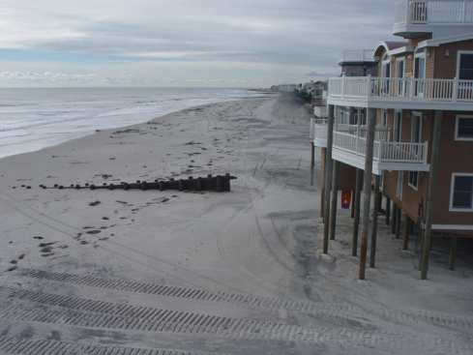
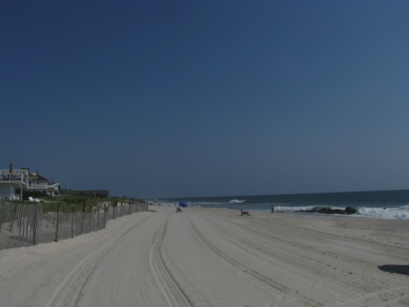
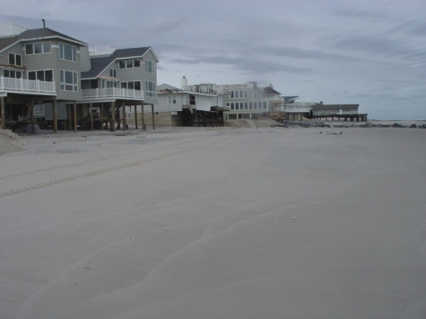
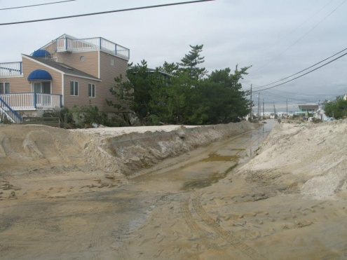
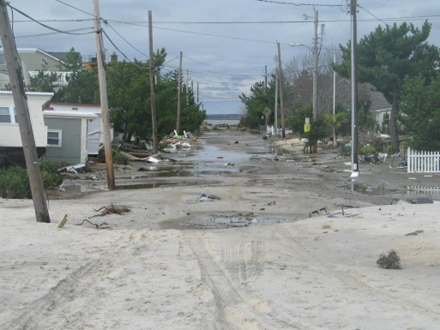
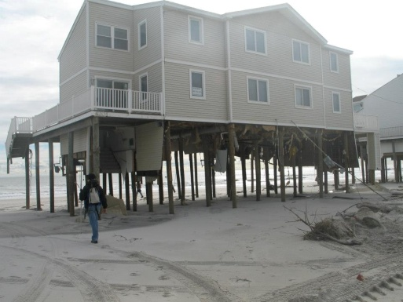
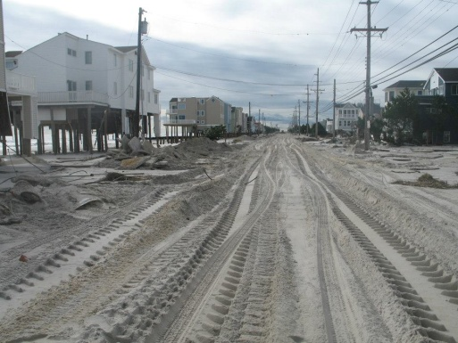
LBI - Holgate
Before
After
Before
After
Notes:
So here’s another area that was particularly hard by Hurricane Sandy. The southern portion of Long Beach Island, particularly Holgate and Beach Haven.
At site 135 in Holgate (to the left) you can see from both the plot and from the before and after photos that the dune was completely removed and the entire first floor of all of these oceanfront homes has been completely removed.
Same story at Site 136 in Beach Haven.
On thing that is interesting to note that we noticed was that the shoreline positions in many of the hardest hit areas didn’t change significantly. What happened was that the storm surge came in so quickly that it immediately elevated the water level to the extent that the swash and berm were underwater and the massive waves began crashing directly onto the dunes.

Slide 17
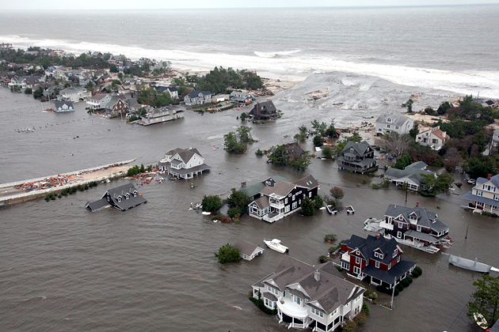
NJ Cumulative Sand Volume Losses From Sandy
Cape May County -2,241,874
Atlantic County -845,132
Ocean County -7,590,414.86
Monmouth County - -3,339,074
Total for NJ -14,016,494.86 cu yd*
*Preliminary numbers, does not count losses to natural areas or sand volume offshore.
Notes:
The background image again shows the Herbert Street Inlet in Mantoloking while still inundated with water during Hurricane Sandy. You can see on the left the Herbert Street bridge; this is the location of the inlet highlighted earlier.
Ok so what were the approximate losses?
Cape May 2.2 million cubic yards
Atlantic 845,000 cubic yards
Ocean 7.6 million cubic yards
And Monmouth 3.3 million cubic yards.
For a total of 14 million cubic yards of sand lost.

Slide 18
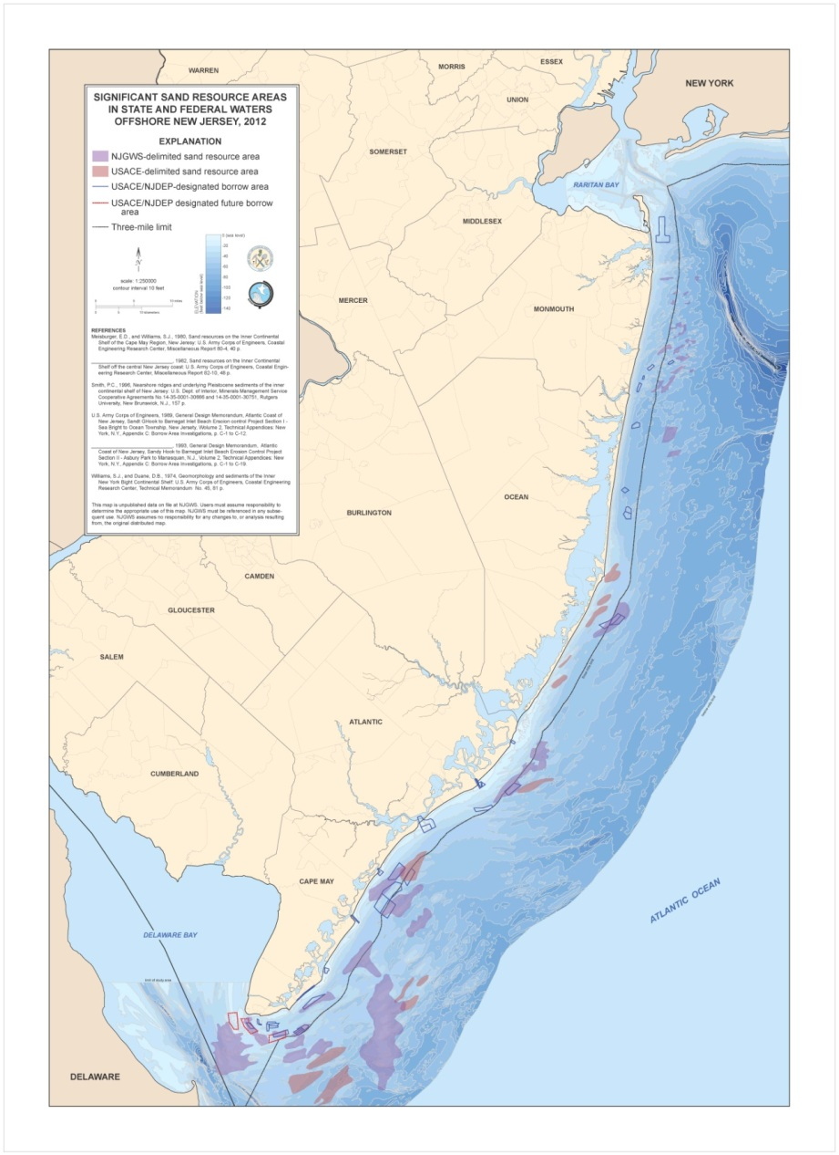
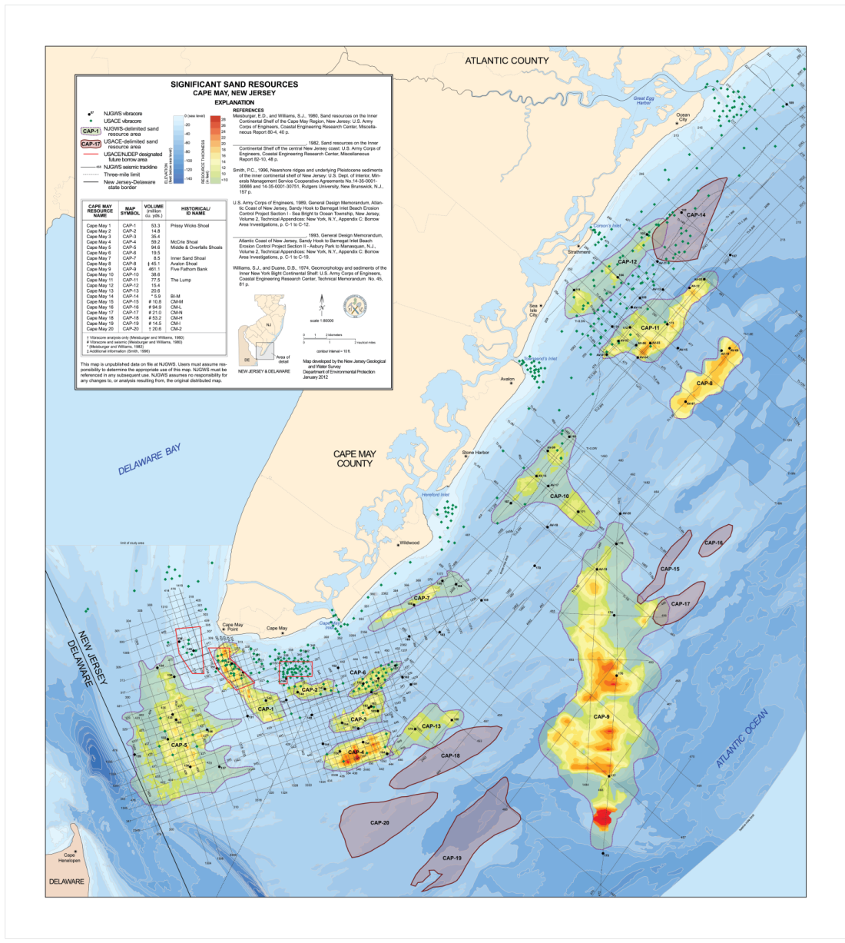
How Can We Respond?
CAP 6
Notes:
So… How can we respond?
We have our final piece of key research that will be used to help us respond to Hurricane Sandy which was conducted by New Jersey’s Geological and Water Survey’s Offshore Resource Exploration Team who:
Located
Characterized
Quantified offshore sediment sources
To date:
1500 miles of seismic profiles
225 vibracores
Identified 32 shoals
400+ million cu yds sand
From a Multi-use data archive
On the left, this statewide coastal map shows several generations of sand source areas, identified by the Army Corps (blue arrows), the NJ Geological Survey (yellow arrows) or both.
(Click)
On the right we have a Cape May County-based thickness plots of offshore sand resource areas,
including sand volumes. Where the brighter reds and yellows represent the thickness of the sand deposits located just offshore in Cape May County.
These slides clearly show that more than enough sand exists offshore to replenish our beaches.

Slide 19
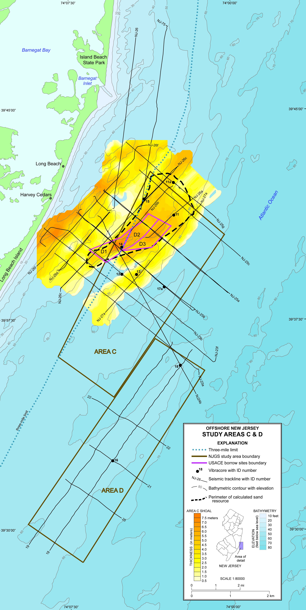
Barnegat Inlet
Sand Resource Delineation
Atlantic Ocean
D2
D1
D3
Shoal offshore Barnegat Inlet
USACE’s D1, D2, and D3
In state and federal waters
Combined analysis by two agencies
Notes:
Here you see a sand resource delineation of an offshore shoal near Barnegat Inlet
NJGWS worked with the ACOE to characterize sites in both State and Federal waters.

Slide 20
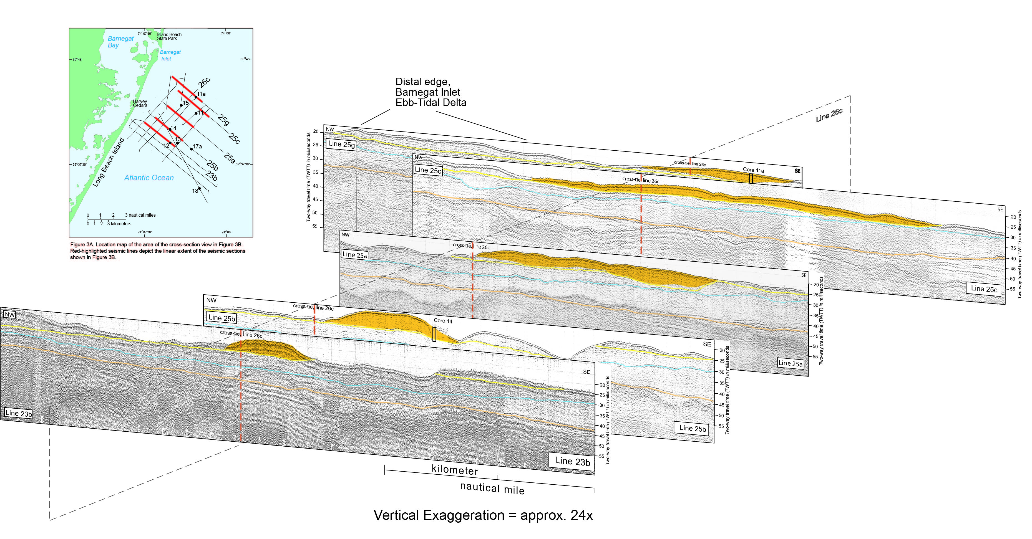
Shoals in Seismic Profile
Notes:
This figure shows the group of seismic profiles that crossed a shoal body shown in the previous slide. You can see the shoal is highlighted in gold on each profile. Similar to an MRI of the shoal body.

Slide 21

Integrated seismic/sediment analysis
Notes:
In order to integrate seismic and sediment analysis; sediment cores are drilled at specific locations to:
1. Determine sediment character and thickness…
2. And to provide additional regional geologic data
Grain size samples are collected at 30-cm intervals from a 6-m long core. These close-spaced samples provide precise feedback on lithologic changes down-core, as seen in the grain-size curve at the lower right.

Slide 22

Calculating shoal extent and thickness
Notes:
Understanding the geology of shoal formation and morphology informs how we determine sand thickness and quality.
In the case of the Barnegat Inlet shoal (highlighted earlier), the base of the shoal is composed of Holocene-aged interbedded sands and muds deposited as sea-level rose after the Last Glacial Maximum. Overlying sand deposits from ebb-tidal deltas and longshore sediment transport have been sculpted by submarine currents and flooded by subsequent sea-level rise.
If one sets a minimum thickness of 3 meters sand as a perimeter, as shown in the figure above, the shoal resource area contains approximately 64 million cubic yards of sand.

Slide 23

Competing uses and potential hazards
Notes:
As shoals are identified, it is important to note other uses or potential hazards.
Other offshore designations include Essential Fish Habitat (shaded gray), and commercial and recreational fishing areas.
Hazards include unexploded ordnance (UXO) from historic firing fans from WW II gun emplacements that blanket Delaware Bay between Delaware and NJ.
So, what this means is that although a significant amount of sand exists; it is not always easily accessible.

Slide 24

Acknowledgments
Jeff Waldner, Bureau of Ocean Energy Management (BOEM), U.S. DOI
Laurie Whitesell, NJGWS
Amanda Fabian, NJGWS
Zehdreh Allen-Lafayette, Cartographer, NJGWS
Dan Barone, CRC
Steven Hafner, CRC
Dr. Mark Mihalasky, USGS
B. Steven Howard, CRC
Michael Flynn, CRC
Crist Robine, CRC
Kimberly McKenna, CRC
Christie Tracey, CRC
Notes:
The image shown in the background is the eventual end result of all of the research we’ve presented to you toady. With sand being hydraulically pumped back onto New Jersey’s beaches to help restore our damaged beaches and coastal communities.
Fill projects already planned, underway, or completed to note:
Cape may city slated for: ½ million cu yds
Lbi slated for - 3 million cu yds
Atlantic City & Ventor - 1 million
Brigantine has already been pumped
Avalon – will be touched up
Stone Harbor – we be filled in the spring
Ocean City – Currently pumping
Asbury park to manasquan, and Sea Bright will be receiving: !0 million cu yds. of sand
Unfortunately Northern Ocean County & LBI are having easement issues, but that’s a whole other can of worms…
Thank you very much and with that I’d be happy to answer any questions you might have?

