Slide 1
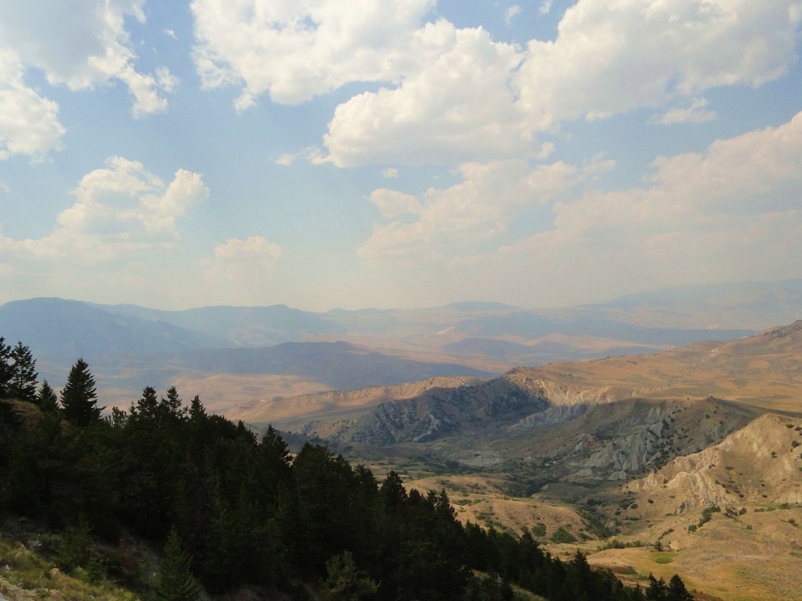

Two episodes of Laramide shortening as revealed by Paleogene unconformities near Heart Mountain, northwestern Wyoming
Laura Neser
Kevin Stewart
The University of North Carolina at Chapel Hill
Department of Geological Sciences

Slide 2
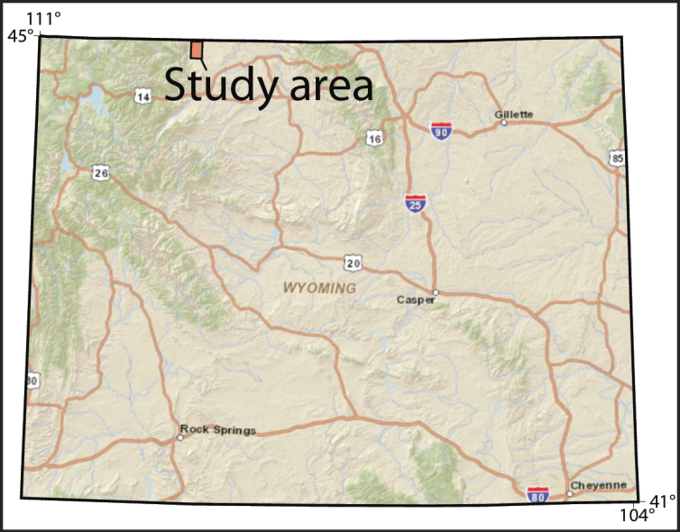
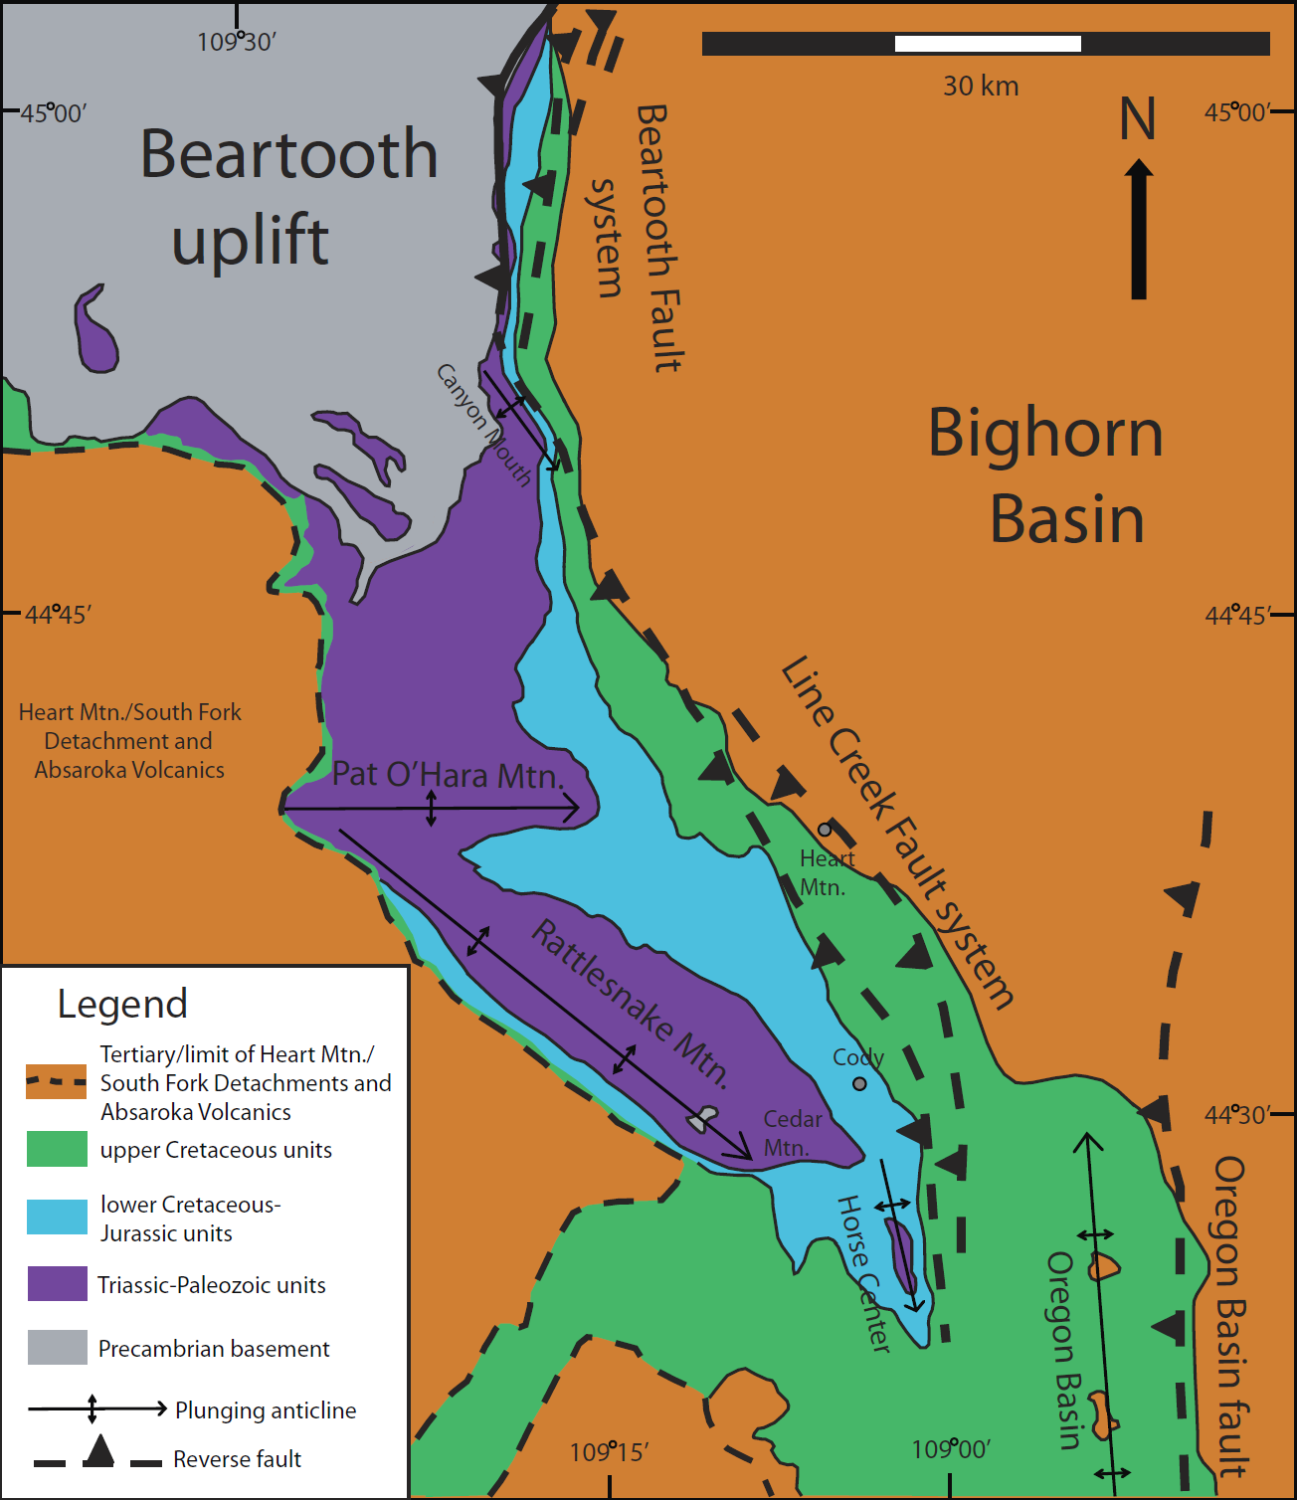
WYOMING
Heart Mountain study area
Index maps showing approximate location of study area
Simplified geologic map of the NW Bighorn Basin (adapted from Neely and Erslev, 2009)
Notes:
Possible slide 2: Background info—location, ages of rock types/names of formations (adjacent to Pat O’Hara Mtn structure)

Slide 3
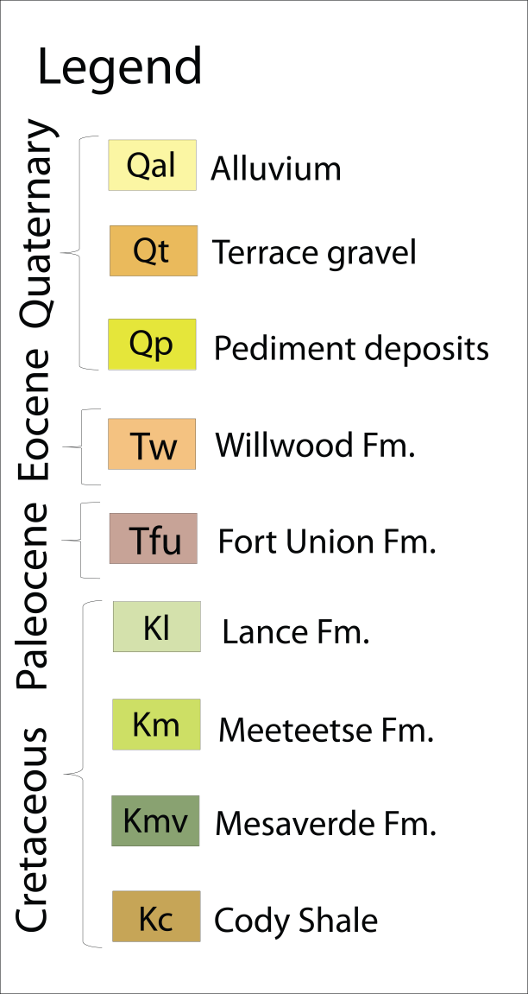
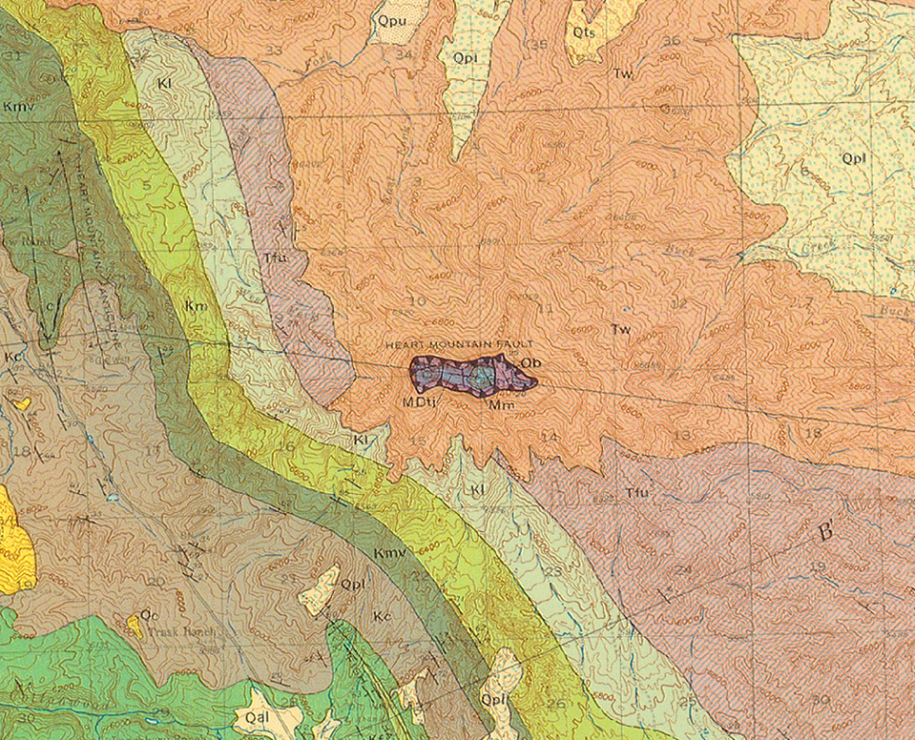
Geologic map of the Heart Mountain area
Pierce, 1965
Cretaceous-Paleogene stratigraphic column
Notes:
Descrip of Pierce’s map—why did you go back there, nature of contacts (unconformities)—next slide, show Pierce’s cross section(s)

Slide 4
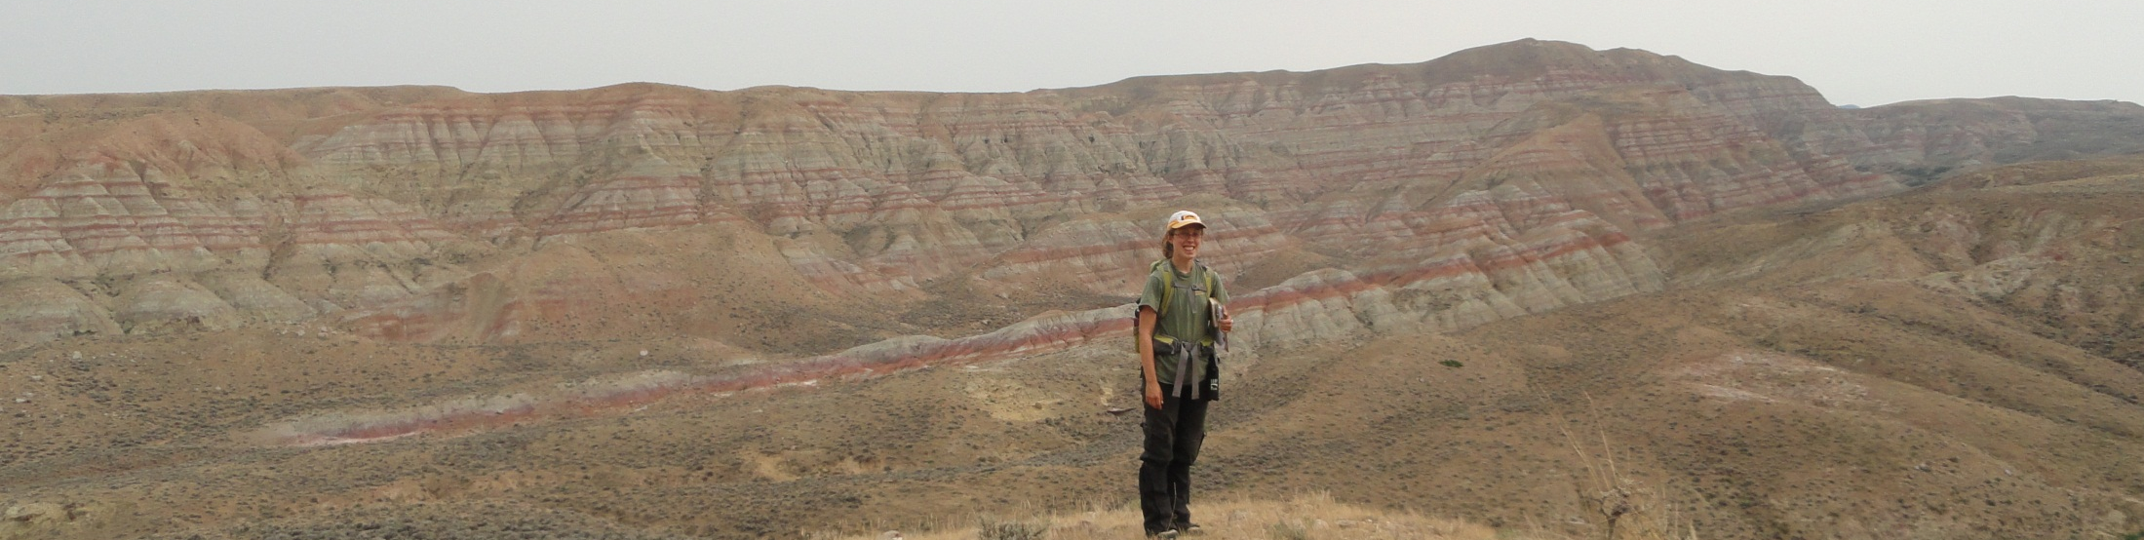
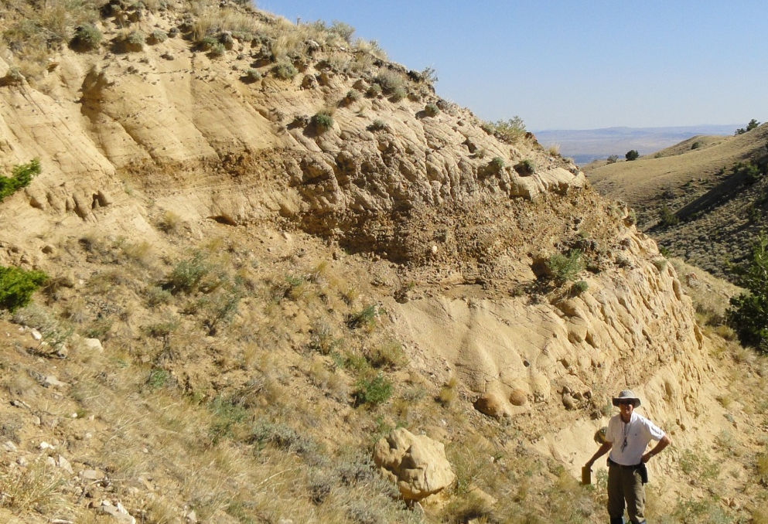
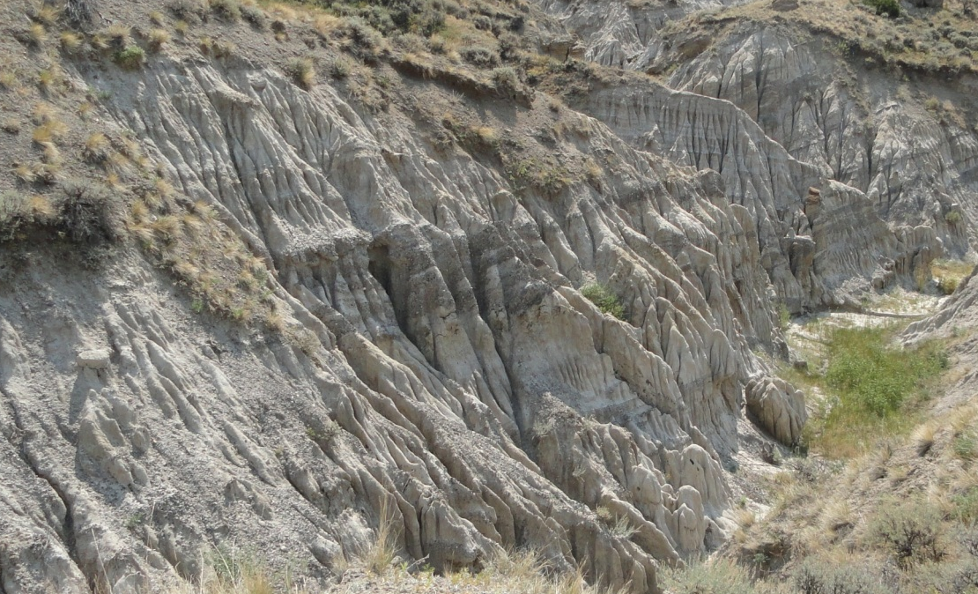
Cretaceous and Paleogene rocks in the vicinity of Heart Mountain
L. Paleocene-Eocene Willwood Formation
Paleocene Fort Union Formation
Cretaceous Lance Formation

Slide 5
Geologic map of western Heart Mountain area
Lillegraven’s proposed thrust fault site that we revisited

Slide 6
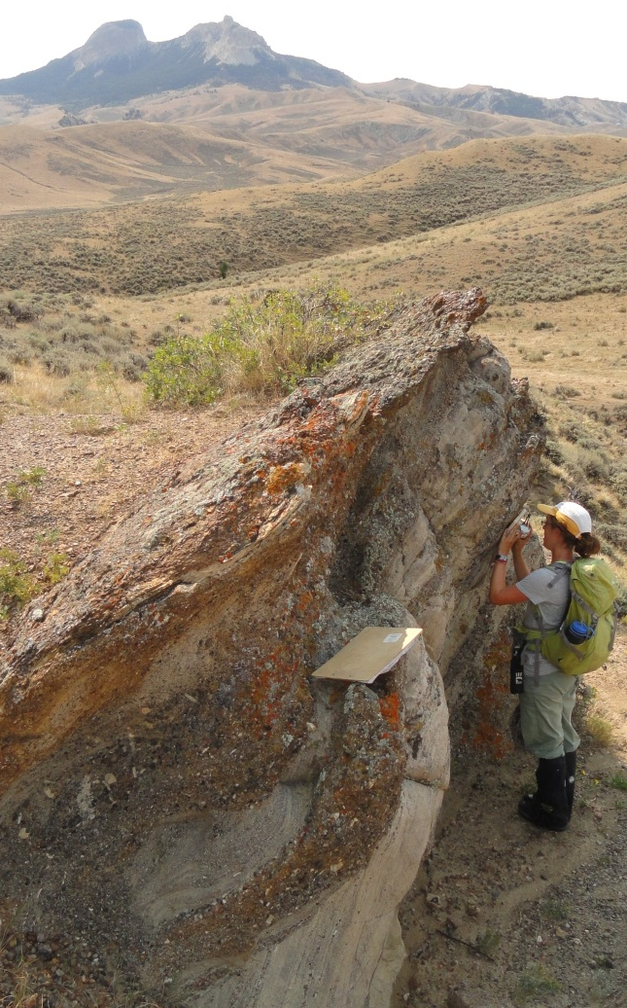
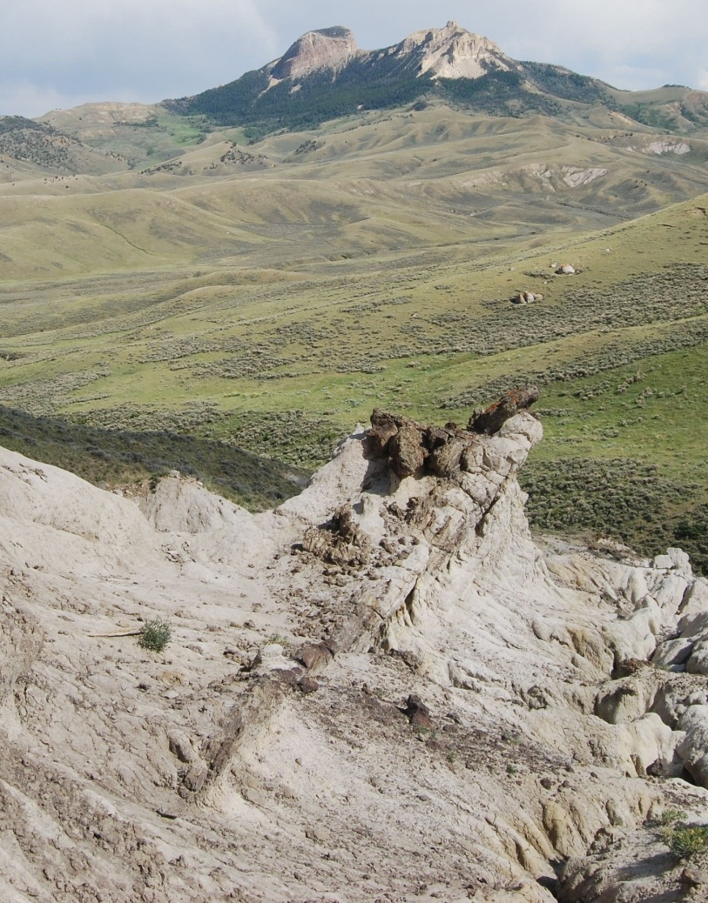
Cretaceous and Paleocene sediments northwest of Heart Mountain
Lillegraven’s proposed thrust fault site that we revisited
Tilted Paleocene Fort Union, conformable with Lance
Tilted Cretaceous Lance
Notes:
Label location on map, show picture(s)

Slide 7

Unconformity northwest of Heart Mountain

Slide 8
Unconformity northwest of Heart Mountain
L. Paleocene-Eocene Willwood
Cretaceous Lance

Slide 9
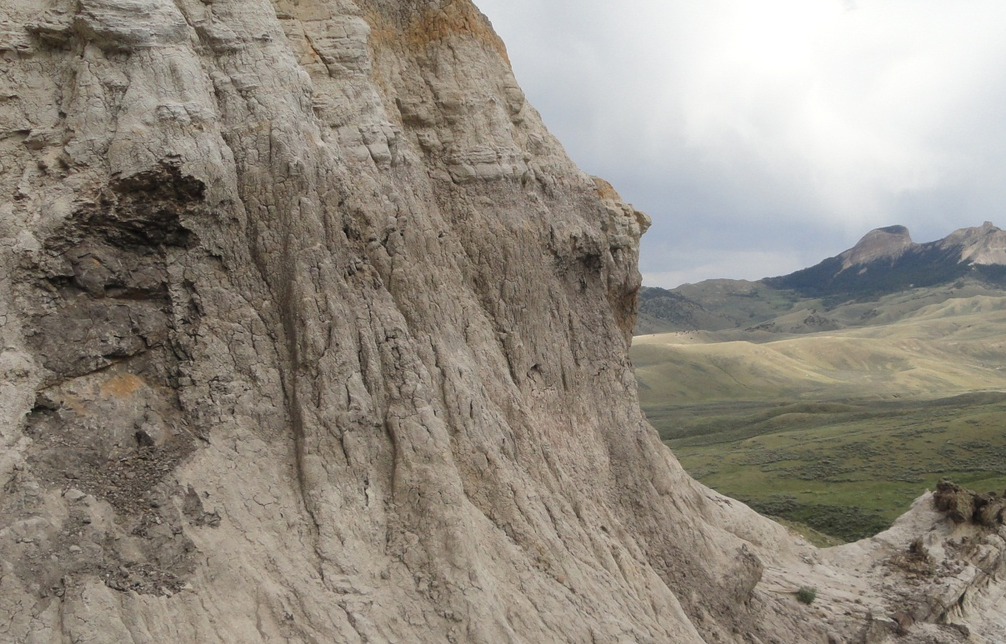
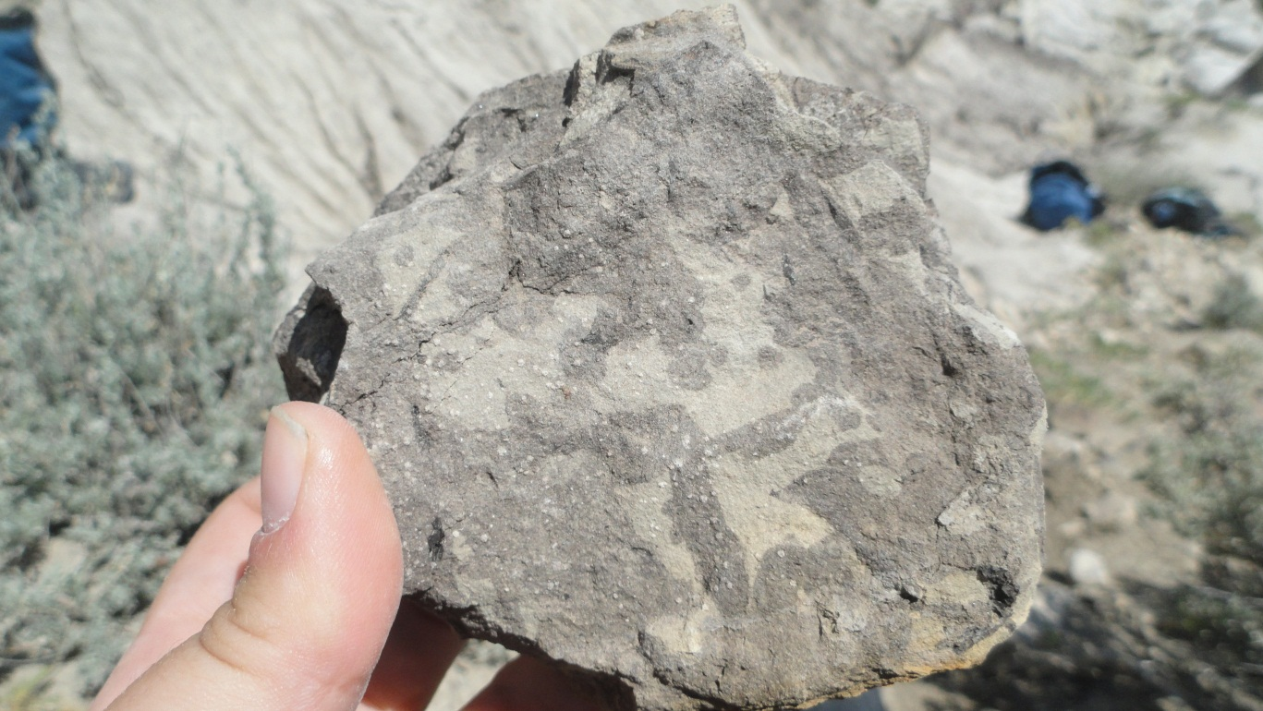
Excavation of contact for evidence of thrust faulting northwest of Heart Mountain
Sampling
Area

Slide 10
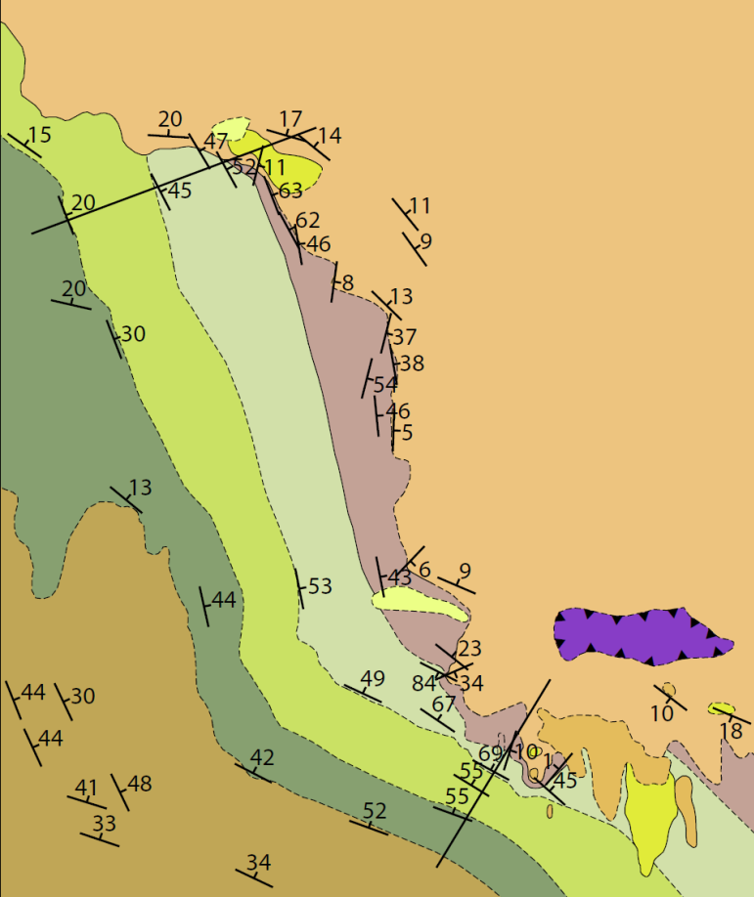
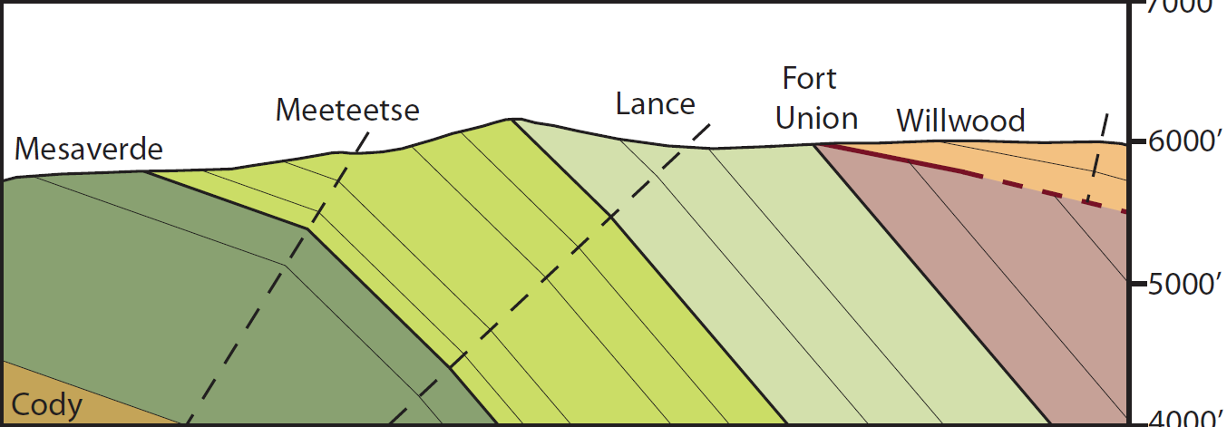
109°10’
44°43’
B’
B
Northwest of Heart Mountain
Fort
Union
Willwood
Mesaverde
Lance
Meeteetse
Heart Mountain
Cody
44°40’
A’
A
B
7000’
B’
6000’
5000’
4000’

Slide 11
Geologic map of southern Heart Mountain area
Lillegraven’s proposed thrust fault site that we revisited

Slide 12
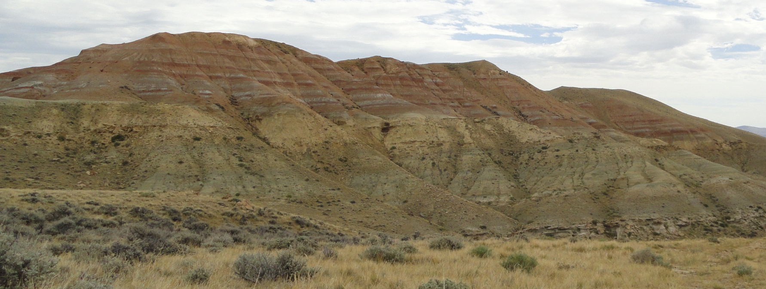
Paleocene and Eocene sediments south of Heart Mountain
Paleocene Fort Union Fm. conformable with L. Paleocene-Eocene Willwood Fm.
Notes:
South of Heart Mtn, Cretaceous rocks are steep and Tfu/Tw are gently-dipping. Also, Cretaceous rocks are striking WNW, while in the northern Ht Mtn area they’re N.

Slide 13
Paleocene and Eocene sediments south of Heart Mountain
L. Paleocene-Eocene Willwood
Paleocene Fort Union
Paleocene Fort Union Fm. conformable with L. Paleocene-Eocene Willwood Fm.
Notes:
South of Heart Mtn, Cretaceous rocks are steep and Tfu/Tw are gently-dipping. Also, Cretaceous rocks are striking WNW, while in the northern Ht Mtn area they’re N.

Slide 14
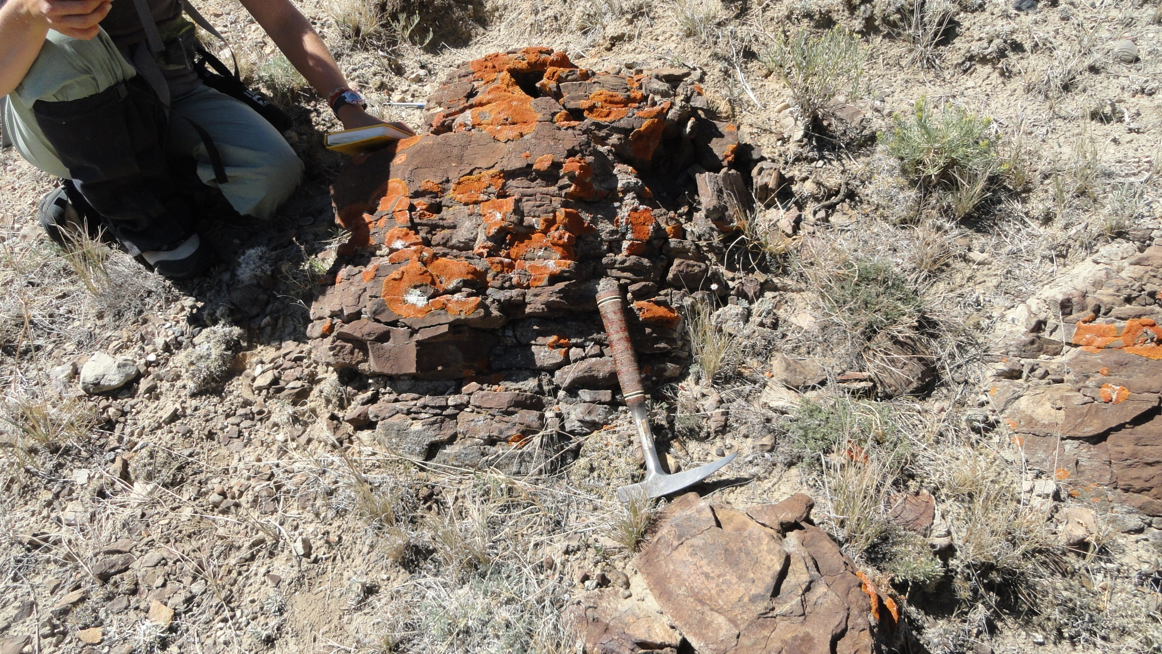
Tilted Cretaceous rocks south of Heart Mountain
Cretaceous Lance Formation dipping 50 degrees
Notes:
South of Heart Mtn, Cretaceous rocks are steep and Tfu/Tw are gently-dipping. Also, Cretaceous rocks are striking WNW, while in the northern Ht Mtn area they’re N.

Slide 15
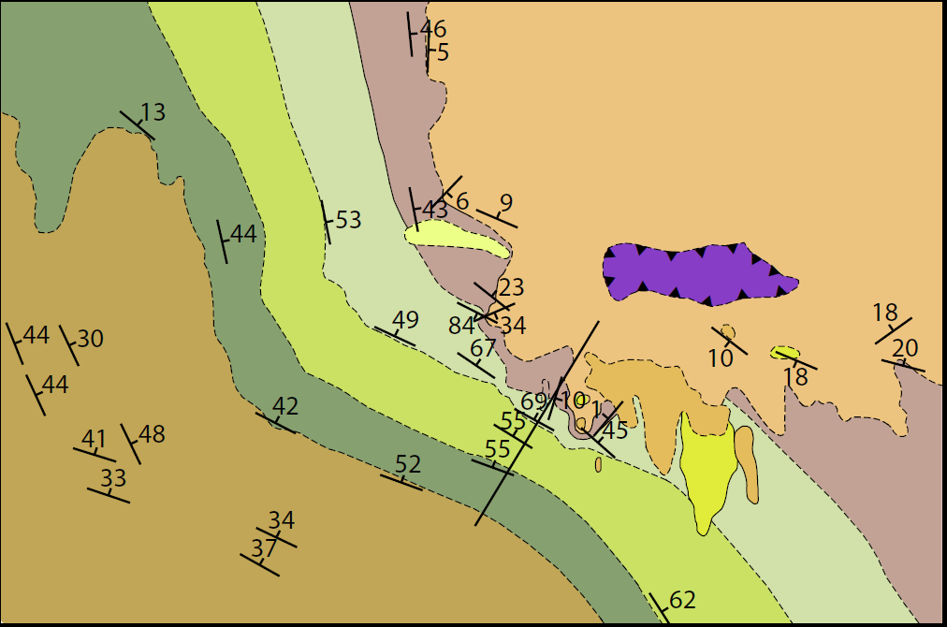
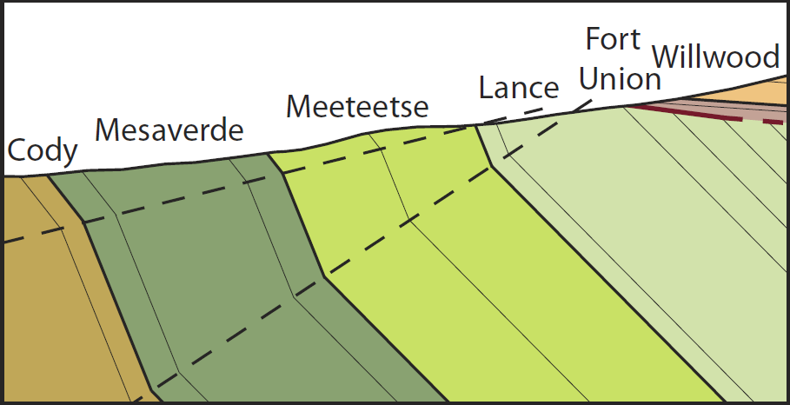
South of Heart Mountain
Heart Mountain
Willwood
A’
44°40’
Meeteetse
Fort
Union
A
Mesaverde
Cody
Lance
109°10’
109°5’
A
A’
7000’
6000’
5000’

Slide 16
Change in trend of Cretaceous strata from western to southern Heart Mountain area
Cretaceous rocks striking WNW in southern Heart Mountain area correspond with older unconformity
Cretaceous rocks striking NNW in western Heart Mountain area correspond with younger unconformity

Slide 17
Index map showing locations of Heart Mountain study area, Pat O’Hara Mountain, Rattlesnake Mountain, and Beartooth uplift
Heart Mountain study area
(adapted from Neely and Erslev, 2009)

Slide 18
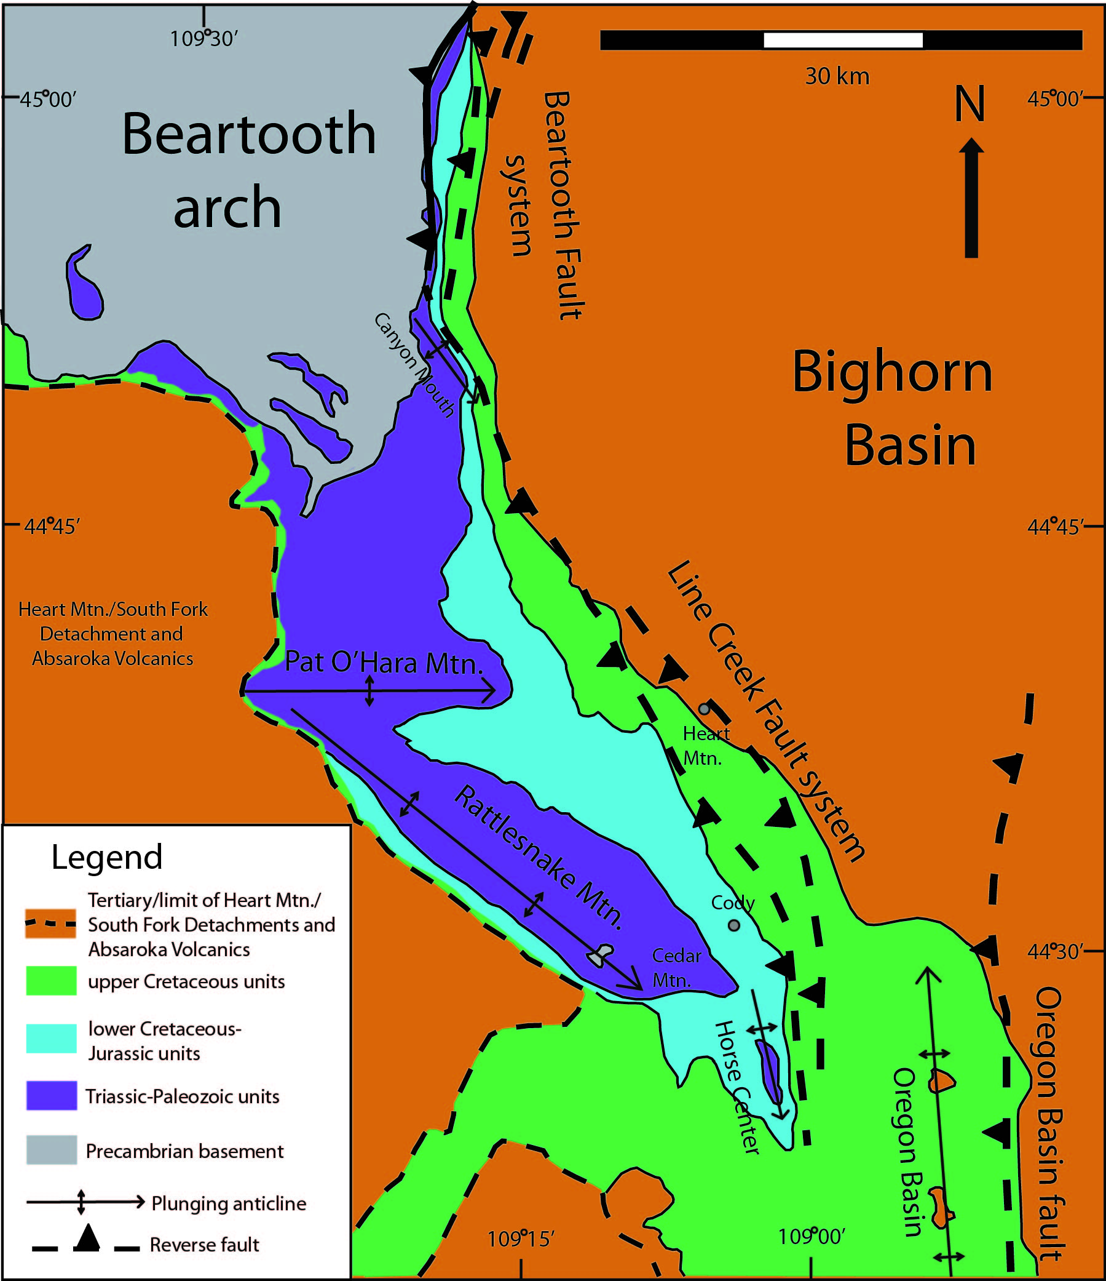
Differently oriented structures have been interpreted to reflect varying shortening directions
Simplified geologic map of the NW Bighorn Basin (adapted from Neely and Erslev, 2009)

Slide 19
Differently oriented structures have been interpreted to reflect reactivation of preexisting basement weaknesses
Simplified geologic map of the NW Bighorn Basin (adapted from Neely and Erslev, 2009)

Slide 20
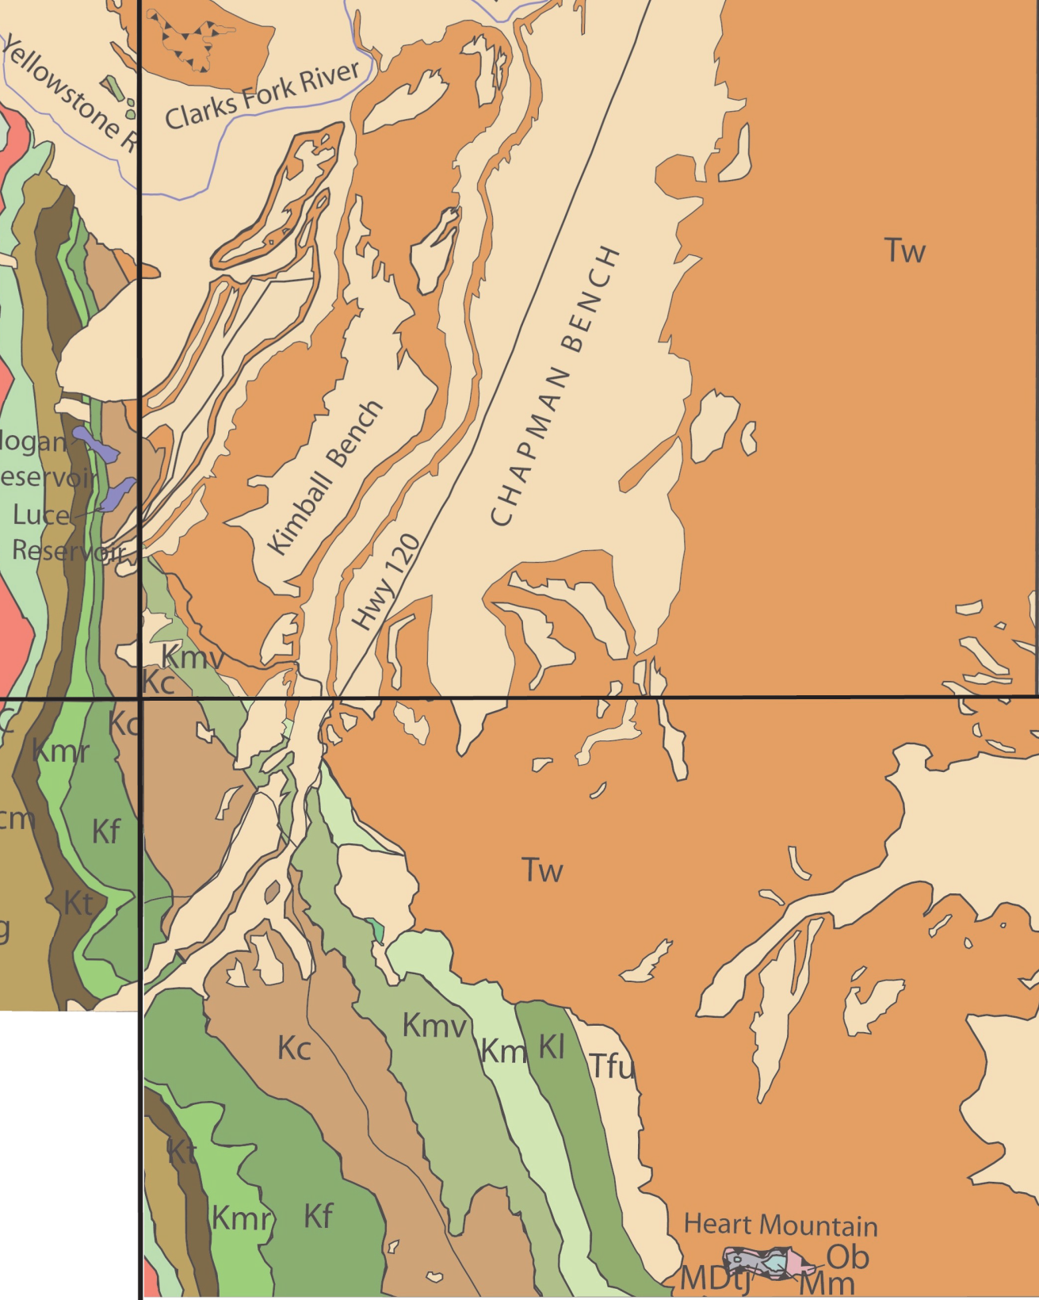
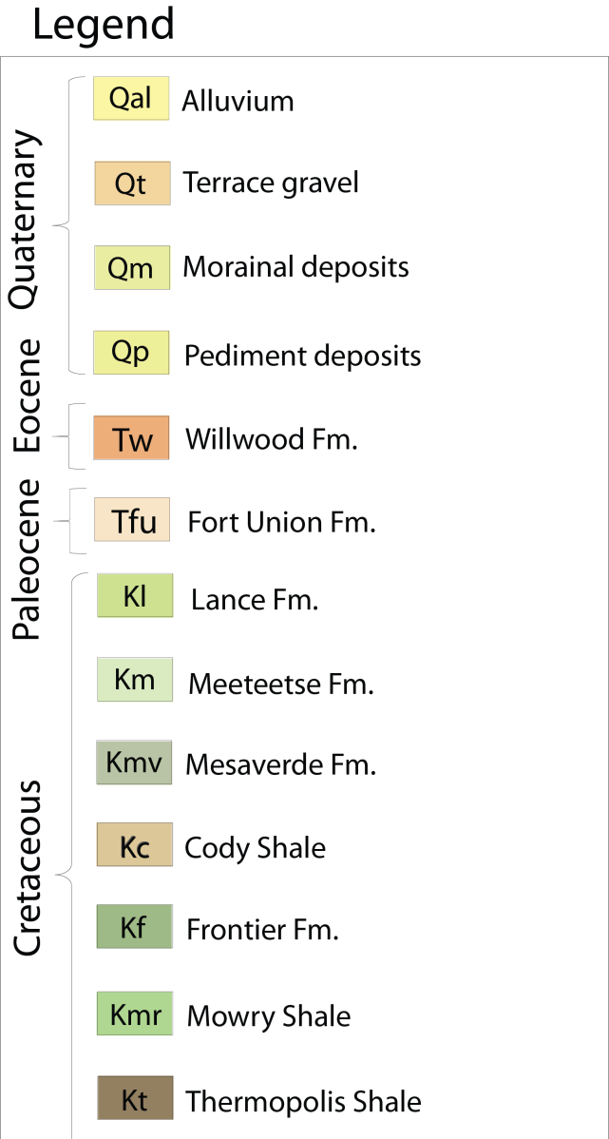
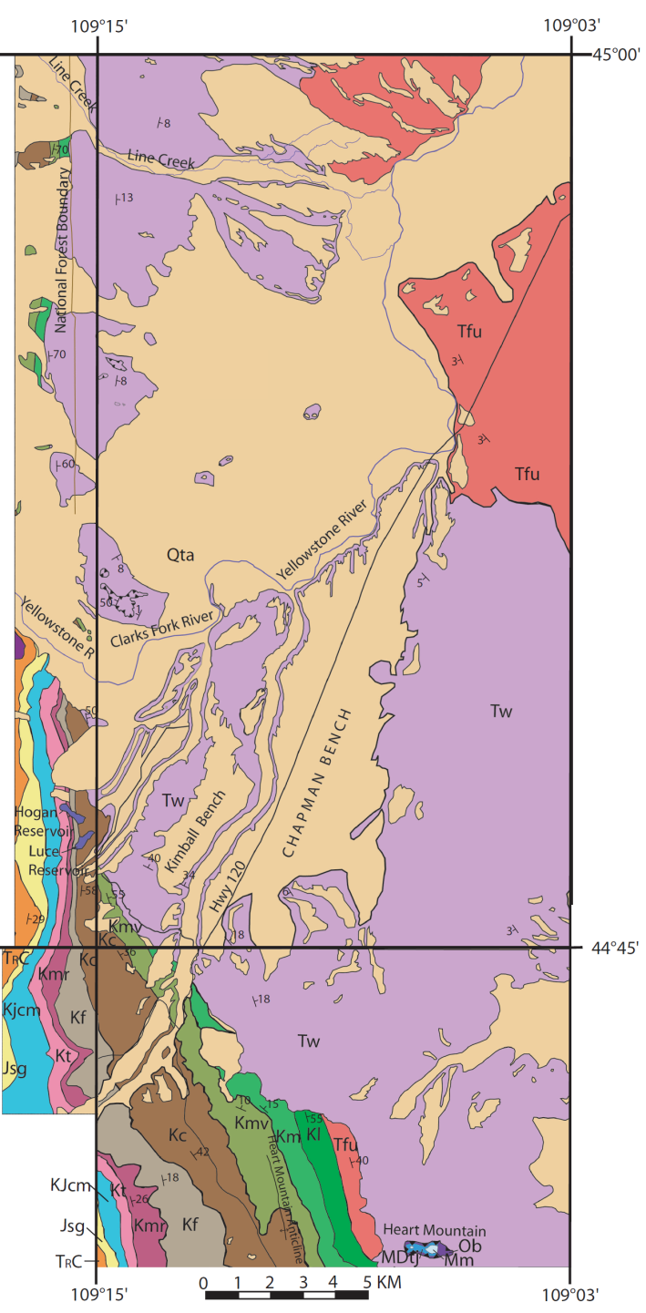
adapted from Pierce, 1965
Hogan Reservoir
Qta
Hogan Reservoir area
Notes:
As you recall, differing orientation of structures have been interpreted to represent two main shortening directions in the area, the first being NE-SW and the second being E to W. I visited the Hogan Reservoir area, labeled in the black box, where the orientation of the contacts is thought to reflect E-W directed shortening.

Slide 21
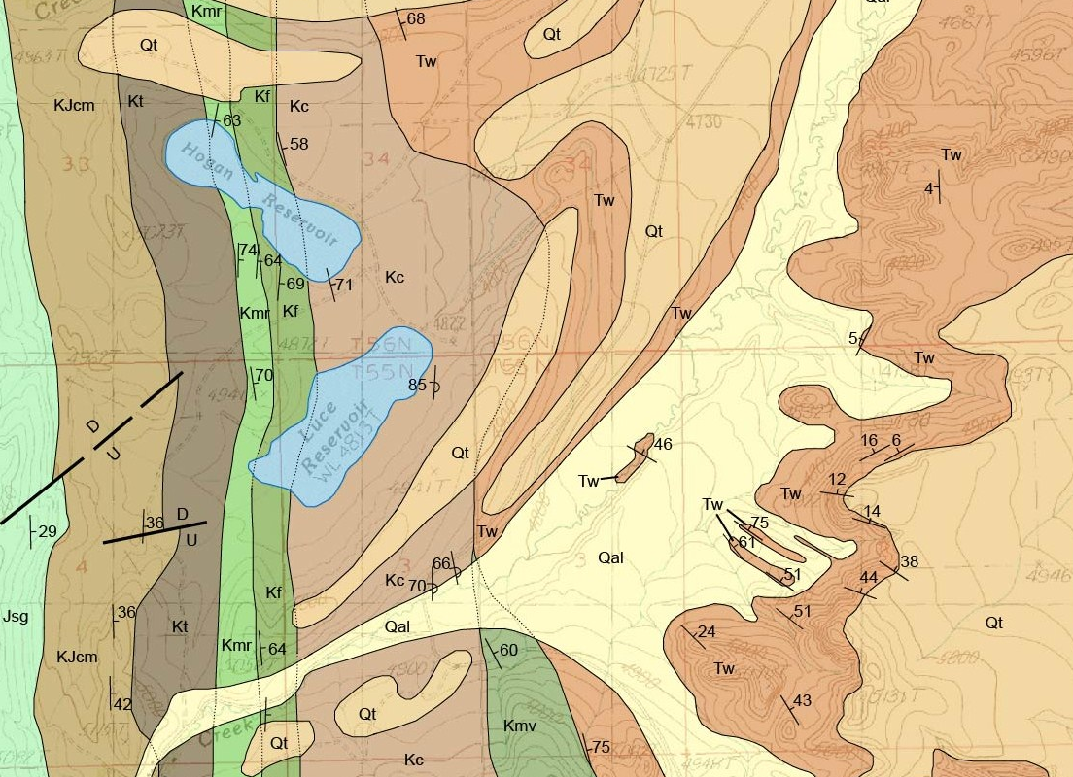
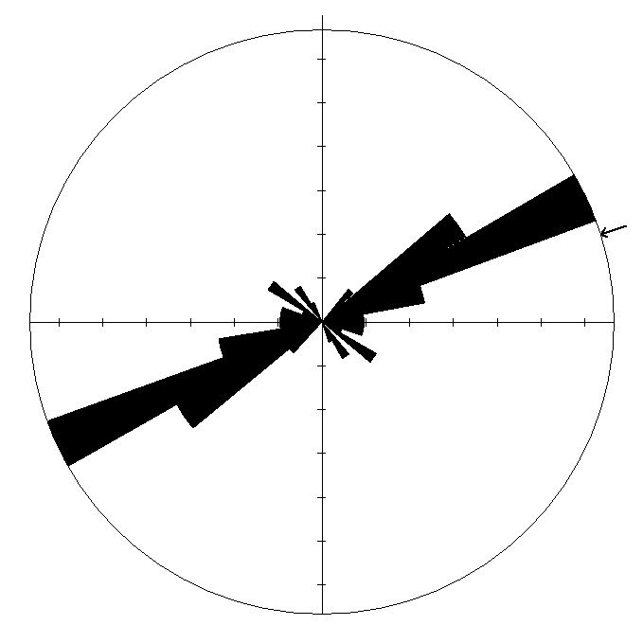
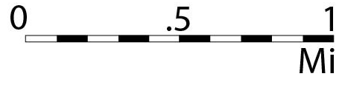
NE/SW-directed shortening at Hogan Reservoir
Rose diagram showing NE/SW-directed joints near Hogan Reservoir, n=42 (bedding rotated to horizontal)
Revised geologic map of Hogan Reservoir area
Notes:
At Hogan Reservoir, I found that no matter how the beds are oriented, there’s strong evidence for NE/SW-directed shortening and little to no evidence of E/W shortening. I measured several joint sets, and their resulting stereonet plot shows a NE-SW shortening component as the strongest. I don’t reject the evidence for E-W directed shortening in the vicinity of the eastern Beartooths, but I do postulate that perhaps an E-W component of shortening occurred synchronously with NE-SW directed shortening, and that could explain why some areas do not show an overprint of E-W shortening and other areas do.

Slide 22
Conclusions
Northwest of Heart Mountain, gently dipping L. Paleocene-Eocene Willwood lies on top of tilted Paleocene Fort Union and Cretaceous rocks
South of Heart Mountain, gently dipping Paleocene Fort Union and L. Paleocene-Eocene Willwood overlie tilted Cretaceous rocks
Ages of unconformities and differences in orientations of Cretaceous rocks reflect two episodes of deformation that occurred in the vicinity of Heart Mountain, Wyoming
Overall NE-SW shortening direction as revealed by jointing in Hogan Reservoir area and slickensided minor faults (Neely and Erslev, 2009)

Slide 23
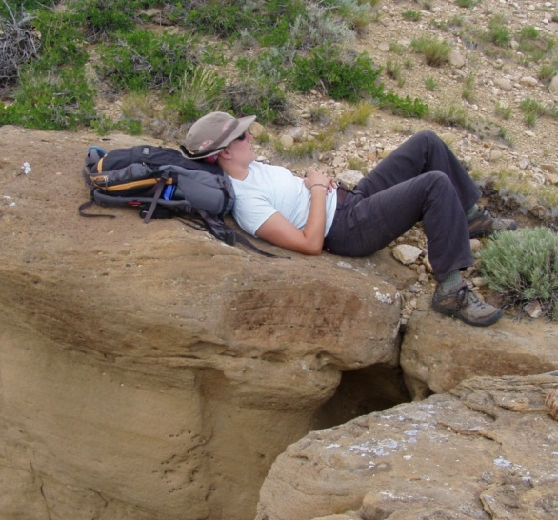

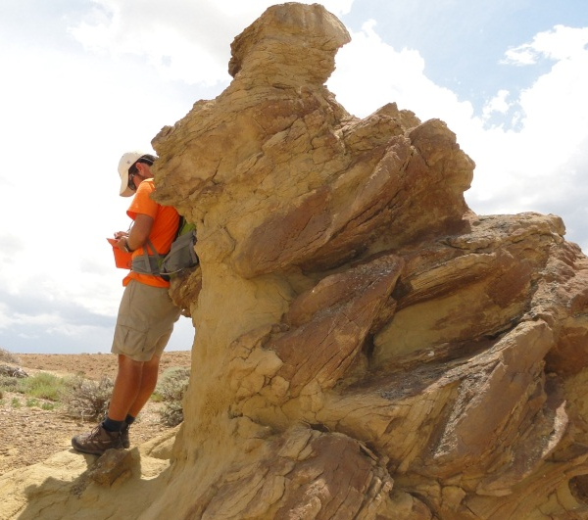
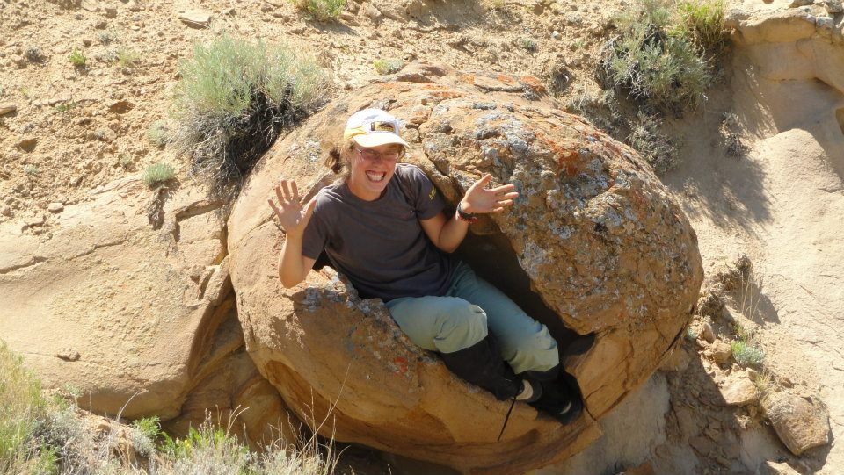
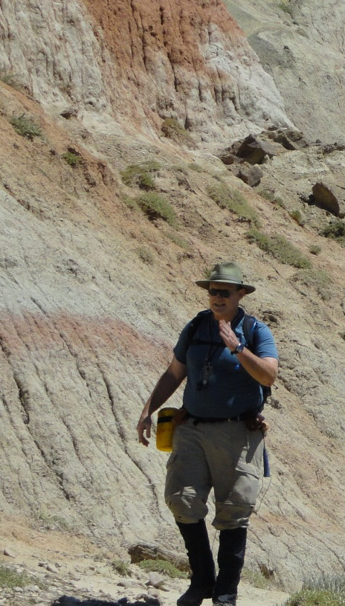
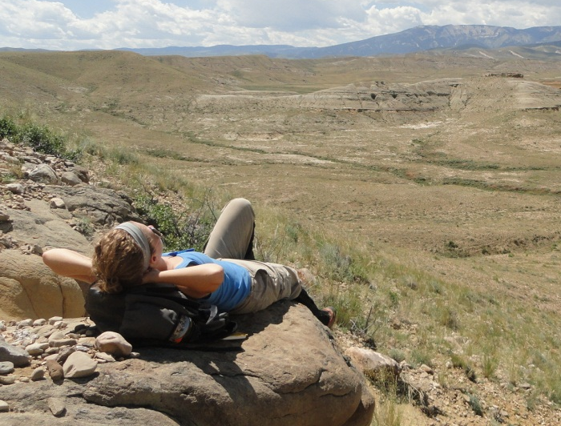
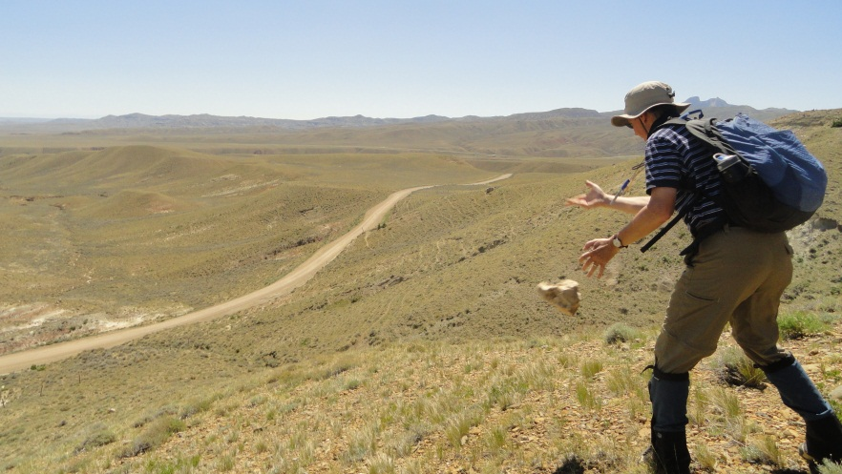
Thank you
- Kevin Stewart, Jason Barnes, Lou Bartek, Jonathan Lees, Lonnie Leithold,
- Karen Bossenbroek, Will Frazier, Siobhan Kenney, Jason Hallman, Mallory Nickel,
- Two Dot Ranch, Don Tolman, Jim Dager,
- EDMAP, GSA, RMS-SEPM, TRGS, USGS, UNC and UNC Geological Sciences

Slide 24

Heart Mountain study area
Pierce, 1965
Simplified geologic map of the NW Bighorn Basin (adapted from Neely and Erslev, 2009)
Notes:
Possible location map

Slide 25
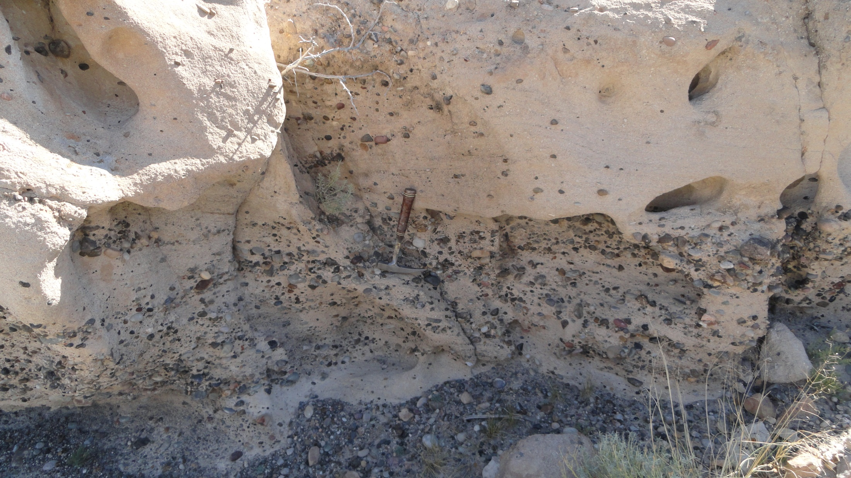
Black chert pebble conglomerate lag in Paleocene Fort Union sandstone

Slide 26

Notes:
Lance

Slide 27
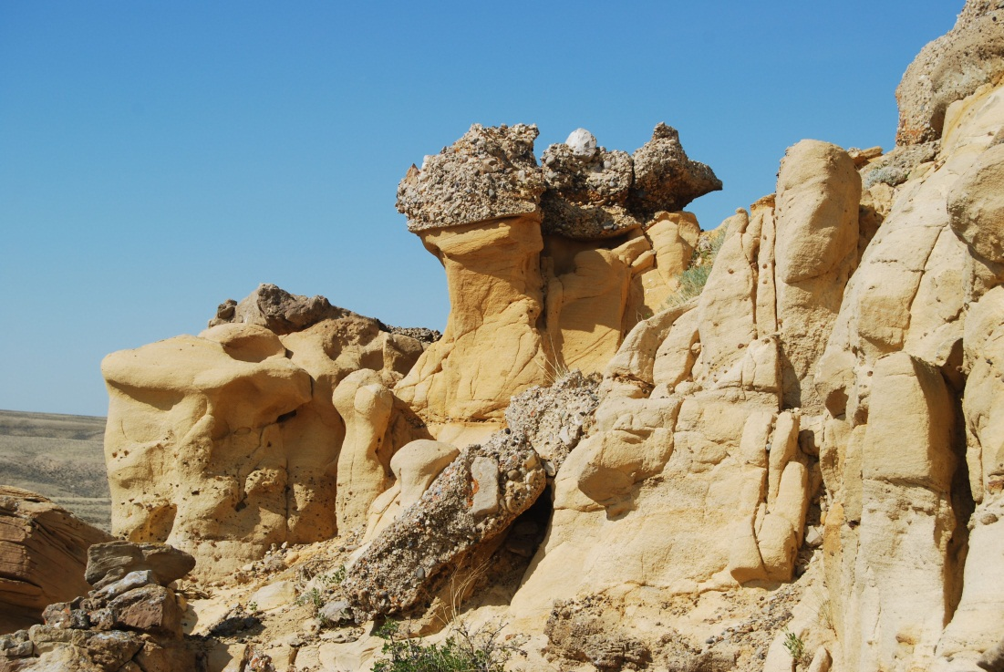
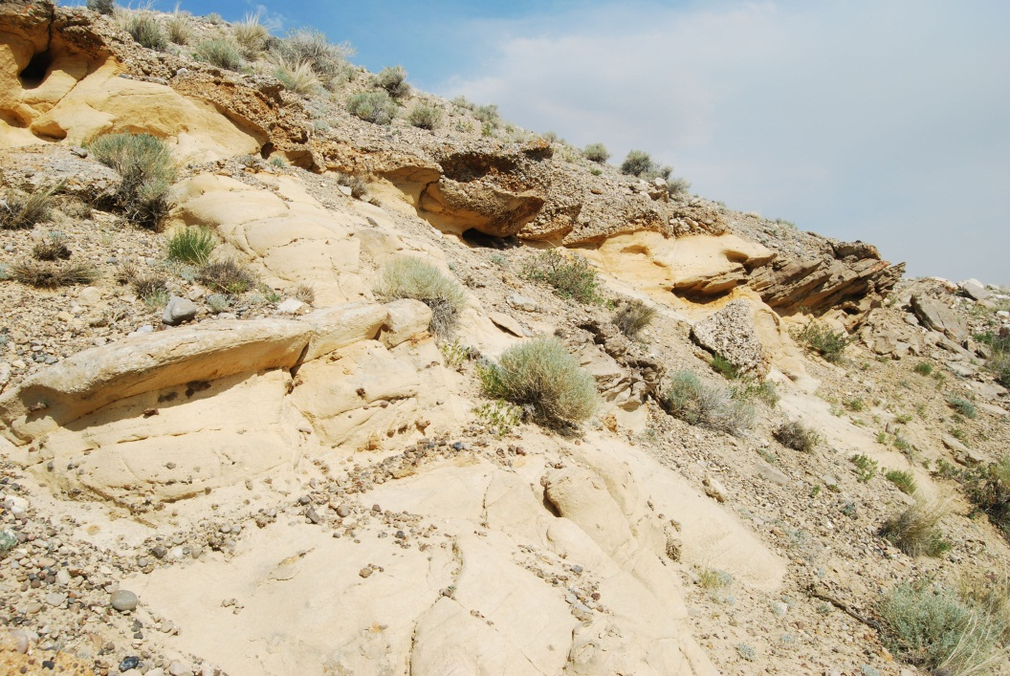
Notes:
Flat Conglo next to Flat Conglo underlain by tilted Tfu

Slide 28
DSC 5958

Slide 29
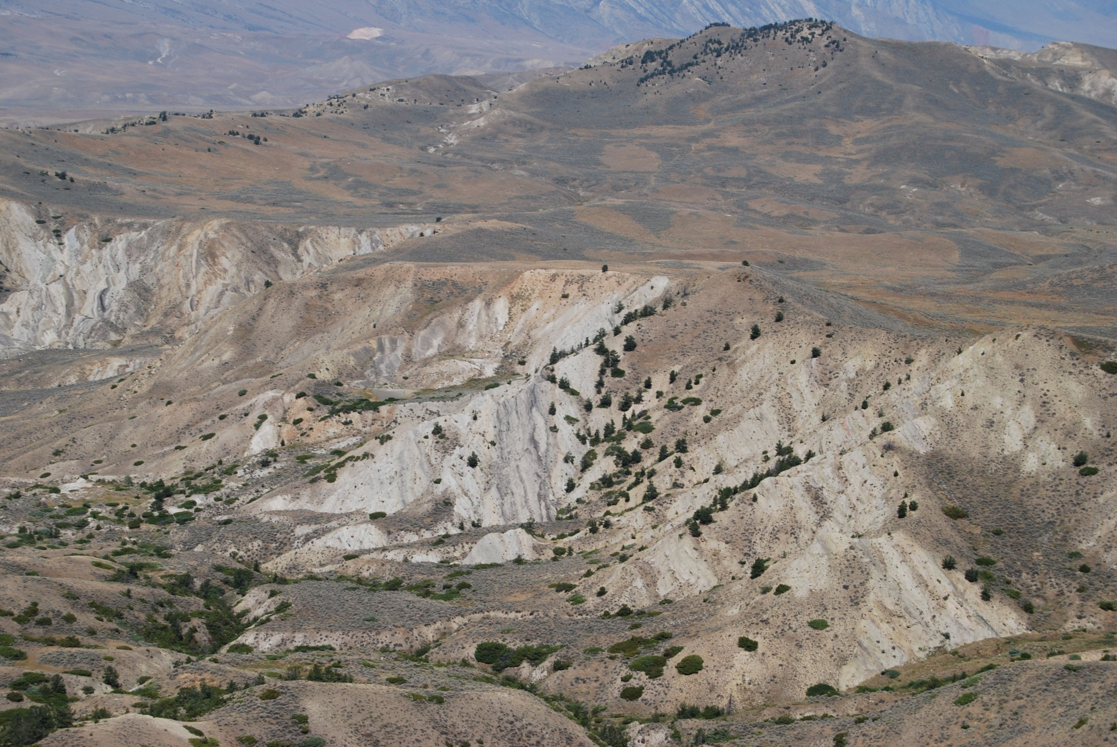
Notes:
A little hard to see, but it’s flat Willwood on top of tilted Cretaceous

Slide 30
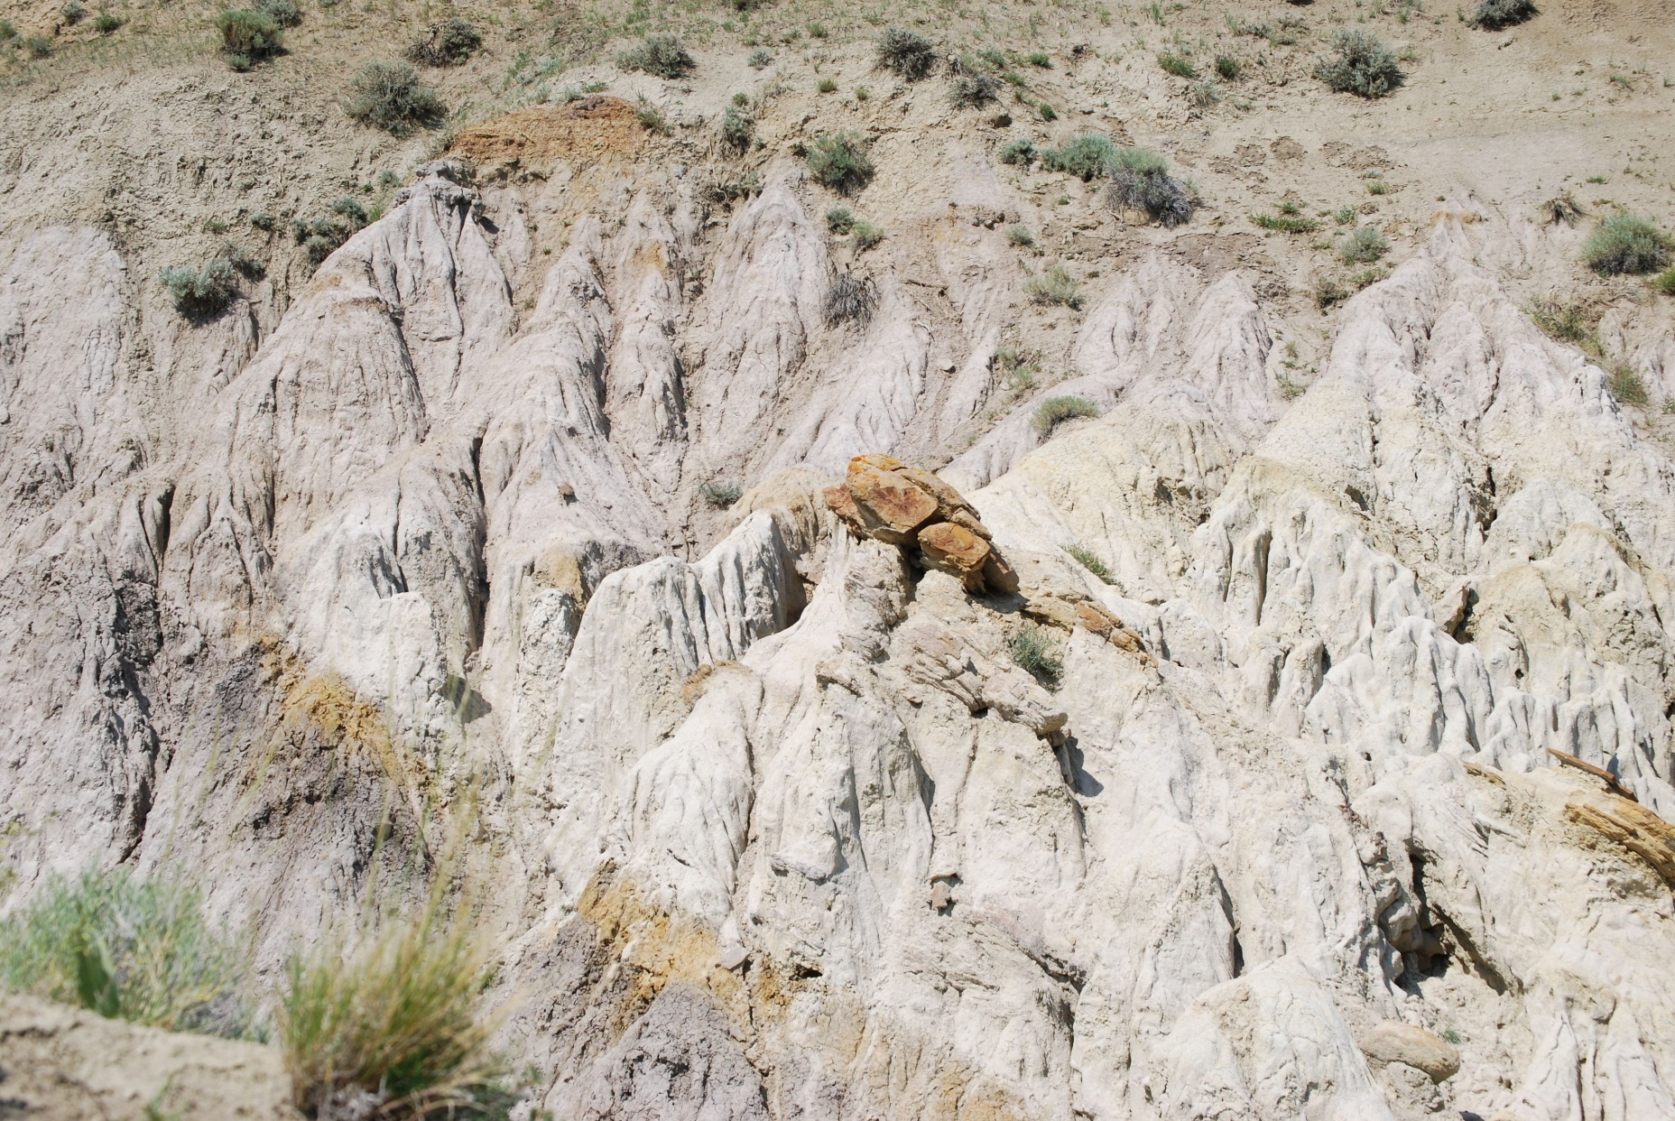
Cretaceous and Paleocene sediments NOT south of Heart Mountain DSC 5783

Slide 31
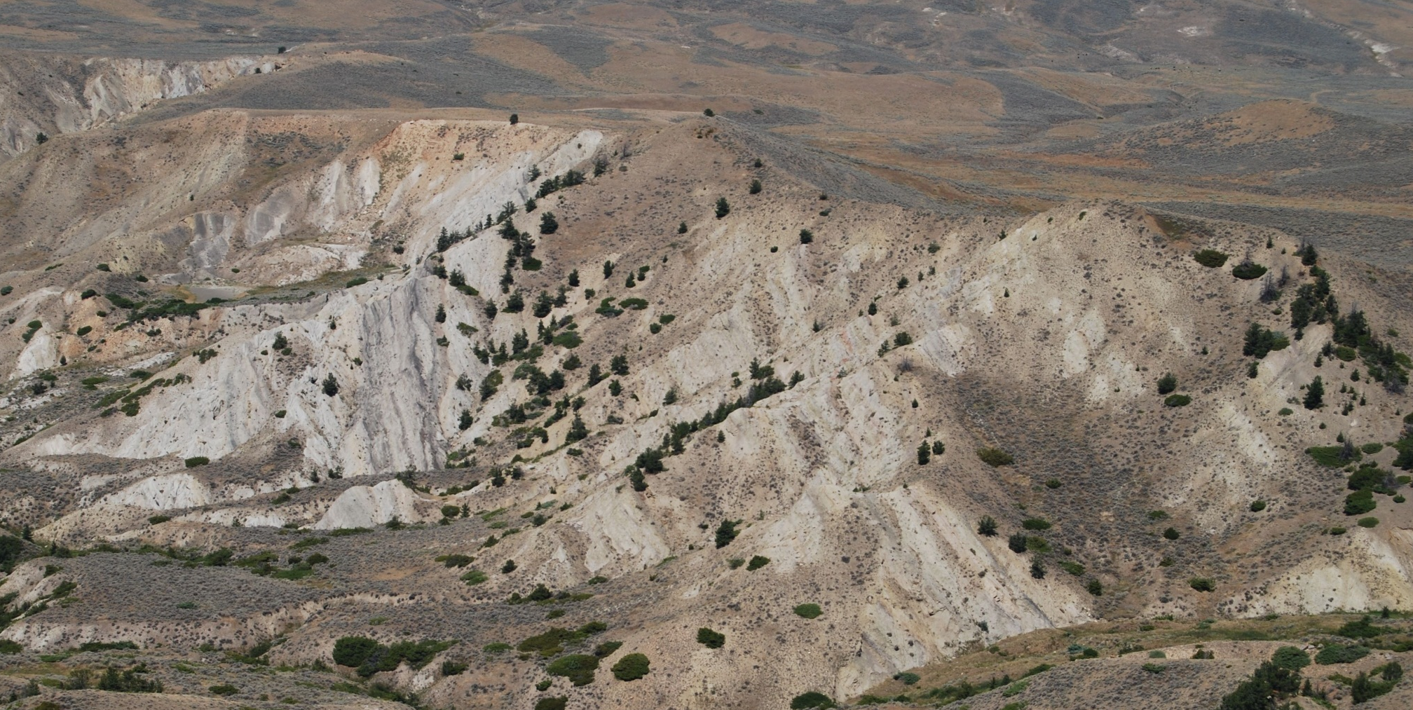
Cretaceous and Paleocene sediments west of Heart Mountain
Cretaceous rocks at angular discordance with Paleocene Fort Union Formation

Slide 32
Cretaceous and Paleocene sediments west of Heart Mountain
Paleocene Fort Union
Tilted Cretaceous
Cretaceous rocks at angular discordance with Paleocene Fort Union Formation

