Slide 1
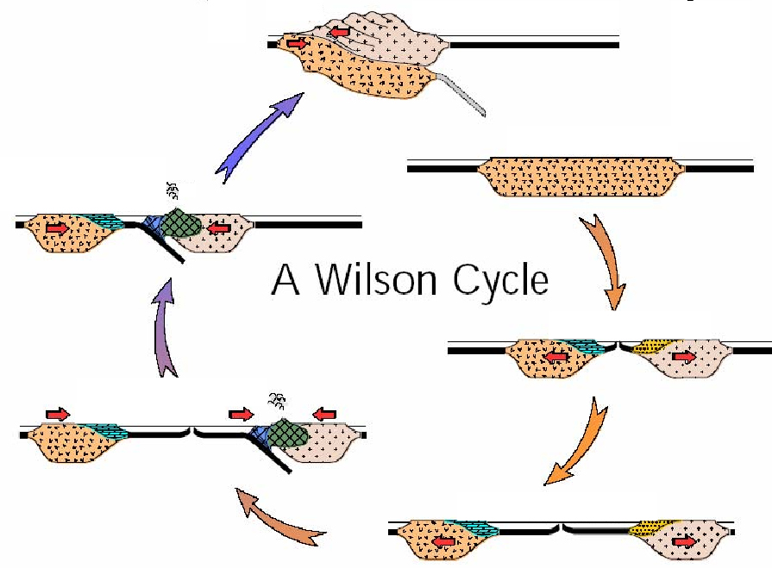

WHY HASN'T THE TEXAS OR LOUISIANA PASSIVE MARGIN TURNED INTO A SUBDUCTION ZONE? Bob Stern UT Dallas T7. New Ideas about the Geologic Evolution and Petroleum Potential of the Gulf of Mexico Thursday 4 April 2013 AT&T Center Classroom 202 4:10 pm

Slide 2
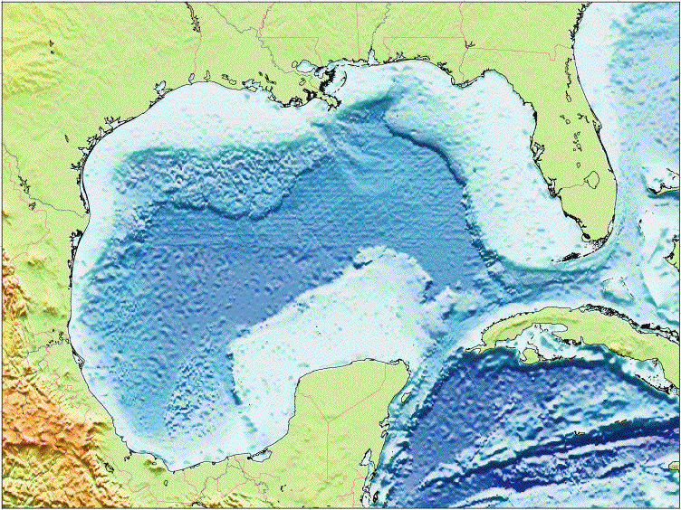
Why hasn’t the NW Gulf of Mexico turned into a subduction zone?
Louisiana
Texas
Florida
Gulf of Mexico
Mexico
Cuba
Campeche Bank
Yucatan

Slide 3
3 Conclusions:
Even though ancient and deeply buried in sediments, NW Gulf of Mexico margin is too strong to collapse into a subduction zone
This is probably generally true for passive continental margins; Passive continental margins do not generally turn into subduction zones.
Wilson Cycle may require 3rd dimension to work (fracture zone collapse): oceans close perpendicular to how they open.

Slide 4

(4)
(1)
John Tuzo Wilson
1908-1993
(3)
(2)
Wilson Cycle: The plate tectonic opening and closing of ocean basins. The Wilson cycle begins with rifting of a continent (1) to form an ocean basin and passive continental margin (2). Subduction begins on one of the margins (3) and the basin closes (4). When the crust begins to thin again, another cycle begins again (1).

Slide 5
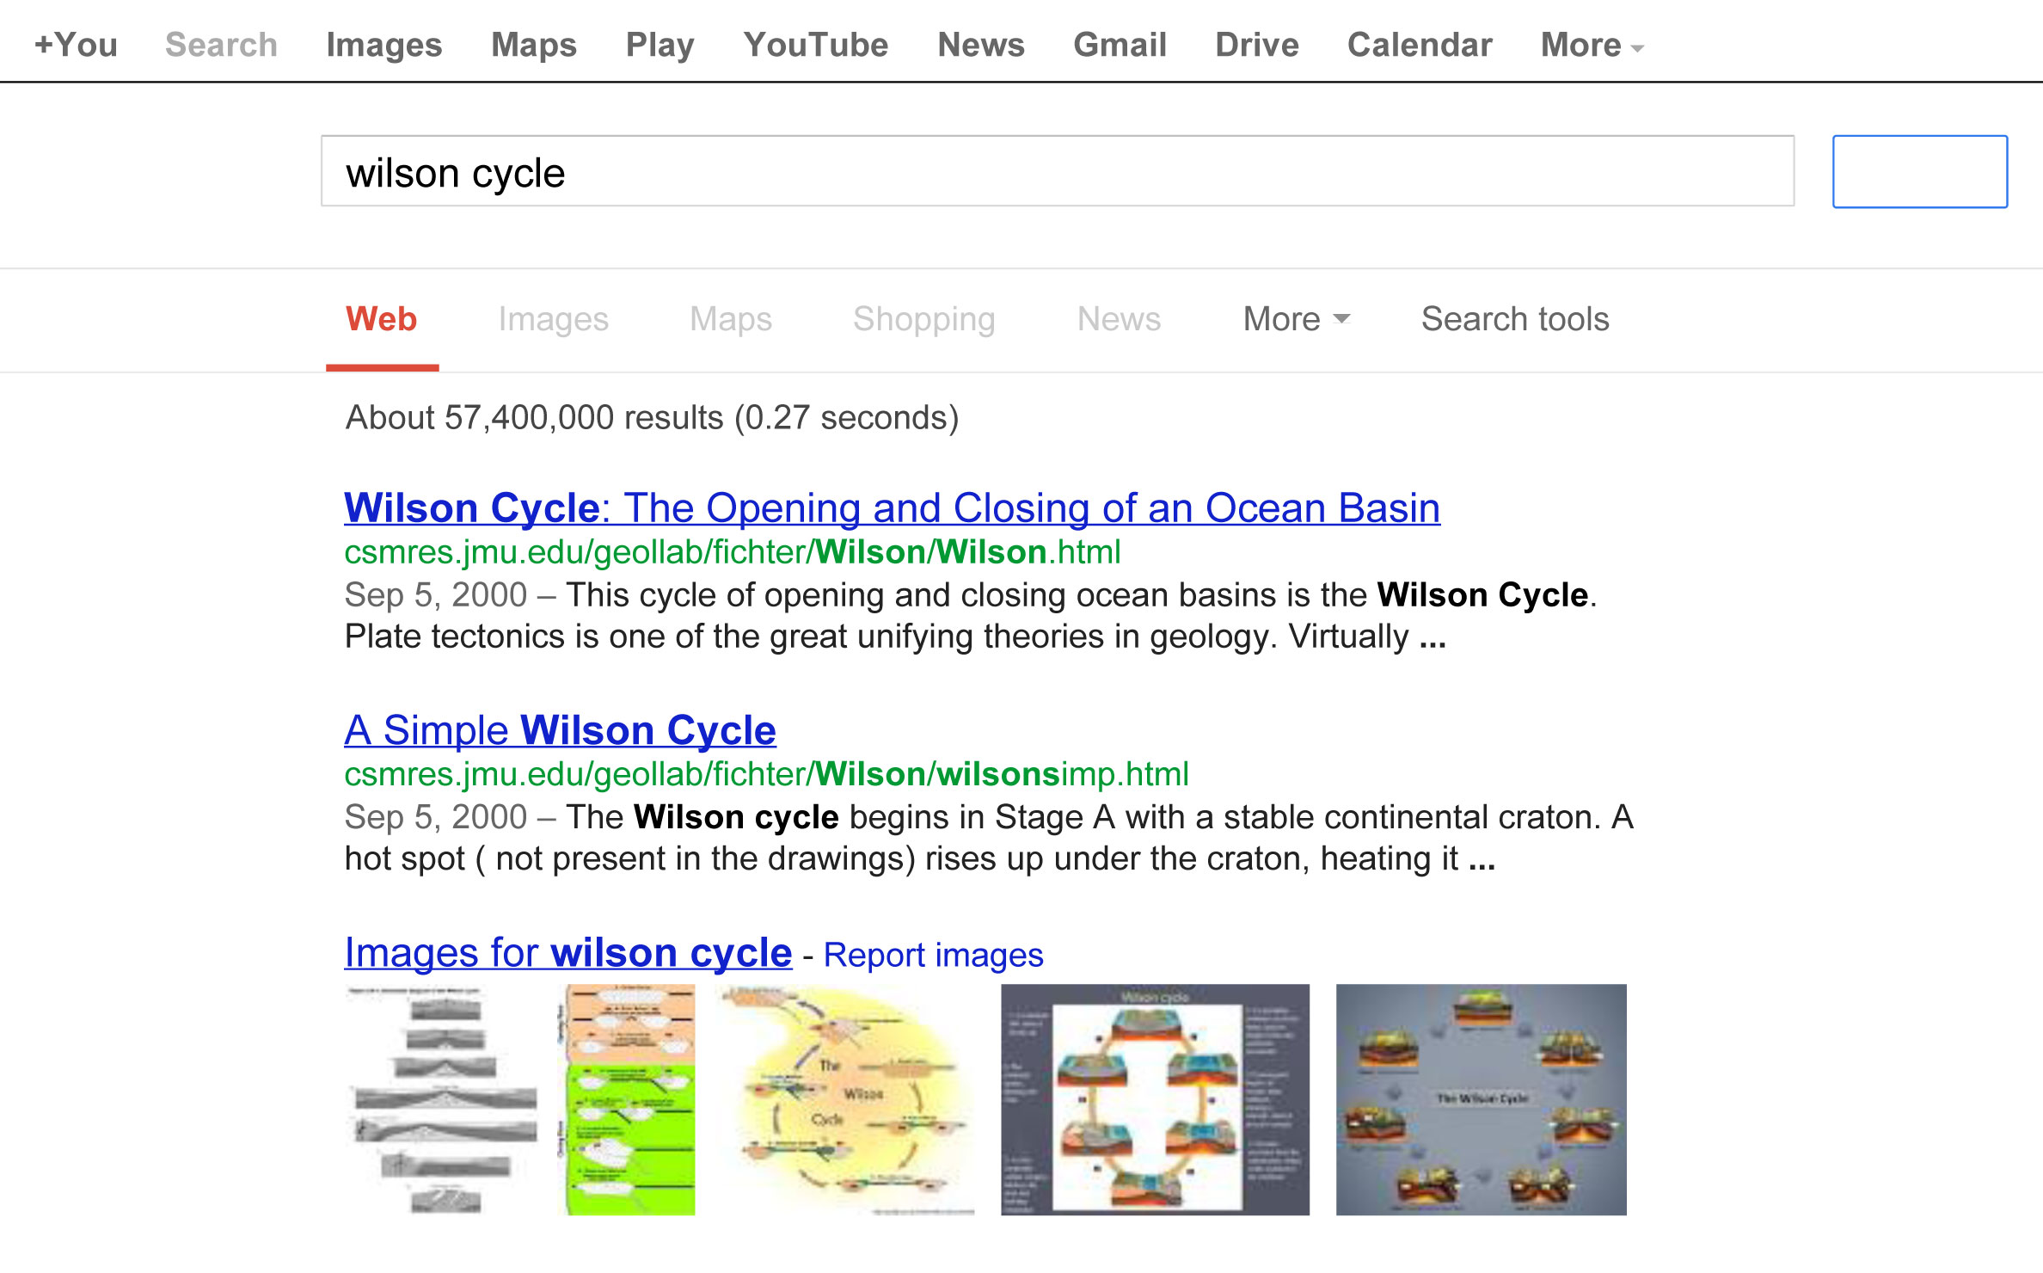
The Wilson Cycle: One of the most deeply embedded concepts in the Solid Earth Sciences
!!!!

Slide 6
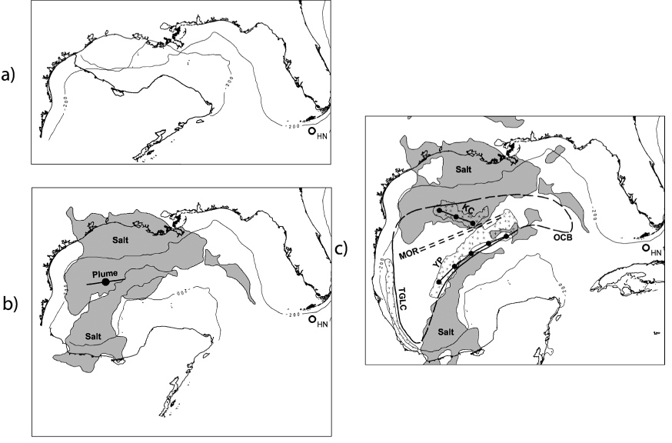
GoM seafloor is Jurassic ~160 Ma
Yucatan
~160 Ma
~140 Ma
Yucatan
Yucatan
~150 Ma
Reconstruction of Gulf of Mexico, 20-m.y. evolution of Yucatan motion. Notice ‘pole of rotation’ of Hall and Najmuddin (1994) = HN. (a) Initial position: about 160 Ma. (b) 10–12 m.y. after 22° rotation and continenta extension (about 150–152 Ma). Seafloor spreading began about this time. (C) 42° total rotation, present position of Yucatan achieved (about 140 Ma). From Hall et al. 2005 AAPG Bull.

Slide 7
Simple question
Conversion of a passive continental margin (like NW Gulf of Mexico) into a subduction zone is an important part of the “Wilson Cycle” – the opening and closing of ocean basins.
The NW Gulf of Mexico has been aging for 160 Ma and has taken on a huge load of sediments.

Slide 8
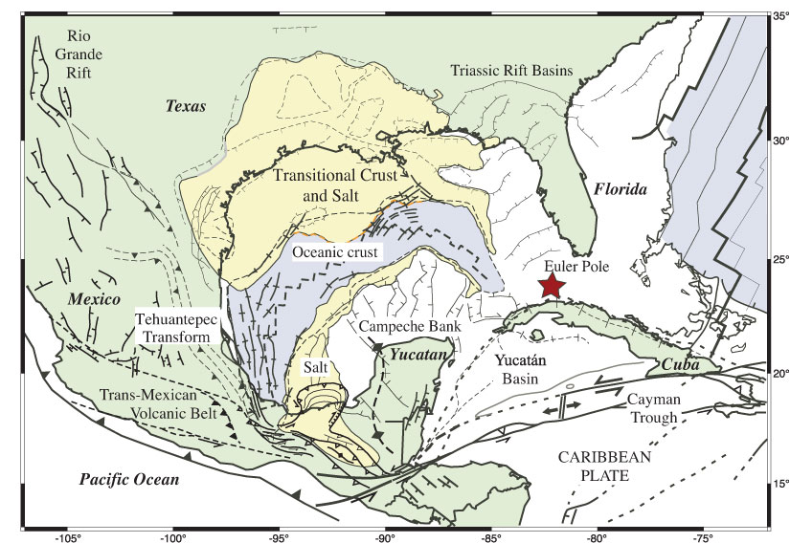
Modified after Pindell and Kennan 2009

Slide 9
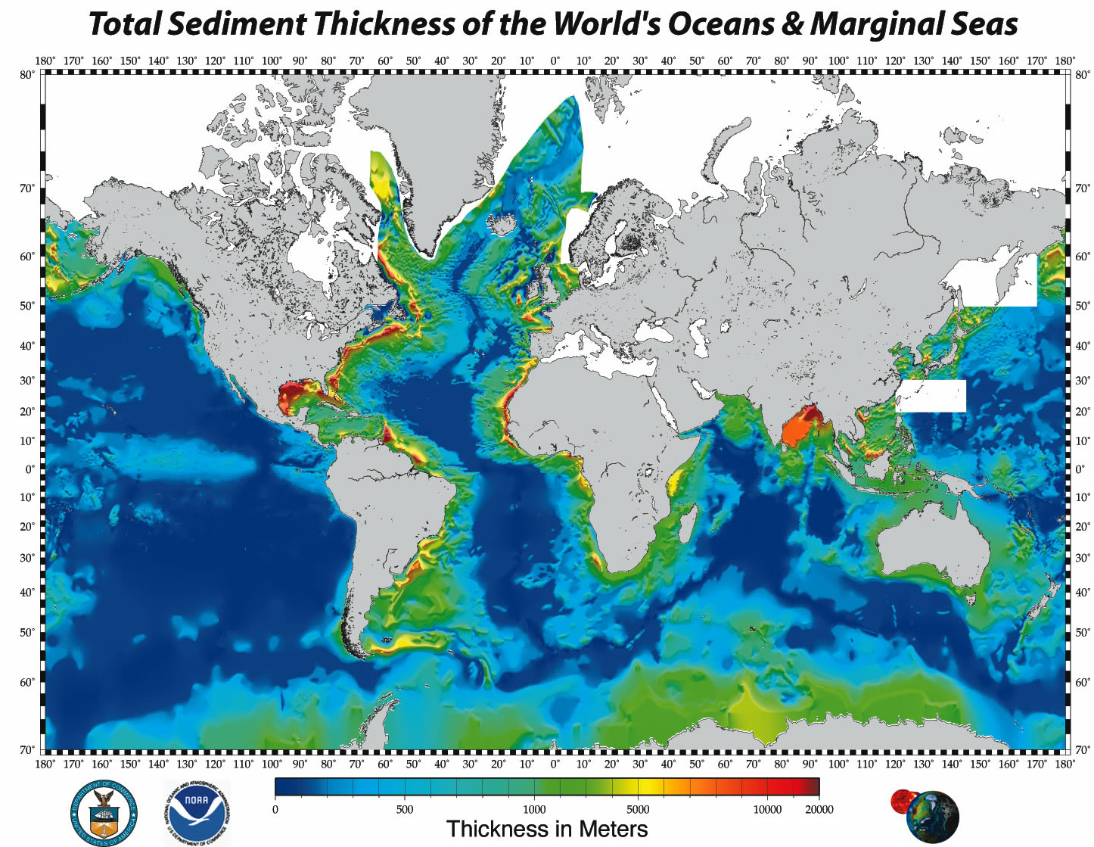
The Gulf of Mexico has one of the thickest piles of sediment on Earth

Slide 10
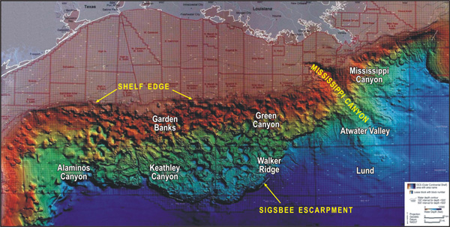
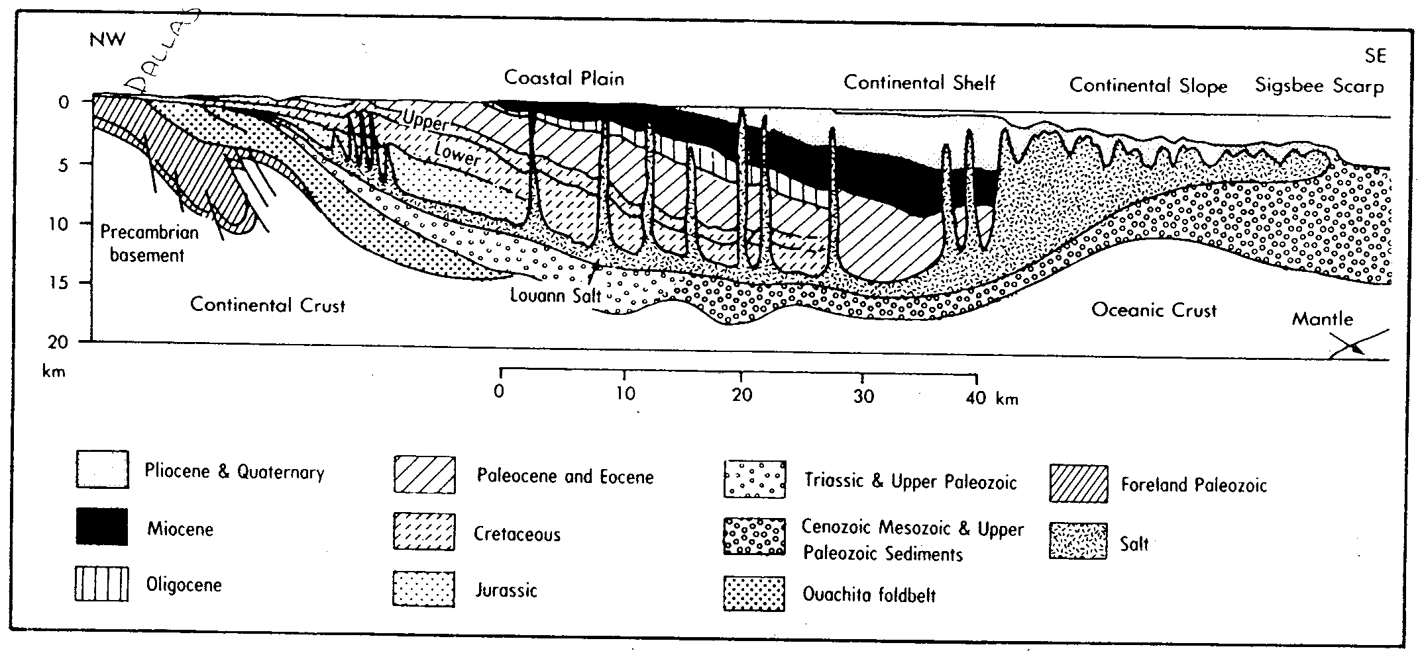
Sediments are especially thick in the NW Gulf of Mexico

Slide 11
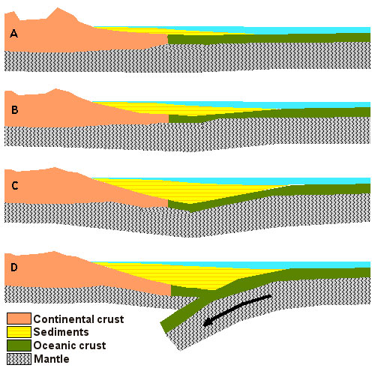
Why hasn’t the NW Gulf of Mexico (esp. in NW where sediments are thickest) had Passive Margin Collapse?
A critical part of the Wilson Cycle is the initiation of subduction. At a passive margin such as the Gulf of Mexico, sediments are deposited on the continental shelf (A). Over hundreds of millions of years this sediment pushes down on the oceanic lithosphere (B and C), and eventually the strain becomes so great that the lithosphere breaks and subduction begins (D)
http://records.viu.ca/~earles/subduction-water-oct01.htm

Slide 12
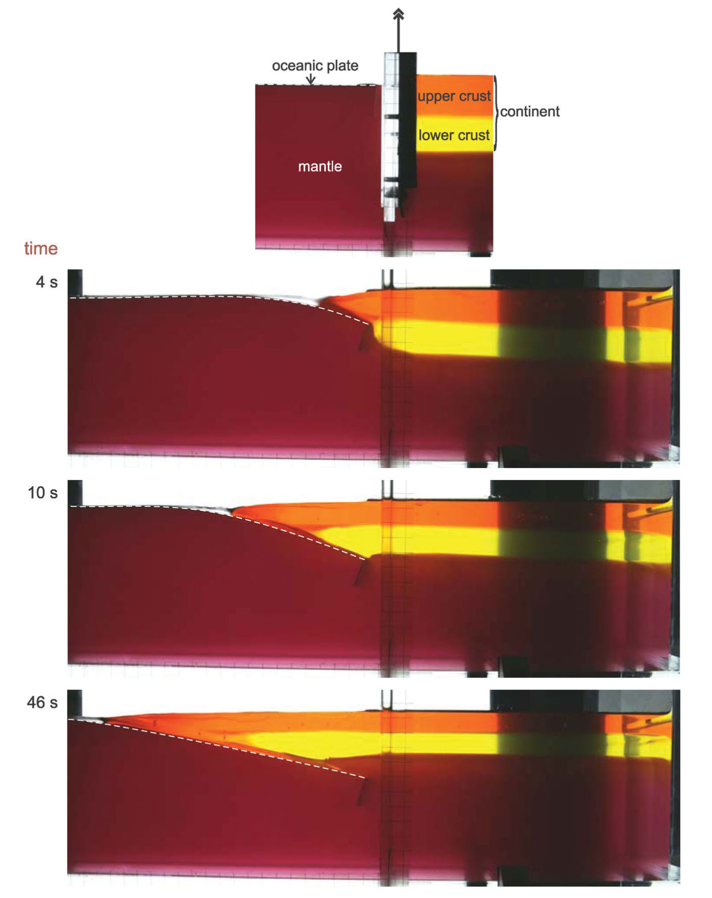
Geodynamic models often show “passive margin collapse”
Continental plate flows over Oceanic lithosphere to start subduction
Experiment with two buoyant fluid layers mimicking upper and lower crust at a passive continental margin. The fluid properties are ρ1u = 1010 kg⁻³, ρ 1l = 1090 kg⁻³, ρ2 = 1200 kg⁻³, η1u = 11.16 Pa s, η1l = 1.67 Pa s and η2 = 3.66 Pa s. The plate is 300μm thick. Levy & Jaupart 2012 GJI

Slide 13
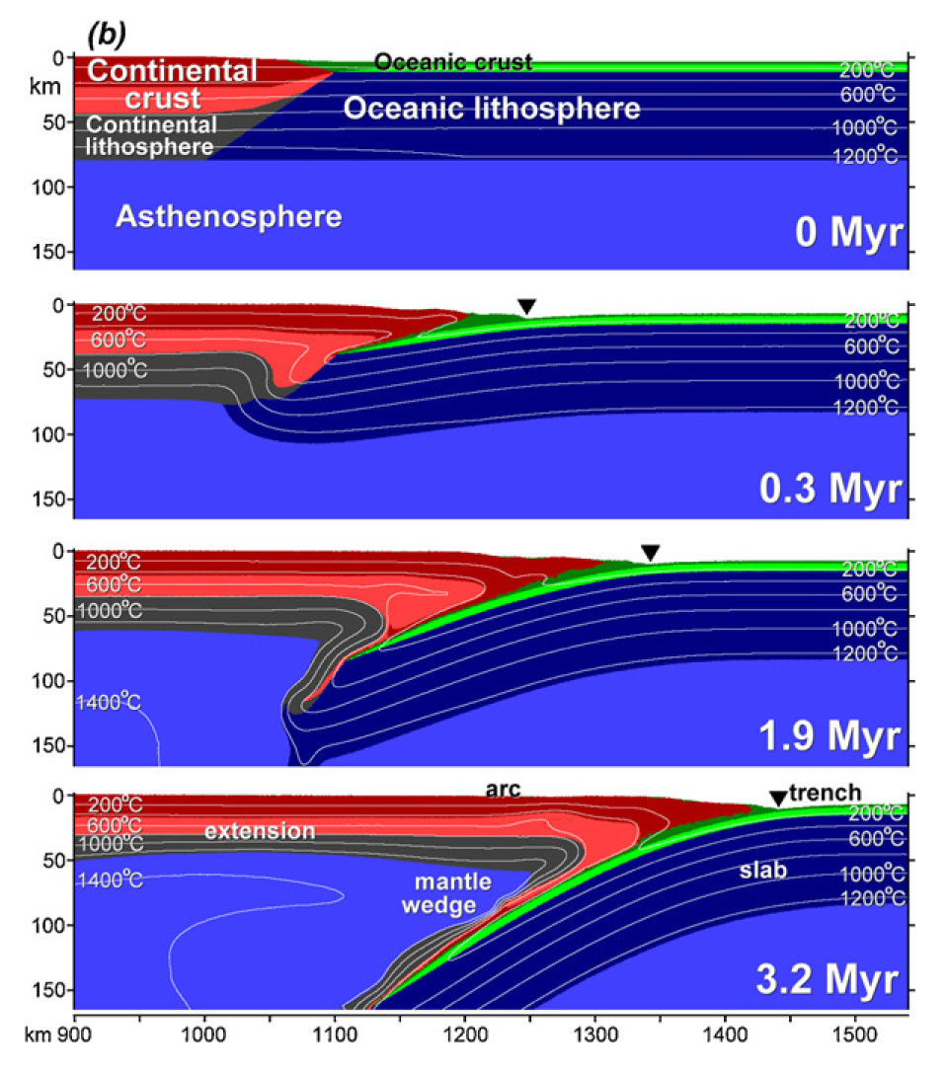
Example of numerical models for spontaneous initiation of subduction at a passive continental margin
(Nikolaeva et al., 2010).

Slide 14
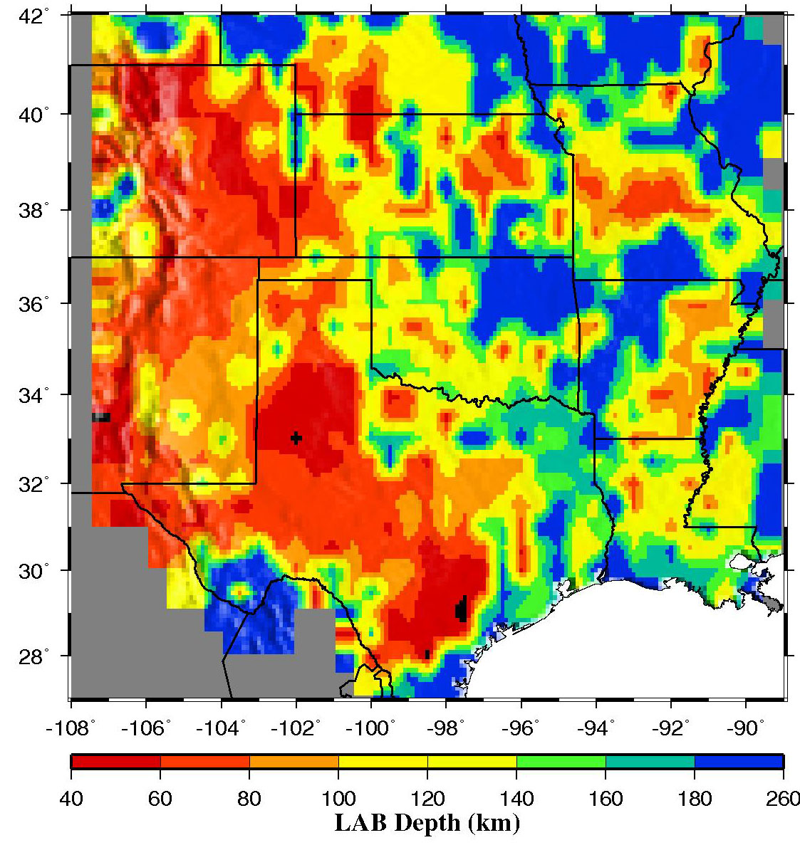
Lithosphere thickness (VPP) Gao & Liu (pers. comm.)
Numerical experiments of Nikolaeva et al. (2010, 2011) suggest that passive margin with rifted continental crust <30–35 km thick could transform into a subduction zone only if its lithosphere is <65–75 km thick.
Passive margins can most easily collapse into subduction zones within some 20 Myr after break-up, when the rifted lithosphere is still thin and hot.
Gulf Coast lithosphere mostly >100km thick.

Slide 15
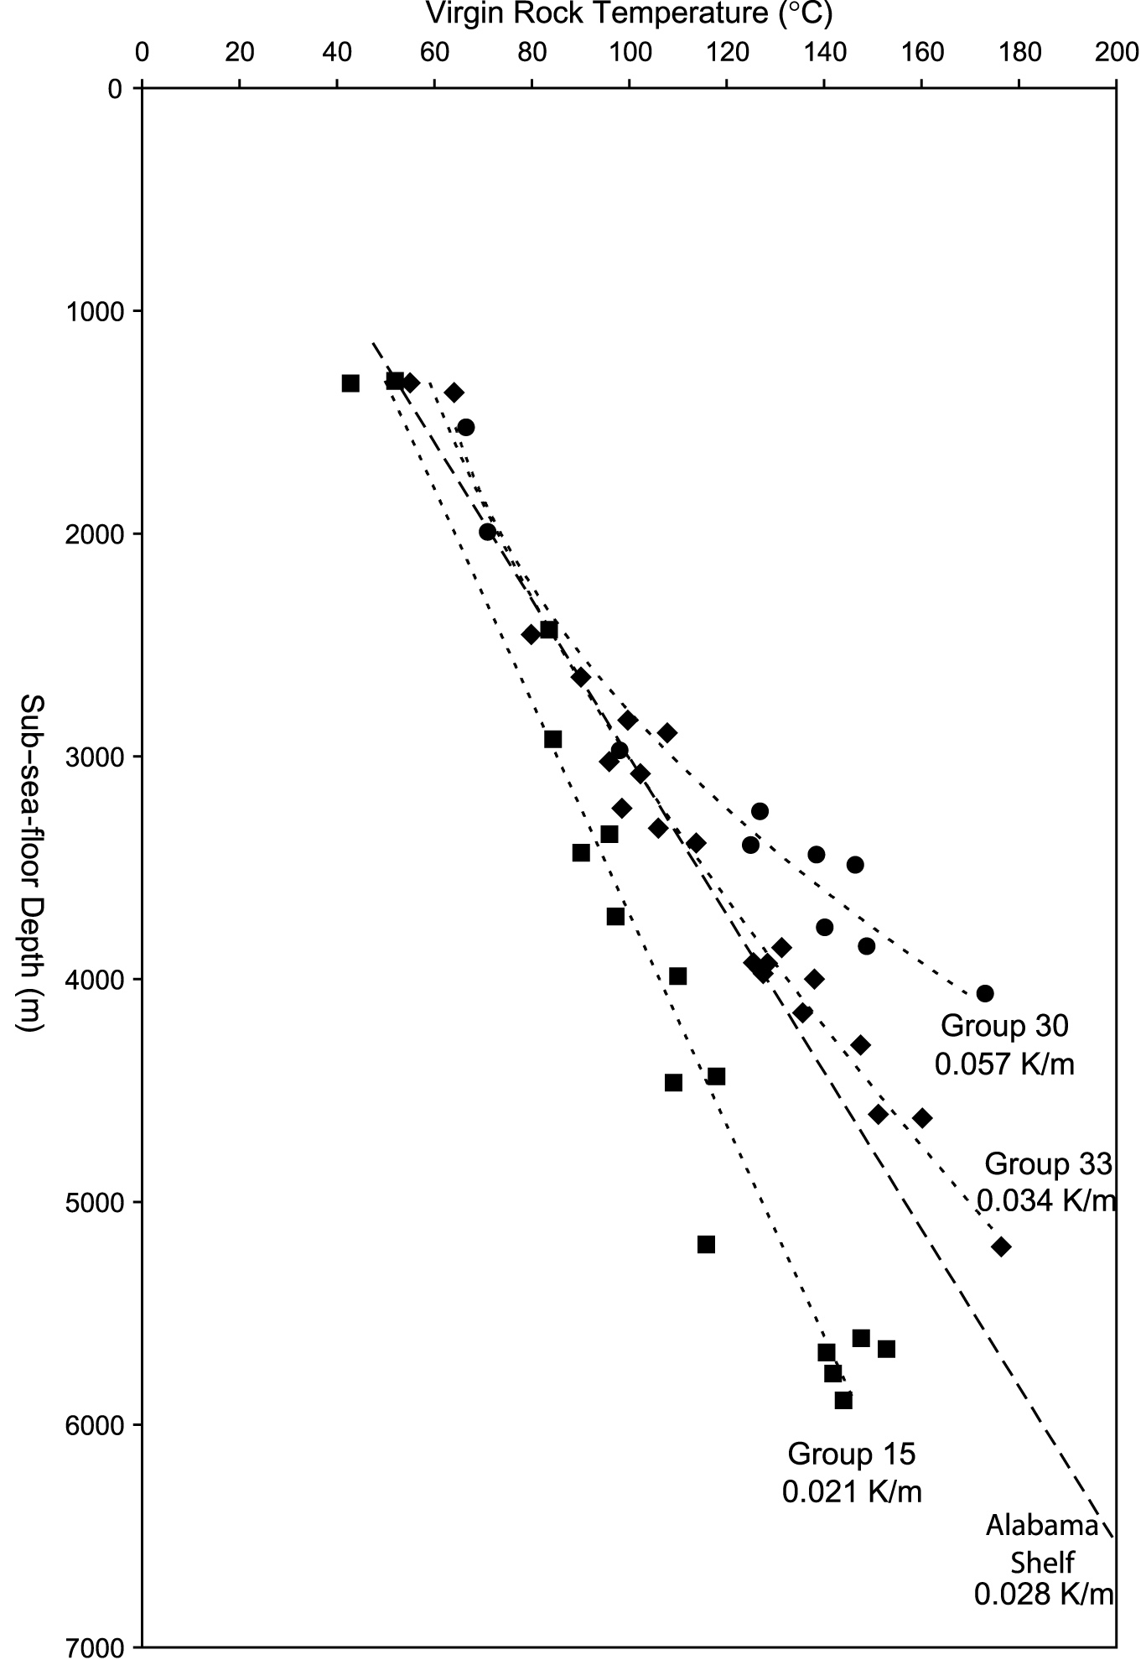
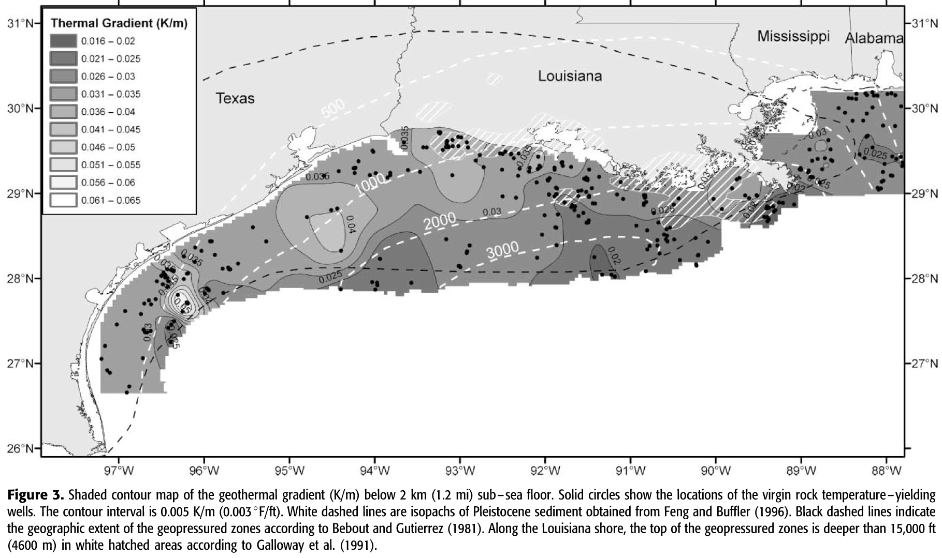
The Gulf Of Mexico: ~30°C/km
Nagihara and Smith 2008 AAPG Bull.
So base of crust must be quite warm: 35 km * 30°/km = 1050°C !

Slide 16
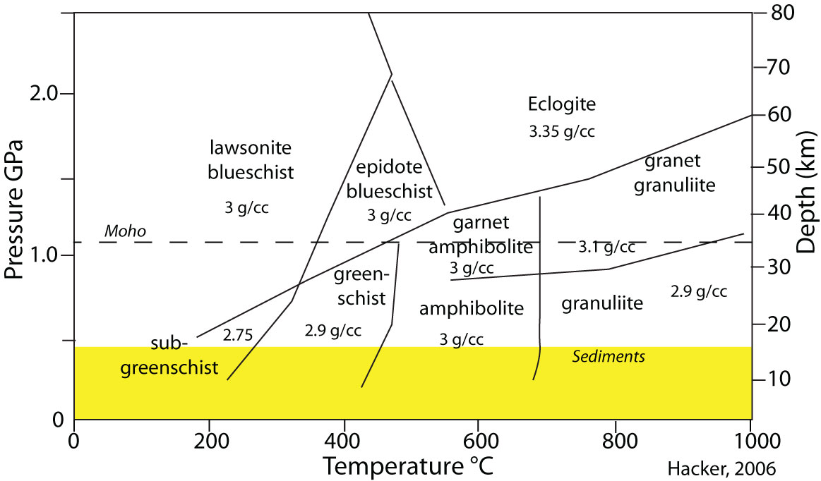
Regardless of Moho T, base of crust probably not in dense Eclogite facies;
No high density lower crust to enhance lithospheric collapse

Slide 17
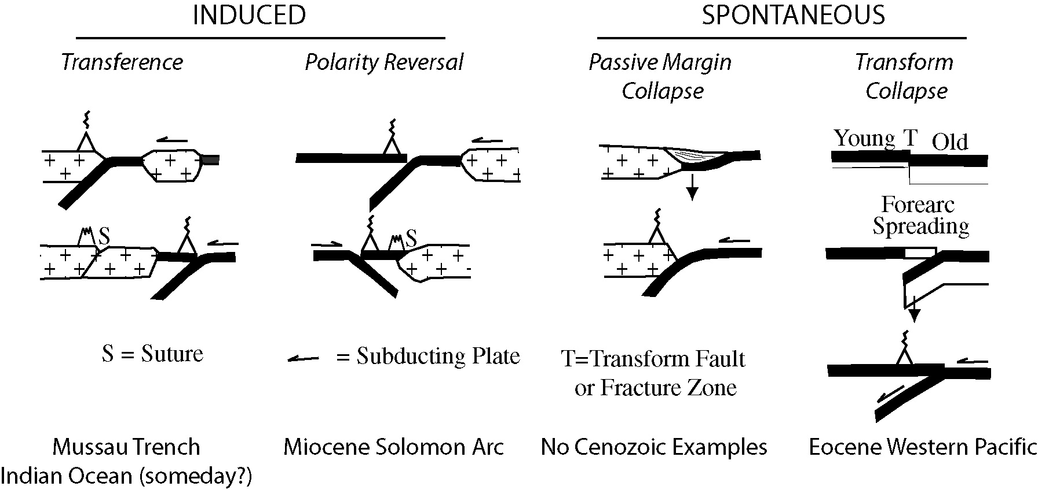
Maybe GoM Subduction needs to be Induced?
Stern 2004 EPSL

Slide 18
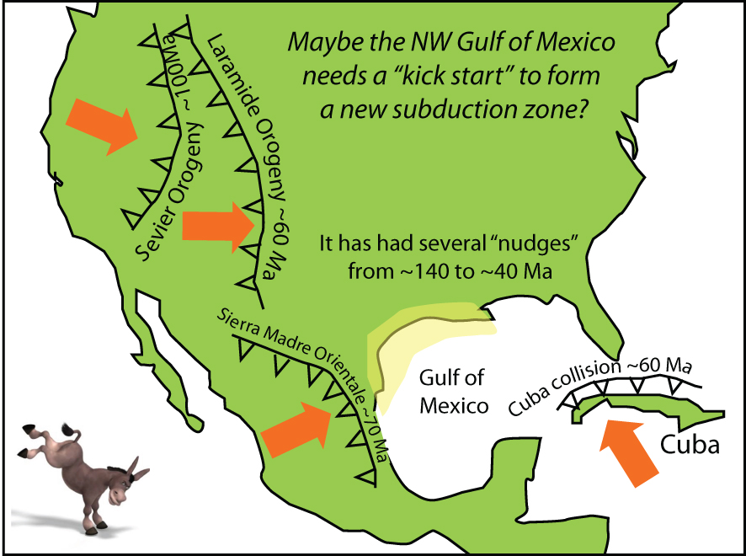

Slide 19
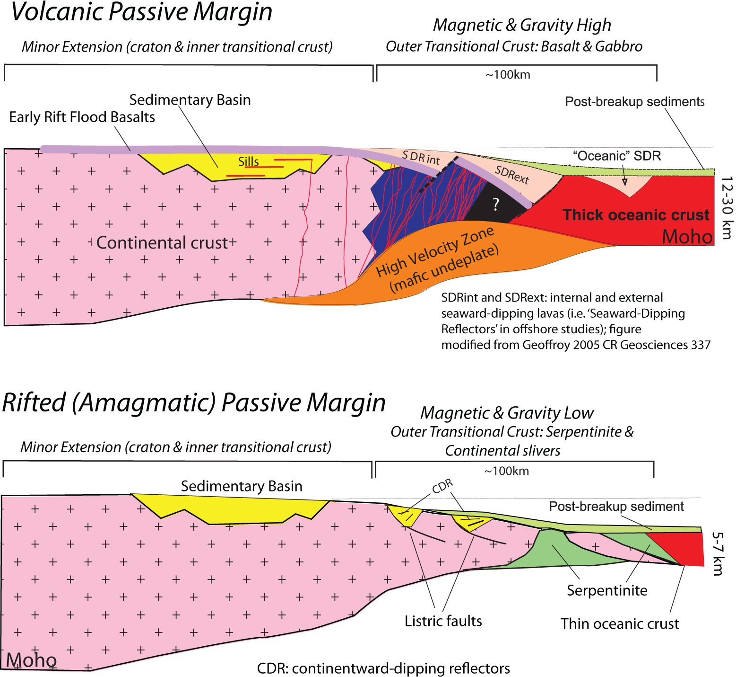
Maybe the likelihood of PM collapse depends on the nature of transitional lithosphere?
Volcanic
Passive
Margin (VPM)
Rifted
Passive
Margin
(RPM)

Slide 20
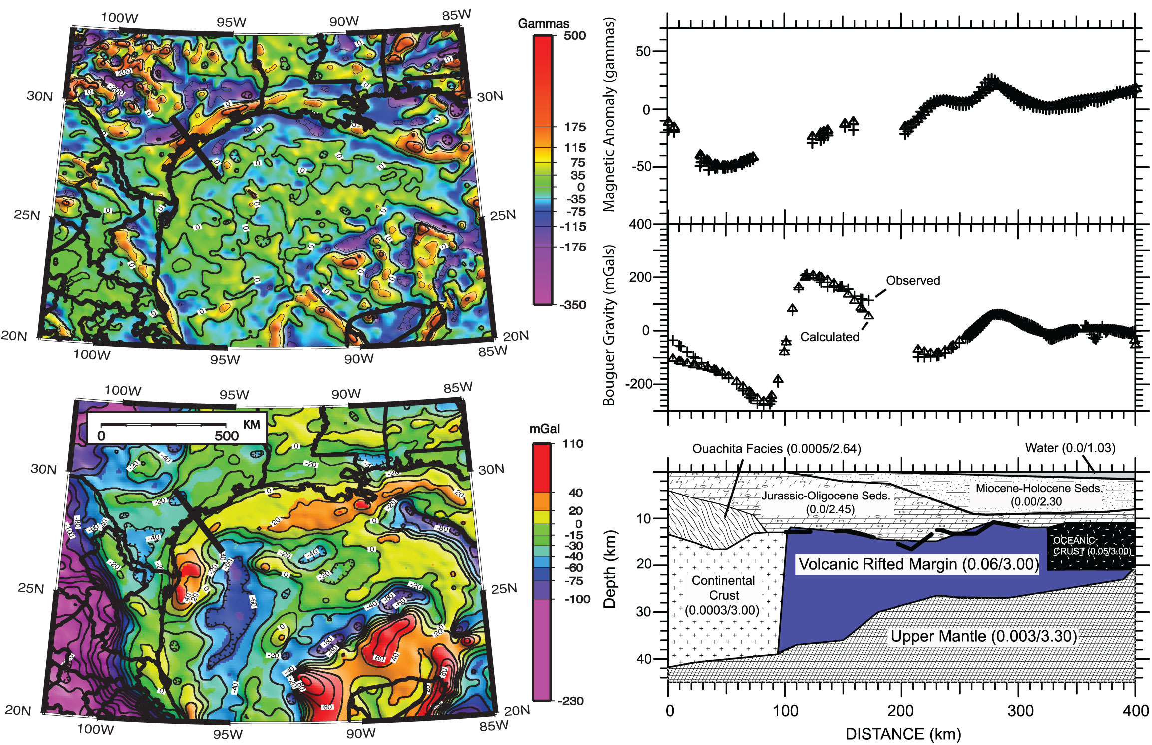
What can potential fields (mag & grav) tell us about nature of NW GoM transitional crust?
Mag
Gravity
Mickus et al., 2009

Slide 21
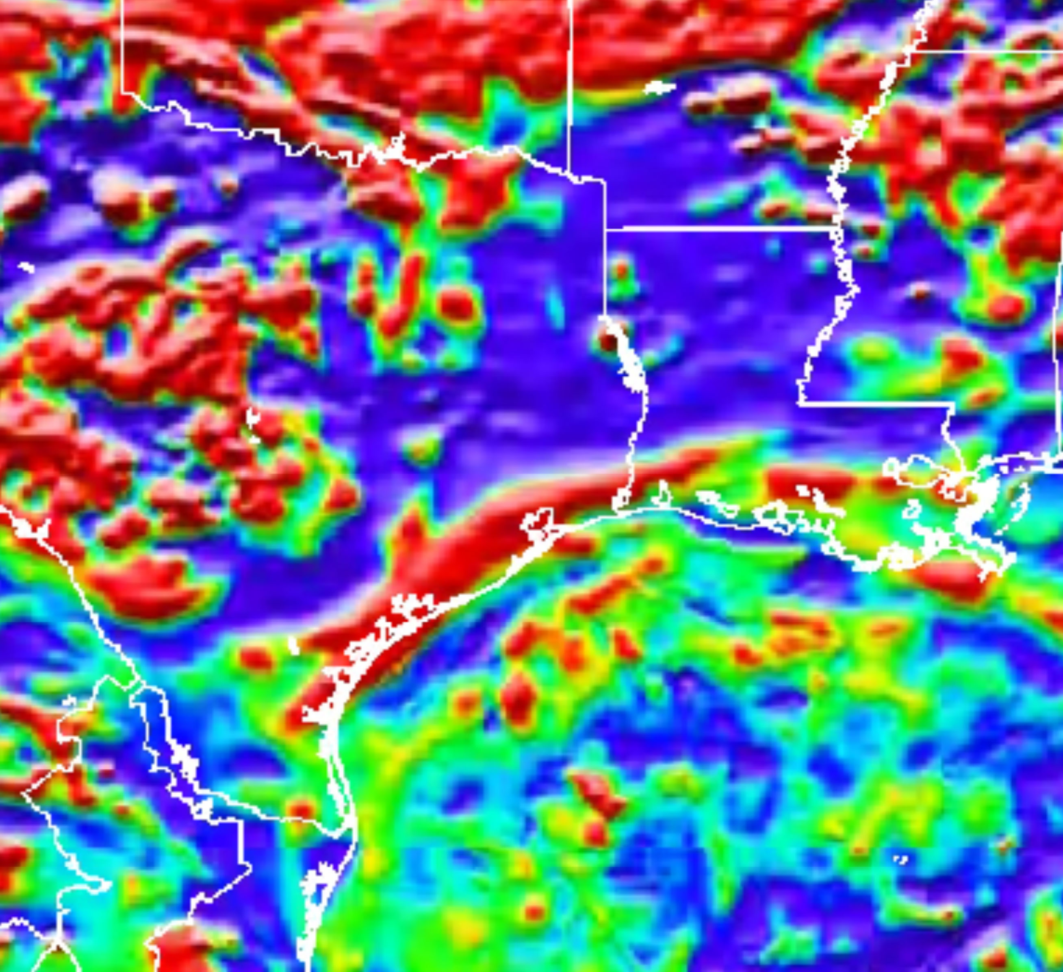
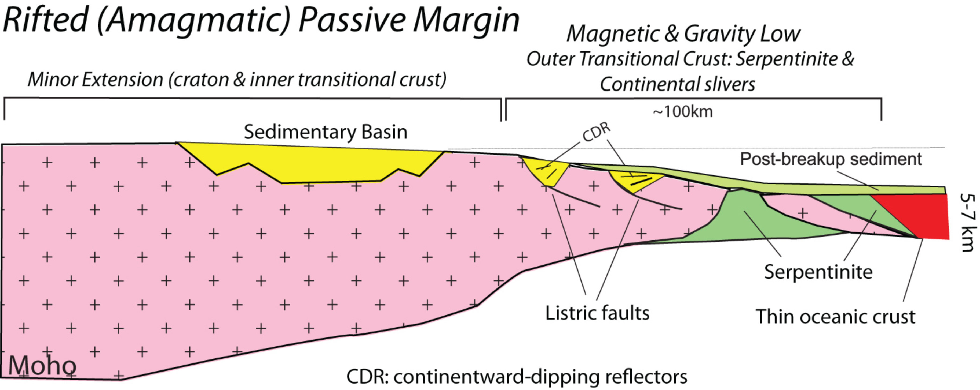
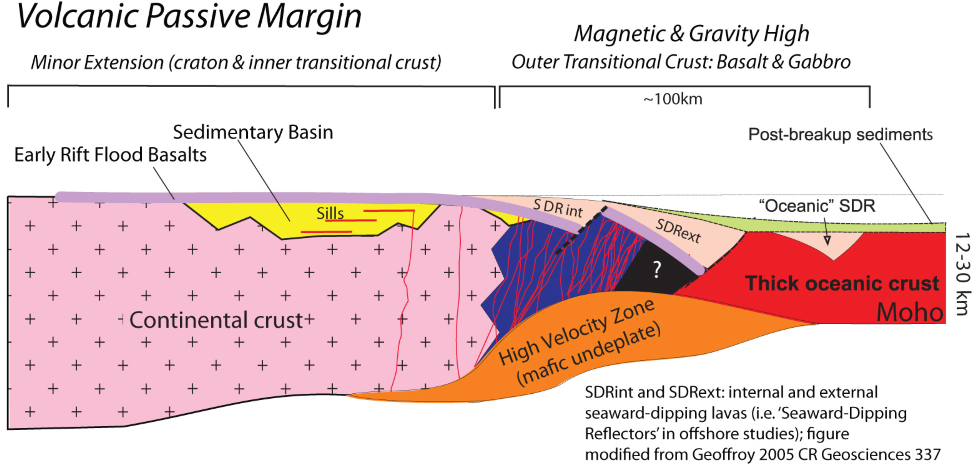
Fundamental differences between Texas and Louisiana transitional lithosphere should affect where a new subduction zone starts to form
Louisiana transitional lithosphere
Texas transitional lithosphere
Magnetic map for NW Gulf of Mexico
(thanks to I. Norton)

Slide 22
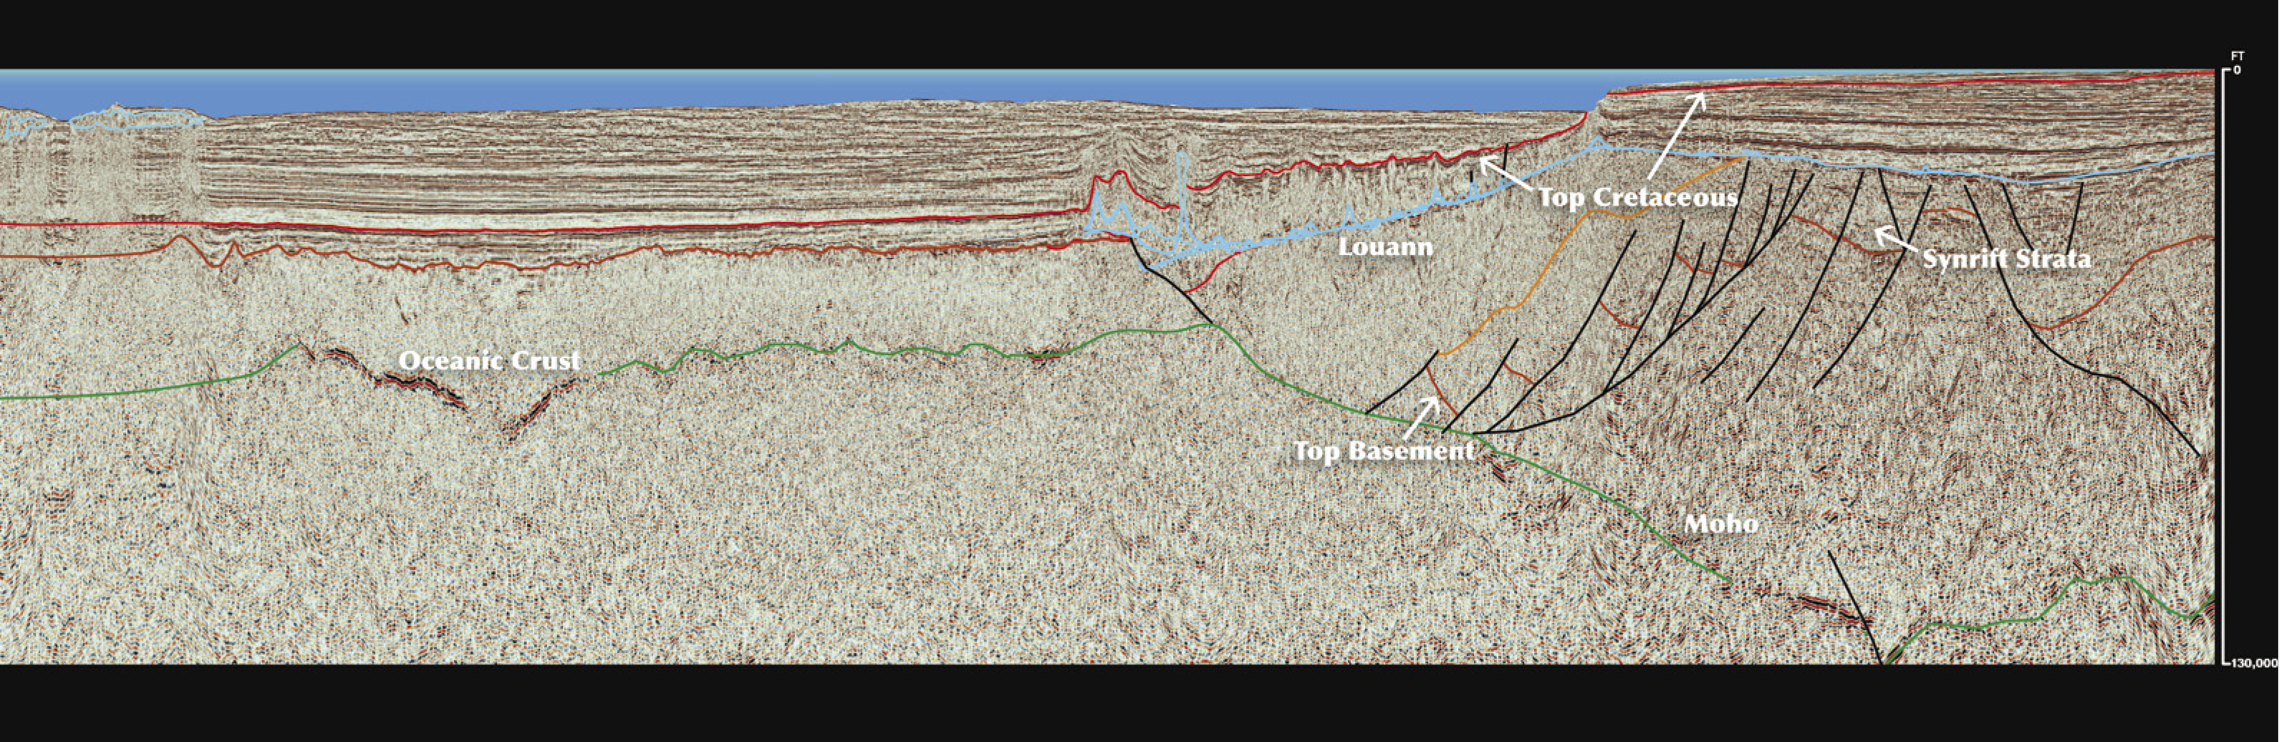
No evidence of Lithospheric Collapse or Overthrusting along GoM margins
Seismic Reflection Profile, Florida Shelf to GoM Deep Basin
Nov. 2012 AAPG Explorer
Advertisement for Dynamic Data Services

Slide 23
Louisiana magnetics & 7 islands salt domes

Slide 24
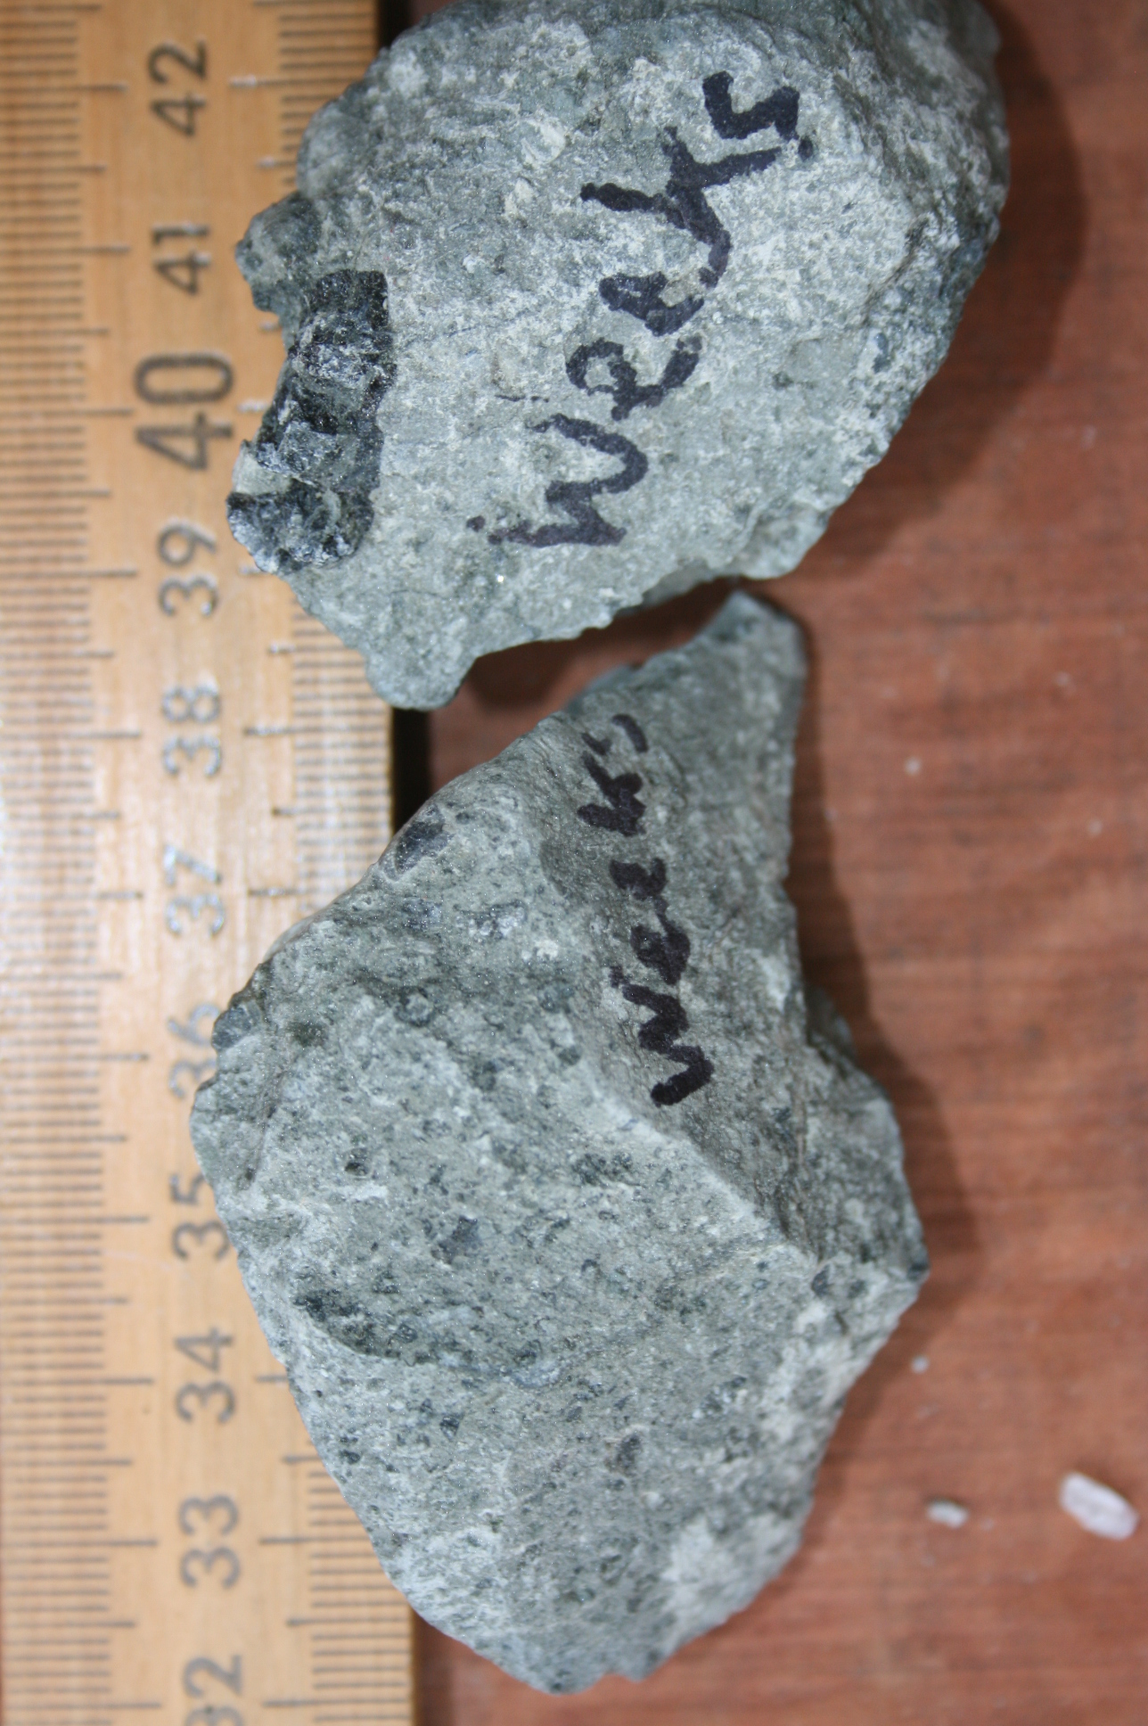
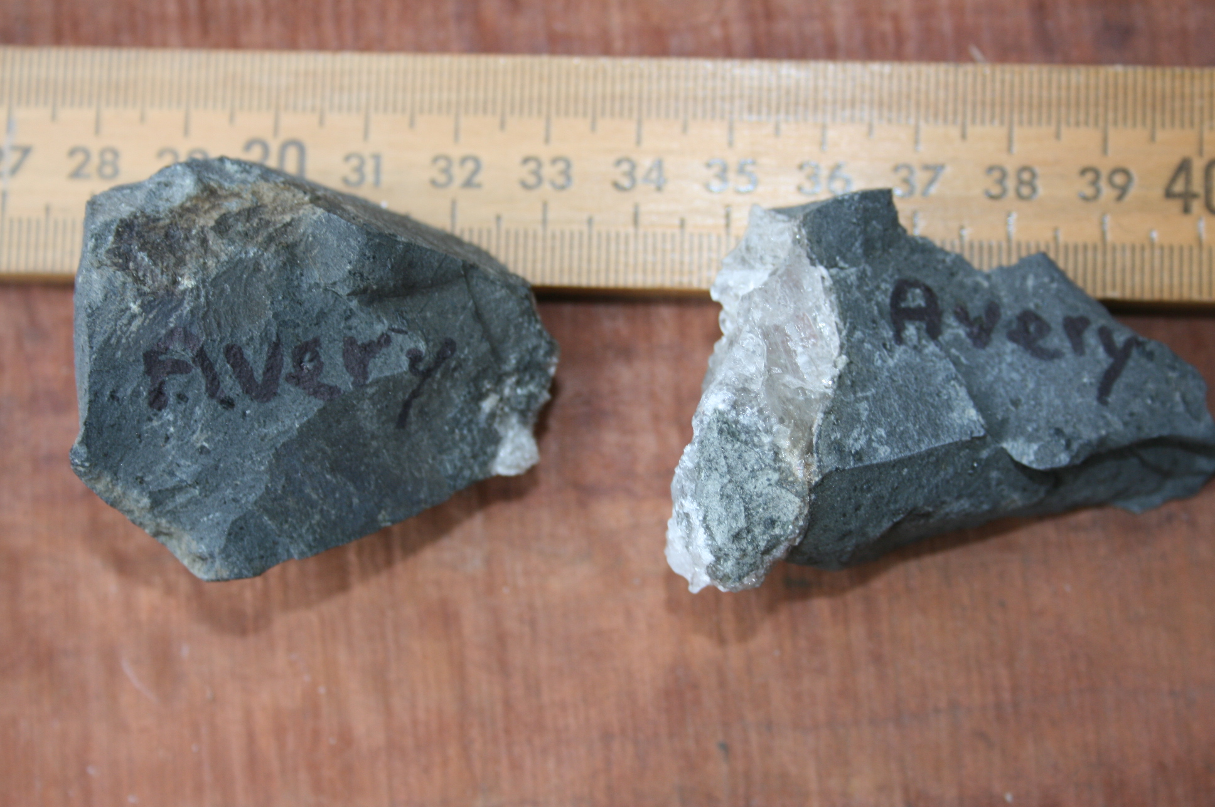
Igneous rocks in Avery and Weeks salt domes
Rocks are altered (low-grade, hydrothermal).

Slide 25
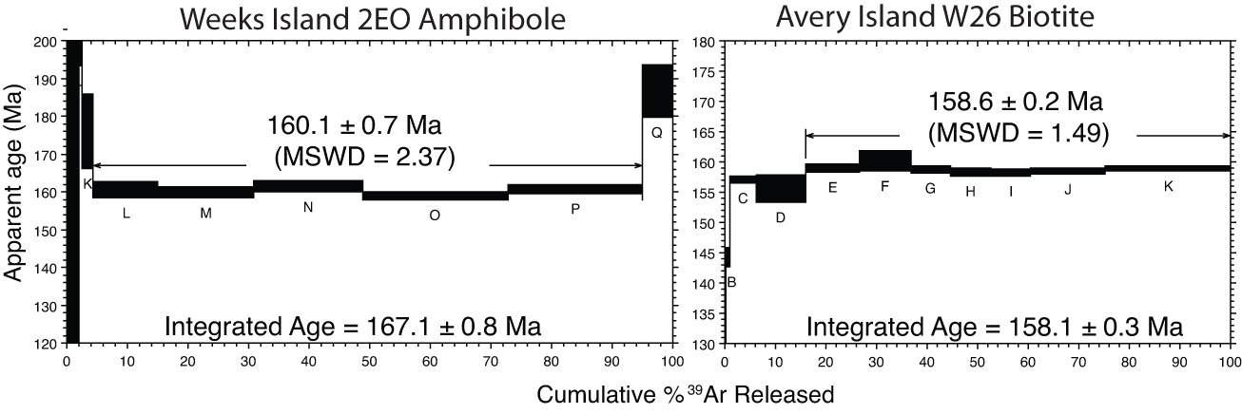
Good ⁴⁰Ar/³⁹Ar plateau ages for two xenoliths: different minerals from different domes
Analyses at NMT
Read more: Stern et al. 2011 Geology
Notes:
25

Slide 26
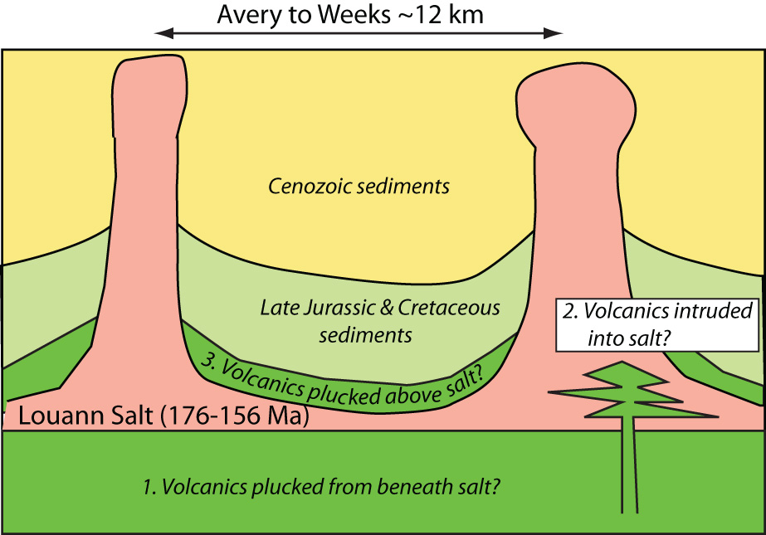
What is relationship between igneous rocks and Louann salt? 3 possibilities:
Notes:
26

Slide 27
3 Conclusions:
Even though ancient and deeply buried in sediments, NW Gulf of Mexico margin is too strong to collapse into a subduction zone
This is probably generally true for passive continental margins; Passive continental margins do not generally turn into subduction zones.
Wilson Cycle may require 3rd dimension to work (fracture zone collapse): oceans close perpendicular to how they open.

