Slide 1
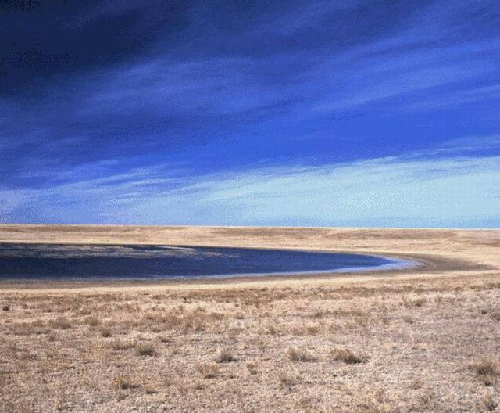

ASSESSING THE FEASIBILITY OF RECHARGE ENHANCEMENT FROM PLAYA LAKES ON THE TEXAS HIGH PLAINS
Texas Water Development Board
Preliminary Resource Assessment and Alternatives Analysis
Notes:
A presentation at the spring 2013 South-Central Section meeting of the Geological Society of America in Austin Texas.

Slide 2
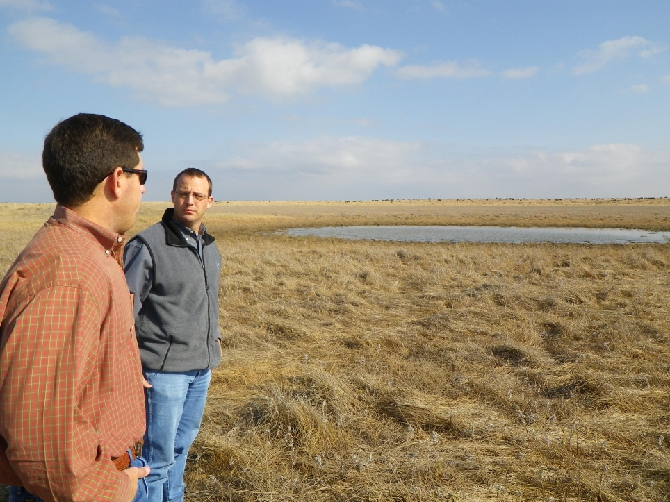
Presentation Outline
Objective #1: quantify water resource potentially available from playa lakes
Playa geography
Field monitoring network
Landsat imagery
Image classification
Reconstructed water levels
Water volumes
Objective #2: evaluate playa modification alternatives
Design objectives
Design alternatives
Preliminary costing
Alternatives analysis
Notes:
This presentation attempts to answer two questions – how much water is potentially available from the playa lakes, and what can we do with it? We’ve gotten a start on answering the first question using a combination of field monitoring and satellite image analysis to reconstruct water level records in a sample of playas. The second question is one of engineering and economics, and alternative selection will depend on location, intended water use, and other factors. This presentation defines a decision process to help guide playa water resource development.

Slide 3
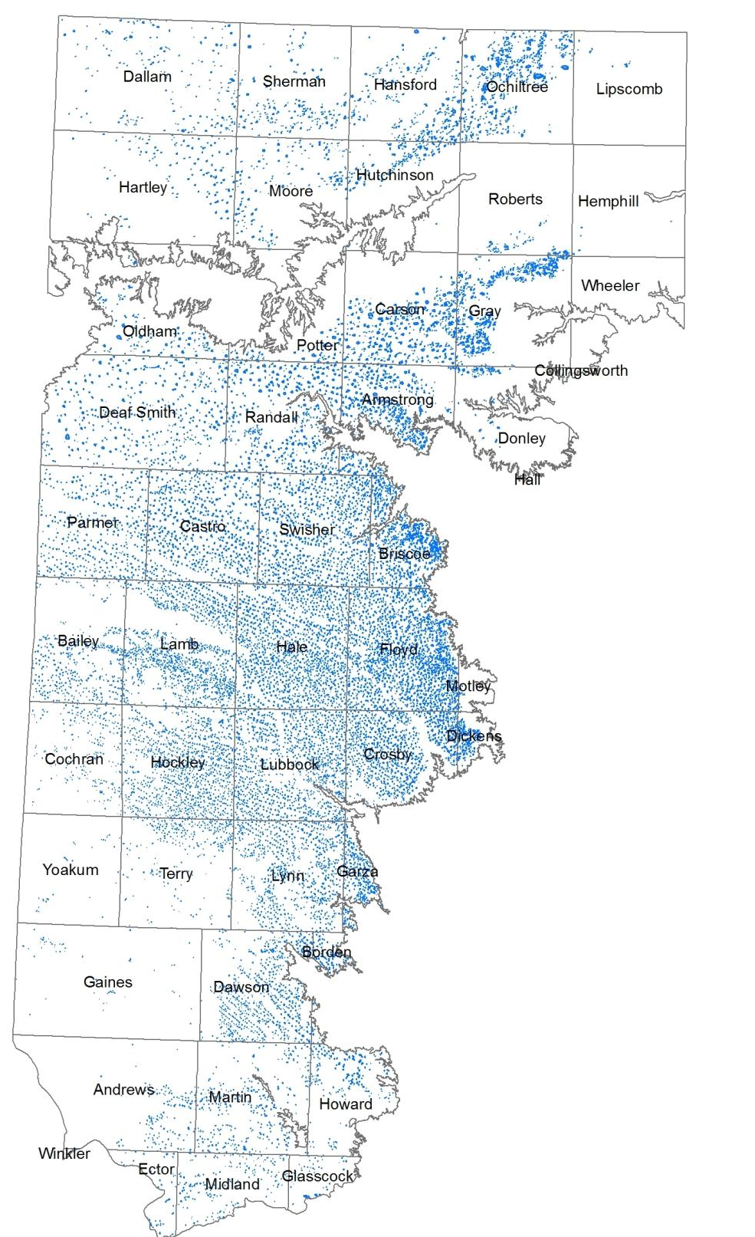
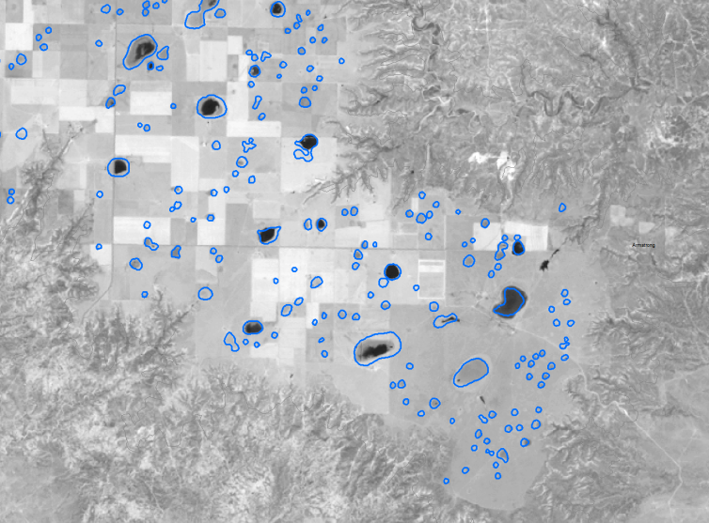
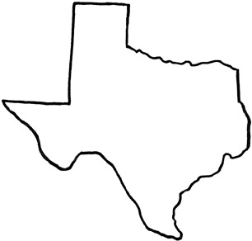
Texas Playa Geography
19,229 mapped playas
Closed basins with clay bottoms
Average 18.77 acres in area
Most basins < 10 feet total depth
Capture 80% to 90% of runoff
Extent of Ogallala Aquifer
Area of detail
North
30 miles
Notes:
Playas are a characteristic feature of the Texas High Plains. Playas capture storm runoff and are the main source of groundwater recharge in the region. Small, shallow playas predominate numerically, but a few large playas hold most of the volume.

Slide 4
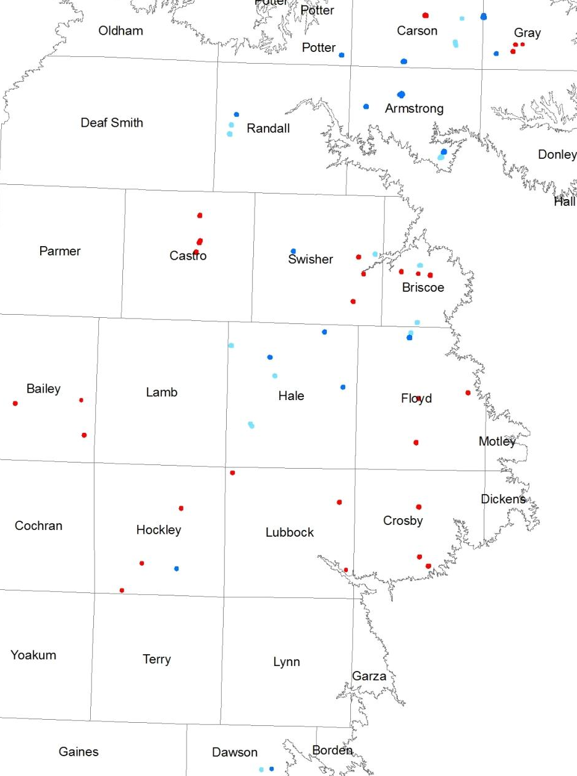
Playa Monitoring Network
Water balance monitoring strategy
Monitoring sites in 15 counties
34 TWDB sites, established 2011 - 2013
17 playas with weather stations and soil moisture sensors
17 playas with water level sensors only
30 ARS/Texas Tech sites, established 2006 - 2010
20 playas with weather stations
10 playas with water level and precipitation only
Relatively short period of record compared to climate cycles
LEGEND
Met Station
Water level only
ARS-TTU site
30 miles
Notes:
Over 60 field monitoring sites are in operation in 15 counties across the Southern High Plains. Some are maintained by the TWDB and some by a group of Texas Tech and USDA researchers based in Lubbock. The field data record the flood frequency and flood depth in the playas and help constrain the water balance for each lake, improving our understanding of rainfall – runoff relationships and the balance between evaporation and infiltration. Field data are only available for the last six or seven years – a short time relative to the periods of climate cycles such as the Pacific decadal oscillation and other sources of climate variability.

Slide 5
Playa Monitoring Network
Supplement field data with longer-term Landsat observations
47 TWDB and ARS-TTU field sites within path 30/row 36 image tile
115 miles
Landsat 30 - 36 image area
LEGEND
Met Station
Water level only
ARS-TTU site
Notes:
Landsat images provide an opportunity to extend our field monitoring record back in time. Images are available for the period 1984 to present, with good coverage from about 1992 to present. The Landsat Path 30 Row 36 image tile covers an area of about 12,000 square miles, including the majority of the field monitoring sites.

Slide 6
Playa Monitoring Network
Supplement field data with longer-term Landsat observations
47 field sites within path 30/row 36 image tile
27 sites with detailed topographic surveys
Landsat 30 - 36 image area
LEGEND
Met Station
Water level only
ARS-TTU site
Notes:
We have competed detailed topographic surveys for 27 of the sites in this image tile, allowing us to calculate water depth and volume from the satellite images.

Slide 7
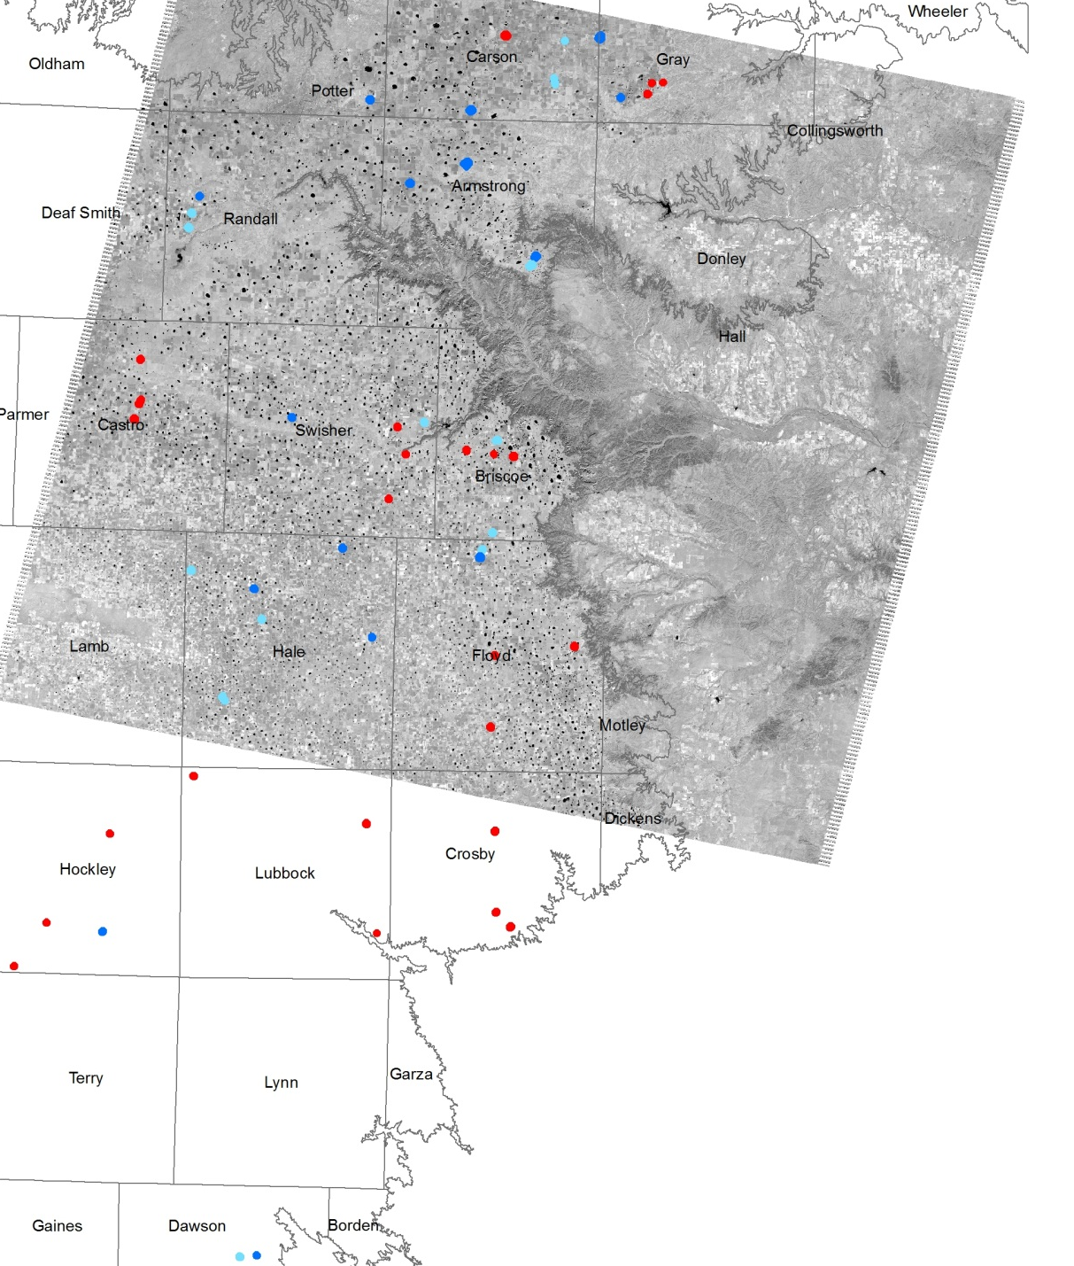
Playa Monitoring Network
Supplement field data with longer-term Landsat observations
47 field sites within path 30/row 36 image tile
27 sites with detailed topographic surveys
142 Landsat scenes from 1/26/02 to 12/15/2012 evaluated
Landsat 30 - 36 image area
LEGEND
Met Station
Water level only
ARS-TTU site
Notes:
We used 142 Landsat scenes coving an 11 year period from January 2002 through December 2012 to reconstruct water level records for these 27 playas.

Slide 8
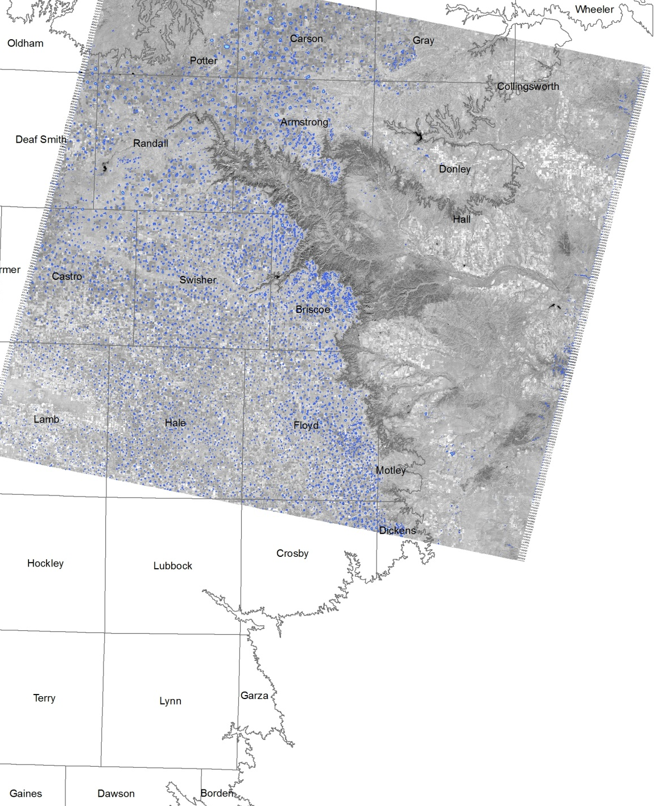
Playa Monitoring Network
Supplement field data with longer-term Landsat observations
47 field sites within path 30/row 36 image tile
27 sites with detailed topographic surveys
142 Landsat scenes from 1/26/02 to 12/15/2012 evaluated
Water areas defined in each scene
Landsat 30 - 36 image area
LEGEND
Met Station
Water level only
ARS-TTU site
Notes:
We used the image classification routines in ArcGIS 10.0 to define water areas in each scene. This image shows particularly wet conditions on 1 December 2004, following widespread rainfall.

Slide 9
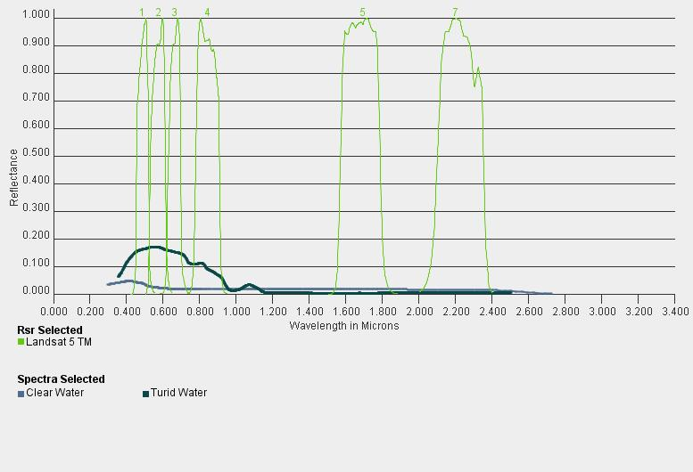
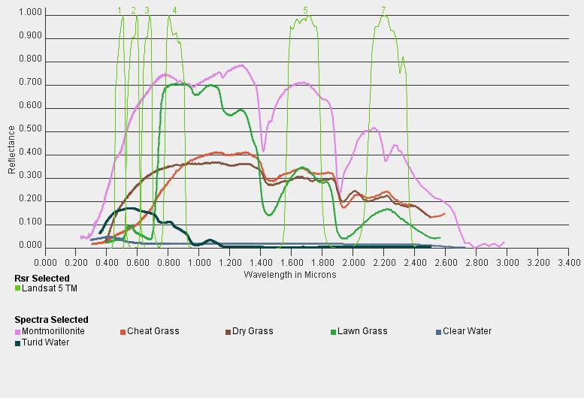
Water Classification
B G R NIR mid-IR thermal IR
Landsat images use 7 bands
Blue, green, red, near IR, mid IR, panchromatic, and thermal IR
Band 5 identifies water best
Open water uniformly dark
Soil minerals bright
Vegetation and moist soil have intermediate reflectance
Cutoff value for water varies seasonally
Landsat Bands with Water Spectrum
Soil and Vegetation Spectrum
Notes:
Although Landsat images have 7 spectral bands, we just used data from Band 5 to define water areas. Band 5 images mid-range infrared light, in which water areas are uniformly dark, while soil minerals and vegetation are bright. The exact cutoff values used to identify water areas varies seasonally with changes in the solar incidence angle and atmospheric conditions.

Slide 10
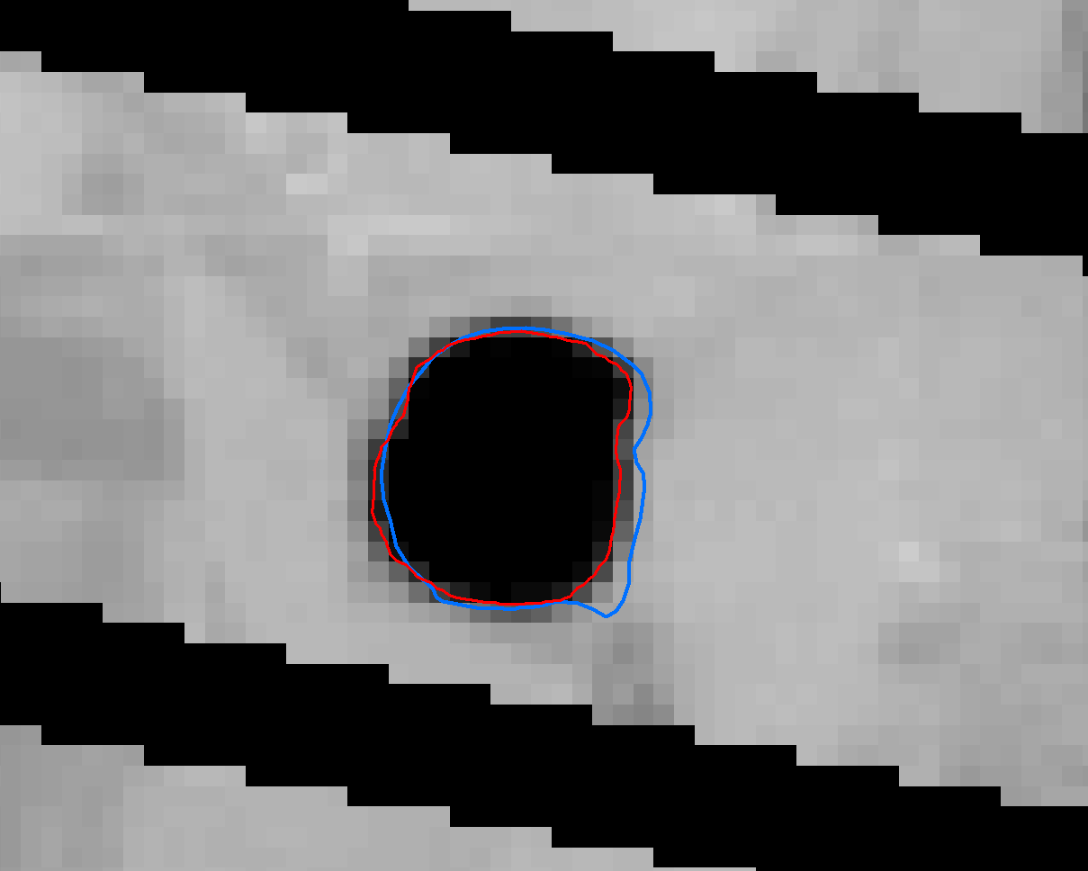
Landsat Band 5 classification
Landsat 5 and Landsat 7 Band 5 imagery utilized
Water areas identified using default ArcMap natural breaks classification
Water pixels contoured and saved as polygons
Polygon areas used with topographic data to derive water depth and volume
Scan line band gap in Landsat 7 imagery
Mapped playa area (blue)
Water area (red)
Notes:
We used both Landsat 5 and Landsat 7 images, although the Landsat 7 scenes with scan-line band gaps generally required hand contouring. To keep things simple we used the default natural breaks image classification algorithm in ArcMap. Water pixels values were contoured and the contours were saved as polygons. The water area polygons were then combined with survey data to obtain water depth and volume estimates.

Slide 11
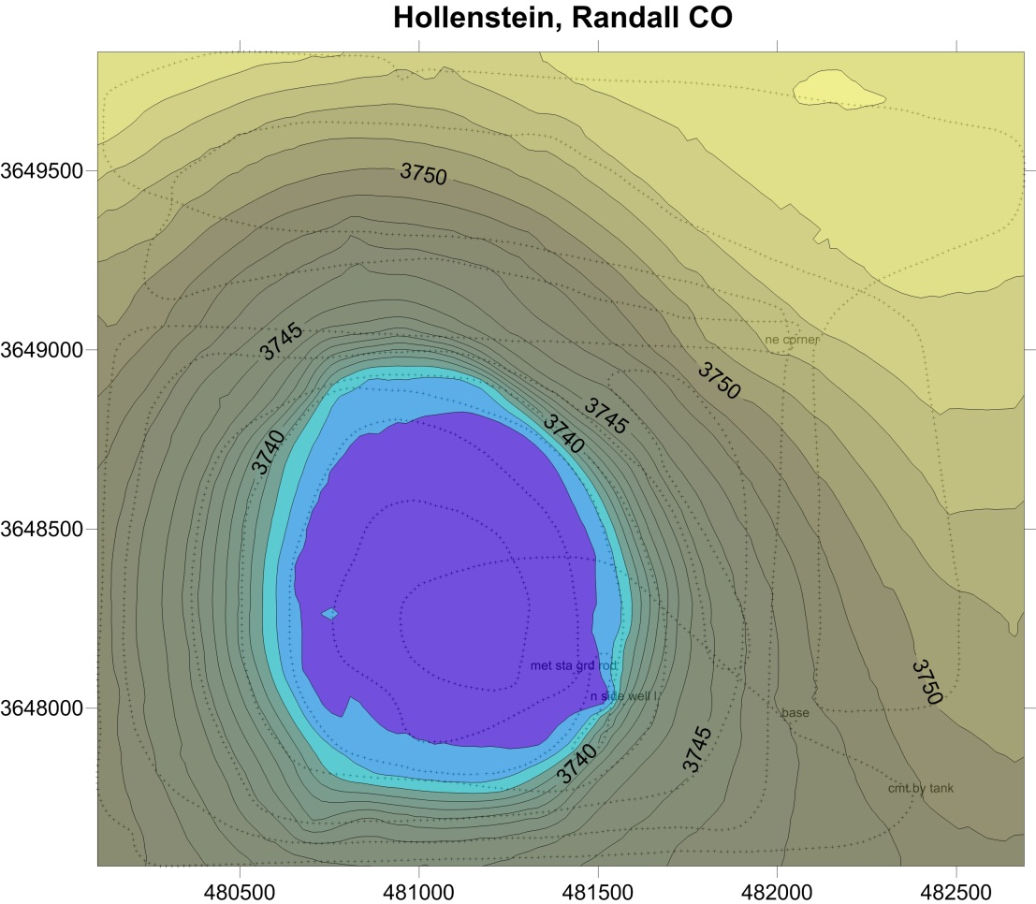
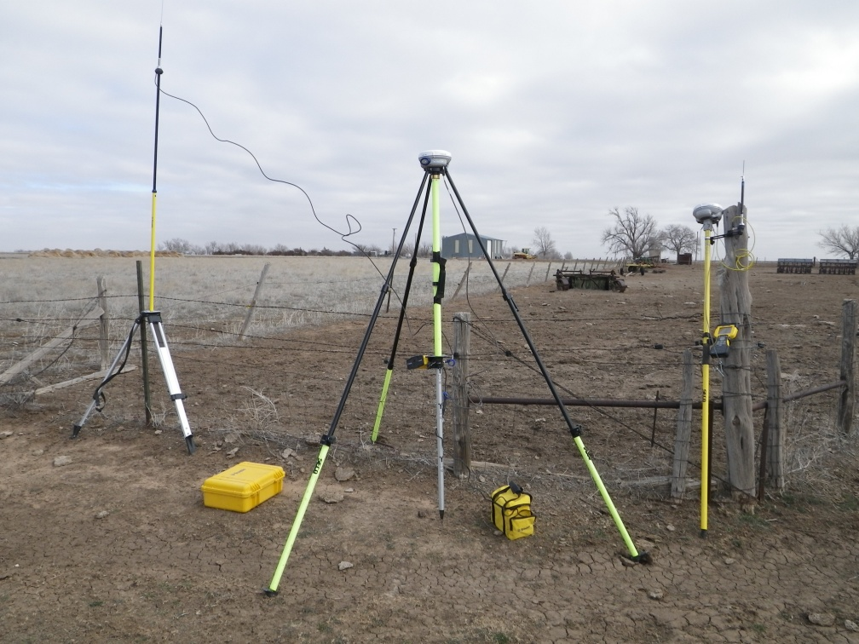
GPS survey of playa topography
Trimble R-6 Base and Rover
Local area survey, not tied to regional benchmarks
Base location on stable point outside playa to allow repeat surveys to assess sedimentation and soil movement
Notes:
Topographic data was obtained with local-area GPS surveys of the playas with a sub-centimeter precision.

Slide 12
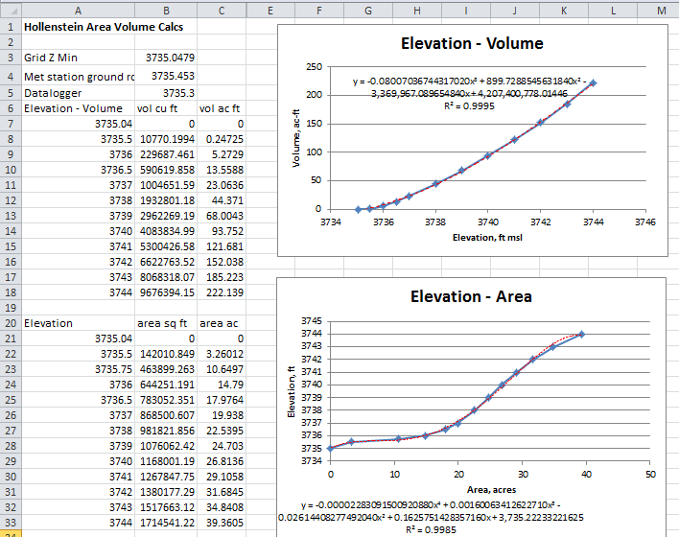
Water level and water volume calculations
Notes:
The survey coordinates were gridded in Surfer, and grid calculations were used to develop area-elevation and elevation-volume curves for each playa in Excel

Slide 13
Reconstructed water levels with GIS and field data
Playa area, acres | Percent time flooded | Total flood vol, ac ft | Annual vol, ac ft
23.3 | 39.4% | 496.4 | 45.1
Notes:
The water levels estimated from the Landsat images agree well with field data where we have overlap, although the Landsat data tend to underestimate the peak flood elevations since the image dates don’t generally coincide exactly with the flood events. Using the reconstructed water levels, we estimated flood frequency, duration and volume for each playa. Some playas, like the one shown above, had regular inundations several feet in depth throughout the monitoring period.

Slide 14
Reconstructed water levels with GIS and field data
Playa area, ac | Percent time flooded | Total flood vol, ac ft | Annual flood vol, ac ft
30.62 | 10.3% | 68.6 | 6.2
Notes:
Other playas, like this one, had infrequent, brief, and shallow inundations.

Slide 15
Summary of reconstructed playa water levels
Playa ID | Area, acres | Flooded time, percent | Annual volume, acre ft | Average flood depth, feet
Minton S | 79.8 | 40.0% | 60.7 | 0.76
SWCROP | 23.3 | 39.4% | 45.1 | 1.94
FLCROP | 31.86 | 39.2% | 39.5 | 1.24
FLRNG | 32.62 | 35.4% | 67.9 | 2.08
Moore | 40.09 | 30.4% | 27.4 | 0.68
BRRNG | 31.25 | 27.6% | 22.0 | 0.70
Minton N | 36.78 | 26.2% | 17.6 | 0.48
Rieff 1 | 32.49 | 25.6% | 20.4 | 0.63
Rieff 2 | 17.41 | 24.5% | 10.9 | 0.63
Herring 1 | 33.76 | 23.5% | 26.6 | 0.79
Glaezner | 48.27 | 20.3% | 35.1 | 0.73
Younger | 47.57 | 20.1% | 15.2 | 0.32
Obert N | 13.62 | 19.1% | 5.6 | 0.41
Bowers | 13.62 | 19.1% | 3.1 | 0.22
Obert M | 14.41 | 18.9% | 4.7 | 0.32
Obert S | 7.9 | 16.9% | 4.5 | 0.57
Crowell | 27.71 | 16.5% | 7.7 | 0.28
Wright | 119.3 | 14.9% | 26.5 | 0.22
Mahagan | 15.39 | 14.1% | 6.1 | 0.40
Bivins N | 99.23 | 13.9% | 104.4 | 1.05
SWRNG | 17.32 | 13.9% | 8.7 | 0.50
Durrett | 61.66 | 13.1% | 6.5 | 0.11
Hollenstein | 21.66 | 12.9% | 7.1 | 0.33
Herring 3 | 22.62 | 12.5% | 7.2 | 0.32
M.Harrell | 30.62 | 10.3% | 6.2 | 0.20
Herring 3a | 12.63 | 8.9% | 2.3 | 0.19
Bivins S | 131.7 | 5.8% | 20.4 | 0.15
Average of 27 playas
39.4 acre area
Flooded 20.9% of time
Range from 40% to 5.8%
22.6 acre feet of floodwater per year
0.6 foot average flood depth
Range from 0.11 to 2.08 feet
Notes:
The average for the 27 playas in this analysis shows them to be flooded 20% of the time, with an average annual flood depth of 0.6 feet.
The limited frequency and volume of flooding will affect playa utilization for recharge purposes, and suggests that site selection will be an important factor in project success.

Slide 16
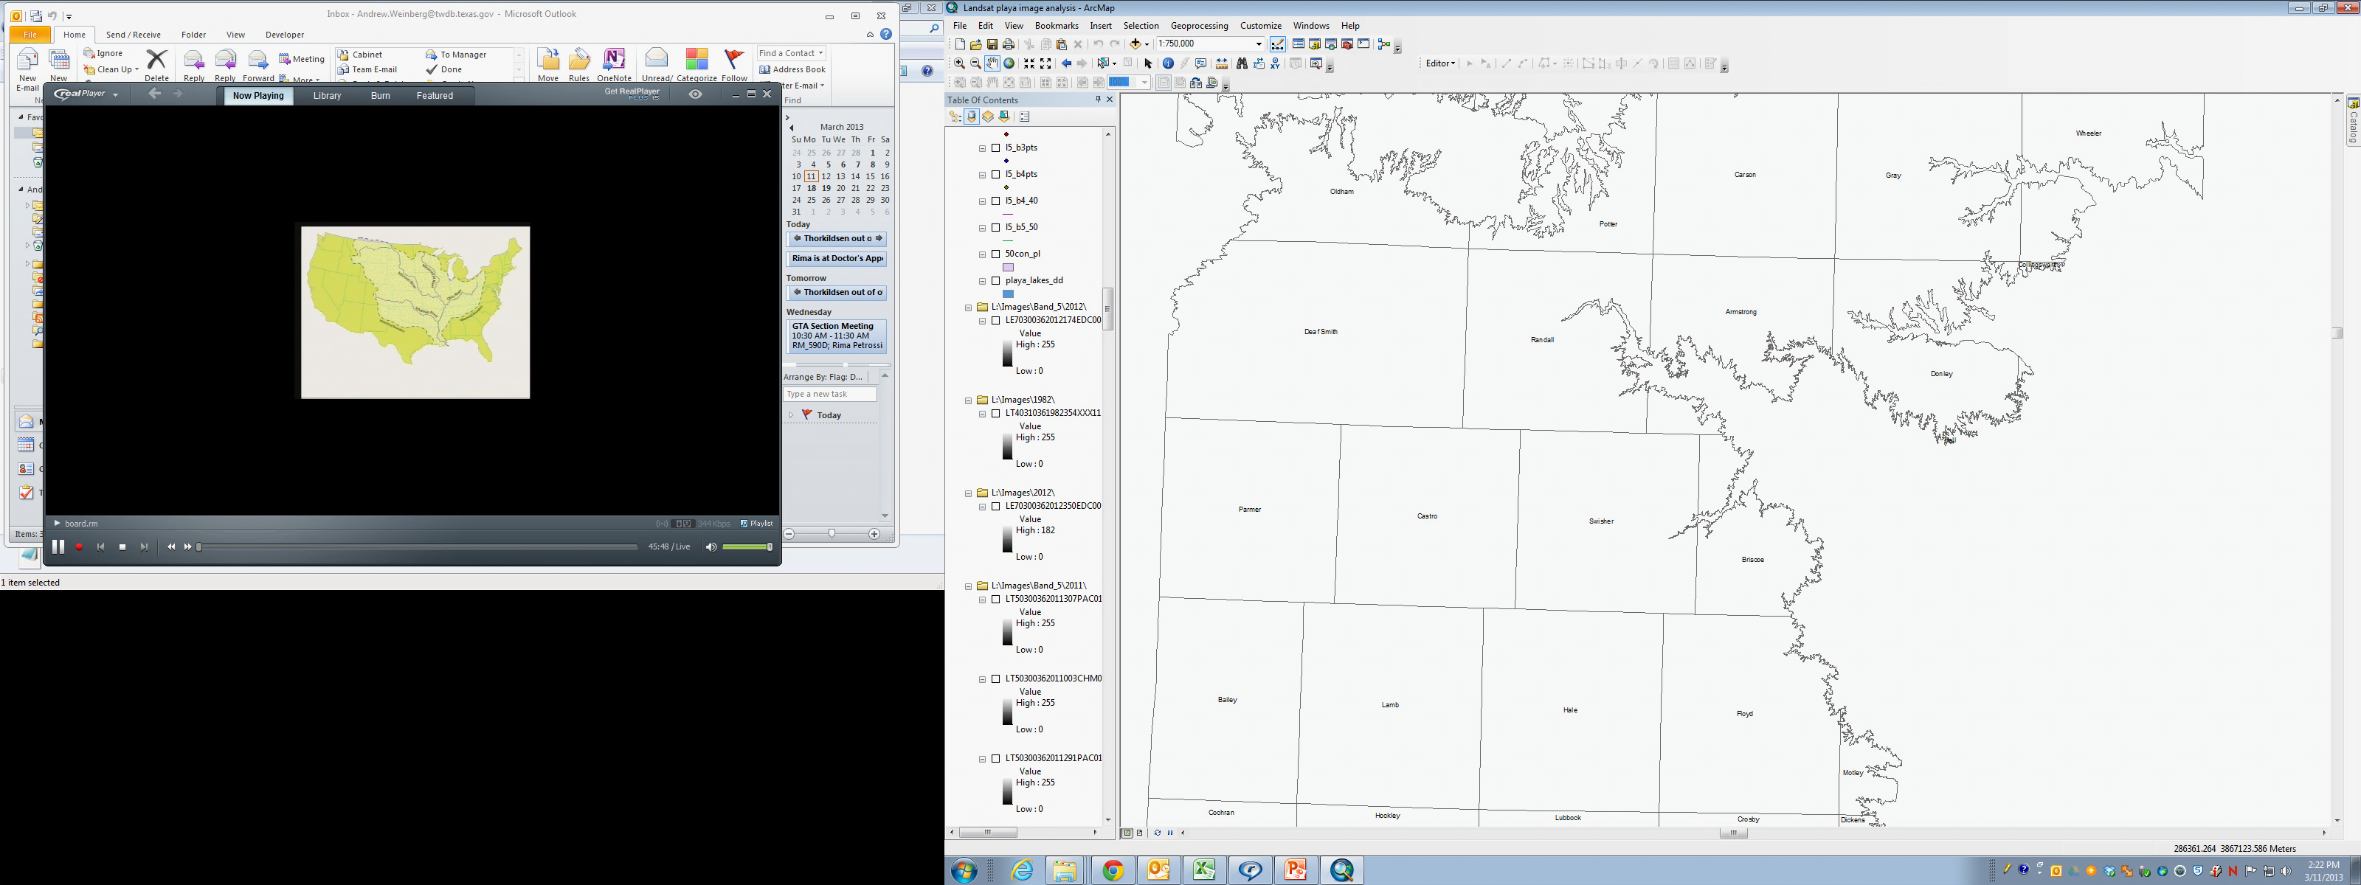
Summary of reconstructed playa water levels
Water yield
Less water than 2003 TWDB estimate
No clear geographic trend
No clear land use trend
Playas with highest yield appear to be more integrated into drainage network
Playas with higher water yield better candidates for modification
Potential playa modification sites can be screened using quick topo survey and GIS tools
Notes:
These results suggest much less water is present in the playas than estimated in the 2003 TWDB Report 357, which found that nearly 60% of the playas contained water at least 75% of the time, with an additional 36% containing water 25% to 75% of the time.
Another point of comparison is the Southern Ogallala groundwater availability model (GAM) (TWDB, Feb 2003), which estimates a predevelopment recharge rate, predominantly from playas, of approximately 57,000 acre feet per year. This represents about 2.16 inches (0.18 ft) of recharge per year from the 316,000 acres of playas in the model area, which is broadly consistent with current estimates, after accounting for evaporation.
The geographic distribution of water yield in the playas studied shows no clear pattern. There are some indications that the watershed area and/or presence of a better-defined drainage network may affect the volume of water the playas collect, but we need more survey data to analyze watershed areas. In any case, the GIS tools developed here give us a way to screen potential playa modification sites in terms of water availability.

Slide 17
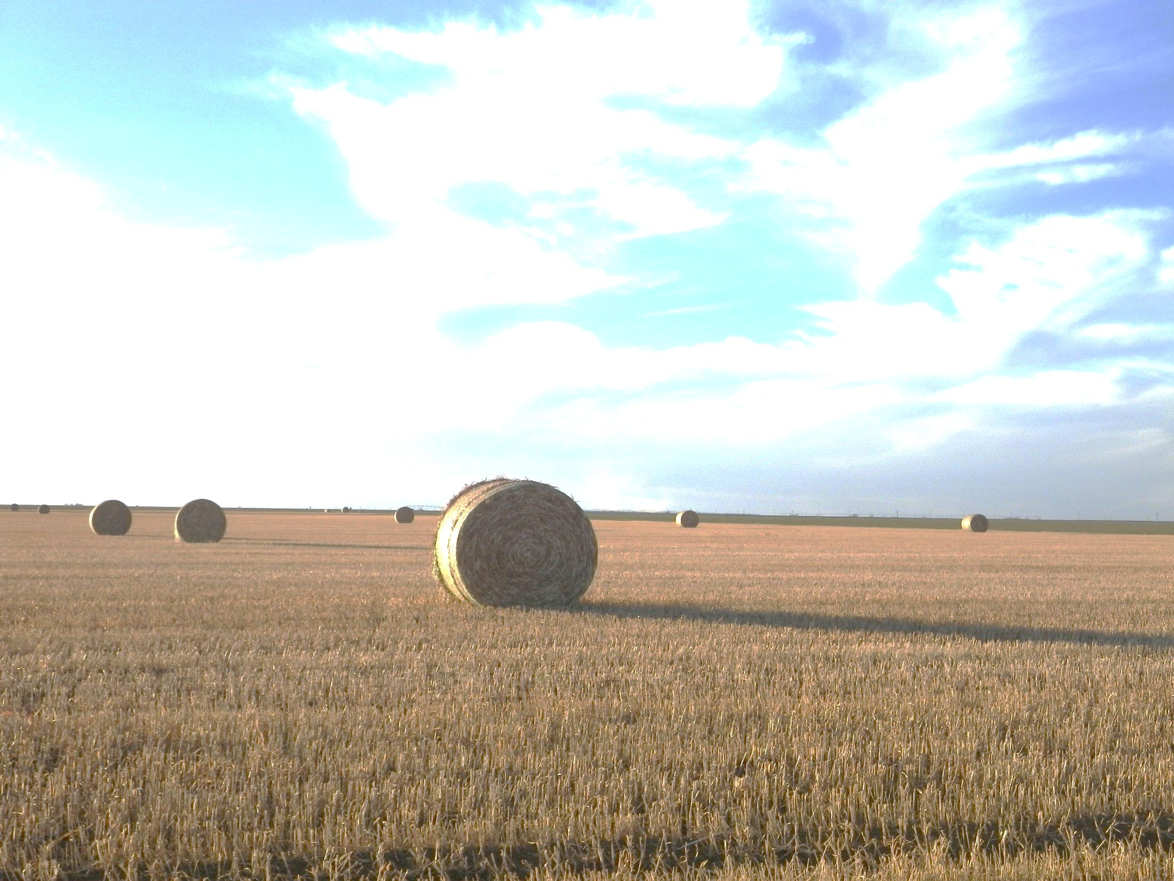
Playa Modification Objectives
Increase groundwater recharge
Minimize initial cost
Utilize low maintenance designs
Incorporate native plant species
Maintain wetland ecosystems
Take water from evaporation, not wildlife
Reduce sedimentation in playa basins
Benefit landowners
Forage crops and wildlife management in short term
More groundwater in the long term
Notes:
While recharge is the main goal of the TWDB study, we recognize the need to maintain wetland ecosystems and provide benefits to the landowners if the technology is to be widely adopted.

Slide 18
Playa Modification Alternatives
Sediment removal & buffer planting
Restores wetland and controls erosion
Increases storage and infiltration
Improves wildlife habitat
Upland percolation basin
More rapid infiltration outside clay area in playa bottom
Active system requires pumps, pipe
Combine with vegetative buffers
Notes:
Several types of playa modifications have been proposed. One type focuses on controlling sediment deposition and/or removing accumulated sediments from playas to increase the basin’s storage capacity and hydroperiod. Recharge is increased as a result of slower flow across the more permeable soil in the buffer zones and because standing water is expected to remain in the playa for a longer time. While buffers are relatively inexpensive, sediment removal add up quickly, making this alternative less attractive.
A second type of modification involves pumping flood water into a smaller, deeper basin on more permeable upland soil adjacent to the playa. The Agricultural Research Service demonstrated this design in the 1960s and 1970s, capturing most of the water present in the playa. The drawback of this design is that it requires active maintenance of pumps, pipes, and power, increasing costs.

Slide 19
Playa Modification Alternatives
Ring dikes
Retains runoff and promotes infiltration
Traps sediments
Minimal maintenance
Deep plowing and/or planting deep-rooted vegetation
Breaks up low permeability layers
Roots establish channels for percolation
Flood-tolerant grasses provide forage crop
Notes:
Another modification alternative is to build a ring dike to retain runoff on the playa slopes, increasing infiltration outside the clay bottom area. A ring dike acts much like a buffer strip.
Other modification alternatives seek to increase the permeability of the clay in the playa bottom, either through physical means, like deep plowing, or by planting deep-rooted flood-tolerant vegetation. Deep plowing is probably not applicable in most cases. The clay soil in playa bottoms typically forms cracks several feet deep as it dries. Plowing this soil would not accomplish much, since it is already broken up. Some deep-rooted perennial grasses, like Alamo Switch grass, may tolerate flooding, but most species are adapted for either wet or dry conditions. Short-lived opportunistic annuals form the native vegetation in playas because they can better exploit the changeable conditions.

Slide 20
Playa Modification Alternatives
Bio-stimulation
Organic additives to replace lost soil carbon and stimulate microbial activity
Promote clay aggregation
Increase forage production
Other concepts – add your ideas!
manure
cotton gin waste
???????
Notes:
And we’re exploring other concepts for playa modification, such as adding organic materials to the soil to alter the microbial community and increase clay permeability.
Over the next year we will develop a suite of design alternatives that can be scaled up for field testing in selected playas.

Slide 21
Playa Modification Cost & Effectiveness
Alternative | Cost | Effectiveness | Volume, acre feet per year
Buffer planting | $5000 | 5% to 20% | 2 to 8
Deep plowing | $10,000 | 5% to 20% | 2 to 8
Organic additives | $15,000 | 5% to 20% | 2 to 8
Ring dike | $50,000 | 15% to 30% | 6 to 12
Upland percolation basin | $300,000 | 30% to 50% | 12 to 20
Sediment removal | $500,000 | 0% to 25% | 0 to 10
Cost based on implementation at 40 acre playa
Effectiveness expressed as percentage of runoff converted to recharge
Volume based on 40 acre feet per year runoff to playa
Notes:
This table ranks the modification alternatives according to rough order-of-magnitude estimates of the cost and effectiveness of the alternatives. While the costs and effectiveness are not well constrained at this point, the rankings are helpful for project planning and also to assess the probability that an alternative might be adopted by landowners. In practice, one or more modifications may be combined, for example buffer planting is compatible with all of the other alternatives.
The effects of sediment removal on recharge are unclear. Sediments may actually increase recharge by allowing rapid initial infiltration and limiting subsequent evaporation. On the other hand, playas that are completely filled in may cease to collect any runoff at all.
Buffer plantings are the clear winner in terms of dollars per acre-foot of recharge.

Slide 22
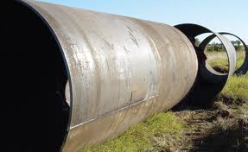
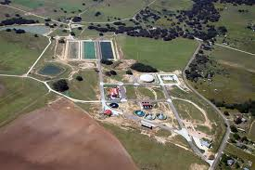
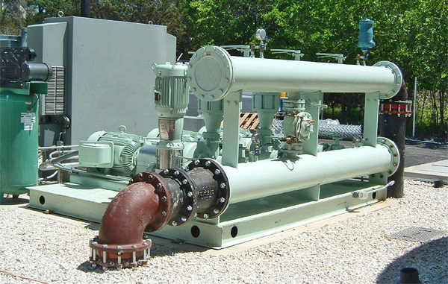
Groundwater Recharge Assessment
Analysis needs to consider:
Water use
Value of water
Recharge system costs
Site specific factors
San Antonio ASR pipeline construction; image from http://www.lan-inc.com/
San Antonio Water System Twin Oaks ASR facility; image from www.edwardsaquifer.net
Production well; image from www.peerlessequipment.com/images
Notes:
Landowners will need to consider the intended use of the water and the value of water for that use, as well site-specific factors including the availability of recharge water in a playa, the distance from the playa to the place of use, location of nearby groundwater production wells, etc. as they evaluate potential recharge modification sites.

Slide 23
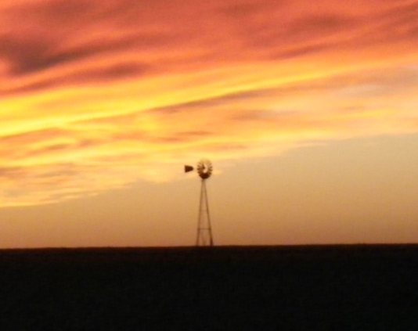
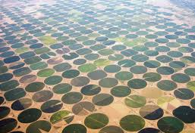

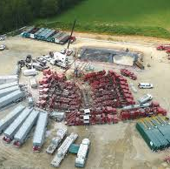
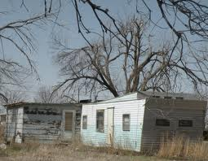
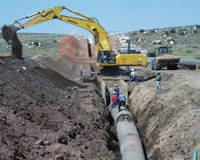
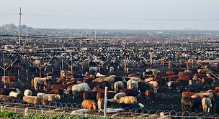
High Plains Water Uses
Dispersed Focused | Volume, ac-ft/yr 1 to 10 10 to 1,000 1,000 to 1,000,000
 | Rural households & ranching | Steam electric & manufacturing | Irrigated agriculture
 | Suburban ranchette | Small urban centers | Oil field/ hydraulic fracturing
 | Colonia | Feedlots & dairies | Large municipal
Notes:
For investments in enhanced recharge to make sense, there needs to be a match between the scale and location of supply and demand. Groundwater uses on the High Plains ranges from low volume, dispersed demands, such as rural households, to high volume focused demands, such as well fields serving large municipalities. Large volume, focused demand is not compatible with the dispersed, low volume expected from playa recharge projects. The red oval indicates the range of volume and focus that might be obtained from playa recharge modifications.
Similarly, the value of water to the end user must be sufficient to justify the costs of playa recharge projects. Uses characterized by low productivity per unit water may have difficulty justifying the costs of playa recharge projects.
And some applications that generate high value per unit water, such as major industrial facilities, may need proven sources of water with a more reliable yield than playa recharge modifications can provide.

Slide 24
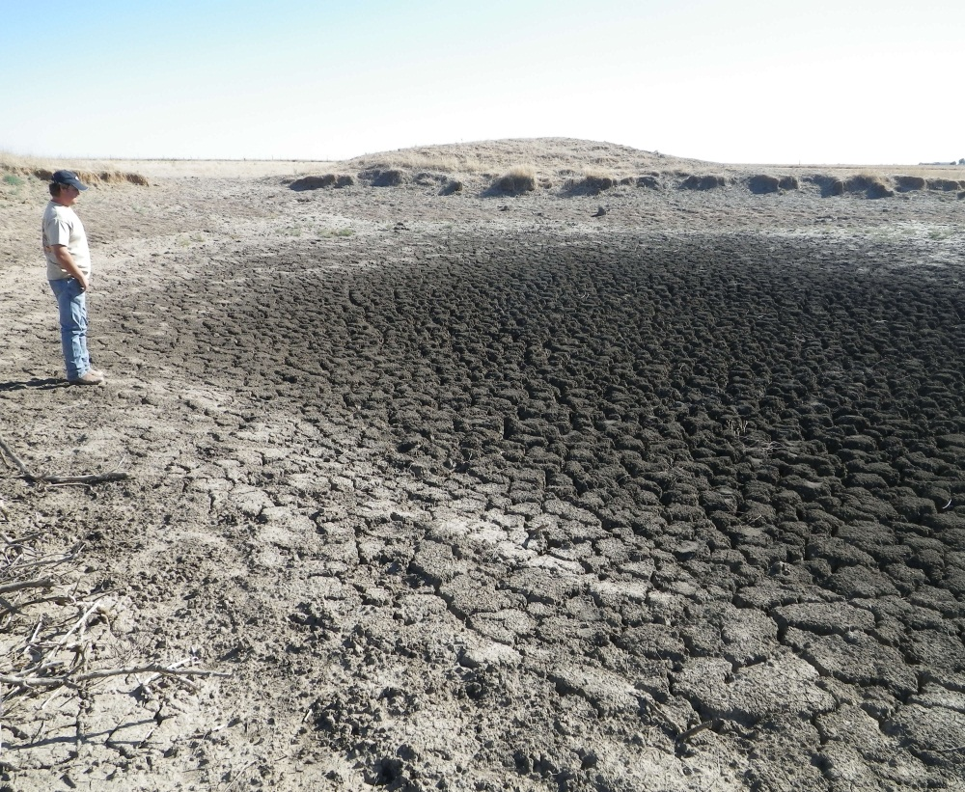
Playa Modification Summary
Use GIS tools to select larger playas with highest yield
Playa modifications best suited as long-term option for:
Small urban centers
Feedlots and dairies
Household and ranch use
Recharge quantities uncertain for most alternatives
Notes:
The TWDB has developed GIS tools we can use to screen potential playa modification sites to determine if there is enough water to make implementation worthwhile in terms of recharge. A preliminary analysis of the likely costs and recharge volumes suggests that playa modification is best suited for dispersed applications using small to moderate volumes of water and yielding moderate economic production from that water over a long-term planning horizon. Small urban centers, feedlots, dairies and larger ranches are applications that fit this profile. Playa modifications may be attractive in additional instances where secondary benefits such as improved grazing or wildlife habitat improvement can be demonstrated. At this time the recharge yield of most alternatives remains uncertain, pending field testing.

Slide 25
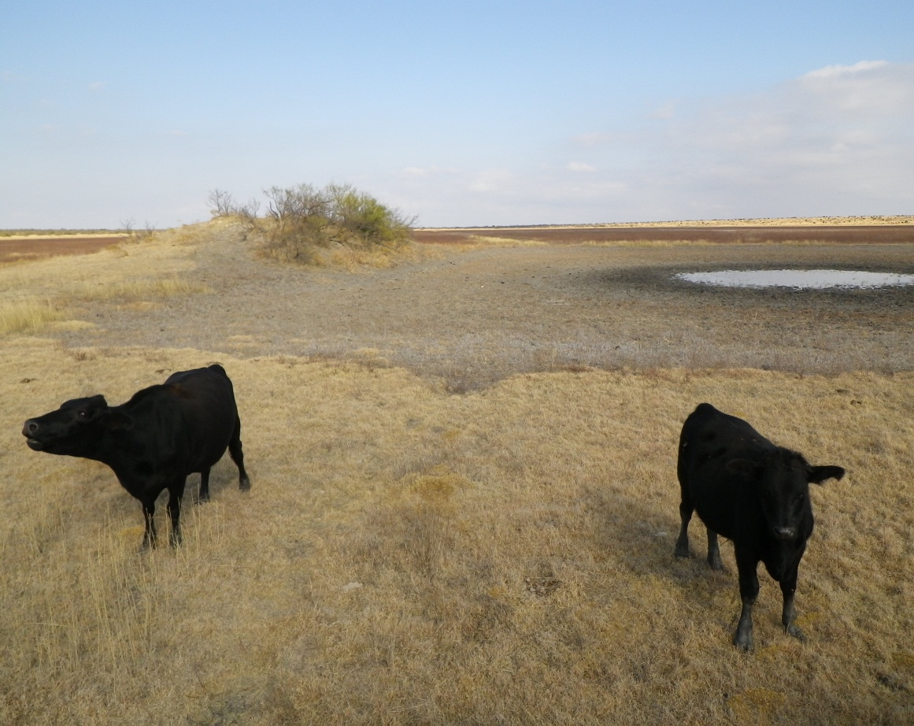
Acknowledgements
Cody Byars, USDA/ARS Lubbock
Cole Camp, Panhandle GCD
Gerald Crenwelge, High Plains UGCD #1
Dennis Gitz , USDA/ARS Lubbock
Ken Rainwater, Texas Tech University
Rick Zartman, Texas Tech University
and
The participating landowners of the Texas High Plains
For additional information, please contact
andrew.weinberg@twdb.texas.gov
512-463-3210

