Slide 1
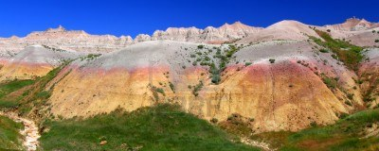
Geological Mapping of Late Cretaceous to Late Eocene Strata Within the Indian Creek Area, Buffalo Gap National Grasslands, South Dakota
Garrett Williamson*, David Schmidt, and Tim Walsh, Wayland Baptist University, Plainview, Texas

Slide 2
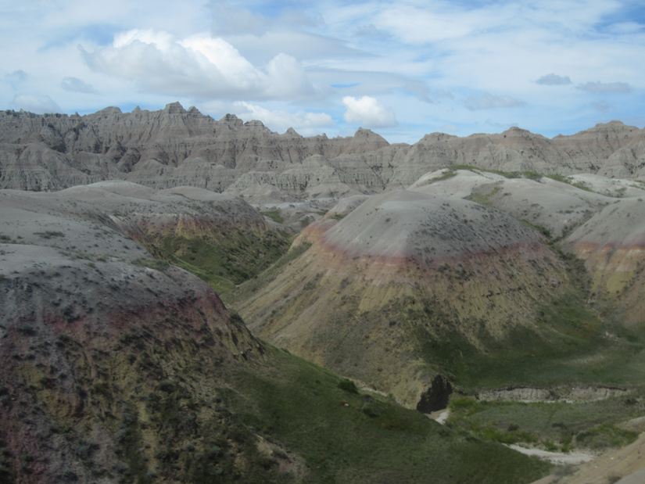
The Badlands

Slide 3
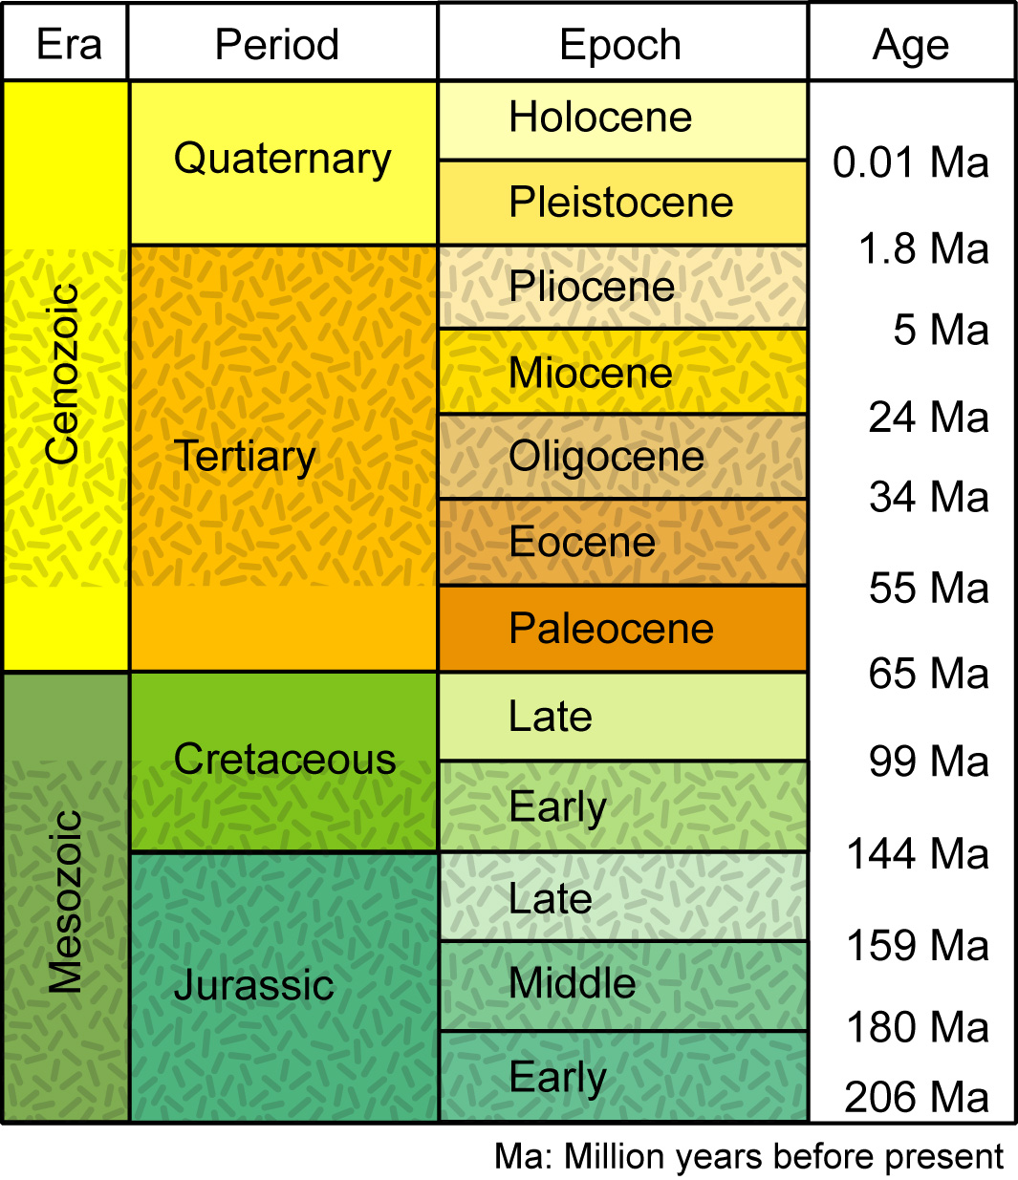
Geologic Time Scale
Late Cretaceous
to
Late Eocene
Unconformity
http://pubs.usgs.gov/of/2008/1206/html/figs/table3_1.html

Slide 4
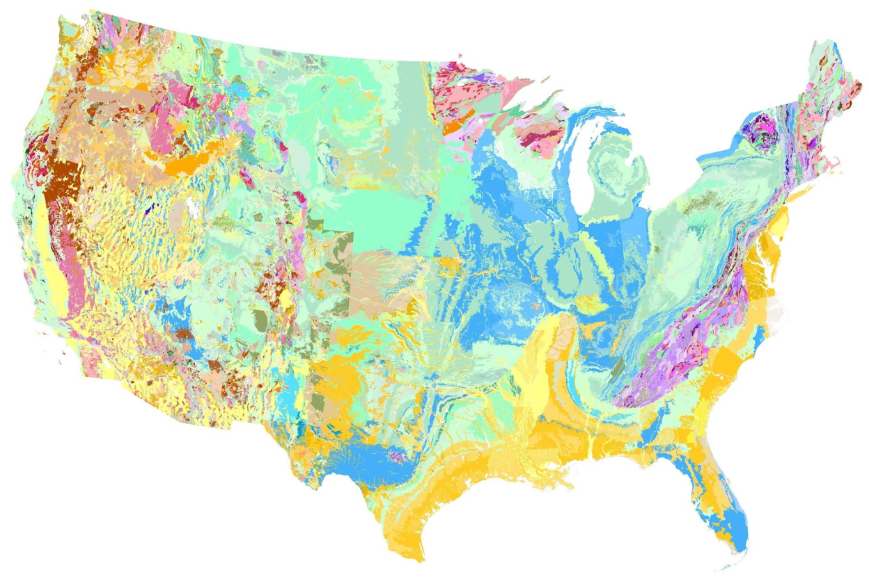
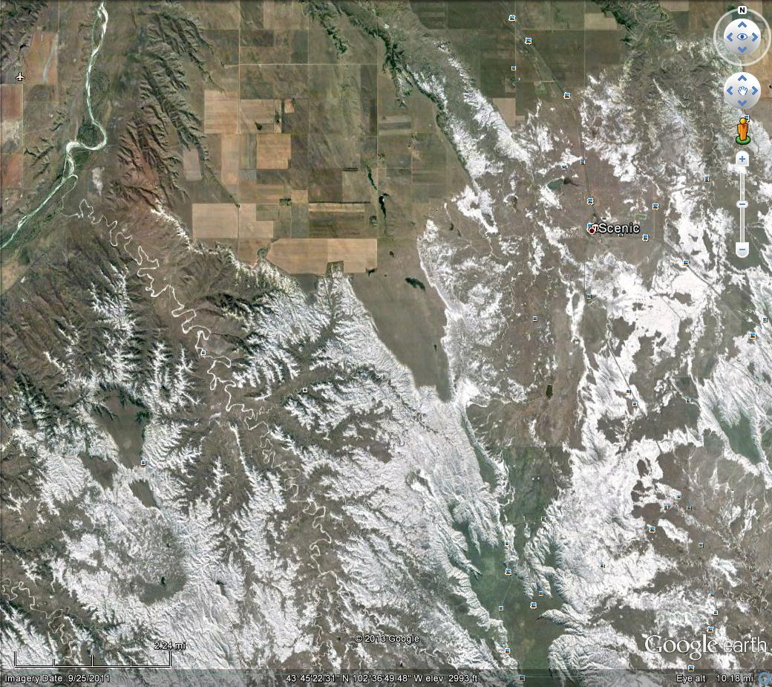
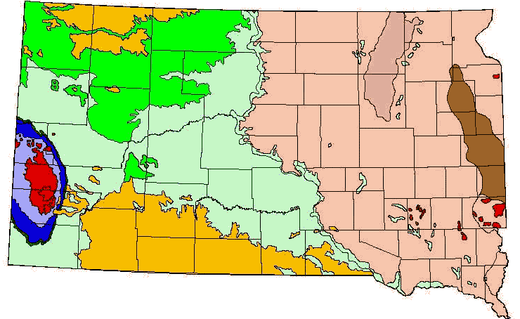
Research Area
The research site was a few miles west of Scenic, SD., in the Indian Creek drainage basin.
http://stategeologists.blogspot.com/2012/09/aasg-celebrates-geologic-map-day.html
http://www.sdgs.usd.edu/geologyofsd/geosd.html

Slide 5
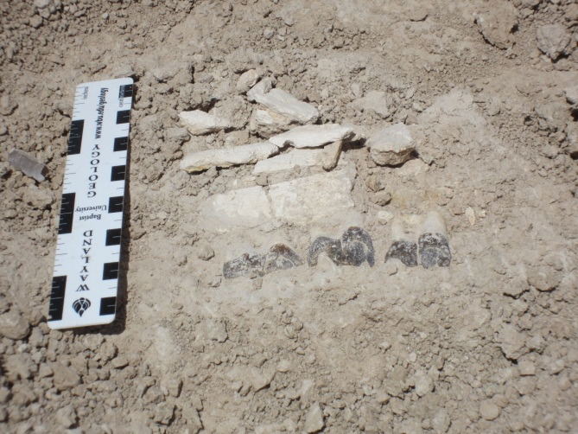
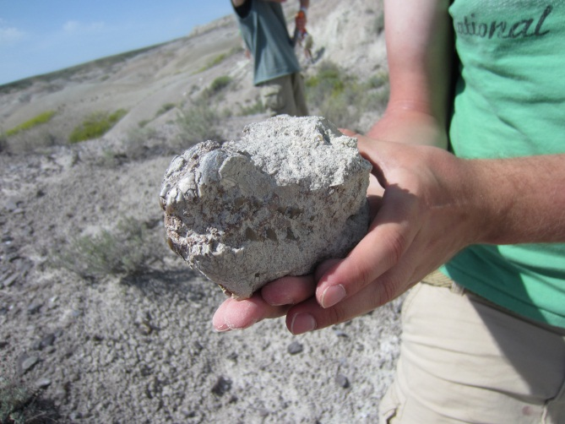
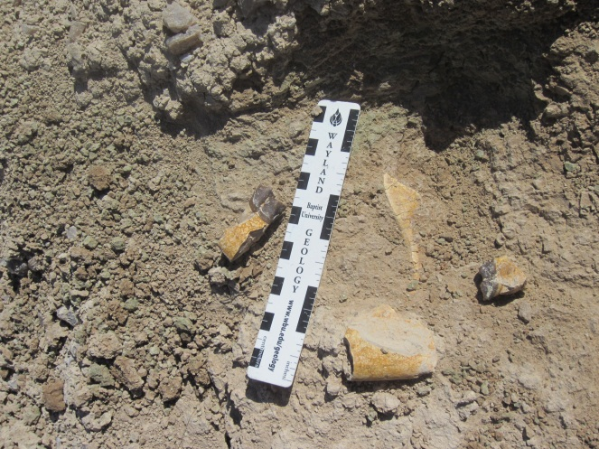
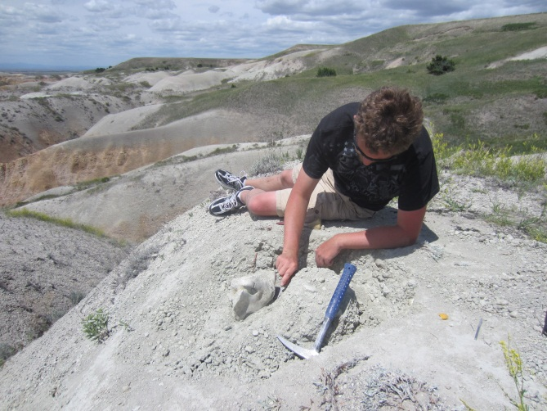
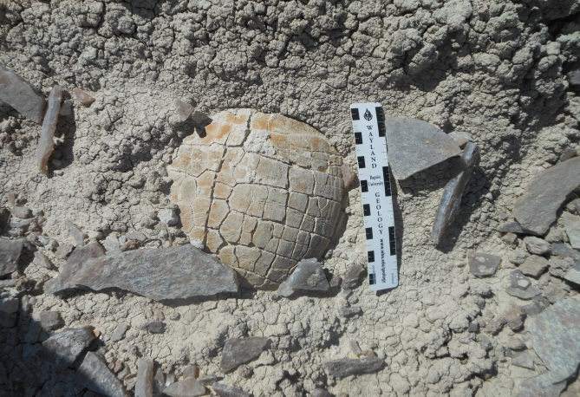
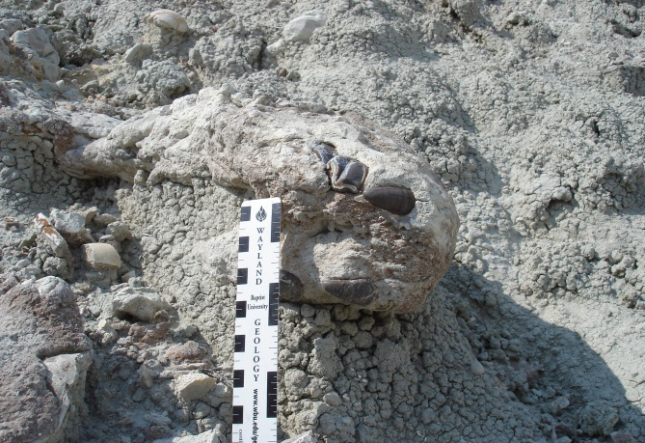
Purpose of Making a Detailed Geologic Map
The badlands produce beautifully preserved paleontological resources.
The focus of this project is to create a detailed geologic map that more efficiently locates the strata that contains certain taxa.

Slide 6
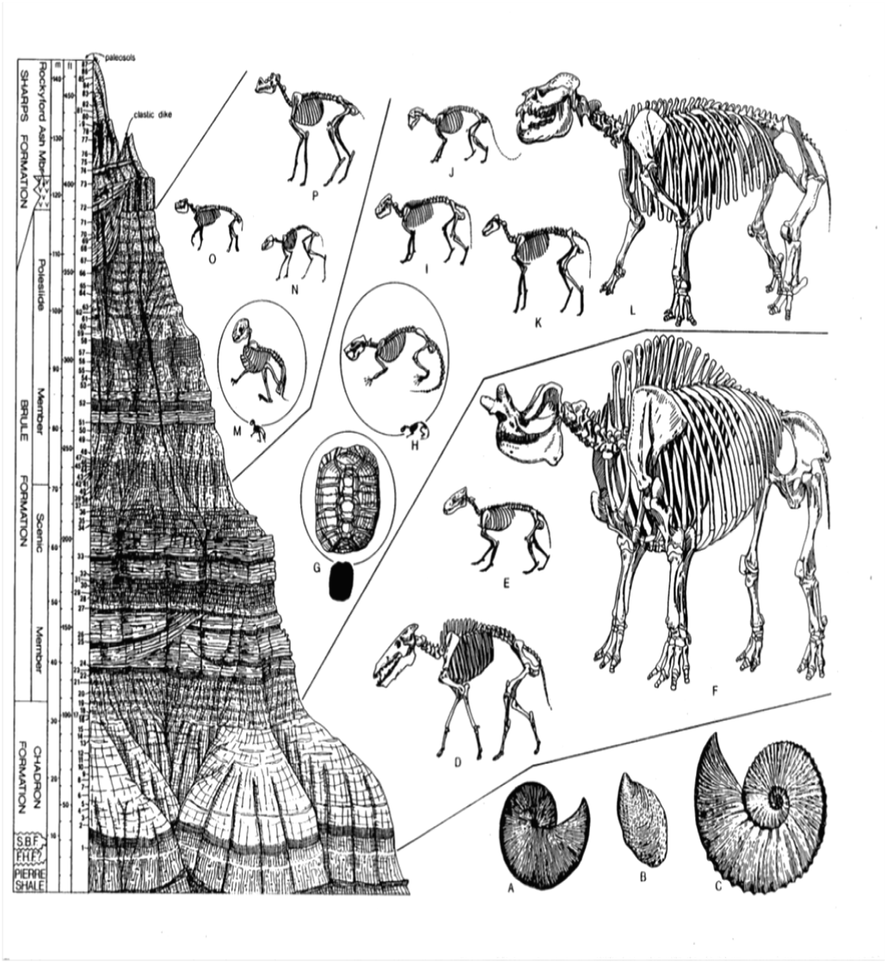
Biostratigraphy
A: Ammonite
B: Bivalve
C: Ammonite
D: Entelodon
E: Creodont
F: Titanothere
G: Land Tortoise
H: Squirl-like Rodent
I: Merycoidodon
J: Sabre-tooth Nimravid
K: Three-toed Horse
L: Amphibious Rhino
Retallack, Greg J. 1983

Slide 7
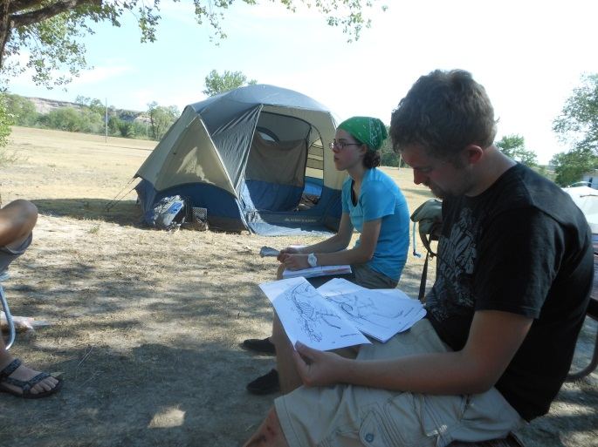
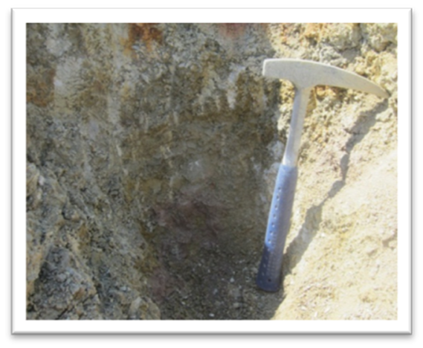
Methods

Slide 8
Literature Search
Describe Research Area
Geologic Mapping
Clark, 1937 & 1967
O’Harra, 1920
Retallack, 1987
Stoffer, 2003
Terry, 1998
Clark, 1937
King and Raymond, 1971
Petsch and Ward, 1953

Slide 9
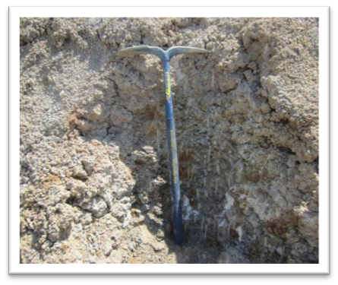
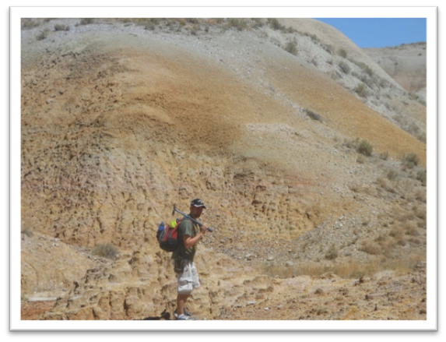
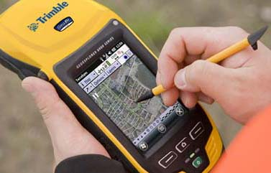
Field Work

Slide 10
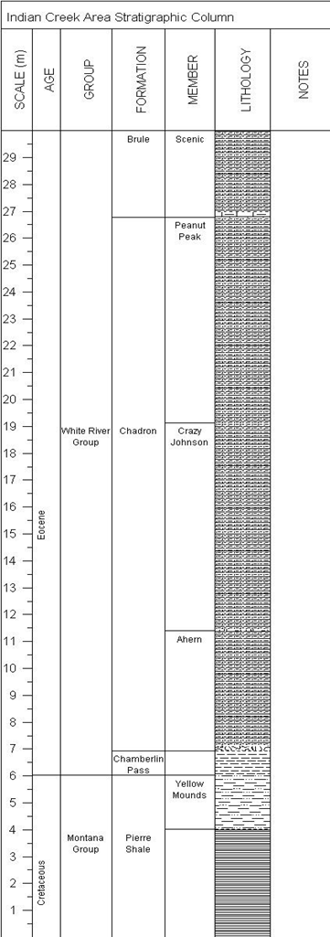
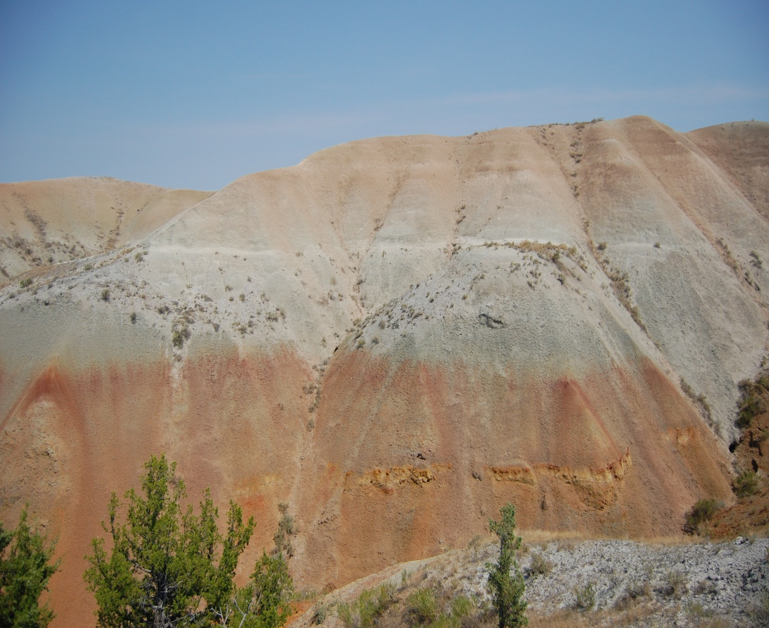
Stratigraphic Column
Brule
Scenic
Discontinuous Carbonate Limestone Lenses
Peanut Peak
Peanut Peak
Contains infrequent sandstone lenses within the middle of the stratum
Crazy Johnson
Ahearn
Chadron
White River Group
Eocene
Contains Abundant Siltstone and Sandstone Lenses Throughout the Middle and Lower portions of the Stratum
Chamberlain Pass
Crazy Johnson
Yellow Mounds Paleosol
Ahearn
Contains minor channel sandstones, and a basal conglomerate (in some localities)
Pierre Shale
orange and yellow silty claystone
Pierre Shale
Montana Group
Cretaceous

Slide 11
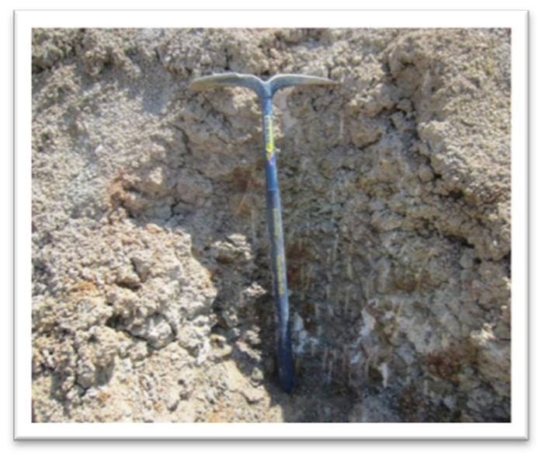
Determining Contacts
Color Variations
Chadron Formation
Ahearn Member
Chamberlin Pass
Formation

Slide 12
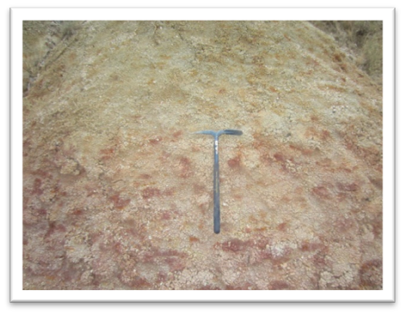
Determining Contacts
Color Variations
Chadron Formation
Ahearn Member
Chamberlin Pass
Formation

Slide 13
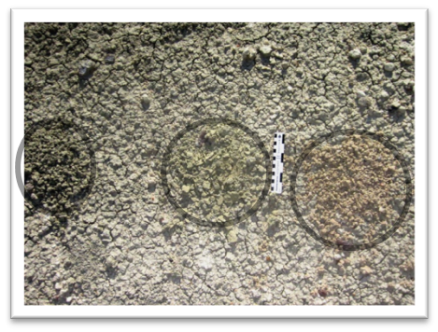
Determining Contacts
Color Variations
Chadron Formation
Crazy Johnson Member
Chadron Formation
Ahearn Member
Chadron Formation
Crazy Johnson Member

Slide 14

Determining Contacts
Color Variations
Chadron Formation
Peanut Peak Member
Chadron Formation
Crazy Johnson
Member
Chadron Formation
Ahearn Member

Slide 15
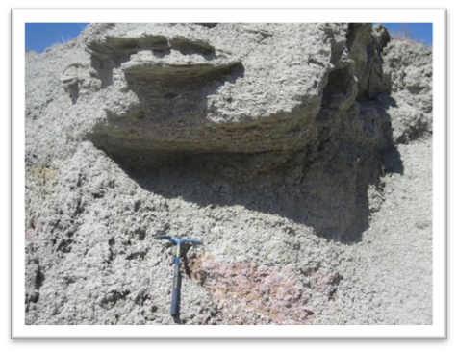
Determining Contacts continued…
Lithological Indicators
Chadron Formation
Ahearn Member
Chamberlin Pass
Formation

Slide 16
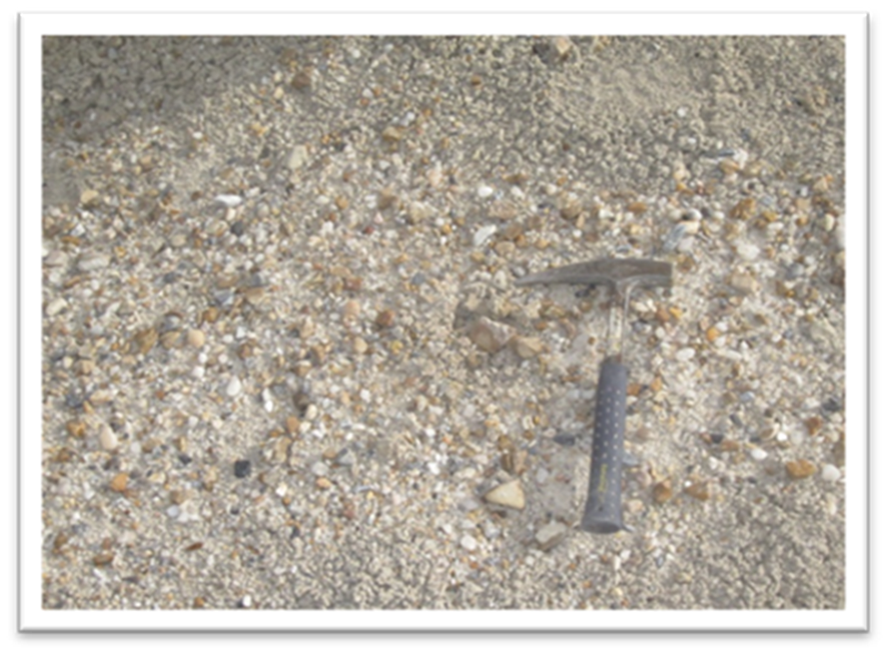
Determining Contacts continued…
Lithological Indicators
Chadron Formation
Crazy Johnson
Member
Chadron Formation
Ahearn Member

Slide 17
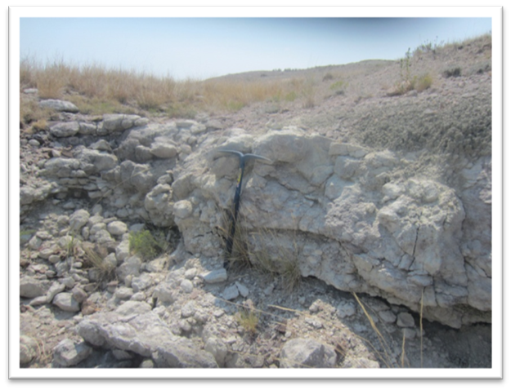
Determining Contacts continued…
Lithological Indicators
Brule Formation
Scenic Member
Chadron Formation
Peanut Peak Member

Slide 18

Collecting GPS Coordinates
Trimble GeoXH
Terrasync 5.30 software was used with the GPS
Coordinates collected at contacts with ≈ 61cm of error
The scale of the map is large enough that differential correction did not have to take place

Slide 19
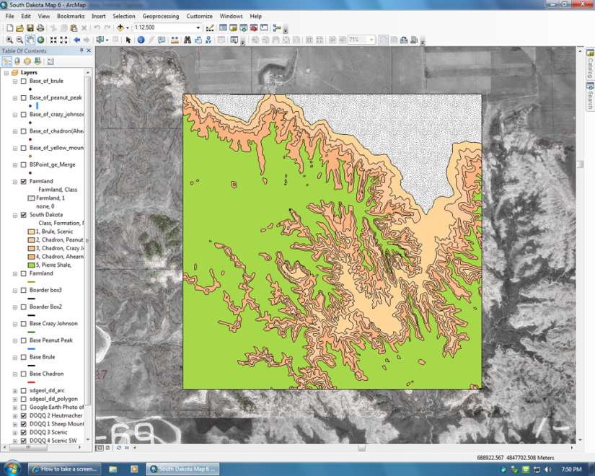
Creating the Geologic Map

Slide 20
Preliminary Steps
Transferring Data
Collecting Maps
GPS coordinates that were collected in the field were transferred into Pathfinder Office and exported as a shape file.
The shape file was then added into ArcGIS 10.0 (ArcGIS 10.0 was used for the remainder of this project).
Digital Raster Graphs (DRG) were uploaded into ArcGIS 10.0 along with Digital Orthophoto Quarter Quadrangles (DOQQ) to aid in constructing the geologic map.

Slide 21
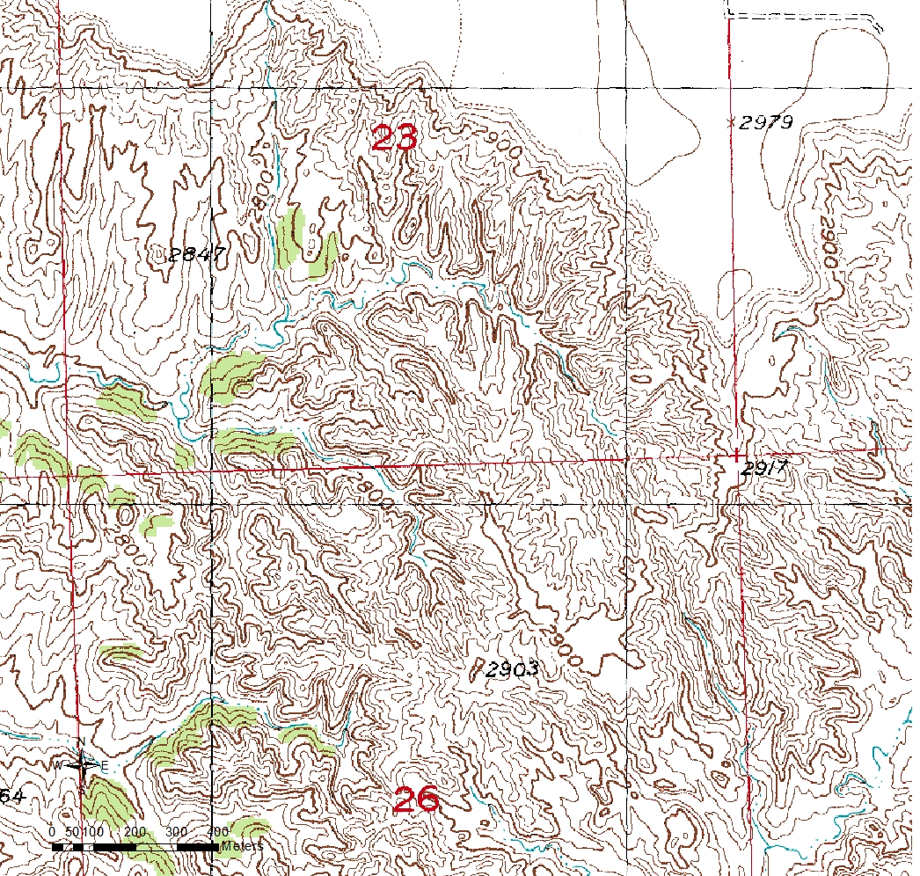
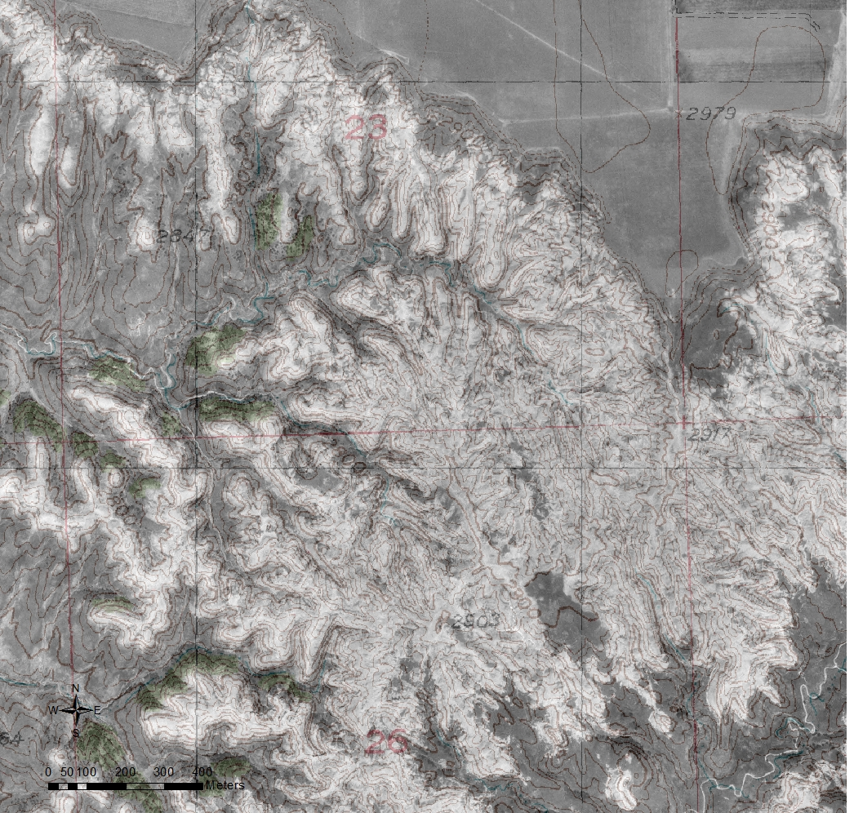
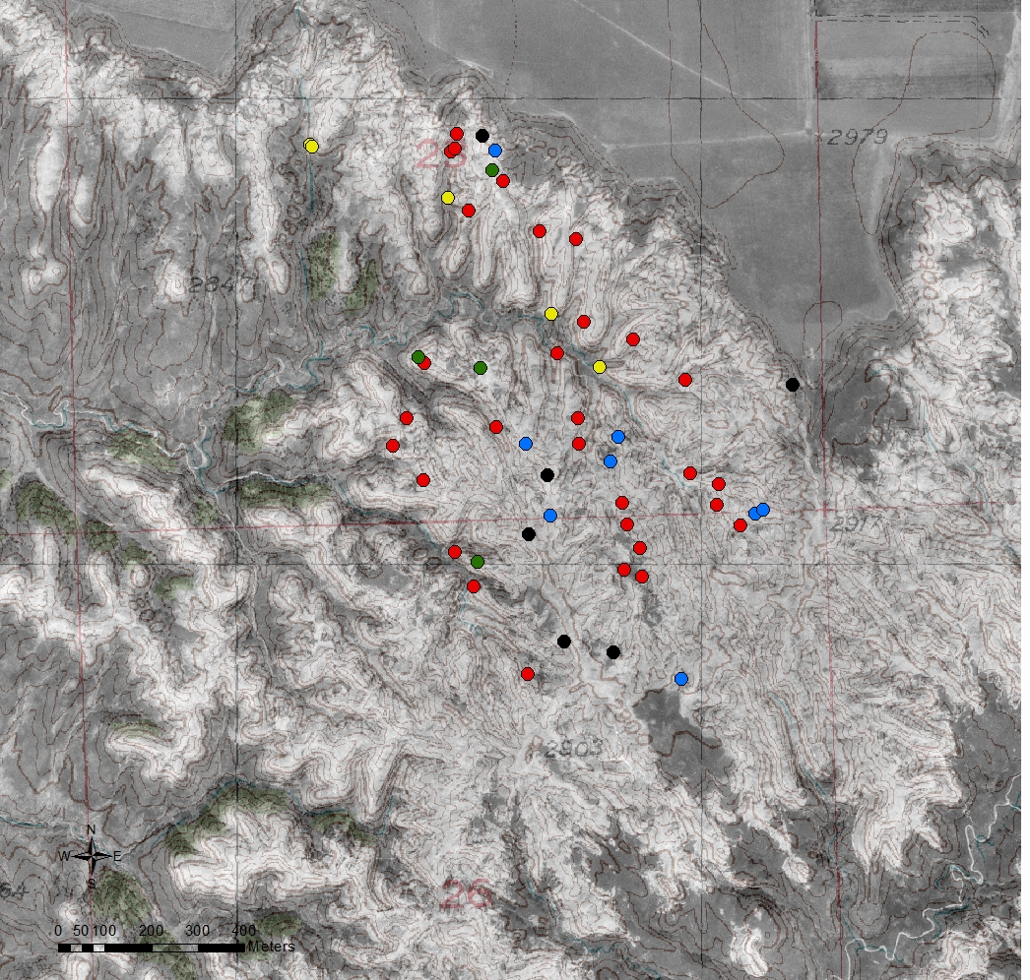
Initial GIS Processes
The DOQQ was overlaid onto the DRG and then made transparent to see where the GPS coordinates were on a topographic map and aerial photo at the same time.

Slide 22
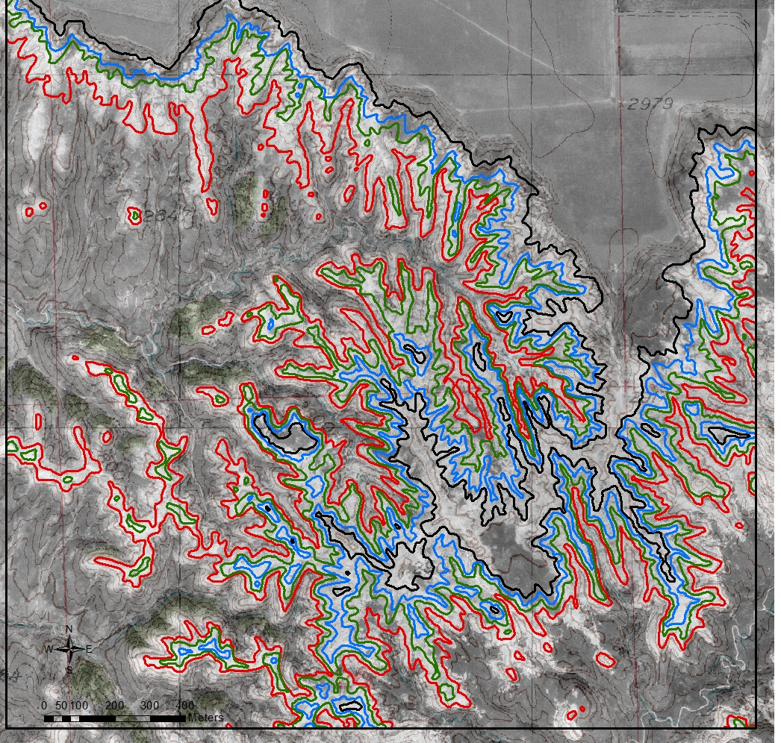
Digitizing the Geologic Map
The DRG and DOQQ were used as a general guide to connect the coordinates while drawing the contact lines for the map.
However, the strata has a slight dip to the south which necessitated corrections during the digitizing process.

Slide 23
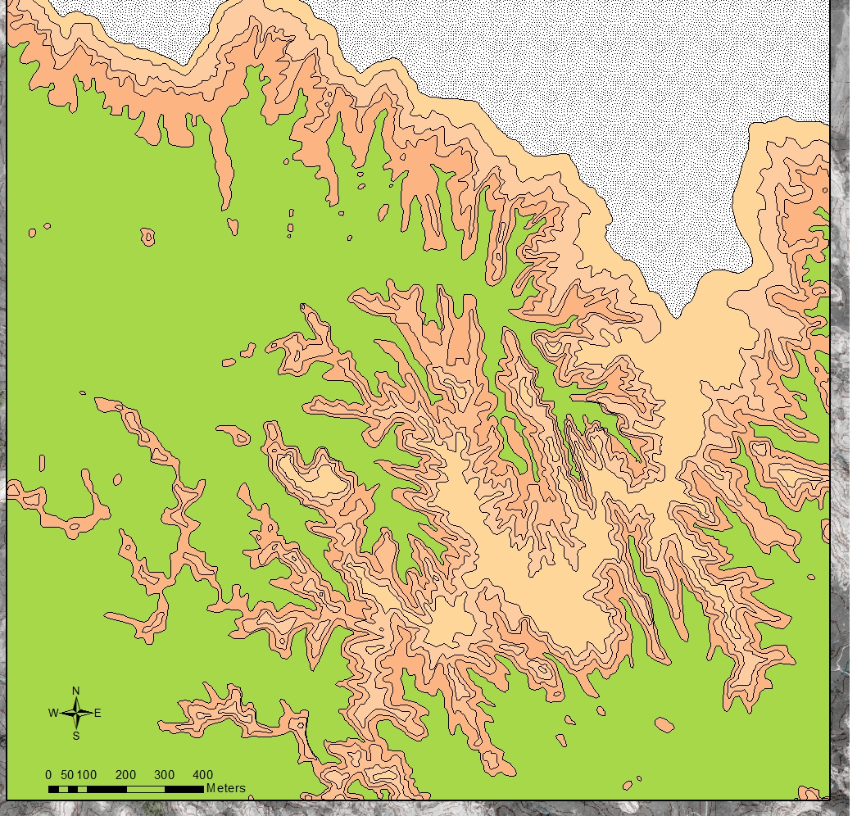
The Preliminary Geologic Map
This map: 1.4km²
Total study area: 9km²
1:8000
In coordination with USGS color standards

Slide 24
Purpose of the Project
The focus of this project was to create a detailed geologic map that more efficiently locates the most fossiliferous strata.

Slide 25
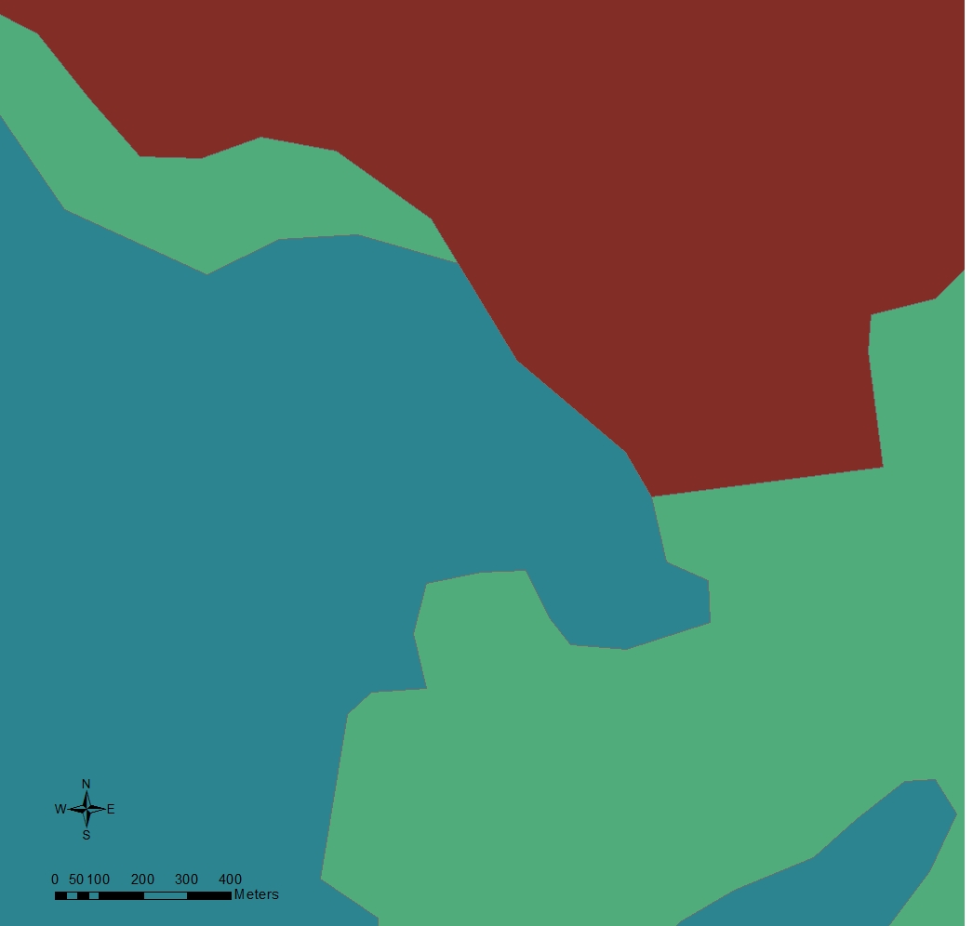
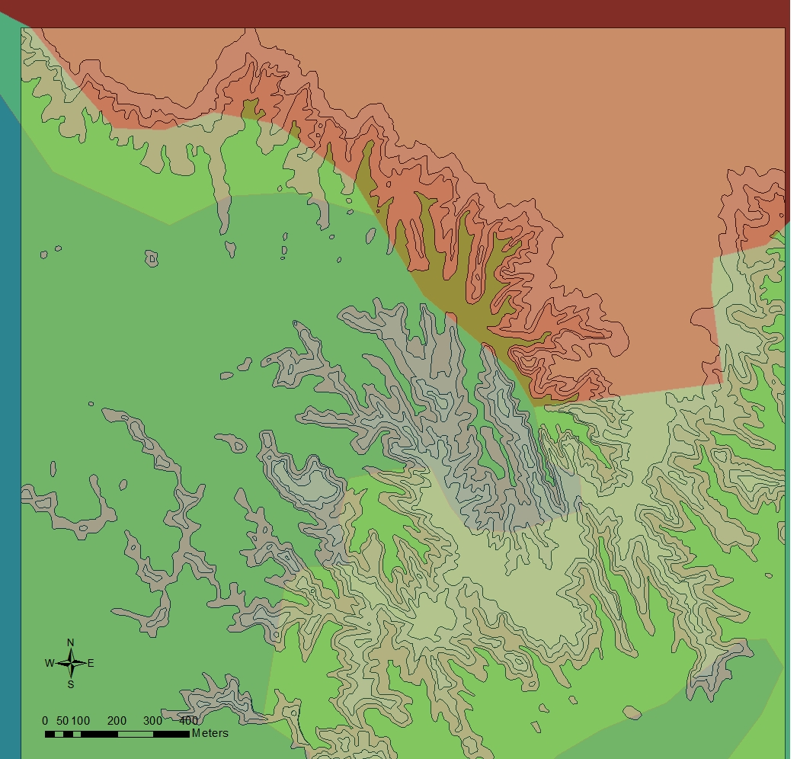
Comparing Geologic Maps
This is the 1953 South Dakota Geological Survey’s map of the Indian Creek Area.
Now overlaid with the completed geologic map.

Slide 26
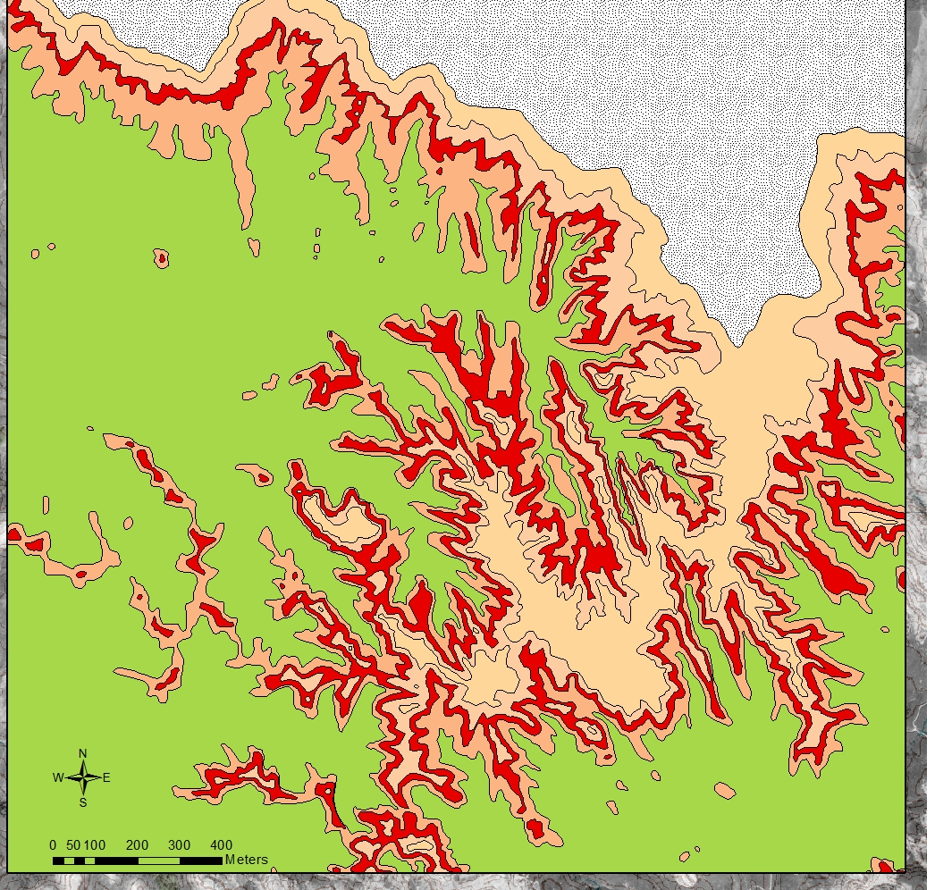
Abundant Fossil Strata
The red layer highlights the Crazy Johnson Member of the Chadron Formation.
This member produces an abundance of well preserved fossil specimens.

Slide 27
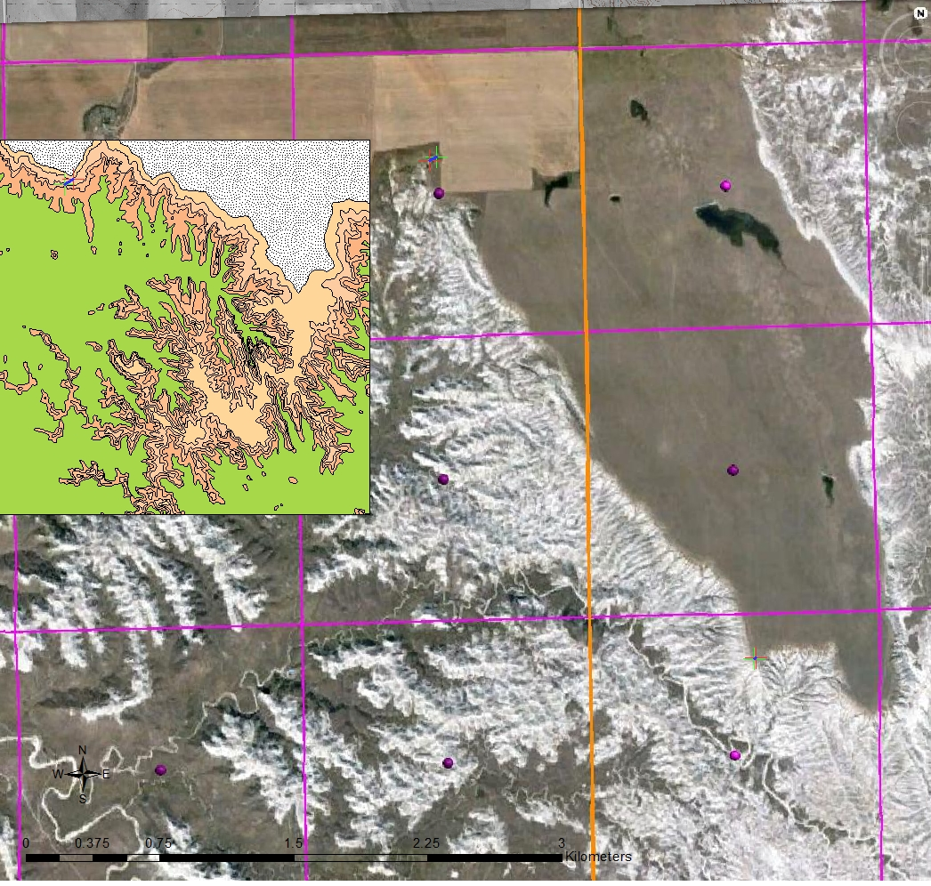
Continued Research
23
24
19
Continue data collection
Locate structural features
Expand the map
Hart Table
26
25
30
35
36
31

Slide 28
Acknowledgments
Wayland Baptist University School of Mathematics and Science
Wayland Baptist University Geology Department
Dr. David Schmidt
Dr. Timothy Walsh
The Field Crew
Hunter Green
Jacob Kemmer
Taryn Shadden
Hanna Wells
Frank Bloom

Slide 29
References
Clark, John. 1937. "The Stratigraphy and Paleontology of the Chadron Formation in the Big Badlands of South Dakota." Annals of the Carnegie Museum XXV: Pages 261-350.
Clark, John, James Beerbower, and Kenneth Kietzke. 1967. Oligocene Sedimentation, Stratigraphy, Paleoecology in the Big Badlands of South Dakota. Field Museum of Natural History. Chicago: Field Museum of Natural History. Vol., V. Print.
King, R.U., and W.H. Raymond. 1971. "Geologic Map of the Scenic Area, Pennington, Shannon, and Custer Counties, South Dakota." Map. U.S. Department of the Interior. Washington, D.C.: U.S. Geological Survey. Print.
O'Harra, Cleophas C. The White River Badlands,. Rapid City, SD: Regents of Education, 1920. Print.
Petsch, Bruno C., and Freeman Ward. 1953. "Geologic Map State of South Dakota." Map. South Dakota: State Geological Survey. Digital.
Retallack, Greg J. 1983. "A Paleopedological Approach to the Interpretation of Terrestrial Sedimentary Rocks: The Mid-Tertiary Fossil Soils of Badlands National Park, South Dakota." Geological Society of America Bulletin 94: 823-840. Print.
Stoffer, Philip W. 2003. Geology of Badlands National Park: A Preliminary Report. Rep. no. 03-35. California: U.S. Geological Survey. Print.
Terry, D.O., Jr., 1998. Lithostratigraphic Revision and Correlation of the Lower White RiverGroup: South Dakota to Nebraska, in Terry, D.O., Jr., LaGarry, H. E., and Hunt, R. M., Jr., eds., Depositional Environment, Lithostratigraphic, and Biostratigrahy of the White River and Arikaree Groups (Late Eocene to Early Miocene, North America): Boulder Colorado, Geological Society of America Special Paper 325.
DOQQ and DRG were obtained from the South Dakota Geological Survey website

Slide 30
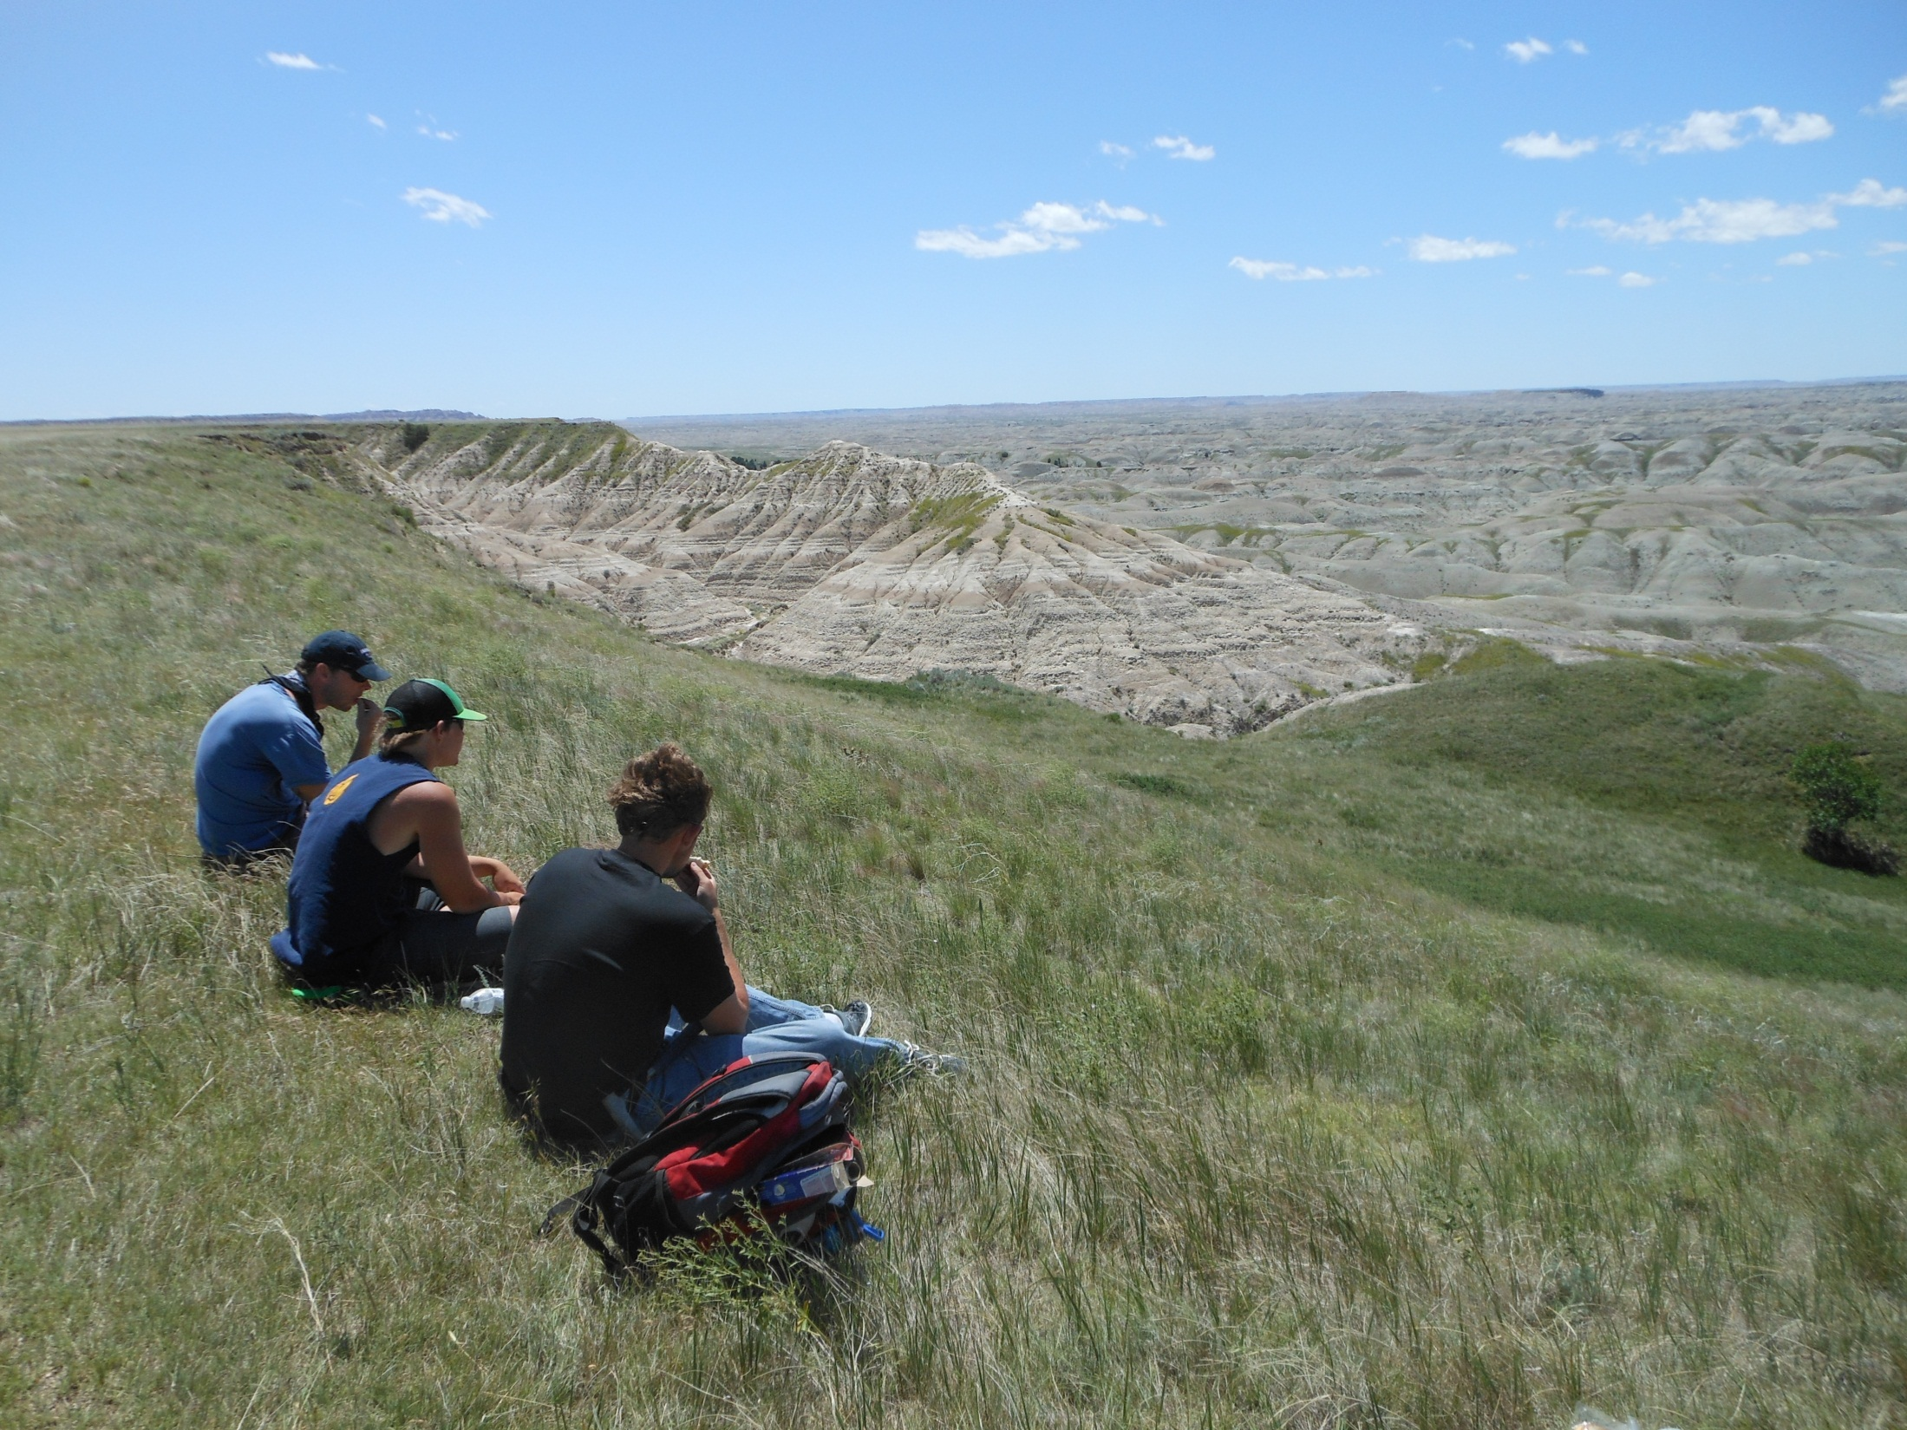
Questions?

