Slide 1
Bengtson Analysis of Folds In The Central Region of The Ouachita Fold-Thrust Belt
Aaron Ball
Geological Society of America
South-Central Section Conference
4/5/2013

Slide 2
Geologic setting
This study focuses on the Boktukola syncline and two associated anticlines
Part of the Ouachita Fold & Thrust Belt, SE Oklahoma
Central region of Ouachita System between the Boktukola and Windingstair faults
Characterized by several broad, north-verging synclines

Slide 3
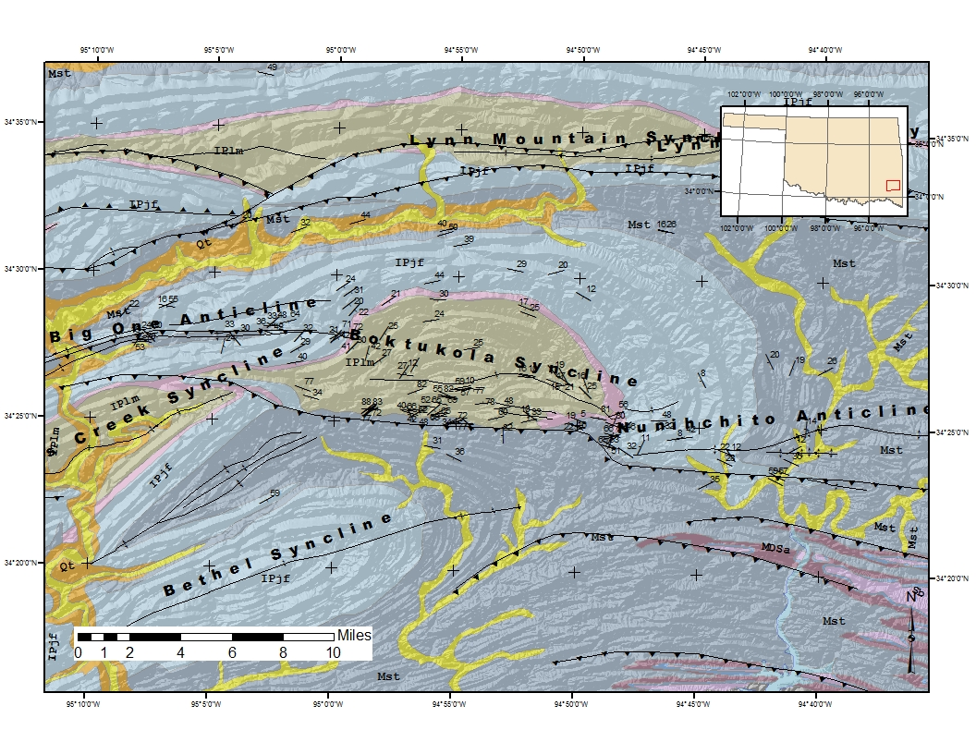
Introduction

Slide 4
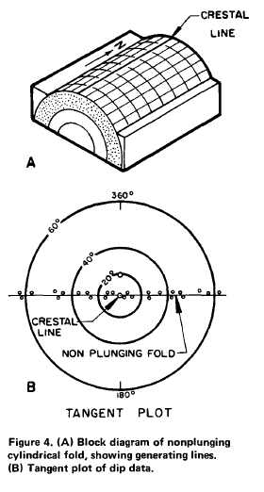
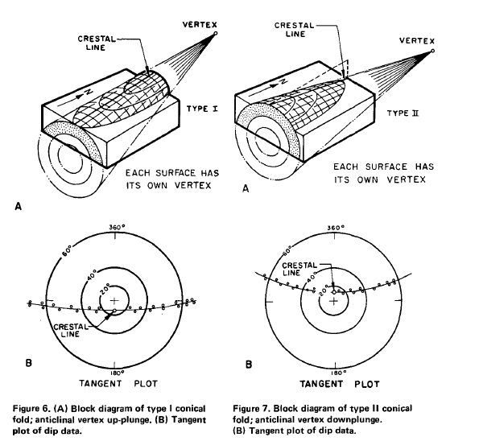
Methods: Bengtson Analysis
Cylindrical Folds
Conical Folds
Adapted from Bengtson 1980

Slide 5
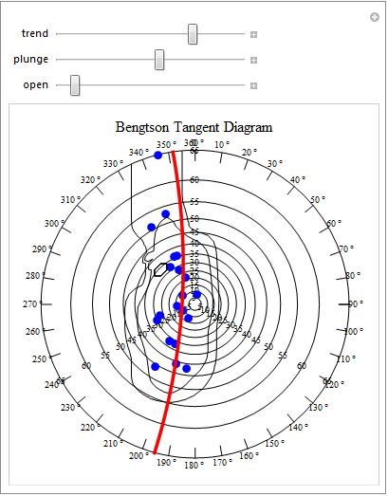
Methods: Mathematica Code
No computer program for Bengtson plots
I developed code for tangent diagram analysis with Mathematica
Used field measurements and published orientation data
Part of M.S. Thesis on geometry and placement of syncline

Slide 6
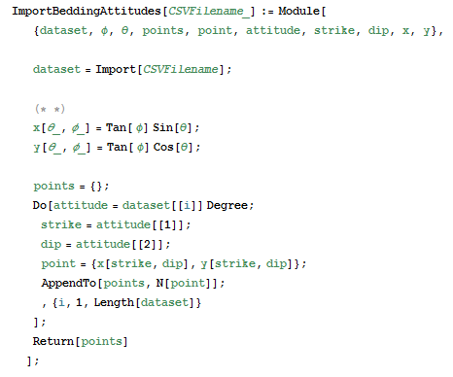
Methods: Mathematica Code

Slide 7
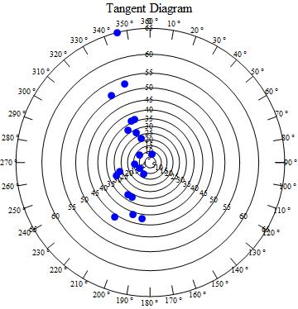
Methods: Mathematica Code
CreateBengtsonDiagram module creates background vector graphic
PlotBeddingAttitudes module plots data points on background

Slide 8

Methods: Mathematica Code
ContourBeddingAttitudes module
Grids plot area using method described by Haneberg (2003)
Counts data points within a search radius
Calculates distance from node to data point
If point is within defined search radius then count value increases
Finally, assigns count value to grid node for contouring

Slide 9
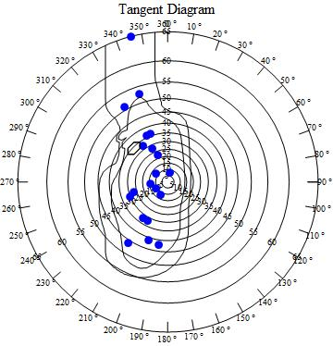
Methods: Mathematica Code
Mathmatica function ListContourPlot generates contour lines from 3D gird
Curve fitted to data for analysis
Although the hyperbola is best fit curve for conical folds (Bengtson, 1980), the a parabola is used here.
Parametric form of parabola can be fitted to data using rotation and translation matrice

Slide 10
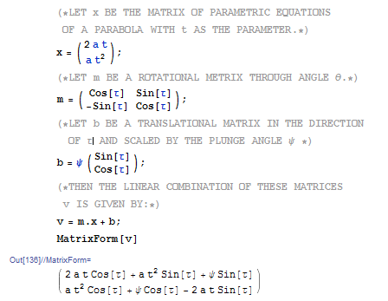
Methods: Mathematica Code

Slide 11
Methods: Mathematica Code
The linear equation for fitting the parabola in parametric equations:
x = a t² sin(τ ) + 2 a t cos(τ ) + ψ sin(τ )
y = a t² cos(τ ) – 2 a t sin(τ ) – ψ cos(τ )
Where :
τ = trend angle - /2,
ψ = plunge angle,
a = openness factor of parabola

Slide 12
Methods: Mathematica Code
Manipulate function allows user to fit curve to determine trend/plunge and openness of parabola
User must interpret contours to determine fold morphology
This process equivalent contouring Kalsbeek Counting Net

Slide 13
Methods: Mathematica Code
The openness factor (a) of parabola is estimated from contour plot.
Cylindrical folds treated as special case of a conical fold with large openness factor (>10)
Function for least-squares fitting or minimizing RMSE of parabolic curve is forthcoming

Slide 14
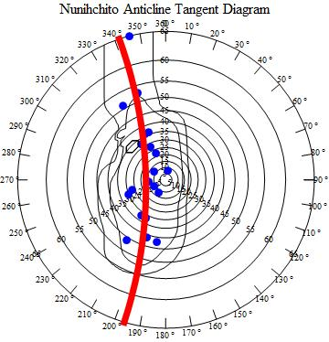
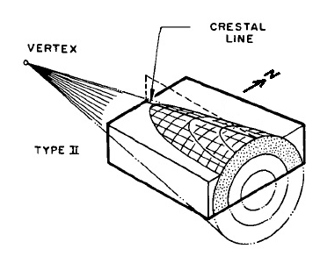
Results: Nunichito Anticline
Gently plunging, conical anticline
Crestline trend/plunge is 271, 16
Openness factor is 2.5
Best fit curve opens away from origin
This indicates vertex is down plunge (type II)

Slide 15
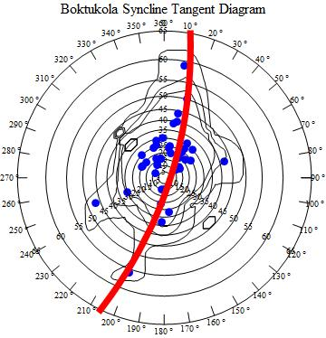
Results: Boktukola Syncline
Subhorizontal, conical syncline
Crestline trend/plunge is 252, 3
Openness factor is 3
Best fit curve opens toward origin
indicating vertex is up-plunge (type II)

Slide 16
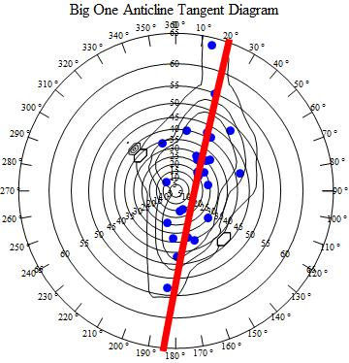
Results: Big One Anticline
Gently plunging, cylindrical anticline
Openness factor is >10
Crestline trend/plunge is 078, 14

Slide 17
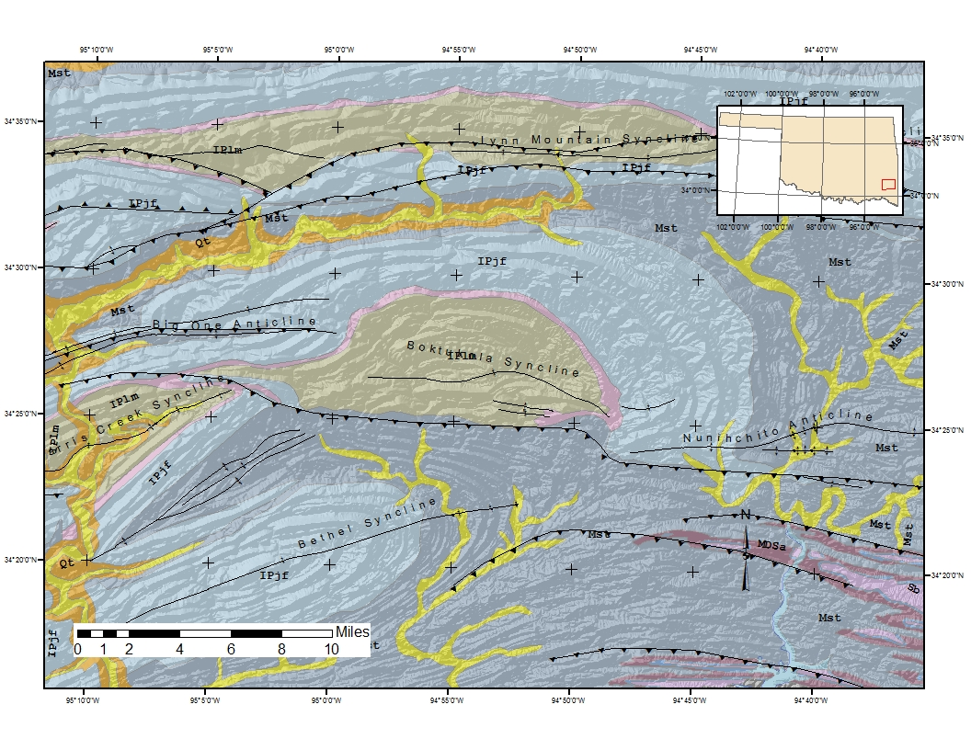

Slide 19
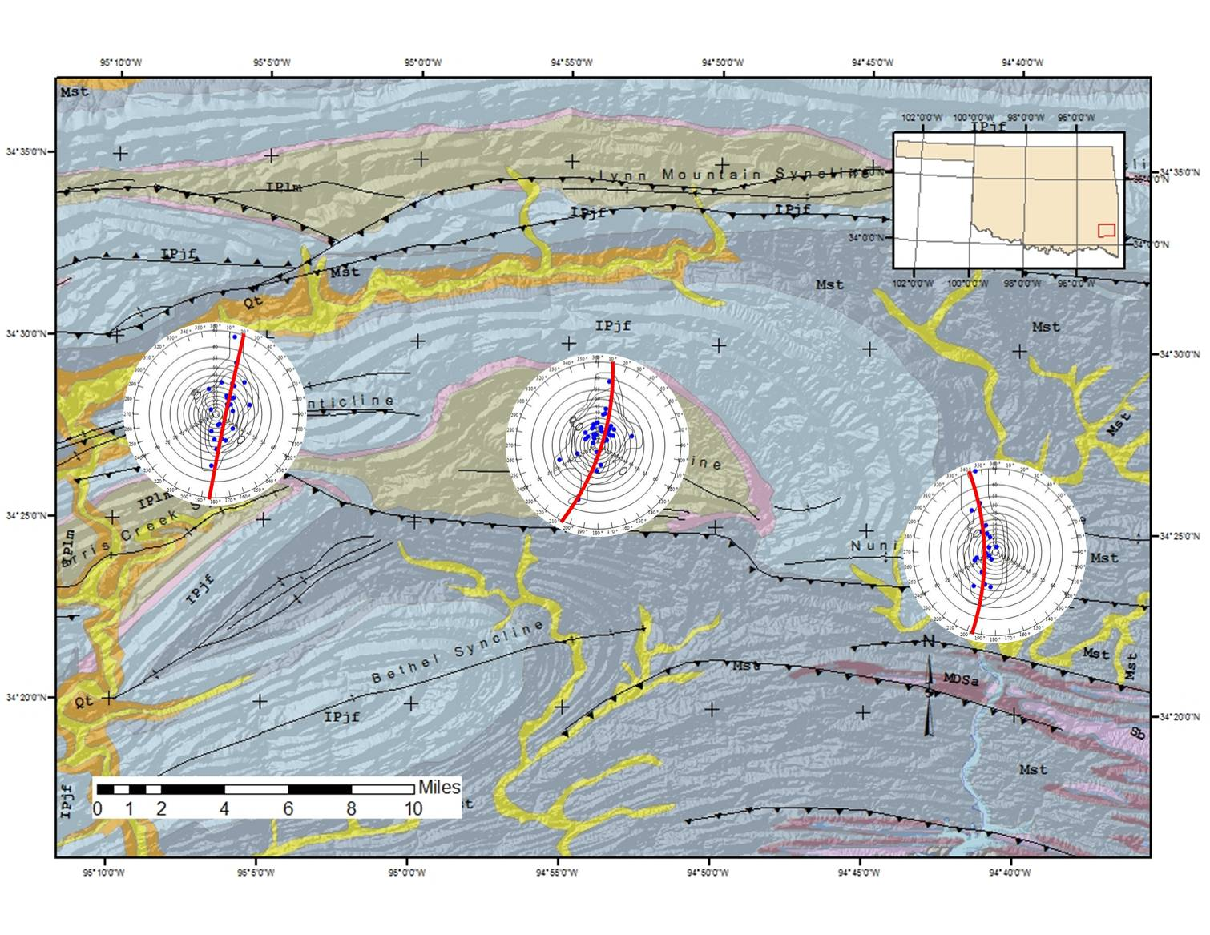
Discussion
Conical folds form during flexural slip with an element of rotation, which may indicate shear along bounding faults (Becker, 1995)
Big One Anticline is cylindrical fold due to decreasing shear along fault; Boktukola and Nunhichito may still have a sense of shear along the fault
Mathematica code provides user a rapid way to plot and analyze bedding attitudes
Analysis suggests shear along Boktukola fault followed compression
This shear may die out along the bend in the orocline

Slide 20
Questions?
Becker, A., 1995, Conical drag folds as kinematic indicators for strike-slip fault motion: Journal of structural geology, v. 17, no. 11, p. 1497-1506.
Bengtson, C. A., 1989, Structural uses of tangent diagrams: Geobyte, v. 4, no. 1, p. 57-61.
Bengtson, C. A., 1981, Comment and Reply on ‘Structural uses of tangent diagrams’: REPLY: Geology, v. 9, no. 6, p. 242-243.
Haneberg, W. C., 2004, Computational Geosciences with Mathematica, Springer-Verlag GmbH.
Whitaker, A. E., and Engelder, T., 2006, Plate-scale stress fields driving the tectonic evolution of the central Ouachita salient, Oklahoma and Arkansas: Geological Society of America Bulletin, v. 118, no. 5-6, p. 710.

