Slide 1
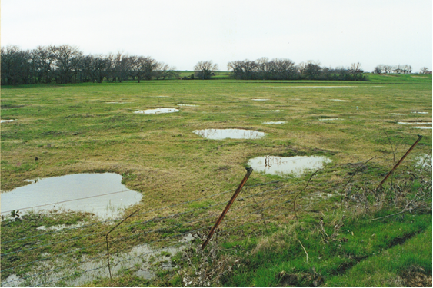
Investigating soil water movement and pedogenic carbonate formation by measuring the stable isotope composition of water in Vertisols
Brandon J. Okafor
Daniel O. Breecker
The University of Texas at Austin
The Jackson School of Geosciences
Notes:
Thank you for being here, My name is Brandon Okafor and I will be talking about my research which is investigating soils water movement and pedogenic carbonate formation by measuring stable isotope composition of soil water in Vertisols.

Slide 2
Outline
Introduction
Hypothesis
Field Site
Methods
Meteoric Water Line
Results
Conclusion
Future sites and research
Notes:
-The talk is actually 20mins, so I think this slide will be useful.
This will be the outline of my talk, I will introduce some key ideas that relates to my research and I will give some background information so that you will understand my research a little better. I will talk about the Global Meteoric water line, my research site, and methods. Tell you my what we have discovered and tell you what we plan on doing in the future with this research.

Slide 3
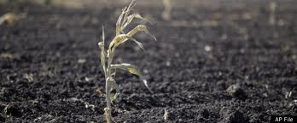
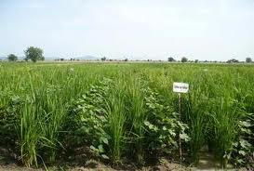
Introduction
Water Movement
Water limited ecosystems in Texas
Recharge to underground resources
Transport of dissolved species
Translocation of salts
Pedogenic carbonate
Paleo-environment
Vertisols
Used for many crops in Texas
Most abundant in rock record
2011 Drought in Texas
Notes:
Since the 2011 drought, understanding the hydrologic cycle in more detail has become very important in Texas. This has also forced us to be more cautious on how we manage our water resources. But to do this, water movement in soils needs to be better understood. Also understanding how water moves in soils links us to understanding how dissolved species are transported and the translocation of salts, such as pedogenic carbonate. Pedogenic carbonates are important because they are used as proxies for past climate and environments. Pedogenic carbonate are usually found in Vertisols, which are used for many crops in Texas and is also used for understanding past climates since it is the most abundant soil in the rock record.

Slide 4
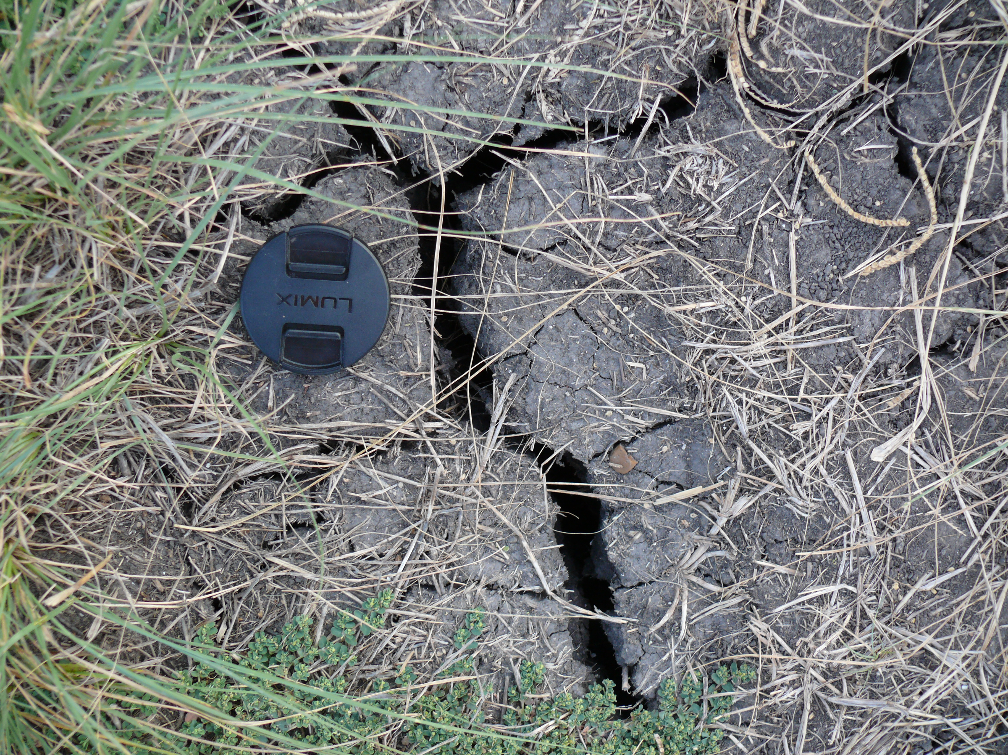
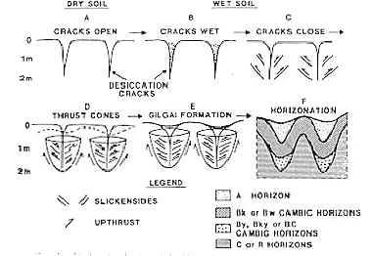
Hypothesis
L. Michel
Wilding and Tessier (1988)
Evaporation occurs deeper in Vertisols than other soils
Pedogenic carbonate records oxygen isotope composition of mean annual precipitation.
Notes:
Vertisols are clay-rich soils that has the ability to shrink and swell with water content. As the soils dries, it shrinks and creates these large cracks that can be a meter in depth. So due to these large cracks, deeper parts of the soil will be exposed to air and cause evaporation to occur at deeper depths than other soils. We also hypothesize that the pedogenic carbonate that forms in these soils will record the oxygen isotope composition of mean annual precipitation.
Now on to our field site.

Slide 5
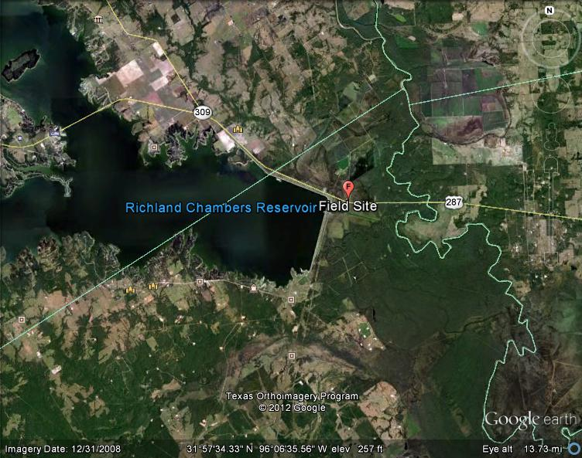
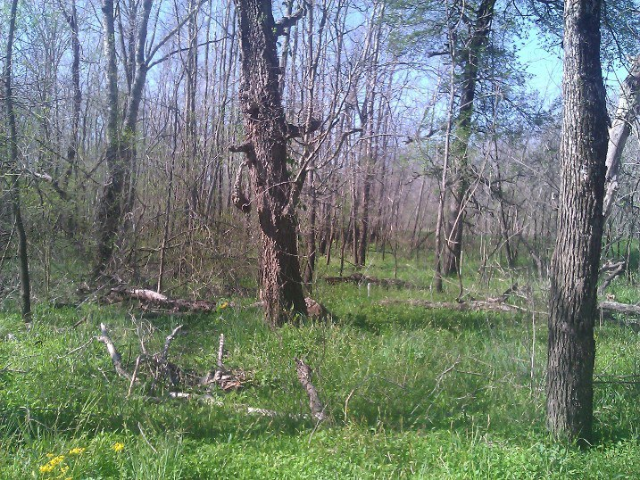
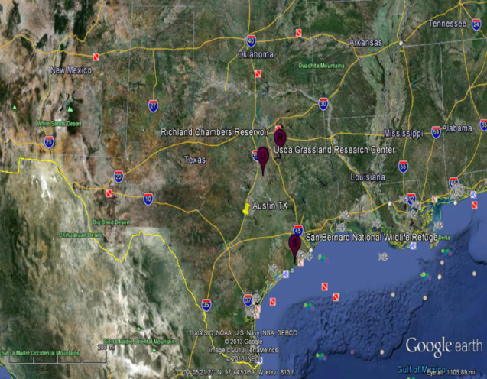
Field Site
Richland Creek Wildlife Management Area in Fairfield, TX. (southeast of Dallas, TX)
Lies within the Trinity River flood plain
Average annual rain fall is 40 inches
Highly vegetated
Notes:
We collected our samples from Richland Creek Wildlife Management Area in Fairfield, TX , which is the balloon right here. It lies on the Trinity river flood plain and has an average annual rainfall in this location is 40 inches. This area is wildly vegetated with crops such as ceder elm and sugarberry.
Located in an ecotone separating the Post Oak Savannah and Blackland Prairie ecological regions
- Lies within the Trinity River flood plain
- Average annual rain fall is 40 inches
- consist of two different soil association, Trinity and Kaufman (Kh), poorly drained, very slowly permeable.
- The vegetation in this area are cedar elm, sugarberry, green ash, Honey Locust, boxelder, black willow, bur oak, shumard oak, overcup oak, water oak, williow oak, and native pecan

Slide 6
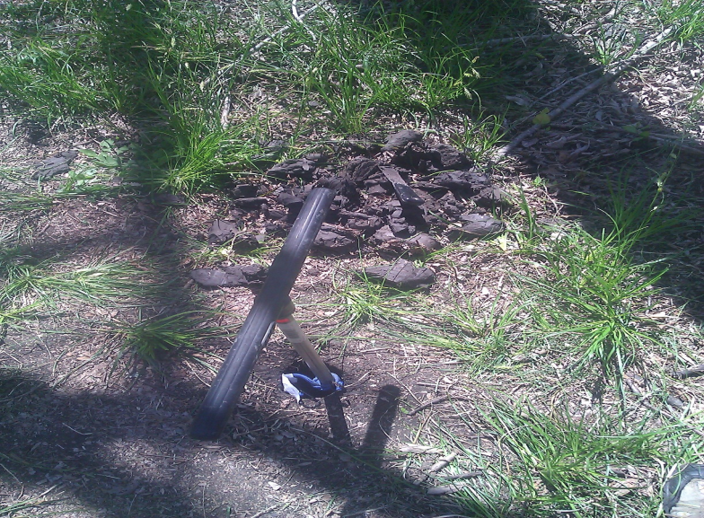
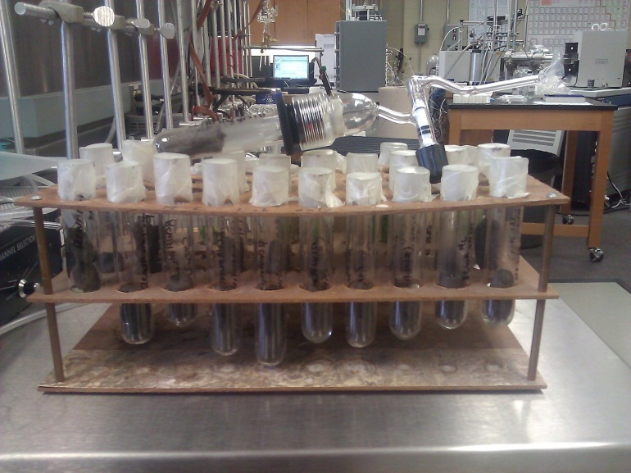
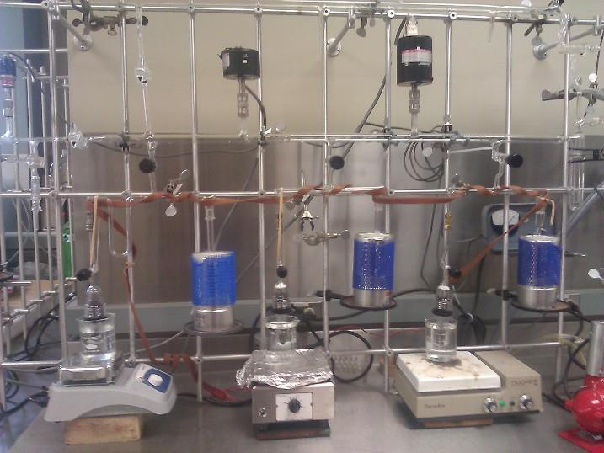
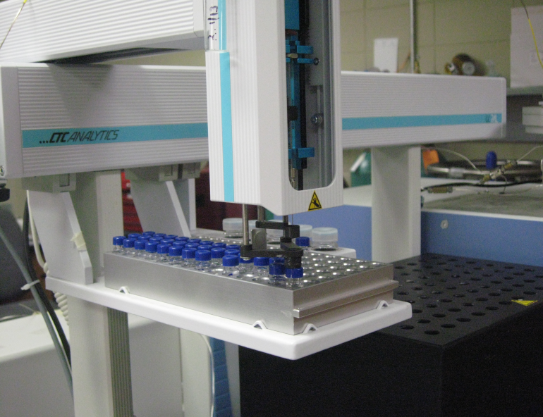
Methods
Samples in glass collection
Notes:
So we went out to the field site and collected soils samples from different depth, shown in this picture here. We used a glass line and extracted the water from the soil samples by vacuum distillation. We then ran the collected water samples in the isotope ratio mass spectrometer for their isotopic composition. We also measured the gravimetric water content from each sample.

Slide 7
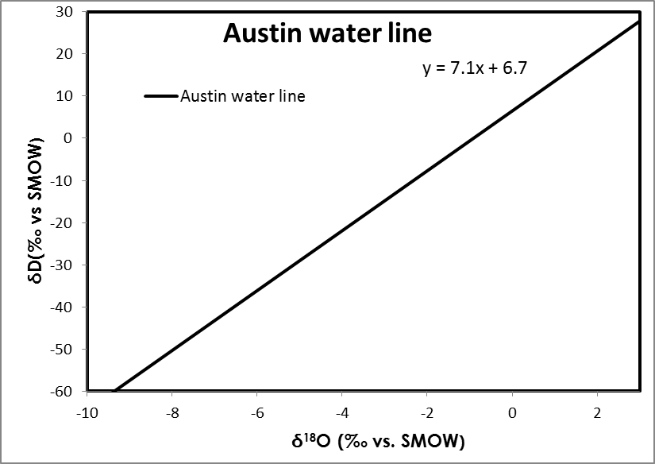
Meteoric Water Line
Evaporation Trend
Notes:
So before I go on to our results, I wanted to introduce the Global Meteoric water line because it will be used in our results for monitoring evaporation. So the GMWL is a graphical relationship between delta O 18 and delta D or H that shows information about precipitation dynamics. Waters that falls on the line has isotopic compositions of meteoric waters, but waters that falls and to the right of the line has been subjected to evaporation, illustrated by this blue line which is the evaporation trend.

Slide 8
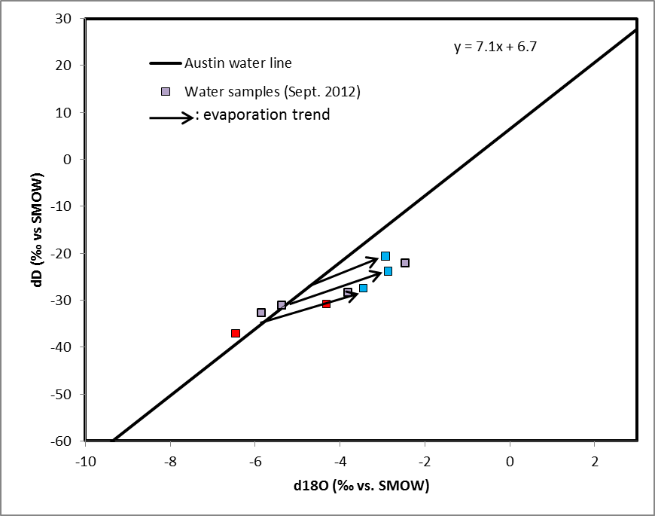


Results
:Wettest samples
:Driest samples
Notes:
So using what I describe in the last slide, the is the austin meteoric line and the blue, red, and gray squares are my samples that I collected in september. The blue squares corresponds to the wettest samples I collected and the red are my driest samples. So 6 out of the 9 samples I collected has isotopic comp. that falls off the line which suggest that they were subjected to evaporation. But we came across one problem, so when you think about evaporation, water is being pulled out of the soil by turning into a gas. So the soil should be dry, but our wettest samples are the ones that has been subjected to the most evaporation. This could be explained by numerous processes, but more testing and analysis would need to be done to find out what process is causing these results.

Slide 9
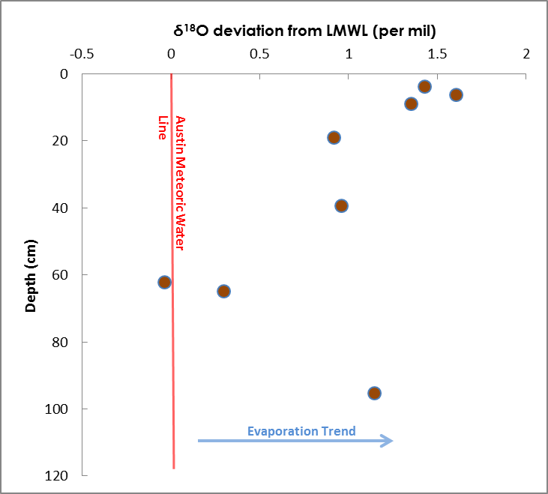
Notes:
So to understand how evaporation is varying with depth, calculated the delta O 18 deviation of each sample and plotted those results with depth. This red line illustrates where the meteoric line. So as you can see, the deviation decreases with depth until about 60cm, with exception of this one outline at 100cm. This suggest that evaporation is higher near the surface and drops to zero at about 60cm. This is not enough information to completely say that evaporation is occurring at deeper depths than other soils, but it is a start for understanding how water is moving the soil. So more analysis will be needed to prove that hypothesis.

Slide 10
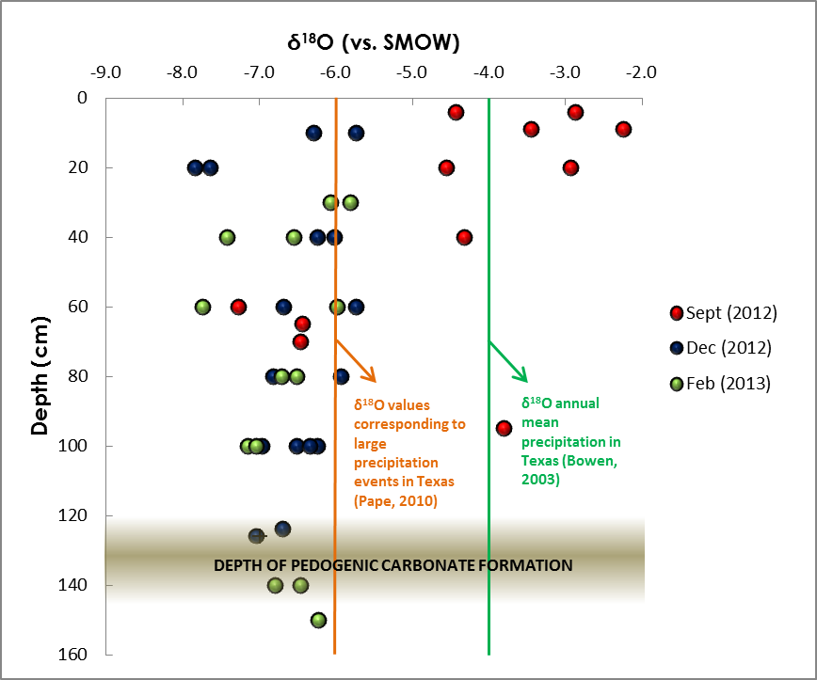
Notes:
This graph illustrates variation of stable oxygen isotopes in the soil water with depth. The red circles are the samples collected in September and the blue circles are the samples collected in Decemeber and green are what I collected in February. As you can see both the dec. and sept. samples generally decreases with depth and that trend can greatly be seen in september than in dec. This green line at -4 per mil represents the oxygen isotopic composition of mean annual precipitation in Texas. The orange line at -6 per mil represents the average oxygen isotopic composition of large rain events in Texas. The brown transitioning area is where pedogenic carbonate has been observed to be form which is about 120-140cm. So 1st, this graph illustrates that the isotopic composition is more variable in the summer than the winter. Also the only water that can be seen past a 1 meter in depth is isotopically light, which suggest that only large and winter rain events can infiltrate that deep. Secondly, if only large and winter rain events are the only source that can infiltrate past a meter, then past studies that states that pedogenic carbonate only records mean annual precipitation could be wrong.
(When we say large rain events, how big are these rain events? = 22cm mean monthly precipitation, small ones with -4per mil = 7-11cm mean monthly precipitation)
The d18O value of MAP certainly varies across Texas, does Bown have values for different regions?
‘large precipitation’ is not quite right. Maybe ‘large precipitation events’

Slide 11
Conclusion
Large rain events are the only source of water that infiltrates past 1 meter in the soil, but more analysis will need to be done to prove this.
If true, pedogenic carbonates that are in equilibrium with this water will be biased towards large rain events.
Notes:
In conclusion, we believe that only large rain events and winter rain events are the only sources of water that can infiltrate past a meter, but more test and analysis will need to be done to prove this. If true, pedogenic carbonate that forms in these soils would be bias towards large and winter rain events.

Slide 12

Future sites
Notes:
The first site is USDA Risel Watershed in Waco, TX and the second site is Bernard Wildlife National Refuge located southeast of Houston, TX. The Risel site will be a great site to work at because there are many research project being conducted there and precipitation and runoff is being measured continuously. The Bernard site is a site that doesn’t have any project being conducted there and it is closer to the coast. We believe if we conduct the same field work at these other two site, we could obtain a more broader and better understanding of water movement in Vertisols in Texas.

Slide 13
Future Research
Saturation state (with respect to calcite) of soil water to better understand carbonate formation
Calculated δ¹⁸O values (-9.0‰ vs. PDB) compare with measured δ¹⁸O values of pedogenic carbonate.
Collect rain water samples
Calculate relative humidity within cracks
Notes:
In the near future, we plan to discover if calcium carbonate is forming under conditions during periods where the soil is saturated. We plan on calculating the oxygen isotopic comp. of the calcium carbonate that is in equilibrium with the soil water we are studying and compare that to the measured d18O values. We also plan to collect rain water samples from each of the site and compare them to the soil water isotopic composition.

Slide 14
Thank you for your time
Any questions???
Notes:
Thank you for you time and I will take questions if there is any!
Finished!!!!

