Slide 1
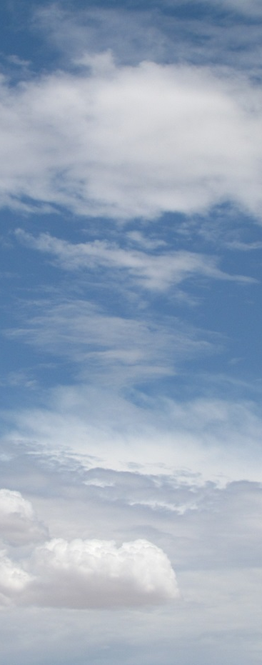
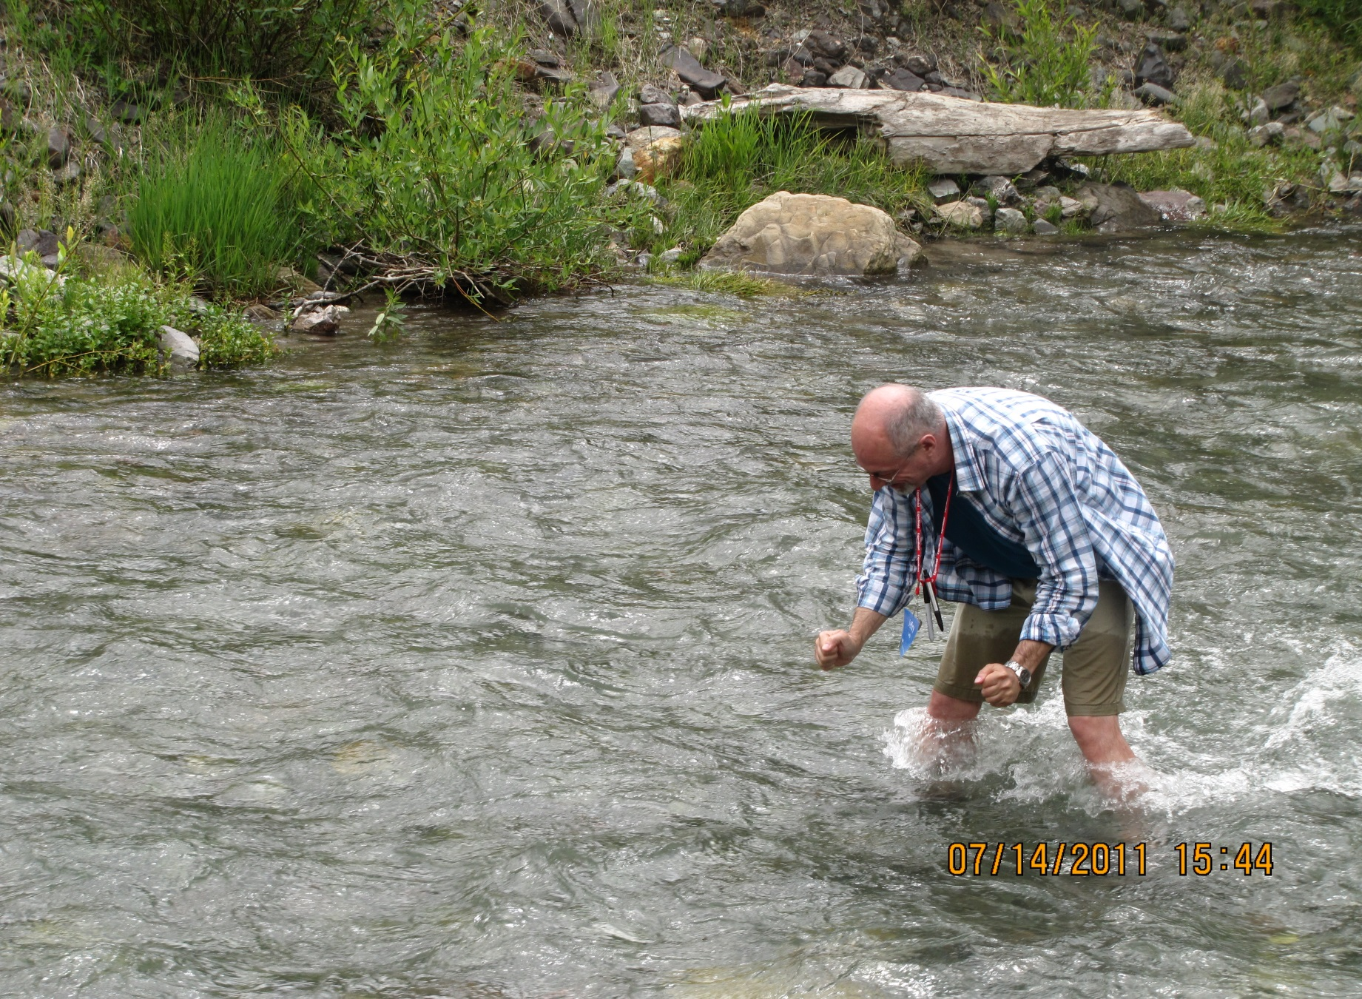
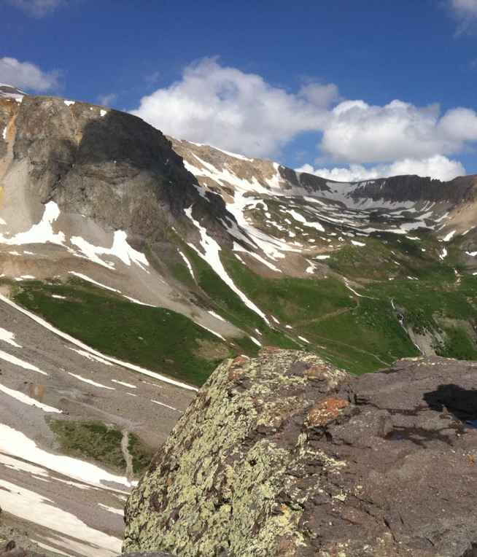
G-Camp
Department of Geology and Geophysics
Texas A&M University

Slide 2

G-Camp
G-Camp for Teachers
2008-2012
G-Camp for Students
2011-2012

Slide 3
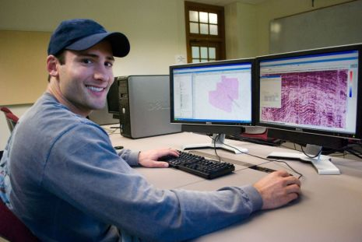
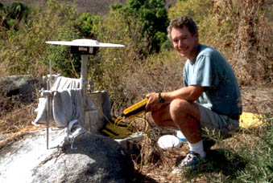
The G-Camp Concept
Three successful ways exist to increase the geoscience workforce:
  Ensuring quality teaching of geosciences in grades 4-12 in order to encourage students to pursue geoscience professions
  Attracting bright, motivated young people to the profession
  Providing students with quality education, vision, and motivation
http://campusdata.uark.edu/resources/images/articles/SMT%20web.jpg
http://geoscience.wisc.edu/geoscience/wp-content/uploads/2010/03/oaxaca1.jpg

Slide 4
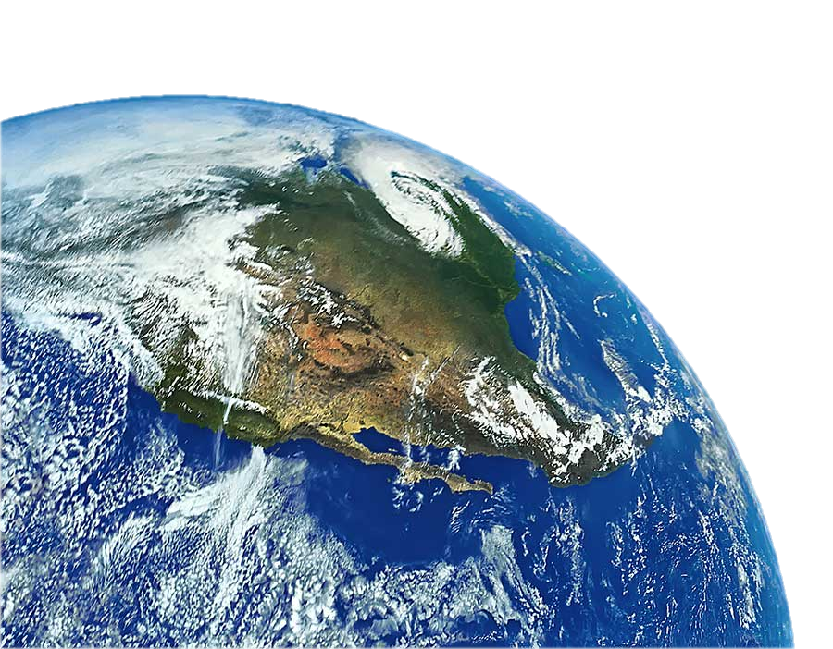
The Mission of G-Camp
Create a well-educated, highly-qualified, highly-motivated, visionary, ethical geoscience workforce by creating a partnership between the geoscience private sector and Texas A&M University

Slide 5
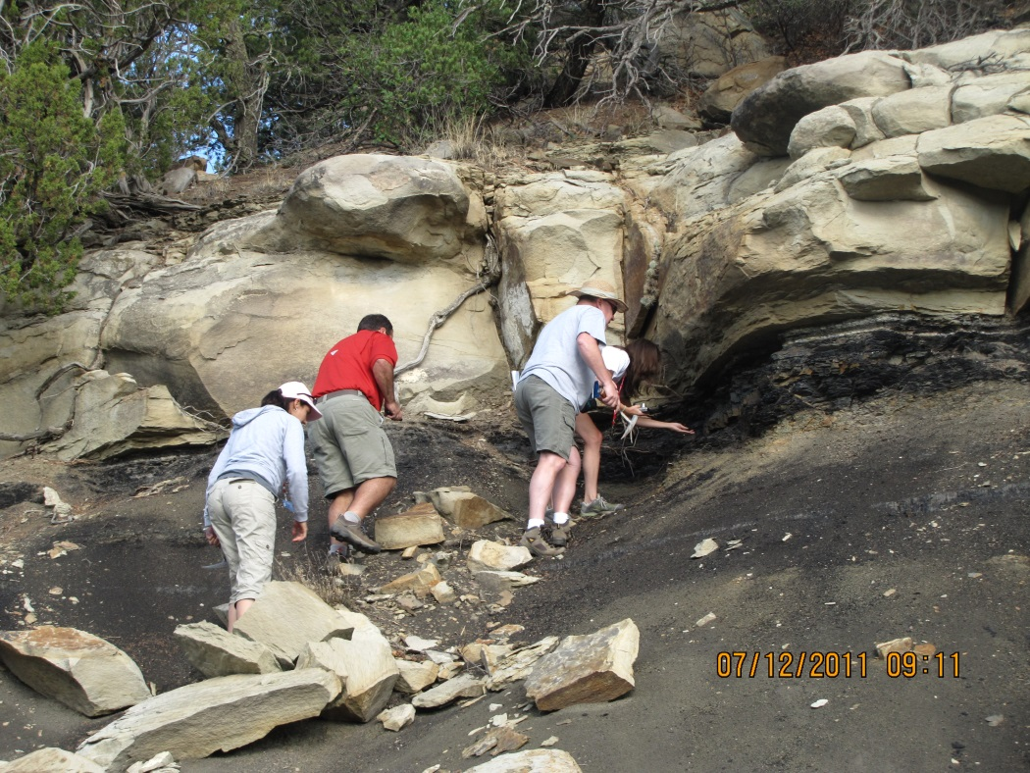
The G-Camp Approach
We inhabit a dynamic planet. To be a successful geoscientist or geoscience teacher, one has to appreciate and understand the processes that form Earth and its resources.
The geosciences are a field-based science.
The field is the place for teaching and learning!
Observing the K/T boundary up close!

Slide 6
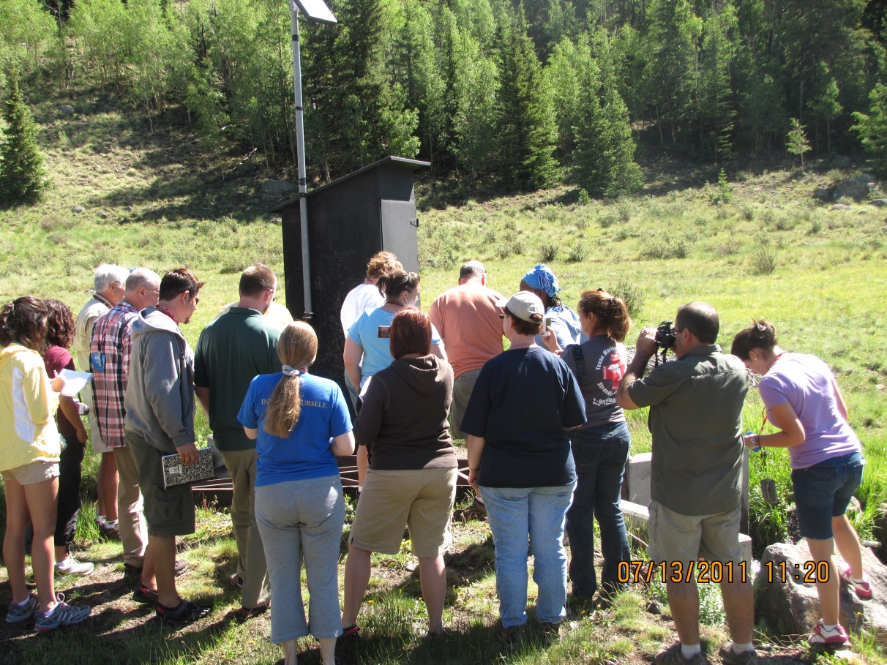
G-Camp: A Two-Tiered System
Increase the quality of teaching of geosciences in grades 4-12 through G-Camp for teachers
Identify and attract outstanding young people to the geosciences through G-Camp for freshmen students
A stream weir at the Continental Divide

Slide 7
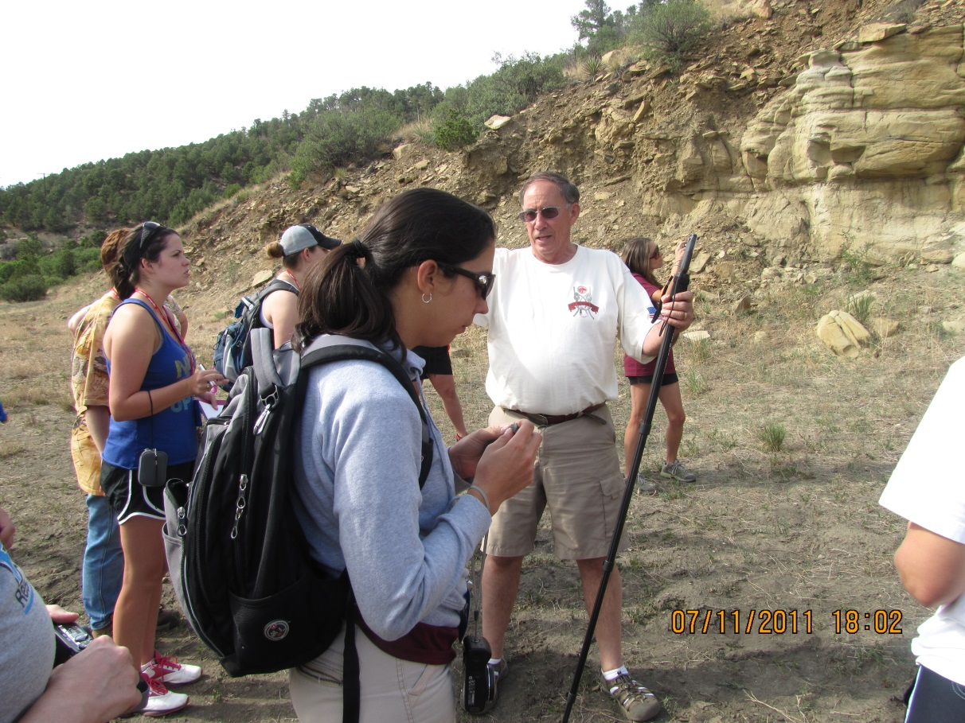
Attending G-Camp
20-30 teachers are selected each year
  Qualifications:
  Currently teaching science in Texas schools
  Highly motivated to incorporate Earth science concepts into whatever science they are teaching
20 incoming freshman are selected
  Potential to be geoscience major
  ACT/SAT scores; class ranking

Slide 8
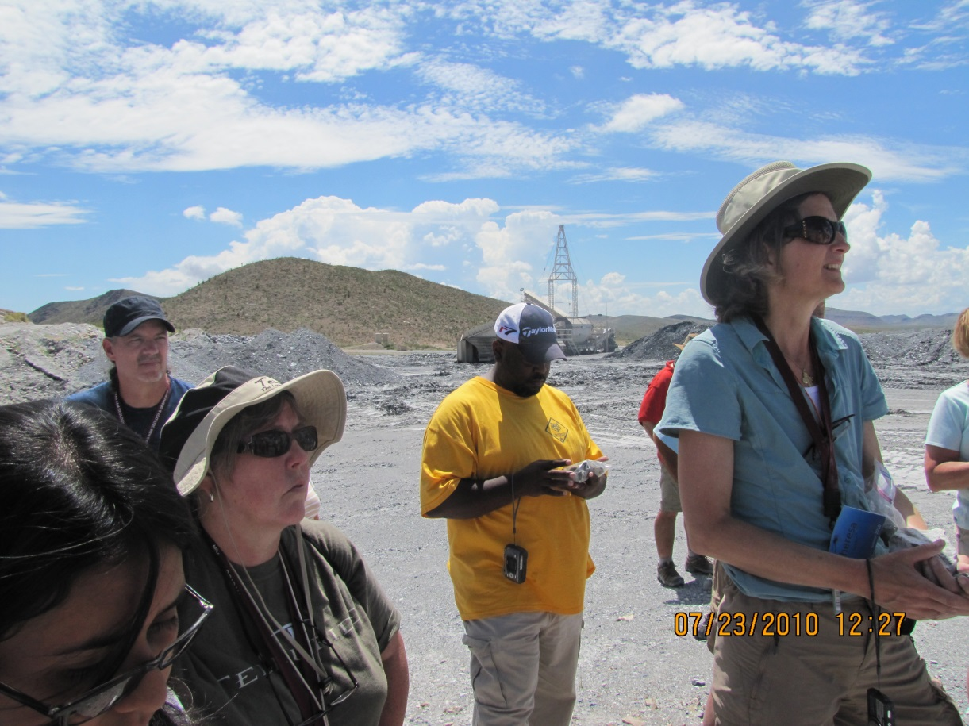
Why do teachers attend?
Teachers who are aware of the possibility of the field experience are excited about it
Many teachers know that the Earth sciences are their weakest area but would like to incorporate ES concepts into their biology, chemistry, or physics lessons
Being somewhere and actually seeing the formation/collected the specimens is exciting for the teachers and enables them to convey their excitement to their students and make it relevant

Slide 9
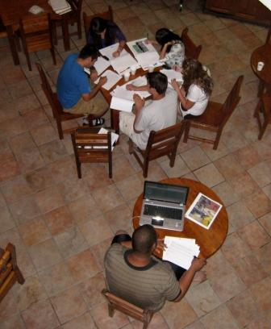
Why do students attend?
Chance to start freshman year early and reduce the first semester class load
Sitting in a classroom hearing about Earth vs. seeing, touching and getting to know Earth personally
Chance to share love of geosciences with dedicated, knowledgeable professors
Opportunity to take the first step to become part of the geoscience profession
http://geonews.tamu.edu/images/news/aggies_study_alpine.jpg

Slide 10
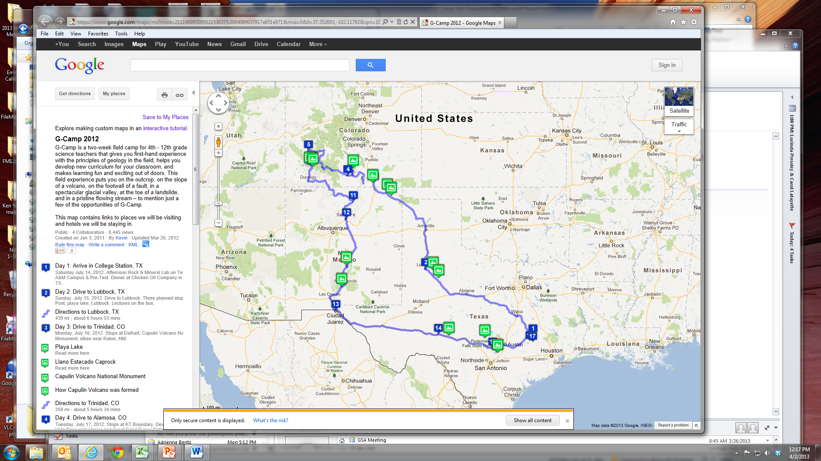
Where do teachers go?
Teachers: Texas, New Mexico, Colorado
Students: Stay in Texas

Slide 11
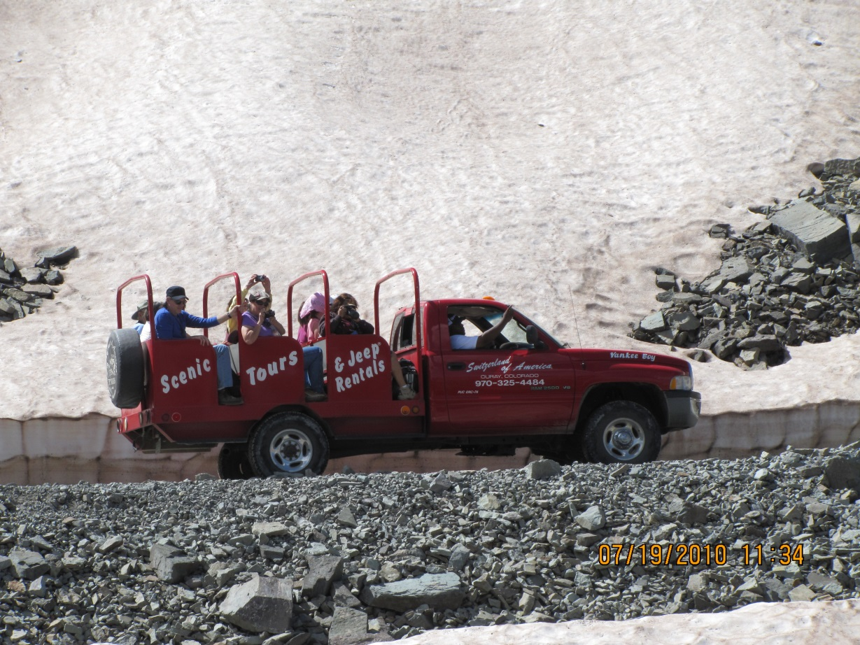
The Evolution of G-Camp
Itinerary has changed over the years
  No longer includes Galveston
  Added and deleted some stops
Some things never change
  Ouray, CO – jeep trip, day of rest & laundry!
  Santa Fe
  Enchanted Rock
Teacher projects changed
  Virtual field trips
  Lab exercises

Slide 12
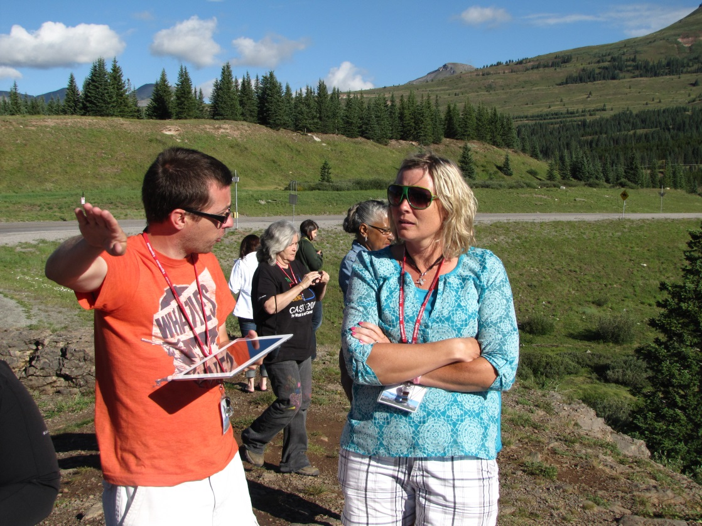
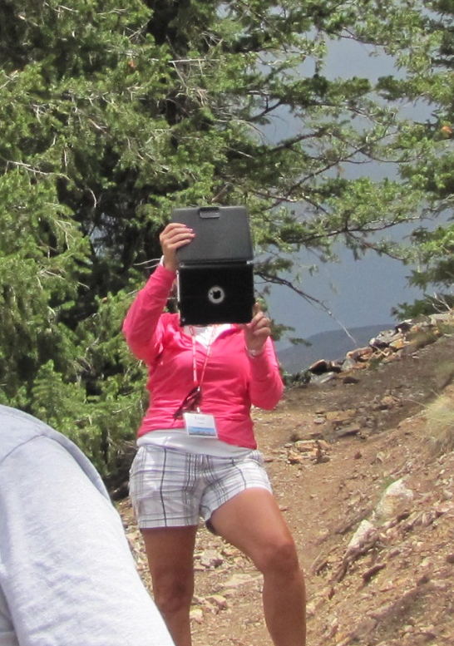
Technology and G-Camp
Facebook as a tool for communicating with G-Campers – before, during, & after trip
iPads checked out to G-Campers
  Pre-loaded with apps
  Photograph structure; illustrate with drawing app over the photo
  Capture stream movement & sound
Authored iBook on principles of geology plus write-ups of stops
Bus with wifi system

Slide 13
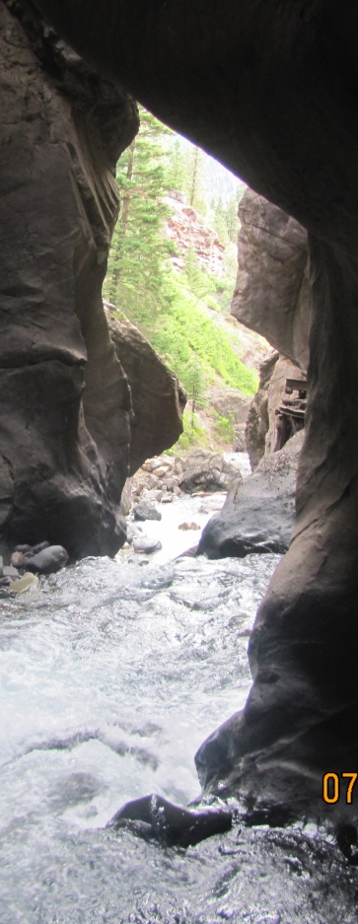
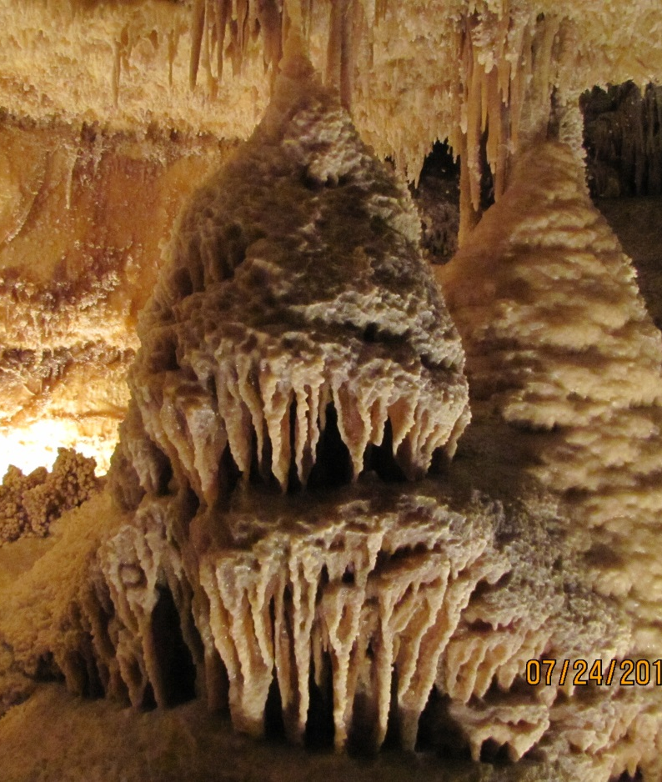
G-Camp Sponsors:
British Petroleum
Chevron
Exxon Mobile
Conoco Phillips
Saudi Aramco
Haliburton
HESS

Slide 14
G-Camp Staff:
Rick Giardino, Dept. of Geology & Geophysics
Jack Vitek, Dept. of Geology & Geophysics
Carolyn Schroeder, Center for Math & Science Ed.
Kevin Gamache, TAMU Division of Research
Fran Giardino, Elementary Teacher

