Slide 1
New insights into the Early Cambrian igneous and sedimentary history of the Southern Oklahoma Aulacogen from basement well penetrations.
Robert E. Puckett Jr., Richard E. Hanson, G. Randy Keller, Matthew E. Brueseke, Casey L. Bulen, Amy M. Eschberger, Stanley A. Mertzman

Slide 2
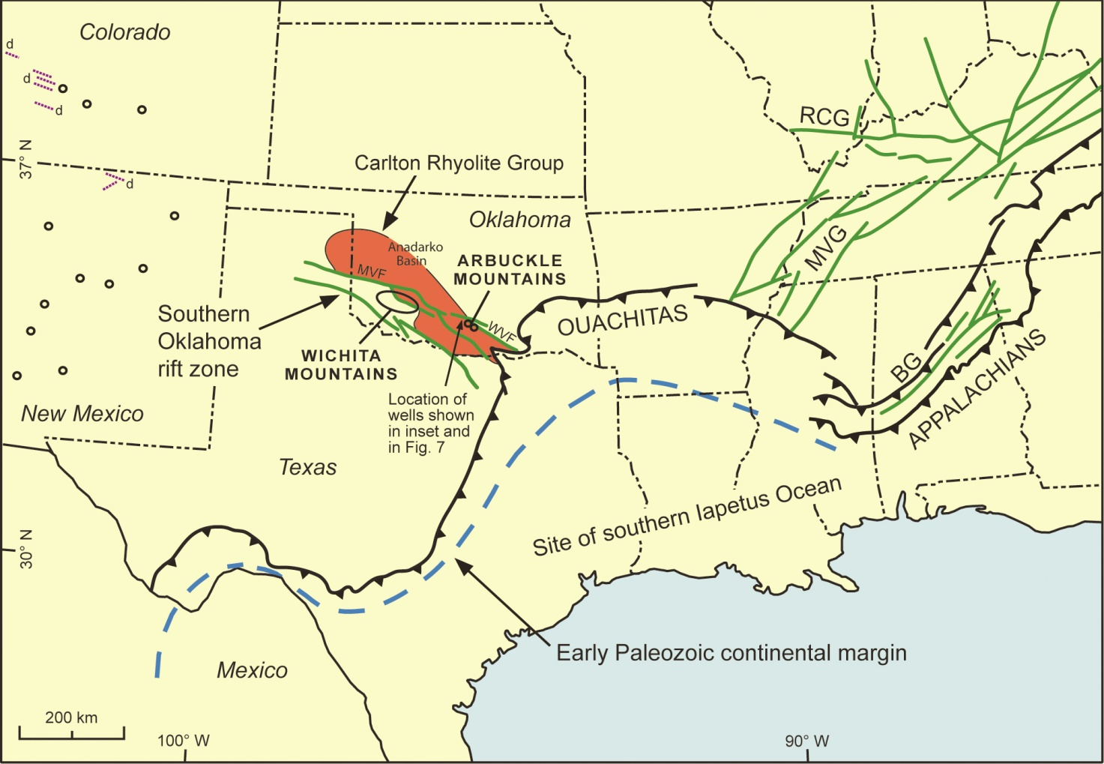
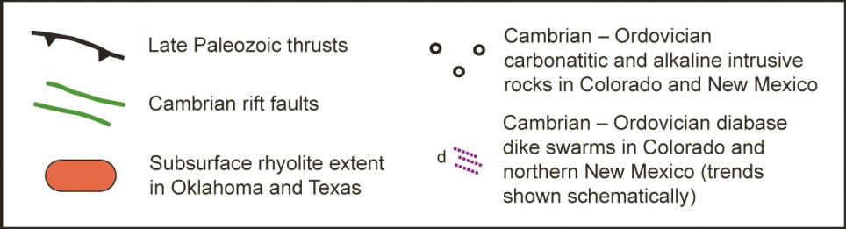
Hanson et al. 2012

Slide 3
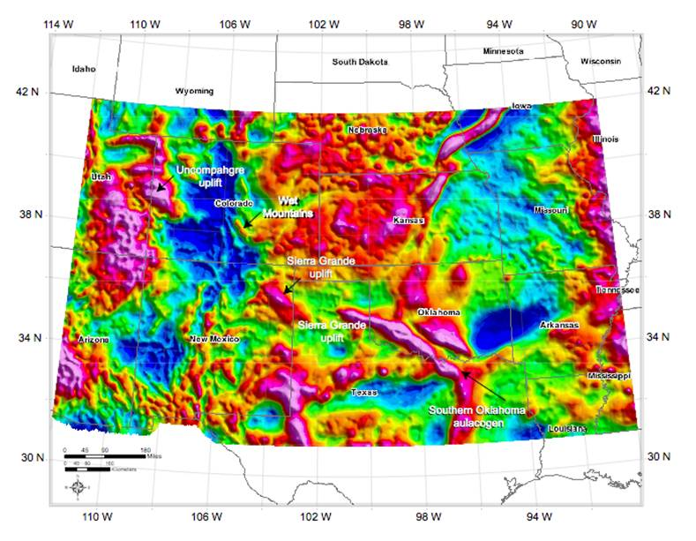
Residual Gravity Anomaly Map
Indicates a series of large gravity highs marking the northwestern extent of the Southern Oklahoma Aulacogen
From Keller et al. 2011, modified from Casillas 2004

Slide 4
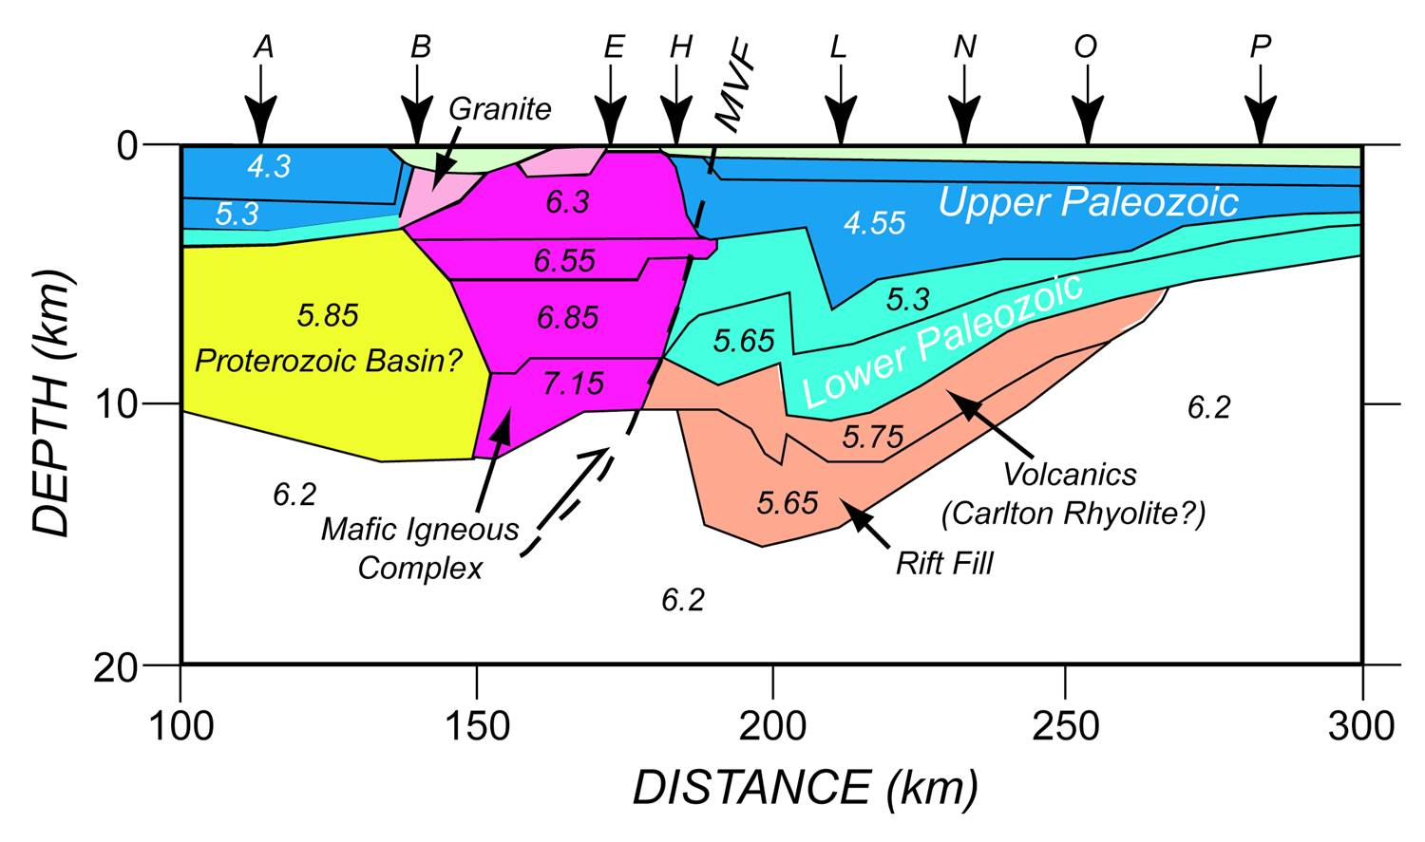
SOA Velocity Model – Upper Crust
From Keller 2012

Slide 5
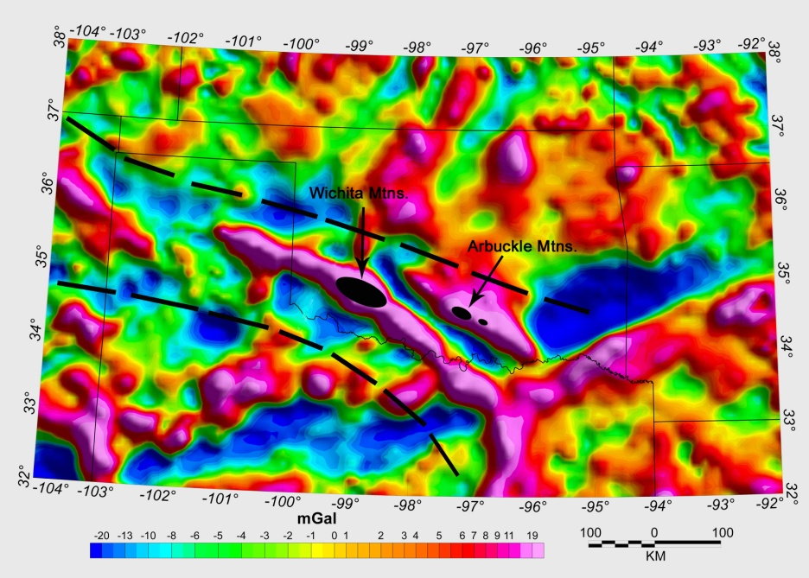
Residual Gravity Map & Cambrian Igneous Rock Outcrops
Modified from Hanson et al. 2012, Aulacogen geometry from Keller 2011

Slide 6
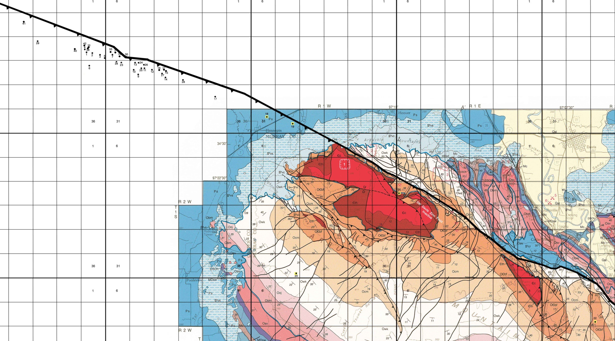
Washita Valley Fault and Overthrust Penetrations
Western Arbuckle Mountains
42 overthrust drilling penetrations
Accessible samples from 29 wells
34 km of uncorrelated igneous section
42 km
Surface Geological Map Modified from Ham et al, 1954, revised by Johnson, 1990

Slide 7
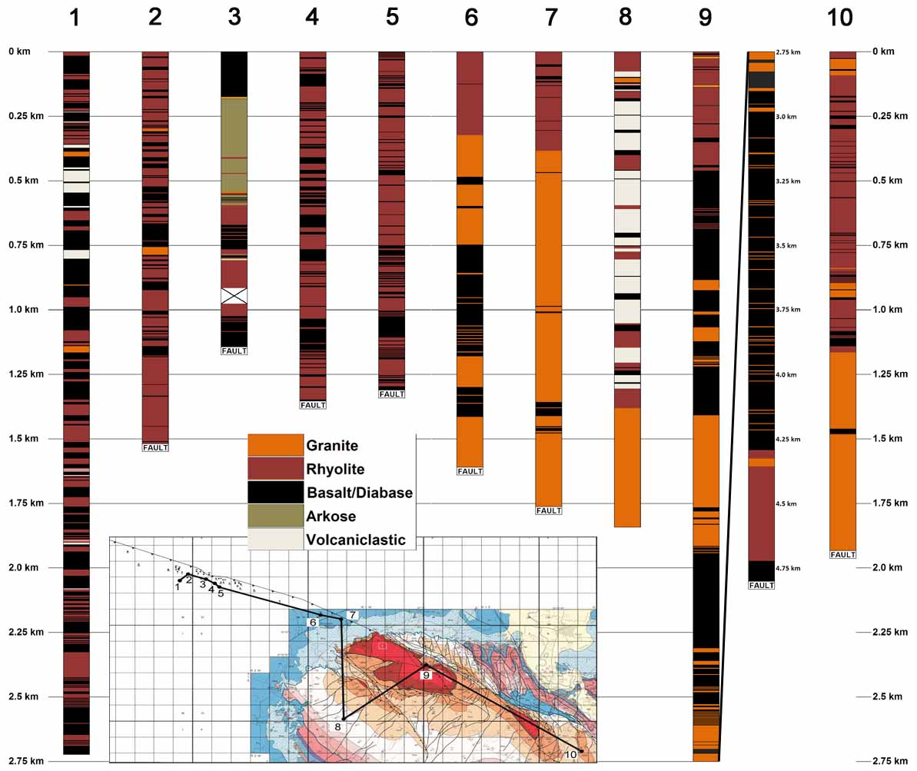
37 km Non-Correlated Cross Section

Slide 8
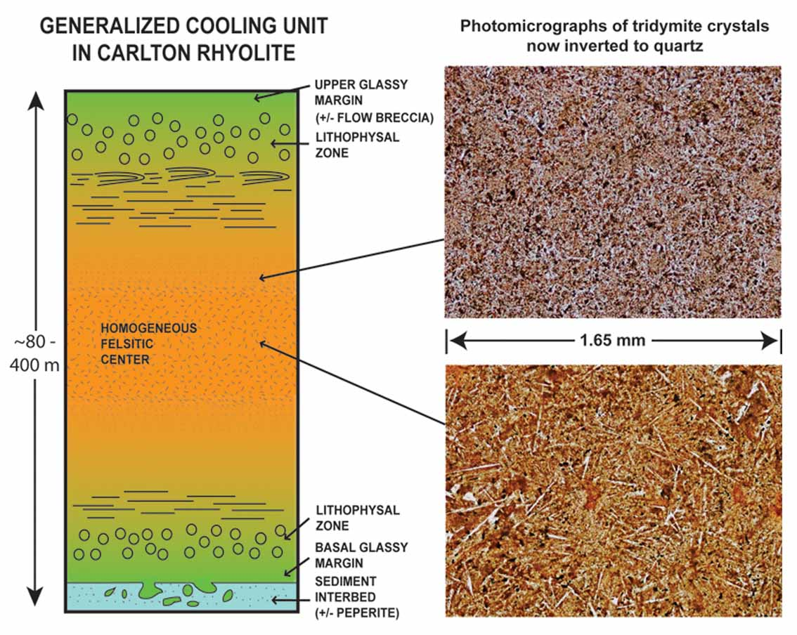
Outcrop-Based Generalized Cooling Unit Diagram
Surface Exposures of the Carlton Rhyolite in the Wichita Mountains
From Puckett et al. 2011

Slide 9
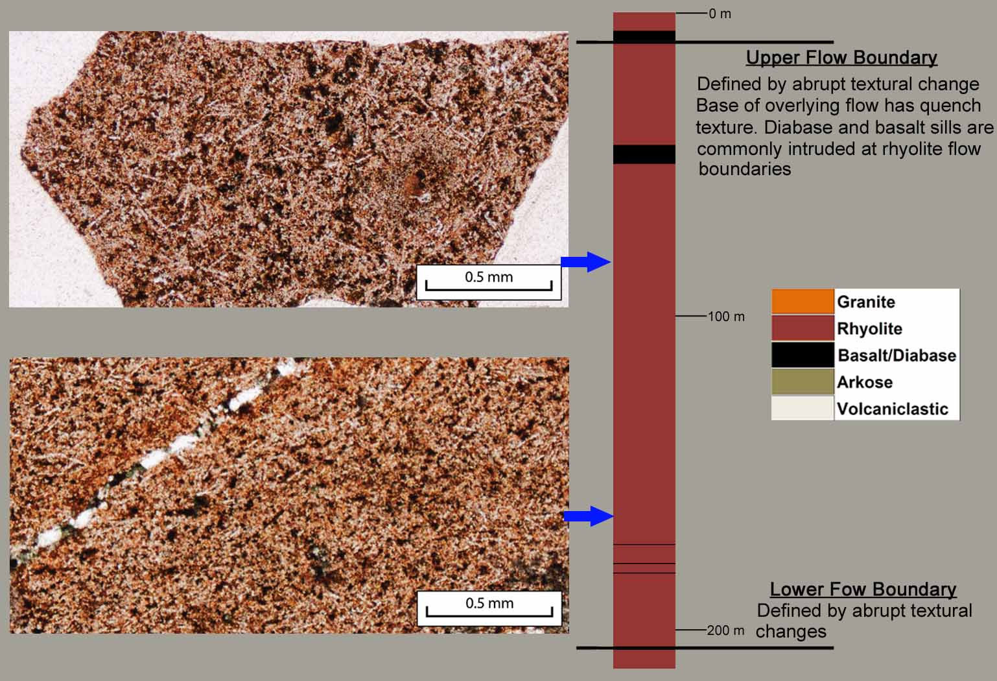
Rhyolite Cooling Unit
Pan American Oil Co. Moore #1-A Sec.20 T1N-R2W

Slide 10
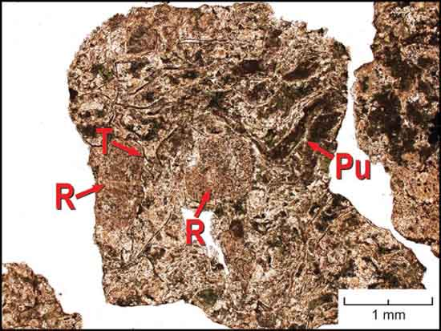
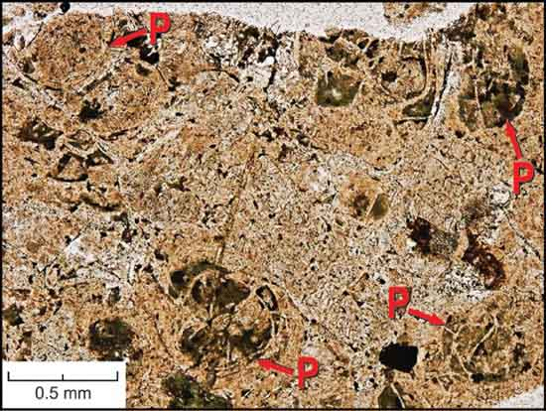
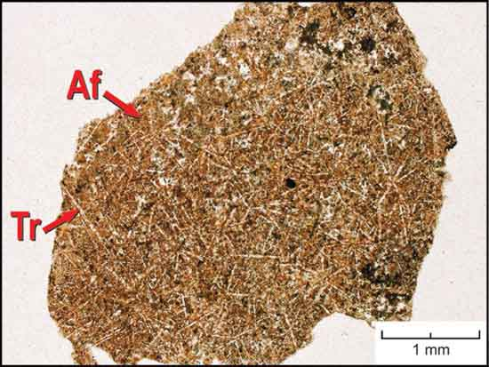
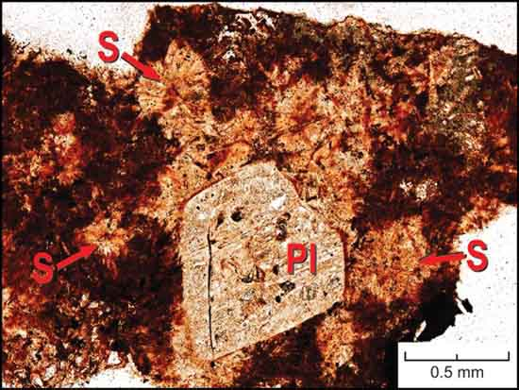
Rhyolite Photomicrographs

Slide 11
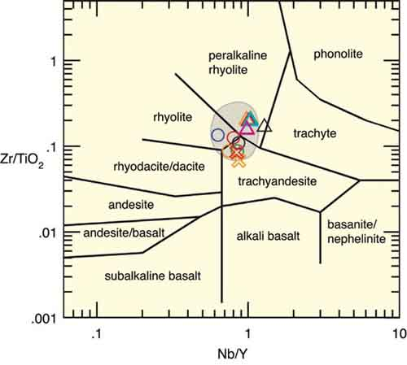
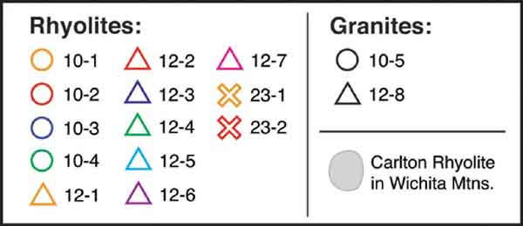
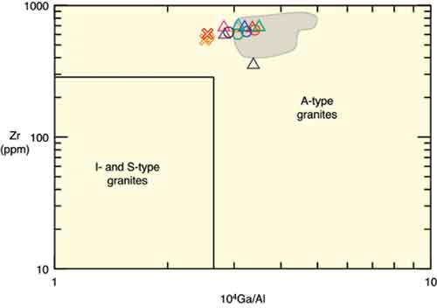
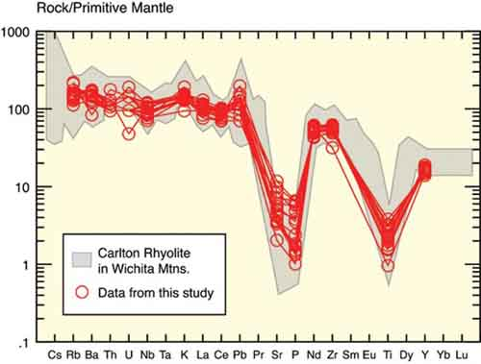
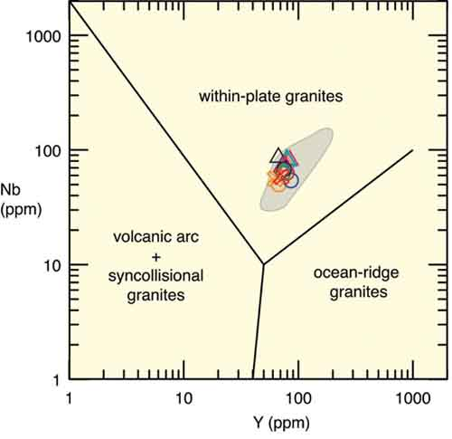
Rhyolite Geochemistry
Dominantly rhyolites and peralkaline rhyolites
Typical within Plate, A-type, consistant with
emplacement in alaucogen type setting
Highly fractionated – Depleted Sr, P, Ti - Typical A-type signature

Slide 12
37 km Non-Correlated Cross Section
Moderate to thick basalt and intermediate flows overlap in time with rhyolite production.

Slide 13
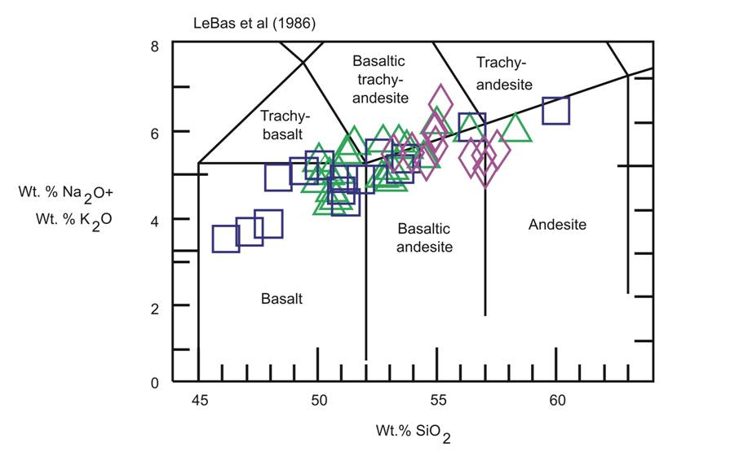
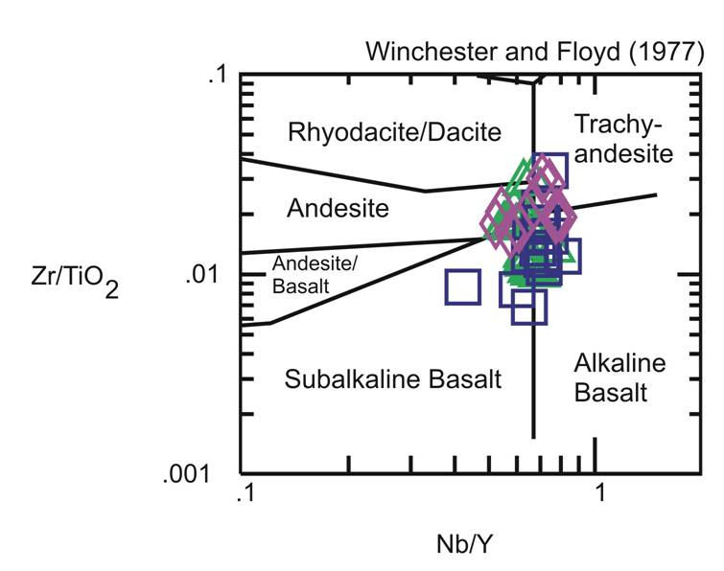
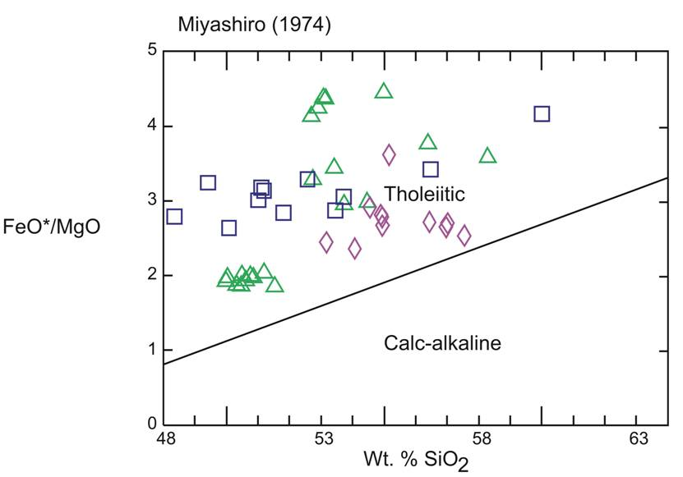

Mafic Rock Geochemistry
Samples classified as basalts to andesites
Samples classified as subalkaline-alkaline
Basalts to andesites-trachyandesites
Pan Am Newberry Sec. 13-T1N-R3W
Pan Am Williams Sec. 20-T1N-R2W
Pan Am Jarman Sec. 19-T1N-R2W
Samples plot dominantly as tholeitic basalts

Slide 14
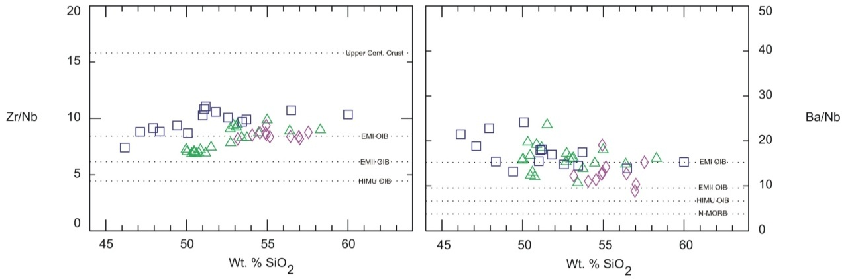
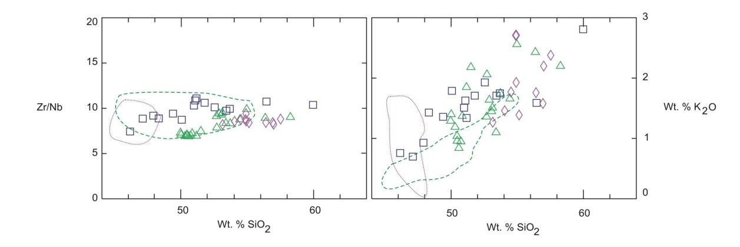
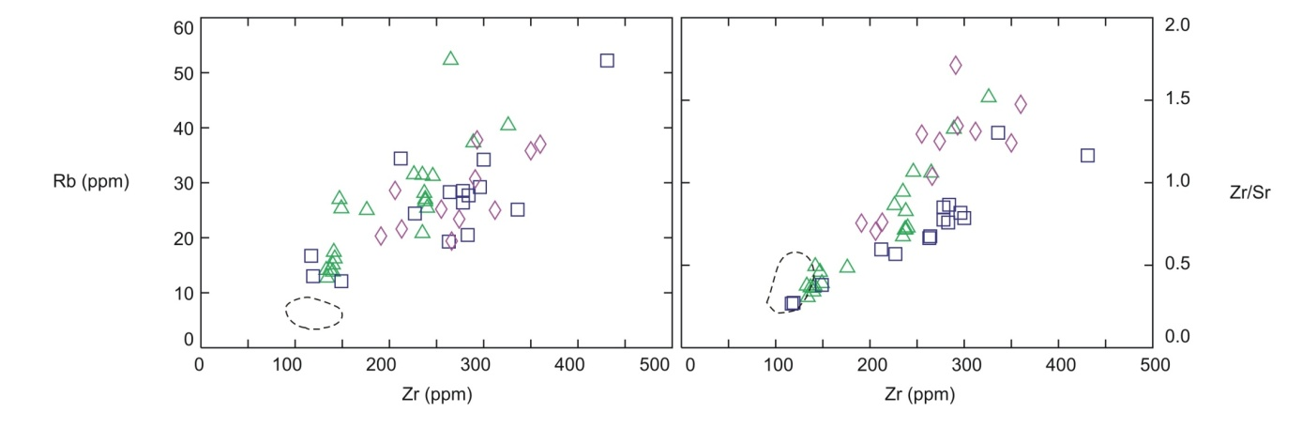
Mafic Rock Geochemistry
Consistent values with rocks sourced from EMI-OIB magma reservoir
Pan Am Newberry Sec. 13-T1N-R3W
Pan Am Williams Sec. 20-T1N-R2W
Pan Am Jarman Sec. 19-T1N-R2W
Samples compared with Wichita Mtns. mafic rocks indicating that
Roosevelt Gabbros may be intrusive equivalent of Arbuckle samples

Slide 15
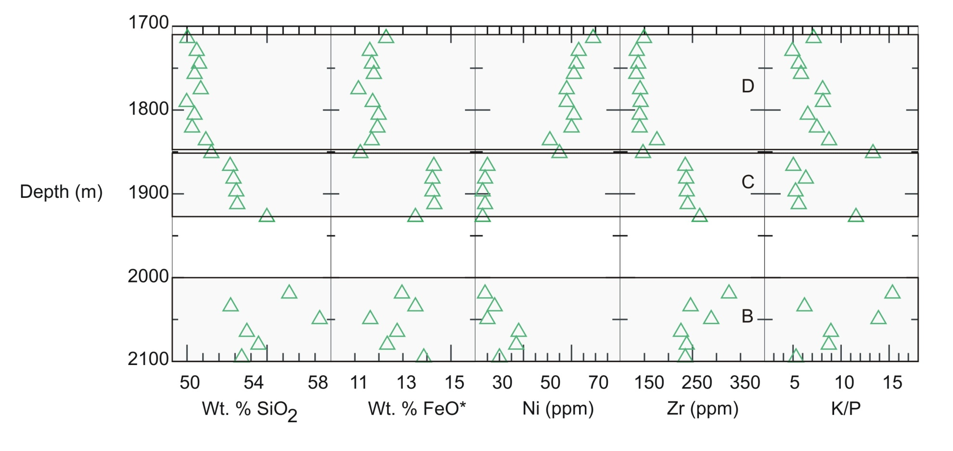
Mafic Rock Geochemistry
Chemostratigraphic Diagram
Three flow packages from Pan Am Williams well. Flow packages
can be geochemically correlated between closely space wells

Slide 16
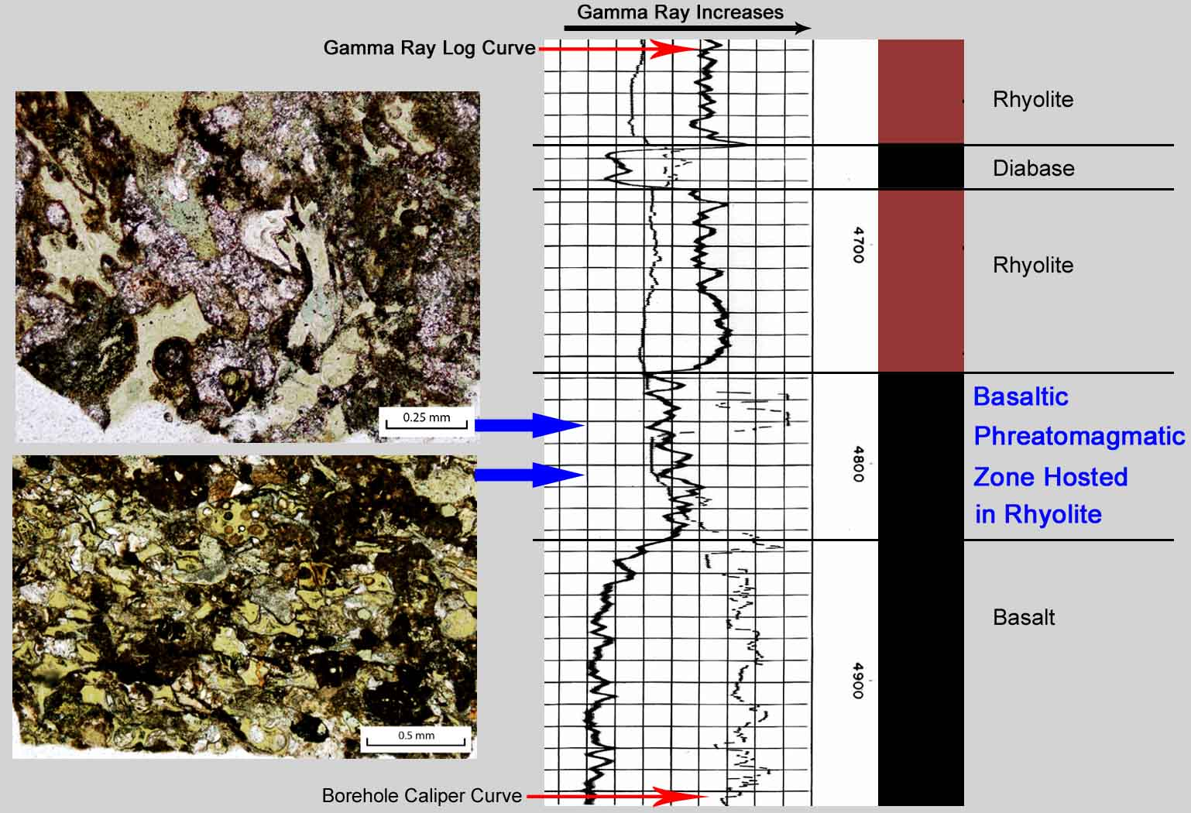
Phreatomagmatic Interval – Magma in Contact With Ground Water
Pan American Oil Co. Whyte #1 Sec. 21-T1N-R1W

Slide 17
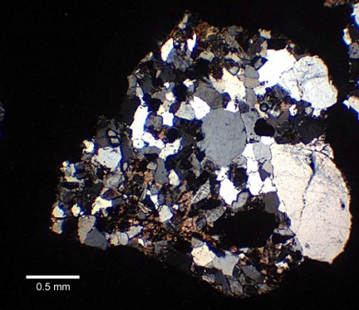
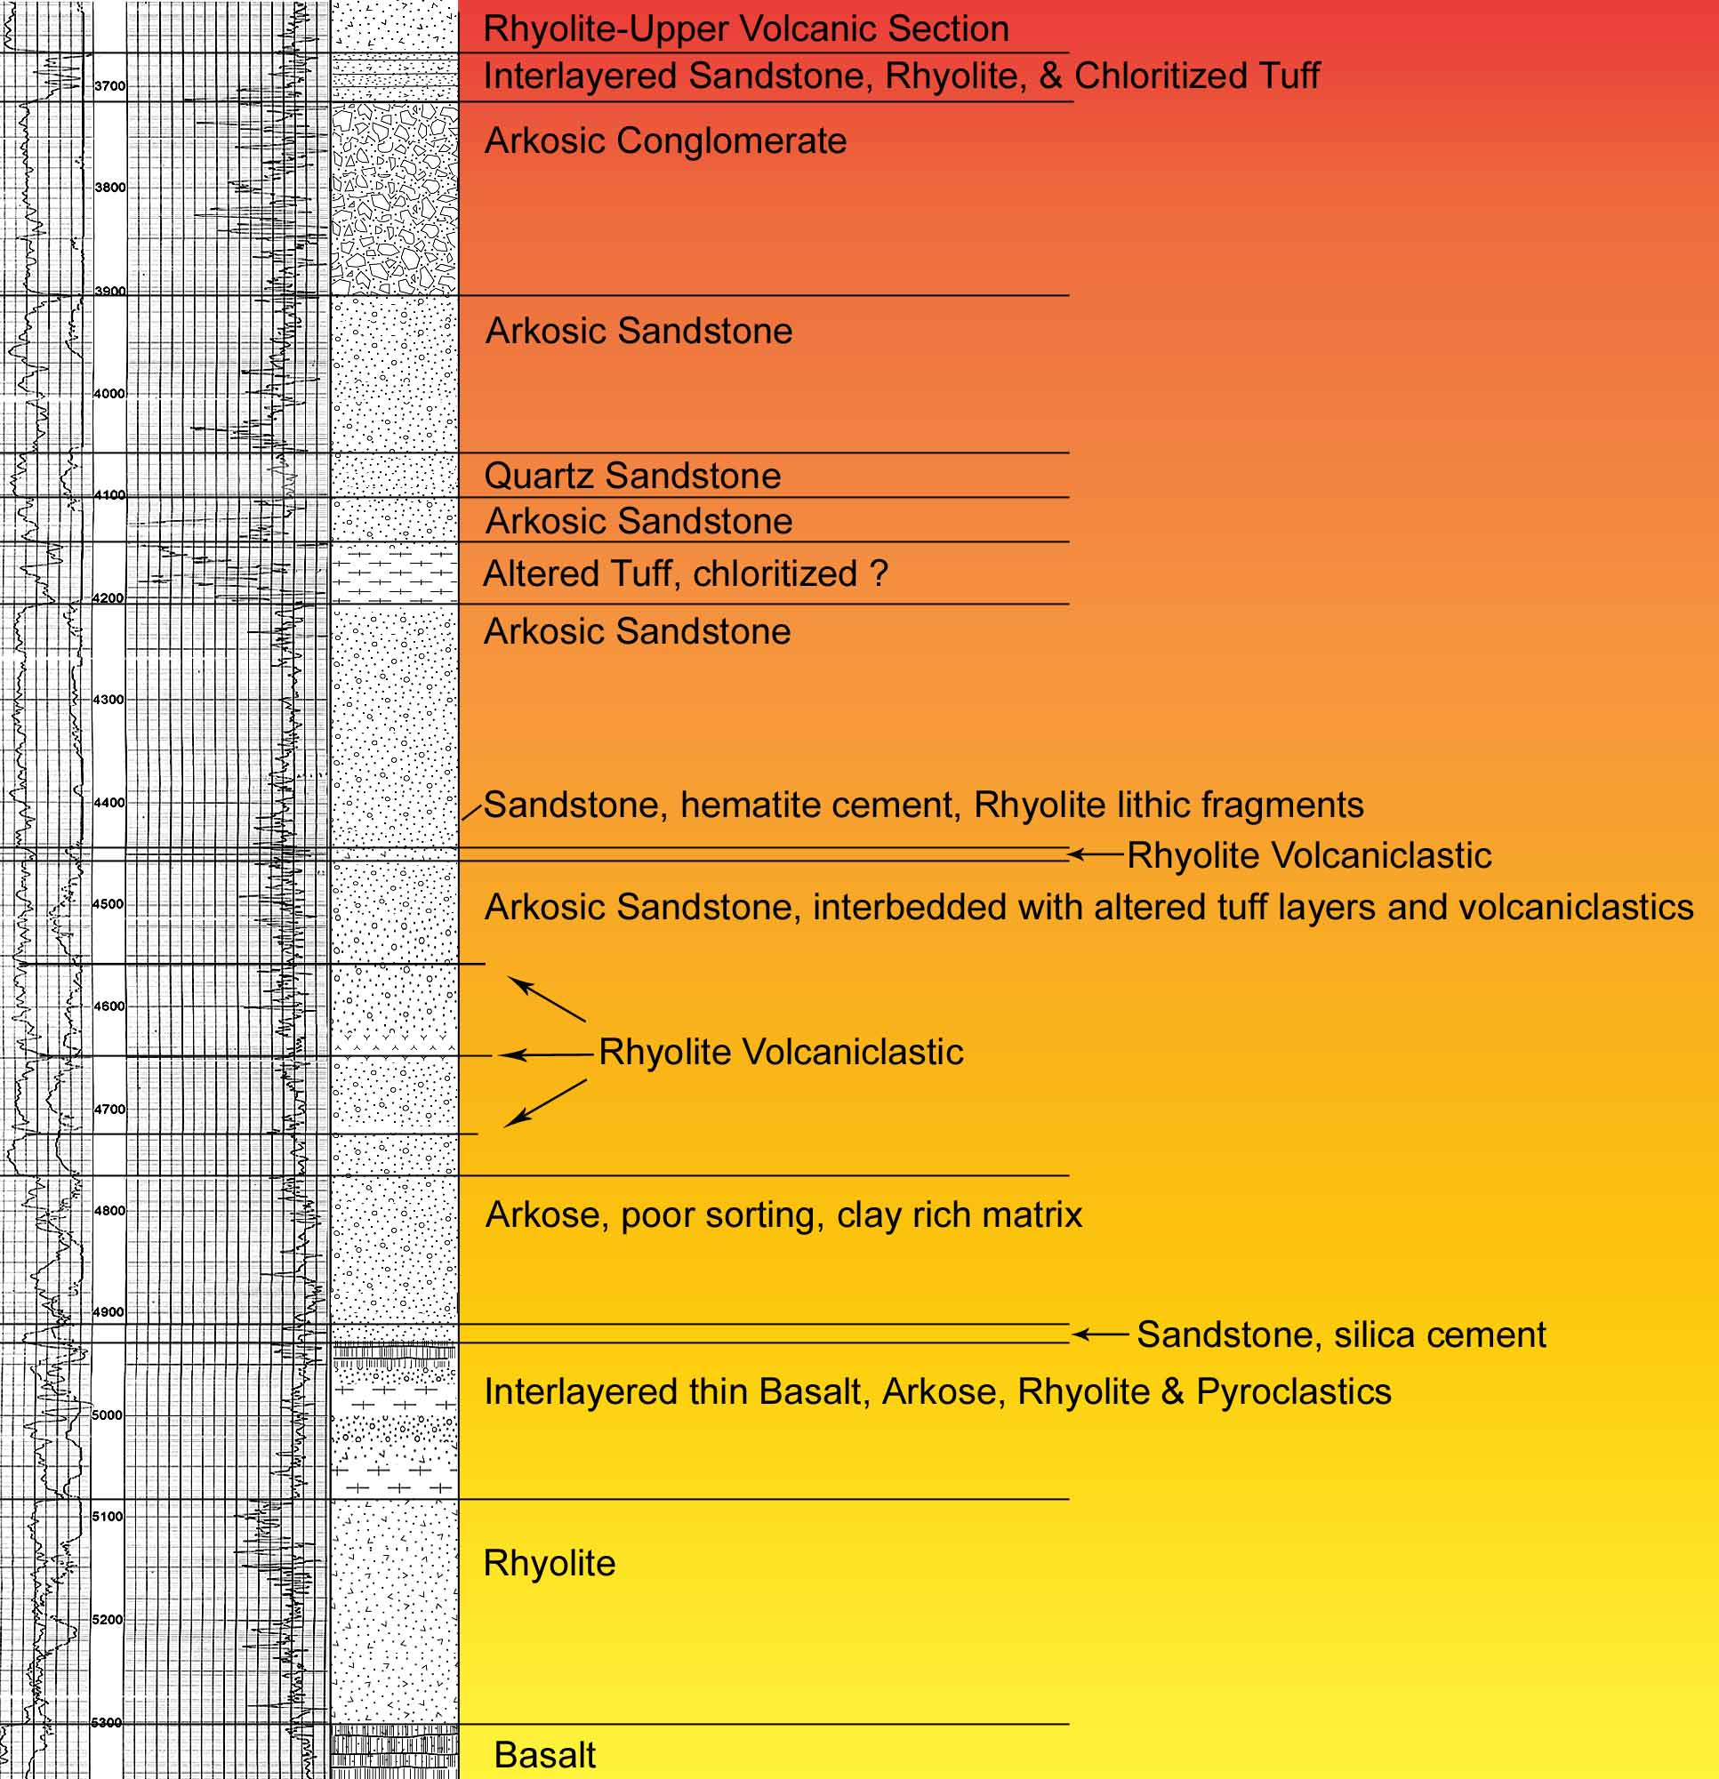
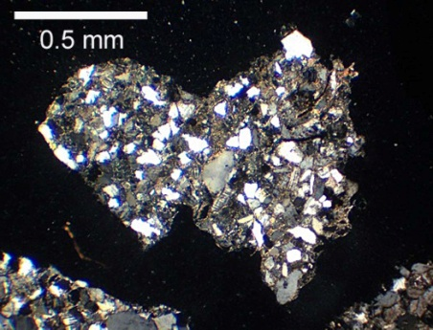
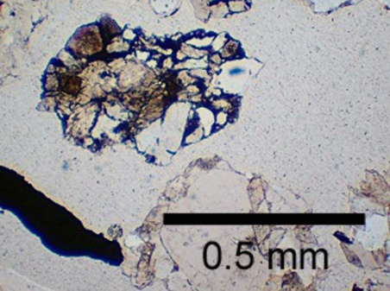
(182 m to eroded top of volcanic section)
395 m
Clastic Interval
Pan Am Jarman #1
Sec. 24-T1N-R3W

Slide 18
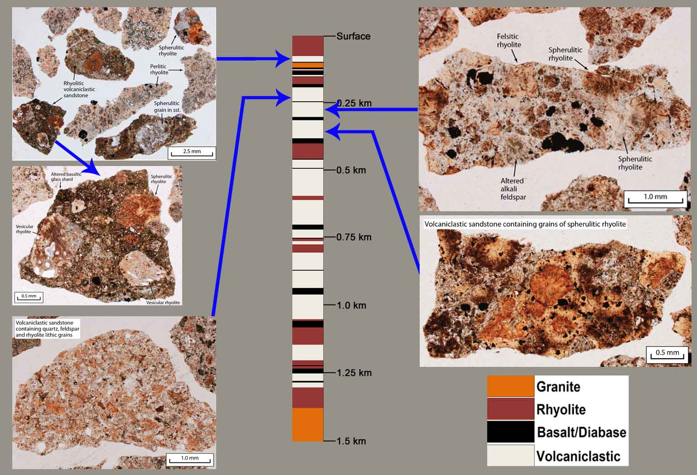
792 m Cumulative Volcaniclastic Interval Intercalated with Rhyolite
Frankfort Oil Co. Sparks Ranch #1 Sec. 32-T1S-R1W

Slide 19
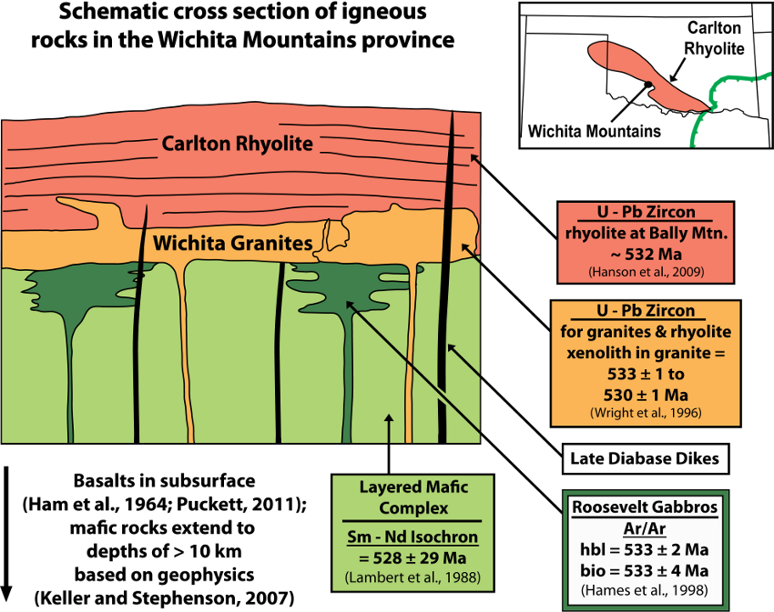
Schematic Igneous Stratigraphy, Wichita Mountains
Hanson et al. 2011
Modified from Hogan and Gilbert, 1998

Slide 20
37 km Non-Correlated Cross Section

Slide 21
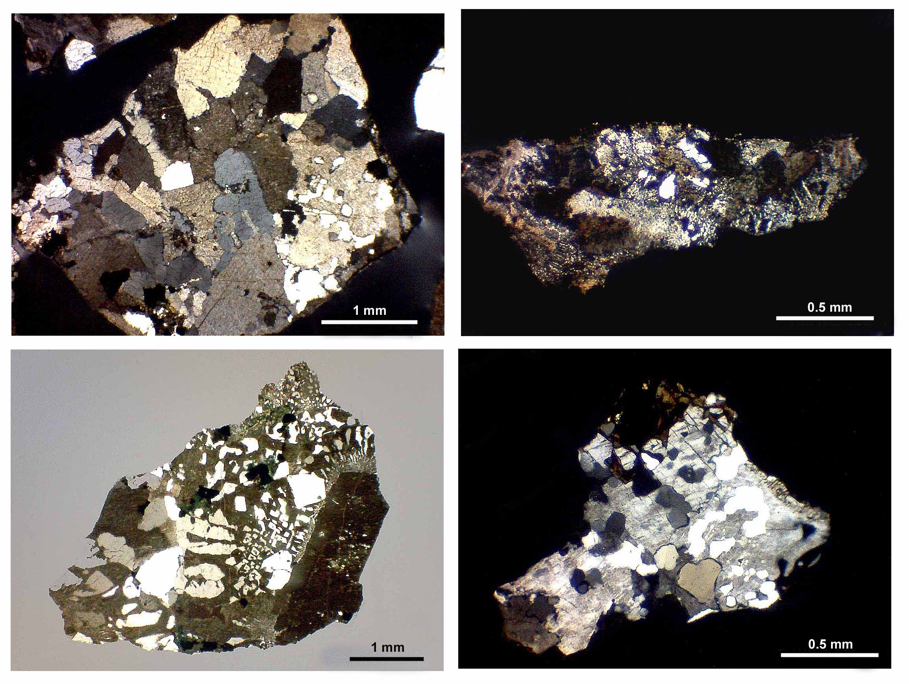
Representative Wichita Granite Textures from Arbuckle Basement Wells

Slide 22
Summary
The Southern Oklahoma Aulacogen contains a minimum emplaced volume of
250,000 km³.
Igneous activity was strongly bimodal and voluminous.
Felsic magmas were A-type, mafic magmas have an EMI-OIB signature.
Mafic and Felsic volcanism phases overlap.
Eruption products are lava-dominated - Rhyolitic pyroclastic deposits are limited to
thin beds between flows - Basalt pyroclastics originate from phreatomagmatic
eruptions.
Cratonic-sourced sedimentation into the rift was active during volcanism
In the Spring of 2014 a two-day Field Seminar will be hosted by the Oklahoma Geological Survey on rift-related igneous rocks in the Arbuckle and Wichita Mountains outcrop areas.

