Slide 1
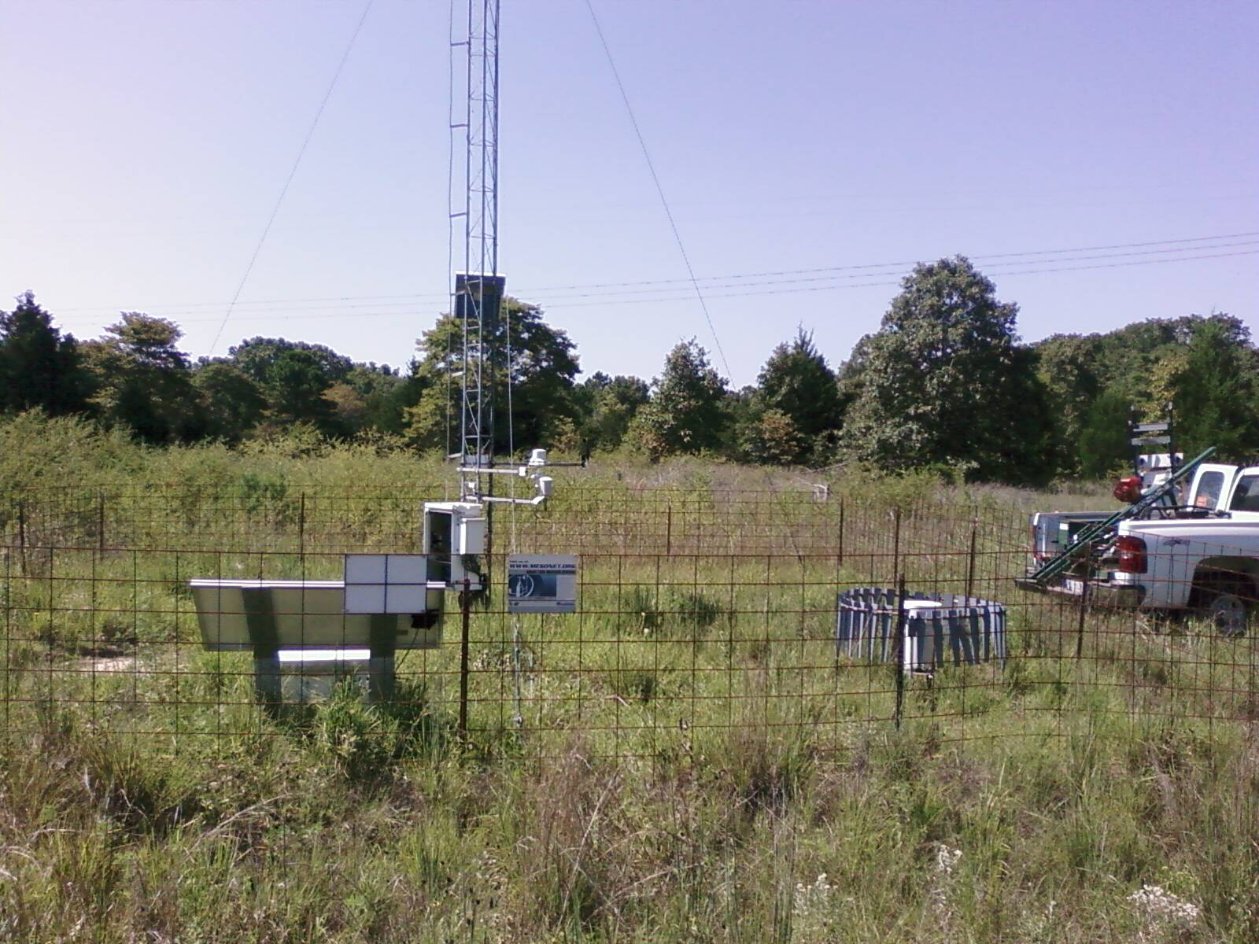
Estimating Groundwater Recharge Using the Oklahoma Mesonet
Sam Wallace
Undergraduate, OSU Dept. Environmental Science
Dr. Tyson Ochsner
Assistant Professor of Soil Physics, OSU Dept. Plant and Soil Sciences

Slide 2
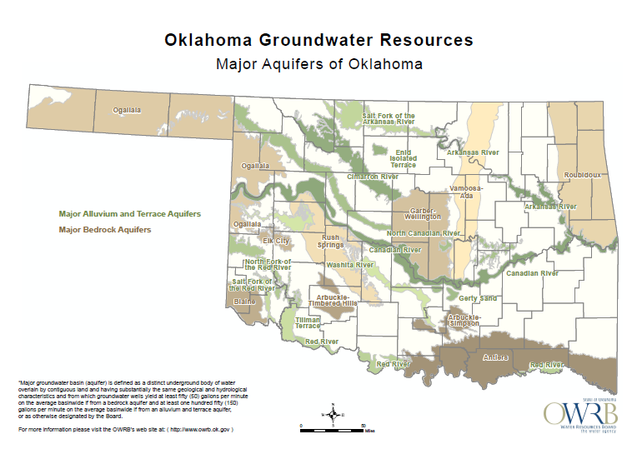

Slide 3
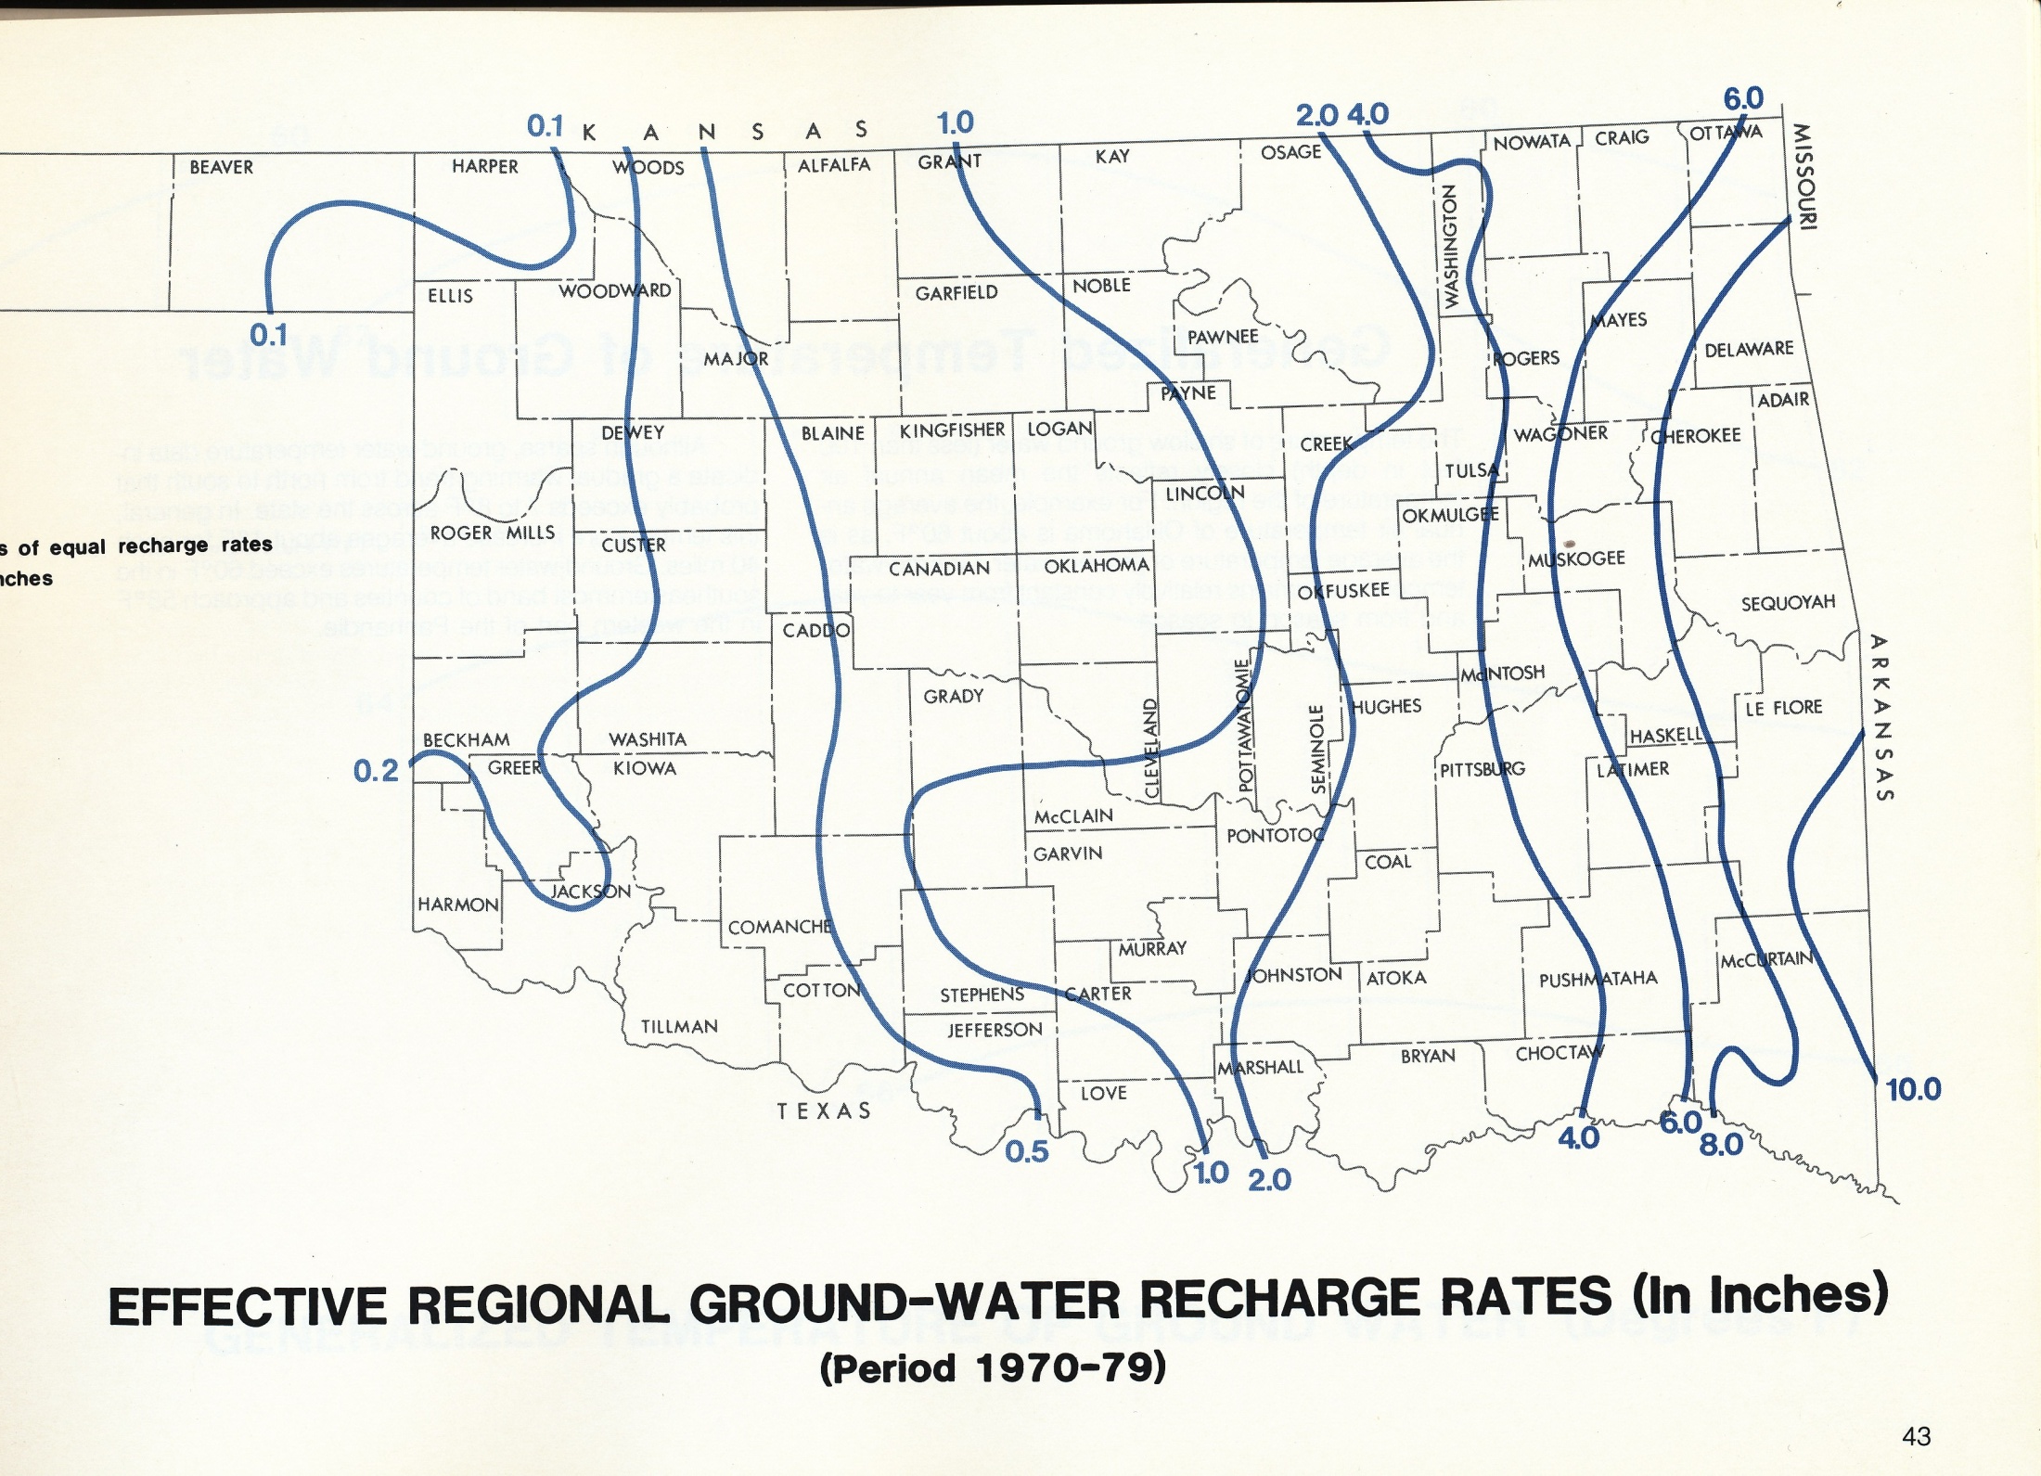
Source: Oklahoma Water Atlas, 1983

Slide 4
Groundwater Monitoring
USGS monitoring wells/streamflow gauges
Real-time monitoring wells
Daily groundwater monitoring
Real-time stream flow gauges
Water Table Fluctuation Method
Water Budget Method

Slide 5
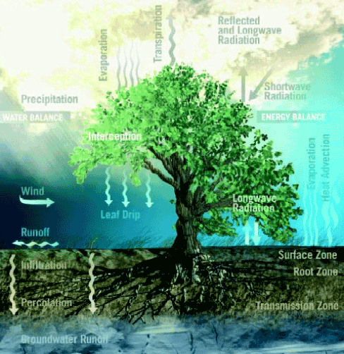
Notes:
How does knowing what groundwater recharge was weeks or months ago help us here?

Slide 6
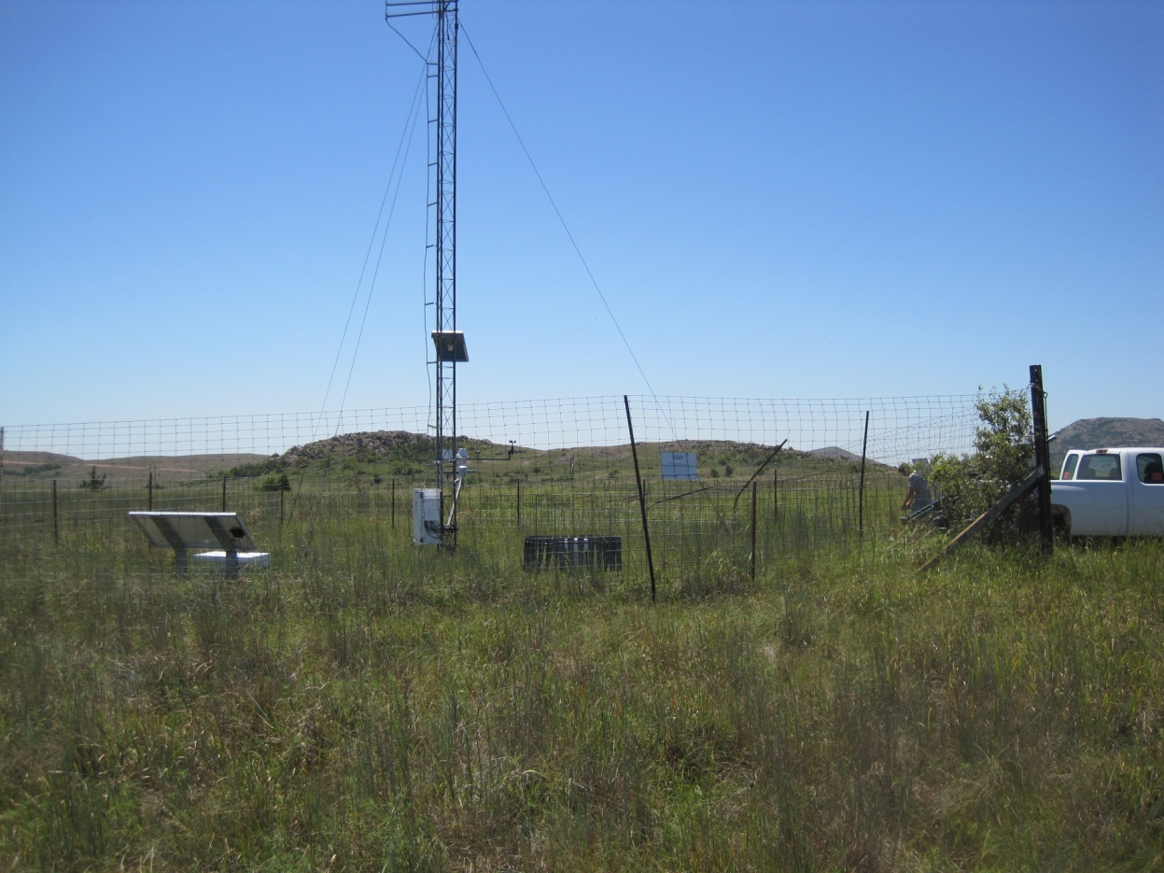

Groundwater Recharge Evaluation through Soil Moisture
Established statewide monitoring network
Long history of monitoring (since 1994)
Soil moisture monitoring at 5, 25, and 60 cm

Slide 7
Our Study
Five Mesonet stations: Acme, El Reno, Fittstown, Shawnee, Spencer
Chosen for availability of both soil moisture sensors and groundwater wells.

Slide 8
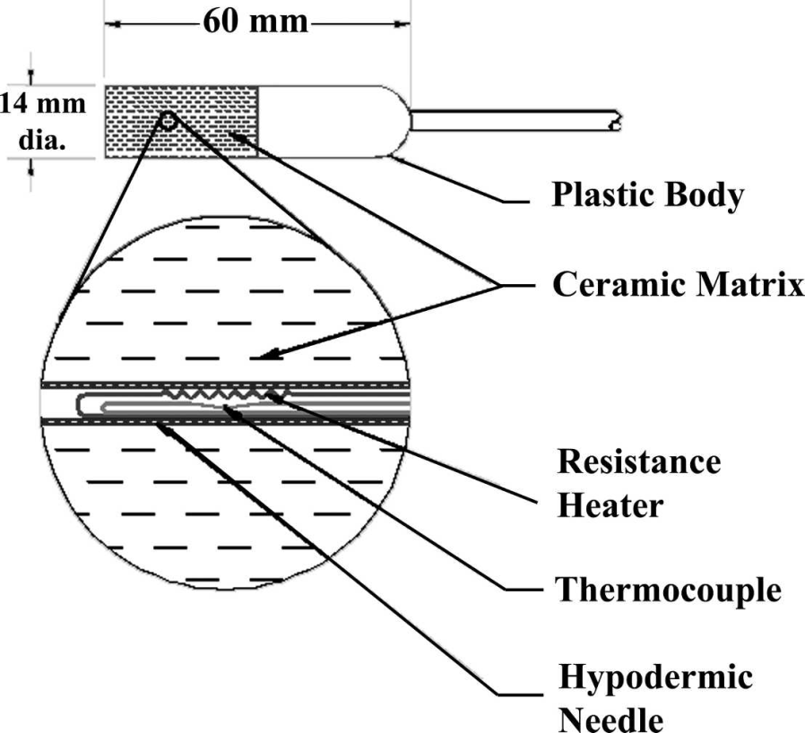
Methods
Mesonet temperature reference values converted to matric potential
Soil hydraulic parameters calculated using ROSETTA
Source: Illston et al., 2008

Slide 9
Methods
Volumetric Water Content
Effective Saturation
Hydraulic Conductivity
Buckingham-Darcy Equation
Where:
q= water flux- groundwater recharge
K(S_{e})= hydraulic conductivity
S_{e}= water content
h= matric potential
z= depth
θ(h) = volumetric water content θ_{r} = residual water content θ_{s} =saturated water content α = fitting parameter n = a measure of the pore-size distribution
K₀ = a fitting matching point at saturation
L = empirical parameter

Slide 10
Results
Table 1: Mean annual precipitation (P), drainage at 60 cm (D), and the ratio D/P for five Mesonet stations using data from 1999 through 2011. For comparison, prior estimates of the ratio of groundwater recharge (R) to P are also shown.
Station | Precip. (P) | Drainage (D) | D/P | Aquifer | Prior R/P | Reference
 | mm | mm | % |  | %
Acme | 768 | 77 | 10 | Rush Springs | 10 | Tanaka and Davis (1963)
El Reno | 817 | 42 | 5.1 | N. Canadian | 4.7 | Daniel (1999)
Fittstown | 917 | 97 | 11 | Arbuckle-Simpson | 12-14 | Fairchild et al. (1990) Christenson et al. (2011)
Shawnee | 864 | 28 | 3.2 | Garber-Wellington | 5-10 | Wood and Burton (1968) Carr and Marcher (1977)
Spencer | 895 | 108 | 12 | Garber-Wellington | 5-10 | Wood and Burton (1968) Carr and Marcher (1977)
Mean | 852 | 70 | 8.3 |  | 8.5

Slide 11
Results

Slide 12
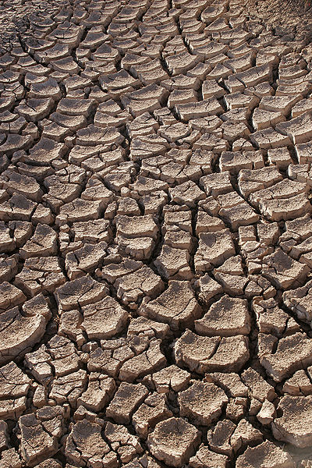
Discussion
Limitations in this new method
No upward water flow
Time lag varies with site, weather
Promising results
Comparable to historical averages
Calculated drainage events correspond to observed water table rises
As always, further research needed
Does this method work in the extremes of the state?
Mechanics of time lag
Source: Wikimedia

Slide 13
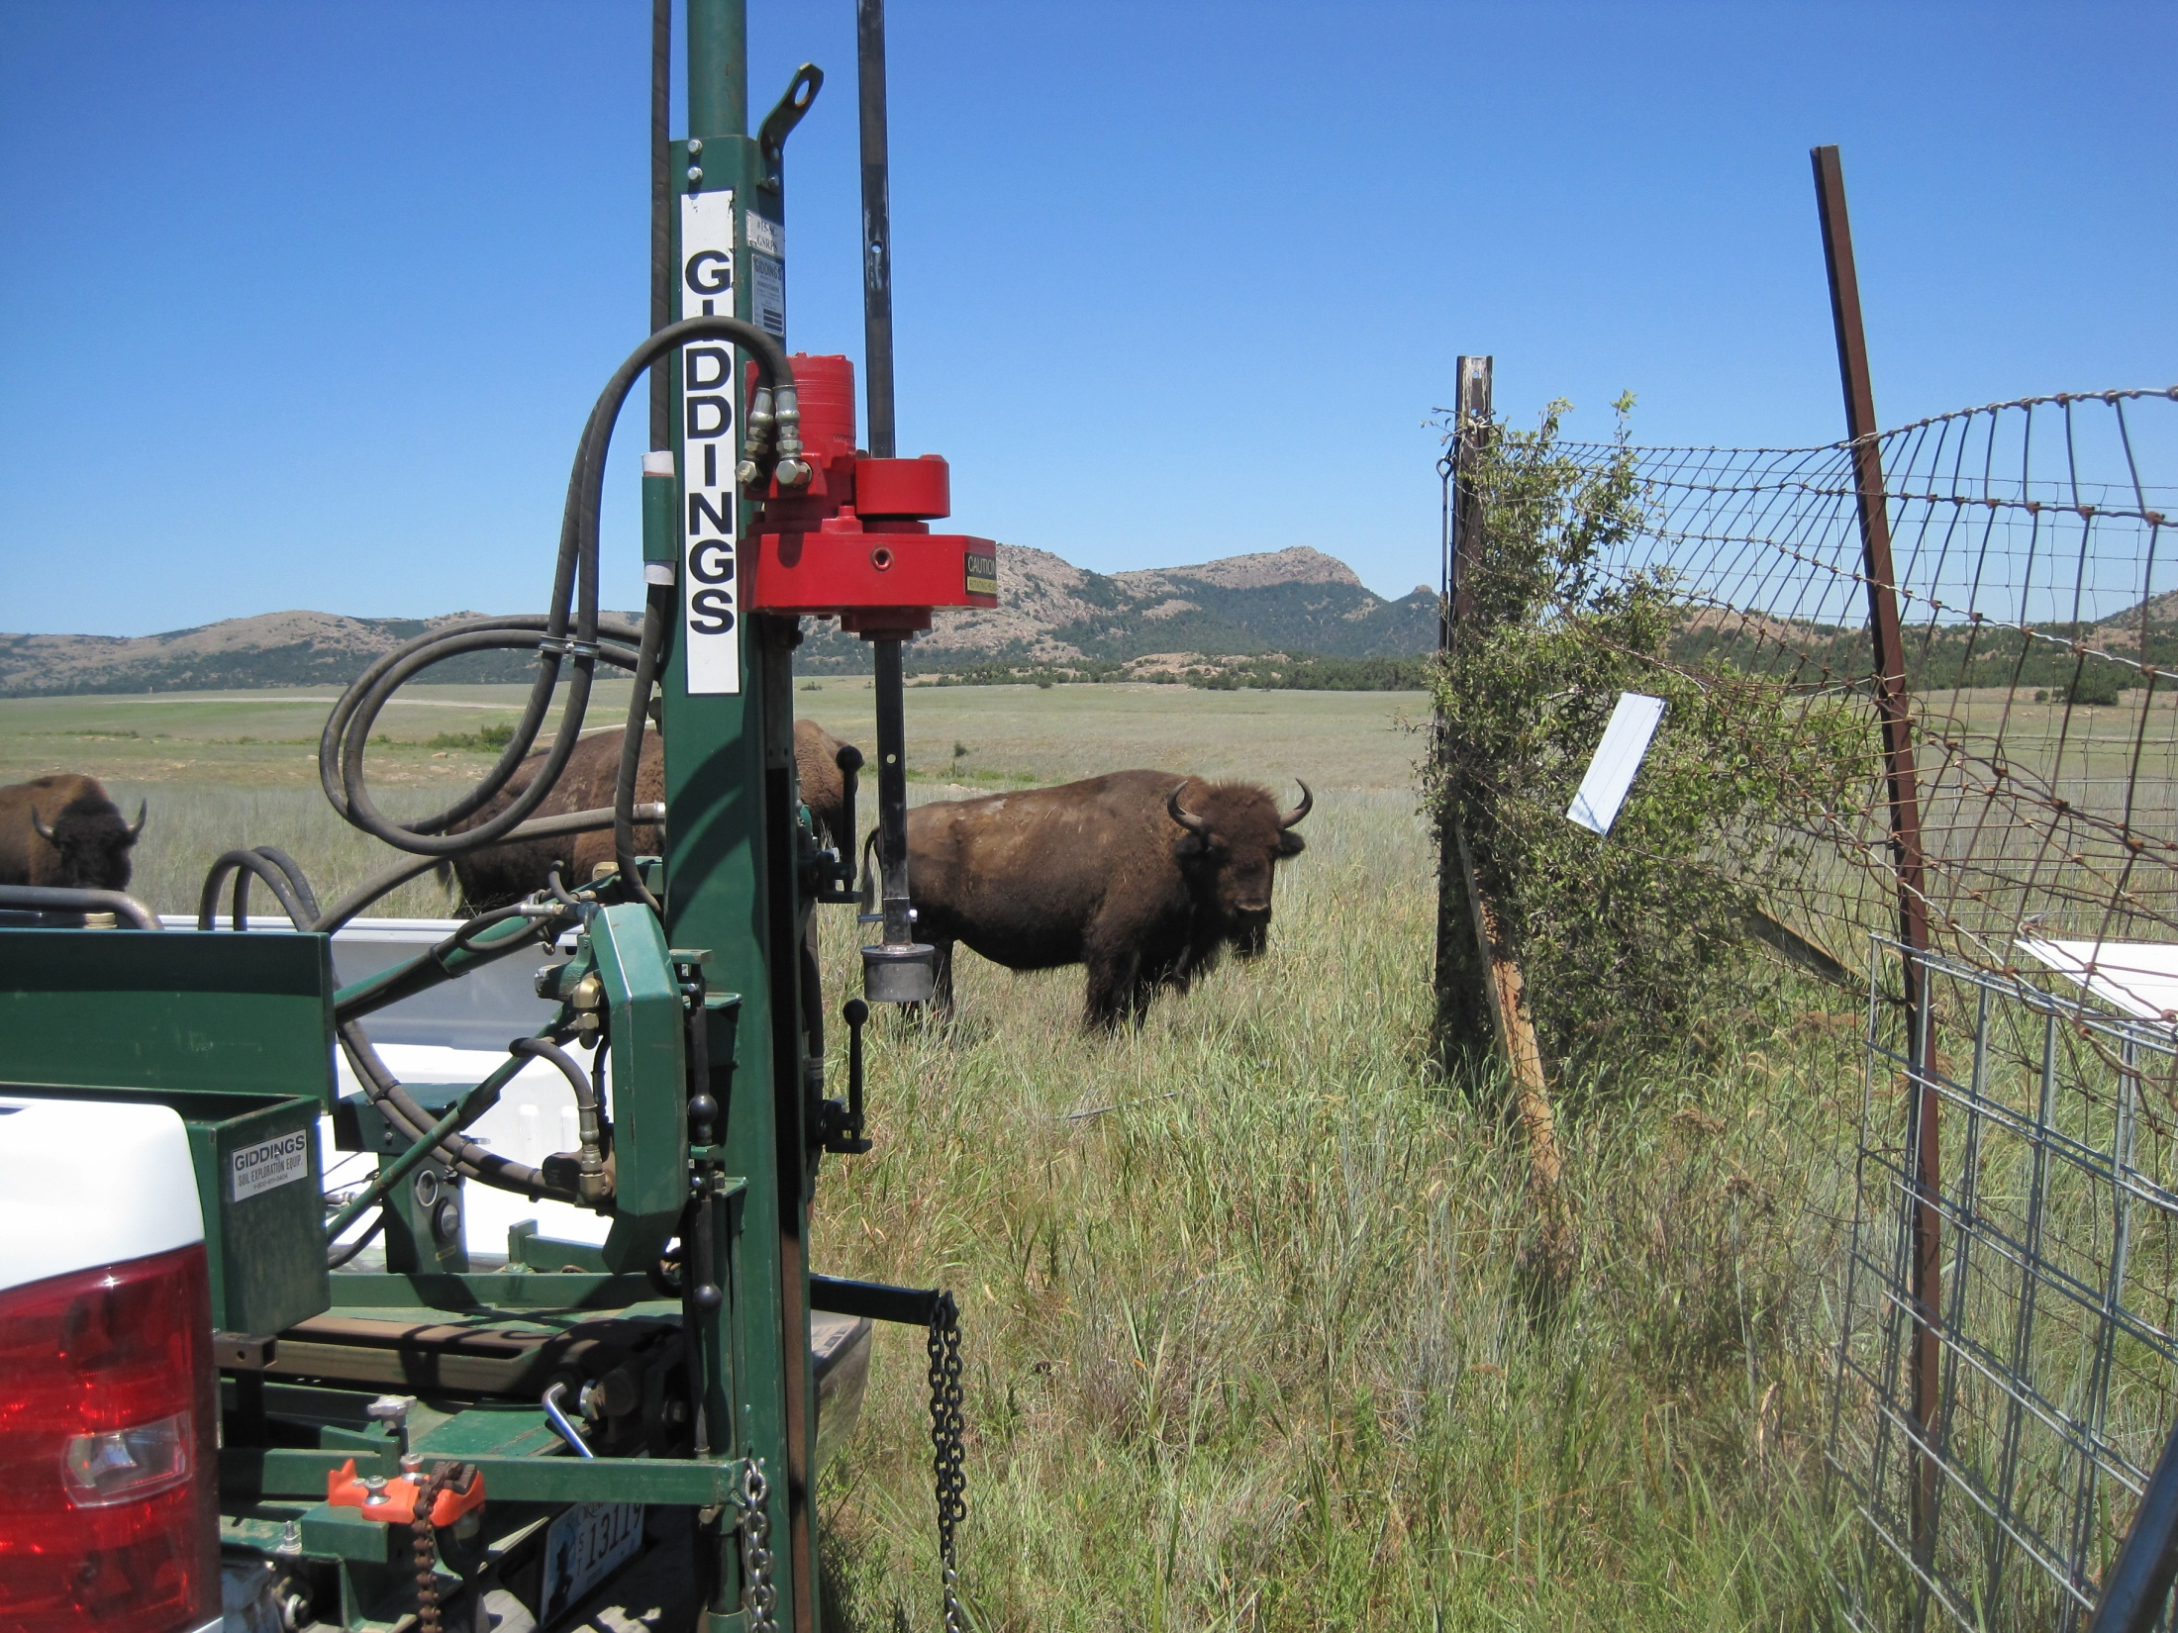
Acknowledgements
I would like to thank the following sponsors:
Oklahoma State University Freshman Research Scholars Program
Oklahoma State University Wentz Research Project
EPA Greater Research Opportunities for Undergraduates Fellowship

