Slide 1
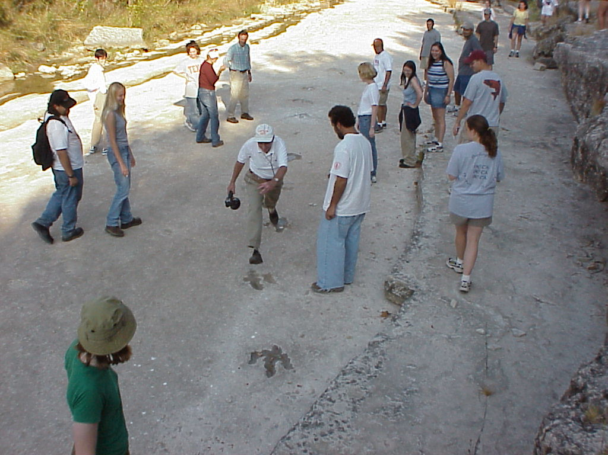
Continuing Leon Long’s Legacy Innovations in geoscience teaching
Laurie Schuur Duncan and Hilary Clement Olson
University of Texas at Austin
Jackson School of Geosciences
Contact us at laurieduncan@jsg.utexas.edu and hilaryclementolson@gmail.com
Notes:
Photo courtesy of Leon E Long

Slide 2
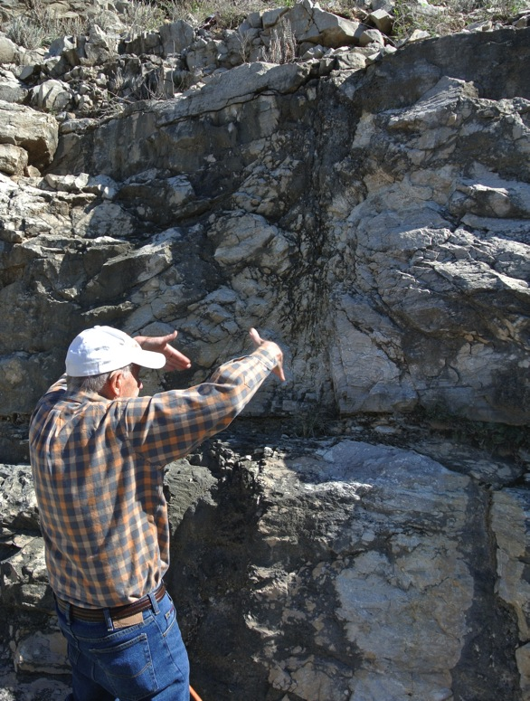
Continuing Leon Long’s Legacy
Preservation of pedagogy High stakes for geoscience teachers What can we learn from a master teacher? Relationships Relevance Rigor Leon’s advice
Notes:
The three R’s of modern education are from the International Center for Leadership in Education: http://www.leadered.com/index.html, Photo by Laurie Schuur Duncan

Slide 3
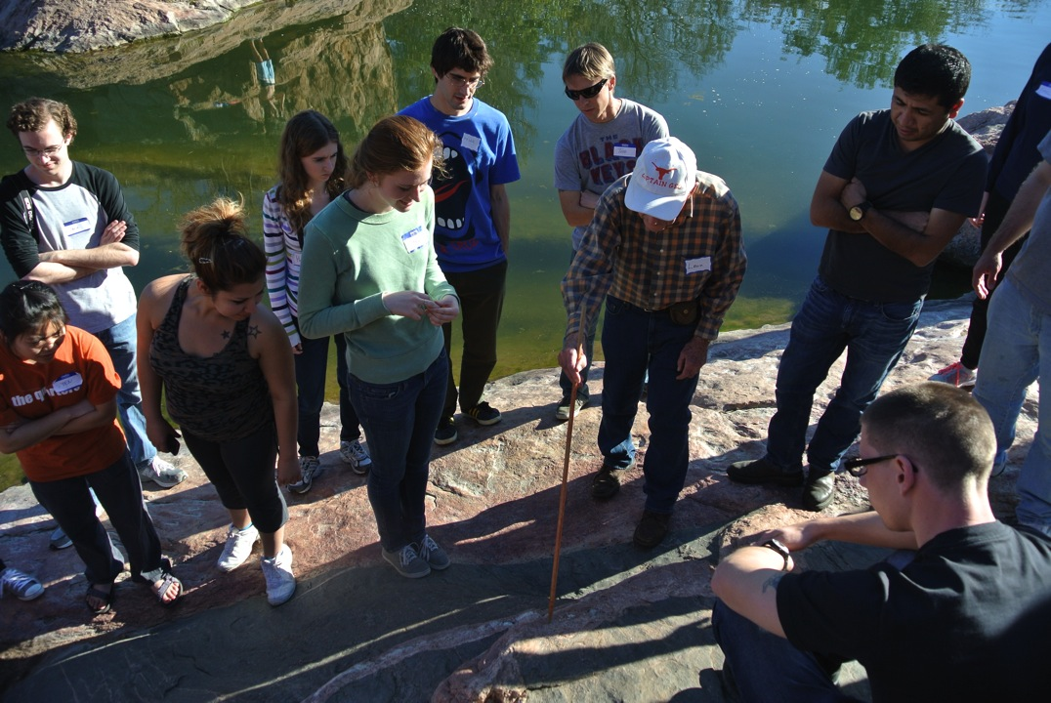
Preservation of Pedagogy
This is the best way to teach and learn geology.
Captain Geo explaining cross-cutting relationships among dikes in the Valley Spring Gneiss at Inks Lake State Park, TX
Notes:
Photo by Laurie Schuur Duncan

Slide 4
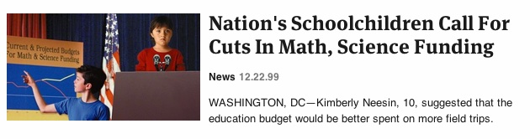

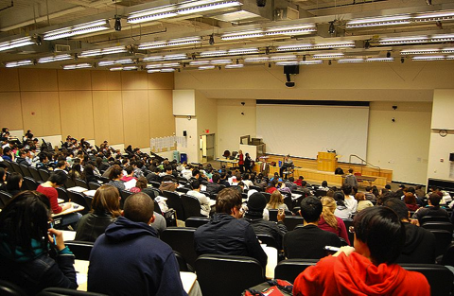
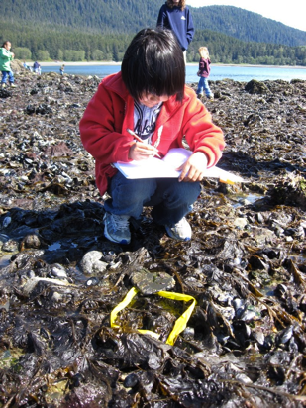
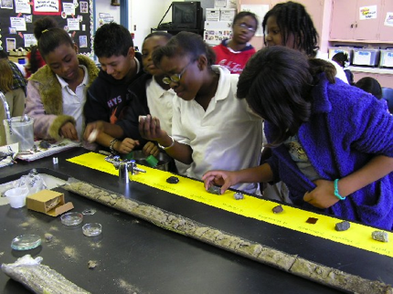
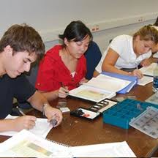
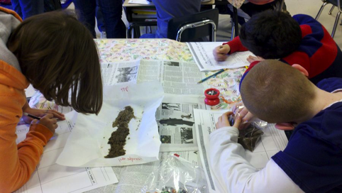
Preservation of Pedagogy
What is the best way to teach geology in other settings?
To different audiences? With our own personal styles?
Notes:
Tulane geoscience lab: http://tulane.edu/sse/eens/courses/physical-geology-laboratory.cfm, Cal State University Bakersfield, summer program http://www.csub.edu/geology/nsf_summer04.htm, Alaska teacher workshop project: http://geointegrations.blogspot.com/

Slide 5
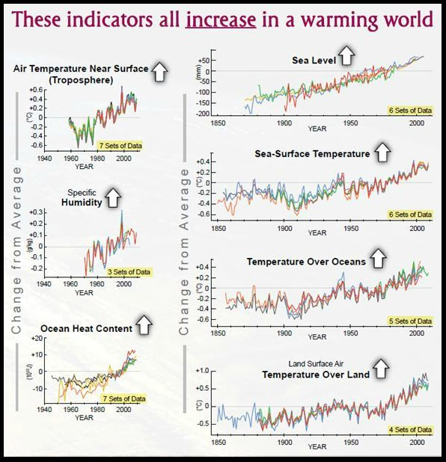
High stakes for geoscience teachers
NOAA State of Climate Change Report 2009
Notes:
Figure from the Union of Concerned Scientists’s webinar on “Bridging the Gap in Understanding Climate Change”: https://s3.amazonaws.com/ucs-webinars/Bridging%20the%20Gap%20in%20Understanding%20Climate%20Change/lib/playback.html

Slide 6
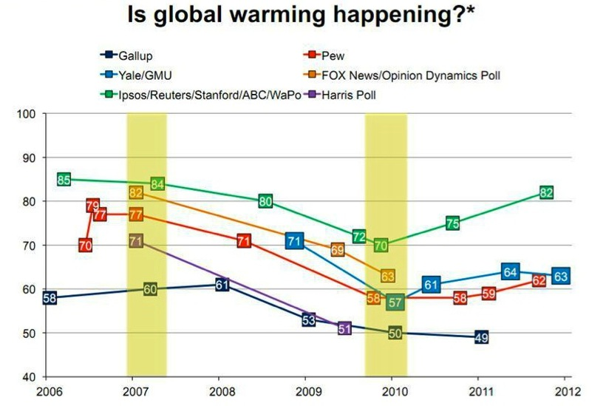
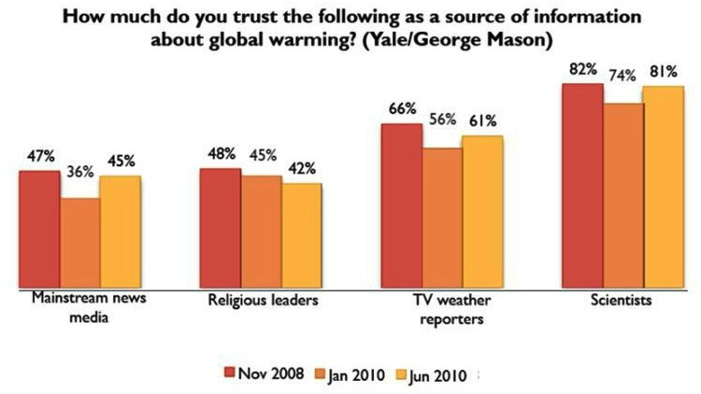

High stakes for geoscience teachers
“The public’s appreciation for science is a mile wide and a nanometer thick”
- Michael Turner, physicist
Notes:
Quote and figure from the Union of Concerned Scientists’s webinar on “Bridging the Gap in Understanding Climate Change”: https://s3.amazonaws.com/ucs-webinars/Bridging%20the%20Gap%20in%20Understanding%20Climate%20Change/lib/playback.html

Slide 7
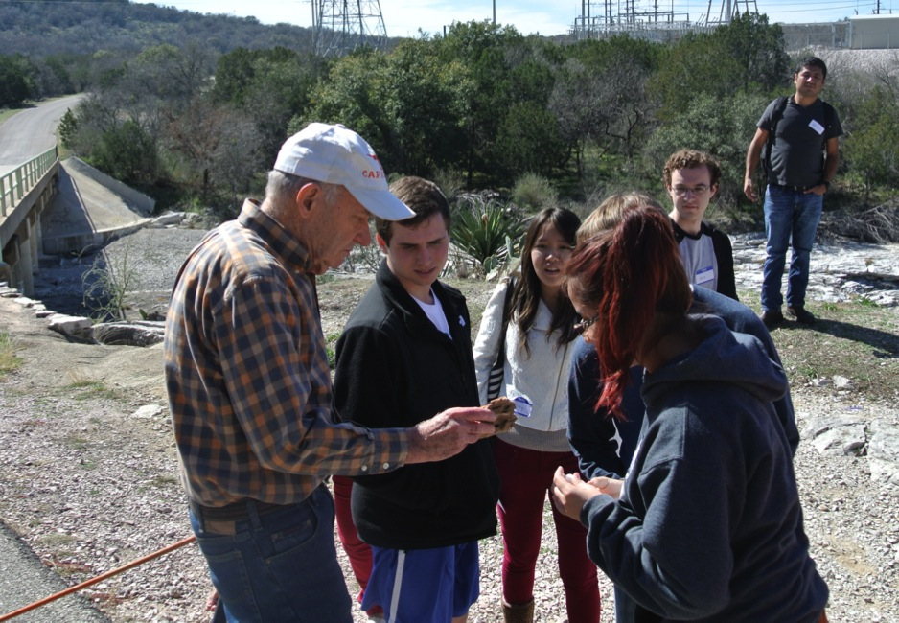
What can we learn from a master teacher?
# 1. Relationships are the foundation.
“I always marveled at the time Leon spent talking to students, until I realized one day, he wasn’t talking to them. He was listening to them.” – Professor Dan Barker, UTDGS
Notes:
Quote from “CAPTAIN GEO: LEON LONG’S FIVE DECADES AS TEACHER, SCIENTIST, AND MENTOR,” by Marc Airhart: http://www.jsg.utexas.edu/news/2012/11/captain-geo-leon-longs-five-decades-as-teacher-scientist-and-mentor/

Slide 8
What can we learn from a master teacher?
# 2. Relevance: Topics that are personally meaningful are more interesting.
Notes:
Data courtesy of Leon E Long

Slide 9

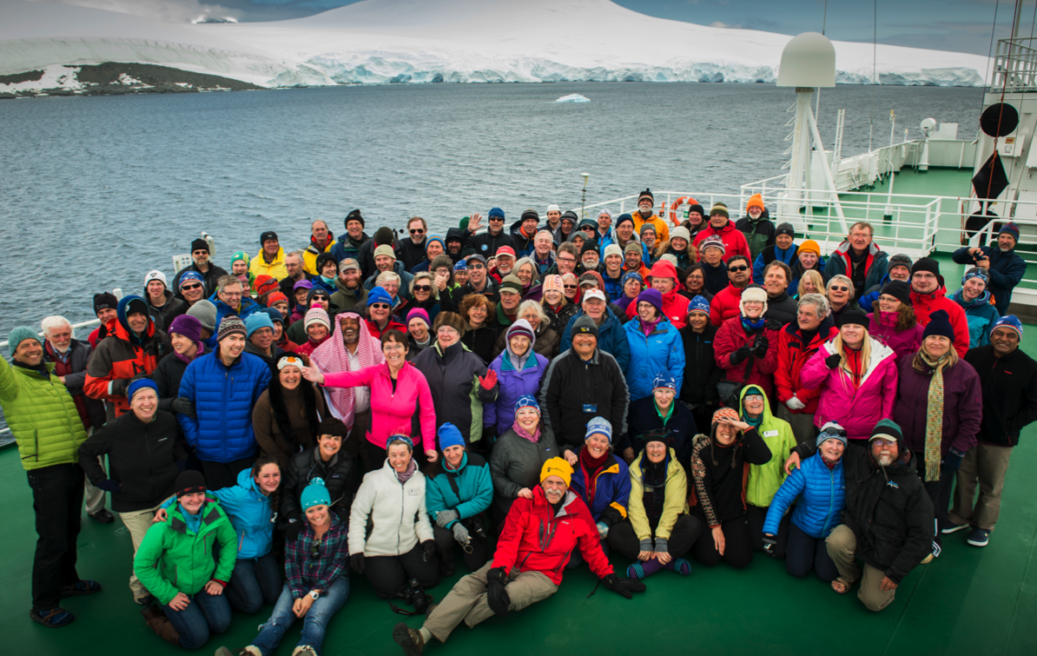
What can we learn from a master teacher?
# 2. Relevance: Exuberance is infectious.
125th Anniversary Expedition of the Geological Society of America, Antarctica
Notes:
http://geosociety.files.wordpress.com/2013/01/antarctica-and-scotia-arc-tectonics-jsg-gsa-group-photo-2.jpg

Slide 10
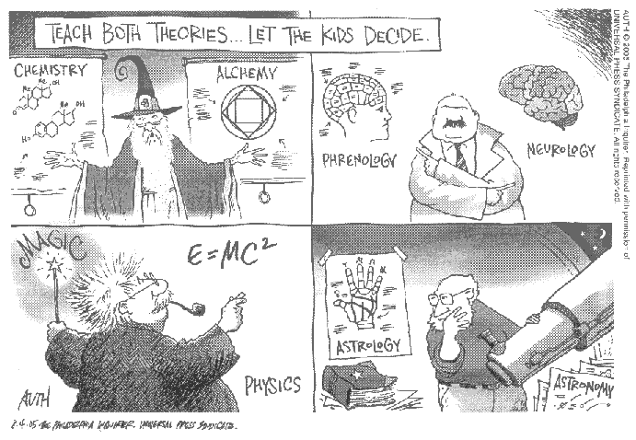
What can we learn from a master teacher?
# 3. Relevance and rigor: Science is a discipline.
Notes:
http://link.springer.com/article/10.1007/s12052-010-0298-x/fulltext.html

Slide 11
What can we learn from a master teacher?
# 3. Rigor: Sometimes it is good to struggle.
Question #5 from Chapter 18 on Structural Geology
In GEOLOGY by Leon Long, 15th edition

Slide 12
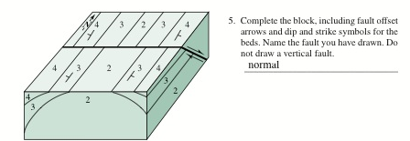
What can we learn from a master teacher?
# 3. Rigor: Sometimes it is good to struggle.
How did you do?

Slide 13
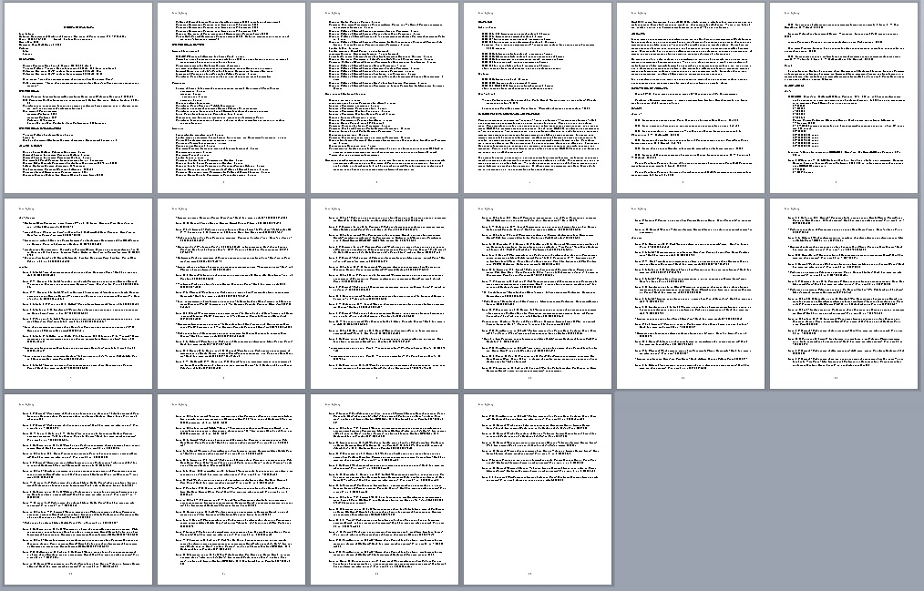
What can we learn from a master teacher?
# 3. Rigor: Personal perseverance and scholarship are important.
Notes:
Figure courtesy of Leon E. Long

Slide 14
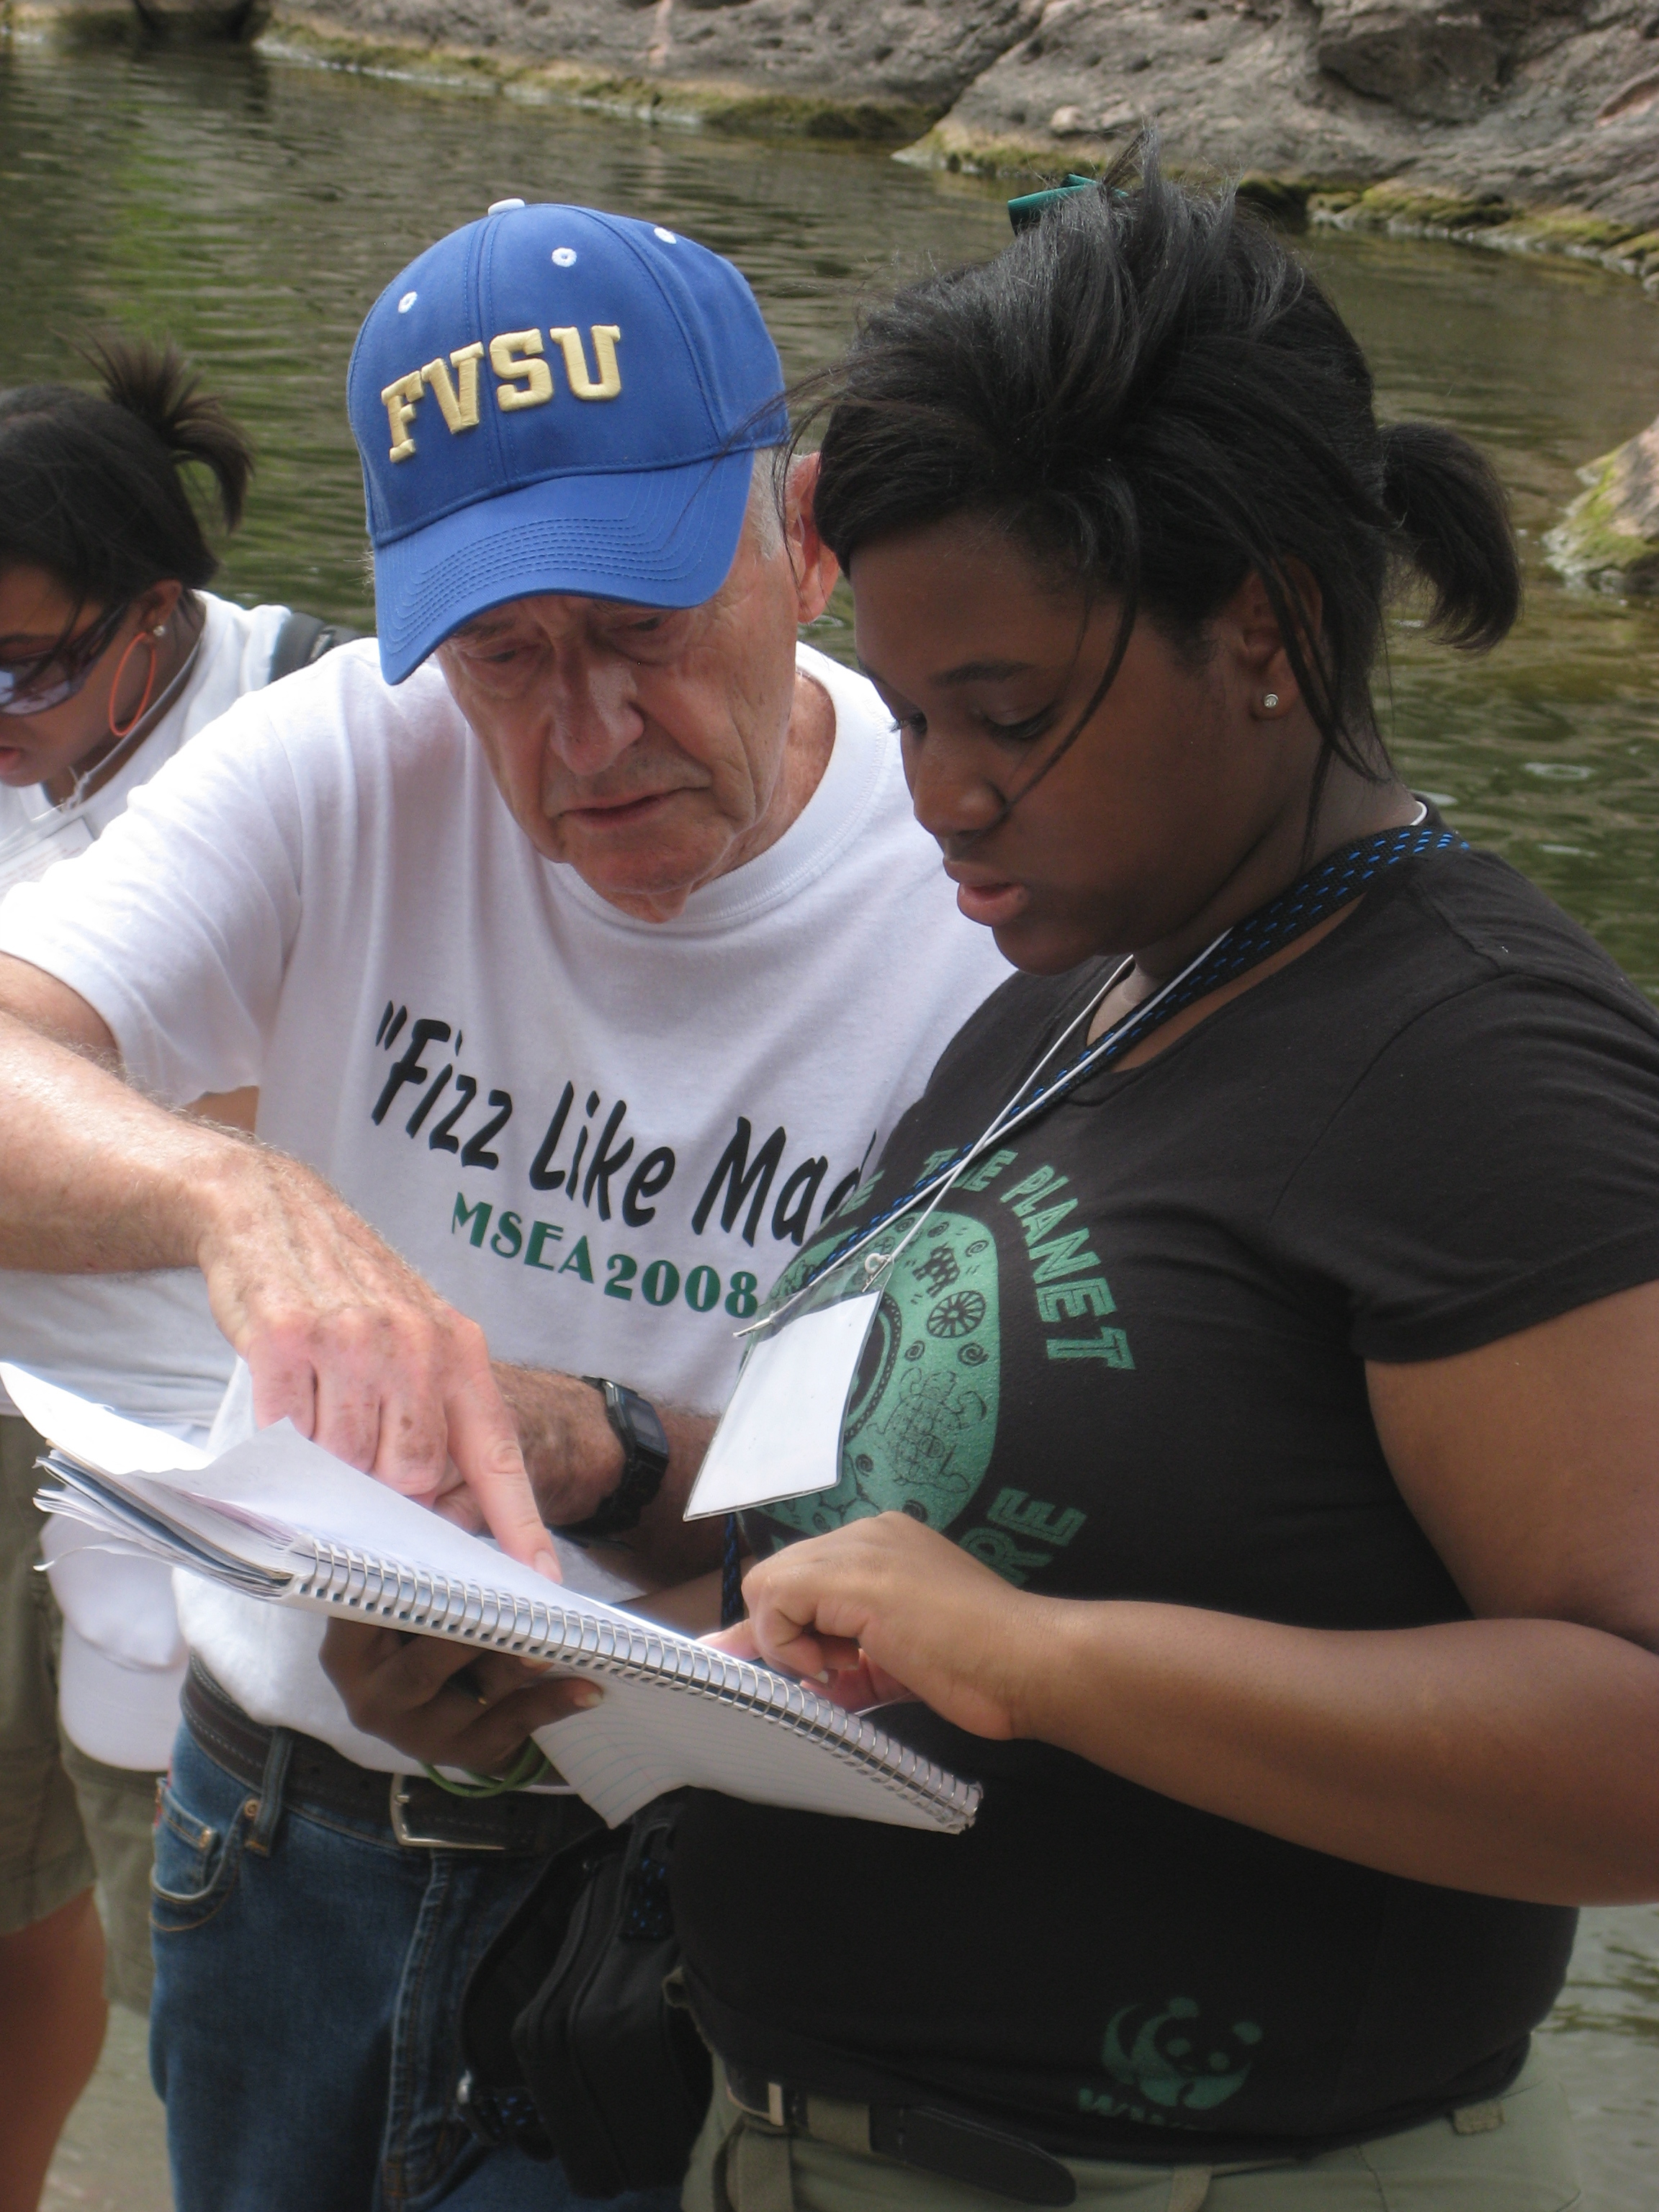
Leon’s questions for geology students
Can you handle this difficult technical subject?
Do you mind working on a scientific problem for which only fragmentary evidence is available?
Do you think you would enjoy doing what a geologist does for years and years?
Notes:
Photo courtesy of Marc Airhart

Slide 15
Leon’s advice
“As a geologist you can do just about anything with your career in combinations pleasing to you, such as working outdoors or indoors, with computers, writing, doing lab work, field work, detailed or large-scale research. Geologists and geology students alike enjoy an incredible variety of experiences combined with great adventure…and risk. They are nuts about travel, seeing as much of this earth as they can!”
- Leon E. Long from the UT Jackson School website

Slide 16
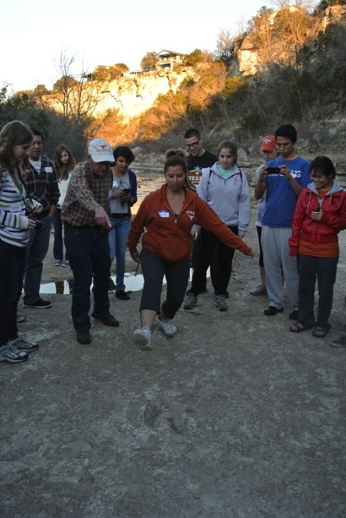
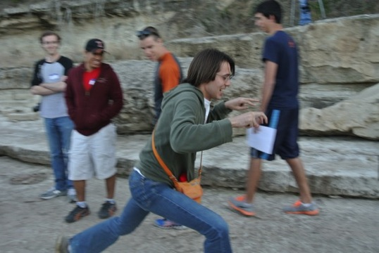
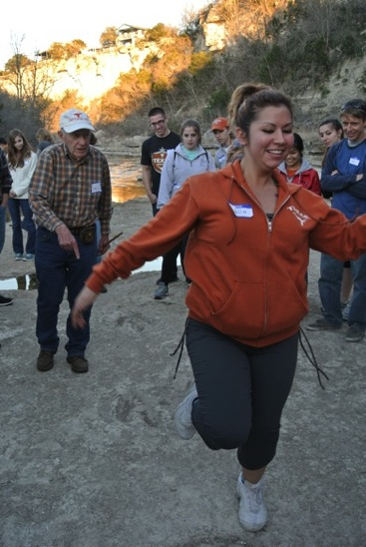
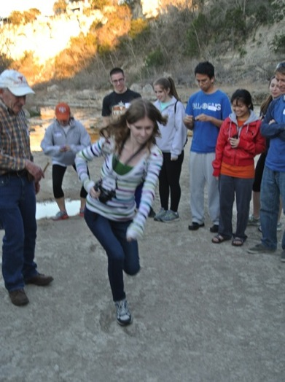
Continuing Leon Long’s Legacy
following in his footsteps
Away we go!

