Slide 1
USING TABLET/SMART-PHONE SPREADSHEETS FOR SOLVING COMMON STRUCTURAL GEOLOGY LAB/FIELD PROBLEMS BY CROSS-PRODUCT OF 3D VECTORS
David T. Allison
Department of Earth Sciences
University of South Alabama
dallison@southalabama.edu
http://www.usouthal.edu/geography/allison/research/VectorMethods.pptx

Slide 2
Presentation Outline
Mathematical and Geometrical Basis of 3D Vector Manipulation
Implementation of Spreadsheets with Examples
Special Considerations for Spreadsheets Running on Tablet and/or Smart Phones

Slide 3
3D Coordinate system for orientation data
Orthogonal coordinate system using directional angles alpha, beta, and gamma.
Directional components of the (x, y, z) axes are equal to cos(α), cos(β), and cos(γ) respectively

Slide 4
Key mathematical concepts for manipulating 3D vectors
Data Conversion: standard azimuth and plunge of a linear orientation can be converted to directional components (x,y,z) or directional angles (α,β,γ)
Dot Product: calculates the angle between two non-parallel vectors
3D Vector addition: operates in the same fashion as 2D “head-to-tail” method but with the additional z component
Cross Product: calculates the vector that is perpendicular to the plane containing 2 non-parallel vectors
Rotation: the rotation of a 3D vector about a 3D rotation axis uses a combination of the above calculations

Slide 5
Converting Orientation Data to 3D Vectors
Planar orientations must be converted to poles
Azimuth and plunge of a linear orientation can be converted to directional components with below equations:
x = sin (azimuth) * sin (90-plunge)
y = cos (azimuth) * sin (90-plunge)
z = cos (90-plunge)
Note that the directional angles α, β, and γ are related to the directional components by:
α = cos⁻¹ (x)
β = cos⁻¹ (y)
γ = cos⁻¹ (z)

Slide 6
Dot Product of 2 Non-Parallel Vectors
For 2 non-parallel data vectors with directional angles (α₁,β₁,γ₁) and (α₂,β₂,γ₂) respectively:

Slide 7
Cross Product
Cross Product Method: given two non-parallel vectors calculates the orientation of the pole (perpendicular) to the plane that contains the two given vectors.
Orientation data must be converted to directional components.
The dot-product is used to calculate the angle θ between the given non-parallel vectors.
The answer is calculated by 3 separate equations: one for each axis component.
The magnitude of the cross-product vector is not important for orientation calculations, but is = (vector 1)(vector 2)(sin θ)

Slide 8
Geometry of the Cross Product Vector

Slide 9
Rotational path generated by a horizontal rotation axis
Equal-Area Lower Hemisphere
R
Rotation of a vector (030, 0=“start”) about an axis (000, 0=“R”) through 360 degrees clockwise as viewed from the center of the net toward the trend of the rotation axis (R)
Note: rotation angles are “mathematical” therefore clockwise angles are negative
-180
start
-135
-90
-45
-315
-270
-225
-360
-180

Slide 10
Horizontal versus non-horizontal rotational axes
Equal Area Projection
Rotation about a horizontal (plunge=0) axis generates a stereonet small circle path
Rotation about a plunging axis generally creates an elliptical path that does not match either a small circle or great circle on the stereonet
N
340
350
R1
10
20
330
30
320
40
310
50
300
60
290
70
280
80
W
R2
E
260
100
250
110
240
120
230
130
220
140
210
150
200
190
170
160
S

Slide 11
Geometry of the Rotational 3D Vector Method

Slide 12
Method of 3D Vector Addition Utilized to Process Rotations
OP is the rotational axis multiplied by the dot product of the rotation axis and data vector. This yields the vector with head at the center of the circle of rotation (OP).
PQ is the vector perpendicular to the cross product of OA and OS. The magnitude of the cross product is equal to
(OA)(OS)(sin θ) where θ is the angle between OA and OS. Since OA and OS are unity, PQ is exactly the magnitude to "touch" the circle of rotation. PS is then calculated by taking the cross product of PQ and OA.
PX is the projection of the rotated data vector (PV) upon the PS vector. The rotation amount is “r”
PY is the projection of the rotated data vector (PV) upon the PQ vector.
By adding OP, PX, and PY "head-to-tail", the rotated data vector is calculated in terms of the orthogonal coordinate
system defined above.
MathCAD © Worksheet link:
http://www.usouthal.edu/geography/allison/GY403/RotationByComponents.mcd
http://www.usouthal.edu/geography/allison/GY403/RotationByComponents.pdf

Slide 13
Programming example of rotational calculations
Given a data vector (x1,y1,z1) and a rotation axis vector (x2,y2,z2) and a rotation angle r, the following equations calculate the new rotated orientation:
tp = (x1*x2+y1*y2+z1*z2) * (1-cos(r))
rot_x = cos(r)*x1+tp*x2+[sin(r)*(y2*z1-z2*y1)]
rot_y = cos(r)*y1+tp*y2-[sin(r)*(x2*z1-z2*x1)]
rot_z = cos(r)*z1+tp*z2+[sin(r)*(x2*y1-y2*x1)]
Note that the rotated position may result in a negative z component that would plot in the upper hemisphere of a stereonet (i.e. a negative plunge). In that case the (x, y, z) components should be multiplied by -1 to “reflect” it back to the lower hemisphere projection.

Slide 14
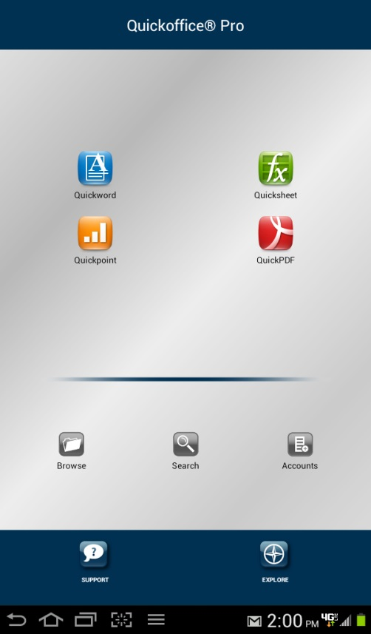
Implementation of 3D Vector Analysis as Excel 2010 Spreadsheets
Quickoffice spreadsheets are simplified versions of Excel 2010
Quickoffice runs on Android, iPad, iPhone OS
Formatting:
Blue cells: data entered
Magenta cells: labels or formulae
Green cells: calculation results

Slide 15
Spreadsheet Implementation: Intersecting Planes (IntersectingPlanes.xlsm)- 2 Fold Limbs
NETPROG diagram
Fold Hinge
N
Limb 1
Limb 2
310, 70E
040, 20E
W
E
In this case the intersecting planes were 2 planar fold limbs, therefore, the intersection is the hinge orientation (122.5, 19.8)
Hinge
122.5, 19.8
S

Slide 16
Application of Cross-Product and Dot-Product Example: yields attitude of fold hinge given the two limb attitudes

Slide 17
Intersecting Planes: Apparent Dip Example
Apparent Dip Example
N
Plane 1
050, 40E
Plane 2
290, 90
W
E
Given strike & dip of 050, 40E (Plane 1), calculate apparent dip along vertical plane trending 110
Apparent dip plane is equivalent to 290, 90 (Plane 2) strike & dip
110, 36
App. Dip
Intersection
S

Slide 18
Spreadsheet Implementation: Common Plane (CommonPlane.xlsm) to 2 Non-parallel Linear Data- Find Strike & Dip from 2 Apparent Dips
Strike & Dip Example
N
App. Dip 1
Pole to Plane
W
E
Strike & Dip: 329.5,38.8W
Note that Cross-Product calculates pole to plane that contains the 2 apparent dip linear vectors
The true dip trend is always 180 degrees from the pole trend, and the dip angle is always = 90 – pole plunge
App. Dip 2
S

Slide 19
Application of Common Plane Spreadsheet to Strike & Dip Calculation from 2 Apparent Dips

Slide 20
Rotational Problem Scenarios
Rotational fault
Retro-deforming a fold limb
Rotating cross-bedding to original attitude

Slide 21
Spreadsheet Implementation: Rotation of a line about a rotational axis (Rotation.xlsm) - Rotational Fault
Rotational Fault Example
350
N
10
330
340
20
30
320
Rotation Path
40
310
120
50
300
48.6
P
60
R
L
290
70
280
80
W
Fault Plane
E
260
L'
100
Rotated Bedding
250
N 39.5 E 72.3 W
110
240
P'
120
230
130
Given a rotational fault axis (300,30) and that bedding (090,40S) was rotated 120 degrees calculate the new bedding attitude = 39.5, 72.3W
220
140
210
200
160
150
190
S
170

Slide 22
Special Considerations for Tablet/Smart Phone Spreadsheets
Spreadsheet layout should be compact for limited screen area
Currently “named” cells are not supported
Graphics are generally not practical or are not supported
VB macros are not supported
Downloadable spreadsheets have been tested with Quickoffice on the Android OS

Slide 23
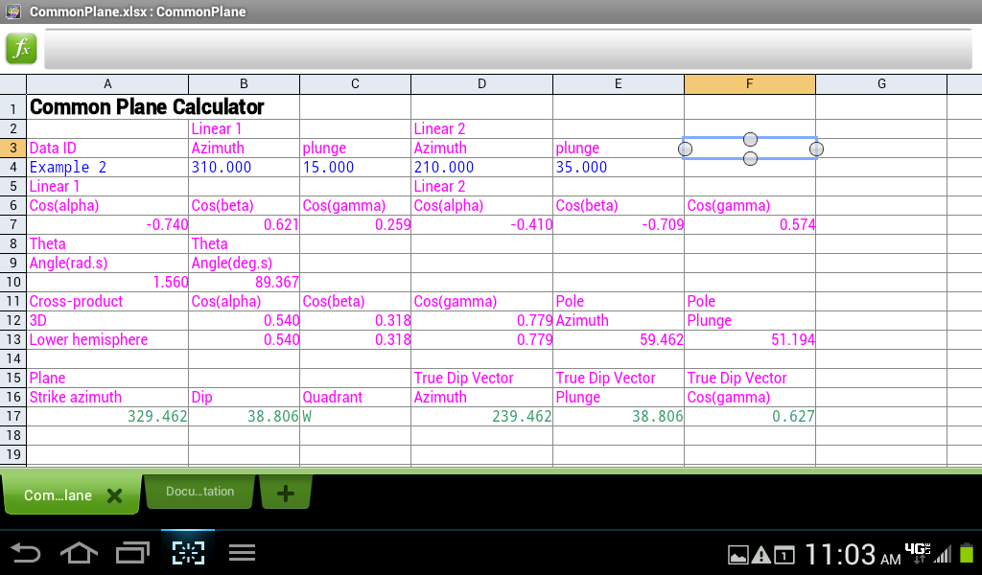
Compact Layout of “CommonPlane.xlsx” in Quickoffice

Slide 24
Excel “Named” Cell Constraints
“Named cells” uses symbolic names to represent cell addresses to clarify formulae
Named cells cannot be used with current Tablet/Smart Phone Excel compatible spreadsheets (example from “CommonPlane.xlsx”
=SIN(RADIANS(Az_1))*SIN(RADIANS(90-Pl_1))
=SIN(RADIANS(B4))*SIN(RADIANS(90-C4))

Slide 25
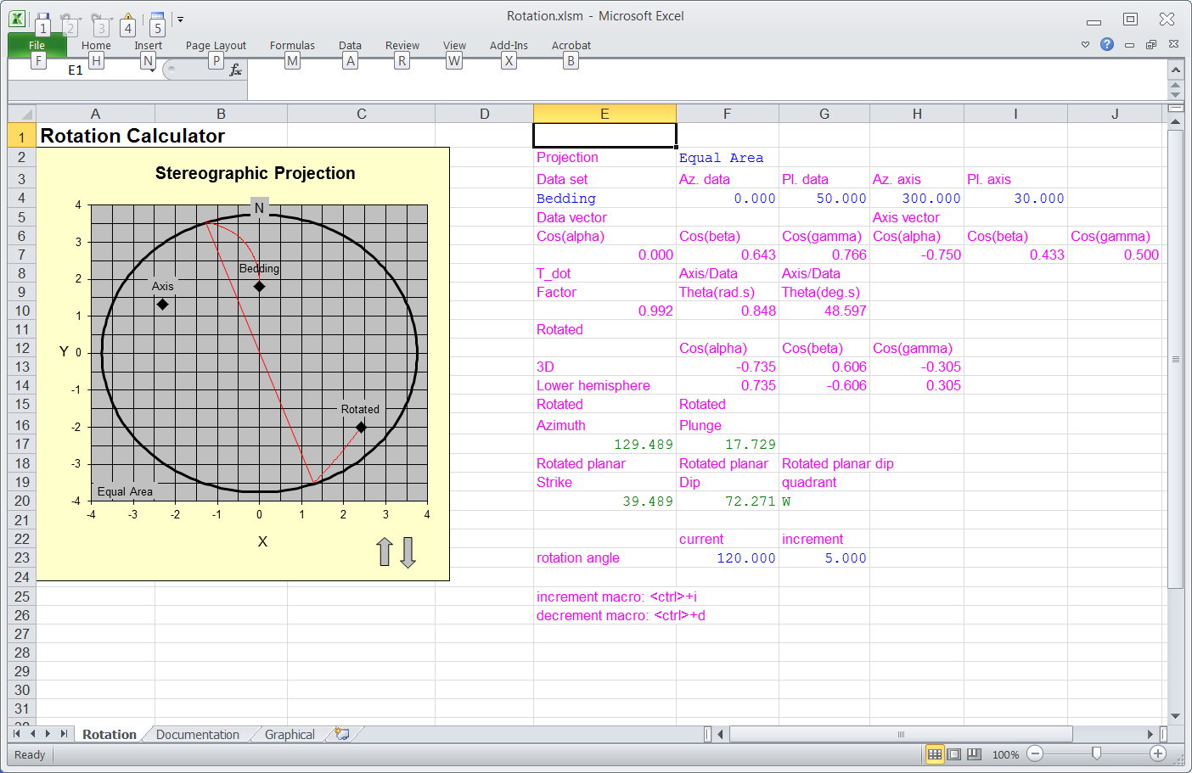
Excel Graphics and VB Macros
VB macros are not supported in current Tablet/Smart Phone applications
Graphics are not practical with smart phones but may be possible on tablets

Slide 26
Web Site Resources
Excel 2010 Spreadsheets with graphics and dynamic VB macros:
http://www.usouthal.edu/geography/allison/GY403/CommonPlane.xlsm
http://www.usouthal.edu/geography/allison/GY403/IntersectingPlanes.xlsm
http://www.usouthal.edu/geography/allison/GY403/Rotation.xlsm
Smart Phone/ Tablet compatible spreadsheet versions:
http://www.usouthal.edu/geography/allison/GY403/CommonPlane.xlsx
http://www.usouthal.edu/geography/allison/GY403/IntersectingPlanes.xlsx
http://www.usouthal.edu/geography/allison/GY403/Rotation.xlsx
NETPROG stereonet application:
http://www.usouthal.edu/geography/allison/w-netprg.htm
QuickOffice web site:
http://www.quickoffice.com/

Slide 27
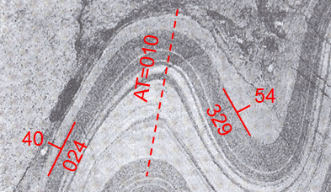
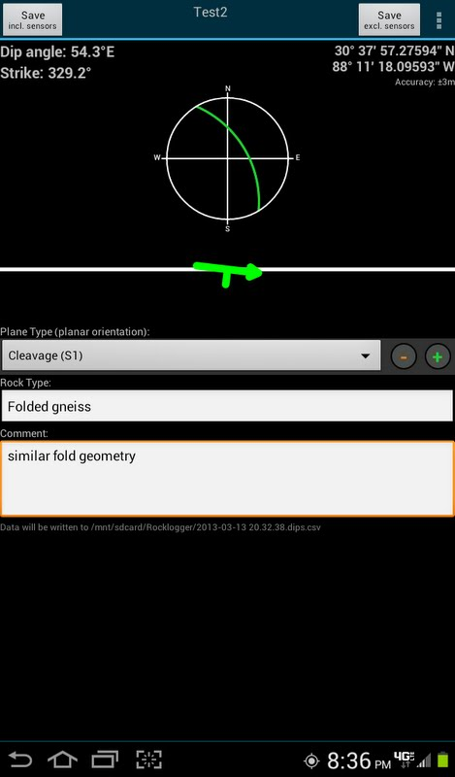
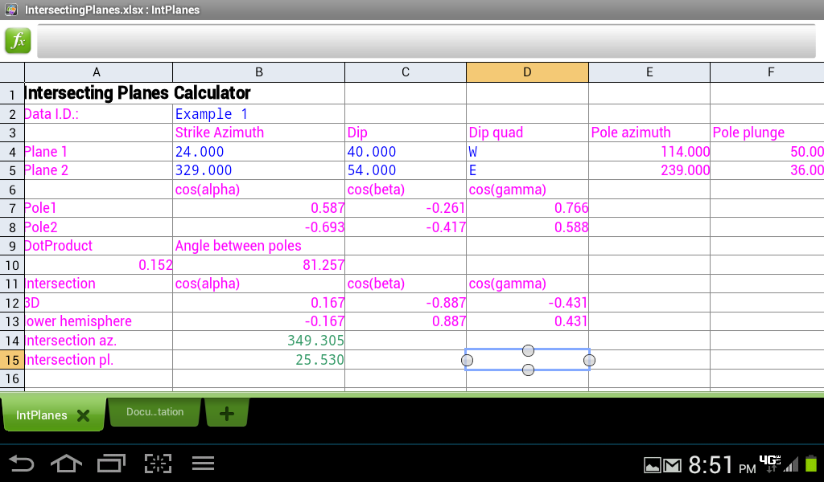
Concluding Scenario…

