Slide 1

Investigating & Improving Conceptions of Temporal Duration Using Computer Animations
Kim A. Cheek
University of North Florida
Southeastern Section Geological Society of America
March 20, 2013

Slide 2

Literature Review
Ascribe relatively short time periods to events (Hidalgo & Otero, 2004)
Strata of equal thickness indicate same depositional period (Dodick & Orion, 2003)
Underestimation of processes requiring long time periods & overestimation of those requiring short ones (Lee et al., 2011)
Size = duration (Piaget, 1969; Casasanto & Boroditsky, 2008)

Slide 3

Do geoscience novices equate spatial size with duration for geologic & non-geologic events and processes across a variety of temporal scales?

Slide 4
Methods
17 introductory geoscience students (12 females, 5 males, median age—21 yrs.
Cognitive interviewing: semi-structured, task-based
Qualitative analysis
Task 1 → Task 2 → Task 1

Slide 5
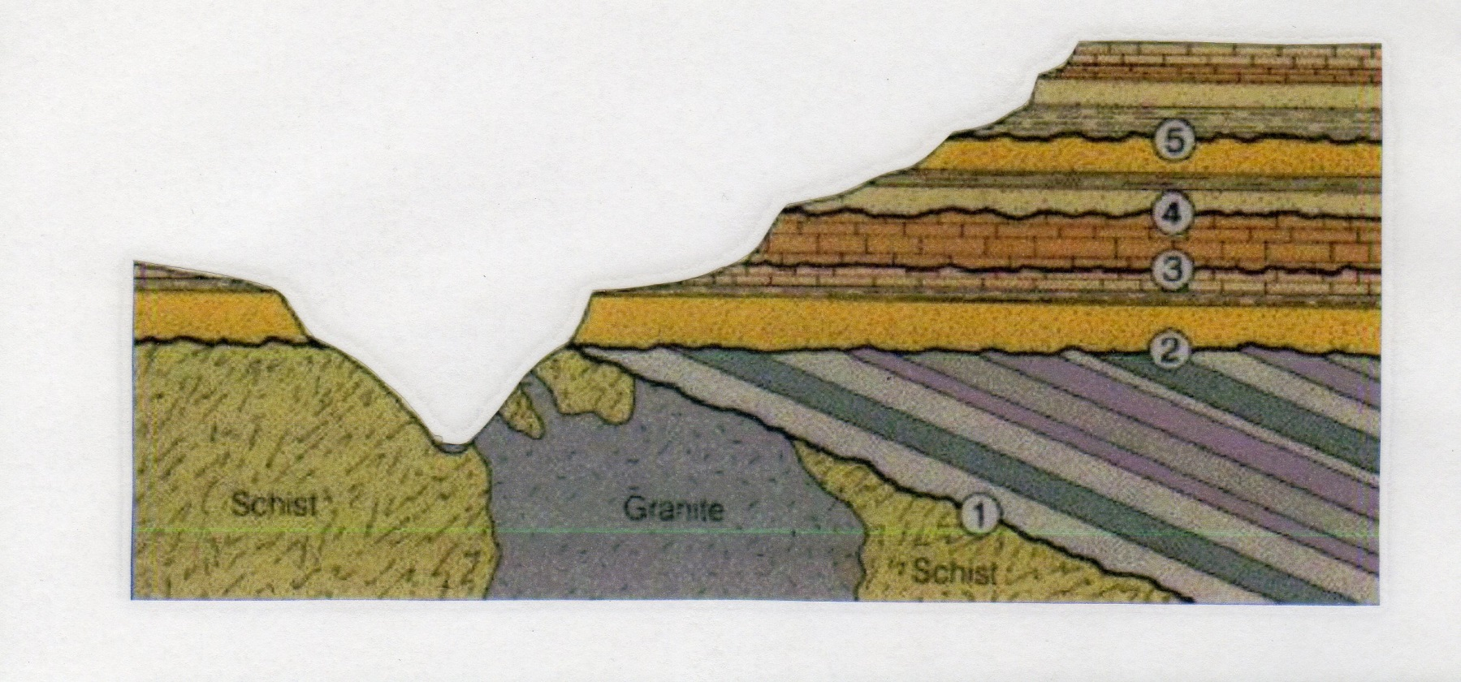
Task 1: Sedimentary Line Drawing

Slide 6



Task 2: Computer Animations
A 1
A 2
A 3

Slide 7
Results
 | Larger | Smaller | Can’t be Determined
Task 1 before Animations | 13 | 1 | 3
Task 1 after Animations | 2 | 6 | 9

Slide 8
Reasons for Responses
Response | Before Animations | After Animations
Larger | More layers, wider, more rock than the other one, deeper, bigger | Larger ones in videos generally took longer, size more important than rate
Smaller | Like an anticline | Larger ones faster in videos, smaller layer is more compact & squashed
Can’t be determined | Smaller more broken up, one may be softer or harder, because layers are different thinner layer may have been eroded | Not there to observe, don’t know about environment or rate of deposition, bigger doesn’t always take longer

Slide 9

It showed me that, I guess, we don’t ever know what the environment’s like or what kind of sediment it is, or you know what I mean? We just can’t make the presupposition that every single sediment will settle at the same rate of time, even though they look the same in that picture. (20 yr.-old female)

Slide 10

Use of Geoscience Vocabulary
 | Term Used | Frequency
Before Animations | Erosion | 3
 | Anticline | 1
 | Metamorphosis | 1
 | Sediment | 1
After Animations | Deposition | 3
 | (Rate) | 5

Slide 11
Conclusions
Tendency to view spatial size & temporal duration as co-varying
Better performance following simple real-time animations
Increased use of relevant geoscience terms after animations
Further exploration of use of spatial metaphors for temporal duration

Slide 12
Animations Data
Animation | % Correct
1 | 56%
2 | 29%
3 | 79%

Slide 13
Category Codes
Direct proportionality of size & duration
Inverse proportionality of rate & duration
Subjective, qualitative impression
Use of iterated, equivalent temporal units
Relationship of rate & size to duration considered simultaneously when both vary

