Slide 1
62th Annual Meeting of the Southeastern GSA
20 – 21 March 2013 – San Juan, Puerto Rico
Efficiency of Zea mays L. in the retention of nutrients in the interstitial water
from Port-au-Prince dredged sediments
Evens Emmanuel, Martine E Mathieu, Pierre M. Samson, Elmyre Clervil
Université Quisqueya
BP 796, Port-au-Prince, HAITI
e-mail: evens.emmanuel@gmail.com

Slide 2
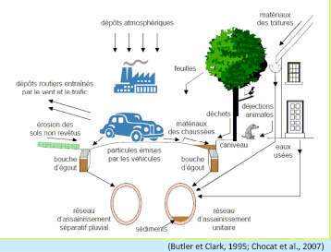
Wastewater management in Haiti
Direct discharge in
Aquatic ecosystems
Jeopardise the bilogical
equilibrium of ecosystems : loss
of aquatic biodiversity
R
I
S
K
S
Human health
ecological
Economical umbalance

Slide 3
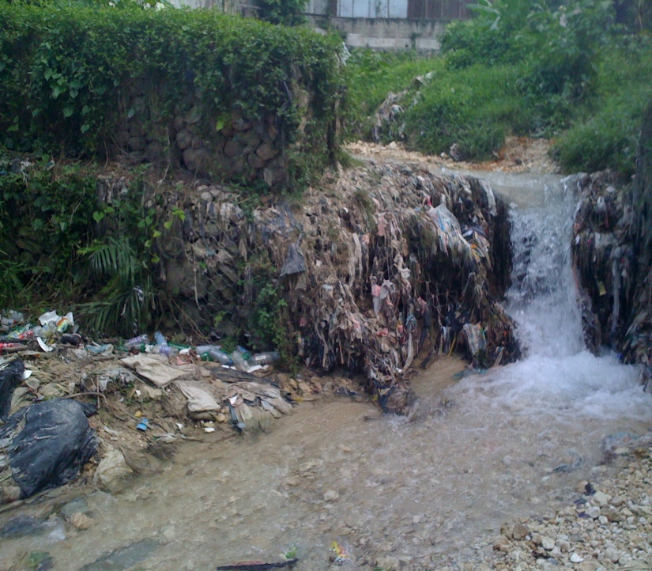
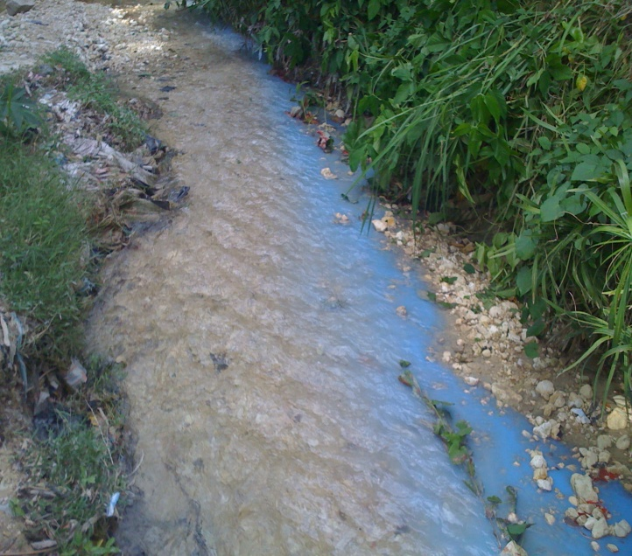
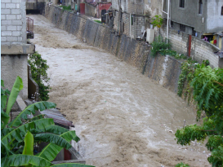
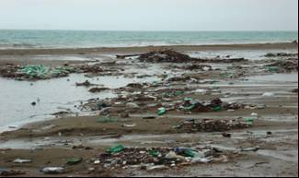
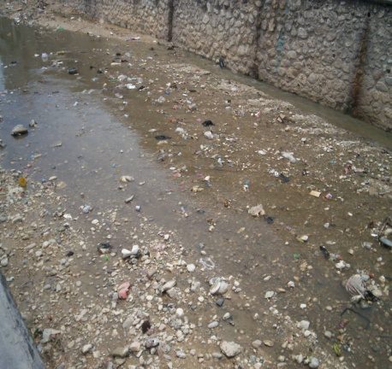
Port-au-Prince Urban wastewater
2
3
1
4
5

Slide 4
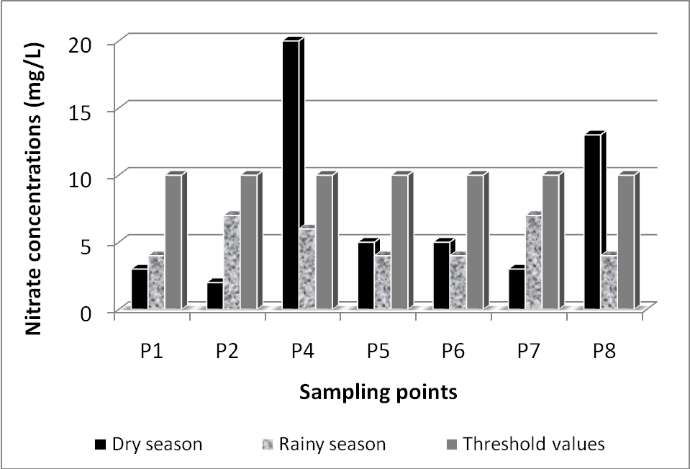
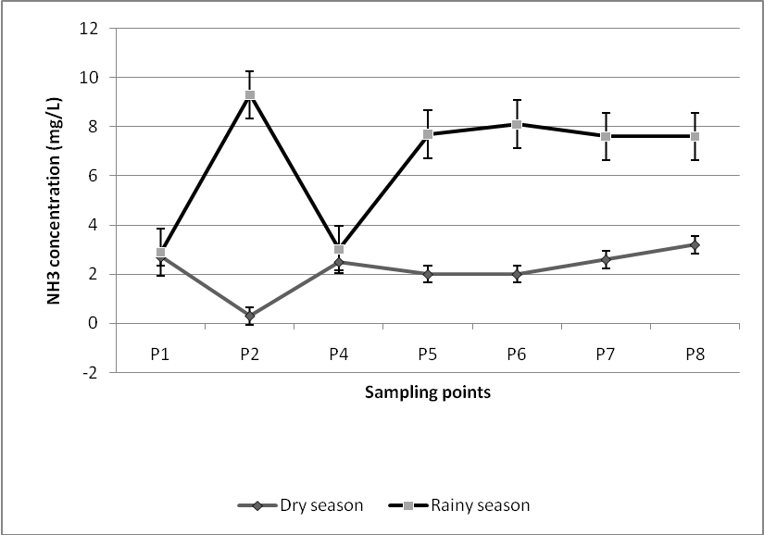
Urban Wastewater characterization

Slide 5





Dredged sediments disposal
Dredged sediments from drainage channel of Port-au-Prince
The bay ecosystems of Port-au-Prince

Slide 6
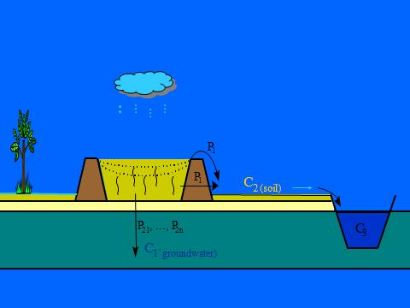
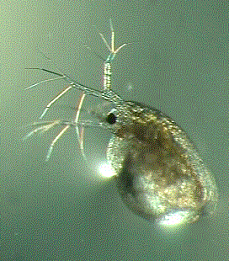
Ecotoxicological approach for management of dredging sediments
Daphnia magna
Pseudokirchneriella subcapitata
Ecotoxicity tests
Brachydanio rerio
Phyto toxicity test

Slide 7
Ecohydrological approach
The ecohydrology of an area or region is determined by climate, geomorphology, plant cover/biota dynamics and anthropogenic modifications. By understanding these factors, the potential exists for the application of Phytotechnologies to increase plant biomass and to regulate nutrients and water dynamics, thereby increasing ecosystem carrying capacity, resilience and functionality. This can lead to significant improvements in water quality, enhanced biodiversity, improved agricultural production, potential bioenergy generation, and remediation of degraded ecosystems (SANTIAGO-FANDINO and NEATE, 2002)

Slide 8
Ecohydrological approach for management of dredging sediments
Phytotechnology
Terrestrial ecohydrology approaches, based on phytotechnology, are mostly used to reduce and manage hazards or risks linked to contaminated sediments.

Slide 9
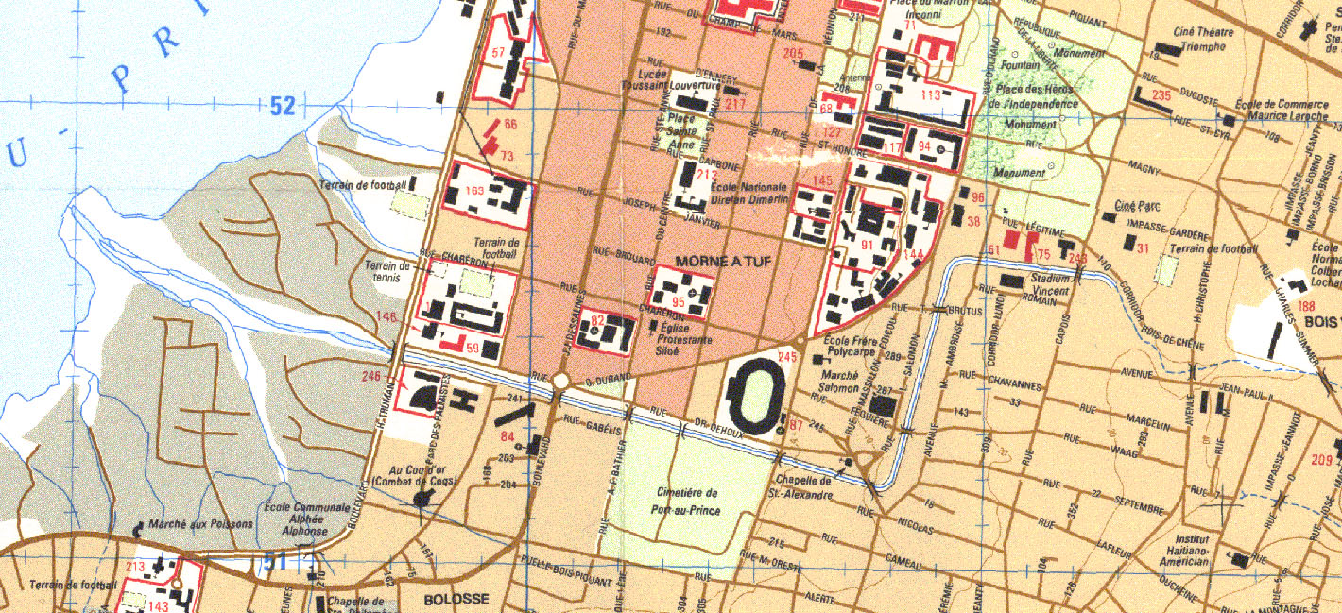
Materials and methods
3 samples of sediments from the drainage channel
1 sample of pilot soil from an agricutural farm
Use of Zea mays L., (gramineae family)
A₂
A₃
A₁

Slide 10
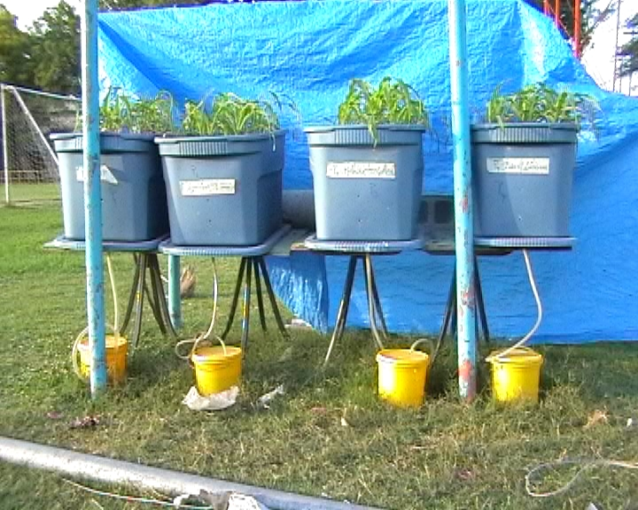
Experimental implementation
Chemical characterization of the interstitial water of dredged sediments (Nitrates, phosphate, NH₃..
Chemical analysis of pilot soil,
Physical characterization of plants (diameter and H cm)
Chemical characterization of plants (N and P)

Slide 11
Phosphate values in interstitial water of dredged sediments

Slide 12
Physical parameters of plants
A.- After one month
Stations Parameters | A₁ | A₂ | A₃ | A₄
Body diameter (cm) | 0.3 | 0.4 | 0.6 | 0.5
H of the body (cm) | 11.5 | 15.7 | 19.6 | 16.0
Roots diameter (mm) | 0.2 | 0.2 | 1.5 | 2.0
H of roots. pr. (cm) | 4.8 | 5.9 | 5.9 | 5.1

Slide 13
B.- Observations at the end of experimentation
Stations Parameters | A₁ | A₂ | A₃ | A₄
H (cm) | 42.75 | 53.65 | 55.60 | 55.00
Presence of fruits | yes | yes | yes | yes

Slide 14
N and P in Zea mays L.
Parts | Body |  | Roots
Parameters Stations | N (g/100g) | P (g/100g) | N (g/100g) | P (g/100g)
A₀ | 1.36 | 0.013 | 1.32 | 0.020
A₁ | 0.67 | 0.023 | 0.14 | 0.016
A₂ | 0.97 | 0.0357 | 0.68 | 0.023
A₃ | 0.95 | 0.0244 | 0.80 | 0.0154

Slide 15
Conclusion
The measured physical parameters reveal that corn samples raised in the sediments had a better growth than those in the pilot soil from agricultural farm.
The analysis of collected plants samples shows the potentialities of Zea mays L in the phytoremediation of nitrogen and phosphorus

Slide 16

UNESCO Chair on Ecohydrology
Humanities: Social Representation of Water in the population - Assessment of behavioral risk
Social sciences (economics):
(i) Management of shared water resources
(ii) Environmental accounting of water resources
Environmental Sciences: Ecotoxicology tropical and process engineering.

Slide 17
Muchas gracias
Thank you
Merci beaucoup

