Slide 1
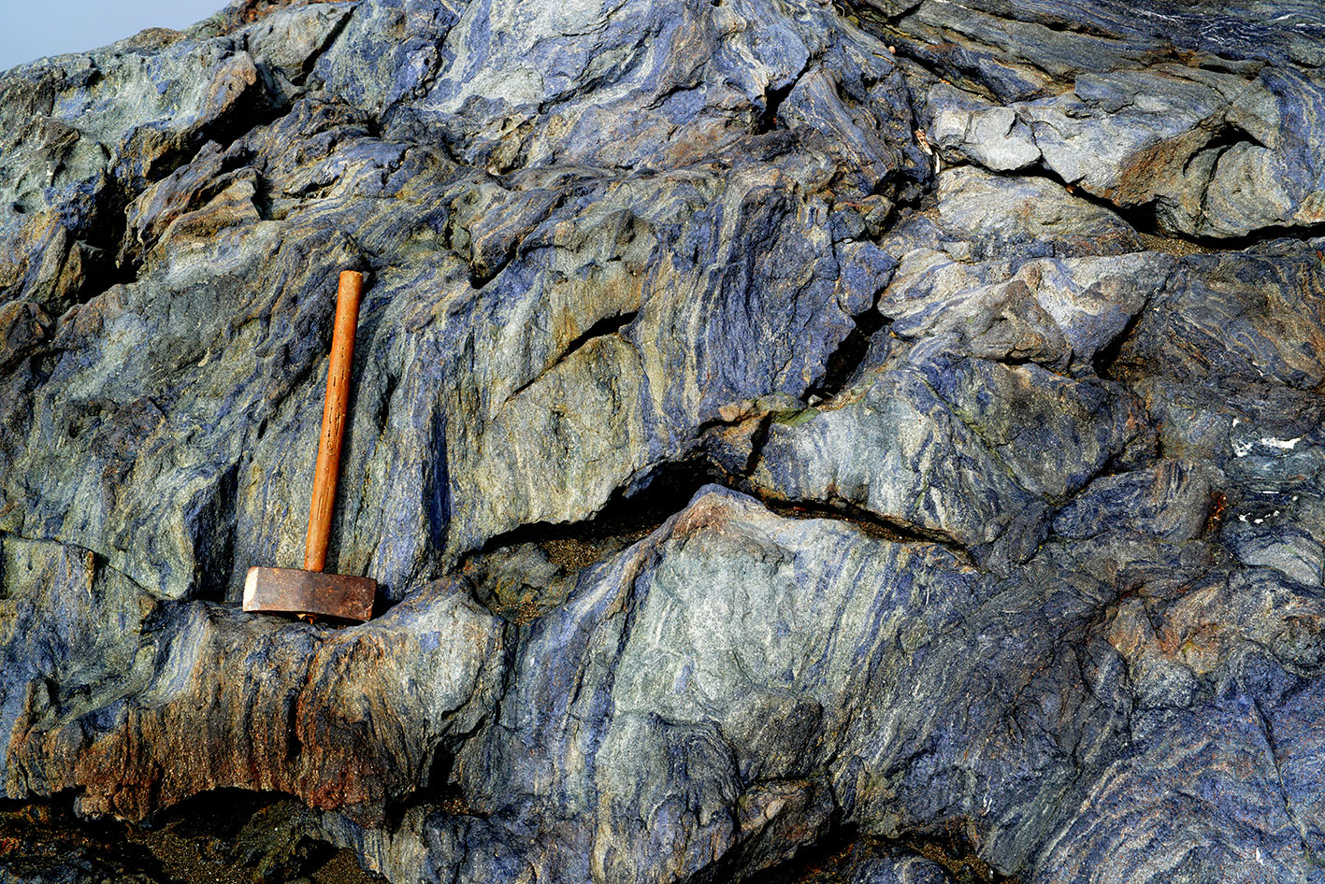
The Importance of HP and UHP rocks and minerals for understanding when Plate Tectonics Began
Robert J. Stern* and Tatsuki Tsujimori**
*U Texas Dallas, USA
**Okayama U, Japan
Notes:
Eclogite-rich zone within folded/deformed blueschist, Jenner Beach December 2013 (Ben Edwards).

Slide 2
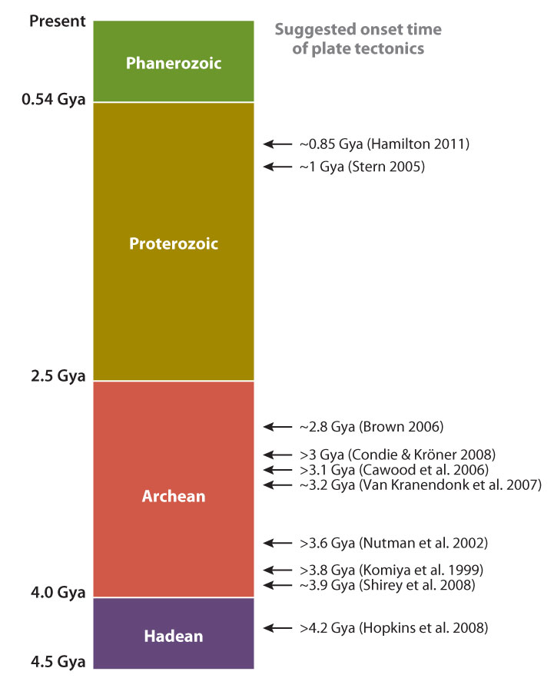
Great disagreement about when Plate Tectonics began
Korenaga 2013

Slide 3
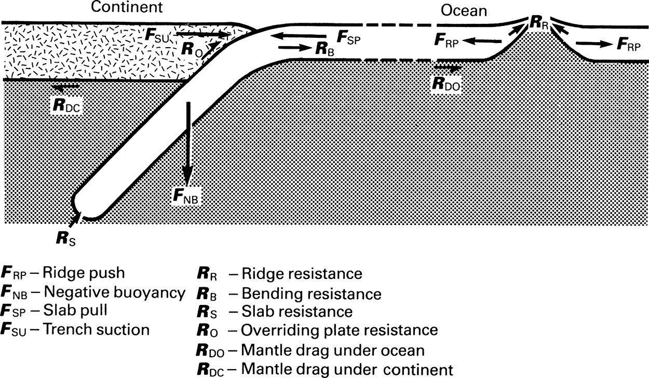
Sinking of lithosphere in subduction zones drives plate tectonics, so presence of subduction zone metamorphic rocks indicates PT processes existed.
Forsythe & Uyeda 1975
975 citations

Slide 4
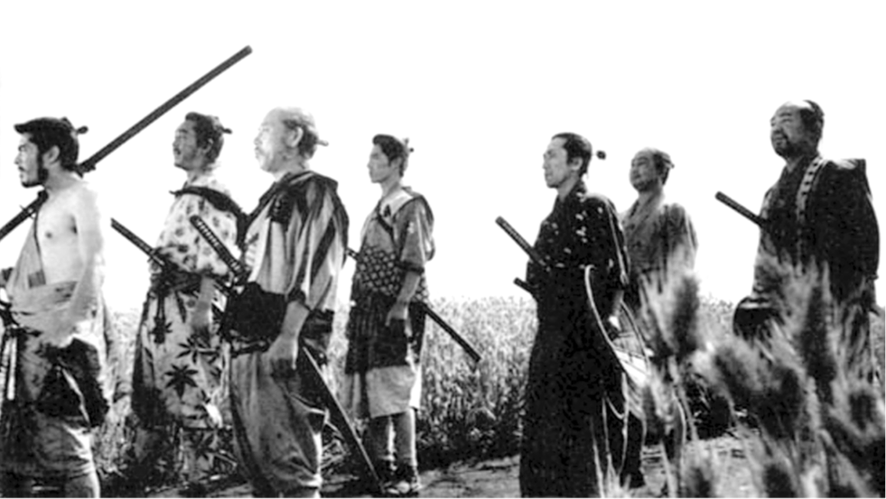
Seven metamorphic indicators of subduction (and plate tectonics)
(apologies to Kurosawa 1954 “Seven Samurai”)
Lawsonite
eclogite
Coesite
eclogite
Diamond
eclogite
Jadeitite
Glaucophane
eclogite
Blueschist
Lawsonite
blueschist
Kurosawa (1954) “Seven Samurai”
Metamorphic Petrology community has a big role to play in determining
#1 Solid Earth problem: when and how did Plate Tectonics begin, and what was Earth’s tectonic regime before this.

Slide 5
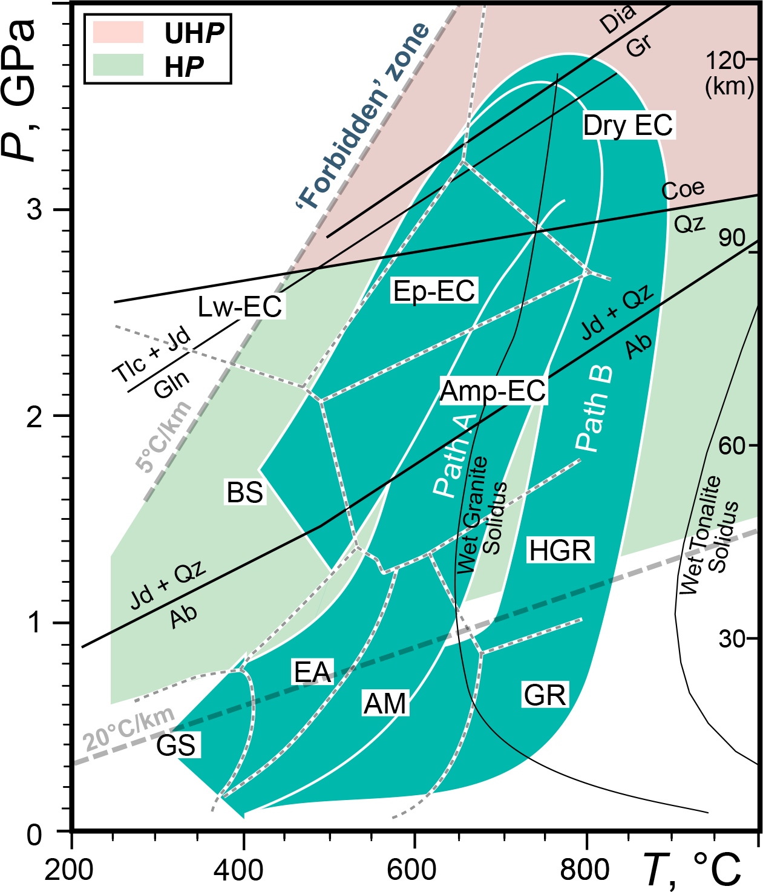
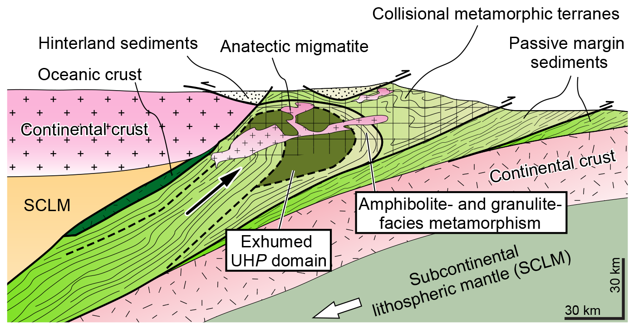
Coesite-/Diamond-bearing UHP eclogites
Mostly continental collision zones (e.g., Himalaya); rare oceanic protolith (W. Alps)
Protoliths:
Continental basement (granitic rocks)
Platform cover (peralminous sediments)
Platform carbonates (impure limestone)
Mafic-ultramafic intrusive rocks
Path A: Small UHP terranes
Path B: Large and thick UHP terranes
(Kylander-Clark et al., 2012)

Slide 6

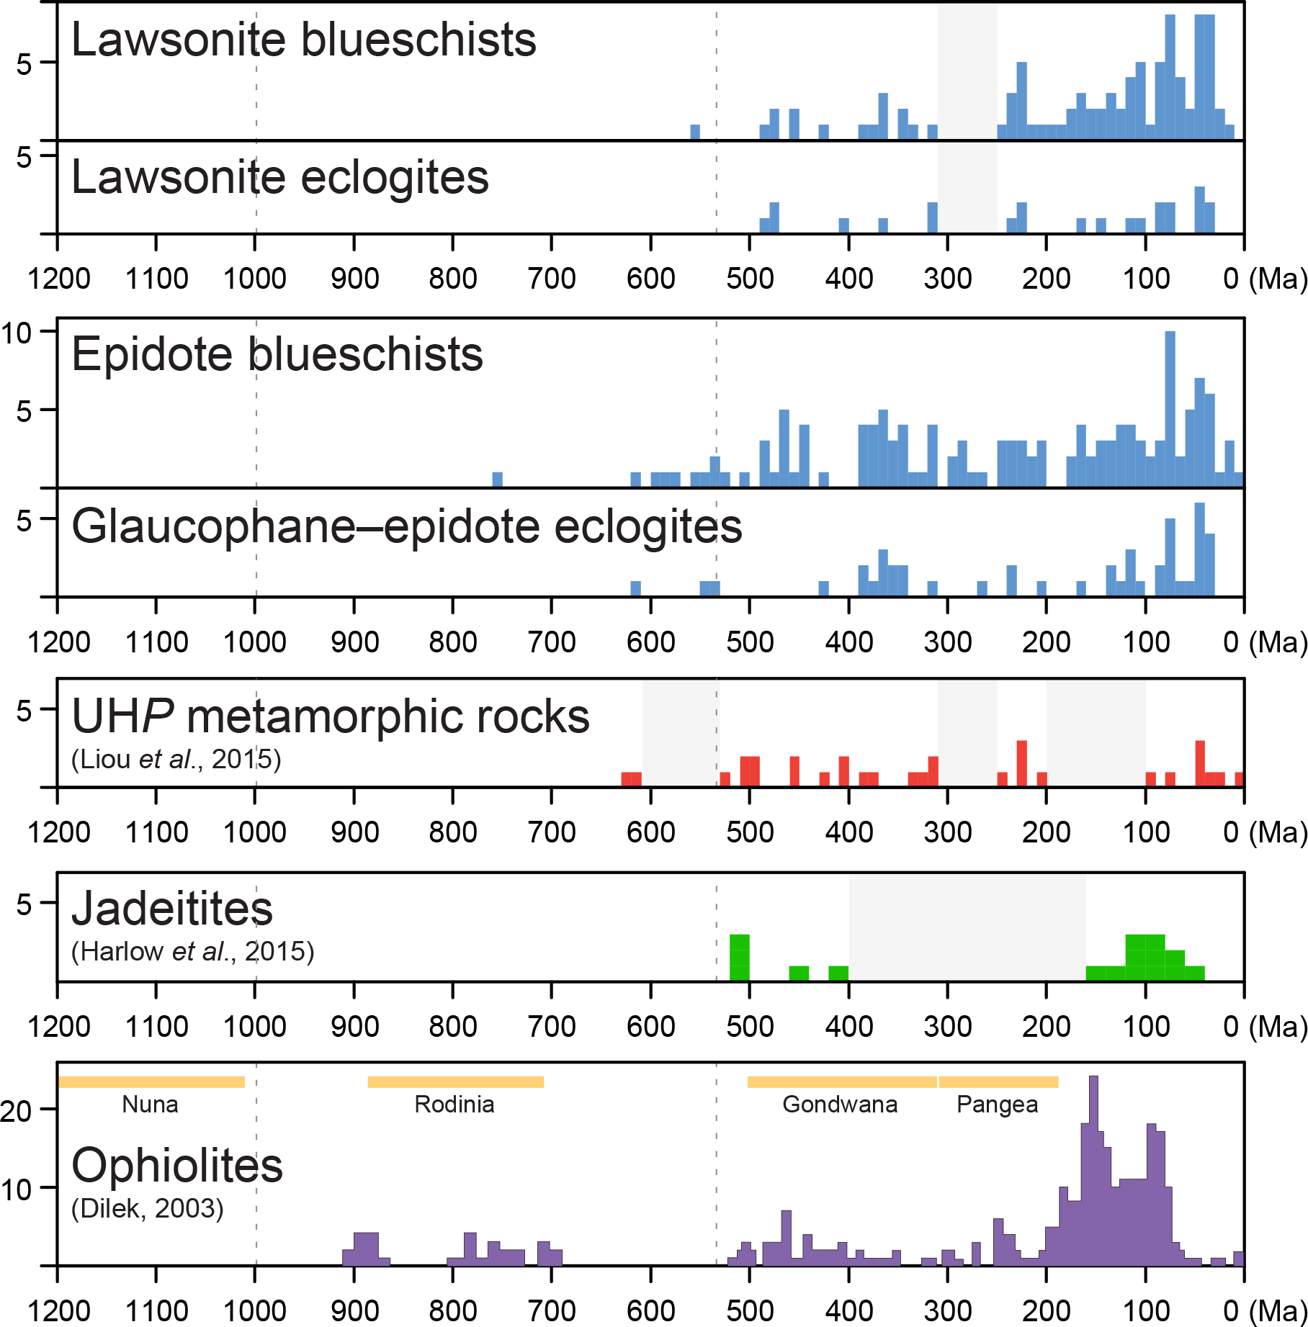
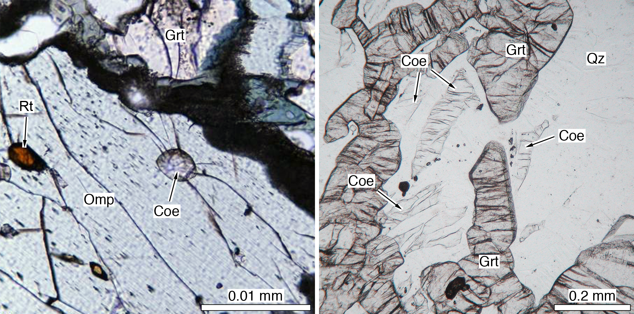
Coesite-bearing UHP eclogites
Gourma (E. Mali) & Pompangeo (Brazil): ~630 Ma
Himalaya
Dora Mira, W. Alps

Slide 7
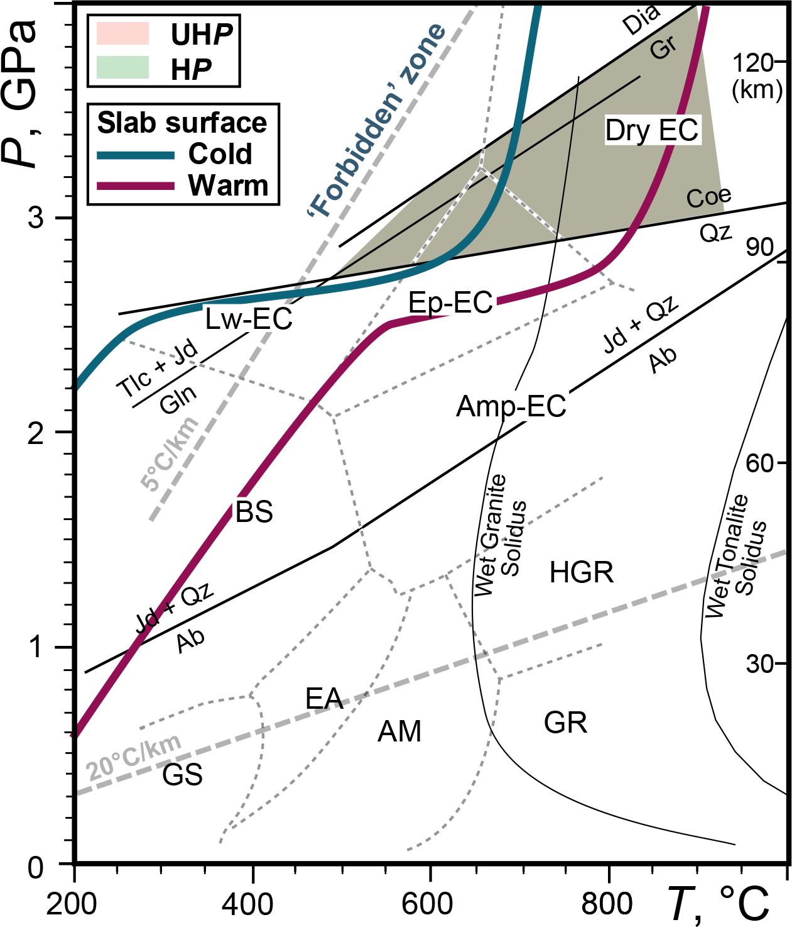
Coesite-bearing UHP eclogites
Gourma (E. Mali) & Pompangeo (Brazil): ~630 Ma

Slide 8

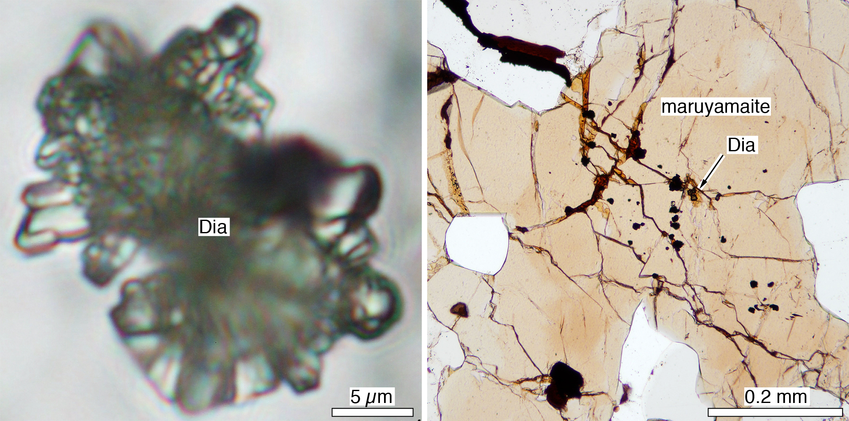
Diamond-bearing UHP eclogites
Kokchetav (Kazakhstan): ~530 Ma
*Dia-bearing granulite, West Greenland (Glassley et al., 2014): ~1800 Ma
Kokchetav UHP marble and gneiss

Slide 9
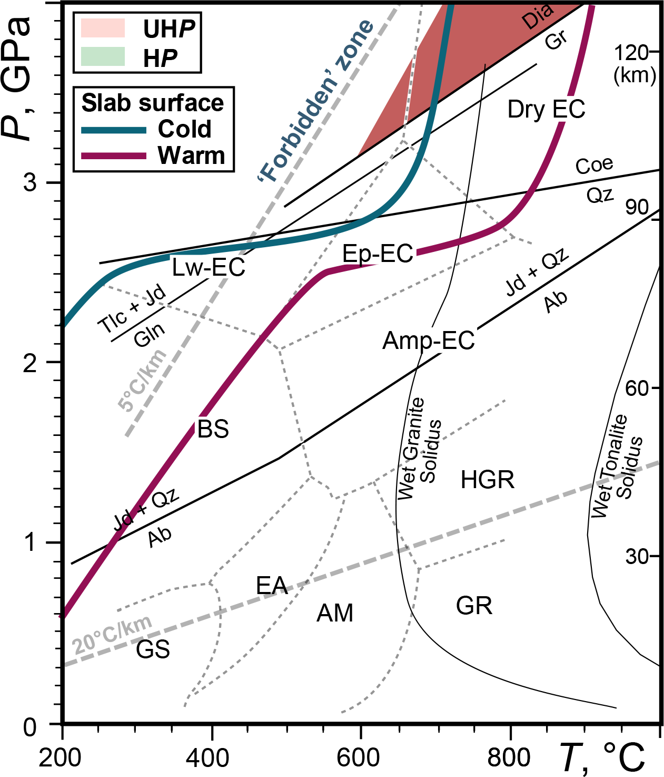
Diamond-bearing UHP eclogites
Kokchetav (Kazakhstan): ~530 Ma
*West Greenland: ~1800 Ma

Slide 10
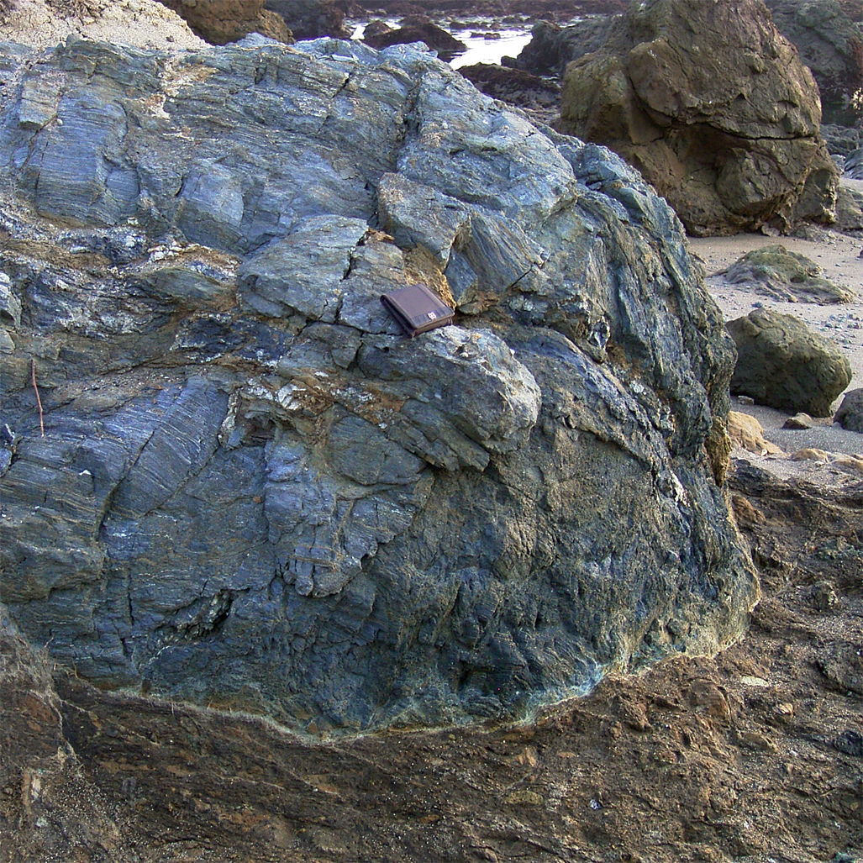
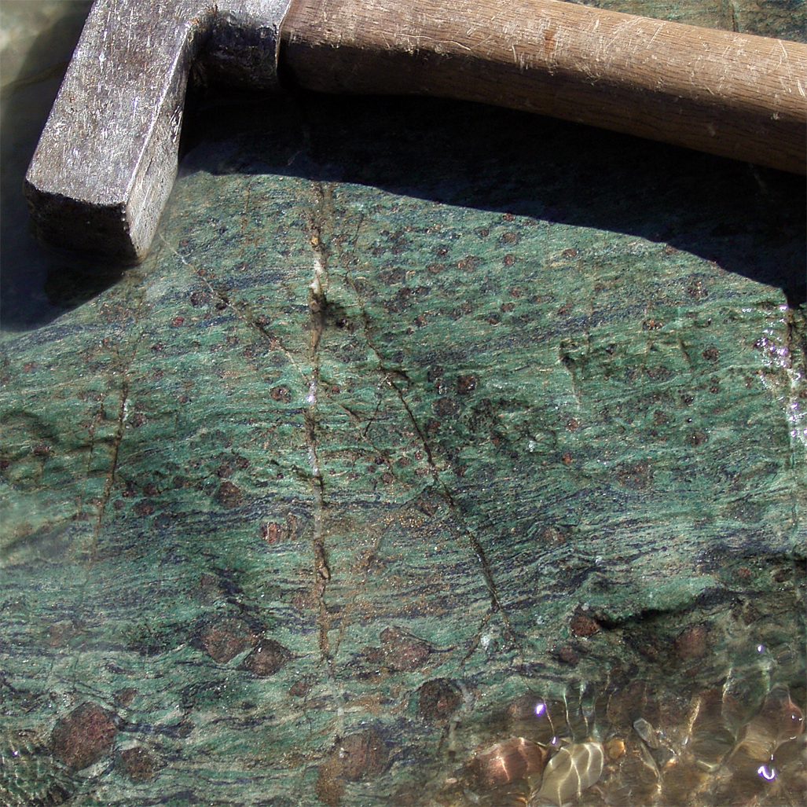
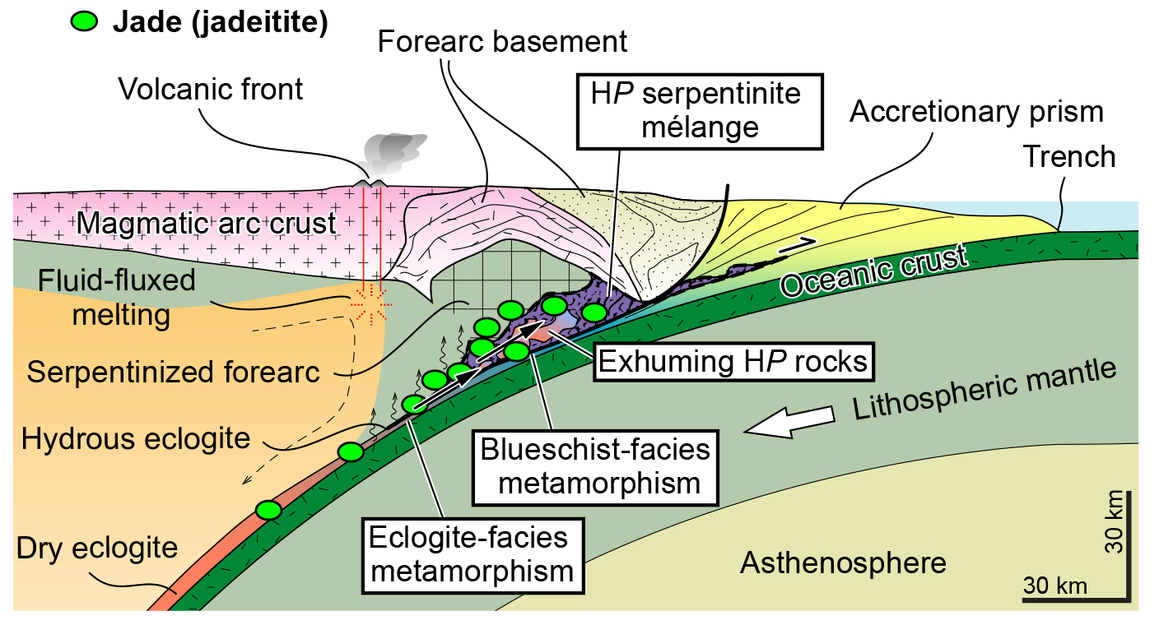
Blueschists and Glaucophane-bearing eclogites
Mostly Pacific-type orogens
(e.g., circum-Pacific) and suture zone (e.g., Tethyan); rare collision zone
Protoliths:
Accretionary prism (Trench-fill sediments [greywacke], MORB, OIB + reefal limestone, Pelagic sediments [Bedded chert etc]
Blueschist
Eclogite

Slide 11
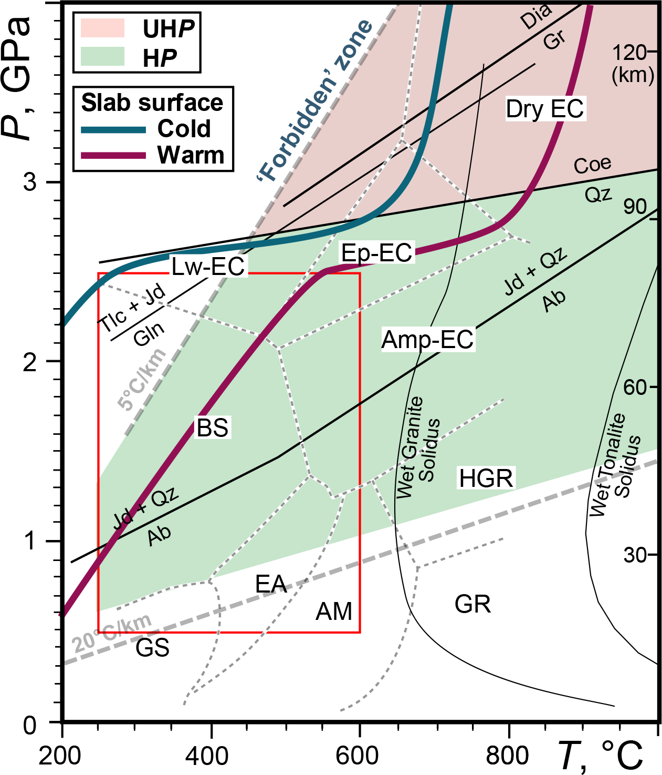
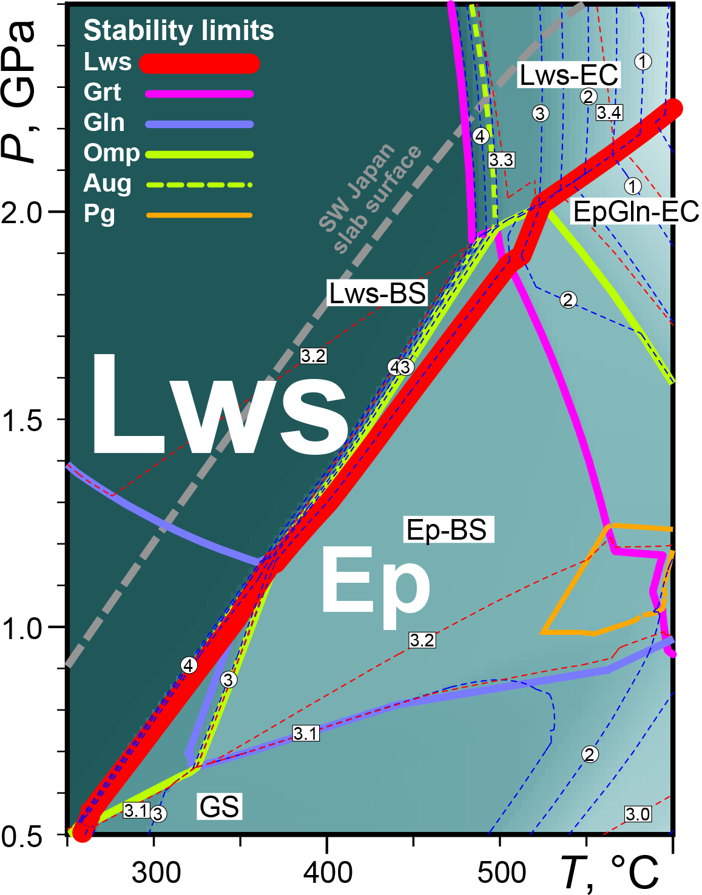
Blueschists and Glaucophane-bearing eclogites
Lawsonite BS = Low geotherm (also high water content)

Slide 12

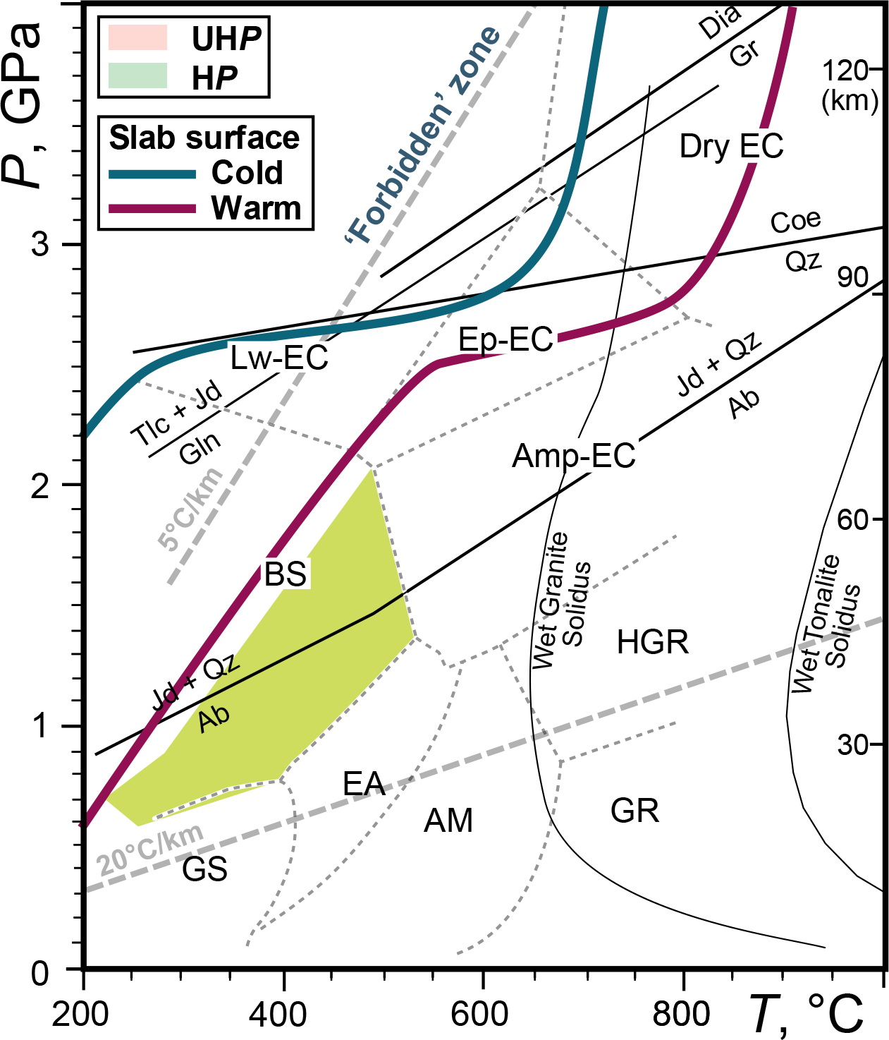
Blueschists (sensu lato)
Low-grade Ep-BS—Aksu (NW China): ~730 Ma

Slide 13

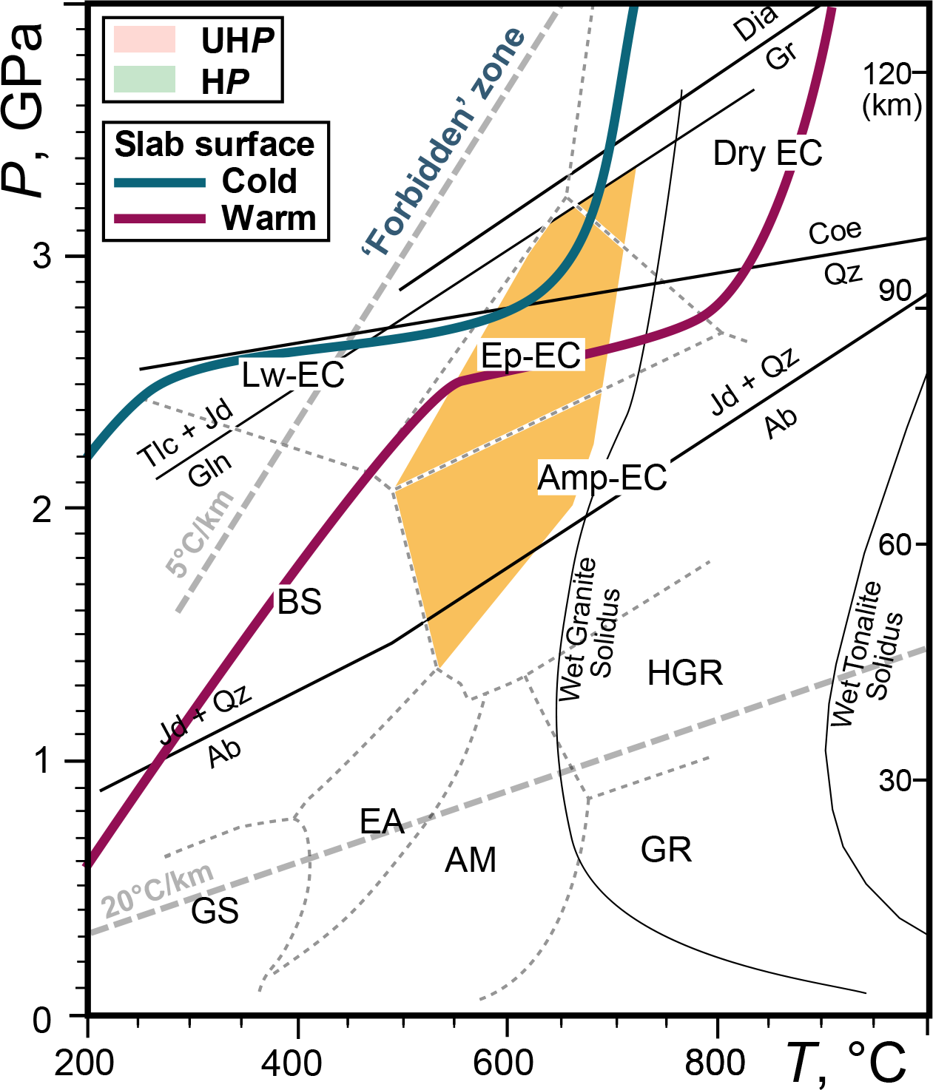
Glaucophane-bearing epidote eclogite
Gln–Ep-EC—Gourma (E. Mali): ~630 Ma

Slide 14

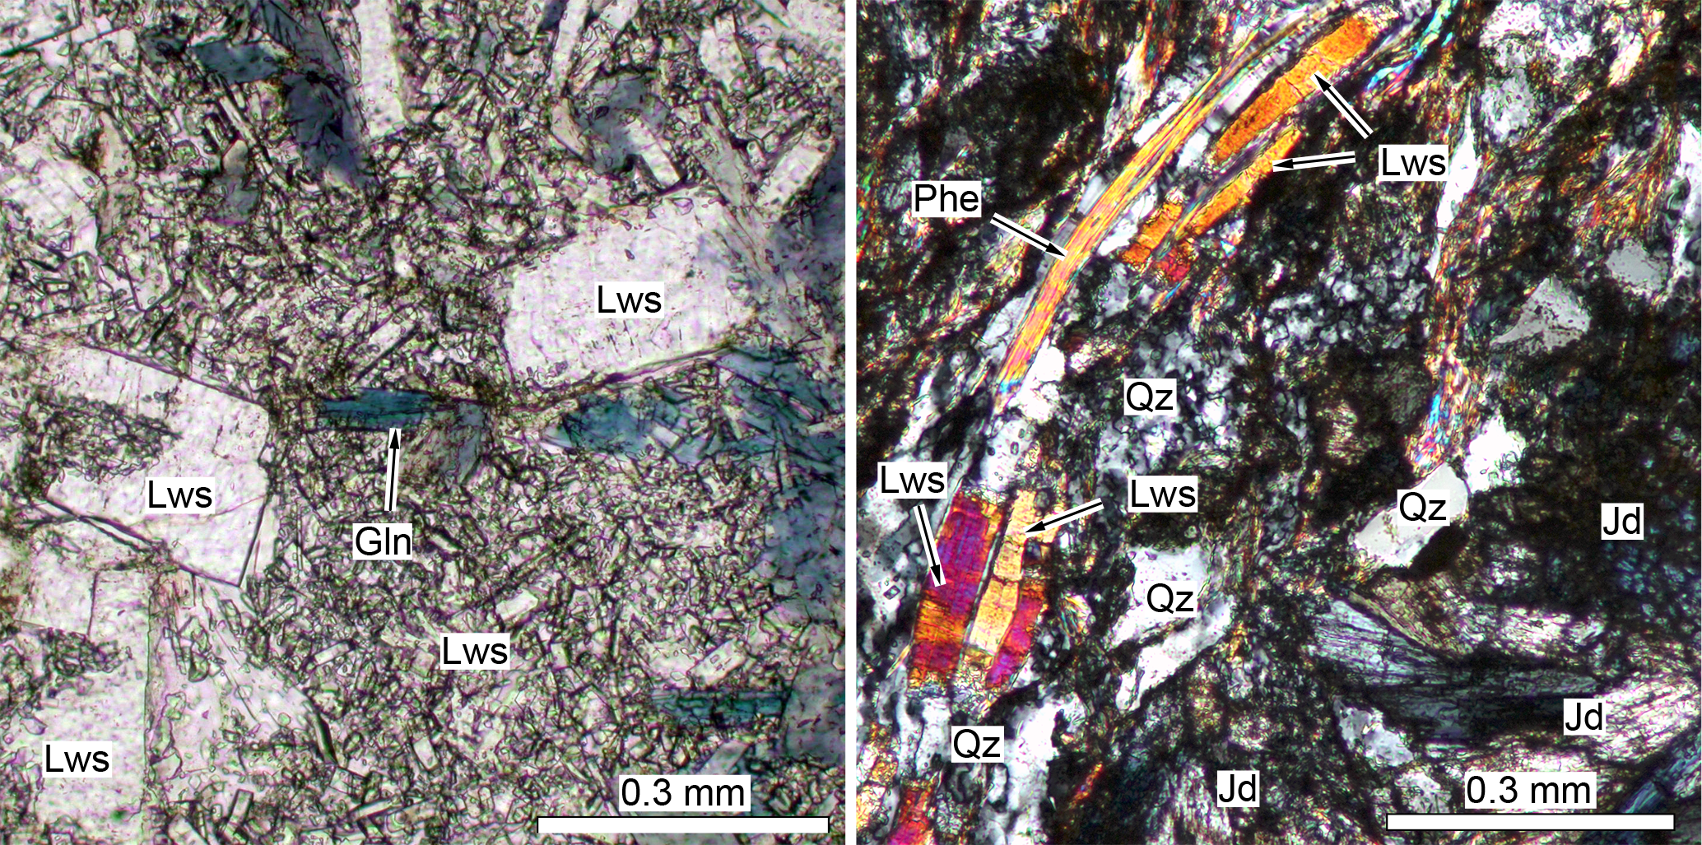
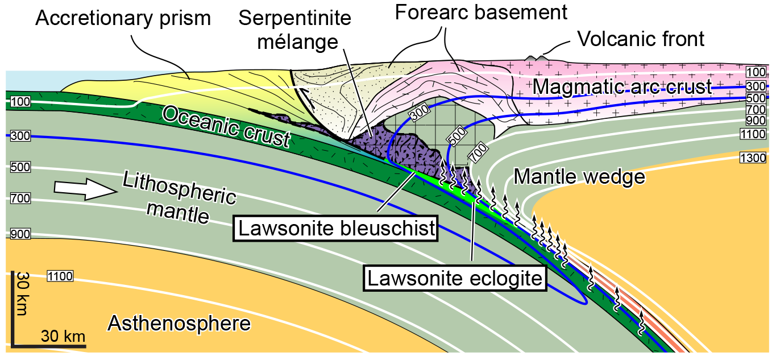
Lawsonite blueschist
Lws-BS—Anglesey (U.K.): ~560 Ma
Absence of lawsonite in rocks of Permian age.
Lws+Gln
Lws+Jd

Slide 15
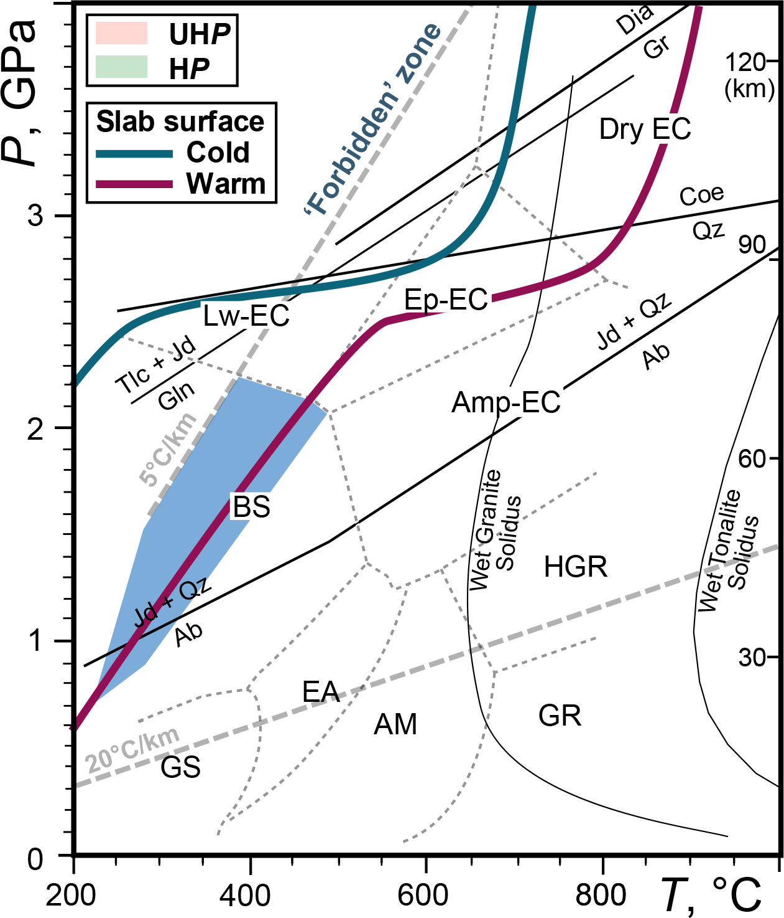
Lawsonite blueschist
Lws-BS—Anglesey (U.K.): ~560 Ma
Absence of lawsonite in rocks of Permian age.

Slide 16

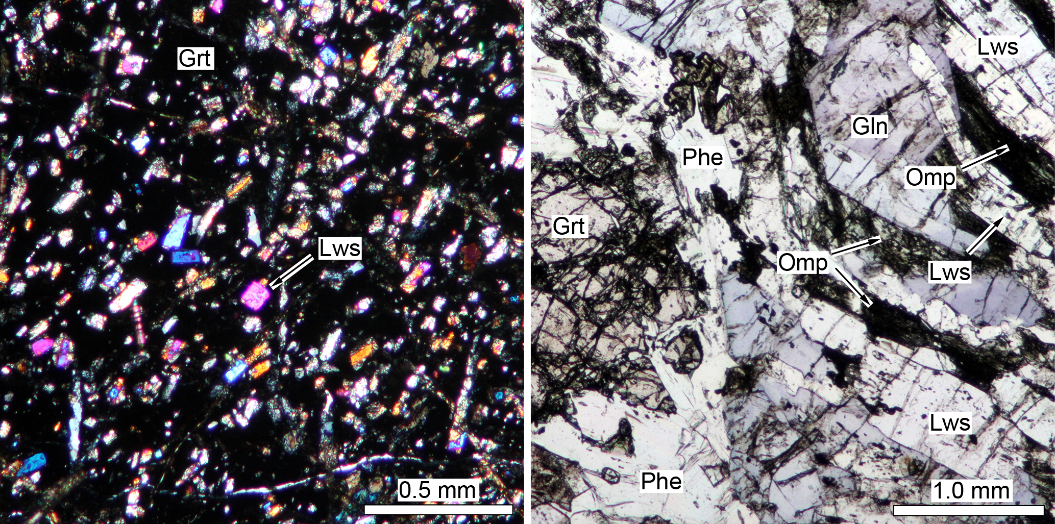
Lawsonite eclogite
Spitsbergen (Norway) & NEFB (E. Australia): ~480 Ma
L-type (Lws only), E-type (Lws + Ep), and U-type (UHP) (Tsujimori & Ernst, 2014)
Grt+Omp+Lws+Rt
Grt+Omp+Gln+Lws

Slide 17
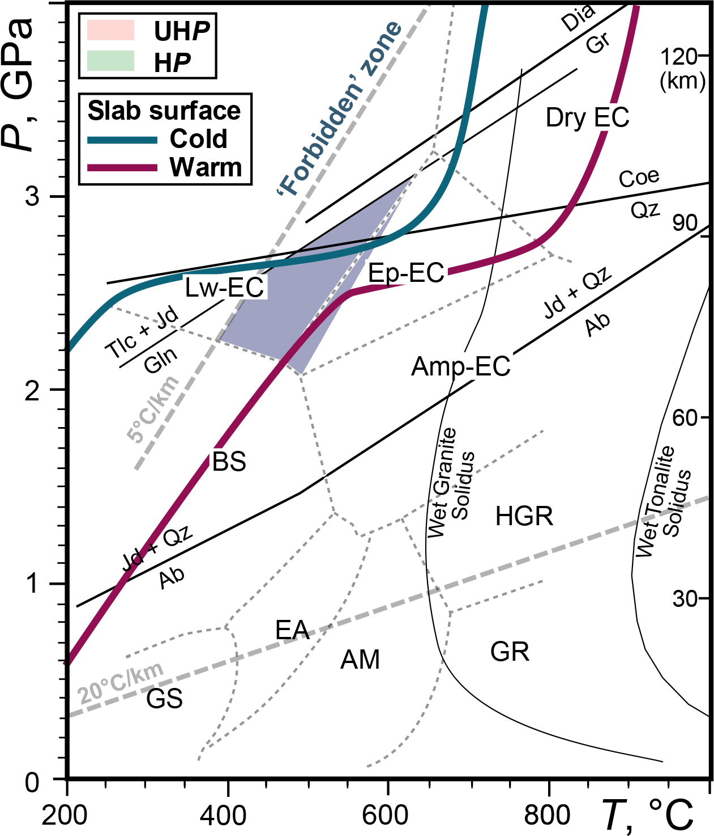
Lawsonite eclogite
Spitsbergen (Norway) & NEFB (E. Australia): ~480 Ma
L-type (Lws only), E-type (Lws + Ep), and U-type (UHP)

Slide 18

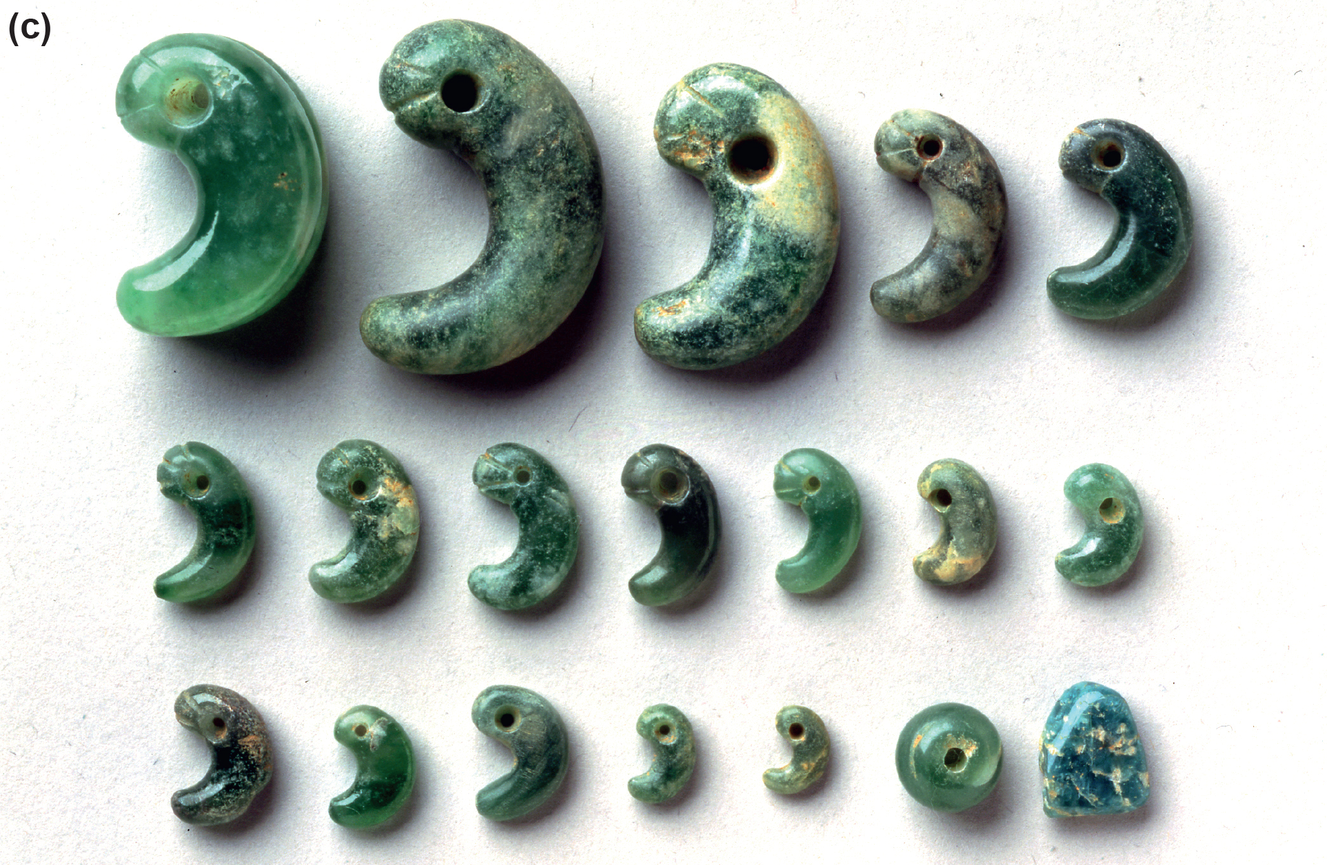
Jadeitite
Mostly Pacific-type orogens (circum-Pacific; Caribbean,
CAOB) and suture zone (Myanmar)
Itoigawa/Osayama (SW Japan) & Borus (Russia): ~520 Ma

Slide 19
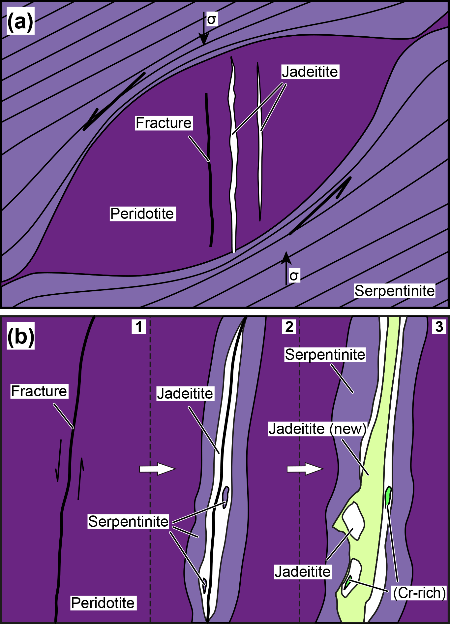
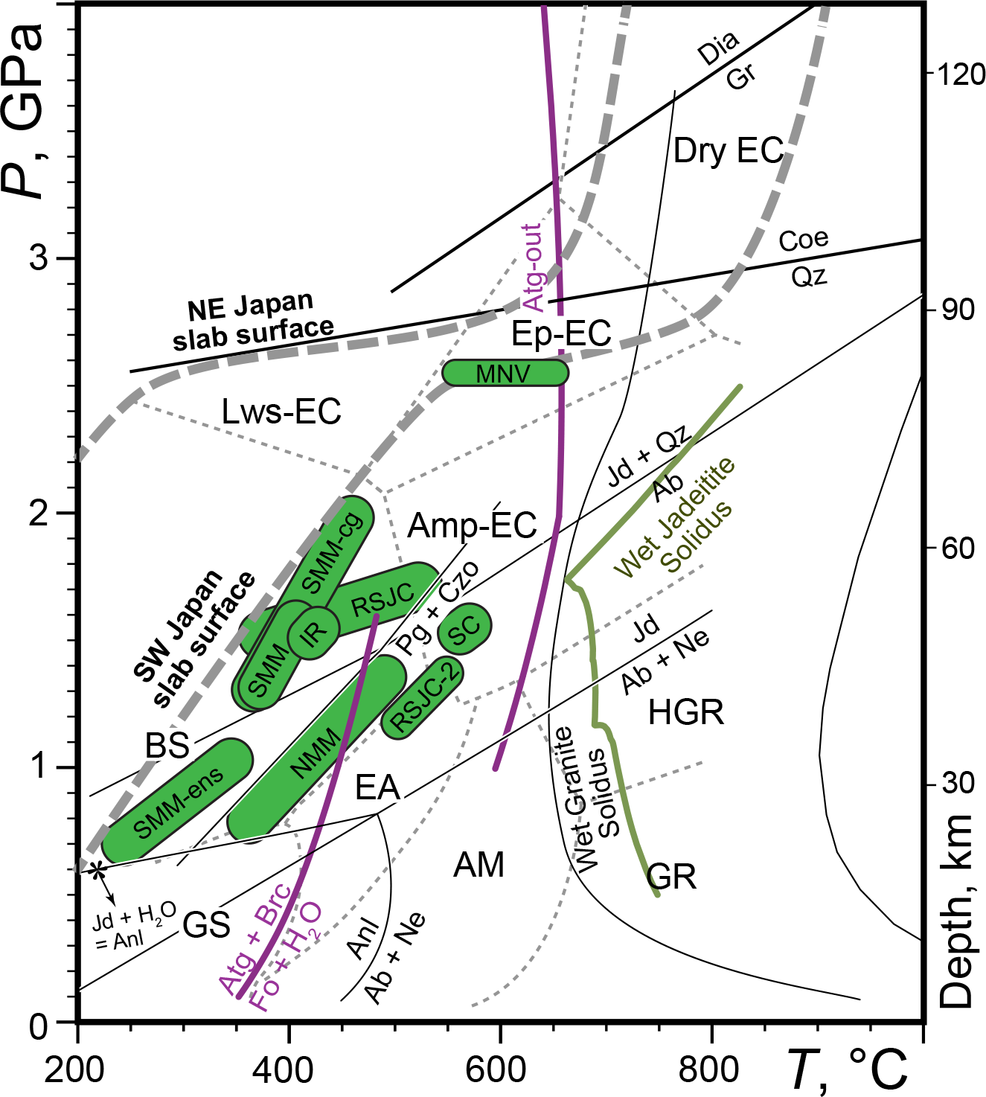
Jadeitite
P-type (fluid precipitates)—No protolith
R-type (metasomatic replacement)
@mantle wedge (Tsujimori & Harlow, 2012)
Harlow, Tsujimori & Sorensen (2015)

Slide 20
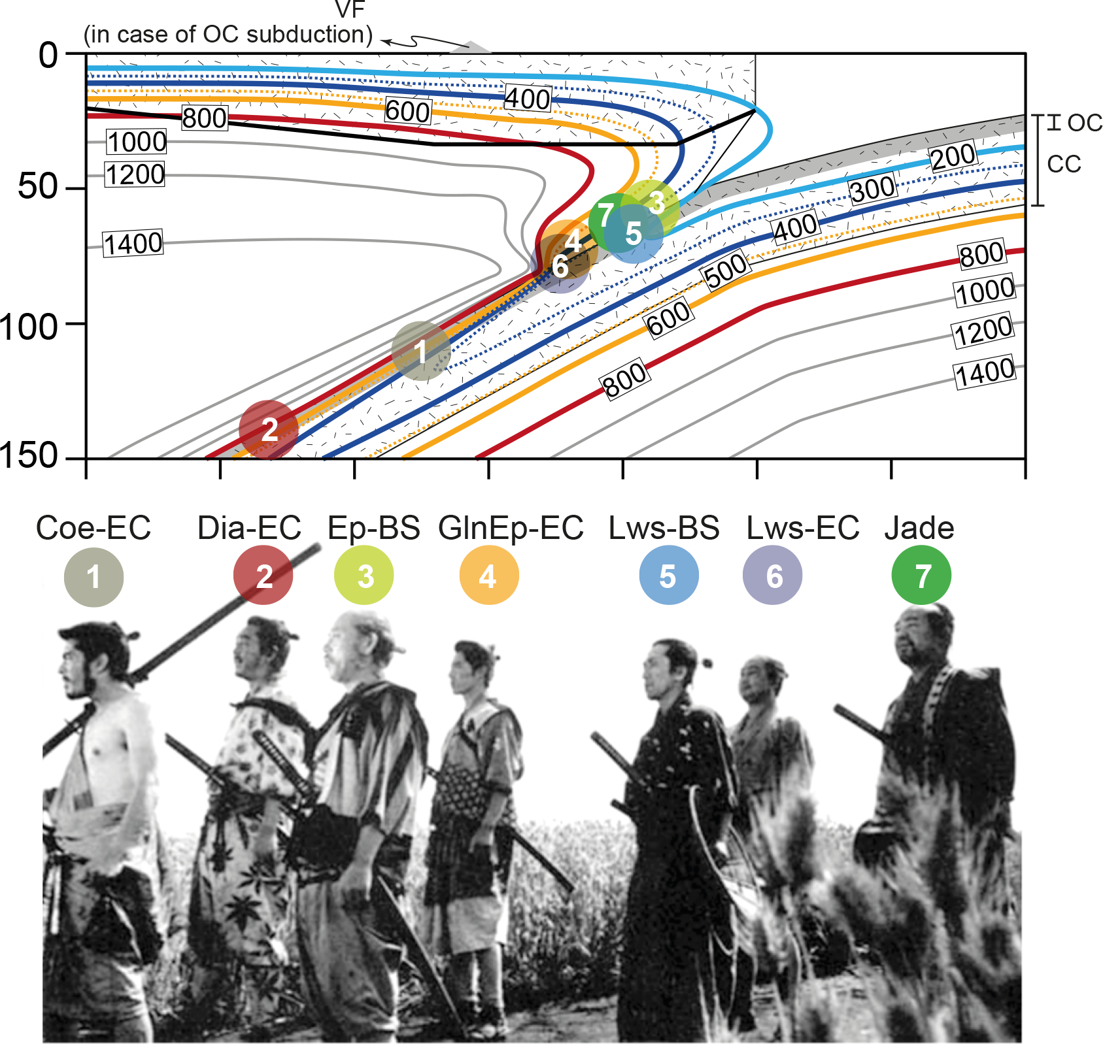
Notes:
Here is a simplified convergent margin for both oceanic and continental subductions.
- Oceanic Crust (OC)
- Continental crust (CC)
Thermal structure is based on a "Cold" oceanic plate subduction of NE Japan by van Keken et al

Slide 21

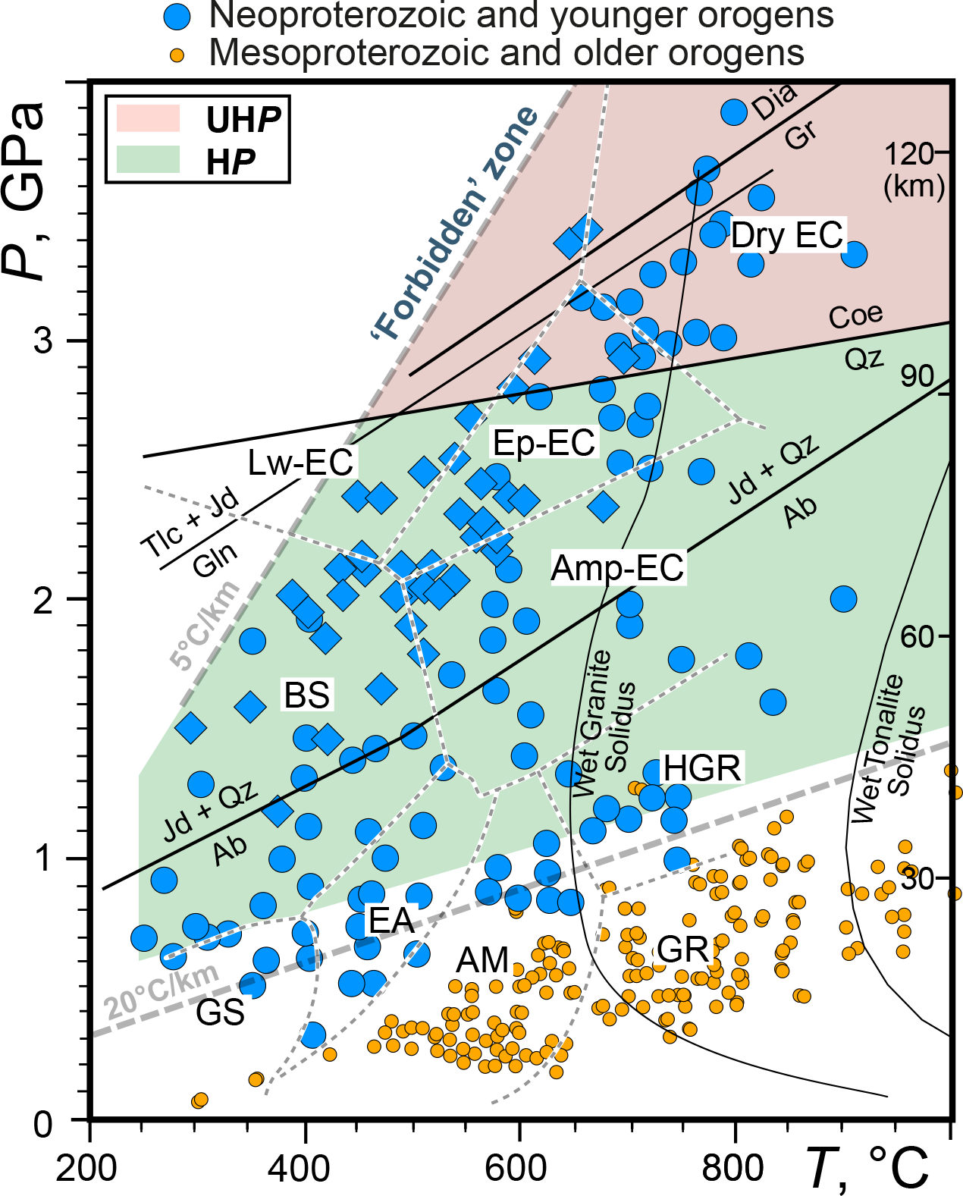
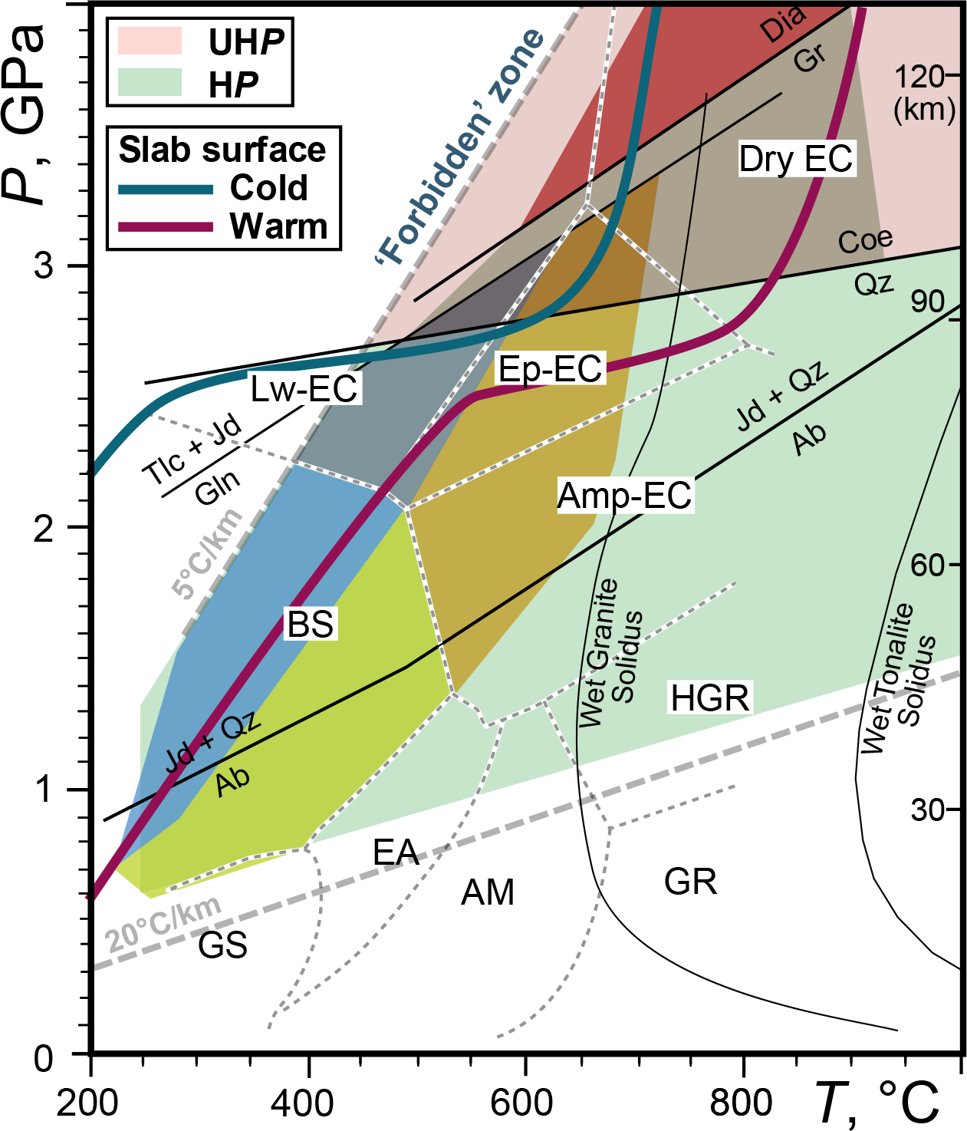
The 7 Samurai (HP and UHP metamorphic rocks) first make their appearance in Neoproterozoic time
Maruyama et al. (1996)
+ Tsujimori et al. (2006), Tsujimori & Ernst (2014)

Slide 23
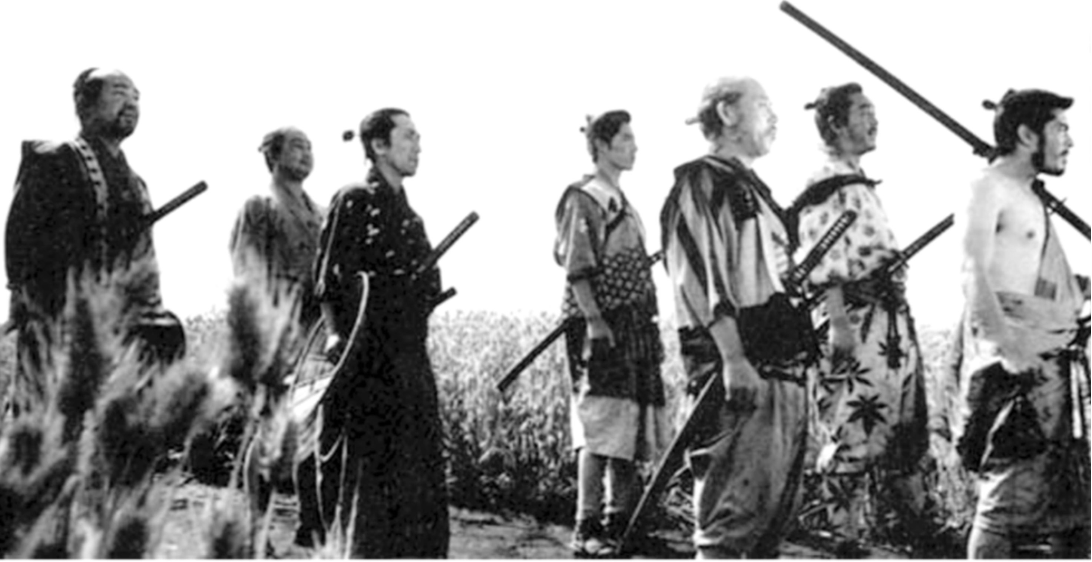
The 7 Samurai say PT began 500-750 Ma ago
Please use your work in HP and UHP metamorphic rocks to contribute to this important discussion.

Slide 26
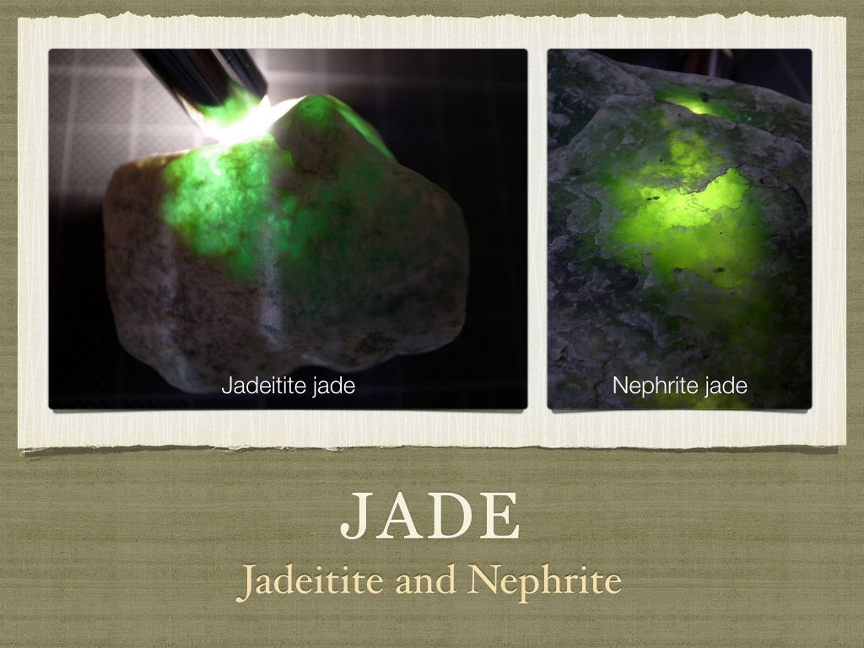

Slide 27
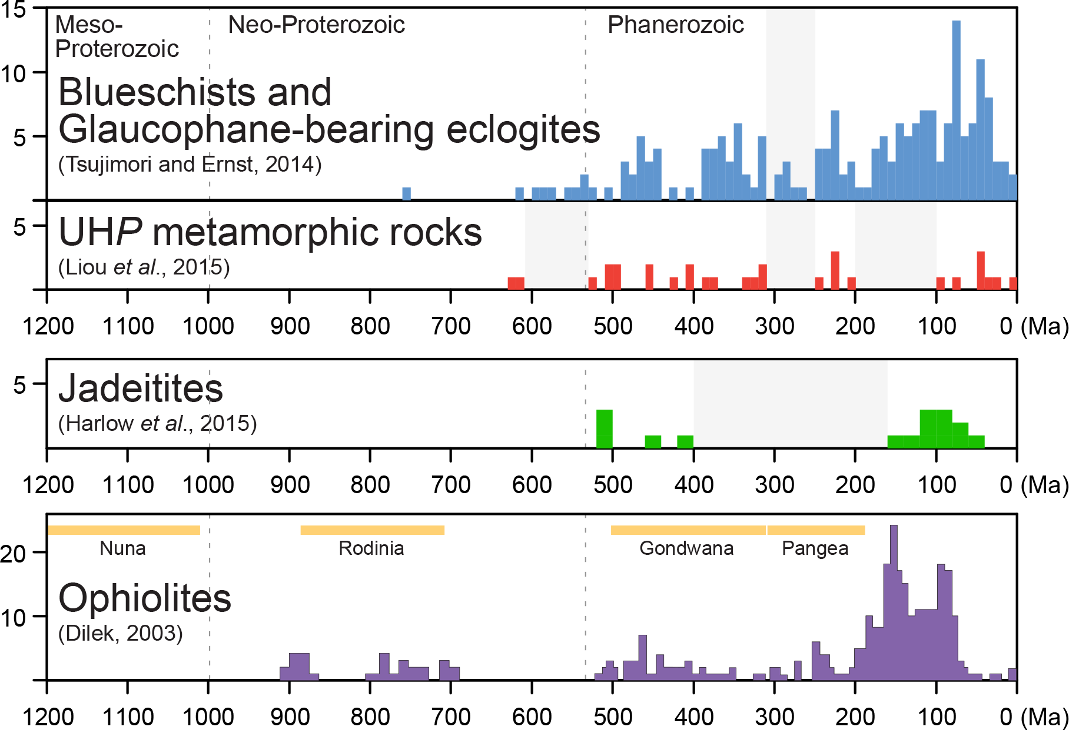
Age summary for 4

Slide 28
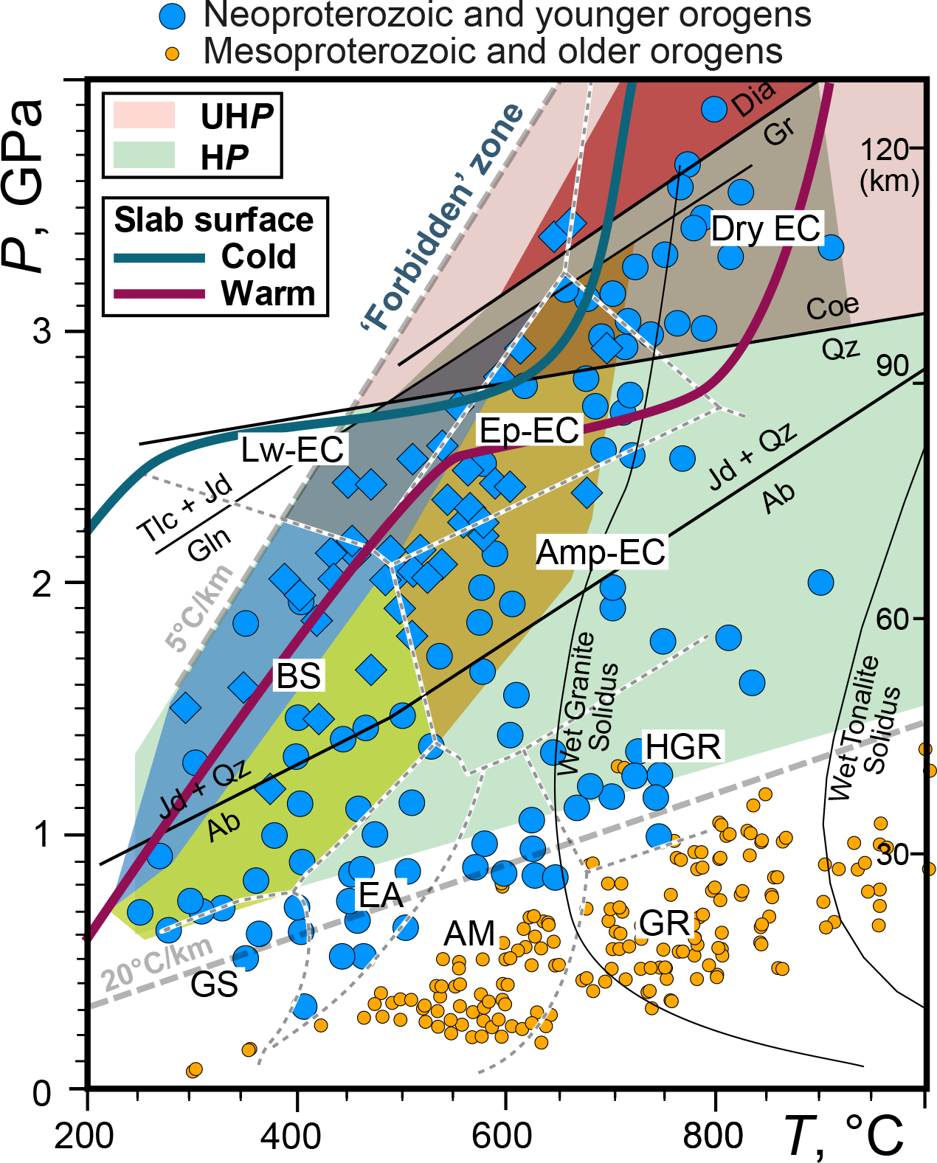

Slide 29
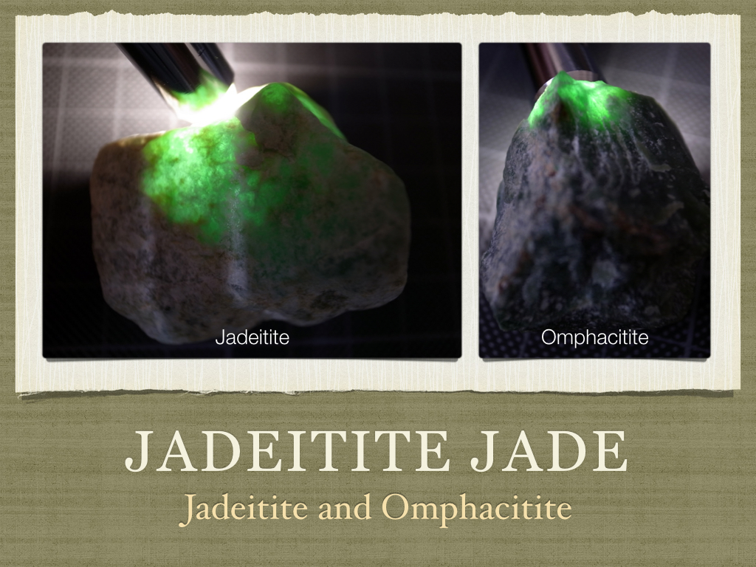

Slide 30
Blueschists (sensu lato) & Gln–Ep eclogite
Low-grade Ep-BS—Aksu (NW China): ~730 Ma;
Gln–Ep-EC—Gourma (E. Mali): ~630 Ma

