Slide 1


Slide 2
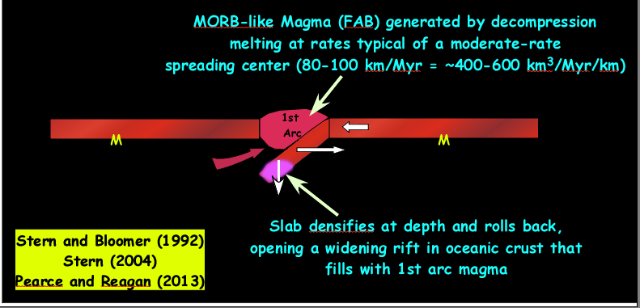
The Why is Because at Newly Established Subduction Zones
Suprasubduction Zone Magmatism
is Volumetrically Prodigious

Slide 3
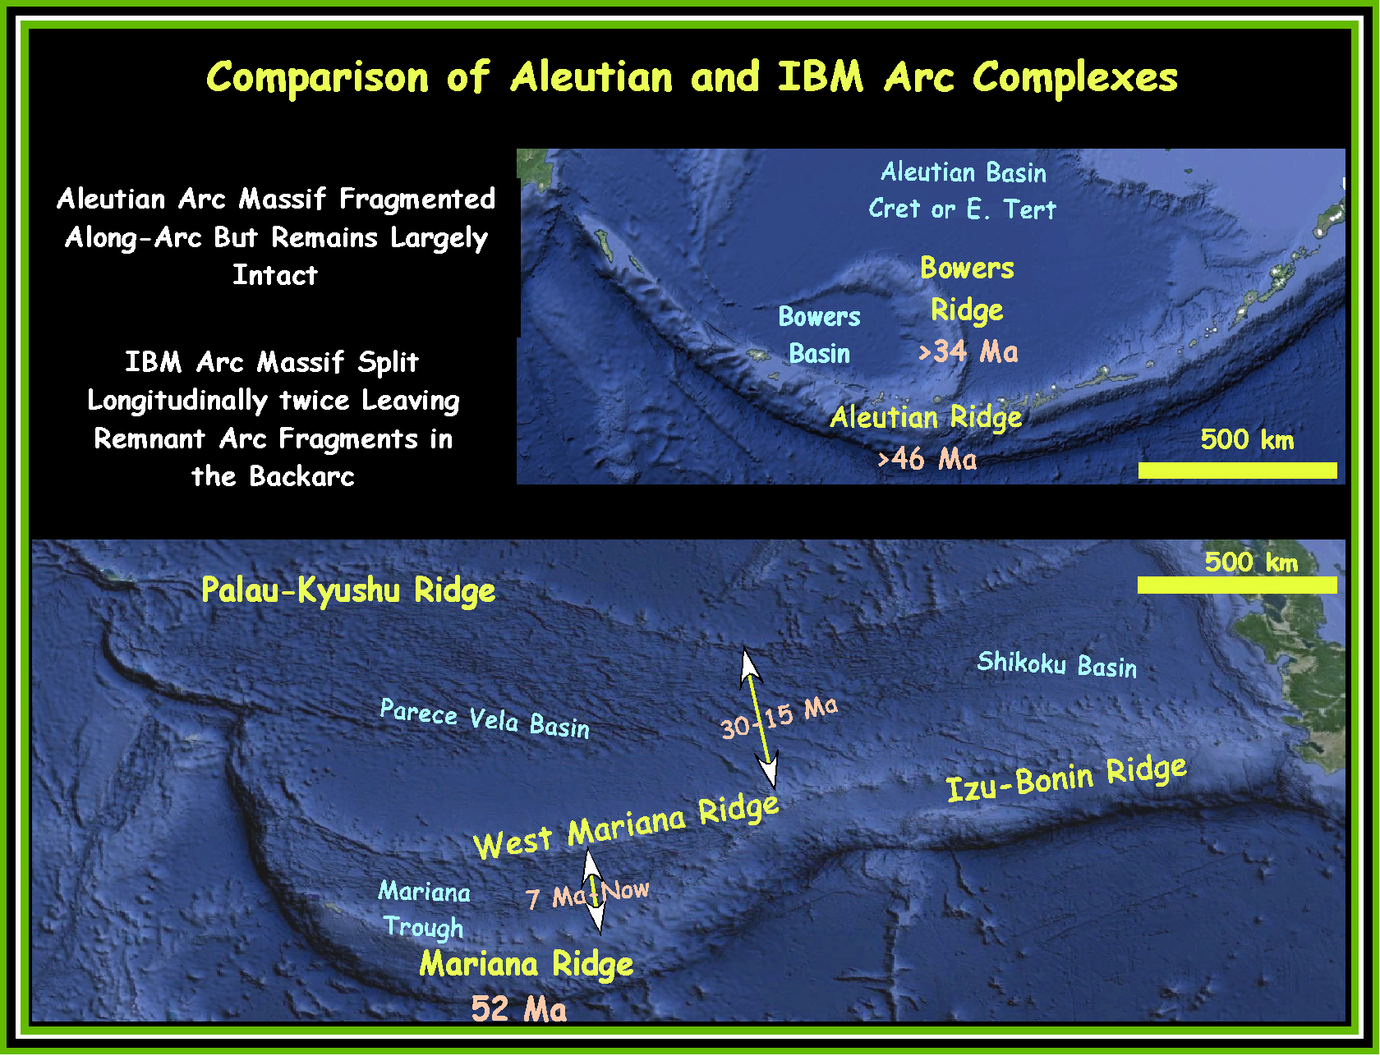

Slide 4
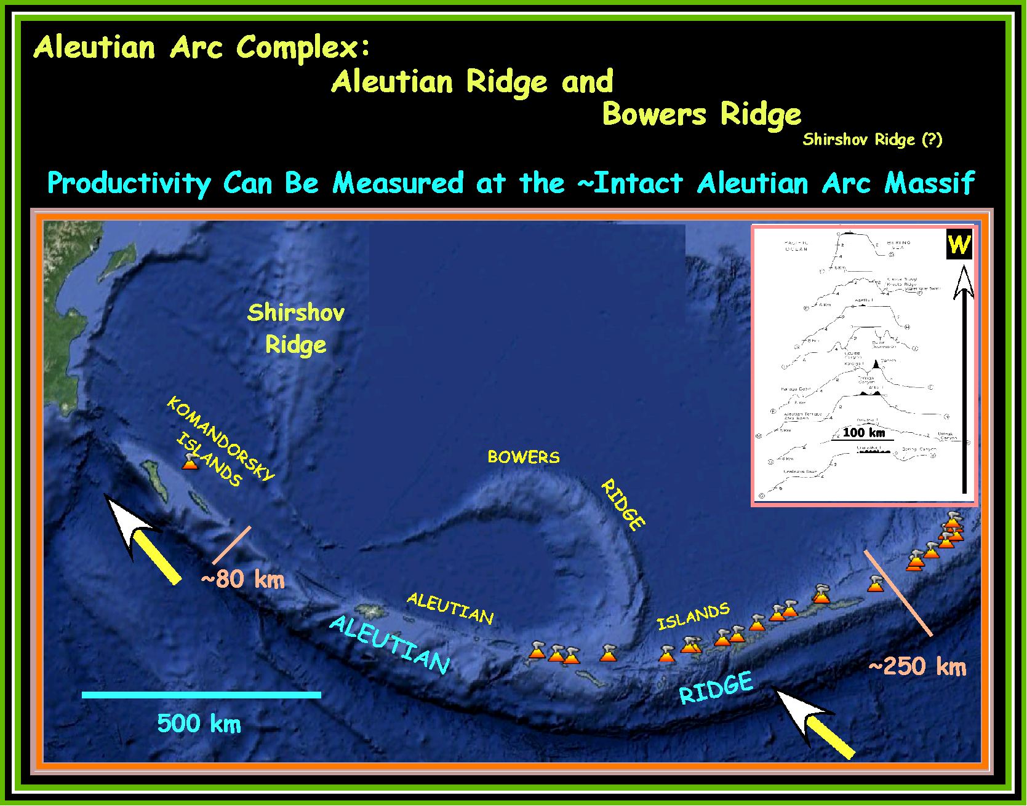

Slide 5
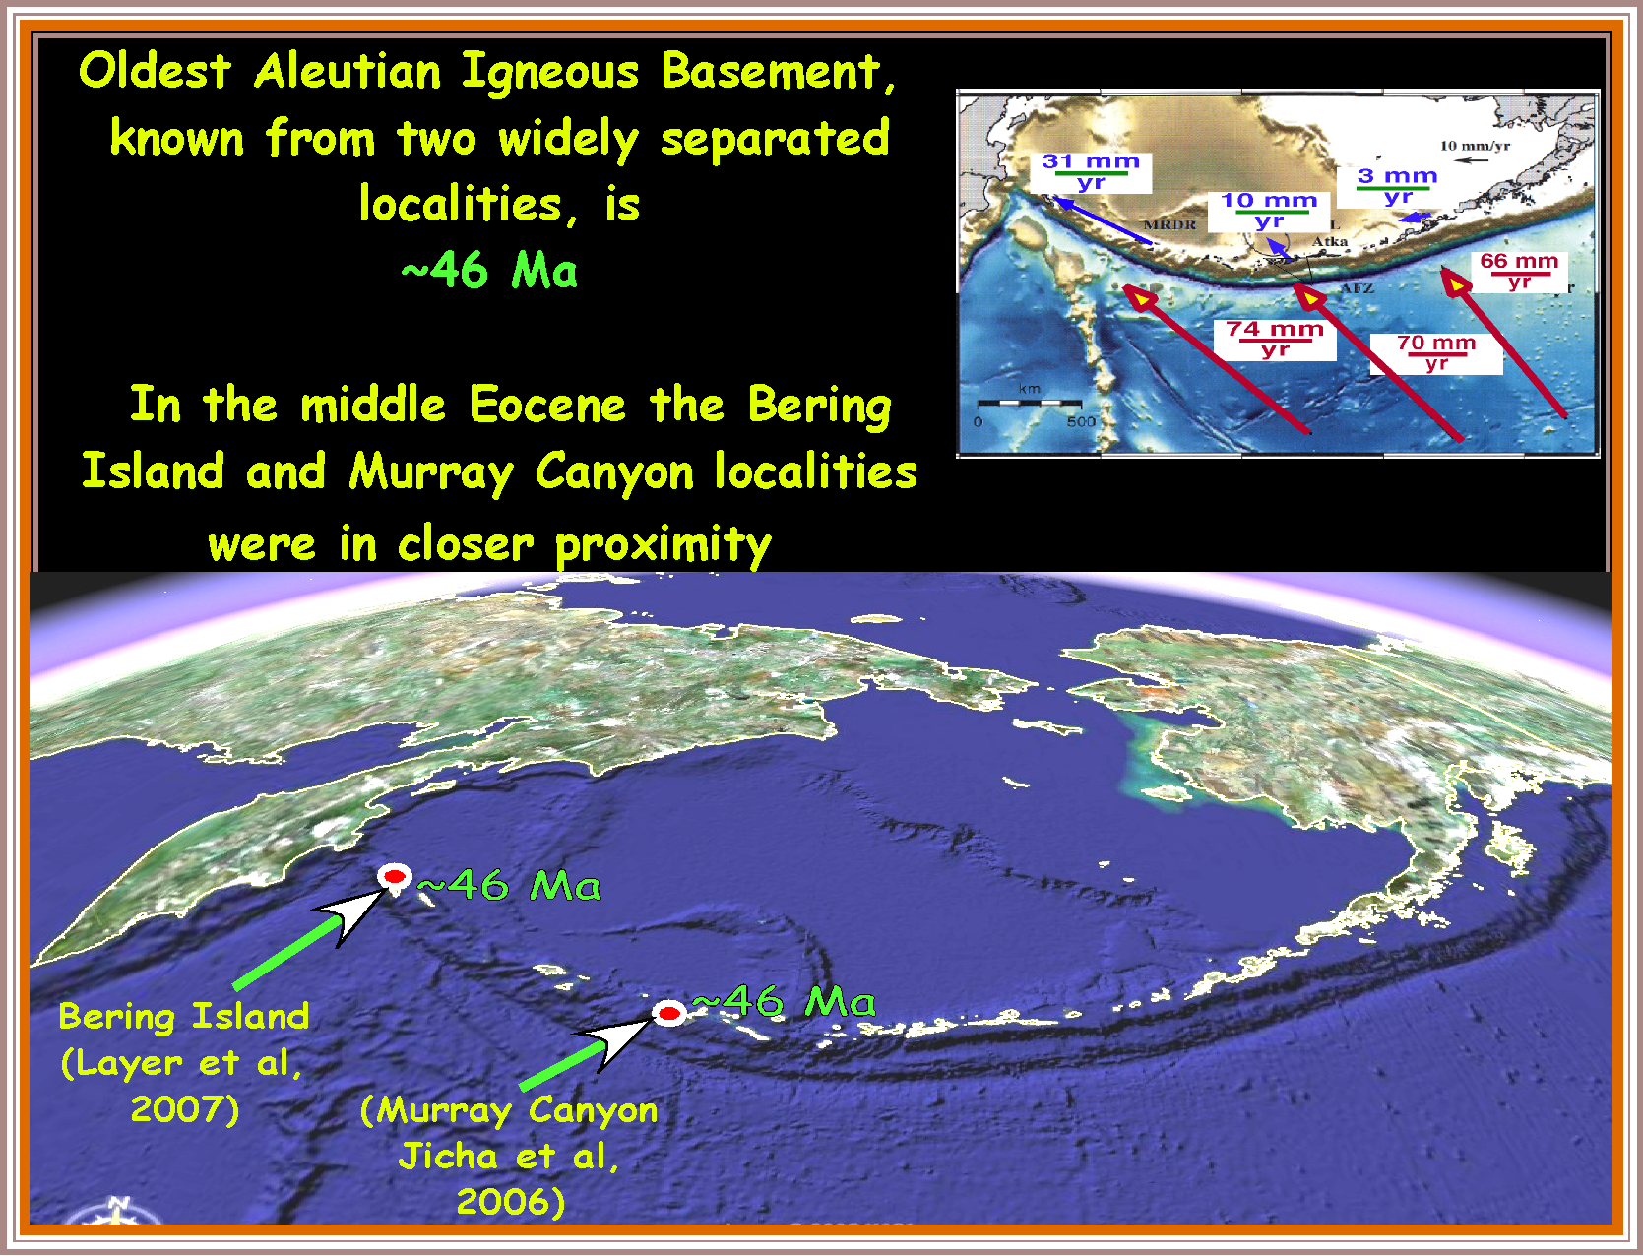

Slide 6
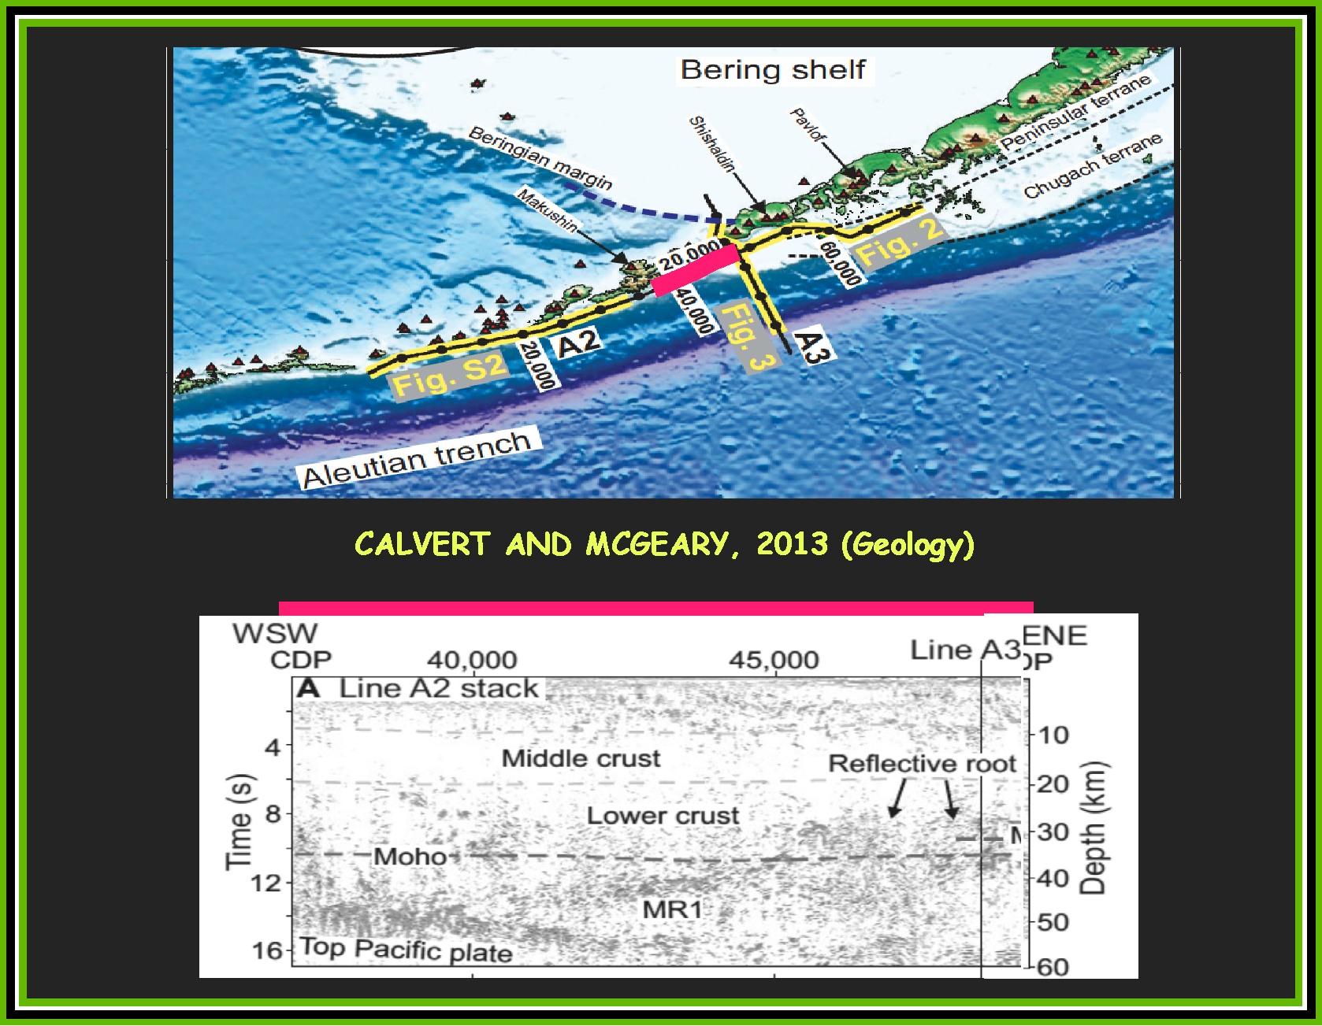

Slide 7
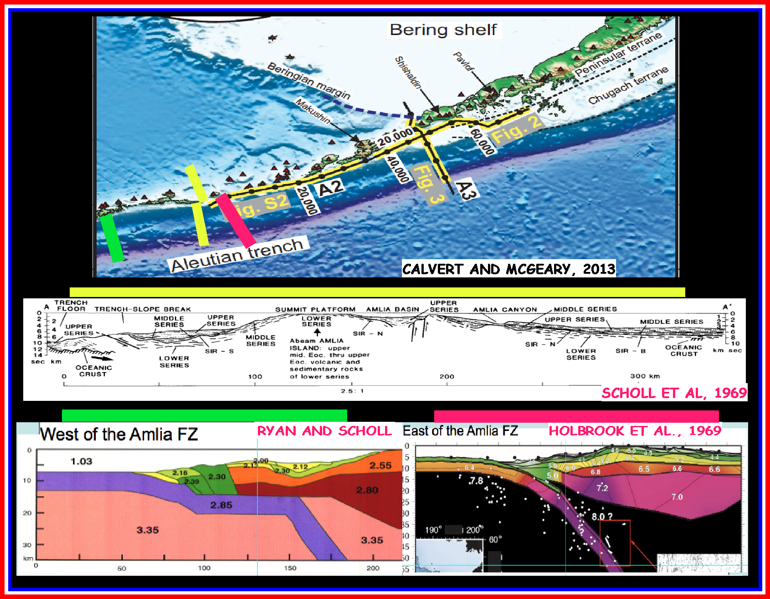

Slide 8
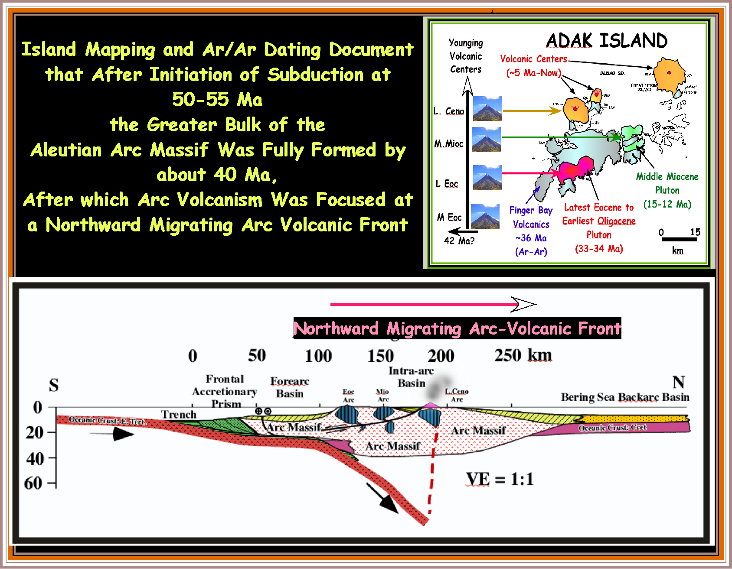

Slide 9
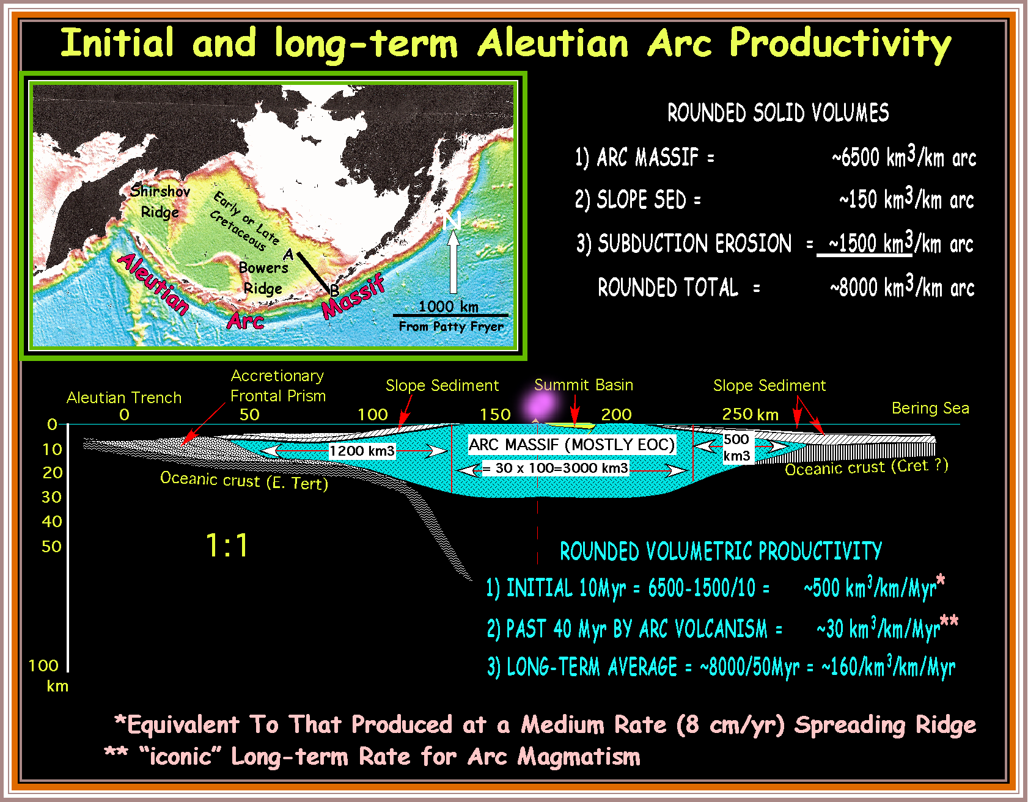

Slide 10
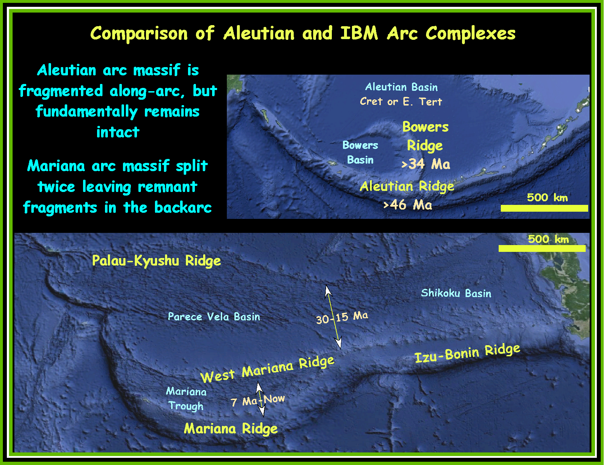

Slide 11
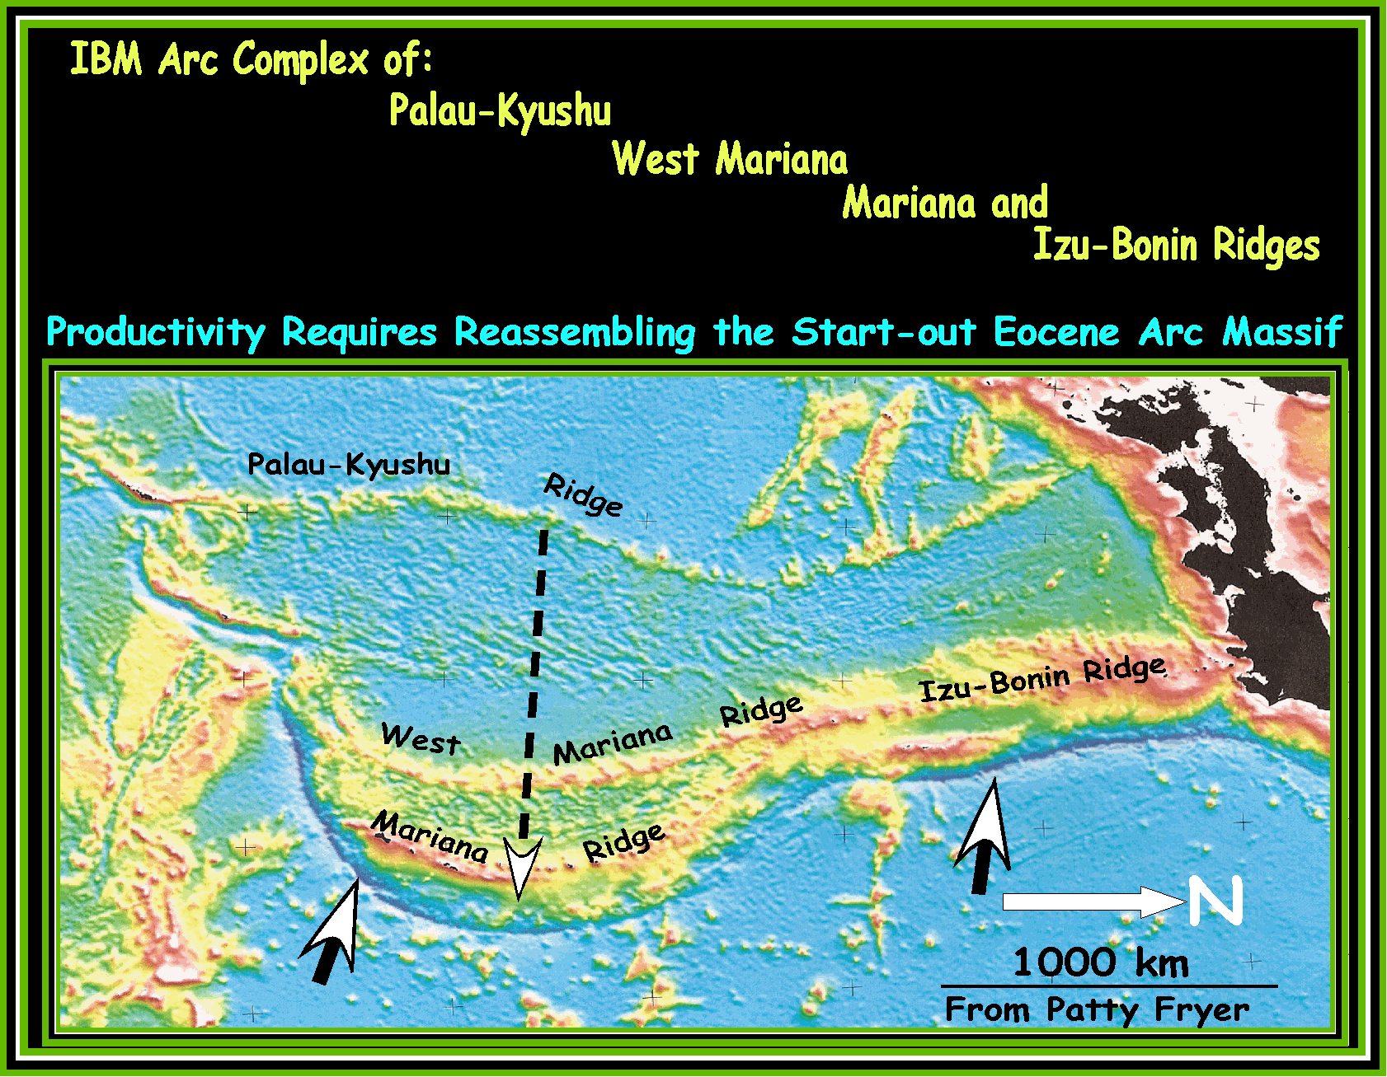

Slide 12
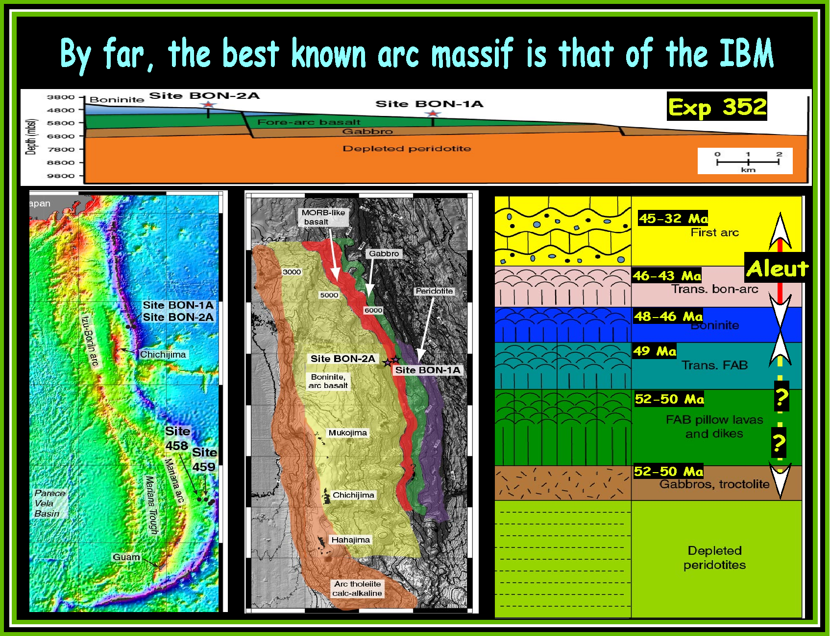
Pearce and Reagan (2013)

Slide 13
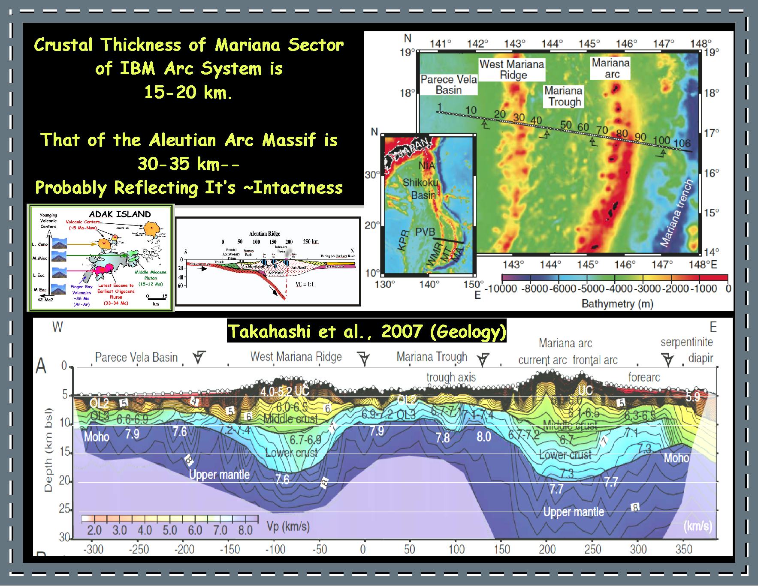

Slide 14
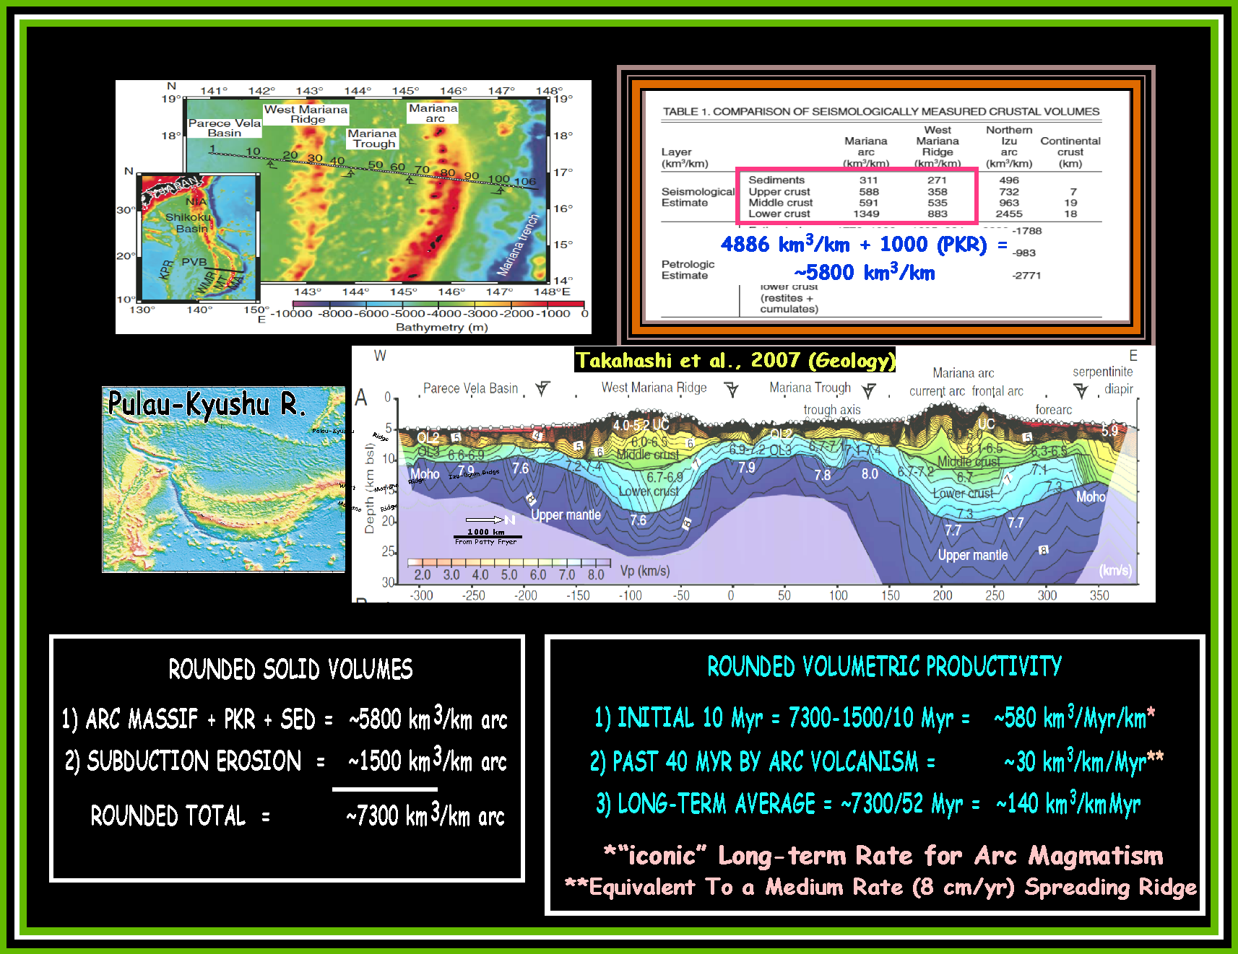

Slide 15
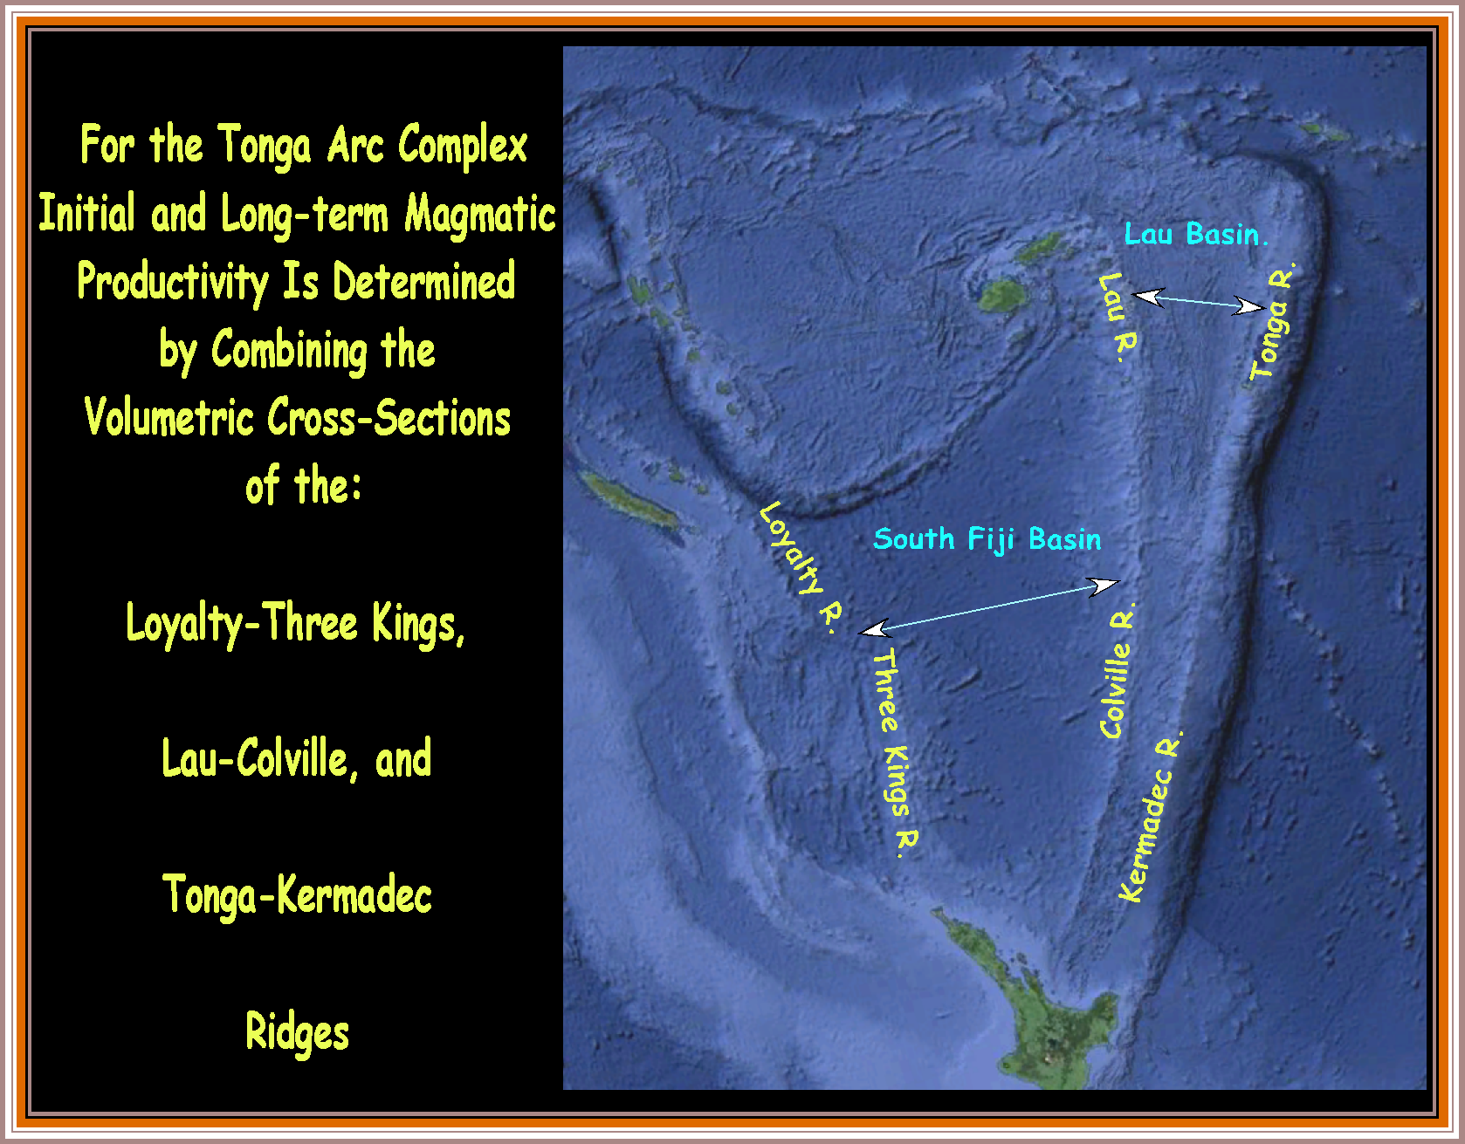

Slide 16
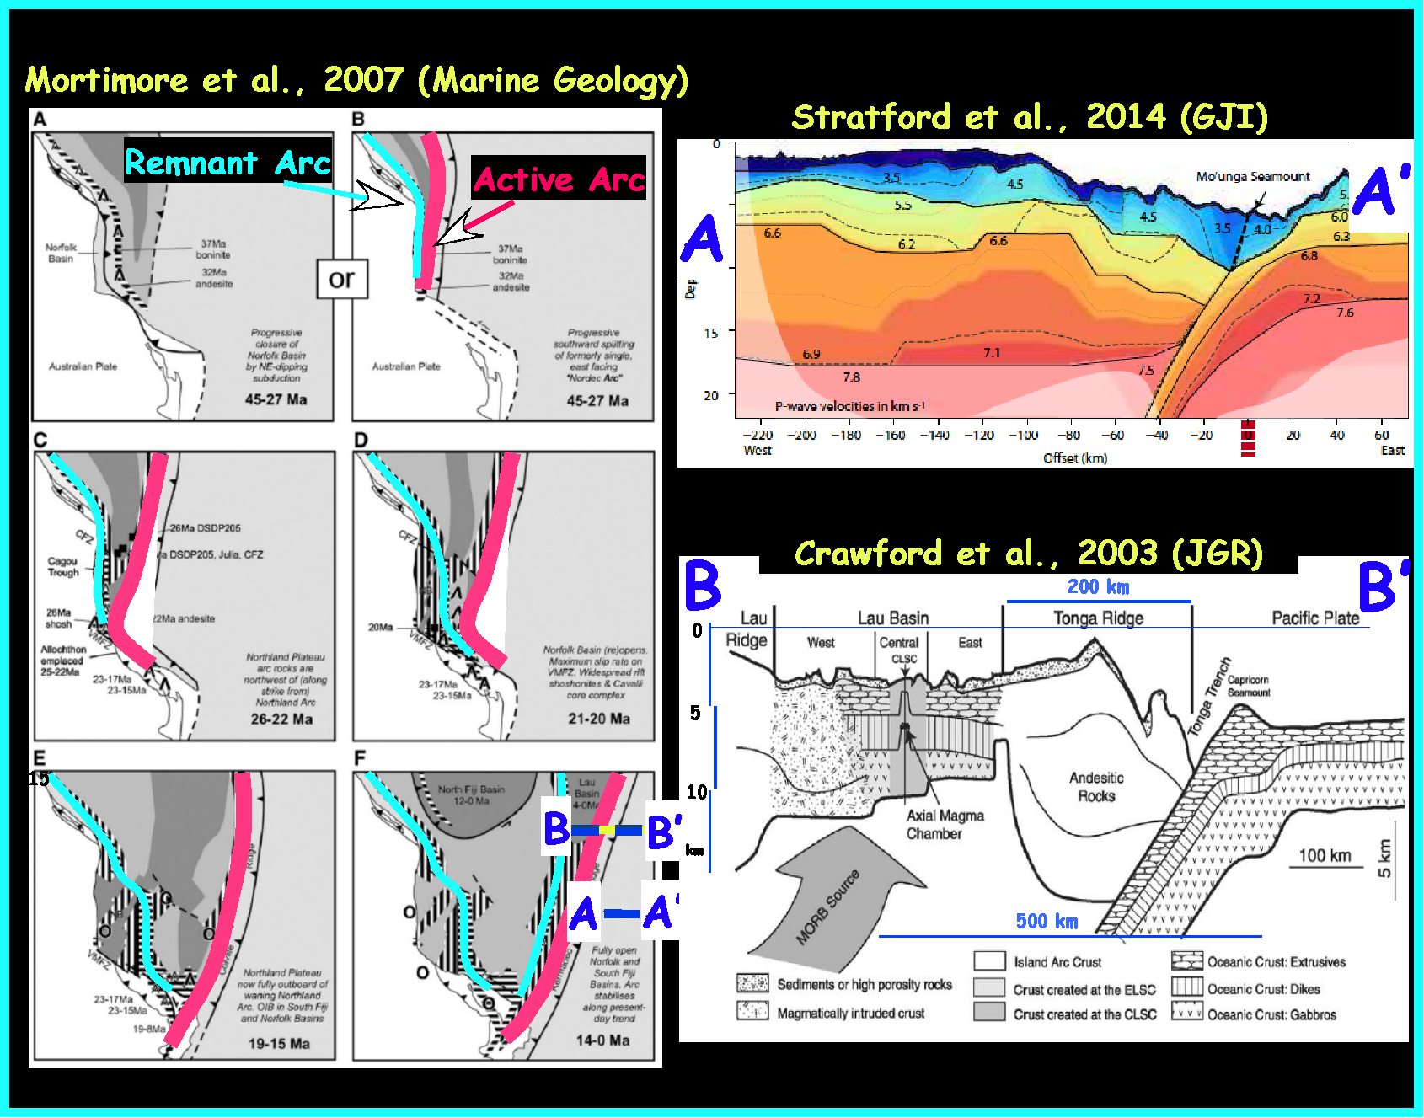

Slide 17
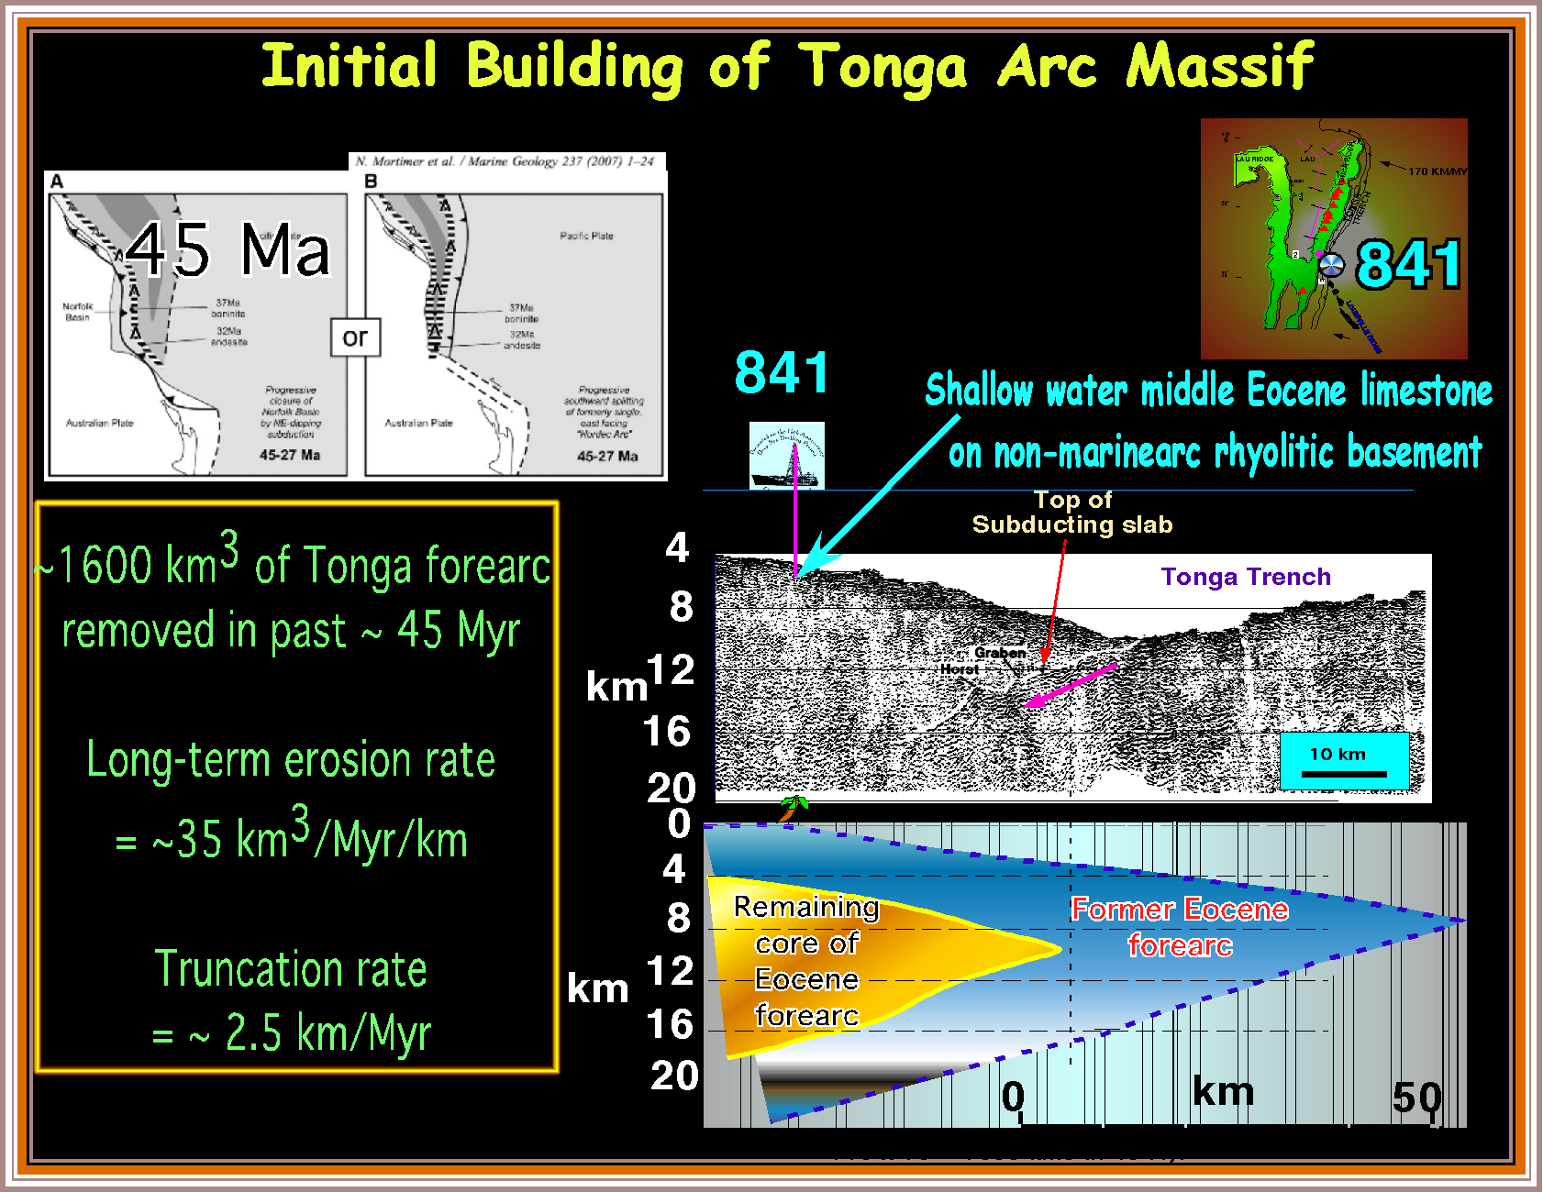

Slide 18
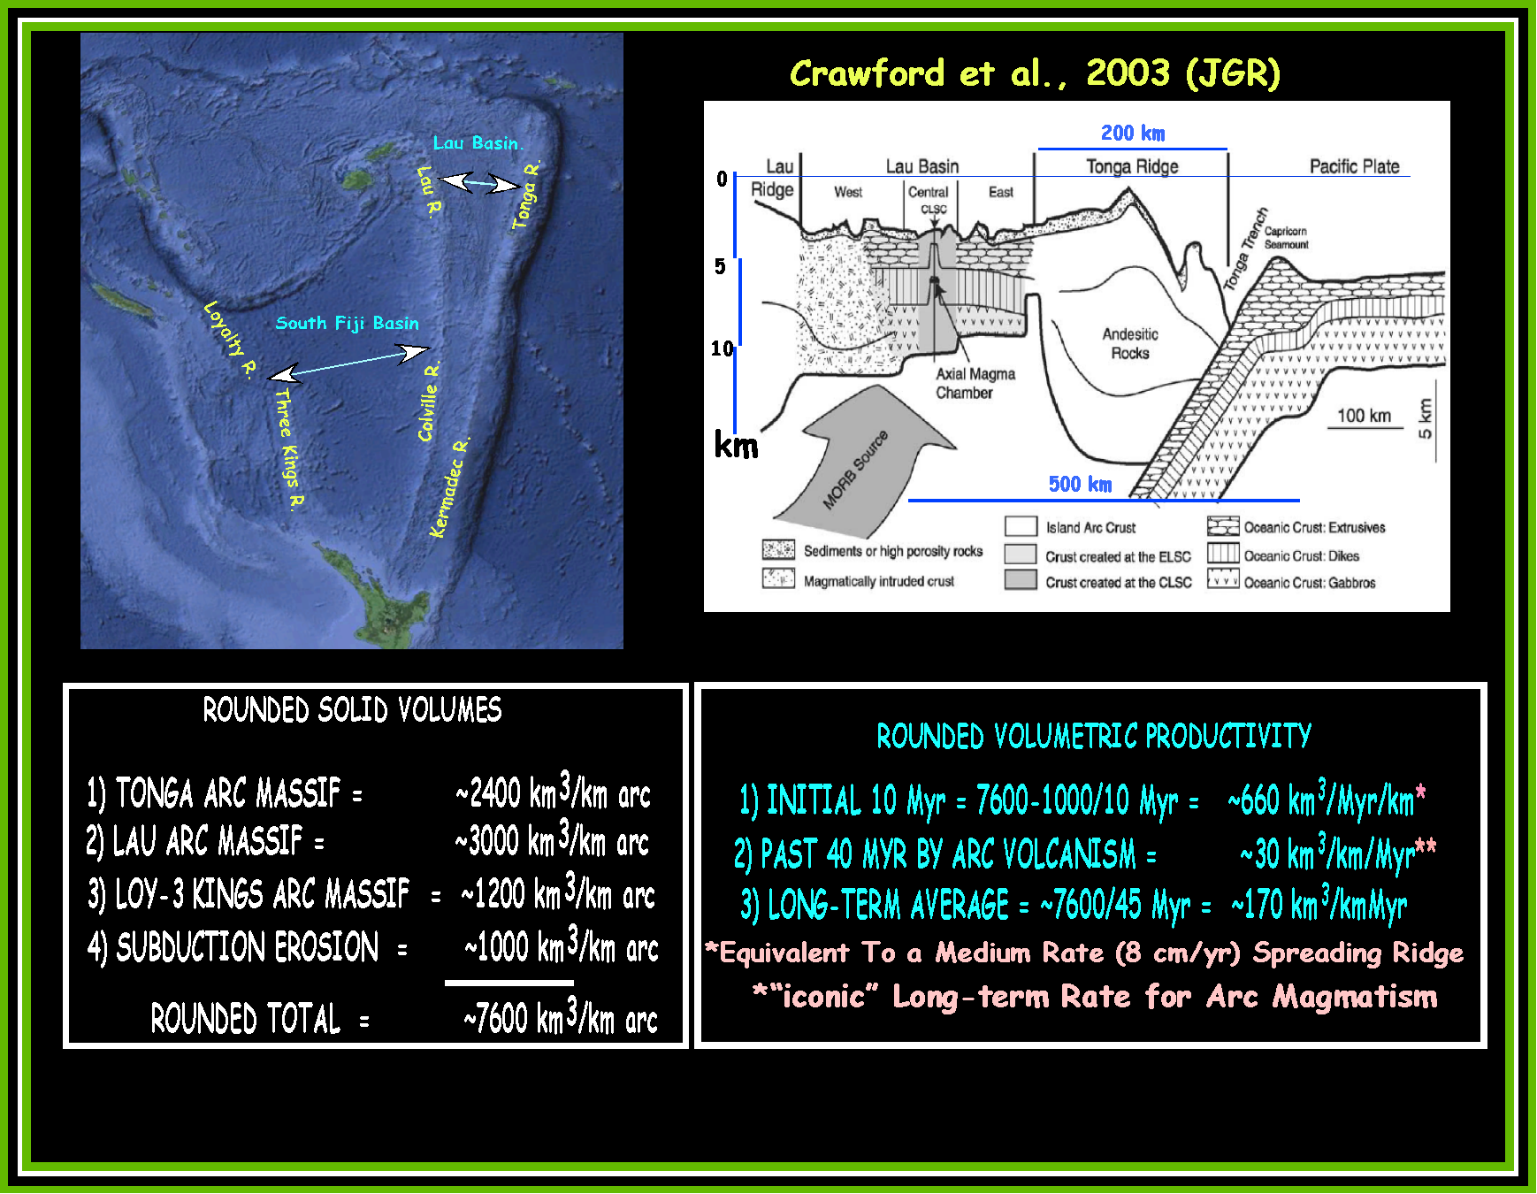

Slide 19
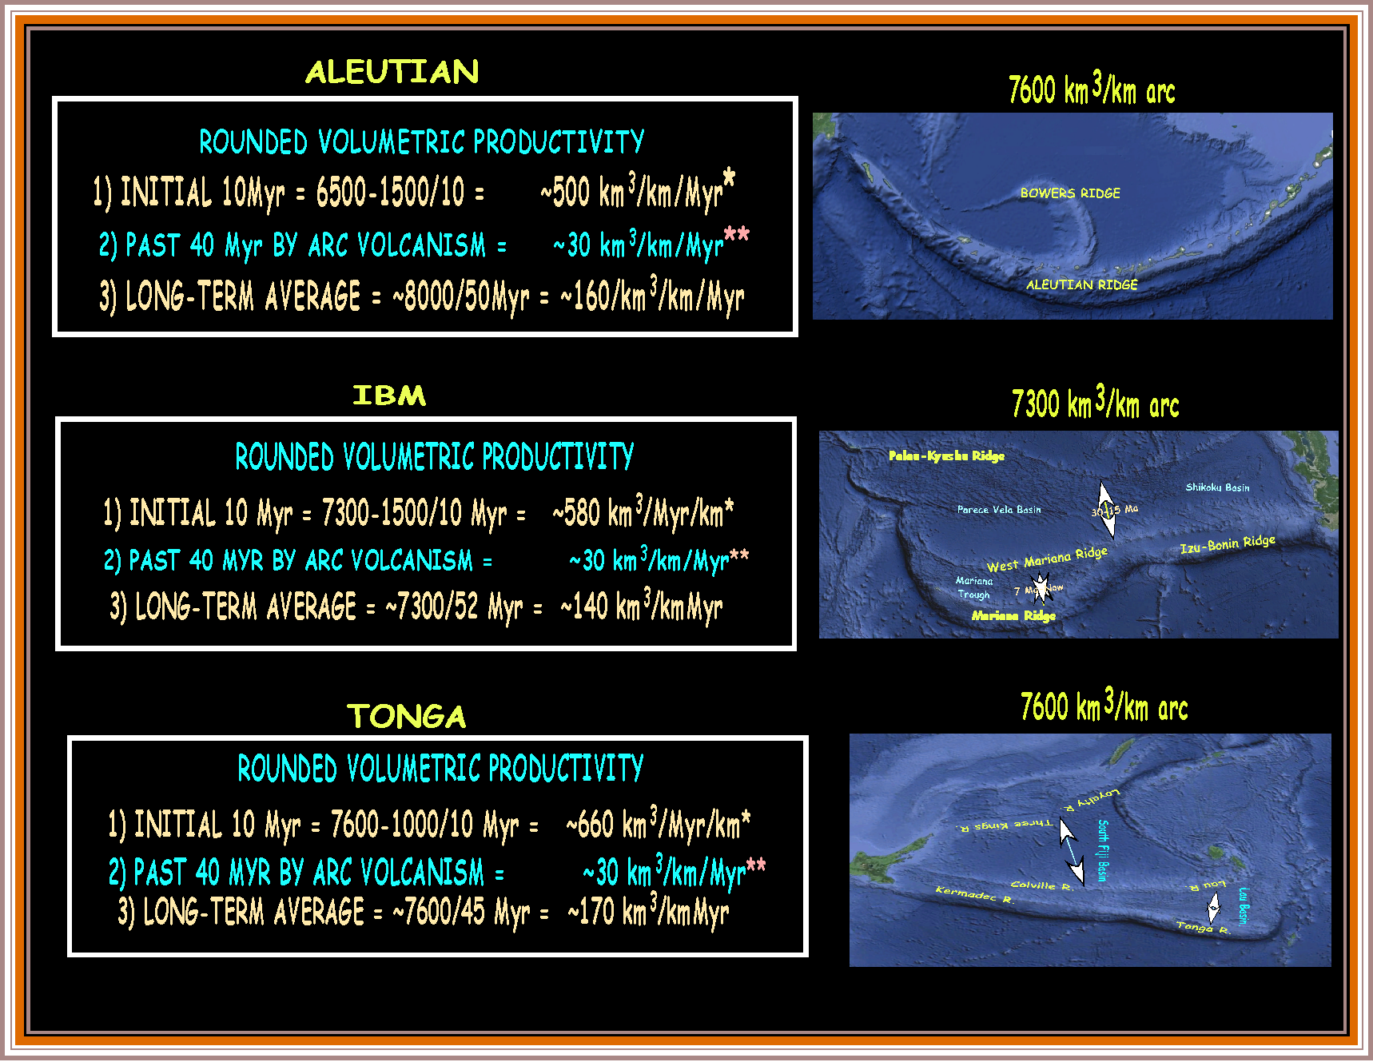

Slide 20
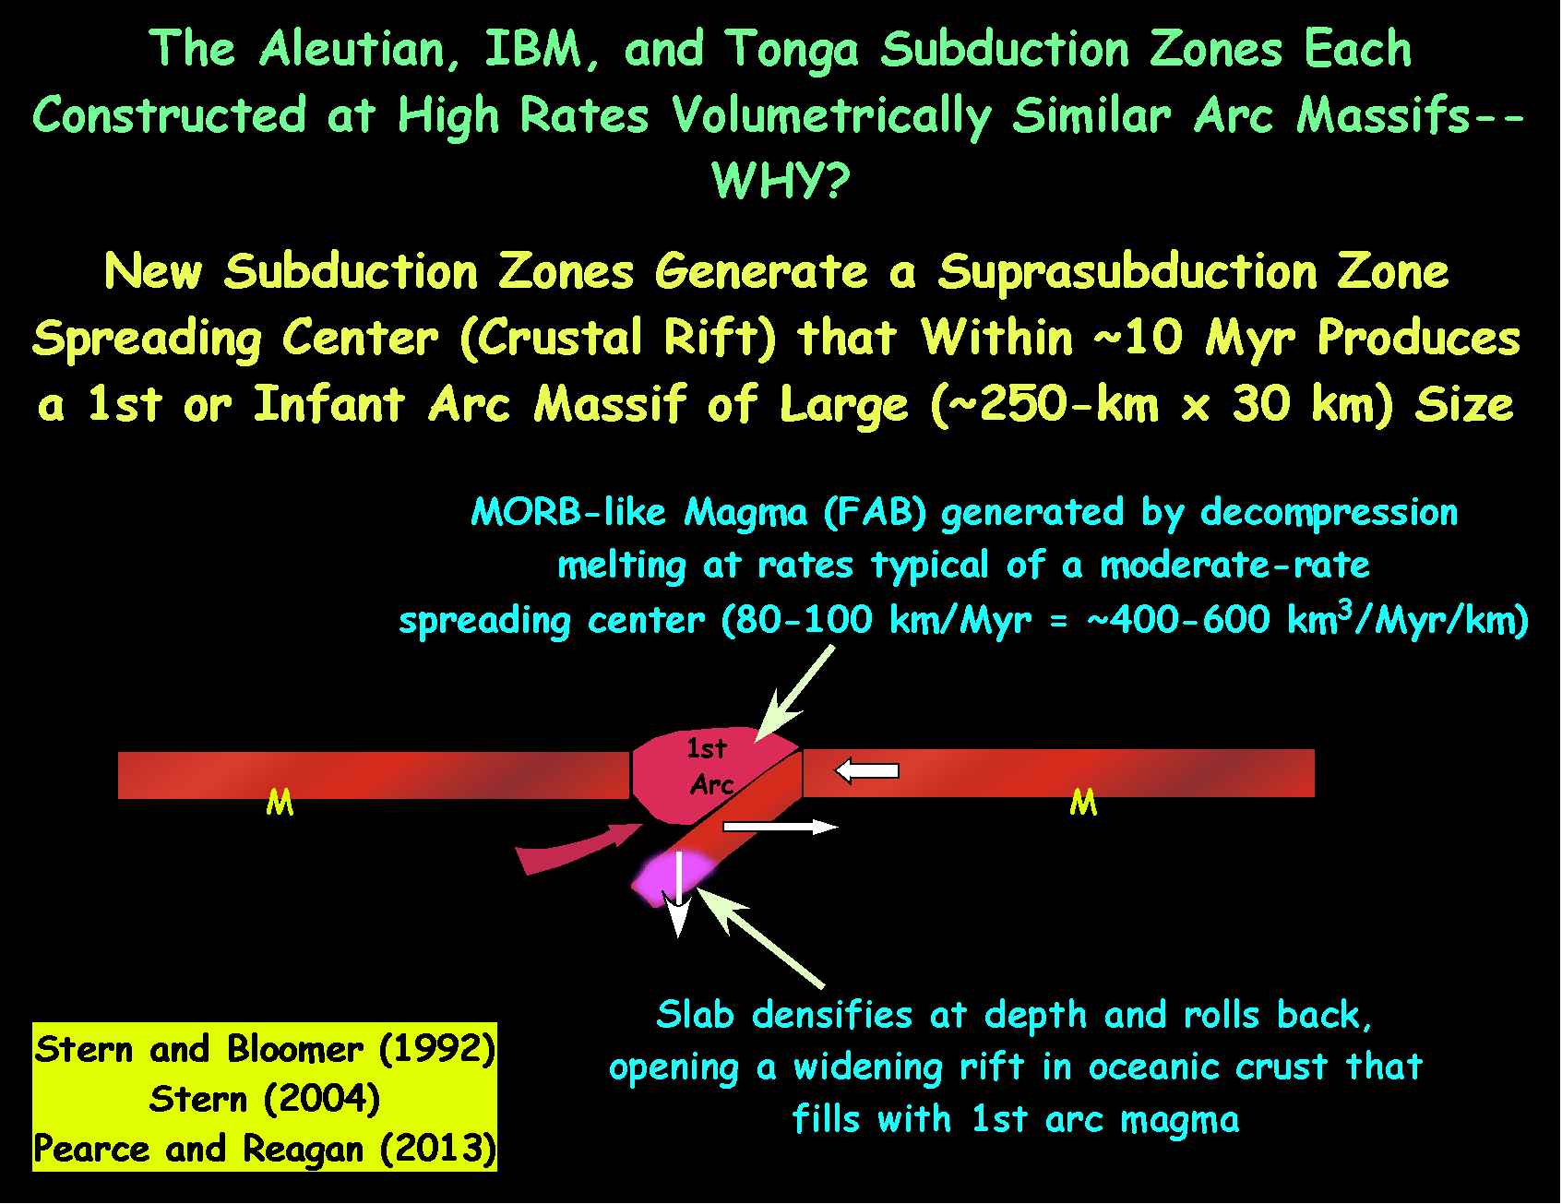

Slide 21
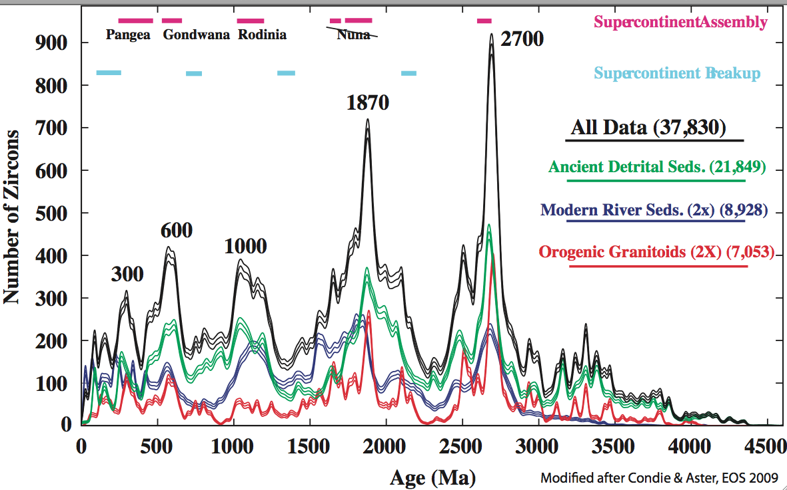
A Significant Contributor to the Record of Continental Growth and Preservation Is, During Supercontinent Brackup, Rapid Crustal
Growth at Newly Established Subduction Zones
Condie and Aster, 2009)

Slide 22
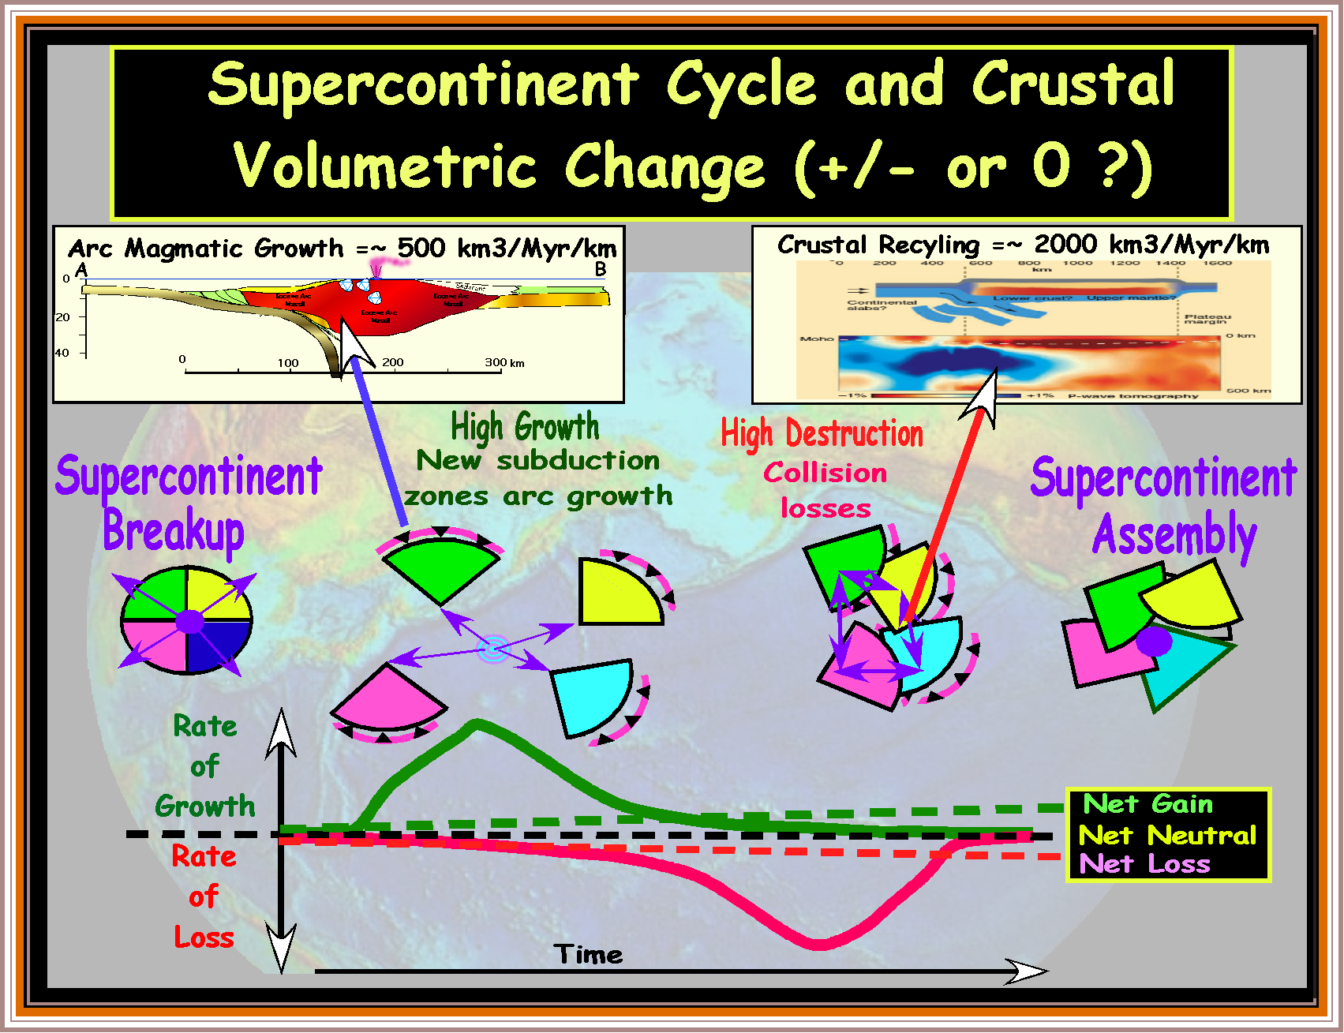

Slide 28
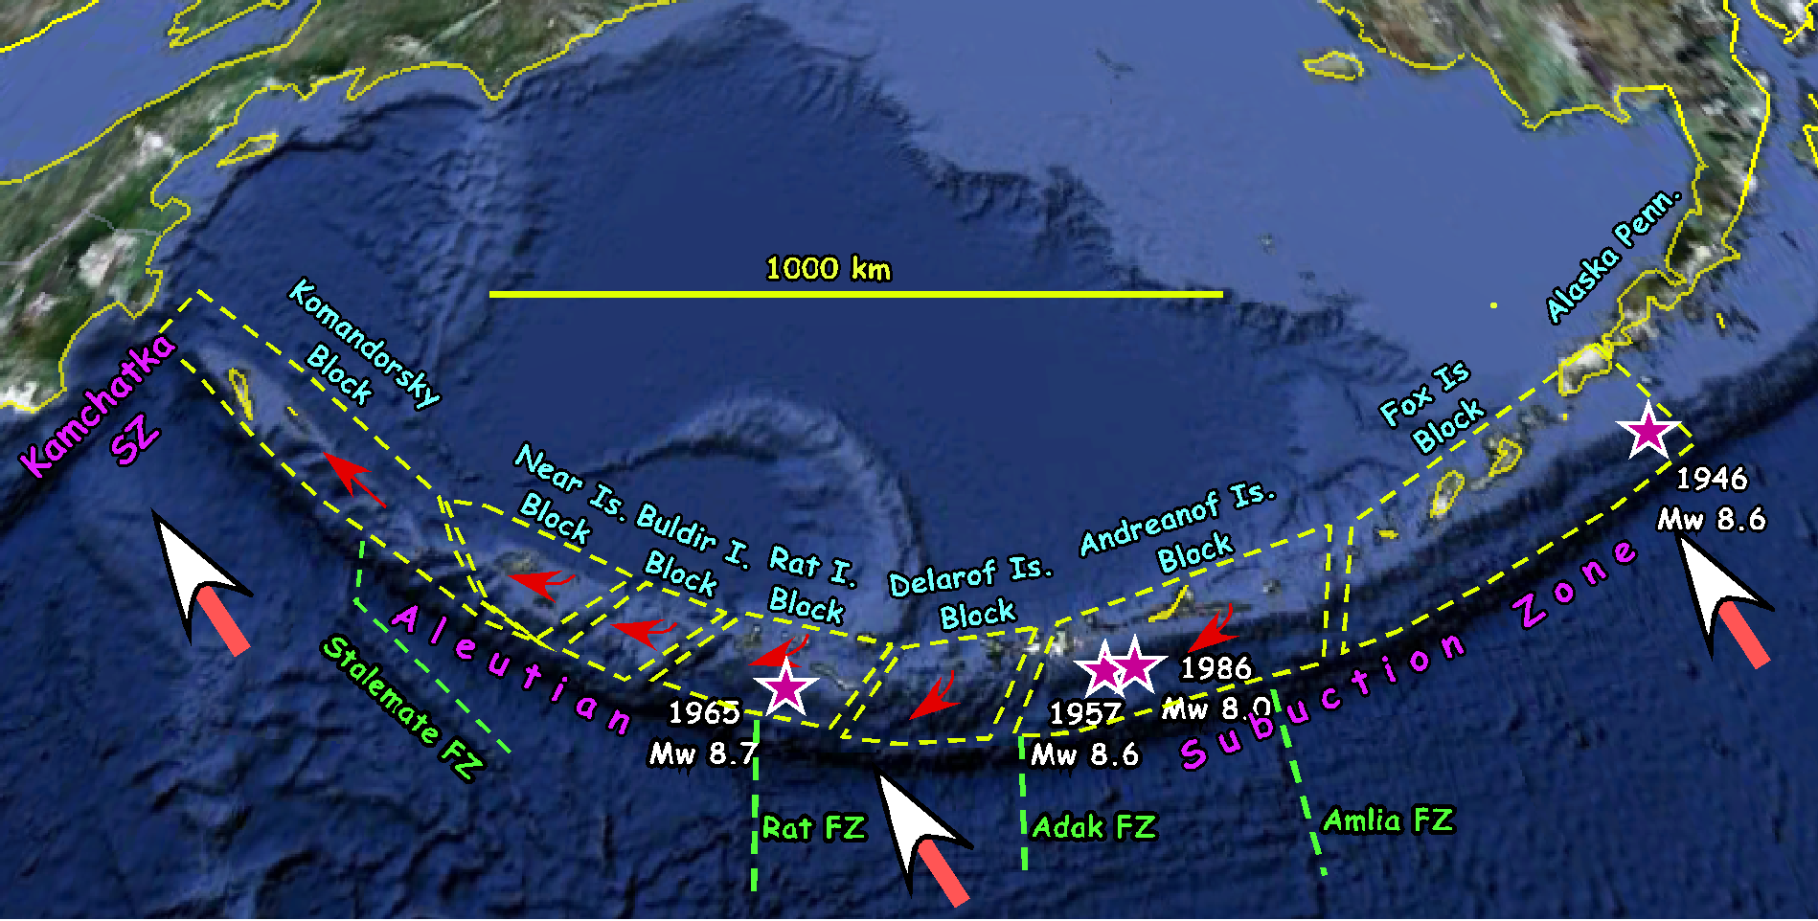
Modern Tectonic Setting
:
To the west, rate of oblique convergence increases
2) To the west, blocks of arc basemen move with increasing speed toward the Kamchatka SZ—tearing the arc massif apart
3) High arc volcanic activity, but with decreasing vigor to the far west
4) Rupture area of 4 of the largest recorded megathrust Earthquakes

Slide 29
