Slide 1
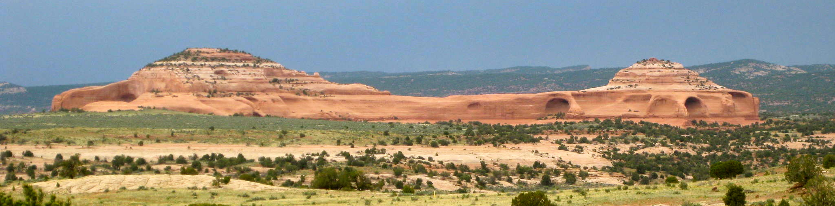

Integrated structural and fracture analysis at Lisbon Valley anticline, Utah
Matt W. Fleming & Mark P. Fischer
Geology and Environmental Geosciences
Northern Illinois University
Notes:
Research is the MS thesis project of Matt Fleming.
Matt will be finishing and starting a job with Repsol in the spring of 2015.
I am presenting on behalf of Matt.

Slide 2
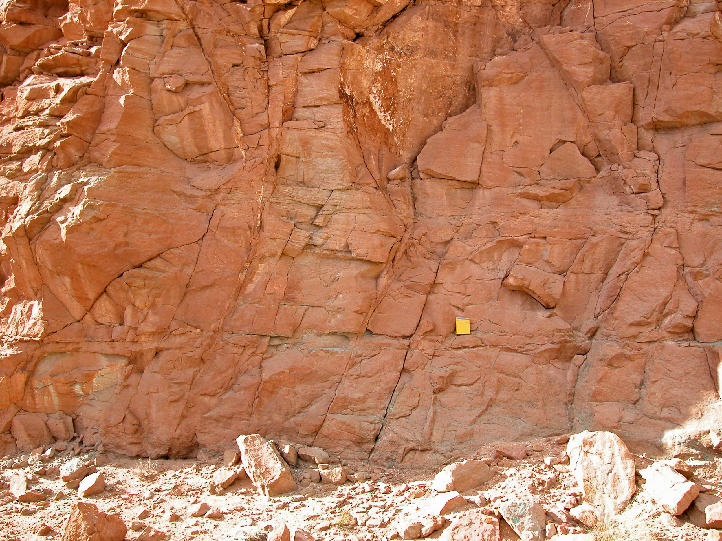
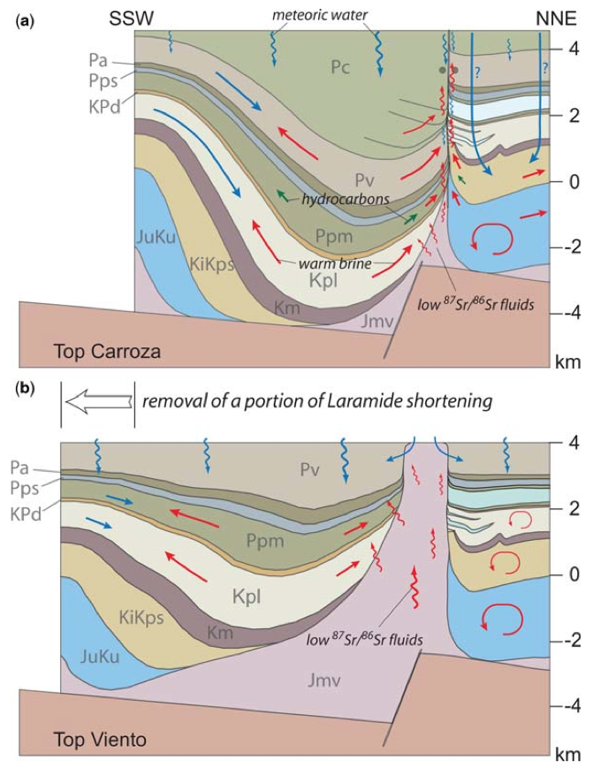
Motivation
Understand fracture-controlled fluid systems in the vicinity of salt structures
  Salt diapirs
    El Papalote, La Popa Basin, Mexico
    Bakio, Cantabrian Basin, Spain
    Onion Creek, Paradox Basin, Utah
  Salt welds
    La Popa Basin, Mexico
    Flinders Ranges, South Australia
  Salt walls
    Lisbon Valley, Utah
    Gypsum Valley, SW Colorado
Notes:
Project is one of a series of projects aimed at understanding how brittle deformation in the vicinity of salt structures influences the movement, storage and distribution of fluids around salt.
We have been conducting similar studies of these salt-related fluid systems in a number of geological settings.
Ideally we’d like to develop conceptual models that describe the structure of fluid systems around salt.
Not always possible because of the lack of data constraining fluid composition, temperature and distribution.

Slide 3
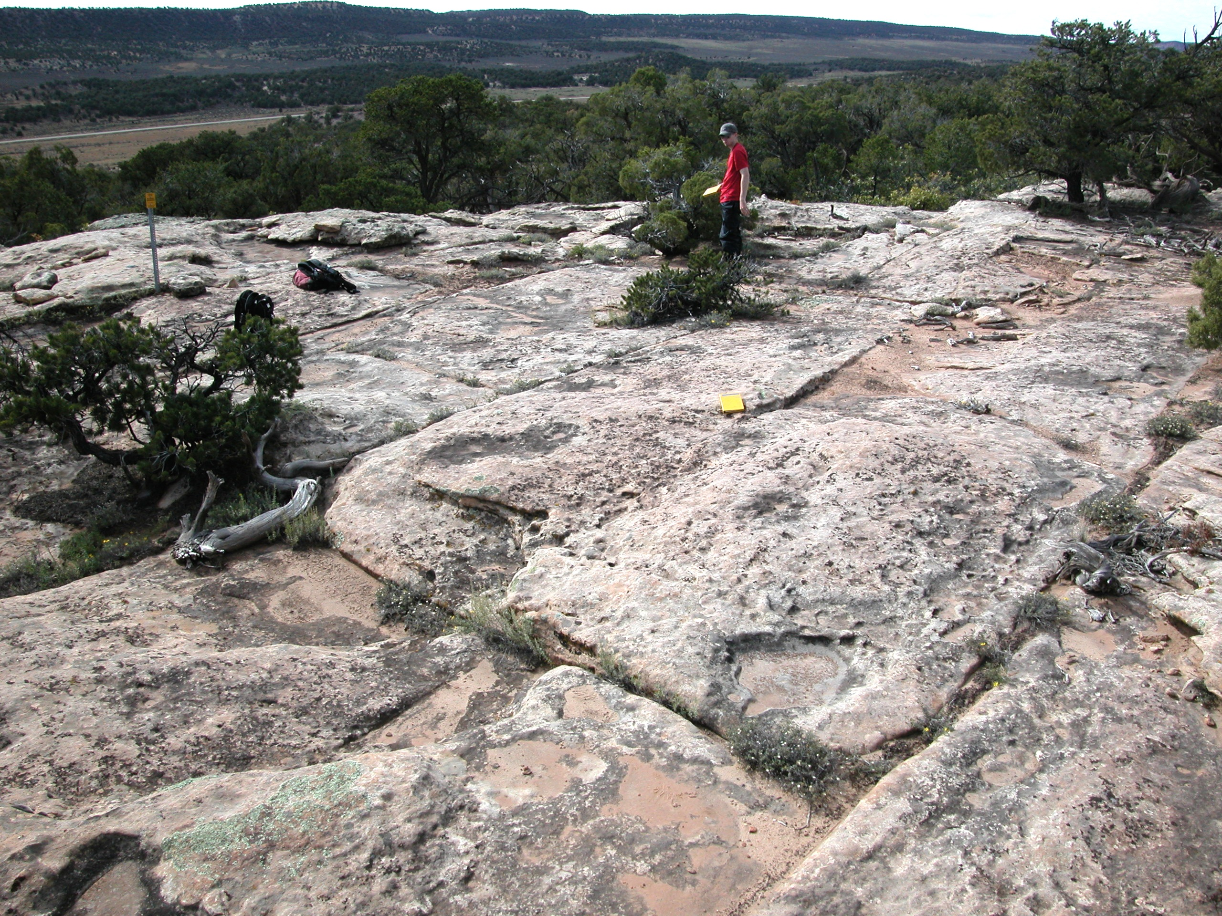
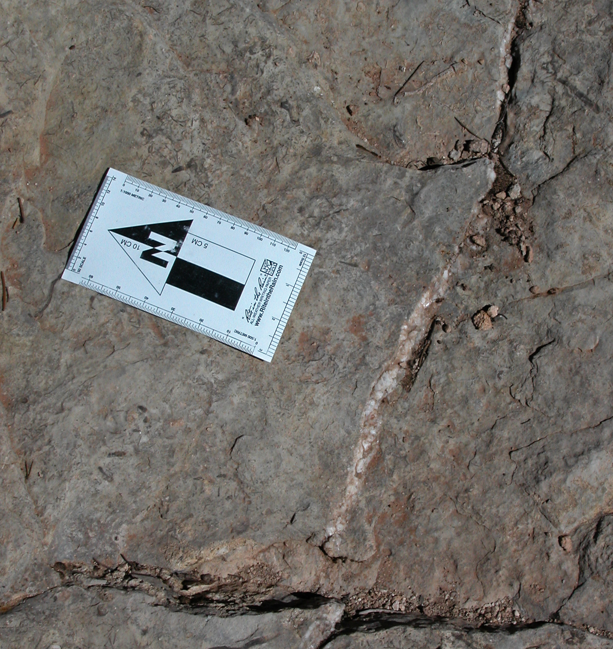
Research approach
Field mesoscopic structural analysis
  Fracture network geometry & timing
Laboratory analysis of veins and host rocks
  Mineral paragenesis from thin section petrography
  Isotope geochemistry: δ¹³C, δ¹⁸O, ⁸⁷Sr/⁸⁶Sr
  Fluid inclusion microthermometry
Structural modeling
  Seismic interpretation
  Cross section construction
  Restoration
Notes:
Use a three-pronged research approach.

Slide 4
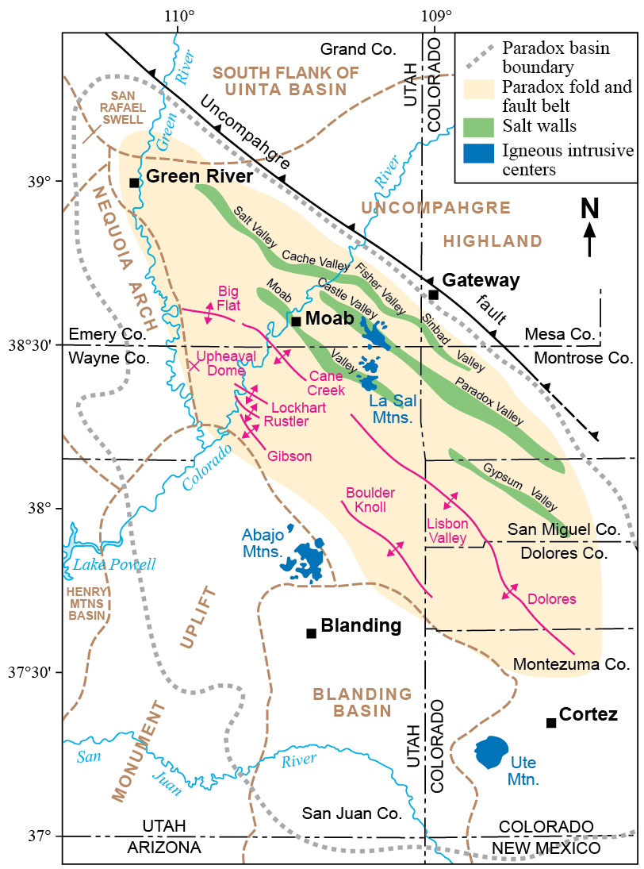
Geological setting
Paradox Basin
  SW-prograding sediment wedge
    Penn – Jurassic
  NW-trending salt anticlines
Lisbon Valley
Kwanza Basin, Angola
Hudec and Jackson (2004)
Doelling (2004)
Notes:
This particular project examines the Lisbon Valley anticline, in the Paradox Basin of eastern Utah.
Second to last significant anticlinal structure in the southwestern part of the basin.

Slide 5
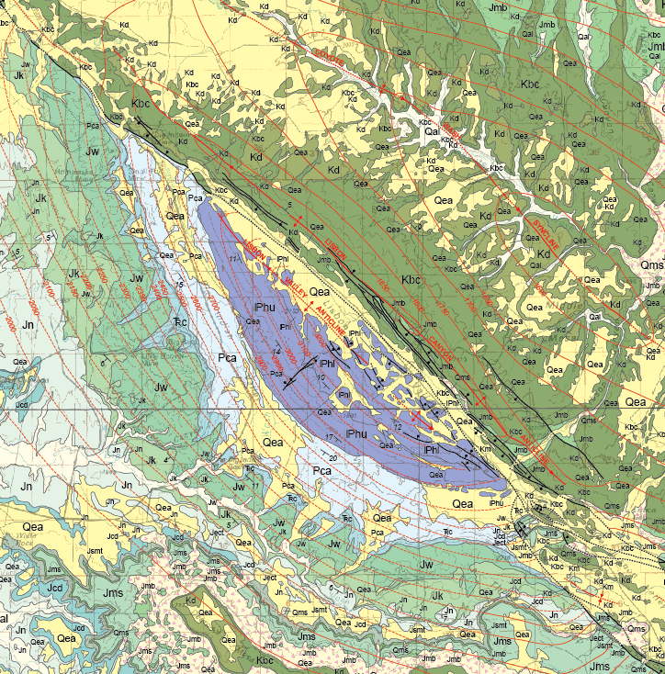
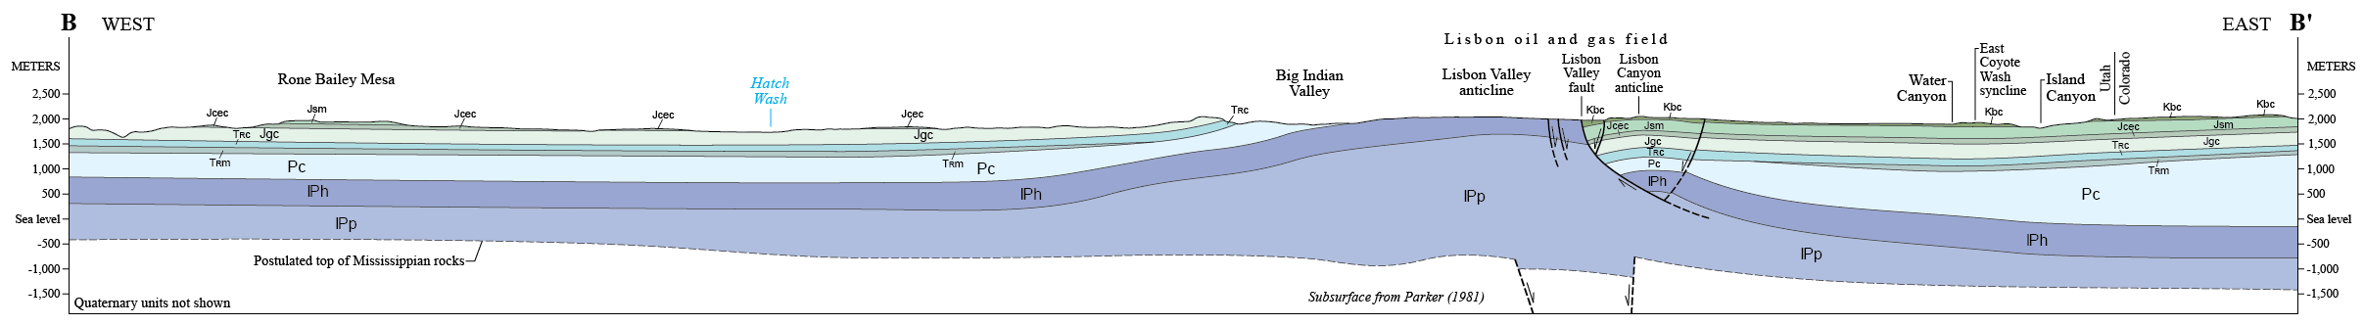
Structural geometry
Paired anticlines
Lisbon Canyon anticline
Entrada (J)
|
Paradox
Burro Canyon (K)
|
Paradox
B
B’
Lisbon Valley anticline
Notes:
La Sal 30 x 60 sheet.
Comprises two anticlines with no significant intervening syncline.
Separated by the east-dipping Lisbon Valley fault.
Younger strata preserved on eastern side.

Slide 6
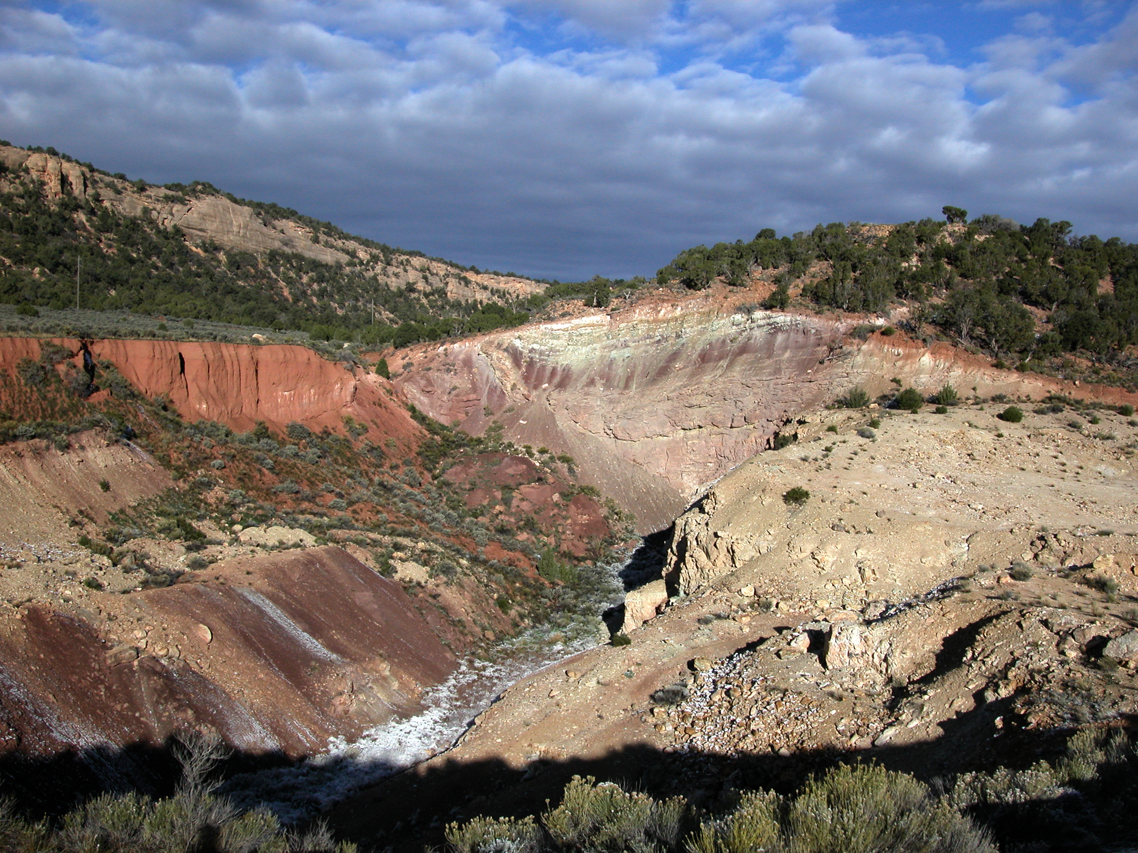
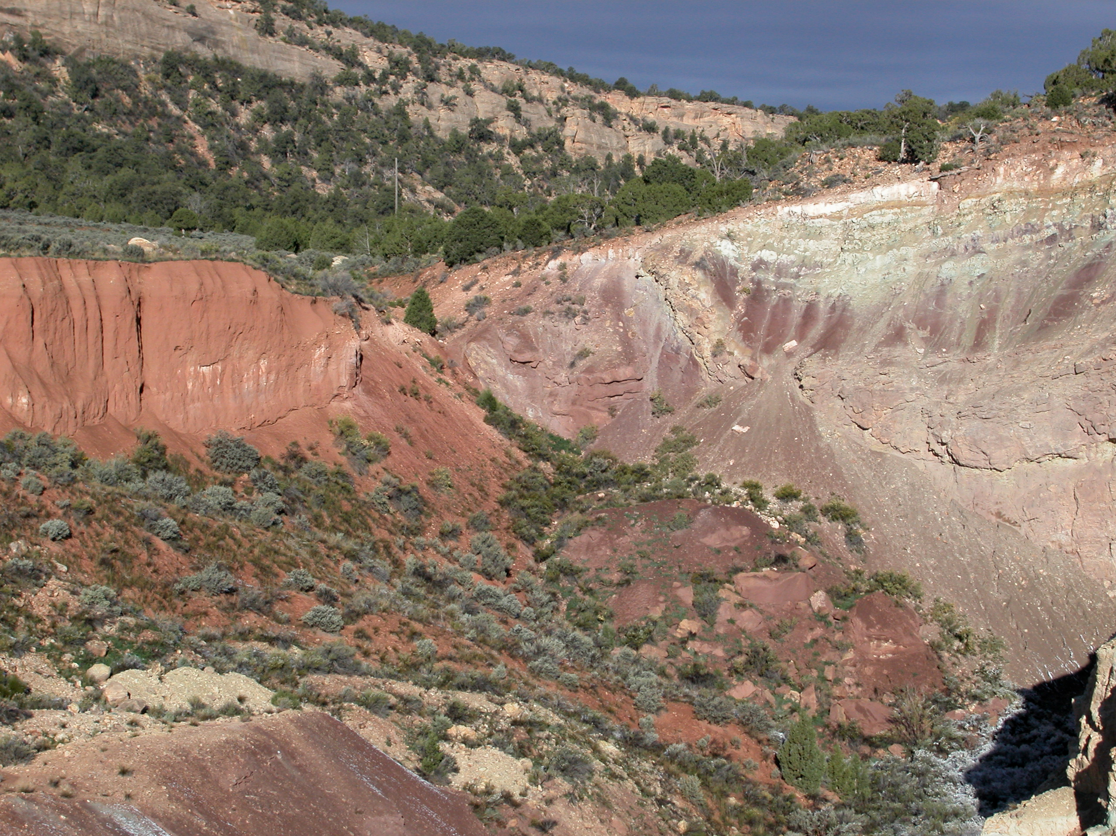
Lisbon Valley fault
Notes:
View looking WNW
Showing Burro Canyon on the right and Chinle through Wingate on the left.

Slide 7
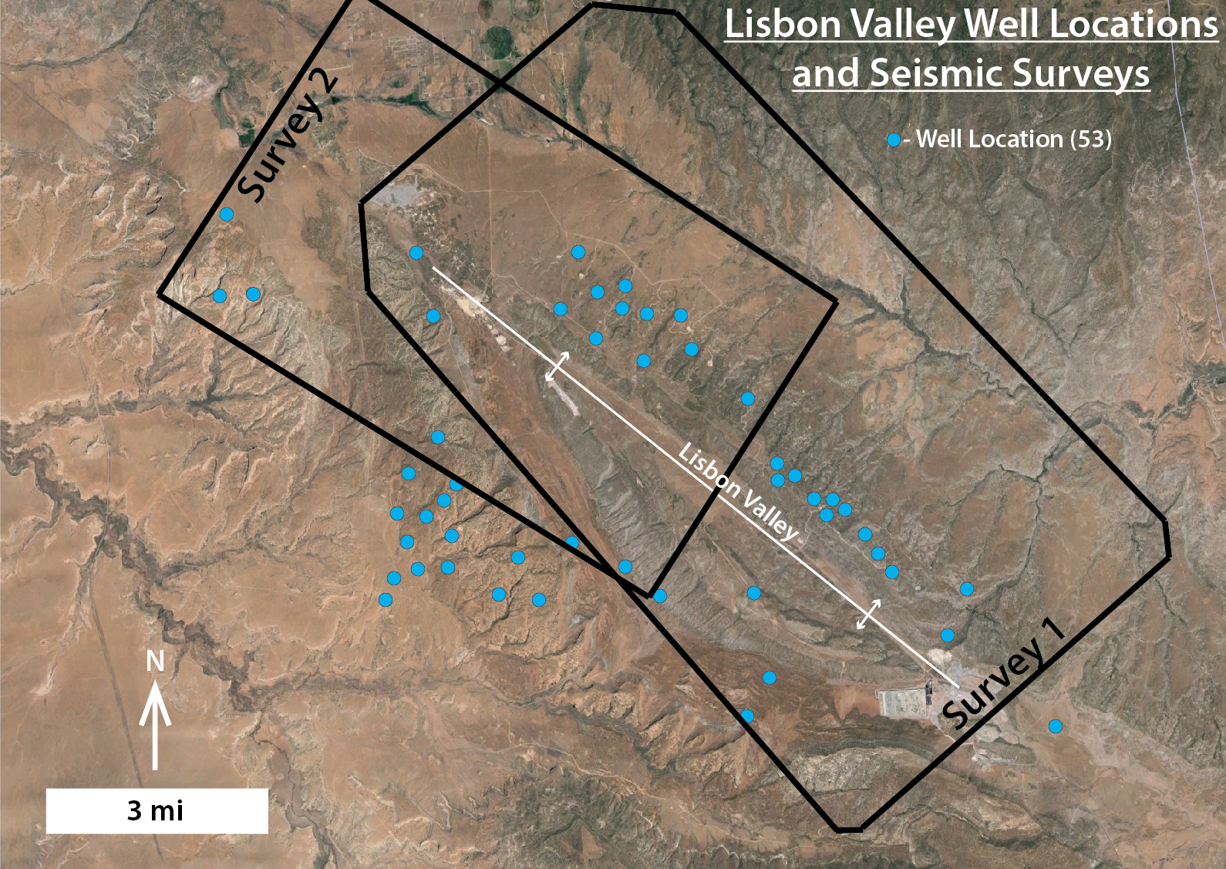
Subsurface constraints
Notes:
To better understand the subsurface structure we obtained from industry, two proprietary, 3-D seismic surveys
Also obtained logs from 53 wells that are shown as the blue dots.

Slide 8
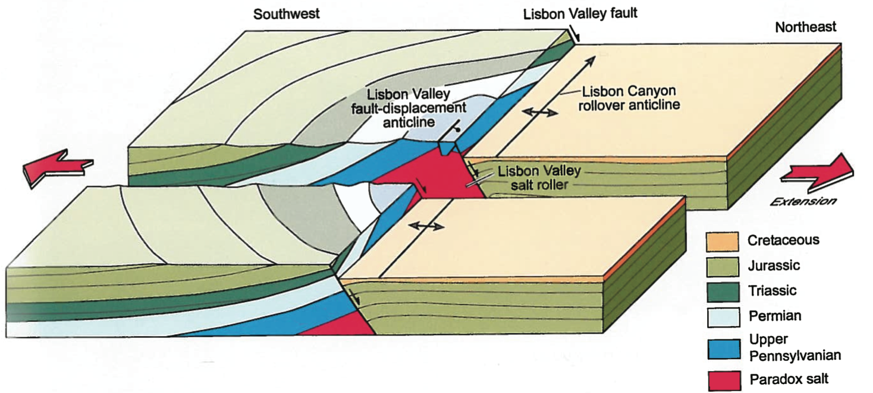
Structural origins
Fault-related fold & rollover anticline
  Localized above salt roller
    Rejuvenated by later extension
Ge et al. (1995) modified by Hudec and Jackson (2011)
Notes:
Current interpretation has structure forming in two episodes.
fault-related folding above a salt roller – Lisbon Valley anticline
Later extension creating the Lisbon Valley fault and Lisbon Canyon anticline

Slide 9
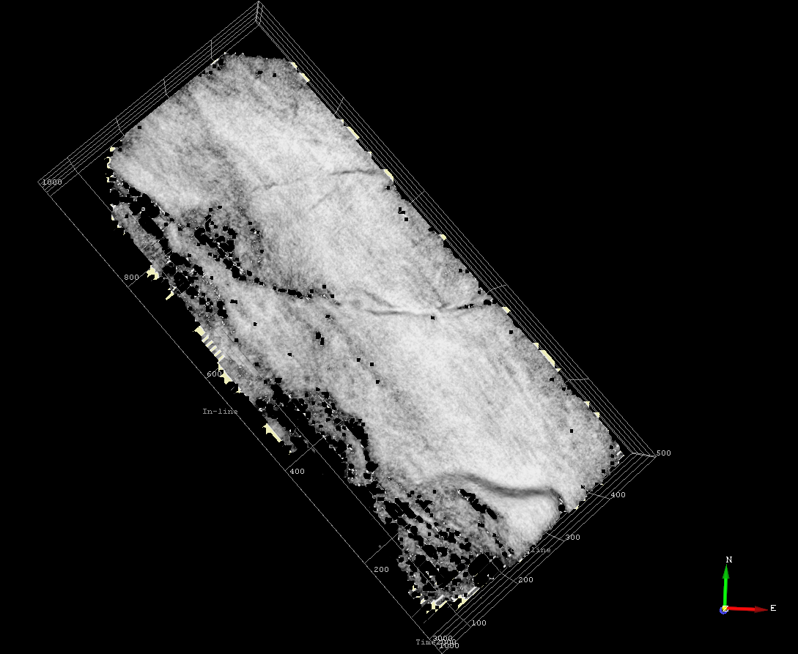
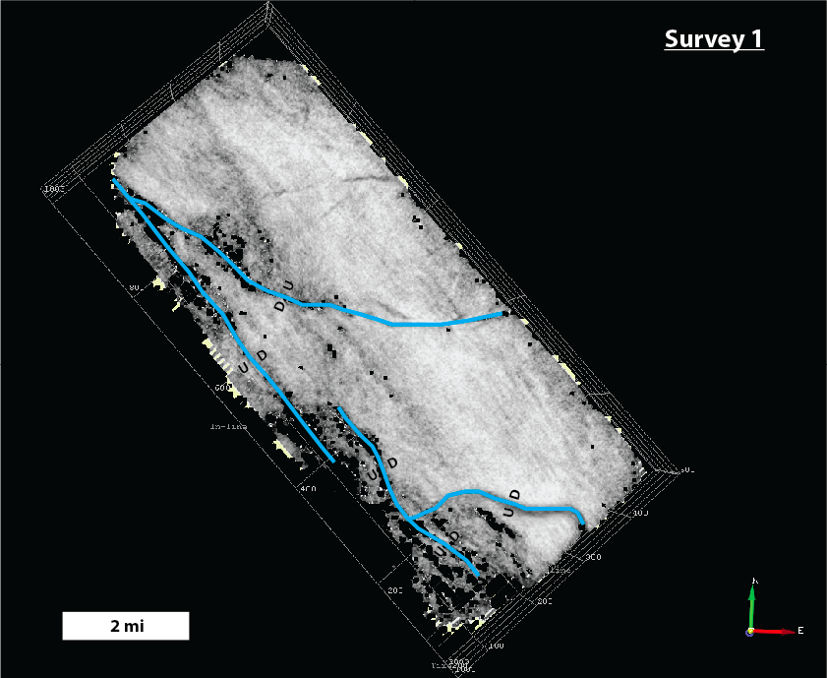
New interpretations
Subsalt normal faults
  Oblique grabens
  Relay structure(?)
Survey 1
base salt
similarity attribute
2 miles
Notes:
So, how is what we’re seeing fitting with the accepted paradigm?
We are seeing a lot of new things, but I’m just going to focus on two here.
Subsalt faulting is more complex than previously recognized
Comprise a series of grabens that are oblique to regional trend
Some appear arranged in relay structures

Slide 10
New interpretations
Inversion?
W
E
Notes:
One particularly interesting observation is that there may be inversion on these subsalt faults.
I’ll leave it to the better seismic interpreters in the audience to tell me later, but, which do you prefer?

Slide 11
New interpretations
Longer (later?) period of salt movement?
W
E
fanning dips indicate growth
Cutler
|
Honaker Trail
Notes:
We also think the seismic gives us good evidence that salt was moving over a much longer time period than previously thought.
The current models generally confine most salt movement to the Cutler, with only minor growth during younger times.

Slide 12
New interpretations
Longer (later?) period of salt movement?
W
E
Cutler
|
Honaker Trail

Slide 13
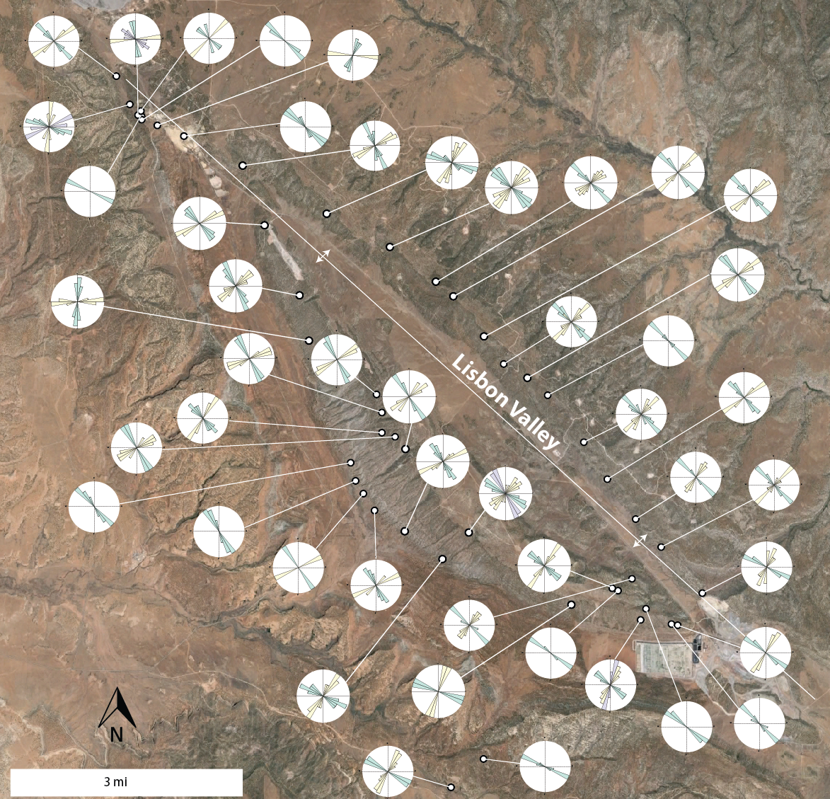
Fracture network geometry
Fracture sets
  Strike
  Strike-oblique
  Cross-strike
Style
  Joints
  Veins
  Deformation bands
48 field stations
Notes:
Data collected from 48 field stations.
Three fracture sets: strike, strike-oblique and cross strike.
Orientations vary with position around the structure so that they are aligned with local bedding strike.
Correlation to structure and lack of similar sets in nearby flat-lying rocks suggests these sets formed in association with the salt anticline.
Style correlates to lithology
joints and veins dominate in carbonates.
joints and deformation bands dominate in sandstones.

Slide 14
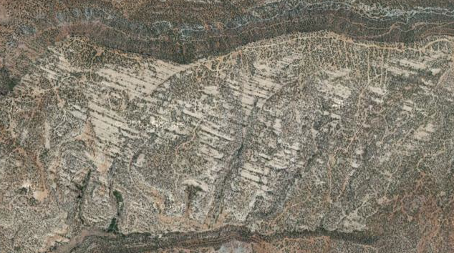
Joint orientation changes
Track local bedding strike
West central region
Wingate Sandstone
1000 ft
Southeast region
Notes:
Spatial variation in permeability anisotropy.

Slide 15
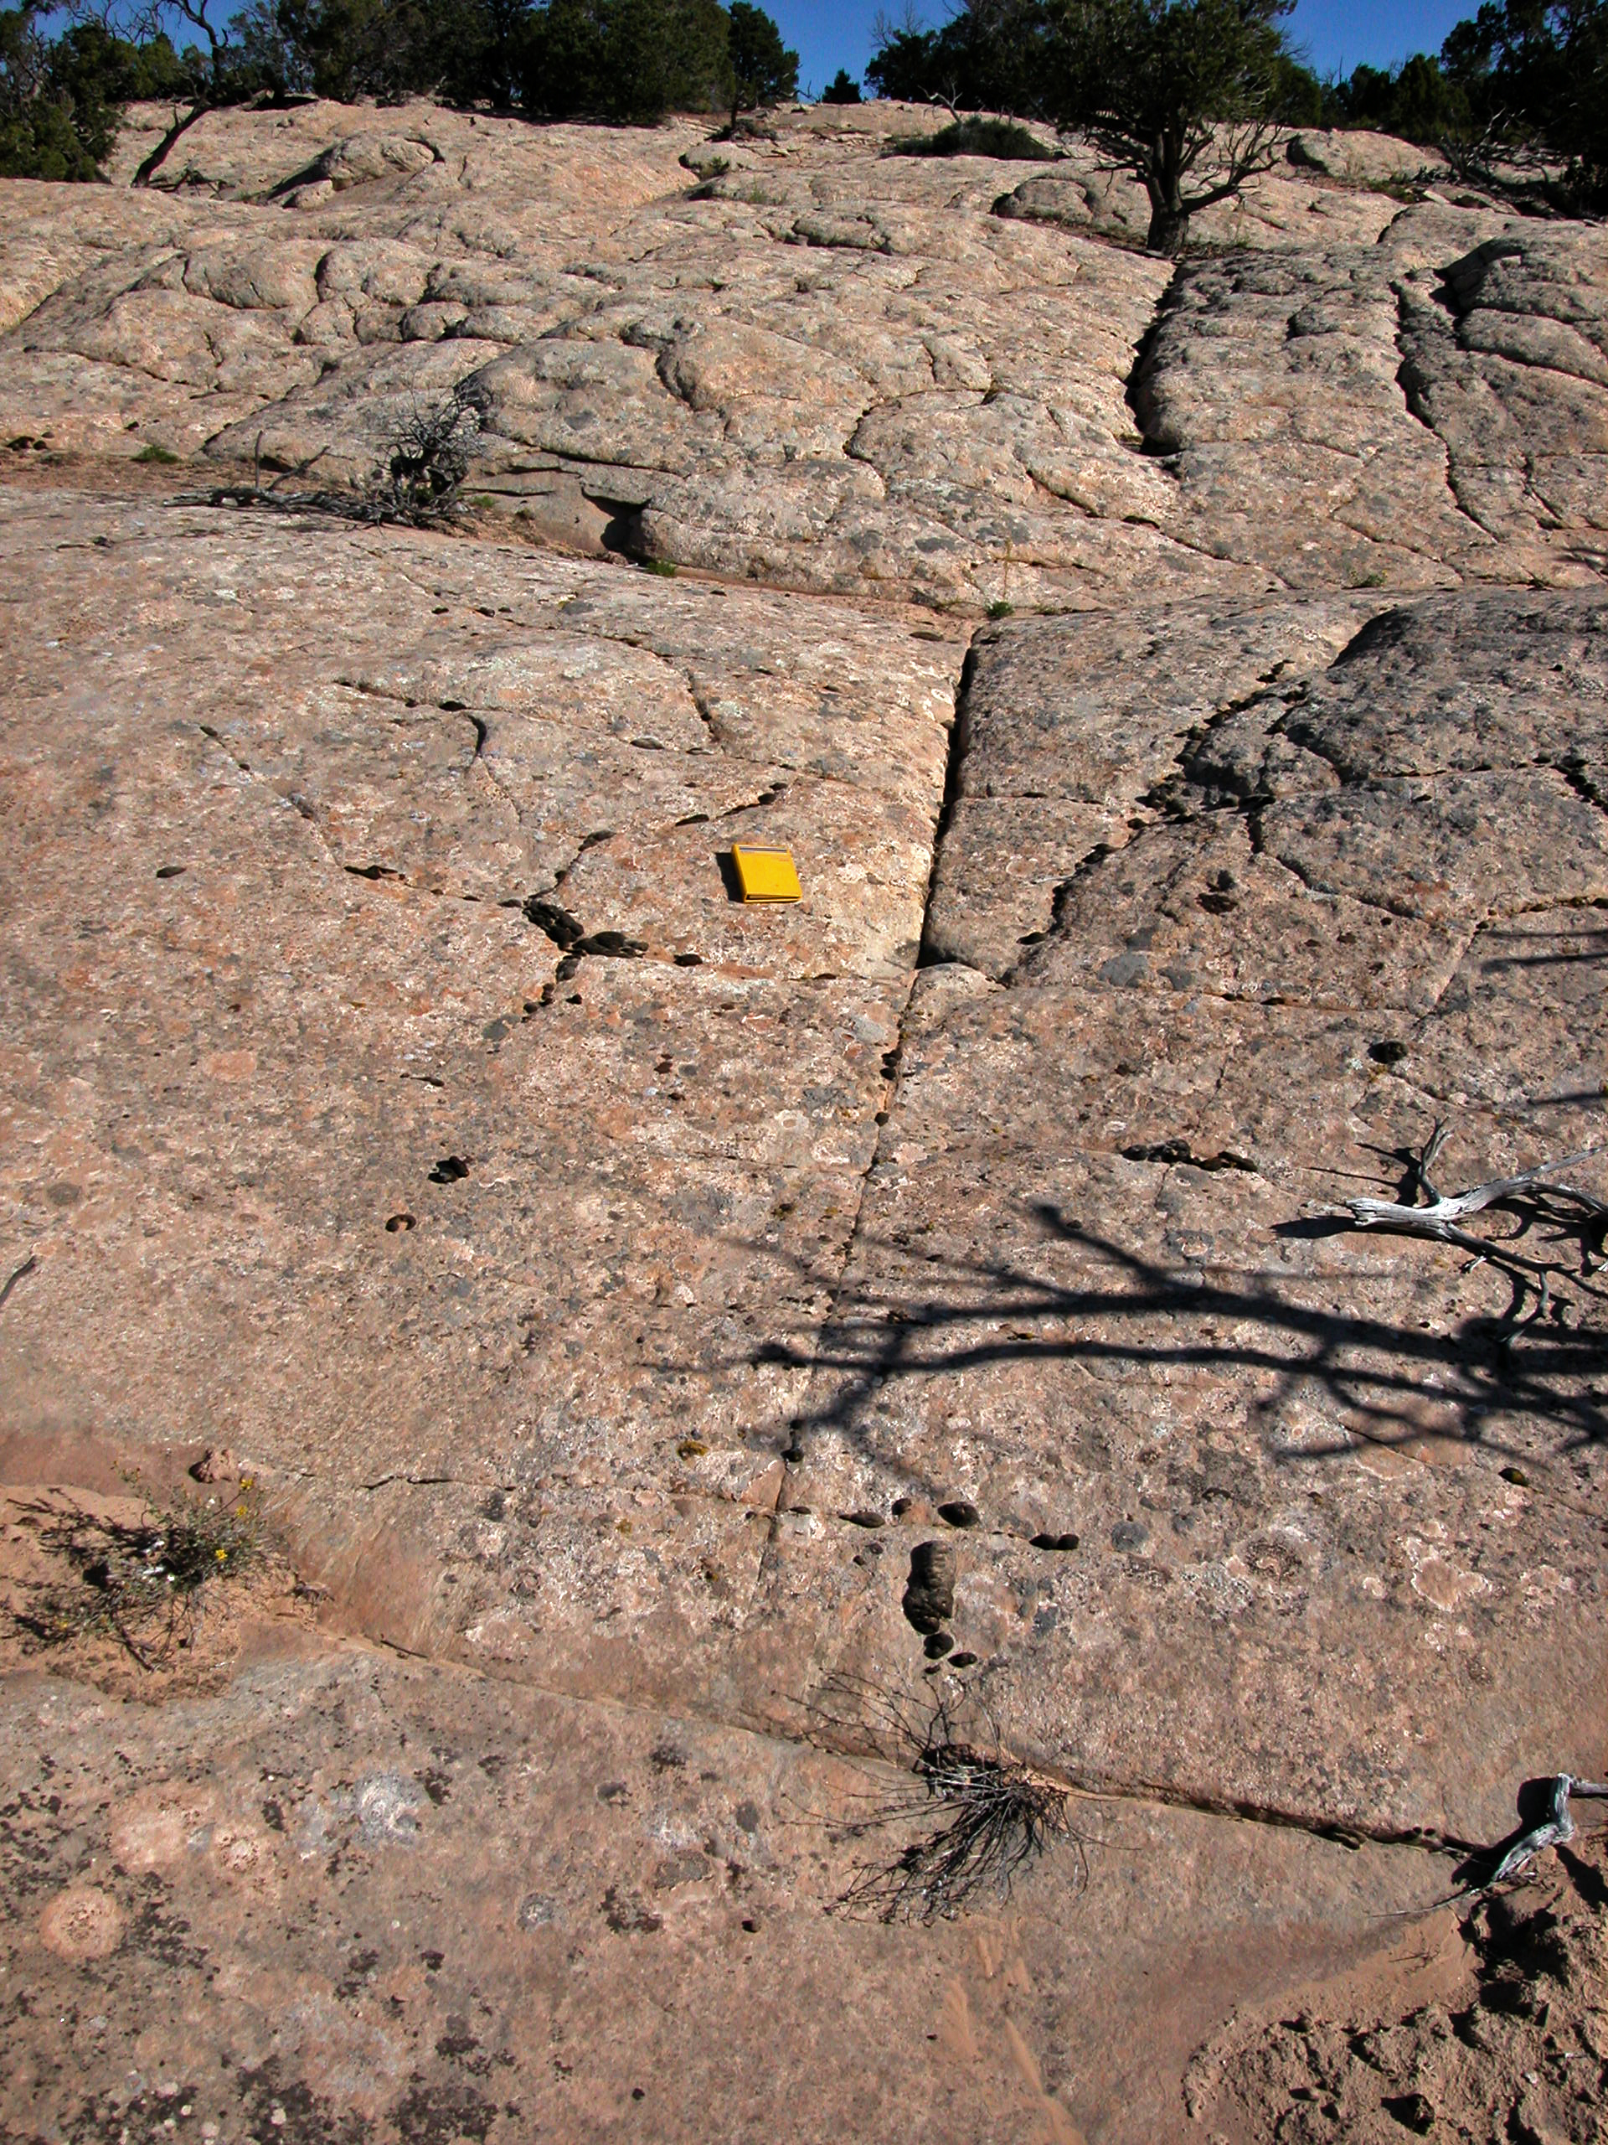
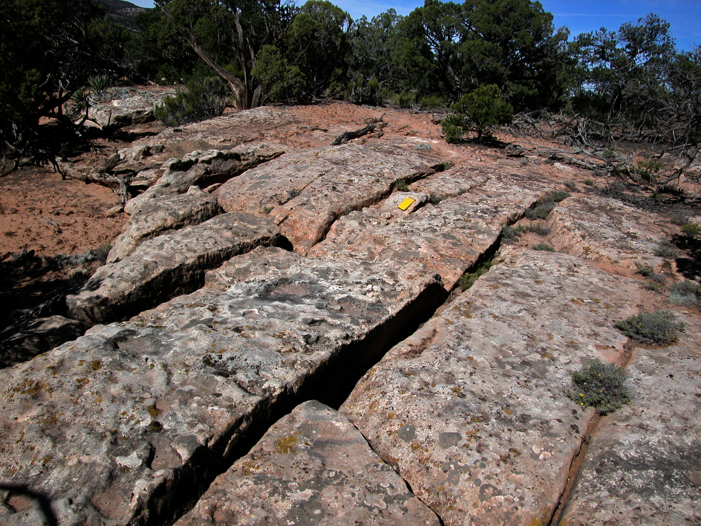
Fracture timing
Strike joints are oldest
strike joints
Notes:
Strike joints are consistently the longest, most continuous, planar fractures.
Cross strike joints consistently abut strike joints.

Slide 16
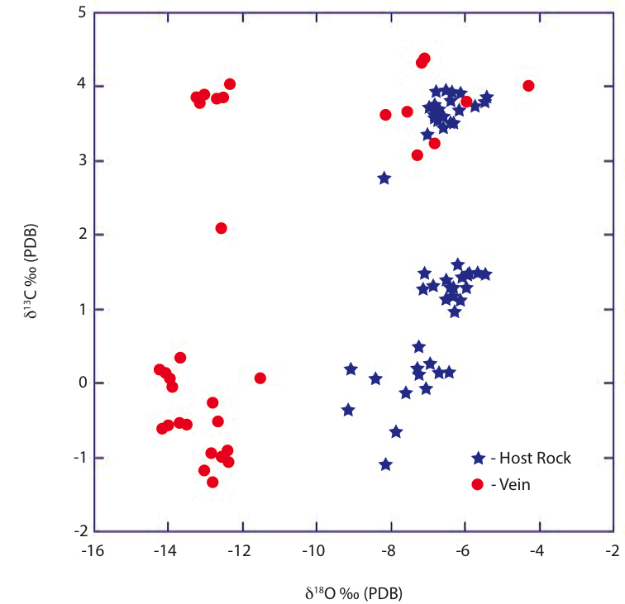
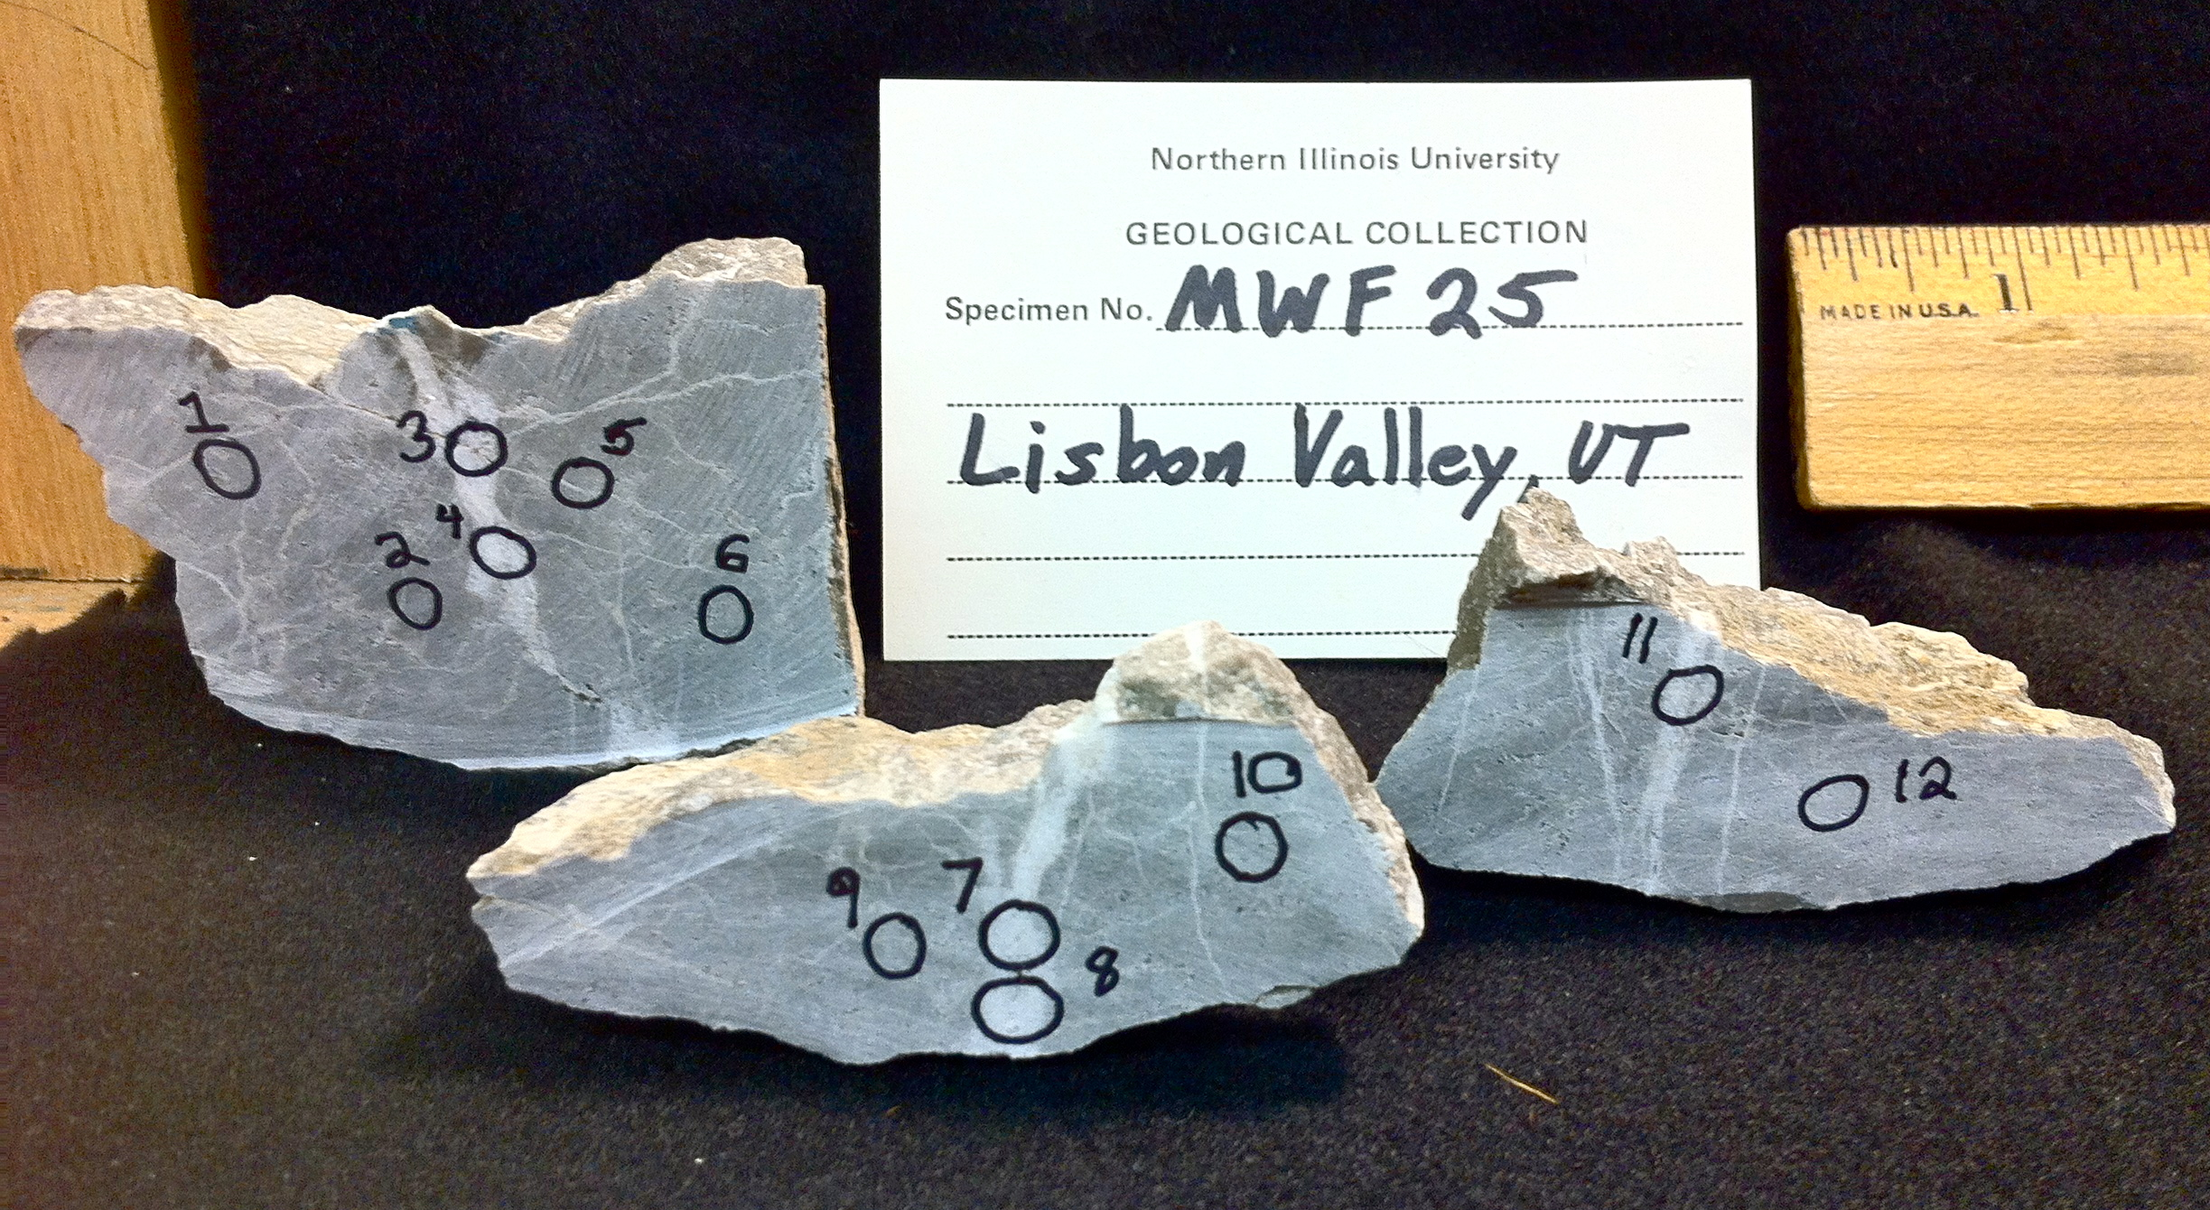
Fracture-controlled fluids
Veins and host rocks are dissimilar in δ¹⁸O
  External fluid source
calcite
5 field stations
Notes:
General lack of mineralization keeps us from saying much about the fluid system.
Powders drilled from multiple locations on each sample.
Multiple powders from both vein and host rock in each sample.
All samples from the Honaker Trail.
d¹⁸O values indicative of meteoric water influence (depending on temperature)
Indicates fractures were substantial fluid conduits

Slide 17
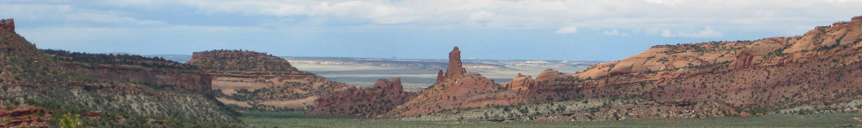
Conclusions
Lisbon Valley structure
  Localized above oblique normal fault grabens and relay structures
  Minor inversion during Laramide?
  Salt movement continues into Triassic or Jurassic(?)
Supra-salt fracture network
  Supra-salt section fractures are synfolding
  Oldest fractures are parallel to local bedding strike
    Strike-fractures form at different times(?)
  Fractures serve as conduits for external fluids

Slide 18




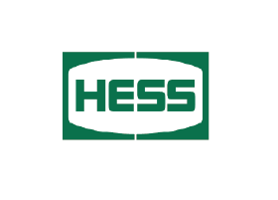

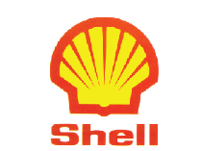


Acknowledgements
Funding provided by
  Salt-sediment Interaction Research Consortium
  GSA graduate student research grant
  AAPG Arthur A. Meyerhoff Memorial Grant for Tectonic Studies
Well logs provided by Castle Commodities Inc.

