Slide 1

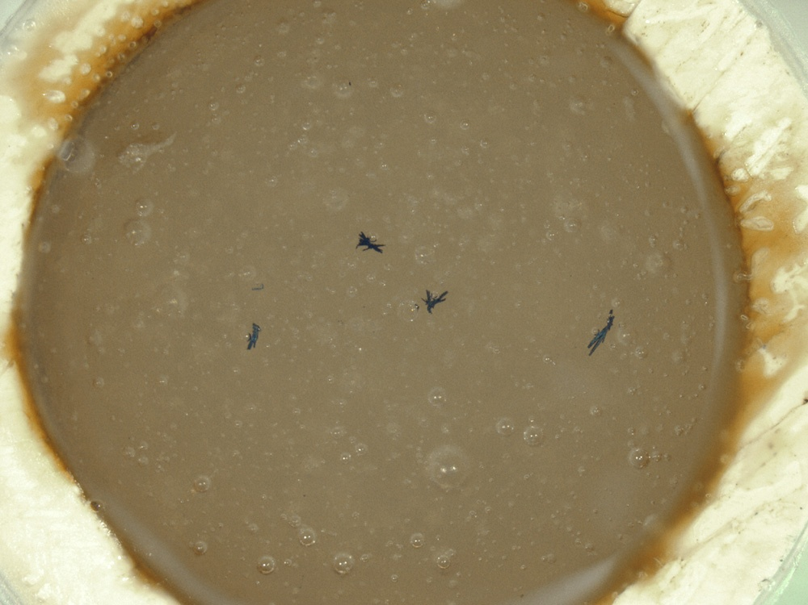
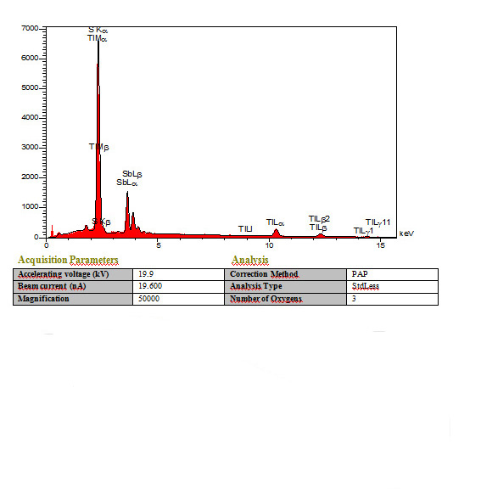
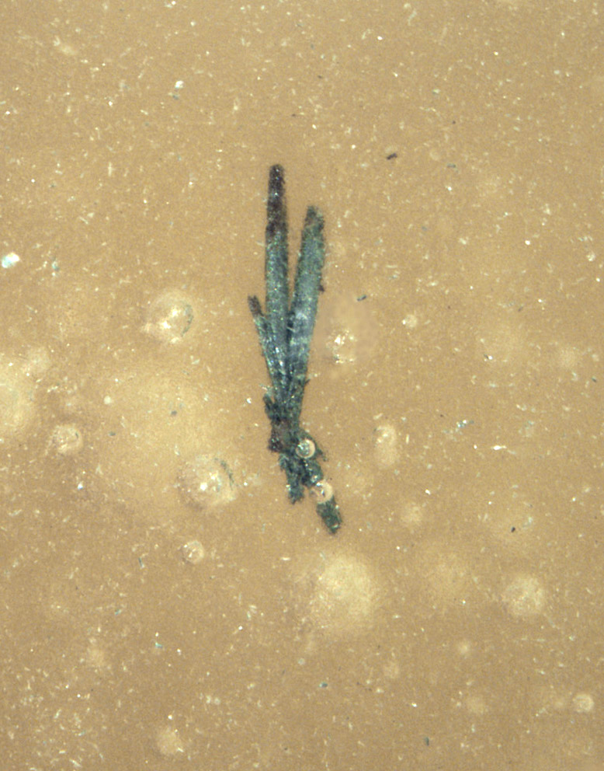
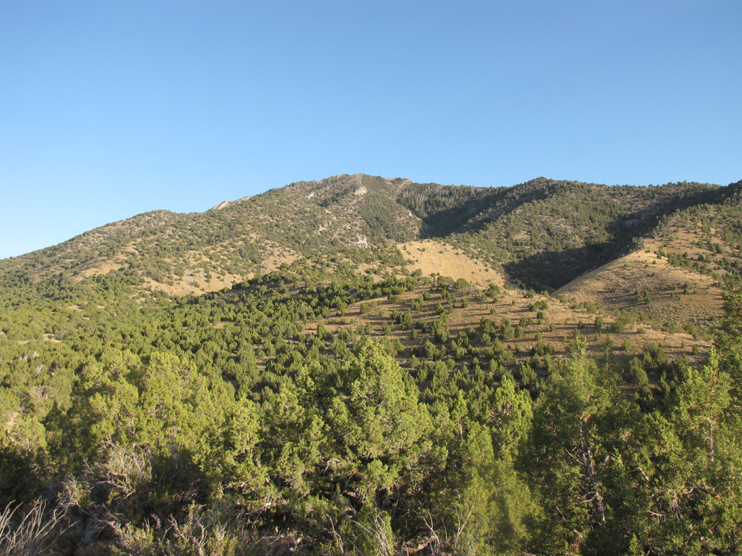
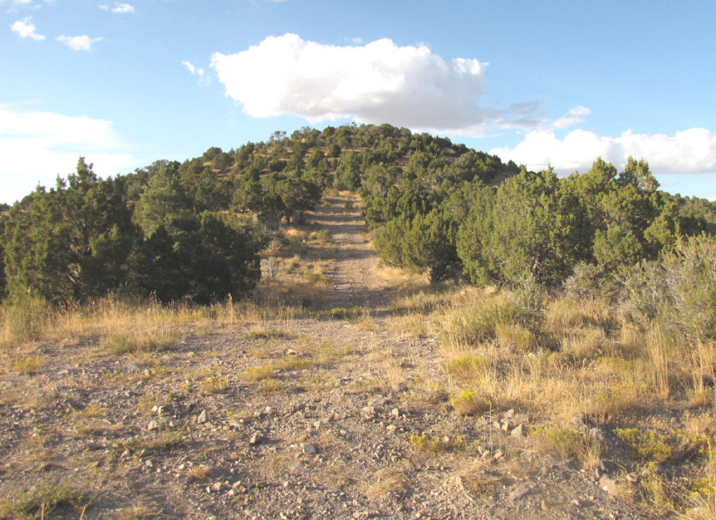
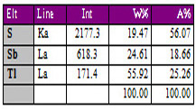
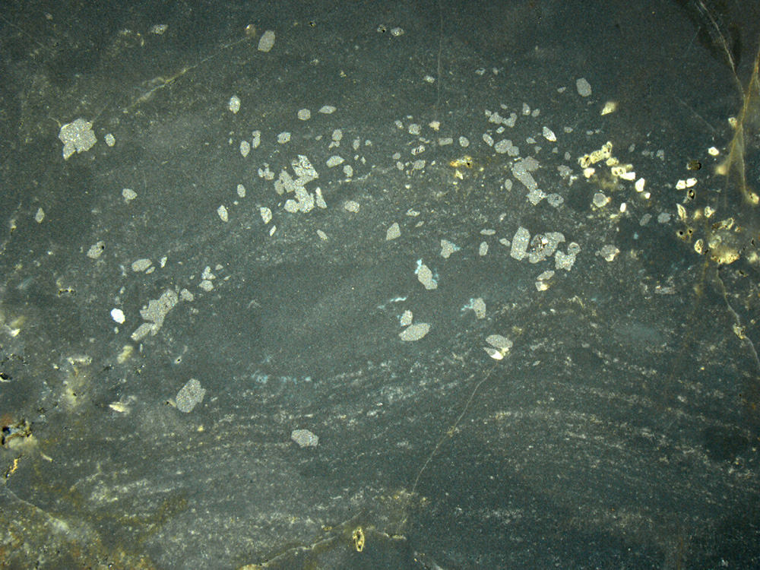
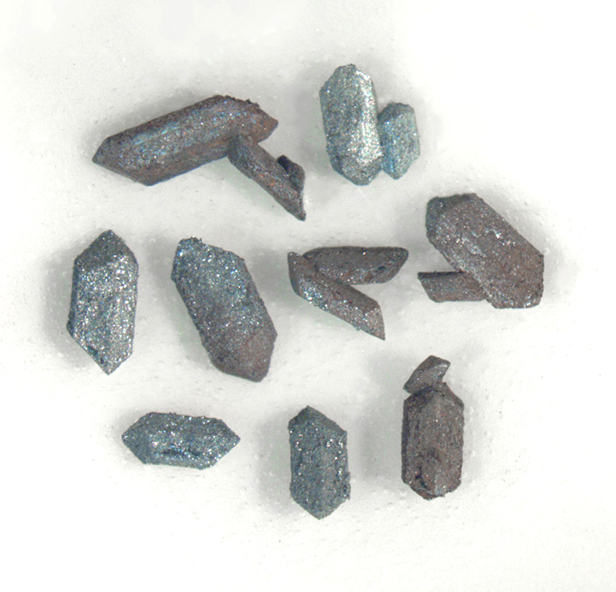
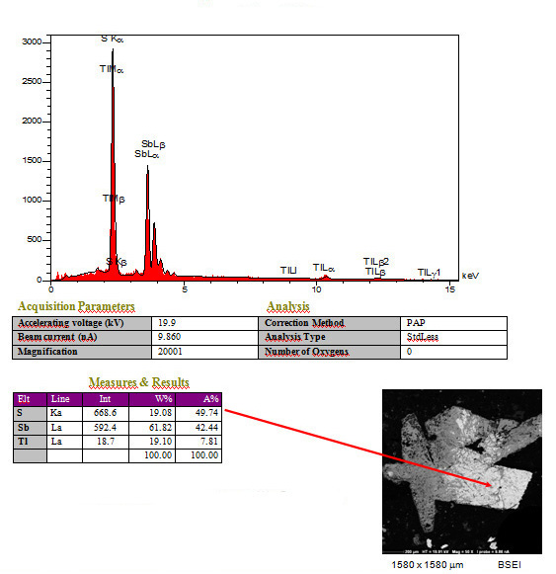
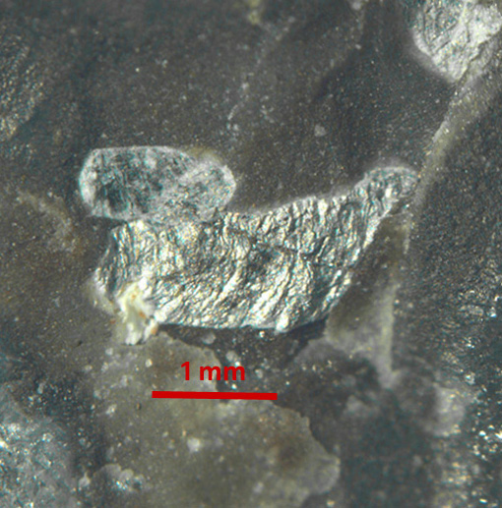
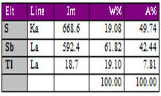
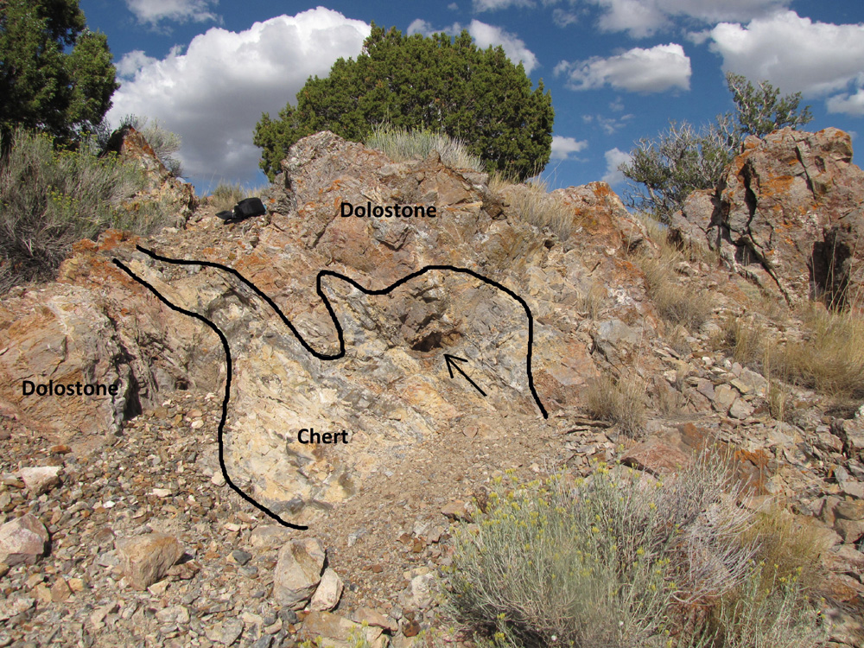
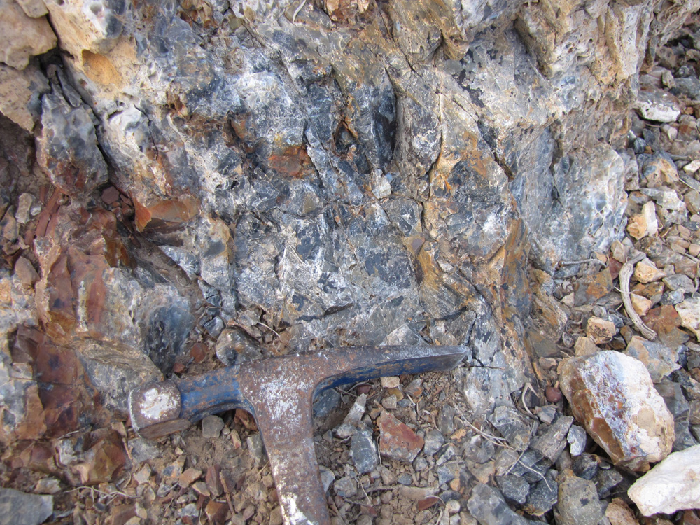
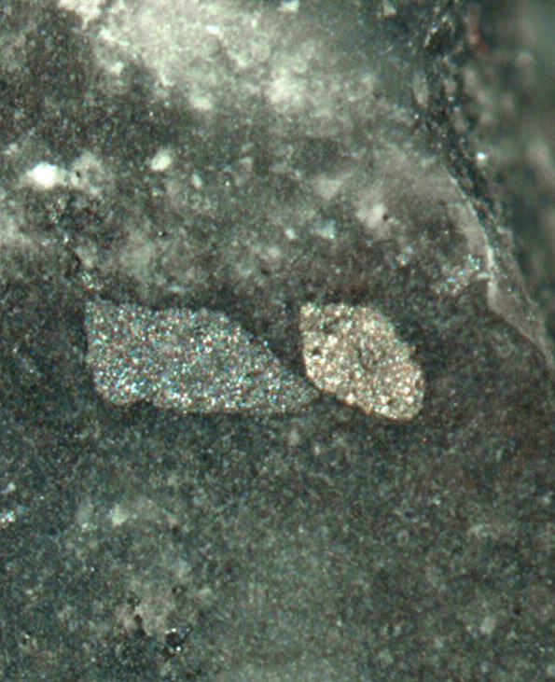
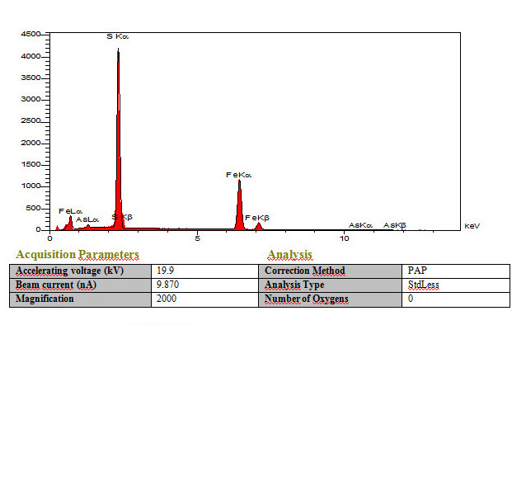
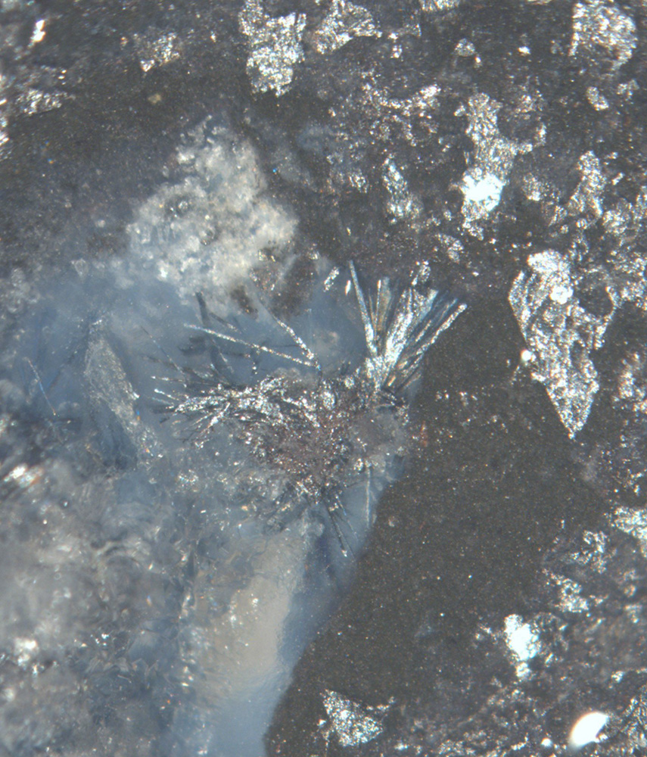
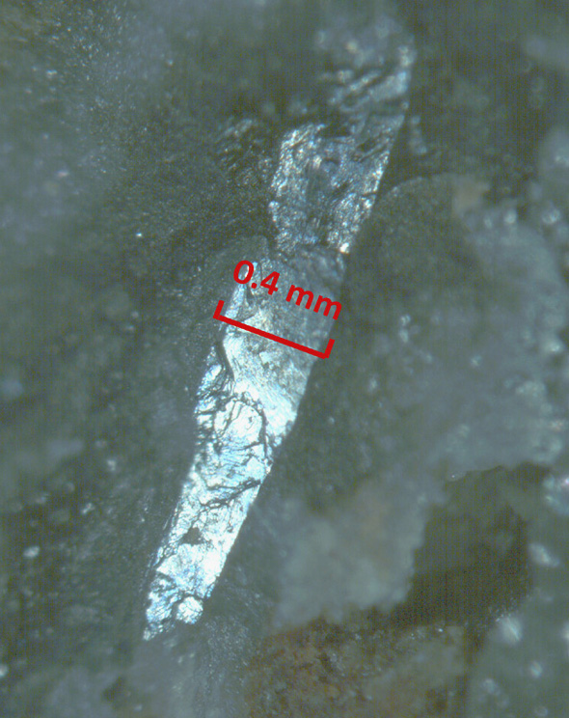
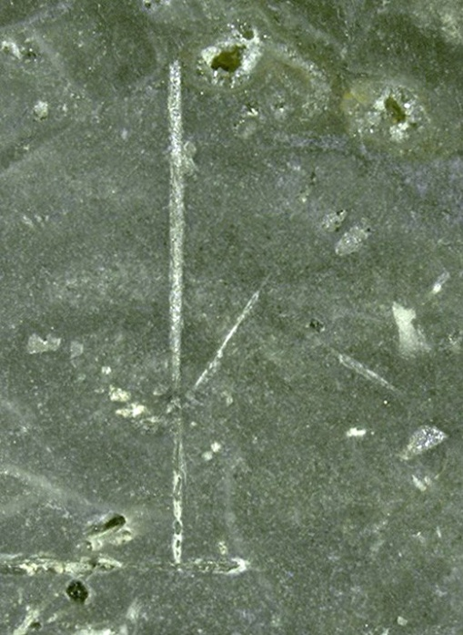
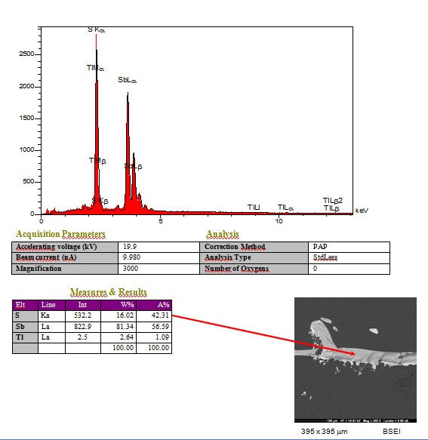

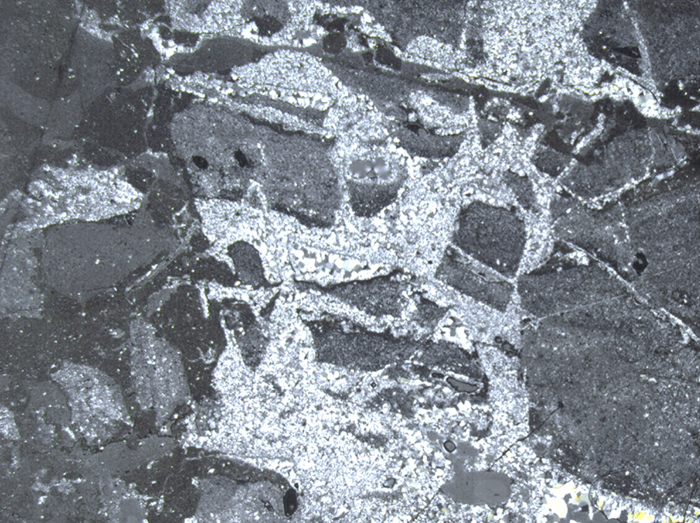
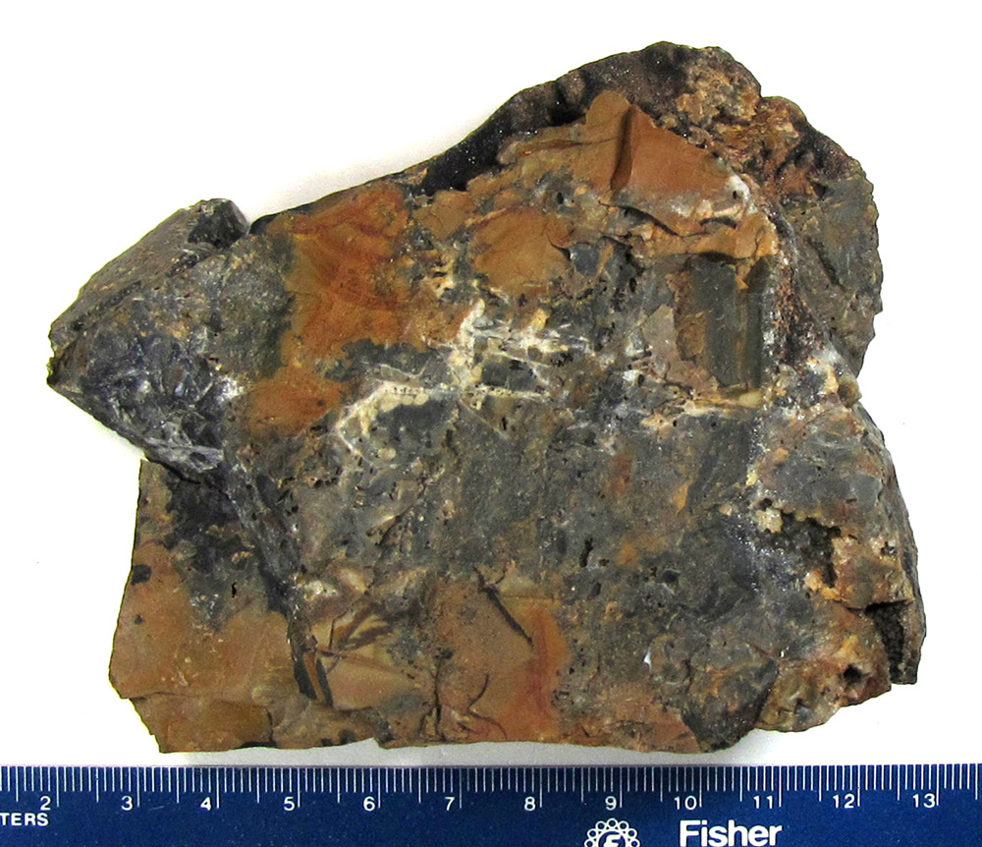

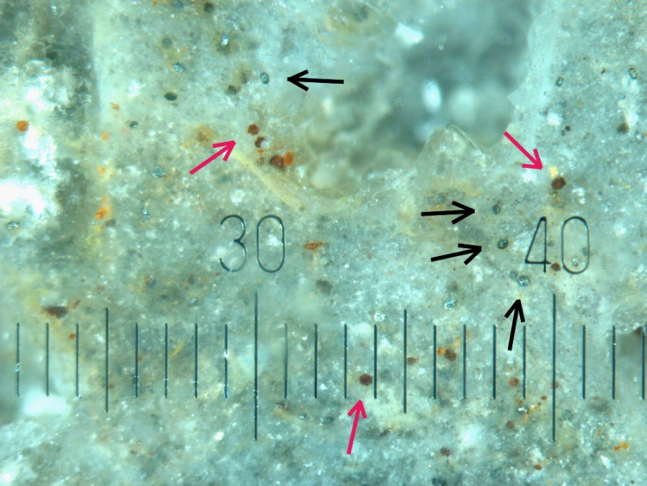
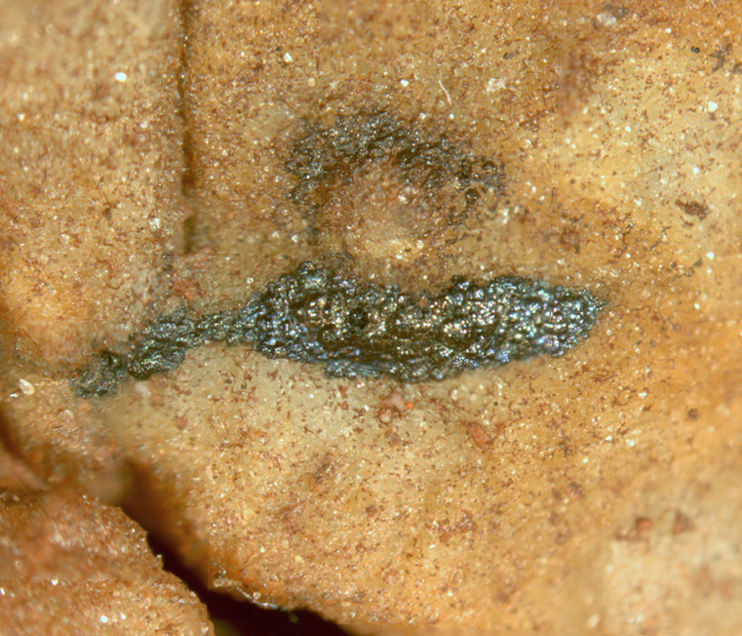
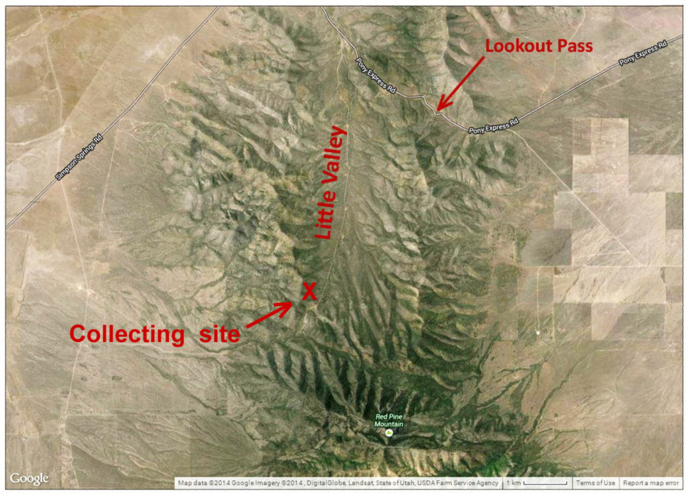
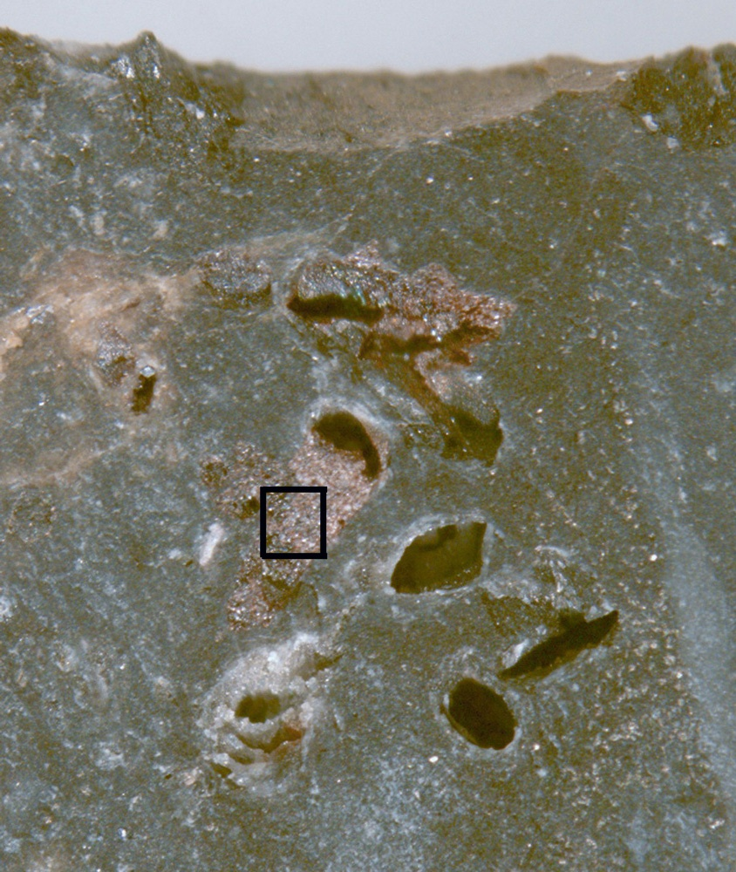
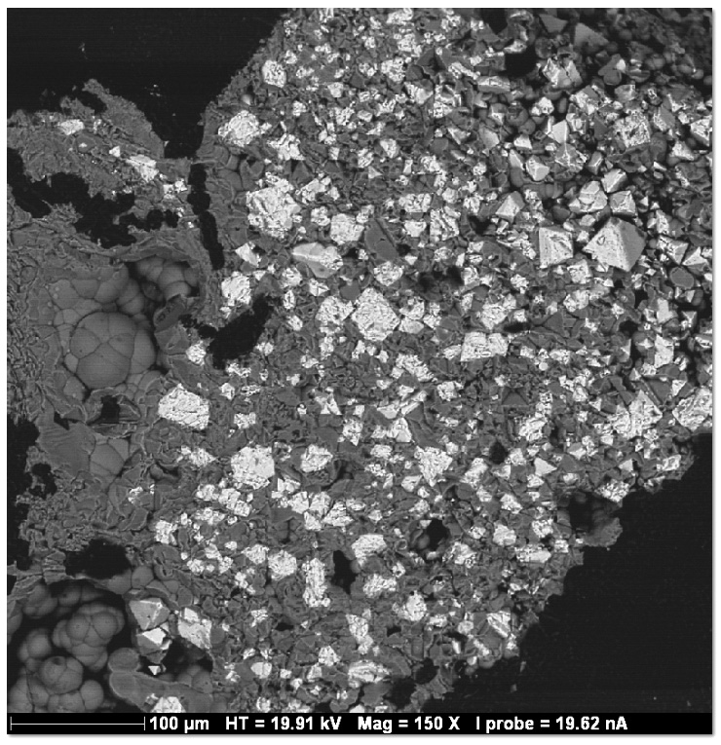
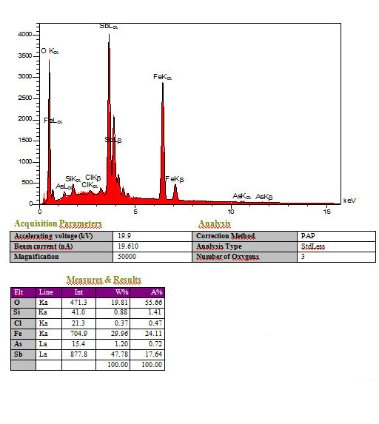
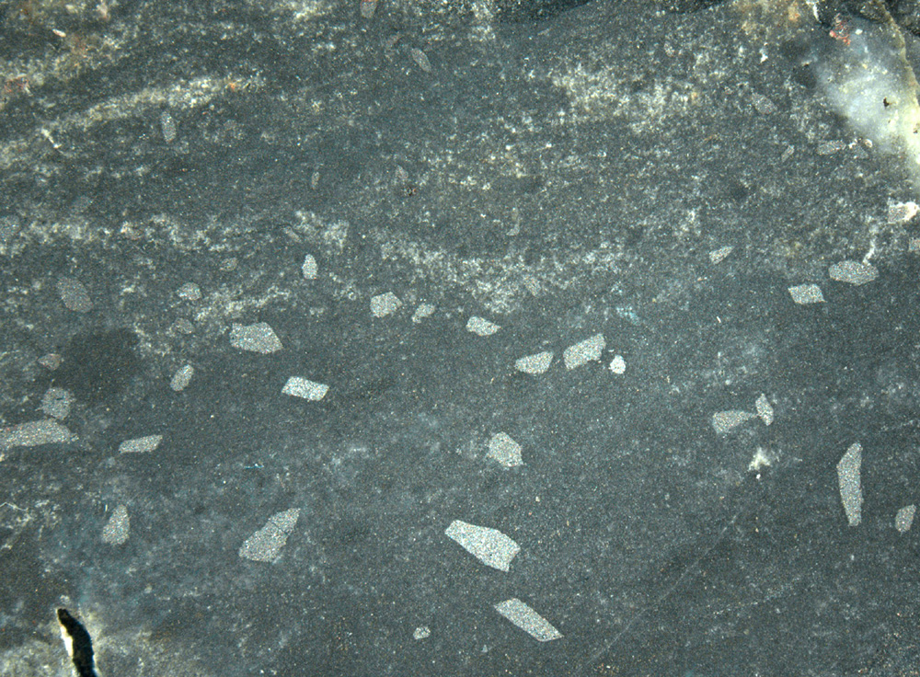
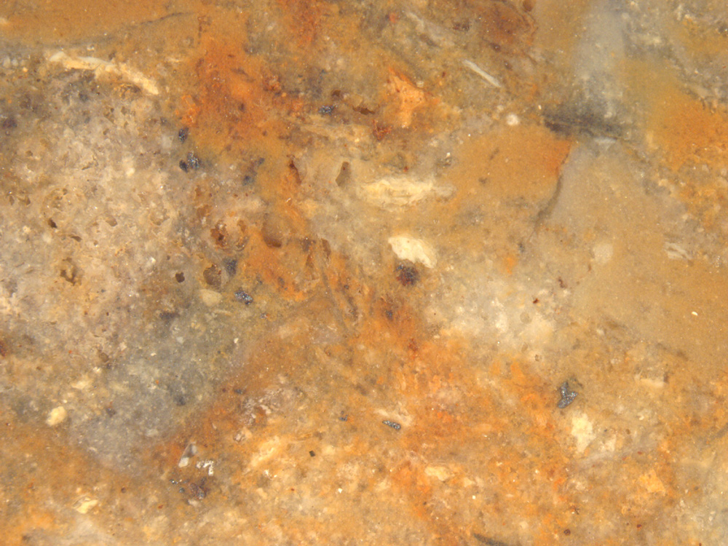
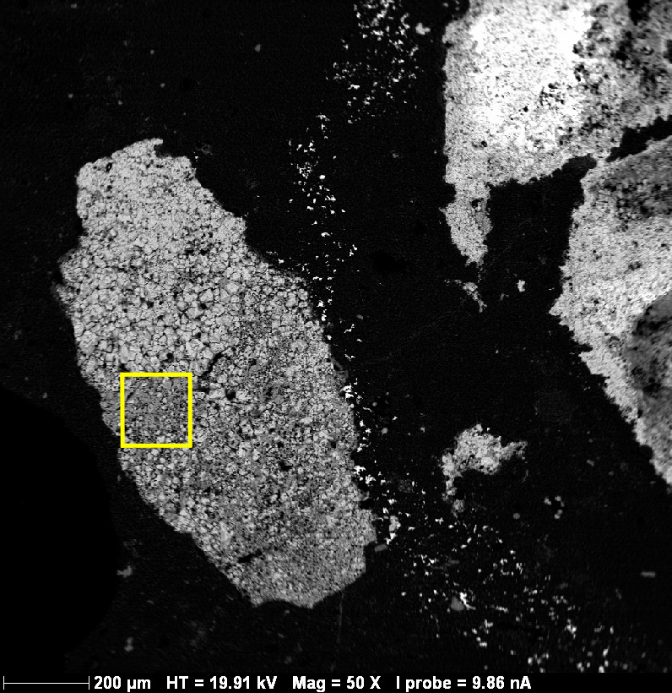
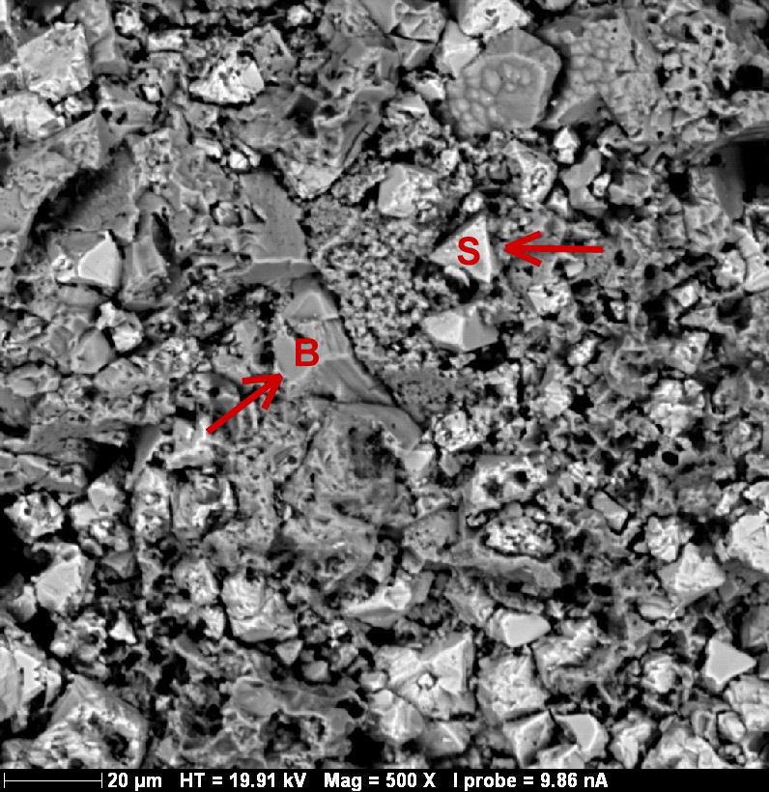
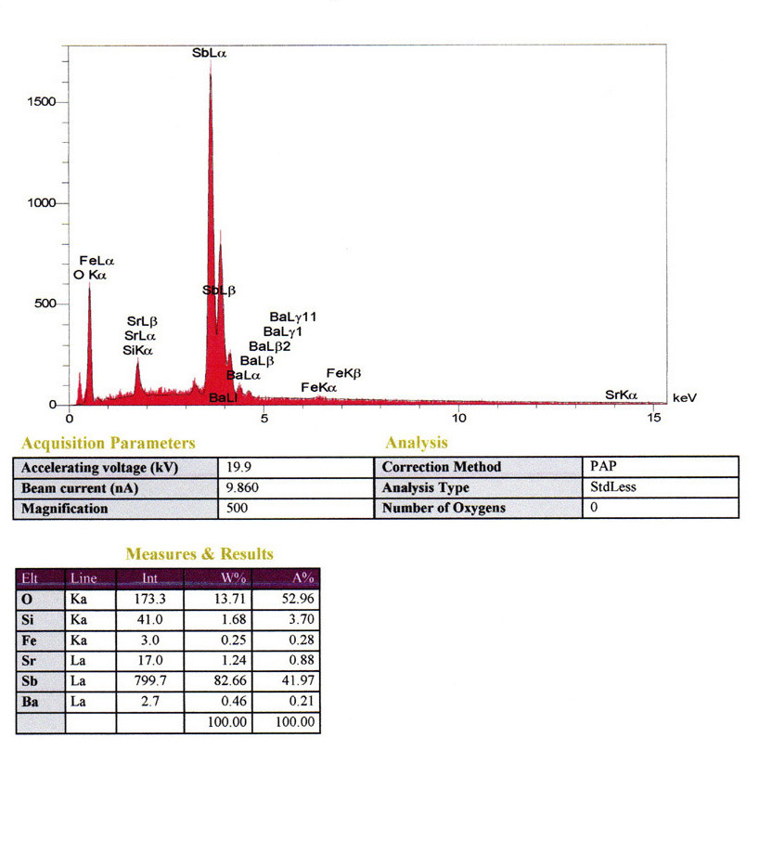
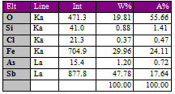
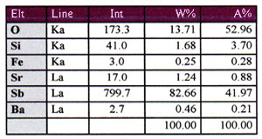
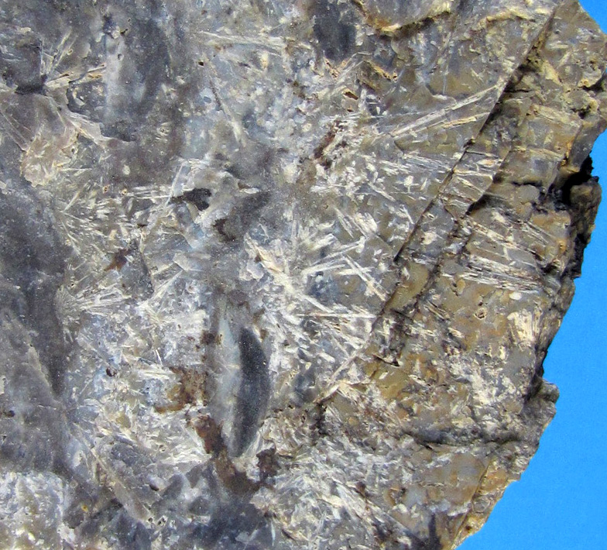
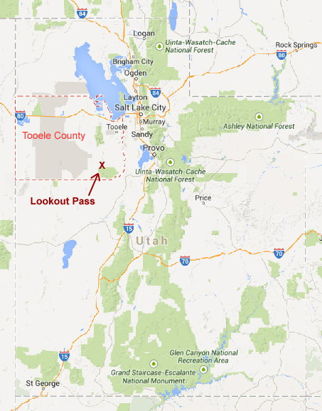
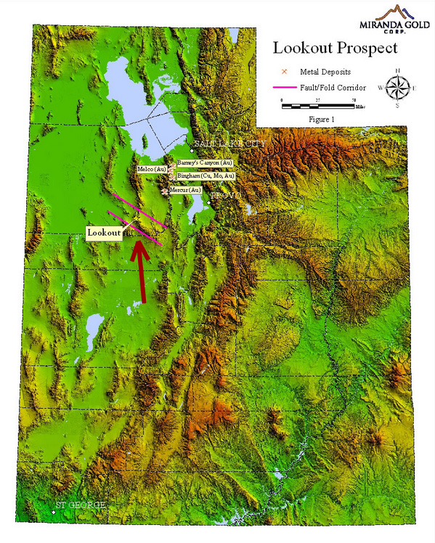
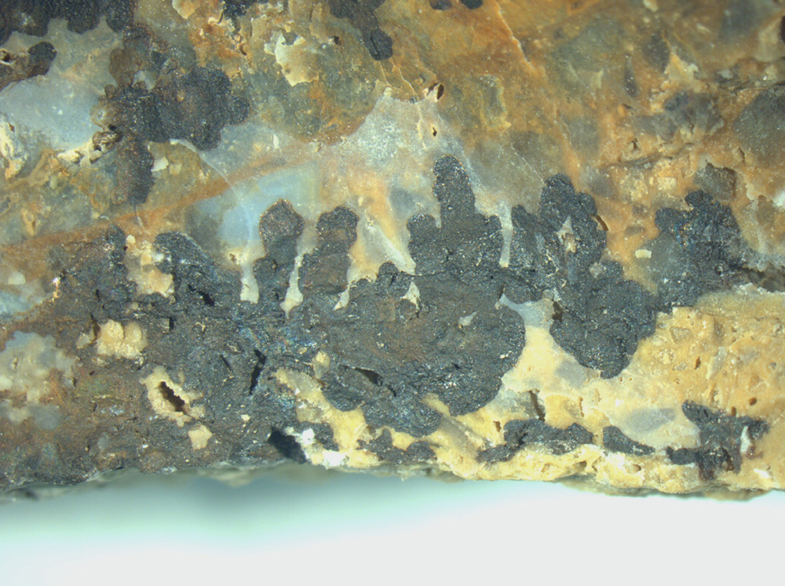
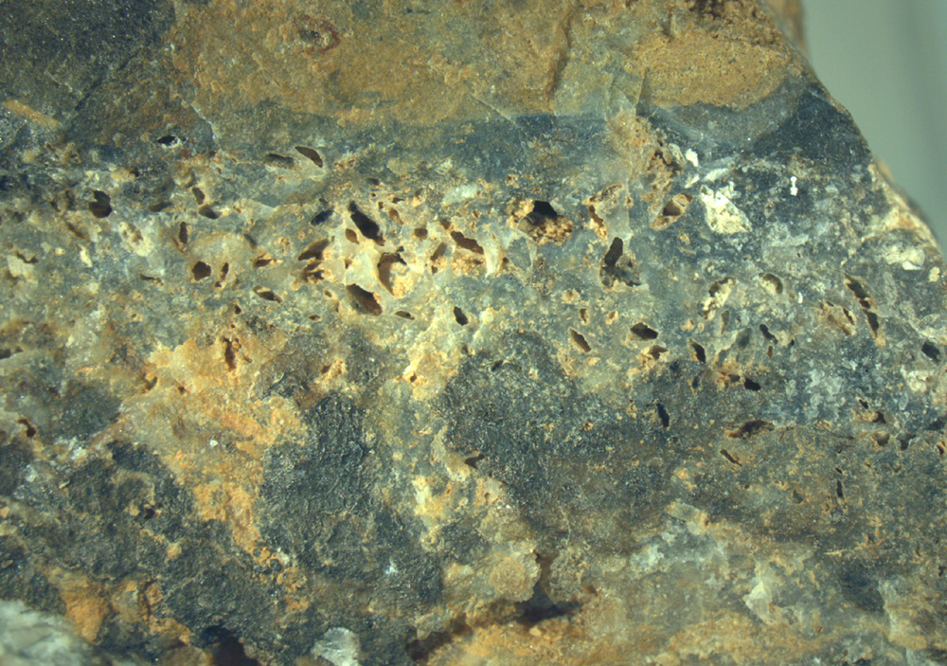
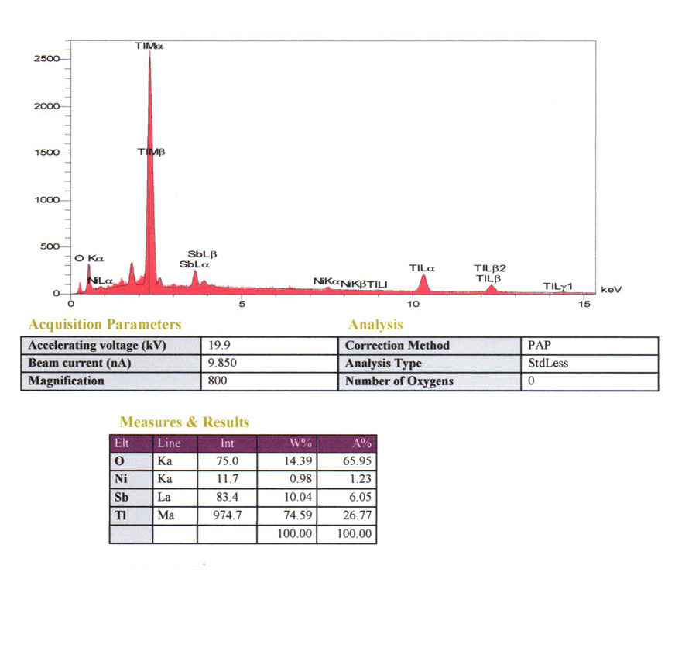
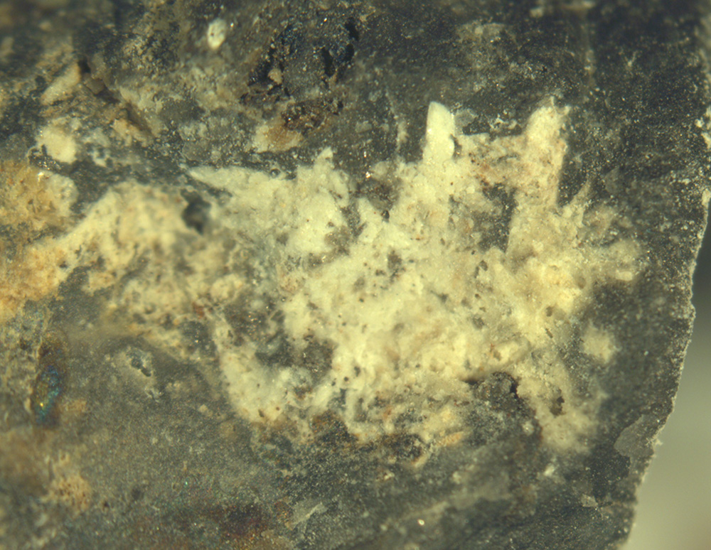
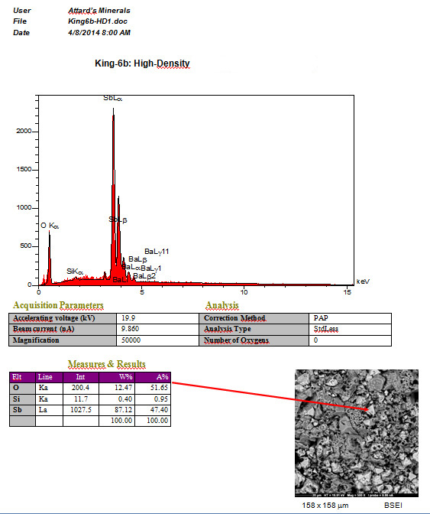
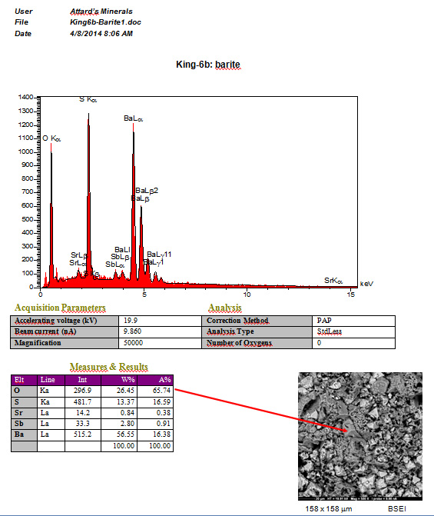
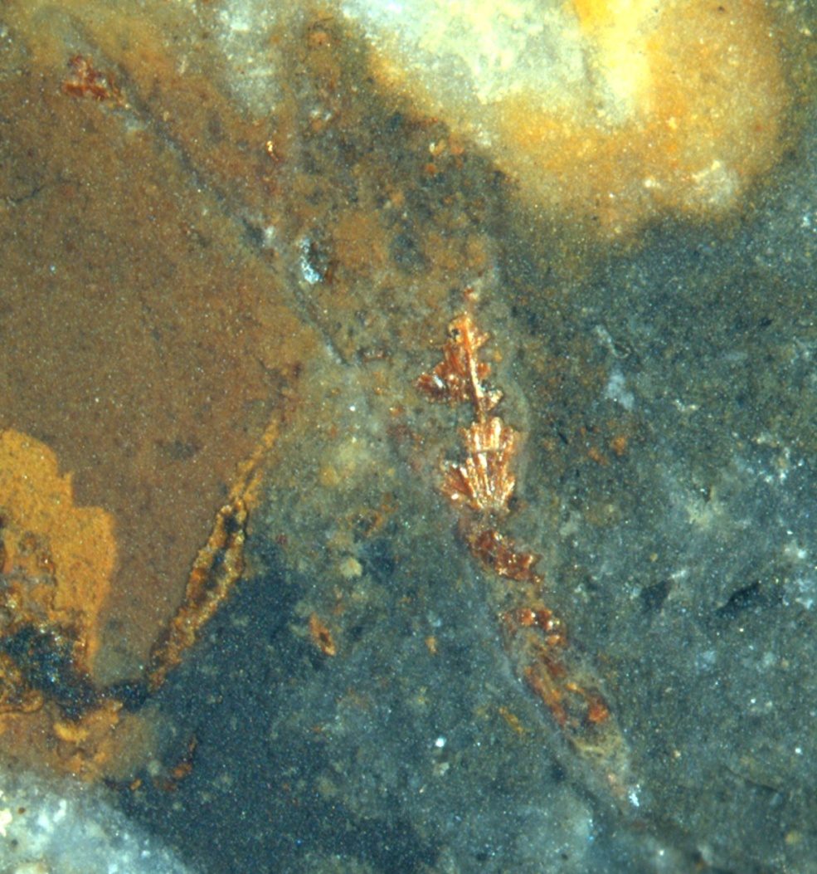
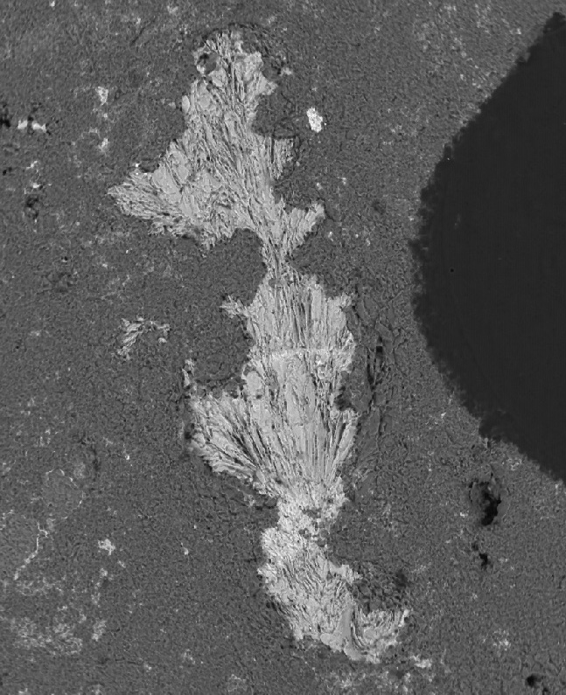
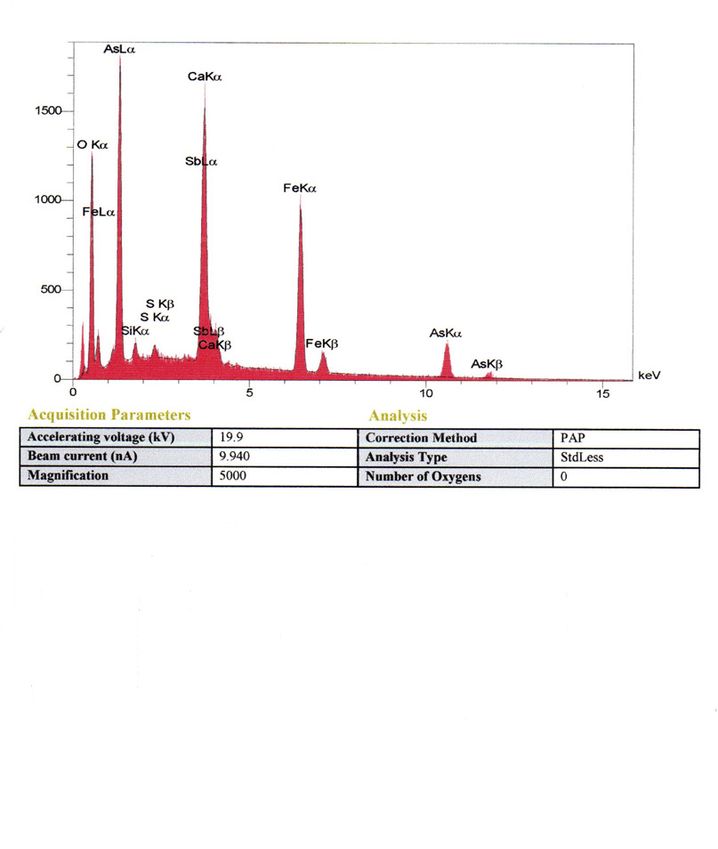
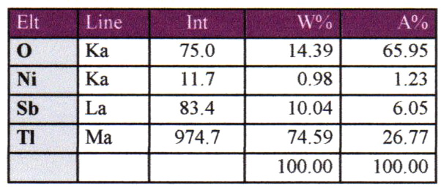
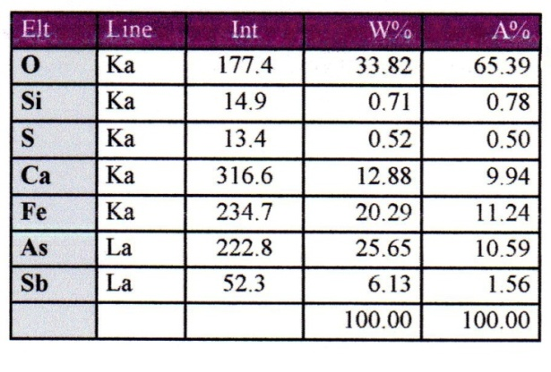

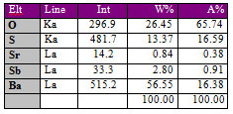
The Mineral Assemblage From Lookout Pass Area, Sheeprock Mountains, Tooele Co., Utah
KING, Norman R., Department of Geology and Physics, University of Southern Indiana, Evansville, IN 47712, nking@twc.com;
RICHARDSON, Philip D., Coreslab Structures (ARIZ) Inc., PO Box 18150, Phoenix, AZ 85005
PARAPIERROTITE, WEISSBERGITE, and STIBNITE
These are gray to black minerals having metallic luster and conspicuous cleavage. Stibnite and parapierrotite were both identified early from Lookout Pass deposits, and both species were described in essentially the same terms—as acicular crystals forming radiating masses of a few centimeters. This is the characteristic habit for stibnite, but there is no record of such material from Lookout Pass having been analyzed, and we found such crystal groups of stibnite only in widely-scattered chalcedony-filled vugs (after the abstract deadline!). The parapierrotite was identified by XRD in 1987, but we did not find parapierrotite in radial masses of acicular crystals, despite the original characterization. Weissbergite was reported anecdotally to have been identified by EDS from Lookout Pass, but no such specimen has been illustrated or otherwise described. We found that the habits of these species at Lookout Pass are distinct, so each can be distinguished from the other materials at Lookout Pass by visual inspection aided only by moderate magnification.
WEISSBERGITE -- TlSbS₂
HISTORY OF PROJECT AND OBJECTIVES
This project began after one of us (Norm King) purchased a mineral specimen from Lookout Pass claimed by the vendor to include several rare minerals in which thallium is an essential component, but no specifics could be provided. A dearth of analyses accompanying published and on-line photos meant that mineral identification would be uncertain, at best. Following extended on-line discussions at the Mindat.org website about identities of Lookout Pass minerals, the discussants agreed that reliable determinations awaited analytical work on the specimens in question. In the mean time, Phil Richardson reported that he had collected several boxes of Lookout Pass thallium-bearing material when the deposit was discovered in 1987, but after all this time he was still unsure what minerals are present. He sent 2.2 kilos of specimens to King, who agreed to identify whatever minerals he could find in that material, commissioning analyses where necessary, and to prepare a guide to their identification for use by amateur collectors.
OUTCROPS AND ROCKS
MINERALS FOUND BY SURFACE COLLECTING
AT LOOKOUT PASS
Lookout Pass jasperoid minerals are listed by whether they formed in
a reducing or oxidizing environment, and by approximate order of abun- dance within those groups as estimated from subjective observations and consideration of processes likely involved in Carlin-type mineralization. Both criteria can be debated, so this order is only qualitative and approxi-mate. Stibnite was identified by analysis after deadline for abstract sub-missions, necessitating a revision of the abstract (see other “handout”). Minerals illustrated in this report are marked by an asterisk (*).
Reducing environment--dark, organic-rich jasperoid:
* Parapierrotite TlSb₅S₈
* Pyrite and/or Marcasite FeS₂
* Graphite C
* Cinnabar HgS
* Stibnite Sb₂S₃
* Weissbergite TlSbS₂
Oxidizing environment--tan, yellow, orange, and red jasperoid and/or as coatings and replacements formed during relatively recent weathering:
* Avicennite Tl₂O₃
* Hematite α-Fe₂O₃
* Hydroxycalcioroméite (Ca,Sb³⁺)₂(Sb⁵⁺,Ti)₂O₆(OH)
* Stibiconite Sb³⁺Sb⁵⁺₂O₆(OH)
Calcite CaCO₃
* Sénarmontite Sb₂O₃
* Tripuhyite Fe³⁺Sb⁵⁺O₄
* Arseniosiderite Ca₂Fe³⁺(AsO₄)₃O₂.3H₂O)
Geothite α-Fe³⁺O(OH)
* Kermesite Sb₂S₂O
* Baryte BaSO₄
Celestine SrSO₄
Sulfur S
PARAPIERROTITE -- TlSb₅S₈
Weissbergite in Lookout Pass habit of simple small sprays with slight bluish cast. These were obtained by HF digestion of 32 grams of organic-rich chert, and then mounted in epoxy.
EDS report for crystal
group at far left in epoxy mount.
Close-up of the crystal spray nearest to right edge of epoxy mount (reoriented). Length 0.82 mm.
View across Little Valley to Lower Paleozoic strata dipping northward (to left).
Active quarry is located atop this hill. Road for exploratory drilling rig is in foreground.
Parapierrotite crystals in slice of organic-rich chert having stromato-litic lamination. Opposite side of this slice was digested in HF, yielding whole crystals of parapierrotite and weissbergite (see photo to right). FOV 25 mm.
Strew of parapierrotite crystals
dissolved from chert matrix. Reddish coating is KERMESITE (analyzed). Largest crystal is about 2.0 mmL.
EDS report for parapier-rotite. Crystals also ana- lyzed by PXRD, single-crystal XRD, and Raman spectroscopy.
Excellent basal cleavage (crosses long direction of crystal) in para-pierrotite allows easy differenti-ation from stibnite (compare second photo of stibnite below).
PYRITE and/or MARCASITE -- FeS₂
EDS does not distinguishing pyrite from marcasite, and we have not separated enough material to run XRD. Iron disulfide, indicated here as pyrite(?), occurs as angular to nodular masses and wispy flakes. It is arsenian in the organic-rich chert.
GEOLOGIC SETTING
The Lookout Pass site lies on the west side of Little Valley, in the north-
ern Sheeprock Mountains, a horst-block mountain range in the Basin
and Range physiographic province.
A thick sequence of Paleozoic sedimentary strata is exposed in this
area. The Cambrian Ajax Dolomite, including shallow-water facies such
as oolitic, stromatolitic, and mud-cracked carbonates, forms the country
rock. Tertiary decalcification of the carbonates led to extensive breccia-
tion, followed by metasomatic silicification to form a variety of chert
known as “jasperoid.”
A series of Tertiary faults trending NW-SE cut the Lookout Pass area in
a zone indicated by red lines on the accompanying physiographic index
map, and produced a prominent NW-SE grain visible on the satellite.
photo. Silicification, mineralization, and concentration of organic mater-
ial occurred along the fault zones.
Drill-hole cores have been taken in this area, with one sample registering
as high as 1.945 oz Au/ton (66 g/t), reported by Miranda Gold Corp. Gold
was not the subject of our study, and was not detected in any of our
analyses. The presence of jasperoid and arsenian pyrite nevertheless
suggests this is a Carlin-type deposit. Exploratory work continues.
STIBNITE -- Sb₂S₃
Hilltop quarry in dolostone partially replaced by chert containing thallium minerals. Arrow shows a “pocket” excavated by previous collectors.
Jasperoid in active quarry. Dark-colored, organic-rich chert grades to reddish-brown oxidized chert left of hammer, then to dolostone (not in picture).
EDS report for arsenian pyrite(?) grain.
Silvery grain of arsenian pyrite(?) in organic-rich chert, next to gray para-pierrotite crystal. Pyrite grain 0.45 mmL.
Radial spray of stibnite crystals in chalcedony-filled vug. Com-pare with stout prisma tic crys-tals of parapierrotite in dark chert. FOV 2.3 mm (L-R).
Single crystal (2.2 mmL) of stibnite in chert showing perfect cleavage on (010), parallel to direction of elongation.
Scattered elongated crys-tals of stibnite in chert. The longest crystal here is unusually long for this locality, at 7 mm.
EDS report for Lookout Pass stibnite.
CINNABAR AND GRAPHITE
HEMATITE --
α-Fe₂O₃
HGS C
Thin section of organic-rich chert in cross-polarized light showing multiple generations of brecciation and silicification. Tiny opaque rhombs are crystals of parapierrotite.
Typical hand-specimen of Lookout Pass jasperoid. Note quartz-filled vugs and interpenetration of reduced zones (dark-gray) and oxidized zones (tan to reddish-brown with liesegang banding).
SATELLITE PHOTO OF THE LOOKOUT PASS SITE
TRIPUHYITE -- Fe³⁺Sb⁵⁺O₄
SÉNARMONTITE, BARITE, AND CELESTINE
Sb₂O₃
BaSO₄
SrSO₄
This botryoidal patch of iron oxide lies in a vug in chert lined by drusy quartz. Identification is based on EDS and the reddish color of very finely-divided material on the quartz. Distinguished from avicennite by its botryoidal habit and brilliant metallic luster. FOV 3.0 mm.
Reddish pseudohexagonal crystals of cinnabar (red arrows) and dark-gray pseudohexagonal crystals of graphite (black arrows) in chert. Divisions in micrometer scale are 0.1 mm.
Vugs in chert created by disso-lution of parapierrotite crystals now filled with mixture of tripuhyite and sénarmontite.
BSEI of botryoidal tripuhyite and octahedral sénarmontite. (The forms are not visible on sawed surface.)
STIBICONITE
Organic-rich chert containing numerous “float-ing” crystals of parapierrotite, and showing stromatolitic lamination. Vug filled largely with chalcedony is at upper right, and empty vug is at lower left. FOV 25 mm.
Chert colored by iron oxides and the arsenate arseniosiderite. Gray metallic crystals are para-pierrotite. Spotty and/or whole-rock oxidation probably occurred after the parapierrotite crystallized. FOV 4 mm.
These three minerals in com-bination form a pseudomorph after a single parapierrotite crystal (below). See BSEI at right for close-up of area in yellow box.
EDS report for tripuhyite.
Sb³⁺Sb⁵⁺₂O₆(OH)
HYDROXYCALCIOROMÉITE
Dominance of Sr over Ba in this EDS report for the sénarmontite-dominated matrix is best explained by presence of celestine (not visible). However, no sulfur was registered at this spot.
(Ca,Sb³⁺) ₂(Sb⁵⁺,Ti) ₂O₆(OH)
Hydroxycalcioroméite (lewisite is synonym) formed
pseudomorphs after parapierrotite in an environ-
ment rich in calcium (Ajax Dolomite) . FOV 8.6 mm. Identified by XRD.
INDEX MAPS
BSEI showing location of the sénarmontite (S) and barite (B) crystals tested.
AVICENNITE -- Tl₂O₃
ARSENIOSIDERITE -- Ca₂Fe³⁺(AsO₄)₃O₂.3H₂O)
Stibiconite forms pseudomorphs after stibnite. We used XRD to identify hydrous stibiconite because EDS doesn’t register the H in water, and therefore it might be confused with sénarmontite or valentinite if using only EDS.
Modified from promotional literature
by Miranda Gold Corp.
Lobate dendroids of black avicennite
on chert and chalcedony. FOV 20 mm.
Avicennite (black) incorporating thal-lium released from dissolution of para-pierrotite crystals now represented by crystal molds (tiny vugs). FOV 25 mm.
EDS report for Lookout Pass avicennite. Ni and Sb oxide are also present.
Modified from Google Maps
EDS report for sénarmontite (see BSEI).
EDS report for barite (see BSEI).
Silky arseniosiderite in vugs.
BSEI of arseniosiderite.
EDS report for arseniosiderite.

