Slide 1
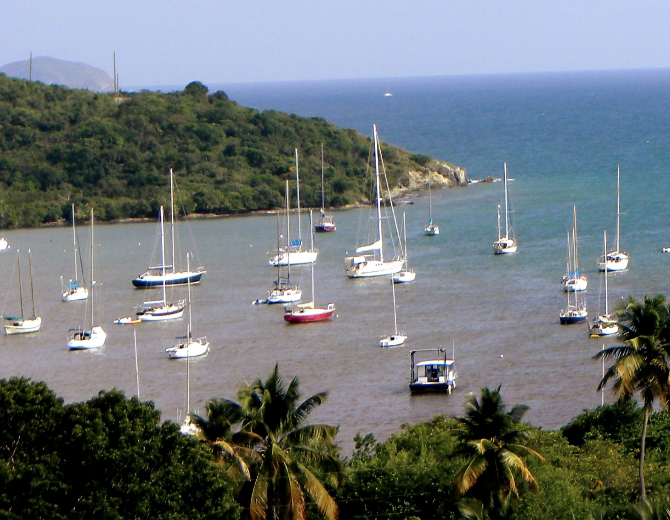


Understanding Natural Coastal Sedimentation to Determine Anthropogenic Impacts:
Virgin Islands National Park
Rebekka A. Larson^{1,2}
Brooks, G.R.¹
Devine, B.³
Schwing, P.T.²
O’Donnell, B.¹
Browning, T.¹
Holmes, C.W.⁴
¹Eckerd College, St. Petersburg FL
²University of South Florida, St. Petersburg, FL
³Tropical Ecosystems Consulting, St. John, USVI
⁴Environchron, Bradenton, FL

Slide 2
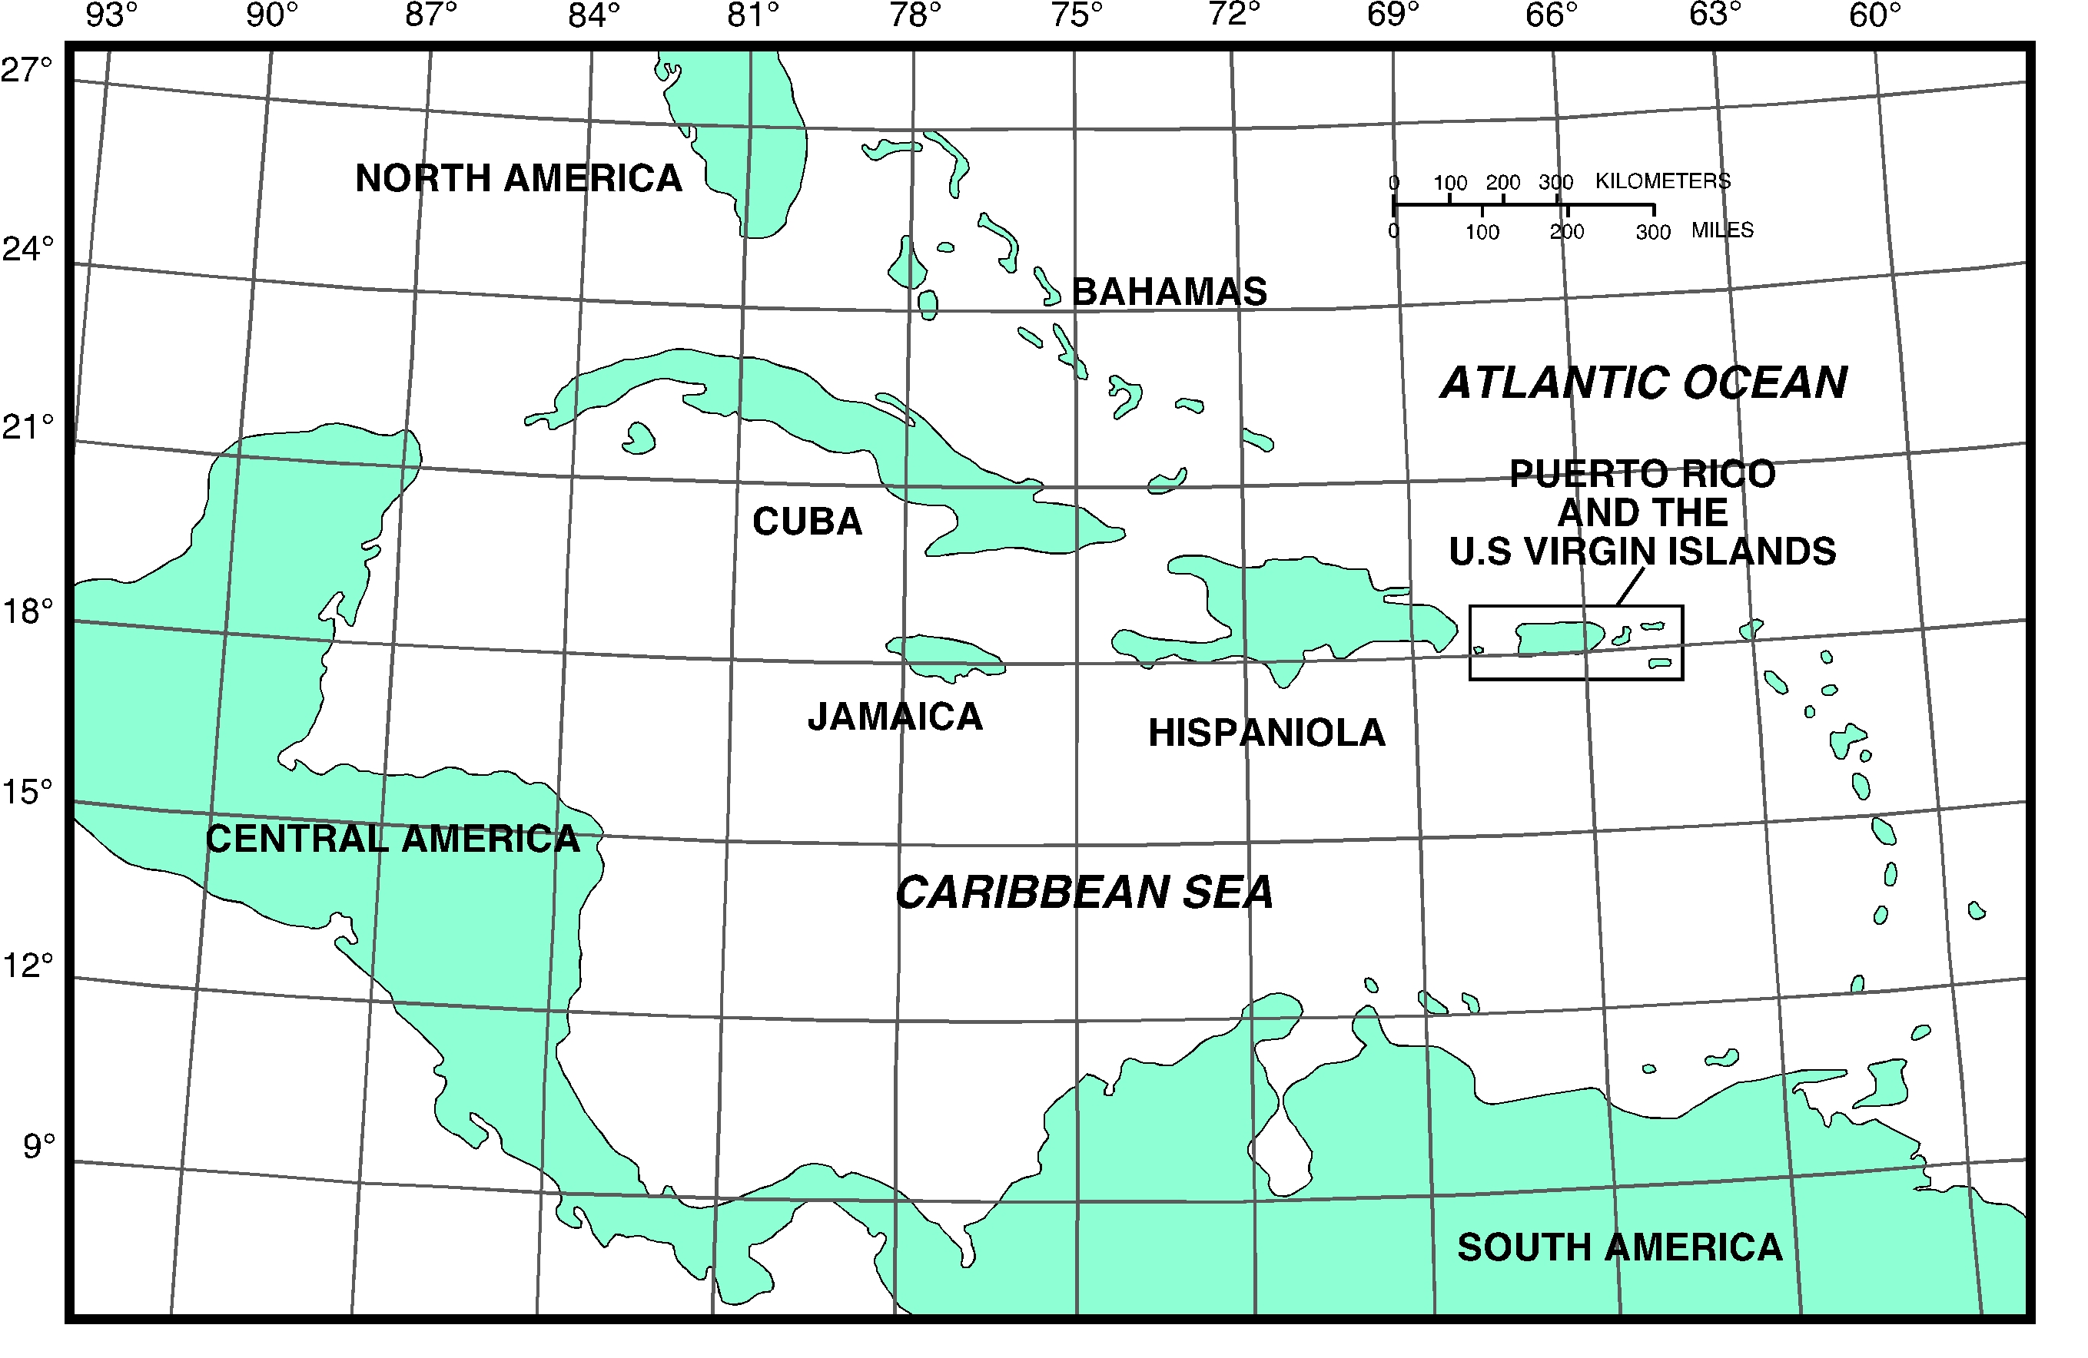

Slide 3
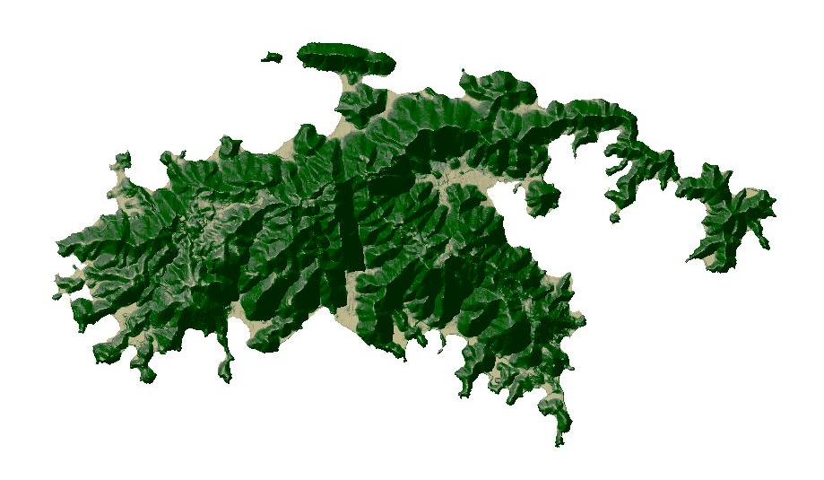
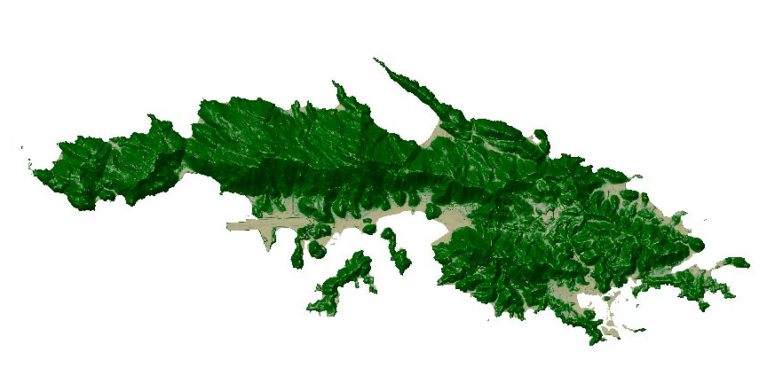
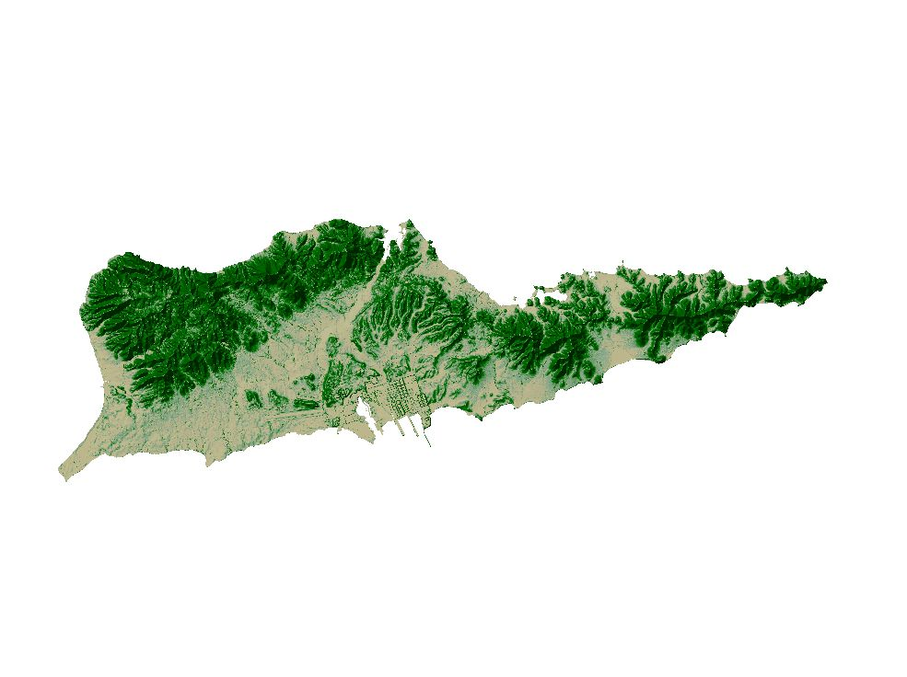
US Virgin Islands
St. John
St. Thomas
St. Croix

Slide 4
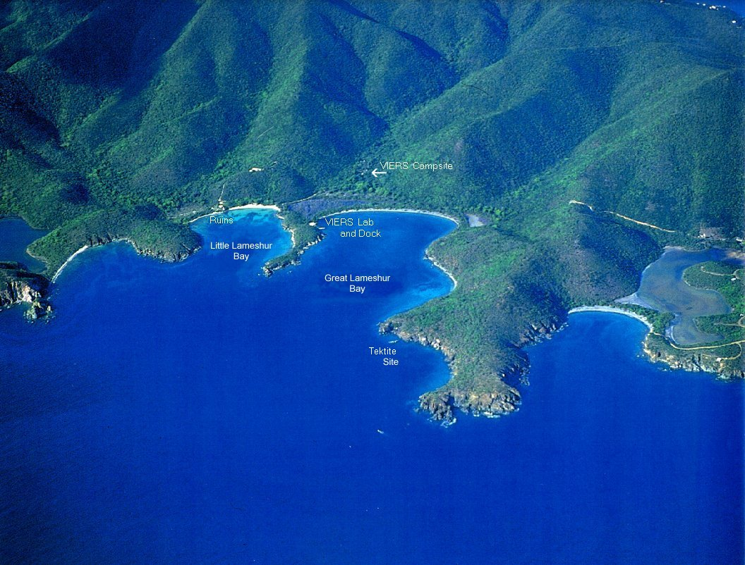
Vulnerable to Erosion!
- Unstable rocks (STT & STJ)
- Steep gradients
- Hot, humid climate
- Human influences?

Slide 5
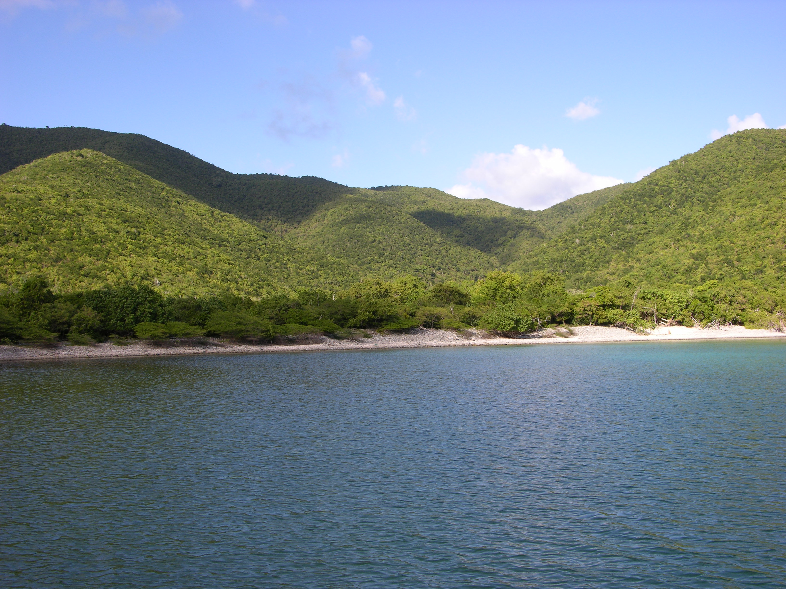

Slide 6
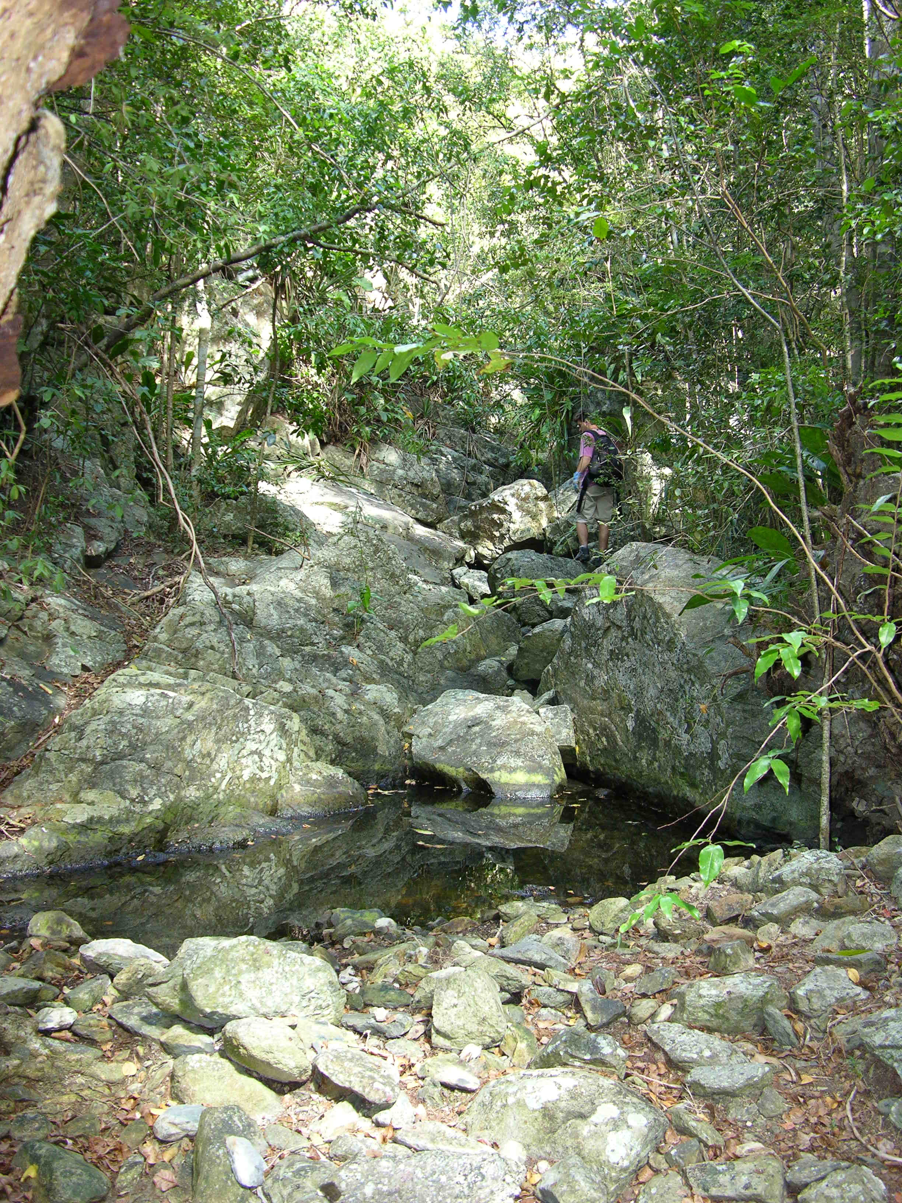
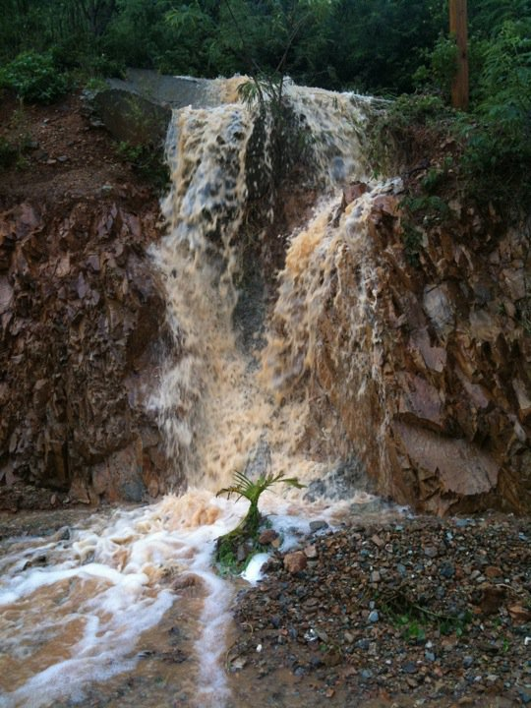

Slide 7
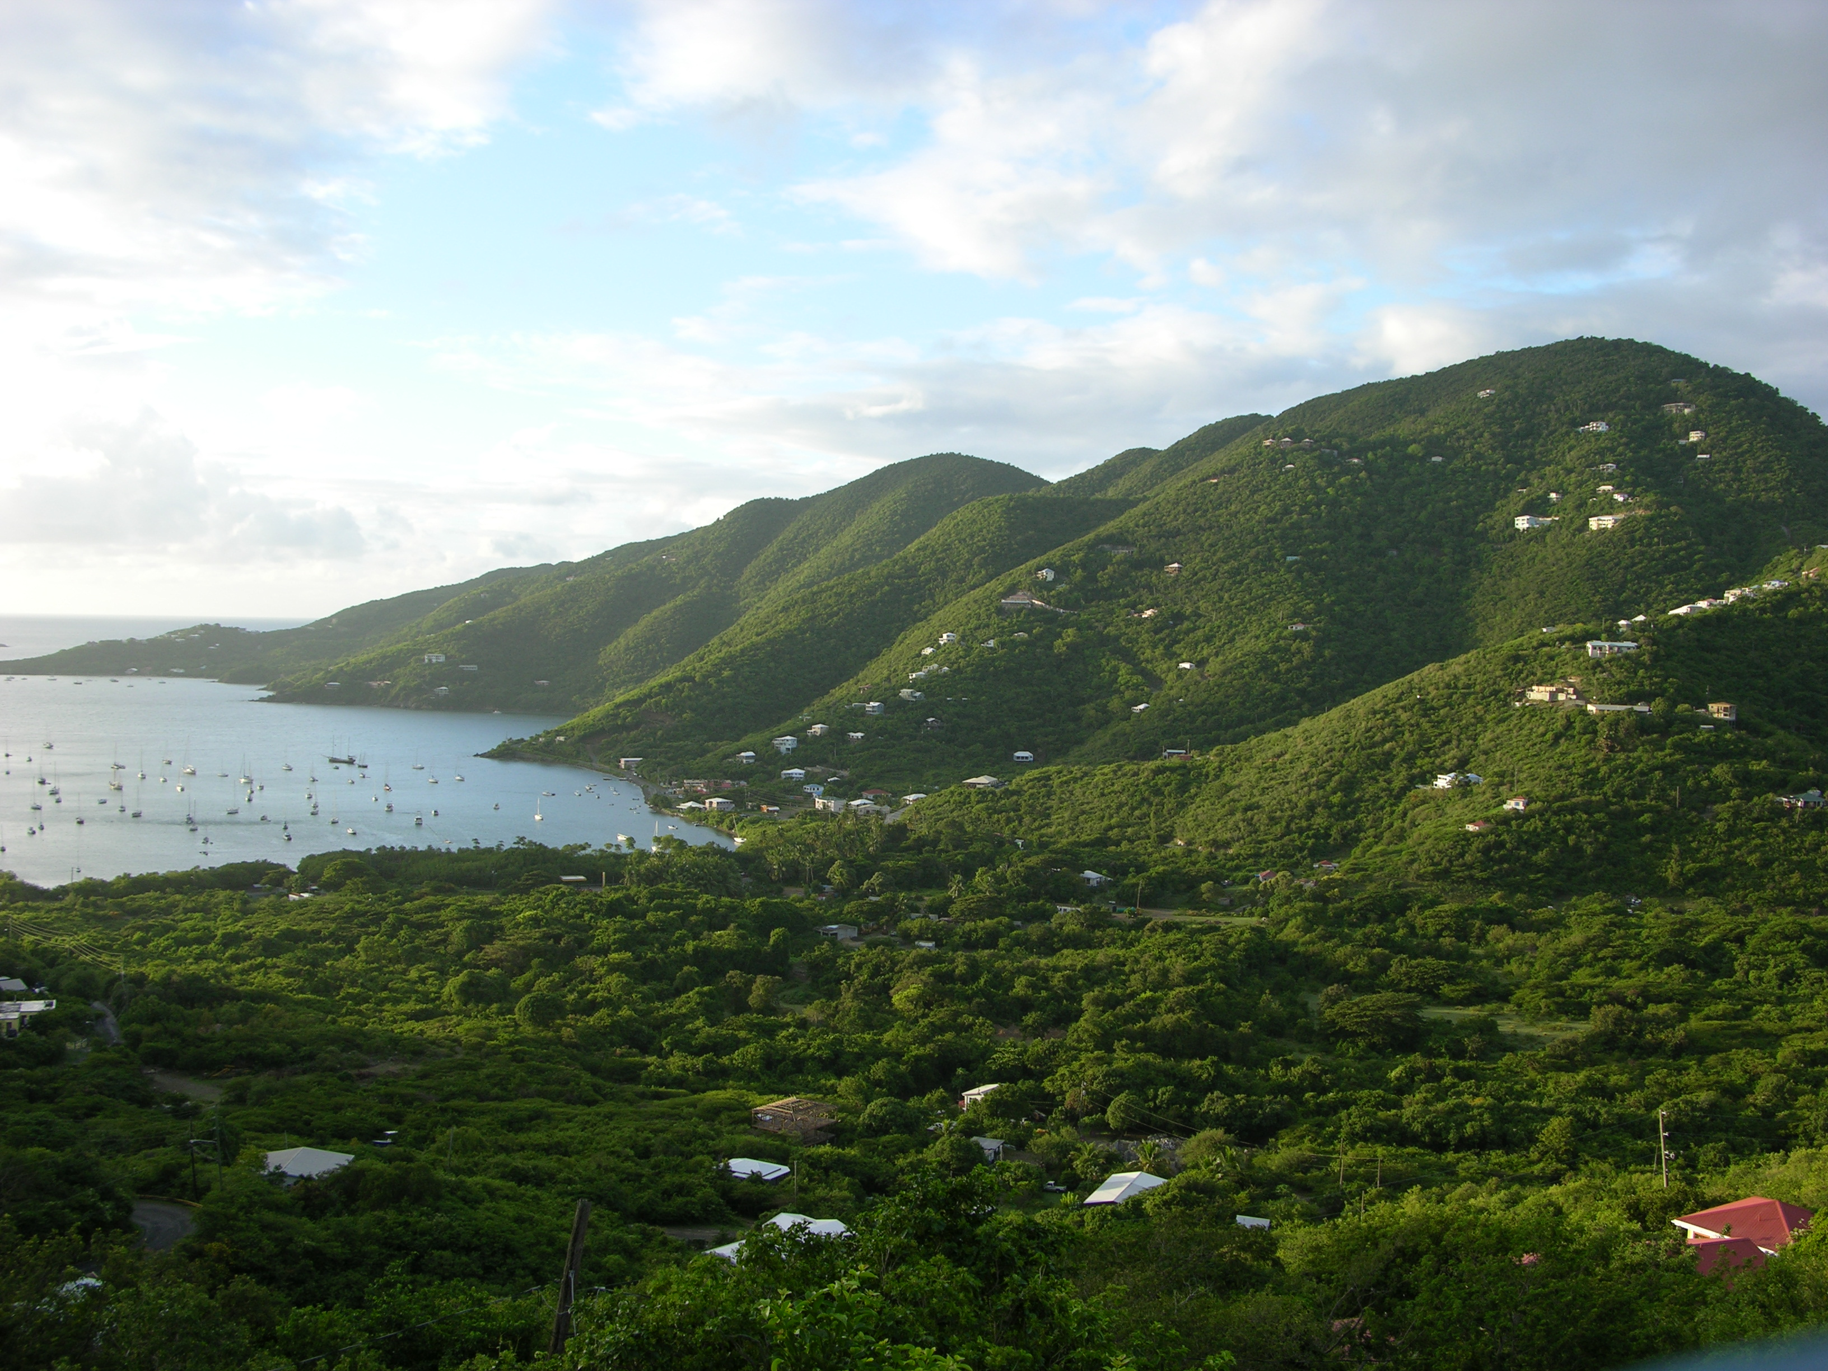

Slide 8
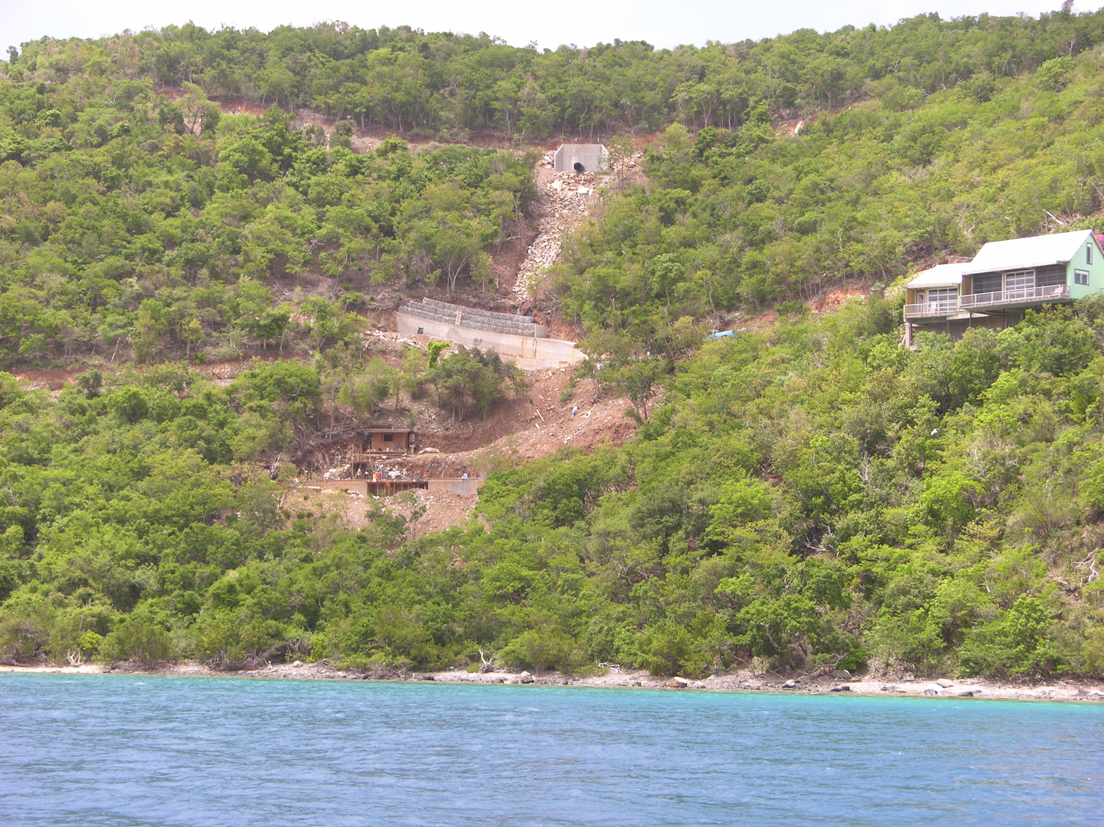

Slide 9
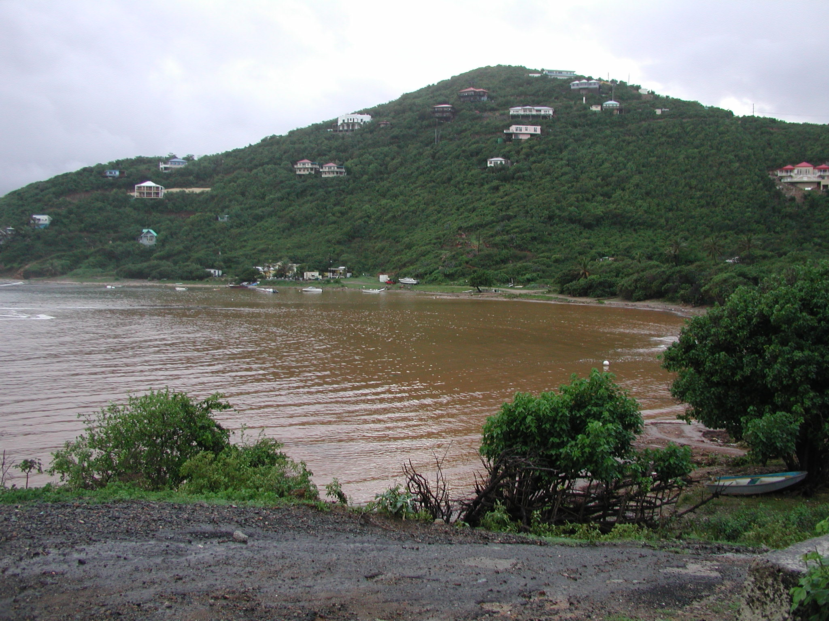
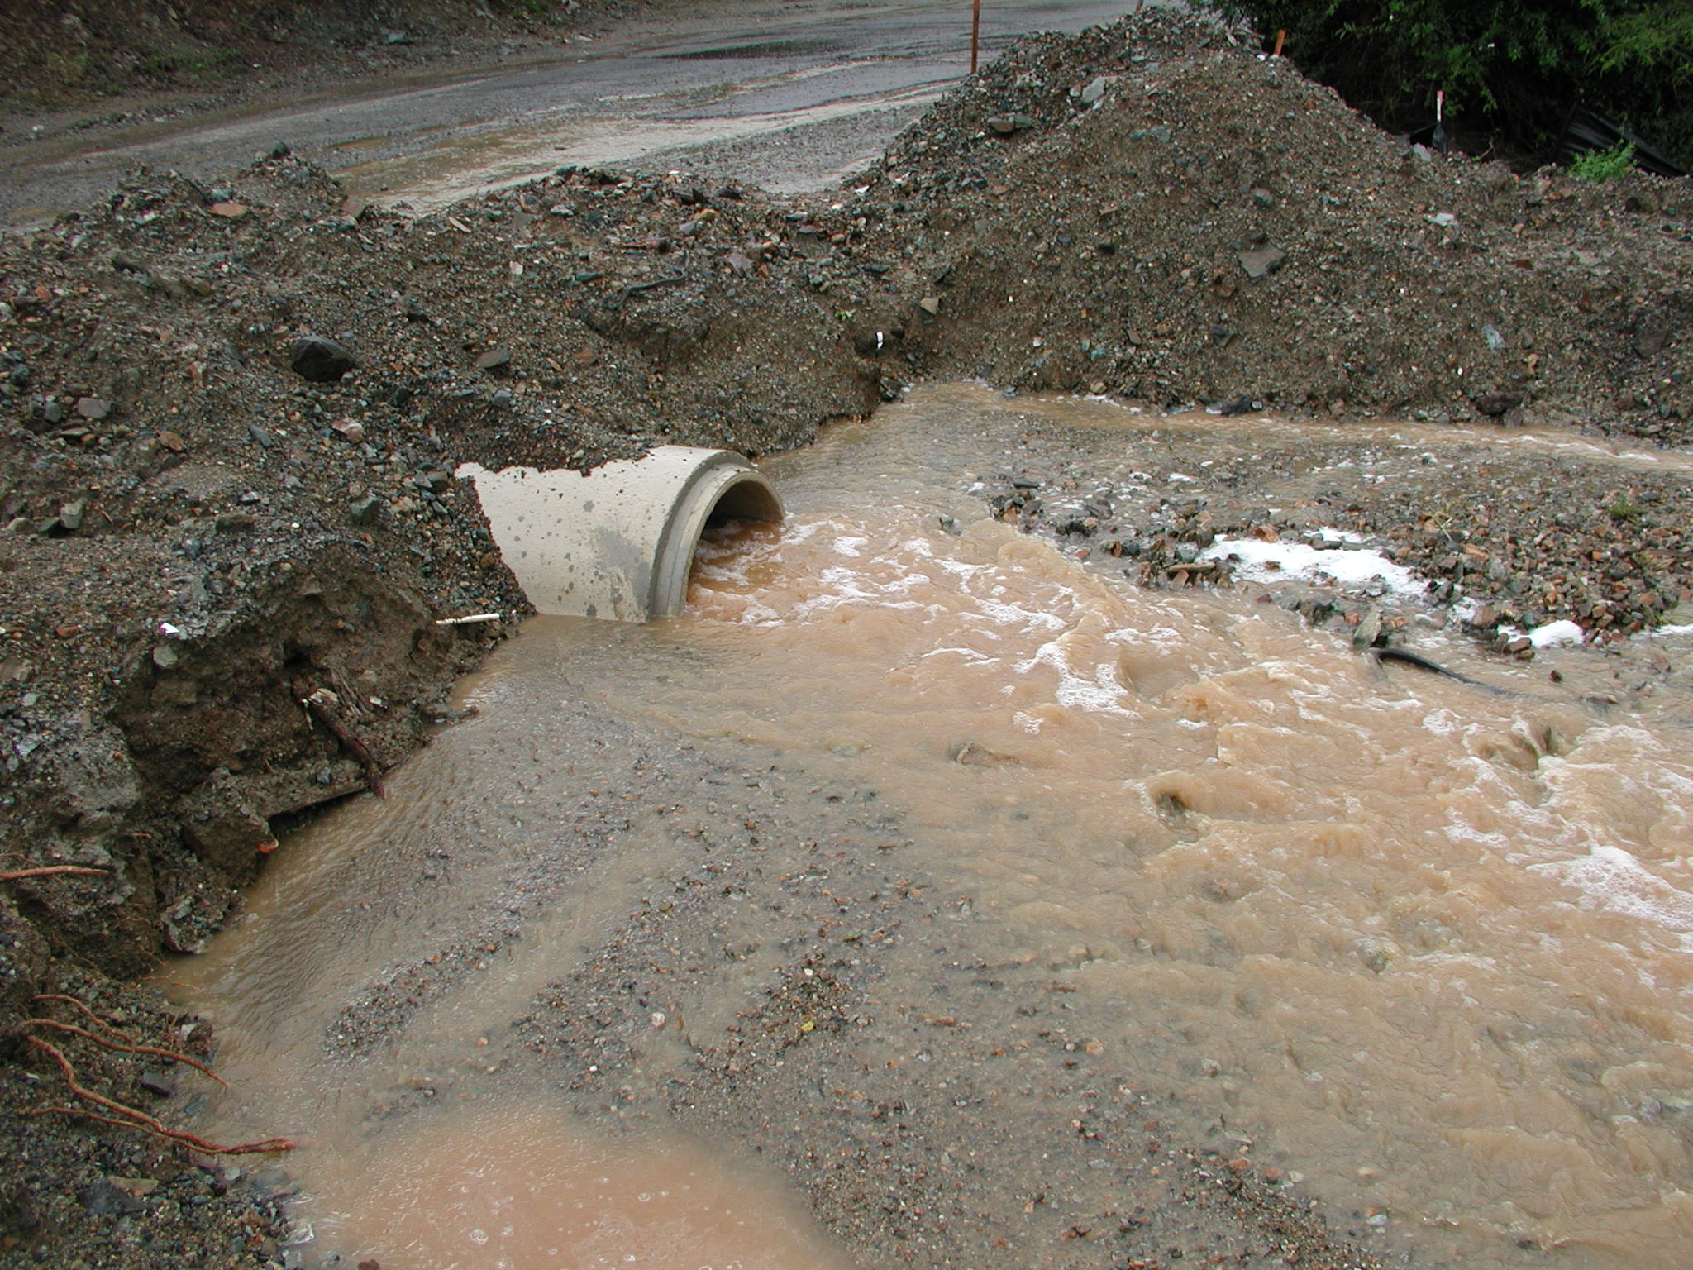
Sediment Pollution: Terrigenous Runoff
The detrimental impacts of sedimentation on coastal environments are well established, and are particularly relevant to the USVI due to:
Exceptionally fragile nature of the coastal ecosystems.
Erodibility of the unstable island rocks that promotes excessive runoff to coastal environments.
3) Exceptionally steep slopes.

Slide 10
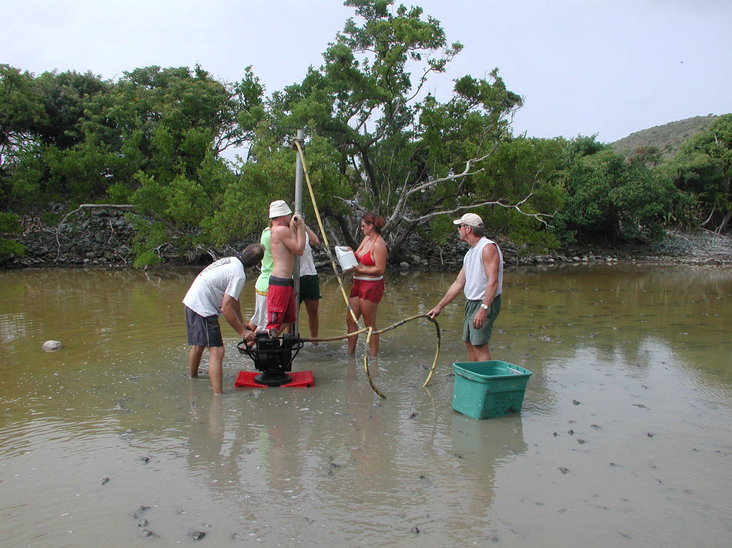
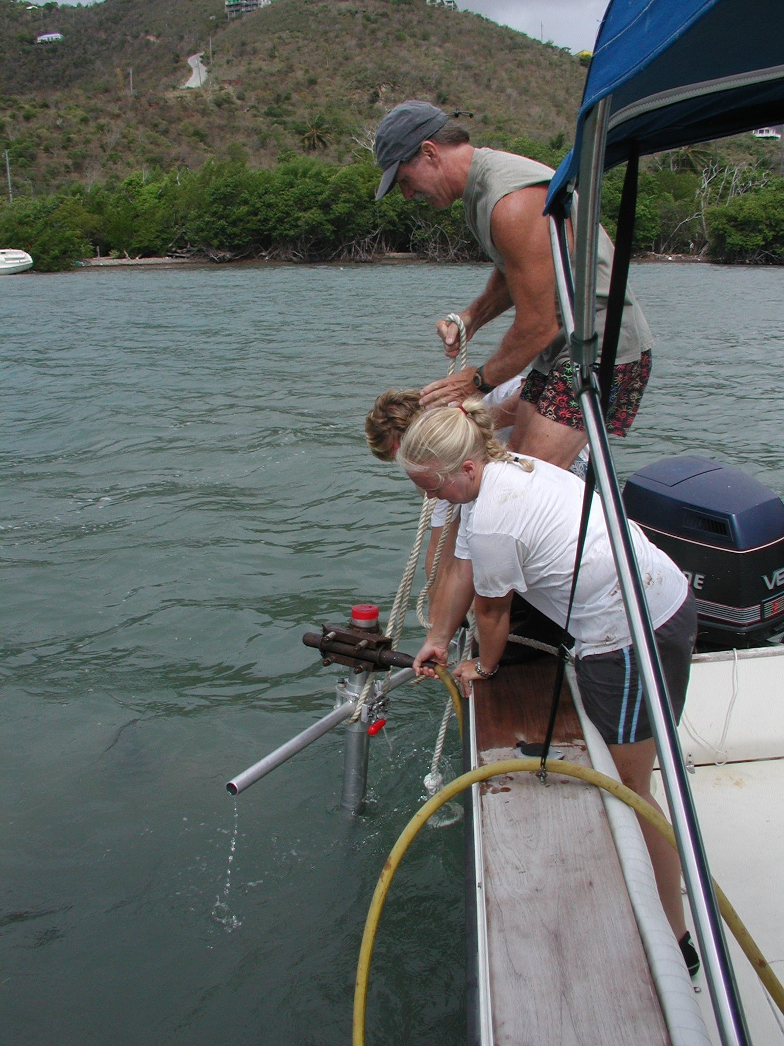
Sediment Sampling - Cores and Surface Samples: USVI
Sediment cores:
Coastal Marine and Salt Ponds
Provide a several thousand-year record of sedimentation.
How the system has developed naturally as well as the degree to which the sediments deviate due to human impacts from the natural sediments.
Surface Sediment Samples:
Coastal Marine
Current sediment distribution patterns.

Slide 11
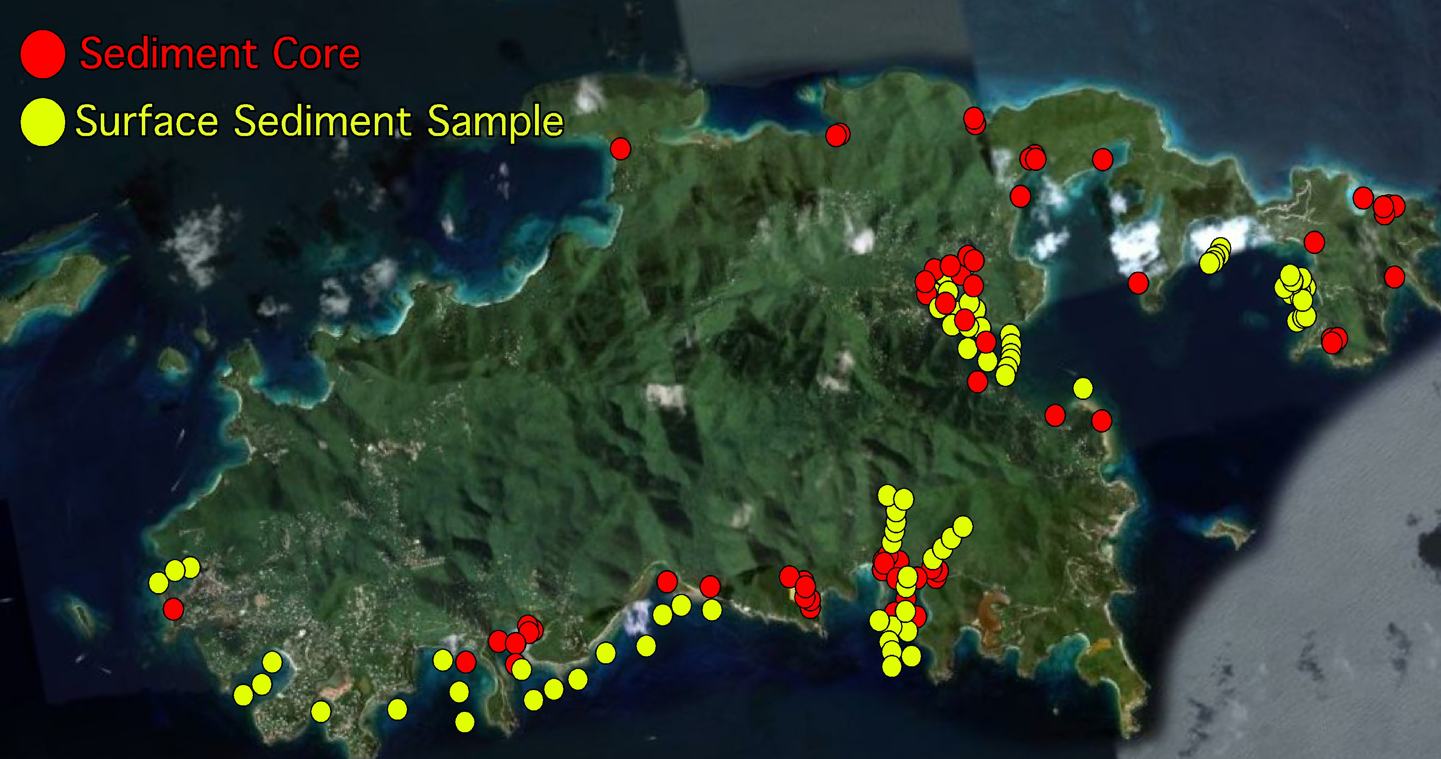
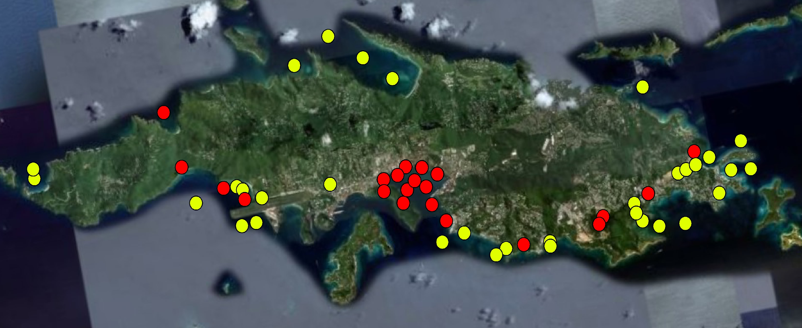
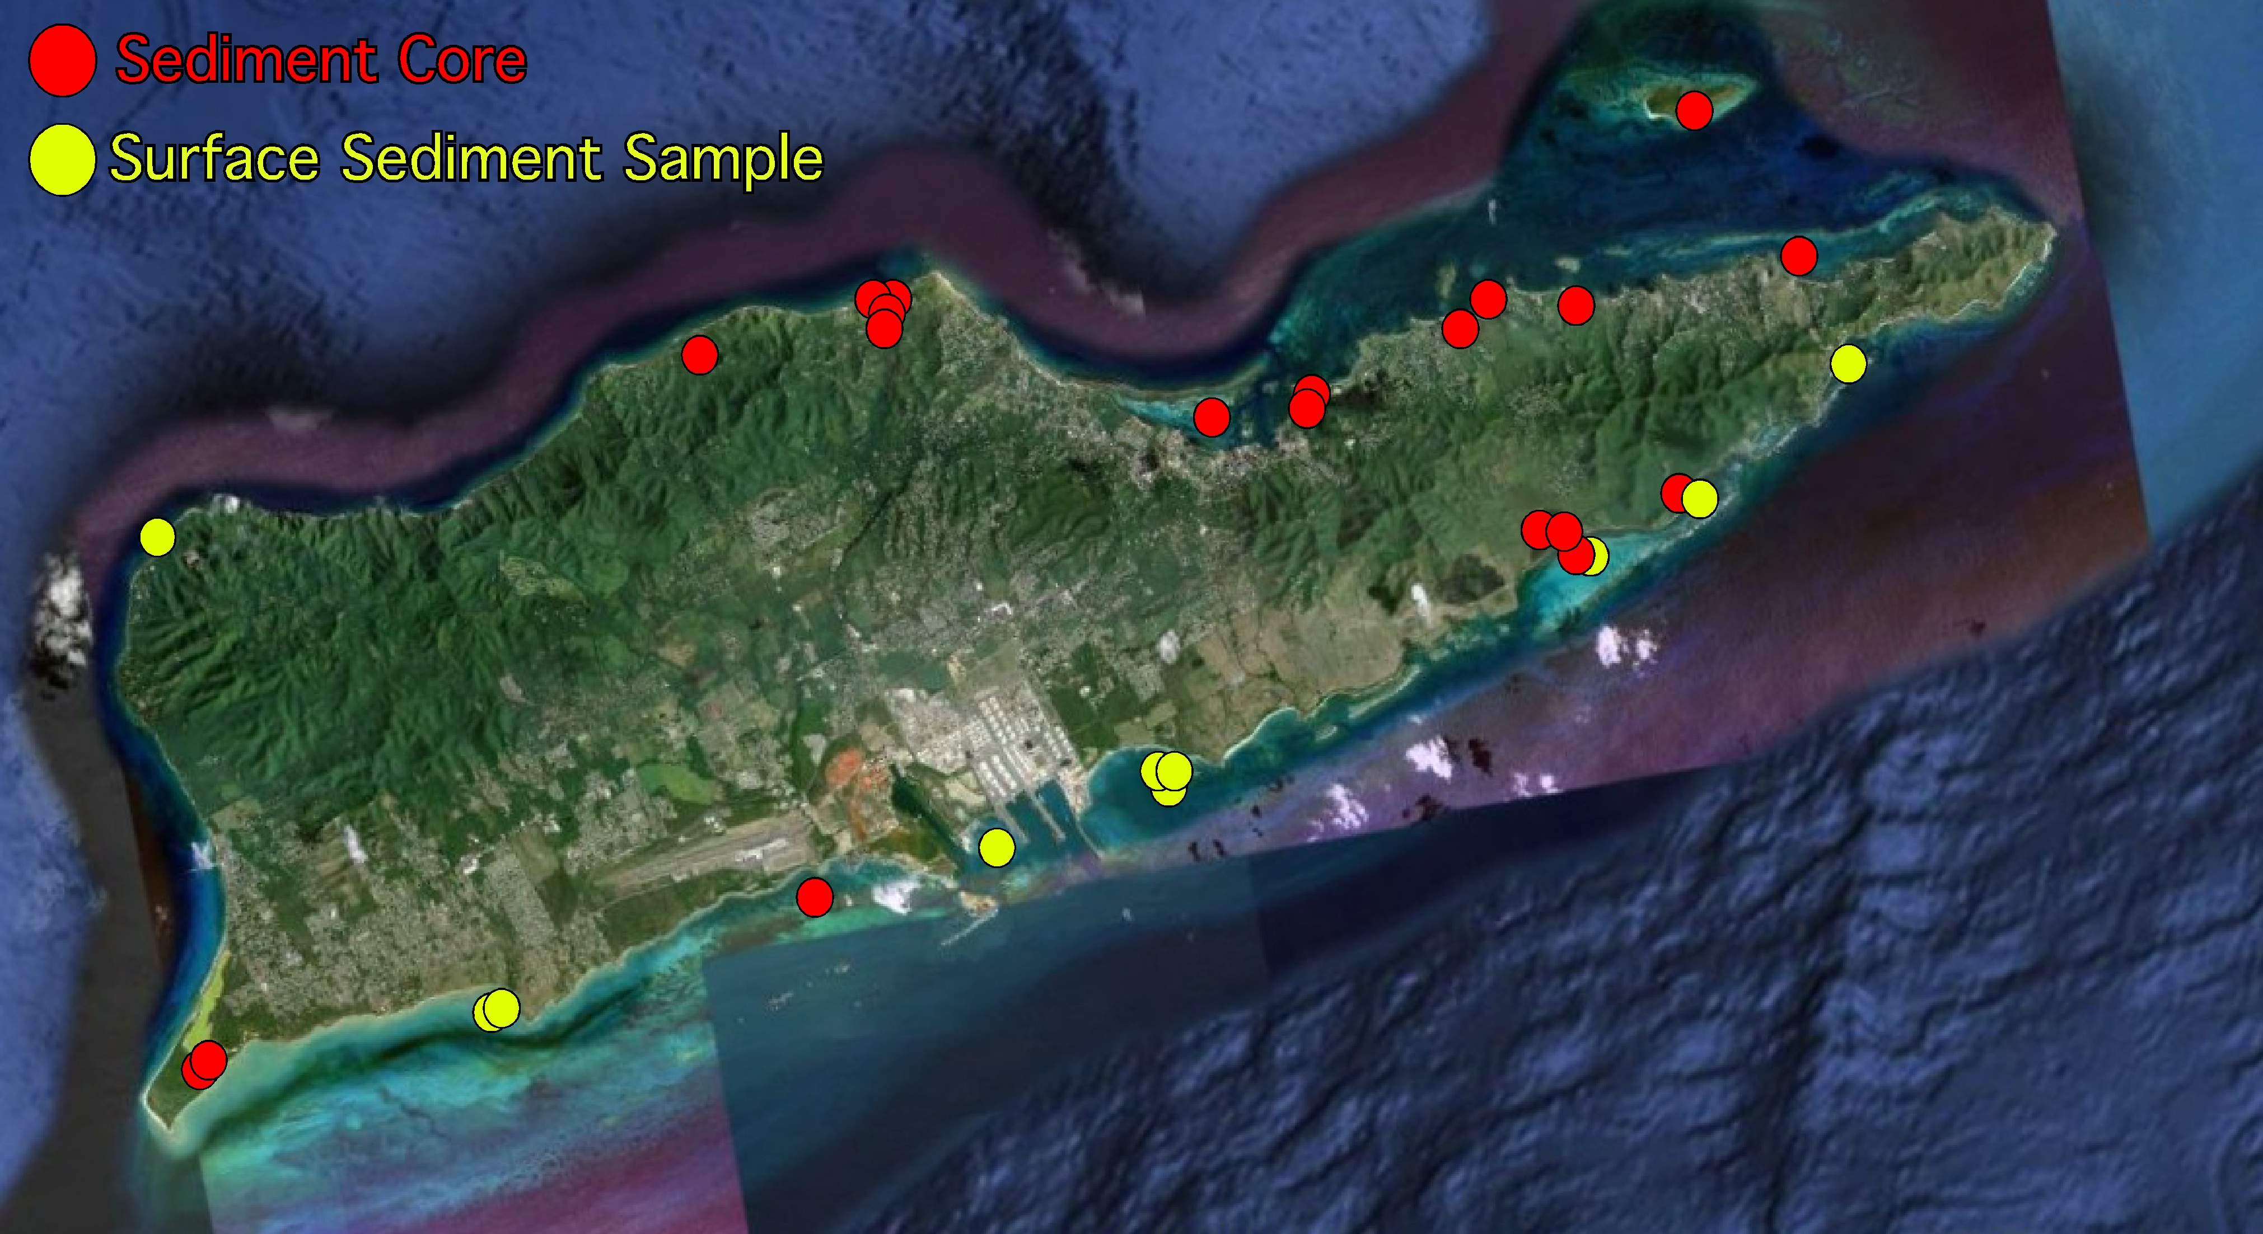
USVI Coastal
Sedimentary Framework
>100 cores
>150 surface samples

Slide 12
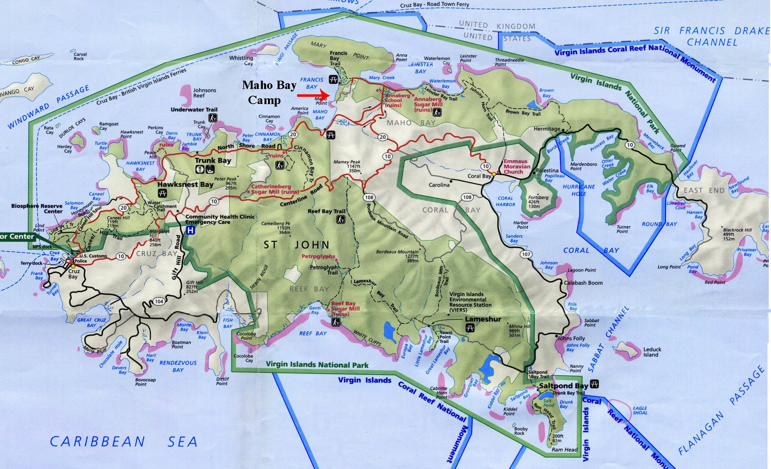
St. John, National Park (green) and Coral Reef National Monuments (blue)

Slide 13
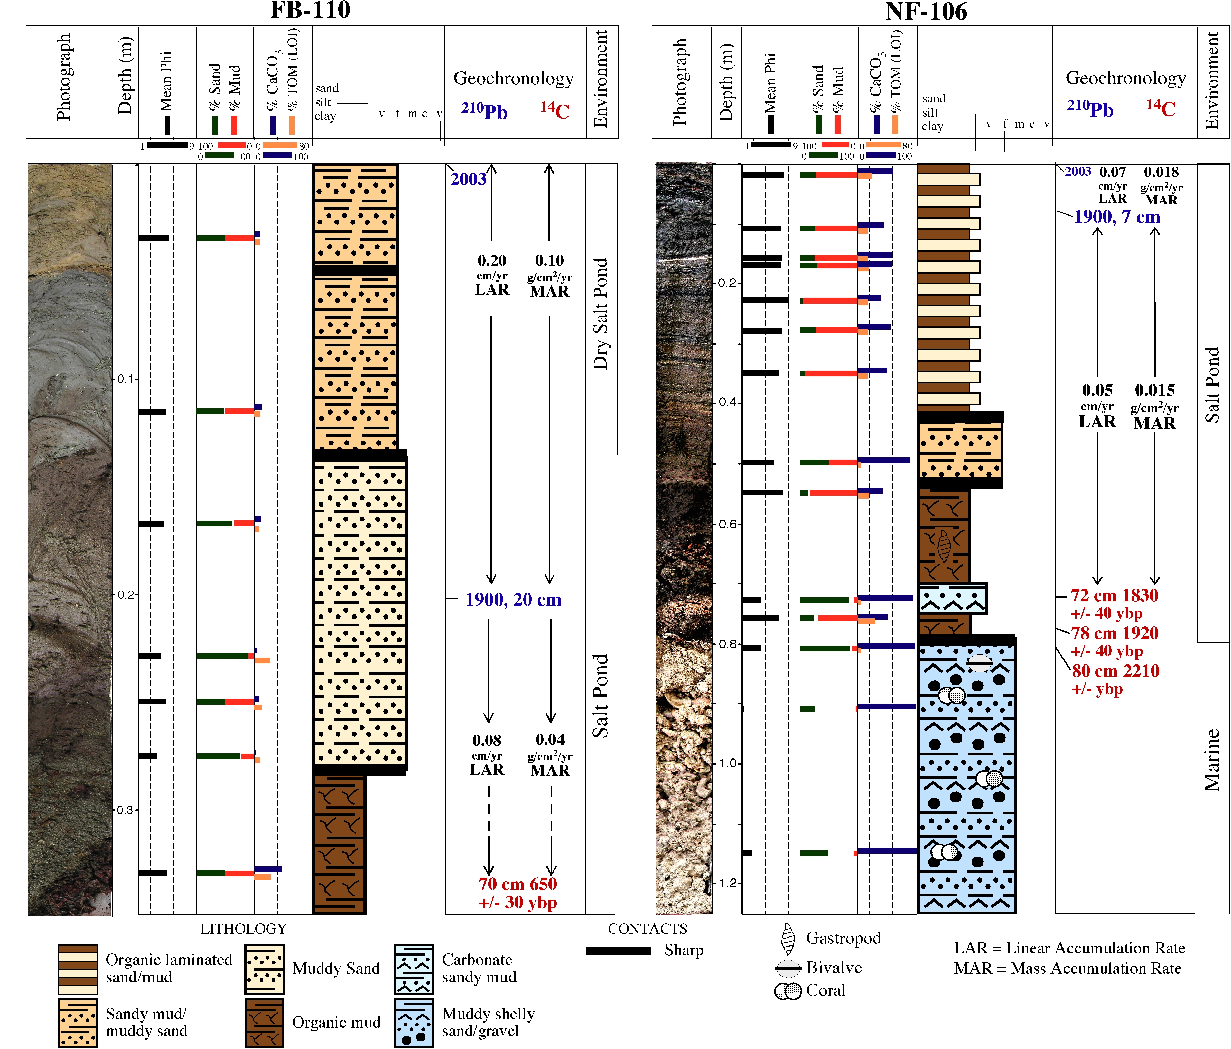
Sediment Cores
Provides natural pre-anthropogenic record to compare to anthropogenic timeframe
Records terrestrial sediment deposition – Texture, Composition, Rates
Geochronology
¹⁴C
²¹⁰Pb
¹³⁷Cs
⁷Be
Sediment Accumulation Rates
MAR
TMAR (Terrigenous)

Slide 14
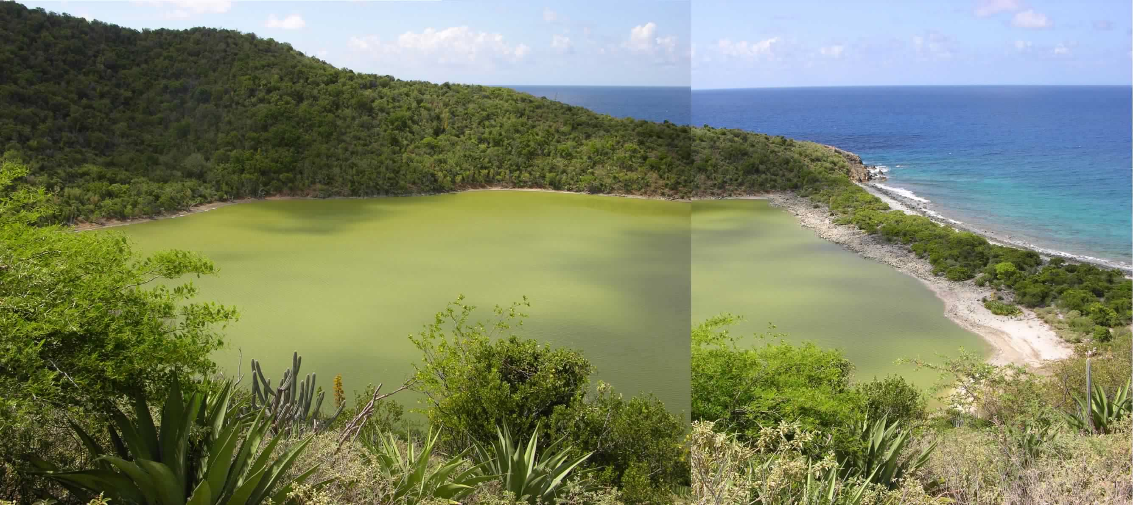
Salt Ponds - Sediment Sources/Inputs
-Terrigenous Runoff
-Marine Overwash
-Atmospheric fallout
Rainfall events lead to
Erosion of hillslopes
Down-slope transport of water and sediment through natural ghut systems.
High marine surge and wave activity
Waters and sediment overtop berm
Tropical Cyclones
Tsunamis
Dust fallout to salt pond and land surfaces
Volcanic ash
African Dust

Slide 15
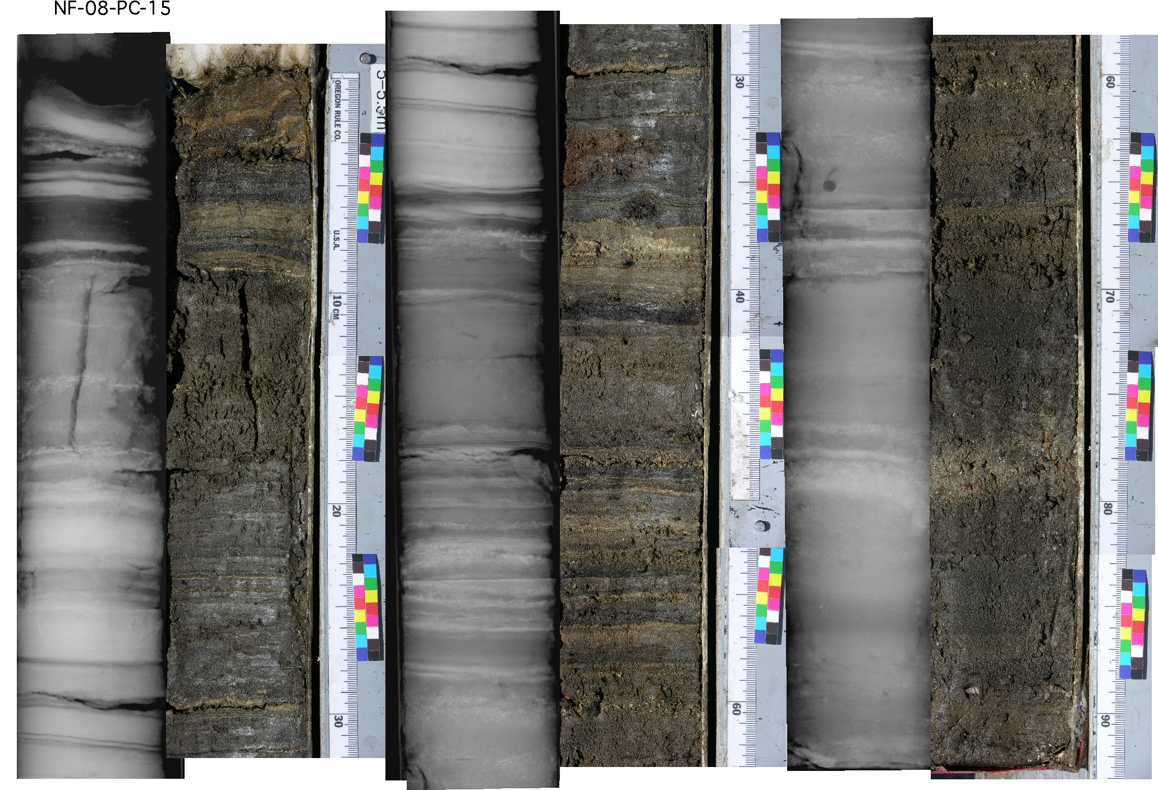
Sediment Cores – Preservation of “Events” - Stratigraphy

Slide 16
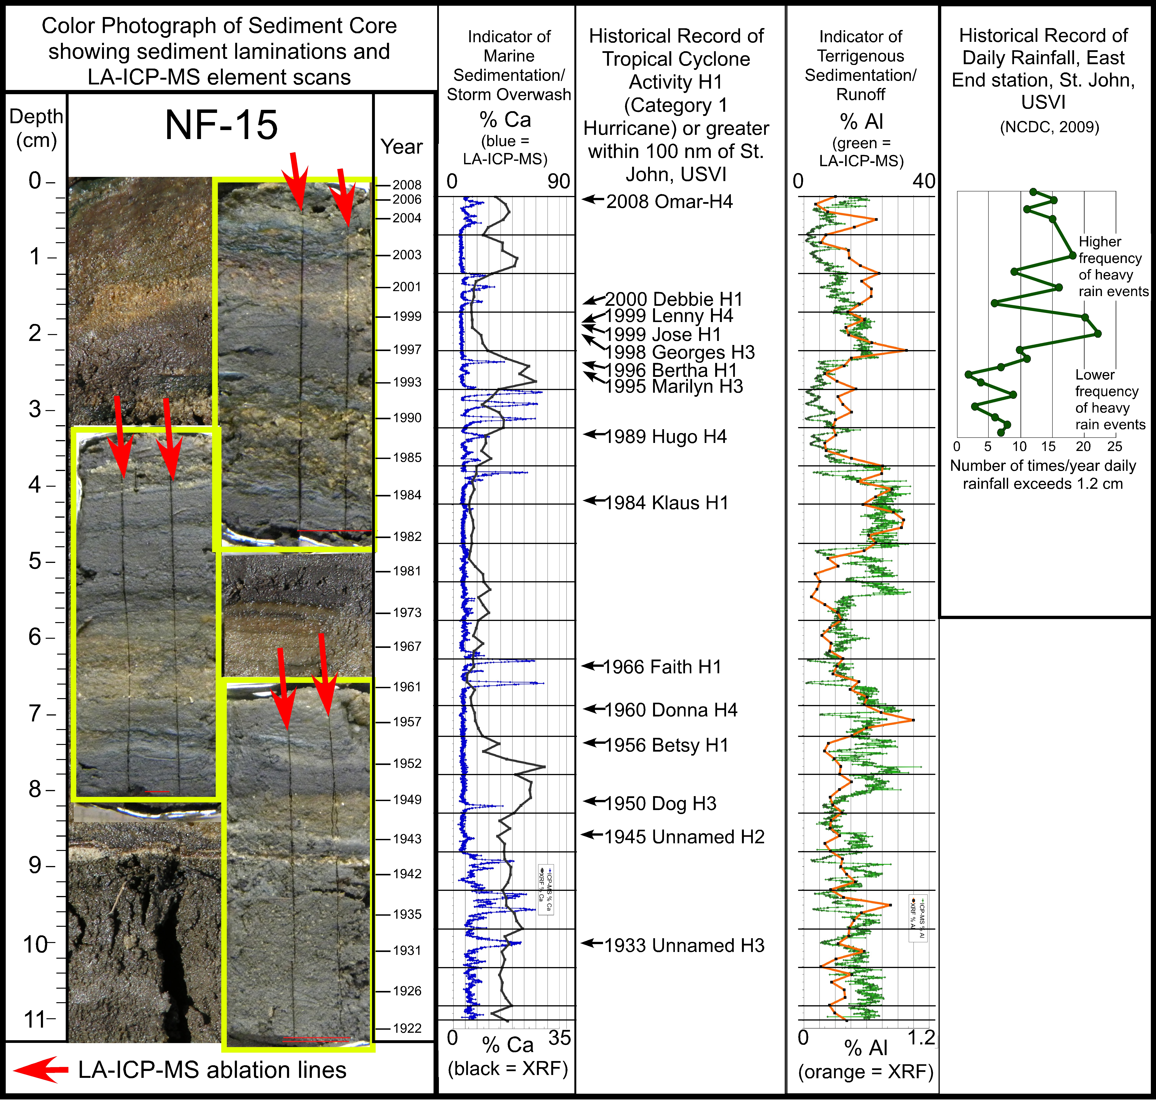

Slide 17
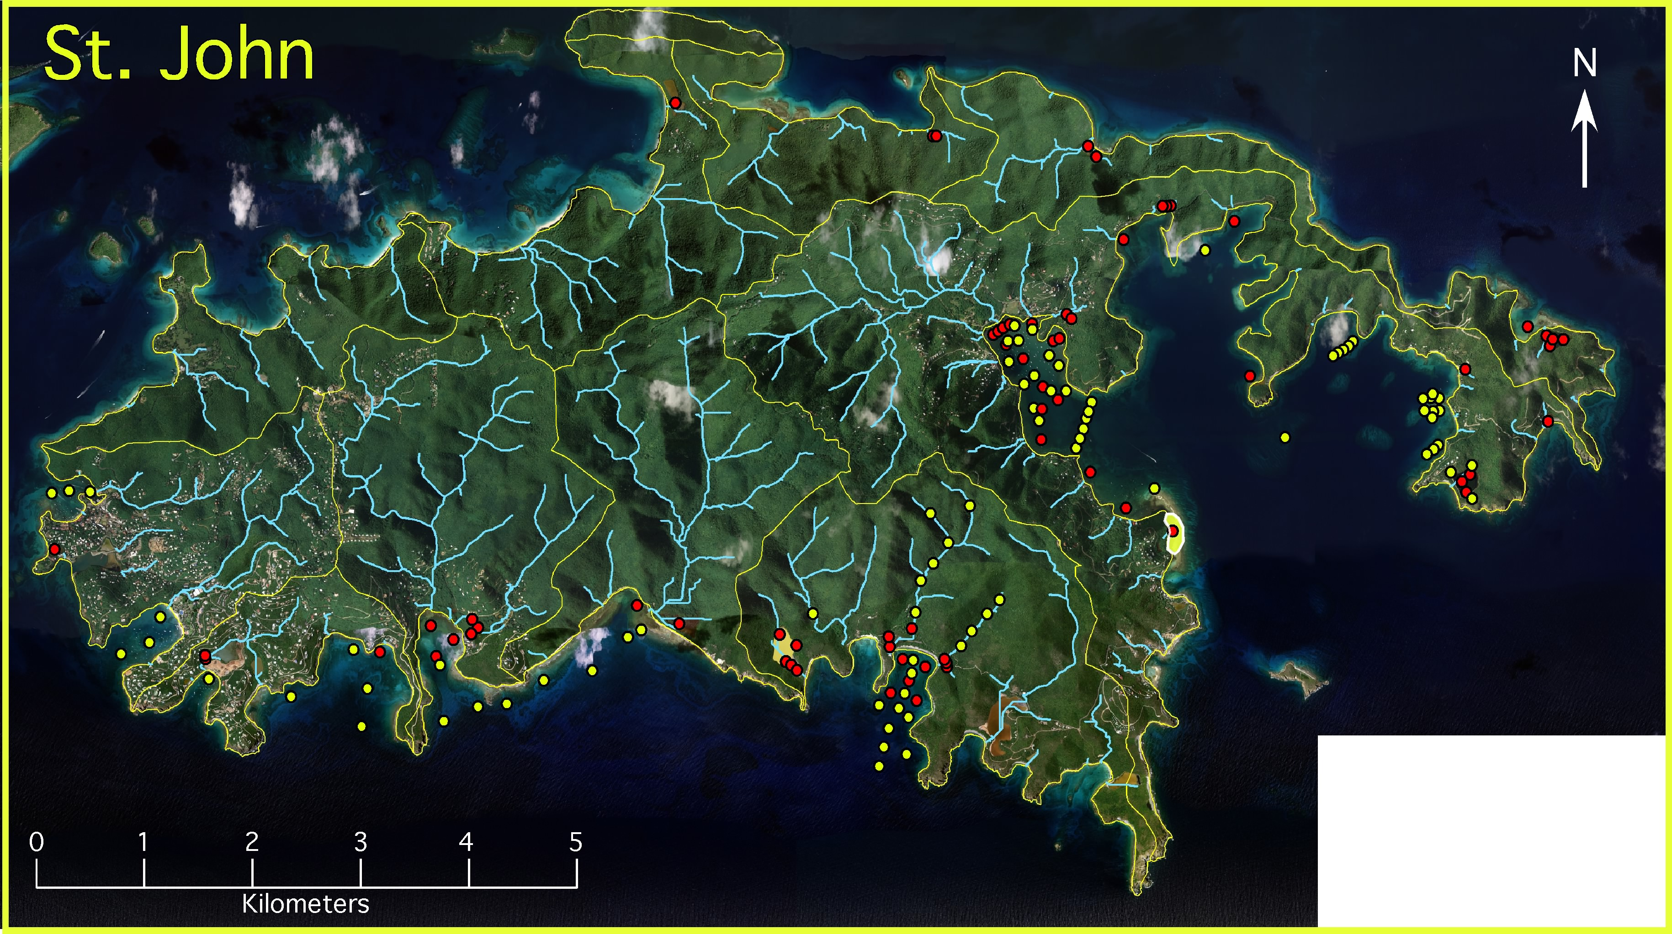
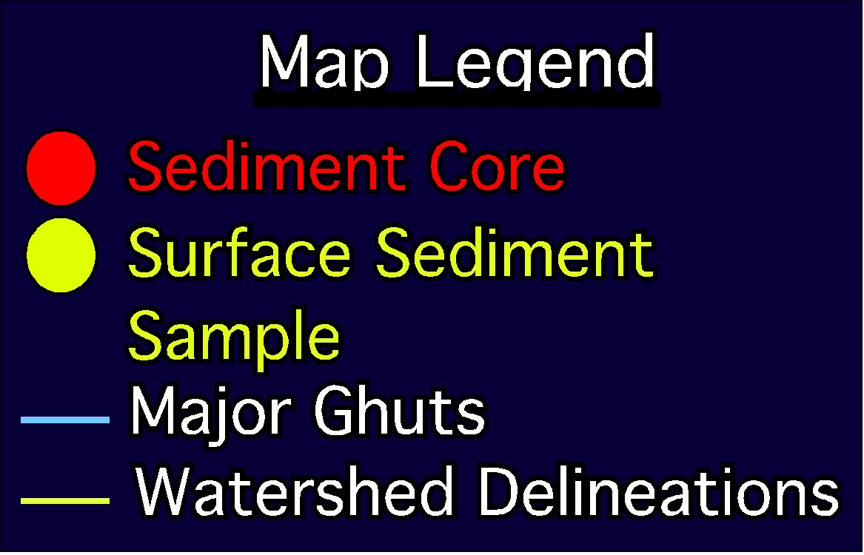

Slide 18
Newfound Bay - no modern development, no increase in accumulation rate.
Fish Bay - Moderate development, modest increase in accumulation rate (2.5X).
MAR
MAR
0.018
g/cm²/yr
0.1
g/cm²/yr
0.015
g/cm²/yr
0.04
g/cm²/yr

Slide 20
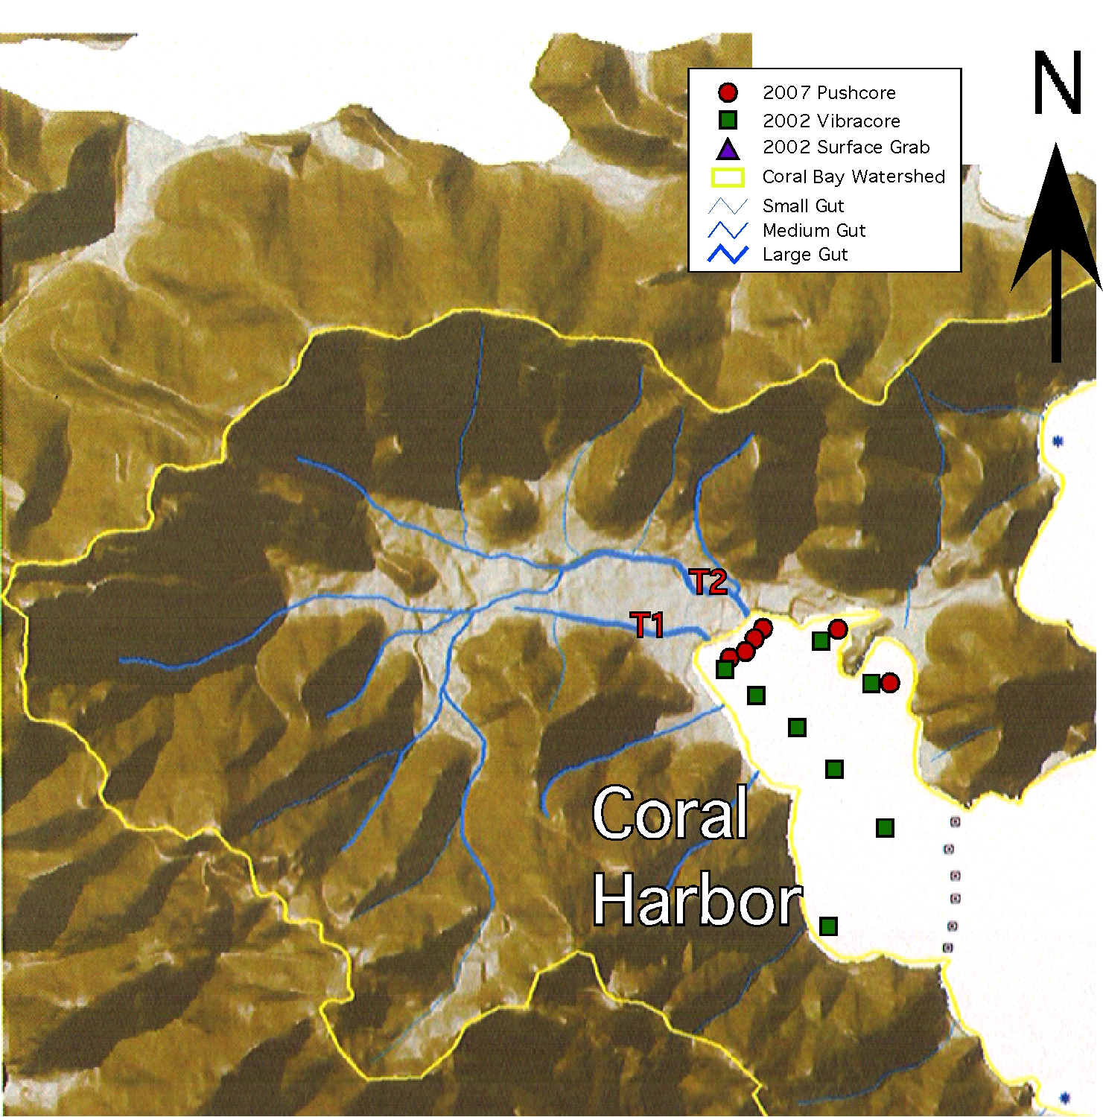
Coral Bay
Most drainage to inner Coral Harbor via 2 main “guts”.
Tributary 1 (T1)
Tributary 2 (T2)
Rapid funneling of water and sediments - “ghuts” - drainage system and delivery to Inner Coral Harbor.
Large watershed drainage area with small coastal input area.
Inner Coral Harbor less flushing by waves and tides.
Defined as “Highly Disturbed” by due to extent of land-use change in the watershed associated with anthropogenic activities.

Slide 21
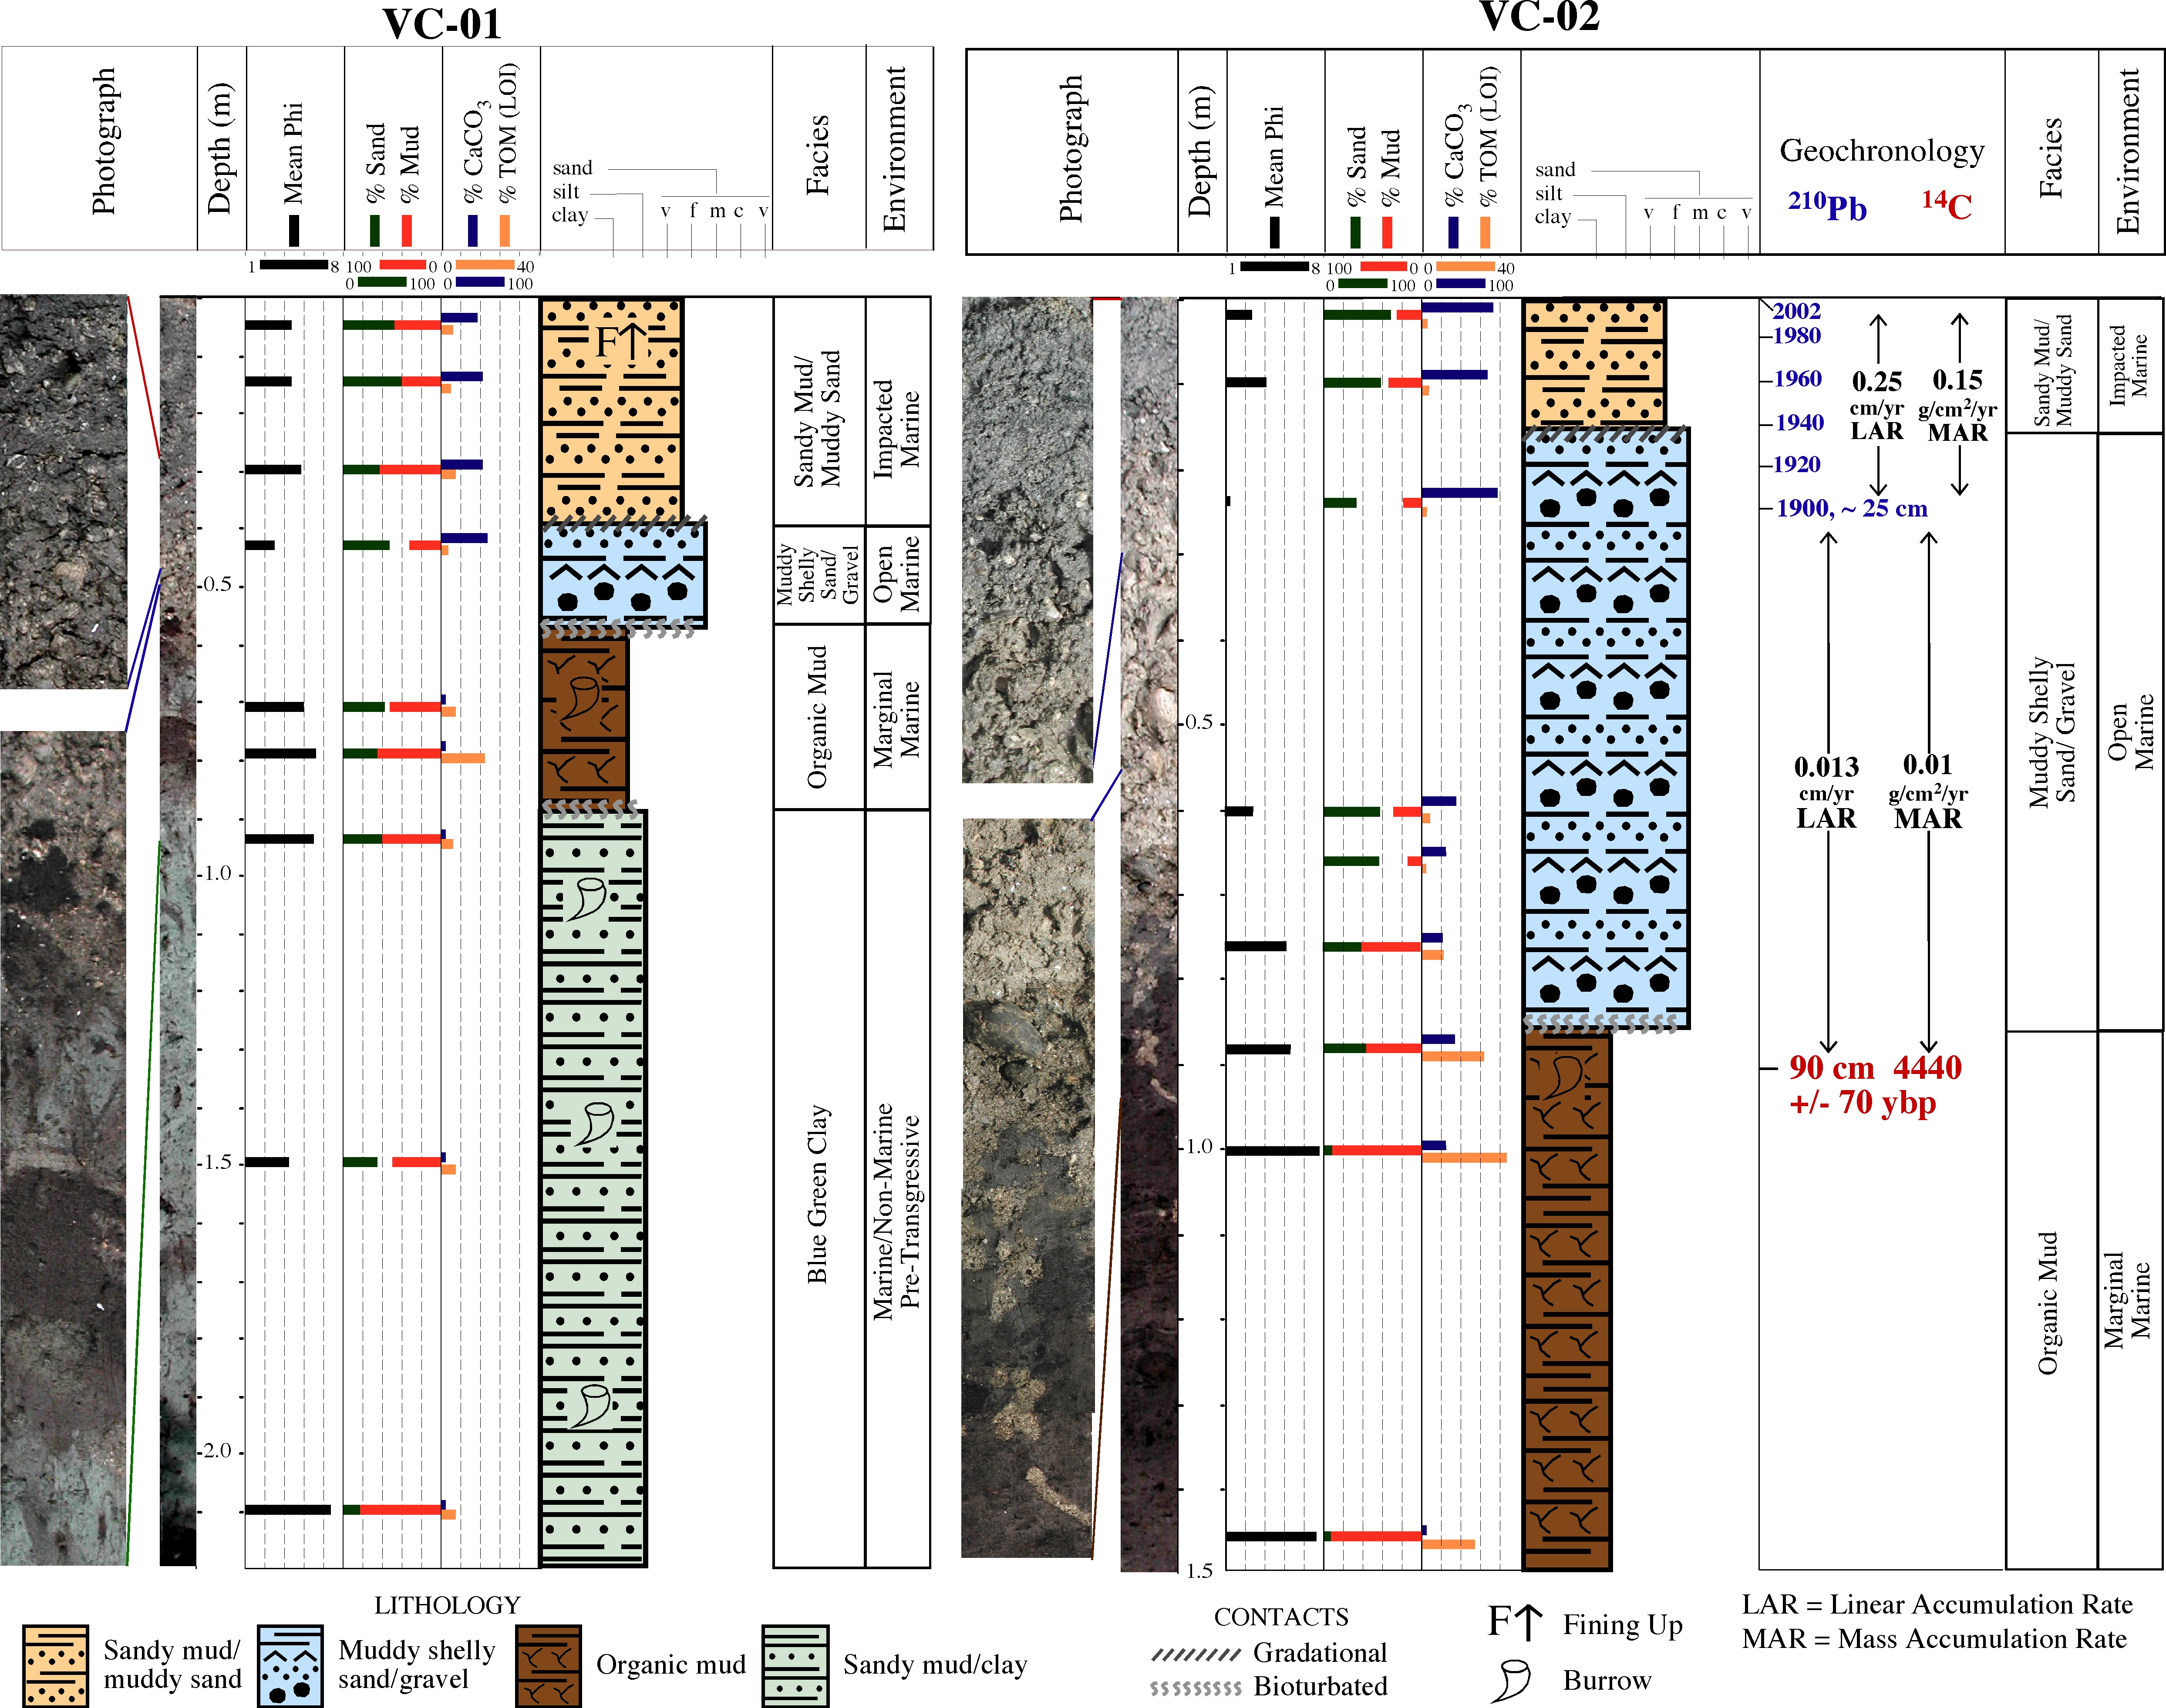
Coral Bay - Heavy development, dramatic increase in accumulation rate (10X).
MAR
0.15
g/cm²/yr
0.01
g/cm²/yr

Slide 22
Historical Context
St. John Pop.
1940 ~722
1960 ~925
1970 ~1729
1980 ~2472
1990 ~3504
2004 ~4307
Coral Bay Pop.
1980 ~256
1990 ~363
2004 ~649
1960 ~ 10 automobiles, mostly donkey/horse/wagon transportation
1947 aerials of Coral Bay, Centerline road (Blue) not in existence. King Hill Road (Red) route to Coral Bay.
1971 aerials of Coral Bay show existence of Centerline Road (Blue).
Since 2000 increased construction of larger homes/villas.

Slide 23
Overall increase in TMAR over the last 100 years
Increase in T1 delivery ~1960’s associated with road construction
Increase in T2 delivery ~ 1970’s with change in drainage to centerline road
Increase in T1 and T2 ~2000’s with increased large homes/villas

Slide 24
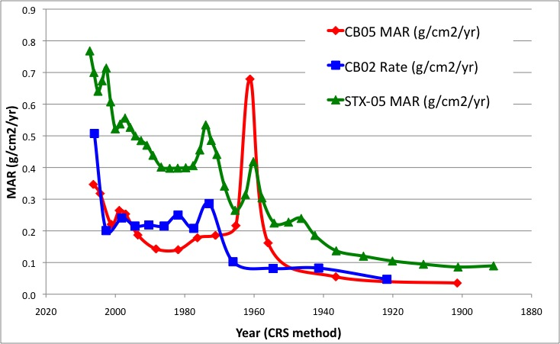
STJ and STX MAR Comparison

Slide 25
Conclusions
Rapid sediment input – natural and human
Human impacts
- Increased sediment input/accumulation since ~1950s
- Directly related to level of human activities
- Heavily developed --- ~10x increase
- Moderately developed --- ~2.5x increase
- No development --- 0 increase
Correlate with specific events
- Human – road construction, major development
- Natural - tropical cyclones, rainfall variability
Natural variability – necessary for human impacts

Slide 26
USVI – Event Stratigraphy
Sediment cores from coastal environments.
Heavy rainfall – terrigenous sediment runoff to coast
Tropical Cyclones/Hurricanes
Tsunamis
Anthropogenic – Land use change, roads, houses, etc.

Slide 27
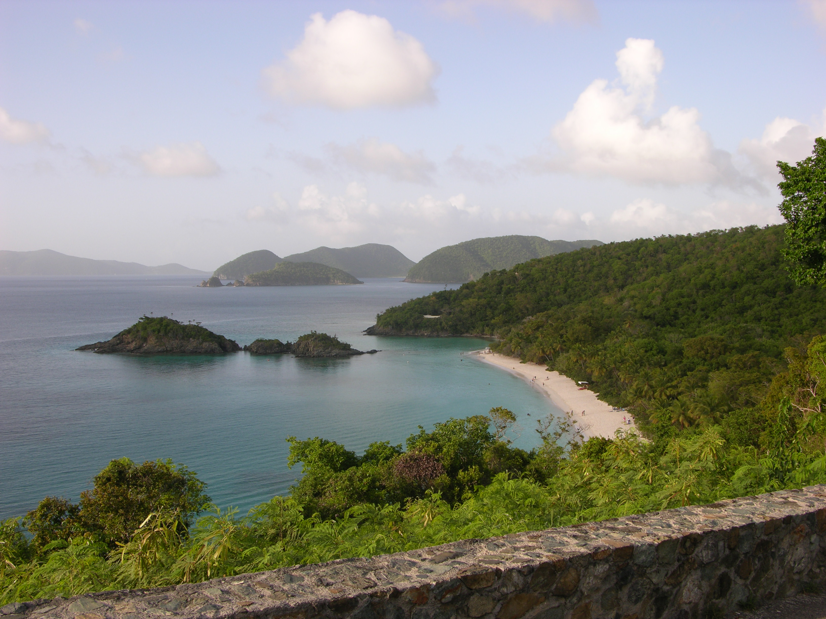
Contributors/Collaborators/Funding Agencies
National Park Service
- Rafe Boulon, Kelly Thomas, Ester Francis, Zandy Hillis-Starr, Meredith Hardy
Department of Planning and Natural Resources - Division of Environmental Protection
Environmental Protection Agency
US Fish and Wildlife Service
Department of Planning and Natural Resources - Fish and Wildlife
Division of Environmental Protection
National Oceanic and Atmospheric Administration
University of the Virgin Islands
Conservation Data Center
Virgin Islands Environmental Resource Station
Coral Bay Community Council
Experimental Program to Stimulate Competitive Research University of the Virgin Islands
The Nature Conservancy
Island Resources Foundation
Island Green Building
Eckerd College
University of South Florida – Endowed Fellowship Program
University of South Florida - Institute for the Study of Latin America and the Caribbean

Slide 28
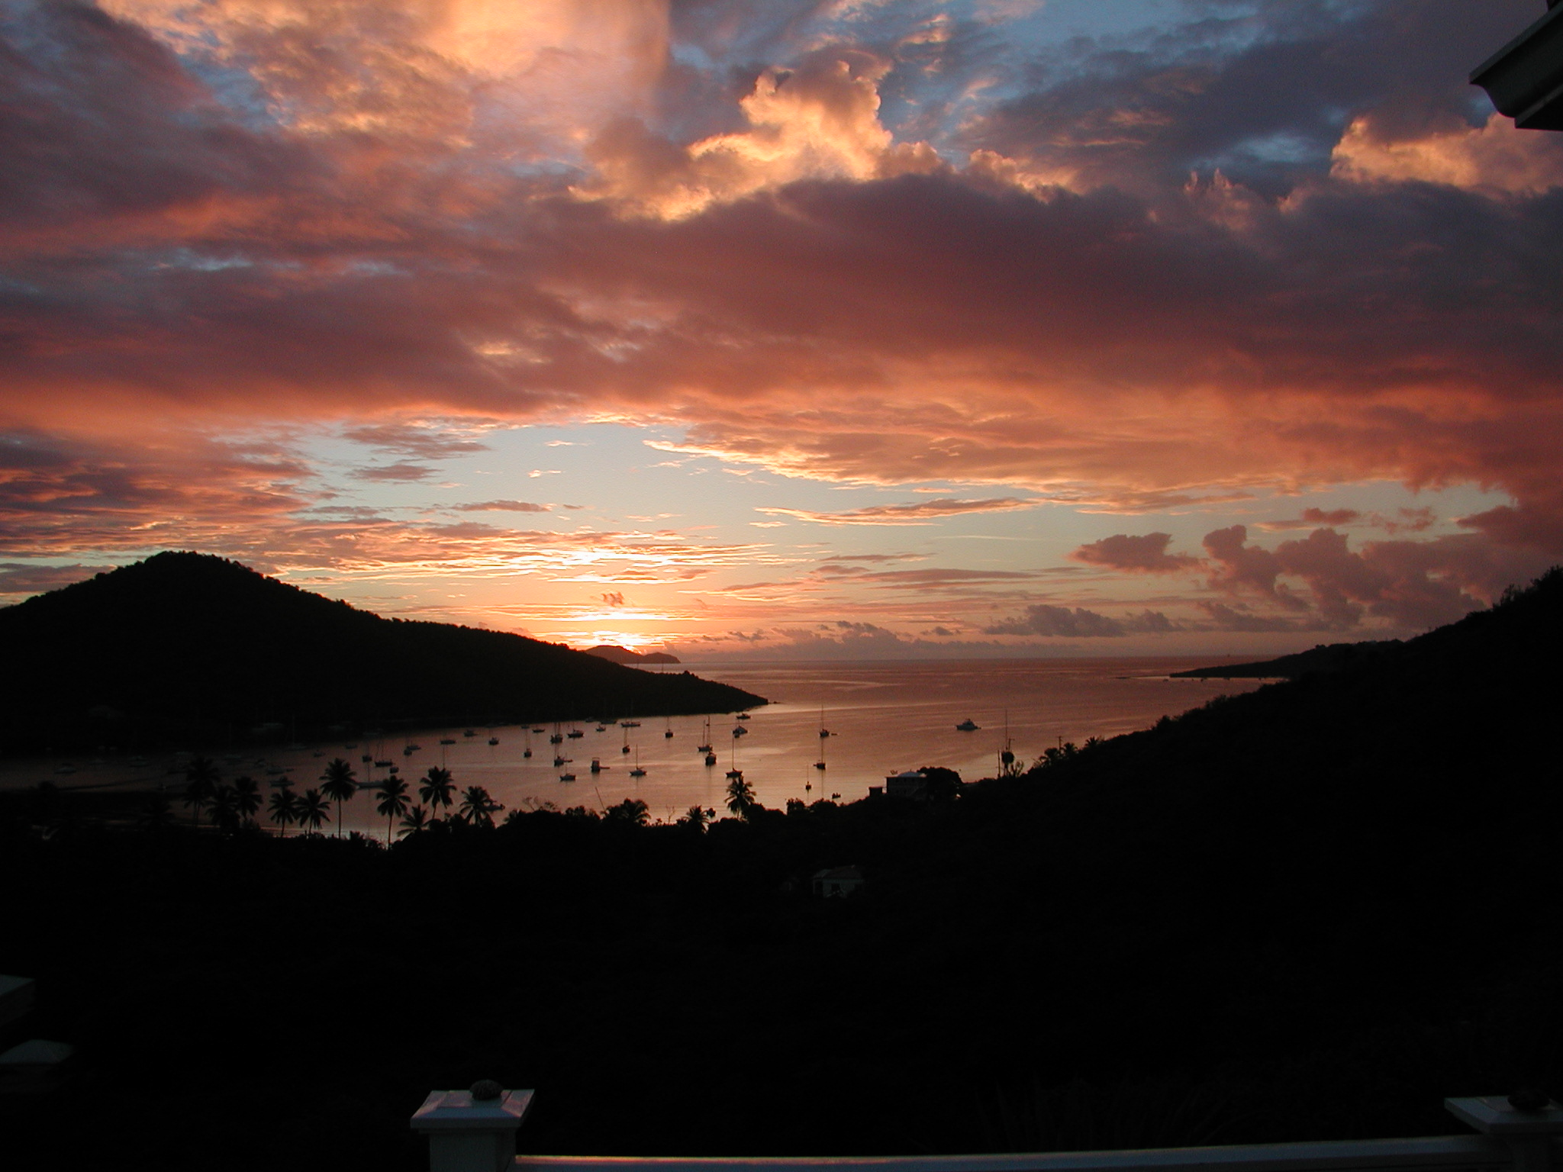
Questions?

