Slide 1
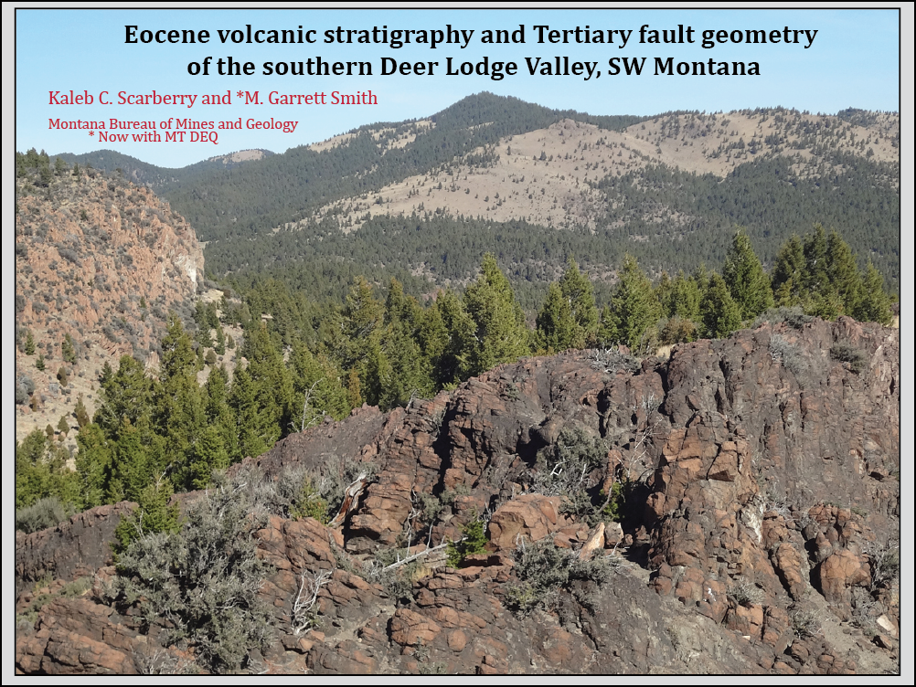

Slide 2
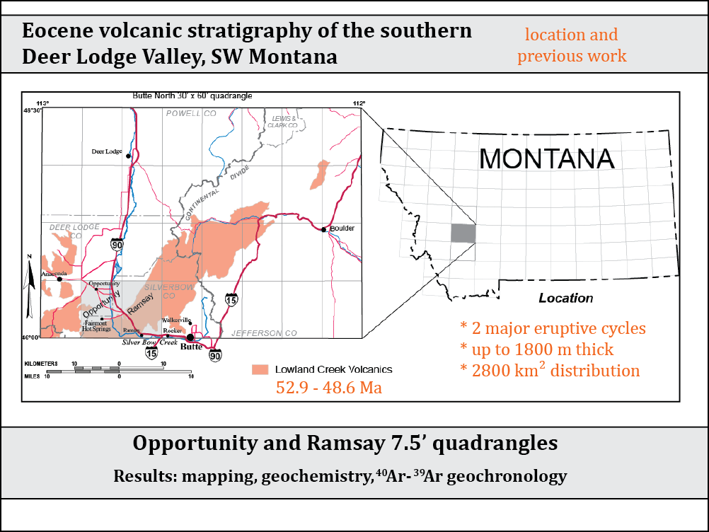

Slide 3
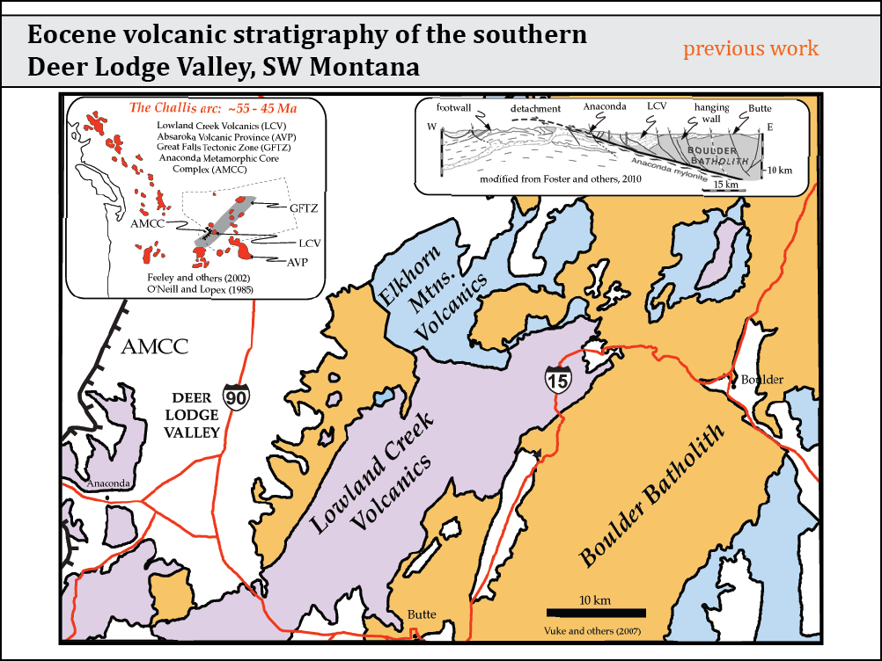

Slide 4
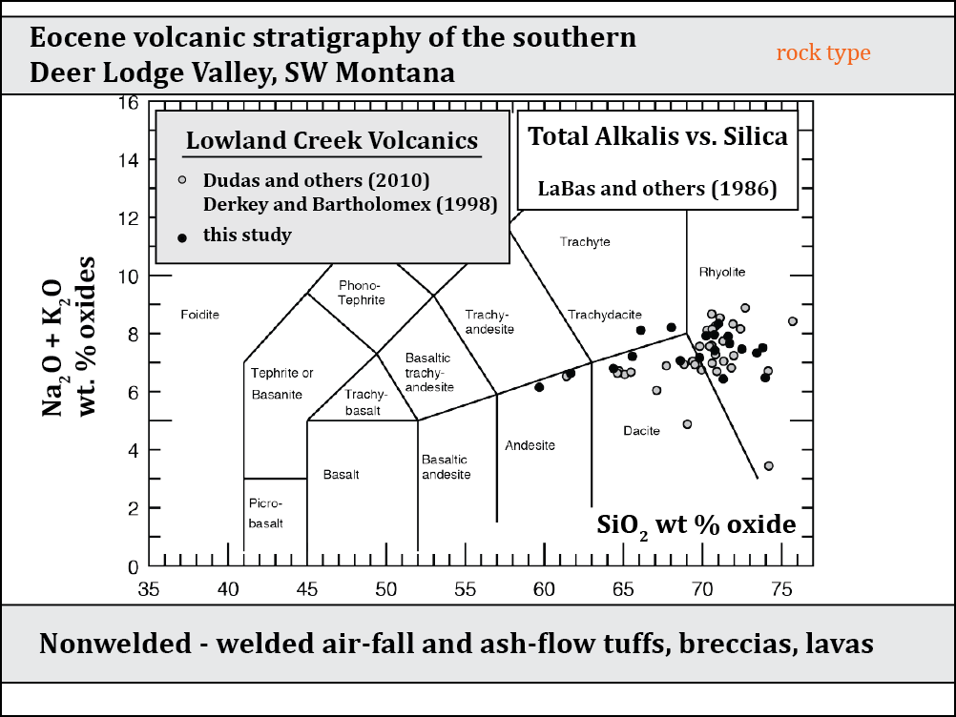

Slide 5
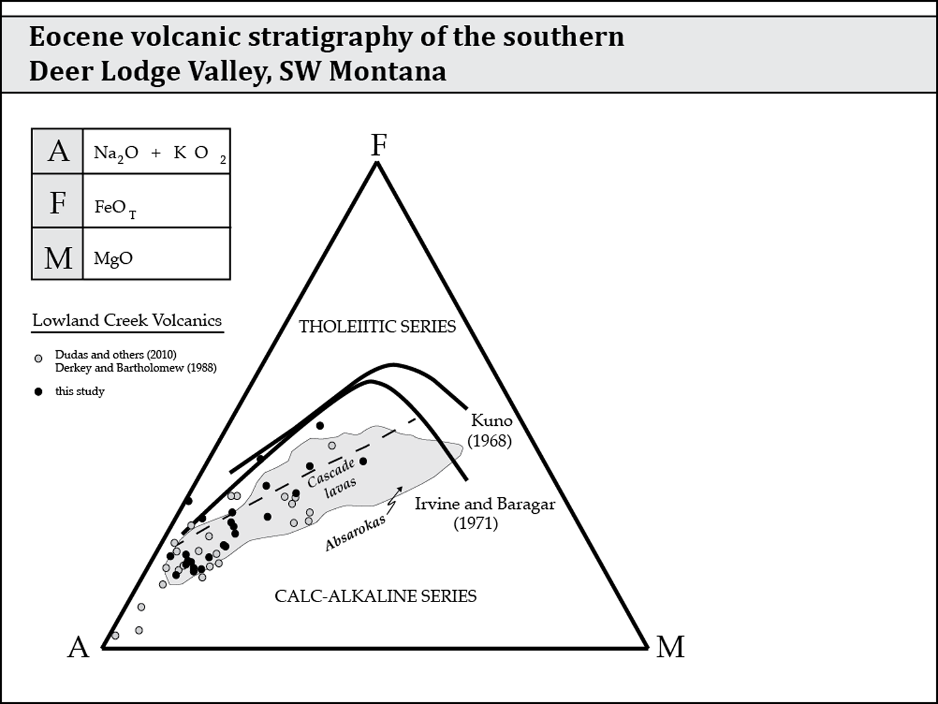
petrology
Tholeiitic series: Mg-rich olivine, followed by pyroxene, steers the crystallization path.
Calc-alkaline series: addition of magnetite balances Fe/Mg ratios to produce a straight crystallization path towards alkalis.
K₂O
AFM Diagram goes here
Lowland Creek Volcanic Field: an evolved component
of a calc-alkaline magma series.
Tectonic setting: Back-arc
basin caldera complex.

Slide 6
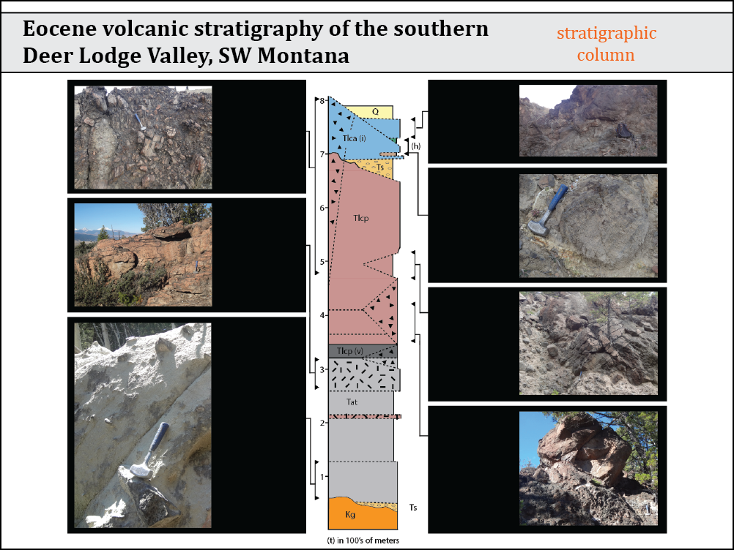
SiO₂
wt.%
48.6 Ma
Tlca
62.6 - 65.2
andesite - dacite
Tlcp
67.0 - 69.8
rhyodacite
Tat
70.4 - 75.1
rhyolite
Ts
~ 50 Ma
-Lacustrine
-Green River
Formation.
Tat
52.50 +/- 0.16
(plagioclase)
52.95 +/- 0.22
(biotite)
Feeder dike:
52.64 +/- 0.20
(biotite)
~ 52.8 Ma
Tlcp
Feeder dike:
51.79 +/- 0.25
(plagioclase)
air fall/
surge
53.0 Ma
Notes:
Different apparent ages in minerals of the same rock can be attributed to Ar-retentivity of phase (ex. Hornblende > biotite > plagioclase) due to post crystalization reheating.

Slide 7
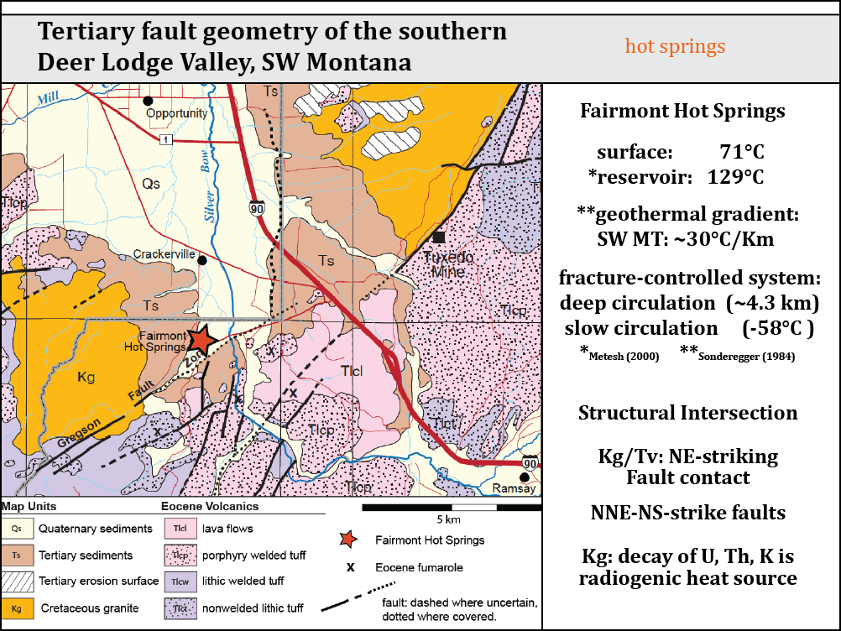
5140’

Slide 8
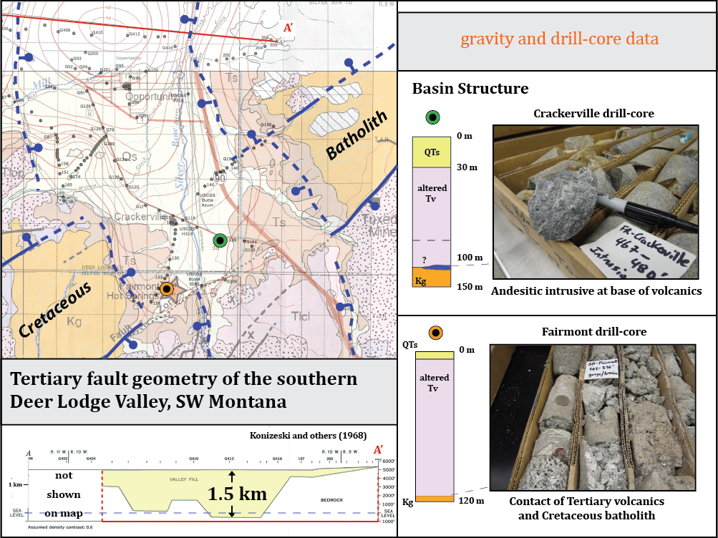

Slide 9
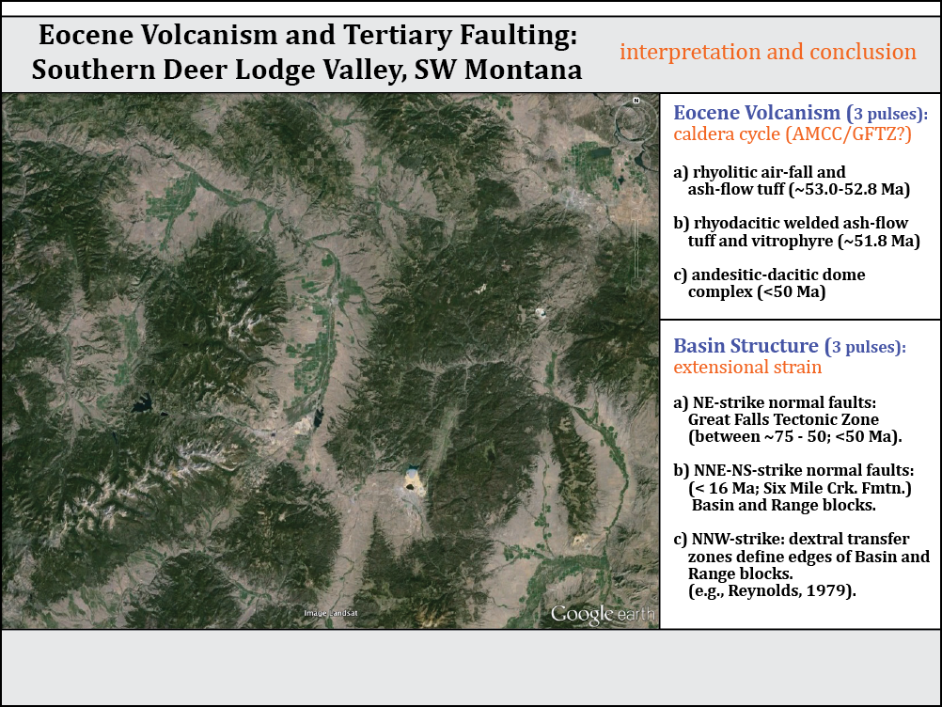
Eocene Time
53-49 Ma
AMCC
> 1 km normal offset
?
?
Cauldron
wall
?
Great Falls
Tectonic Zone
?

Slide 10
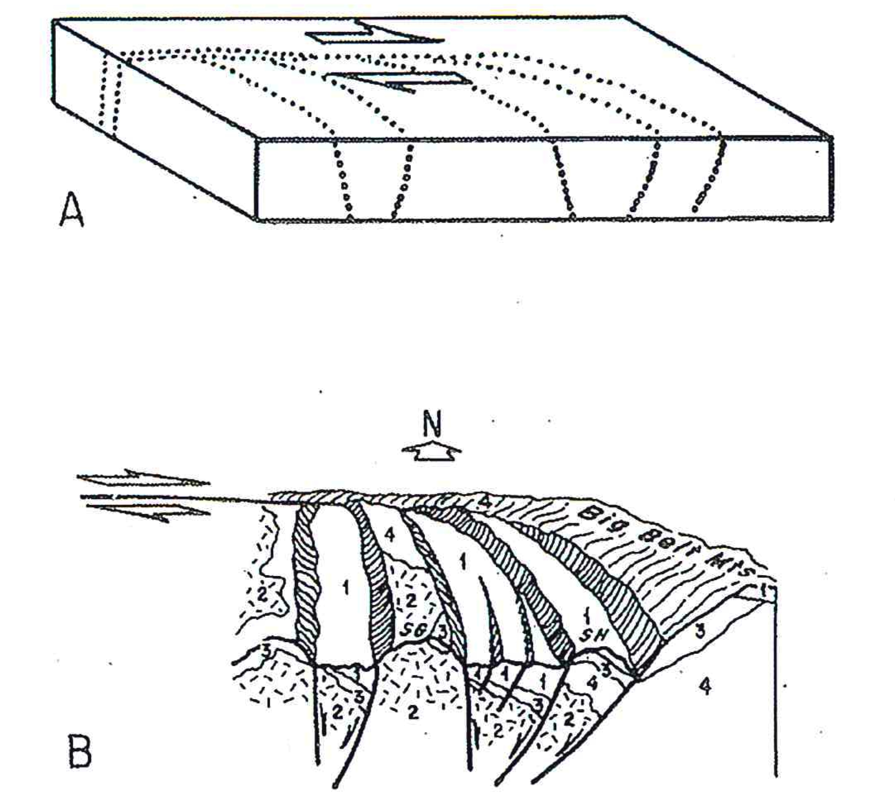
Mid-Late Miocene
< 16 Ma
Reynolds (1979)

Slide 11
Mid-Late Miocene
< 16 Ma

