Slide 1
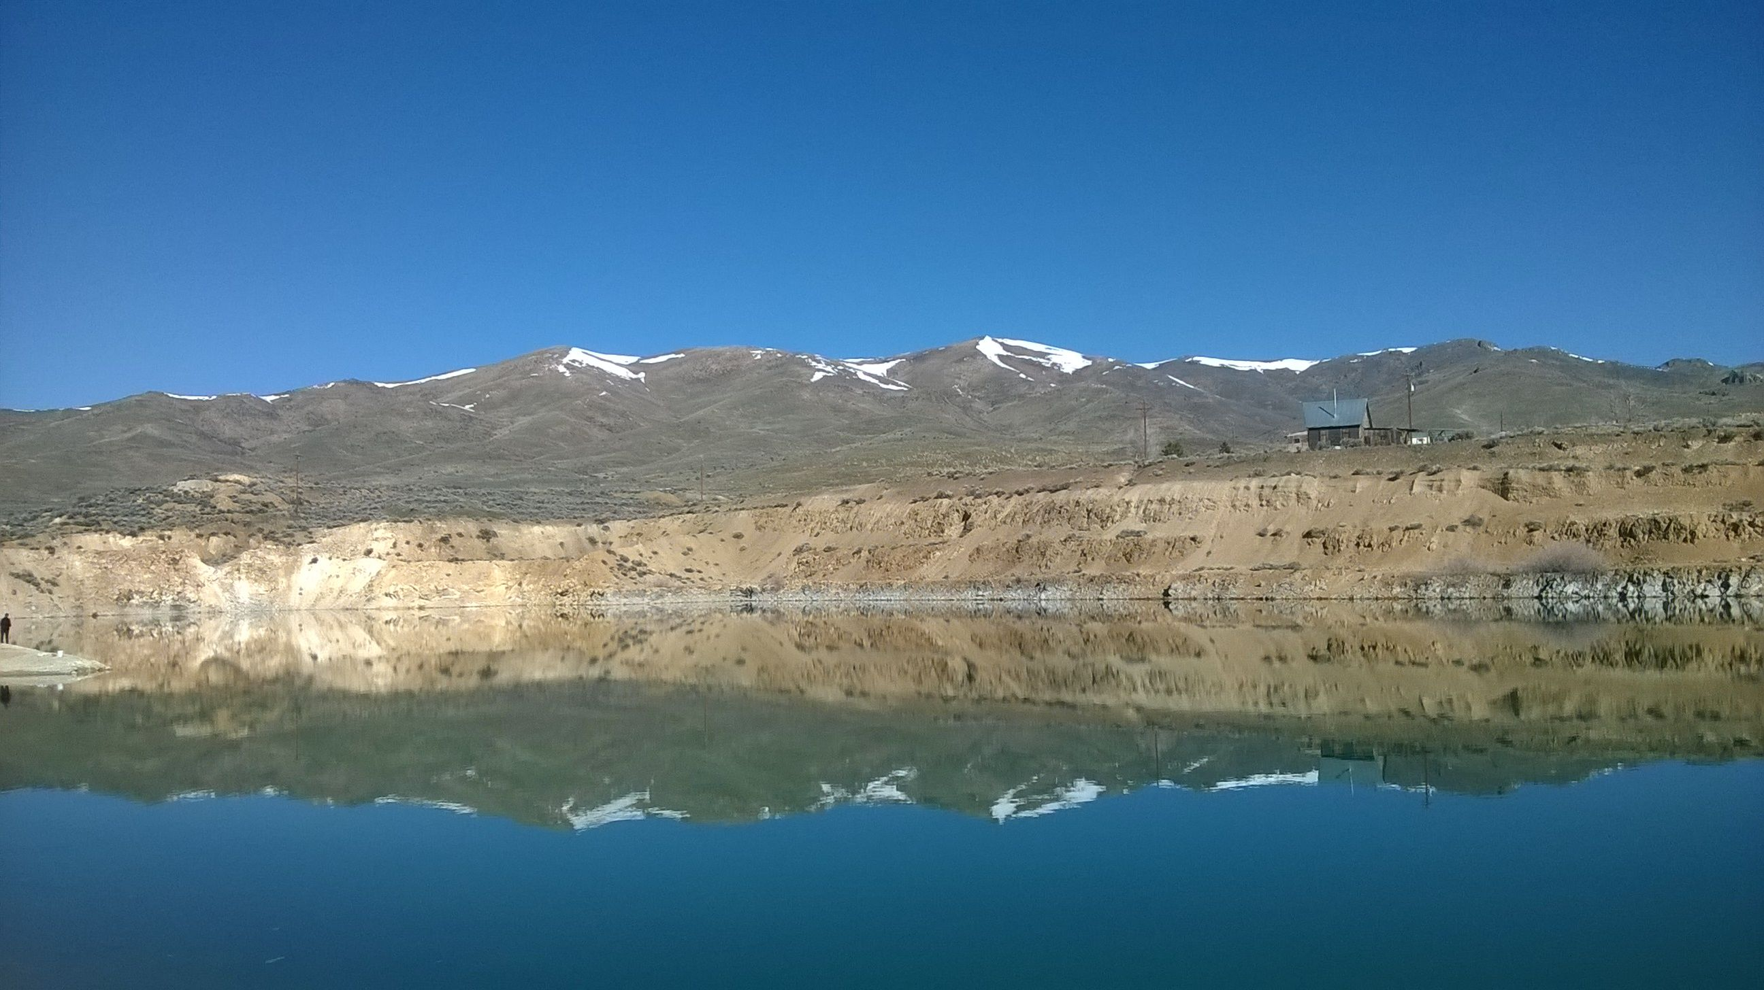
Geochemical Modeling and Principal Component Analysis of the Dexter Pit Lake, Tuscarora, Nevada
Connor Newman
University of Nevada, Reno
5/19/2014
Notes:
-for those of you who don’t know me I’m Connor Newman and I will be presenting today on my thesis research which is focused on the geochemistry of non-conservative elements in DPL

Slide 2
Outline for Today
Site background
Methods
Statistics
Computer modeling
Results
Summary and Conclusions
Notes:
-here is the outline for my presentation today
-first I will introduce the study area and the concept of pit lakes in general
-I will also introduce some background on As geochemistry
-I will then talk about the methods for this research which involved both statistics and numerical computer modeling
-following methods I will take you through some of my results (some because I am still currently doing modeling)
-I will finish up with my conclusions thus far and I will talk about the research which I will continue to work on in the coming months

Slide 3
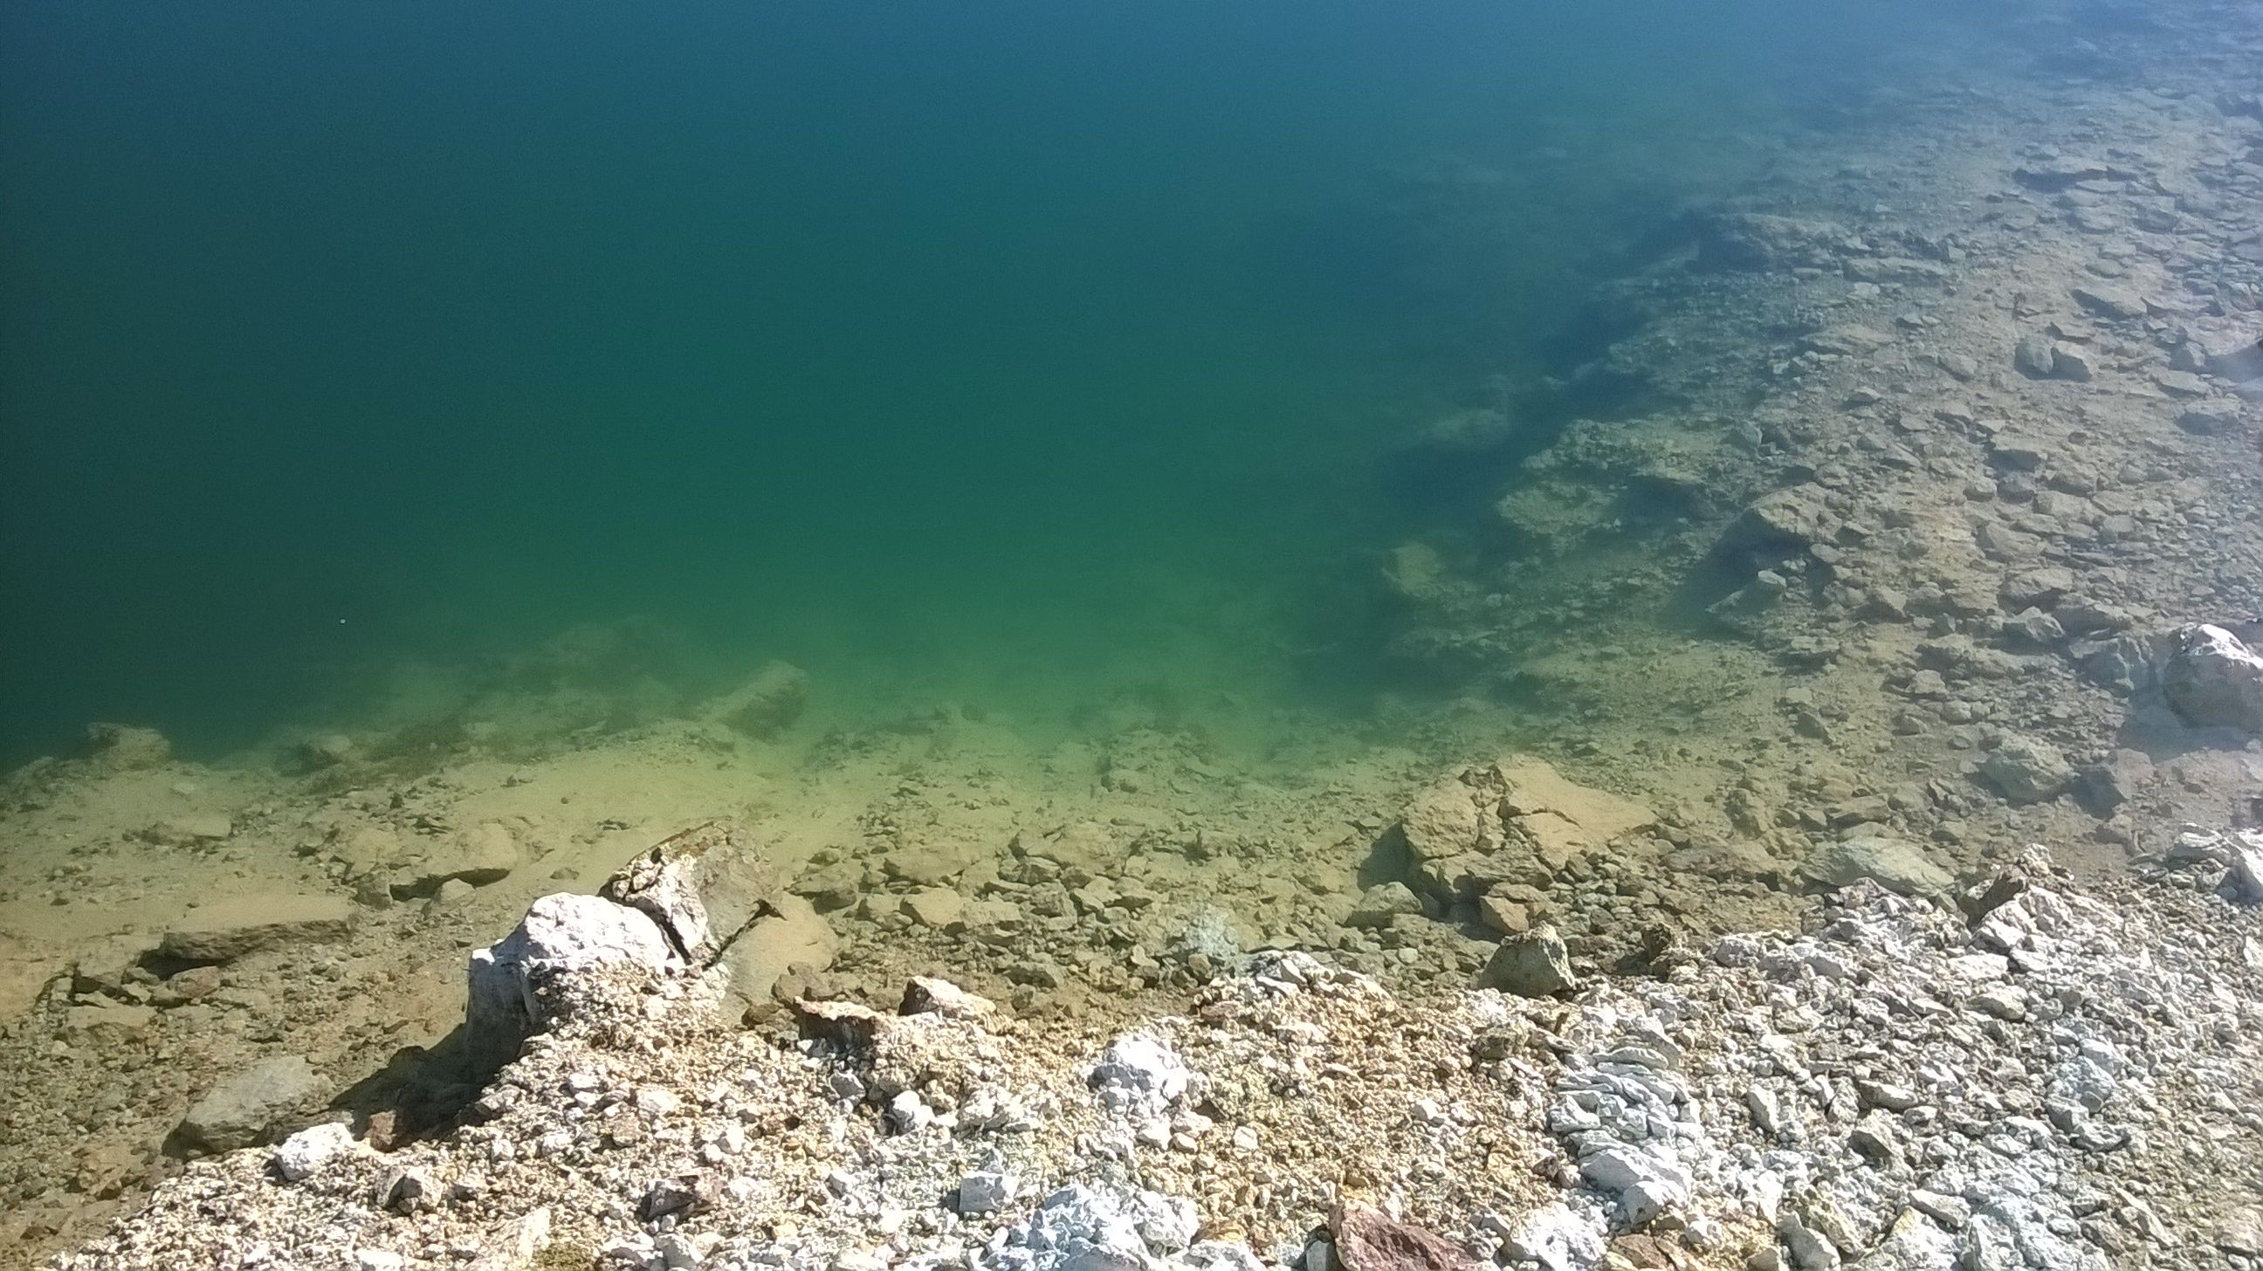
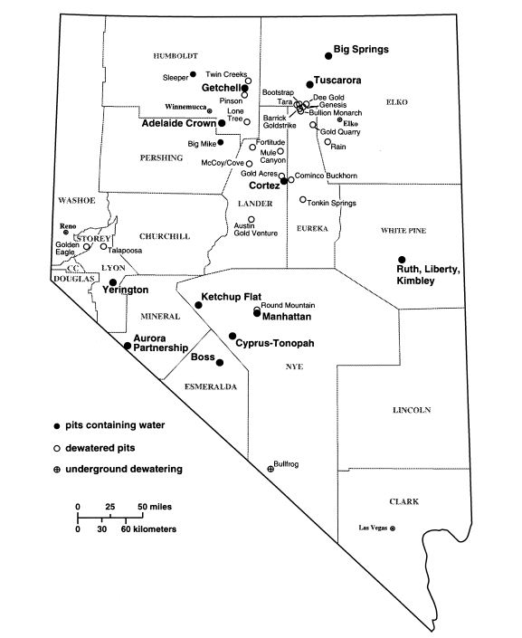
Nevada Pit Lakes
Shevenell et al., 1999
Notes:
-this is the distribution of pit lakes in NV in 1999, there are currently roughly 30 pit lakes in the state
-point to location of Tuscarora for regional context

Slide 4
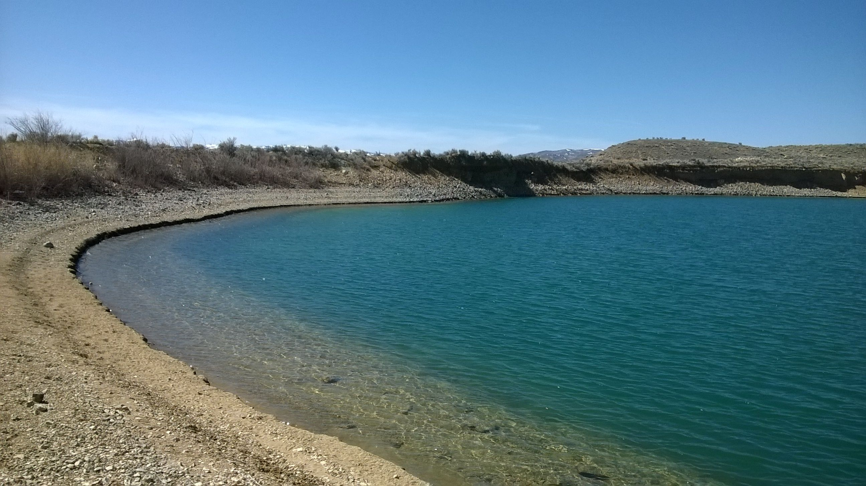
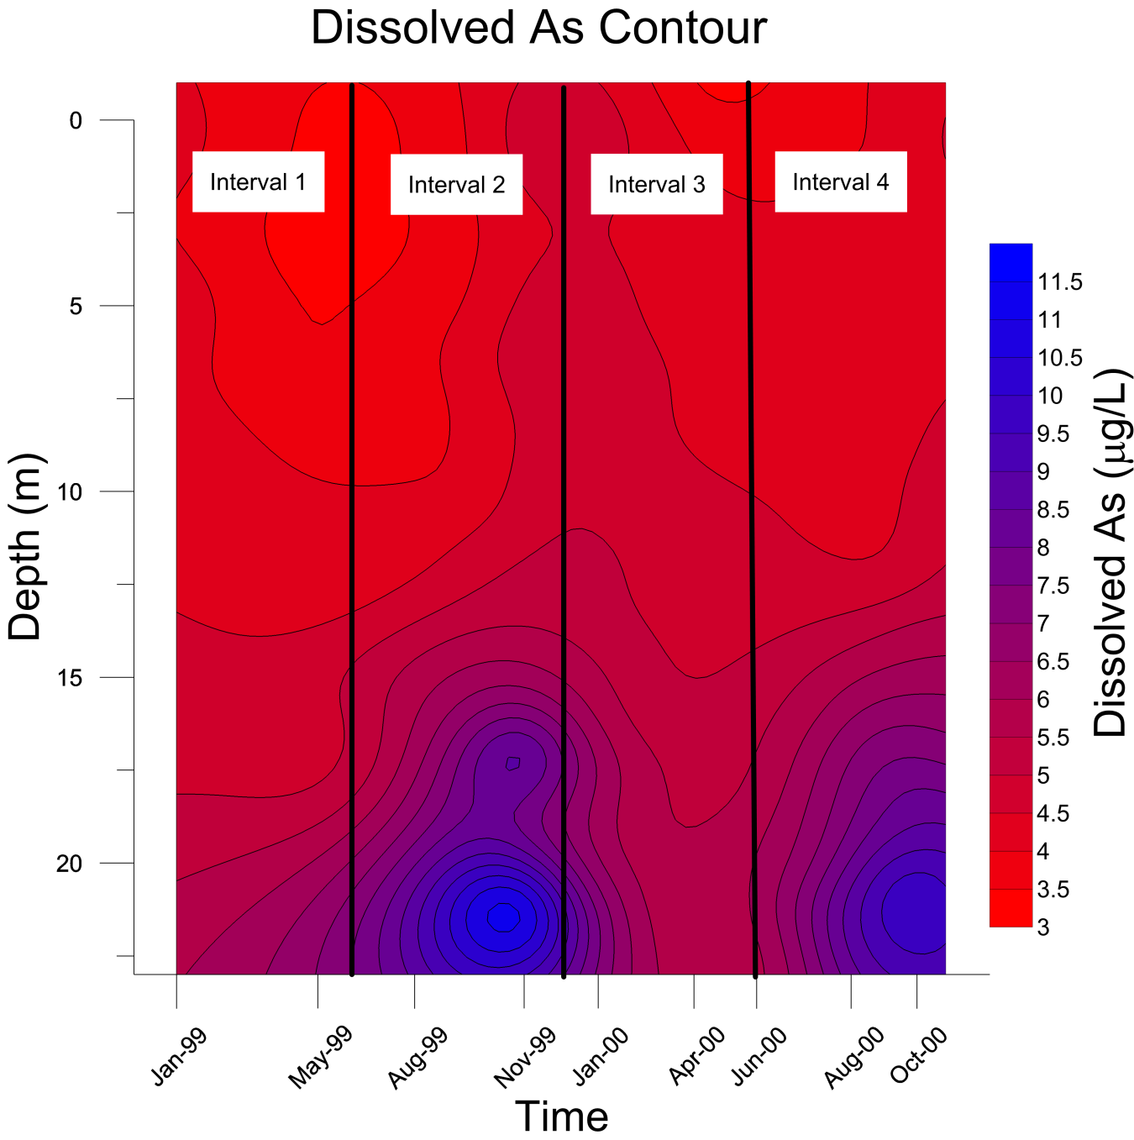
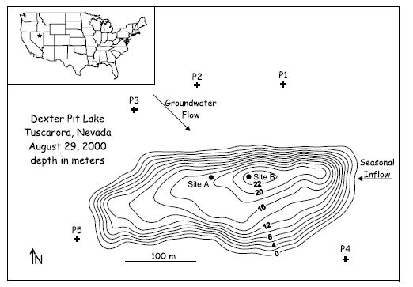
Previous Study
Balistrieri et al., 2006
Notes:
-DPL has been the subject of a previous study, this study served to outline both hydrology and geochemistry of the lake
-the study determined that the pit lake is a flow through system, with water primarily derived from groundwater inflow from the north-west supplemented by surface inflow from the east
-this study also showed that the pit lake is chemically stratified, with levels of dissolved As concentrations above the EPA limit in the bottom of the lake

Slide 5
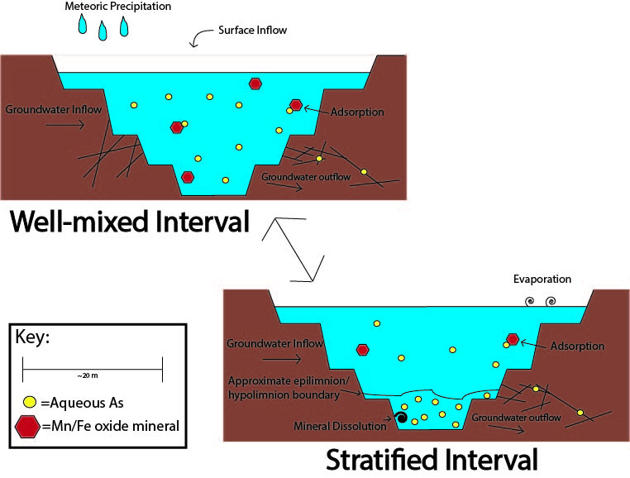
Notes:
-the main goal of my study is to determine the physical and chemical processes which affect As, Mn and Fe in the pit lake
-this will lead to the creation of an accurate conceptual model, similar to those seen here, which may be applied to other pit lakes

Slide 6
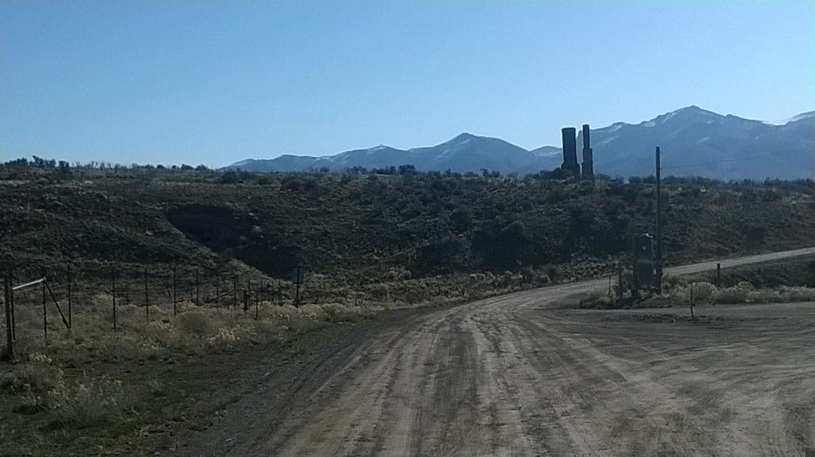
Methods
Statistics
SPSS
Correlations analysis
Principal component analysis (PCA)
Geochemical Modeling
EQ3/6 and Visual MINTEQ
Fluid mixing
Mineral precipitation/dissolution
Adsorption
Notes:
-ADD SCREEN SHOTS OF PROGRAMS TO MAKE IT MORE INTERESTING?
-first I applied statistical analyses to my dataset
-I used both correlations analysis and PCA
-these are common procedures in large geochemical datasets and was done to allow parameters to be grouped and to determine underlying trends and connections
-following statistical analyses I used several geochemical modeling programs
-the first program is called EQ3/6, this allowed me to model water mixing, mineral dissolution and precipitation, and gave elemental speciation results
-following EQ3/6 modeling I moved onto to use the program Visual MINTEQ, which allows for adsorption calculations and also speciation results

Slide 7
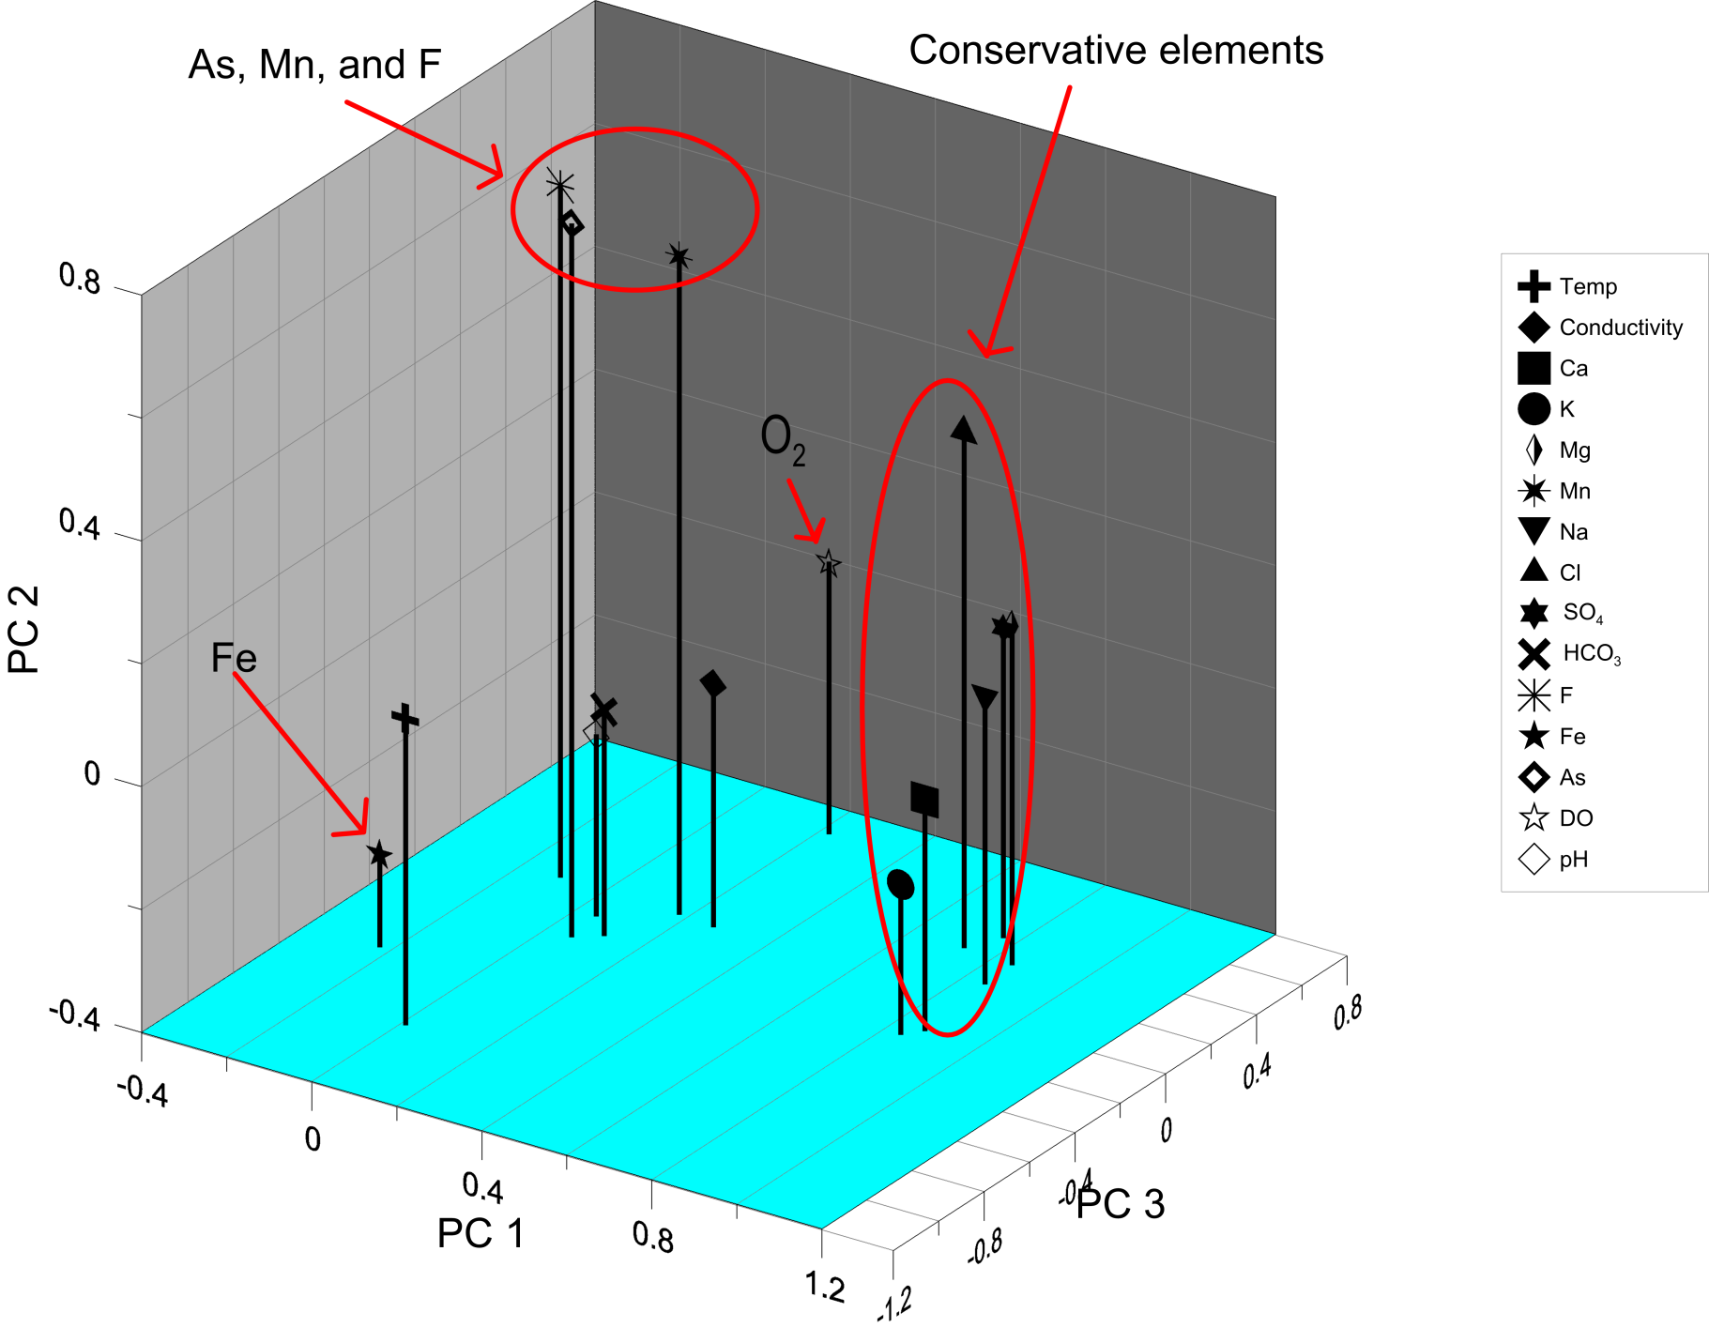
Principal Components Analysis Results
Notes:
-these plots are a much better way to visualize the PCA analysis results
-this shows that as we observed previously As, Mn, and F group together, as do conservative elements
-it is interesting to note that Fe does not group with either set of elements, and thus may be controlled by differing factors
-WHJAT OTHER FACTORS CONTROL FE AND DO?

Slide 8
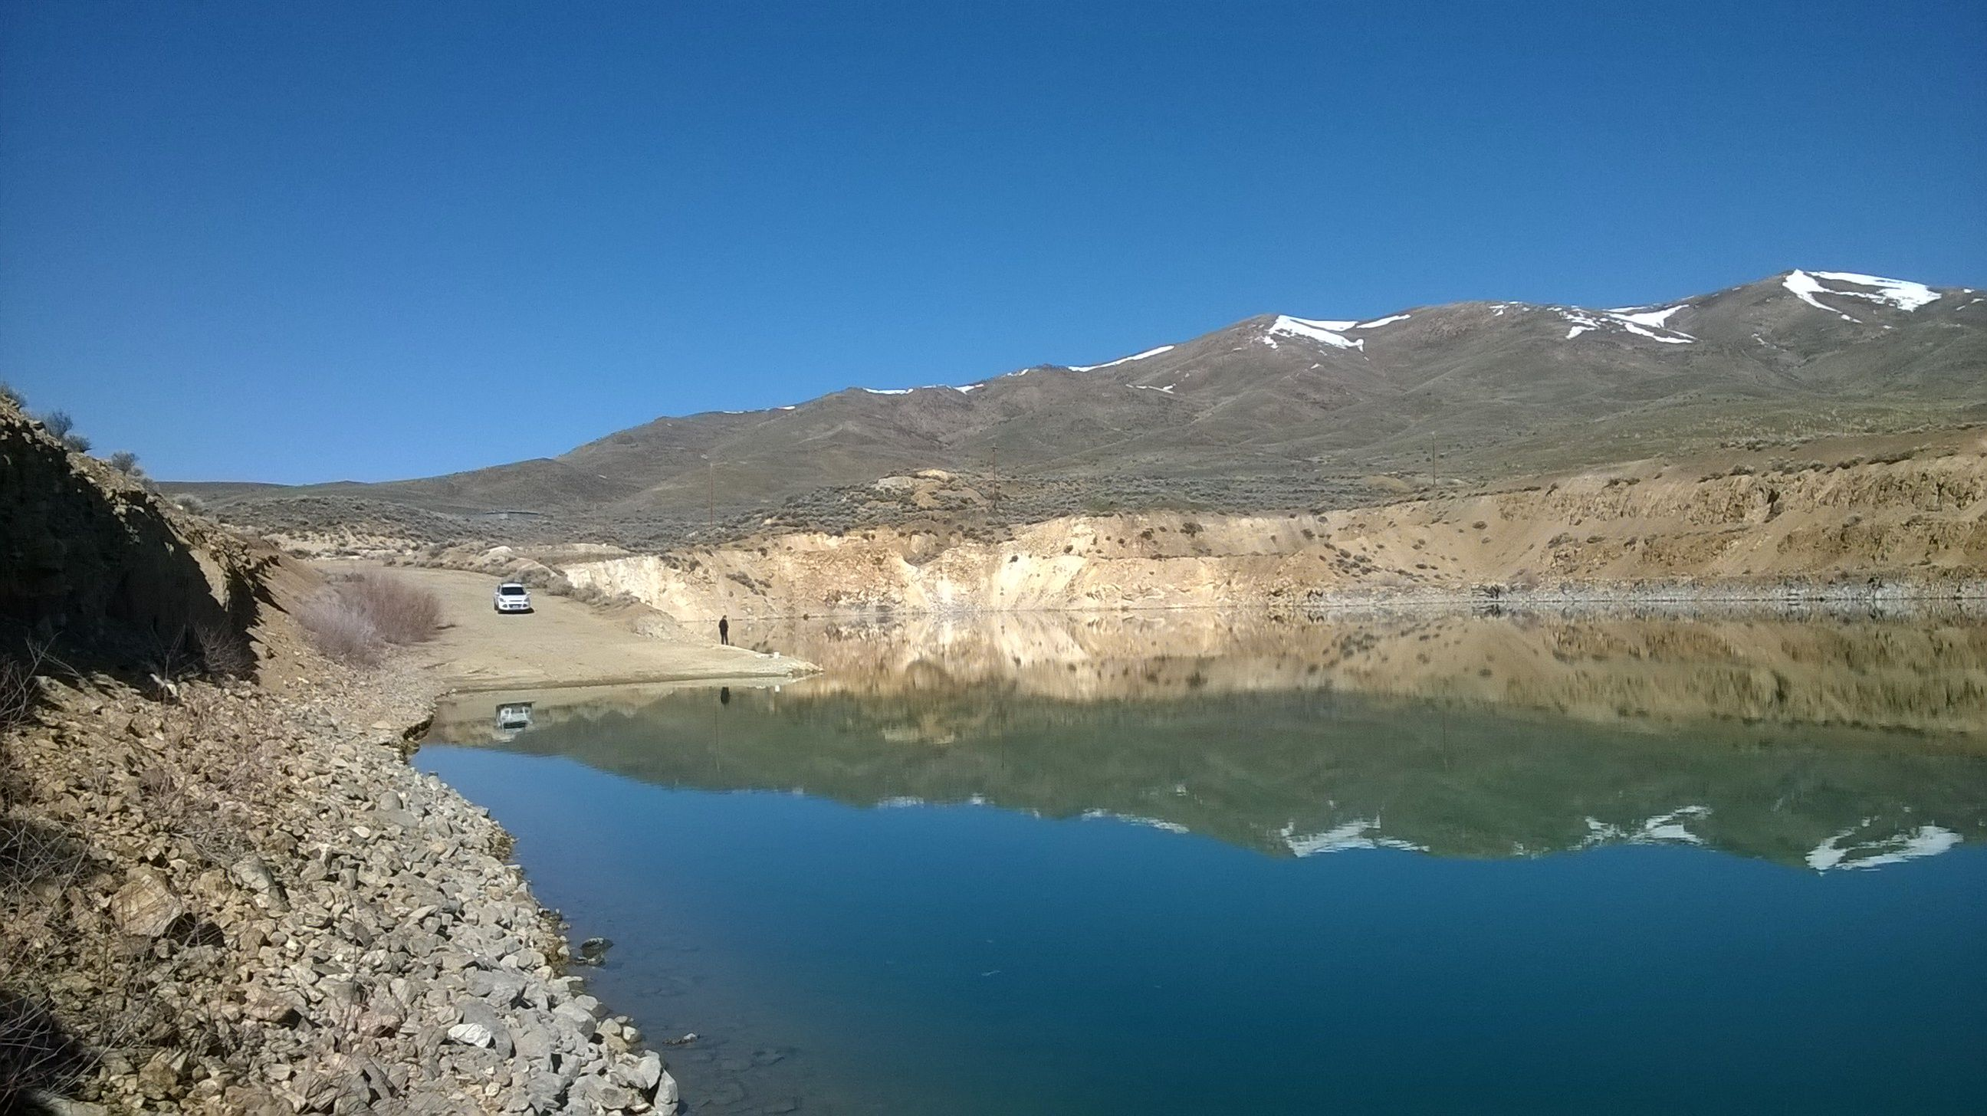
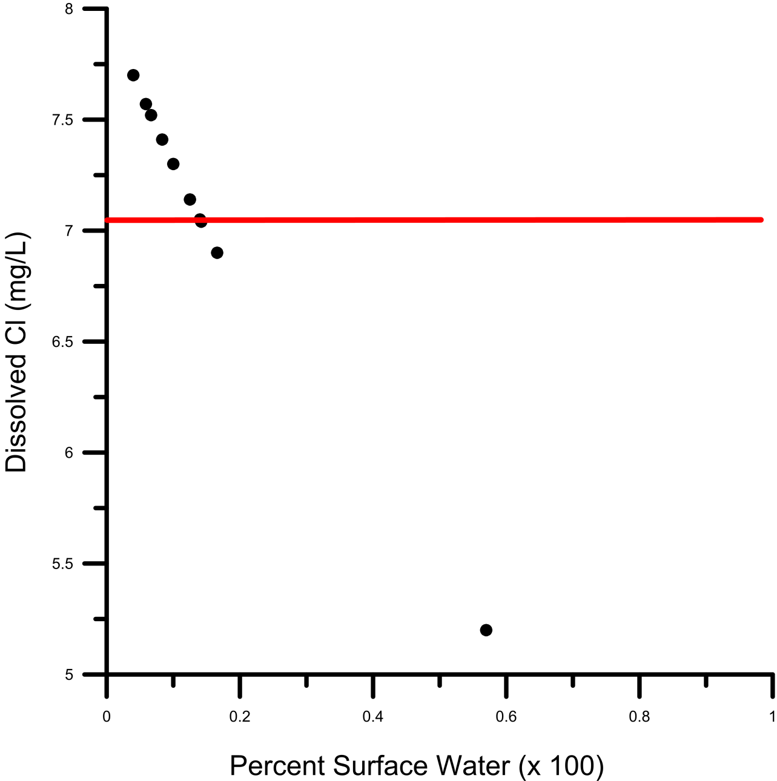
Fluid Mixing
Balistrieri et al., 2006
Notes:
-as I said earlier DPL waters are made up of a mixture between groundwater and precipitation, which have differing chemical makeups
-the first step in modeling was to determine the mixing proportions of these two endmembers, to do this chloride was used as this element is conservative and thus only affected by dilution, evaporation and mixing
-I used EQ3/6 to mix the compositions of local groundwater and regional precipitation, seen on this figure
-conceptually this figure displays pure groundwater on the right, and pure rainwater on the left
-the position on the x-axis essentially represents % rainwater
-different mixing calculations are shown by the black dots, with the observed value shown as the red line
-the results of this calculation showed a makeup of 14% precipitation and 86% groundwater

Slide 9
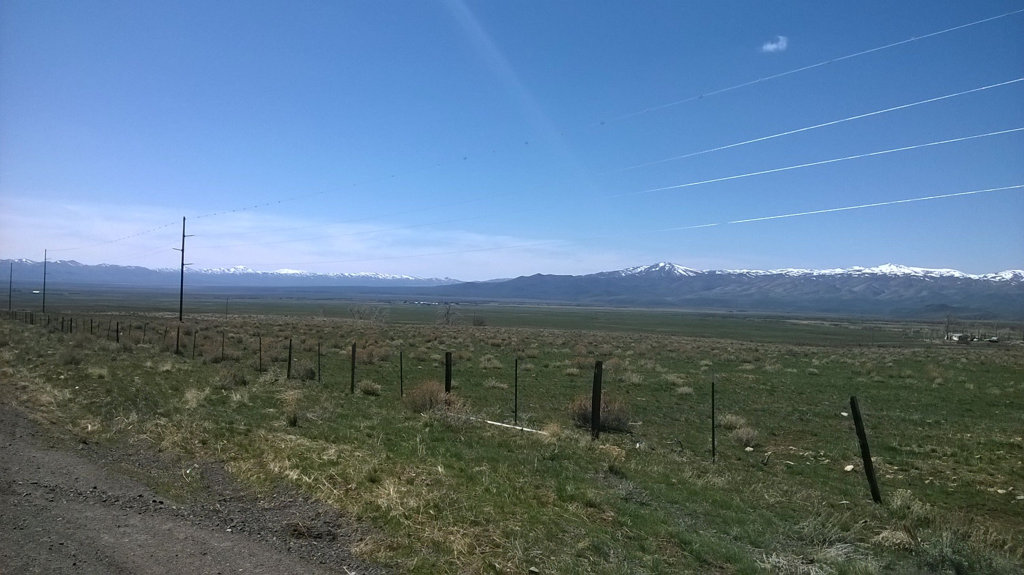
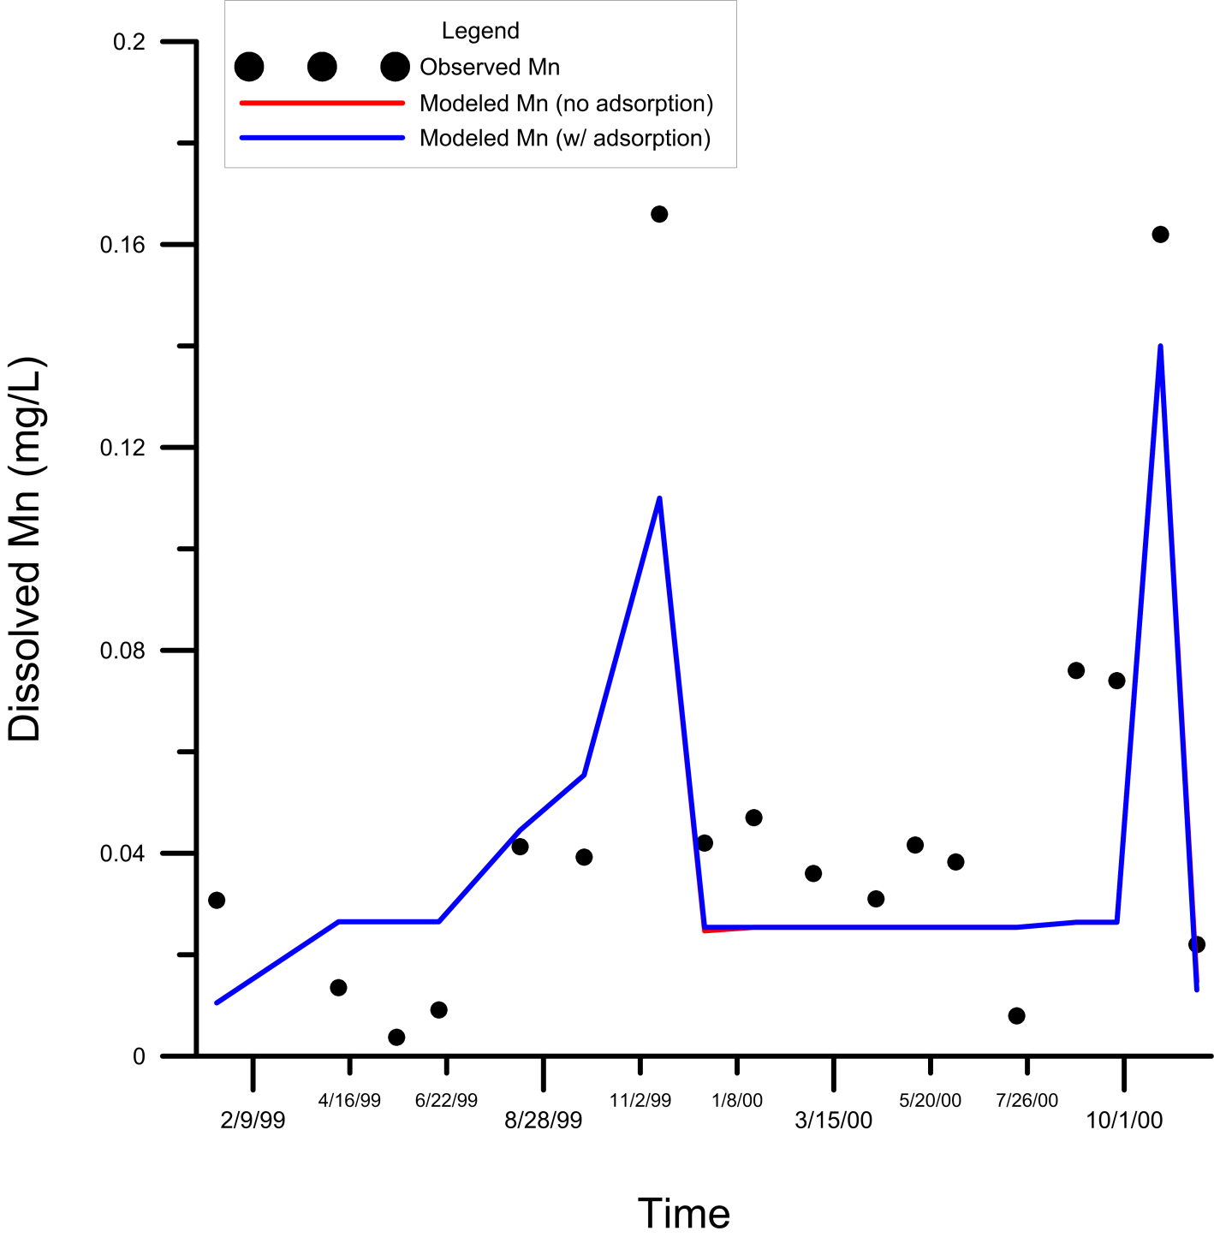
Manganese Time Series
Notes:
-following water mixing I started to model mineral dissolution during stratification, followed by mixing and possible adsorption
-I will show several of these plots, the x-axis is time and the y-axis is the dissolved concentration of our element of interest, different lines represent observed and modeled values, you only see two lines on this plot because two of them overlap
-these results show dissolved Mn concentrations, which closely approximate observed values
-this was done by modeling the dissolution of manganite, a Mn oxide, which illustrates that inflowing ground and surface waters do not alone account for dissolved metal concentrations, thus wall rock mineral dissolution is necessary
-the sharp decline in January represents overturn of the lake, dissolved metals are then taken up as oxide minerals
-much of this decline is also caused by dilution with the epilimnion waters, which are much lower in [Mn] and make up a larger volume of the lake

Slide 10
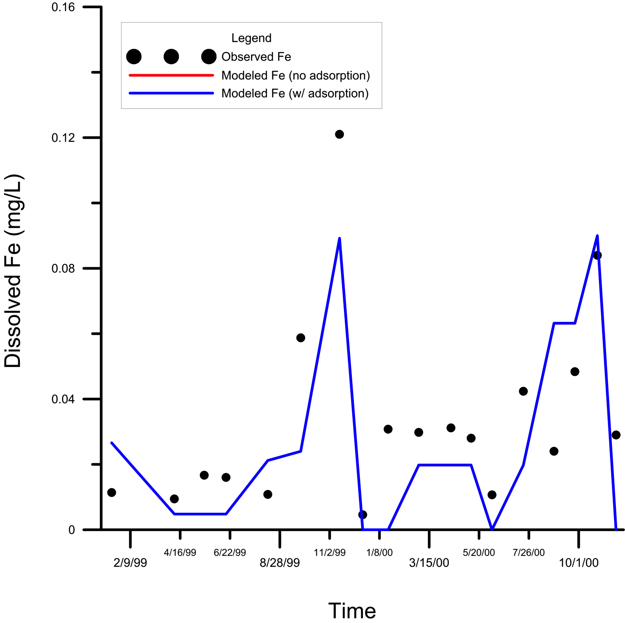
Iron Time Series
Notes:
-results showing dissolved Fe concentrations are similar, although they differ to a larger degree from observed values than dissolved Mn concentrations
-it is interesting to note that modeled Fe concentrations following turnover (point to January) drop down to nearly zero, this is due to thermodynamic predictions and is not representative of natural systems, but has been noted in other modeling research
-WHY DOESN’T THIS MATCH CLOSER? COME UP WITH REASONS
-I previously tried differing amounts of input mineral dissolution, and these resulted in vastly too much [Fe] in solution
-the results which most closely matched are shown

Slide 11
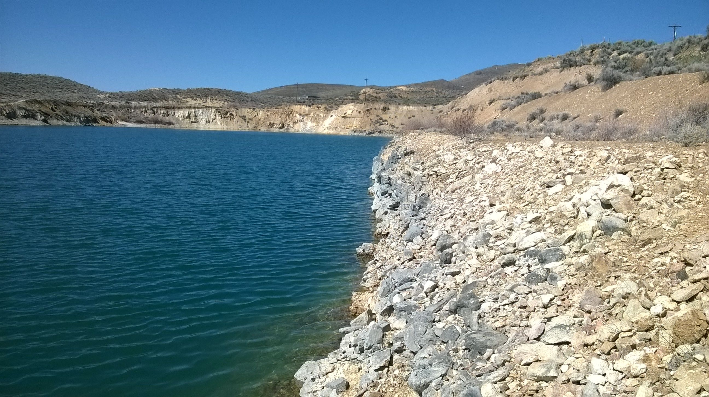
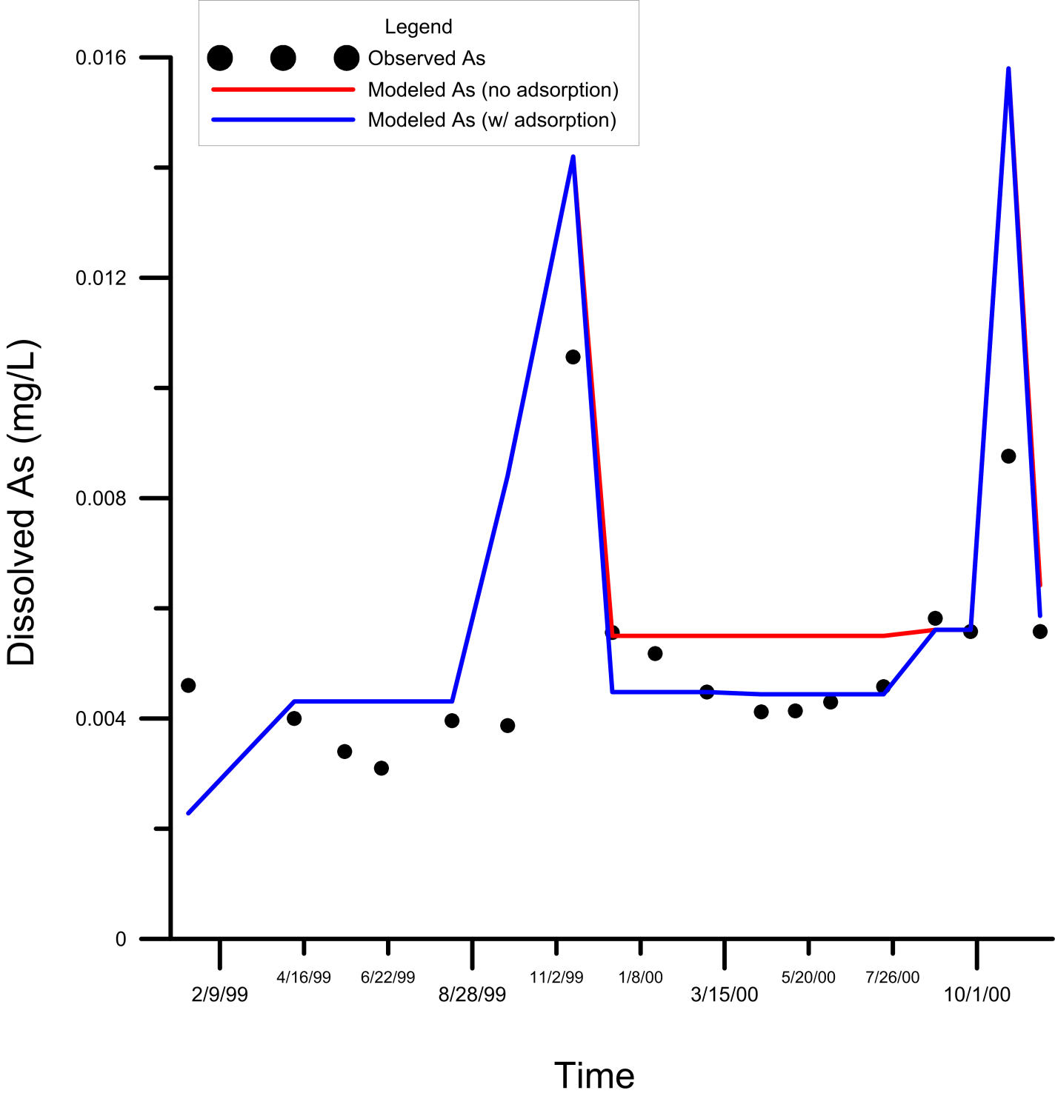
Arsenic Time Series
Notes:
-this is the most interesting plot as it shows As concentrations and how they are effected by adsorption
-the red line shows the model without adsorption, and the blue line shows the model with adsorption
-immediately following turnover the red line (no adsorption) accurately matches observed values, however As concentrations in later months show more agreement with the adsorption model
-this result may indicate that adsorption plays a role, but that the majority of the As is DPL is not adsorbed
-the amount adsorbed is of concern, and this is likely dictated by the amount of solid material present
-WHY DOES AS SHOW A SHARP DECREASE FOLLOWING TURNOVER IF NO AS MINERALS ARE FORMED (in no adsorption case)?
-likely due to the relative volumes of the epilimnion and hypolimnion

Slide 12
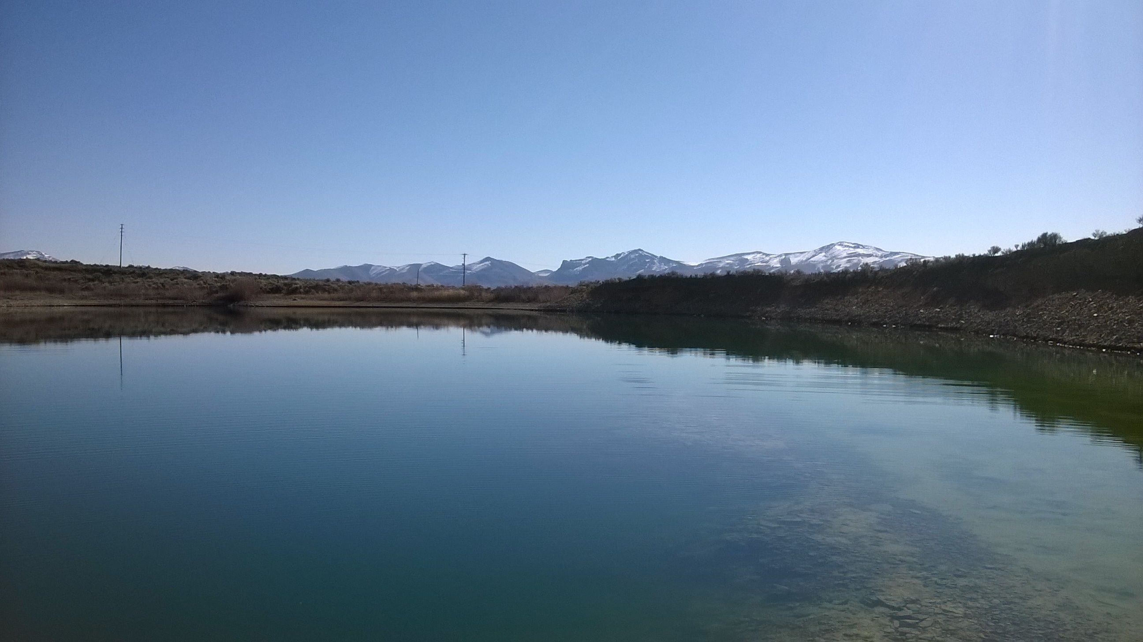
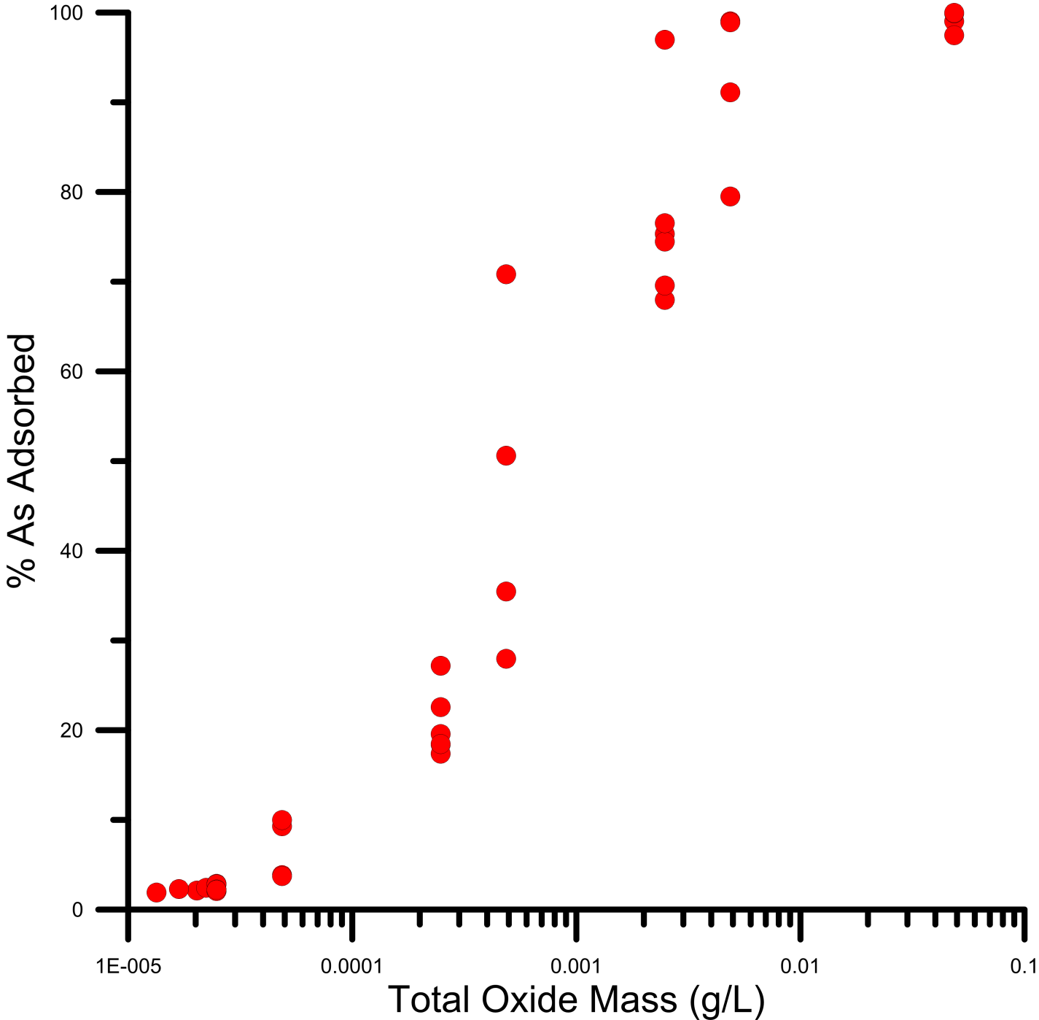
Adsorption Modeling Results
Notes:
-this plot shows that the percent of As adsorbed depends largely on the mass of sorbent (surface for adsorption) present in solution, and on the type of adsorption modeled
-the amount of As adsorbed in model calculations varied from 2-98%
-it is evident that adsorption quickly increases when even small amounts of solid are present in solution
-notice the grouping of points between roughly 10%-20% adsorption, these points closely match dissolved concentrations of As observed in DPL, and thus it is likely that between 10% and 20% of As is adsorbed in DPL

Slide 13
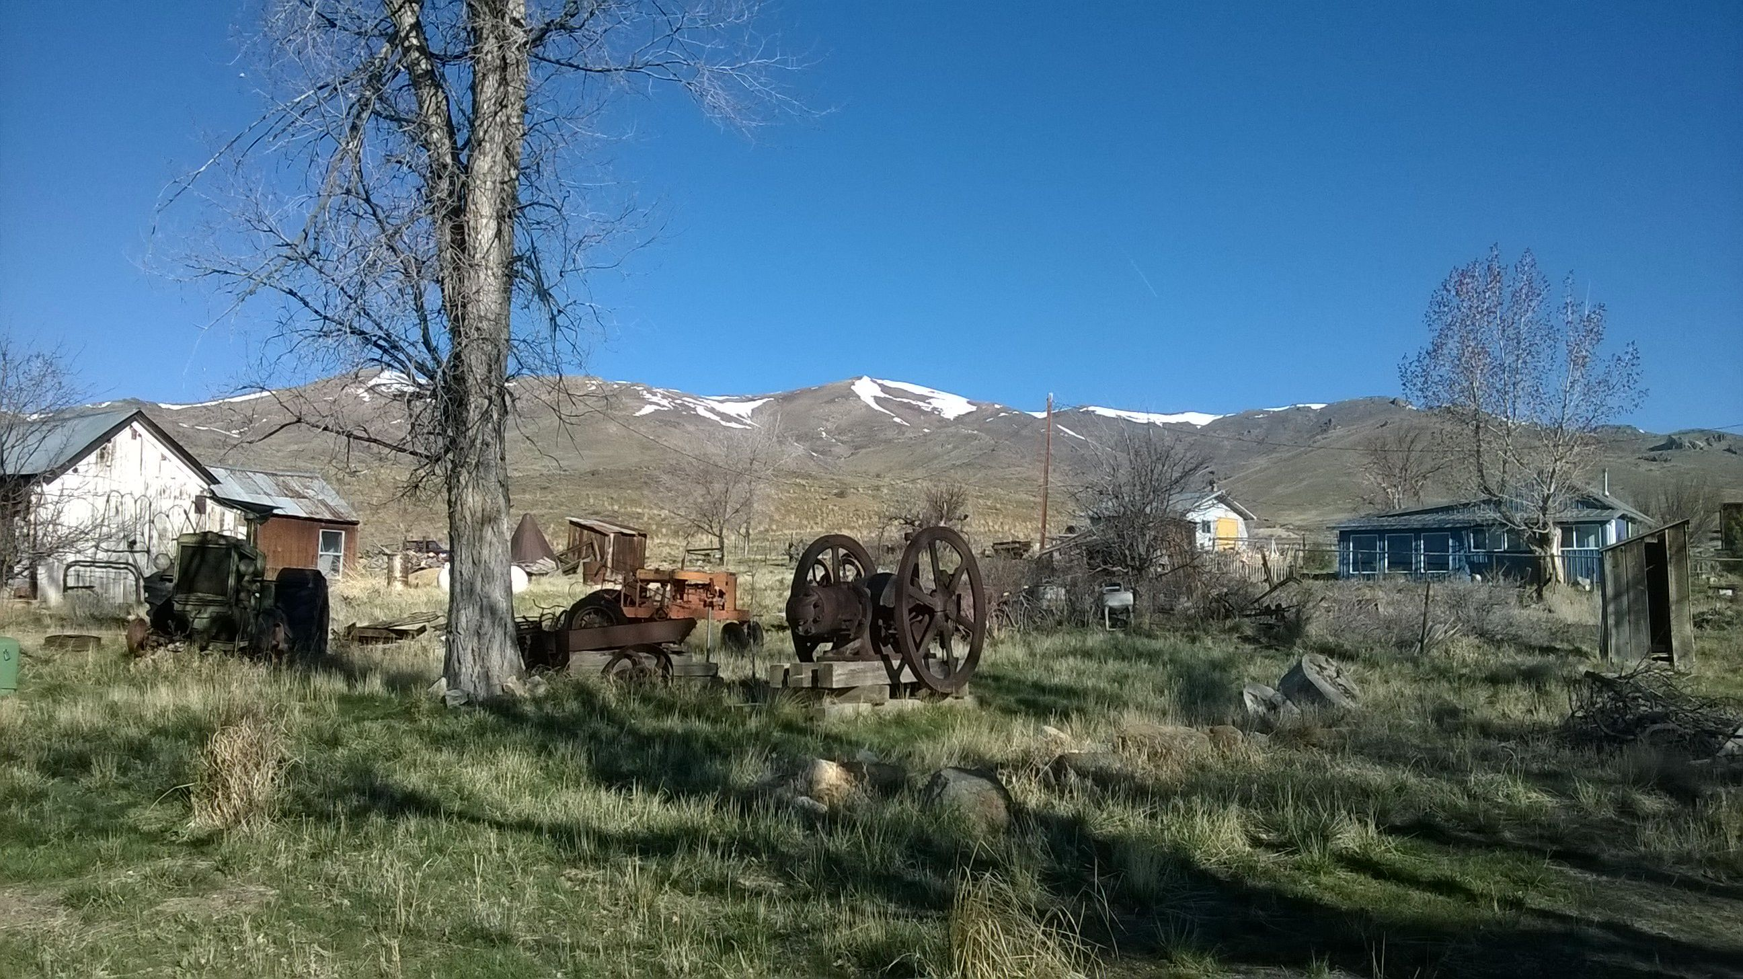
Adsorption Modeling Results
% As Adsorbed | Modeled Dissolved As (μg/L) | Observed Dissolved As (μg/L)
18.45 | 6.05 | 5.06
69.57 | 6.05 | 5.06
2.27 | 5.45 | 5.06
19.56 | 4.44 | 5.06
76.52 | 1.31 | 5.06
9.971 | 5.86 | 5.60
70.837 | 1.89 | 5.60
99.023 | 6.36*10⁻² | 5.60
Notes:
-I would like to draw your attention to this result (point to third from bottom), which is the closest adsorption match for the observed values, this indicates that likely ~20% of the As present in DPL is adsorbed

Slide 14
Conclusions
Dexter Pit Lake is a mix of 86% ground water and 14% precipitation/surface runoff
Dissolution of wall rock minerals is necessary, which may be the source for As, Mn and F
Turnover results in oxide mineral precipitation
Between 10% and 20% of the total arsenic present is adsorbed
Notes:
-modeling shows the water balance of DPL
-modeling also indicates that wall rock dissolution is a necessity to produce the observed metal concentrations of DPL (although this is not necessarily still going on, it may just have occurred during the first few years of pit lake formation, as the pit lake is now stable)
-these metals are then up taken during seasonal overturn and precipitated as oxides
-modeling shows that various amounts of As may be adsorbed depending on other parameters such as solid concentration, it is most likely however that ~1/5 of As is adsorbed

Slide 15
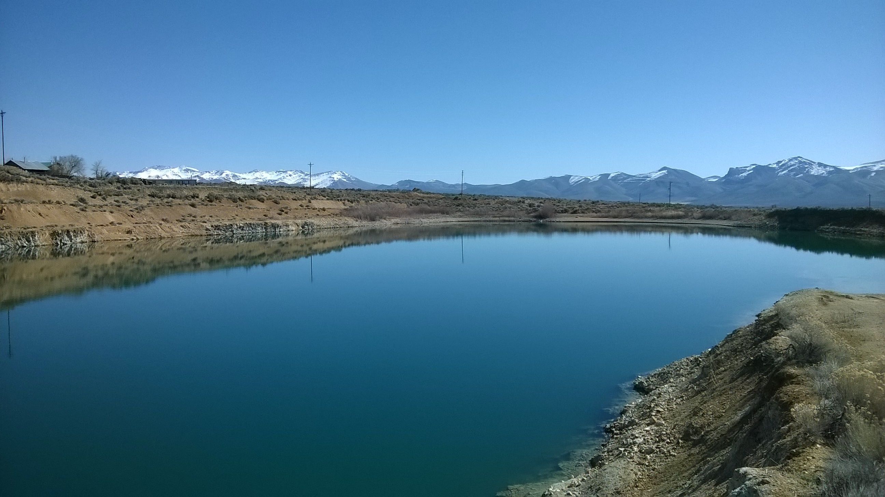


Thank you to Gina Tempel,
Lisa Stillings, Laurie Balistrieri,
Ron Breitmeyer, Tom Albright,
the USGS and UNR.
Questions?

Slide 16
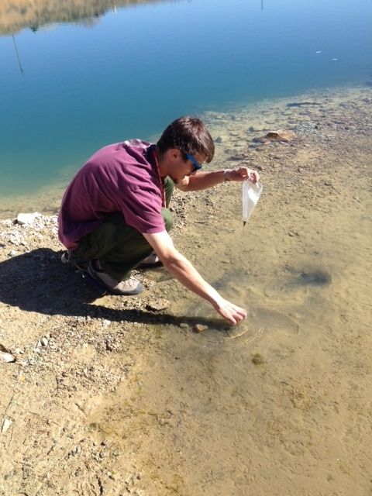
References
Balistrieri, L.S., Tempel, R.N., Stillings, L.L., and Shevenell, L. a., 2006, Modeling spatial and temporal variations in temperature and salinity during stratification and overturn in Dexter Pit Lake, Tuscarora, Nevada, USA: Applied Geochemistry, v. 21, no. 7, p. 1184–1203, doi: 10.1016/j.apgeochem.2006.03.013.
Boehrer, B., Schultze, M., 2009, Stratification and Circulation of Pit Lakes, in Castendyk, D., Eary, E. ed., Mine Pit Lakes: Characteristics, Predictive Modeling and Sustainability, SME, Littleton, Colorado, p. 304.
Bowell, R., 2002, The hydrogeochemical dynamics of mine pit lakes: Mine Water Hydrogeology and Geochemistry, v. 198, p. 159–185.
Castendyk, D.N., 2009, Conceptual Models of Pit Lakes, in Castendyk, D. N., Eary, L.E. ed., Mine Pit Lakes: Characteristics, Predictive Modeling and Sustainability, SME, Littleton, Colorado, p. 304.
Castor, S.B., Boden, D.R., Henry, C.D., Cline, J.S., Hofstra, A.H., McIntosh, W.C., Tosdal, R.M., Wooden, J.P., 2003, The Tuscarora Au-Ag District : Eocene Volcanic-Hosted Epithermal Deposits in the Carlin Gold Region , Nevada: Economic Geology, v. 98, p. 339–366.
Eary, L.E., 1999, Geochemical and equilibrium trends in mine pit lakes: Applied Geochemistry, v. 14, no. 8, p. 963–987, doi: 10.1016/S0883- 2927(99)00049-9.
Lengke, M., Tempel, R., Stillings, S., Balistrieri, L., 2000, Wall Rock Mineralogy and Geochemistry of Dexter Pit, Elko County, Nevada, in International Conference on Acid Rock Drainage (ICARD), p. 319–325.
Lu, K.-L., Liu, C.-W., and Jang, C.-S., 2012, Using multivariate statistical methods to assess the groundwater quality in an arsenic-contaminated area of Southwestern Taiwan.: Environmental monitoring and assessment, v. 184, no. 10, p. 6071–85, doi: 10.1007/s10661-011-2406-y.
Mahlknecht, J., Steinich, B., and Navarro de Leon, I., 2004, Groundwater chemistry and mass transfers in the Independence aquifer, central Mexico, by using multivariate statistics and mass-balance models: Environmental Geology, v. 45, no. 6, p. 781–795, doi: 10.1007/s00254-003- 0938-3.
Pedersen, H.D., Postma, D., and Jakobsen, R., 2006, Release of arsenic associated with the reduction and transformation of iron oxides: Geochimica et Cosmochimica Acta, v. 70, no. 16, p. 4116–4129, doi: 10.1016/j.gca.2006.06.1370.
Radu, T., Kumar, A., Clement, T.P., Jeppu, G., and Barnett, M.O., 2008, Development of a scalable model for predicting arsenic transport coupled with oxidation and adsorption reactions.: Journal of contaminant hydrology, v. 95, no. 1-2, p. 30–41, doi: 10.1016/j.jconhyd.2007.07.004.
Sherman, D.M., and Randall, S.R., 2003, Surface complexation of arsenic(V) to iron(III) (hydr)oxides: structural mechanism from ab initio molecular geometries and EXAFS spectroscopy: Geochimica et Cosmochimica Acta, v. 67, no. 22, p. 4223–4230, doi: 10.1016/S0016-7037(03)00237- 0.
Shevenell, L., Connors, K. a, and Henry, C.D., 1999, Controls on pit lake water quality at sixteen open-pit mines in Nevada: Applied Geochemistry, v. 14, no. 5, p. 669–687, doi: 10.1016/S0883-2927(98)00091-2.
Tempel, R.N., Shevenell, L. a, Lechler, P., and Price, J., 2000, Geochemical modeling approach to predicting arsenic concentrations in a mine pit lake: Applied Geochemistry, v. 15, no. 4, p. 475–492, doi: 10.1016/S0883-2927(99)00057-8.
Tempel, R.N., Sturmer, D.M., and Schilling, J., 2011, Geochemical modeling of the near-surface hydrothermal system beneath the southern moat of Long Valley Caldera, California: Geothermics, v. 40, no. 2, p. 91–101, doi: 10.1016/j.geothermics.2011.03.001.

Slide 17
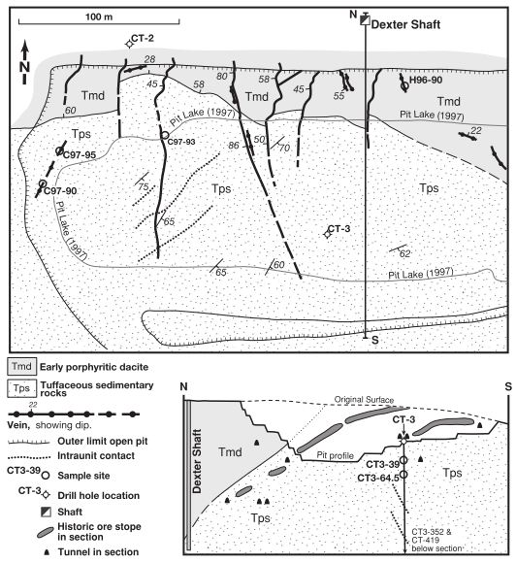
Dexter Pit Lake
Castor et al., 2003
Notes:
-INSERT PICTURE(S) OF DEXTER
-possibly make my own regional figure? THIS IS A PAIN!
-this is the Dexter pit lake, found in the Dexter pit which is located right outside of the town of Tuscarora
-the Dexter mine was operational from 1898-1903 and again from 1987-1990 (when the pit was excavated)
-the Dexter mine was a gold mine which targeted low-sulfidation epithermal mineralization created by a mineralizing episode at roughly 40 Ma
-following the end of mining activities in 1990 the DPL started to form

Slide 18
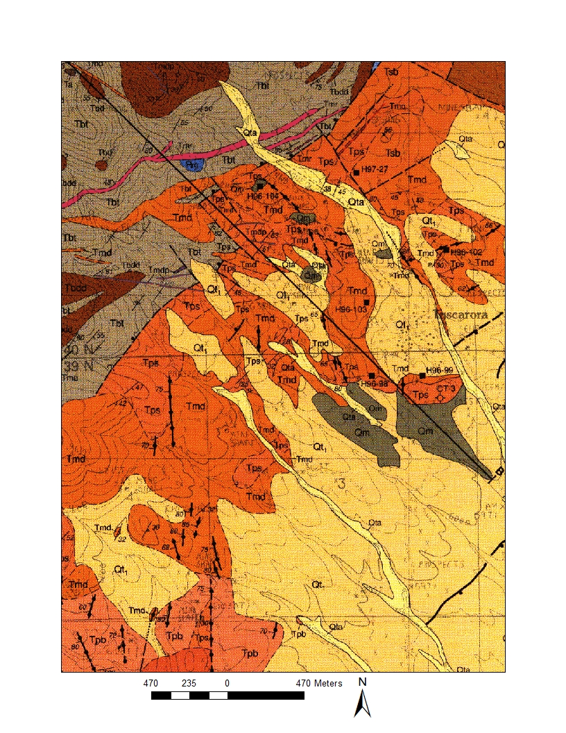


Tuffaceous sedimentary rocks
Early porphyritic dacite
Henry et al., 1999
Notes:
-this is the region of the Dexter Pit (shown by black star)
-region is characterized by volcanic rocks including Tps which is a tuffaceous sedimentary rock, and Tmd which is a porphyritic dacite

Slide 19
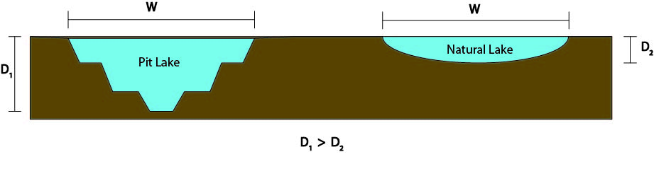
Pit Lakes
Notes:
-just to give everyone a primer on pit lakes, I will review several basic processes
-the map on the left shows the location of pit lakes in NV in 1999, there are currently roughly 30 pit lakes in NV
-pit lakes form in former open pit mines, and because of this pit lakes are much deeper compared to their surface area than average natural lakes
-this large relative depth results in some pit lakes being either seasonally or perennially stratified according to density (shown in the figure at right)

Slide 20
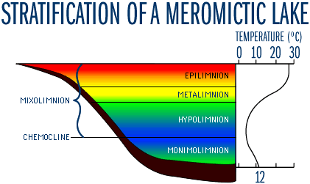
www.lakeaccess.org
Notes:
-I will be talking about several of the layers seen in this figure, and so it is useful to remember a couple terms; the epilimnion is the surface layer, and the hypolimnion is the bottom layer
-DPL does not have a monimolimnion and in my research the metalimnion is disregarded for simplicity

Slide 21
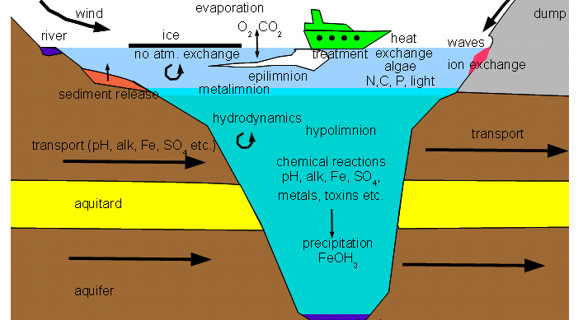
Previous Study
www.pitlakq.com
Notes:
-one of the most important findings of the Balistrieri et al. study was that As, Mn, and Fe do not behave conservatively in DPL waters, while many other elements do
-explain conservative behavior
-conservative behavior is when the dissolved concentration of an element is only affected by physical processes (dilution, evapo- concentration, point to these on figure) and not by chemical processes such as mineral precipitation/dissolution
-so on this figure many of the elements in DPL do not participate in these reactions, while As, Mn, and Fe do (point to chemical rxns, precipitation, etc.)
-non-conservative behavior of As, Mn, and Fe was one of the driving reasons for my study
-the dataset which was used in my research is the same as that collected for the Balistrieri et al. (2006) study

Slide 22
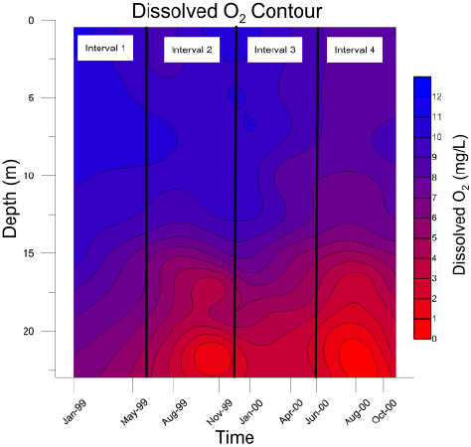
Notes:
-data from this study also show that the pit lake is seasonally stratified, seen here is DO stratification while stratification of other elements (As, Mn, Fe) and temperature also exists
-the findings of Balistrieri et al. showed that the lake is stratified during late summer and fall, and undergoes turnover in late fall

Slide 23
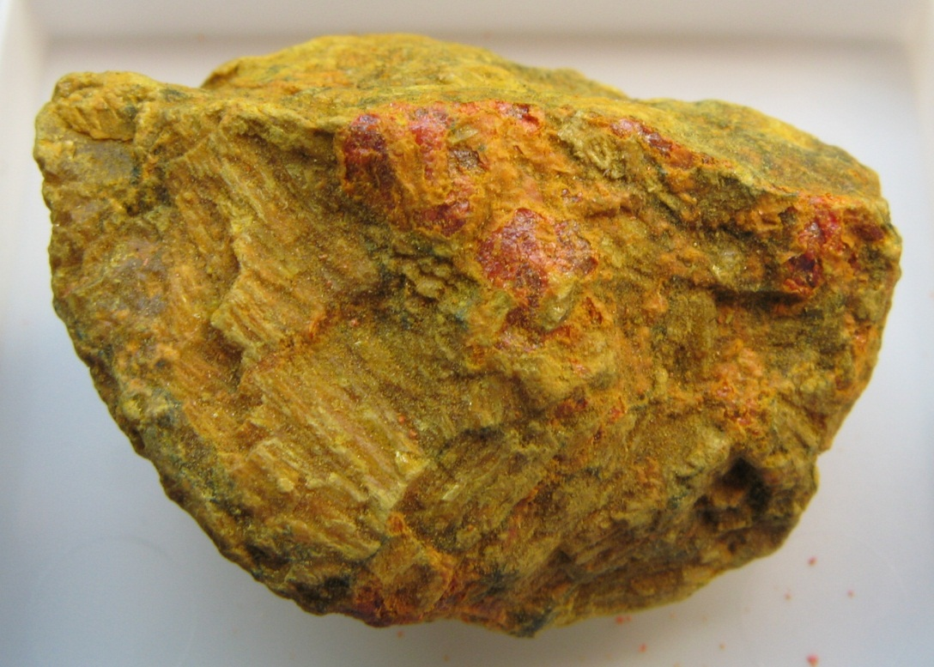
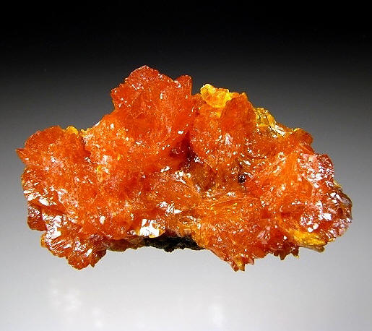
Arsenic Geochemistry
www.mindat.org
Notes:
-because non-conservative behavior of As is one of the driving reasons for this study it is useful to give everyone a background on As geochemistry
-As occurs in 2 common valence states in nature, as both the 3+ and the 5+ ion, with the 3+ form being more toxic to life
-As occurs naturally in numerous minerals, the mineral which has been noted in the Dexter pit is orpiment, with a coarse grained sample seen on the right and a finer grained sample which we are all probably more used to on the left

Slide 24
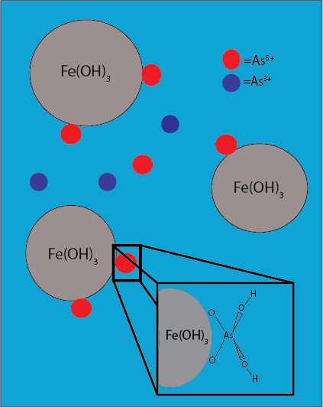
Notes:
-As also undergoes a process called adsorption
-adsorption is the attachment of a species in solution to the surface of a solid, often times iron oxides or other oxides
-adsorption essentially takes the species (As in our case) out of solution as it becomes unreactive, but the As does not become part of the mineral structure of the solid it is adsorbed onto
-this schematic shows that As⁵⁺ is more strongly adsorbed than As³⁺
-the inset graphic shows how As is adsorbed, with bonding between tetrahedral O atoms and the surface of the oxide

Slide 25
Redox Sensitive Speciation
Notes:
-essentially all of the redox sensitive elements are present in their oxidized form

Slide 26
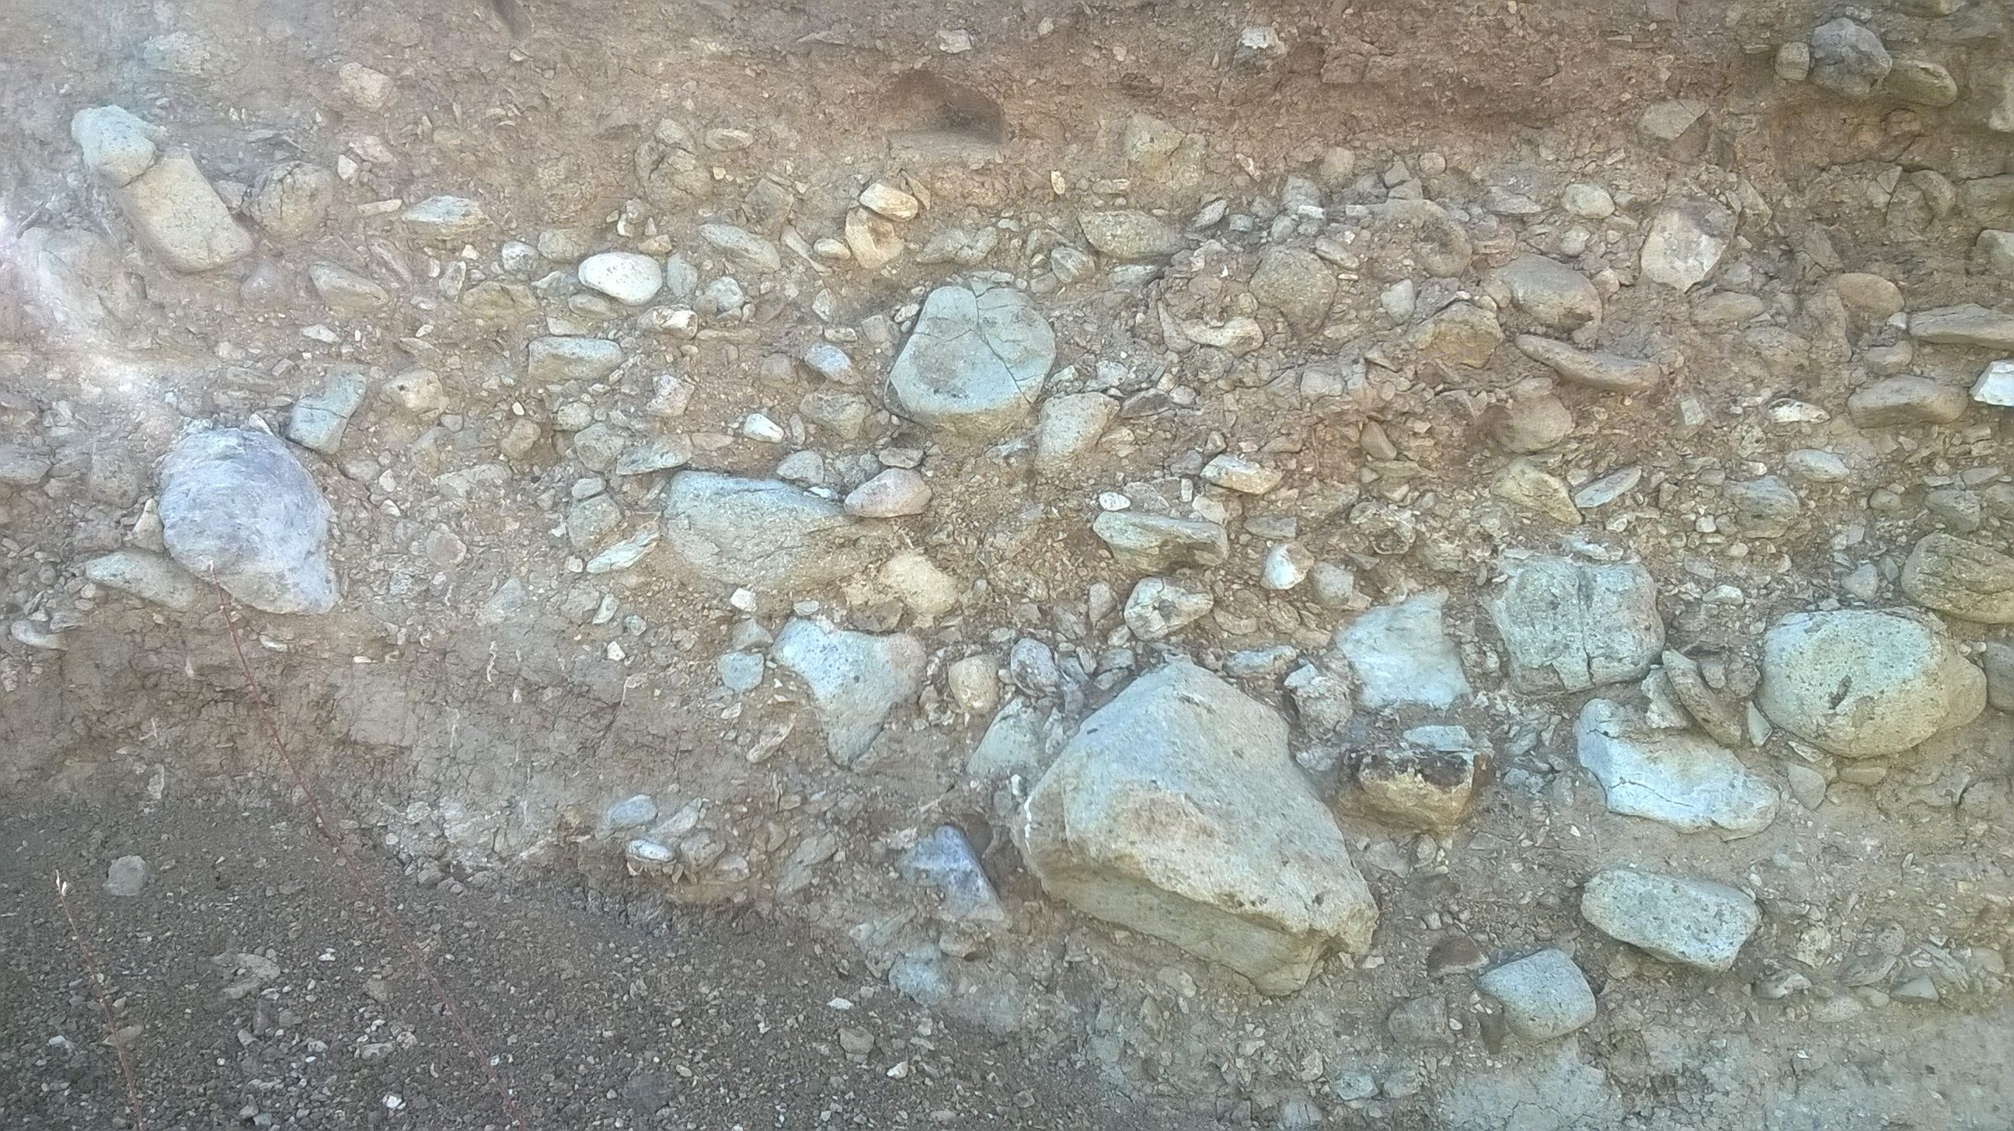
 | Component
 | 1 | 2 | 3 | 4 | 5
Temp | .012 | .100 | -.808 | .361 | .043
Cond | .268 | -.003 | .069 | -.402 | .012
Ca | .873 | -.023 | -.133 | -.101 | -.214
K | .842 | -.155 | -.182 | -.246 | -.170
Mg | .848 | .155 | .296 | .131 | .270
Mn | .181 | .673 | .080 | -.002 | .261
Na | .853 | .062 | .169 | .034 | .300
Cl | .728 | .447 | .312 | .030 | .230
SO₄ | .767 | .104 | .411 | .167 | .202
HCO₃ | .112 | -.031 | -.120 | -.020 | .895
F | -.105 | .728 | .094 | .100 | -.142
Fe | -.225 | -.245 | -.479 | -.633 | -.039
As | .062 | .762 | -.170 | -.093 | -.070
O₂ | .223 | .044 | .662 | .313 | -.129
pH | .050 | -.103 | -.038 | .905 | -.008
Notes:
-these are the results from PCA analysis, which I will briefly explain
-PCA converts all the original values for variables in “components”, which are weighted combinations of the original scores
-the association of each original variable with the extracted components are then displayed as scores, which may be interpreted the same way as a correlation coefficient (Pearson’s r)
-this is the table of extracted components and parameter scores, since we all like visuals better than tables I will move on quickly
-the one thing I want to point out is that component 1 has high scores for conservative parameters, and that component two appears to be linked to As, Mn, and F

Slide 27
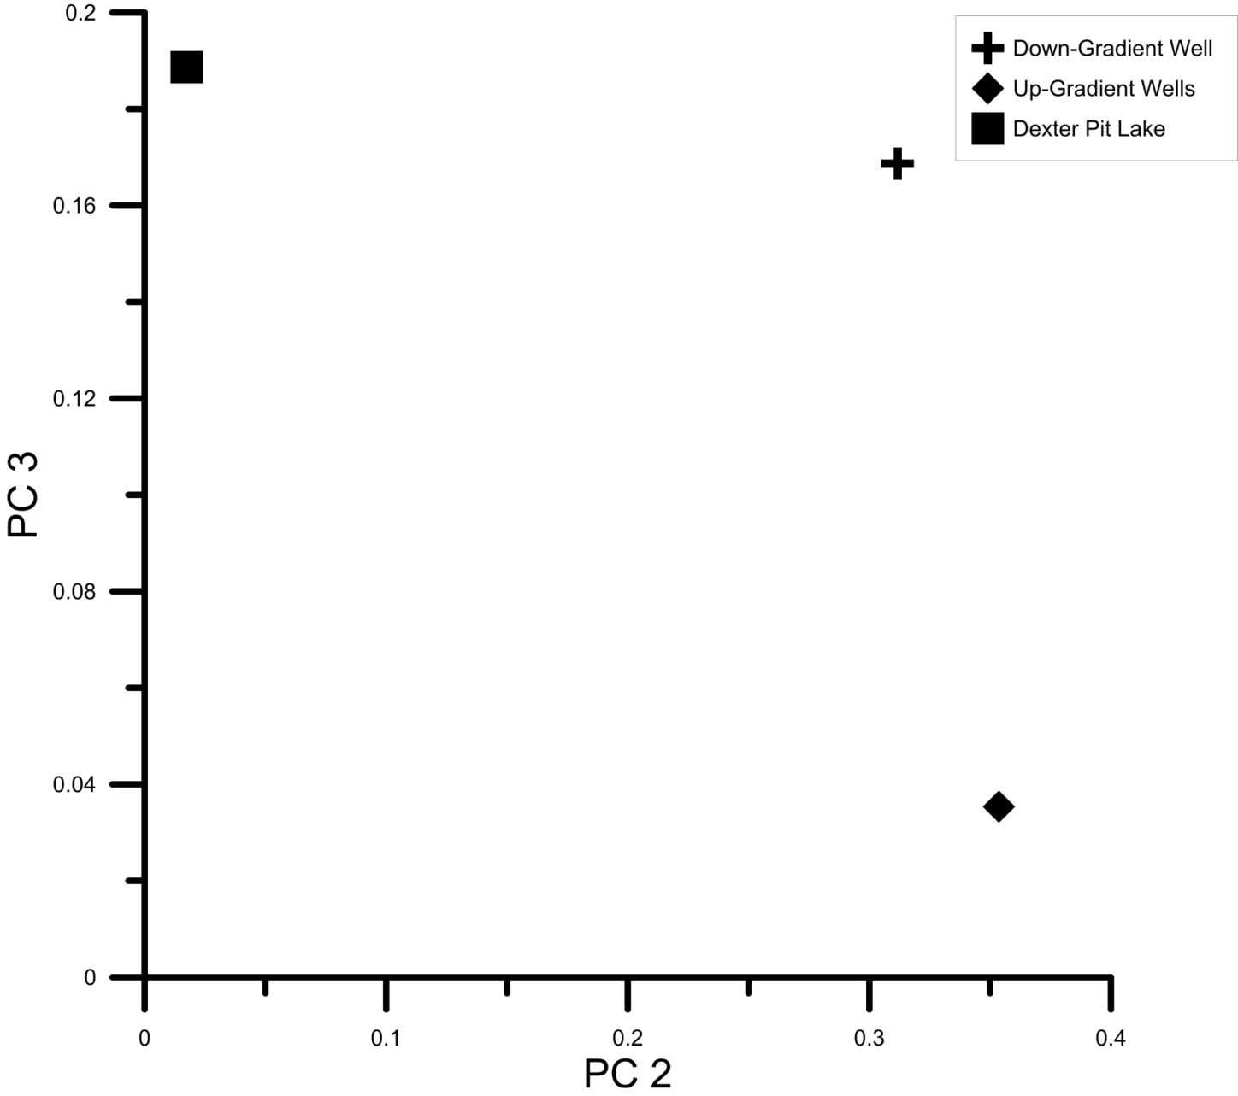
PCA Water Sourcing Results

Slide 28
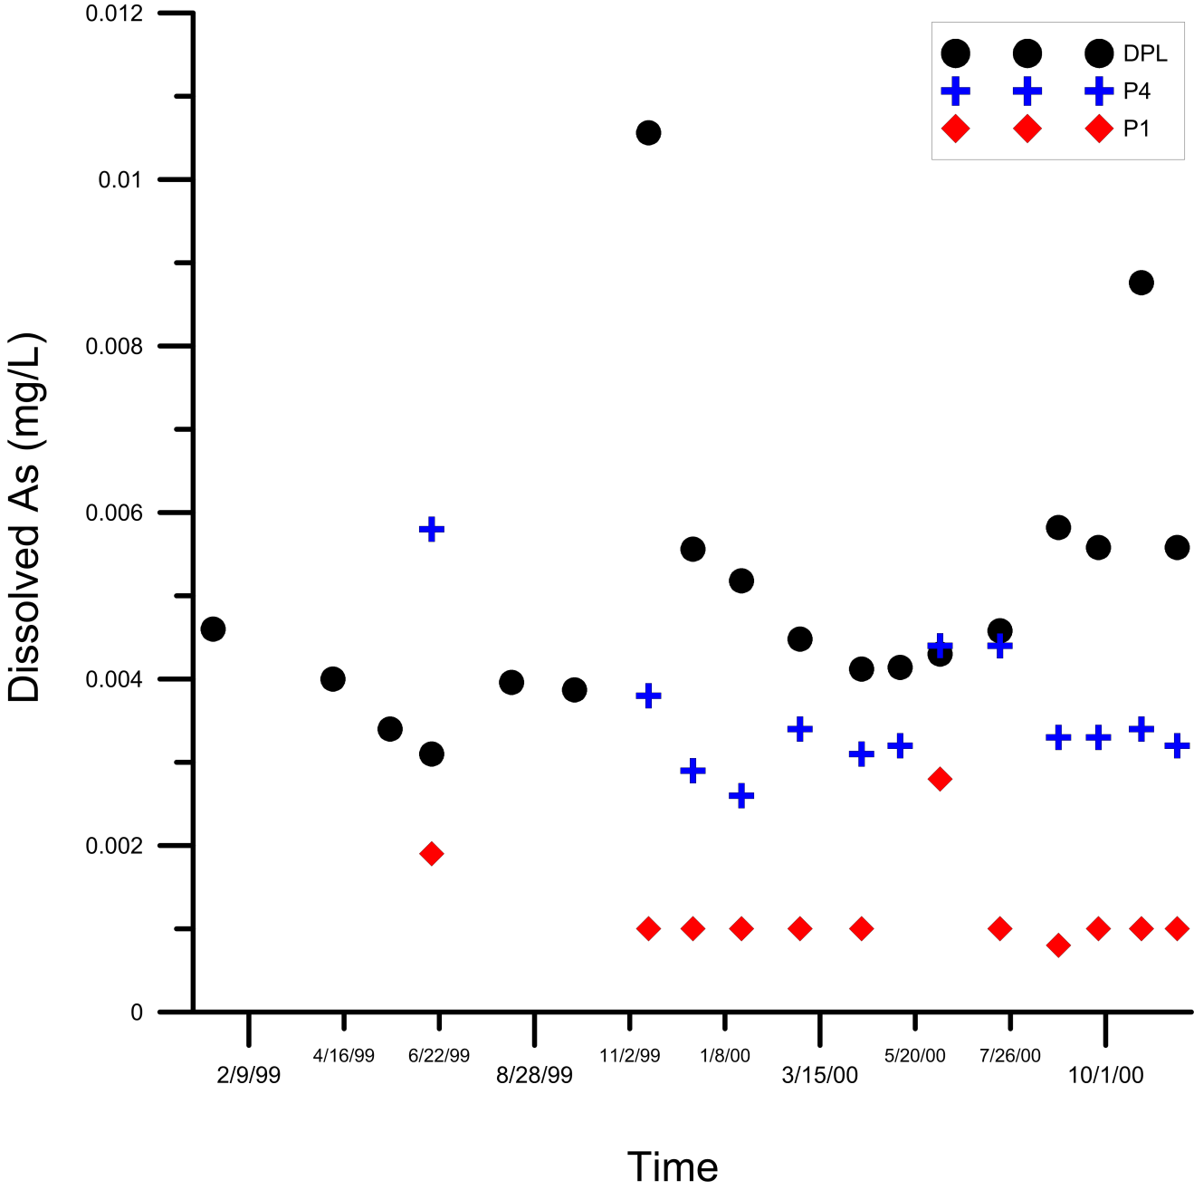
Down-gradient As Contamination

Slide 29
Interval Four Adsorption
Total Solid Mass (g/L) | Modeled Dissolved As (μg/L) | Observed Dissolved As (μg/L) | % As Adsorbed
0 | 6.51 | 5.60 | 0
0 | 6.51 | 5.60 | 0
4.86*10⁻⁵ | 6.51 | 5.60 | 9.292
4.86*10⁻⁴ | 6.51 | 5.60 | 50.602
4.86*10⁻³ | 6.51 | 5.60 | 91.104
4.86*10⁻² | 6.51 | 5.60 | 99.03
4.86*10⁻⁵ | 5.86 | 5.60 | 9.971
4.86*10⁻⁴ | 1.89 | 5.60 | 70.837
4.86*10⁻³ | 6.36*10⁻² | 5.60 | 99.023
4.86*10⁻² | 5.30*10⁻³ | 5.60 | 99.919
4.86*10⁻⁵ | 6.51 | 5.60 | 3.735
4.86*10⁻⁴ | 6.51 | 5.60 | 27.95
4.86*10⁻³ | 6.51 | 5.60 | 79.501
4.86*10⁻² | 6.51 | 5.60 | 97.48
4.86*10⁻⁵ | 6.26 | 5.60 | 3.85
4.86*10⁻⁴ | 4.20 | 5.60 | 35.464
4.86*10⁻³ | 7.13*10⁻² | 5.60 | 98.904
4.86*10⁻² | 1.72*10⁻³ | 5.60 | 99.973

Slide 30
Arsenic Oxidation State
Interval | As Valence State | Molality
3 | +3 | 1.21*10⁻²⁸
3 | +5 | 6.55*10⁻⁸
4 | +3 | 4.91*10⁻²⁹
4 | +5 | 7.83*10⁻⁸

Slide 31
Arsenic Complexation
Interval | Program | Lake Layer | As Species | % of total As
1 | EQ3/6 | Bulk pit lake | AsO₃F²⁻ HAsO₃F⁻ | 95.18 4.82
2 | EQ3/6 | Bulk pit lake | AsO₃F²⁻ HAsO₃F⁻ | 98.41 1.59
2 | EQ3/6 | Epilimnion | AsO₃F²⁻ HAsO₃F⁻ | 98.52 1.48
2 | EQ3/6 | Hypolimnion | AsO₃F²⁻ HAsO₃F⁻ | 98.54 1.46
3 | EQ3/6 | Bulk pit lake | AsO₃F²⁻ HAsO₃F⁻ | 98.49 1.51
3 | Visual MINTEQ | Bulk pit lake | HAsO₄²⁻ H₂AsO₄⁻ >FeH₂AsO₄ (1) >FeHAsO₄⁻ (1) >FeAsO₄²⁻ (1) >FeOHAsO₄²⁻ (1) | 67.127 13.954 0.023 2.158 12.534 4.189

Slide 32
Adsorption Type | Total Solid Mass (g/L) | Dissolved As (μg/L) | % As Adsorbed
A | 2.03*10⁻⁵ | 6.05 | 2.29
B | 2.03*10⁻⁵ | 5.97 | 2.28
C | 0.000167 | 6.05 | 18.01
C | 0.00167 | 6.05 | 68.94
C | 0.0167 | 6.05 | 96.07
D | 0.000167 | 4.91 | 18.91
D | 0.00167 | 1.43 | 76.31
D | 0.0167 | 0.13 | 97.85
E | 0.00002482 | 5.41 | 2.86
E | 0.0002482 | 4.06 | 27.18
E | 0.002482 | 0.16 | 96.97

Slide 33
Precipitant Mass
Mineral | Precipitant Mass (g/L) | Total Pit Lake Precipitant Mass (g)
Goethite (FeOOH) | 1.53*10⁻⁵ | 9,121
Manganite (MnOOH) | 9.53*10⁻⁶ | 5,681

Slide 34
Statistical Results
 | Temp | Cond | Ca | K | Mg | Mn | Na | Cl | SO₄ | HCO₃ | F | Fe | As | O₂ | pH
Temp | 1.000
Cond | -.088 | 1.000
Ca | -.003 | .178 | 1.000
K | -.015 | .264 | .855 | 1.000
Mg | -.131 | .166 | .552 | .500 | 1.000
Mn | .057 | .046 | .133 | .049 | .302 | 1.000
Na | -.121 | .210 | .577 | .565 | .947 | .183 | 1.000
Cl | -.121 | .135 | .493 | .399 | .865 | .506 | .760 | 1.000
SO₄ | -.219 | .121 | .518 | .410 | .891 | .220 | .787 | .812 | 1.000
HCO₃ | .059 | .038 | .033 | .070 | .210 | .165 | .272 | .172 | .161 | 1.000
F | -.041 | -.042 | -.086 | -.198 | .040 | .267 | -.009 | .241 | .065 | -.107 | 1.000
Fe | .144 | -.012 | -.077 | .072 | -.426 | -.222 | -.301 | -.410 | -.427 | -.017 | -.169 | 1.000
As | .103 | .025 | .084 | .010 | .074 | .316 | .065 | .243 | .016 | .022 | .338 | -.143 | 1.000
O₂ | -.283 | -.039 | .150 | .077 | .332 | .208 | .167 | .345 | .409 | -.072 | -.006 | -.497 | -.031 | 1.000
pH | .242 | -.184 | -.030 | -.128 | .109 | -.060 | .067 | -.049 | .145 | .021 | .081 | -.521 | -.138 | .193 | 1.000
Notes:
-I have highlighted here the results of correlations analysis, which unfortunately do not provide very useful results
-using a cutoff for a strong correlation of r=+0.5 (all of which are highlighted in red)
-this shows that conservative elements correlate well, which is expected
-it also shows that Fe has a negative correlation with pH, which may be expected as Fe minerals become less soluble at increasing pH
-also significance scores are not shown but all strong correlations showed low significance scores

Slide 35
 |  | Temp | Cond | Ca | K | Mg | Mn | Na | Cl | SO₄ | HCO₃ | F | Fe | As | O₂ | pH
Sig. (1-tailed) | Temp
 | Cond. | .230
 | Ca | .490 | .068
 | K | .450 | .012 | .000
 | Mg | .137 | .082 | .000 | .000
 | Mn | .318 | .351 | .132 | .341 | .005
 | Na | .156 | .038 | .000 | .000 | .000 | .062
 | Cl | .155 | .129 | .000 | .000 | .000 | .000 | .000
 | SO₄ | .032 | .155 | .000 | .000 | .000 | .032 | .000 | .000
 | HCO₃ | .312 | .375 | .393 | .280 | .038 | .082 | .010 | .074 | .088
 | F | .367 | .362 | .237 | .048 | .370 | .012 | .472 | .021 | .294 | .185
 | Fe | .114 | .460 | .260 | .274 | .000 | .030 | .005 | .000 | .000 | .443 | .077
 | As | .194 | .416 | .242 | .466 | .268 | .003 | .293 | .020 | .448 | .427 | .002 | .115
 | O₂ | .008 | .374 | .104 | .260 | .002 | .040 | .081 | .002 | .000 | .273 | .480 | .000 | .399
 | pH | .020 | .061 | .400 | .143 | .181 | .310 | .287 | .342 | .112 | .431 | .250 | .000 | .124 | .052

Slide 36

Notes:
-INSERT AS STRATIFICATION FIGURE

Slide 37
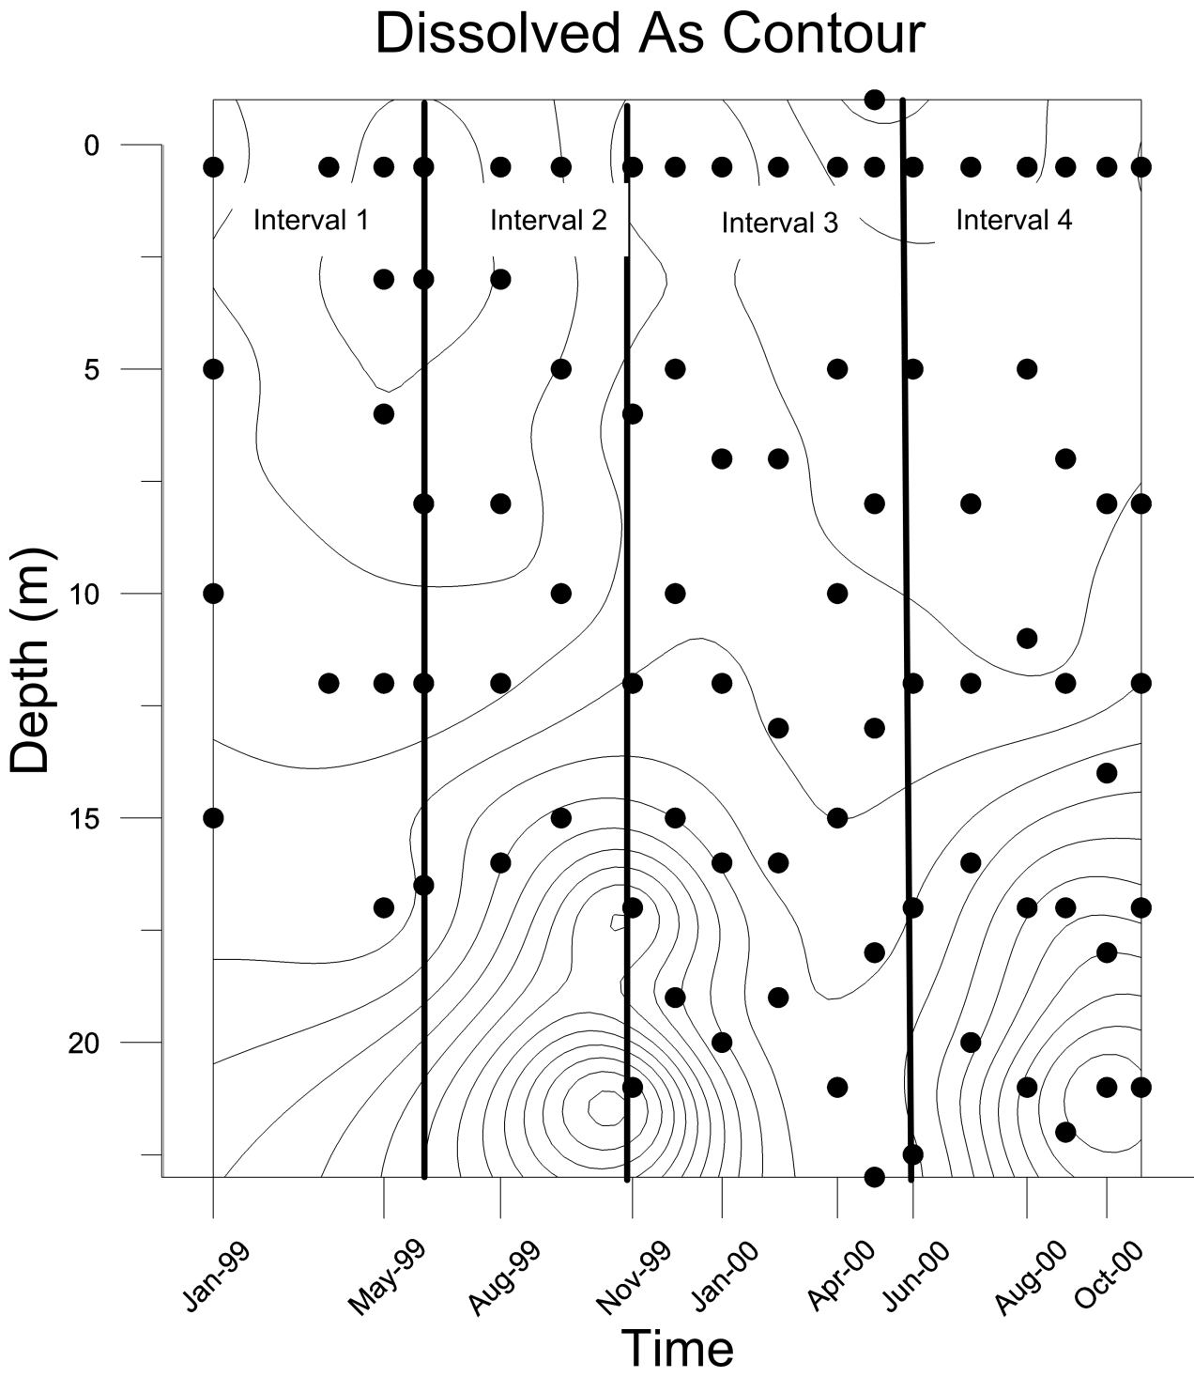

Slide 38
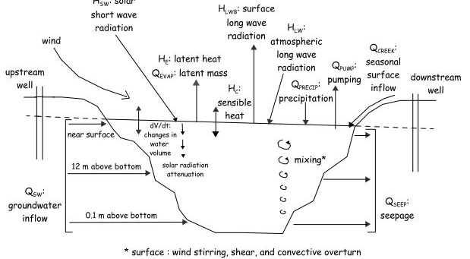
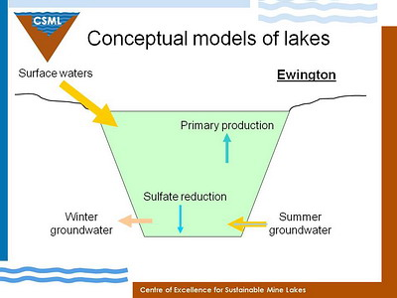
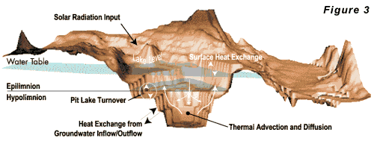
Current Research
Balistrieri et al., 2006
members.iinet.net.au
www.hgcinc.com
Notes:
-now that we know the necessary background, it is time to talk about my research
-the goal of my research is to accurately describe the chemical and physical processes which affect the concentrations of non-conservative elements, with a special emphasis on As, in DPL
-this research will create a “conceptual model” for the system, this conceptual model may hopefully be more widely applied to other systems in the future, as many conceptual models currently do not deal with all complexities concerning As

Slide 39
Hypotheses
Dissolved concentrations of manganese and iron are controlled by mineral equilibria
Dissolved concentrations of arsenic are partially controlled by adsorption
Notes:
-as I just said my goals are to determine the controlling factors on As, Mn, and Fe
-my hypotheses for this research are that Mn and Fe concentrations are controlled by mineral precipitation and dissolution, and that these cycles are linked to pit lake stratification
-following from this hypothesis is the prediction that As concentrations are partly controlled by adsorption onto Mn/Fe minerals

