Slide 1


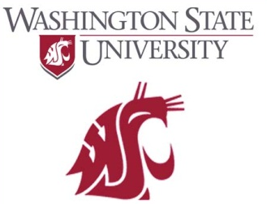
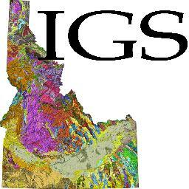
Newly Recognized Pre-Belt Quartzite in the Southern Priest River Complex
Andy Buddington – Spokane Community College
Ted Doughty – PRISEM Geoscience
Da Wang, Jeff Vervoort, Chris Fisher – Washington State University
Reed “The Interim” Lewis – Idaho Geologic Survey

Slide 2
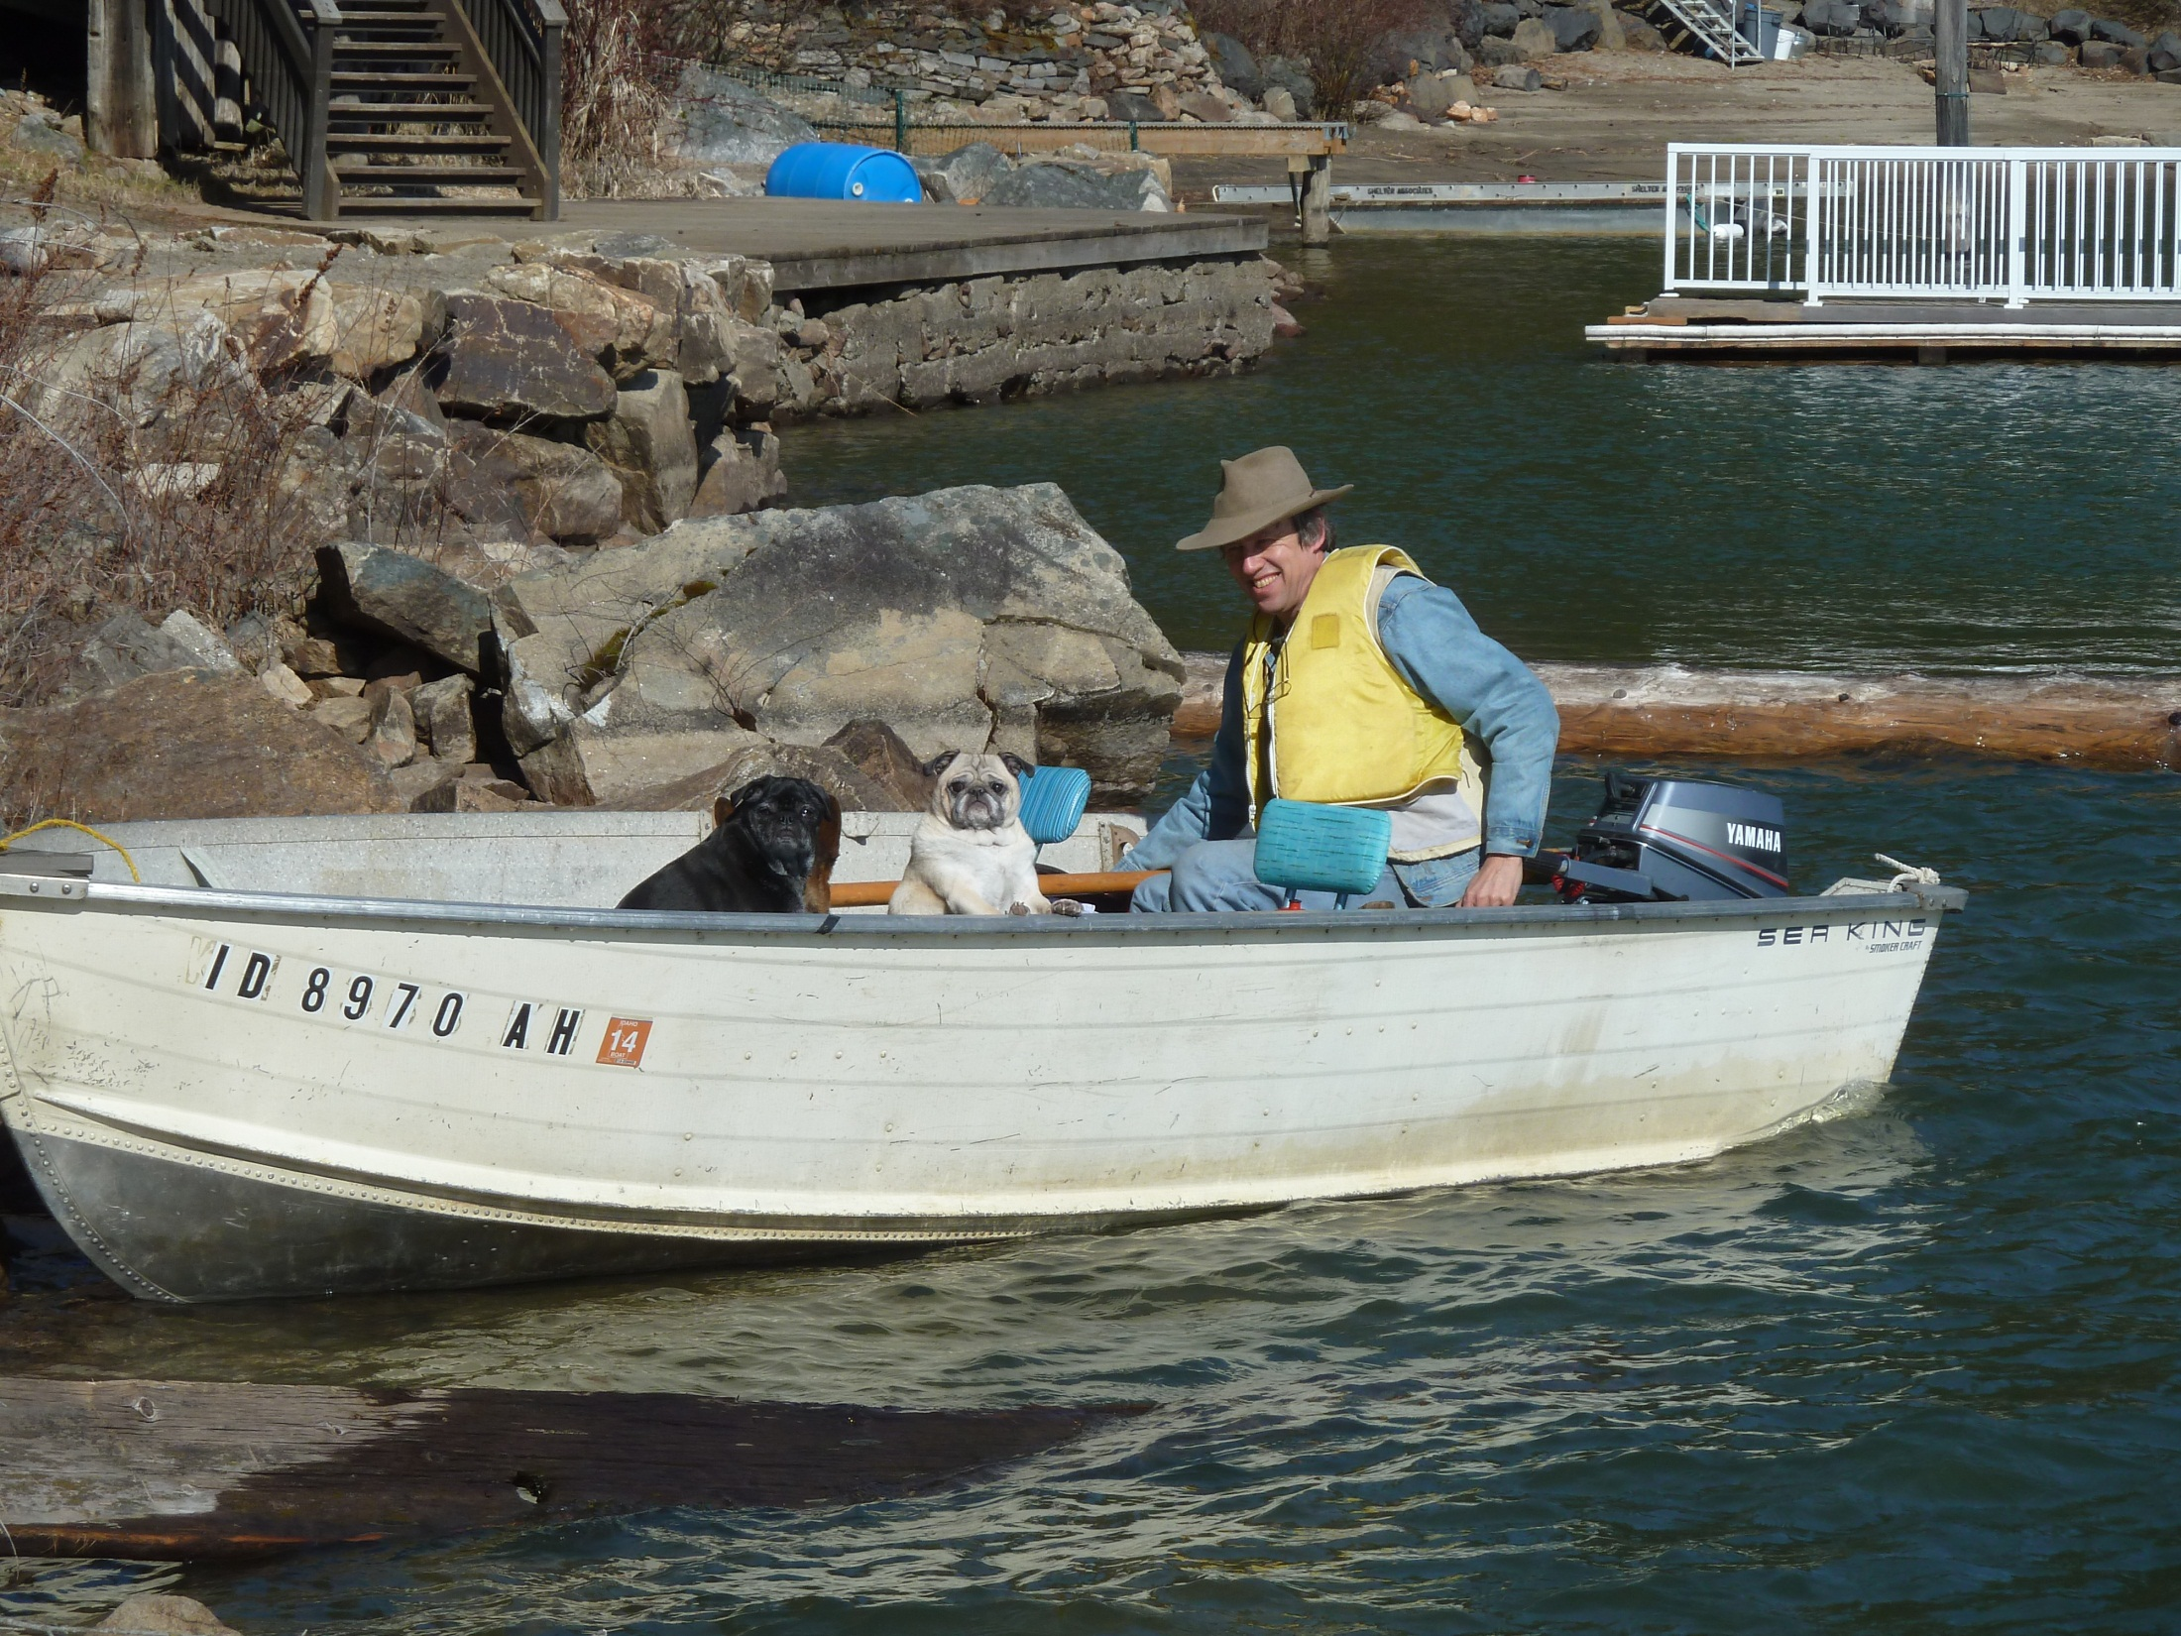

Slide 3
History
originally mapped as Prichard Fm. (1973)
later workers ➔ orthogneisses = Cretaceous
quartzites assumed to be Belt (?)
1.8 Ga date (orthogneiss) ➔ Gaschnig & Vervoort (WSU)

Slide 4
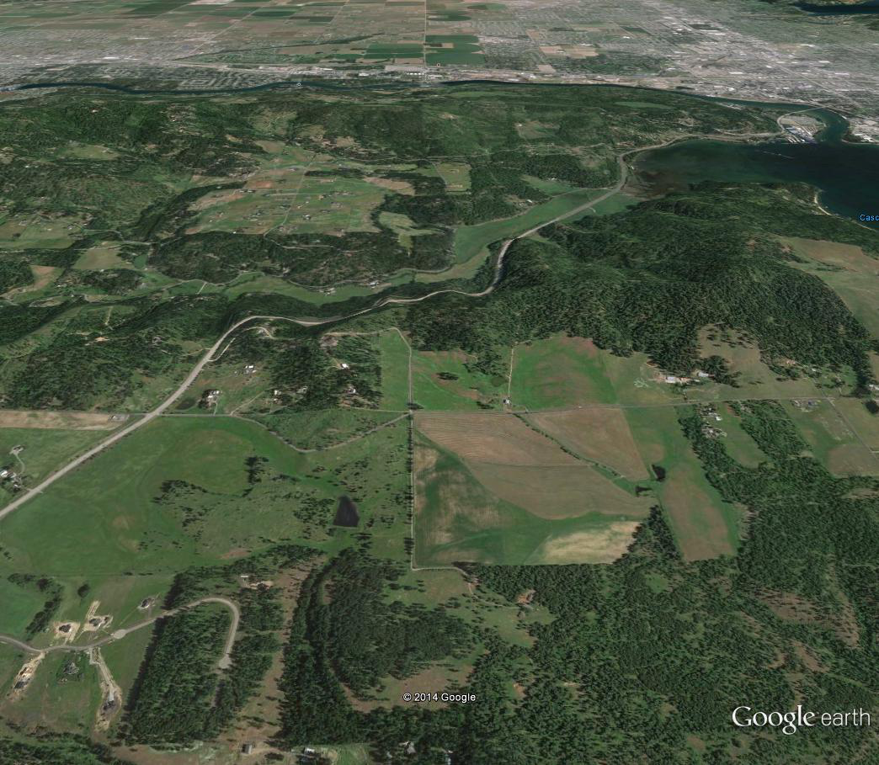
N
Coeur d’Alene, ID
Qtzite
Cougar Bay
2.6 Ga amphibolite
Wang et al, 2014
1.8 Ga orthogneiss
Gaschnig & Vervoort
Hwy. 95

Slide 5
Summary
Razorback quartzite is pre-Belt
rests “unconformably” on Neoarchean amphibolite - Mesoproterozoic orthogneiss basement
below Hauser Lake Gneiss (meta-Belt)
newly recognized PRMC culmination
Razorback - Gold Cup - Neihart correlation

Slide 6
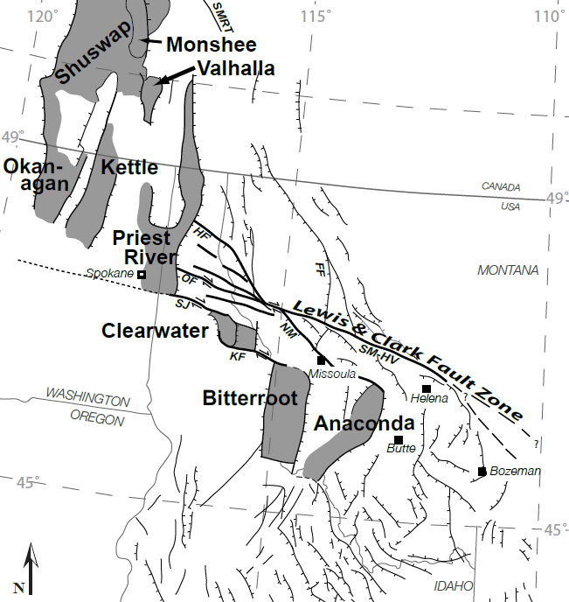
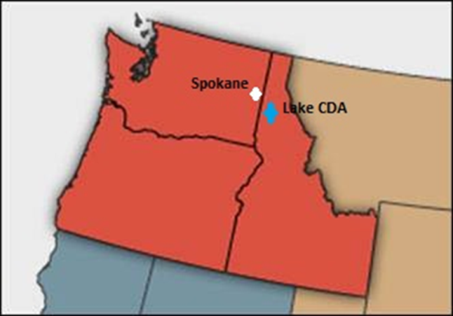
Inland Northwest MCC’s (Foster et al., 2007)
Gold Cup
Study Area

Slide 7
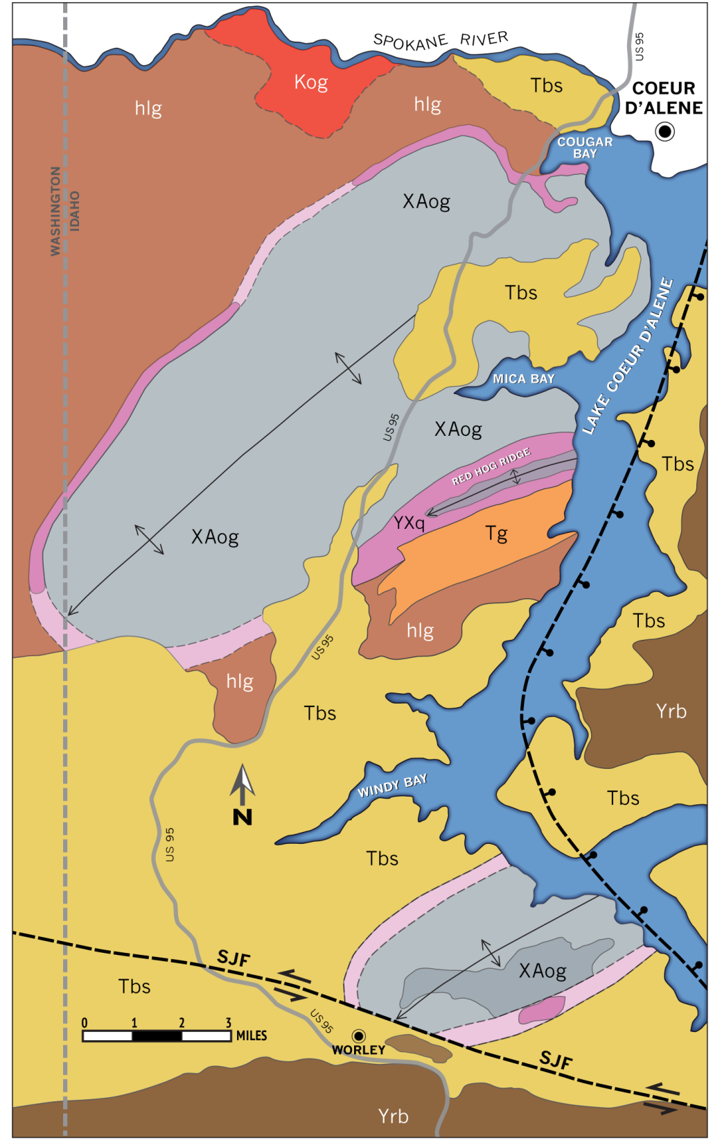
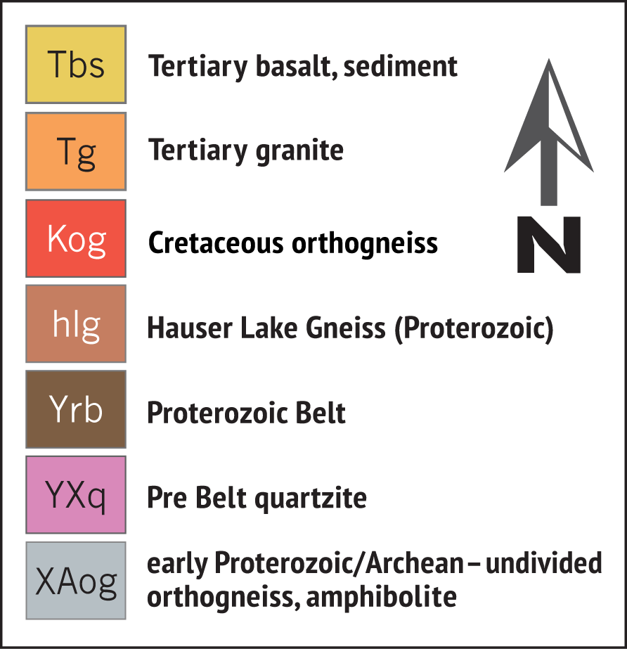
Generalized geologic map of the Cougar Gulch area

Slide 8
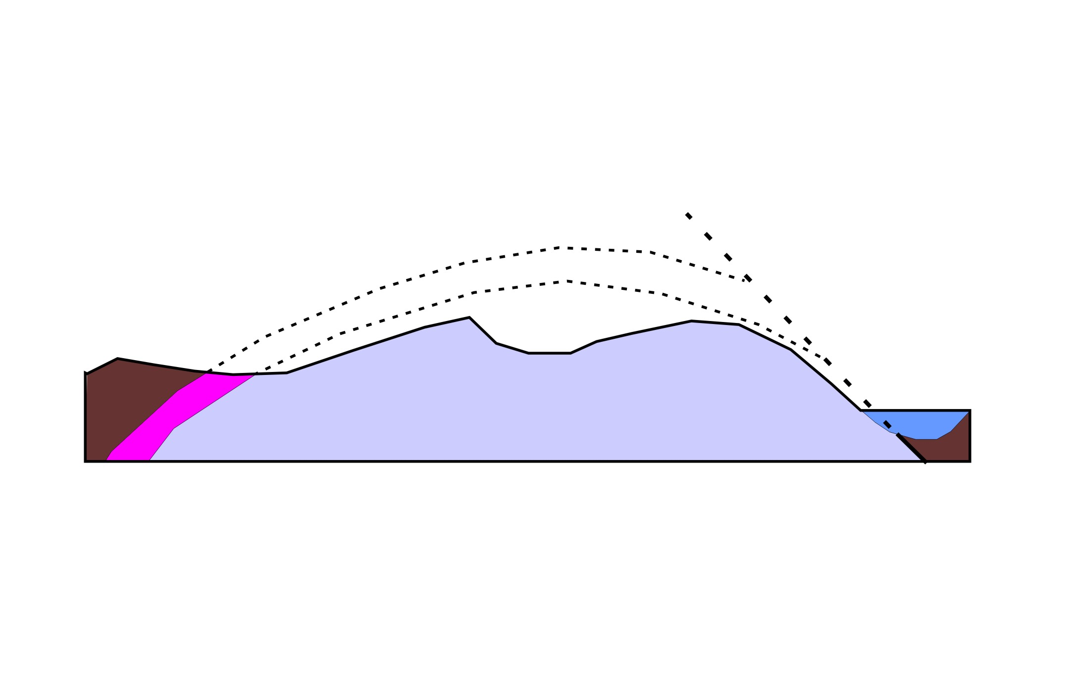
W
E
Purcell Trench - Lk. CDA Fault
Lake CDA
hlg
YXq
XAog
Razorback
quartzite
Simplified Cross Section
of Cougar Gulch Culmination

Slide 9
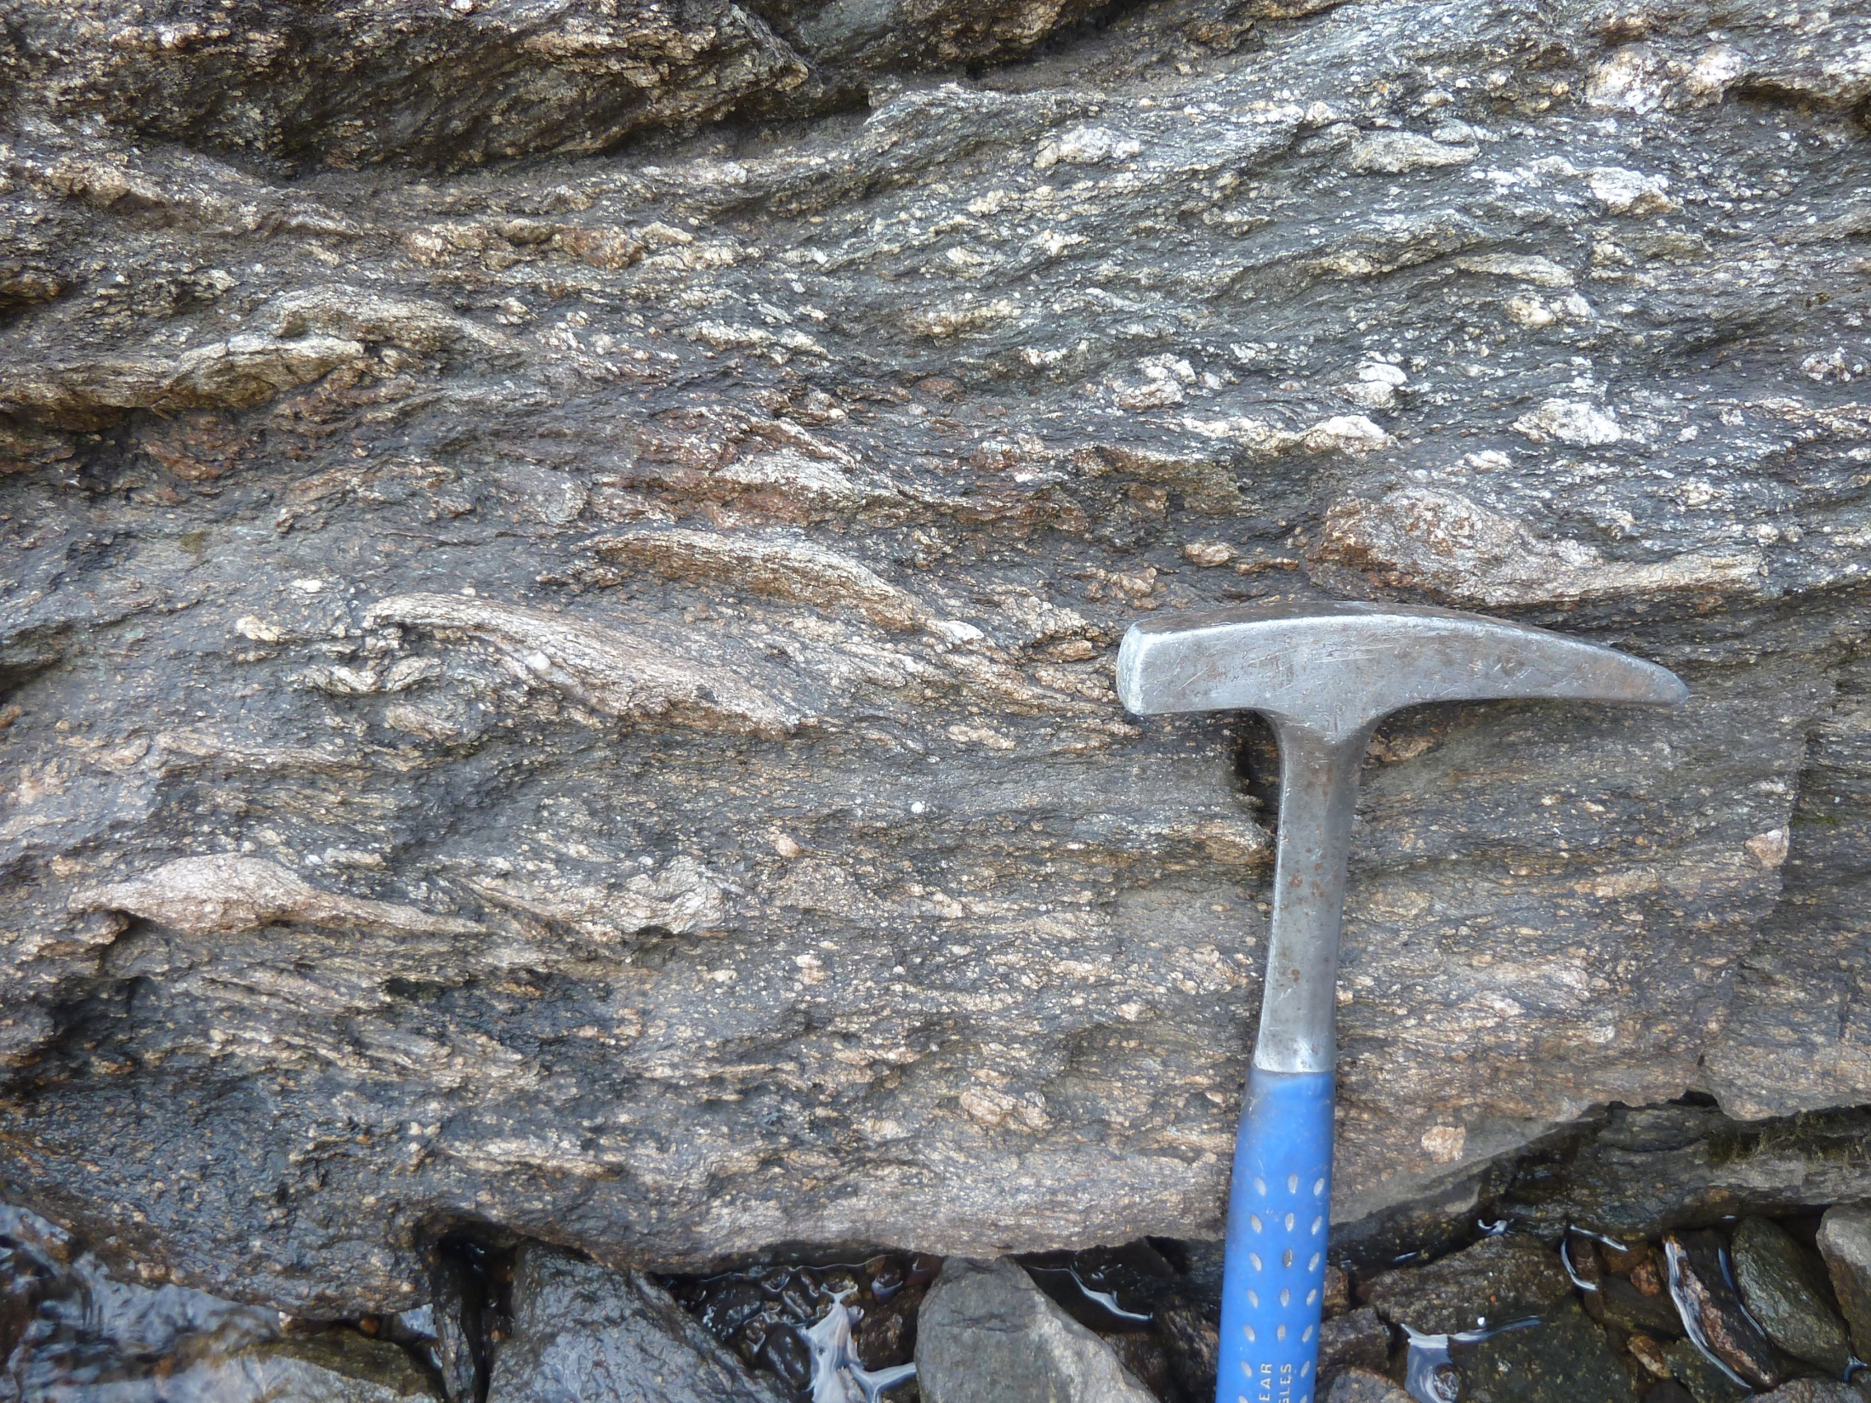

Slide 10
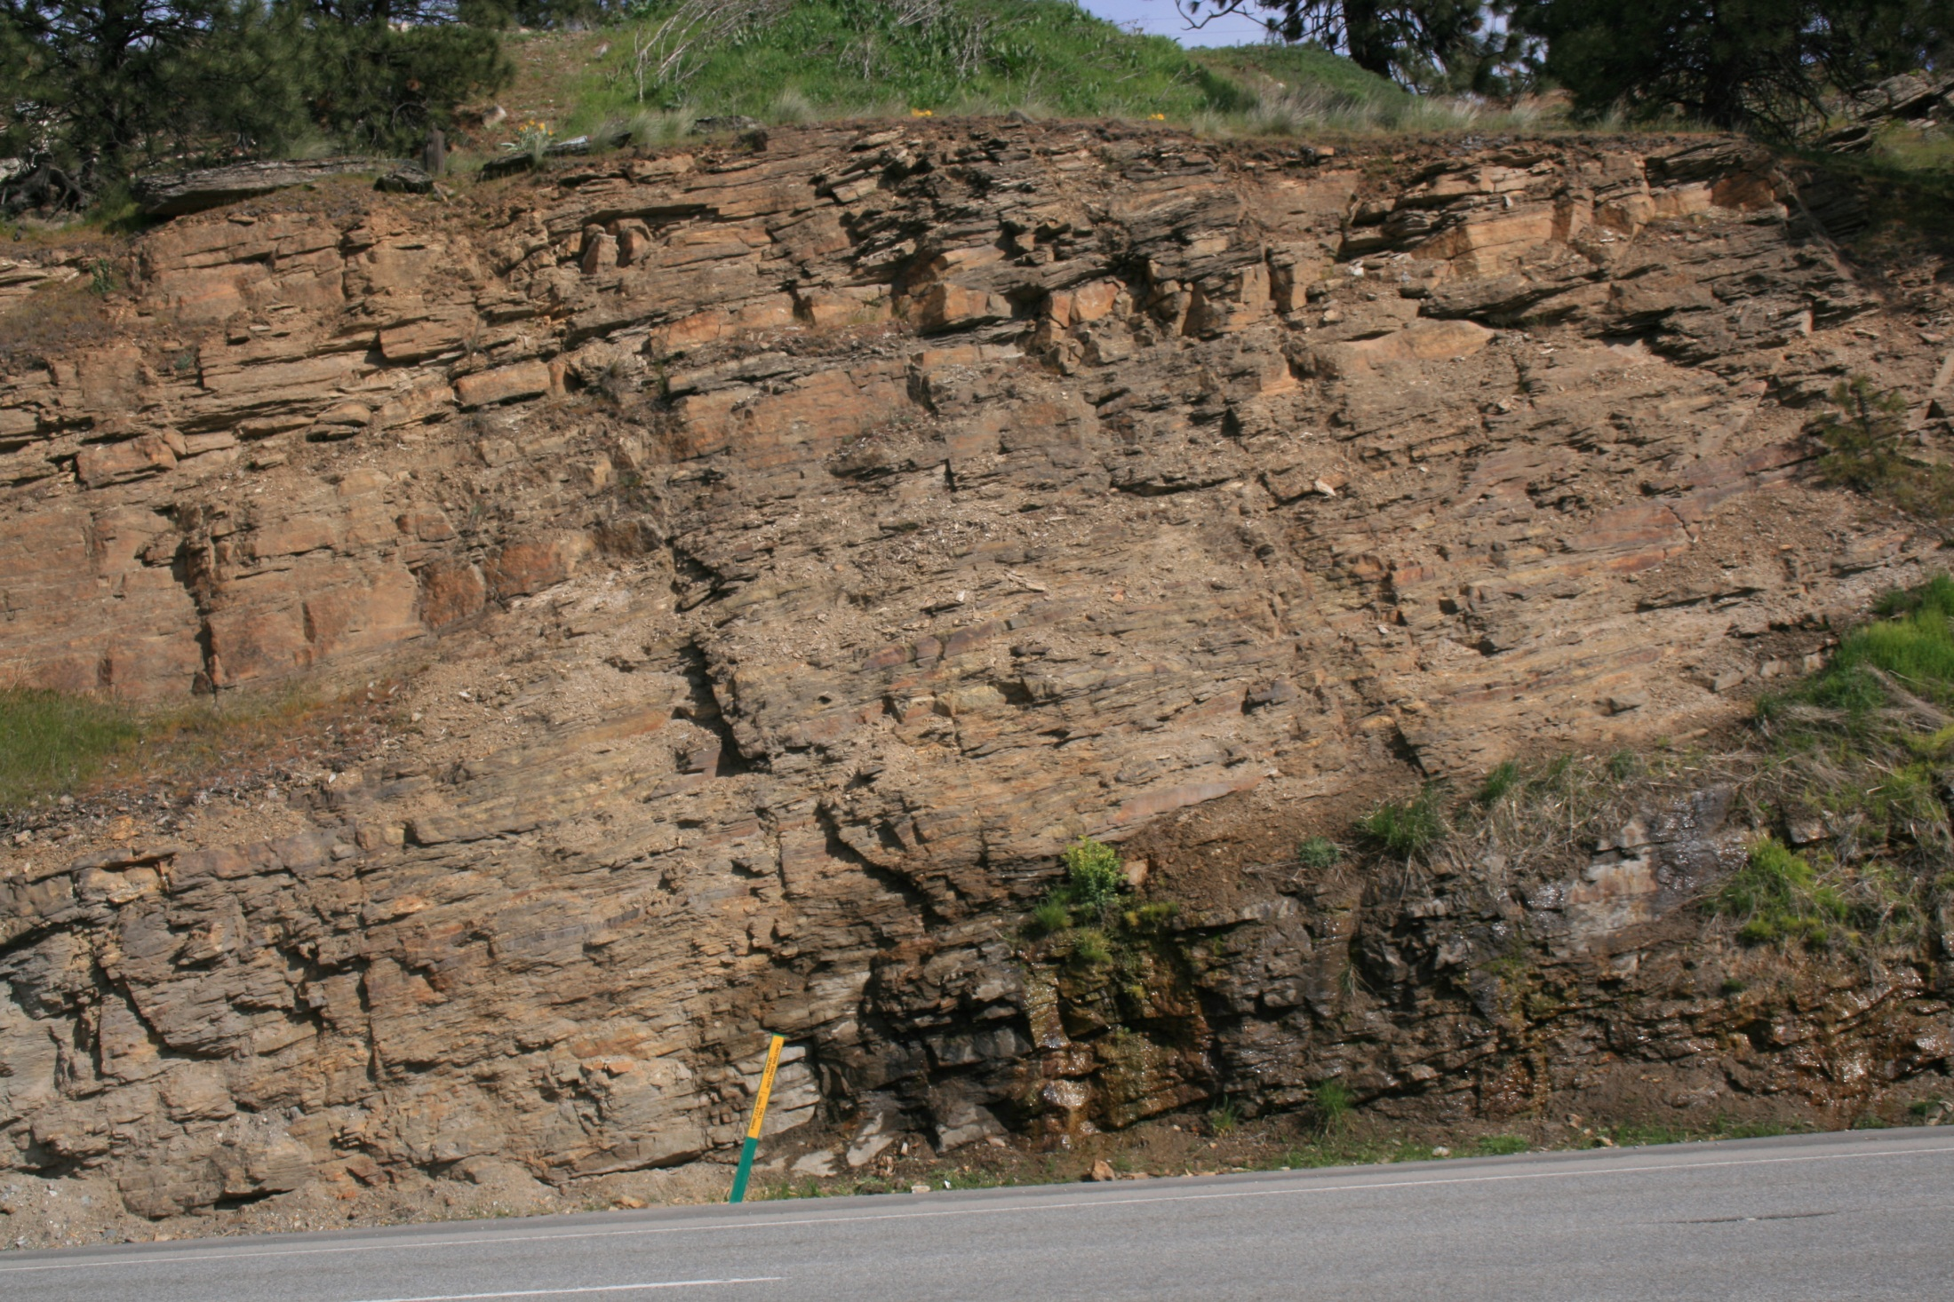
Hauser Lake Gneiss

Slide 11
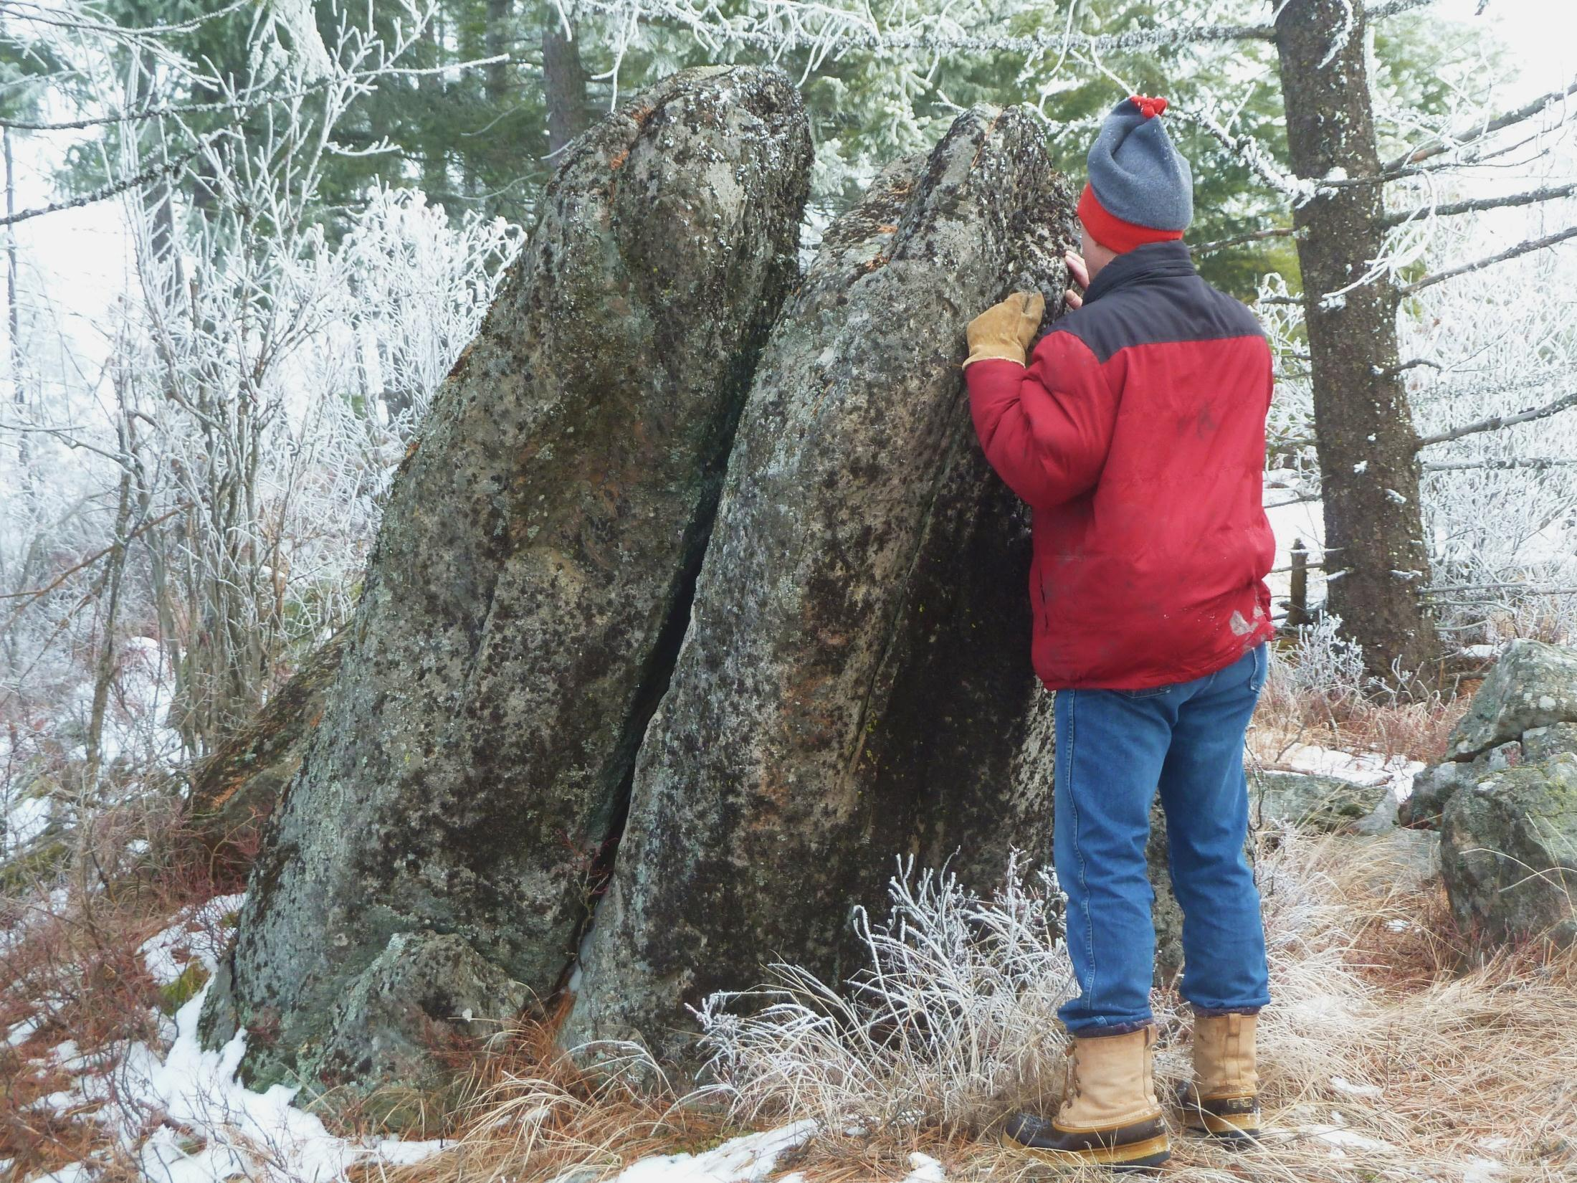

Slide 12
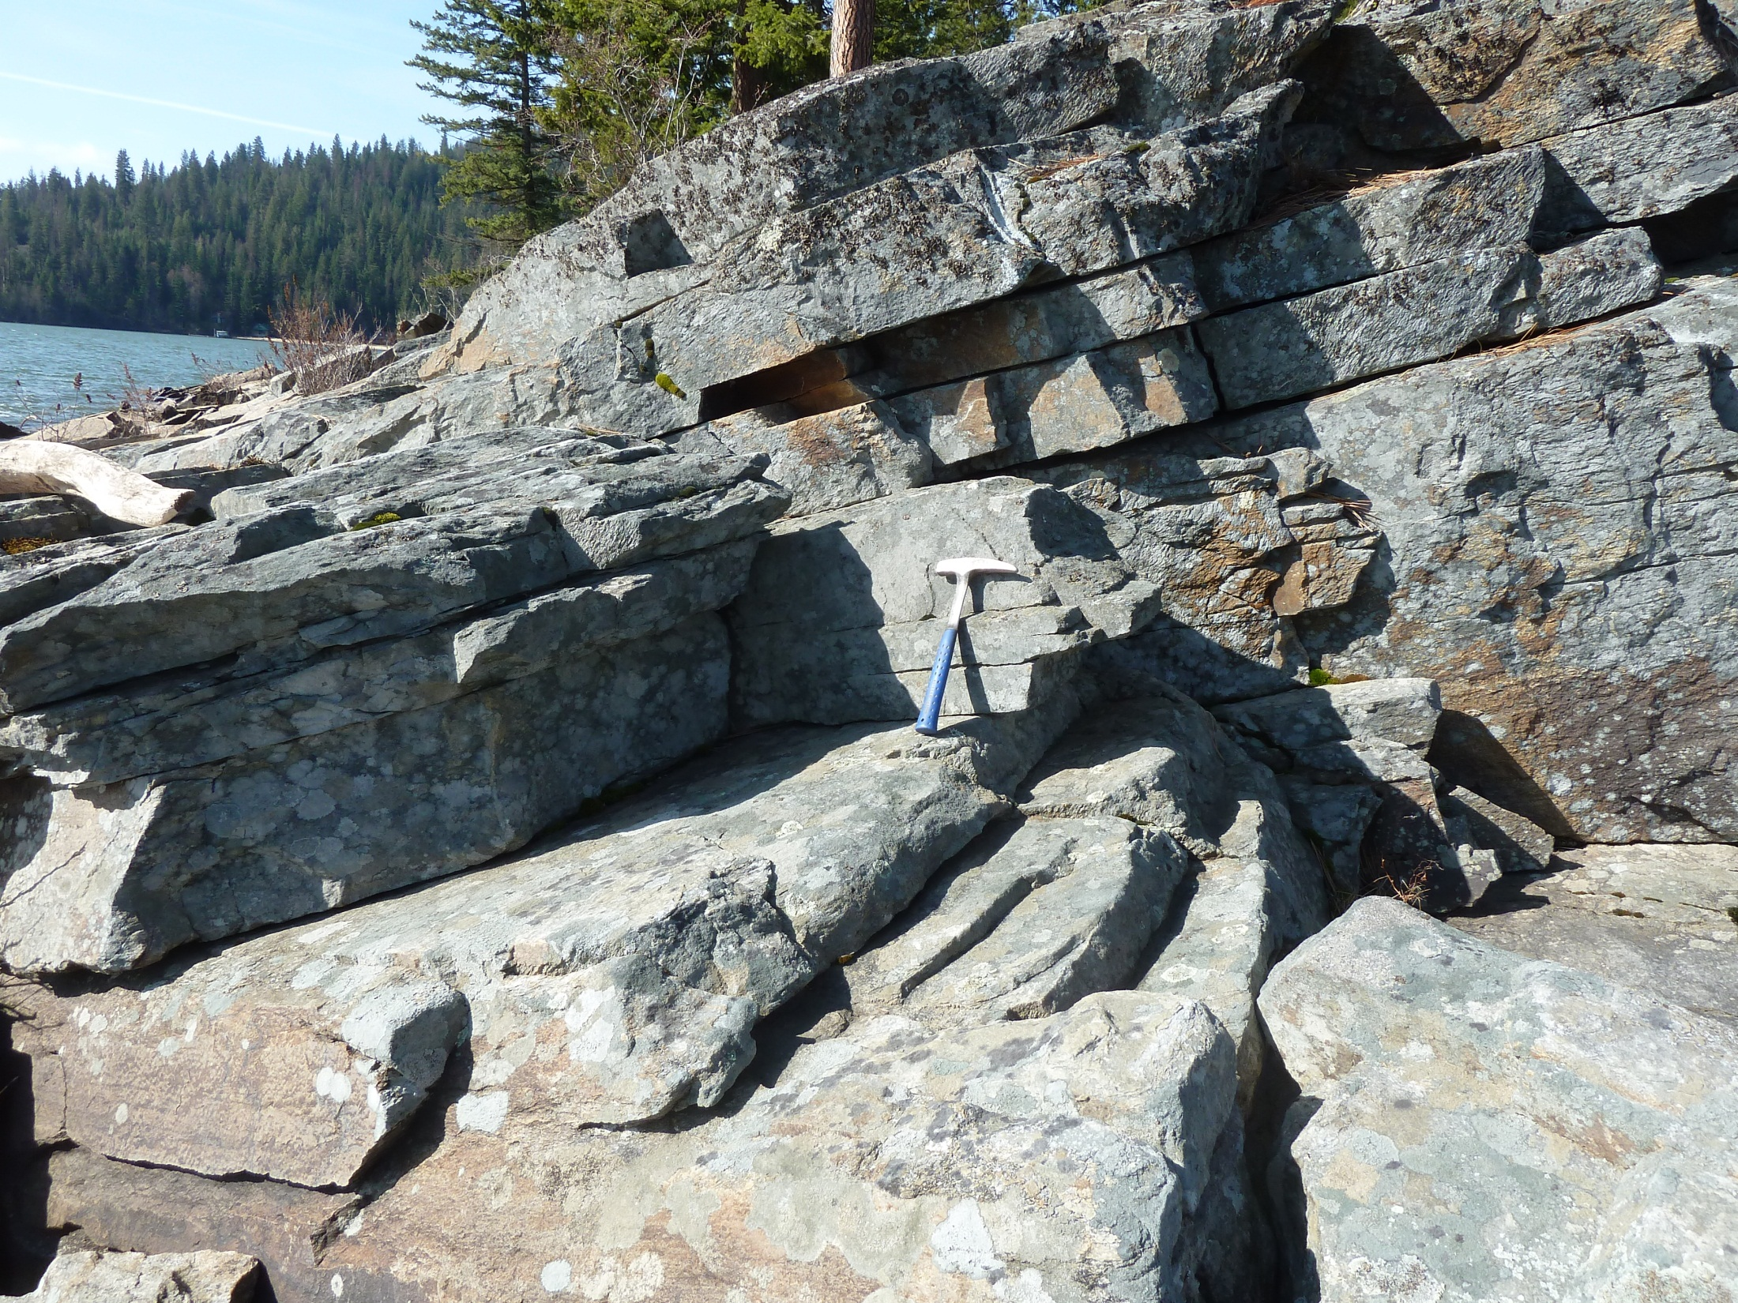

Slide 13
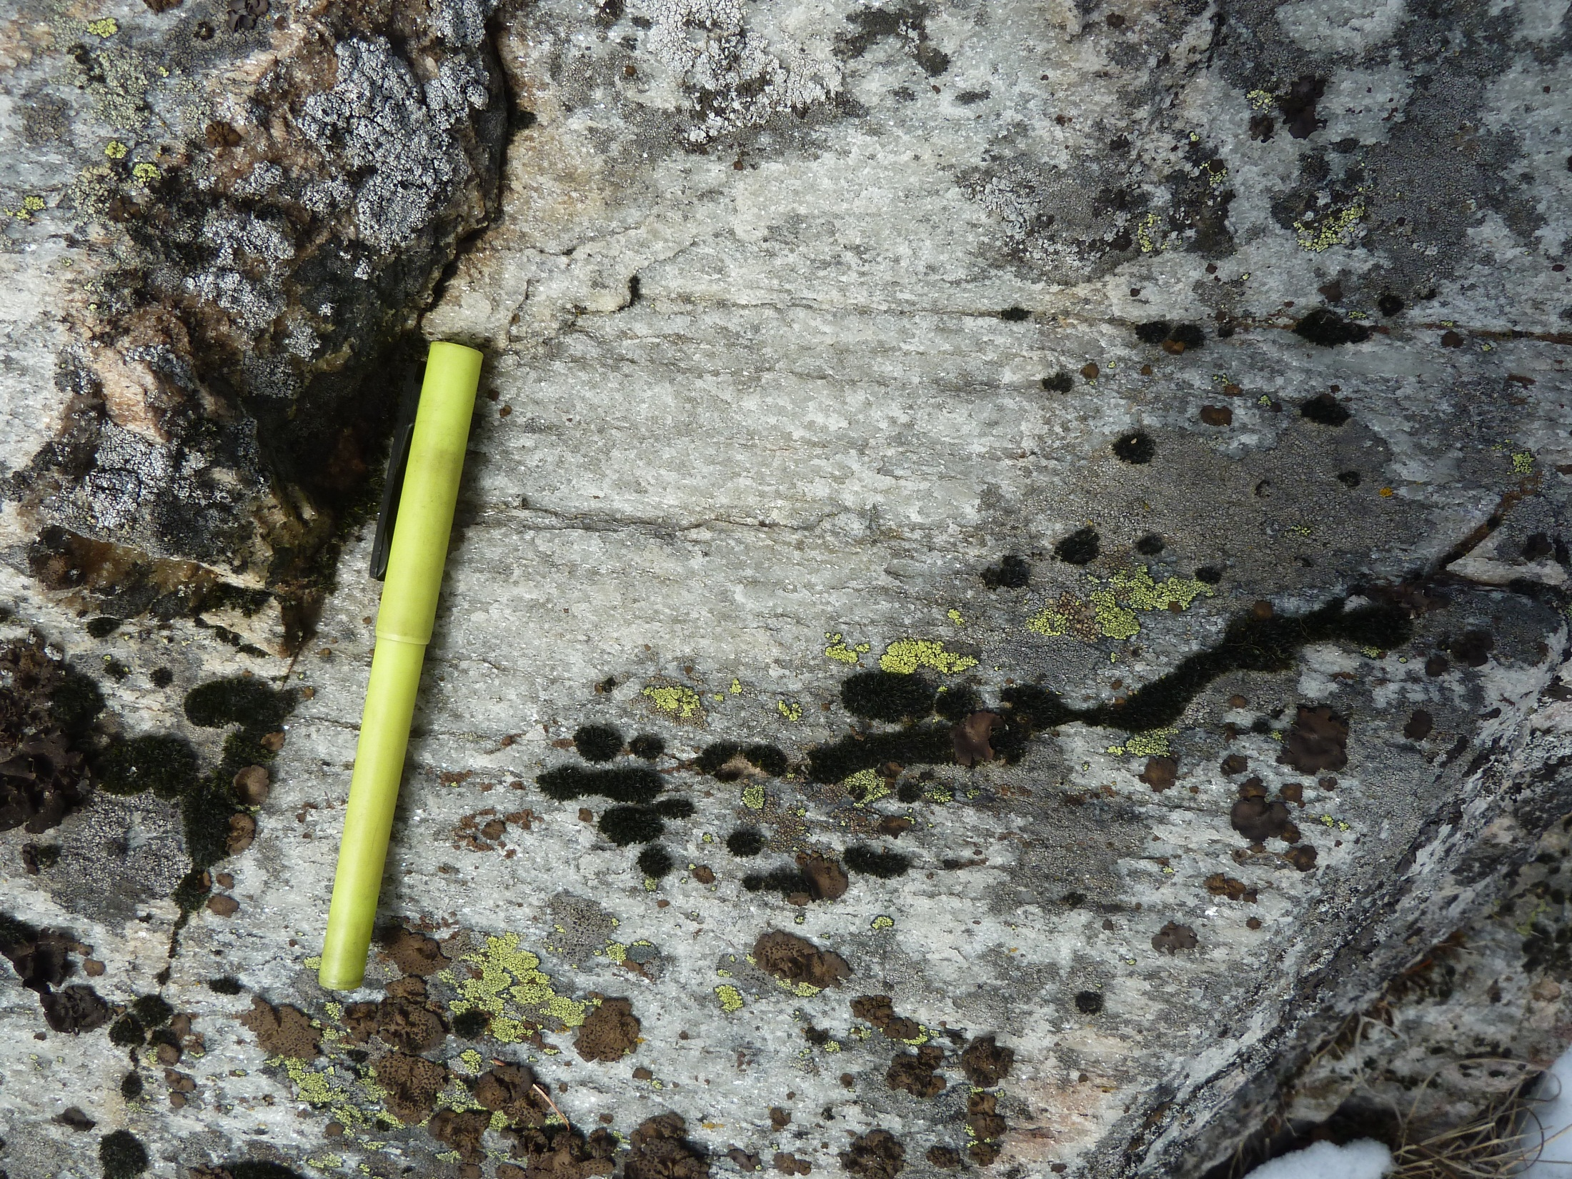

Slide 14
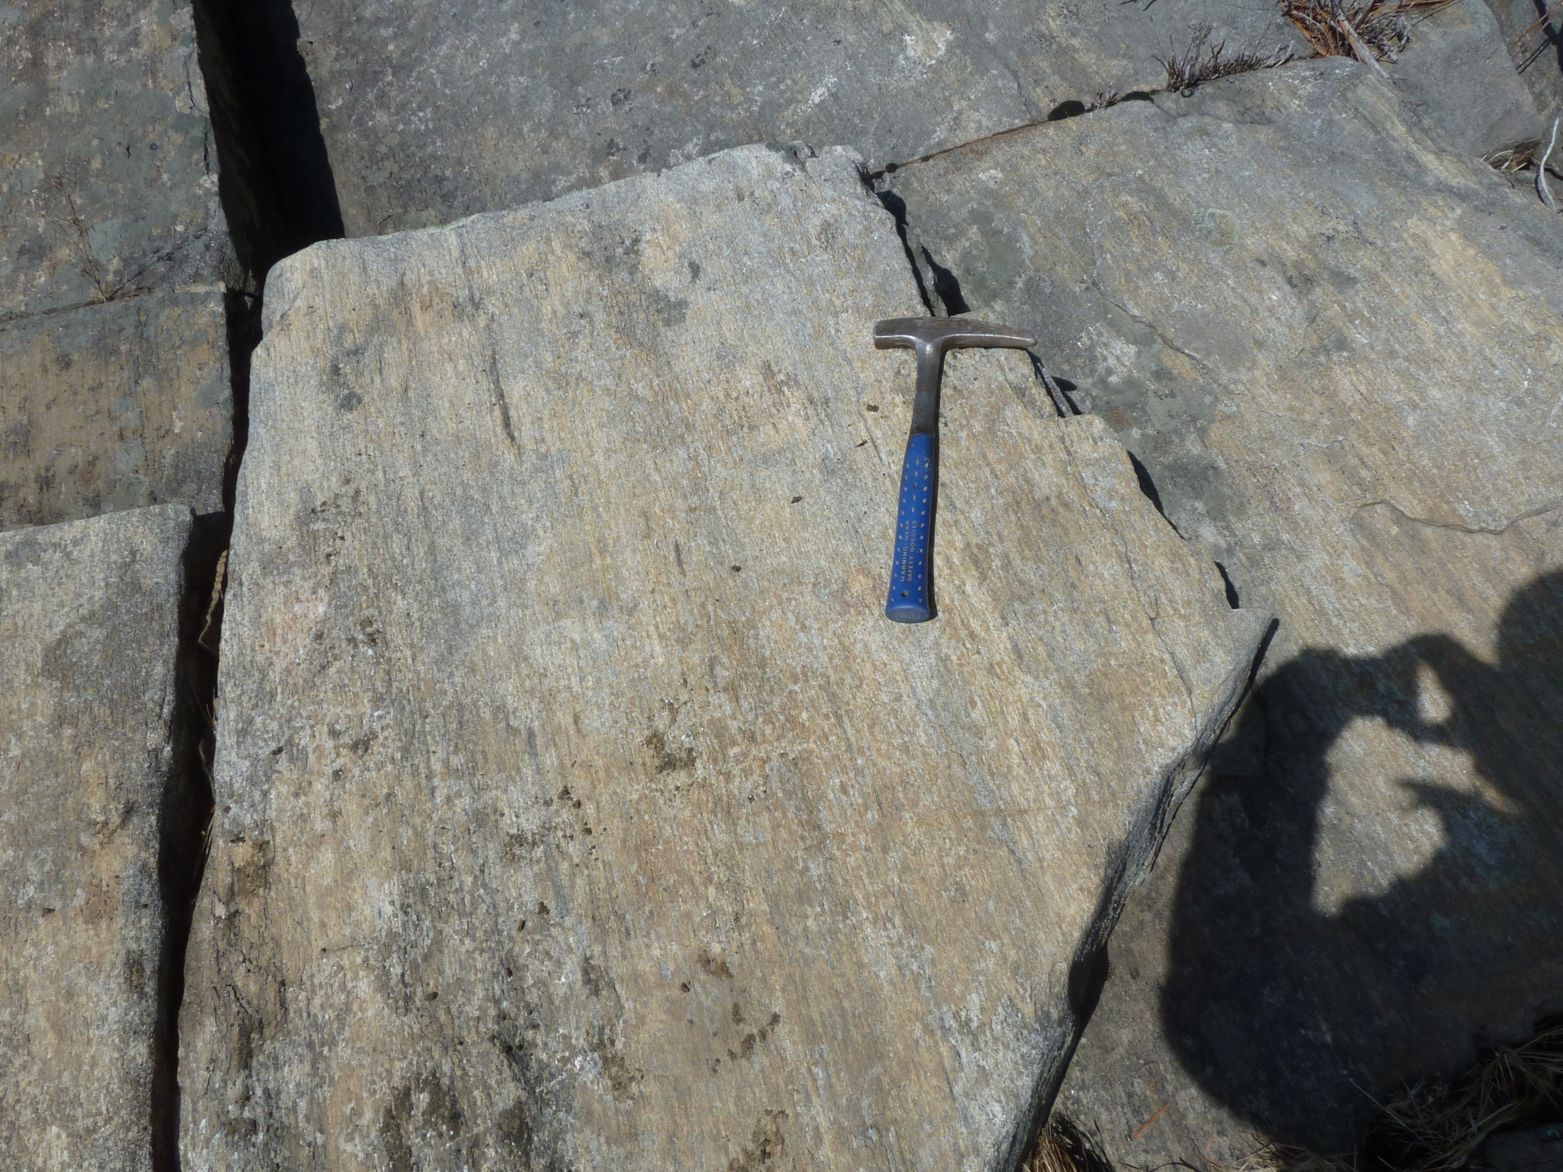

Slide 15
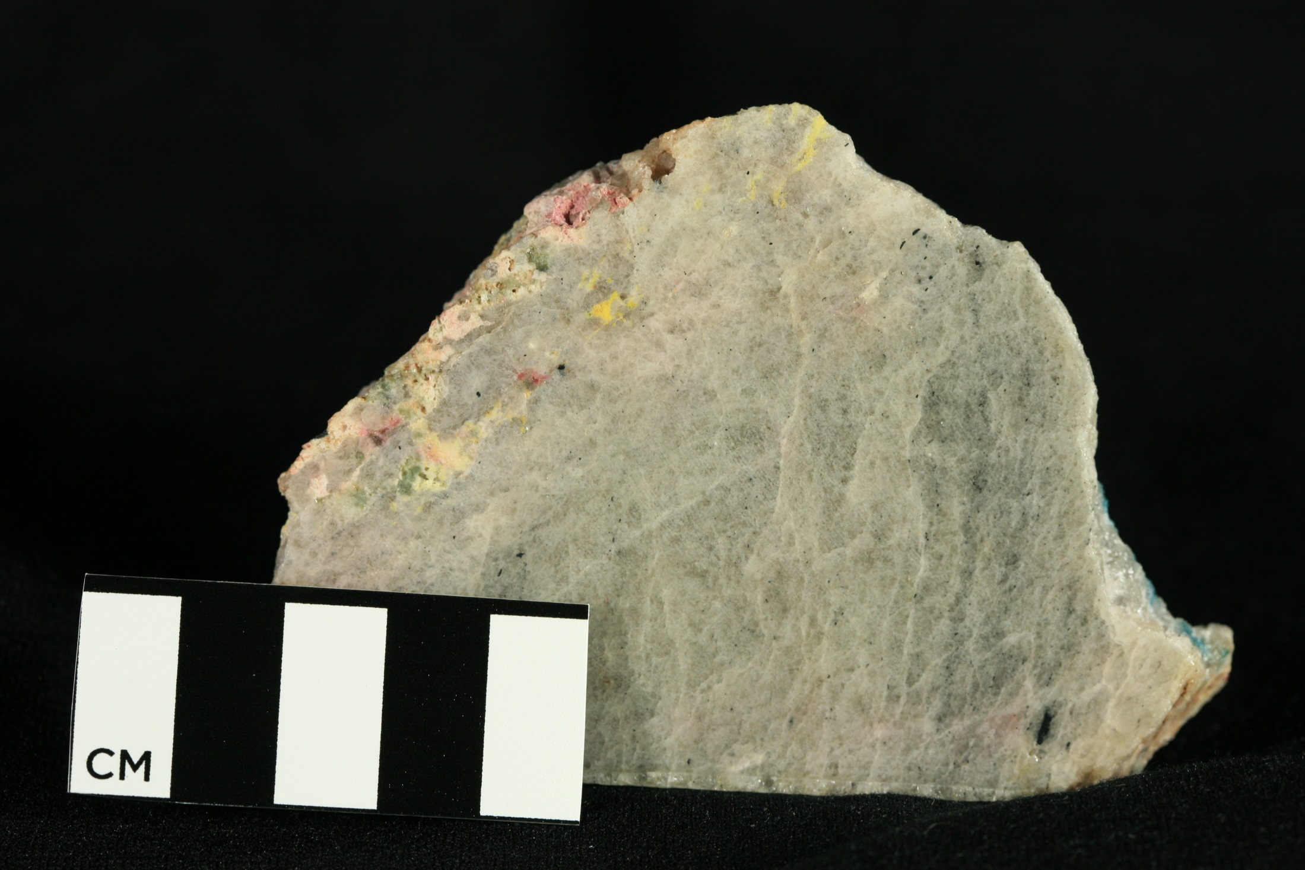

Slide 17
1 mm

Slide 18
250μm

Slide 19
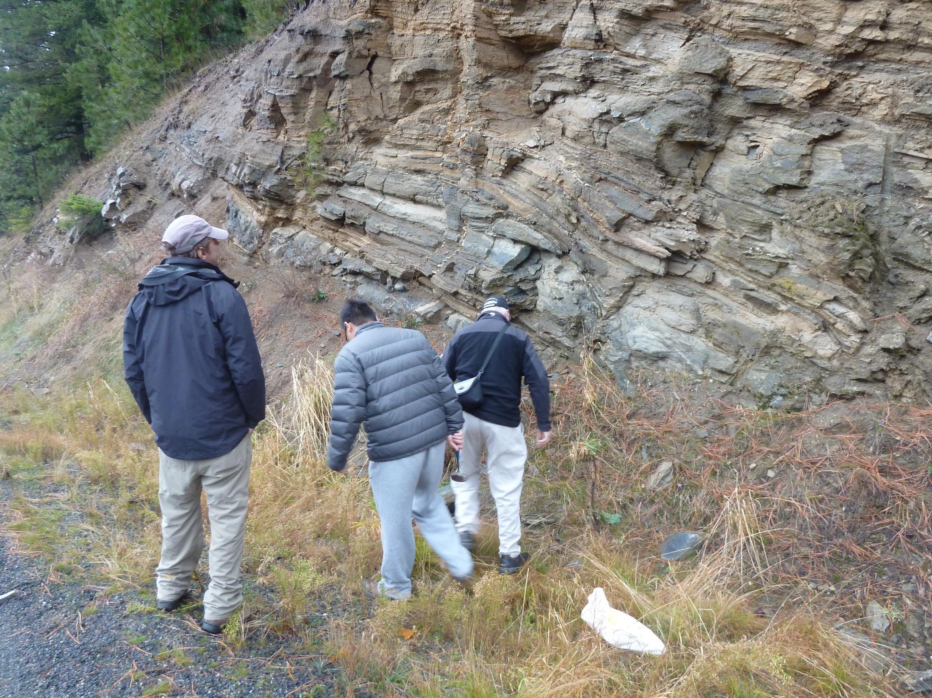

Slide 20
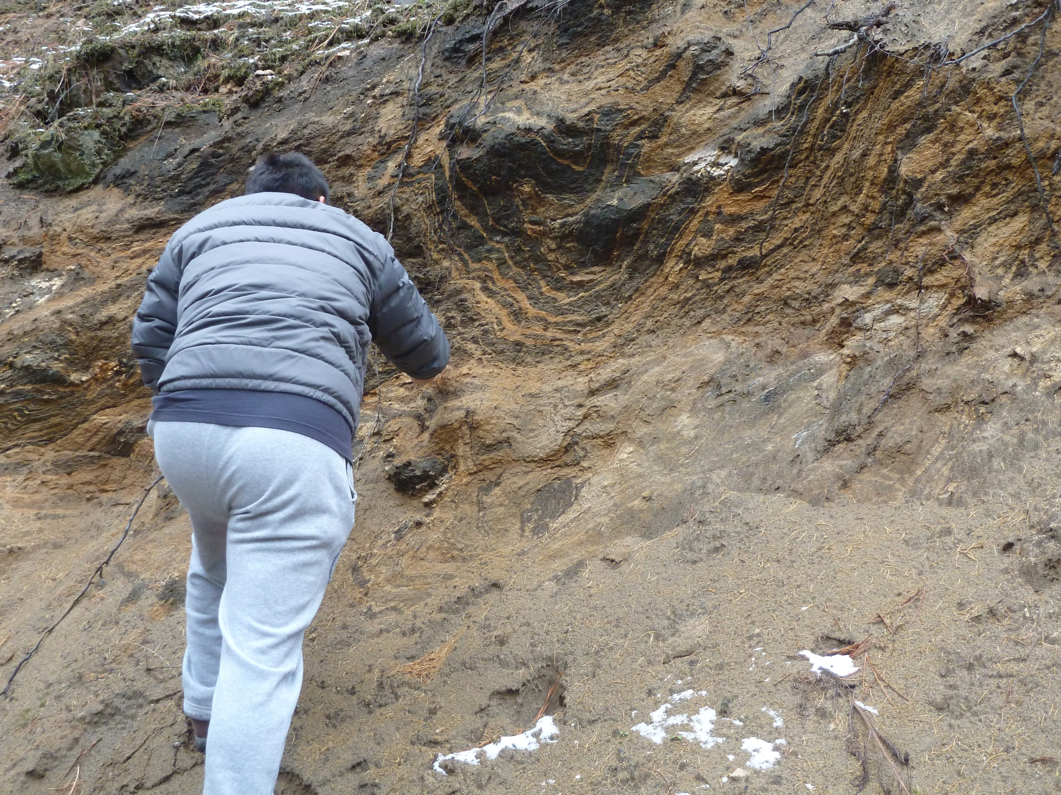

Slide 21
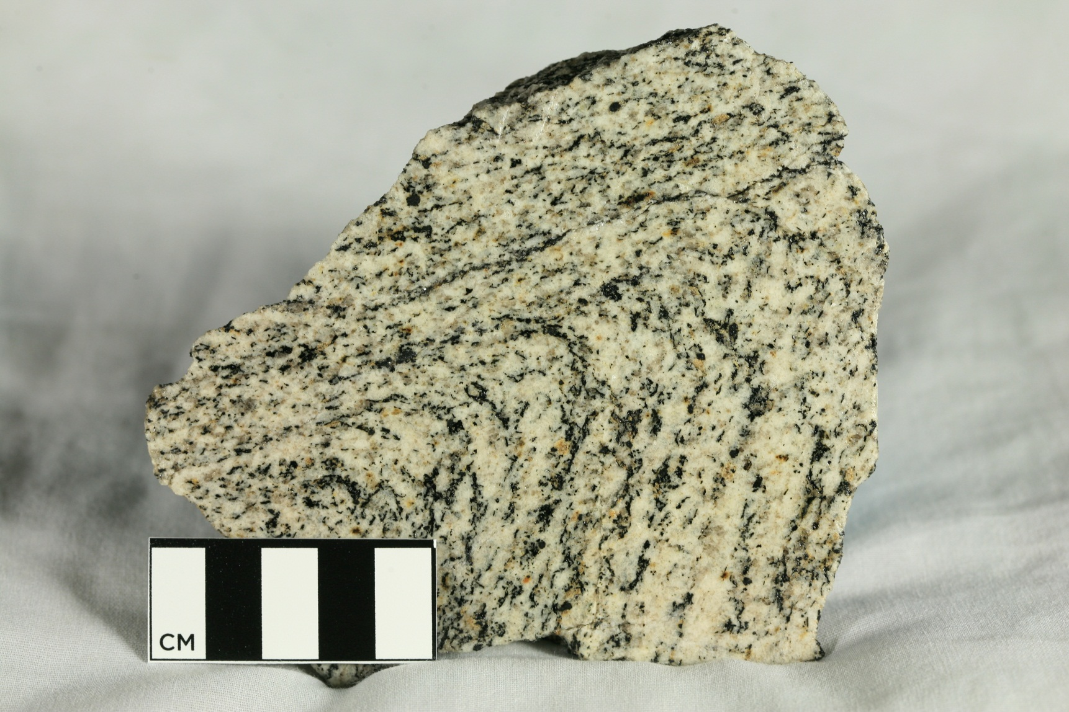
1.86 Ga granitic orthogneiss, Wang et al., 2014

Slide 22
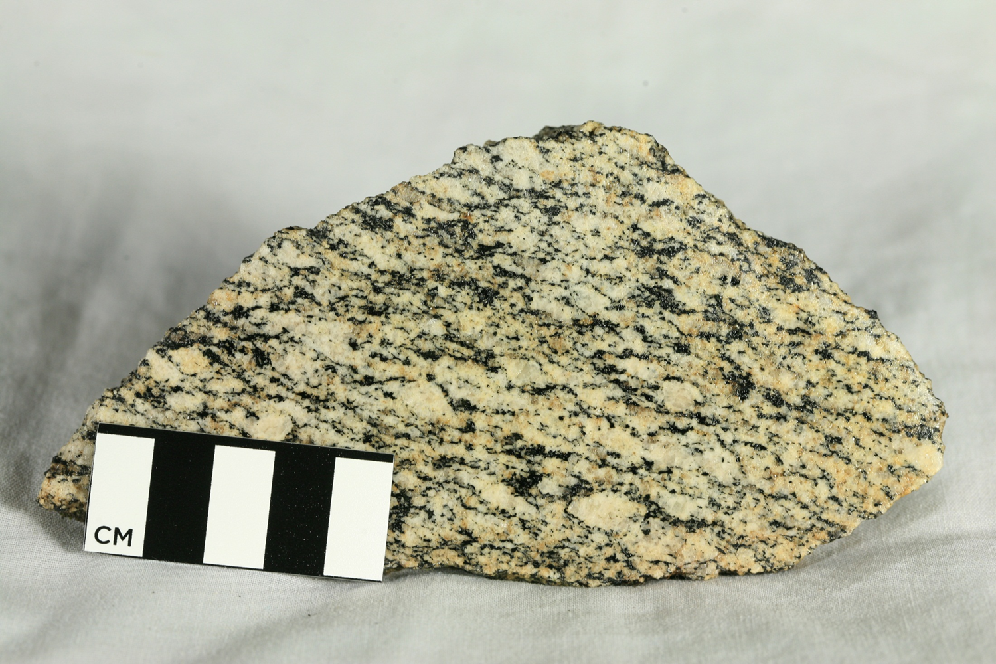
1.87 Ga granitic orthogneiss, Wang et al., 2014

Slide 23
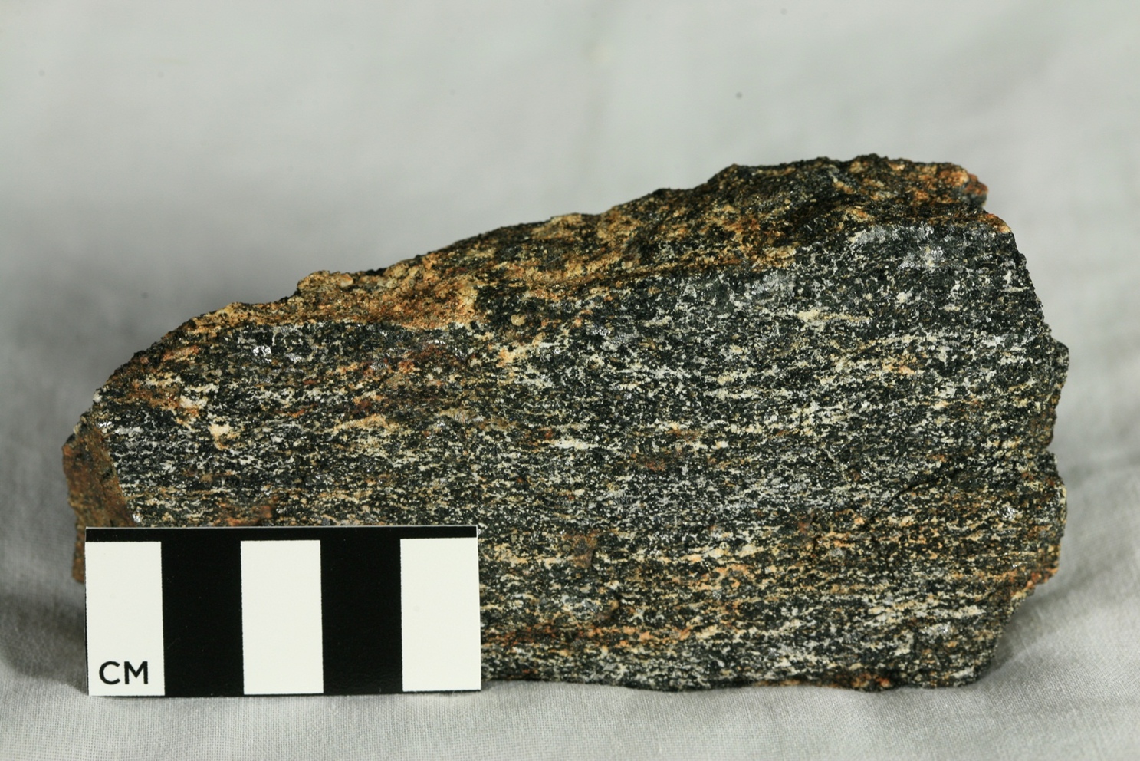
2.64 Ga amphibolite, Wang et al., 2014

Slide 24
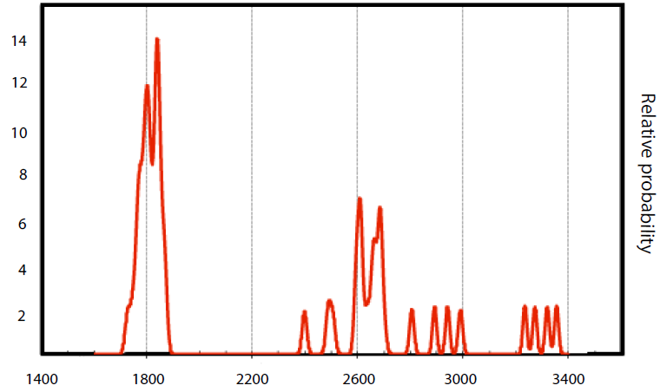
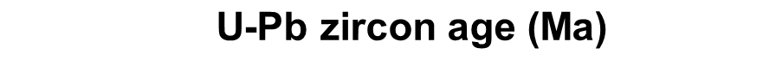
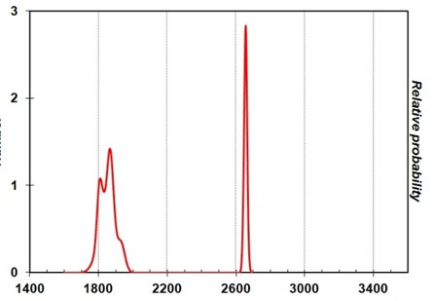
Razorback
(this study)
Gold Cup
Doughty & Chamberlain, 2007

Slide 25
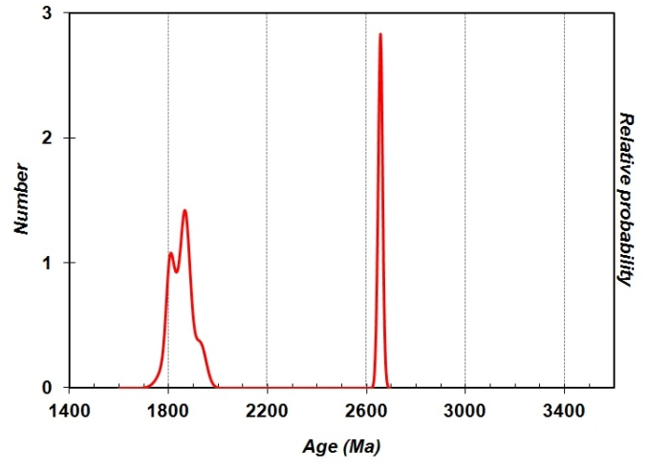
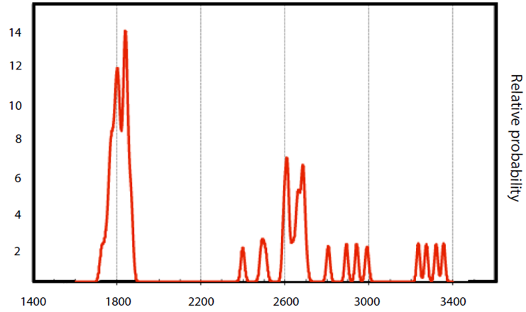
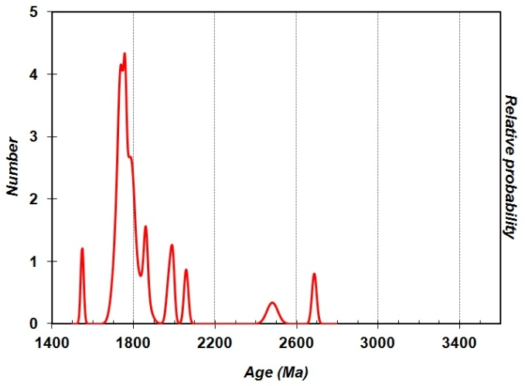
Gold Cup
Doughty & Chamberlain, 2007
Razorback
(this study)
Hauser Lake Gneiss
Doughty & Chamberlain, 2007

Slide 26

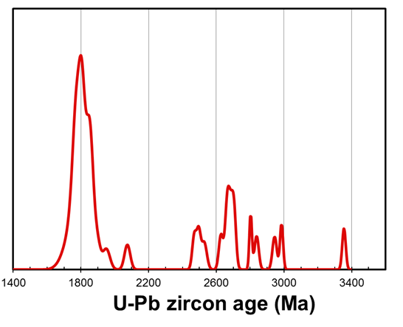
Neihart
Mueller et al, 2008

Slide 27

Cougar Gulch, ID
(this study, south of CDA)
Priest River, ID
(Doughty, et al 1998)
Hauser Lake
Gneiss
(meta-Belt)
Hauser Lake Gneiss
(1.47 Ga)
amphibolites
Razorback quartzite
(graphitic)
Gold Cup Quartzite
(graphitic)
Pend Oreille Gneiss
(2.6 Ga)
XA – orthogneiss
& amphibolite
(1.8-2.6 Ga)

Slide 28
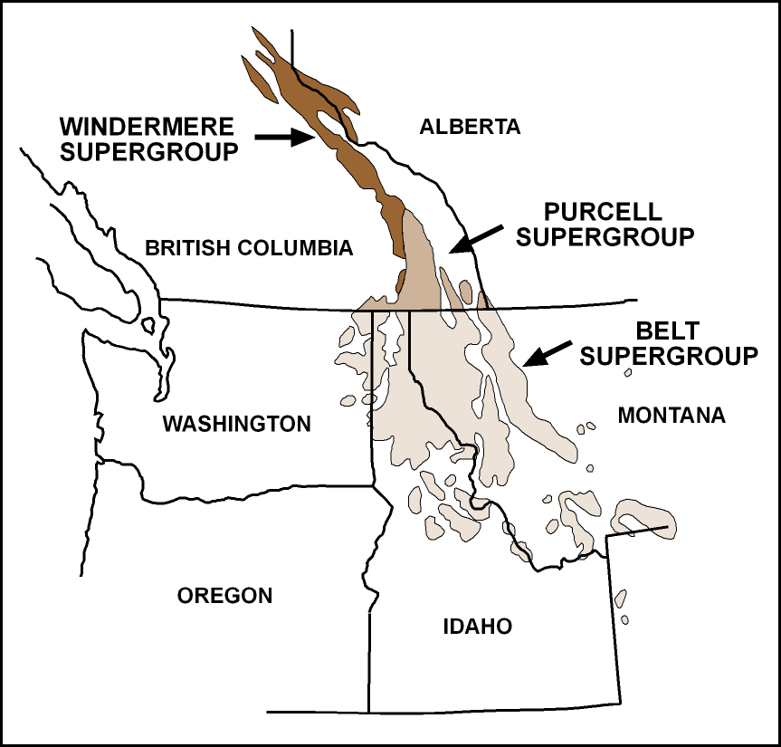
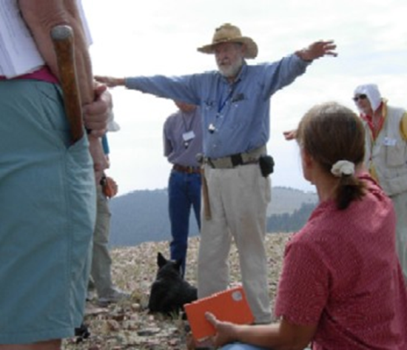


from IGS - website

Slide 29
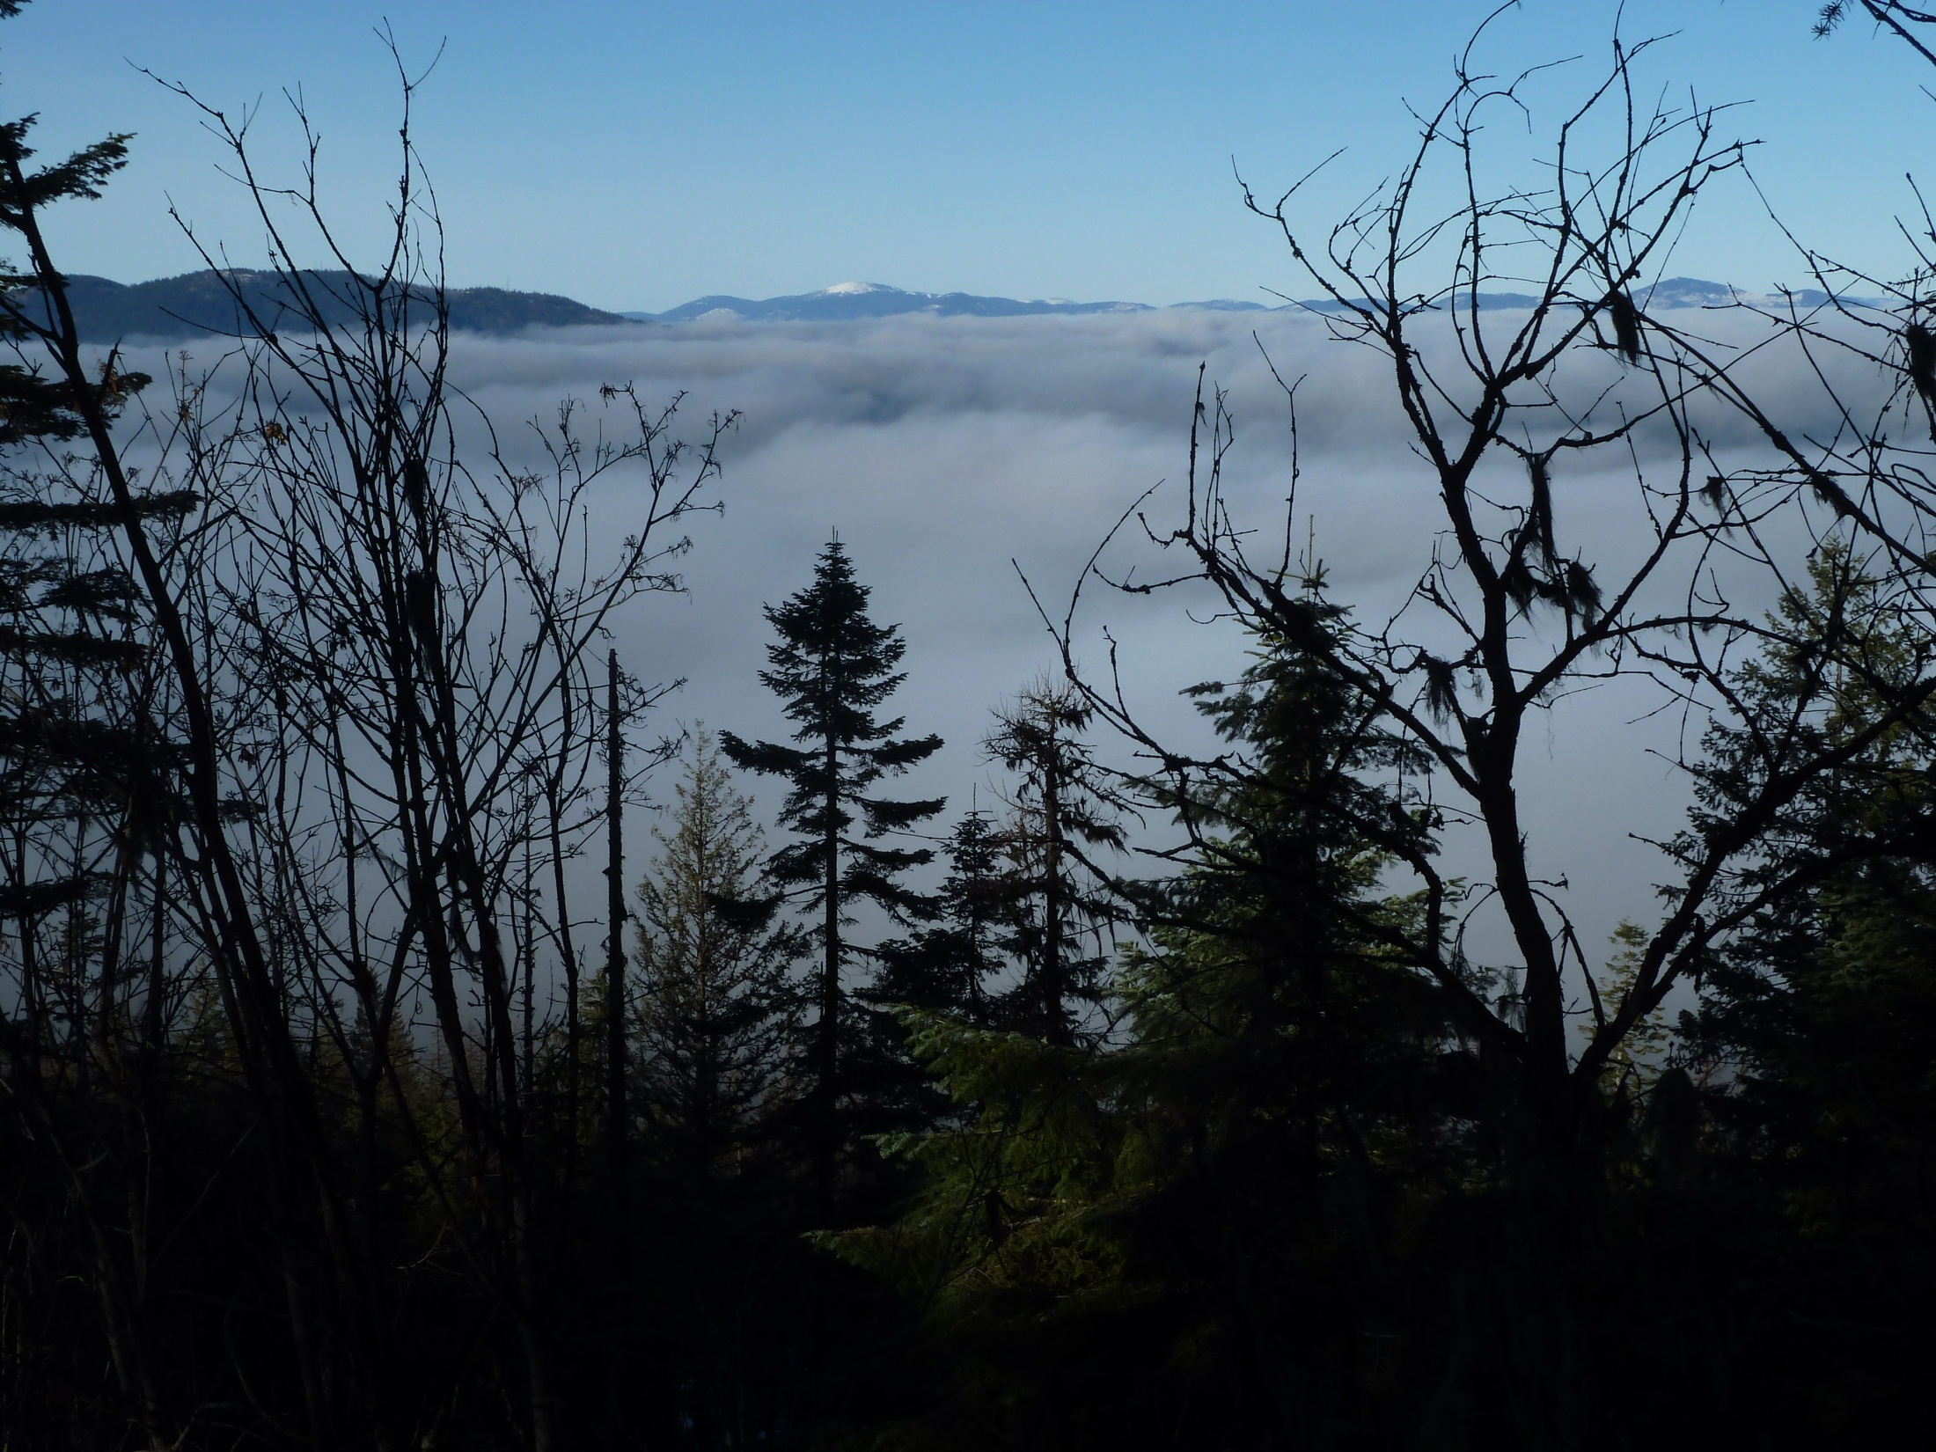
Thanks Don!

