Slide 1
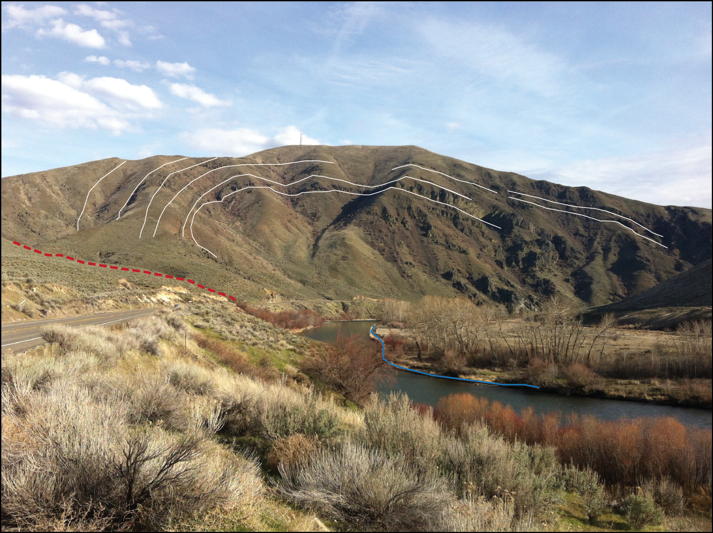

Uplift and incision of the Yakima River Canyon from channel planform mapping and cosmogenic ²⁶Al/¹⁰Be isochron dating
Skyler Sorsby, Colin Amos, Paul Bierman, Kathryn Hansen, Dylan Rood, Burch Fisher, Harvey Kelsey
?
Channel narrowing
GSA Cordilleran/Rocky Mts
Joint section meeting
Paper No. 15-9
May 20, 2014

Slide 2
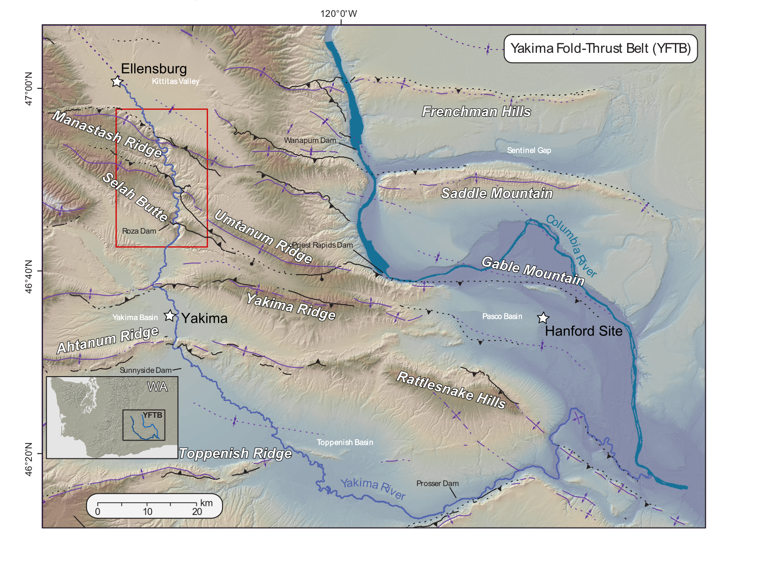
Tectonic setting
Study
area
~1-2 mm/yr GPS shortening
NE-SW to E-W trending folds and thrust faults deforming miocene CRB
Tight anticlinal ridges and broad synclinal valleys cross-cut by the Yakima River.
GPS data predict ~1-2 mm/yr NE shortening (McCaffrey et al., 2013)

Slide 3
Outline
Fluvial analysis components
Methodology
High resolution channel width data from planform mapping with Matlab toolkit Changeom (Fisher et al., 2013, Geomorphology)
Terrace mapping and topographic analysis from lidar
CRN terrace dating
Key Questions
Are Yakima structures currently active?
Is Quaternary uplift differential or spatially uniform?
How do the Yakima Canyon terraces correlate?
What can CRN dating tell us about relative uplift rates?

Slide 4
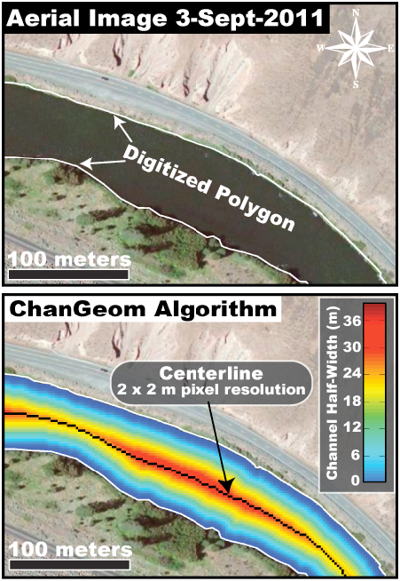
Methods: Changeom
Premise: Rivers may narrow across actively growing folds to gain incision power.
Methodology:
Channel planform digitized with high-resolution Google Earth imagery
Changeom creates channel centerline through binary thinning
Planform width is calculated from the centerline.
from Fisher et al. (2013),
Published in Geomorphology
Notes:
Changeom implements binary thinning algorithms to delineate channel centerline.

Slide 5
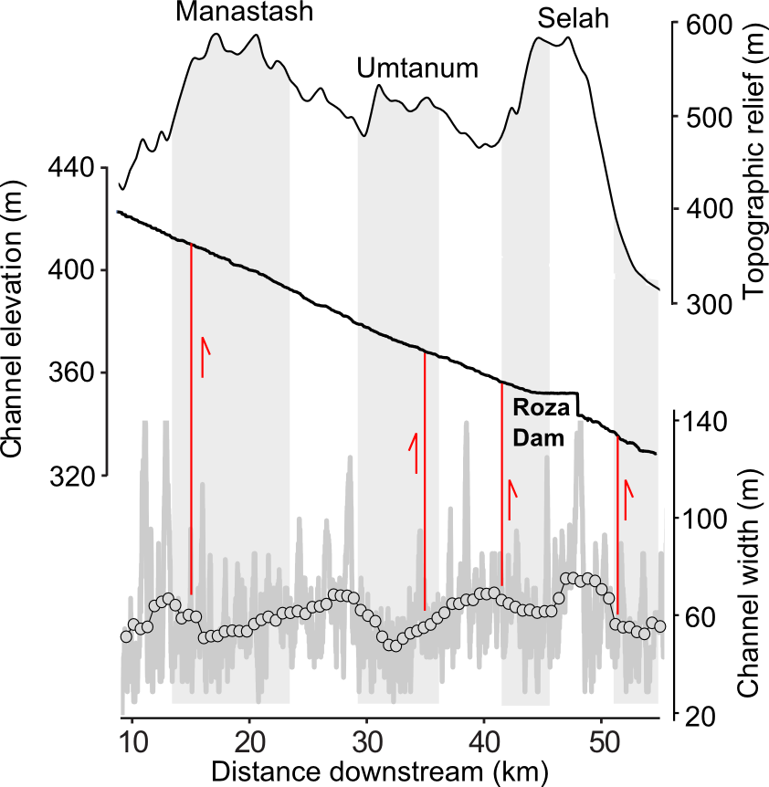
Changeom results
Channel width anomalies
Distinct channel narrowing across Manastash, Umtanum, and Selah Butte structures
Spatial correlation with mapped faults
Substrate is uniform throughout the canyon (CRB)
Lidar survey reveals a lack of prominent knickpoints

Slide 6
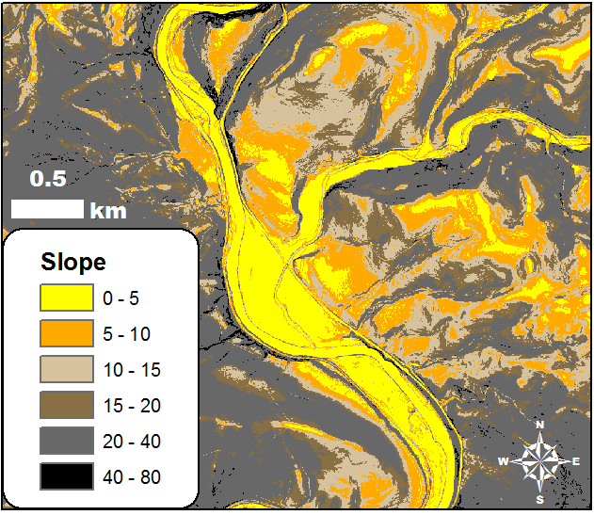
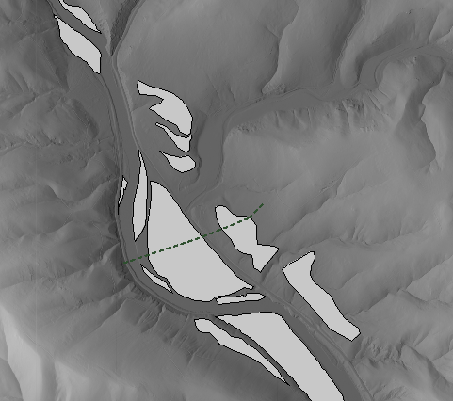
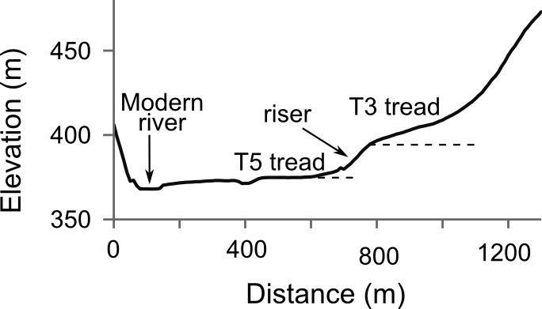
Terrace mapping
Slope map from lidar
Preliminary terrace map
T5
T1
T2
T3
T4
T5
Old
Young
T5
T3
T3
T5
T4
T3
T5
T3
Topographic profiling
T5
T4

Slide 7
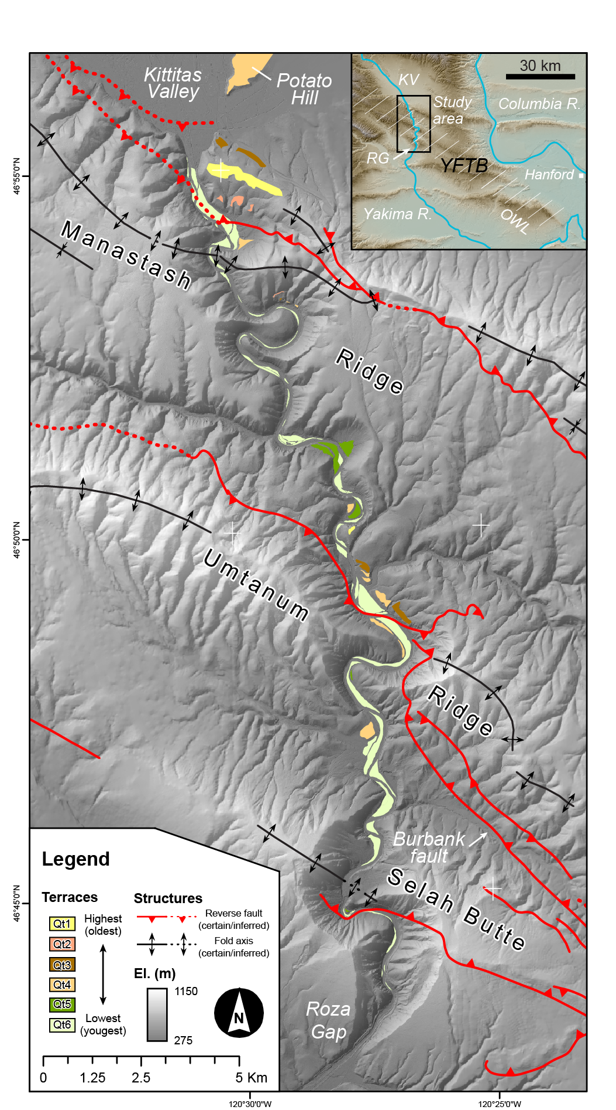
Results: mapping
Terraces
Preliminary correlation based only on similar height above modern channel.
Treads are often mantled with alluvium or altered anthropogenically
Paleosurface remnants are patchy; downstream correlation is difficult from elevation data alone.

Slide 8
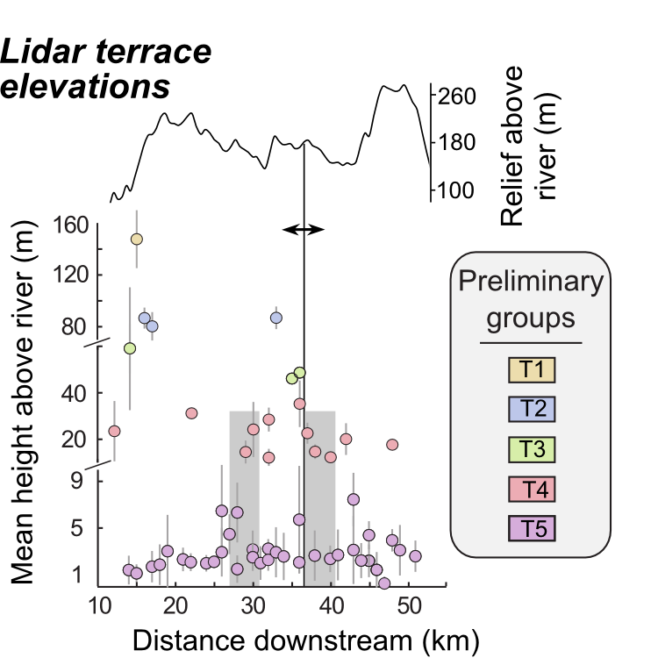
Results: mean elevation
Selah
Umtanum
Manastash
Higher terraces proximal to Manastash and Umtanum folds.
Synclinal regions show greater clustering of lower terraces
Implications for differential uplift across the canyon

Slide 9
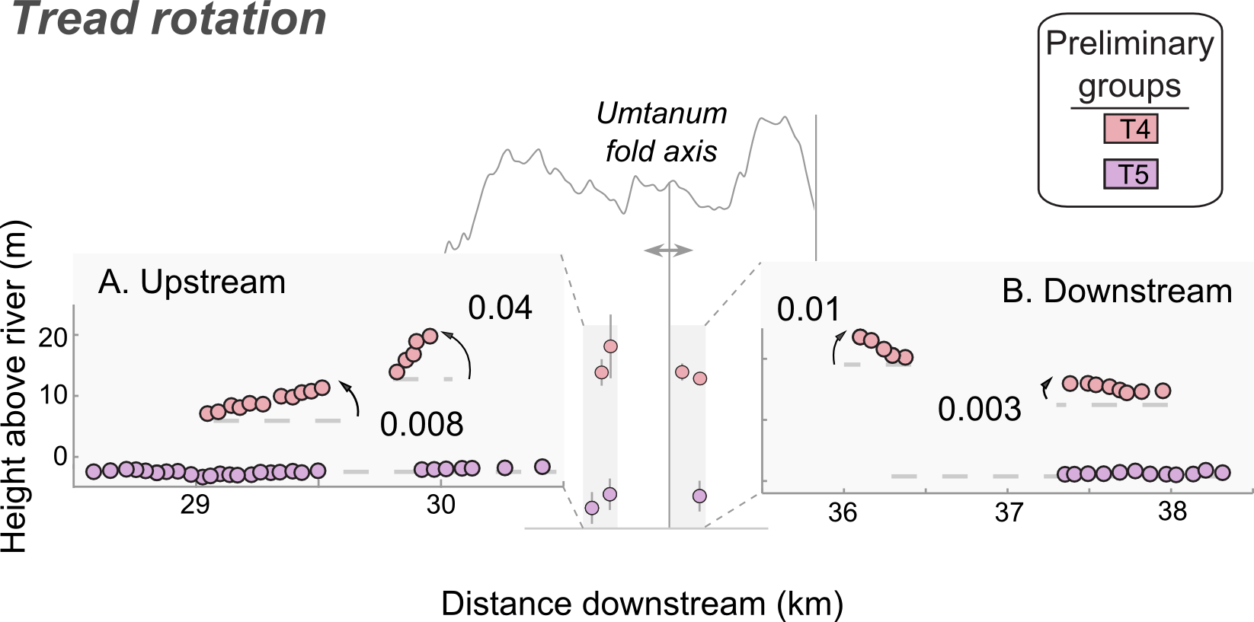
Results: Tread profiling
VE=30
VE=30
Profiles
Profiling of terrace treads reveals:
Increasing tilt as Umtanum fold axis is approached
Negligible deflection of modern surface

Slide 10
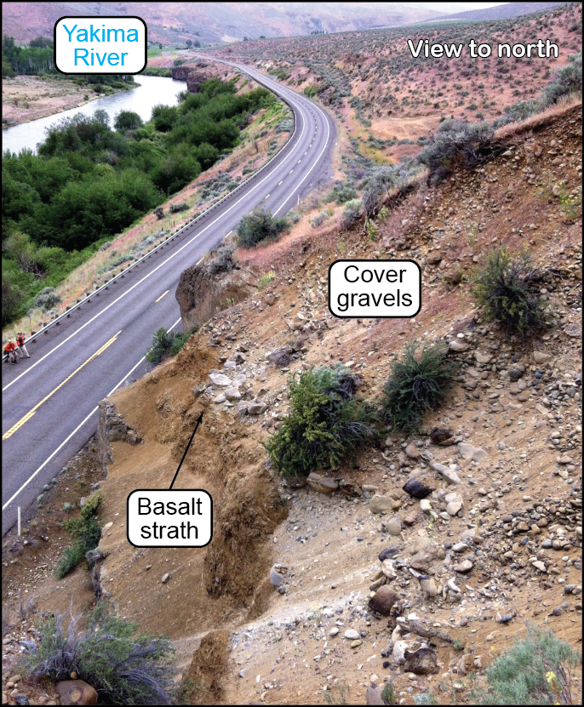
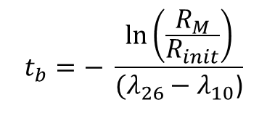
Methods: ²⁶Al/¹⁰Be CRN dating
Isochron burial-
Dating equation:
$$t_{b}=− \frac{\ln\left(\frac{R_{M}}{R_{init}}\right)}{(λ_{26}−λ_{10}\text{)}}$$
(from Balco and Rovey 2008)
Sampling procedure
Quartz-rich river cobbles (likely source: Mt. Stuart Batholith)
Sampled >2 meters depth to ensure proper shielding from cosmic rays
Quartz cleaned and extracted at UVM
Analysis performed at the SUERC AMS lab in East Kilbride, Scotland.
T3

Slide 11
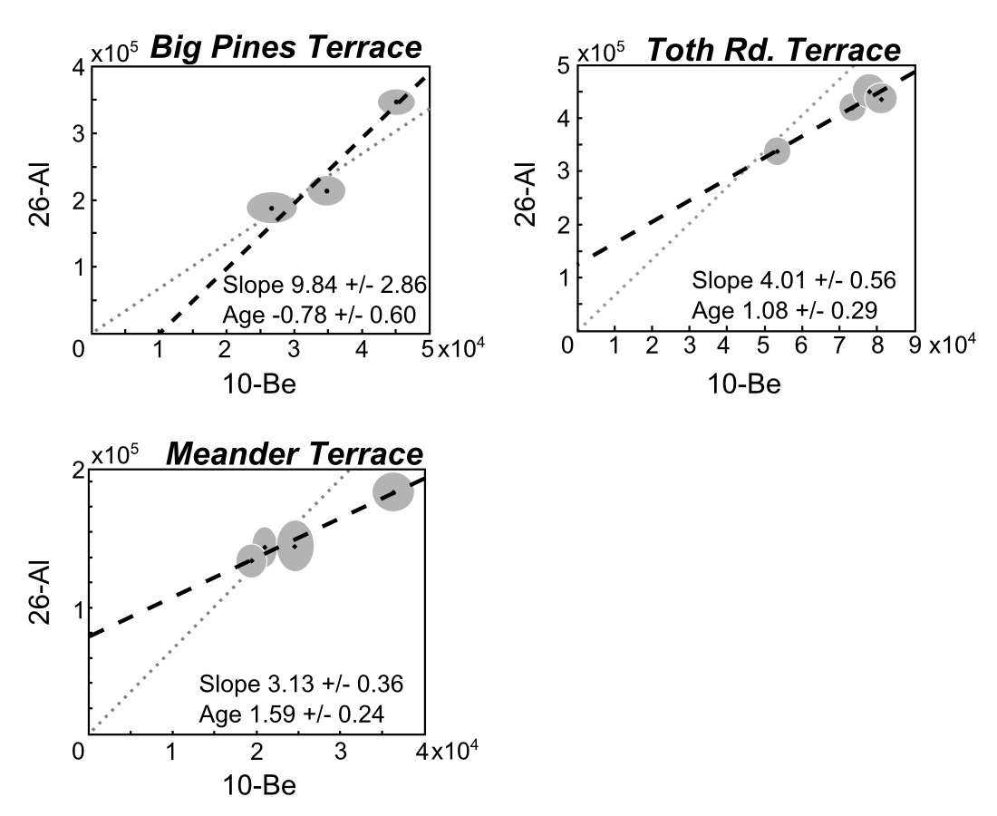
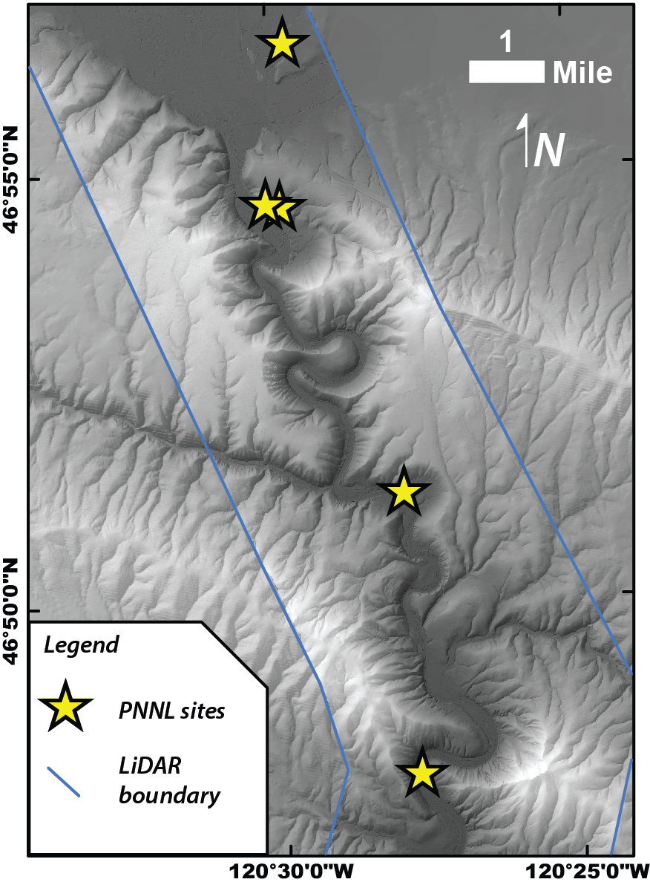
²⁶Al/¹⁰Be isochron plots
Toth Rd.
MR
Meander
UR
Big Pines
Lab results:
²⁶Al and ¹⁰Be concentrations are uniformly low (increases error to 1 std)
YK-03 (Big Pines terrace):
higher ²⁶Al/¹⁰Be ratio—age is indistinguishable from modern.
3. YK-04 (Meander) and YK-05 (Toth Rd.):
lower ²⁶Al/¹⁰Be ratio; ages are 1.59 ± 0.25 and 1.08 ± 0.29 Ma respectively.

Slide 12
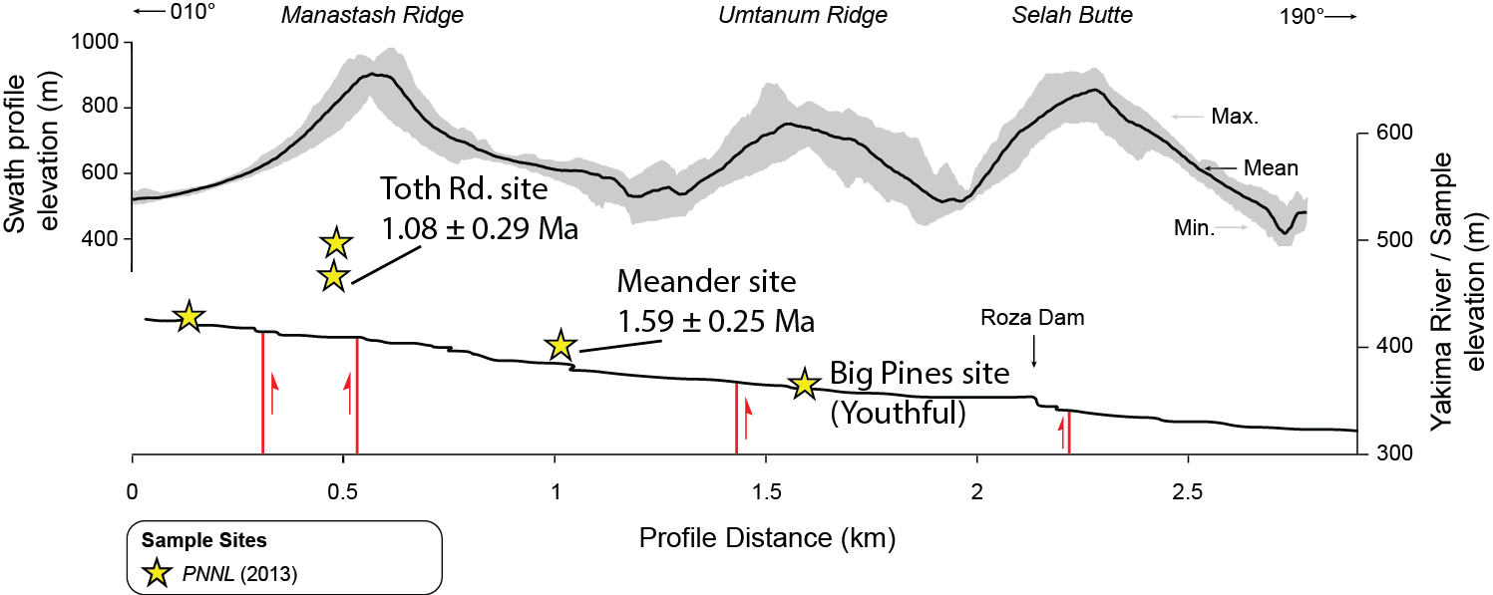
Results: CRN dates
Similar ages at considerably different elevations!
T2
T4
T5
Site | CRN age (Ma) | Incision depth | Incision rate
Toth Rd. | 1.08 ± 0.29 | 58 m | 0.05 m/kyr (-0.002/+0.04)
Meander | 1.59 ± 0.25 | 16 m | 0.01 m/kyr (-0.004/+0.004)
Big Pines | ~ modern | 3 m | -------------------------------------

Slide 13
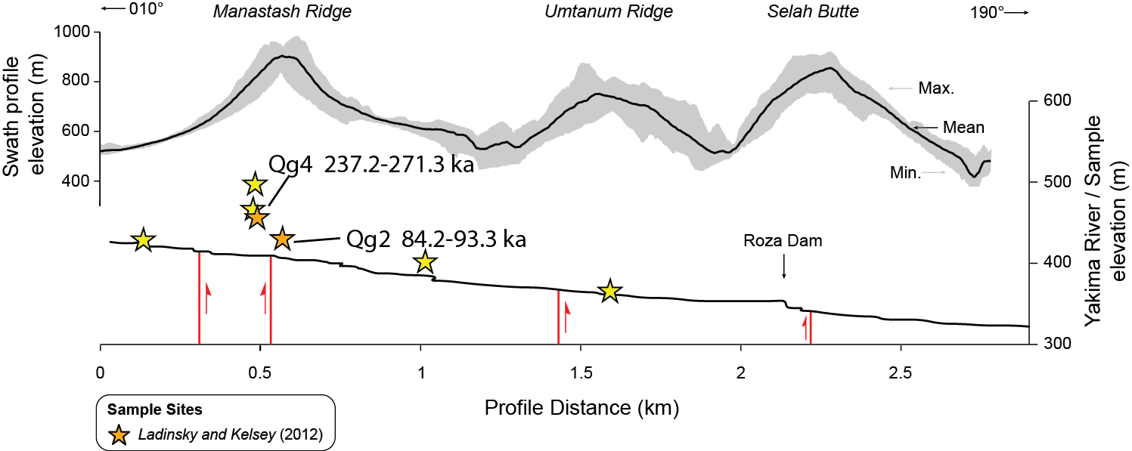
Ladinsky and Kelsey dates
Site | CRN age (ka) | Incision depth | Inferred uplift rate
Qg2 | 84.2 – 93.3 | 15 m | 0.16 – 0.18 m/kyr
Qg4 | 237.2 – 271.3 | 48 m | 0.18 – 0.20 m/kyr

Slide 14
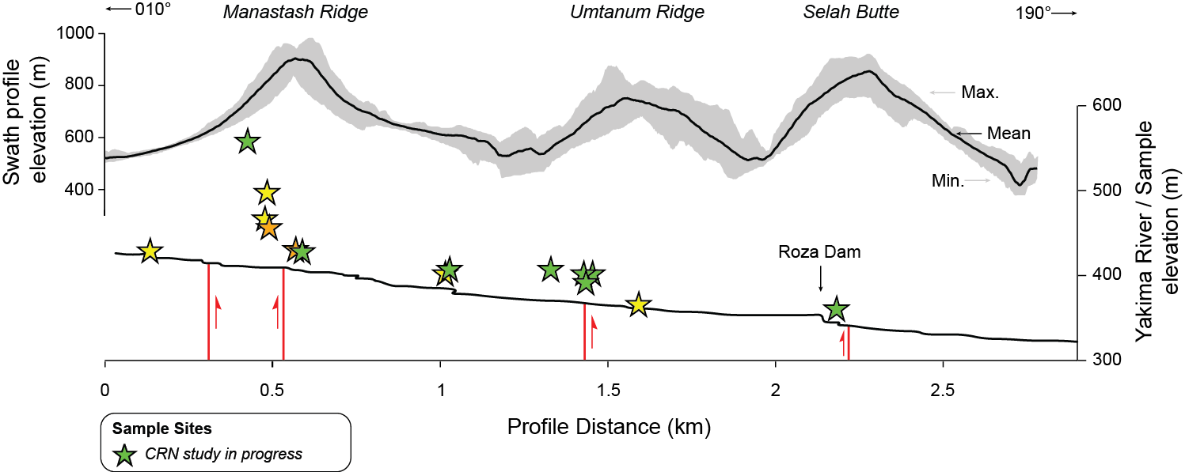
Terraces under current investigation
Adrian Bender (WWU MSc thesis) will date additional terraces (CRN burial) to
assess differential incision rates in the Yakima River Canyon

Slide 15
Summary
Channel narrowing across Manastash, Umtanum, and Selah Butte indicates the presence and distribution of modest Quaternary deformation.
Evidence for Quaternary uplift of Umtanum seen in tilted terrace treads.
Evidence for the Quaternary uplift of Manastash from CRN dating (same ages high on an anticline, low on a syncline)
Further terrace dating will better constrain the timing, magnitude, and distribution of tectonic deformation in the Yakima Canyon.

